Slide 1
God’s People, The Light of the World

Slide 2
The Antiochan Model
Proactive Openness to Outsiders (Acts 11:19-21)
Sacrificial Love for the Needy (Acts 11:27-30)
Devotion to Fasting and Prayer (Acts 13:2-3)
Commitment to Truth (Acts 13:1; 15:1-5)
Mission: Kingdom Expansion (11:19-26; 13:1-3; 15:35-41)

Slide 3
Then God said, Let us make man in our image, according to our likeness; and let them rule…
Genesis 1:26

Slide 5
And I will make you a great nation, And I will bless you, And make your name great; And so you shall be a blessing…
Genesis 12:2

Slide 7
“Now then, if you will indeed obey My voice and keep My covenant, then you shall be My own possession among all the peoples…”
Exodus 19:5

Slide 9
I will raise up your seed after you, who will come forth from you, and I will establish his kingdom. … My lovingkindness shall not depart from him … Your house and your kingdom shall endure before Me forever, your throne shall be established forever.”
2 Samuel 7:12, 15-16
“You are my Son, today I have begotten you. Ask of Me, and I will surely give the nations as Your inheritance.”
Psalm 2:7-9

Slide 10
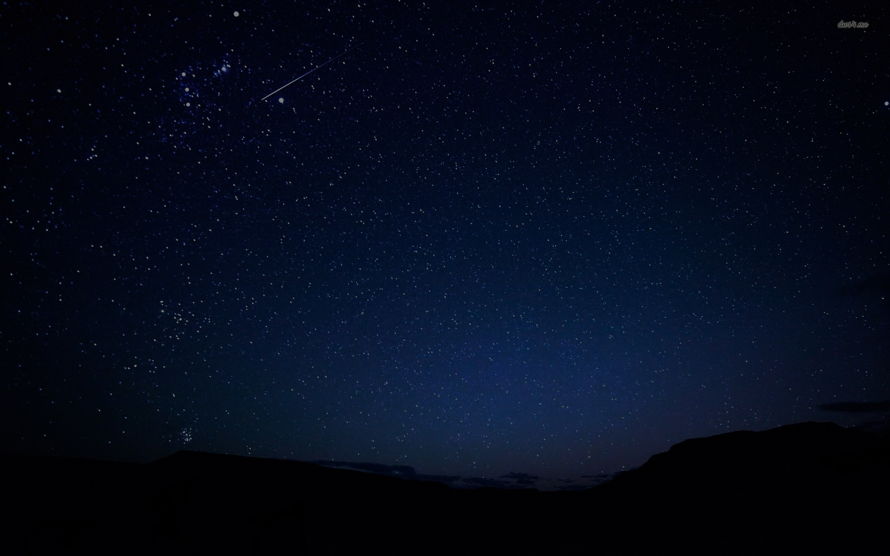
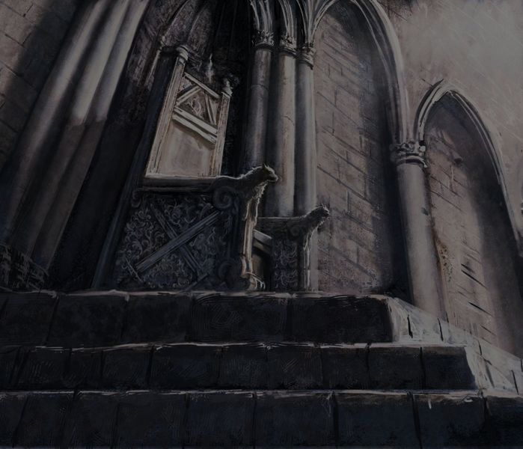
Be Fruitful and Multiply, Fill the Earth
(Genesis 1:26-31)
Go Out, Be a Blessing
(Genesis 12:1-3)
Serve as God’s Kingdom of Priests and Holy Nation
(Exodus 19:6)
Build a House for God’s Name
(2 Samuel 7:12-16)
Notes:
Purposes that God commanded for the people who He promised to extend good.

Slide 11
Notes:
Christ fulfills all the purposes God had throughout history.
Exact image of God – Hebrews 1 // Colossians 1 // John 1
Seed of Abraham – Galatians 3
Holy One, High Priest – John 6 // Hebrews 1-7 // Psalm 110
True David – Jeremiah 33 // Matthew 1 // Romans 1

Slide 12
“They multiplied”
(Acts 9:31; 6:1, 7; 12:24)
“You are Abraham’s seed”
(Galatians 3:29)
“Coming to Him … You are … a royal priesthood, a holy nation”
(1 Peter 2:4, 9)
“To the one who overcomes…I will give authority over the nations”
(Revelation 2:26)
Notes:
NT allusions to the OT promises / purposes that connect those who are part of the body of Christ to God’s plans for light in the World.

Slide 13
Shining as Lights in the World Today
Who do I include in ‘my circle’?
What tangible investments can I make in the needs of others?
Am I reliant on the Lord through fasting and prayer?
Do I dligently listen to the Word of God?
How can I do my part to further expand the Kingdom?

