Slide 1
Genesis 2:1-3

Slide 2
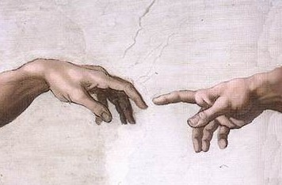
Genesis for Evangelism:
Genesis 2: “The Nature of Man”

Slide 3
Genesis 2:1-3
“Thus the heavens and the earth, and all the host of them, were finished. And on the seventh day God ended His work which He had done, and He rested on the seventh day from all His work which He had done. Then God blessed the seventh day and sanctified it, because in it He rested from all His work which God had created and made.”
During the seven days of creation, God made both “the heavens and the earth” (the universe) and “all the host of them”; that is, every type of living being that exists in the universe (including the angels and even Satan!) was
made at this time. The Bible simply does not give much detail regarding this since its focus is on human history
Genesis 2:
“The Nature of Man”

Slide 4
Genesis 2:1-3
“Thus the heavens and the earth, and all the host of them, were finished. And on the seventh day God ended His work which He had done, and He rested on the seventh day from all His work which He had done. Then God blessed the seventh day and sanctified it, because in it He rested from all His work which God had created and made.”
God finished His masterwork of creation and rested! He did not enter into an absolute rest: He still upholds
the universe “by the word of His power” [Hb 1:3]. But
the entire work of creation was completed during that week. God is no longer forming new creatures into His universe; only procreation continues, per His fixed law.
Genesis 2:
“The Nature of Man”

Slide 5
Genesis 2:1-3
“Thus the heavens and the earth, and all the host of them, were finished. And on the seventh day God ended His work which He had done, and He rested on the seventh day from all His work which He had done. Then God blessed the seventh day and sanctified it, because in it He rested from all His work which God had created and made.”
None
at all!
Notice that God made a distinction with regard to this day, “sanctifying” (“separating”) it from the others for Himself [cp. 1:4, 6-7, 9-10, 12, 14, 21 e 24]
What instruction does God give concerning this day?
God’s instructions about this day would be given only centuries later, to Israel in the desert! [Dt 5:12-15; Ex 20]
Genesis 2:
“The Nature of Man”

Slide 6
Genesis 2:4-7
“This is the history of the heavens and the earth when they
were created, in the day that the Lord God made the earth and
the heavens, before any plant of the field was in the earth and
before any herb of the field had grown. For the Lord God had
not caused it to rain on the earth, and there was no man to till
the ground; but a mist went up from the earth and watered
the whole face of the ground. And the Lord God formed man
of the dust of the ground, and breathed into his nostrils the
breath of life; and man became a living being.”
Genesis 2:
“The Nature of Man”

Slide 7
Genesis 2:4-7
“This is the history of the heavens and the earth when they
were created, in the day that the Lord God made the earth and
the heavens, before any plant of the field was in the earth and
before any herb of the field had grown. For the Lord God had
not caused it to rain on the earth, and there was no man to till
the ground; but a mist went up from the earth and watered
the whole face of the ground.” [2:4-6]
Note that the verbs are in past tense – creation is seen as a completed work by this point in the narrative
Literally, this is the “genealogy” of heaven and earth; it is the story of the creation of the family of heaven and earth. This “story” was told in generic form in Genesis 1 – in Genesis 2 we will see specific details regarding the most important part of the story: the creation of man!
Genesis 2:
“The Nature of Man”

Slide 8
Genesis 2:4-7
“This is the history of the heavens and the earth when they
were created, in the day that the Lord God made the earth and
the heavens, before any plant of the field was in the earth and
before any herb of the field had grown. For the Lord God had
not caused it to rain on the earth, and there was no man to till
the ground; but a mist went up from the earth and watered
the whole face of the ground.” [2:4-6]
Yes!
Hadn’t God already made “grass, the herb that yields seed, according to its kind”? [1:11-12]
This is a parallel with chapter 1: a “situation” must be addressed – the plants had not yet sprouted [NASB, “borne fruit”] – and again it is God who resolves this
Genesis 2:
“The Nature of Man”

Slide 9
Genesis 2:4-7
“This is the history of the heavens and the earth when they
were created, in the day that the Lord God made the earth and
the heavens, before any plant of the field was in the earth and
before any herb of the field had grown. For the Lord God had
not caused it to rain on the earth, and there was no man to till
the ground; but a mist went up from the earth and watered
the whole face of the ground.” [2:4-6]
There are two reasons the plants had not yet “sprouted”:
❶
God had not yet made it rain (it seems it only rained the first time in the flood! [cp Gen 6-7; Heb 11:7])
❷
God had not yet made man who could till the soil; God would create man with a purpose – a “partnership”
Genesis 2:
“The Nature of Man”

Slide 10
Genesis 2:4-7
“This is the history of the heavens and the earth when they
were created, in the day that the Lord God made the earth and
the heavens, before any plant of the field was in the earth and
before any herb of the field had grown. For the Lord God had
not caused it to rain on the earth, and there was no man to till
the ground; but a mist went up from the earth and watered
the whole face of the ground.” [2:4-6]
There are two reasons the plants had not yet “sprouted”:
God had not yet made it rain (it seems it only rained the first time in the flood! [cp Gen 6-7; Heb 11:7])
God Himself waters the plants (without rain!) and creates man, giving him the work of providing for their future cultivation: this will be one aspect of man’s “dominion” of the earth, in the likeness of God...
❶
❷
God had not yet made man who could till the soil; God would create man with a purpose – a “partnership”
Genesis 2:
“The Nature of Man”

Slide 11
Genesis 2:4-7
“And the Lord God formed man of the dust of the ground, and
breathed into his nostrils the breath of life; and man became a
living being.” [2:7]
With all the rest of creation, “God said” “...and it was so”:
but with man, God consulted with Jesus (and the Holy Spirit?) and then “formed” man...
This verb describes the more intimate process by which the LORD personally “designed” His creation, with care and precision so that man would come out exactly as God in His perfection determined
Genesis 2:
“The Nature of Man”

Slide 12
Genesis 2:4-7
“And the Lord God formed man of the dust of the ground, and
breathed into his nostrils the breath of life; and man became a
living being.” [2:7]
From the basest, dirtiest material on the earth, God shaped and formed His man...
“we are the clay, and You our potter.” [Is 64:8]
Genesis 2:
“The Nature of Man”

Slide 13
Genesis 2:4-7
“And the Lord God formed man of the dust of the ground, and
breathed into his nostrils the breath of life; and man became a
living being.” [2:7]
Man is the only being who is uniquely the perfect “marriage” of heaven and earth, having an earthly body of dust united with breath from the Spirit of God
From the basest, dirtiest material on the earth, God shaped and formed His man...
...and of the breath (lit., ‘spirit’) of life that belongs to Him, He breathed into his nostrils...
“we are the clay, and You our potter.” [Is 64:8]
“...He gives to all life, breath, and all things.”
[Acts 17:25]
Genesis 2:
“The Nature of Man”

Slide 14
Genesis 2:4-7
“And the Lord God formed man of the dust of the ground, and
breathed into his nostrils the breath of life; and man became a
living being.” [2:7]
The end result of this “union” of heaven and earth is that man becomes a “living being” (lit., “soul” ASV, DBY); that part of man that goes beyond the physical into immortality [cp Ec 12:7; Mt 10:28]
Genesis 2:
“The Nature of Man”

Slide 15
Genesis 2:8-14
“The Lord God planted a garden eastward in Eden, and there He
put the man whom He had formed. And out of the ground the
Lord God made every tree grow that is pleasant to the sight and
good for food. The tree of life was also in the midst of the
garden, and the tree of the knowledge of good and evil.
Now a river went out of Eden to water the garden, and from there
it parted and became four riverheads. The name of the first is
Pishon; it is the one which skirts the whole land of Havila, where
there is gold. And the gold of that land is good. Bdellium and the
onyx stone are there. The name of the second river is Gihon; it is
the one which goes around the whole land of Cush. The name of
the third river is Hiddekel; it is the one which goes toward the
east of Assyria. The fourth river is the Euphrates.”
Genesis 2:
“The Nature of Man”

Slide 16
Genesis 2:8-14
“The Lord God planted a garden eastward in Eden, and there He
put the man whom He had formed. And out of the ground the
Lord God made every tree grow that is pleasant to the sight and
good for food. The tree of life was also in the midst of the
garden, and the tree of the knowledge of good and evil.” [2:8-9]
Of all the beautiful places that God made in the universe, God “separated” a special place called Eden (‘paradise’), within which He prepared a garden especially for man [with loving care]
Genesis 2:
“The Nature of Man”

Slide 17
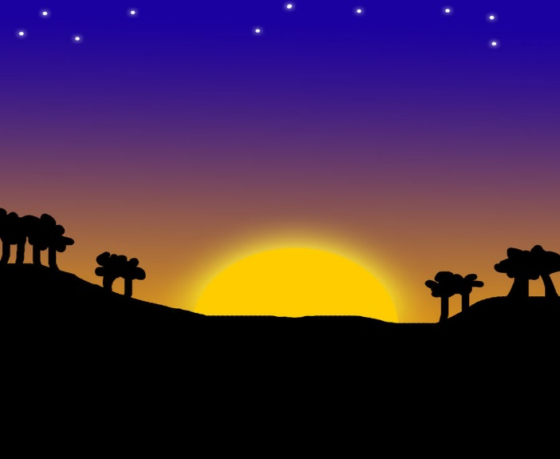
Genesis 2:8-14
“The Lord God planted a garden eastward in Eden, and there He
put the man whom He had formed. And out of the ground the
Lord God made every tree grow that is pleasant to the sight and
good for food. The tree of life was also in the midst of the
garden, and the tree of the knowledge of good and evil.” [2:8-9]
What good are trees that are only “pleasant to the sight”?
It is a question of beauty, a sign of God’s goodness:
[1 Chronicles 16:29]
“...worship the Lord in the beauty of holiness.”
“One thing I have desired of the Lord, that I will seek: that I may dwell in the house of the Lord all the days of my life, to behold the beauty of the Lord...” [Psalm 27:4]
Genesis 2:
“The Nature of Man”

Slide 18
Genesis 2:8-14
“The Lord God planted a garden eastward in Eden, and there He
put the man whom He had formed. And out of the ground the
Lord God made every tree grow that is pleasant to the sight and
good for food. The tree of life was also in the midst of the
garden, and the tree of the knowledge of good and evil.” [2:8-9]
God provided in the garden for all of man’s needs, both physical and spiritual...
Genesis 2:
“The Nature of Man”

Slide 19
Genesis 2:8-14
“The Lord God planted a garden eastward in Eden, and there He
put the man whom He had formed. And out of the ground the
Lord God made every tree grow that is pleasant to the sight and
good for food. The tree of life was also in the midst of the
garden, and the tree of the knowledge of good and evil.” [2:8-9]
God provided in the garden for all of man’s needs, both physical and spiritual...
This tree would soon serve as a test of man’s love and obedience
Genesis 2:
“The Nature of Man”

Slide 20
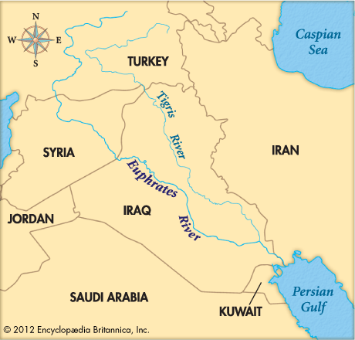
Genesis 2:8-14
“Now a river went out of Eden to water the garden, and from there it
parted and became four riverheads. The name of the first is Pishon;
it is the one which skirts the whole land of Havila, where there is
gold. And the gold of that land is good. Bdellium and the onyx stone
are there. The name of the second river is Gihon; it is the one which
goes around the whole land of Cush. The name of the third river is
Hiddekel; it is the one which goes toward the east of Assyria. The
fourth river is the Euphrates.” [2:10-14]
God continued to take care of the plants’ need for water; still without making it rain, God provided a river which then forked into four rivers...
Is this the spot where Eden was
located?
Genesis 2:
“The Nature of Man”

Slide 21
Genesis 2:8-14
“Now a river went out of Eden to water the garden, and from there it
parted and became four riverheads. The name of the first is Pishon;
it is the one which skirts the whole land of Havila, where there is
gold. And the gold of that land is good. Bdellium and the onyx stone
are there. The name of the second river is Gihon; it is the one which
goes around the whole land of Cush. The name of the third river is
Hiddekel; it is the one which goes toward the east of Assyria. The
fourth river is the Euphrates.” [2:10-14]
Why would God mention that He placed precious stones and metals here?
✓
They are objects of beauty
These are objects that reflect the beauty of Eden: we will see them later in the temple of God and in the beauty of the New Jerusalem in Revelation! [cp Ex 25:10-40; 28:5-10; Rv 21:18]
Genesis 2:
“The Nature of Man”

Slide 22
Genesis 2:15-17
“Then the Lord God took the man and put him in the garden of
Eden to tend and keep it. And the Lord God commanded the
man, saying, ‘Of every tree of the garden you may freely eat;
but of the tree of the knowledge of good and evil you shall not
eat, for in the day that you eat of it you shall surely die.”
“To tend and keep” is a much lighter job than “to till” and “to plant”: God gave the man a perfectly prepared garden that would only require proper maintenance
This is a shadow of the rest which God gives to His faithful servants
“...houses full of all good things, which you did not fill, hewn-out wells, which you did not dig, vineyards and olive trees which you did not plant...” [Dt 6:10-12; cp Josh 24:13; Mt 11:28-30; Hb 4:10; Rv 14:13]
Genesis 2:
“The Nature of Man”

Slide 23
Genesis 2:15-17
“Then the Lord God took the man and put him in the garden of
Eden to tend and keep it. And the Lord God commanded the
man, saying, ‘Of every tree of the garden you may freely eat;
but of the tree of the knowledge of good and evil you shall not
eat, for in the day that you eat of it you shall surely die.”
God begins commanding the man with a generic law: “you may freely eat” of every tree...
Genesis 2:
“The Nature of Man”

Slide 24
Genesis 2:15-17
“Then the Lord God took the man and put him in the garden of
Eden to tend and keep it. And the Lord God commanded the
man, saying, ‘Of every tree of the garden you may freely eat;
but of the tree of the knowledge of good and evil you shall not
eat, for in the day that you eat of it you shall surely die.”
God begins commanding the man with a generic law: “you may freely eat” of every tree...
Then God gives him a specific law: “but of the tree of the knowledge of good and evil you shall not eat...”
Generic laws may be obeyed in any way that does not violate the law itself; specific laws, however, must be obeyed exactly as they are revealed. Usually revealed along with a specific law is some form of punishment if it is disobeyed...
Genesis 2:
“The Nature of Man”

Slide 25
Genesis 2:15-17
“Then the Lord God took the man and put him in the garden of
Eden to tend and keep it. And the Lord God commanded the
man, saying, ‘Of every tree of the garden you may freely eat;
but of the tree of the knowledge of good and evil you shall not
eat, for in the day that you eat of it you shall surely die.”
Not at all! It is quite simple!
Is God’s law here hard to understand?
Also, No!
Was God testing Adam’s intelligence?
Then what is the law of God meant to test?
Genesis 2:
“The Nature of Man”

Slide 26
The Word of God:
A Test of Love and Obedience
Remember...
The word of God, as Creator, gives order to (organizes) creation;
Disorder is the result of disobedience to the word of God
The word of God, in geral, is not difficult to understand:
“With many such parables Jesus spoke the word to them, as much as they could understand.” [Mark 4:33 NIV]
“Now we have received, not the spirit of the world, but the Spirit who is from God, that we might know the things that have been freely given to us by God.” 1 Corinthians 2:12
“...when you read, you may understand my knowledge in the mystery of Christ...” Ephesians 3:4

Slide 27
The Word of God:
A Test of Love and Obedience
Remember...
The word of God, as Creator, gives order to (organizes) creation;
Disorder is the result of disobedience to the word of God
The word of God, in geral, is not difficult to understand:
Obedience to His word shows whether we love God or not:
“...for the Lord your God is testing you to know whether you love the Lord your God with all your heart and with all your soul. You shall walk after the Lord your God and fear Him, and keep His commandments and hear His voice...” Deuteronomy 13:3-4
“This is love, that we walk according to His commandments.” 2 John 6
“If you love Me, keep My commandments.”
John 14:15

Slide 28
Genesis 2:18-20
“And the Lord God said, ‘It is not good that man should be
alone; I will make him a helper comparable to him.’ Out of the
ground the Lord God formed every beast of the field and every
bird of the air, and brought them to Adam to see what he
would call them. And whatever Adam called each living
creature, that was its name. So Adam gave names to all cattle,
to the birds of the air, and to every beast of the field. But for
Adam there was not found a helper comparable to him.”
Genesis 2:
“The Nature of Man”

Slide 29
Genesis 2:18-20
“And the Lord God said, ‘It is not good that man should be
alone; I will make him a helper comparable to him.’” [2:18]
This is a shocking declaration after hearing God declare SEVEN times “it was good” [1:4, 10, 12, 18, 21, 25, 31]
Note that this declaration is not a reaction from God regarding a situation that was poorly dealt with during creation: we are still in the context of the sixth day, after which God saw that everything “was very good”! [1:31]
In fact, God is being proactive here, addressing issues before they can become a problem in the universe He created...
Genesis 2:
“The Nature of Man”

Slide 30
Genesis 2:18-20
“And the Lord God said, ‘It is not good that man should be
alone; I will make him a helper comparable to him.’” [2:18]
Many people have the idea that God saw that the man was lonely after some time had passed and realized that it was not a good situation. The truth is that God, in His eternal wisdom, already understood that it would not be good for man to be alone, and Genesis 2 describes for us how God Himself determined to address this...
It is important to remember that both man and woman were formed on the sixth day [1:27]. In accordance with the Bible, we simply cannot imagine that the man spent some long time alone without the woman
Genesis 2:
“The Nature of Man”

Slide 31
Genesis 2:18-20
“And the Lord God said, ‘It is not good that man should be
alone; I will make him a helper comparable to him.’” [2:18]
This is God’s divine and pre-planned solution for man’s alone-ness! (alone is a state; lonely is a feeling...)
God determined to make a “helper”, an associate; the word literally speaks of aid (think, “first aid”)
The man perhaps would have made another man to be his helper (that’s how it appears to be among the angels!), but God made the woman
Genesis 2:
“The Nature of Man”

Slide 32
Genesis 2:18-20
“Out of the ground the Lord God formed every beast of the field
and every bird of the air, and brought them to Adam to see
what he would call them. And whatever Adam called each
living creature, that was its name. So Adam gave names to all
cattle, to the birds of the air, and to every beast of the field.
But for Adam there was not found a helper comparable to
him.’” [2:19-20]
Note again that God did not make the animals in response to man’s loneliness: when He made the man on the sixth day, all the animals had already been made!
Perhaps so that the man could see his dire need for a helper comparable to him, God brought all the animals first...
Genesis 2:
“The Nature of Man”

Slide 33
Genesis 2:18-20
“Out of the ground the Lord God formed every beast of the field
and every bird of the air, and brought them to Adam to see
what he would call them. And whatever Adam called each
living creature, that was its name. So Adam gave names to all
cattle, to the birds of the air, and to every beast of the field.
But for Adam there was not found a helper comparable to
him.’” [2:19-20]
To the ancients, names had great significance (think ‘Smith’, ‘Wainwright’, etc); perhaps Adam named each by their duties
“heavy lifter”
“seed spreader”
“pollinator”
Genesis 2:
“The Nature of Man”

Slide 34
Genesis 2:18-20
“Out of the ground the Lord God formed every beast of the field
and every bird of the air, and brought them to Adam to see
what he would call them. And whatever Adam called each
living creature, that was its name. So Adam gave names to all
cattle, to the birds of the air, and to every beast of the field.
But for Adam there was not found a helper comparable to
him.’” [2:19-20]
Hand me a hammer
?
Adam’s real need for a comparable helper could not be met by animals...
Genesis 2:
“The Nature of Man”

Slide 35
Woman: The Comparable Helper
From the moment of her creation...
The woman was made, in God’s wisdom, with the role of helper
Sadly, by man’s “wisdom”, this role has been despised and has become a theme of ridicule...
- Some despise the woman’s role by treating her as a slave or
as someone of no real importance or value
- Some despise the woman’s role by trying to make her role
“equal to” or “superior” to the man’s role
Neither of these two approaches pleases God, who made her and defined her role!!

Slide 36
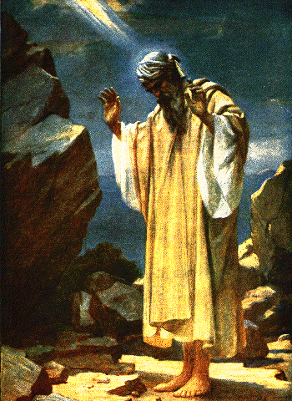
Woman: The Comparable Helper
From the moment of her creation...
The woman was made, in God’s wisdom, with the role of helper
Sadly, by man’s “wisdom”, this role has been despised and has become a theme of ridicule...
The woman was made, in God’s wisdom, as being comparable
“comparable” means that she ‘corresponds’ perfectly to what the man is; she is what he needs in order to fulfill his service
- having a different role is not being worthless or ridiculous...
Which of them is worthless or ridiculous...?
God planned the universe...
Jesus died on a cross...
The Spirit revealed it all...

Slide 37
Woman: The Comparable Helper
From the moment of her creation...
The woman was made, in God’s wisdom, with the role of helper
Sadly, by man’s “wisdom”, this role has been despised and has become a theme of ridicule...
The world thinks this way; the servant of God does not!
Is true service
a contemptible role? Was it for Jesus???
The woman was made, in God’s wisdom, as being comparable
“comparable” means that she ‘corresponds’ perfectly to what the man is; she is what he needs in order to fulfill his service
- having a different role is not being worthless or ridiculous...
- having a role of service – of assistant – is not contemptible
“You know that those who are considered rulers over the Gentiles lord it over them, and their great ones exercise authority over them. Yet it shall not be so among you; but whoever desires to become great among you shall be your servant. And whoever of you desires to be first shall be slave of all. For even the Son of Man did not come to be served, but to serve, and to give His life a ransom for many.” Mark 10:42-45

Slide 38
Woman: The Comparable Helper
From the moment of her creation...
The woman was made, in God’s wisdom, with the role of helper
Sadly, by man’s “wisdom”, this role has been despised and has become a theme of ridicule...
The woman was made, in God’s wisdom, as being comparable
“comparable” means that she ‘corresponds’ perfectly to what the man is; she is what he needs in order to fulfill his service
- having a different role is not being worthless or ridiculous...
- having a role of service, of assistant is not contemptible...
We must work to develop the mind of God regarding service:
“Husbands, love your wives, just as Christ also loved the church and gave Himself for her.” Ephesians 5:25
“...submitting to one another in the fear of God.” Ephesians 5:21
“Nor was man created for the woman, but woman for the man.”
1 Corinthians 11:9

Slide 39
Genesis 2:21-25
“And the Lord God caused a deep sleep to fall on Adam, and he
slept; and He took one of his ribs, and closed up the flesh in
its place.
Then the rib which the Lord God had taken from the man He
made into a woman, and He brought her to the man.
And Adam said:
‘This is now bone of my bones and flesh of my flesh, she shall
be called woman, because she was taken out of man.’
Therefore a man shall leave his father and mother and be
joined to his wife, and they shall become one flesh. And they
were both naked, the man and his wife, and were not ashamed.”
Genesis 2:
“The Nature of Man”

Slide 40
Genesis 2:21-25
“And the Lord God caused a deep sleep to fall on Adam, and he
slept; and He took one of his ribs, and closed up the flesh in
its place.
Then the rib which the Lord God had taken from the man He
made into a woman, and He brought her to the man.” [2:21-22]
God performed the first “surgery”, even causing the man to sleep for the process...
Genesis 2:
“The Nature of Man”

Slide 41
Genesis 2:21-25
“And the Lord God caused a deep sleep to fall on Adam, and he
slept; and He took one of his ribs, and closed up the flesh in
its place.
Then the rib which the Lord God had taken from the man He
made into a woman, and He brought her to the man.” [2:21-22]
Why would God have chosen to make woman from a rib?
Popular thought:
Not from the head, so she wouldn’t feel superior to man...
But from a rib, so that they wouldn’t forget that they are equals before God and should walk side by side...
Not from the foot, so man wouldn’t feel superior to her...
Maybe.... however:
Genesis 2:
“The Nature of Man”

Slide 42
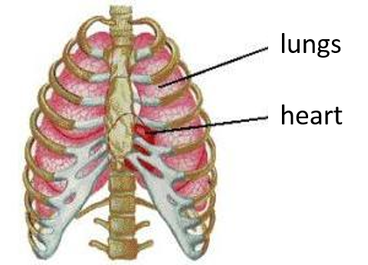
Genesis 2:21-25
“And the Lord God caused a deep sleep to fall on Adam, and he
slept; and He took one of his ribs, and closed up the flesh in
its place.
Then the rib which the Lord God had taken from the man He
made into a woman, and He brought her to the man.” [2:21-22]
Why would God have chosen to make woman from a rib?
In this way, as the woman properly carries out her role, she protects man’s vitality:
“The heart of her husband safely trusts her...”
“Her husband is known in the gates when he sits
among the elders of the land.”
“Her husband...praises her; ‘Many daughters have
done well, but you excel them all.”
[Prov 31:11, 23, 28-29]
The function of ribs is to protect the vital organs
Genesis 2:
“The Nature of Man”

Slide 43
Genesis 2:21-25
“And the Lord God caused a deep sleep to fall on Adam, and he
slept; and He took one of his ribs, and closed up the flesh in
its place.
Then the rib which the Lord God had taken from the man He
made into a woman, and He brought her to the man.” [2:21-22]
God “brought” the woman before Adam, just as He had done with all the animals. [cp 2:19] This time, however, his reaction would be quite different!
Genesis 2:
“The Nature of Man”

Slide 44
Genesis 2:21-25
“And Adam said:
‘This is now bone of my bones and flesh of my flesh, she shall
be called woman, because she was taken out of man.’
Therefore a man shall leave his father and mother and be
joined to his wife, and they shall become one flesh. And they
were both naked, the man and his wife, and were not ashamed.”
[2:23-25]
Adam realized that the woman is exactly what was missing; SHE is what he needed! Now that he has named all the animals, he can see the superiority of the woman: she is like him!
Genesis 2:
“The Nature of Man”

Slide 45
Genesis 2:21-25
“And Adam said:
‘This is now bone of my bones and flesh of my flesh, she shall
be called woman, because she was taken out of man.’
Therefore a man shall leave his father and mother and be
joined to his wife, and they shall become one flesh. And they
were both naked, the man and his wife, and were not ashamed.”
[2:23-25]
Just as Adam had done with all the animals, he gave a name to the woman – but this was not just any name: this time, he gave the woman his own name!
Even today there are remnants of this act in our culture: when we are married, the wife takes the name of her husband!
Genesis 2:
“The Nature of Man”

Slide 46
Genesis 2:21-25
“And Adam said:
‘This is now bone of my bones and flesh of my flesh, she shall
be called woman, because she was taken out of man.’
Therefore a man shall leave his father and mother and be
joined to his wife, and they shall become one flesh. And they
were both naked, the man and his wife, and were not ashamed.”
[2:23-25]
Who said these words?
At first reading, it looks as if Adam himself said this, which would be a little odd, seeing as he had no father or mother...
In the New Testament, when some try to defy Jesus’ teaching on divorce, He says: “Have you not read that He who made them at the beginning ‘made them male and female’, and said, ‘For this reason a man shall leave his father and mother...?’” [Mt 19:4-5]
Genesis 2:
“The Nature of Man”

Slide 47
Genesis 2:21-25
“And Adam said:
‘This is now bone of my bones and flesh of my flesh, she shall
be called woman, because she was taken out of man.’
Therefore a man shall leave his father and mother and be
joined to his wife, and they shall become one flesh. And they
were both naked, the man and his wife, and were not ashamed.”
[2:23-25]
This plan estabished by God in Genesis 2 is cited by Him in the whole Bible as marriage law
[Mal 2:13-16; Mt 19:4-6; Mk 10:6-9; Eph 5:30-32;
1 Cor 6:16-18; etc]
Who said these words?
These words are God’s commentary about Adam and Eve’s union, expressing His plan that all marriages should follow this example:
Marriage as God models it in this example follows a plan: (1) one man and one woman [any other combination is illicit]; (2) leave father and mother [forming a new family relationship]; and (3) become one flesh [inseparable except by death]
Genesis 2:
“The Nature of Man”

Slide 48
Genesis 2:21-25
“And Adam said:
‘This is now bone of my bones and flesh of my flesh, she shall
be called woman, because she was taken out of man.’
Therefore a man shall leave his father and mother and be
joined to his wife, and they shall become one flesh. And they
were both naked, the man and his wife, and were not ashamed.”
[2:23-25]
“one flesh” describes a perfect union – no doubt the woman is exactly what the man needed!
There are two inherent aspects to this union: (1) unity of purpose, which is the goal of every good relationship, and (2) physical union, which in the context of a sinless paradise has not even the slightest hint of shame. Shame at their nakedness and divisive strife are the first visible signs of sin in Genesis 3...
Genesis 2:
“The Nature of Man”

Slide 49
Marriage: Christ and the Church
The real reason behind God’s plan for marriage...
Ephesians 5:28-32
Marriage, in its purity and at its best, is a reflection of the loving desire God has to be united with us...
Are YOU united with God in Christ?

Slide 50
For further study on this subject, or if you have any comments, questions or suggestions about these slides, please contact me, Carl D. Ballard, via e-mail: carldballard@hotmail.com

