Slide 1
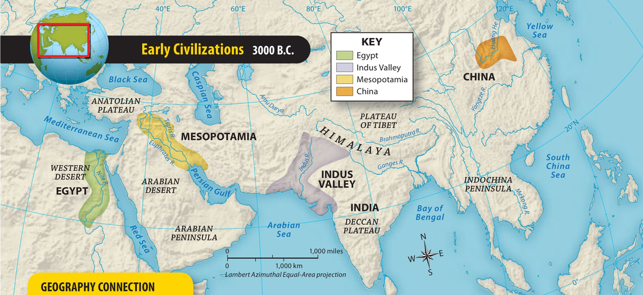

Slide 2
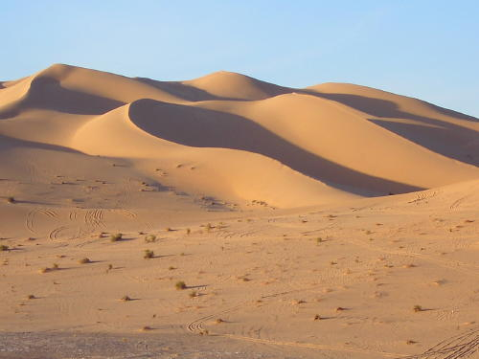
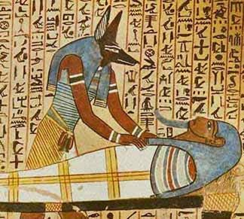
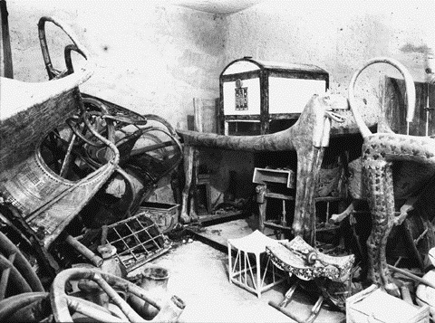
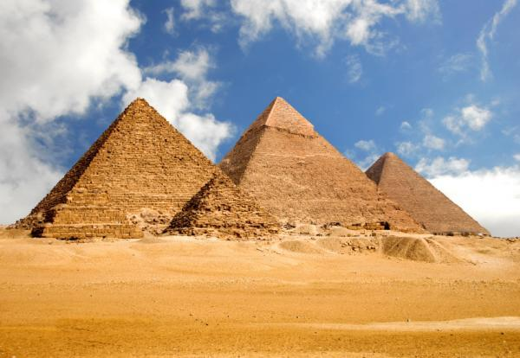
Egypt – Burials, Mummification and Tombs

Slide 3
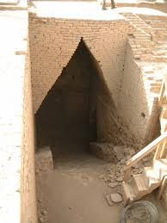
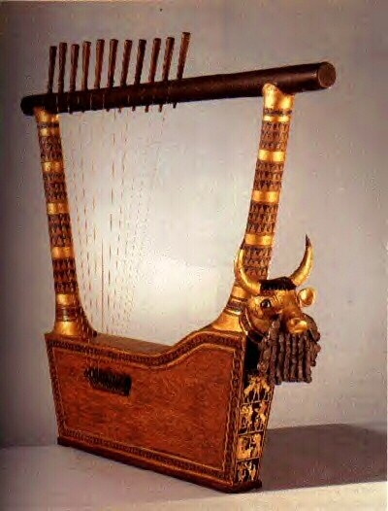
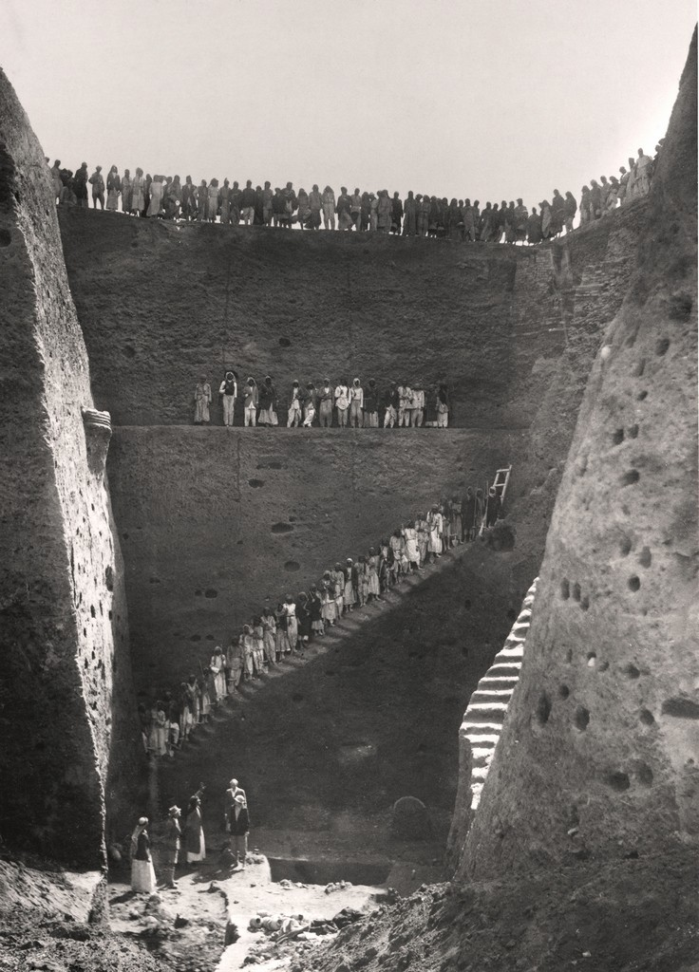
Mesopotamia – Royal Tombs of Ur

Slide 4
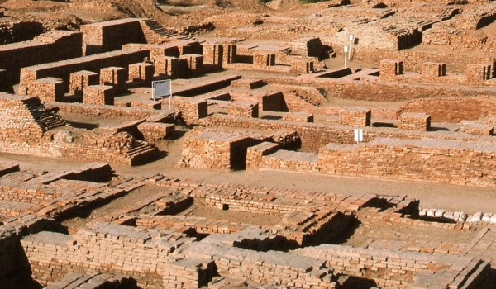
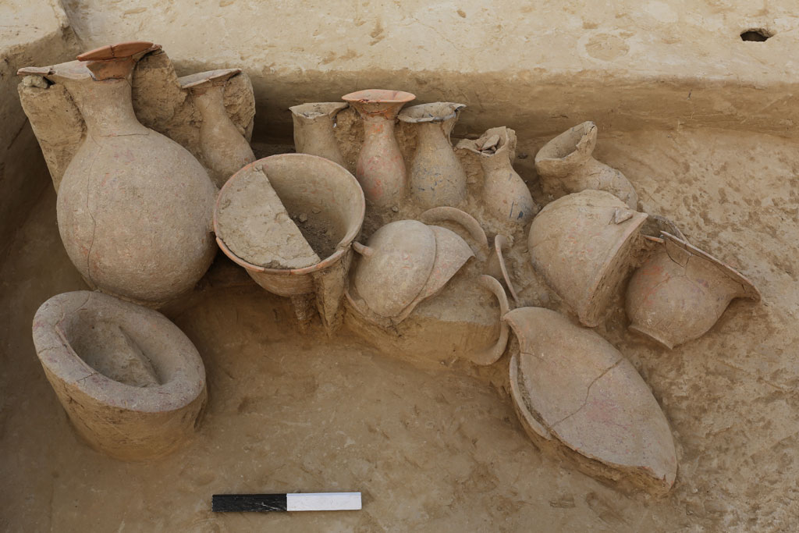
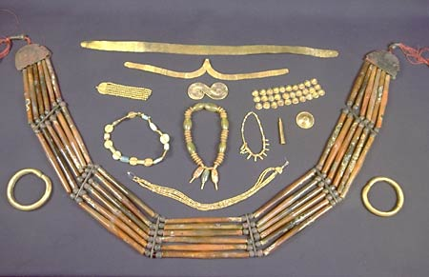
Indus Valley – Harappan Burials

Slide 5
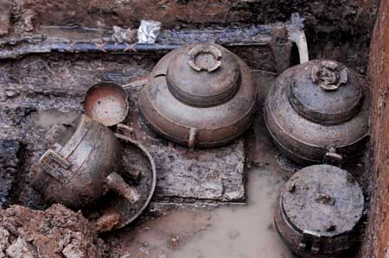
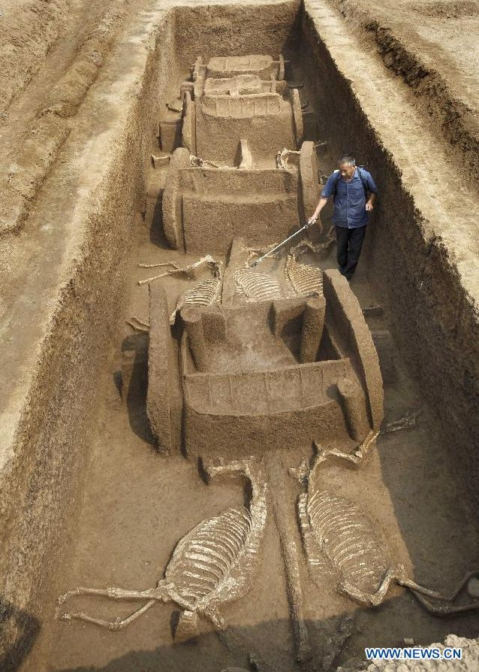
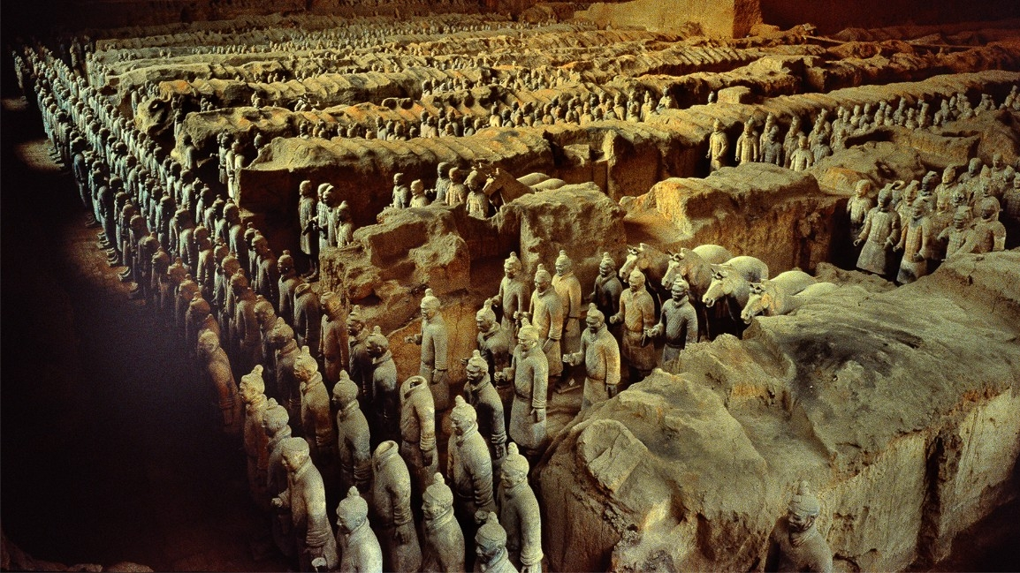
Yellow Valley – Chinese Burials

Slide 6
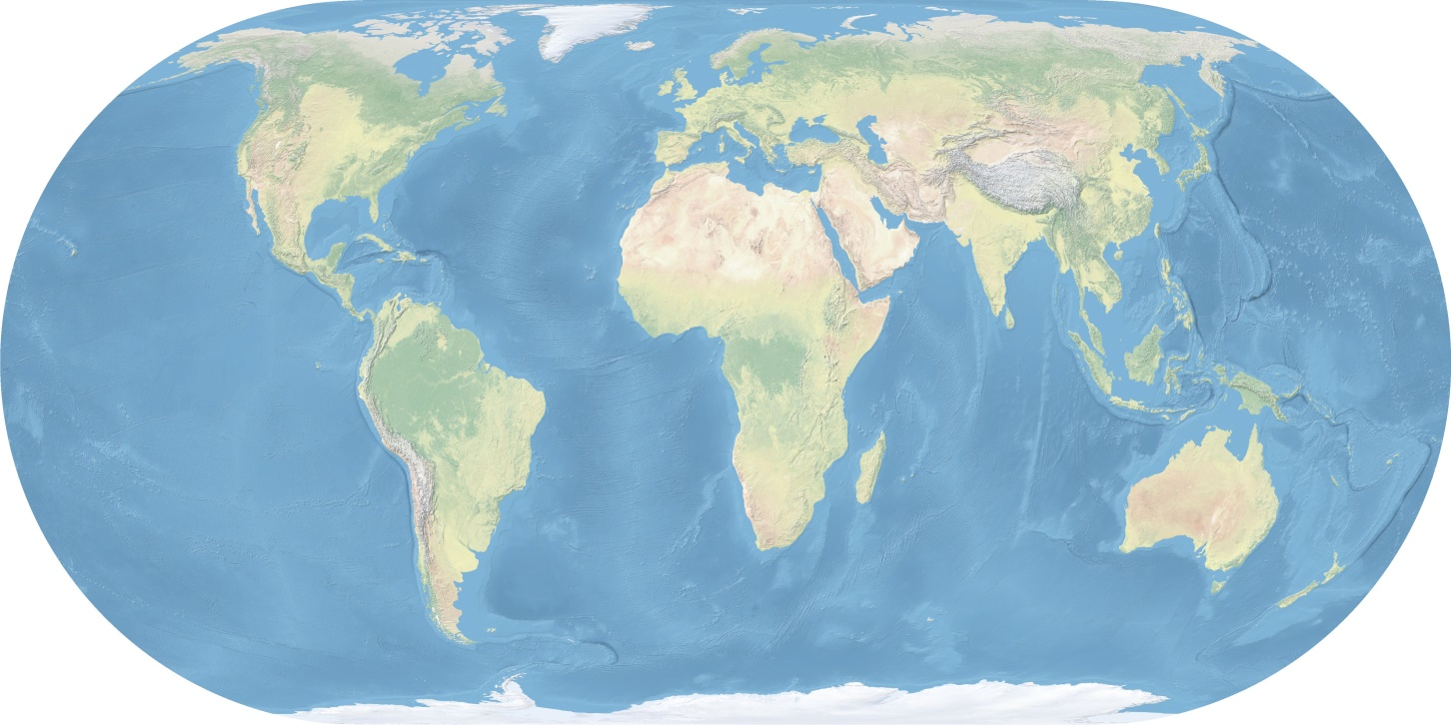
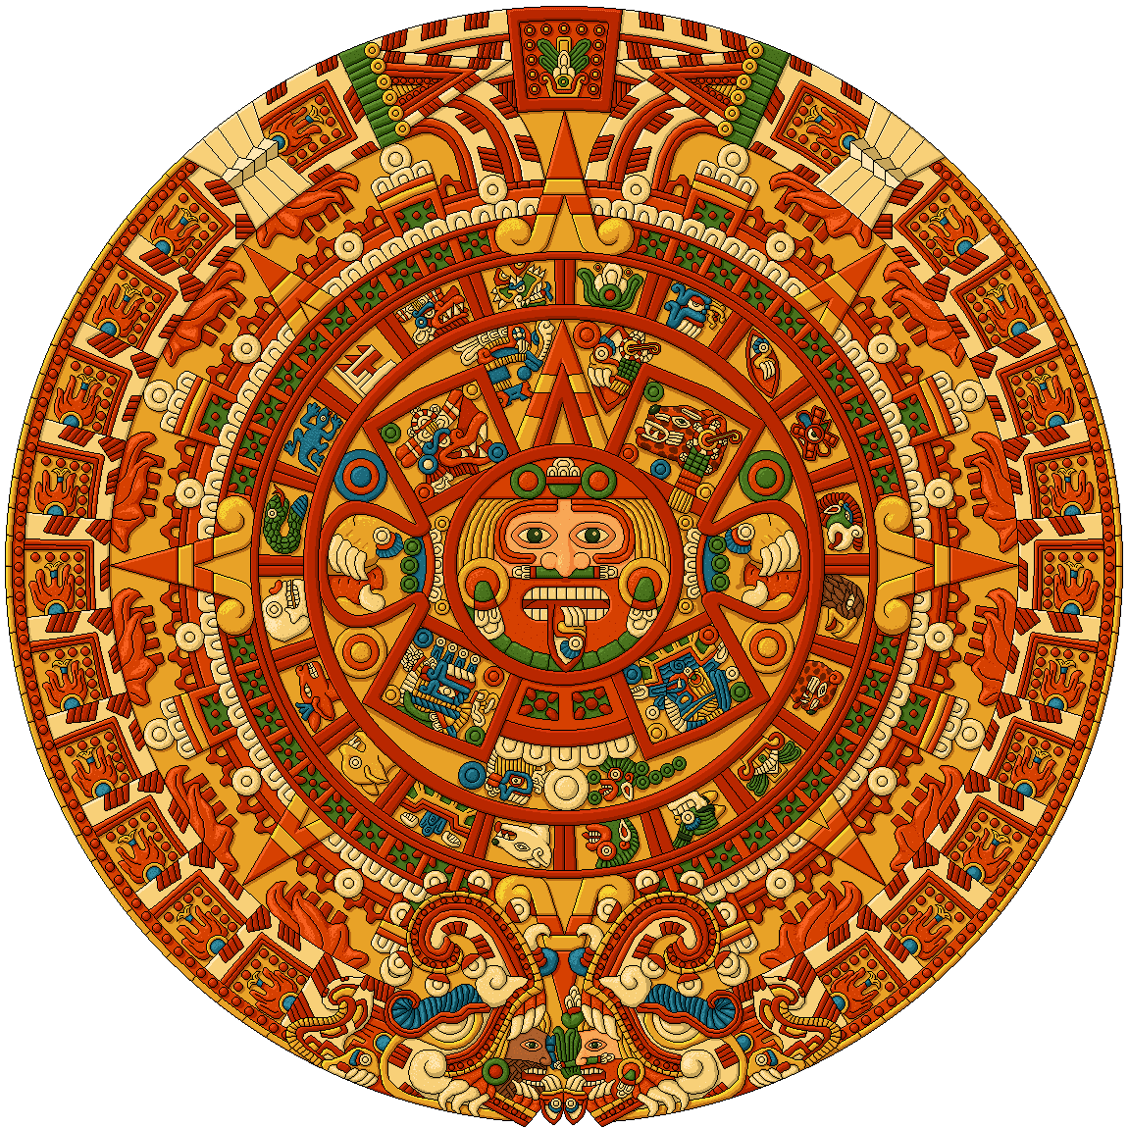
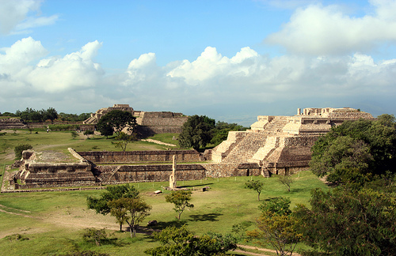
The Americas – Afterlife Beliefs

Slide 7
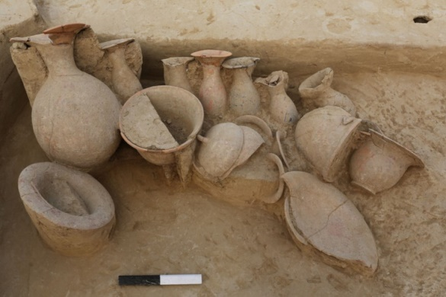
Why did everyone believe in an
afterlife?

Slide 8
Have I Been Told the Truth?
Messages which challenge today’s conventional thinking about…
Human Destiny
Is There An
AFTERLIFE?

Slide 9
Is There An
AFTERLIFE?
Two bodies of evidence
Ecclesiastes 3:11
He has made everything beautiful in its time. Also, he has put eternity into man's heart,…
(English Standard Version)
Eternity is innately a part of us

Slide 10
Is There An
AFTERLIFE?
Two bodies of evidence
James 2:26
For as the body apart from the spirit is dead, so also faith apart from works is dead.
The Bible
- humans have a soul
Matthew 10:28
And do not fear those who kill the body but cannot kill the soul. Rather fear him who can destroy both soul and body in hell.

Slide 11
Is There An
AFTERLIFE?
Two bodies of evidence
The Bible
- God wants eternal fellowship with us
John 3:16
"For God so loved the world, that he gave his only Son, that whoever believes in him should not perish but have eternal life.

Slide 12
Is There An
AFTERLIFE?
Two bodies of evidence
The Bible
- Christ, the Son of God is the link
John 6:35-40
5:25-29
14:1-6
Regarding the afterlife Christ is the:
Proof
Promise
Path

Slide 13
Is There An
AFTERLIFE?
If there is an afterlife,
if all the Bible says is true then…
This life is a prelude
The meaning and worth of your life extends way beyond this one
Knowing and preparing for the next life is of utmost importance

Slide 14
Is There An
AFTERLIFE?
If there is an afterlife,
if all the Bible says is true then…
At this time, in this place we are merely sojourners
I Peter 2:11
Philippians 3:20-21
Deuteronomy 2:3

Slide 15
Have I Been Told the Truth?
Messages which challenge today’s conventional thinking about…
Is There An
AFTERLIFE?

