Slide 1
The Gospel of Matthew
Notes:
Acknowledge speed of classes
Emphasizes the importance of personal study
Allows you to see bigger ideas and themes

Slide 2
Outline | Chapters 26-27
Final Events Before Arrest
Plot to kill Jesus
Jesus anointed at Bethany
Judas betrays Jesus
Passover meal with the disciples
Institution of the Lord’s Supper
Jesus foretells Peter’s denial
Jesus prays in Gethsemane
Arrest and Trial
Arrested in Gethsemane
Jesus before Caiaphas and the Council
Peter’s denial
Judas hangs himself
Jesus before Pilate
Crowd chooses Barabbas
Jesus delivered to be crucified
The Crucifixion
Jesus is mocked
The crucifixion
The death of Jesus
Jesus is buried
Guards at the tomb

Slide 3
Notes:
26:1-5
The Plot to Kill Jesus
Jesus just finished teaching parables, talking about the final judgment, and now in this chapter we begin the final events before the crucifixion. These first few verses tell us it’s 2 days before Passover, which is when the last supper took place.
And Jesus says, I’m going to be delivered up to be crucified…something that he’s told the disciples already. And Matthew here writing, to show how correct Jesus was, tells us that the chief priests and elders all gathered with the high priest, Caiaphas, to figure out how they were going to do this without a huge backlash.
So you get this image of all these evil men hunched around…we’ve had the movie Aladdin on here lately, the kids like the songs…so I’m envisioning Jafar here, for those of you who’ve seen the movie, he just looks like a bad guy…so him and all of the other chief priests and elders are throwing out ideas on how to commit this murder in a politically satisfying way…which is just…the height of man’s sin.
They don’t know scripture, they don’t know God, they’ve made up their own laws…if you recall back in the book of numbers there’s an Israelite named Phinehas who’s zeal for God is praised after he murders a fellow Israelite and his Midianite partner after they flaunt their sin right in the middle of the people.
And when you read the story you’ll notice that God never praises the acts of Phinehas, only his zeal. The book of numbers is about Israel’s 40 years in the wilderness and you’ll recall there wasn’t much zeal for God at this time. So this passion coming from Phinehas was important.
But sadly, this story of Phinehas was twisted by Israel in later years to show that it’s okay to murder if you catch the people in the act of their sin…which is something that God never warrants. That specific law which the Jews called Jus Zelatorum, is what the priests and elders were invoking back here in Matt 26 to justify their killing of Jesus.
So they don’t know scripture, or God, they’re making up their own laws, they’re not even following their own laws accurately because they’re waiting to execute judgment, they fear the response of others…which is a good sign that your motives are not quite right, they choose a politically opportune time…after the feast so there won’t be as many people.
You still see this in politics today they call it the Friday news dump. The idea being you can announce a bunch of controversial stuff on Friday at 5 so the blowback won’t be as bad since everyone’s leaving work for the weekend.
And so if you bundle everything up that we just said…we’ve painted a pretty ugly picture of the chief priests and elders…if you bundle that up and take a step back and look at this picture we’ve just painted…
I want everyone in this room to understand that that could be you. Some of us have made mistakes because we don’t know scripture.
Some of us sin because we don’t know the true nature of God. Some of us have elevated man’s laws higher than God’s.
Some of us fear the consequences of truth. Some of us get too political on how to address an issue. Verse 3-5 is us, and we can never look at the bad guys from the gospels and scoff at how ridiculous they were, because we can be that ridiculous too. Page knows that I can be ridiculous.
And so that’s why we’re studying this, so that we don’t make these same mistakes.
Let’s keep rolling

Slide 4
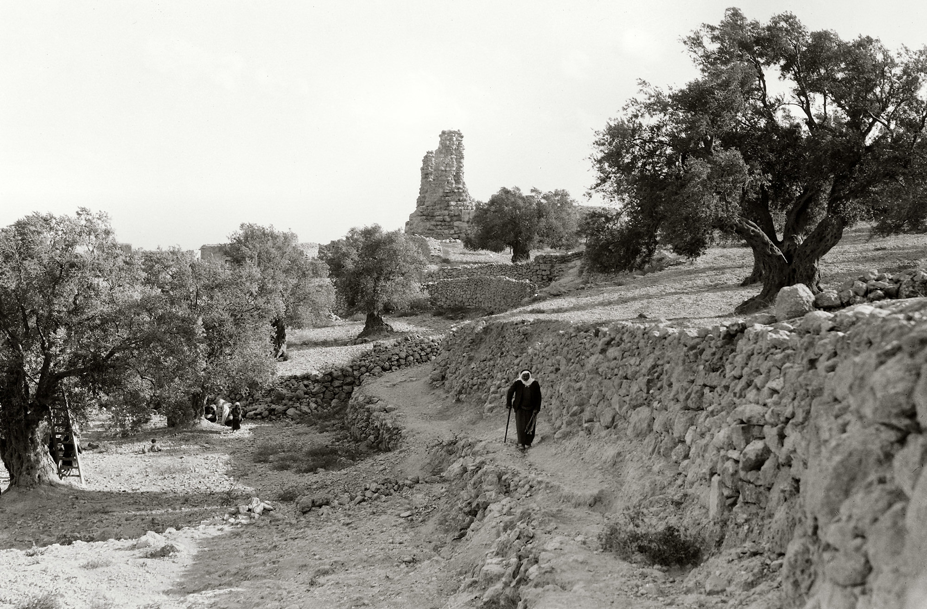
Now when Jesus was in Bethany, in the house of Simon the leper . . .
Bethany and the traditional house of Simon the leper
26:6
Notes:
Prominent remains in the village are identified with the home of Simon the Leper but there is no way of proving that identification today without excavations. This American Colony photograph was taken between 1934 and 1939.
mat14207

Slide 5
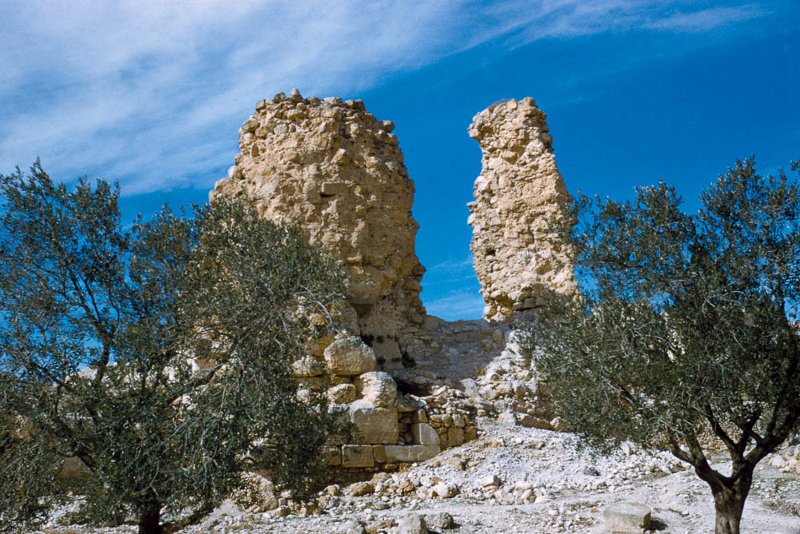
Now when Jesus was in Bethany, in the house of Simon the leper . . .
Ruins of the traditional house of Simon the Leper at Bethany
26:6
Notes:
This American Colony photograph was taken between 1948 and 1958.
mat23203

Slide 6
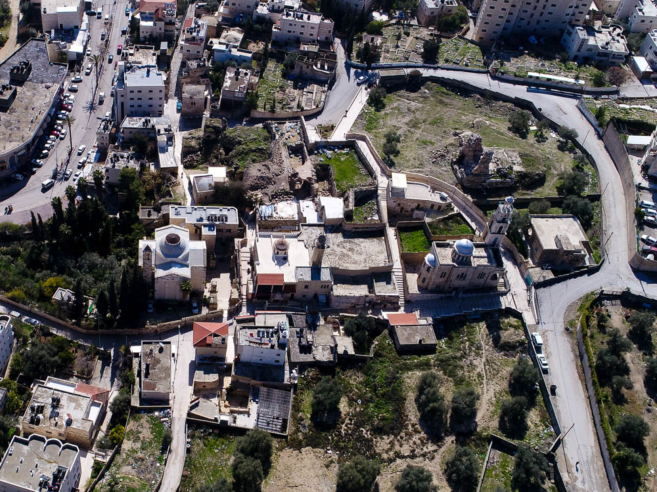
Now when Jesus was in Bethany, in the house of Simon the leper . . .
Traditional house of Simon the leper
Catholic church
Orthodox church
Tomb of Lazarus
Bethany (aerial view from the north)
26:6
Notes:
ws012917304

Slide 7
Mary
Judas
Sought Him
“A woman came up to him”
v 7
Valued Him Highly
“…came up to him with an alabaster flask of very expensive ointment”
v 7
Sought His Betrayal
“…went to the chief priests”
v 14
Did Not Consider Value
“What will you give me…?”
v 15
Notes:
26:6-13
Jesus Anointed at Bethany
Verse 6, Now when Jesus was at Bethany in the house of Simon the leper. Show slides.
This is the story of Mary anointing Jesus with the expensive ointment, we know it’s Mary from another account…and the lesson material asks us to contrast the character of Mary and Judas who we’ll read about in a second…so let me know what you found in these verses about Mary, what do we learn about her character or her motives?
Reveal Mary
26:14-16
Judas to Betray Jesus
Then in the next few verses we see some things about Judas (get reader, look for what you learn about Judas).
What do you see about Judas?
Reveal Judas
What we see in this contrast between Mary and Judas is the importance of what you do before problems occur, just as it is important what you do after. We always compare Judas and Peter…two men who betrayed or denied Jesus but handled their sin in completely different ways…but what about what you do leading up to those events?
Mary sought Him out, assigned value to Him. If you did, literally, only those two things you would be well on your way to the kind of relationship with God that he wants with you….because both of those things feed into everything else you do.
This other way is not the way to go. Judas bad, Mary good…let me boil that down to a nice simple point.

Slide 8
Notes:
26:17-35
The Passover with the Disciples
Institution of the Lord’s Supper
Jesus Foretells Peter’s Denial
So after this, this is a couple of days later, Jesus participates in Passover with the disciples in what we like to call the last supper, and the Lord’s Supper, what we participate in every Sunday is instituted.
And Jesus, when he tells them to drink from the cup says “…this is my blood of the covenant, which is poured out for many for the forgiveness of sins.”
This supper means something, and it’s an event we talk about a lot here so I’m not going to drill into this text for now, but we see it as an event with paramount importance, and it’s the last thing Jesus does with the disciples before heading off to the place he would be betrayed.

Slide 9
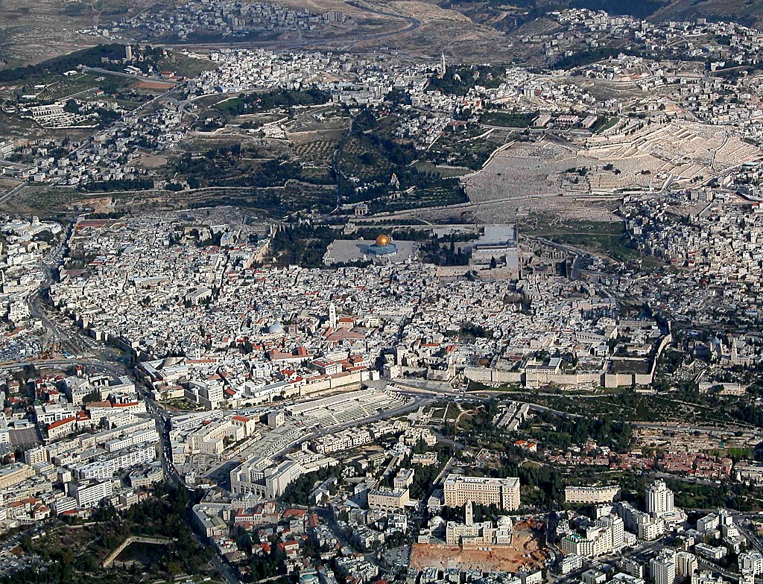
And when they had sung a hymn, they went out toward the Mount of Olives
Gethsemane
Upper Room (traditional location)
The Old City of Jerusalem (aerial view from the west)
26:30
Notes:
If the traditional location for the Upper Room on the Western Hill (modern Mount Zion) is correct, Jesus would have traveled east towards the “City of David,” then out a gate in the eastern wall of the city (no longer in existence), down into the Kidron Valley (cf. John 18:1) and northward to the area of the traditional location of the Garden of Gethsemane on the lower slopes of the Mount of Olives.
tb010703226

Slide 10
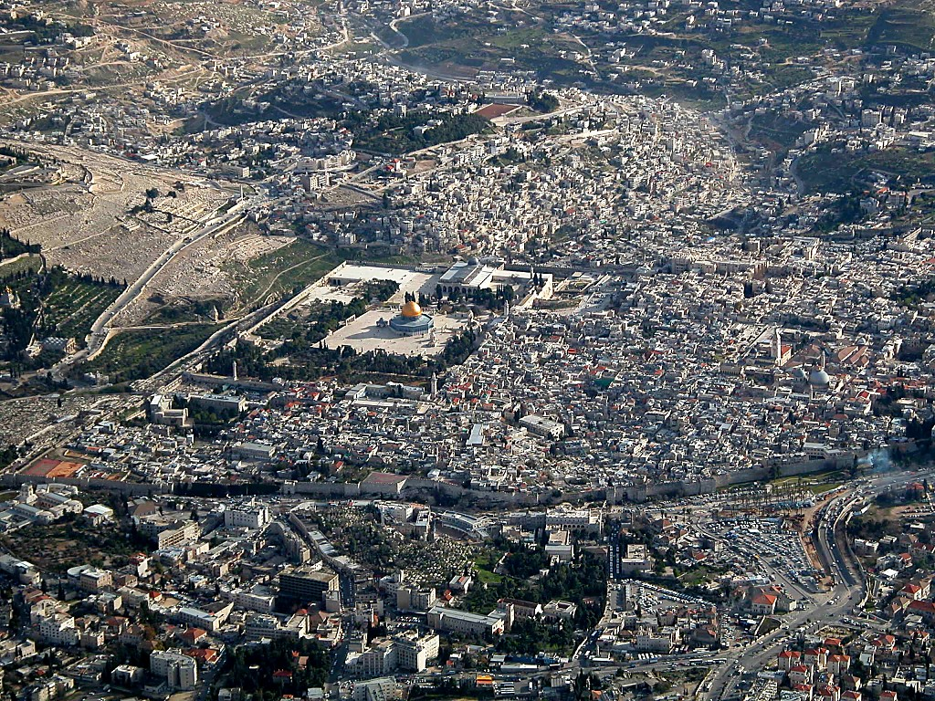
And when they had sung a hymn, they went out toward the Mount of Olives
Kidron Valley
Upper Room
Gethsemane
The Old City of Jerusalem (aerial view from the north)
26:30
Notes:
The location of the Upper Room is off the right edge of the photo. Jesus may have traveled towards Gethsemane by avoiding the Temple Mount, and traveling south of it. Some have suggested that Jesus traveled across the Temple Mount, suggesting that the reference to the vine in John 15:1 could have been in view of the grape clusters depicted on the temple façade. In either case, Jesus then descended into the Kidron Valley (cf. John 18:1) before arriving at Gethsemane.
tb010703223

Slide 11
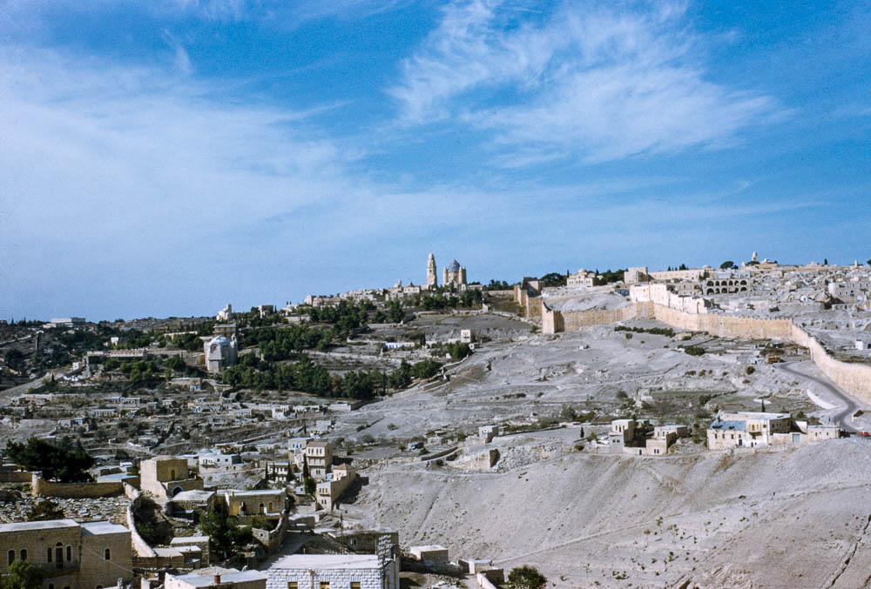
And when they had sung a hymn, they went out toward the Mount of Olives
Upper Room
Gethsemane
Kidron Valley
City of David and Mount Zion (from the east)
26:30
Notes:
This photo shows the possible route that Jesus took with his disciples in walking from the Western Hill down to the Kidron Valley. This American Colony photograph was taken between 1948 and 1958.
mat23211

Slide 12
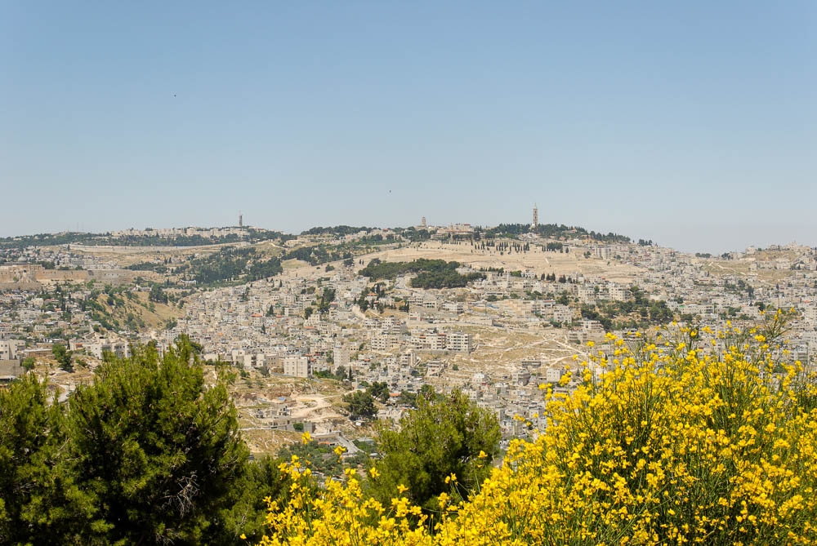
And when they had sung a hymn, they went out toward the Mount of Olives
Mount of Olives (from the south)
26:30
Notes:
This image gives a broader perspective of the Mount of Olives as seen from Haas Promenade. The southern wall of the Temple Mount is visible on the left side.
tb051907755

Slide 13
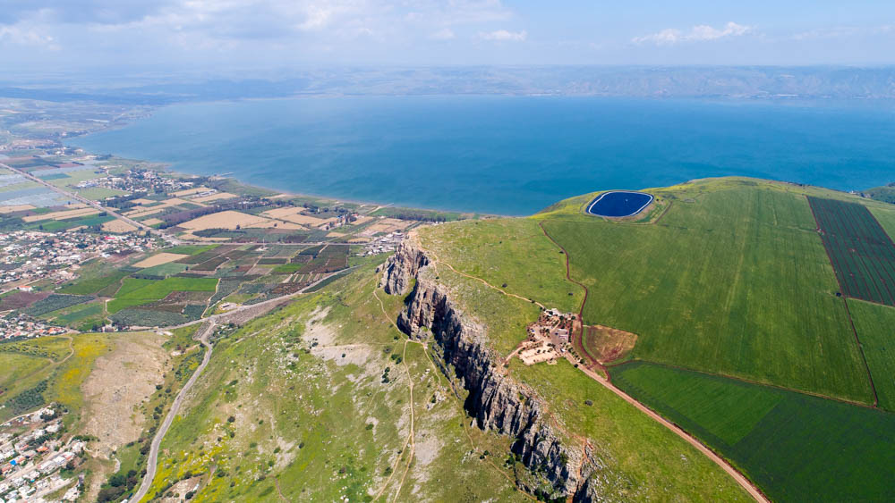
But after I am raised up, I will go before you into Galilee
The Sea of Galilee and Arbel cliffs (aerial view from the west)
26:32
Notes:
Jesus gave His disciples instructions on what would happen after His resurrection. This view shows the primary area of Jesus’s ministry in Galilee as recorded in the Gospels.
ws040317340

Slide 14
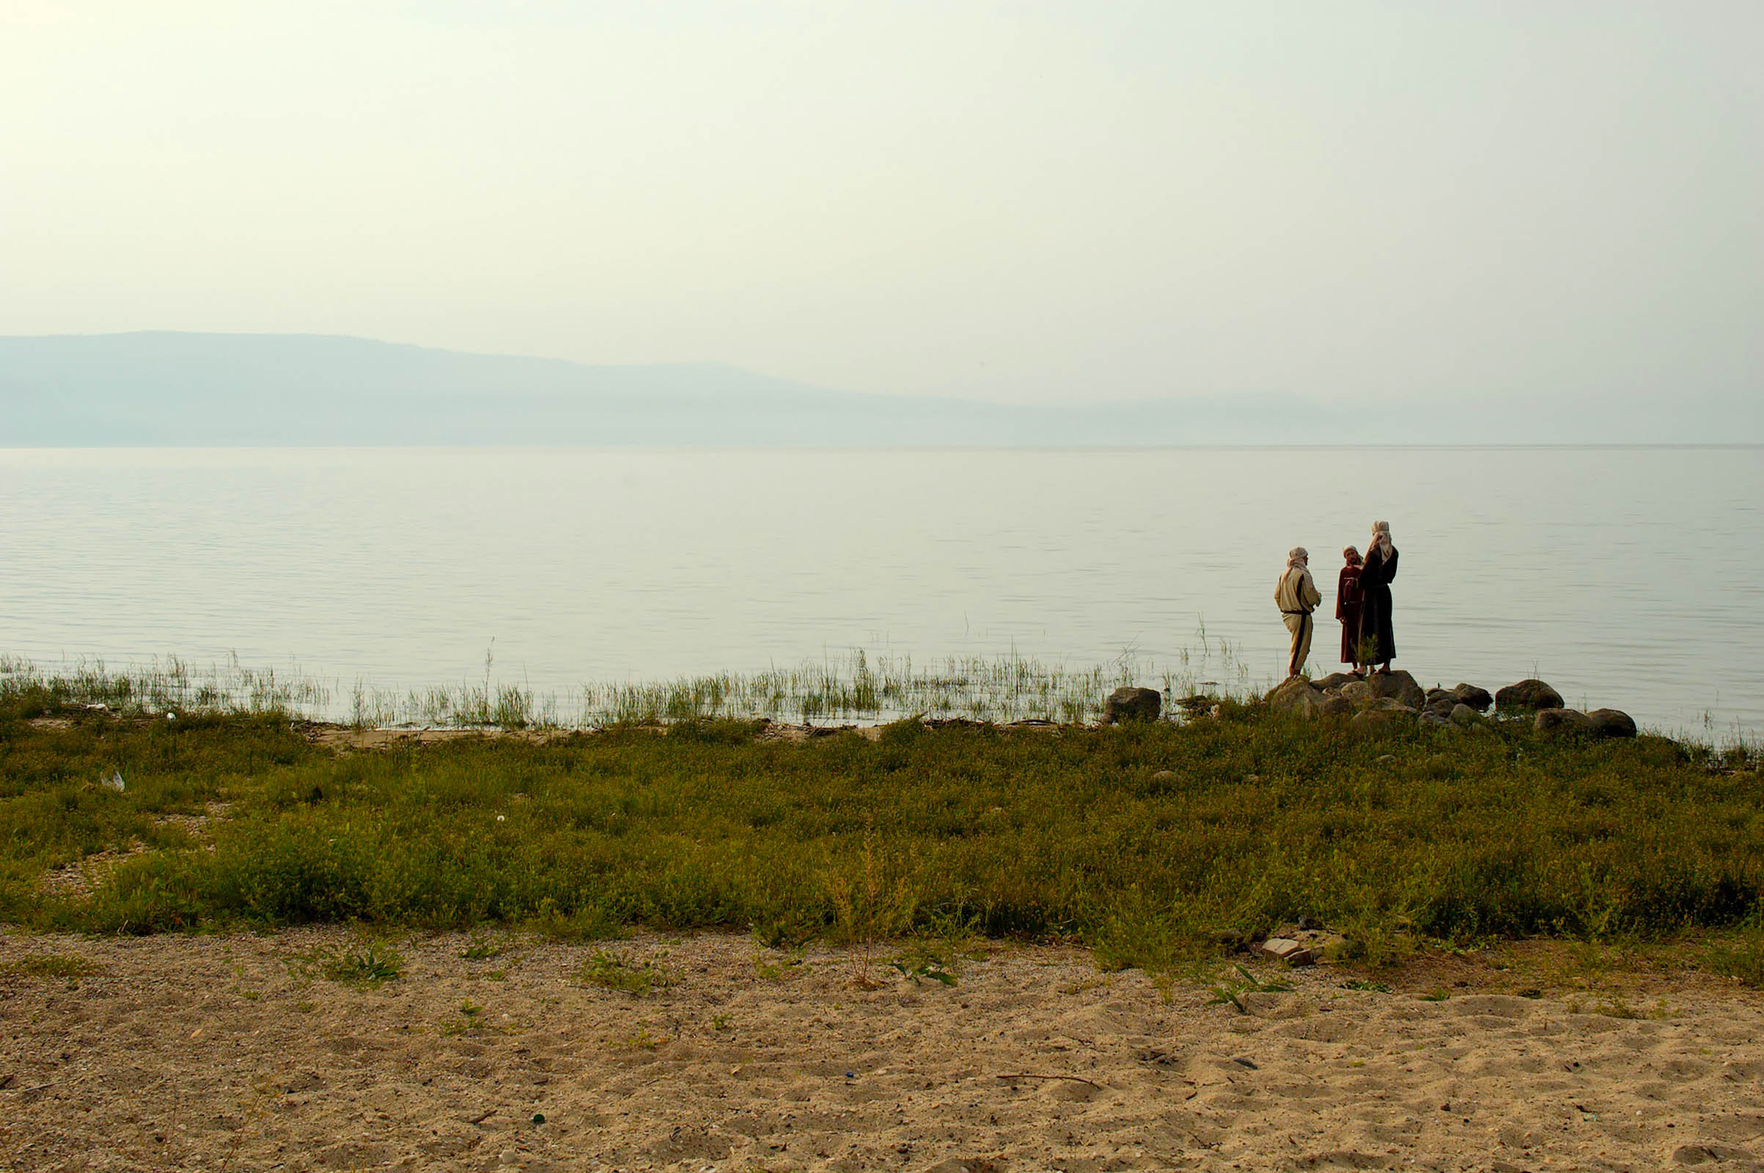
But after I am raised up, I will go before you into Galilee
Reenactment of disciples talking on the shoreline of the Sea of Galilee
26:32
Notes:
This photo was taken on the eastern side of the Sea of Galilee.
tb040706255

Slide 15
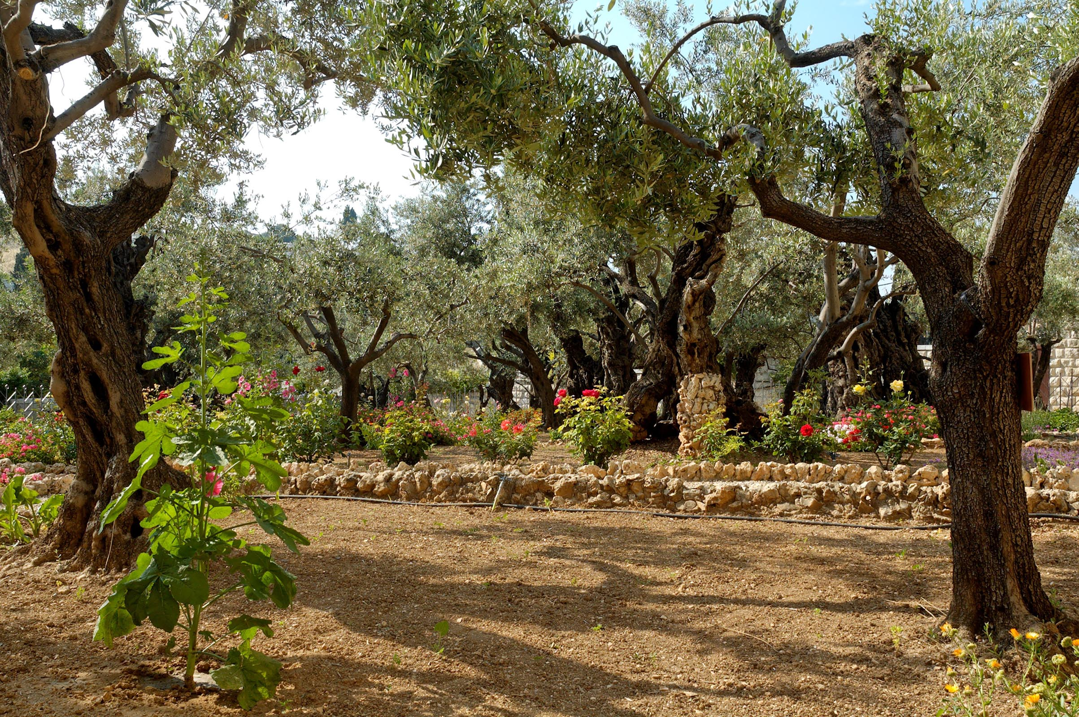
Then Jesus came with them to a place called Gethsemane
Olive trees in the Garden of Gethsemane
26:36
Notes:
tb051906418

Slide 16
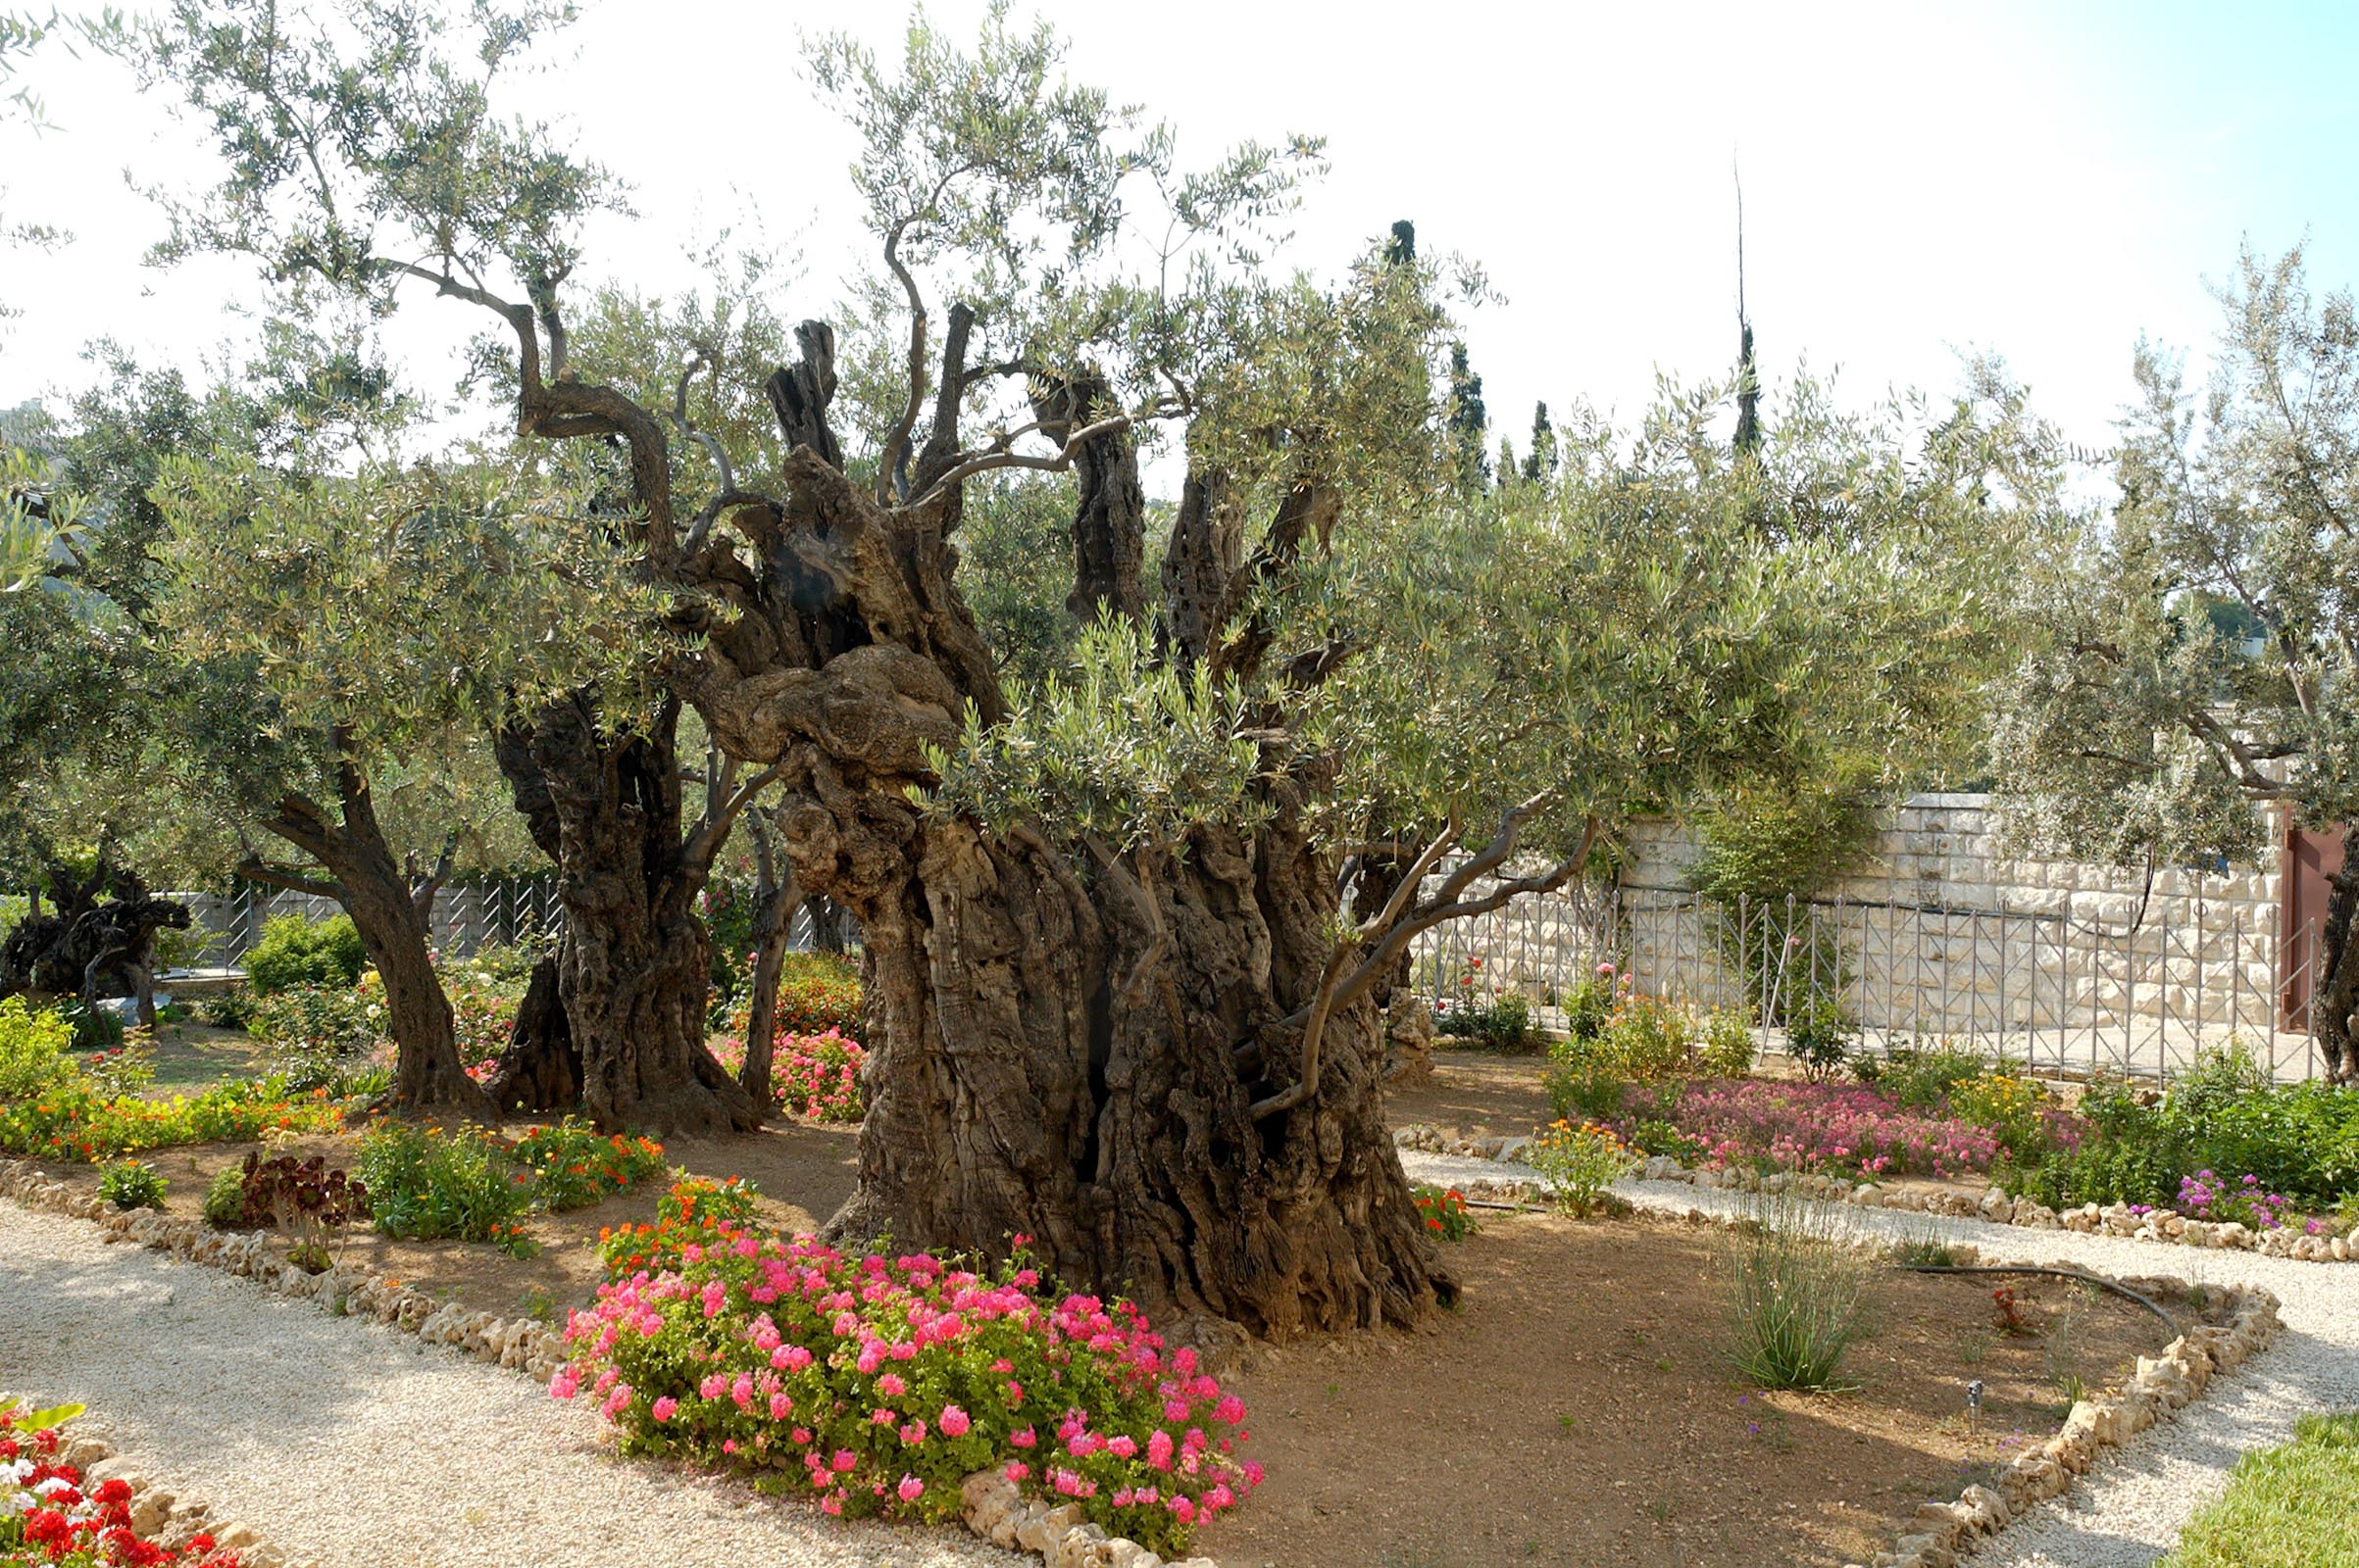
Then Jesus came with them to a place called Gethsemane
Olive trees in the Garden of Gethsemane
26:36
Notes:
Adjacent to the Church of All Nations is an olive garden with eight large and ancient olive trees. Scholars estimate the age of these trees to be between one and two thousand years old. It is unlikely that these trees were here in the time of Christ because the Romans reportedly cut down all the trees in the area during their siege of Jerusalem in AD 70.
tb051906422

Slide 17
Jesus in Times of Tumult
Went to a place of peace and comfort (Gethsemane)
Prayed
Multiple times
For a specific thing
For God’s will
Surrounded himself with friends (Peter, James, John)
Shared what he was going through
Remained himself (questioned and taught the disciples instead of being angry, v 40-41)
Denounces violence
Spoke directly, but controlled (v 55)
Notes:
26:36-56
Jesus Prays in Gethsemane
Betrayal and Arrest of Jesus
Verse 30, And when they had sung a hymn, they went out to the Mount of Olives. Slides.
Verse 32, But after I am raised up, I will go before you to Galilee. Slides.
Verse 36, Then Jesus went with them to a place called Gethsemane. Slides.
I want everyone to look down to verses 36-56 and do a quick scan to find what Jesus does when facing danger and hostility. What actions does he take? I know this is in your lesson but I know some of you didn’t do it, so take 1 minute and scan this…if you did your lesson, share your answers with your neighbor and we’ll all talk about it in 1 minute.
Get answers, then Reveal
What a great example on how to handle these times. Look at the one where he remained himself…
I can’t say something ugly to Page and then justify it by my long day at work. She can’t say something ugly and justify it by a stressful day. It may give insight as to why something ugly was said, but it doesn’t justify it. If Jesus did that then the entire planet would have justifiably been reduced to ash around this time. Instead he remains himself…he teaches…he exposes wrongdoing. Hopefully we can do the same.

Slide 19
Peter
Judas
Remembered Past Teaching
“Peter remembered the saying of Jesus…”
26:75
Mourned
“And he went out and wept bitterly.”
26:75
Looks to Absolve Himself
“…brought back the thirty pieces of silver…”
27:3
Kills Himself
“…he went and hanged himself.”
27:5
Notes:
26:57-75
Jesus Before Caiaphas and the Council
Peter Denies Jesus
So Jesus is arrested and taken before the council made up of Caiaphas the high priest and some scribes and elders, and they get what they were looking for. They ask if he’s the Christ, the Son of God, and he says, (read 64)
And this enrages them, they think this is blasphemy in their ignorance…and they have all they need under their made up law to condemn Him to death. Of course they have to go through Pilate first since they were under Roman occupation, but under Jewish law, Jesus’ fate was sealed.
And there’s this one line at the end of this section where it says that “…some slapped him, saying ‘Prophesy to us, you Christ! Who is it that struck you?’”…and this really stands out to me, which may seem odd.
If you think of all the things that happened to Jesus this surely ranks low on the list, but to me it’s so incredibly shameful and embarrassing to read…because you could make the argument that all of the other things that happened were people carrying out orders, or doing their job…which doesn’t make it any better but I think we’ve all heard of the psychological experiments that have shown what man is capable of when he feels obliged to do something.
But this is different. No one was told to do this, no one was obliged to do it. It’s a manifestation of each of those peoples ignorant, hateful hearts, which is the complete opposite of what God wanted in His people. They slapped him.
To me this just really shows the depth of man’s sin.
And then Peter denies him three times to top it all off, and here’s where we come to the question in the lesson material Contrast the regret of Peter and the regret of Judas. What does this teach us about how we face our failures? 26:68 – 27:10
What did y’all come up with for that? What does Peter do?
Reveal
What does Judas do?
Reveal
So these two examples teach us something about how we face our failures.

Slide 20
Remember what you’ve been taught, it will serve you well in times of failure
It is okay to mourn your failure for a period
Do not become selfish, look to rectify the failure, not your part of the failure
Death serves no one, think of how much good was done by Peter later

Slide 21
But now we are released from the law, having died to that which held us captive, so that we serve in the new way of the Spirit and not in the old way of the written code.
Rom 7:6 (ESV)
Notes:
So now Jesus goes before Pilate who makes an attempt to release Jesus. He asks him questions…hoping to get some kind of answer that would allow him to wash his hands of the situation.
He tries using one of the Jews traditions of releasing someone during the Passover feast, thinking surely they would pick Jesus over Barabbas, who we know…they did not.
So when those things failed he literally washes his hands to show the crowd that he wants nothing to do with this situation, and releases Jesus to them to be crucified.
And that wraps up the arrest and trial portion of these chapters, but it ends with such an intriguing character, Pilate. There is hardly a person in the world who doesn’t know his name because of the role he played in these events.
And part of me feels bad for him because of this situation he found himself in, but then he also showed some very poor character in the decisions he made.
But let me ask, what are some good qualities about Pilate, and/or, what are some good things he does?
He makes an attempt at learning the truth
He judges Jesus correctly
He makes multiple attempts to release Him
Now what are the bad qualities, or bad things he does?
He wants to learn the truth for his job, not for the truth
He doesn’t execute his judgment, instead relying on a secondary issue (the reaction to correct judgment)
His attempts at release attempt to avoid responsibility
Do you notice how the underlying problem of Pilate is his motives? I think he is an archetype for the change that Jesus is putting into motion with His death on the cross.
What did Jesus put away through His death and resurrection?
The old law Reveal and read
And what was the old law replaced with?
Jesus, which means that the acts of reconciliation that the law accounted for (sacrifice, compulsory acts of giving, etc), have all been accomplished by Jesus…the only thing that remains is our hearts. Our new relationship with God does not rely on sacrificing animals and the strict code of the law, it’s on the hearts that we have driving our thoughts and actions.
And there’s a lot more that could be said about this…we’re still responsible for certain actions, and in the old law the heart was still important…the weight has just shifted now. Jesus has taught that it’s your heart that should be of concern. Which brings us back to Pilate.
Pilate was operating under principles of law. What can I say and do that will accomplish the desired result. It doesn’t matter what he thinks, it doesn’t matter what the people think, it doesn’t matter what’s right or wrong, only that the desired result is accomplished. And for Pilate that meant not allowing a riot, while not doing anything illegal that would jeopardize his position. So…ask a few questions to try to understand what’s going on, do your due-diligence. Make some attempts at doing what you think is right while avoiding any negative consequences…but if they’re unavoidable…just get the job done.
Pilate’s motives were wrong. The Jewish leadership’s motives were wrong. Often times, our motives are wrong. So any good that we see in Pilate should be a reminder that it’s not okay to do the right things for the wrong reasons. That’s how a lot of people were thinking with the old law…as long as I kill this bull in the right way I’m good. But not anymore, you need to do the right thing and have the right heart behind it.
Show how all good things were based on worldly concerns, not truth
Compare to ourselves and the danger of doing good for the wrong reasons

Slide 22
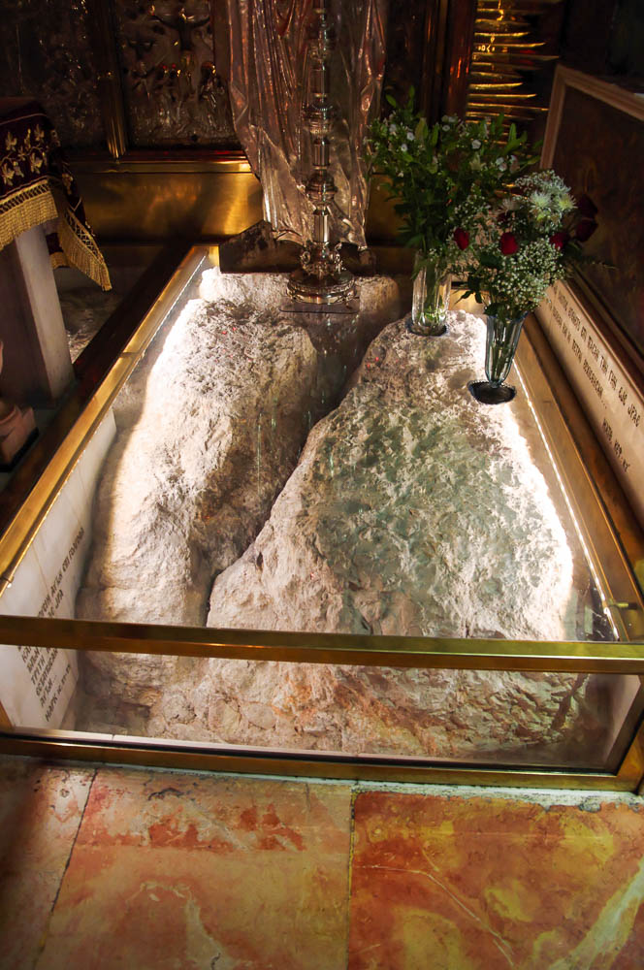
And when they came to a place called Golgotha, that is to say, “Place of a Skull”
Rock outcrop, possible Golgotha, in the Church of the Holy Sepulcher
27:33
Notes:
This is another view of the bedrock shown in the previous photo. Today a Greek Orthodox chapel is built over and around the rock.
adr1306234878

Slide 23
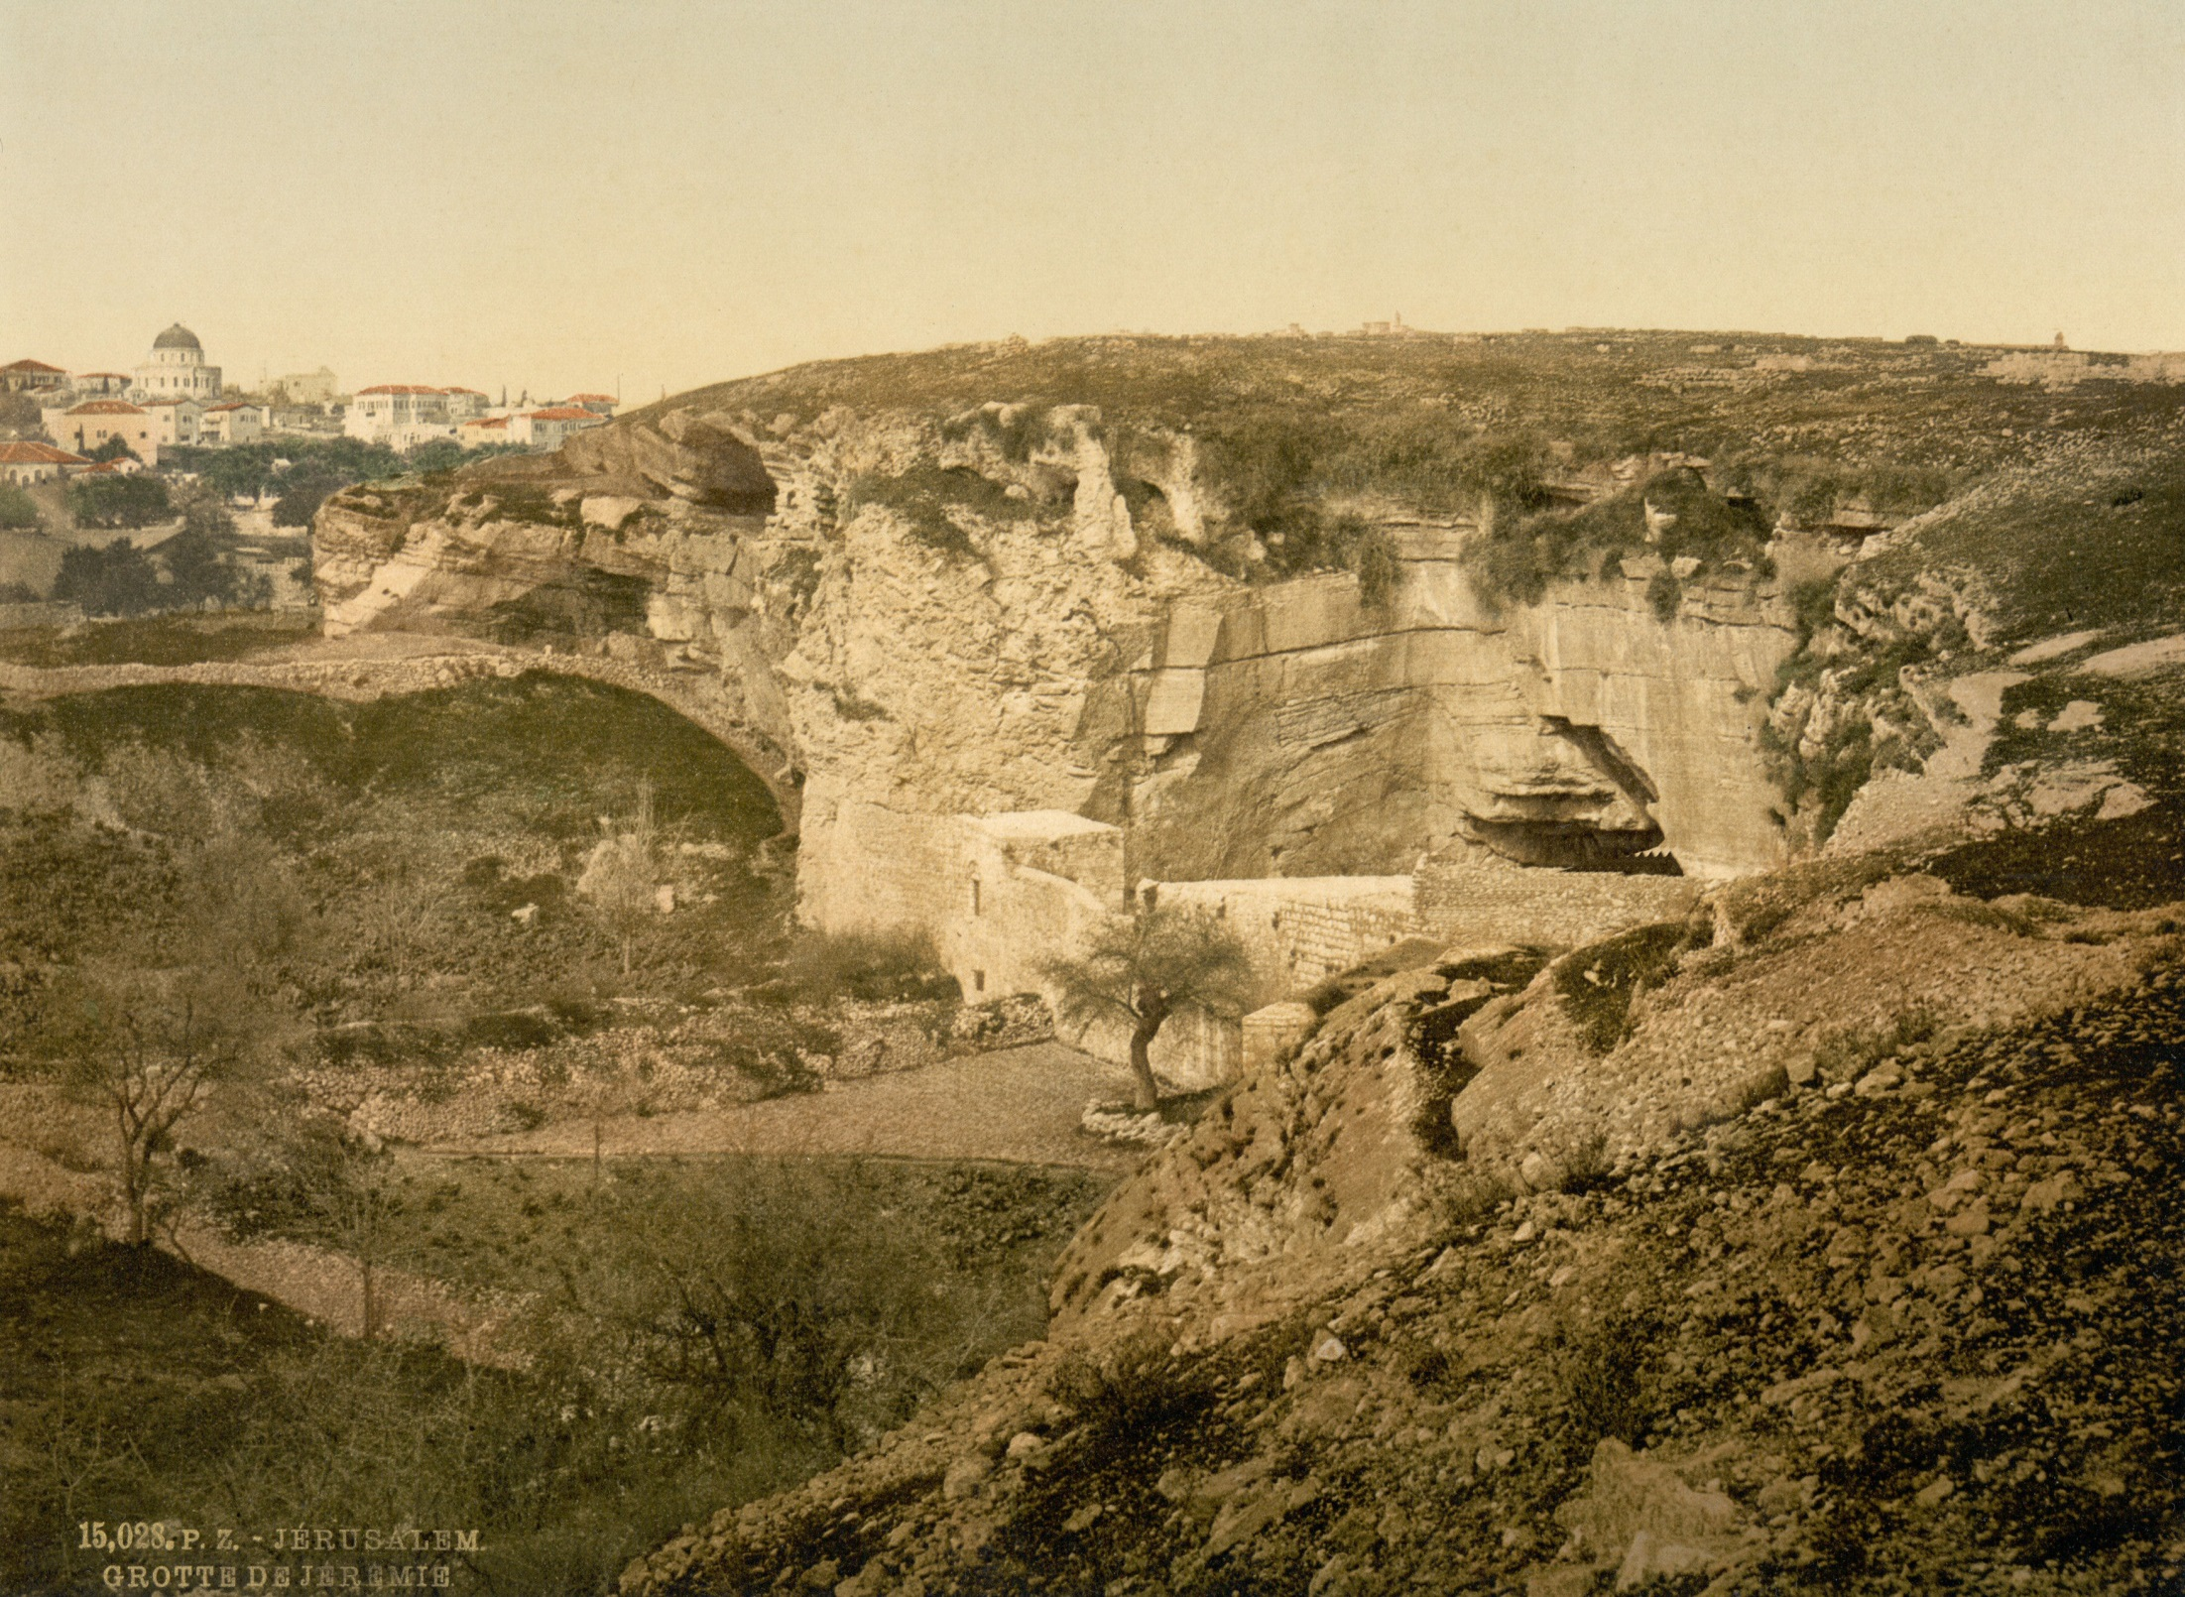
And when they came to a place called Golgotha, that is to say, “Place of a Skull”
Gordon’s Calvary, possible place of Jesus’s crucifixion
27:33
Notes:
This photochrom image was taken in the 1890s, before the modern Arab bus station was built and the Muslim cemetery was so extensive. The skull itself is not visible from this vantage point, but one can visualize the scene of the crucifixion on the hill above.
pcm02704

Slide 24
Notes:
27-56
The Crucifixion
Verse 33, And when they came to a place called Golgotha (which means Place of a Skull). Slides.
Verse 27-56 details the death of Jesus, and there are a lot of details in this section that are really striking.
What stands out to you? Talk to your neighbor for a couple of minutes and name 1 or 2 things that stand out to you personally from this section, then we’ll get back together and share a few.
For me it’s the last verse in this section v56. I sometimes wonder what it would have been like to actually witness these things. What would it be like to witness anyone dying in such a way, but especially someone with the significance of Jesus. And to put it into context I’ll think about the possibility of witnessing something like this with Page, or one of our children…which is hard to even say. But that’s what happened that day. To these women, Jesus was a friend, someone who would have felt like family…we know from another account that his mother was their…literal family…that was her son.
And despite what she knew about him, or how necessary this was…I imagine that part of her held out hope that he wouldn’t die. That something would happen that would save him…and what an awful gut wrenching thing to have to witness that. And nothing puts into perspective the sin of man, and the gravity of Jesus’ sacrifice…quite like this scene…for me. I can’t imagine watching a loved one die like that. But that’s what they did…and I’m sure that stayed with them the rest of their lives when they were proclaiming His name and spreading Christianity.
Hopefully we can recall some of these scenes when we’re out in the world. When we’re at the grocery store or a friend’s house or our jobs or the movie theater, wherever. The message that God has given us to spread, is an important message. It’s a message that saves souls. Builds a relationship with God the creator. Let’s all be very mindful of that when we determine our motivations, and lets put our full hearts behind it.

