Slide 1
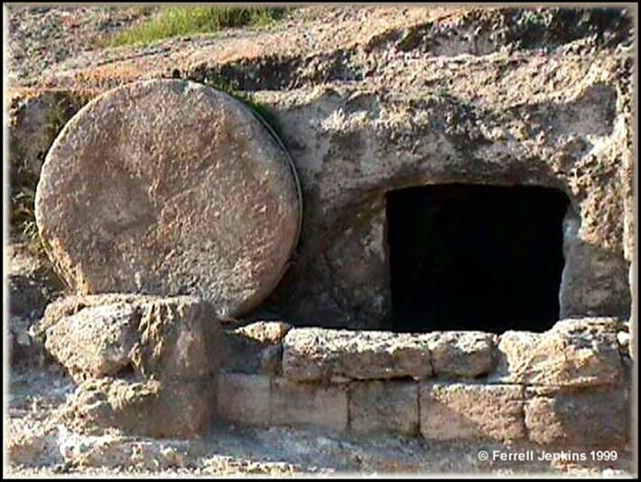
Gospel of Matthew
Chapter 28

Slide 2
“All authority has been given to Me in heaven and on earth.”
(Matthew 28:18)
How did he back up that claim?
Jesus said - If I do not do the works of My Father, do not believe Me; but if I do them, though you do not believe Me, believe the works, (John 10:37-38)
The ultimate miracle is his resurrection. Greater evidence for this miracle than others.
This is the fundamental basis for our faith. It was the cornerstone of apostolic preaching. Everything rests on the factuality of this one event.
Therefore having overlooked the times of ignorance, God is now declaring to men that all people everywhere should repent, ³¹ because He has fixed a day in which He will judge the world in righteousness through a Man whom He has appointed, having furnished proof to all men by raising Him from the dead.” (Acts 17:30-31)

Slide 3
The Resurrection – What if it is not factual?
Now if Christ is preached, that He has been raised from the dead, how do some among you say that there is no resurrection of the dead? ¹³ But if there is no resurrection of the dead, not even Christ has been raised;¹⁴ and if Christ has not been raised, then our preaching is vain, your faith also is vain. ¹⁵ Moreover we are even found to be false witnesses of God, because we testified against God that He raised Christ, whom He did not raise, if in fact the dead are not raised. ¹⁶ For if the dead are not raised, not even Christ has been raised; ¹⁷ and if Christ has not been raised, your faith is worthless; you are still in your sins. ¹⁸ Then those also who have fallen asleep in Christ have perished. ¹⁹ If we have hoped in Christ in this life only, we are of all men most to be pitied. (I Corinthians 15:12-19)

Slide 4
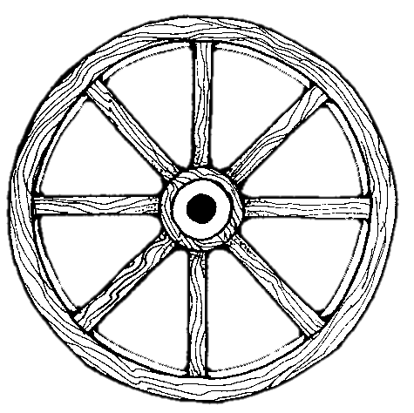
Resurrection is at the Heart and Core of all we Believe
(I Cor. 15:14-18)
All assaults on our faith must be filtered through this reality.
Christ’s Work
Christ’s Deity
Preaching
Res. Of
Christ
Our Hope
Our Faith
Hope for the dead
Evangelism
Rem. of Sins

Slide 5
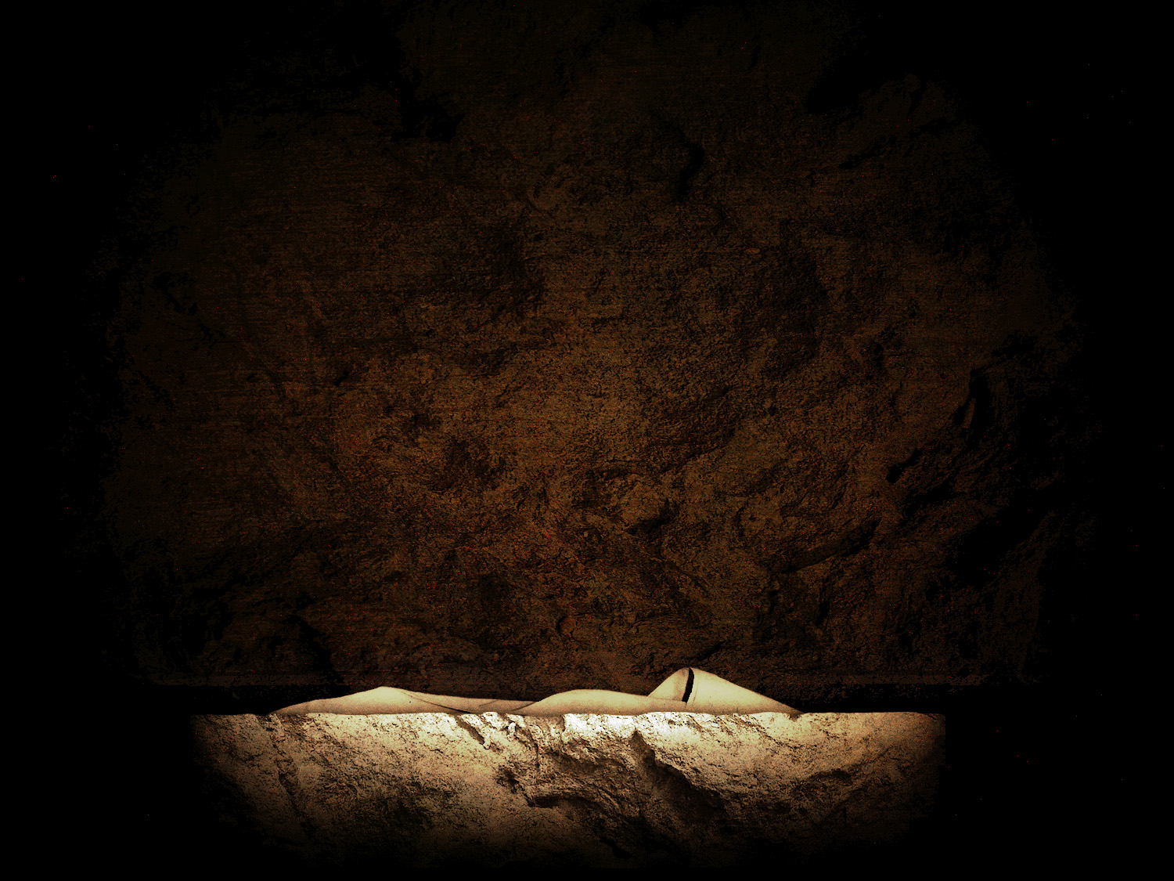
The Empty Tomb - Foretold
¹⁸ The Jews then said to Him, “What sign do You show us as your authority for doing these things?” Jesus answered them, “Destroy this temple, and in three days I will raise it up.” ... ²¹ But He was speaking of the temple of His body. ²² So when He was raised from the dead, His disciples remembered that He said this; and they believed the Scripture and the word which Jesus had spoken. John 2:18–22
5

Slide 6
The Empty Tomb - Foretold
Then some of the scribes and Pharisees said to Him, “Teacher, we want to see a sign from You.” ³⁹ But He answered and said to them, “An evil and adulterous generation craves for a sign; and yet no sign will be given to it but the sign of Jonah the prophet; ⁴⁰ for just as Jonah was three days and three nights in the belly of the sea monster, so will the Son of Man be three days and three nights in the heart of the earth. Matthew 12:38–40
6

Slide 7
The Empty Tomb - Precautions
Now on the next day, the day after the preparation, the chief priests and the Pharisees gathered together with Pilate, ⁶³ and said, “Sir, we remember that when He was still alive that deceiver said, ‘After three days I am to rise again.’ ⁶⁴ “Therefore, give orders for the grave to be made secure until the third day, otherwise His disciples may come and steal Him away and say to the people, ‘He has risen from the dead,’ and the last deception will be worse than the first.” Matthew 27:62–64
7

Slide 8
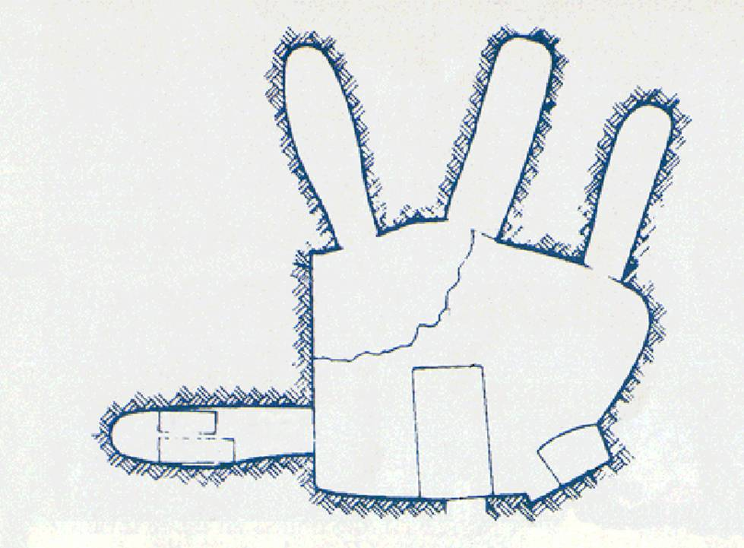
First Century
Tomb

Slide 9
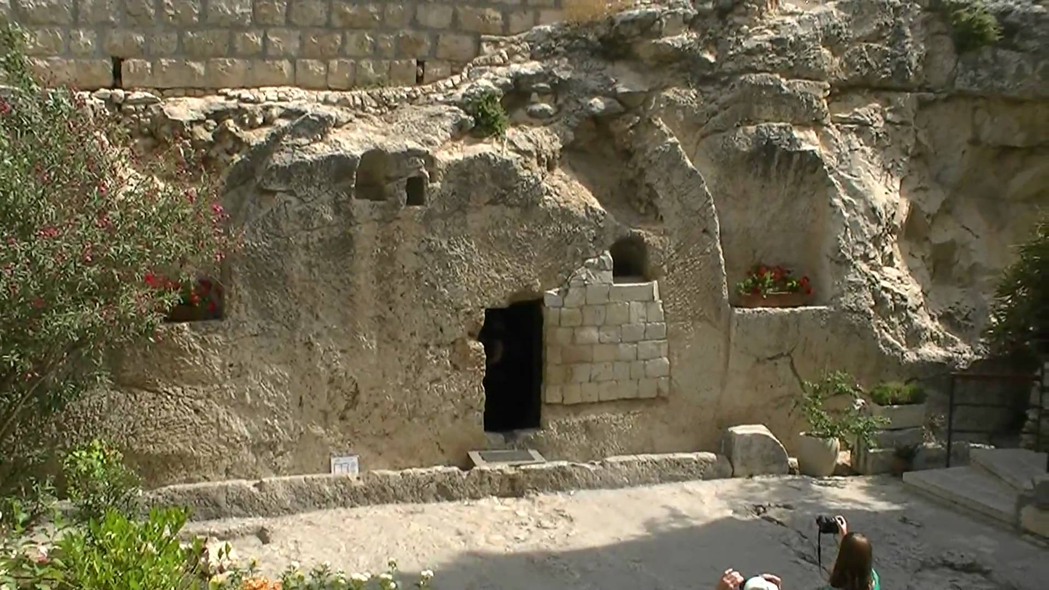
“Laid In A New Tomb” - Mt 27:57-61
Cut out of solid rock
No chance for rear entry
No chance for escape
First Century Garden Tomb in Jerusalem

Slide 10
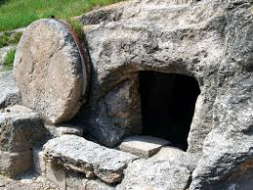
Stone Door
About a ton
no escape
Women worried about who would help them - Mk 15:46

Slide 11
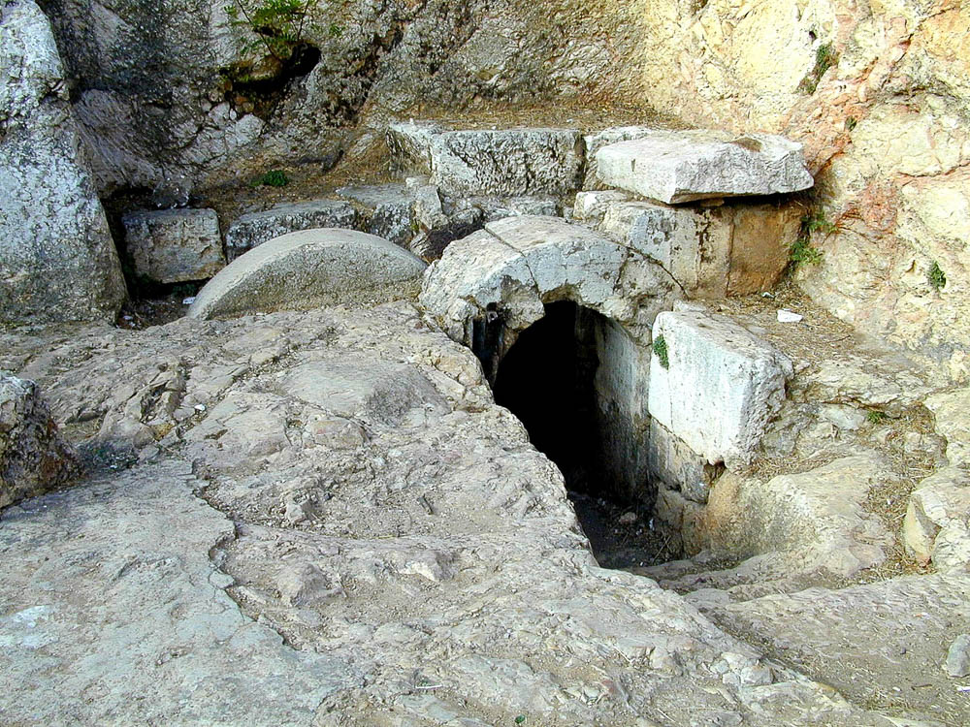
28:2

Slide 12
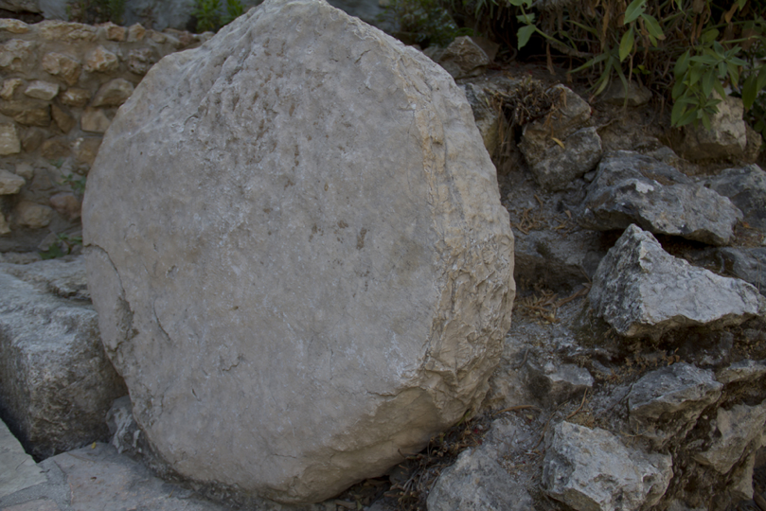
The Empty Tomb
Central tenet of the Faith
12

Slide 13
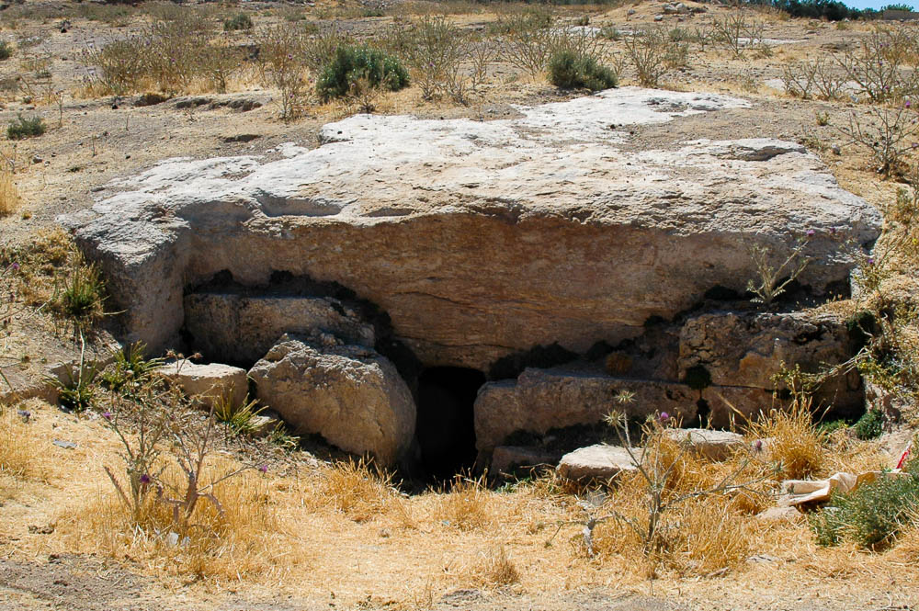
Stone rolled away from tomb near Tell Hesban
28:2

Slide 14
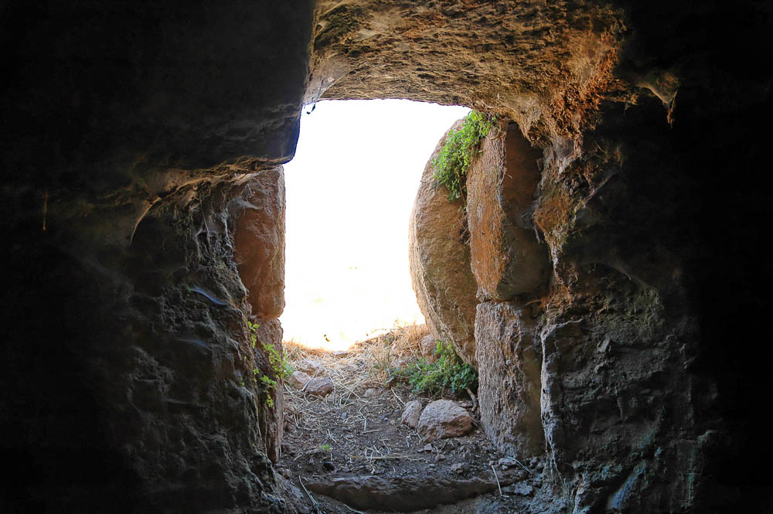
Rolling stone from inside the tomb at Tell Hesban
28:2
Notes:
tb061304085

Slide 15
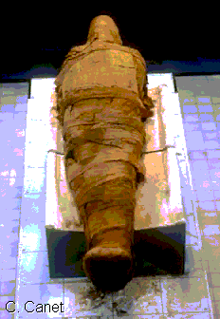
Burial Preparation
About 100 lbs of myrrh & Aloes – John 19:39
Bound in linen - John 19:40
Head napkin detail (Jn 20:7)
Bound in a resin (myrrh)
No “escape”
Difficult to remove

Slide 16
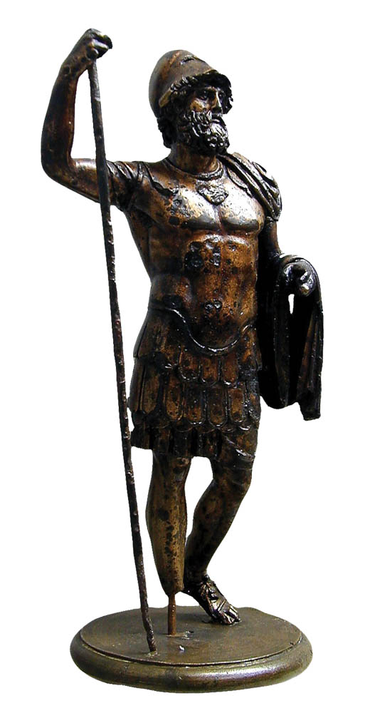
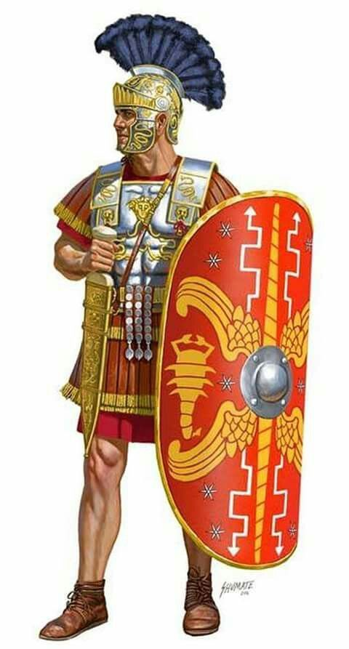
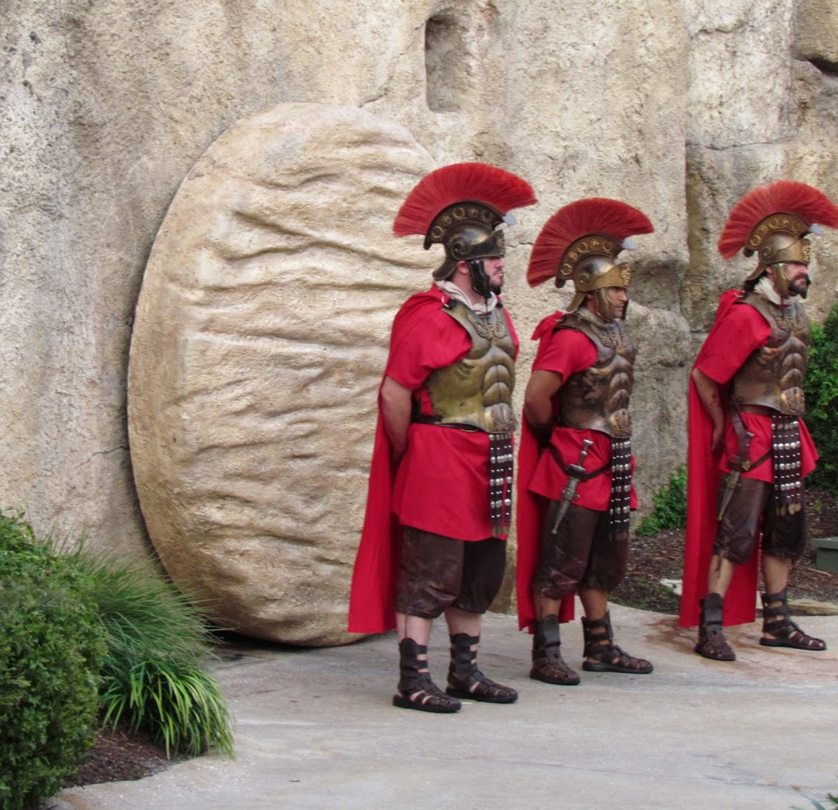
Guards (Roman)
4-12? highly trained and disciplined guards (cf Acts 12:4)
Round the clock shifts
Consequences for failure
Note: May have been Jewish guards instead of Roman.

Slide 17
Matthew 28:1-7
Now after the Sabbath, as it began to dawn toward the first day of the week, Mary Magdalene and the other Mary came to look at the grave.
All agree that it was on “the ﬁrst day of the week” that the women came “very early in the morning” (Luke 24:1), “while it was still dark” (John 20:1), probably arriving “when the sun had risen” (Mark 16:2)
“Mary, the mother of James and Joseph” (27:56). Mark informs us that Salome, the mother of James and John was with them (Mark 16:1), while Luke adds that Joanna, and “other women” were also present (Luke 24:10)
Mark explains that the purpose of their visit was to bring spices to anoint Jesus’ body (Mark 16:1).
The two Mary's (and possibly some of these same women) watched while Joseph and Nicodemus had buried Jesus (27:59-61; John 19:38-40). They saw “how his body was laid” (Luke 23:55), and “where he was laid” (Mark 15:47).

Slide 18
Matthew 28:1-7
Now after the Sabbath, as it began to dawn toward the first day of the week, Mary Magdalene and the other Mary came to look at the grave. ² And behold, a severe earthquake had occurred, for an angel of the Lord descended from heaven and came and rolled away the stone and sat upon it. ³ And his appearance was like lightning, and his clothing as white as snow. ⁴ The guards shook for fear of him and became like dead men.

Slide 19
Matthew 28:1-7
Now after the Sabbath, as it began to dawn toward the first day of the week, Mary Magdalene and the other Mary came to look at the grave. ² And behold, a severe earthquake had occurred, for an angel of the Lord descended from heaven and came and rolled away the stone and sat upon it. ³ And his appearance was like lightning, and his clothing as white as snow. ⁴ The guards shook for fear of him and became like dead men. ⁵ The angel said to the women, “Do not be afraid; for I know that you are looking for Jesus who has been crucified. ⁶ He is not here, for He has risen, just as He said. Come, see the place where He was lying. ⁷ Go quickly and tell His disciples that He has risen from the dead; and behold, He is going ahead of you into Galilee, there you will see Him; behold, I have told you.”
Luke records that the angel quoted Jesus to say, “The Son of Man must be delivered into the hands of sinful men, and be cruciﬁed, and the third day rise again” (Luke 24:7)
The prominence of women in the story of Jesus

Slide 20
Matthew 28:8-10
And they left the tomb quickly with fear and great joy and ran to report it to His disciples. ⁹ And behold, Jesus met them and greeted them. And they came up and took hold of His feet and worshiped Him. ¹⁰ Then Jesus said to them, “Do not be afraid; go and take word to My brethren to leave for Galilee, and there they will see Me.”
It is a powerful evidence of the reliability of the biblical record of the resurrection that the word of women is the ﬁrst testimony offered.

Slide 21
THE RESURERCTION
One Possible Sequence of Events that Fits the Accounts.
M Broadwell
8/18/99

Slide 22
Appearances
Mary Magdalene Mark 16:9-11; John 20:10-18
The Other Women Matthew 28:8-10
Peter in Jerusalem Luke 24:34; 1 Corinthians 15:5
The Two on the Road Mark 16:12, 13; Luke 24:13-31
Ten Disciples Mark 16:14; Luke 24:36-43; John 20:19-25
Eleven Disciples John 20:26-31; (“after 8 days”) 1 Corinthians 15:5
7 Disciples Fishing John 21:1-23 (“third time” vs 14)
11 Disciples on Mtn Matthew 28:16-20
A Crowd of 500 I Corinthians 15:6
Jesus' brother James I Corinthians 15:7
The Ascension Luke 24:44-49; Acts 1:3-8
To these He also presented Himself alive after His suffering, by many convincing proofs, appearing to them over a period of forty days and speaking of the things concerning the kingdom of God. (Acts 1:3)

Slide 23
Resurrection Sequence (The Setting)
Valley of Jehoshaphat
Golgotha
Garden
Tomb
Mt. of
Olives
Peter &
John (?)
Damascus
Gate
Jerusalem
Stephen’s
Gate
Garden of
Gethsemane
Road to
Emmaus
Joppa
Gate
Temple
Area
Bethany
Mary &
Women
Gihon Valley
Zion
Gate
Kidron Valley
Upper
Room (?)
Valley of Hinnom

Slide 24
Resurrection Sequence (first Sunday)
Valley of Jehoshaphat
Golgotha
Garden
Tomb
Mt. of
Olives
Peter &
John
Damascus
Gate
Stephen’s
Gate
Garden of
Gethsemane
Road to
Emmaus
Joppa
Gate
Temple
Area
Bethany
Gihon Valley
Zion
Gate
Kidron Valley
women
Mary & women Start for tomb.
Upper
Room
Resurrection. An angel moves the stone & disables soldiers.
Valley of Hinnom

Slide 25
Resurrection Sequence (first Sunday)
Valley of Jehoshaphat
Golgotha
Garden
Tomb
Mt. of
Olives
Peter &
John
Damascus
Gate
women
Stephen’s
Gate
soldiers
Garden of
Gethsemane
Road to
Emmaus
Joppa
Gate
Temple
Area
Bethany
Gihon Valley
Zion
Gate
Kidron Valley
women
Upper
Room
The Soldiers Leave to Report to the Chief Priest.
Valley of Hinnom
Women Continue to tomb.

Slide 26
Resurrection Sequence (first Sunday)
Valley of Jehoshaphat
Golgotha
Garden
Tomb
Mt. of
Olives
Mary
women
Peter &
John
Damascus
Gate
Stephen’s
Gate
Garden of
Gethsemane
Road to
Emmaus
Joppa
Gate
Temple
Area
Bethany
Gihon Valley
Zion
Gate
Kidron Valley
Upper
Room
Women arrive, find tomb empty.
Mary reports to Peter & John.
Valley of Hinnom

Slide 27
Resurrection Sequence (first Sunday)
Valley of Jehoshaphat
Golgotha
Garden
Tomb
Mt. of
Olives
Mary
women
Peter &
John
women
Damascus
Gate
Stephen’s
Gate
Garden of
Gethsemane
Road to
Emmaus
Joppa
Gate
Temple
Area
Bethany
Gihon Valley
Zion
Gate
Kidron Valley
Upper
Room
Angel(s) appear to the women.
The women go to tell the disciples.
Valley of Hinnom

Slide 28
Resurrection Sequence (first Sunday)
Valley of Jehoshaphat
Golgotha
Garden
Tomb
Peter
& John
Mt. of
Olives
Mary
Peter
& John
Peter
& John
Damascus
Gate
Stephen’s
Gate
Garden of
Gethsemane
Road to
Emmaus
Joppa
Gate
Temple
Area
Bethany
Gihon Valley
Zion
Gate
Kidron Valley
Peter & John return to tomb, enter, find the grave clothes.
Upper
Room
Peter & John leave.
Valley of Hinnom

Slide 29
Resurrection Sequence (first Sunday)
Valley of Jehoshaphat
Golgotha
Garden
Tomb
Mt. of
Olives
Mary
Mary
Damascus
Gate
Stephen’s
Gate
Garden of
Gethsemane
Road to
Emmaus
Joppa
Gate
Temple
Area
Bethany
Gihon Valley
Zion
Gate
Kidron Valley
Upper
Room
Mary arrives (again) at tomb.
Mary enters & sees two angels.
Valley of Hinnom

Slide 30
Resurrection Sequence (first Sunday)
Valley of Jehoshaphat
Golgotha
Garden
Tomb
1
Mt. of
Olives
Mary
Damascus
Gate
Mary
Stephen’s
Gate
Garden of
Gethsemane
Road to
Emmaus
Joppa
Gate
Temple
Area
Bethany
Gihon Valley
Zion
Gate
Kidron Valley
Upper
Room
Mary turns and sees Jesus.
Mary goes to tell disciples.
To Bible
References
Valley of Hinnom

Slide 31
Resurrection Sequence (first Sunday)
Valley of Jehoshaphat
Golgotha
Garden
Tomb
1
Mt. of
Olives
3
Damascus
Gate
Peter
Stephen’s
Gate
Garden of
Gethsemane
Road to
Emmaus
Joppa
Gate
Temple
Area
Bethany
Gihon Valley
Zion
Gate
Kidron Valley
women
2
Upper
Room
Jesus appears to the women.
Jesus appears to Peter.
To Bible
References
Valley of Hinnom

Slide 32
Resurrection Sequence (first Sunday)
Valley of Jehoshaphat
Golgotha
Garden
Tomb
1
Mt. of
Olives
3
Damascus
Gate
4
Stephen’s
Gate
2 disciples
Garden of
Gethsemane
Road to
Emmaus
Joppa
Gate
Temple
Area
Bethany
Gihon Valley
Zion
Gate
Kidron Valley
2
Upper
Room
Jesus appears to two on road to Emmaus.
To Bible
References
Valley of Hinnom
The two return to Jerusalem.

Slide 33
Resurrection Sequence (first Sunday)
Valley of Jehoshaphat
Golgotha
Garden
Tomb
1
Mt. of
Olives
3
Damascus
Gate
4
Stephen’s
Gate
Garden of
Gethsemane
Road to
Emmaus
Joppa
Gate
Temple
Area
2
Bethany
Peter
women
Gihon Valley
Zion
Gate
Kidron Valley
2
Peter & women gather with others.
Upper
Room
5
The two return with their story, & hear of other appearances.
To Bible
References
Valley of Hinnom
Jesus appears to the ten (plus).

Slide 34
Resurrection Sequence (later appearances)
Valley of Jehoshaphat
Golgotha
Garden
Tomb
1
Mt. of
Olives
3
Damascus
Gate
4
Stephen’s
Gate
Garden of
Gethsemane
Road to
Emmaus
Joppa
Gate
Temple
Area
Bethany
Gihon Valley
Zion
Gate
Kidron Valley
2
Upper
Room
6
5
Jesus appears to eleven, (in-cluding Thomas) one week later.
To Bible
References
Valley of Hinnom

Slide 35
Resurrection Sequence (later appearances)
Valley of Jehoshaphat
Golgotha
Garden
Tomb
1
7-10
Mt. of
Olives
In Galilee:
To 7 fishing
To 11 on mtn
To 500 at once
To James
3
Damascus
Gate
4
Stephen’s
Gate
Garden of
Gethsemane
Road to
Emmaus
Joppa
Gate
Temple
Area
Bethany
Gihon Valley
Zion
Gate
Kidron Valley
2
Upper
Room
6
5
Other Appearances in Galilee
To Bible
References
Valley of Hinnom

Slide 36
Resurrection Sequence (later appearances)
Valley of Jehoshaphat
Golgotha
Garden
Tomb
1
7-10
Mt. of
Olives
In Galilee:
To 7 fishing
To 11 on mtn
To 500 at once
To James
3
11
Damascus
Gate
4
Stephen’s
Gate
Garden of
Gethsemane
Road to
Emmaus
Joppa
Gate
Temple
Area
Bethany
Gihon Valley
Zion
Gate
Kidron Valley
2
Upper
Room
6
5
Jesus Ascends to Heaven from Mount of Olives
Valley of Hinnom

Slide 37
Matthew 28:11-15
¹¹ Now while they were on their way, some of the guard came into the city and reported to the chief priests all that had happened. ¹² And when they had assembled with the elders and consulted together, they gave a large sum of money to the soldiers, ¹³ and said, “You are to say, ‘His disciples came by night and stole Him away while we were asleep.’ ¹⁴ And if this should come to the governor’s ears, we will win him over and keep you out of trouble.” ¹⁵ And they took the money and did as they had been instructed; and this story was widely spread among the Jews, and is to this day.
Those who had plotted Jesus’ death are now confronted with the truth of his resurrection from eye witnesses, and commit fraud in order to conceal its reality

Slide 38
Dialogue With Trypho
c. AD 165
“You have sent chosen and ordained men throughout all the world to proclaim that a godless and lawless heresy had sprung from one Jesus, a Galilean deceiver, whom we crucified, but his disciples stole him by night from the tomb where he was laid when unfastened from the cross, and now deceive men by asserting that he has risen from the dead and ascended to heaven.” (Dialogue 108)
Why is this an absurd claim?

Slide 39
Stolen Body Theory
Disciples stole it
Consider the fear and mental state of the disciples
How could they without waking the guards? (how did the guards know who stole the body if they were asleep?)
Transformation of disciples from fear and doubt to boldness
Why give your lives for a lie?
The fact that neither the guards or the “grave robbers” were punished for their crimes demonstrates the implausibility of this false claim.

Slide 40
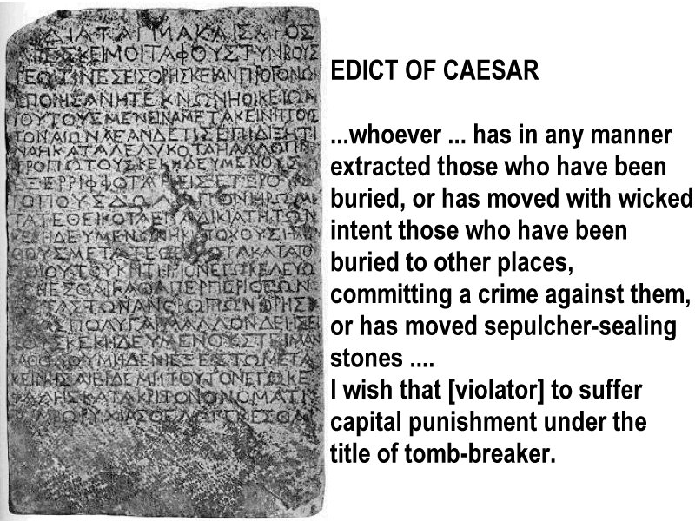
The Nazareth Inscription – marble inscription believed to date to the first century

Slide 41
Stolen Body Theory
Enemies stole it (Jewish/Roman authorities)
What motive would they have? They asked for guards to prevent it.
Could have produced the dead body and destroyed “Christianity”
Neither explains the conversion of Paul & James
Jesus’ brothers did not believe in him (John 7:3-5)
Paul persecuted Christians
Why the radical alteration of character in both men?
What was Paul’s motive? Look at the physical consequences of his faith.

Slide 42
Facts To Be Accounted For
Jesus actually lived
Death by Roman cross
Buried according to Jewish custom
Tomb believed empty by both friend and foe
Many believed they saw Him alive
Even skeptics believed
Guards remained
Disciples preached a real resurrection . . .
. . . even to the point of death!
Church quickly began in Jerusalem
Sunday became day of worship
Notes:
33

Slide 43
First Century
Tomb

Slide 44
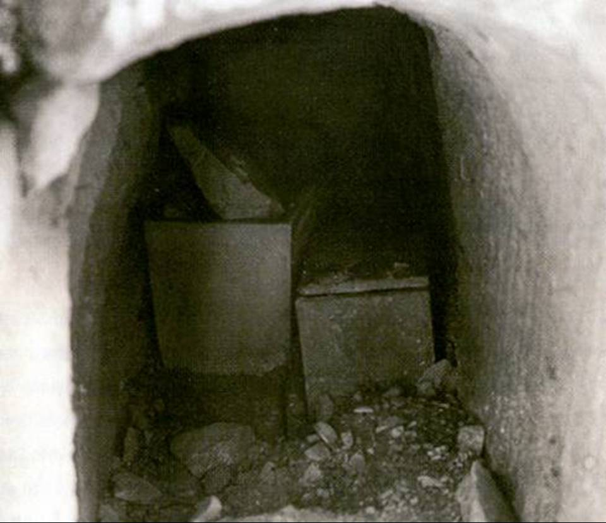
Discovered in 1990 south of Jerusalem by workers widening a road.

Slide 45
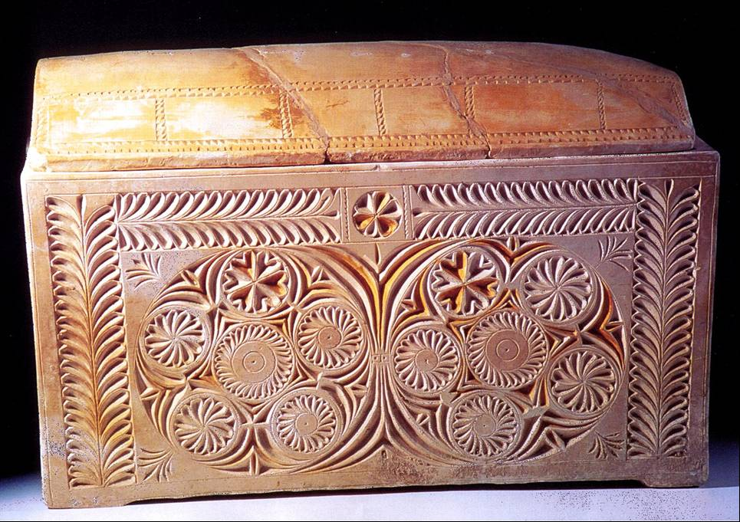

Slide 46
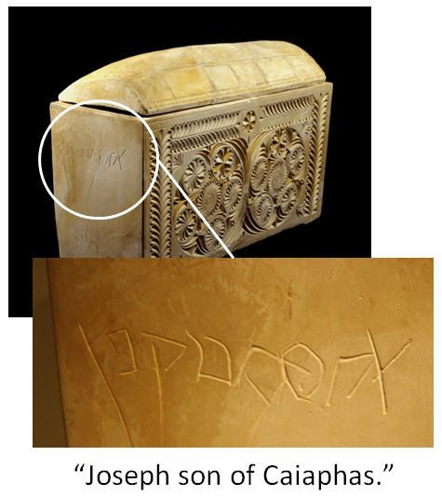
Matthew 26 - Then the chief priests and the elders of the people were gathered together in the court of the high priest, named Caiaphas; ⁴ and they plotted together to seize Jesus by stealth and kill Him
⁶² The high priest stood up and said to Him, “Do You not answer? What is it that these men are testifying against You?” ⁶³ But Jesus kept silent. And the high priest said to Him, “I adjure You by the living God, that You tell us whether You are the Christ, the Son of God.” ⁶⁴ Jesus *said to him, “You have said it yourself; nevertheless I tell you, hereafter you will see the Son of Man sitting at the right hand of Power, and coming on the clouds of heaven.” ⁶⁵ Then the high priest tore his robes and said, “He has blasphemed! What further need do we have of witnesses? Behold, you have now heard the blasphemy; ⁶⁶ what do you think?” They answered, “He deserves death!”
⁶⁷ Then they spat in His face and beat Him with their fists; and others slapped Him, ⁶⁸ and said, “Prophesy to us, You Christ; who is the one who hit You?”

Slide 47
I Corinthians 15
²⁰ But now Christ has been raised from the dead, the first fruits of those who are asleep²³ But each in his own order: Christ the first fruits, after that those who are Christ’s at His coming,… ²⁴ then comes the end, when He hands over the kingdom to the God and Father, when He has abolished all rule and all authority and power.
⁵¹ Behold, I tell you a mystery; we will not all sleep, but we will all be changed, ⁵² in a moment, in the twinkling of an eye, at the last trumpet; for the trumpet will sound, and the dead will be raised imperishable, and we will be changed. ⁵³ For this perishable must put on the imperishable, and this mortal must put on immortality. ⁵⁴ But when this perishable will have put on the imperishable, and this mortal will have put on immortality, then will come about the saying that is written, “Death is swallowed up in victory. ⁵⁵ O death, where is your victory? O death, where is your sting?” ⁵⁶ The sting of death is sin, and the power of sin is the law; ⁵⁷ but thanks be to God, who gives us the victory through our Lord Jesus Christ. ⁵⁸ Therefore, my beloved brethren, be steadfast, immovable, always abounding in the work of the Lord, knowing that your toil is not in vain in the Lord.

Slide 48
Matthew 28:16-20
But the eleven disciples proceeded to Galilee, to the mountain which Jesus had designated. ¹⁷ When they saw Him, they worshiped Him; but some were doubtful. ¹⁸ And Jesus came up and spoke to them, saying,
Matthew is aware that the Eleven had already seen Christ in Jerusalem, when their doubts were removed. The “some” presupposes a larger gathering than the Eleven only”. Could be the time Jesus appeared to “over five hundred at once” (I Cor 15:6)

Slide 49
“The Great Commission”
“exousia” - “the power of rule or government” - His rule is not limited.
“All authority has been given to Me in heaven and on earth. ¹⁹ Go therefore and make disciples of all the nations, baptizing them in the name of the Father and the Son and the Holy Spirit, ²⁰ teaching them to observe all that I commanded you; and lo, I am with you always, even to the end of the age.”
“Disciple” = Learner, Follower
“Preach the gospel” - Mk 16:15

Slide 50
What is this “Gospel”? (Mk 16:15)
Now I make known to you, brethren, the gospel which I preached to you, which also you received, in which also you stand, ² by which also you are saved, if you hold fast the word which I preached to you, unless you believed in vain. ³ For I delivered to you as of first importance what I also received, that Christ died for our sins according to the Scriptures, ⁴ and that He was buried, and that He was raised on the third day according to the Scriptures, ⁵ and that He appeared… (1 Cor. 15:1-4)
“…declared to be the Son of God with power… by the resurrection from the dead” (Romans 1:4)

Slide 51
“The Great Commission”
“All authority has been given to Me in heaven and on earth. ¹⁹ Go therefore and make disciples of all the nations, baptizing them in the name of the Father and the Son and the Holy Spirit, ²⁰ teaching them to observe all that I commanded you; and lo, I am with you always, even to the end of the age.”

Slide 52
Promise to Abraham fulfilled through Jesus Christ
Matthew 28:19 "Go therefore and make disciples of all the nations, baptizing them in the name of the Father and the Son and the Holy Spirit,
Genesis 22:18 "And in your seed all the nations of the earth shall be blessed . . .”
Matthew 1:1 The book of the genealogy of Jesus Christ, the son of David, the son of Abraham.

Slide 53
Making Disciples
Convincing a prospect that a certain teacher or university is best for him is not enough to make him a student.
Two things are necessary:
-- Formal enrollment
-- Instruction
These are necessary to be disciples of Jesus – Note what this involves.

Slide 54
Enrollment Plus Instruction
Go therefore and make disciples of all the nations, baptizing them in the name of the Father and of the Son and of the Holy Spirit, teaching them to observe all things that I have commanded you;”
Enrollment + Instruction

Slide 55
“The Great Commission”
The Promise
“All authority has been given to Me in heaven and on earth. ¹⁹ Go therefore and make disciples of all the nations, baptizing them in the name of the Father and the Son and the Holy Spirit, ²⁰ teaching them to observe all that I commanded you; and lo, I am with you always, even to the end of the age.”
Bookends with 1:23 - and they shall call His name Immanuel,” which translated means, “God with us.

