Slide 1
The Gospel of Matthew

Slide 2
Class Goals
To better understand the life of Jesus…
To equip one another to imitate Matthew…
To spotlight bold teachings of Jesus…
To avoid the pitfalls of hypocrisy…
To increase confidence in the Scriptures…

Slide 3
Jesus Explains His Approaching Death In Great Detail…
“Behold, we are going up to Jerusalem; and the Son of Man will be delivered to the chief priests and scribes, and they will condemn Him to death, and will hand Him over to the Gentiles to mock and scourge and crucify Him, and on the third day He will be raised up.” (Matthew 20:18-19)
Notes:
The time: At the end of this journey.
The place: Jerusalem
His accusers: chief priests and scribes.
His sentence: to death
His executioners: Gentiles
His means of punishment: Mock, Scourge, Cruficy
His victory: 3rd day, raised up.

Slide 4
About The Last Week
Constructing A Timeline Depends on Key Phrases In All 4 Gospels.
“Jesus entered Jeru…already late.”Mark 11:11 (Sun)
“On the next day…” Mark 11:12 (Mon)
“They came again to Jerusalem…” Mark 11:27 (Tues)
“the first day of the feast….” Matt. 26:17 (Thur)
“When the morning was come…” Matt. 27:1 (Fri AM)
“When the evening was come…” Matt. 27:57 (Fri PM)
“Now the next day…” Matt. 27:62 (Sat)
“as it began to dawn toward the first day…”28:1 (Sun)
Notes:
Over 1/3 of Matthew’s Gospel Is Dedicated To Jesus’ Final Week.

Slide 5
Overview of Matthew 21-23
Chapter 21
Royal Entry & Cleansing the Temple
Disputes About The Authority of Jesus
Indisputable Parables of Jesus: 2 Sons & Landowner
Chapter 22: Jesus Is Greater Than The Herodians (16), Sadducees(23), or Pharisees (34)
Parable of Marriage Feast
Tribute to Caesar, Resurrection Relationships, Greatest Commands
Chapter 23: 8 Woes Rebuking Hypocrisy
Notes:
Ch 21…while they challenge His authority…He challenges their actions.
Ch 22…they bring a series of questions to Him. He answers them all. He asks them one…they cannot.
Ch 23…heartbreak. The Savior who has been driven by compassion, mercy, service, holiness, and humility….call out the evil hearts of the Hypocrits.

Slide 6
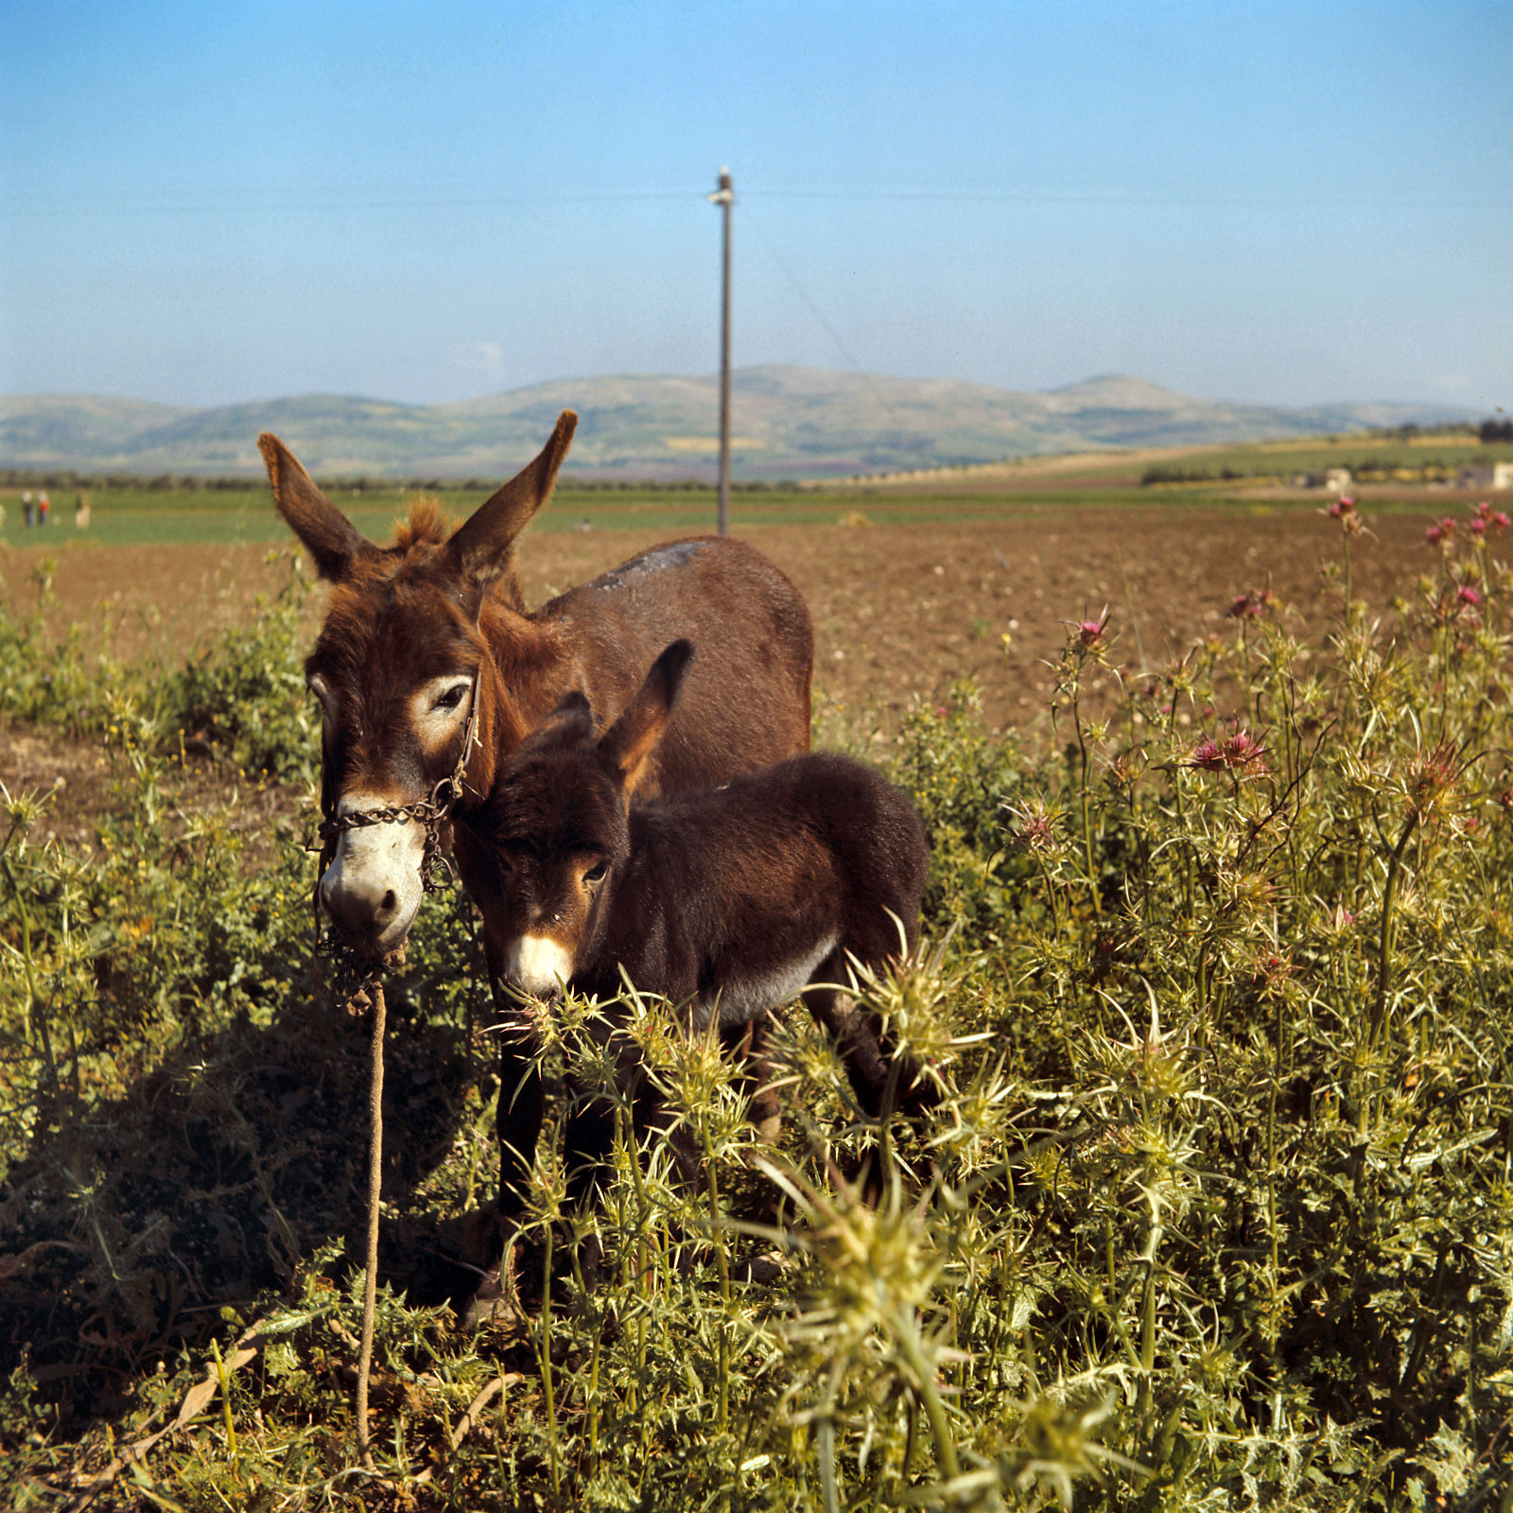
Go to the village opposite you, and immediately you will find a donkey tied, and a colt with her
Donkey with colt in the Dothan Valley
21:2
Notes:
David Bivin took this photograph in 1969.
db6905207207

Slide 7
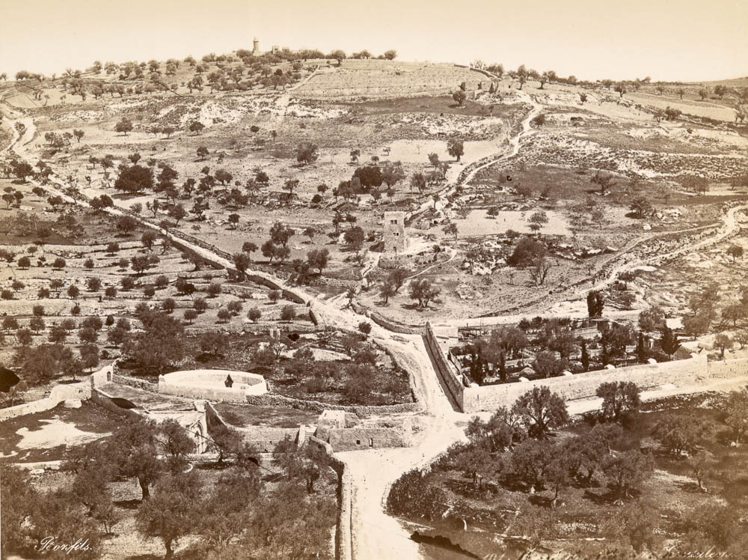
And when He came into Jerusalem, the whole city was stirred
Mount of Olives and the Garden of Gethsemane (from the west)
21:10
Notes:
This historic photograph shows three routes over the Mount of Olives to the Kidron Valley (at bottom). Jesus most likely traveled down either the middle route or the one from the right, as he was coming from Bethany. This photograph comes from Félix Bonfils, Palestine and Syria, circa 1870–1890. Public domain, from The New York Public Library, https://digitalcollections.nypl.org/items/510d47d9-5fb6-a3d9-e040-e00a18064a99.
nypl79628

Slide 8
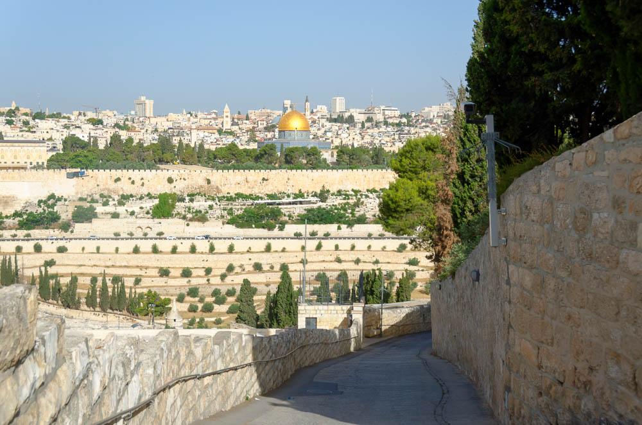
And when He came into Jerusalem, the whole city was stirred
Path down Mount of Olives
21:10
Notes:
tb060116958

Slide 9
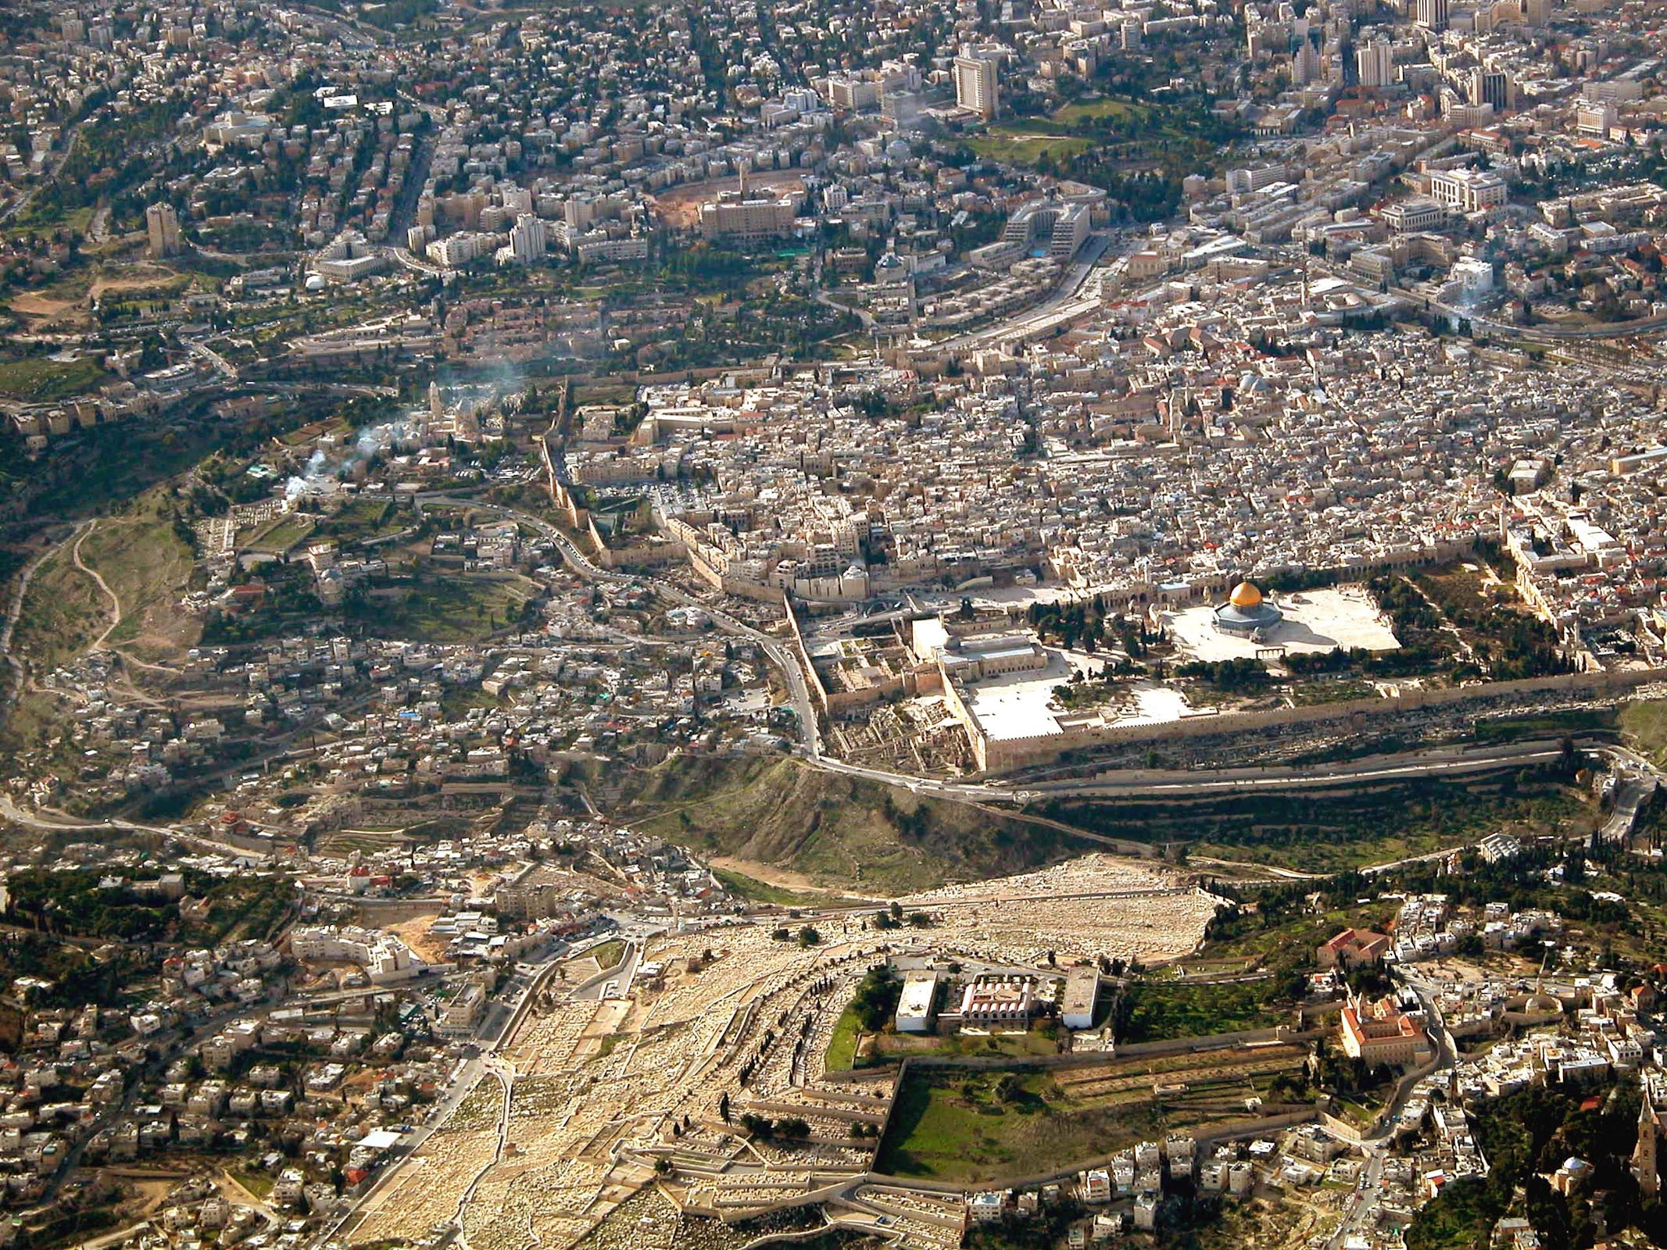
And Jesus entered the temple area
Jerusalem and the Temple Mount (aerial view from the east)
21:12
Notes:
The modern route from Bethany and Bethphage travels up from the bottom right of the photo, passing the red-roofed buildings on the right side before descending into the Kidron Valley near Gethsemane. See the next slide for labels.
tb010703232

Slide 10
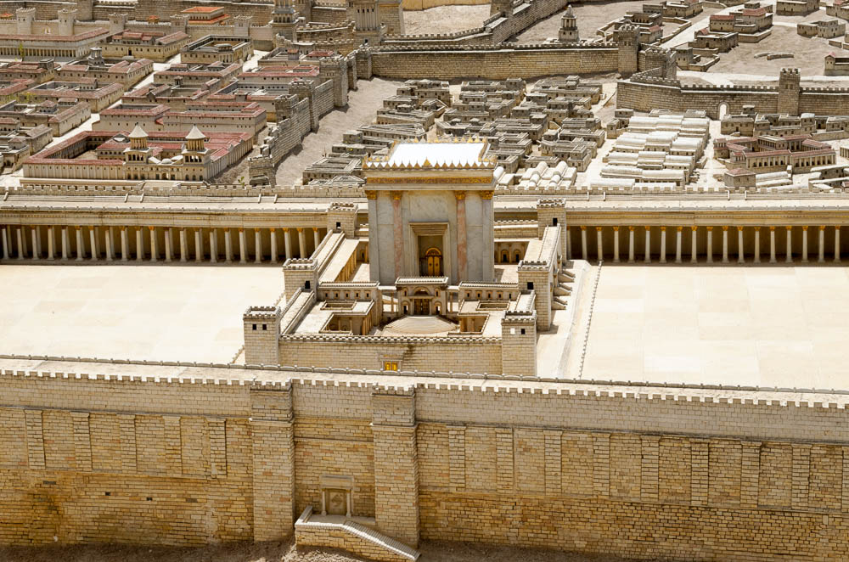
And Jesus entered the temple area
Herod’s Temple with eastern gates in the Jerusalem model
21:12
Notes:
Scholars who created this model chose to locate an eastern gate in the wall of the Temple Mount directly opposite the entrance to the Temple itself. This was a scholarly guess that has not been proved. Others believe that the first-century gate was located underneath today’s Golden Gate, further to the north along the eastern wall. Thus, we cannot say with any certainty where Jesus entered the Temple precincts. This Jerusalem model is on display at the Israel Museum.
tb060316631

Slide 11
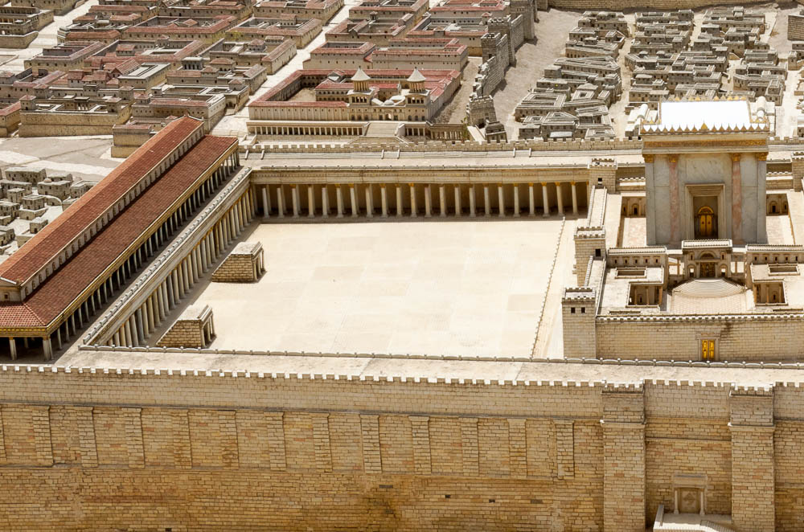
And Jesus . . . drove out all who sold and bought in the temple
The Court of the Gentiles on the Jerusalem model (from the east)
21:12
Notes:
This photograph provides a closer view of the proposed area for the cleansing of the Temple courts.
tb060316625

Slide 12
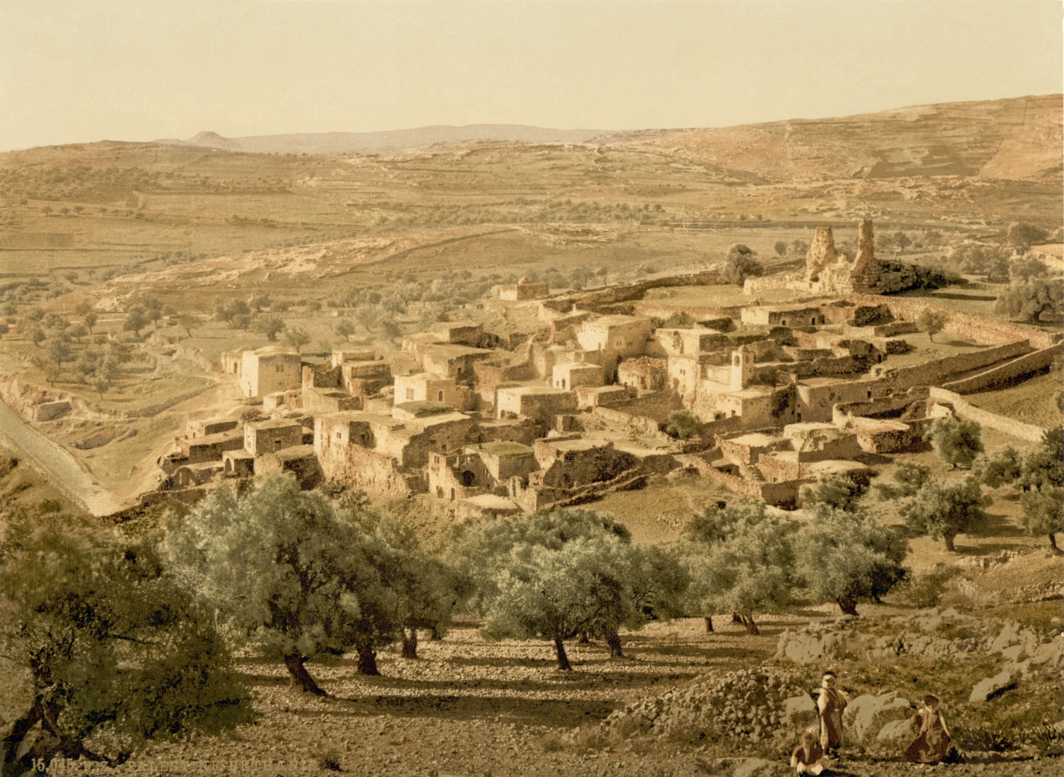
And leaving them, He went forth out of the city to Bethany, and lodged there
Bethany (view from the north)
21:17
Notes:
This photochrom image was taken in the 1890s. The conical shape of the Herodium is visible in the distance.
pcm02654

Slide 13
Matthew 21: Jesus In Jerusalem
Royal Entry 21:1-11, Psalm 118:25-26
Hosanna: “Save now!”
Son of David
At The Temple
Driving Out Those Buying & Selling (21:12)
Healing The Blind (21:14)
Notes:
Royal Entry is all about HIS Identity. Messianic Awareness of the crowd.
See Page 369 in Chumbley’s commentary. “Let heaven itself join us in acclaiming Him.”
Workbook Questions
Transition: Next let’s look at the lesson of the fig tree. This is a lesson that we really should bring out when studying the book as a whole because Jesus has been using the idea of a tree and it’s fruit ever since chapter 3 with the preaching of John the baptist! What is happening here in 21 is built on 3 years of teaching!

Slide 14
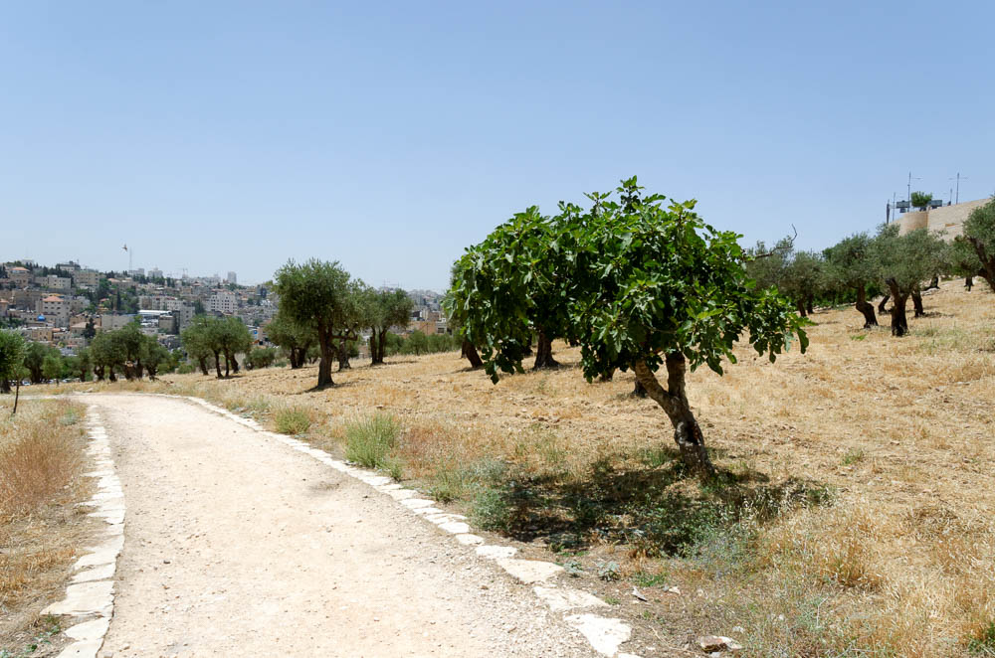
And seeing a fig tree by the road . . .
Fig tree along path on Mount of Olives
21:19
Notes:
This fig tree is in Emek Zurim, a bit to the north of the area on the Mount of Olives where Jesus walked in from Bethany.
tb060116332

Slide 15
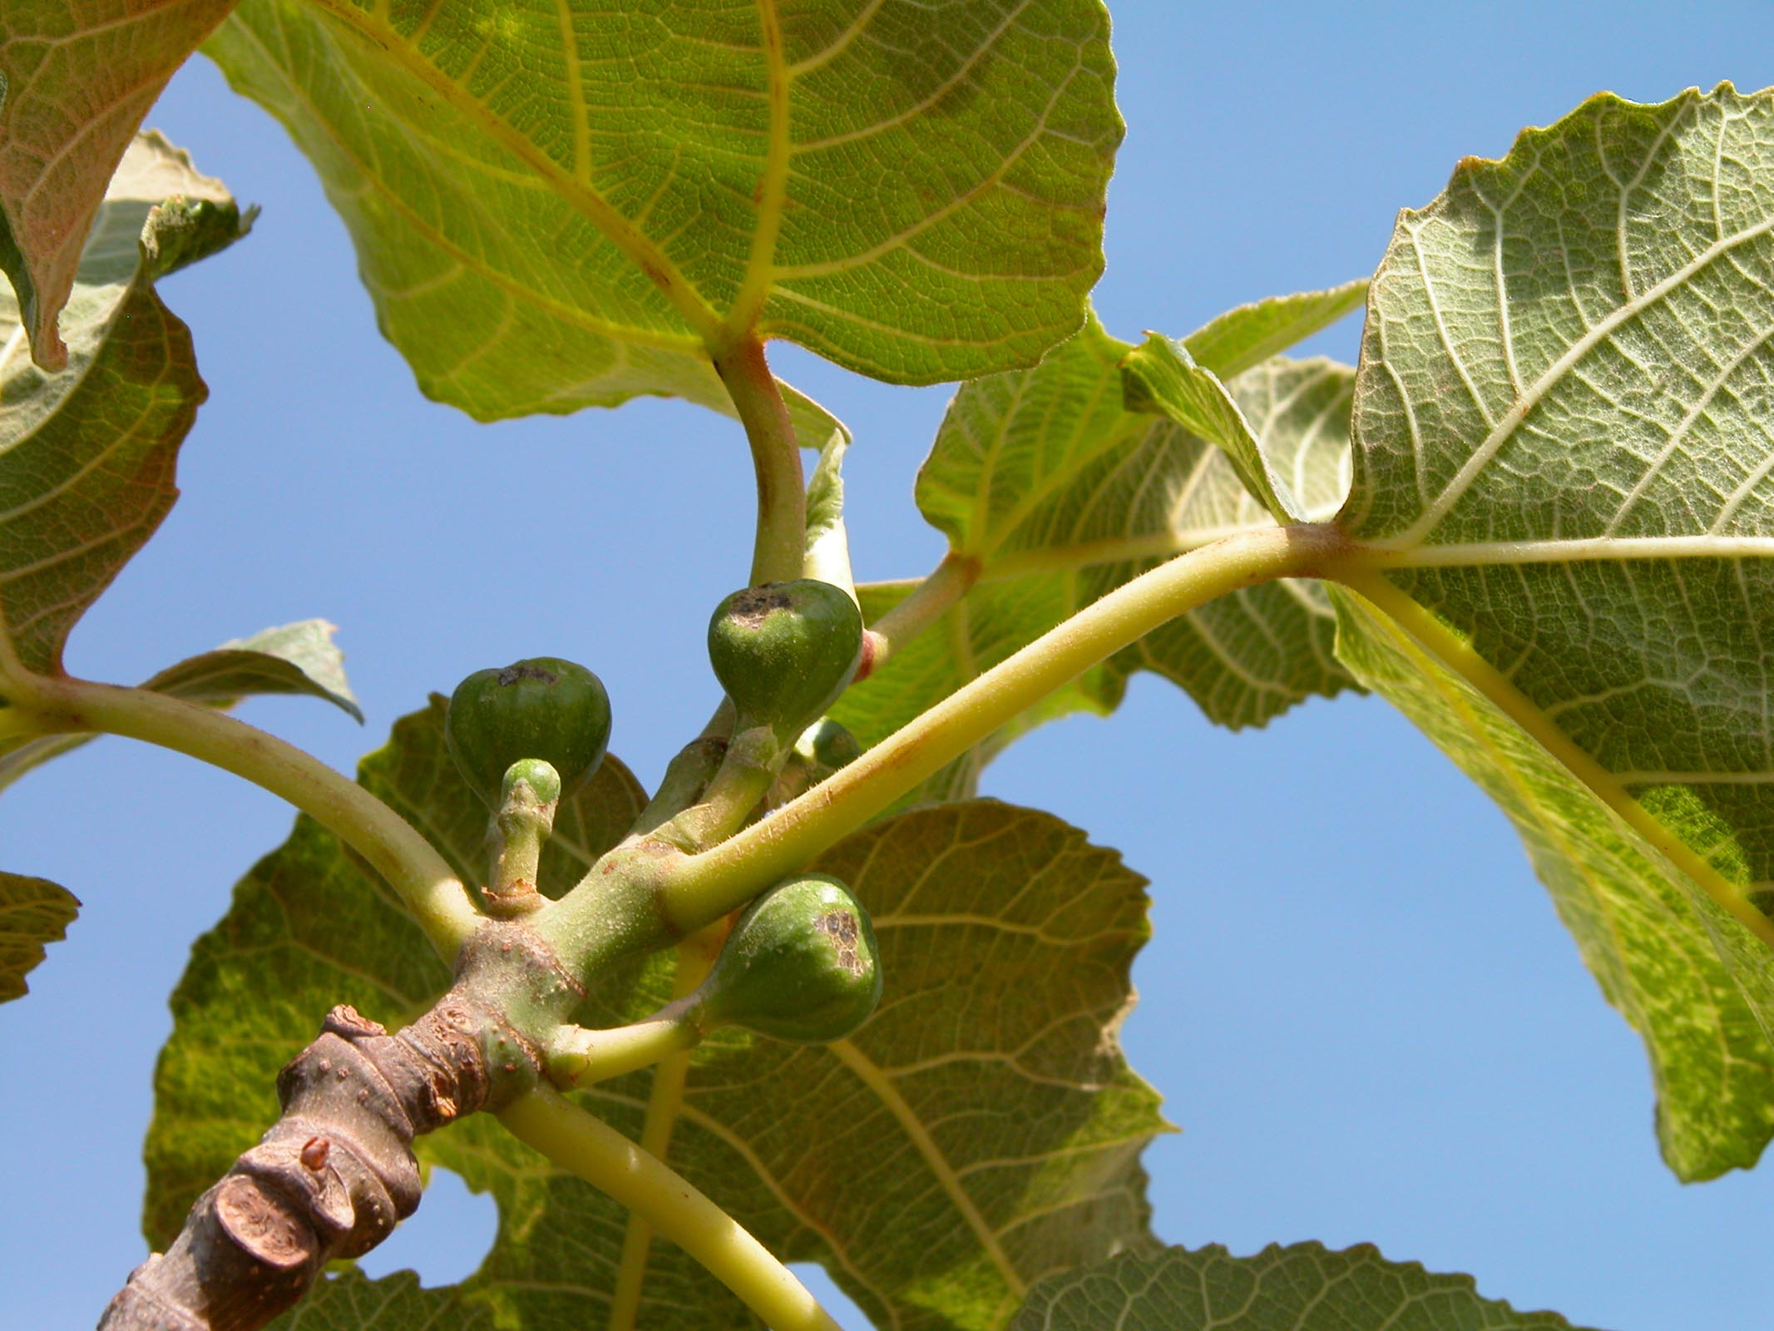
And seeing a fig tree by the road, He came to it, and He found nothing on it but only leaves
Early figs on tree at Umm al-Hedamus
21:19
Notes:
Jesus expected to find figs on the tree. Umm al-Hedamus is located near the traditional hometown of Elijah at Tishbe.
tb060403147

Slide 16
Matthew 21: The Barren Fig Tree
“does not bear good fruit…”
Matthew 3:10
Matthew 7:19
“tree is known by its fruit.”
Matthew 12:33
Mustard seed “becomes a tree”
Matthew 13:32
“Now learn the parable from the fig tree…”
Matthew 24:32-35: His Kingdom Is Coming!
Notes:
Jesus came back to this simple idea over and over. It is one of the things Matthew really wants us to know and understand.
The Tree SHOULD produce good fruit.
The Tree is JUDGED by its fruit.
A New Tree is Coming.
The Old Tree has been Judged.
*** WE MUST BE FRUITFUL! *** This is true in WHAT we produce: Children of God / Christians (as opposed to 23:15). Kingdom Citizens with the HEART of the Beattitudes. This is also true in HOW MUCH we produce. We must sow the seed in other hearts.
Ch. 24 is going to bring us to the National Judgment
Ch. 25 is going to bring us to the Final Judgment (Individually We Will Be Judged.)

Slide 17
Matthew 21: Powerful Parables
Matthew 21:28-32, 33-42
They Challenge Jesus’ Authority. He Challenges Their Actions!
You Have Not Obeyed The Father’s Will.
You Are Without Excuse, Because You Saw Others Obey But Still Did Not Believe.
You Will Kill The Servants & The Son.
You Will Be Crushed By The Rejected Stone.
Notes:
Just as the apostles claimed that THEY would not flee or deny Him. The Pharisees reject the notion that they are anything like the generation that killed the prophets, and yet they will do this and more!
TRANSITION: Consider these images of the Tower and the Rejected Stone…. Think of the CARE of GOD in making this wonderful plan to send His SON! Will we reject him? This question leads into the next parable…

Slide 18
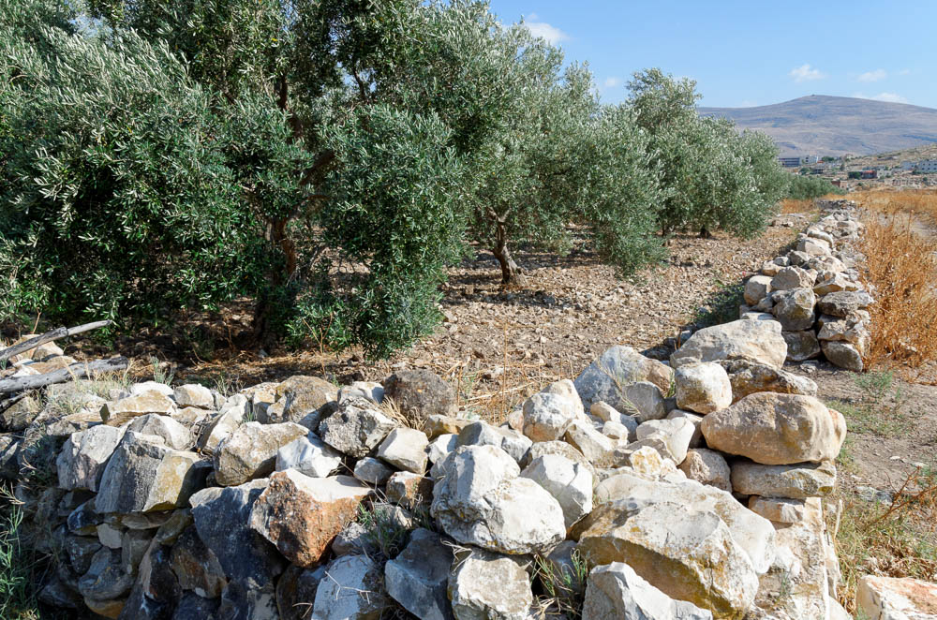
A landowner planted a vineyard, and put a wall around it
Olive grove surrounded by stone wall at Tirzah
21:33
Notes:
tb052916616

Slide 19
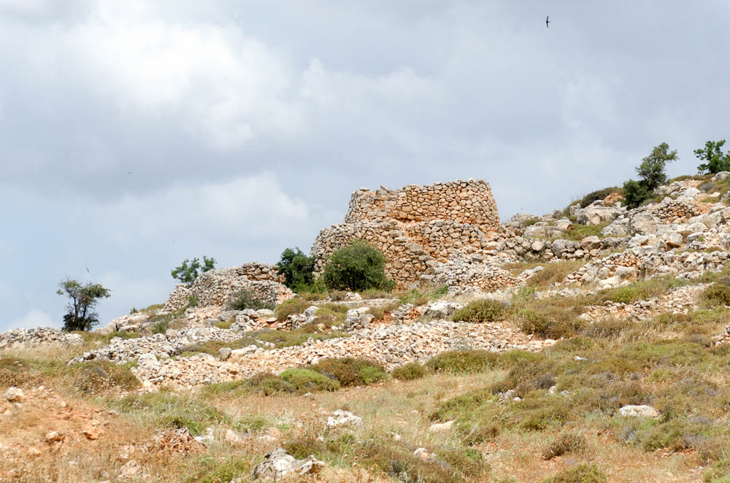
A landowner planted a vineyard, and . . . built a tower
Watchtower near Baal Hazor
21:33
Notes:
tb052916364

Slide 20
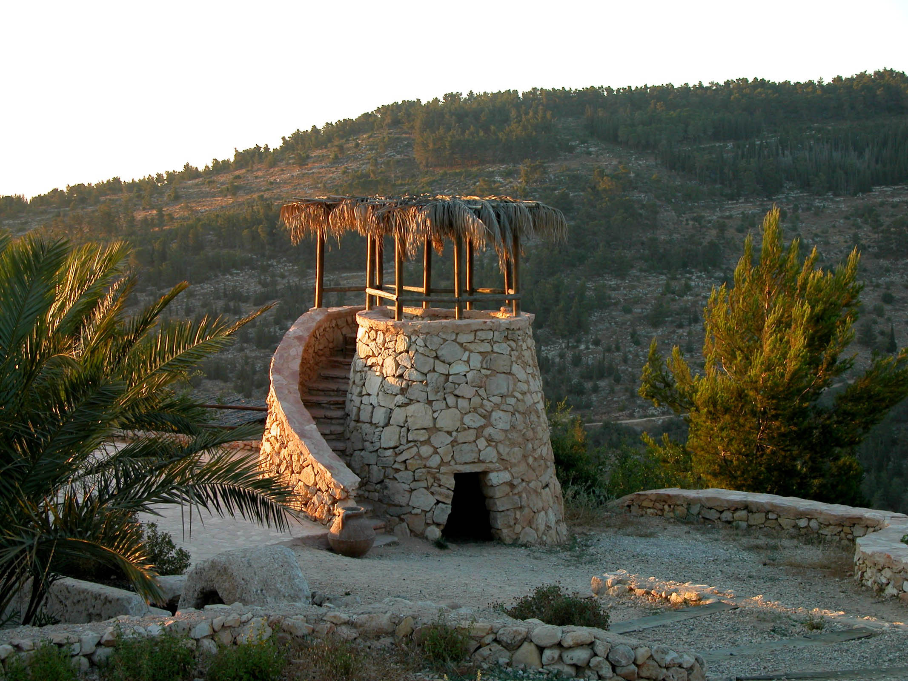
A landowner planted a vineyard, and . . . built a tower
Watchtower at Yad HaShmonah
21:33
Notes:
This reconstructed watchtower is located in the Biblical Gardens of Yad HaShmonah in the Judean hills west of Jerusalem.
tb061803476

Slide 21
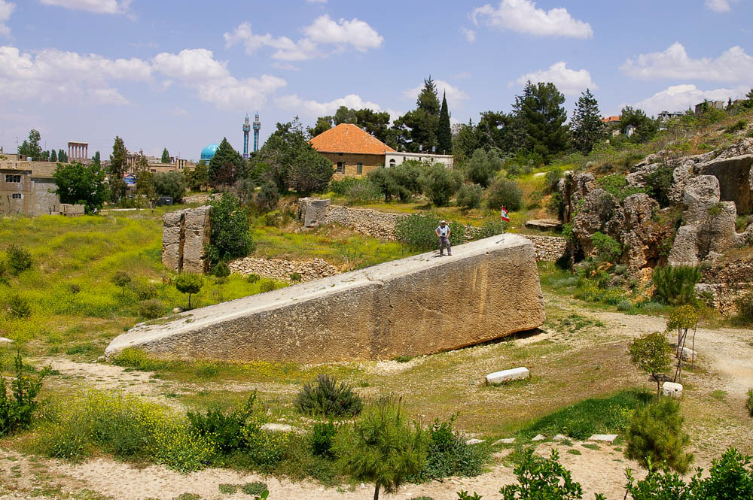
The stone which the builders rejected
Stone of the Pregnant Woman in Baalbek (from the southwest)
21:42
Notes:
This stone is known locally as Hajjar el-Hibla, “Stone of the Pregnant Woman.” Still attached to bedrock, this stone is 65.5 feet (20 m) long, 13 feet (4 m) wide, and 13 feet (4 m) tall. It weighs over 1,000 tons.
adr090511053

Slide 22
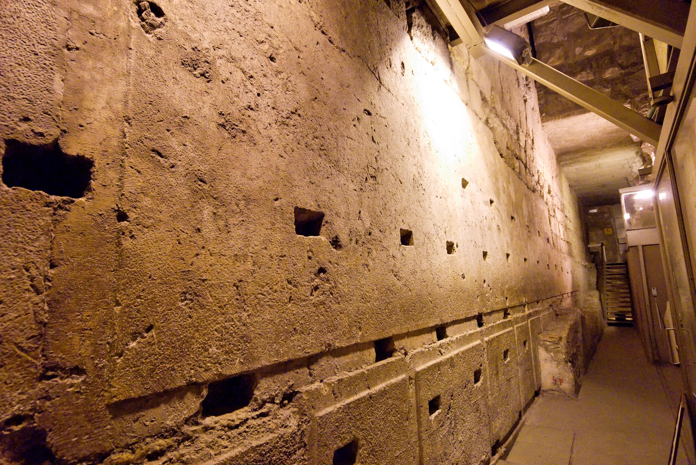
The stone which the builders rejected, the same has become the cornerstone
Largest Herodian stone in the Western Wall of the Temple Mount
21:42
Notes:
This stone is the largest known in the Temple Mount construction. It measures 43.4 feet (13.55 m) long, 10.2 feet (3.2 m) tall, and an estimated 13.4–15.7 feet (4.2–4.9 m) deep. It is located along the western wall, north of the prayer plaza and Wilson’s Arch, and south of Warren’s Gate. See the next slide for lines marking the stone’s edges.
tb123109463

Slide 23
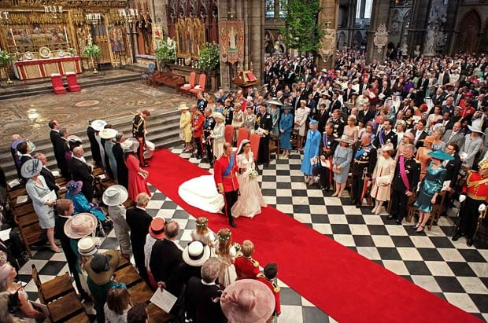
Matthew 22: The Marriage Feast
Notes:
Imagine being invited to a royal wedding!!! This is a once in a lifetime invitation, that is far greater than we deserve.
Prince Philip & Catherine Middleton (2011, Westminster Abbey)

Slide 24
Matthew 22: The Marriage Feast
Not Just Any Feast: The King’s Son!!!
Vs. 1-6
Just Punishment for Harboring Terrorist
Vs. 7
The King’s Son Will Be Honored
Vs. 8-10
The Rebellious Will Be Cast Out
Vs. 11-14
Notes:
I will do whatever it takes to accept the invitation.
I will do whatever it takes to honor the Son.
I will do whatever it takes to avoid being cast out.

Slide 25
Matthew 22: The Jewish Sects Silenced
The Herodians & Pharisees
“Render…to God the things that are God’s.”
The Sadducees
“They neither marry nor are given in marriage, but are like angels in heaven.”
A Lawyer from the Pharisees
“You shall love the Lord your God…”
Notes:
** What do you admire about how well Jesus answers these questions?
Like angels in heaven: This is an upgrade. I don’t know How, or in What form. But I do know that EVERYTHING about heaven is better. So whatever angelic status we will posses – I am sure it will be better.
Speculation: Without Gender? Completely Devoted to & Fulfilled with God?

Slide 26
Matthew 23:1-12 Warnings About The Pharisees
Then Jesus spoke to the crowds and to His disciples, saying: “The scribes and the Pharisees have seated themselves in the chair of Moses; therefore all that they tell you, do and observe, but do not do according to their deeds, for they say things and do no do them. They tie up heavy burdens and lay them on men’s shoulders…”
Notes:
Understand these practices continue today…

Slide 27
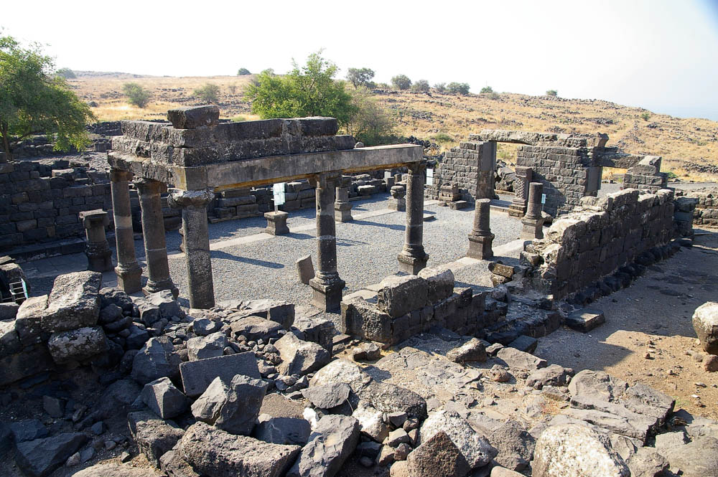
The scribes and the Pharisees sit on Moses’s seat
Chorazin synagogue with seat of Moses
23:2
Notes:
Jesus’s reference to the “seat of Moses” is the earliest such known reference. While it could be understood metaphorically, real chairs have been discovered in several synagogues where the rabbi sat to address the congregation. The seat of Moses is visible in the photo above on the far wall to the left of the main entrance. See the next slide for a close-up.
adr0807087101

Slide 28
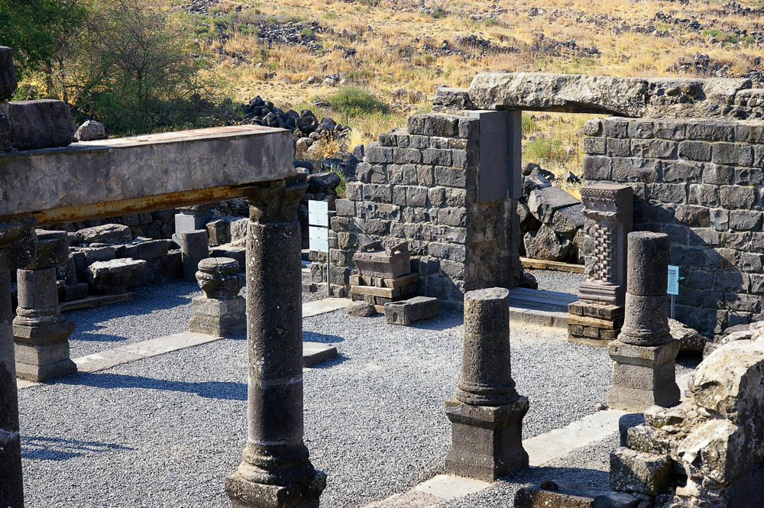
The scribes and the Pharisees sit on Moses’s seat
Chorazin synagogue with seat of Moses
23:2
Notes:
The seat of Moses is visible on the far wall to the left of the main entrance.
adr0807087111

Slide 29
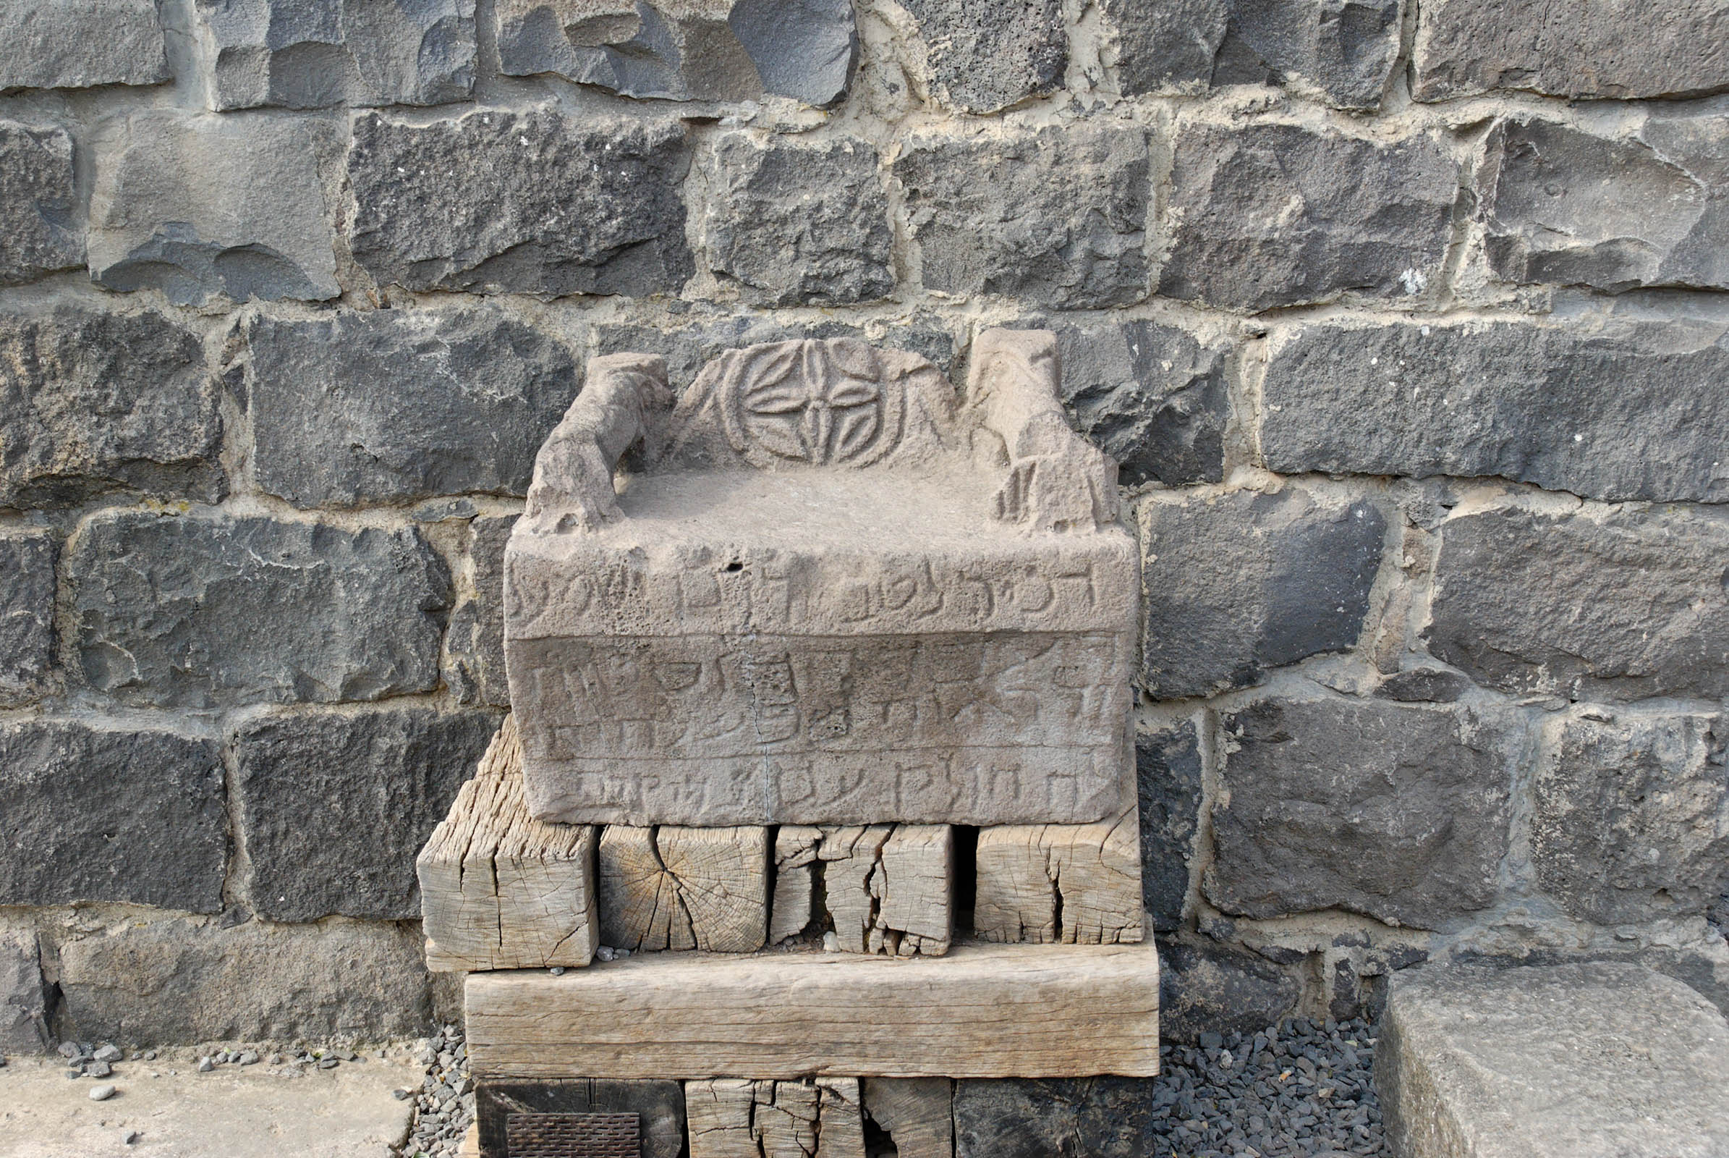
The scribes and the Pharisees sit on Moses’s seat
Seat of Moses (on-site replica) in the synagogue of Chorazin
23:2
Notes:
If you visit Chorazin today, you will see this on-site replica of the “seat of Moses” found in excavations of the synagogue.
tb052708486

Slide 30
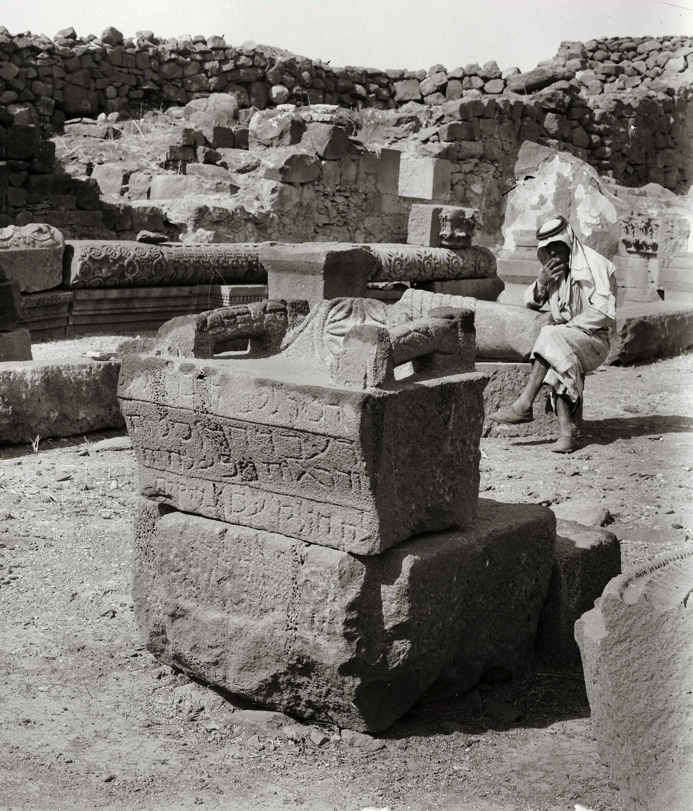
The scribes and the Pharisees sit on Moses’s seat
Seat of Moses in excavations of Chorazin synagogue
23:2
Notes:
This American Colony photograph and the one following were taken shortly after the synagogue’s excavation in the 1920s, showing the original basalt seat on location. Today this artifact is in the Israel Museum in Jerusalem (see following slides).
mat02805

Slide 31
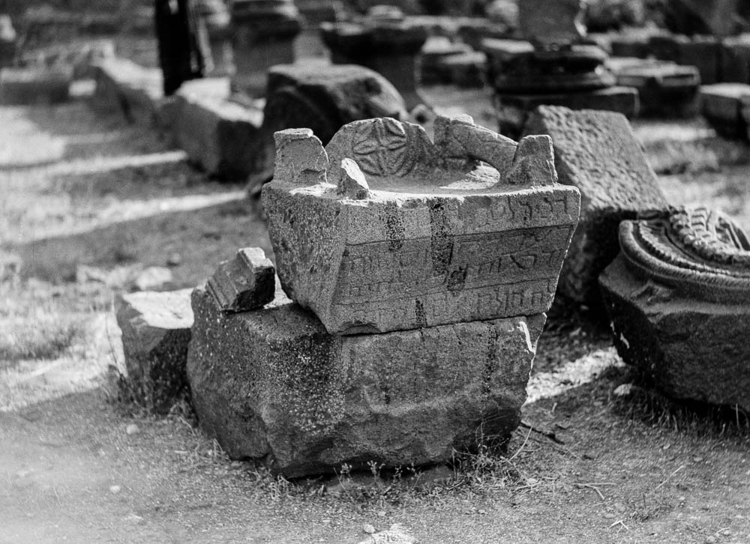
The scribes and the Pharisees sit on Moses’s seat
Seat of Moses in the synagogue at Chorazin
23:2
Notes:
This American Colony photograph was taken in October 1934.
mat16475

Slide 32
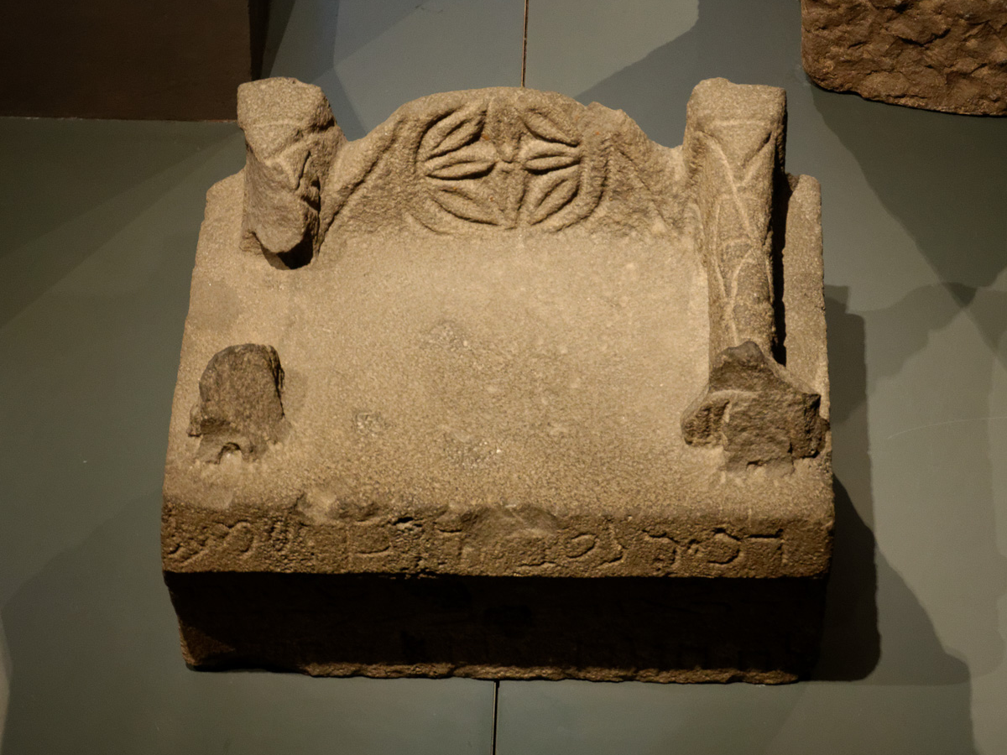
The scribes and the Pharisees sit on Moses’s seat
Seat of Moses from Chorazin synagogue, 4th–6th centuries AD
23:2
Notes:
This photo shows the object now on display in the Israel Museum in Jerusalem.
tb032014760

Slide 33
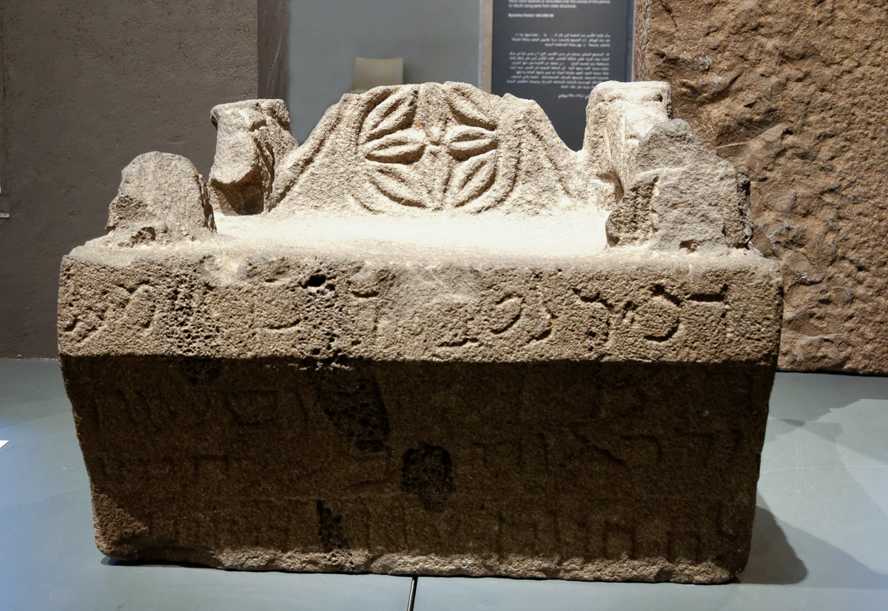
The scribes and the Pharisees sit on Moses’s seat
Seat of Moses from Chorazin synagogue, 4th–6th centuries AD
23:2
Notes:
The Aramaic inscription on this seat of Moses remembers “Yudan.” This object is now on display in the Israel Museum in Jerusalem.
tb032014777

Slide 34
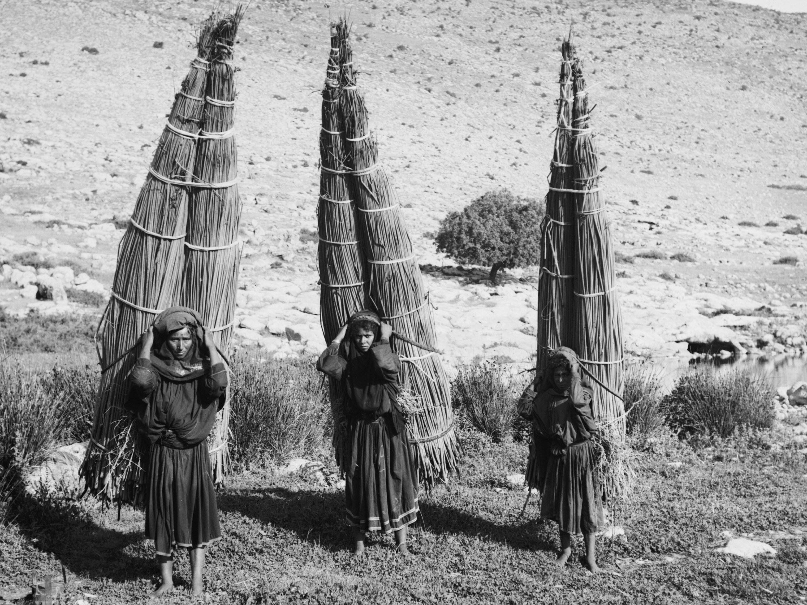
They tie up heavy loads . . . and put them on men’s shoulders
Bedouin women carrying papyrus bundles
23:4
Notes:
This American Colony photograph was taken in the first half of the twentieth century.
mat04636

Slide 35
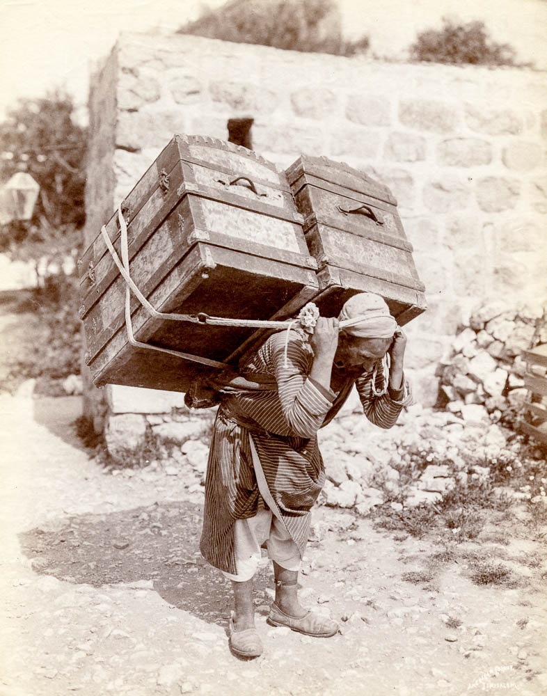
They tie up heavy loads . . . and put them on men’s shoulders
Porter with heavy load
23:4
Notes:
This photograph comes from The Miriam and Ira D. Wallach Division of Art, Prints and Photographs: Photography Collection, public domain, from The New York Public Library, https://digitalcollections.nypl.org/items/510d47d9-77e4-a3d9-e040-e00a18064a99.
nypl112614

Slide 36
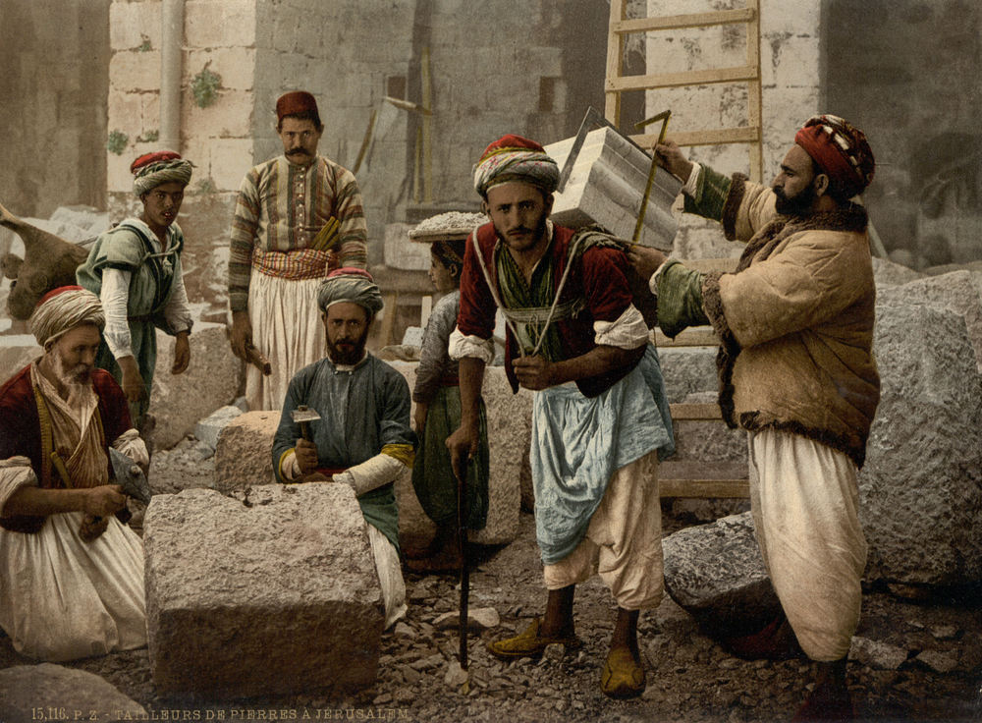
They tie up heavy loads . . . and put them on men’s shoulders
Stone cutters of Jerusalem
23:4
Notes:
pcm02758

Slide 37
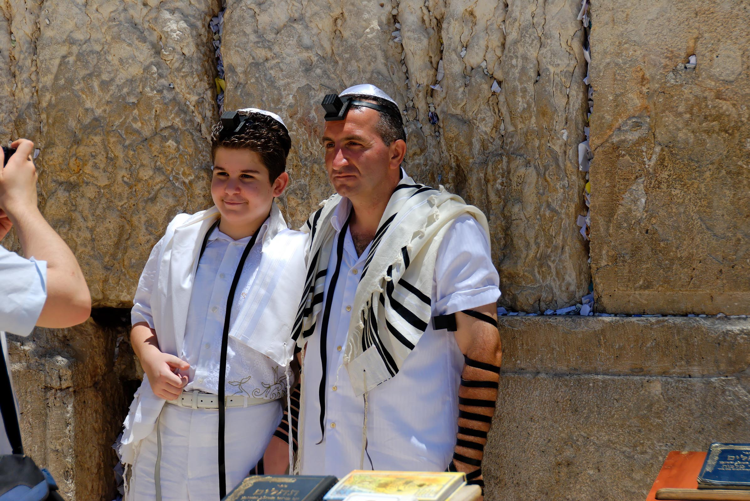
They enlarge their phylacteries, and lengthen the fringes of their garments
Father and son with phylacteries at the Western Wall
23:5
Notes:
During morning prayers, Jewish men (from the time of their bar mitzvah on) wear a head phylactery and a hand phylactery. They wear these in the belief that they are literally obeying Deuteronomy 6:8: “And you shall bind them as a sign upon your hand, and they shall be frontlets between your eyes.”
tb071207088

Slide 38
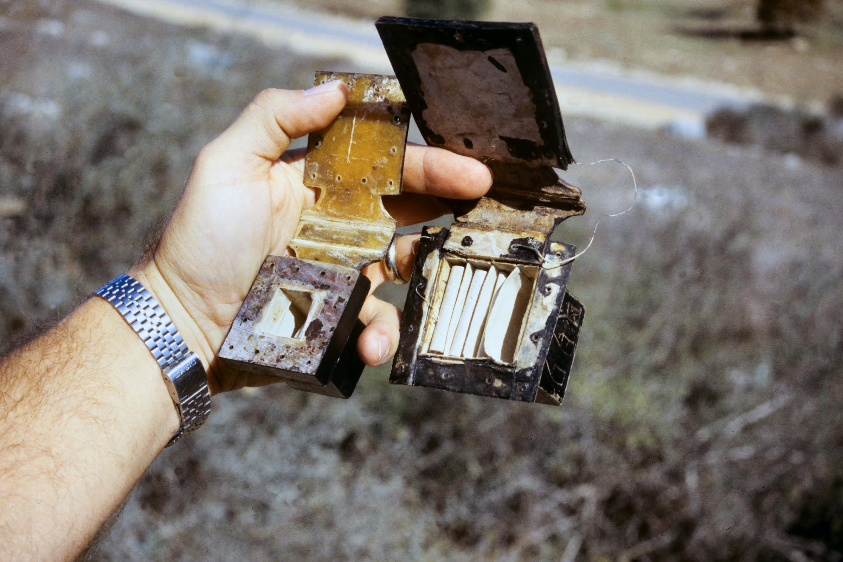
They enlarge their phylacteries, and lengthen the fringes of their garments
Phylacteries open with Scriptures
23:5
Notes:
“The hand-phylactery has only one compartment, which contains the four Biblical selections written upon a single strip of parchment in four parallel columns and in the order given in the Bible (Men. 34b). The head-phylactery has four compartments, formed from one piece of leather, in each of which one selection written on a separate piece of parchment is deposited perpendicularly” (Jewish Encyclopedia: http://www.jewishencyclopedia.com/articles/12125-phylacteries).
tbs86179611

Slide 39
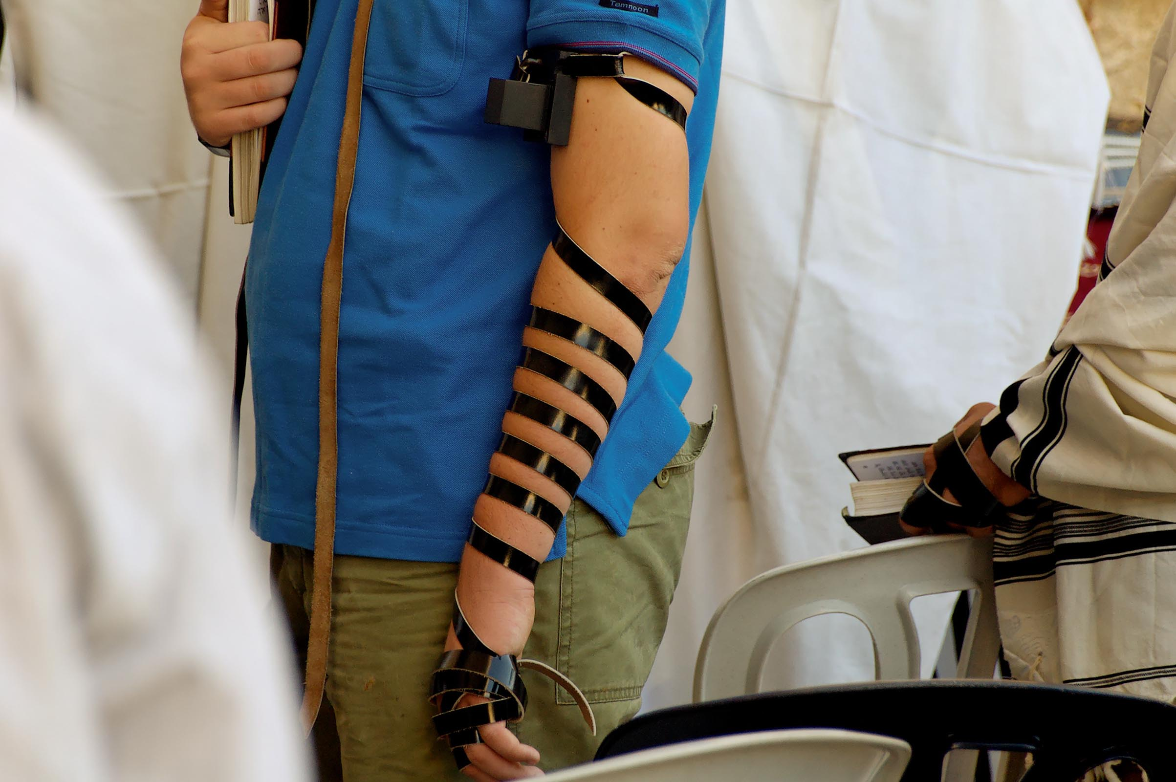
They enlarge their phylacteries, and lengthen the fringes of their garments
Phylactery on man’s arm at the Western Wall
23:5
Notes:
The Jewish Encyclopedia explains how the hand-phylactery is put on. “In putting on the tefillin, the hand-phylactery is laid first (Men. 36a). Its place is on the inner side of the left arm (ib. 36b, 37a), just above the elbow (comp. "Sefer Ḥasidim," §§ 434, 638, where the exact place is given as two fist-widths from the shoulder-blade; similarly the head-phylactery is worn two fist-widths from the tip of the nose); and it is held in position by the noose of the strap so that when the arm is bent the phylactery may rest near the heart (Men. 37a, based on Deut. xi. 8; comp. "Sefer Ḥasidim," §§ 435, 1742). If one is left-handed, he lays the hand-phylactery on the same place on his right hand (Men. 37a; Oraḥ Ḥayyim, 27b). After the phylactery is thus fastened on the bare arm, the strap is wound seven times round the arm” (http://www.jewishencyclopedia.com/articles/12125-phylacteries).
tb083104466

Slide 40
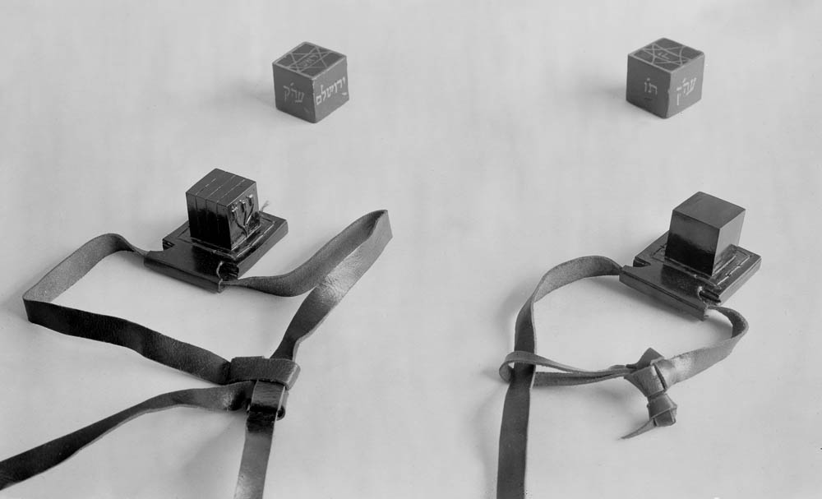
They enlarge their phylacteries, and lengthen the fringes of their garments
Phylacteries for head and arm
23:5
Notes:
This photograph was taken in the 1930s.
mat03893

Slide 41
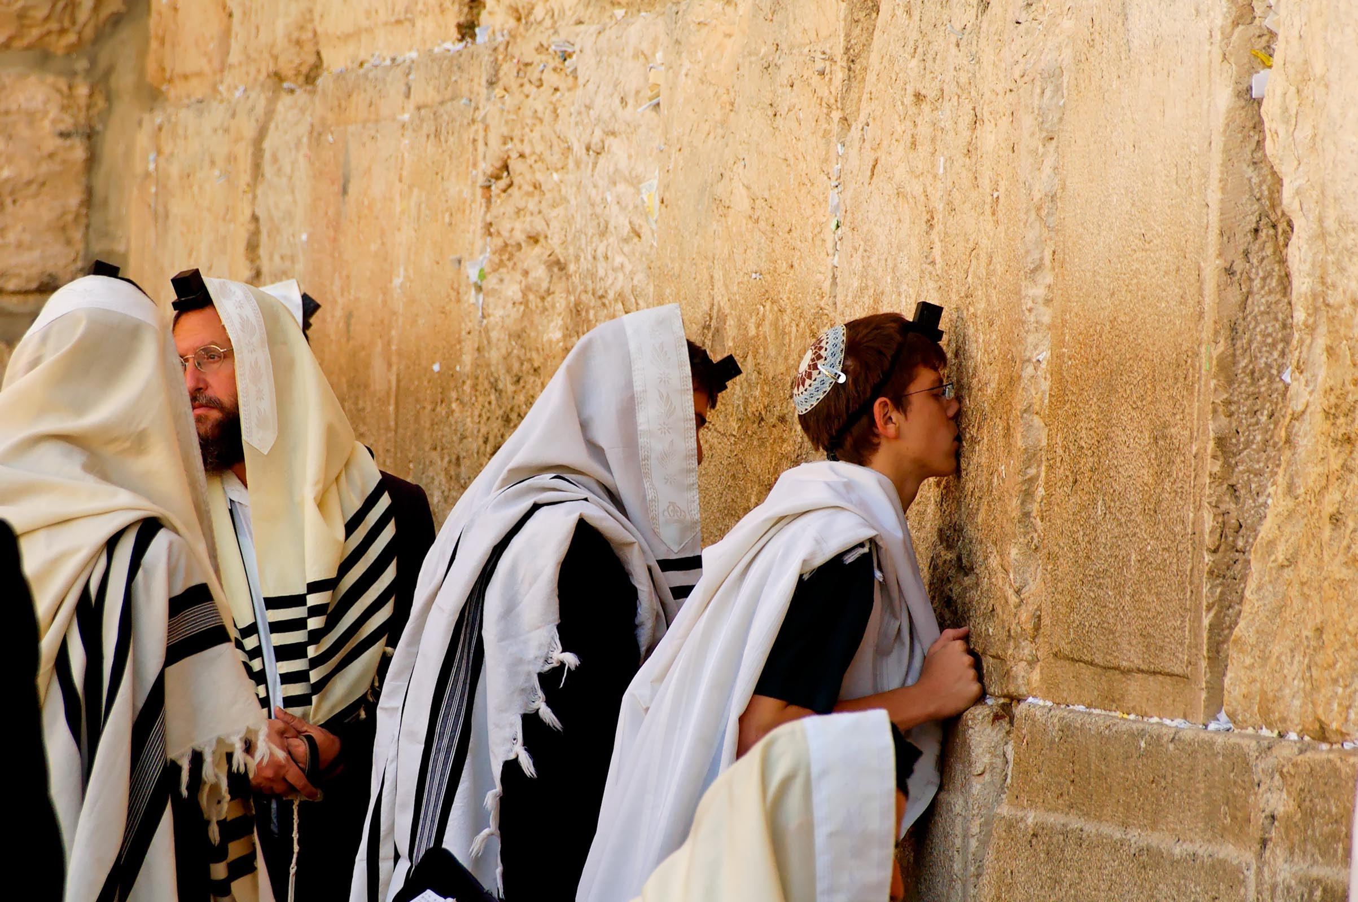
They enlarge their phylacteries, and lengthen the fringes of their garments
Man kissing the Western Wall while wearing phylactery
23:5
Notes:
tb083104444

Slide 42
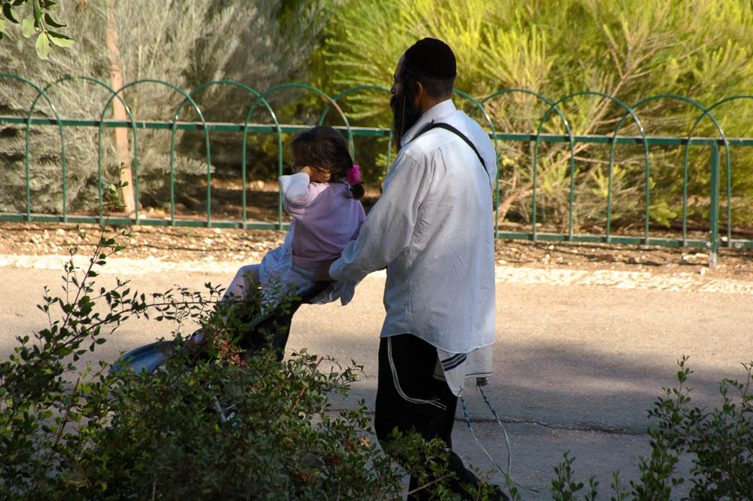
They enlarge their phylacteries, and lengthen the fringes of their garments
Man with fringes of prayer shawl showing
23:5
Notes:
The wearing of fringes is done in obedience to Numbers 15:38-40 and Deut 22:12. The Hebrew word for fringes is “tzitzit” (ẓiẓit). This photo was taken at the Jerusalem Biblical Zoo where the man is pushing his daughter on a stroller.
Numbers 15:38–40 (ASV) “Speak unto the children of Israel, and bid them that they make them fringes in the borders of their garments throughout their generations, and that they put upon the fringe of each border a cord of blue: ³⁹and it shall be unto you for a fringe, that ye may look upon it, and remember all the commandments of Jehovah, and do them; and that ye follow not after your own heart and your own eyes, after which ye use to play the harlot; ⁴⁰that ye may remember and do all my commandments, and be holy unto your God.“
tb082505698

Slide 43
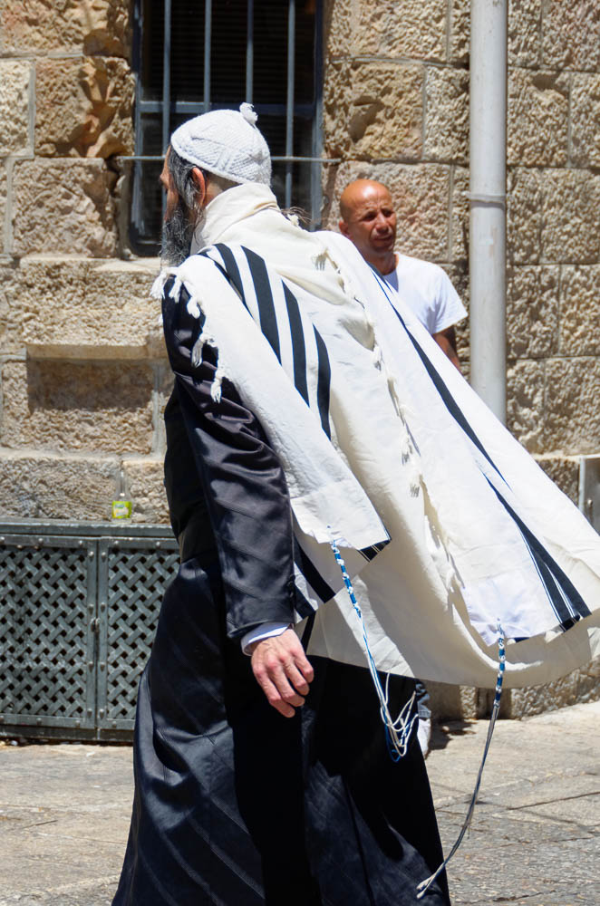
They enlarge their phylacteries, and lengthen the fringes of their garments
Jewish man with prayer shawl and fringes, tzitzit
23:5
Notes:
From the Jewish Encyclopedia: “Threads with a cord of blue entwined, fastened to the four corners of the Arba' Kanfot and the Ṭallit and pendent, like a tassel, in conformity with Num. xv. 38-40 and Deut. xxii. 12. The ẓiẓit consisted, according to Bet Shammai, of four threads of white wool and four threads of blue, but according to Bet Hillel of two threads of each (Men. 41b). The "arba' kanfot," or "ṭallit ḳaṭon," was worn by day as an undergarment. The regular ṭallit, as an overgarment, was used only during the morning prayer.”
tb061116054

Slide 44
Matthew 23: The 8 Woes
Shut off the kingdom
Devour widows houses & for pretense make long prayers
Proselyte…make him twice as much a son of hell.
Unholy, Unfulfilled Oaths
Neglect of Weightier Matters.
Insides full of Robbery & Self-Indulgence.
Whitewashed Tombs full of Hypocrisy & Lawlessness
Killing the Prophets
Notes:
Mt. 23:33 – Jesus uses very servere language in this chapter.
Small Thinking: Only people like me belong in the kingdom of heaven. Big Thinking: God’s family is open to all.
Small Thinking: I deserve the praise and the glory. Big Thinking: God deserves all the praise and glory.
Small Thinking: People should act more like my group. Big Thinking: People should act more like Christ.
Small Thinking: God will accept us based on technicalities. Big Thinking: God will accept us based on our hearts.
Small Thinking: Obedience is measured in the details. Big Thinking: Obedience is measured in love and devotion.
Small Thinking: I only need to clean up what others can see. Big Thinking: I want to be pure in the eyes of God.
Small Thinking: I can just “straighten up a little”. Big Thinking: I must be transformed to LIFE.
Small Thinking: Not me, I’d never…. Big Thinking: Only with God’s word and servants can I know and please Him.
Transition: Because of these 8 traits of hypocrisy…they were like decorated tombs…consider these images. There is great skill and artistry in the carvings…but remember what they contain: Death.
Today, there is great skill and artistry in much that is done in the name of Christianity…but that doesn’t make it LIVING and TRUE. We can’t get wrapped up in appearances!!!

Slide 45
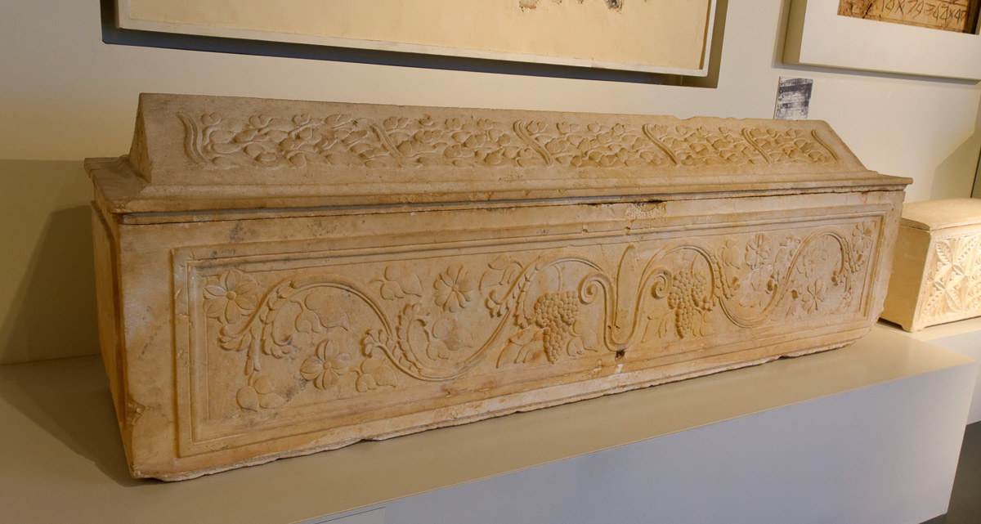
You are like whitewashed tombs, which from the outside appear beautiful . . .
Sarcophagus from the Tomb of Nazirite, Jerusalem, 1st century AD
23:27
Notes:
While ossuaries (bone boxes) are more common, some beautifully hewn sarcophagi are known from first-century Jerusalem. This one is on display in the Israel Museum in Jerusalem.
tb032014562

Slide 46
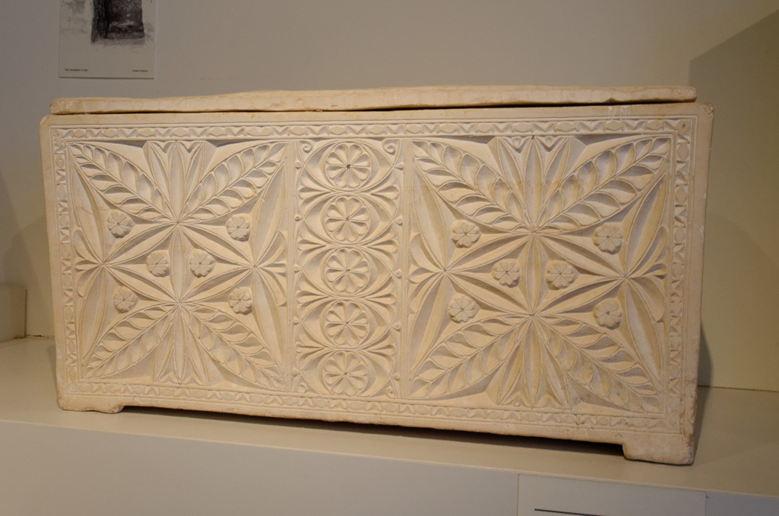
You are like whitewashed tombs, which from the outside appear beautiful . . .
Ossuary with Aramaic inscription from Jerusalem, 1st century AD
23:27
Notes:
This beautiful limestone bone box is on display in the Israel Museum in Jerusalem.
tb032014557

Slide 47
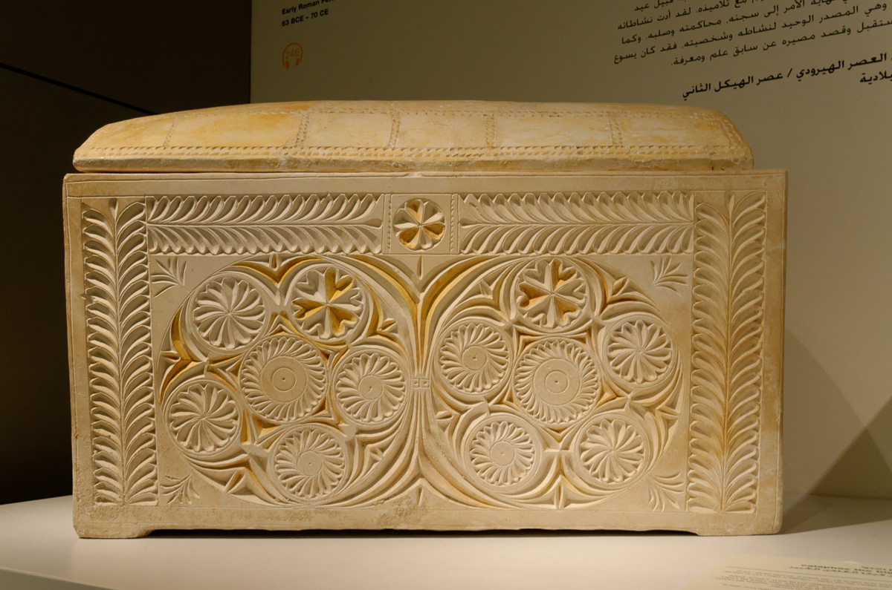
You are like whitewashed tombs, which from the outside appear beautiful . . .
Ossuary of Joseph son of Caiaphas, from Jerusalem, 1st century AD
23:27
Notes:
One of the most beautifully decorated ossuaries from the first century AD belongs to Joseph, the son of Caiaphas. It is on display in the Israel Museum in Jerusalem.
tb032014607

Slide 48
Avoiding Hypocrisy
Proclaim & Grow HIS Kingdom
Walk with Humility
Lead To The Word of God
Honesty & Integrity
Justice, Mercy, & Faithfulness
Purify Our Hearts
Walk In Righteousness
Obey God’s Word
Notes:
I will do whatever it takes to accept the invitation.
I will do whatever it takes to honor the Son.
I will do whatever it takes to avoid being cast out.

Slide 49
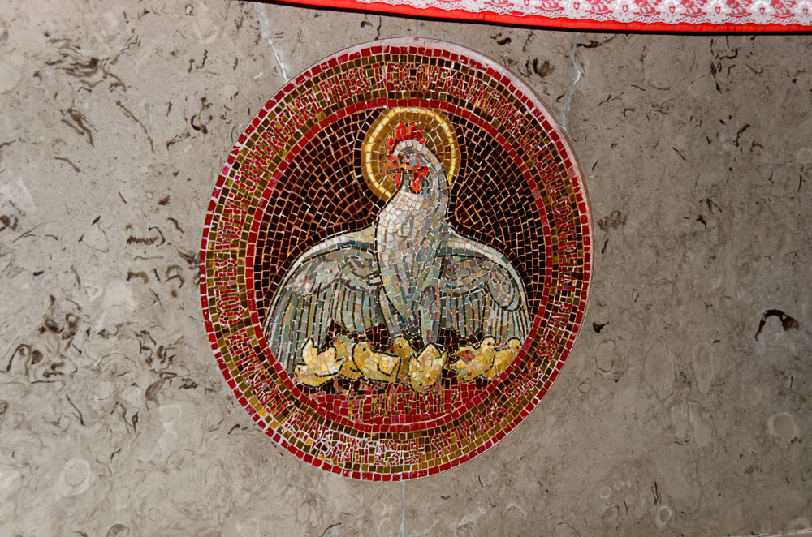
As a hen gathers her chicks under her wings
Mural of hen gathering her chicks at Dominus Flevit
23:37
Notes:
Dominus Flevit is the traditional place on the Mount of Olives where the Lord wept over Jerusalem.
tb060116984

Slide 50
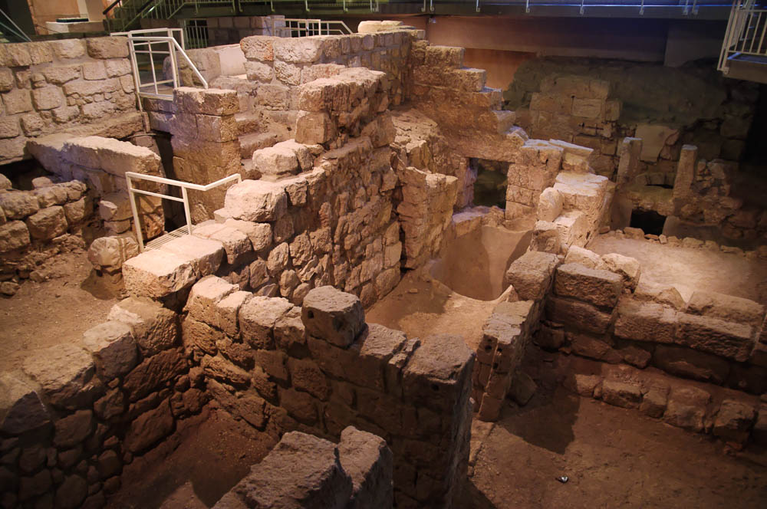
Behold, your house is left to you desolate!
House destroyed by the Romans in the first century AD in the Jewish Quarter of Jerusalem
23:38
Notes:
These excavations are on display in the Wohl Museum.
adr1305134698

Slide 51
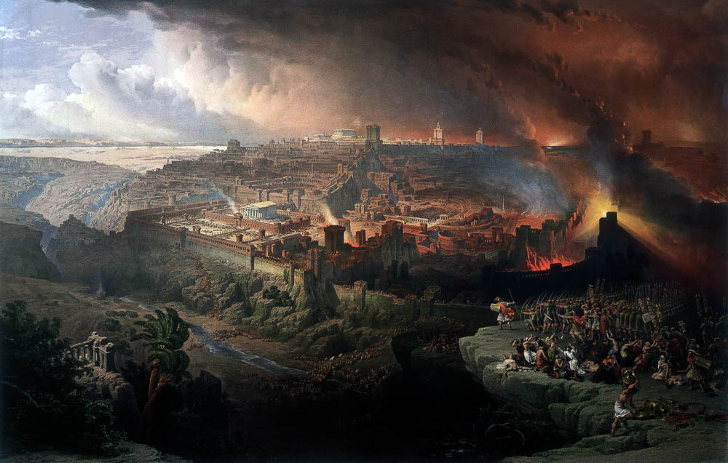
Behold, your house is left to you desolate!
The Siege and Destruction of Jerusalem, by David Roberts, 1850
23:38
Notes:
This image comes from Wikimedia and is in the public domain. Source: https://commons.wikimedia.org/wiki/File:Roberts_Siege_and_Destruction_of_Jerusalem.jpg
drra1850

Slide 52
The Gospel of Matthew
Notes:
Matthew wants us to know the HIGH COST of rejecting JESUS and the GREAT EFFORT Jesus has made to turn us away from self-righteousness – and to teach us to put our faith, trust, and obedience in Jesus Christ.

