Slide 1
Do not love the world or the things in the world. If anyone loves the world, the love of the Father is not in him. ¹⁶ For all that is in the world—the lust of the flesh, the lust of the eyes, and the pride of life—is not of the Father but is of the world. ¹⁷ And the world is passing away, and the lust of it; but he who does the will of God abides forever. (1 John 2:15-17, NKJV)

Slide 2
Consumerism
Sands of our Time

Slide 3
Consumerism:
the protection or promotion of the interests of consumers

Slide 4
Quotes about Consumerism
https://en.wikipedia.org/wiki/Consumerism
The term "consumerism" would pin the tag where it actually belongs—on Mr. Consumer, the real boss and beneficiary of the American system. (1955, John Bugas, #2 at Ford Motor Company)
Fable of the Bees by Bernard Mandeville
"a shift away from values of community, spirituality, and integrity, and toward competition, materialism and disconnection.” (2007, Madeline Levine)
Our enormously productive economy demands that we make consumption our way of life, that we convert the buying and use of goods into rituals, that we seek our spiritual satisfaction and our ego satisfaction in consumption. We need things consumed, burned up, worn out, replaced and discarded at an ever-increasing rate. (1955, Victor Lebow)
"subconsciously still driven by an impulse for survival, domination and expansion ... an impulse which now finds expression in the idea that inexorable economic growth is the answer to everything, and, given time, will redress all the world's existing inequalities.” (William Rees // Warren Hern)

Slide 5
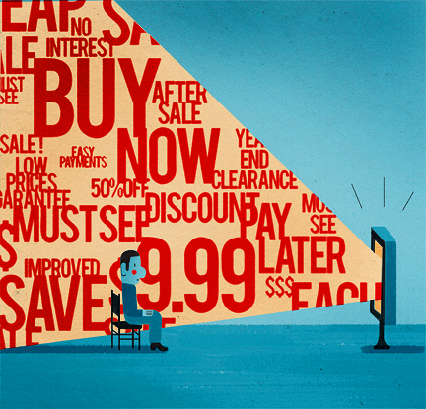
Consumerism: the protection or promotion of the interests of consumers
Notes:
Our enormously productive economy demands that we make consumption our way of life, that we convert the buying and use of goods into rituals, that we seek our spiritual satisfaction and our ego satisfaction in consumption. We need things consumed, burned up, worn out, replaced and discarded at an ever-increasing rate. (1955, Victor Lebow)

Slide 6
Consumerism: the protection or promotion of the interests of consumers
Let us hold fast the confession of our hope without wavering, for He who promised is faithful; and let us consider how to stimulate one another to love and good deeds, not forsaking our own assembling together, as is the habit of some, but encouraging one another; and all the more as you see the day drawing near.
Hebrews 10:23-25, NASB
In Worship Participation

Slide 7
Consumerism: the protection or promotion of the interests of consumers
Wherefore be ye not foolish, but understand what the will of the Lord is. ¹⁸ And be not drunken with wine, wherein is riot, but be filled with the Spirit; ¹⁹ speaking one to another in psalms and hymns and spiritual songs, singing and making melody with your heart to the Lord; ²⁰ giving thanks always for all things in the name of our Lord Jesus Christ to God, even the Father; ²¹ subjecting yourselves one to another in the fear of Christ.
Ephesians 5:17-21, ASV
In Worship Participation

Slide 8
Consumerism: the protection or promotion of the interests of consumers
Let all these things be done for the strengthening of the church.
1 Cor. 14:26b, NET
The secrets of his heart are disclosed, and in this way he will fall down with his face to the ground and worship God, declaring, “God is really among you.”
1 Cor. 14:25, NET
In Worship Participation

Slide 9
Consumerism: the protection or promotion of the interests of consumers
How Paul Preached
Not Worldly Wise
Contemptible Speech
Weak Presence
Long and Rambling
Hard to Understand
In Worship Participation
Toward Preachers / Preaching

Slide 10
Consumerism: the protection or promotion of the interests of consumers
Would you want Paul of Tarsus to be your preacher?
In Worship Participation
Toward Preachers / Preaching

Slide 11
The world teaches us to be consumers in the pursuit of our own self-interest.
The Lord commands us to be contributors to His purposes and for the benefit of others through self-sacrifice.

Slide 12
Living a Life of Self-Sacrifice (Romans 12)
Renewed view self: a Working Member of the Body, not an Autonomous Individual
Seek out needs and opportunities to meet needs
Let love rule over all decisions and relationships

Slide 13
I beseech you therefore, brethren, by the mercies of God, that you present your bodies a living sacrifice, holy, acceptable to God, which is your reasonable service. And do not be conformed to this world, but be transformed by the renewing of your mind, that you may prove what is that good and acceptable and perfect will of God.
Romans 12:1-2, NKJV

Slide 14
I beseech you therefore, brethren, by the mercies of God, that you present your bodies a living sacrifice, holy, acceptable to God, which is your reasonable service. And do not be conformed to this world, but be transformed by the renewing of your mind, that you may prove what is that good and acceptable and perfect will of God.
Romans 12:1-2, NKJV

