Slide 1
“In the Beginning was the Logos. … The Logos became flesh and dwelt among us, and we beheld his glory, glory of the only begotten of the Father, full of grace and Truth.” (John 1:1, 14)
So Jesus said to the Jews who had believed him, “If you abide in my word, you are truly my disciples, ³² and you will know the truth, and the truth will set you free.” (John 8:31-32)
“For this reason I have come, to testify of the truth.” (John 18:37)

Slide 2
Subjectivism
Sands of our Time

Slide 3
Plato’s “Forms”
Independent Universal Standards
Aristotle’s “Particulars”
Dependent Universal Standards

Slide 4
“I think, therefore I am.”

Slide 5
“Peace comes from within. Do not seek it without.”
“We are what we think. All that we are arises with our thoughts. With our thoughts, we make the world.”

Slide 6
Quotes about Subjectivism
https://en.wikipedia.org/wiki/Subjectivism
https://en.wikipedia.org/wiki/Ren%C3%A9_Descartes#Philosophical_work
Initially, Descartes arrives at only a single principle: thought exists. Thought cannot be separated from me, therefore, I exist (Discourse on the Method and Principles of Philosophy). Most famously, this is known as cogito ergo sum (English: "I think, therefore I am"). Therefore, Descartes concluded, if he doubted, then something or someone must be doing the doubting, therefore the very fact that he doubted proved his existence. "The simple meaning of the phrase is that if one is skeptical of existence, that is in and of itself proof that he does exist.”
https://en.wikipedia.org/wiki/S%C3%B8ren_Kierkegaard

Slide 7
Quotes about Subjectivism
Pocket College Lecture on Subjectivism
Now that may seem far out, but as we progress during the week we shall see how this came about quite logically, granted Descartes premise. As Kushman a historian of the history of philosophy has said and I quote: “For Descartes, reality lies within the self, and the next question for him is how to get out of the self.” And indeed this was the question for Descartes, and for all of modern philosophy. How to get out of the self, except, after a while, as they find it impossible, they abandon the desire to get out of the self; why bother? “If I am the ultimate, if I am my own universe and my own world, why bother to get out of myself, why not abandoned the quest?”
So, Descartes began by doubting his senses, his sight, his hearing, his touch. Doubting his reason, but not himself. “I exist. I think, therefore I am.” So that however fallacious the world out there may be, and what I experience waking may be as much an illusion as what I dream when I sleep, what is real is myself. This is the one certainty
Now, from this point of course philosophy as I indicated, took its new starting point. God for Anselm had been the starting point of all philosophy, but for Descartes this concern had been eliminated. What Descartes did therefore was first of all to take truth, knowledge, and to make it something entirely separate from God. So that while Descartes later said there is a god, but only as a limiting concept, we will come to that in a moment, what he had done was to separate truth and knowledge from God, so that his God no longer had any centrality in his system or any real importance.
Kant separated knowledge you see from any correlation to things out there. “What I organize are my ideas, my sense impressions, I stay within the locked world of my own mind, and there is nothing wrong with that. It’s my Universe.” And so, with Kant, the only truly knowable world became the mind of man. Total subjectivism. The implication of this subjectivism subsequent philosophy was to develop, down to the present day

Slide 8
I’m OK—You’re OK.
“That’s just your opinion.”
“Do what you think is right.”
“_______ just isn’t for me.”
Twitterization of Information

Slide 9
In those days there was no king in Israel. Everyone did what was right in his own eyes.
Judges 17:6

Slide 10
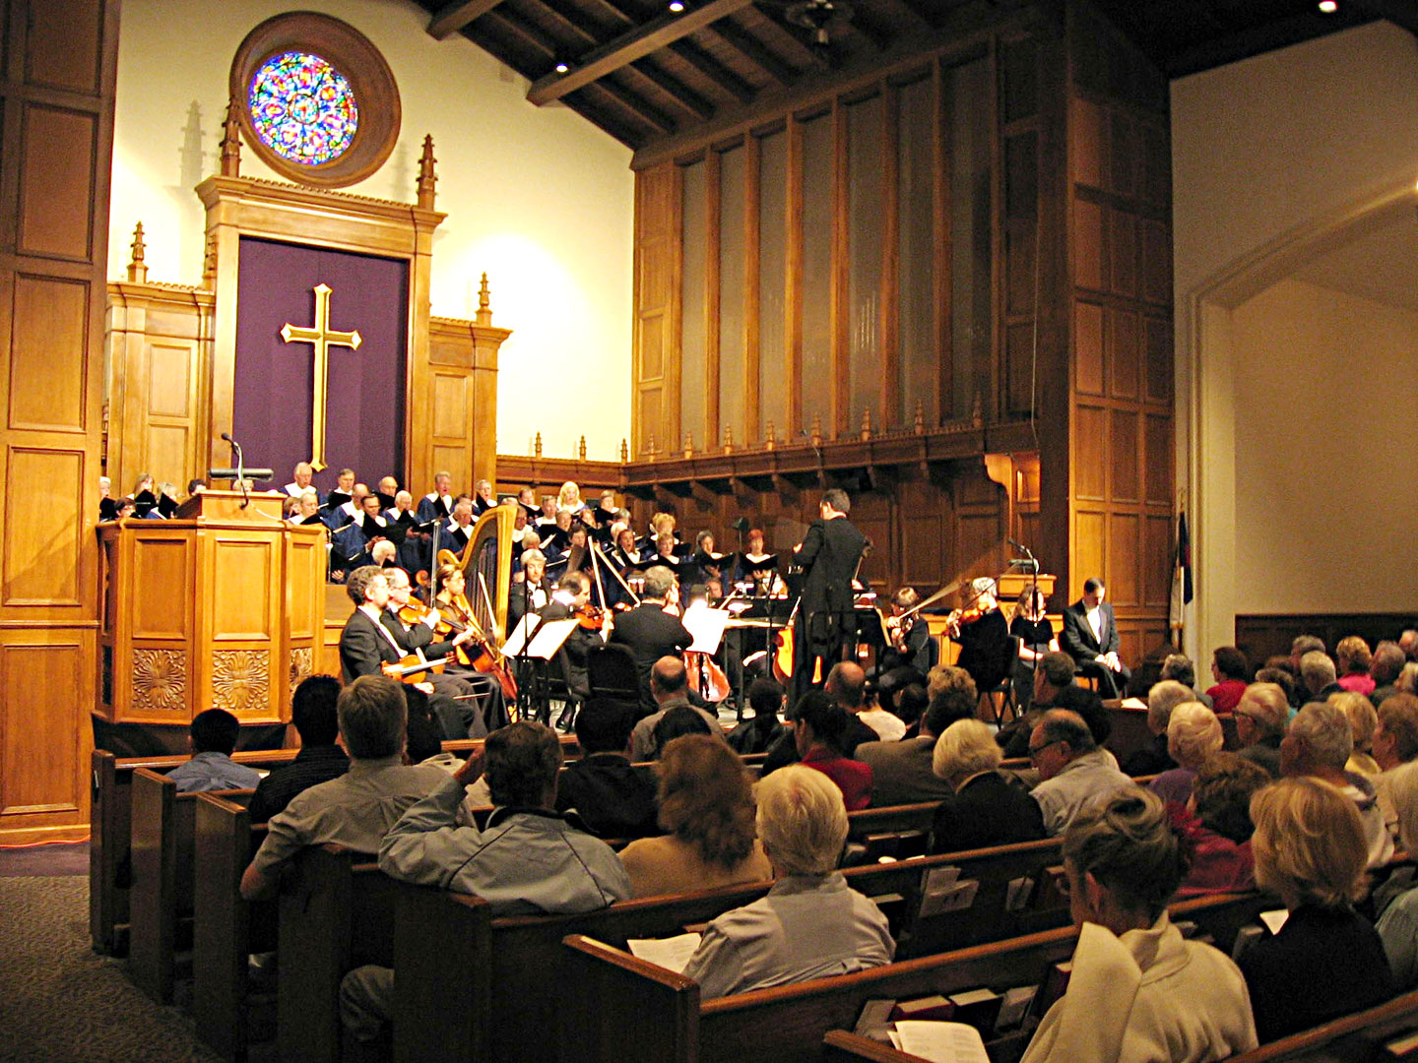
Notes:
Segregated Services (‘contemporary’, ‘traditional’)
Different Days for Worship Assembly
Choir / Band Worship
Various Methods and Uses for Collected Funds
Flexible Schedule of Lord’s Supper
Removal of Restrictions in Male / Female Roles

Slide 11
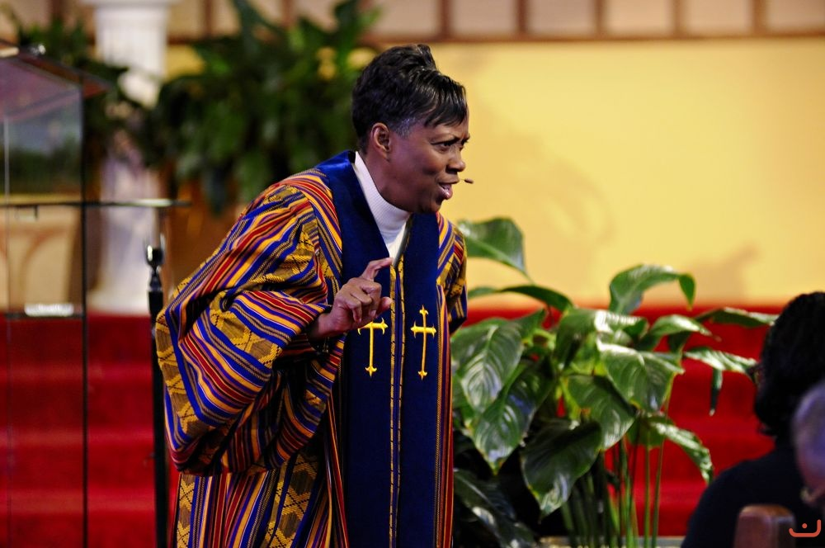
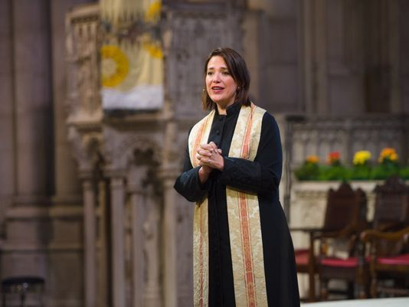
Notes:
Segregated Services (‘contemporary’, ‘traditional’)
Different Days for Worship Assembly
Choir / Band Worship
Various Methods and Uses for Collected Funds
Flexible Schedule of Lord’s Supper
Removal of Restrictions in Male / Female Roles

Slide 12
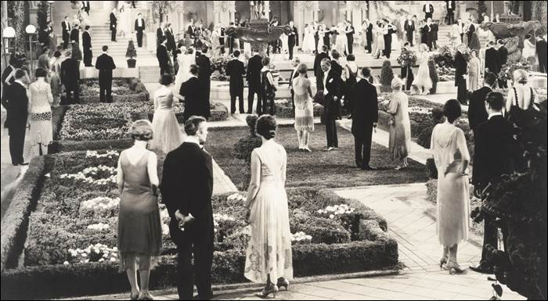
20s-30s
40s-60s
60s-70s
80s-90s
00s-10s
Notes:
20s – ‘Petting Parties’
30s-50s – War Children
60s-70s – ‘Free Love’ Era
80s-90s – No-Fault Divorce, 1st Divorced President, Impeached President over Illicit Sexual Relationship
00s-10s – LGBT Promotion

Slide 13
In those days there was no king in Israel. Everyone did what was right in his own eyes.
Judges 21:25

Slide 14
“My people are destroyed for lack of knowledge” – Hosea 4:6
Yet the Lord warned Israel and Judah by every prophet and every seer … But they would not listen, but were stubborn, as their fathers had been, who did not believe in the Lord their God. They despised his statutes and his covenant that he made … and the warnings that he gave them.
1 Kings 17:13-15

Slide 15
Without an objective standard you cannot live a life of substance.

Slide 16
Without the truth of the Gospel you cannot live a life of substance.

