Slide 1
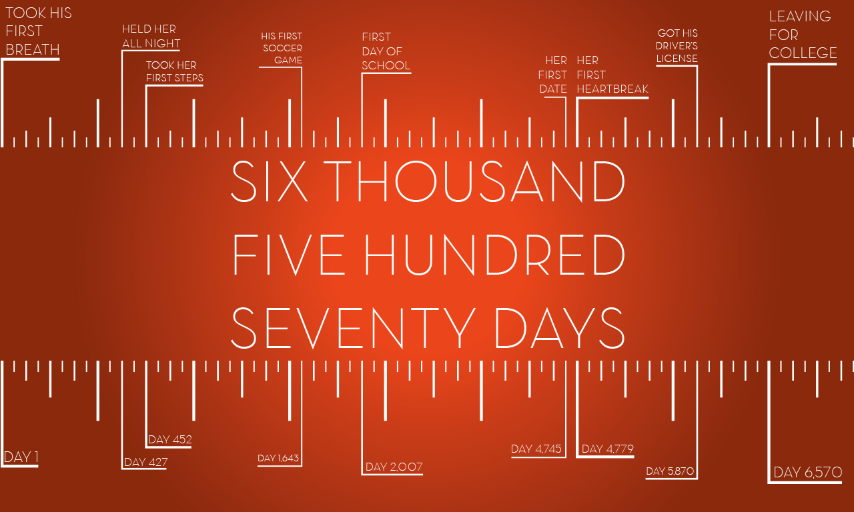
Parenting
Notes:
The Bible calls on us to number our days…but have you ever sat down and numbered the days you will have your children under your roof?
From birth to 18 is only 6,570 days.
I understand that we will continue to be a big part of their life – but friends. The window of time that they are in our home is…well, my heart says …. Looks awfully small.
It seems even smaller when we admit that most of our kids aren’t newborns! Many of these days are already gone…

Slide 2
How Many Days Do We Have Left?
With Our 3 Yr Olds = 5,475
With Our 6 Yr Olds = 4,380
With Our 10 Yr Olds = 2,920
With Our 14 Yr Olds = 1,460
With Our 16 Yr Olds = 730
Notes:
MY POINT:: This is not a series to make mothers cry – this is a series to help us have one of Jesus favorite TRAITS - Alertness - Over and over he calls us to BE ALERT.
Today – I want to share 5 ideas I want to be absolutely sure are planted in the hearts of our CHILDREN.

Slide 3
Christian Parenting
“Children obey your parents in the Lord, for this is right. HONOR YOUR FATHER AND MOTHER (which is the first commandment with a promise), SO THAT IT MAY BE WELL WITH YOU, AND THAT YOU MAY LIVE LONG ON THE EARTH. Fathers, do not provoke your children to anger, but bring them up in the discipline and instruction of the Lord.”
Ephesians 6:1-4
Notes:
Every family is going to look a little different. We can give examples and tips for application – and these will vary in usefulness and effectiveness based on the child’s age, personality, etc…. I’ll make some of those recommendations and you can agree or disagree with things that are matters of opinion…but in matters of God’s word – we should all be united around the Scriptures. And that’s going to mean our approach is very similar…
But there is a foundational apporach that ALL of us

Slide 4
Christian Parenting
“Children obey your parents in the Lord, for this is right. HONOR YOUR FATHER AND MOTHER (which is the first commandment with a promise), SO THAT IT MAY BE WELL WITH YOU, AND THAT YOU MAY LIVE LONG ON THE EARTH. Fathers, do not provoke your children to anger, but bring them up in the discipline and instruction of the Lord.”
Ephesians 6:1-4
Roles & Obedience
Accountability to the Lord
Standard of Right & Wrong
Notes:
Every family is going to look a little different. We can give examples and tips for application – and these will vary in usefulness and effectiveness based on the child’s age, personality, etc…. I’ll make some of those recommendations and you can agree or disagree with things that are matters of opinion…but in matters of God’s word – we should all be united around the Scriptures. And that’s going to mean our approach is very similar…
But there is a foundational apporach that ALL of us

Slide 5
Christian Parenting
“Children obey your parents in the Lord, for this is right. HONOR YOUR FATHER AND MOTHER (which is the first commandment with a promise), SO THAT IT MAY BE WELL WITH YOU, AND THAT YOU MAY LIVE LONG ON THE EARTH. Fathers, do not provoke your children to anger, but bring them up in the discipline and instruction of the Lord.”
Ephesians 6:1-4
Obedience & Roles
Accountability to the Lord
Standard of Right & Wrong
Know & Practice Honor
God’s Commands
God’s Faithful Promises
God’s Faithful Blessings
Notes:
Every family is going to look a little different. We can give examples and tips for application – and these will vary in usefulness and effectiveness based on the child’s age, personality, etc…. I’ll make some of those recommendations and you can agree or disagree with things that are matters of opinion…but in matters of God’s word – we should all be united around the Scriptures. And that’s going to mean our approach is very similar…
But there is a foundational apporach that ALL of us

Slide 6
Christian Parenting
“Children obey your parents in the Lord, for this is right. HONOR YOUR FATHER AND MOTHER (which is the first commandment with a promise), SO THAT IT MAY BE WELL WITH YOU, AND THAT YOU MAY LIVE LONG ON THE EARTH. Fathers, do not provoke your children to anger, but bring them up in the discipline and instruction of the Lord.”
Ephesians 6:1-4
Obedience & Roles
Accountability to the Lord
Standard of Right & Wrong
Know & Practice Honor
God’s Commands
God’s Faithful Promises
God’s Faithful Blessings
Father’s Involvement
Love, Avoiding Hypocrisy
Over Time, Day by Day
Correction & Self-Discipline
Knowledge & Application
Notes:
Every family is going to look a little different. We can give examples and tips for application – and these will vary in usefulness and effectiveness based on the child’s age, personality, etc…. I’ll make some of those recommendations and you can agree or disagree with things that are matters of opinion…but in matters of God’s word – we should all be united around the Scriptures. And that’s going to mean our approach is very similar…
But there is a foundational apporach that ALL of us

Slide 7
6570 Days for Training Them Up
1. We Love You & Will Go Out of Our Way To Help You Succeed.
1 Thessalonians 2:7-12
2 Corinthians 12:14
2. God Is Real & He Is Really Watching.
Psalm 139, Matthew 10:26-33
Ecclesiastes 12:13-14
Notes:
WE WILL GO OUT OF OUR WAY…
We have been entrusted with these amazing children – these amazing little lambs of God – and in that sense every parent here is a shepherd in their family.
Every parent has one of God’s lambs to tend, love and train up.
The psalmist understood this precious responsibility. Ps 78:3-7
…Abraham went out of His way to find Isaac a Godly wife.
…Luke 15 – The father of the prodigal son goes out of his way to WELCOME back his son who has repented.
…Paul describes the tender love that should be present in a Godly parent child relationship.
God is Real: From creation to His providence. From His inspired word to His control of History we want to not just tell them – but show them the evidence all around that God is real and is working in human History.
Really is Watching: I don’t mean watching – waiting for us to mess up – I mean watching – like a proud and supportive parent in the stands cheering us on!!
When I was tempted to wreck my life, this was the seat-belt that kept me from dying. It didn’t matter what I could hide from anyone else – I knew that GOD would always see. God would always know. And God would be dissappointed and unpleased. I didn’t want to do that to the HEAVENLY FATHER who Loves Me So MUCH!!

Slide 8
6570 Days for Training Them Up
3. All of Life Revolves Around Our Relationship With God.
Matthew 6:24
Matthew 6:33
4. Our Family Makes Godly Choices.
Joshua 24:15
1 Corinthians 10:13
Notes:
Godly Choices – Our kids must know the POWER and SIGNIFICANCE of their choices. That they can build a life on SOLID ROCK or on SINKING SAND.
*They must know that in considering their options – there is always a path to avoid SIN. Everytime. It is never hopeless. It is never impossible.
Our family makes godly choices – and the most important choice is that God comes first.

Slide 9
6570 Days for Training Them Up
5. We Must Search The Scriptures for Truth & Follow Our Savior for Life.
John 17:17, 2 Timothy 3:16-17
John 5:39-40, Luke 9:23-256
6. Loving Discipline Is For Your Improvement.
Hebrews 12:9-10
Proverbs 13:24, 29:15,17
Notes:
THE B-I-B-L-E that’s the book for me!
Make Scripture Memorization a Fpundational part of their upbringing. They will literally study hundreds of books, but this ONE stands above all others. Teach them to know, use, learn from, and trust their Bibles.
John 5:39-40 ** Jesus makes the fantastic point that the scriptures are given for a reason > to help us follow Him!

Slide 10
6570 Days for Training Them Up
7. With God, We Are Breaking Unhealthy Cycles.
Favoritism, Deception, Greed: Genesis 27:30-41
Colossians 3:21
The Power of the Cross Is FAR GREATER Than The Power of Your Past.
Matthew 11:29
Notes:
THE B-I-B-L-E that’s the book for me!
Make Scripture Memorization a Fpundational part of their upbringing. They will literally study hundreds of books, but this ONE stands above all others. Teach them to know, use, learn from, and trust their Bibles.
John 5:39-40 ** Jesus makes the fantastic point that the scriptures are given for a reason > to help us follow Him!

Slide 11
Taking The First Step
Peter said to them, “Repent, and each of you be baptized in the name of Jesus Christ for the forgiveness of your sins; and you will receive the gift of the Holy Spirit. For the promise is for you and your children and for all who are far off, as many as the Lord our God will call to Himself.”
Acts 2:38-39
Notes:
You are not alone - God’s promise to cleanse you and to help you is calling out for you this morning.
Please, take the first step by coming to the Lord today.
Do it for Christ,
Do it for Heaven, and
Do it so that you can share this promise
with the next generation.
Please, come while we stand and sing.

Slide 12
Parenting

