Slide 1
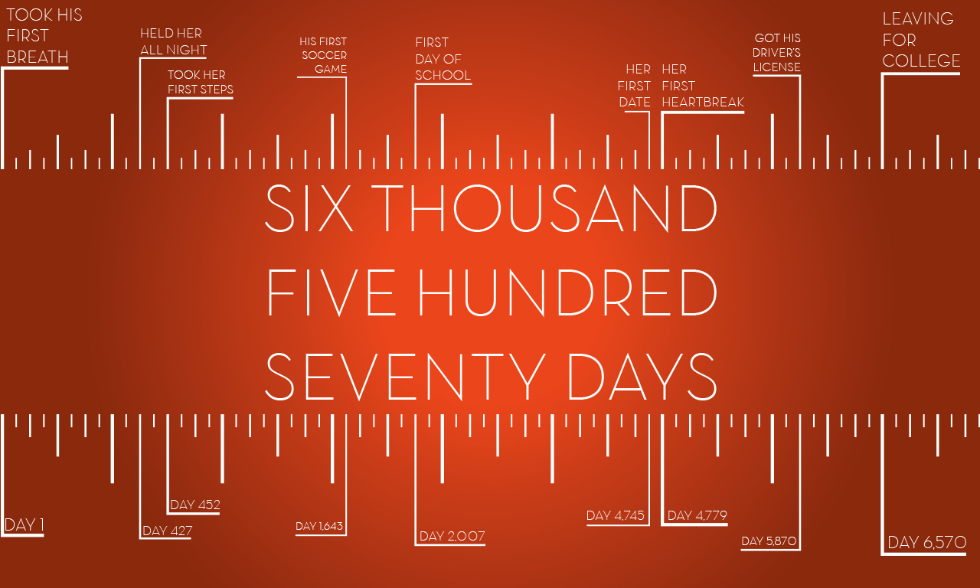
Parenting

Slide 2
How Many Days Do We Have Left?
With Our 3 Yr Olds = 5,475
With Our 6 Yr Olds = 4,380
With Our 10 Yr Olds = 2,920
With Our 14 Yr Olds = 1,460
With Our 16 Yr Olds = 730
Notes:
MY POINT:: This is not a series to make mothers cry – this is a series to help us have one of Jesus favorite TRAITS - Alertness - Over and over he calls us to BE ALERT.
Today – I want to share 5 ideas I want to be absolutely sure are planted in the hearts of our CHILDREN.

Slide 3
We love you and will go out of our way to help you succeed.
God is real and He is really watching.
All of life revolves around our relationship with God.
Our family makes Godly choices.
We must search the Scriptures for truth and follow Jesus for life.
Loving discipline is for your improvement.
With God, we are breaking unhealthy cycles.

Slide 4
Psalm 127: Aim Thoughtfully
Aiming @ Godly Character
Aim at who you want them to BE, not just what you want them to DO.
Aiming @ Loving Obedience
Ephesians 6:1-4, 1 Samuel 2:22-25, 3:12-13
Aiming @ Godly Priorities
“Don’t O.D. on Options” (Luke 10:41-42)
Notes:
**** LEARN FROM OTHER MASTER MARKSMEN! **David Banning told me: You be the thermostat, not just a thermometer. I must influence, I can’t just react.
Keep Our Eye on the Target…
Who You Want Them To Be… Kind, Good, Pure, Honest, Thankful. We’ve got to be careful not to get wrapped up in the world’s push for us to make them a GREAT athlete, a GREAT musician, a GREAT student. Let’s make it clear to them that WHO THEY ARE is far more important to us than what worldly status they accomplish
Aiming for Loving Obedience - Being Too Permissive Leads To Big Trouble
. Reality is that they did not listen. We look at the REBUKE and the reality is – He let them get away with it. There was no follow up. The discipline necessary to STOP their behavior wasn’t there.
*Its not easy to get them to listen and its not easy to put a stop to every behavior. But that is the aim. And when it comes to OUT-RIGHT sin: We are to be bold enough, consistent enough, serious enough to put a stop to it. Here and now.
Not every act of disobedience calls for Harsh response – but there are times when our response needs to be strong enough to cause them to choose obedience – right now.
Personal Maturity – I most especially mean – learning to both RELY on GOD and TAKE CARE of THEMSELVES. Aim to work yourself out of your job – but don’t quit it!

Slide 5
Help For Hitting The Target
1. Use The Power of Repetition.
Deuteronomy 6:6-9
2. Tell Your Children ‘How Good They Have It.’
Joshua 23:3-11
3. Tell Your Children When The Punishment Could Be Much Worse.
Numbers 12:10-14
4. Take Time To Sharpen Important Skills.
Ecclesiastes 10:10, Philippians 4:9
Notes:
REPETITION: when they are little, when they get bigger, and when they get older. It is funny we may feel like we repeat ourselves 1,000 times – That’s a good thing. That is how we lock those lessons in. Academically we know they won’t remember their ABC’s the first time they hear the song. Morally, they won’t remember the fountains of wisdom you are trying to bestow from just one discussion either. It takes repitition.
Never, Never, Never Underestimate The Power of Repetition.
HOW GOOD YOU’VE GOT IT: This is not to tear them down – this is to instill a realisitic view of life! God reminded them. Eventually they came to appreciate it.
PUNISHMENT COULD BE WORSE: Sometimes you’ll show mercy. When you do – tell them. Let them understand that you have the right to be even harder. This promotes more gratitude, more humility, and helps prepare them for answering to God.
SHARPEN IMPORTANT SKILLS: With Practice & (*Help them practice what you practice.)
Practice Responding To “No”
Practice Participating In Worship
From Sitting Quietly to Giving Financially
Practicing Searching The Scriptures
Practicing Thoughtfulness
Thank You’s, Get Well’s
Respecting Other Gentlemen & Young Ladies
Practicing Independence
RIGHT ANSWERS: The Scriptures contain the RIGHT ANSWERS to the BIG questions of life. Don’t leave your children lost and searching without a compass. Don’t even just give them a compass and trust them to figure out how to use it. You take the time to tell them.
Jesus put on the form of a man to come and SHOW US how to live. Fathers, we especially have a responsibility to SHOW your children the right way to live.
Remember we Serve the God of the Harvest: Sowing is a lot of work, but trying to undo what you’ve sown is even worse. Trust In The God of the Harvest. What you plant now will be fruitful later & greater.

Slide 6
Help For Hitting The Target
5. Treasure The Differences Between Your Sons & Daughters. (Psalm 144:12)
Sons: Power, Love, & Self-Control (2 Timothy 1:7)
Sons: To Excel In Good Deeds (Titus 2:6-8)
Sons: Sacrificial Love & Servant Leadership (Mt. 20:25)
Daughters: Not Second Class (Job 42:12-17)
Daughters: Teach Her About Wise Commitments (Numbers 30:3-5)
Daughters: Teach Her To Recognize Men of Faith & Courage. (Judges 1:12-13, 1 Corinthians 7:36-38)
Notes:
TREASURE DIFFERENCES: Titus 2 – Differing Instruction to Young Men & Young Women.
SONS: Self-Control…from Proverbs teachings about avoiding fornication and adultery to diligence at work. It’s the defining attribute.
DAUGHETERS:
Not Second Class: Can’t believe it even has to be said in 2017. But it does! Women are to be treated well!
*I’ll admit I’m going to slant toward the dads in this point. Mother’s the Bible shows you’re very special relationship – even quoting the old phrase “Like mother, like daughter” and Jesus highlighting the closeness that parents often have with children of the same gender – as you raise them up.
But rarely do we teach on the special things about fathers and daughters and I think we need to cover this today.
JOB 42:13-15…. KEY Verse = 15. He gave them an inheritance with the rest. They were not 2nd class in his home.
Men who are Faithful to God, can be faithful to her.
Men who are Courageous to serve God, have what it takes to be Courageous in Serving Their Family.

Slide 7
Help For Hitting The Target
6. Leverage Outside Influences With Wisdom.
Galatians 4:1-2, 1 Corinthians 15:33, Psalm 1
Psalm 119:63, Romans 1:12
7. In Heartbreak & Rebellion Show Them An Open Door.
“So he got up and came to his father. But while he was still a long way off, his father saw him and felt compassion for him, and ran and embraced him and kissed him.” Luke 15:20
Notes:
LEVERAGE INFLUENCES: Pursue Each Child Strategically & Relentlessly. *Imagine an old stereo system with the great big knobs like the volume knob, the way we turn and adjust it just right…. These are days of: Exhaustion & Exhilaration: One of the big-picture take aways from the book of proverbs is that kids can bring extreme joy, but also extreme sadness.
HEARTBREAK & REBELLION: I’m not being fatalistic. I’m saying – they are kids – they are going to do stupid things. And once they get old enough they don’t like to be called a kid anymore – that’s when they are going to do REALLY stupid things.
Times come that we have to Pray and let them face the consequences. Then pray and wait for them to Come to their senses. Then pray and wait for them to turn back to the Lord. But every step of the way, we pray they will return to the open door we provide.
They need to know WE ARE NOT OK with these choices. BUT WE ARE PREPARED for these choices! We are prepared with the punishment. We are prepared with the instructions, and we hope can minimize the long-term damage.
It’s LUKE 15 everytime – and I wish I had more insight. I wish I could tell you exactly how to touch their hearts. But I will tell you this – when we come to Luke 15 we are not coming to a tired or worn out passage. WE ARE COMING TO A PASSAGE that is the bedrock of this relationship. We are coming to a passage of HOPE because I believe the attitude of the other brother shows us – most people had written this guy off. Most people thought this was a dark day in the family’s past…. THE FATHER HAD NOT GIVEN UP HOPE. *Don’t EVER give up HOPE.
Luke 15 – Even the one who stayed – He needed guidance. He needed attitude adjustment. He needed a renewed sense of family. YOU NEVER stop being a parent!

Slide 8
Parenting
Notes:
Ps. 90:12. Pray – Lord, help us to number our days….
Help each of us to have a positive influence on the children and young adults around us.
Help the parents who are studying this to be blessed with wisdom, with wise counselors, with…
Help the children to obey their parents – to walk in the paths of goodness that lead to life…but also to HONOR their parents.
Father, when we face heartbreak – help us to provide that open door.
When I Examine Myself, I Will… Remember The LAST DAY Is Coming Soon.
The Last Day…
They Are Under My Roof.
I Have To Guide Them On Earth.
Before My Family & I Stand In Judgment.

