Slide 1
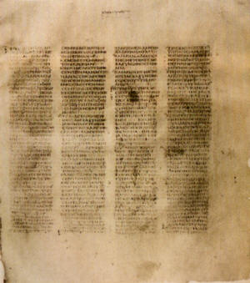
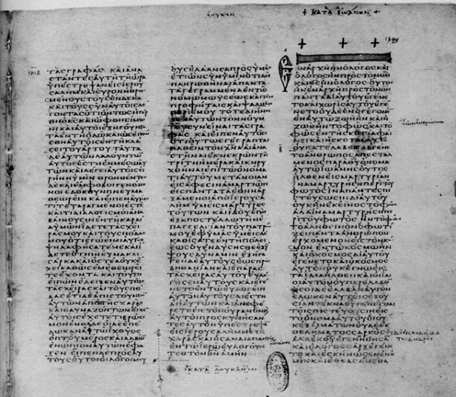
HOW WE GOT the Bible
A class on Bible origin, transmission and reliability
January 2018
Lesson 6
The Canon of the New Testament

Slide 2
Class Objectives
Show the importance of the Bible to our faith & that it is reliable.
Demonstrate that we can be confident that we have God’s inspired word today.
Understand the difference in modern versions of English Bible
Be able to answer questions about the origin of the Bible

Slide 3
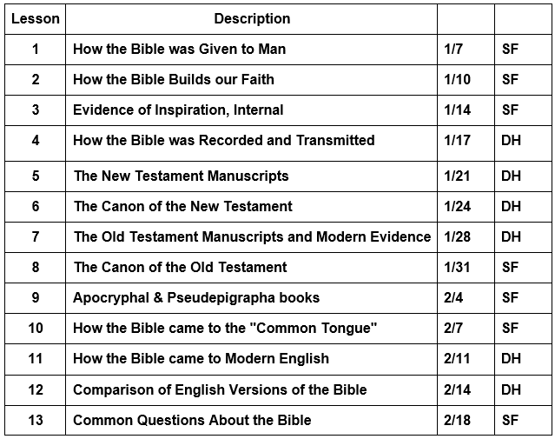
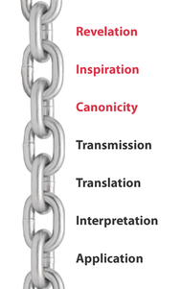
Course Content

Slide 4
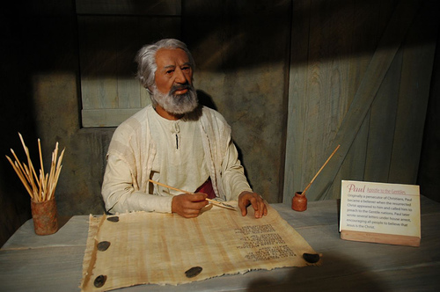
Apostles write or dictate
Autograph Text

Slide 5
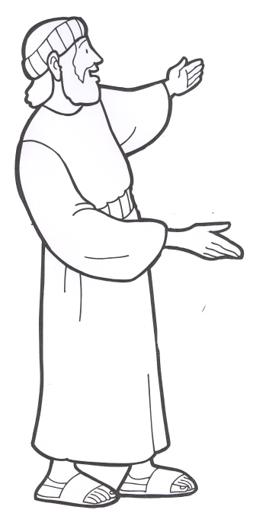
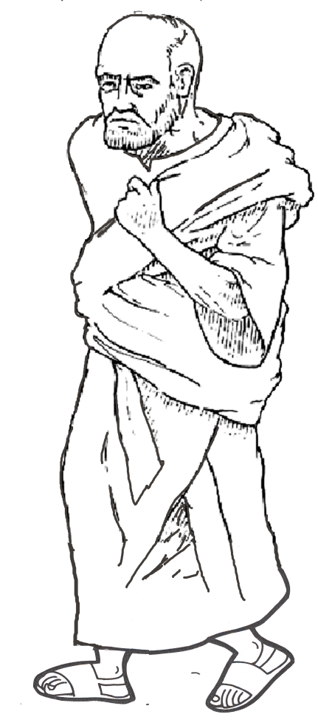
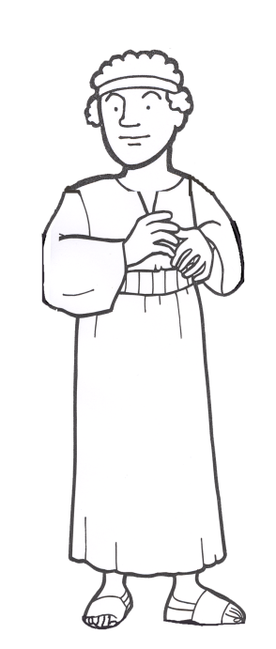
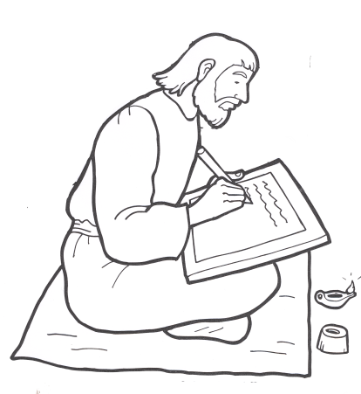
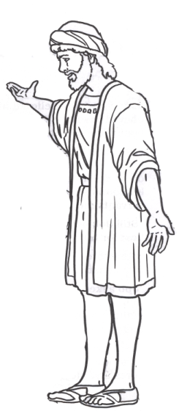
Books & Circulation Christians
Reading Aids – many
meant to Showcase Writing
Read to church
1 Thess 5:27 (ESV) I put you under oath before the Lord to have this letter read to all the brothers.
Copies for individuals & other churches
Colossians 4:16 (ESV) And when this letter has been read among you, have it also read in the church of the Laodiceans; and see that you also read the letter from Laodicea.
Author
Apostles
Companions of Apostles
Paul – answer, etc a Church
Others – General/Region/People
Notes:
The New Testament came into being gradually also, although the books themselves were written in a comparatively short period of time (A.D. 50– 100). The books were mostly letters penned by inspired men and addressed to different churches and individuals. From the first, however, they were looked upon as distinctively authoritative writings; thus they were received with respect and read in the public assemblies (1 Thess. 5: 27). Soon afterward came the interchange of extant letters among the churches (cf. Col. 4: 16), the individual churches in this way profiting from an exchange of apostolic instructions. The next step was the embodiment in writing of the central events of the life of Jesus. At first oral accounts of his work by eyewitnesses filled the needs of the infant church, but as years passed eyewitness accounts became few and insufficient. Now the demand was for authoritative written narratives, and in fulfillment of this demand Matthew, Mark, Luke, and John sent out their witness to Jesus (cf. Luke 1: 1– 4; John 20: 30– 31). The logical outgrowth of the Four Gospels was the Book of Acts,
Lightfoot, Neil R.. How We Got the Bible (p. 24). Baker Publishing Group. Kindle Edition.

Slide 6
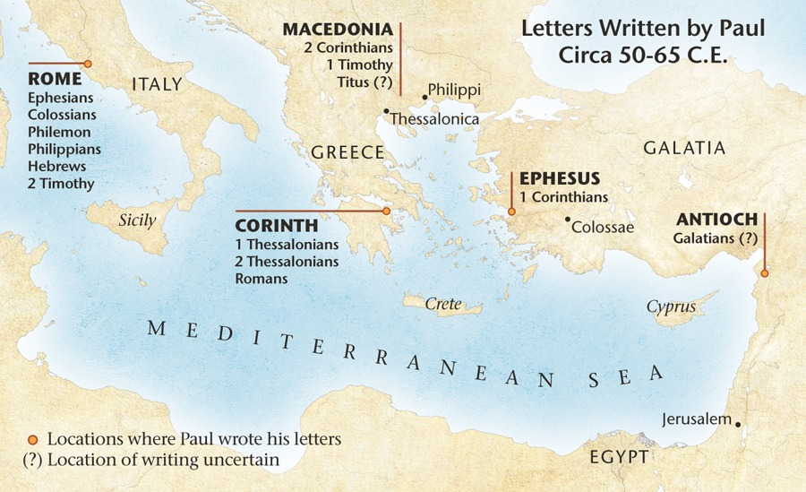
Books & Circulation Christians

Slide 7
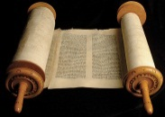
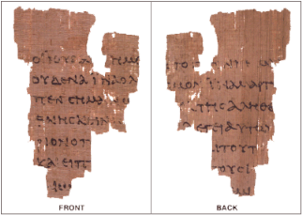




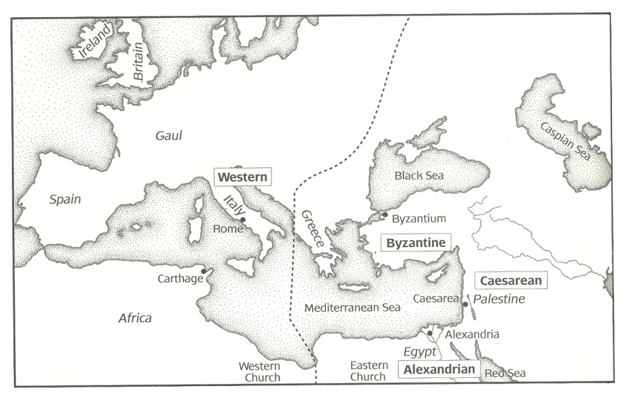
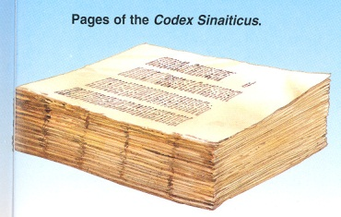
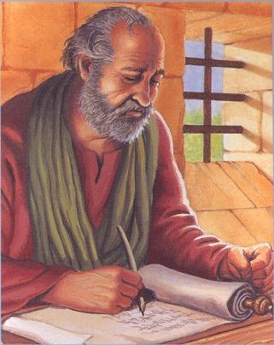
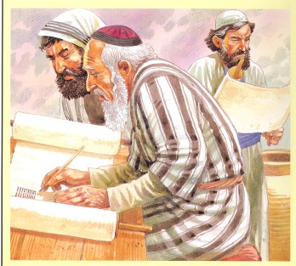
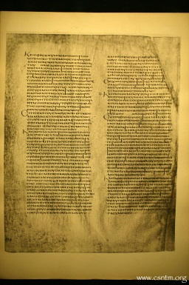
From Autograph to Manuscripts
Original Gospel, Epistles and Revelation written on Papyrus & Lost
Fragments of
Papyri
Codex Vaticanus
Copies collected at Bible Centers and Copied
Copies made & circulated
Codex Alexandrinus

Slide 8
Matthew via Egyptian Papyrus
Gospel of Matthew 100 to 300 AD
ID | Text Quality | Transmission | Date
P1 | strict | strict | 250
P35 | strict | strict | 3rd
P37 | normal | free | 260
P45 | normal | free | 250
P53 | strict | normal | 3rd
P64+67 | strict | strict | 200
P70 | strict | free | 3rd
P77 | strict | free | 150-200
P101 | normal | free | 3rd
P102 | strict | strict | 3rd
P103 | normal | very free | 275-300
P104 | normal | strict | 150-200
P110 | normal | very free | 250-300
O171 | normal | free | 300
Text Quality - how well corresponds to reconstructed initial text
Transmission - free is a freer readiness to adapt the text to harmonize, accidental changes etc

Slide 9
Matthew via Egyptian Papyrus
~30 AD
55-65 AD
100
P77-104
200
P1
P64+67
300
80-90
Matthew
About 50 yrs
Gospel of Matthew 100 to 300 AD
ID | Text Quality | Transmission | Date
P77 | strict | free | 150-200
P104 | normal | strict | 150-200
P64+67 | strict | strict | 200
P1 | strict | strict | 250
P45 | normal | free | 250
P37 | normal | free | 260
P110 | normal | very free | 250-300
P103 | normal | very free | 275-300
P35 | strict | strict | 3rd
P53 | strict | normal | 3rd
P70 | strict | free | 3rd
P101 | normal | free | 3rd
P102 | strict | strict | 3rd
P35-102
Text Quality - how well corresponds to reconstructed initial text
Transmission - free is a freer readiness to adapt the text to harmonize, accidental changes etc

Slide 10
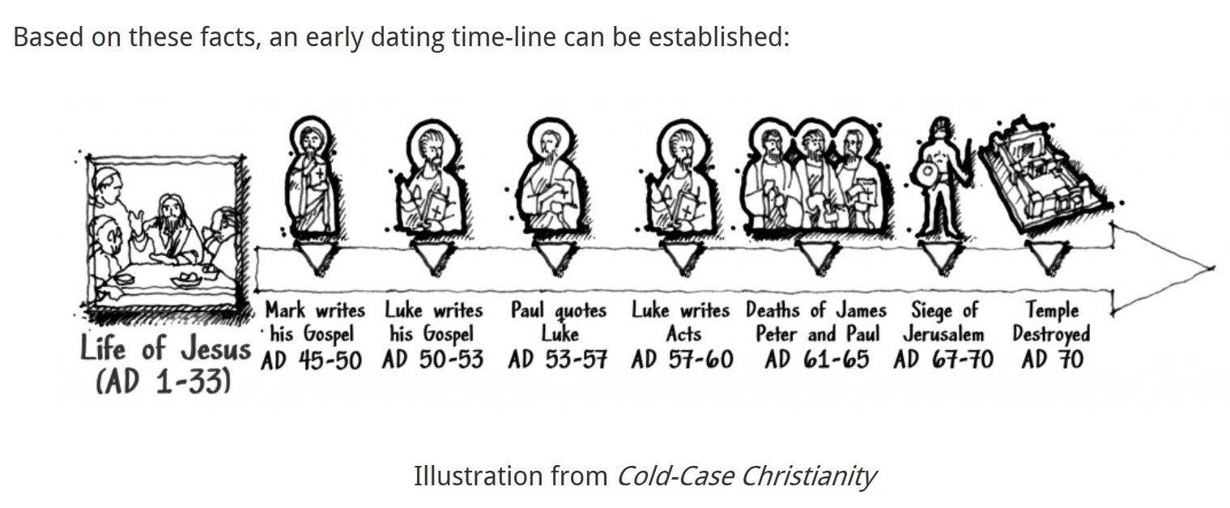
Critics prediction means written after
Luke’s Gospel Predates the Book of Acts
Paul Quoted Luke’s Gospel in His Letter to Timothy
& Letter to Corinthians
Luke Said Nothing About the Deaths of Paul and Peter
The New Testament Fails to Describe the Siege & Destruction of the Temple
Luke Quoted Mark (and Matthew) Repeatedly

Slide 11
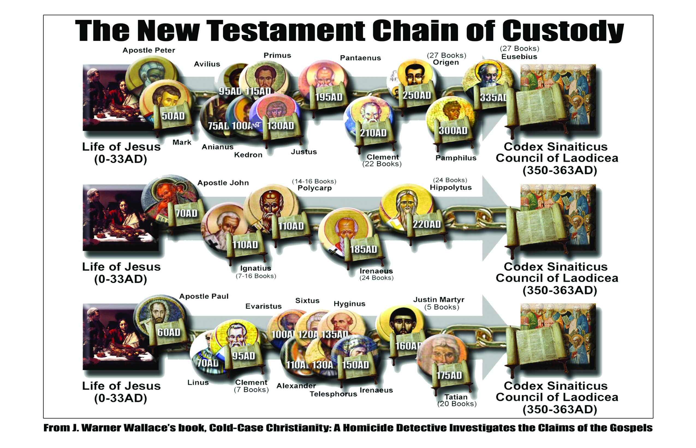

Slide 12
Early Church Fathers Reference New Testament Books

Slide 13
MSS Distribution by Century & Type
Century | 2 100’s | 3 200’s | 4 | 5 | 6 | 7 | 8 | 9 | 10 | 11 | 12
Papyri Uncial Minuscule Lectionary | 1 | 31 3 | 20 16 1 | 8 44 1 | 9 60 3 | 13 29 4 | 3 27 22 | 47 13 116 | 18 125 143 | 1 436 241 | 586 490
Century | 13 | 14 | 15 | 16 | 17 | 18 | 19 | Totals
Papyri Uncial Minuscule Lectionary | 569 398 | 535 313 | 248 168 | 138 194 | 44 73 | 16 11 | 4 | 85 245 2,745 2,147
A General Introduction to the Bible – Norman L. Geisler, William E. Nix

Slide 14
Five Important Greek Codex Bibles
The form of writing is used to date ancient documents - for example, the following MSS are all uncials:
Codex (A) Alexandrinus - 5th century
Codex (B) Vaticanus - 4th century
Codex (C) of Ephraem - 5th century
a palimpsest
Codex (D) Bezae - 5th or 6th century (most questionable)
Codex (a) Sinaiticus - 4th century

Slide 15
Codex (B) Vaticanus - 4th century A.D.
Housed in the Vatican Library (founded by Pope Nicholas V in 1448)
Greek is written continuously with small neat writing in 3 columns
300-325 AD?
Early 4th Century

Slide 16
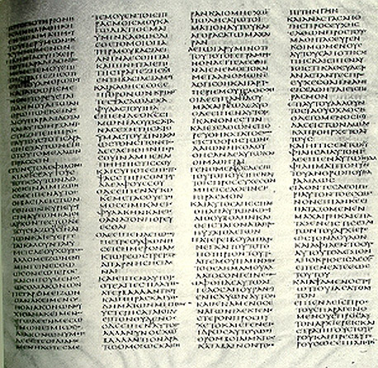
Codex Sinaiticus (a)
Discovered at Mt. Sinai in 1844.
The British Museum, purchased for 100,000£ from Soviet Union in 1933.
Large vellum pages of outstanding quality, 4 columns per page.
Contains all 27 books of the N.T.
Includes Apocrypha, Barnabas Epistle, and Shepherd of Hermas.
Dates to A.D. 340..

Slide 17
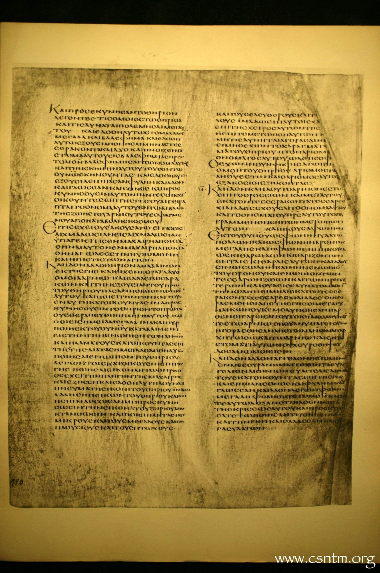
Codex Alexandrinus (A) -- (5th century A.D.)
Offer to King James of England in 1627 AD by Cyril Lucar and he might have got it between 1602 to 1621.
Vellum 2 columns per page written on large letters
The British Museum
400-440 AD?

Slide 18
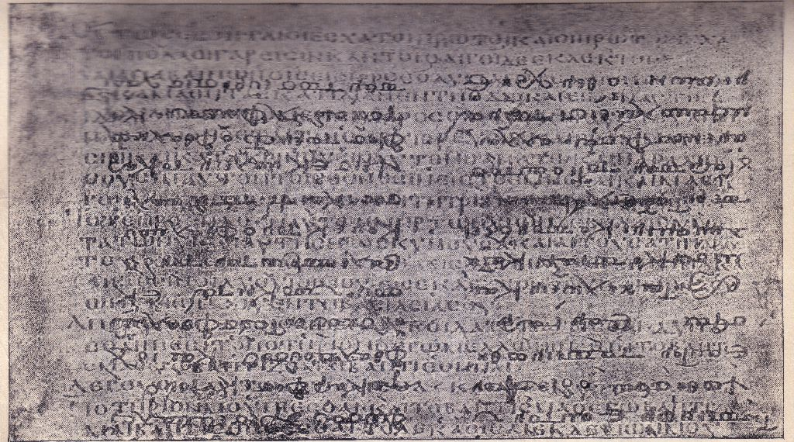
Codex (C) of Ephraem - 5th century a palimpsest
Paris, National Library
It receives its name, as a codex in which the treatises of Ephraem the Syrian, in Greek translations, were written over a former text that had been washed off its vellum pages, thus forming a palimpsest. The later text was produced in the 12th century.
450 AD?
After the fall of Constantinople in 1453, the Codex was brought to Florence by an emigré scholar. Catherine de' Medici brought it to France as part of her dowry

Slide 19
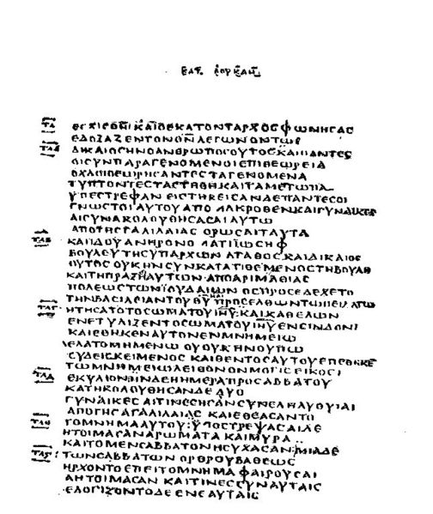
Codex (D) Bezae - 5th century
Cambridge University Library
It is written in an uncial hand on vellum and contains, in both Greek and Latin,
Written with one column per page it has 406 leaves, out of perhaps an original 534, and the Greek pages on the left face Latin ones on the right.
400 AD?
The Greek text is unique, with many interpolations found nowhere else, with a few remarkable omissions, and a capricious tendency to rephrase sentences.

Slide 20
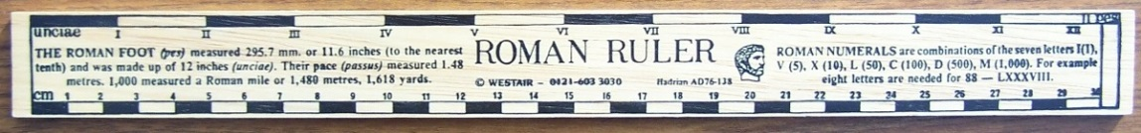
‘Canon’
The term ‘canon’ is from the Greek word ‘kanon’ meaning a reed used for a rule/standard of measurement.
‘Canon’ is a term that describes a theological concept used to describe the collection of books called Scripture.
‘Canon’ often is used to refer to the list of books accepted by Christians as Holy Scripture
Notes:
- The term canon is meant to indicate those books which are the standard of the Word of God.

Slide 21
The Canon as ‘closed’
Inasmuch as it is understood that God is no longer giving Scripture through the writing of His authoritative messengers, the canon is considered ‘closed.’
Since salvation history has been completed and recorded, there is no longer a need for any Scriptures to be added to the canon.
Therefore, all major traditions of Christianity today believe that the canon is “closed” and not to be “reopened.”

Slide 22
What comprises the ‘canon’ of the New Testament?
The following principles have been derived for recognizing the NT Canon
  Was the book written by an apostle or someone with recognized authority?
  Did it agree with the ‘canon of truth?’
  Did it enjoy universal acceptance among the church(es)?
  Does it have a self-authenticating divine nature?
These were the same general criteria used by the early church!
Notes:
Again, it is important to understand when discussing this entire topic is that canonicity is NECESSARILY a product of Church tradition, but that this is an ORGANIC process of recognition of authority rather than an arbitrary decision of a person or church as part of a political or religious power play to create or maintain authority (which is the narrative of some…). That is summed up in the next quote…

Slide 23
Canonization of Scripture
A flood of apocryphal and pseudopigraphical works began to be read publicly during the 2nd & 3rd centuries.
Diocletian persecutions (c. 302–305) caused the Christians to be more attentive to establishing the definite canon.
Notes:
We will talk about OT & NT apocrypha/pseudopigrapha in a later class to expand on this aspect of canonicity
Presentation notes:
These persecutions forced Christians to be more attentive to the matter of canon since there was a increasing possibility that one would be killed for the possession of Christian Scripture. In short, Christians wanted to know which books were worth dying for.

Slide 24
Non-Canon
Is It Considered Reliable?
  When written?
  Heretical Influence (Gnostic)
How Does It Corroborate the Life of Jesus?
Where (and Why) Does It Differ from the Reliable Accounts?

Slide 25
Canonization of Scripture
Eusebius, a fourth-century Church historian, speaks plainly about the condition of the canon in his day:
    Homologomena: Universally-agreed-upon books were the four Gospels, Acts, Letters of Paul (which included Hebrews), 1 Peter, 1 John, and Revelation.
    Antilogoumena: Books that were accepted by the majority (including Eusibius), but disputed by some: James, 2 Peter, 2 & 3 John, and Jude.
    Pseudepigrapha: Acts of Paul, the Didache, and the Shepherd of Hermas.

Slide 26
Canonization of Scripture
Athanasiaus, a fourth-century bishop of Alexandria, sent out a cyclical letter affirming the 27 books of the NT (367 A.D.). This is the first formal attestation to our canon in its full/current form.

Slide 27
Canonization (catalogs)
A catalog is a list of books.
These lists are obtained from the writings of various Christians, who wrote to churches and individuals.
The list may be in one paragraph or sentence, or it may be obtained from references throughout the writing..

Slide 28
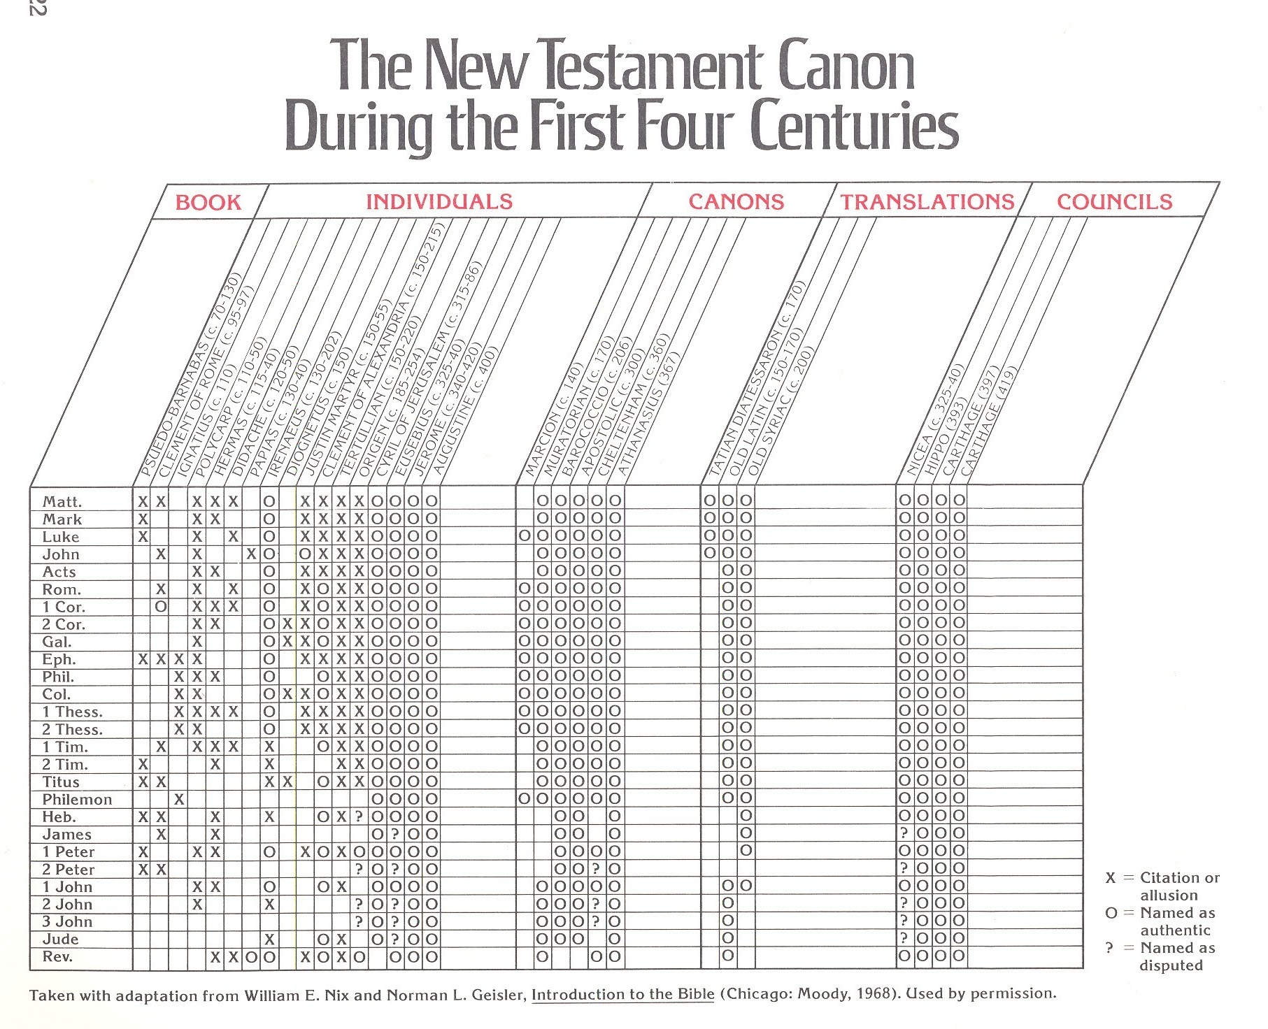
Individuals
Canons
Councils

Slide 29
Individuals
Canons
Councils

Slide 30
Catalog of NT Books

Slide 31
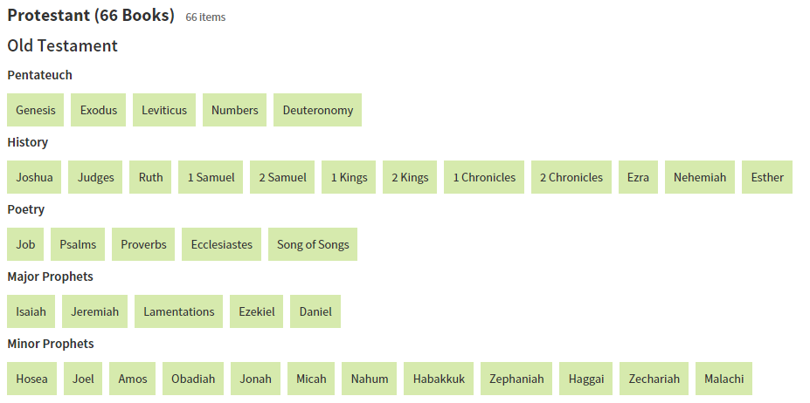
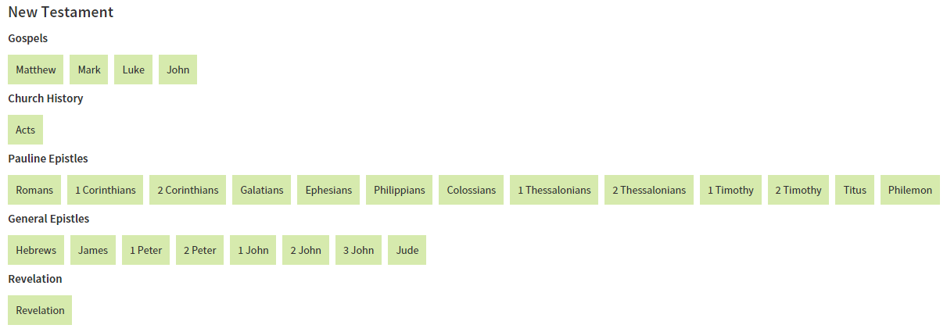

Slide 32
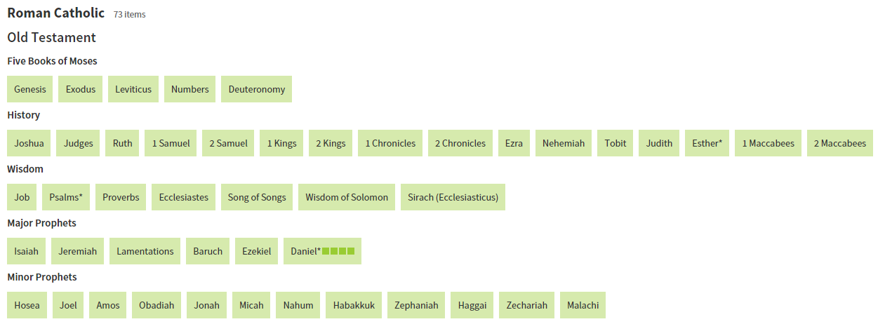
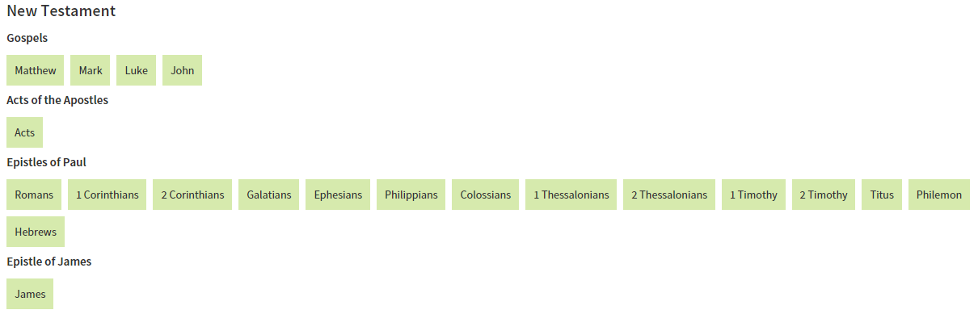





Slide 33
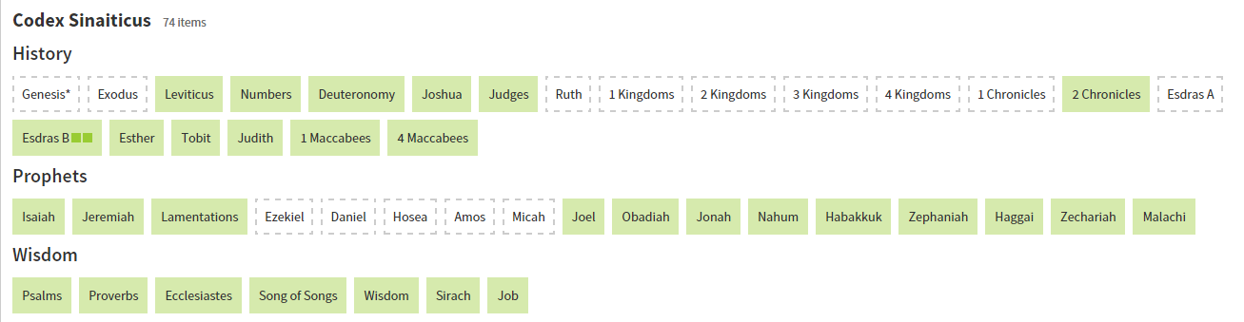
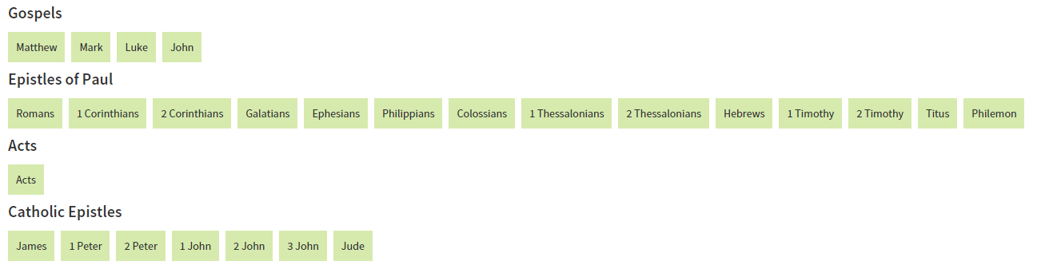
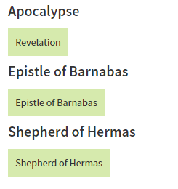

Slide 34

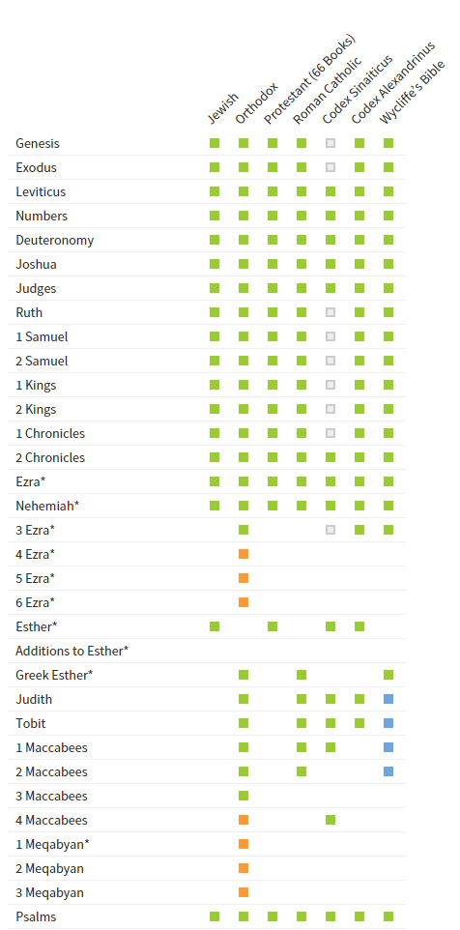
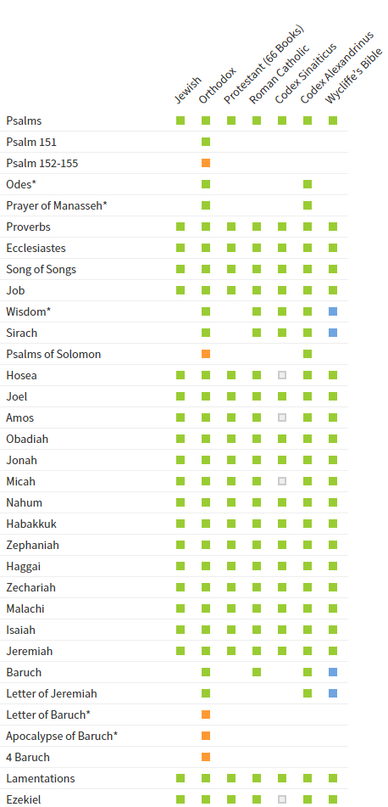
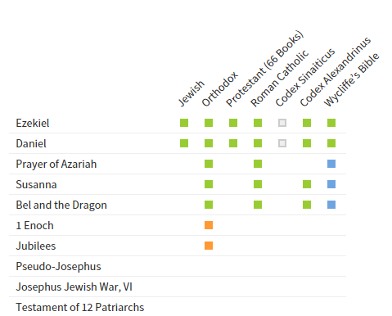

Slide 35
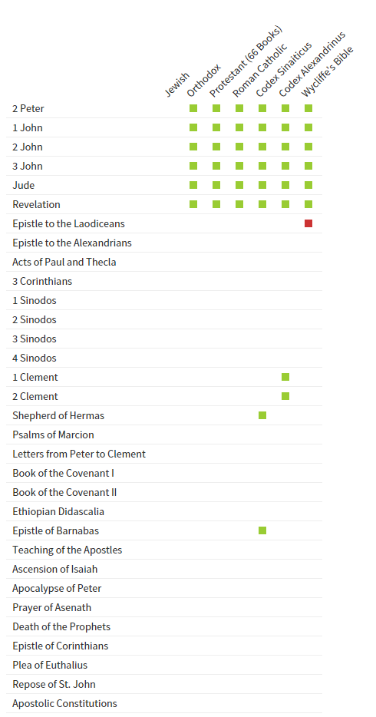
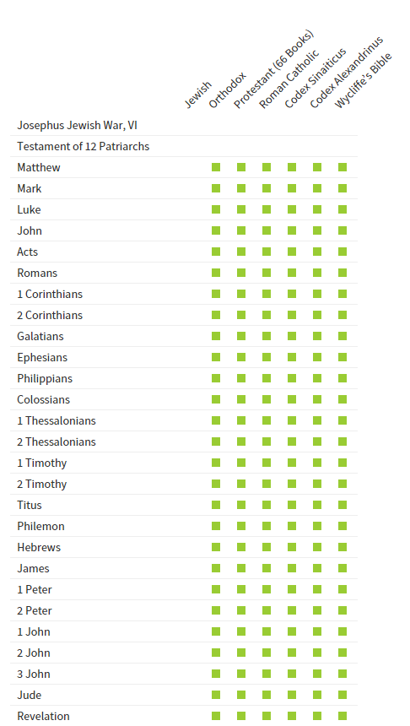

Slide 36
Can the word of God remain forever if it cannot be reliably transmitted to us today?
If the Bible has over 200000 scribal errors in just the New Testament can it be reliable.

Slide 37
Degree of Accuracy
Even with 25 thousand NT manuscripts, they are so close that we are virtually certain of 97% - 98% of the New Testament.
For the remaining 2-3%, almost ½ are 1 and 2 word variants for spelling, adding “the”, etc. None of these affect doctrine.
For details: www.BibleQuery.org

Slide 38
Textual Variations in the New Testament
Trivial variations
Substantial variations of no consequence
Substantial variations of consequence

Slide 39
Textual Variations in the New Testament
Trivial variations
The great majority of variations include differences in spelling, grammar, different forms of the same Greek words, or a different order of words.
? ? ? ? ? ?

Slide 40
Question: Mark the variants in the following example?
MSS. 1 | Jesus Christ is the Savior of the whole worl.
MSS. 2 | Christ Jesus is the Savior of the whole world.
MSS. 3 | Jesus Christ s the Savior of the whold world.
MSS. 4 | Jesus Christ is th Savior of the whle world.
MSS. 5 | Jesus Christ is the Savor of the whole wrld.

Slide 41
Textual Variations in the New Testament
Substantial variations of no consequence
Words, phrases, sentences which differ but are not supported by most authoritative textual witnesses.
? ? ?

Slide 42
NT Textual Variations
Mark 16:9-20 (KJV, NAB, NKJV)
Luke 6:5
Luke 11:2 (KJV, NKJV)
John 7:53-8:11 (KJV, NKJV)
Acts 8:37
Acts 20:28 (KJV, NASB, NAB, NIV, NKJV, RDB)
1 John 5:7-8 (KJV, NKJV)
Textual Groups

Slide 43
Textual Variations in the New Testament
Substantial variations of consequence --
Mark 16:9-20 is unique!
NOT IN Codices B or '
Codex Sinaiticus
Codex Vaticanus
NT Textual Variations is of consequence due reliable manuscripts differ

Slide 44
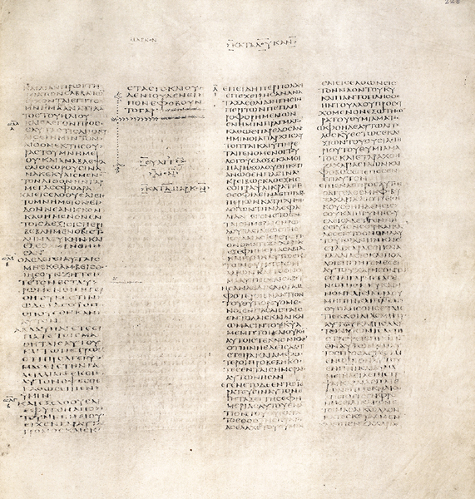
Textual Variations in the New Testament
Codex Sinaiticus
Substantial variations of consequence --
Mark 16:9-20 is unique!
Mark 16:8
The only other Greek witness with exactly this form of chapter 16 is a 12th-century copy of Matthew and Mark

Slide 45
Textual Variations in the New Testament
Long form is found in more than
1,600 Greek manuscripts (or almost 95 percent of all the manuscripts we have). Some date to the late fourth or early fifth century.
These include (in approximate chronological order) manuscripts known as Codex Bezae,
Codex Alexandrinus (now in the British Library); and Codex Ephraemi
Also found in a wide range of early translations.
Most manuscripts of the Old Latin; the Vulgate (Jerome’s Latin translation);
Syriac translations known as the Curetonian
Peshitta (which was eventually accepted as the standard version of the New Testament in Syriac)
Substantial variations of consequence --
Mark 16:9-20 is unique!

Slide 46
Textual Variations in the New Testament
Substantial variations of consequence --
Mark 16:9-20 is unique!
Known among the early church fathers.
The Christian apologist Justin Martyr (d. c. 165) probably knew the longer ending;
The church father Irenaeus, who quotes Mark 16:19 in his work Against Heresies (written c. 175), certainly did.
The apologist Tatian apparently cited it in his Diatessaron, a late-second-century harmony of the Four Gospels,
Church father Hippolytus (c. 170–236) quotes 16:17–18.
Observation of Eusebius (also echoed by Jerome), who, after stating that “nearly all the copies of Mark” ended at 16:8, goes on to say:
“What follows [that is, verses 9–20] is found but seldom, in some copies but by no means in all.”

Slide 47
Early Witness to Mark 16:9-20
Witness second century Fathers of the church - Justin, Tatian and Irenaeus”
Justin Martyr (A.D. 150) in his writings refers to verse 20 of this questionable text, indicating that it was in the ancient copies of Scripture that he used.
Irenaeus (ca. A.D. 180) makes note of 16: 19 and Tatian (ca. 170) in in creating a harmony of the gospels in the latter part of the second century included these twelve verses.
Eusebius (A. D. 280-340), who alludes to the presence of copies of the New Testament that omit these verses by the beginning to the early part of the fourth century.
The major evidence today of those manuscripts referred to by Eusebius are the Sinaiticus and Vaticanus manuscripts of the New Testament which were produced about A.D. 350 or so.
Jerome includes in the Vulgate, a fifth century Latin translation based, he says, on many Greek manuscripts.
L.A. Stauffer, Edited by Mike Willis. Truth Commentary - Mark
Notes:
The inclusion of the last twelve verses of Mark is “explicitly supported by the witness of such second century Fathers of the church as Justin, Tatian and Irenaeus” (Farmer 40). Justin Martyr (A.D. 150) in his writings refers to verse 20 of this questionable text, indicating that it was in the ancient copies of Scripture that he used. This takes scholars back near the first of the second century. So it was by the middle of the century when Irenaeus (ca. A.D. 180) makes note of 16: 19 and Tatian (ca. 170) in in creating a harmony of the gospels in the latter part of the second century included these twelve verses.
Eusebius (A. D. 280-340), who alludes to the presence of copies of the New Testament that omit these verses by the beginning to the early part of the fourth century.
The major evidence today of those manuscripts referred to by Eusebius are the Sinaiticus and Vaticanus manuscripts of the New Testament which were produced about A.D. 350 or so.
includes them in the Vulgate, a fifth century Latin translation based, he says, on many Greek manuscripts.
L.A. Stauffer, Edited by Mike Willis. Truth Commentary - Mark

Slide 48
Substantial Variations of No Consequence
Some manuscripts do not include 7:53-8:11; others add the passage here or after 7:36 or after 21:25 or after Luke 21:38, with variations in the text
John 7:53-8:11 (KJV, NKJV)
ESV
John 8 [The earliest manuscripts do not include John 7:53–8:11]
The Woman Caught in Adultery
[They went each to his own house,
but Jesus went to the Mount of Olives.
Early in the morning he came again to the temple. All the people came to him, and he sat down and taught them.
The scribes and the Pharisees brought a woman who had been caught in adultery, and placing her in the midst
they said to him, “Teacher, this woman has been caught in the act of adultery.
Now in the Law Moses commanded us to stone such women. So what do you say?”
This they said to test him, that they might have some charge to bring against him. Jesus bent down and wrote with his finger on the ground.
And as they continued to ask him, he stood up and said to them, “Let him who is without sin among you be the first to throw a stone at her.”
And once more he bent down and wrote on the ground.
But when they heard it, they went away one by one, beginning with the older ones, and Jesus was left alone with the woman standing before him.
Jesus stood up and said to her, “Woman, where are they? Has no one condemned you?”
She said, “No one, Lord.” And Jesus said, “Neither do I condemn you; go, and from now on sin no more.”]

Slide 49
Substantial Variations of No Consequence
John 7:53 The words And everyone through sin no more (8:11) are bracketed by NU-Text as not original. They are present in over 900 manuscripts.
John 7:53-8:11 (KJV, NKJV)
NKJV
John 8
But Jesus went to the Mount of Olives.
Now early in the morning He came again into the temple, and all the people came to Him; and He sat down and taught them.
Then the scribes and Pharisees brought to Him a woman caught in adultery. And when they had set her in the midst,
they said to Him, “Teacher, this woman was caught in adultery, in the very act.
Now Moses, in the law, commanded us that such should be stoned. But what do You say?”
This they said, testing Him, that they might have something of which to accuse Him. But Jesus stooped down and wrote on the ground with His finger, as though He did not hear.
So when they continued asking Him, He raised Himself up and said to them, “He who is without sin among you, let him throw a stone at her first.”
And again He stooped down and wrote on the ground.
Then those who heard it, being convicted by their conscience, went out one by one, beginning with the oldest even to the last. And Jesus was left alone, and the woman standing in the midst.
When Jesus had raised Himself up and saw no one but the woman, He said to her, “Woman, where are those accusers of yours? Has no one condemned you?”
She said, “No one, Lord.” And Jesus said to her, “Neither do I condemn you; go and sin no more.”

Slide 50
Substantial Variations of No Consequence
(Luke 6:5)
“On the same day seeing one working on the sabbath day, he said to him, Man, if you know what you are doing; you are blessed; but if you do not know, you are accursed and a transgressor of the law.” (Codex D Bezae –questionable source or significant variance)
“And He said to them, ‘The Son of Man is also Lord of the Sabbath.’” (NKJV)
“And He was saying to them, ‘The Son of Man is Lord of the Sabbath.’” (NASB)
Words, phrases, sentences which differ but are not supported by most authoritative textual witnesses.

Slide 51
Substantial Variations of No Consequence
Acts 8:37
“And Philip said, if you believe with all your heart, you may. And he answered and said, ‘I believe that Jesus Christ is the Son of God.’”
NOT IN
Codices: A (Alexandrinus), B (Vaticanus), C (Ephraemi);
Versions: Arabic, Syriac, Coptic (Sahidic), Ethiopic, Slovanic, etc.
ESV omits verse and has it as a footnote
Some manuscripts add all or most of verse 37: And Philip said, “If you believe with all your heart, you may.” And he replied, “I believe that Jesus Christ is the Son of God.”
NKJV
Acts 8:37 NU-Text and M-Text omit this verse. It is found in Western texts, including the Latin tradition.

Slide 52
Substantial Variations of No Consequence
“For there are three that bear witness in heaven: the Father, the Word, and the Holy Spirit: and these three agree as one.”
I John 5:7 (NKJV)
FOUND IN Late Latin Copies
NOT FOUND IN ANY Ancient Manuscripts

Slide 53
1 John 5:6-9 (NASB)
6 This is the one who came by water and blood, Jesus Christ; not with water only, but with the water and with the blood.
7 And it is the Spirit who bears witness, because the Spirit is the truth.
8 For there are three that bear witness, the Spirit and the water and the blood; and the three are in agreement.
9 If we receive the witness of men, the witness of God is greater; for the witness of God is this, that He has born witness concerning His Son.

Slide 54
Eight Reasons Given for Omission of
1 John 5:6-9 (by Adam Clarke)
1. Not present in any uncial Greek manuscript
2. Appears first in 15th or 16th century cursives
3. Omitted in all ancient versions, including Jerome’s Vulgate
4. Not used by the Greek “fathers” in support of the Trinity
5. Originally included in an exegesis by Cyprian (d. 258)
6. Found its way into the Textus Receptus because Erasmus found it in the Codex Britannicus (discovered in 1514)
7. Apparently the apostate church retained it to support their doctrine of the Trinity
8. First appears in Latin writers at end of 5th century

