Slide 1
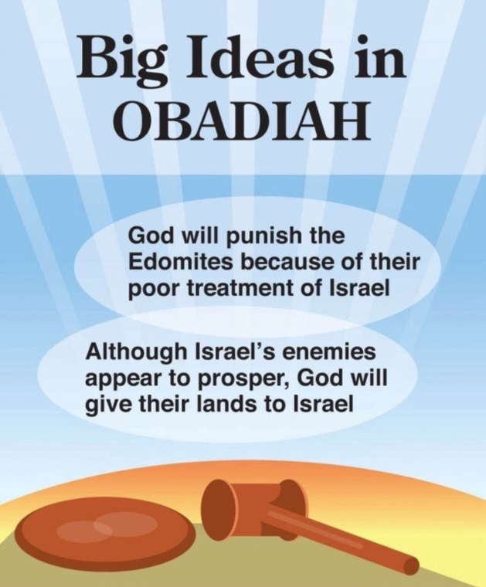
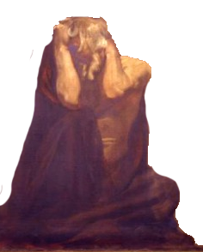
Lesson 2
Minor
Prophets
Obadiah

Slide 2
Ahijah
Jehu
Man of God
Micaiah
Man of God
Syria
Shemaiah
Azariah
Hanani
Assyria
Babylon/Persia

Slide 3
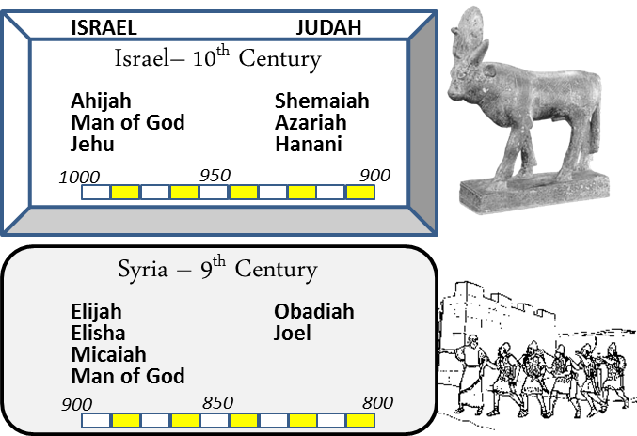
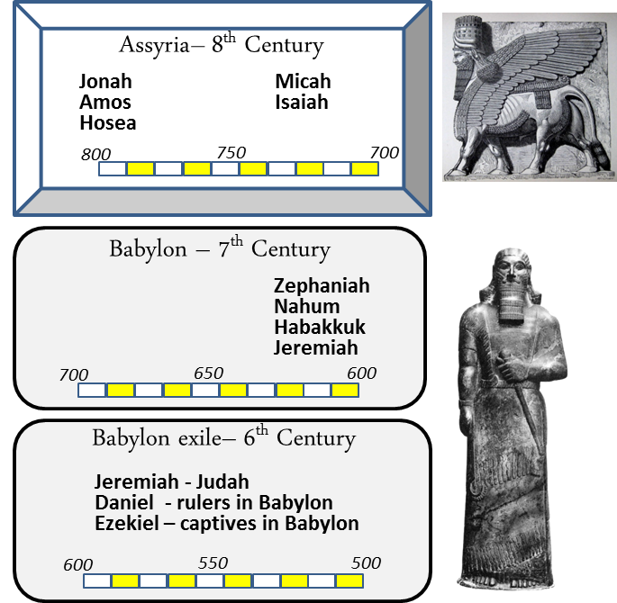
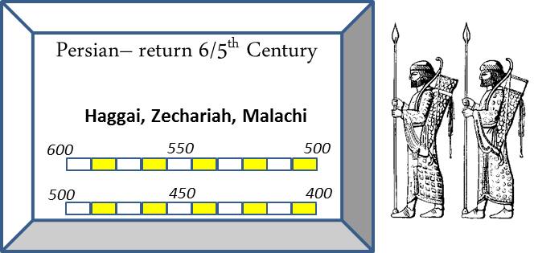
When

Slide 4
Four Invasions of Jerusalem Record in OT
By Shishak pharaoh of Egypt in 925 BC
I Kgs 14:25-26 & 2 Chr 12
By Philistines & Arabians ~ 845 BC in reign of Jehoram
2 Chron 21:16-17, 8-10, Amos 1:6, 11-12
By Jehoash, king of Israel ~790 BC
2 Kgs 14 & 2 Chr 25
By Nebuchadnezzar, King of Babylon, in 586 BC
2 Kgs 24-25

Slide 5
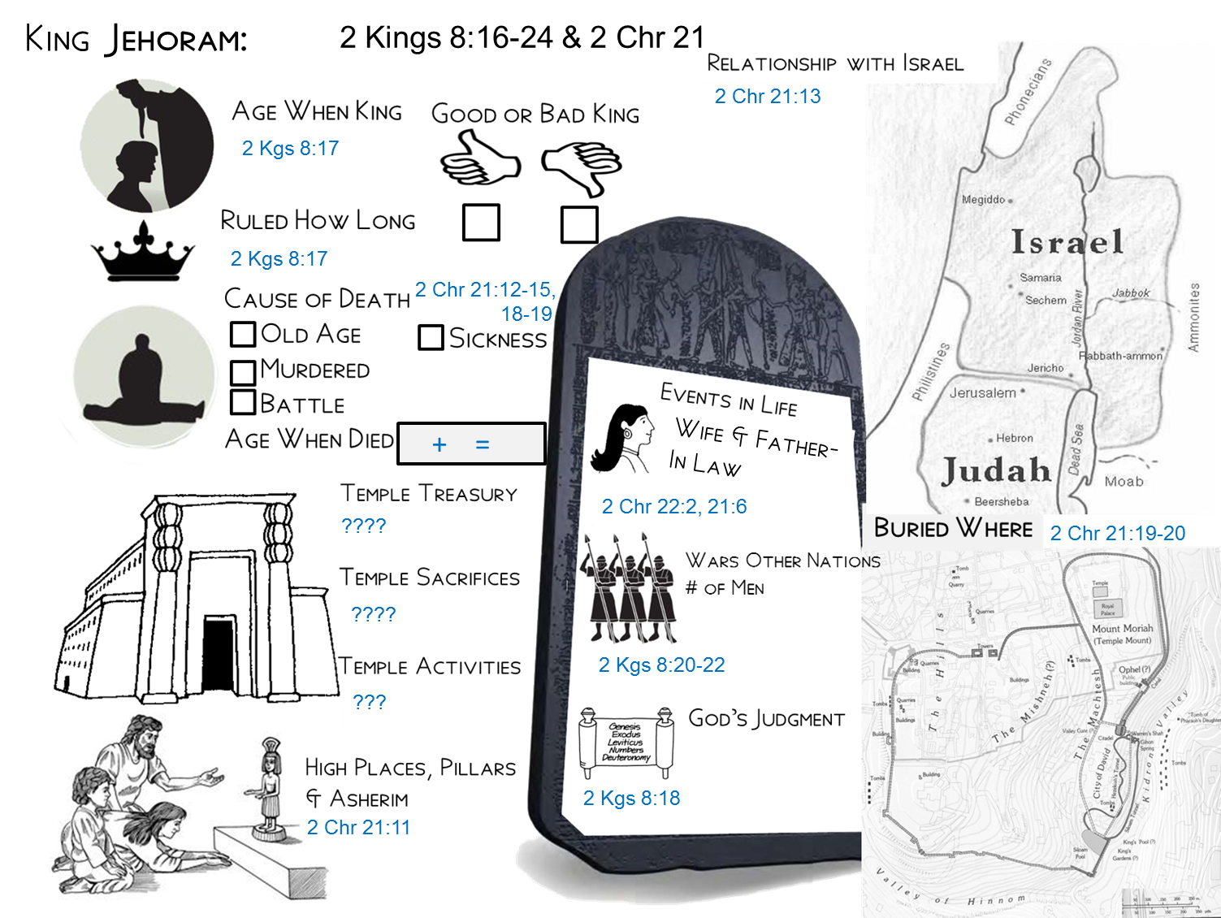
Walked in the ways of Israel and enticed Judah into the same.
32
8
Sickness in bowels
40
Married to Athaliah, daughter of Ahab
Buried in the city of David, but NOT in tombs of the kings. (buried with no one’s regret)
Edom and Libnah revolted
He walked in the way of the kings of Israel, Ahab. He did what was evil in the sight of the Lord.
Made high places and led Judah into whoredom

Slide 6
Obadiah vs Jehoram’s Account
Obadiah 1:11-14 (NKJV)
¹¹ In the day that you stood on the other side-- In the day that strangers carried captive his forces, When foreigners entered his gates And cast lots for Jerusalem-- Even you were as one of them. ¹² But you should not have gazed on the day of your brother In the day of his captivity; Nor should you have rejoiced over the children of Judah In the day of their destruction; Nor should you have spoken proudly In the day of distress. ¹³ You should not have entered the gate of My people In the day of their calamity. Indeed, you should not have gazed on their affliction In the day of their calamity, Nor laid hands on their substance In the day of their calamity. ¹⁴ You should not have stood at the crossroads To cut off those among them who escaped; Nor should you have delivered up those among them who remained In the day of distress.
2 Chronicles 21:8-10 (NKJV)
⁸ In his days the Edomites revolted against Judah's authority, and made a king over themselves. ⁹ So Jehoram went out with his officers, and all his chariots with him. And he rose by night and attacked the Edomites who had surrounded him and the captains of the chariots. ¹⁰ Thus Edom has been in revolt against Judah's authority to this day. At that time Libnah revolted against his rule, because he had forsaken the LORD God of his fathers.
2 Chronicles 21:16-17 (NKJV)
¹⁶ Moreover the LORD stirred up against Jehoram the spirit of the Philistines and the Arabians who were near the Ethiopians. ¹⁷ And they came up into Judah and invaded it, and carried away all the possessions that were found in the king's house, and also his sons and his wives, so that there was not a son left to him except Jehoahaz, the youngest of his sons.

Slide 8
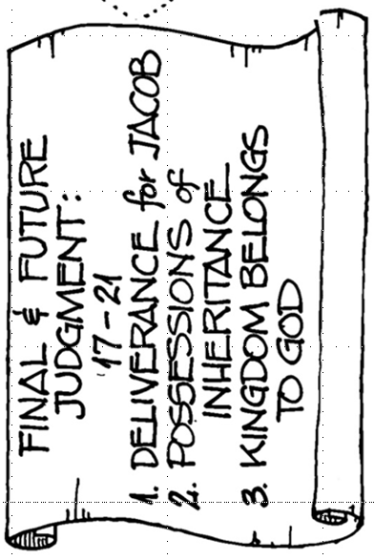
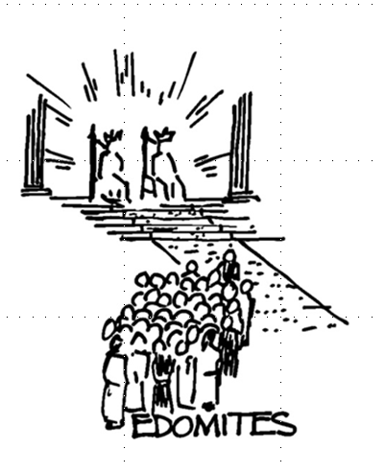
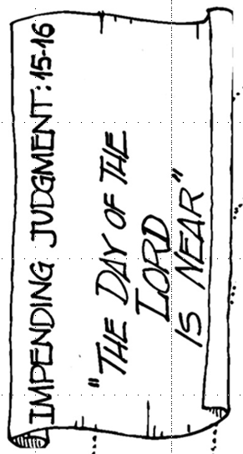
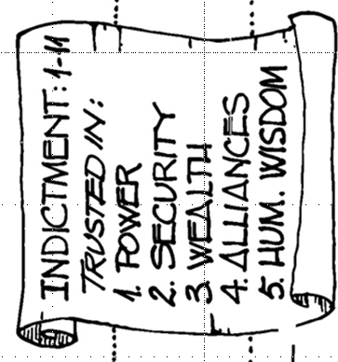
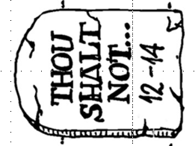
Edomites Day Of Judgement

Slide 9
Prophet’s Visual Aids
Vs 4
Vs 5
Vs 18
Other

Slide 10
Obadiah

Slide 11
Obadiah's Prophecies
What is the prophecy range?
(may need to look up history of Edom)
Judgment on Edom > 1-15
Restoration > 19-21

Slide 12
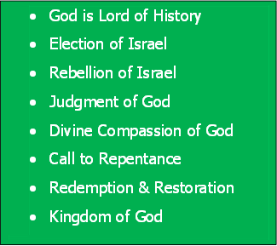
Bible Study Skills
Prophetic Paradigm
By Chapter

Slide 13
Bible Study Skills
 | Looking for -
A | Repeated Words and Phrases
B | Peculiar Words and Phrases
C | Comparisons and Contrasts

Slide 14
Bible Study Skills
D | Figurative Expressions
E | Anything Strange
F | Any prophetic statements

Slide 15
Prophetic Paradigms Patterns Seen in the Prophets
 | Looking for - | Obadiah
A | God says /word of the Lord
B | Election of Israel Relationship of Nineveh to God
C | Rebellion of Israel Rebellion of Nineveh
D | Judgment of God

Slide 16
Prophetic Paradigms Patterns Seen in the Prophets
E | Divine Compassion of God
F | Call to Repentance
G | Redemption & Restoration
H | Kingdom of God

Slide 18
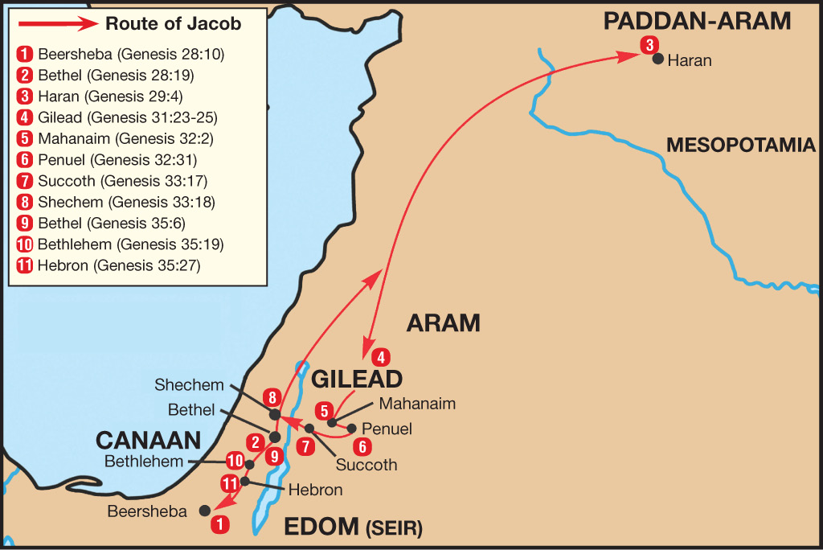
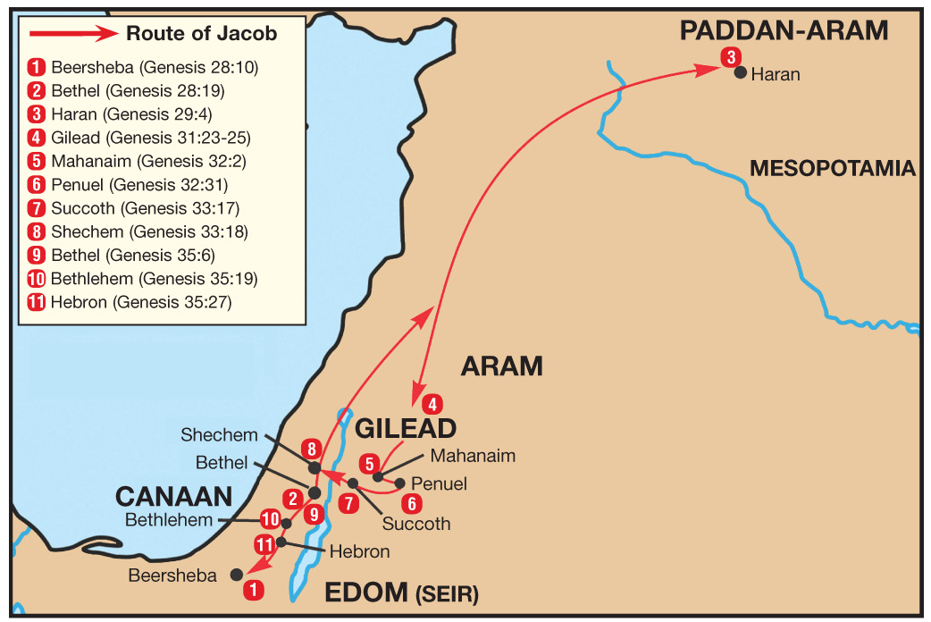
Israel & Edom or Jacob & Esau

Slide 19
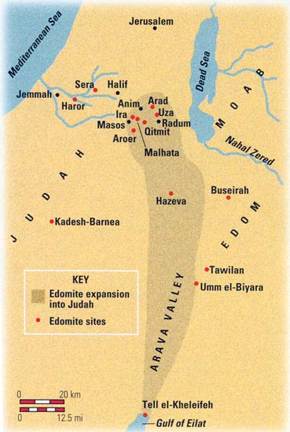
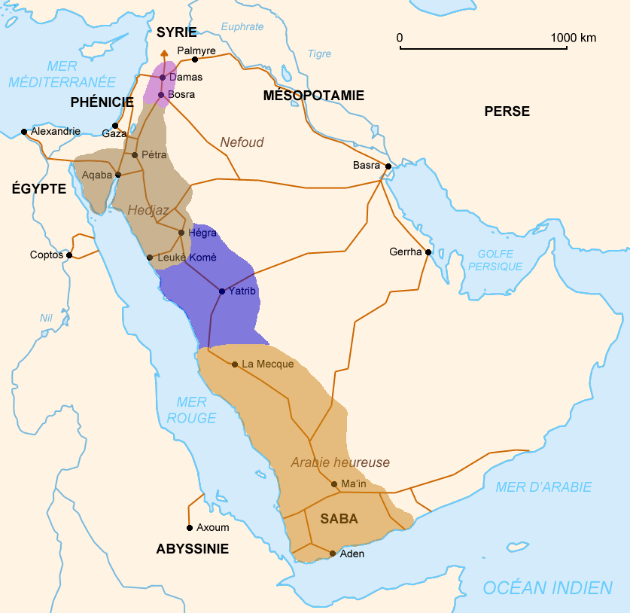
Edom’s Fate

Slide 20
Obadiah the Prophet
When
Where
• Prophecies the judgment of Edom
• Either a contemporary of Elisha and/or Elijah
Who
What
Outline
1-4: First Judgment to Edom
5-7: Second judgment to Edom
8-15: Judgment, accusation & warning
due to Edom's actions
16-18: Promise of restoration & victory
to Israel
19-21: Promise of restoration &
Yahweh's kingship
Key Verses
¹² Do not gloat over your brother's day, the day of his misfortune. And do not rejoice over the sons of Judah in the day of their destruction; yes, do not boast in the day of their distress.
¹⁵ For the day of the Lord draws near on all the nations. As you have done, it will be done to you. Your dealings will return on your own head.
Why

