Slide 1
Lesson 8
Minor
Prophets
Micah Overview
2:1 Hear, all you peoples!
3:1 “Hear now,
3:4 But He will not hear them
3:9 Now hear this,
5:15 On the nations that have not heard.”
6:1 Hear now what the Lord says:
6:2 Hear, O you mountains, the Lord’s complaint,
6:9 “Hear the rod!
7:7 My God will hear me.

Slide 2
The purpose of the prophets was threefold:
Minor
Prophets
To warn the nations of the coming judgment.
To explain why the judgment had come upon them.
To give assurance, at least to a remnant, of a hope that lay beyond the judgment.
Notes:
1. The purpose of the prophets was threefold:
a. To warn the nations of the coming judgment.
b. To explain why the judgment had come upon them.
To give assurance, at least to a remnant, of a hope that lay beyond the judgment.

Slide 3
The Role of the Prophets
Minor
Prophets
They are Spokesmen for God, serving as “forthtellers,” speaking what God put in their mouth.
They are Preachers of the Covenant, relating their message to God’s previous promises to the nation of Israel. These covenants were made with or through Abraham, Moses, and David
They are historians, or Interpreters of the Israelites’ History. With out their interpretation God’s people would not know why an event was occurring.

Slide 4
Ahijah
Jehu
Man of God
Micaiah
Man of God
Syria
Shemaiah
Azariah
Hanani
Assyria
Babylon/Persia

Slide 5
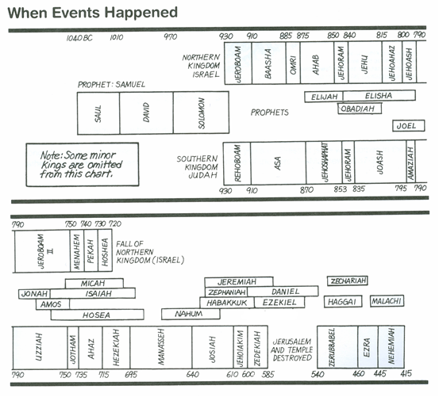
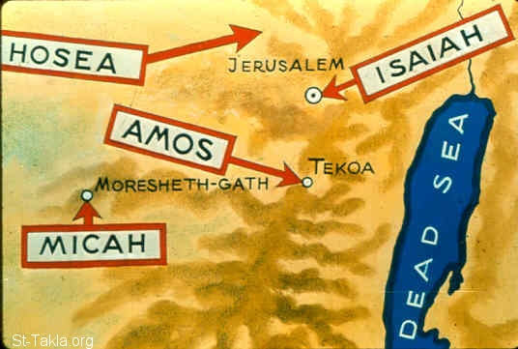
Kings & Prophets

Slide 6
Prophets of the Assyrian Period
Obadiah (~845 BC)
Joel (~830)
Jonah (~780)
Amos (~755)
Hosea (750-725)
Isaiah (740-690)
Micah (735-700)

Slide 7
Outline of Micah
Minor
Prophets
Judgment on Israel & Judah (1:2-2:13)
Present Injustice (3:1-12)
Restoration of Justice (4:1-5:18)
Lord’s Indictment (6:1-16)
Shame & Restoration of Relationship (7:1-20)
Hear All you People
Hear Now
He will not hear
Now hear this
Nations not heard
Hear Now
Hear Lord’s complaint
Hear the rod
God will hear me

Slide 8
Micah 6
¹Hear now what the Lord says:
“Arise, plead your case before the mountains,
And let the hills hear your voice.
² Hear, O you mountains, the Lord’S complaint,
And you strong foundations of the earth;
For the Lord has a complaint against His people,
And He will contend with Israel.
⁸ He has shown you, O man, what is good;
And what does the Lord require of you
But to do justly,
To love mercy,
And to walk humbly with your God?
⁹ The Lord’S voice cries to the city—
Wisdom shall see Your name:
“Hear the rod!
Who has appointed it?
Minor
Prophets
Micah 1
² Hear, all you peoples!
Listen, O earth, and all that is in it!
Let the Lord GOD be a witness against you,
The Lord from His holy temple.
Micah 3
¹And I said:
“Hear now, O heads of Jacob,
And you rulers of the house of Israel:
Is it not for you to know justice?
⁴ Then they will cry to the Lord,
But He will not hear them;
He will even hide His face from them at that time,
Because they have been evil in their deeds.
⁹ Now hear this,
You heads of the house of Jacob
And rulers of the house of Israel,
Who abhor justice
And pervert all equity,
Micah 7
⁷ Therefore I will look to the Lord;
I will wait for the God of my salvation;
My God will hear me.
Micah 5
¹⁵ And I will execute vengeance in anger and fury
On the nations that have not heard.”

Slide 9
Outline of Micah
Judgment on Israel & Judah (1:2-2:13)
Present Injustice (3:1-12)
Restoration of Justice (4:1-5:18)
Lord’s Indictment (6:1-16)
Shame & Restoration of Relationship (7:1-20)

Slide 10
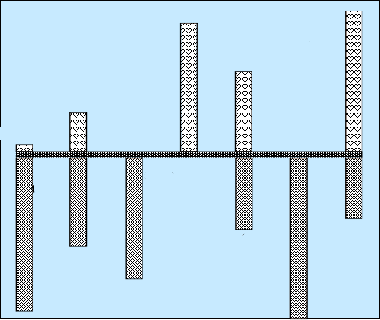
Hear Micah
Sermon 5
Woe is me
Sermon 3
He has Laid
Siege
4:1-13
Mentions
Samaria
& Jerusalem
Words of Comfort & Hope
2:12-13
Sermon 4
Hear now
7:7-20
5:2-9
1:1
5:1, 10-15
7:1-6
2:1-11
3:1-12
6:1-16
1:2-16
Words of Warning/Judgment
Focus on
Israel then
Jerusalem
Sermon 1
Hear All
You Peoples
Sermon 2
Hear now

Slide 11
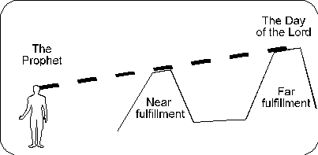
Prophecy – Near & Far
Within Few years of prophecy
Lifetime
Of prophet
Days of Micah
Jotham (750-731 BC)
Ahaz (735-715 BC)
Hezekiah (~725-698 BC)
Long
Range
Prophecies
Medium
Range
Prophecies
Messianic
Short
Term
Samaria Heap
733/722 BC
1:6, 5:3-15
Sennacherib
– 701 BC
1:09
6:/7:
Babylonian Captivity
604, 597, 586 BC
Micah 2:4-5/3:16
5:3-15, 6:/7:
Gather Remnant
2:12-13
4:1-13
5:2
Micah 2:12 (NKJV) ¹² "I will surely assemble all of you, O Jacob, I will surely gather the remnant of Israel..
Micah 2:13 (NKJV) ¹³ …And go out by it; Their king will pass before them, With the LORD at their head."
Micah 1:6 (NKJV) ⁶ "Therefore I will make Samaria a heap of ruins in the field, Places for planting a vineyard; I will pour down her stones into the valley, And I will uncover her foundations.
Micah 1:9 (NKJV) ⁹ For her wounds are incurable. For it has come to Judah; It has come to the gate of My people-- To Jerusalem.
Micah 2:4 (NKJV) ⁴ In that day one shall take up a proverb against you, And lament with a bitter lamentation, saying: 'We are utterly destroyed! He has changed the heritage of my people; How He has removed it from me! To a turncoat He has divided our fields.' "

Slide 12
740
735
Jotham
Pekah
Tiglath-pileser III
730
734 – Coastline down to Gaza
733 – Northern Israel conquered
732 – Conquers Damascus
725
Hoshea
Ahaz
Shalmaneser V
720
715
Sargon II
726– Hoshea Revolts with death of Pul
725–722 Siege of Samaria
705
700
Hezekiah
705– Hezekiah Revolts with death of Sargon II
701 Siege of Jerusalem
695
Sennacherib
690
685
Manasseh
680
685
Esarhaddon
Judah
Israel
assyria
670

Slide 13
Sermon 1 (Micah1-2)
1:2-5
Hear, all you peoples!
Behold Lord is coming out of His place
Source of sins – Samaria/Jerusalem
God is Lord of History
1:6-8
Therefore – Samaria a heap of ruins in the field
Therefore I will wail & howl – like jackals-ostriches
1:9-16
For her wounds are incurable – come to gate of Jerusalem
The cities to gate of Jerusalem
Judgment
2:1-2
Woe to those who work wickedness on their beds
Covet fields
2:3-5
Therefore –devising disaster/”We are utterly destroyed
Rebellion
People tell prophets not to prattle
Do not My words do good
My people risen up as an enemy
2:6-9
2:10-11
Even a prophet we speaks of wine & drink is a prattler to these people
2:12-13
Gather remnant of Israel like sheep in a fold
Redemption/Restoration

Slide 14
Micah 1:3 - 4 (NKJV)
³ For behold, the Lord is coming out of His place;
He will come down
And tread on the high places of the earth.
⁴ The mountains will melt under Him,
And the valleys will split
Like wax before the fire,
Like waters poured down a steep place.

Slide 15
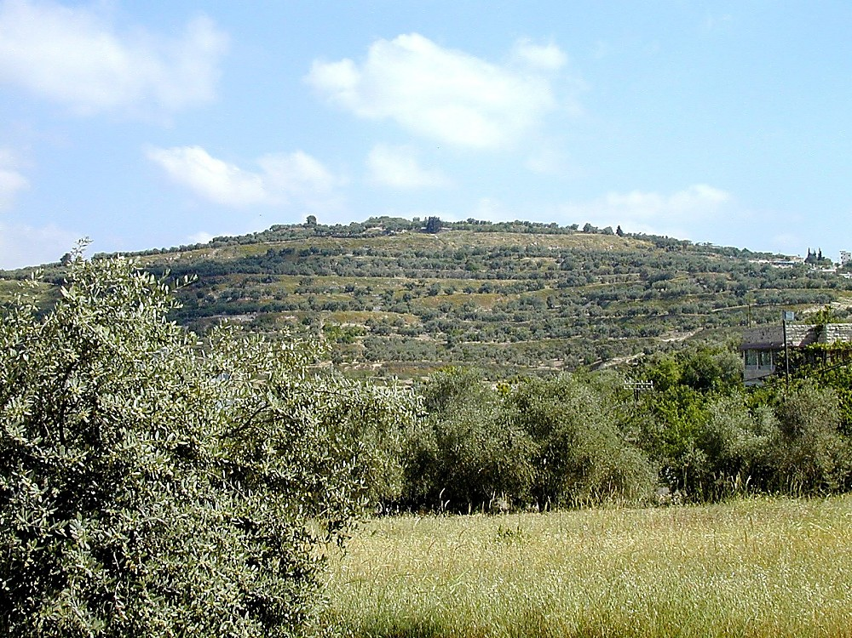
Tell Samaria from south
Micah 1:6 (NKJV)
⁶ “Therefore I will make Samaria a heap of ruins in the field,
Places for planting a vineyard;
I will pour down her stones into the valley,
And I will uncover her foundations.
Tell Samaria from south
Notes:
Samaria: Introduction
The site may have been as large as 150 acres (as large as Hezekiah’s Jerusalem). At 100 people per acre, the population would equal 15,000.
The importance of the site diminished with non-westward-looking rulers. “For as long as there ruled in the land a power with no interests towards the coast and sea, Samaria was forced to yield again to central Shechem the supremacy which Ahab and Herod, with their western obligations, had taken from Shechem to give her” (G. A. Smith 1931: 229).
Isaiah 28:1 (NIV) “Woe to that wreath, the pride of Ephraim’s drunkards, to the fading flower, his glorious beauty, set on the head of a fertile valley–to that city, the pride of those laid low by wine!”
Geographical Situation
Samaria was in the tribal territory of the sons of Joseph (Josh 16-17).
It was in a good position for defense, as illustrated by history. The summit sits 300 ft above the valleys below.
It withstood lengthy sieges:
By the Syrians (2 Kings 6).
By the Assyrians–it withstood a 3 year Assyrian siege before capture (2 Ki 17:5).
By the Hasmoneans–it resisted Hasmonean capture for one year.
“‘It must before the invention of gun-powder have been almost impregnable’ (Conder). The sieges of Samaria were always prolonged” (G. A. Smith 1931: 228).
It was centrally located on the Trans-Samaria highway, looking towards the west. Samaria was the capital of the northern kingdom from the time of Omri (880 B.C.) to the final conquest of the nation (722 B.C.). In this period of time, the two powerful dynasties of Omri and Jehu dominated the city and country, followed only by a quick succession of weak and short-lived rulers.
Mountains surround and overlook Samaria on three sides, but Samaria has a view to the west. Thus the city faced toward Phoenicia, with easy access by a gentle valley to the coastal plain or through Dothan Valley to Jezreel Valley. It was 23 mi from the coast.
Omri made a treaty with the king of Tyre, marrying his son Ahab to Jezebel.
A temple was built to Baal in Samaria.
Omri recognized that he needed this link to Tyre. It gave him a good market for selling his grain, gave him a link to sea, and further facilitated the international relations which prospered his kingdom economically.
“Forts and isolated defensive towers protected important strategic points and roads in the kingdom. About a dozen fortresses, discovered in a survey of the vicinity of Samaria, created a defensive belt around the capital and protected all its access roads” (Mazar 1990: 416).

Slide 16
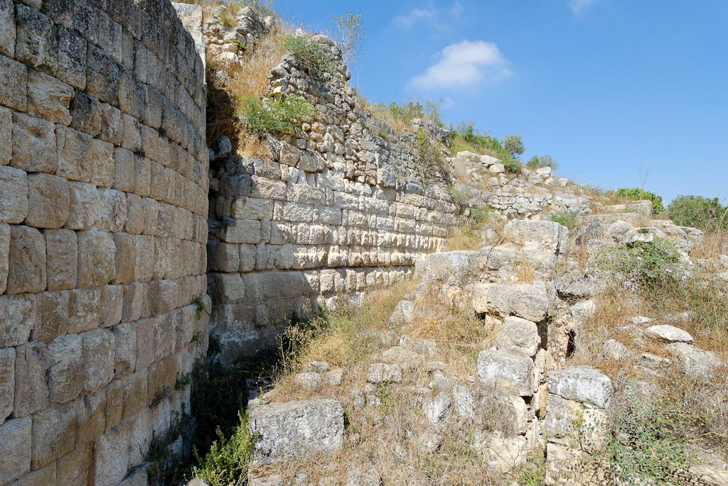
Samaria Israelite wall
Notes:
tb070507730

Slide 17
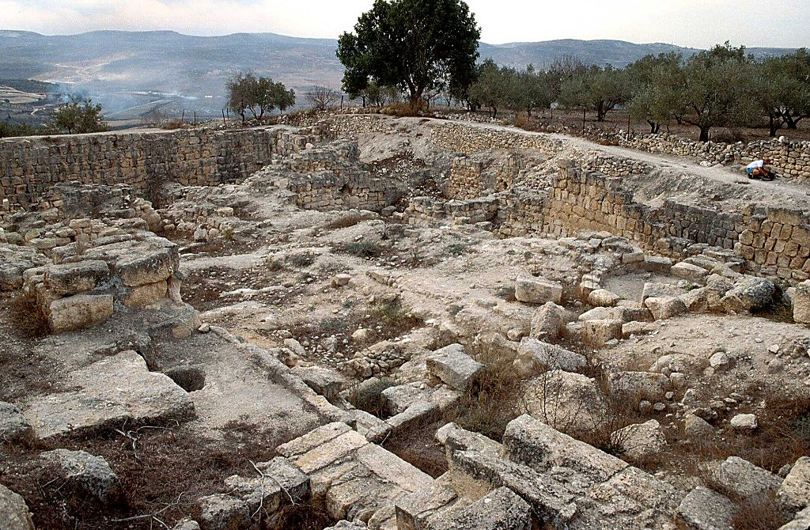
Samaria ruins of Iron Age acropolis
Micah 1:6 (NKJV)
⁶ “Therefore I will make Samaria a heap of ruins in the field,
Places for planting a vineyard;
I will pour down her stones into the valley,
And I will uncover her foundations.
Samaria ruins of Iron Age acropolis
Notes:
Acropolis
“The extent of the planning and building operations on the acropolis of Samaria was unprecedented in the architectural history of the country, except perhaps in Solomon’s buildings in Jerusalem” (Mazar 1990: 406).
The royal enclosures at Samaria and Jerusalem were well-planned and equaled the size of an average town (the acropolis of Samaria was about 6.5 acres; the acropolis in Jerusalem may have been larger).
Royal enclosures were fortified and often built on a leveled, raised platform.
Royal compounds with large, lime-paved courtyards were common.
The royal palace at Samaria was the lodging place of the kings of Israel (1 Ki 20:43; 21:1, 2; 22:39; 2 Ki 1:2; 15:25).
“A smaller structure on the acropolis contained a hoard of carved ivories–the most important collection of such artwork from Iron Age Israel...Furthermore, only in this structure at Samaria was it possible to discern various building phases and to determine the internal development of pottery” (Mazar 1990: 408).

Slide 18
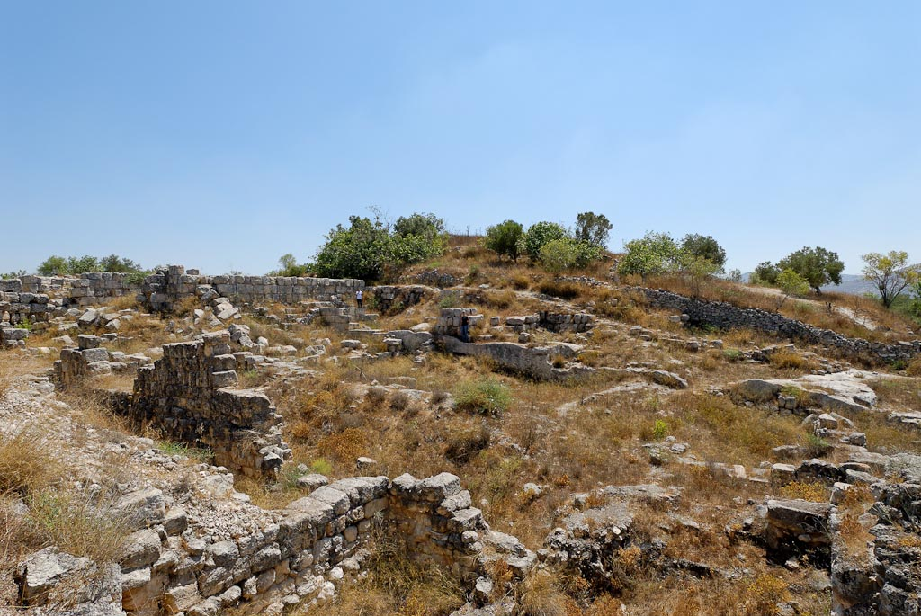
Micah 1:6 (NKJV)
⁶ “Therefore I will make Samaria a heap of ruins in the field,
Places for planting a vineyard;
I will pour down her stones into the valley,
And I will uncover her foundations.
tomb
tomb
Samaria acropolis, area of possible royal tombs
Notes:
tb070507812

Slide 19
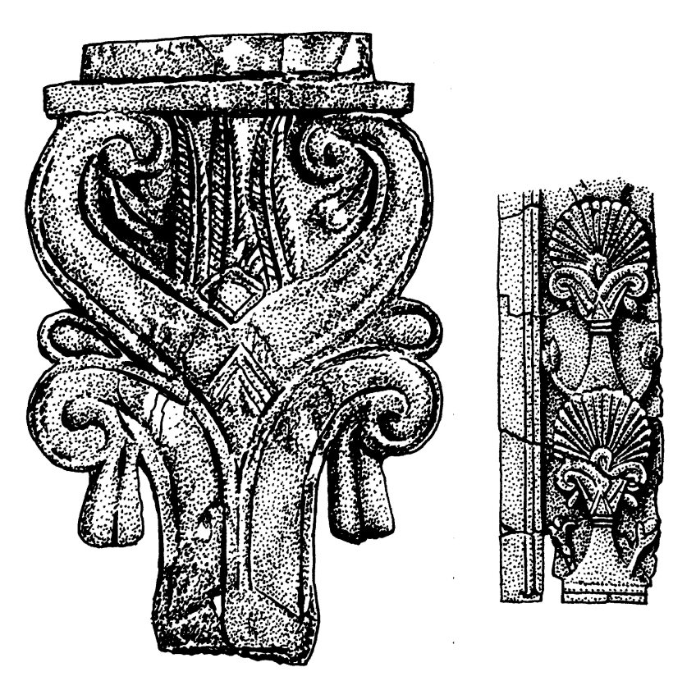
Ivory
Trees were a favorite motif in ivory carvings. On the left is a stylized palm tree with the panicles pictured on the bottom; on the right is another stylized tree. These pieces were found in Samaria (9th/10th century BCE).
1000 Bible Images. Bellingham, WA : Logos Research Systems, 2009

Slide 20
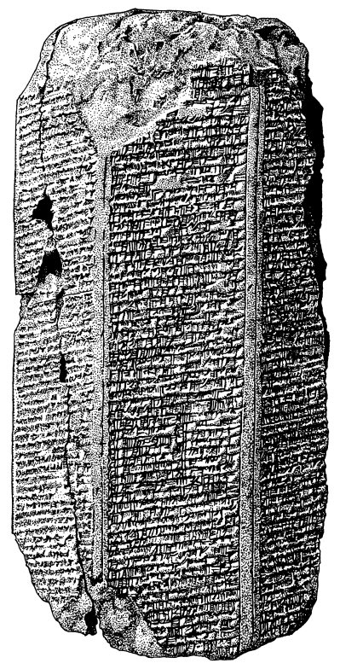
Conquest of a Samaria
The Assyrians recorded historical events on prisms that could be inscribed on six sides. On this prism, among other things it is reported that Samaria was conquered.
1000 Bible Images. Bellingham, WA : Logos Research Systems, 2009

Slide 21
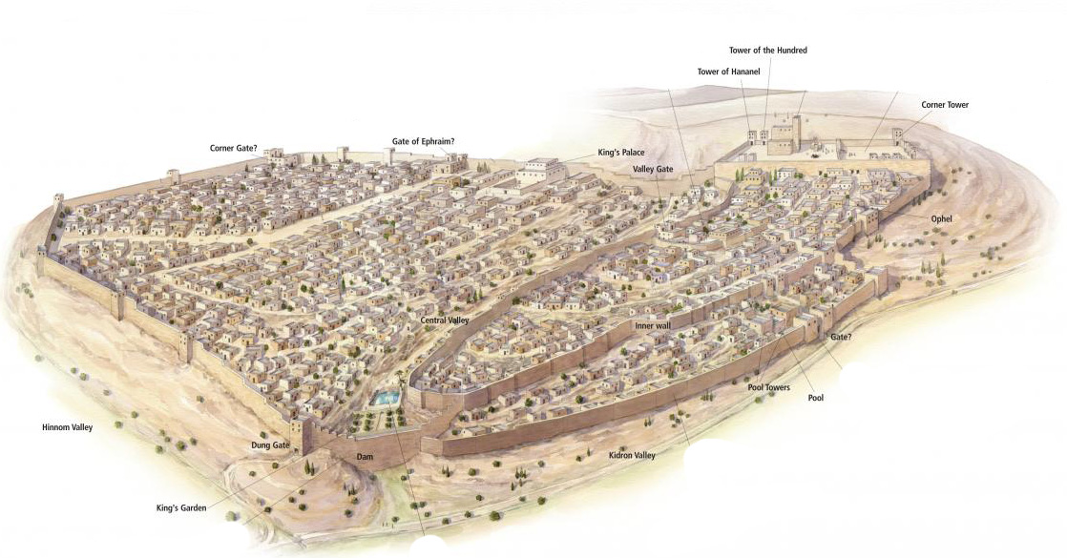
Jerusalem in the Time of Hezekiah (c. 725–686 b.c.)
Micah 1:5 (NKJV) ⁵ All this is for the transgression of Jacob And for the sins of the house of Israel. What is the transgression of Jacob? Is it not Samaria?
And what are the high places of Judah? Are they not Jerusalem?
Notes:
Jerusalem in the Time of Hezekiah (c. 725–686 b.c.)
During the reign of King Hezekiah, the city of Jerusalem expanded more than ever before. Many refugees from the Assyrian invasion settled on the Western Hill, as the ancient city built by King Solomon on the Eastern Hill was not able to absorb them. New city walls encircled both hills, and thus Jerusalem became a city that was “bound firmly together” (Ps. 122:3).
21

Slide 22
Micah 1 To the Gates of Jerusalem

Slide 23
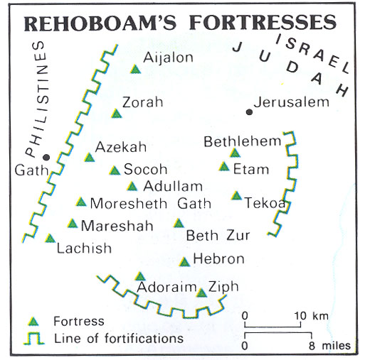
Rehoboam’s Fortresses & Micah;s Cities of Destruction
2 Chronicles 11:5 - 12 (NKJV)
⁵So Rehoboam dwelt in Jerusalem, and built cities for defense in Judah. ⁶And he built Bethlehem, Etam, Tekoa, ⁷Beth Zur, Sochoh, Adullam, ⁸ Gath, Mareshah, Ziph, ⁹Adoraim, Lachish, Azekah, ¹⁰Zorah, Aijalon, and Hebron, which are in Judah and Benjamin, fortified cities.
¹¹And he fortified the strongholds, and put captains in them, and stores of food, oil, and wine. ¹²Also in every city he put shields and spears, and made them very strong, having Judah and Benjamin on his side.

Slide 24
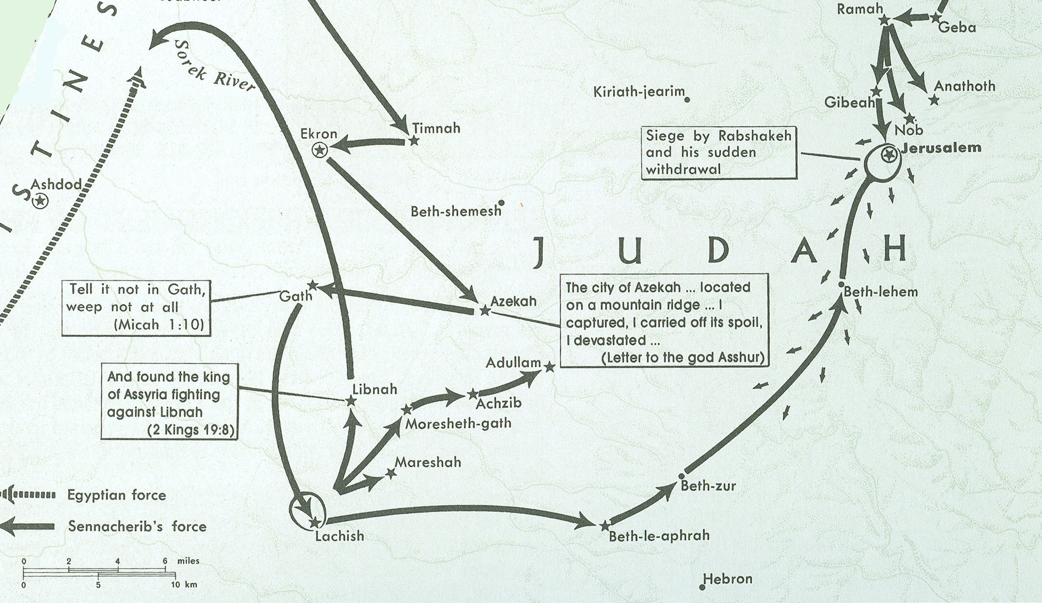
Sennacherib in Philistia & Judah 701 BC
Beth-le-aphrah/ophrah
Micah’s
hometown

Slide 25
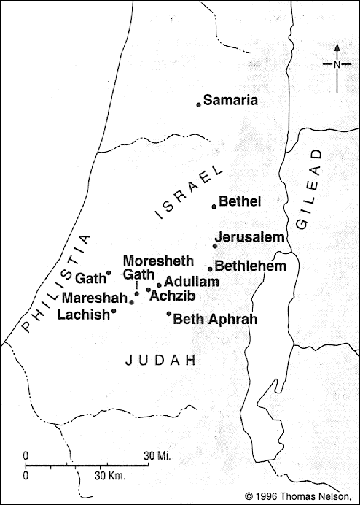

Slide 26
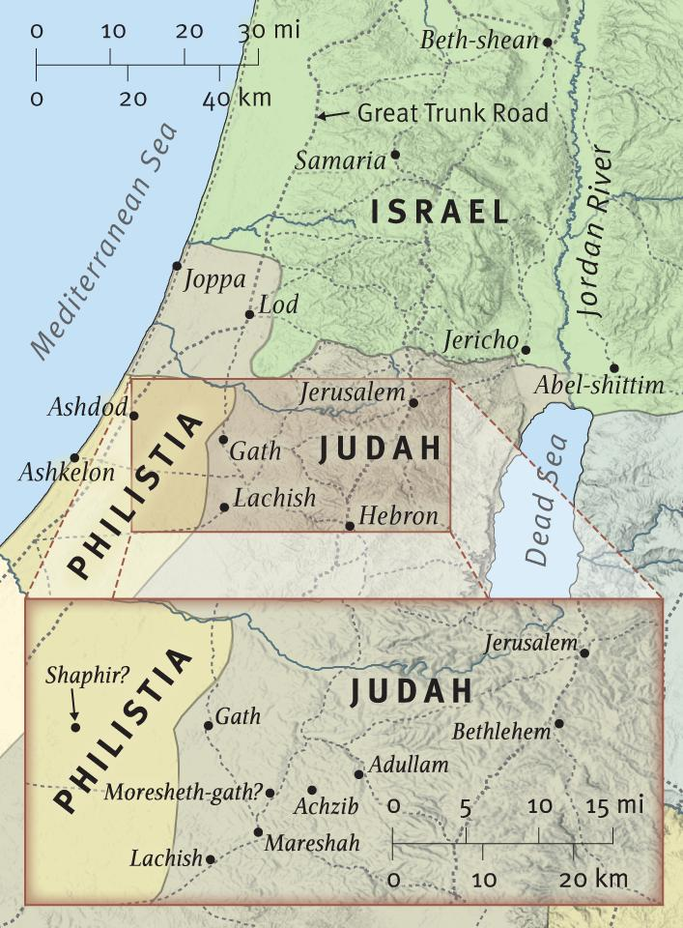
Micah Prophesies of Destruction Micah 1:10-15
Gath
Tell Town
Tell it not
Notes:
Micah Prophesies Destruction
c. 740 b.c.
Micah foretold the destruction that awaited Jerusalem and the towns that guarded the approach to the city. Though these towns lay to the southwest of Jerusalem, they lay along the route normally traveled by invading forces from the north, who typically followed the Great Trunk Road south until they reached Gath.
26

Slide 27
Sennacherib in Philistia & Judah 701 BC
Beth-le-aphrah
"house of dust"
Dust Town
Beth-le-aphrah/ophrah
Roll yourself in
the dust.
Micah’s
hometown

Slide 28
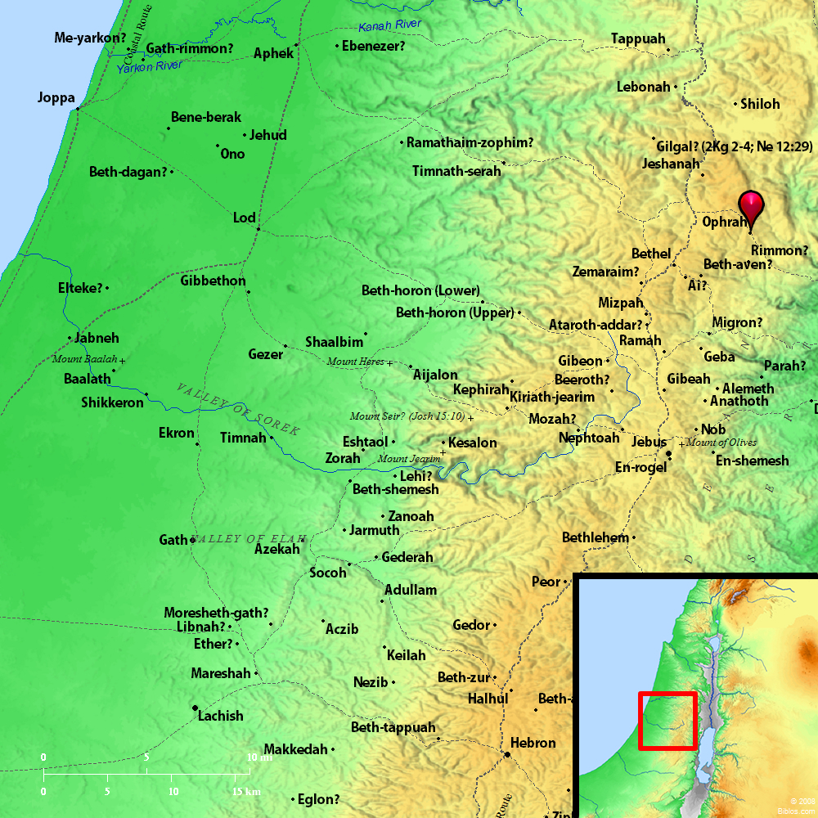
BETH-LE-APHRAH/OPHRAH
Micah Prophesies of Destruction Micah 1:10-15
Beth-le-aphrah
"house of dust"
Dust Town
Roll yourself in
the dust.
Notes:
BETH-LEAPHRAH beth-le-af'-ra (beth le`aphrah; Septuagint ex oikou kata gelota, "house of dust"): The name of a place found only in Micah 1:10. From the connection in which it is used it was probably in the Philistine plain. There seems to be a play upon the name in the sentence, "at Beth le-`apharah have I rolled myself in the dust," `aphrah meaning "dust," and possibly another on Philistine in rolled, hith-palldshithi (see G. A. Smith, The Book of the Twelve Prophets, called Minor, in the place cited.).

Slide 29
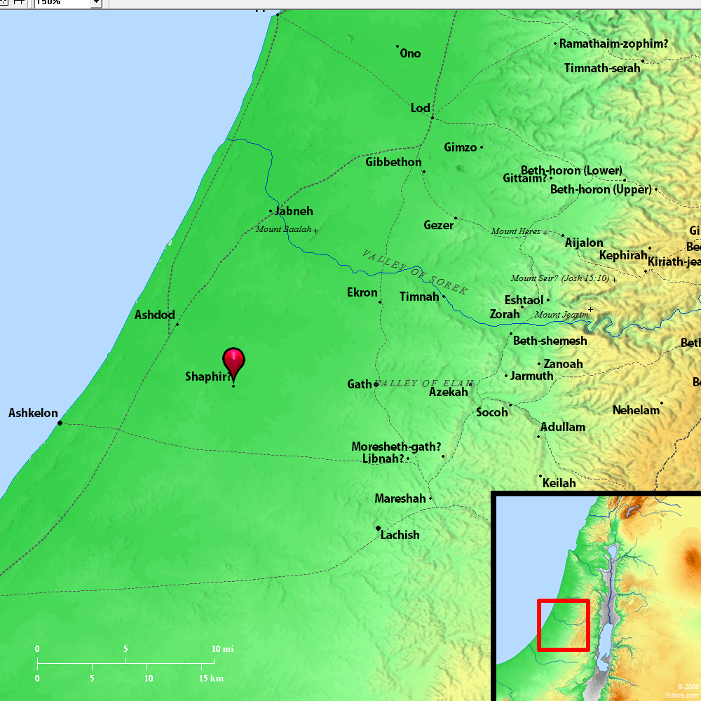
SHAPHIR
Shaphir-unknown??
Micah Prophesies of Destruction Micah 1:10-15
Inhabitant of Shaphir
Fair/beautiful
Naked/shamed
Notes:
SHAPHIR sha'-fer (shaphir, "glittering"; kalos; the King James Version Saphir): One of a group of towns mentioned in Micah 1:10-15. From the association with Gath, Achzib (of Judah) and Mareshah, it would seem that the places mentioned were in Southwestern Palestine. According to Eusebius, in Onomasticon, there was a Sapheir, "in the hill country" (from a confusion with Shamir (Joshua 15:48), where Septuagint A has Sapheir) between Eleutheropolis and Ascalon. The name probably survives in that of three villages called es-Suafir, in the plain, some 3 1/2 miles Southeast of Ashdod (PEF, II, 413, Sh XV). Cheyne (EB, col. 4282) suggests the white "glittering" hill Tell ec-Cafi, at the entrance to the Wady ec-Sunt, which was known to the Crusaders as Blanchegarde, but this site seems a more probable one for GATH (which see). E. W. G. Masterman

Slide 30
ZAANAN
Zaanan-unknown??
Micah Prophesies of Destruction Micah 1:10-15
Zaanan
come out
/to go forth
march town
does not come out
Notes:
ZAANAN za'-a-nan (tsa`anan; Sennaar): A place named by Micah in the Shephelah of Judah (1:11). In this sentence the prophet makes verbal play with the name, as if it were derived from yatsa', "to go forth": "The inhabitant (margin "inhabitress") of tsa'anan is not come forth" (yatse'ah). The place is not identical. It is probably the same as ZENAN.

Slide 31
BETH-EZEL
Beth-ezel -unknown??
Micah Prophesies of Destruction Micah 1:10-15
Beth-ezel
Adjoining house/ neighbor town
Its place is taken away from you
Notes:
BETH-EZEL beth-e'-zel (beth ha-'etsel; oikos echomenous autes; literally, "adjoining house"): A place named along with other cities in the Philistine plain (Micah 1:11). The site has not been identified. By some it is thought to be the same as Azel of Zechariah 14:5; but see AZEL.

Slide 32
MAROTH
Maroth -unknown??
Micah Prophesies of Destruction Micah 1:10-15
Maroth
bitterness
bitter town
Longs for goodness/ Pined for good
Notes:
MAROTH ma'-roth, ma'-roth (maroth; (katoikousa) (odunas): An unknown town probably in the Philistine plain, named by Micah (1:12).

Slide 33
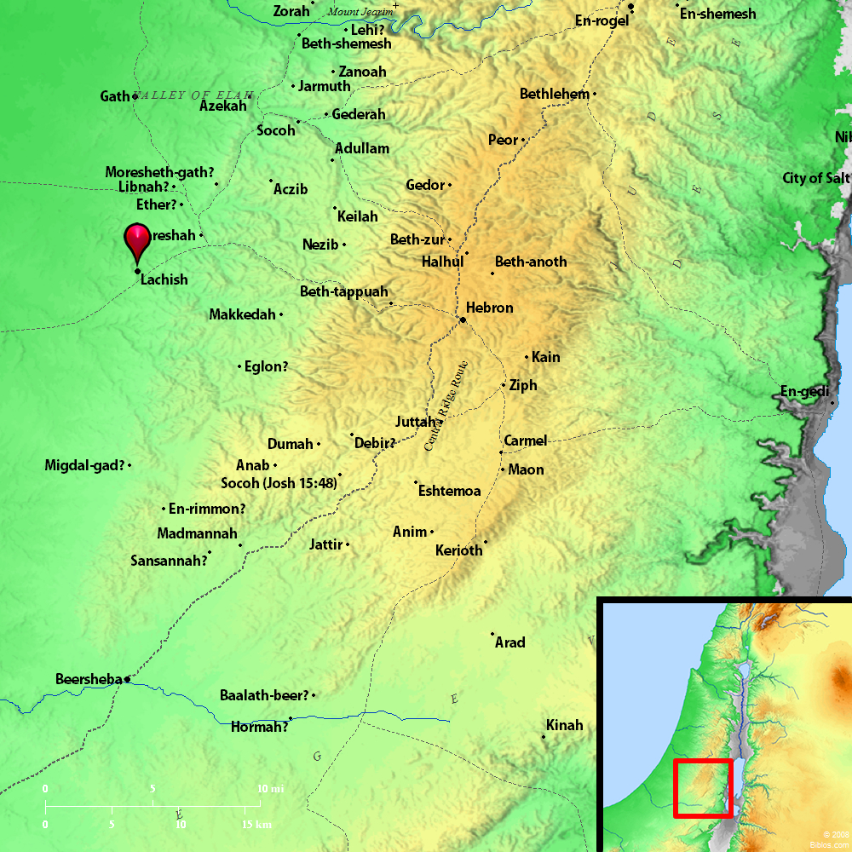
LACHISH
Lachish
Micah Prophesies of Destruction Micah 1:10-15
Lachish
Horse town
Steeds (larekesh)
Harness chariot to swift (courier) horses
Notes:
LACHISH la'-kish (lakhish; Septuagint Lachis (Joshua 15:39), Maches): 1. Location: A town in the foothills of the Shephelah on the border of the Philistine plain, belonging to Judah, and, from the mention of Eglon in connection with it, evidently in the southwestern portion of Judah's territory. Eusebius, Onomasticon locates it 7 miles from Eleutheropolis (Beit Jibrin) toward Daroma, but as the latter place is uncertain, the indication does not help in fixing the site of Lachish. The city seems to have been abandoned about 400 B.C., and this circumstance has rendered the identification of the site difficult. It was formerly fixed at Umm Lakis, from the similarity of the name and because it was in the region that the Biblical references to Lachish seem to indicate, but the mound called Tell el-Hesy is now generally accepted as the site. This was first suggested by Conder in 1877 (PEFS, 1878, 20), and the excavations carried on at the Tell by the Palestine Exploration Fund in 1890-93 confirmed his identification. Tell el-Hesy is situated on a wady, or valley, of the same name (Wady el Hesy), which runs from a point about 6 miles West of Hebron to the sea between Gaza and Askelon. It is a mound on the very edge of the wady, rising some 120 ft. above it and composed of debris to the depth of about 60 ft., in which the excavations revealed the remains of distinct cities which had been built, one upon the ruins of another. The earliest of these was evidently Amorite, and could not have been later than 1700 B.C., and was perhaps two or three centuries earlier (Bliss, Mound of Many Cities). The identification rests upon the fact that the site corresponds with the Biblical and other historical notices of Lachish, and especially upon the discovery of a cuneiform tablet in the ruins of the same character as the Tell el-Amarna Letters, and containing the name of Zimridi, who is known from these tablets to have been at one time Egyptian governor of Lachish. The tablets, which date from the latter part of the 15th or early part of the 14th century B.C., give us the earliest information in regard to Lachish, and it was then an Egyptian dependency, but it seems to have revolted and joined with other towns in an attack upon Jerusalem, which was also an Egyptian dependency. It was perhaps compelled to do so by the Khabiri who were then raiding this region. The place was, like Gaza, an important one for Egypt, being on the frontier and on the route to Jerusalem, and the importance is seen in the fact that it was taken and destroyed and rebuilt so many times. 2. History: We first hear of it in the history of Israel when Joshua invaded the land. It was then an Amorite city, and its king, Japhia, joined the confederacy formed by Adonizedek, king of Jerusalem, to resist Joshua. They were defeated in the remarkable battle at Gibeon, and the five confederate kings were captured and put to death at Makkedah (Joshua 10 passim; Joshua 12:11). Lachish was included in the lot of Judah (15:39), and it was rebuilt, or fortified, by Rehoboam (2 Chronicles 11:5, 9). It was besieged by Sennacherib in the reign of Hezekiah and probably taken (2 Kings 18:13) when he invaded Judah and besieged Jerusalem, but the other references to the siege leave it doubtful (2 Kings 18:14, 17; 2 Kings 19:8 2 Chronicles 32:9 Isaiah 36:2; Isaiah 37:8). The Assyrian monuments, however, render it certain that the place was captured. The sculptures on the walls of Sennacherib's palace picture the storming of Lachish and the king on his throne receiving the submission of the captives (Ball, Light from the East, 190-91). This was in 701 B.C., and to this period we may assign the enigmatical reference to Lachish in Micah 1:13, "Bind the chariot to the swift steed, O inhabitant of Lachish: she was the beginning of sin to the daughter of Zion." The cause of the invasion of Sennacherib was a general revolt in Phoenicia, Palestine, and Philistia, Hezekiah joining in it and all asking Egypt for aid (Rawlinson, Five Great Monarchies of the Ancient Eastern World, chapter ix). Isaiah had warned Judah not to trust in Egypt (Isaiah 20:5, 6; Isaiah 30:1-5; 31:1), and as Lachish was the place where communication was held with Egypt, being a frontier fortress, perhaps even having an Egyptian garrison, it would be associated with the "sin" of the Egyptian alliance (HGHL, 234). The city was evidently rebuilt after its destruction by Sennacherib, for we find Nebuchadnezzar fighting against it during his siege of Jerusalem (Jeremiah 34:7). It was doubtless destroyed by him, but we are informed by Nehemiah (11:30) that some of the returned Jews settled there after the captivity. It is very likely that they did not reoccupy the site of the ruined city, but settled as peasants in the territory, and this may account for the transference of the name to Umm Lakis, 3 or 4 miles from Tell el-Hesy, where some ruins exist, but not of a kind to suggest Lachish (Bliss, op. cit). No remains of any importance were found on the Tell indicating its occupation as a fortress or city later than that destroyed by the king of Babylon, but it was occupied in some form during the crusades, Umm Lakis being held for a time by the Hospitallers, and King Richard is said to have made it a base of operations in his war with Saladin (HGHL). The Tell itself, if occupied, was probably only the site of his camp, and it has apparently remained since that time without inhabitants, being used for agricultural purposes only. See further, PALESTINE EXPLORATION, III, 1. H. Porter

Slide 34
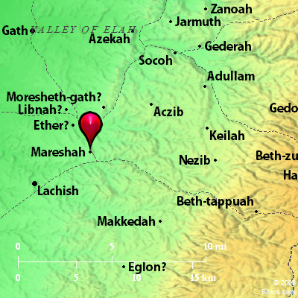
MORESHETH-GATH
Moresheth-gath
Micah Prophesies of Destruction Micah 1:10-15
Moresheth-gath
Me’orasah
“one who is betrothed”
You shall give presents
Micah 1:14 Therefore you will give a parting gift to Moresheth Gath. The houses of Achzib will be a deceitful thing to the kings of Israel.
Notes:
MORESHETH-GATH mo'-resh-eth-gath, mo-resh'-eth-gath (moresheth gath, "inheritance or possession of Gath"; Septuagint kleronomias Geth): A place mentioned only in Micah 1:14. It must have been in the vicinity of Gath as the meaning of the name would indicate, and was the home of the prophet Micah (Micah 1:1 Jeremiah 26:18). It was probably in the vicinity of Mareshah (Micah 1:15). Jerome, in his preface to his work on Micah, places it a little to the East of Eleutheropolis (Beit Jibrin), and it would be natural to find it there if the latter place was Gath as some think. Robinson (BR, II, 68) found ruins of a village between one and two miles East of Beit Jibrin. It must have been among the foot-hills of Judah between the hill country and the Philistine plain on the route from Jerusalem to Lachish, Gaza and Egypt. Mareshah was certainly in that region, and the prophecy of Micah mentions towns and villages in the Shephelah and the Philistine country as though they were familiar to him (see HGHL and G. A. Smith, "Micah," in his Minor Prophets). H. Porter

Slide 35
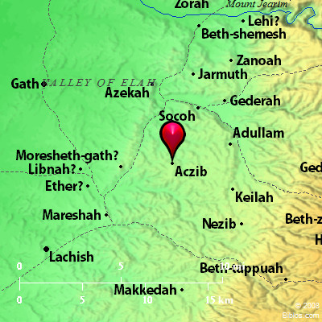
ACHZIB
Achzib
Micah Prophesies of Destruction Micah 1:10-15
Achzib
Azab - deceitful
'akhzibh, "lying" or "disappointing"):
You shall be a lie to the kings of Israel
Micah 1:14 Therefore you will give a parting gift to Moresheth Gath. The houses of Achzib will be a deceitful thing to the kings of Israel.
Notes:
ACHZIB ak'-zib ('akhzibh, "lying" or "disappointing"): The name of two towns in Palestine: (1) A town in western Judah in the lowlands, mentioned in connection with Mareshah and Keilah as one of the cities allotted to Judah (Joshua 15:44), and in Micah (1:14), where it suggests play upon its meaning, "deceptive" or "failing," possibly the place having received its name from a winter spring or brook, which failed in summer. It is also called Chezib (kezibh (Genesis 38:5)), where Judah was at the time of the birth of his son Shelah. In 1 Chronicles 4:22 it is called Cozeba, the King James Version "Chozeba" (kozebha'), clearly seen to be the same as Achzib, from the places with which it is grouped. (2) It has been identified with the modern `Ayin-Kezbeh in the valley of Elah, and north of Adullam. Edward Mack

Slide 36
Jeremiah 26:18 Micah the Morashtite prophesied in the days of Hezekiah king of Judah; and he spoke to all the people of Judah, saying, Thus says Yahweh of Armies: Zion shall be plowed as a field, and Jerusalem shall become heaps, and the mountain of the house as the high places of a forest.
Micah 1:1 The word of Yahweh that came to Micah the Morashtite in the days of Jotham, Ahaz, and Hezekiah, kings of Judah, which he saw concerning Samaria and Jerusalem.
Mareshah
Micah Prophesies of Destruction Micah 1:10-15
Maraeshah
Heir town
I will yet bring an heir to you
Micah 1:14 Therefore you will give a parting gift to Moresheth Gath. The houses of Achzib will be a deceitful thing to the kings of Israel.
Notes:
MARESHAH ma-re'-sha (mareshah; Septuagint: Codex Vaticanus Bathesar; Codex Alexandrinus Maresa): A town in the Shephelah of Judah named with Keilah and Achzib (Joshua 15:44). It occupied such a position that Rehoboam thought well to fortify it for the protection of Jerusalem (2 Chronicles 11:8). In the valley of Zephathah at Mareshah, Asa overwhelmed Zerah the Ethiopian and his army, pursuing them as far as Gezer (2 Chronicles 14:9). From Mareshah came Eliezer the prophet who denounced disaster upon the commercial copartnery of Jehoshaphat and Ahaziah (2 Chronicles 20:37). The place is mentioned in Micah (2 Chronicles 1:15). Mareshah was plundered and burned by Judas Maccabeus (Ant., XII, viii, 6; 1 Maccabees 5:66 the Revised Version margin). Hither Gorgias escaped, having been rescued from the hands of Dositheus by a Thracian horseman (2 Maccabees 12:35). It was taken by John Hyrcanus, who allowed the inhabitants to remain on condition that they adopt circumcision and submit to the Jewish law. This they did; and later John avenged an injustice done to Mareshah by the Samaritans. It is then described as "a colony of Jews" (Ant., XIII, ix, 1; x, 2). The city was treated with favor by Pompey (XIV, iv, 4). When the Parthians invaded Judea in support of Antigonus they demolished Mareshah (xiii, 9). According to Eusebius, Onomasticon, Mareshah was 2 Roman miles from Eleutheropolis (Beit Jibrin). Until recently it was thought that Khirbet Mir`ash, where the old name lingers, not far Southwest of Beit Jibrin, represented the ancient city. The work of Dr. Bliss, however ("Excavations in Palestine," PEF), shows that it must be located at Tell Sandachannah, about a mile South of Beit Jibrin. A series of remarkable tombs was discovered here. From 1 Chronicles 2:42 we may perhaps gather that Hebron was colonized by the men of Mareshah. W. Ewing

Slide 37
ADULLAM
Jeremiah 26:18 Micah the Morashtite prophesied in the days of Hezekiah king of Judah; and he spoke to all the people of Judah, saying, Thus says Yahweh of Armies: Zion shall be plowed as a field, and Jerusalem shall become heaps, and the mountain of the house as the high places of a forest.
Micah 1:1 The word of Yahweh that came to Micah the Morashtite in the days of Jotham, Ahaz, and Hezekiah, kings of Judah, which he saw concerning Samaria and Jerusalem.
Adullam
Micah Prophesies of Destruction Micah 1:10-15
Adullam
The wild beast’s cave
The glory of Israel shall come
Micah 1:14 Therefore you will give a parting gift to Moresheth Gath. The houses of Achzib will be a deceitful thing to the kings of Israel.
Notes:
ADULLAM a-dul'-am (`adhullam): (1) A city, with dependencies, and in ancient times having a king, mentioned five times in the Old Testament, each time in a list with other cities (Joshua 12:15; Joshua 15:35 2 Chronicles 11:7 Micah 1:15 Nehemiah 11:30). In the list of 31 kings whom Joshua smote, Adullam follows Hormah, Arad, Libnah, and precedes Makkedah. Among the 14 Judahite cities of the first group in "the lowland" Adullam is mentioned between Jarmuth and Socoh. In the list of 15 cities fortified by Rehoboam it appears between Socoh and Gath. Micah gives what may be a list of cities concerned in some Assyrian approach to Jerusalem; it begins with Gath, includes Lachish, and ends with Mareshah and Adullam. And Adullam is still in the same company in the list in Nehemiah of the cities "and their villages" where the men of Judah then dwelt. In the time of the patriarchs it was a place to which men "went down" from the central mountain ridge (Genesis 38:1). Judas Maccabeus found it still existing as a city (2 Maccabees 12:38). Common opinion identifies Adullam with the ruin `Aid-el-Ma, 13 miles West-Southwest from Bethlehem (see HGHL, 229). This is in spite of the testimony of the Onomasticon, which, it is alleged, confuses Adullam with Eglon. Presumably the city gave its name to the cave of Adullam, the cave being near the city. (2) The cave of Adullam, David's headquarters during a part of the time when he was a fugitive from Saul (1 Samuel 22:1 2 Samuel 23:13 1 Chronicles 11:15). Sufficient care has not been exercised in reading the Bible statements on this subject. To begin with, Hebrew syntax permits of the use of the word "cave" collectively; it may denote a group or a region of caves; it is not shut up to the meaning that there was one immense cave in which David and his 400 men all found accommodations at once. All reasonings based on this notion are futile. Further, by the most natural syntax of 2 Samuel 23:13-17 (duplicated with unimportant variations in 1 Chronicles 11:15-19), that passage describes two different events, and does not connect the cave of Adullam with the second of these. "And three of the thirty chief men went down, and came to David in the harvest time unto the cave of Adullam; and the troop of the Philistines was encamped in the valley of Rephaim. And David was then in the stronghold; and the garrison of the Philistines was then in Beth-lehem. And David longed, and said, Oh that one would give me water," etc. Concerning these three seniors among David's "mighty men" it is narrated, first, that they were David's comrades in a certain battle, a battle which the Chronicler identifies with Pas-dammim, where David slew Goliath; second, that they joined David at the cave of Adullam, presumably during the time when he was hiding from Saul; third, that at a later time, when the Philistines were in the valley of Rephaim (compare 2 Samuel 5:18), and David was "in the stronghold" (Josephus says "at Jerusalem," Ant, VII, xii, 4), these men broke through the Philistine lines and brought him water from the home well of Bethlehem. The cave of Adullam, like the city, was "down" from the central ridge (1 Samuel 22:1 2 Samuel 23:13). The city was in Judah; and David and his men were in Judah (1 Samuel 23:3) at a time when, apparently, the cave was their headquarters. Gad's advice to David to return to Judah (1 Samuel 22:3, 5) was given at a time when he had left the cave of Adullam. If the current identification of `Aid-el-Ma as Adullam is correct, the cave of Adullam is probably the cave region which has been found in that vicinity. It has been objected that this location is too far from Bethlehem for David's men to have brought the water from there. To this it is replied that thirteen or fourteen miles is not an excessive distance for three exceptionally vigorous men to go and return; and a yet stronger reply is found in the consideration just mentioned, that the place from which the men went for the water was not the cave of Adullam. The one argument for the tradition to the effect that Chariton's cave, a few miles Southeast of Bethlehem, is Adullam, is the larger size of this cave, as compared with those near `Aid-el-Ma We have already seen that this has no force. In our current speech "cave of Adullam" suggests an aggregation of ill-assorted and disreputable men. This is not justified by the Bible record. David's men included his numerous and respectable kinsmen, and the representative of the priesthood, and some of David's military companions, and some men who afterward held high office in Israel. Even those who are described as being in distress and debt and bitter of soul were doubtless, many of them, persons who had suffered at the hands of Saul on account of their friendship for David. Doubtless they included mere adventurers in their number; but the Scriptural details and the circumstances alike indicate that they were mainly homogeneous, and that most of them were worthy citizens. Willis J. Beecher

Slide 38
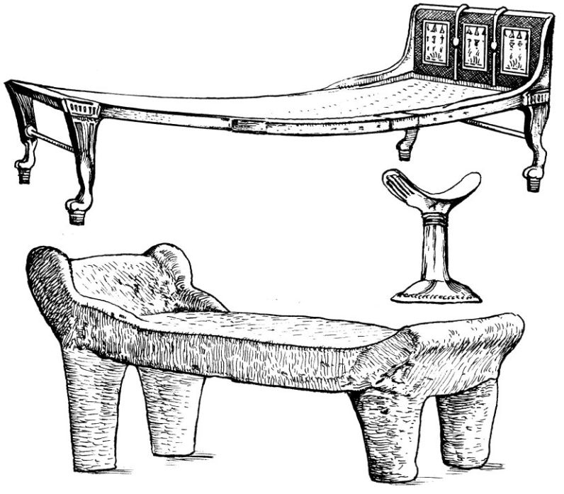
Beds of Ivory
Micah 2
¹ Woe to those who devise iniquity,
And work out evil on their beds!
At morning light they practice it,
Because it is in the power of their hand.
² They covet fields and take them by violence,
Also houses, and seize them.
So they oppress a man and his house,
A man and his inheritance.
Amos 6:3-7(NKJV) ³ Woe to you who put far off the day of doom, Who cause the seat of violence to come near; ⁴ Who lie on beds of ivory, Stretch out on your couches, Eat lambs from the flock And calves from the midst of the stall; ⁵ Who sing idly to the sound of stringed instruments, And invent for yourselves musical instruments like David; ⁶ Who drink wine from bowls, And anoint yourselves with the best ointments, But are not grieved for the affliction of Joseph. ⁷ Therefore they shall now go captive as the first of the captives, And those who recline at banquets shall be removed.

Slide 39
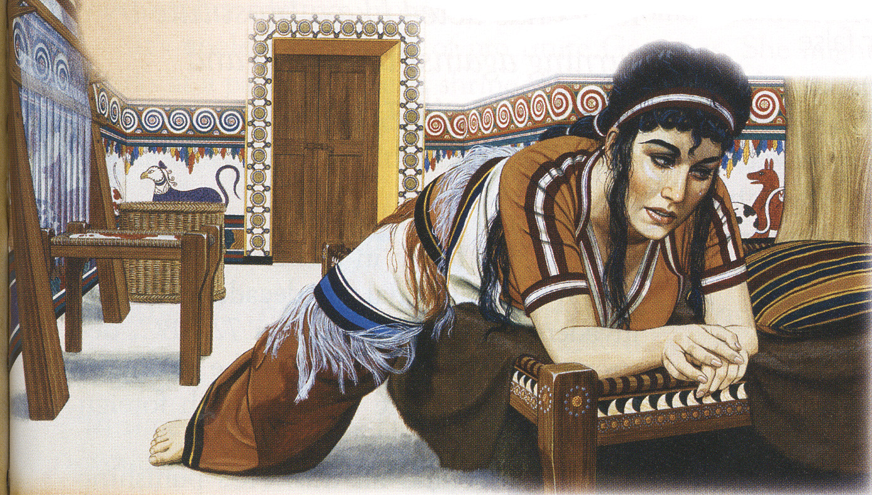
Woe to beds
⁴ Who lie on beds of ivory, Stretch out on your couches, Eat lambs from the flock And calves from the midst of the stall;
Woe to those who devise iniquity,
And work out evil on their beds!
At morning light they practice it,
Because it is in the power of their hand.
Amos
Micah

Slide 40
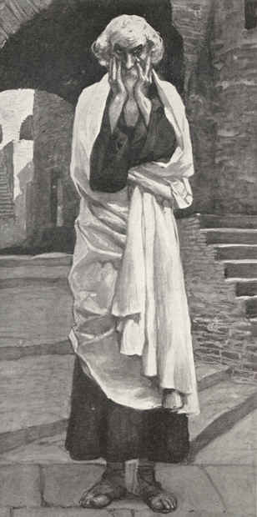
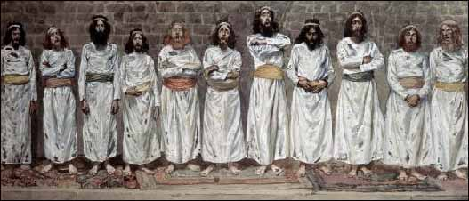
Micah 2:6
ESV:⁶“Do not preach”—thus they preach—
“one should not preach of such things;
disgrace will not overtake us.”
TLB:⁶“Don’t say such things,” the people say. “Don’t harp on things like that. It’s disgraceful, that sort of talk. Such evils surely will not come our way.”
Micah
NKJV:⁶“Do not prattle,” you say to those who prophesy.
So they shall not prophesy £to you;
£They shall not return insult for insult.
KJV:⁶Prophesy ye not, say they to them that prophesy: they shall not prophesy to them, that they shall not take shame.
NKJV:⁶“Do not prattle,” you say to those who prophesy.
So they shall not prophesy to you;
They shall not return insult for insult.
People

Slide 41
Micah 2:6
ESV:⁶“Do not preach”—thus they preach—
“one should not preach of such things;
disgrace will not overtake us.”
TLB:⁶“Don’t say such things,” the people say. “Don’t harp on things like that. It’s disgraceful, that sort of talk. Such evils surely will not come our way.”
Micah
NKJV:⁶“Do not prattle,” you say to those who prophesy.
So they shall not prophesy to you;
They shall not return insult for insult.
KJV:⁶Prophesy ye not, say they to them that prophesy: they shall not prophesy to them, that they shall not take shame.
People

Slide 42
Micah 2:6
TLB:⁶“Don’t say such things,” the people say. “Don’t harp on things like that. It’s disgraceful, that sort of talk. Such evils surely will not come our way.”
Micah
ESV:⁶“Do not preach”—thus they preach—
“one should not preach of such things;
disgrace will not overtake us.”
People

Slide 43
Micah 2:11
TLB:¹¹“I’ll preach to you the joys of wine and drink”—that is the kind of drunken, lying prophet that you like!
NKJV:¹¹If a man should walk in a false spirit
And speak a lie, saying,
‘I will prophesy to you of wine and drink,’
Even he would be the prattler of this people.
KJV:¹¹If a man walking in the spirit and falsehood do lie, saying, I will prophesy unto thee of wine and of strong drink; he shall even be the prophet of this people.
ESV:¹¹If a man should go about and utter wind and lies,
saying, “I will preach to you of wine and strong drink,”
he would be the preacher for this people!
ASV:¹¹If a man walking in a spirit of falsehood do lie, saying, I will prophesy unto thee of wine and of strong drink; he shall even be the prophet of this people.

Slide 44
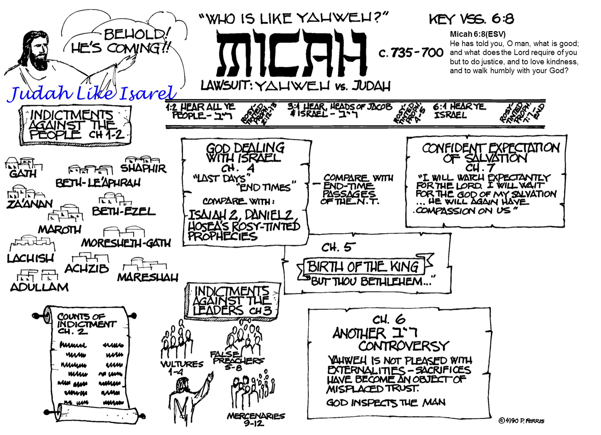

Slide 45
Prophet’s Visual Aids
Micah 1:4 (NKJV) ⁴
The mountains will melt under Him, And the valleys will split Like wax before the fire,
Like waters poured down a steep place.
Micah 2:12 (NKJV) ¹² "I will surely assemble all of you, O Jacob, I will surely gather the remnant of Israel; I will put them together like sheep of the fold, Like a flock in the midst of their pasture; They shall make a loud noise because of so many people.

