Slide 1
Does the Eyewitness Evidence of the Biographies of Jesus the Christ Stand Up to Scrutiny?
Lesson 3

Slide 2
Class Outline
Lesson | Description
1 | Jesus of the Bible vs Reinvented Jesus of Modern Man
2 | Tools for Examination of the Evidence
3 | Does the Eyewitness Evidence of the Biographies of Jesus the Christ Stand Up to Scrutiny?
4 | Was the Documentary Evidence (Jesus’ Biographies) Reliably Preserved for Us?
5 | Is There Credible Non-Biblical Evidence for Jesus outside His Biographies?
6 | Does Archaeology/the Scientific Evidence Confirm or Contradict Biographies of Jesus?
7 | Was Jesus Really Convinced That He Was the Son of God and did Jesus the Christ fulfill the Attributes of God?
8 | The Psychological Evidence; Was Jesus Crazy When He Claimed to Be the Son of God?
9 | The Fingerprint Evidence – Prophecy Did Jesus—and Jesus Alone—Match the Identity of the Messiah?
10 | The Resurrection – was Jesus Raised from the Dead?
11 | What is the Evidence of that Jesus was seen Alive after His Death on the Cross?
12 | Tactics for Discussing the Case for Jesus the Christ
13 | What Does the Evidence Establish—And What Does It Mean Today?

Slide 3
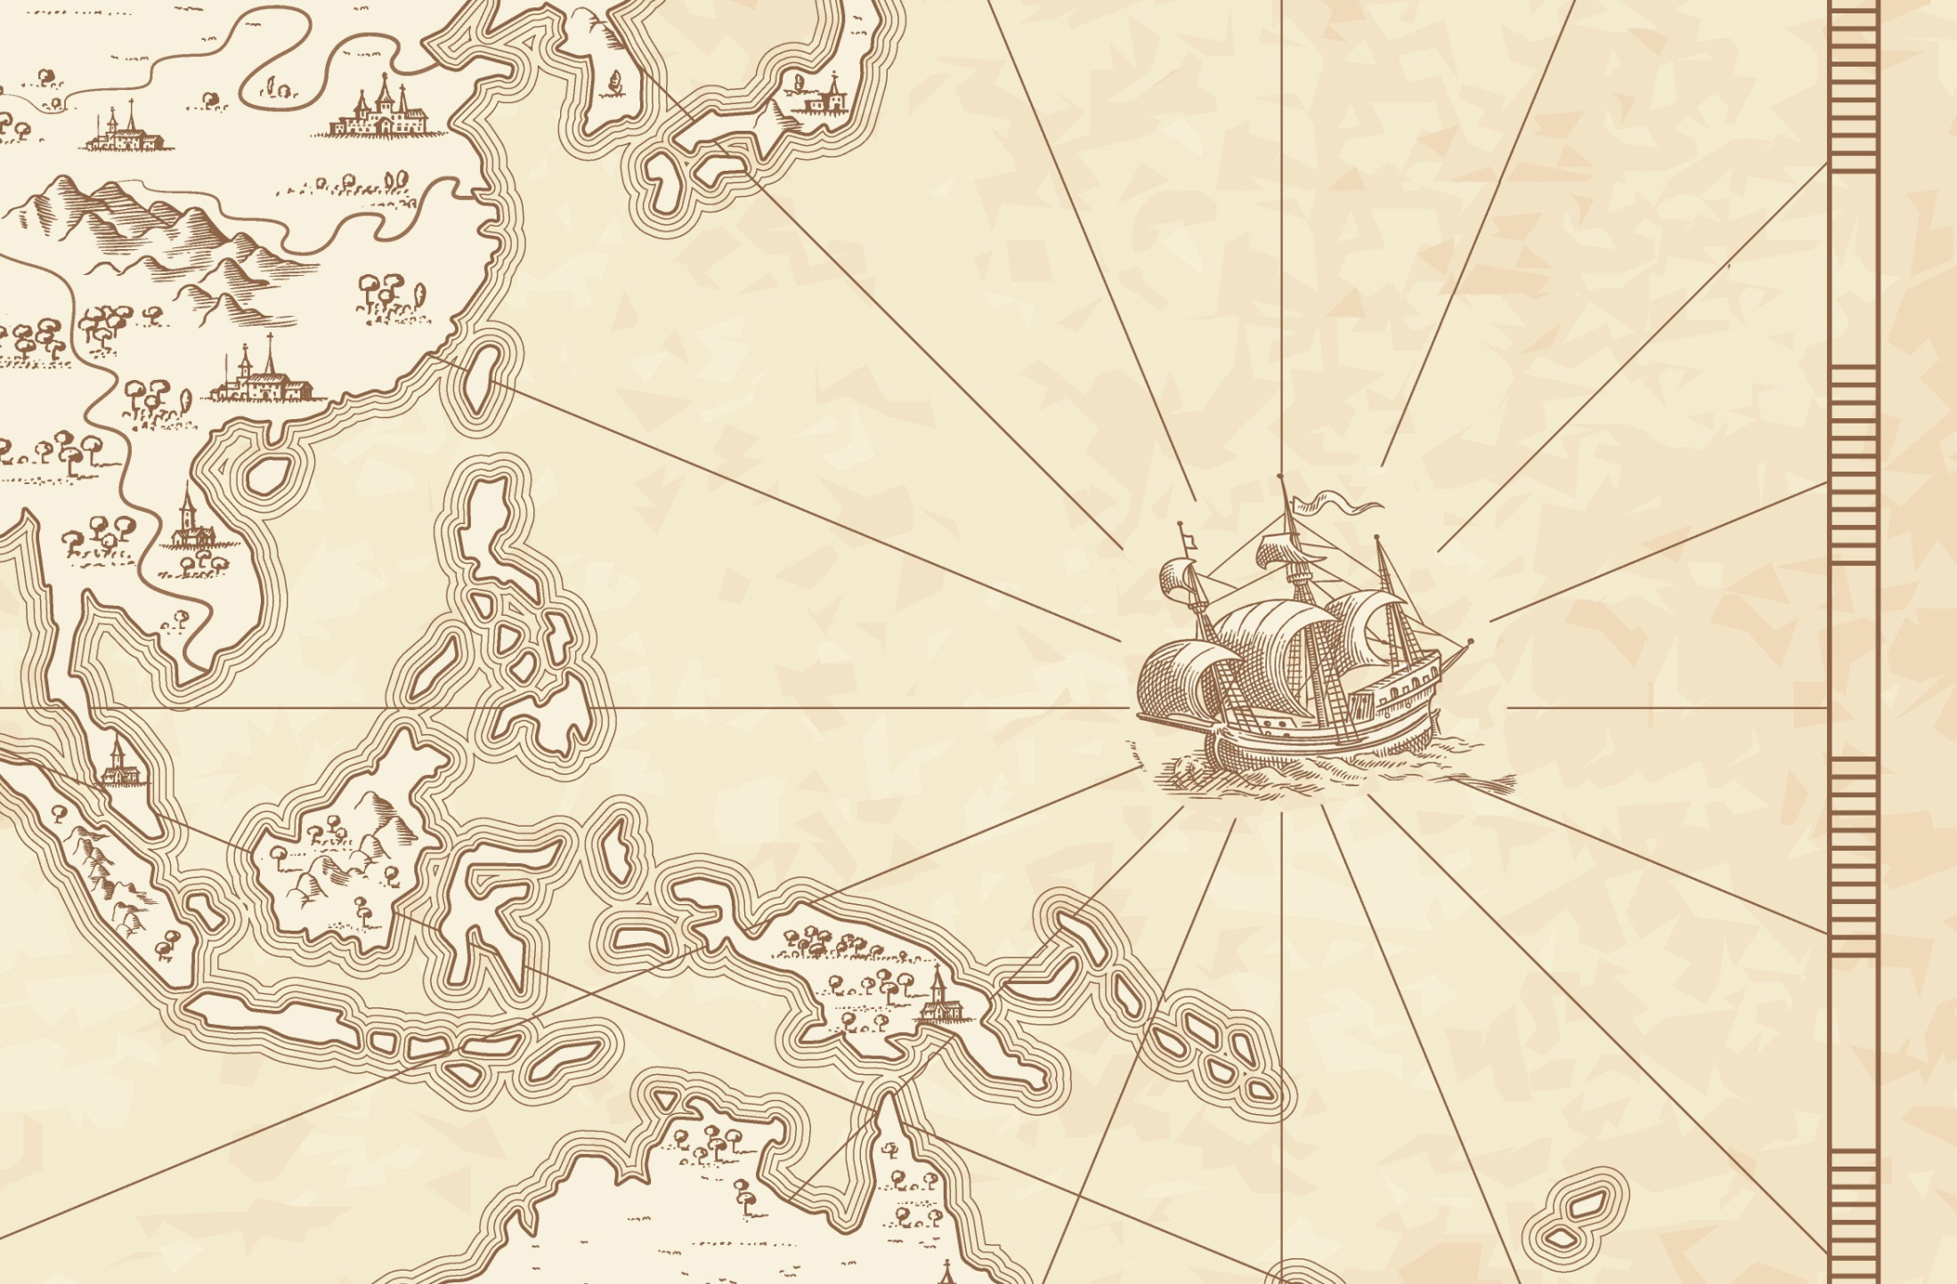
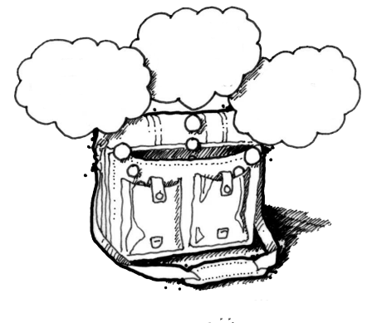
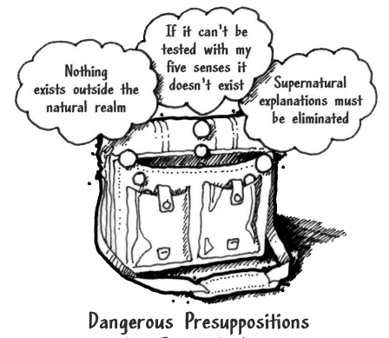
God
Supreme Being
We are created
Bible is
Accurate
Bible is Inspired
Bible is
Reliable
Super Naturalism it is possible that there is
a supreme being/someone beyond natural order
Intelligent Design – a programmer
nothing exists beyond the natural realm
Philosophical Naturalism The presuppositional belief
that only natural laws and forces occur
No God
No Supreme Being
We come from nothing
Using God
To fill in the Gaps

Slide 4
Bible Authority Established
Creation, Flood, Redemption Story, Moses, Moral Laws, Miracles, Nature of Man, Purpose of Man, Nature of God, Christ & Holy Spirit, Requirements for Worship, Personality of Jesus, Coming Judgment, Heaven, Hell, Angels, Demons, & Satan
Bible would be Accurate
Based on Bible Testimony Jesus is Son of God
Teachings of
Jesus are True
Accurate Account of Jesus’ Life
A Step of Faith not
A Leap of Faith
Bible can be Understood
Bible is Inspired
Bible is Accurate
Bible is Reliable
If Bible Revelation of Creator then
Divine Revelation Possible
& Accurate So Purpose is Known
Starting Point for
How We Got the Bible
class
Creation
has a purpose
Likely a Moral Law
Miracles &
Revelations
Universe had an Intelligent, Personal Origin
Possible that Universe had Supernatural Origin
It is Possible that there is Supernatural Force
Based on material from mmb, jr Establishing Bible Authority Class - 10/30/2002

Slide 5
Class Objectives
Examine who wrote the Gospels and determine if the Gospel witnesses hold up to scrutiny.

Slide 6
J Wallace 4 questions to evaluate witnesses
1. Was the witness truly PRESENT to see what he or she claims to have seen?
2. Can the statements and claims of the witness be VERFIED in some way?
3. Has the witness been HONEST and ACCURATE over time, or did his or her account change over time?
4. Does the witness possess a BIAS that would motivate him or her to lie?

Slide 7
Strobel’s 8 Questions
THE INTENTION TEST This test seeks to determine whether it was the stated or implied intention of the writers to accurately preserve history.
THE ABILITY TEST Even if the writers intended to reliably record history, were they able to do so?
THE CHARACTER TEST This test looks at whether it was in the character of these writers to be truthful.
THE CONSISTENCY TEST Here’s a test that skeptics often charge the gospels with failing. After all, aren’t they hopelessly contradictory with each other?

Slide 8
THE BIAS TEST This test analyzes whether the gospel writers had any biases that would have colored their work.
THE COVER-UP TEST When people testify about events they saw, they will often try to protect themselves or others by conveniently forgetting to mention details that are embarrassing or hard to explain.
THE CORROBORATION TEST When the gospels mention people, places, and events, do they check out to be correct in cases in which they can be independently verified?
THE ADVERSE WITNESS TEST This test asks the question, where others present who would have contradicted or corrected the gospels if they had been distorted or false?

Slide 9
Written by Paul - Undisputed
First Epistle to the Thessalonians (51 AD)
Epistle to the Galatians (47 (51-53)AD?)
First Epistle to the Corinthians (52-56 AD)
Second Epistle to the Corinthians (52-56 AD)
Epistle to the Philippians (60-62 AD)
Epistle to Philemon (60-62 AD)
Epistle to the Romans (52-57 AD)

Slide 10
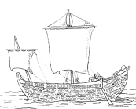
Mark in the 70s, Matthew and Luke in the 80s, John in the 90s.
100-200 AD
P104/ P. Oxy. 4404
Matthew 21
P. Oxy. 3523
Paul’s Epistles
1 Thess ~50 AD
Gal ~53
1 Cor ~53-54
Phil ~55
Phmn~55
2 Cor ~55-56
Ro ~57
Mark
175-200 AD
Magdalen" papyrus
Matthew 3,5,26
70 AD
Temple
Destroyed
Matthew
Luke
Polycarp
120 AD
Letter Quotes
16 NT Books
Clement
95 AD
Letter Quotes
10 NT Books
125-175 AD
J Ryland
John 18
27-30 AD
Ministry of Jesus
John
Luke
John
25 AD
50 AD
75 AD
100 AD
150 AD
200 AD
250 AD
Mark
Matthew
Tertullian (c. 150-c. 229) quotes from 23 of the 27 NT canon
AD 115,
Ignatius, bishop of Antioch,
Refers to “The Gospel” as
authoritative writing

Slide 11
Mark in the 70s, Matthew and Luke in the 80s, John in the 90s.
• 2 – Titus 3:1, Acts 20:35
• 7 – 1 Pet 3:20, 2 Pet 2:5
• 9 – Heb 11:5
• 34 – Quotes 1 Cor 2:9 and calls it scripture
• 35 – Rom 1:32
• 36 – Heb 1:3-4
• 37 and 38 – Church as a body metaphor, as in 1 Corinthians
• 46 – James 4:1
• 46 – Jesus' “millstone” quote (which is
present in Matthew, Mark and Luke)
• 49 – James 5:20
100-200 AD
P104/ P. Oxy. 4404
Matthew 21
Mark
P. Oxy. 3523
Paul’s Epistles
1 Thess ~50 AD
Gal ~53
1 Cor ~53-54
Phil ~55
Phmn~55
2 Cor ~55-56
Ro ~57
175-200 AD
Magdalen" papyrus
Matthew 3,5,26
70 AD
Temple
Destroyed
Polycarp
120 AD
Letter Quotes
16 NT Books
Clement
95 AD
Letter Quotes
10 NT Books
125-175 AD
J Ryland
John 18
27-30 AD
Ministry of Jesus
Luke
John
25 AD
50 AD
75 AD
100 AD
150 AD
200 AD
250 AD
Mark
Matthew
Tertullian (c. 150-c. 229) quotes from 23 of the 27 NT canon
AD 115,
Ignatius, bishop of Antioch,
Refers to “The Gospel” as
authoritative writing

Slide 12
Matthew 16:13 (NKJV) When Jesus came into the region of Caesarea Philippi, He asked His disciples, saying, "Who do men say that I, the Son of Man, am?"
Matthew 16:14 (NKJV) So they said, "Some say John the Baptist, some Elijah, and others Jeremiah or one of the prophets."
Matthew 16:15 (NKJV) He said to them, "But who do you say that I am?"
Matthew 16:16 (NKJV) ¹⁶ Simon Peter answered and said,
"You are the Christ, the Son of the living God."

Slide 13
Who is Jesus
He is the Christ (Messiah), the Anointed One foreseen by the Old Testament prophets.
(Isaiah 9:6; Matthew 16:16; John 4:25–26; John 6:69)
He is the Savior of the world, the one who delivers from sin.
(John 3:16–18; John 4:42; Acts 5:31; 1 John 4:14)
He is the Lamb of God, the one who sacrificed His life for sins.
(Isaiah 53:7; John 1:29)
He is the Son of God, having a unique and intimate relationship with God the Father.
(John 20:31)
He is the Creator of all things. (John 1:3; Colossians 1:16–17, Hebrews 1:2, 3)
He is equal to God. (John 5:23; Philippians 2:6)
He is eternal, existing with God from the very beginning. (John 1:1–2)
He is God in the flesh, revealing to us what God is like. (John 1:18, Hebrews 1:3)
He is the Lord of all. (Acts 10:36, Philippians 2:9–11)
He was born of a virgin. (Isaiah 7:14, Matthew 1:22–23; Luke 1:27–35)
He has the authority to forgive sins. (Mark 2:10)
He is worshiped. (John 9:38; Luke 24:52; Hebrews 1:6)
He is the living Savior, raised from the dead and sitting today at the right hand of God;
By His resurrection we have new life. (1 Peter 3:21–22; Romans 8:34)

Slide 14
Jesus of Modern Scholar
The followers of Jesus invented his deity after his death
Jesus was a Magician
Jesus is a non-apocalyptic, teasing teacher
Jesus was an apocalyptic prophet
Jesus was a Cynic
Jesus just man
Jesus never claimed to be God
Jesus was a revolutionary, a sage, an iconoclastic Jew

Slide 15
Who do Men Say
Jesus of Nazareth, or Jesus Christ (as Christians call him), is undoubtedly the best known and most influential human person in world history.
If we say Jesus is purely a construct, without any historical roots, then Christianity itself would be in danger of collapsing
For if the dead do not rise, then Christ is not risen.
And if Christ is not risen, your faith is futile; you are still in your sins!
Then also those who have fallen asleep in Christ have perished.
If in this life only we have hope in Christ, we are of all men the most pitiable.
1 Cor 15:16-19 (NKJV)

Slide 16
Class Questions
Don’t the Gospels give contradictory reports as to the time Christ was crucified?
What could be an explanation for differences between Matthew & Luke in Matthew 8:5-13 it says a centurion himself came to ask Jesus to heal his servant,” “However, Luke 7:1-10 says the centurion sent the elders to do this.

Slide 17
Day starts at 6 AM
9 AM
Mark 15:25 (NKJV) ²⁵ Now it was the third hour, and they crucified Him.
Mark 15:25 (HCSB) ²⁵ Now it was nine in the morning when they crucified Him.
12 PM
Matthew 27:45-46 (NKJV) ⁴⁵ Now from the sixth hour until the ninth hour there was darkness over all the land. ⁴⁶ And about the ninth hour Jesus cried out with a loud voice, saying, "Eli, Eli, lama sabachthani?" that is, "My God, My God, why have You forsaken Me?"
3 PM
12 PM
Luke 23:44 (NKJV) ⁴⁴ Now it was about the sixth hour, and there was darkness over all the earth until the ninth hour.
3 PM
Day starts at 12 AM
6 AM
John 19:14 (NKJV) ¹⁴ Now it was the Preparation Day of the Passover, and about the sixth hour. And he said to the Jews, "Behold your King!"

Slide 18
Class Questions
Luke 7:1-10 (NKJV)
¹ Now when He concluded all His sayings in the hearing of the people, He entered Capernaum. ² And a certain centurion's servant, who was dear to him, was sick and ready to die. ³ So when he heard about Jesus, he sent elders of the Jews to Him, pleading with Him to come and heal his servant. ⁴ And when they came to Jesus, they begged Him earnestly, saying that the one for whom He should do this was deserving, ⁵ "for he loves our nation, and has built us a synagogue." ⁶ Then Jesus went with them. And when He was already not far from the house, the centurion sent friends to Him, saying to Him, "Lord, do not trouble Yourself, for I am not worthy that You should enter under my roof. ⁷ Therefore I did not even think myself worthy to come to You. But say the word, and my servant will be healed. ⁸ For I also am a man placed under authority, having soldiers under me. And I say to one, 'Go,' and he goes; and to another, 'Come,' and he comes; and to my servant, 'Do this,' and he does it." ⁹ When Jesus heard these things, He marveled at him, and turned around and said to the crowd that followed Him, "I say to you, I have not found such great faith, not even in Israel!" ¹⁰ And those who were sent, returning to the house, found the servant well who had been sick.
Matthew 8:5-10 (NKJV)
5 Now when Jesus had entered Capernaum, a centurion came to Him, pleading with Him,
6 saying, "Lord, my servant is lying at home paralyzed, dreadfully tormented."
7 And Jesus said to him, "I will come and heal him."
8 The centurion answered and said, "Lord, I am not worthy that You should come under my roof. But only speak a word, and my servant will be healed.
9 For I also am a man under authority, having soldiers under me. And I say to this one, 'Go,' and he goes; and to another, 'Come,' and he comes; and to my servant, 'Do this,' and he does it."
10 When Jesus heard it, He marveled, and said to those who followed, "Assuredly, I say to you, I have not found such great faith, not even in Israel!

