Slide 1
Jeremiah – 40 years of prophecy
Lesson 8: Jeremiah’s prophecy of 70 years

Slide 2
Class Objectives
Give examples of how God moves in the Nations and in Time to accomplish His will
See Jeremiah as a real person in history, and how God developed his faith
See how idolatry betrays our relationship with God
See God’s mercy displayed, even in judgement

Slide 3
Outline of Jeremiah
Part I: Chapter 1
Part II: Chapter 2-20
Part III: Chapters 21-39
Part IV: Chapters 40-45
Part V: Chapters 46-51
Historical Appendix: Chapter 52
Jeremiah’s call
Speeches and Prophecies during rule of Josiah
Prophecies of Specific Events during rule of Jehoiakim & Zedekiah
Judah After the Fall of Jerusalem
The Lord’s Word Against Foreign Nations
The Fall of Jerusalem
Notes:
Part I: Chapter 1 Jeremiah’s call
Part II: Chapter 2-20 Speeches and Prophecies Concerning Judah & Jerusalem Primarily During the Time of Josiah, (641-610 B.C.)
Part III: Chapters 21-39 Prophecies of Specific Events during the Time of
Jehoiakim (608-597) and Zedekiah, (597-586),
1: Woe to Zedekiah, Chs. 21-24
2: In the Fourth Year of Jehoiakim, Chs. 25-26
3: In the Fourth Year of Zedekiah, Chs. 27-29
4: The Book of God’s Consolation, Chs. 30-33
5: Under the Reign of Zedekiah, Ch. 34
6: Under the Reign of Jehoiakim, Chs. 35-36
7: Under Zedekiah, Chs. 37-39
Part IV: Chapters 40-45 Jeremiah’s Ministry to Judah After the Fall of
Jerusalem,
Part V: Chapters 46-51 The Lord’s Word Against Foreign Nations,
Historical Appendix: Chapter 52 The Fall of Jerusalem

Slide 4
Dating of Jeremiah’s Prophecies
645
KINGS
Of
JUDAH
640
EVENTS
635
Josiah begins reforms
630
1-6
Josiah purges idolatry
625
Jeremiah Called
JOSIAH
11-13
Book of Law found
620
18-20
615
7-10
22:1-23
Nineveh falls
JEHOAHAZ
610
25
26
35
36:1-8
45:1-49:33
605
36:9-32
First Deportation, Daniel & Ezekiel taken
JEHOIAKIM
JEHOIACHIN
600
14-17
23-24
29-31
49:34-39
595
Second Deportation
ZEDEKIAH
22:24-30
50-51
590
21
27-28
GEDALIAH
585
32-34
37
38-44
Destruction of Jerusalem, Final Deportation
580
575
570
565
52
560
Jehoiachin released & fed at kings table

Slide 5
Jeremiah’s Time…
2Ch 35:20-21 After all this, when Josiah had prepared the temple, Necho king of Egypt came up to fight against Carchemish by the Euphrates; and Josiah went out against him. (21) But he sent messengers to him, saying, "What have I to do with you, king of Judah? I have not come against you this day, but against the house with which I have war; for God commanded me to make haste. Refrain from meddling with God, who is with me, lest He destroy you."
It is 605 BC (when we start Chapter 25)
In the 4th year of King Jehoiakim
In the 23rd year of Jeremiah’s work of prophecy
In the first year of Nebuchadnezzar…
World Events are shaping up
Babylon and Medes rebelled against Assyria in 612 (Battle of Ninevah)
Egypt marched to Carchemish to help Assyria against Babylon.
Josiah was killed in the Battle of Megiddo in 609
Johoahaz made King after his father, but carried away by Pharoah Necho
Assyria/Egypt were defeated by Babylon/Medes/Persians/Scythians in the battle of Carchemish in 605

Slide 6
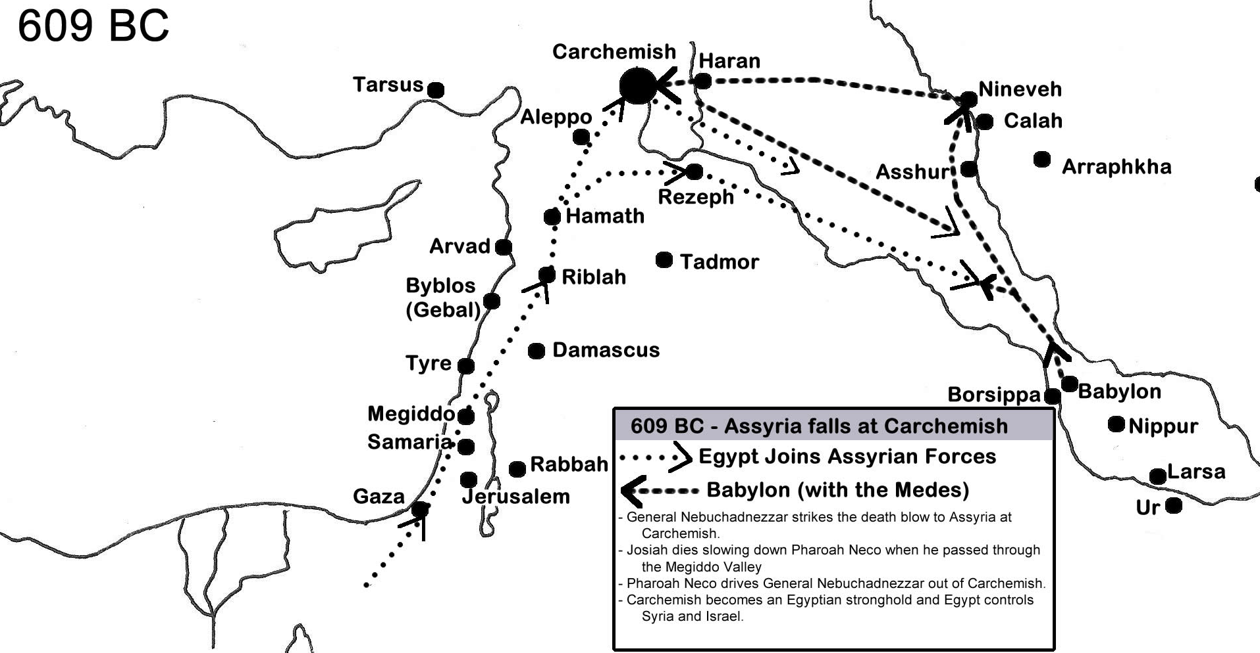
Assyria Defeated
Babylon rebels at Ninevah
Josiah dies in battle at Megiddo
Egypt joins Assyria at Carchemish

Slide 7
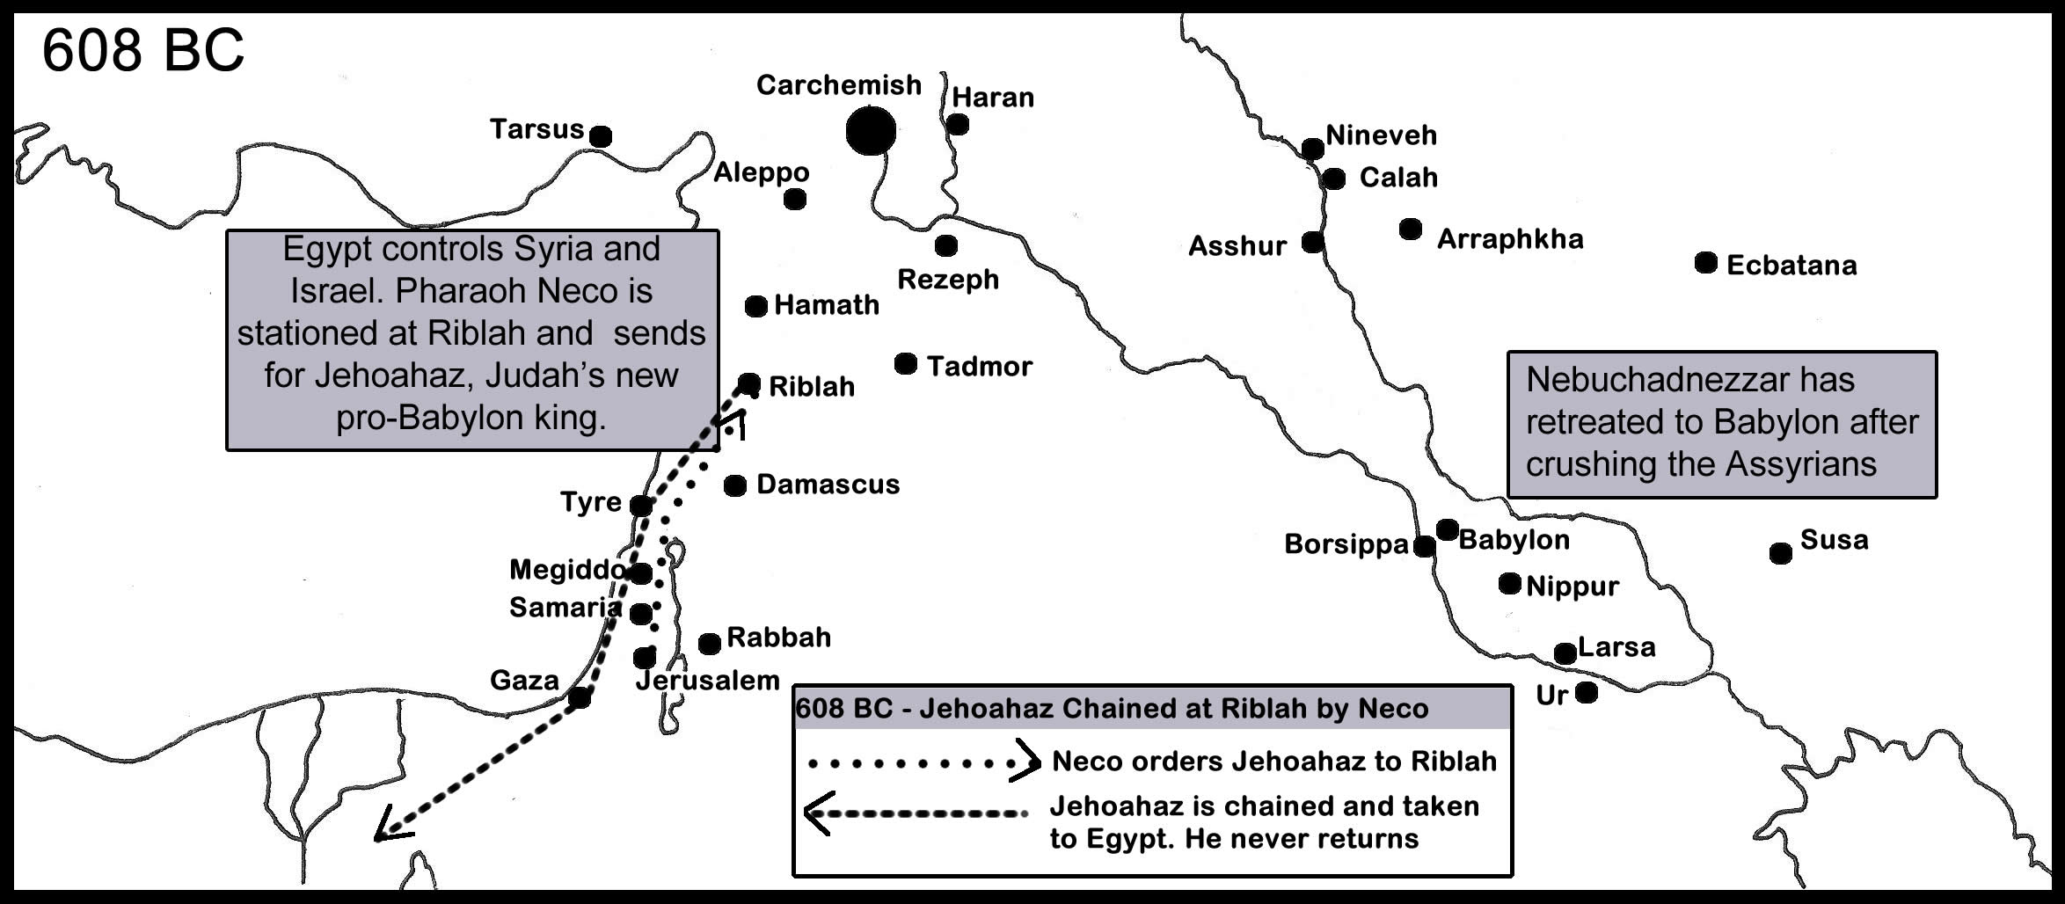
Egypt controls Judah
Jehoahaz crowned and deported
Jehoiakim Crowned

Slide 8
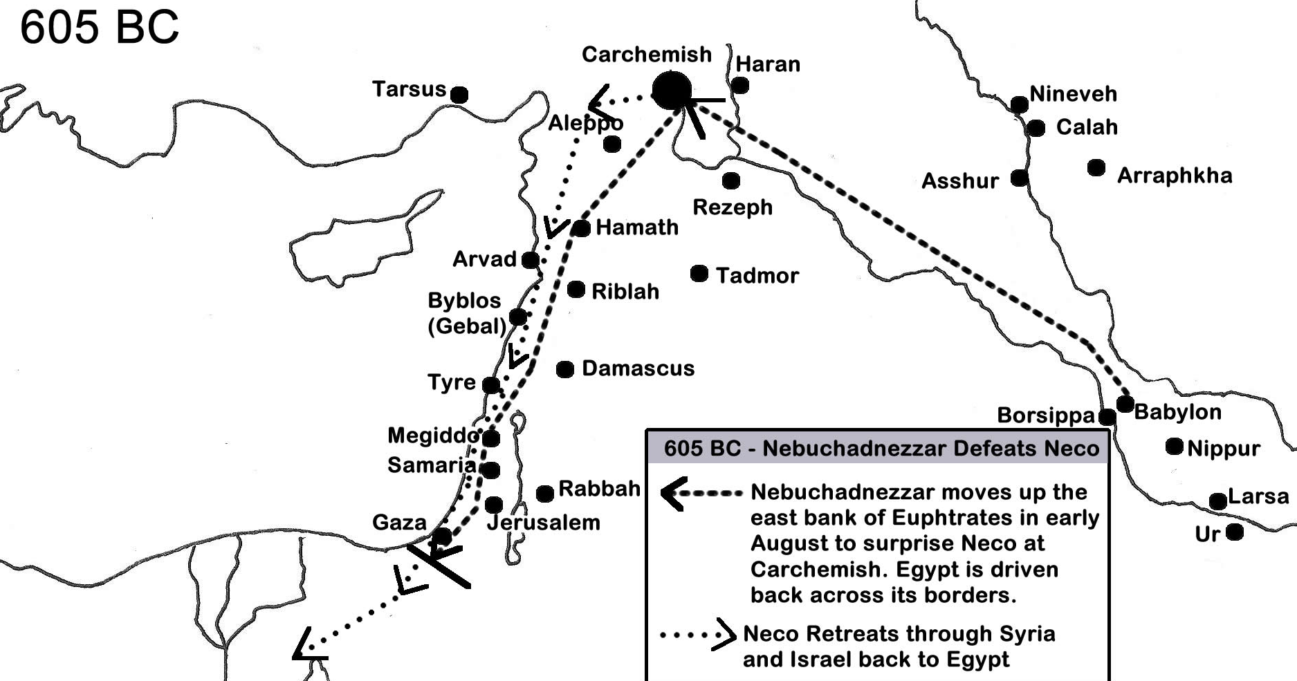
Babylon Controls judah
Egypt defeated
First deportations from Judah

Slide 9
The messages thus far…
The Charge: Idolatry and unrighteousness (Ch 1-3)
The Example: Israel’s destruction as a lesson (Ch 4-6)
In the Temple: Warning against false religion (Ch 7-10)
The Broken Covenant: they forgot the law (Ch 11-12)
The Ruined Sash: Israel’s pride is of no value (Ch 13)
The Drought: Forgiveness requires repentance (Ch 14-17)
The Potter and Clay: God’s sovereign right to act (Ch 18-20)
The Query from Zedekiah: Doom is set. Choose the way of life or the way of death (Ch 21)
The Kings: Messages to the House of Josiah (Ch 22)
The Prophets: Speaking or believing error (Ch 23)

Slide 10
Judah WILL go into captivity
Jer 25:9-11 behold, I will send and take all the families of the north,' says the LORD, 'and Nebuchadnezzar the king of Babylon, My servant, and will bring them against this land, against its inhabitants, and against these nations all around, and will utterly destroy them, and make them an astonishment, a hissing, and perpetual desolations. (10) Moreover I will take from them the voice of mirth and the voice of gladness, the voice of the bridegroom and the voice of the bride, the sound of the millstones and the light of the lamp. (11) And this whole land shall be a desolation and an astonishment, and these nations shall serve the king of Babylon seventy years.
God has made His case against the people
They did not repent and return to Him. Their hearts were hardened
Destruction was determined
Captivity…
Jer 21:7 And afterward," says the LORD, "I will deliver Zedekiah king of Judah, his servants and the people, and such as are left in this city from the pestilence and the sword and the famine, into the hand of Nebuchadnezzar king of Babylon, into the hand of their enemies, and into the hand of those who seek their life; and he shall strike them with the edge of the sword. He shall not spare them, or have pity or mercy." '
Jer 6:22-23 Thus says the LORD: "Behold, a people comes from the north country, And a great nation will be raised from the farthest parts of the earth. (23) They will lay hold on bow and spear; They are cruel and have no mercy; Their voice roars like the sea; And they ride on horses, As men of war set in array against you, O daughter of Zion."
Jer 5:15 Behold, I will bring a nation against you from afar, O house of Israel," says the LORD. "It is a mighty nation, It is an ancient nation, A nation whose language you do not know, Nor can you understand what they say.

Slide 11
Nebuchadnezzar – Servant of God?
God would use the King of Babylon for His purposes (He reigned 43 years)
Later, Babylon itself would be punished
But how was this foreign monarch a “servant of God”?
Dan 4:34-37 And at the end of the time I, Nebuchadnezzar, lifted my eyes to heaven, and my understanding returned to me; and I blessed the Most High and praised and honored Him who lives forever: For His dominion is an everlasting dominion, And His kingdom is from generation to generation. (35) All the inhabitants of the earth are reputed as nothing; He does according to His will in the army of heaven And among the inhabitants of the earth. No one can restrain His hand Or say to Him, "What have You done?" (36) At the same time my reason returned to me, and for the glory of my kingdom, my honor and splendor returned to me. My counselors and nobles resorted to me, I was restored to my kingdom, and excellent majesty was added to me. (37) Now I, Nebuchadnezzar, praise and extol and honor the King of heaven, all of whose works are truth, and His ways justice. And those who walk in pride He is able to put down.
Dan 3:28-29 Nebuchadnezzar spoke, saying, "Blessed be the God of Shadrach, Meshach, and Abed-Nego, who sent His Angel and delivered His servants who trusted in Him, … Therefore I make a decree that any people, nation, or language which speaks anything amiss against the God of Shadrach, Meshach, and Abed-Nego shall be cut in pieces, and their houses shall be made an ash heap; because there is no other God who can deliver like this."
Dan 2:46-47 Then King Nebuchadnezzar fell on his face, prostrate before Daniel, and commanded that they should present an offering and incense to him. (47) The king answered Daniel, and said, "Truly your God is the God of gods, the Lord of kings, and a revealer of secrets, since you could reveal this secret."

Slide 12
Jeremiah Encourages the Captives (CH 29)
A letter sent to the elders, priests, prophets, and people in captivity
By the hand of high officials
After the second captivity (Jeconiah, family, and nobles)
Settle in, it will be a long wait
Build houses, dwell in them
Have sons and daughters, give them in marriage
Seek peace of the city, and pray for them
Ignore the false prophets who say you will return soon
After 70 years, I will visit you and perform my good word
Concerning those who remain: Sword, Famine, and Pestilence
And God will punish those who falsely prophecy in His name

Slide 13
Questions
Is freedom always a good thing? Were the people “free” to stay in the land if they chose to instead of going to captivity in Babylon?
Is servitude always bad? What benefits would come from surrendering to the Babylonians?
How was Nebuchadnezzar God’s servant? In what ways might his interactions with God benefitted the people of Israel in captivity?
In what ways did God work in the Nations at this time to achieve His will?

Slide 14
Jeremiah’s Yoke
Commanded to make Bonds and Yoke for his neck
A message to foreign Kings (27:1-11)
God has the right to deal with His own creation
A message to submit to the King of Babylon
If you submit, you will stay in your own land
A message to Zedikiah (27:12-15)
Submit and Live!
Ignore prophets who lie
A message to the Priests and the People (27:16-22)
Ignore prophets who lie

Slide 15
Cup of the lord’s wrath
Jeremiah commanded to make them drink (25:15-29)
They would stagger and go mad because of the sword
Judah, Egypt, Uz, Philistines, Edom, Moab, Ammon, Tyre, Sidon, Dedan, Tema, Buz, Arabia, Zimri, Elam, Medes… all the kingdoms of the world
Jeremiah commanded to send them yokes
They were under the same judgement

Slide 16
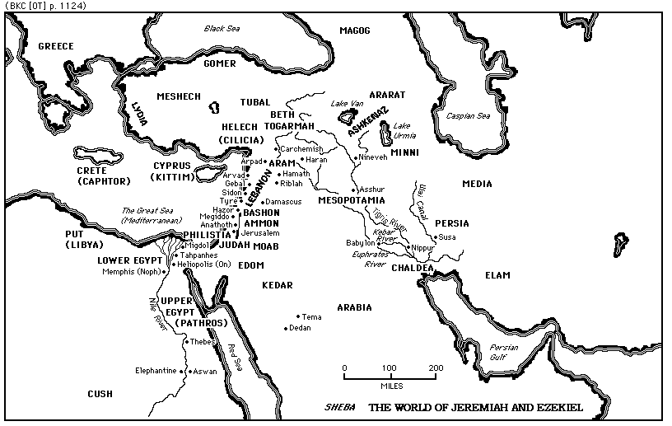

Slide 17
Contentions
In the Temple, with the Priests and Prophets
Commanded to speak the complete word of God (26:1-6)
Priests, prophets, and People want to kill him (26:7-9)
Defended by the Elders and Rulers (26:10-19)
Before King Jehoiakim
Urijah the prophet killed (26:20-24)
Jeremiah protected by Ahikam
By Hananiah, the Prophet
“Within 2 full years, God will return the people and vessels to Jerusalem” (28:1-9)
Broke Jeremiah’s yoke and prophesied falsely
Died within the year

Slide 18
Questions
How was Jeremiah yoked?
How was Jeremiah a “prophet to the nations”, as God had said in Jer 1:5?
Why would this calamity come upon these nations that did not know God (Hint: Jer 25:29)

Slide 19
Thank you

