Slide 1
Patience In Relationships
Notes:
Life is full of people who will sometimes rub us the wrong way. Whether it’s within our family, workplace, church, or community, we've all encountered at least one person who drives us absolutely crazy. Maybe they say sly insults, tell bad jokes, or invade our personal space. Whatever their annoying or hurtful habits are, our spirits are dampened and flustered by their presence in our lives.
As Christians, how do we cope with difficult people? Christ calls us to love selflessly and ceaselessly. So are we just supposed to force a smile and fake a laugh, while inside we're cringing or crying or wanting to flee? How can we possibly be genuine with all these negative emotions broiling just beneath the surface?
What are the steps we take to help us build greater compassion, empathy, and love for our neighbors—even the ones who have caused us pain, anger, or frustration? And do so with humility knowing our own sins and weaknesses make us the ONE who drives someone else crazy.

Slide 2
Tonight’s Special Classes On Patience
Patience When Enduring: How Christians deal with Hardships
Room 12 with Barry Caudill
Patience When Hoping: How Christians Deal with Delayed Dreams
Room 13 with David Hamlett
Patience In Relationships: How Christians Deal with Upsetting People
Auditorium with Phillip Shumake

Slide 3
Patience In Relationships
Notes:
Life is full of people who will sometimes rub us the wrong way. Whether it’s within our family, workplace, church, or community, we've all encountered at least one person who drives us absolutely crazy. Maybe they say sly insults, tell bad jokes, or invade our personal space. Whatever their annoying or hurtful habits are, our spirits are dampened and flustered by their presence in our lives.
As Christians, how do we cope with difficult people? Christ calls us to love selflessly and ceaselessly. So are we just supposed to force a smile and fake a laugh, while inside we're cringing or crying or wanting to flee? How can we possibly be genuine with all these negative emotions broiling just beneath the surface?
What are the steps we take to help us build greater compassion, empathy, and love for our neighbors—even the ones who have caused us pain, anger, or frustration? And do so with humility knowing our own sins and weaknesses make us the ONE who drives someone else crazy.

Slide 4
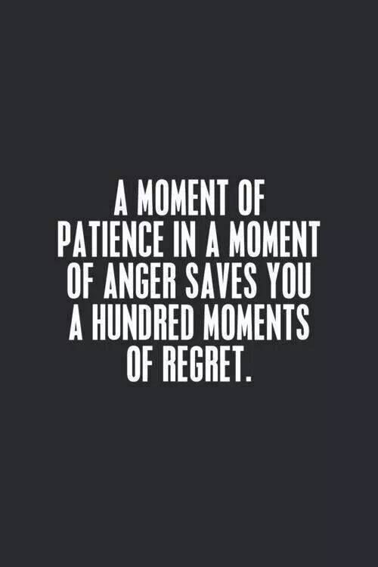
Notes:
The Need for Patience is real. WE see people struggling to practice patience and regretting when they’ve lost their patience.
It shows up in inspirational images online like this one….

Slide 6
The Bible Is Full of Real Relationships That Test Our Patience.
David’s Patience Under The Rule of King Saul.
1 Samuel 24:5-12, Psalm 37:7-9
Joseph’s Patience While In Prison For A Crime He Didn’t Commit - Forgotten By Family & Friends.
Genesis 39:19-23, 40:23-41:1, 14
Job’s Patience With Family & Friends Who Blame Him (And His Children) For Their Suffering.
Job 8:4-6, Job 42:9
Notes:
Saul attacked his friend.
Hunted him relentlessly.
**Lessons:
1.) David always let his relationship with GOD determine his response to others.
2.) Once they came around, Joseph was quick to forgive and restore.
3.) I need the humility to come to the one who has been patient with me and admit my wrongs?

Slide 7
Patience In Relationships
“Can your spouse count on having a patient wife or husband to deal with? Can she know that locking her keys in the car will be met by your calm understanding rather than a demeaning lecture that makes her feel childish? Can he know that being found watching a football game won’t automatically invite a loud-mouthed laundry list of better ways he should be spending his time?” (2013, p. 3).
The Love Dare by Stephen and Alex Kendrick
Notes:
Like Job, Sometimes It Is The People We Love The Most Who Try Our Patience The Most.

Slide 8
Notes:
We hope to have a lot less…
A lot less Arguing,
a lot less loosing our cool,
a lot less murmuring and grumbling,
or taking matters into our own hands.
And a lot more of this…. We want to be working together, moving in the same direction, lending each other a hand so that we all reach the summit together.

Slide 9
Patience In Relationships: Looking To Jesus
How Did Jesus Respond In Tough Moments?
When Helpful, He Told A Story (Luke 7:40-42)
When Useful, He Asked Questions (Mk 11:28-29)
When Suitable, He Remained Silent (John 8:6)
When Necessary, He Used Rebuke (John 8:46-47)

Slide 10
Patience In Relationships: Looking To The Prophets
James 5:10 “As an example…take the prophets who spoke in the name of the Lord.”
When We Feel Betrayed & Hurt.
The Patience of Hosea (Ch. 3:2)
When We Don’t Understand Why God Doesn’t Intervene.
The Patience of Habakkuk (Ch. 1:2,5. 3:17-19)
When We Must Confront Excuses.
The Patience of Haggai (Ch. 1:2-8)
Notes:
Hosea: My patience increases, when I determine to act in a God-directed and loving manner.
Habakkuk: My patience increases, when I grow in awe of God and trust God’s plan no matter how bad things around him appeared.
Haggai: My patience increases, when I seek to inspire people to their best work, not simply point out their failures from the past. He is able to ask them to examine themselves and pointed to tangible, undeniable evidence that they WERE CAPABLE of better behavior.

Slide 11
Patience In Relationships: Looking To Proverbs
Is this an issue I can simply overlook? (Prov. 12:16)
Is the response I’m considering full of self-control? (Prov. 16:32)
If I anticipate trouble, how can I approach this person to defuse the problem before it begins? (Prov. 17:14)
Is this person trying to provoke me? (Prov. 20:3)
Is reducing my interaction with this person a wise and godly choice? (Prov. 22:24)
Is there a way I can extend kindness to break a cycle and elevate the relationship? (Prov. 25:21-22)
Notes:
So how do I know when to do each of these? Turn to the wisdom of Proverbs!

Slide 12
Practical Steps To Bring Patience To Our Relationships
Listen (James 1:19)
Stay Calm (Prov. 15:1)
Avoid Judgment (1 Cor. 8:1)
Offer Respect (Phil. 2:3)
Identify Needs (Prov. 6:30-31)
Identify Hurts (1 Thess. 5:14)
Recruit Help (Matt. 18:16)
Don’t Mock (1 Peter 3:9)
Seek Reconciliation (1 Cor 6:7)
Request Peaceful Tone (Eph 4:29)
Establish Limits (Rom. 12:18)
Clear Your Mind (Col. 3:1)
Notes:
These are constructive actions we can take…so we aren’t just waiting, but we are actually restoring and improving the relationship.

Slide 13
Patience In Relationships
I Can Put To Death The Sins That Shatter Relationships.
Colossians 3:8-9
I Can Remember That God Extended His Love Towards Me When I Needed It The Most.
Colossians 3:12a “those chosen of God”
I Can Base My Identity & Confidence On Being Acceptable To God, Not Seeking Acceptance In Others.
Colossians 3:12b “holy and beloved…”
Notes:
The GREATER PEACE we Have, The Greater The PATIENCE WE Extend.
I think we have to focus on what we CAN DO.

Slide 14
Patience In Relationships
I Can Amplify My Patience with Compassion, Kindness, Humility, Gentleness?
Compassion: “bowels of mercy” moved to help like the good Samaritan. Paying attention to what others need.
Kindness: Free from all that is harsh, rough, and bitter.
Humility: “Lowliness of mind” Philippians 2:3-4
Gentleness: In medicine, only enough force to bring healing. (Plato)
I Can Put These Virtues Into Practice Through:
Bearing With One Another
Forgiving Each Other
Notes:
Amplify Your Patience…whatever amount of patience you have – keep working on learning more. But also – Let’s make the Patience you DO HAVE – make it’s maximum impact!
When Something Isn’t Actually Wrong: They Just Do It Differently Than I Prefer – I can accept that my preferences should not be a yoke or burden on others.
Forgiving: When Something Is Truly Wrong, And Others Repent – Do I Begin To Keep A Count of all the times they’ve upset me, or Do I match genuine repentance with genuine forgiveness.

Slide 15
Patience In Relationships
I Can Submit To The Love & Peace of Christ?
Colossians 3:14-15a, Luke 6:27
I Can Keep In Mind The Qualities In This Person That I Am Thankful For.
Colossians 3:15b
I Can Surround Myself With Christians Who Build Me Up & Fill My Heart With The Words of Christ.
Colossians 3:16-17
Notes:
Ruling my heart…so that I am not responding from selfishness, but from rest.
Surrounding Myself with Christians - - “My child’s teacher is so disappointing…” or. “My neighbor is so disappointing…”. Well, there comes a point you know you can’t chaange that person – but you will have much greater peace when fellow Christians are the people you are closest too!

Slide 16
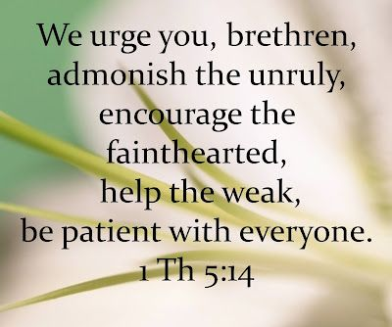
Patience In Relationships
Notes:
1 Thess. 5:14

Slide 17
Patience In Relationships

