Slide 1
Does Archaeology/the Scientific Evidence Confirm or Contradict Biographies of Jesus?
Lesson 6

Slide 2
Class Outline
Lesson | Description
1 | Jesus of the Bible vs Reinvented Jesus of Modern Man
2 | Tools for Examination of the Evidence
3 | Does the Eyewitness Evidence of the Biographies of Jesus the Christ Stand Up to Scrutiny?
4 | Was the Documentary Evidence (Jesus’ Biographies) Reliably Preserved for Us?
5 | Is There Credible Non-Biblical Evidence for Jesus outside His Biographies?
6 | Does Archaeology/the Scientific Evidence Confirm or Contradict Biographies of Jesus?
7 | Was Jesus Really Convinced That He Was the Son of God and did Jesus the Christ fulfill the Attributes of God?
8 | The Psychological Evidence; Was Jesus Crazy When He Claimed to Be the Son of God?
9 | The Fingerprint Evidence – Prophecy Did Jesus—and Jesus Alone—Match the Identity of the Messiah?
10 | The Resurrection – was Jesus Raised from the Dead?
11 | What is the Evidence of that Jesus was seen Alive after His Death on the Cross?
12 | Tactics for Discussing the Case for Jesus the Christ
13 | What Does the Evidence Establish—And What Does It Mean Today?

Slide 3
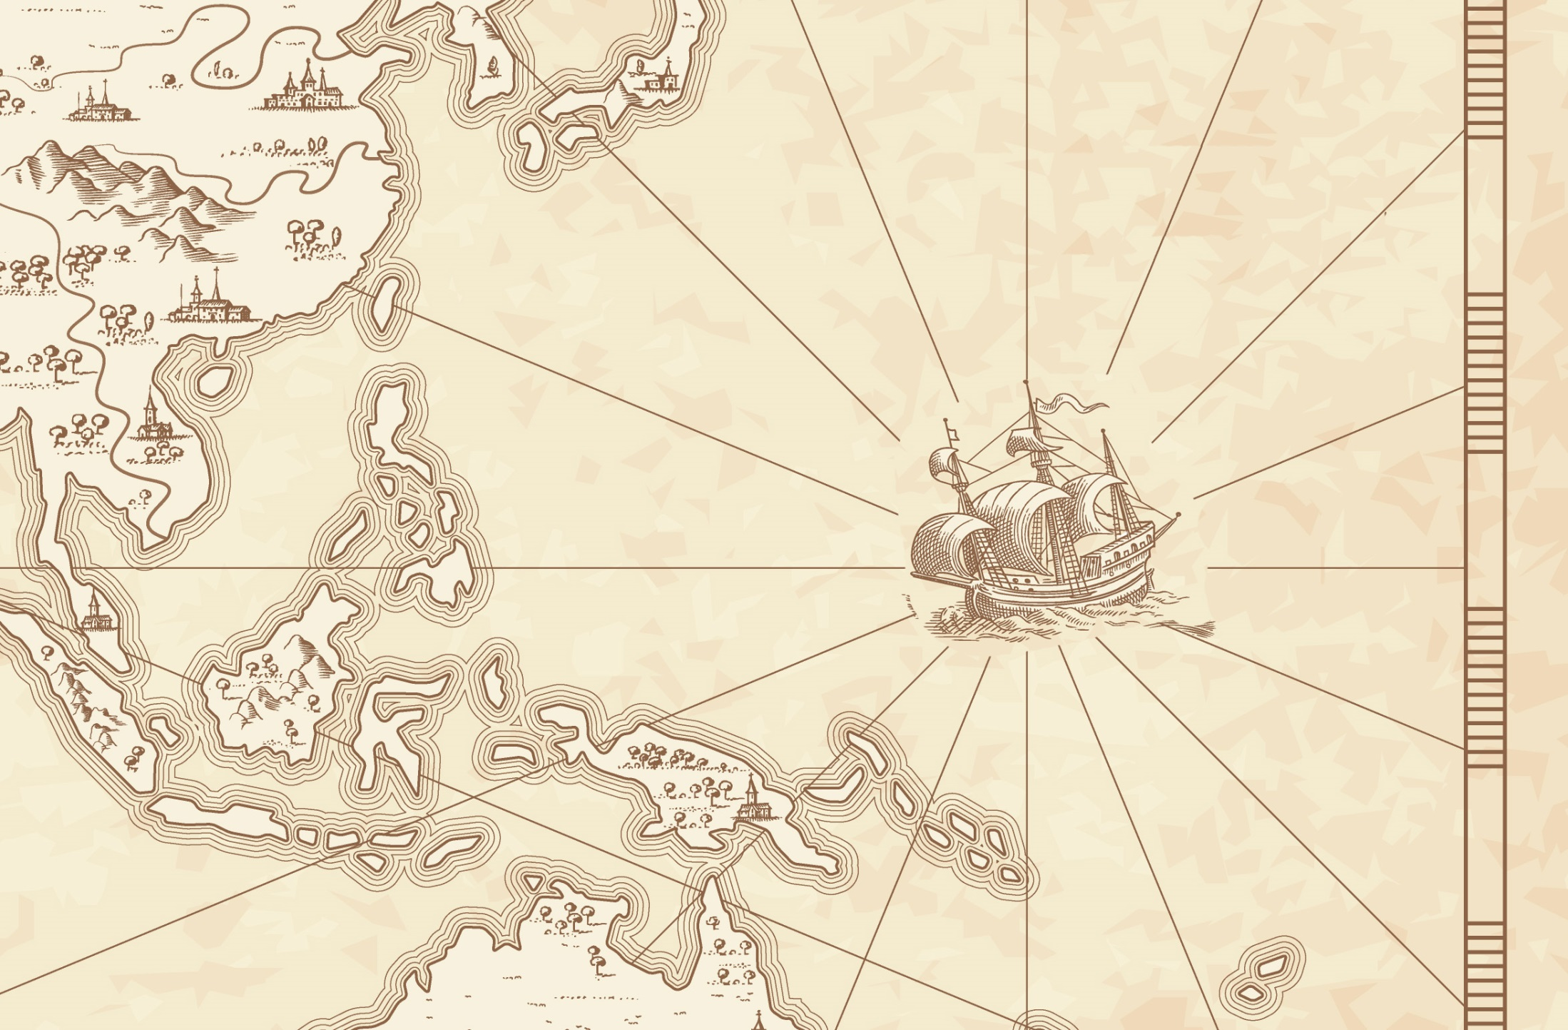
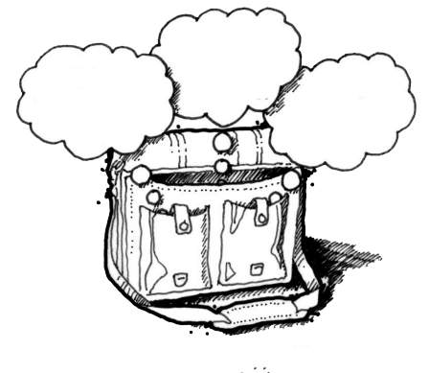
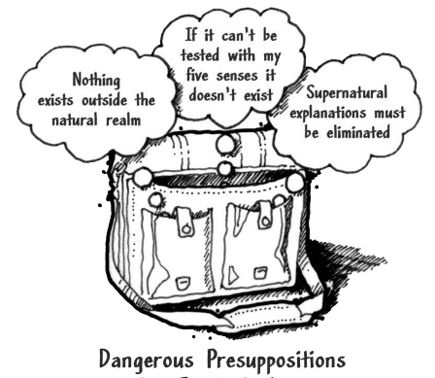
God
Supreme Being
We are created
Bible is
Accurate
Bible is Inspired
Bible is
Reliable
Super Naturalism it is possible that there is
a supreme being/someone beyond natural order
Intelligent Design – a programmer
nothing exists beyond the natural realm
Philosophical Naturalism The presuppositional belief
that only natural laws and forces occur
No God
No Supreme Being
We come from nothing
Using God
To fill in the Gaps

Slide 4



God
Supreme Being
We are created
Super Naturalism
Bible is
Accurate
Bible is Inspired
Bible is
Reliable
Resurrection
Prophecy/Messiah
Jesus Son of God
Was
Jesus
Crazy
Archaeology/the Scientific
Credible
Non-Biblical
Evidence
nothing exists beyond the natural realm
Reliably Preserved
Gospel Eyewitness Evidence
No God
No Supreme Being
We come from nothing

Slide 5
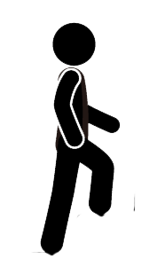


Bible Authority Established
Creation, Flood, Redemption Story, Moses, Moral Laws, Miracles, Nature of Man, Purpose of Man, Nature of God, Christ & Holy Spirit, Requirements for Worship, Personality of Jesus, Coming Judgment, Heaven, Hell, Angels, Demons, & Satan
Bible would be Accurate
Based on Bible Testimony Jesus is Son of God
Teachings of
Jesus are True
Accurate Account of Jesus’ Life
A Step of Faith not
A Leap of Faith
Bible can be Understood
Bible is Inspired
Bible is Accurate
Bible is Reliable
If Bible Revelation of Creator then
Divine Revelation Possible
& Accurate So Purpose is Known
Starting Point for
How We Got the Bible
class
Creation
has a purpose
Likely a Moral Law
Miracles &
Revelations
Universe had an Intelligent, Personal Origin
Possible that Universe had Supernatural Origin
It is Possible that there is Supernatural Force
Based on material from mmb, jr Establishing Bible Authority Class - 10/30/2002

Slide 6
Class Objectives
Show that archaeology can help provide context to the Gospels/Biographies of Jesus

Slide 7
Questions
Does archaeological evidence prove the Bible?
How do archaeological discoveries relate to events in Life of Jesus?
What three ancient prophecies are fulfilled in Matthew 2?
Confirms/gives context
The class tonight
Mt 2: 5-6 Born in Bethlehem – Micah 5:2
Mt 2:13-15 Flees to Egypt - Hosea 11:1
Mt 2:16-18 Death of male children in Bethlehem – Jeremiah 31:15
Mt 2:22-23 He shall be called a Nazarene ?
Notes:
Matthew 2:5-6 (NKJV) ⁵ So they said to him, "In Bethlehem of Judea, for thus it is written by the prophet:
⁶ 'But you, Bethlehem, in the land of Judah, Are not the least among the rulers of Judah; For out of you shall come a Ruler Who will shepherd My people Israel.' " Micah 5:2
Matthew 2:13-15 (NKJV) ¹³ Now when they had departed, behold, an angel of the Lord appeared to Joseph in a dream, saying, "Arise, take the young Child and His mother, flee to Egypt, and stay there until I bring you word; for Herod will seek the young Child to destroy Him."
¹⁴ When he arose, he took the young Child and His mother by night and departed for Egypt,
¹⁵ and was there until the death of Herod, that it might be fulfilled which was spoken by the Lord through the prophet, saying, "Out of Egypt I called My Son." (Hosea 11:1)
Matthew 2:16-18 (NKJV) ¹⁶ Then Herod, when he saw that he was deceived by the wise men, was exceedingly angry; and he sent forth and put to death all the male children who were in Bethlehem and in all its districts, from two years old and under, according to the time which he had determined from the wise men.
¹⁷ Then was fulfilled what was spoken by Jeremiah the prophet, saying:
¹⁸ "A voice was heard in Ramah, Lamentation, weeping, and great mourning, Rachel weeping for her children, Refusing to be comforted, Because they are no more." Jeremiah 31:15
Matthew 2:22-23 (NKJV) 22 But when he heard that Archelaus was reigning over Judea instead of his father Herod, he was afraid to go there. And being warned by God in a dream, he turned aside into the region of Galilee.
And he came and dwelt in a city called Nazareth, that it might be fulfilled which was spoken by the prophets, "He shall be called a Nazarene.“
Three major options exist for interpreting this verse. First, it may be that Matthew is associating the word Nazarene with the Hebrew word netser (“branch or sprout”). The “Branch” was a common term for the Messiah, such as in Isaiah 11:1: “A shoot will come up from the stump of Jesse; from his roots a Branch will bear fruit.” Hebrew was written with only consonants, and netser would have appeared as NZR—the same main consonants as Nazareth. In fact, in Aramaic, the common language of Jesus’ day, the word for “Nazareth” and the Hebrew word for “branch” sounded very much alike. Matthew’s point could be that Jesus was “sprouting up” from an obscure village in Galilee; Jesus was the Branch predicted by the prophets, and the name of the town He grew up in happens to sound just like the prophets’ word for “branch.”
A second option is that Matthew is citing a prophecy not found in the Old Testament but in another source. If so, Matthew referred to a prophecy known to his original audience yet unknown to us today. However, this is unlikely and an argument from silence.
A third option is that Matthew uses the word Nazarene in reference to a person who is “despised and rejected.” In the first century, Nazareth was a small town about 55 miles north of Jerusalem, and it had a negative reputation among the Jews. Galilee was generally looked down upon by Judeans, and Nazareth of Galilee was especially despised (see John 1:46). If this was Matthew’s emphasis, the prophecies Matthew had in mind could include these two passages concerning the Messiah:
“But I am a worm and not a man, scorned by everyone, despised by the people. All who see me mock me; they hurl insults, shaking their heads” (Psalm 22:6–7). It’s true that Nazarenes were “scorned by everyone,” and so one could see this messianic prophecy as an allusion to Jesus’ hometown of Nazareth.
“He was despised and rejected by mankind, a man of suffering, and familiar with pain. Like one from whom people hide their faces he was despised, and we held him in low esteem” (Isaiah 53:3). Again, in Jesus’ day, Nazarenes were “despised and rejected,” and so Isaiah’s prophecy could be viewed as an indirect reference to Jesus’ background as the supposed son of a carpenter from Nazareth.
If Psalm 22:6–7 and Isaiah 53:3 are the prophecies that Matthew had in mind, then the meaning of “He shall be called a Nazarene” is something akin to “He shall be despised and mocked by His own people.”

Slide 8
Strobel’s 8 Questions
THE INTENTION TEST This test seeks to determine whether it was the stated or implied intention of the writers to accurately preserve history.
THE ABILITY TEST Even if the writers intended to reliably record history, were they able to do so?
THE CHARACTER TEST This test looks at whether it was in the character of these writers to be truthful.
THE CONSISTENCY TEST Here’s a test that skeptics often charge the gospels with failing. After all, aren’t they hopelessly contradictory with each other?

Slide 9
THE BIAS TEST This test analyzes whether the gospel writers had any biases that would have colored their work.
THE COVER-UP TEST When people testify about events they saw, they will often try to protect themselves or others by conveniently forgetting to mention details that are embarrassing or hard to explain.
THE CORROBORATION TEST When the gospels mention people, places, and events, do they check out to be correct in cases in which they can be independently verified?
THE ADVERSE WITNESS TEST This test asks the question, where others present who would have contradicted or corrected the gospels if they had been distorted or false?

Slide 10
Matthew 16:13 (NKJV) When Jesus came into the region of Caesarea Philippi, He asked His disciples, saying, "Who do men say that I, the Son of Man, am?"
Matthew 16:14 (NKJV) So they said, "Some say John the Baptist, some Elijah, and others Jeremiah or one of the prophets."
Matthew 16:15 (NKJV) He said to them, "But who do you say that I am?"
Matthew 16:16 (NKJV) ¹⁶ Simon Peter answered and said,
"You are the Christ, the Son of the living God."

Slide 11
Who is Jesus
He is the Christ (Messiah), the Anointed One foreseen by the Old Testament prophets.
(Isaiah 9:6; Matthew 16:16; John 4:25–26; John 6:69)
He is the Savior of the world, the one who delivers from sin.
  (John 3:16–18; John 4:42; Acts 5:31; 1 John 4:14)
He is the Lamb of God, the one who sacrificed His life for sins.
  (Isaiah 53:7; John 1:29)
He is the Son of God, having a unique and intimate relationship with God the Father.
  (John 20:31)
He is the Creator of all things. (John 1:3; Colossians 1:16–17, Hebrews 1:2, 3)
He is equal to God. (John 5:23; Philippians 2:6)
He is eternal, existing with God from the very beginning. (John 1:1–2)
He is God in the flesh, revealing to us what God is like. (John 1:18, Hebrews 1:3)
He is the Lord of all. (Acts 10:36, Philippians 2:9–11)
He was born of a virgin. (Isaiah 7:14, Matthew 1:22–23; Luke 1:27–35)
He has the authority to forgive sins. (Mark 2:10)
He is worshiped. (John 9:38; Luke 24:52; Hebrews 1:6)
He is the living Savior, raised from the dead and sitting today at the right hand of God;
By His resurrection we have new life. (1 Peter 3:21–22; Romans 8:34)

Slide 12
Jesus of Modern Scholar
The followers of Jesus invented his deity after his death
Jesus was a Magician
Jesus is a non-apocalyptic, teasing teacher
Jesus was an apocalyptic prophet
Jesus was a Cynic
Jesus just man
Jesus never claimed to be God
Jesus was a revolutionary, a sage, an iconoclastic Jew

Slide 13
The Real Jesus” in December 2017 has the following comments. The discovery of the Magdala Synagogue pretty much ends the argues made by people like Crossan who says there was no synagogues built in Galilee. With this observation much of Crossan’s argument about Luke in the above paragraph falls apart.

Slide 14
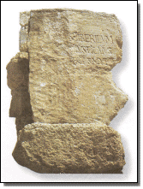
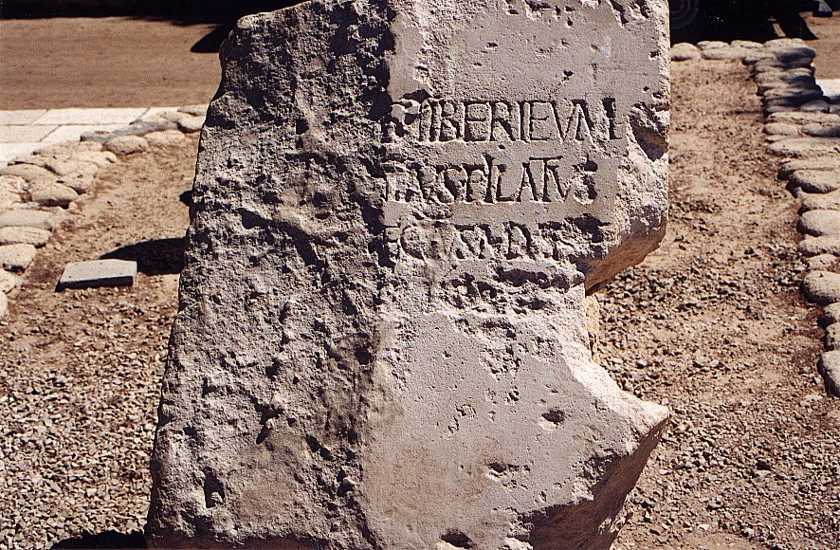
Pilate Inscription
Discovered at Caesarea in secondary use in a later wall, this inscription bears witness to a major New Testament figure and settles the debate over Pilot’s title of Prefect rather than the inferior Procurator.
Notes:
Pilate Inscription:
Discovered at Caesarea in secondary use in a later wall, this inscription bears witness to a major New Testament figure and settles the debate over Pilot’s title of Prefect rather than the inferior Procurator.
7) Pontius Pilate inscription - 1961
Italian excavators working at the Roman theater in Caesarea Maritima uncovered a monumental inscription naming another central figure in Christ's crucifixion drama. Though only partly legible, it clearly says: "Pontius Pilatus, Prefect of Judea." Visitors to Caesarea's theater today see a replica, the original is in the Israel Museum in Jerusalem.

Slide 15
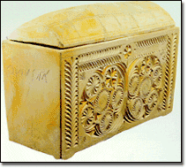
Caiaphas Ossuary
From the Caiaphas family tomb in Jerusalem,
Ossuary bears the inscription "Yehosef bar Qafa: (Joseph, son of Caiaphas)
Dated to the Second Temple Period
Caiaphas is the name of the High Priest who presided over the trial of Jesus.
Notes:
6) Caiaphas' ossuary - 1991
A dump truck accidentally smashed through the roof of a tomb during some work at the Jerusalem Peace Forest. Inside were found a number of ossuaries, stone boxes for retaining bones of the deceased. One of the ossuaries was inscribed with the name of Caiaphas, the high priest who presided over the trial of Jesus shortly before his

Slide 16
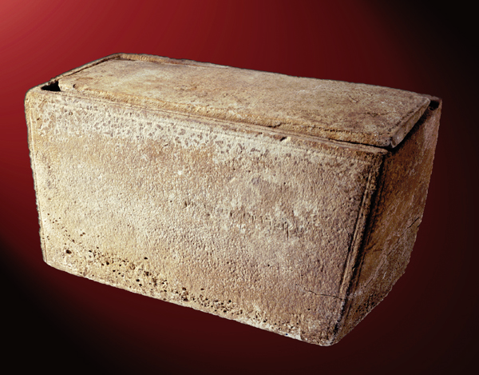
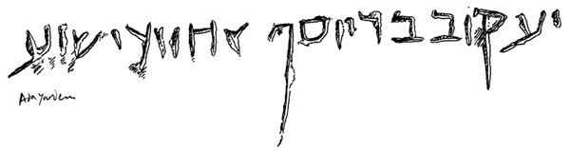
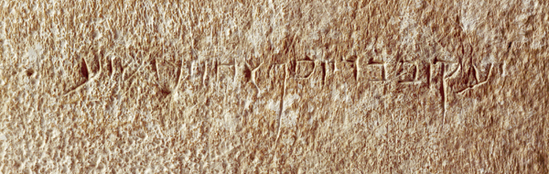
James Ossuary
A plain, 20-inch-long limestone ossuary, a box for bones widely used in first-century C.E. Jerusalem
Aramaic inscription that reads, “James, son of Joseph, brother of Jesus.”
The inscription clearly dated between 20 BC & 70 AD
Over two generations, 0.05 percent of the population would likely be called “Jacob son of Joseph brother of Jesus.”
The estimated population of Jerusalem at this time was about 80,000,20 which means that about 40,000 of the people were male. In Jerusalem during the two generations before 70 C.E., there were therefore probably about 20 people who could be called “James/Jacob son of Joseph brother of Jesus.” It is, however, impossible to estimate how many of these 20 people were buried in ossuaries and how many of these ossuaries would be inscribed.
Notes:
The inscription, reading “James, son of Joseph, brother of Jesus” has been authenticated by two eminent paleographers (specialists in dating, interpreting and authenticating inscriptions): André Lemaire of the Sorbonne and Ada Yardeni of the Hebrew University of Jerusalem. In 2003, however, the Israel Antiquities Authority (IAA) appointed a committee of scholars to study the “brother of Jesus” inscription and report its findings. The committee concluded that the inscription was a forgery.
ely plain, 20-inch-long limestone ossuary, a box for bones widely used in first-century C.E. Jerusalem, bears a significant Aramaic inscription that reads, “James, son of Joseph, brother of Jesus.” (See detail and drawing of inscription.)
Author André Lemaire thought the inscription clearly dated between 20 B.C.E. and 70 C.E.—but, to make certain, he had it analyzed by geologists. As shown in the sidebar “Epigraphy—and the Lab—Say It’s Genuine,” they concluded that the box has no modern elements, was worked by no modern tools—and does seem to be authentic. Could this box have held the bones of the James who was the brother of Jesus of Nazareth? Lemaire concludes that it likely did, making this ossuary the earliest archaeological attestation of Jesus yet found.

Slide 17
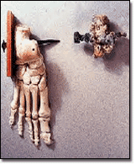
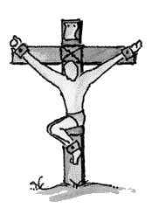
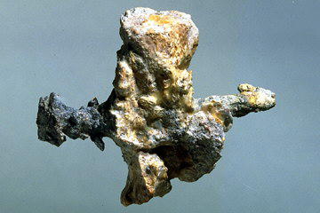
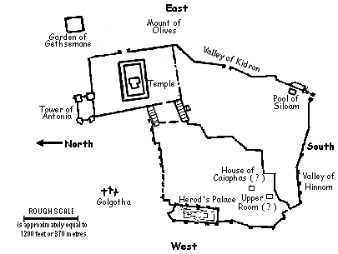
Crucified Man
The only physical evidence of crucifixion ever discovered.
Ossuary found bearing name "Yehochanan“
Full skeleton of a man crucified in the first century
Buried with a bent crucifixion nail through his heel bone.
Notes:
Crucified Man:
An ossuary bearing the name "Yehochanan" contained the full skeleton of a man crucified in the first century and buried with a bent crucifixion nail through his heel bone. It is the only physical evidence of crucifixion ever discovered.

Slide 18
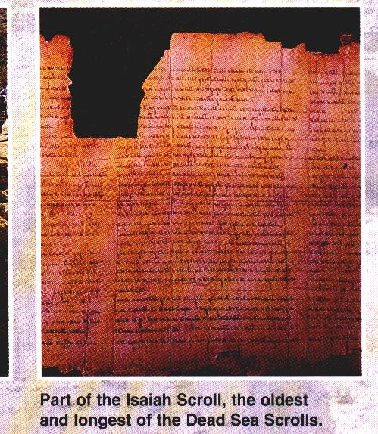
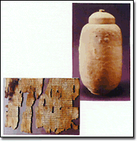
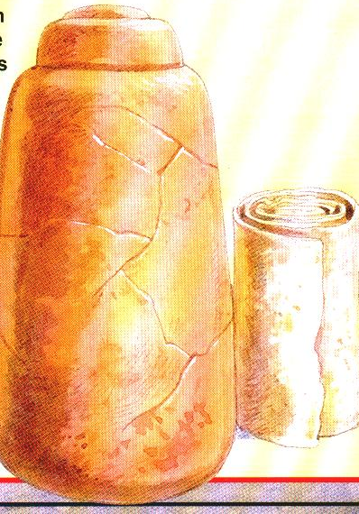
Dead Sea Scrolls
Library of an ancient Jewish sect (Essenes)
Collection includes the oldest extant copies of the Hebrew Scriptures known
Scrolls were stored in clay jars and sealed in caves along the Dead Sea
Manuscripts pre-date the earliest previously-known Biblical manuscripts by more than 1,000 years.
Notes:
Dead Sea Scrolls:
Thought by many to be the library of an ancient Jewish sect (Essenes), this collection includes the oldest extant copies of the Hebrew Scriptures known, as well as many previously unknown books. The scrolls were stored in clay jars and sealed in caves along the shores of the Dead Sea. These manuscripts pre-date the earliest previously-known Biblical manuscripts by more than 1,000 years.
1) Dead Sea Scrolls - 1947
This chance discovery by bedouin shepherds in a cave overlooking the Dead Sea occurred just before the half way mark of the century, as the brand new state of Israel was being birthed. It appears on most lists of top archaeological discoveries and top religious events of the 20th century. The Dead Sea Scrolls are 2,000 year old documents, found in 11 caves in all, including the oldest versions of Hebrew scriptures.
...These documents provide a critical window into events in the cradle of monotheistic religions at a time when rabbinic judaism was forming, Christianity was about to begin, and the canonization of holy scripture was underway. The significance and meaning of the hundreds of Dead Sea Scrolls documents is still being debated by scholars.
...Portions of the Dead Sea Scrolls are on display in the Shrine of the Book, at the Israel Museum in Jerusalem. Others, including the Copper Scroll, can be seen at the Archaeological Museum in Amman. Many of the smallest scroll fragments are kept at the Rockefeller Museum in East Jerusalem.

Slide 19
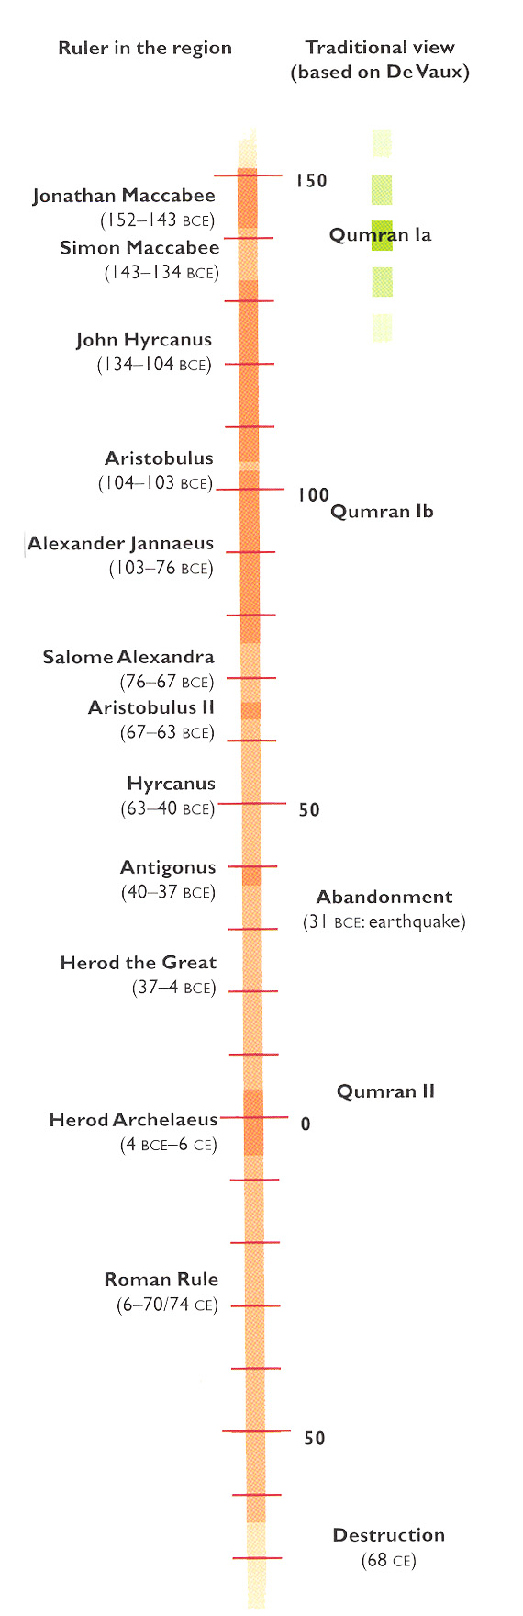
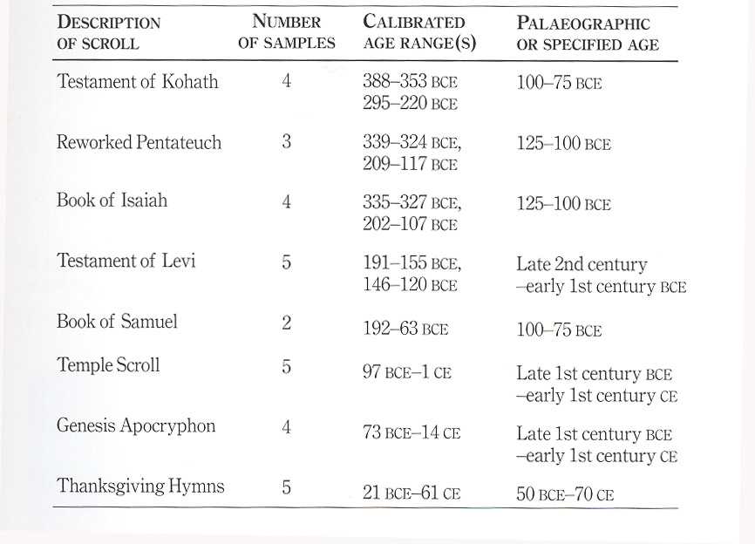
Qumran Dates

Slide 20
Dead Sea Scrolls

Slide 21
Archaeology Shows Fallacy of the Critic
Crossan says Luke was wrong about the roofs at Capernaum, the synagogue at Nazareth, and the scrolls read by Jesus. But this does not undermine the validity of Luke’s message — that he thinks there was a synagogue - as - building shows only that he envisioned the events as occurring in an environment like his and his audience’s. The issue of a building at Capernaum was surely incidental to Luke, and to speak about the “synagogue of Jesus” at Capernaum has no archaeological credibility.
The National Geographic article “The Real Jesus” in December 2017 has the following comments. The discovery of the Magdala Synagogue pretty much ends the argues made by people like Crossan who says there was no synagogues built in Galilee. With this observation much of Crossan’s argument about Luke falls apart.

Slide 22
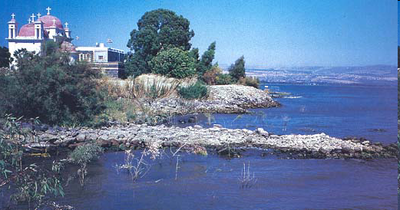
Cities of Galilee - Capernaum
Capernaum
Aish
Tabgha
Kfar Aovya
Gennesar
Magdala
Kursi
(Gergesa)
Ammaus
Ein Gofra
A bustling port welcomed visitors to the prosperous village of Capernaum in Jesus’ time. A 2,500-foot-long promenade lined the shore. Boats moored along the harbor’s array of paired curved piers, straight docks and triangular piers.
Tiberias
Sussita
(Hippos)
Sennabris
Duerban
Old Jordan
Outlet
Beit Yerah
Duerban
Tel Samra
(Gadara’s Harbor)
Notes:
At least 15 man-made harbors dotted the shores of the Sea of Galilee, known in Hebrew as the Kinneret. The harbors consisted of two basic elements (see, for example, Gennesar, on the northwestern shore): a short pier jutting straight into the water, and a long curved stone breakwater, which protected moored boats from the violent storms that suddenly sweep across the lake. To enter the harbor, boats slipped through the narrow passage between the pier and breakwater.
Editor, H. S. 2002;2002. BAR 25:04 (July/Aug 1999). Biblical Archaeology Society
Mendel Nun
A bustling port welcomed visitors to the prosperous village of Capernaum in Jesus’ time. A 2,500-foot-long promenade lined the shore. Boats moored along the harbor’s array of paired curved piers, straight docks and triangular piers. The remains of these unusually shaped piers are still visible during dry seasons.
Editor, H. S. 2002;2002. BAR 25:04 (July/Aug 1999). Biblical Archaeology Society

Slide 23
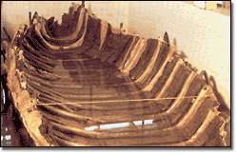
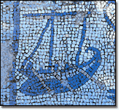
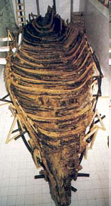
Galilean Fishing Boat
Hull of a fishing boat from first century CE recovered from the mud along the receding shoreline of the Sea of Galilee.
Design of boat is similar to that of one depicted in a mosaic excavated at Migdal
(ancient Tarichaeae).
Notes:
4) Galilee Boat - 1986
Two brothers from Kibbutz Ginnosar, on the northwest shore of the Sea of Galilee, stumbled across the remains of a 2,000 year old boat when lake levels were low. The boat was rescued from rising water levels and preserved in a solution of polyethleneglycol for almost ten years, and can now be seen in a special building at the kibbutz Ginnosar. The boat was dubbed "The Jesus Boat" when archaeologists confirmed that it represented the typical fisherman's craft that plied the Galilee waters during the time when Jesus' and his disciples lived and worked there.
Zev Radovan
About a mile north of Migdal, a perfectly preserved wooden boat—also equipped for rowing and sailing—was found in the mud. Apparently, a master craftsman from the time of Jesus built the boat to last.
Editor, H. S. 2002;2002. BAR 25:04 (July/Aug 1999). Biblical Archaeology Society

Slide 24
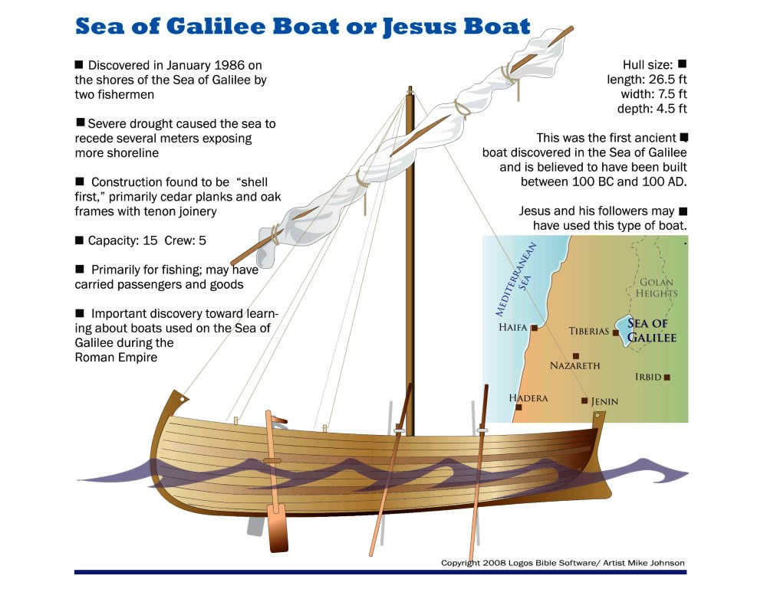

Slide 25
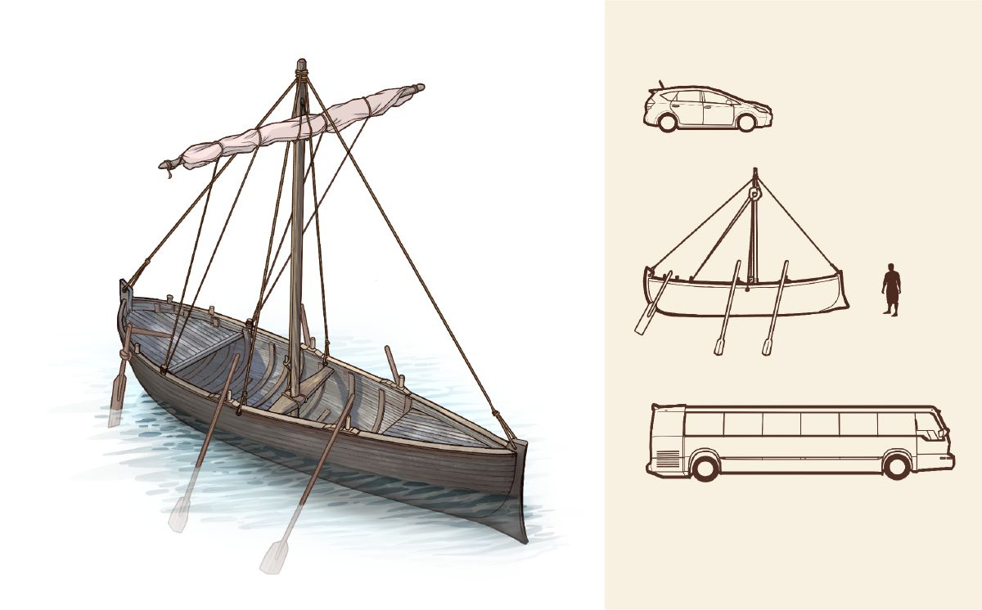
Matthew 4:18-22 Jesus calls Peter and his brother Andrew
¹⁹ And he said to them, “Follow me, and I will make you fishers of men.”
Matthew 8:23-27 Jesus calms storm
²⁶ And he said to them, “Why are you afraid, O you of little faith?” Then he rose and rebuked the winds and the sea, and there was a great calm.
Matthew 9:1 Crosses Sea of Galilee to come to Capernaum

Slide 26
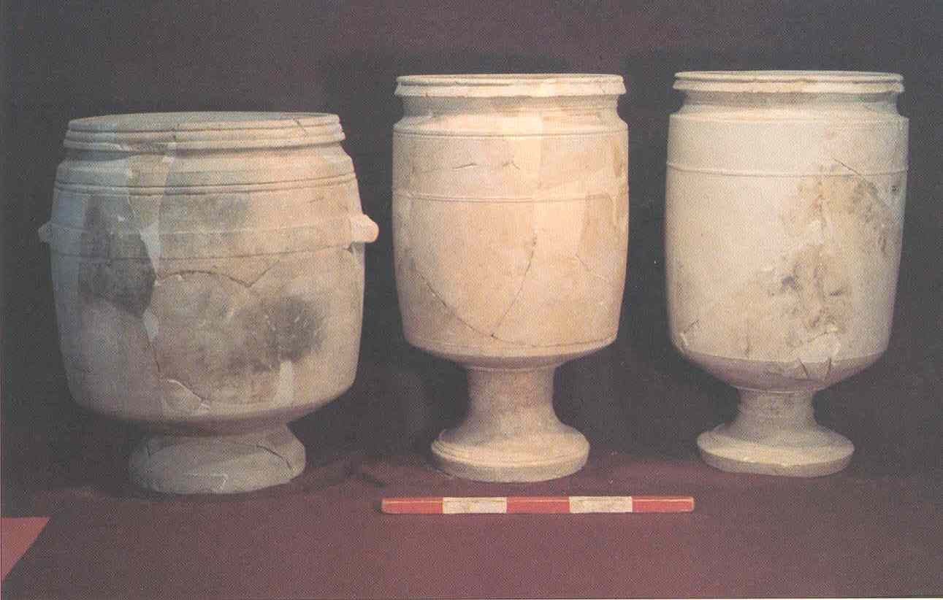
Common Items from Time of Jesus – Stone Jars
John 2:6 Now there were set there six waterpots of stone, according to the manner of purification of the Jews, containing twenty or thirty gallons apiece.

Slide 27
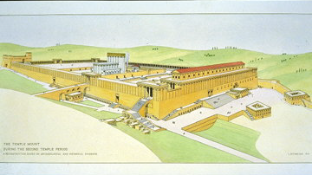
Wailing/Western Wall
& Wilson Arch
Western Wall
Wailing Wall
Wilson’s Arch

Slide 28
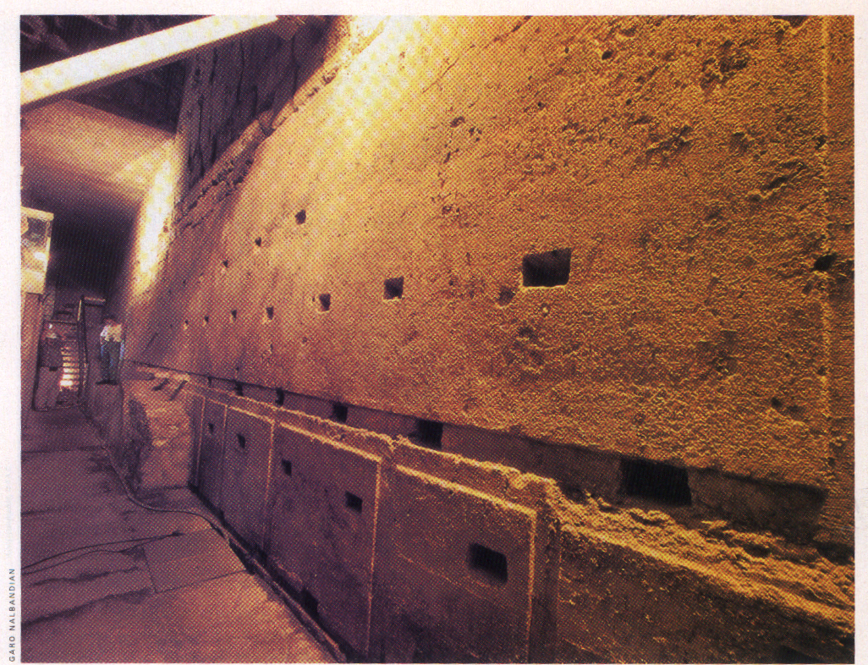
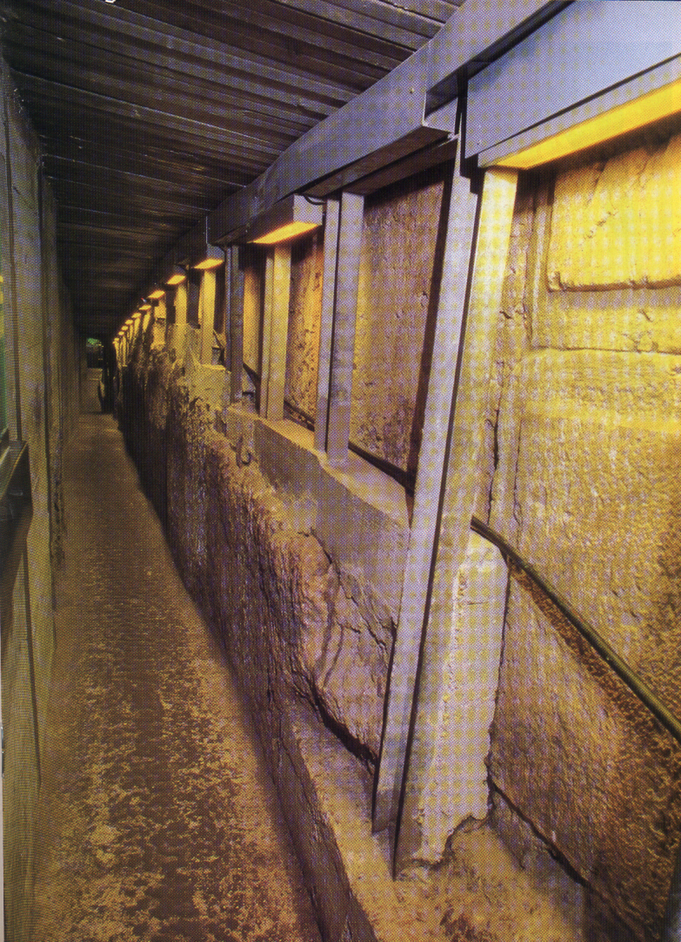
Western Wall Tunnel
“Master Course”
Four Blocks 11 ft High
6 ft long to 42 ft long
(14 ft Deep, 1.2 mil lbs)
Roman - 2nd Century
Holes to Support
Rough Stone for
Waterproof Plaster
Biblical Archaeology Review
pg. 40-41, Vol. 21 No 6, Nov/Dec 1995

Slide 29
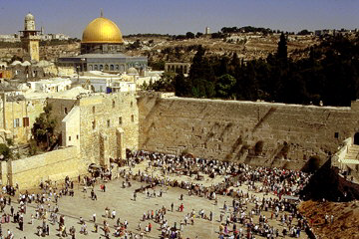
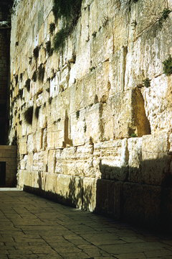
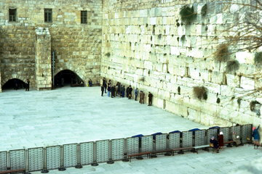
Western/Wailing Wall
The Western Wall, for centuries revered by Jews as the only remaining wall of the ancient Temple area.

Slide 30
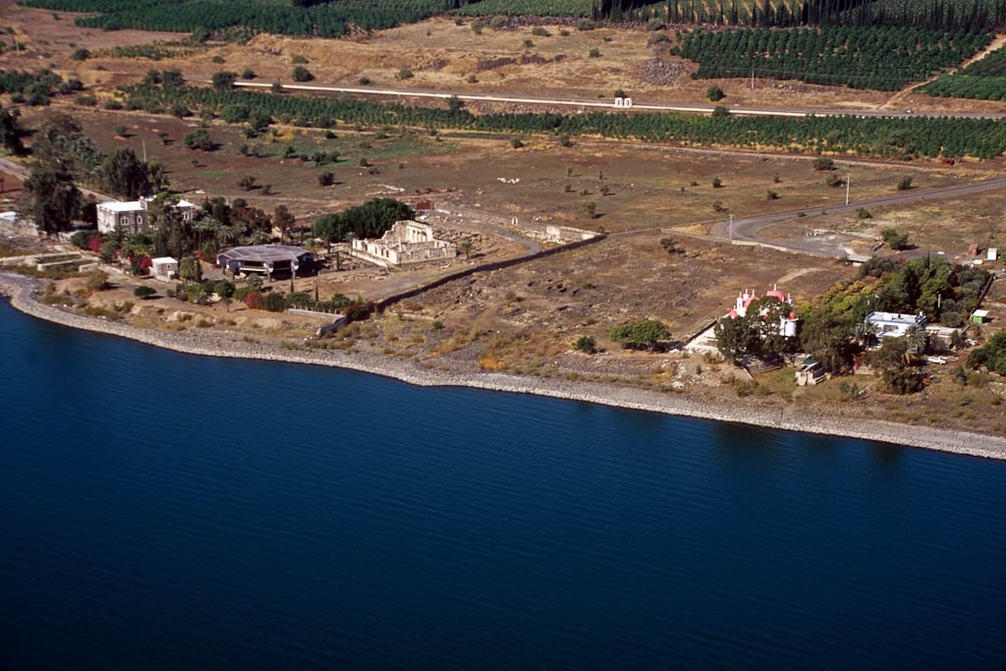
Road
Capernaum synagogue
Greek Orthodox church
Peter’s house
Capernaum aerial from southeast
Notes:
tbs115180011

Slide 31
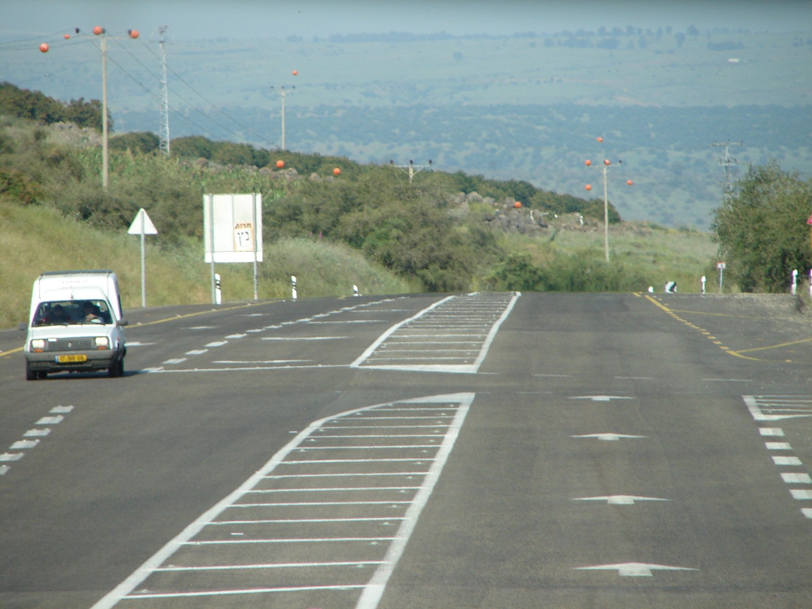
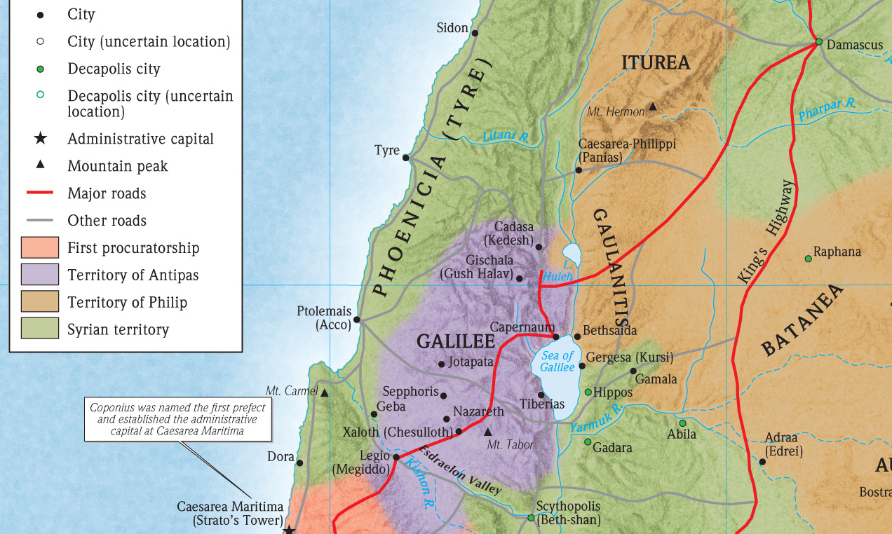
Modern Road
By Capernaum
Major by Capernaum
In time of Jesus

Slide 32
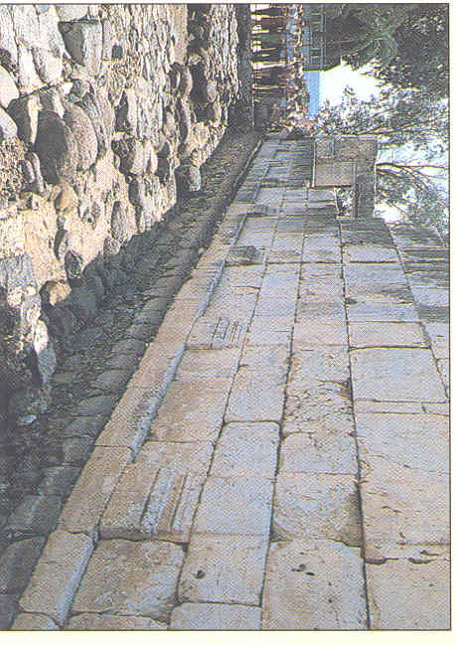
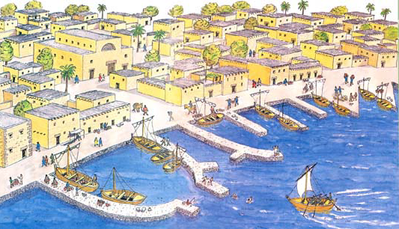
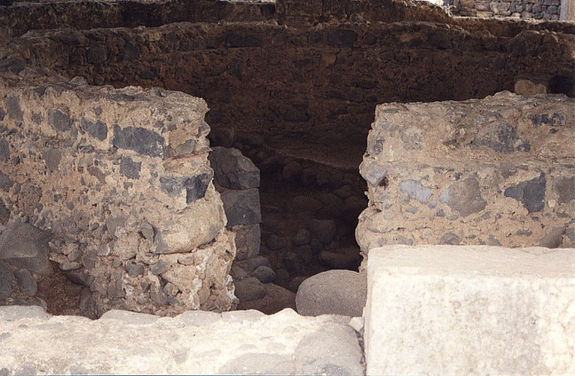
Capernaum Reconstruction
Peter’s House?
Capernaum Synagogue
Notes:
Leen Ritmeyer
In this representation of biblical Capernaum as drawn by archaeological draftsman Leen Ritmeyer, Capernaum’s synagogue, where Jesus preached ( John 6:59 ), appears at upper left. It is shown with three doors and a raised central roof with an arched motif at one end. The building identified since the fourth century as the home of the apostle Peter lies between the synagogue and the harbor. According to Matthew 8:14–16 and Mark 2:1 , Jesus lodged here. The home consists of several small rooms built around two central courtyards.
Editor, H. S. 2002;2002. BAR 25:04 (July/Aug 1999). Biblical Archaeology Society

Slide 33
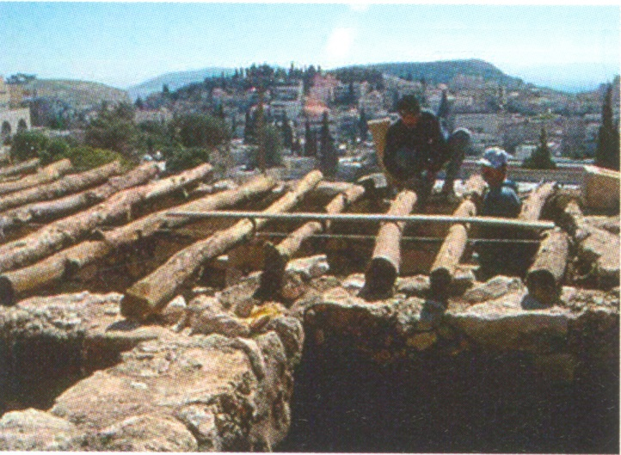
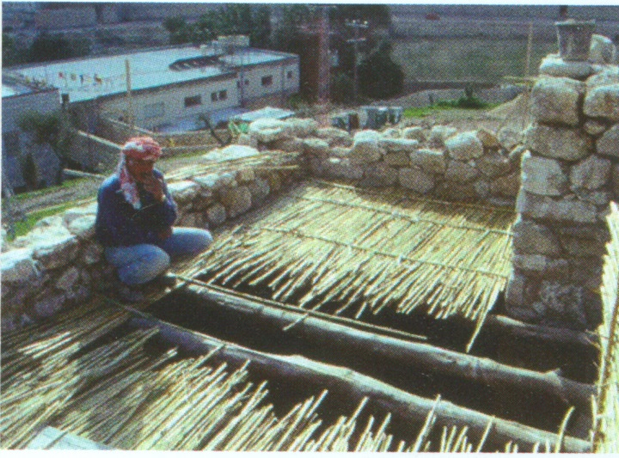
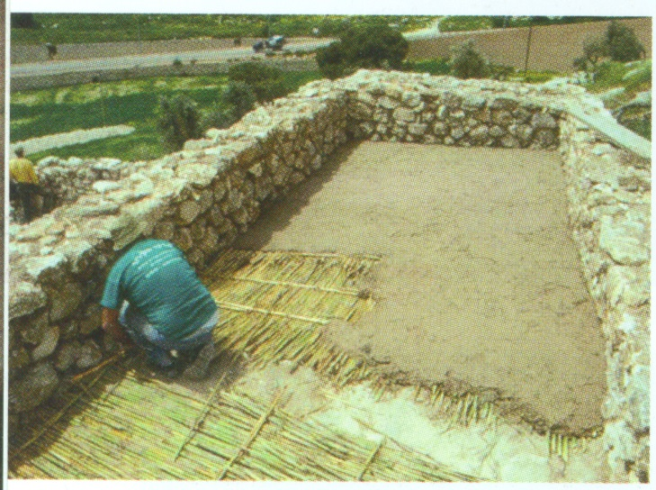
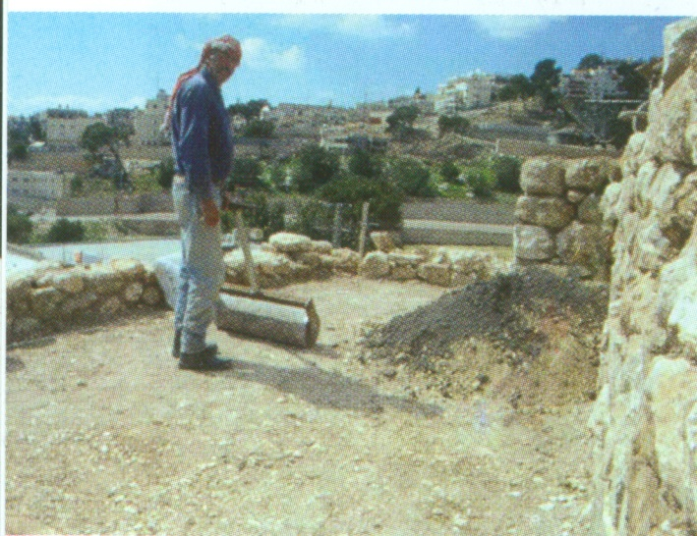
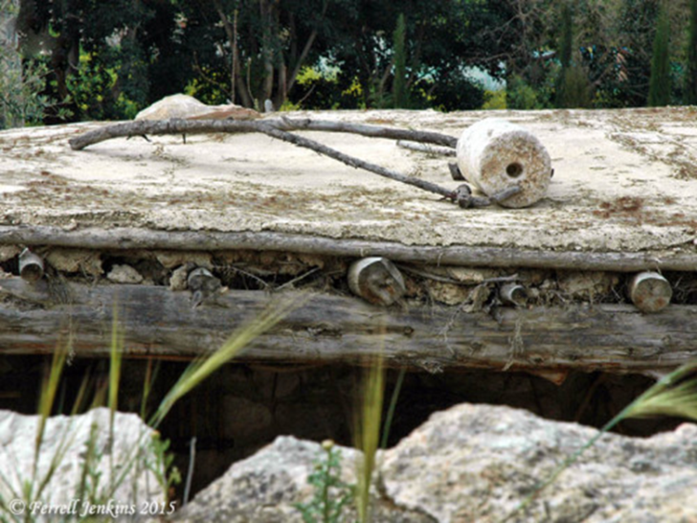
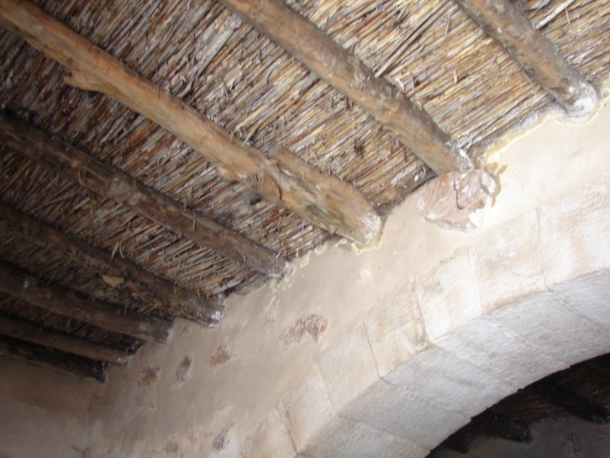
Roof Tops - Nazareth

Slide 34
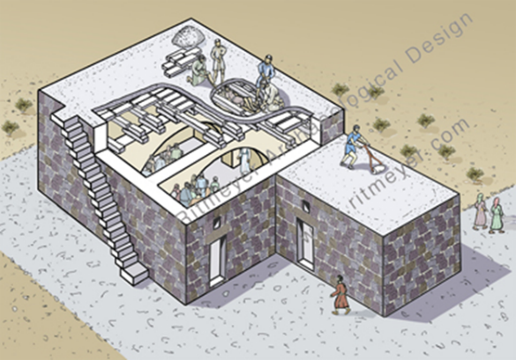
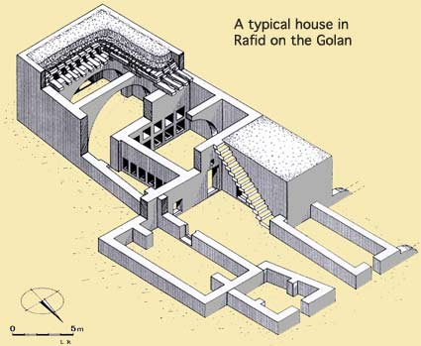
Peter’s Roof
Even though Luke says Jesus is said to have exorcised demons (Mark 1:21) and taught (John 6:59) and the Capernaum “centurion” presumes a synagogue structure at Capernaum, an edifice built with the centurion’s benevolence (Luke 7:5). Crossan says Luke was also wrong about the roofs at Capernaum, the synagogue at Nazareth, and the scrolls read by Jesus. But this does not undermine the validity of Luke’s message — that he thinks there was a synagogue - as - building shows only that he envisioned the events as occurring in an environment like his and his audience’s. The issue of a building at Capernaum was surely incidental to Luke, and to speak about the “synagogue of Jesus” at Capernaum has no archaeological credibility.

Slide 35
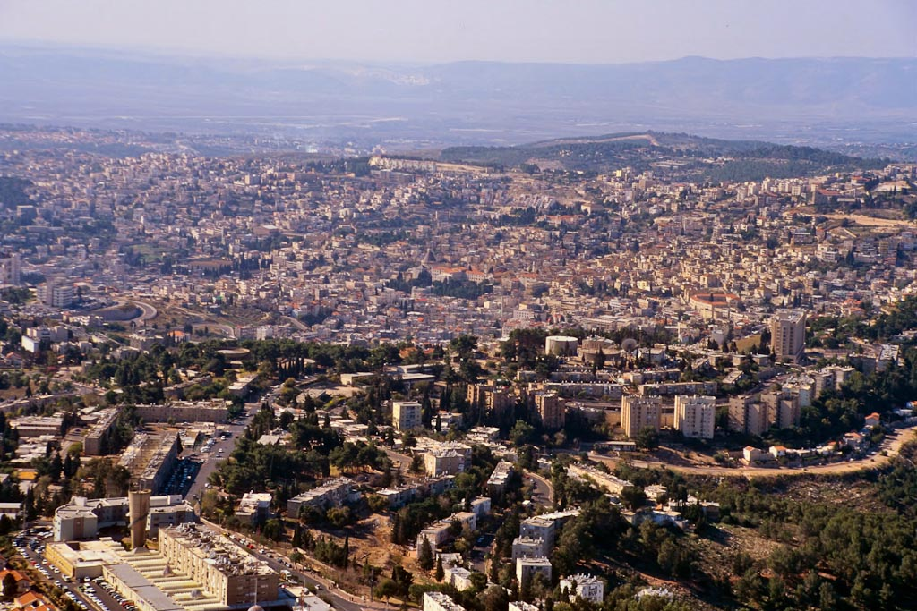
Nazareth – Time of Jesus
Hard to find a old synagogue
Nazareth aerial from northeast
Notes:
Nazareth: Introduction
Situated inside a depression atop the ridge north of the Jezreel Valley, Nazareth was a relatively isolated village in the time of Jesus. It is estimated that the village’s population was less than two hundred.
Though relatively isolated in the hill country, Nazareth was not far from the International Highway and the district capital of Galilee, Sepphoris.
Today Nazareth is home to more than 60,000 Israeli Arabs, and Nazareth Illit (“Upper Nazareth”) is home to thousands of Jewish residents.
tbs121290011

Slide 36
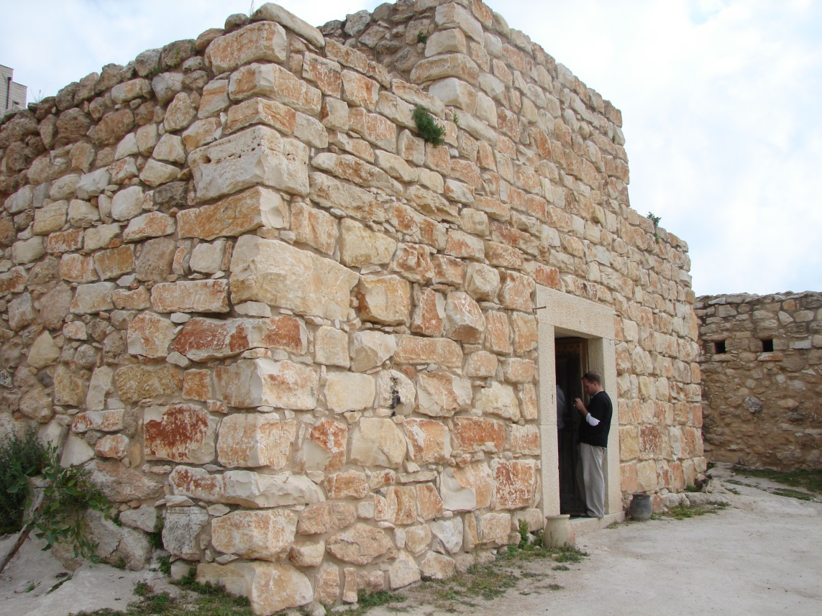
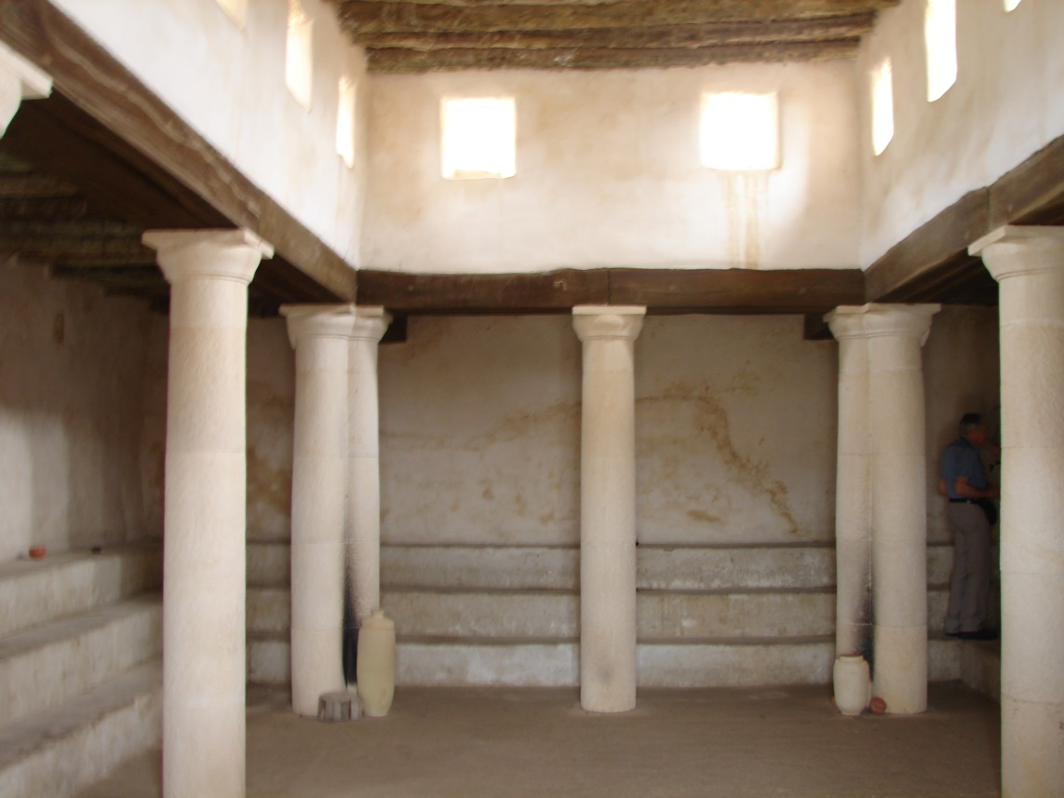
Reconstructed Synagogue Layout

Slide 37
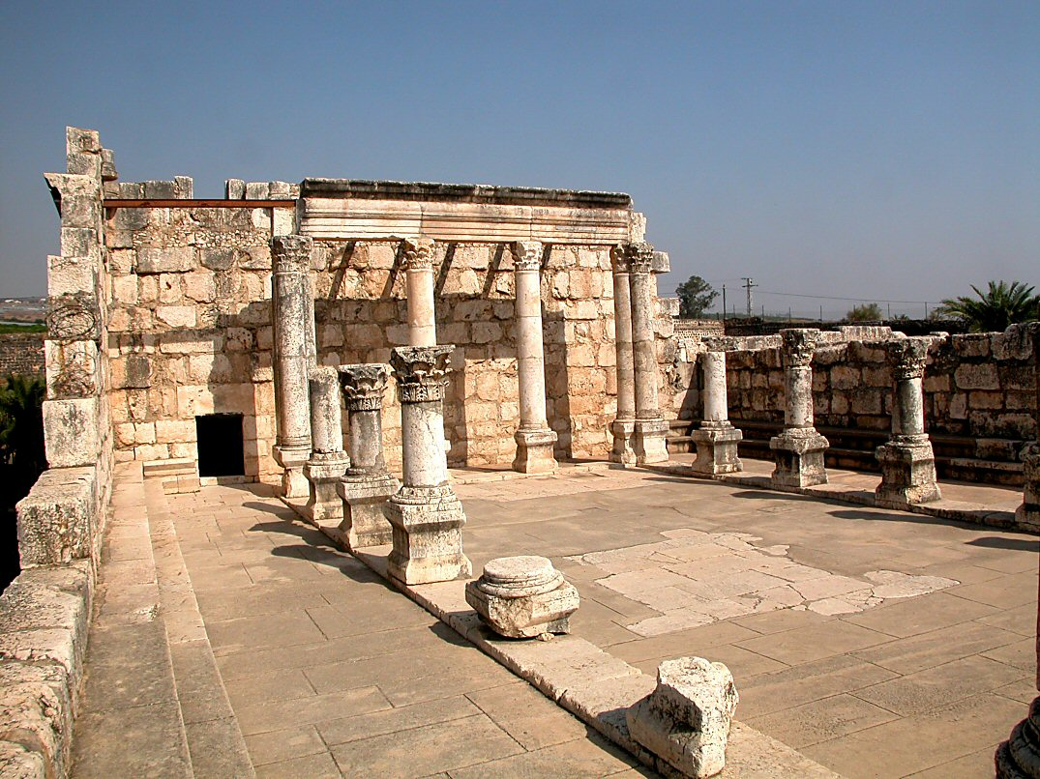
Capernaum synagogue interior
Notes:
Interior of the Synagogue
Benches on which the elders sat lined the inside wall. There were probably mats on the floor inside the synagogue for people to sit on (Strange and Shanks 1983: 26).
The architrave was originally a single piece of limestone, but it has been broken.
The corner columns are heart shaped.
The synagogue in Capernaum is a typical Galilean synagogue. The doors face Jerusalem and the worshippers prayed in that direction. The Torah must have been wheeled around to the door area (see the inscription found with Torah on a cart). Later synagogues have doors which are located on the opposite side from Jerusalem.
tb102602011

Slide 38


A Question of Synagogues
The 1st century Synagogue of Capernaum where Jesus preached.
A cutaway reconstruction drawing of the 4th century Byzantine Synagogue of Capernaum.

Slide 39


The 4th century synagogue rests on the remains of the 1st century synagogue that was made of basalt stones.
Below the floor of the 4th century synagogue, excavations have revealed remains of walls and floor levels of the 1st century synagogue.

Slide 40




Capernaum Synagogue
A
B
C
Limestone synagogue – 4-5th Cent
Black Basalt from 1st Cent Synagogue
C. Road Pavement from 1st Cent
Donald D. Binder, "Capernaum."
http://faculty.smu.edu/dbinder/capernaum.html
[accessed: 7/26/2003]
Notes:
Most recent excavations have revealed two synagogues, a white limestone synagogue dating from the fourth to fifth centuries CE, and a black basalt synagogue dating from the first half of the first century CE. Only foundation walls, gray marble column fragments and a cobblestone floor remain from the earlier structure, which measured 24.5 by 18.7 meters on the exterior and possessed walls over a meter thick.
View of the IV-V century Limestone synagogue, looking north. This structure was built on top of an earlier synagogue that was founded in the first century CE and constructed out of basalt. Only the foundation walls and cobblestone floor remain from this earlier building
View of trench 25, looking north. A. East stylobate (column foundation wall) of the Limestone synagogue; B. The Basalt Stone wall (MB 5) of the I CE synagogue (a stylobate of the earlier structure); C. The first century CE stone pavement.

Slide 41

Cities of Galilee - Magdala
Capernaum
Aish
Tabgha
Kfar Aovya
Gennesar
Magdala
Kursi
(Gergesa)
Ammaus
Ein Gofra
Tiberias
Sussita
(Hippos)
“The place where fish were salted”— rough translation of Tarichea, Magdala’s Greek name. The more familiar Aramaic name of the town is preserved in name of most famous resident, Mary Magdalene
Sennabris
Duerban
Old Jordan
Outlet
Beit Yerah
Duerban
Tel Samra
(Gadara’s Harbor)
Notes:
Mendel Nun
“The place where fish were salted”—a rough translation of Tarichea, Magdala’s Greek name—suggests that the Galilee’s fish-processing industry was centered at this harbor. The more familiar Aramaic name of the town is preserved in the moniker of the most famous resident, Mary Magdalene, the first witness to Jesus’ Resurrection.
Editor, H. S. 2002;2002. BAR 25:04 (July/Aug 1999). Biblical Archaeology Society

Slide 42


Magdala Synagogue
THE MAGDALA SYNAGOGUE consists of a room measuring 36 by 36 feet and a hallway enclosing it. Mosaics were supposed to adorn the hallway pavement, but were left largely unfinished—possibly due to the First Jewish Revolt against Rome (66–70 C.E.)
TORAH READING TABLE?

Slide 43



Reconstructed

Slide 44

Herodium, Synagogue
    The remains of the first century A.D. synagogue at Herodium, Israel. (Luke 12:11)

Slide 45




Gamla Synagogue `60’s AD
BAR 18:01 (Jan/Feb 1992)
Danny Syon
Notes:
Since 1982, Danny Syon has worked for the Gamla Excavations as a permanent staff member—as administrative director, photographer, area supervisor and public relations officer. He is currently preparing the excavated coins for publication. Now a research fellow in archaeology at the University of Haifa, Syon has a keen interest in natural history, hiking and nature photography.
Editor, H. S. 2002;2002. BAR 18:01 (Jan/Feb 1992). Biblical Archaeology Society
In the very first season of excavation, we uncovered near the wall a magnificent ancient synagogue, the oldest yet found in a city in Israel. At first, some questions were raised as to whether it was actually a synagogue; perhaps it was simply a large public building. No specifically Jewish artifacts were found in it, nor were Jewish symbols, such as a menorah (seven-branched candelabrum), found as any part of its decoration. However, the discovery of a mikveh (ritual bath) adjacent to it proved that it functioned as a communal religious center Editor, H. S. 2002;2002. BAR 18:01 (Jan/Feb 1992). Biblical Archaeology Society

Slide 46

The Synagogue and Jewish Worship
Not only the walls, but the door and window frames were all made of basalt stones and the roof was made of long basalt slabs, which rested on corbels which projected from the walls.
I was quite sure that the Gamla Synagogue had a similar flat roof and that is what it shown in the drawing below (used by permission). As an interesting aside and as mentioned in a previous blog, this type of roof construction would explain how the paralytic man could have been let down through the “tiling” (Luke 5.19) in order to be healed by Jesus. It is more than likely that the roof of the house in Capernaum, where the houses were also made of basalt, was made of long basalt slabs laid at a short distance from each other and which were then covered with flat basalt tiles. After removing these tiles and taking away the basalt cross beams, a space would have been created large enough to let a man down through.
a typical Jewish synagogue in the town of Gamla
Notes:
The Synagogue and Jewish Worship
In cities other than Jerusalem, the synagogue was the center of Jewish worship during the time of Christ. Synagogues were located in most of the leading towns of Israel. Although very little remains of the original first-century synagogue at Nazareth, extensive archaeological evidence exists for a typical Jewish synagogue in the town of Gamla, which would have had much in common with the synagogues Jesus visited in Nazareth and other cities.
This illustration is based on the excavation of the Gamla synagogue, one of the oldest in Israel. The city of Gamla was 6 miles (9.7 km) northeast of the Sea of Galilee. It was destroyed by the Romans in a.d. 67, early in the Jewish Revolt.

Slide 48










Paul’s Epistles
1 Thess ~50 AD
Gal ~53
1 Cor ~53-54
Phil ~55
Phmn~55
2 Cor ~55-56
Ro ~57
70 AD
Temple
Destroyed
27-30 AD
Ministry of Jesus
75 AD
100 AD
150 AD
200 AD
250 AD
25 AD
50 AD

Slide 49

Paul’s Epistles
1 Thess ~50 AD
Gal ~53
1 Cor ~53-54
Phil ~55
Phmn~55
2 Cor ~55-56
Ro ~57
70 AD
Temple
Destroyed
Polycarp
120 AD
Letter Quotes
16 NT Books
Clement
95 AD
Letter Quotes
10 NT Books
27-30 AD
Ministry of Jesus
75 AD
100 AD
150 AD
200 AD
250 AD
25 AD
50 AD
Tertullian (c. 150-c. 229) quotes from 23 of the 27 NT canon
AD 115,
Ignatius, bishop of Antioch,
Refers to “The Gospel” as
authoritative writing

Slide 50



100-200 AD
P104/ P. Oxy. 4404
Matthew 21
150-200 AD
P90 /P. Oxy. 3523
John 18-19
Paul’s Epistles
1 Thess ~50 AD
Gal ~53
1 Cor ~53-54
Phil ~55
Phmn~55
2 Cor ~55-56
Ro ~57
175-200 AD
Magdalen" papyrus
Matthew 3,5,26
70 AD
Temple
Destroyed
Polycarp
120 AD
Letter Quotes
16 NT Books
Clement
95 AD
Letter Quotes
10 NT Books
125-175 AD
J Ryland
John 18
27-30 AD
Ministry of Jesus
75 AD
100 AD
150 AD
200 AD
250 AD
25 AD
50 AD
Tertullian (c. 150-c. 229) quotes from 23 of the 27 NT canon
AD 105- 115
Ignatius, bishop of Antioch,
Refers to “The Gospel” as
authoritative writing

Slide 51



50 AD
Christ cup
Egypt
93 AD
Josephus
The Antiquities
100-200 AD
P104/ P. Oxy. 4404
Matthew 21
150-200 AD
P90 /P. Oxy. 3523
John 18-19
Paul’s Epistles
1 Thess ~50 AD
Gal ~53
1 Cor ~53-54
Phil ~55
Phmn~55
2 Cor ~55-56
Ro ~57
175-200 AD
Magdalen" papyrus
Matthew 3,5,26
70 AD
Temple
Destroyed
Polycarp
120 AD
Letter Quotes
16 NT Books
Clement
95 AD
Letter Quotes
10 NT Books
125-175 AD
J Ryland
John 18
27-30 AD
Ministry of Jesus
75 AD
100 AD
150 AD
200 AD
250 AD
25 AD
50 AD
28-29 AD
Death of
John The Baptist
Jesus ~30 AD
62 AD
Death of
James
Brother of Jesus
Tertullian (c. 150-c. 229) quotes from 23 of the 27 NT canon
AD 115,
Ignatius, bishop of Antioch,
Refers to “The Gospel” as
authoritative writing
Notes:
Suetonius Tranquillas (AD 69-160) wrote under the Roman emperor Hadrian, and he was a friend of Pliny the Younger. mentions early Christians and may refer to Jesus Christ in his work Lives of the Twelve Caesars, written in AD 121

Slide 52

115 AD
Tacitus
Nero & Christians
50 AD
Christ cup
Egypt
93 AD
Josephus
The Antiquities
100-200 AD
P104/ P. Oxy. 4404
Matthew 21
150-200 AD
P90 /P. Oxy. 3523
John 18-19
Paul’s Epistles
1 Thess ~50 AD
Gal ~53
1 Cor ~53-54
Phil ~55
Phmn~55
2 Cor ~55-56
Ro ~57
175-200 AD
Magdalen" papyrus
Matthew 3,5,26
70 AD
Temple
Destroyed
Polycarp
120 AD
Letter Quotes
16 NT Books
Clement
95 AD
Letter Quotes
10 NT Books
125-175 AD
J Ryland
John 18
27-30 AD
Ministry of Jesus
75 AD
100 AD
150 AD
200 AD
250 AD
25 AD
50 AD
64 AD
28-29 AD
Death of
John The Baptist
Jesus ~30 AD
62 AD
Death of
James
Brother of Jesus
Tertullian (c. 150-c. 229) quotes from 23 of the 27 NT canon
AD 115,
Ignatius, bishop of Antioch,
Refers to “The Gospel” as
authoritative writing
Notes:
Suetonius Tranquillas (AD 69-160) wrote under the Roman emperor Hadrian, and he was a friend of Pliny the Younger. mentions early Christians and may refer to Jesus Christ in his work Lives of the Twelve Caesars, written in AD 121

Slide 53


Mark 9:38-39 (NKJV) ³⁸ Now John answered Him, saying, "Teacher, we saw someone who does not follow us casting out demons in Your name, and we forbade him because he does not follow us."
³⁹ But Jesus said, "Do not forbid him, for no one who works a miracle in My name can soon afterward speak evil of Me.
111 AD
Pliny the Younger
Letter to Trajan
115 AD
Tacitus
Nero & Christians
121 AD
Suetonius
Claudius, Nero & Christians
50 AD
Christ cup
Egypt
93 AD
Josephus
The Antiquities
100-200 AD
P104/ P. Oxy. 4404
Matthew 21
150-200 AD
P90 /P. Oxy. 3523
John 18-19
Paul’s Epistles
1 Thess ~50 AD
Gal ~53
1 Cor ~53-54
Phil ~55
Phmn~55
2 Cor ~55-56
Ro ~57
175-200 AD
Magdalen" papyrus
Matthew 3,5,26
70 AD
Temple
Destroyed
Polycarp
120 AD
Letter Quotes
16 NT Books
Clement
95 AD
Letter Quotes
10 NT Books
125-175 AD
J Ryland
John 18
27-30 AD
Ministry of Jesus
75 AD
100 AD
150 AD
200 AD
250 AD
25 AD
50 AD
28-29 AD
Death of
John The Baptist
Jesus ~30 AD
~53 AD
Jews out Rome
62 AD
Death of
James
Brother of Jesus
Tertullian (c. 150-c. 229) quotes from 23 of the 27 NT canon
AD 115,
Ignatius, bishop of Antioch,
Refers to “The Gospel” as
authoritative writing
Notes:
Suetonius Tranquillas (AD 69-160) wrote under the Roman emperor Hadrian, and he was a friend of Pliny the Younger. mentions early Christians and may refer to Jesus Christ in his work Lives of the Twelve Caesars, written in AD 121

Slide 54
Written by Paul - Undisputed
Resurrection, Miracles, Deity
L07 First Epistle to the Thessalonians (51 AD) Danny H
L07 Epistle to the Galatians (47 (51-53)AD?) Joel Y
L11 First Epistle to the Corinthians (52-56 AD)
L11Second Epistle to the Corinthians (52-56 AD) Corey W
L08 Epistle to the Philippians (60-62 AD) Jana S, Chester T, Corey W, DeAnna B
L08 Epistle to Philemon (60-62 AD) Sara H
L13 Epistle to the Romans (52-57 AD) Marty B

