Slide 1
^{9:31}Then the churches throughout all Judea, Galilee, and Samaria had peace and were edified. And walking in the fear of the Lord and in the comfort of the Holy Spirit, they were multiplied.
The Book of Acts
2:41 – 3000
2:47- “added daily”
4:4 – 5000 men
5:14 - “constantly added to their number”
6:7 – “# of disciples continued to increase greatly in Jerusalem”
Lesson 6: Acts 8-9
Notes:
The church had a test with the corruption of Ananias and Saphira but what resulted?
They then had test with the attacks on the apostles in Chapter 5 but after being imprisoned and flogged they rejoiced and continued right on preaching
They had a test of division that came as a result of complaints from the Hellenistic widows who were Christians. There leaders responded and the church picked 7 men and the apostles appointed them and the issues was fixed.
So we see where there have been threats and imprisonment and then flogging but in chapter 7 we see Stephen killed and this tight knit, unified, large, active group of Christians in Jerusalem were tested with this heartbreak. And we will see that Saul, the one who held the cloaks of those who stoned Stephen will wreak havoc such that the Christians in Jerusalem had to flee and we will see what happens but I want to go to the last verse of our reading for tonight's lesson and that is in 9:31
Even after this tight knit group was scattered, because of their love for their Lord and evangelistic hearts they were able to advance the kingdom. Trusting in Gods Power and the HS – relying on the eyewitness testimony, knowing scripture and following it praying and even though they perhaps were not together like they once were, they were creating new family members as individuals obeyed King Jesus’ instruction on how to call on the name of the Lord and they were added to that universal church as they were being saved.

Slide 2
Theme
The progress of the Kingdom of God in spite of all opposition
Acts 1:3 - To these He also presented Himself alive after His suffering, by many convincing proofs, appearing to them over a period of forty days and speaking of the things concerning the kingdom of God
Acts 28:30-31 – And he stayed two full years in his own rented quarters and was welcoming all who came to him, ³¹ preaching the kingdom of God and teaching concerning the Lord Jesus Christ with all openness, unhindered
Acts 5:38-39 “So in the present case, I say to you, stay away from these men and let them alone, for if this plan or action is of men, it will be overthrown; ³⁹ but if it is of God, you will not be able to overthrow them; or else you may even be found fighting against God.”
The beginning and end of the letter emphasizes the kingdom. Throughout the book the kingdom of God is a central focus. Acts is a picture of God’s rule expanding and taking over the world.

Slide 3
Acts Memorization
Chapter 1:
Chapter 2:
Chapter 3:
Chapter 4:
Chapter 5:
Chapter 6:
Chapter 7:
Chapter 8:
Ascension & Reign of the King / Waiting on the Spirit/
Matthias replaces Judas
Peter preaches on Pentecost /Outpouring of the Holy Spirit/
Beginning of the Church
Lame man healed / Peter’s 2nd Sermon
Peter & John Arrested
Ananias & Sapphira / Apostles arrested
Widows neglected
Stephen’s Defense & Martyrdom
Church Scattered/ Samaria & Ethiopian

Slide 4
Short Outline:
Jesus said to the apostles that they would be witnesses to Him in “Jerusalem, and in all Judea and Samaria, and to the remotest part of the earth.” (1:8)
(chapters 1-7) - The gospel is preached in Jerusalem
(chapters 8-12)- The gospel is preached in Judea and Samaria
(chapters 13-28) - The gospel is preached to the end of the earth
Acts Chapters 1 to 11, Peter and Jerusalem church are Prominent.
Acts Chapters 12 to 28, Paul and Antioch church are Prominent

Slide 5
Class Goals
To better understand the challenges, growth and practices of the New Testament church. Especially their worship, leadership, sharing, perseverance, and involvement in the Great Commission.
To equip one another to imitate the role models of the early church
First, to respond to the gospel with trust and loyalty towards God
Second, to tell others about Jesus in a loving and bold manner.
Third, to serve one another thoughtfully for edification.
Learn and imitate the teaching of the early Christian preachers, by evaluating the background and needs of the audience, and studying the content of the inspired preachers.

Slide 6
How They Continued What Jesus Began (Acts 1:1) (Kingdom)
Luke 4:43 - “I must preach the kingdom of God to the other cities also, for I was sent for this purpose.”
Jesus began the Kingdom and his Apostles and His Church must continue.
Power of God & Holy Spirit –
Trusted & Obeyed Scripture –
Apostolic Witness –
Prayer –
Togetherness –
They were continually devoting themselves to the Apostle’s teaching and to fellowship, to the breaking of bread and prayer. Acts 2:42
And the congregation of those who believed were of one heart and soul Acts 4:32
The King’s Church today will advance the Kingdom in like manner
Notes:
The first account I composed, Theophilus, about all that Jesus began to do and teach, ² until the day when He was taken up to heaven, after He had by the Holy Spirit given orders to the apostles whom He had chosen.
Holy Spirit – 2, 5, 8, 16
Scripture – 3 (cf. Luke 24), 16, 20
Apostolic Witness – 8, 13, 17, 20, 21-22, 23-26
Prayer - 14, 24, (cf. references in chs. in Acts)
Together-ness - 6, 14 (x2), 15, 21, 22, 26
Holy Spirit - There is a great emphasis on the HS. The kingdom is not something that comes by power or might of humans. The kingdom grows by his Spirit in Zechariah chapter 4. Now we are responsible to obey and trust in God but it is God through his spirit are building this kingdom. In luke 4 when Jesus began his ministry and his first sermon Luke records and he speaks from Isaiah 61 where the Messiah says the spirit of the Lord God has anointed me to rpeach the good news to the poor… it is God who does it, it is his kingdom and he is moving it.
Apostolic Witnesses - A third key to continuing the kingdom is the apostolic witness. That was critical and is critical to the growth of the kingdom. They were eyestinesses and they took his kingdom forward and that he was on the throne and what Daniel depicted in chatper 7 really happened. WE trust in what the apsotles say.
Togetherness - 5th key it togetherness. Do you notice how much being together is emphasized. 1:3,4,6,12,14,15, 21, 26
We should work together with other believers.

Slide 7
Acts 8:1-4 (The Jerusalem Church Dispersed)
Saul was in hearty agreement with putting him to death. And on that day a great persecution began against the church in Jerusalem, and they were all scattered throughout the regions of Judea and Samaria,
a victory for Satan turned out to be victory for the Lord
Acts 1:8 - But you shall receive power when the Holy Spirit has come upon you; and you shall be witnesses to Me in Jerusalem, and in all Judea and Samaria, and to the end of the earth.”
Notes:
Paul, being a dedicated Jew, believed the sentence carried out in Stephen's case was exactly as ought to have been done, for such was the teaching in the Law of Moses. Moses had taught that anyone who came teaching men to ignore the Law was to be executed."
The words "And on that day" are the beginning of the second major division of the book of Acts. The day Stephen was killed saw the beginning of the first of a number of waves of persecution that swept over the church. The tumult did not subside when Stephen was dead. The persecutors went looking for others to "discipline" until they either recanted of this new heresy, or were dead! It is clear from the following record that this persecution involved much suffering, imprisonment, the confiscating of men's goods and property, the believers being made "a public spectacle through reproaches and tribulations,"4 and even death for many.
How much of the Church was scattered - just the Hellenistic portion, or the whole congregation, both Hellenistic and Hebrew?
C. HIS LATER CONFESSION... 1. Admits he persecuted the church “beyond measure” in an attempt to destroy it - Ga 1:13 2. It was due to his great zeal - Php 3:6 3. Though ignorant, he was a blasphemer, persecutor, and insolent man - 1Ti 1:13 4. For such reasons, he considered himself the least of the apostles, not worthy to be called an apostle - 1Co 15:9
¹³ For you have heard of my former manner of life in Judaism, how I used to persecute the church of God beyond measure and tried to destroy it; ¹⁴ and I was advancing in Judaism beyond many of my contemporaries among my countrymen, being more extremely zealous for my ancestral traditions. ¹⁵ But when God, who had set me apart even from my mother’s womb and called me through His grace, was pleased ¹⁶ to reveal His Son in me so that I might preach Him among the Gentiles, I did not immediately consult with flesh and blood
Philippians 3:6 New American Standard Bible (NASB)
⁶ as to zeal, a persecutor of the church; as to the righteousness which is in the Law, found blameless

Slide 8
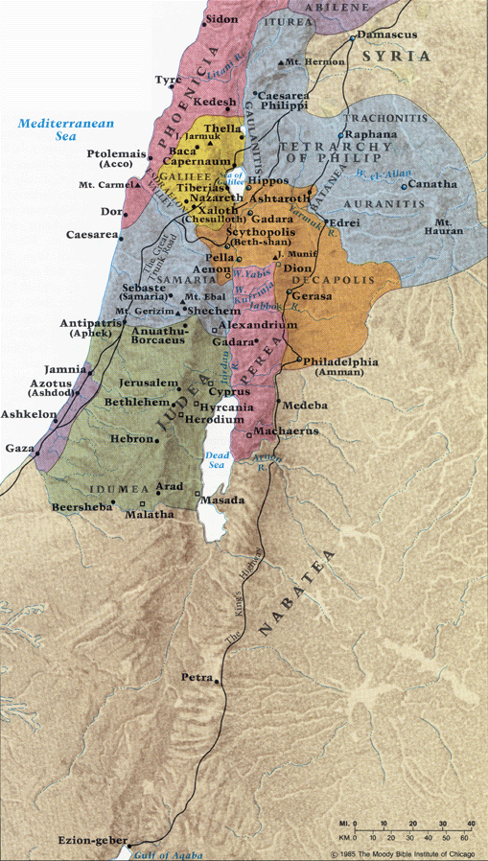
you shall be My witnesses both in Jerusalem, and in all Judea and Samaria… Acts 1:8
Notes:
This is a story of God and his Power and this is an outline for the entire book

Slide 9
Acts 8:1-4 (The Jerusalem Church Dispersed)
Saul was in hearty agreement with putting him to death. And on that day a great persecution began against the church in Jerusalem, and they were all scattered throughout the regions of Judea and Samaria, except the apostles. ² Some devout men buried Stephen, and made loud lamentation over him. ³ But Saul began ravaging the church, entering house after house, and dragging off men and women, he would put them in prison. ⁴ Therefore, those who had been scattered went about preaching the word.
the word is used to speak of the devastation caused by a wild beast
The Greek word is "evangelizing”
Evidence for the resurrection?
Notes:
It is an interesting thing to note the complete determination of Paul in his opposition to the church during this part of his life. Later, after his conversion, we will see him equally zealous and determined to promote the cause of Christ. This is typical of New Testament Christianity.
You see their complete dedication after the death of Stephen and the scattering, wherever they went and whoever they stayed with, they were telling the good news of the Gospel

Slide 10
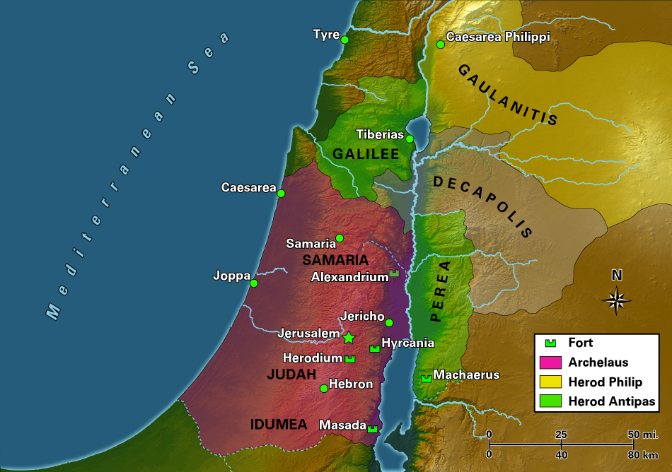
Acts 8:5-13 (Philip in Samaria)
⁵ Philip went down to the city of Samaria and began proclaiming Christ to them.
What qualified Philip to be an evangelist?
Notes:
As he leaves Jerusalem, he becomes an evangelist, the title by which he is called in Acts 21 :8. There does not seem to have been a special commission in order for him to become an evangelist. He simply went, evangelizing, because he saw a need he could fill

Slide 11
Origin of the Samaritans
Assyrian Captivity. (2 Kings 17)
Vs 6- In the ninth year of Hoshea, the king of Assyria captured Samaria and carried Israel away into exile to Assyria
Vs 24 - The king of Assyria brought men from Babylon and from Cuthah and from Avva and from Hamath and Sepharvaim, and settled them in the cities of Samaria in place of the sons of Israel. So they possessed Samaria and lived in its cities.
Samaritans were from marriages between poor Israelites and relocated foreigners when Assyria captured the world. Partially because of their mixed blood there was animosity between the Jews and the Samaritans.
Perhaps this background of the Samaritans helps explain why God used a Hellenist to evangelize the area.

Slide 12
Jews & Samaritans
Jews and Samaritans have no dealings with each other. John 4:9
Their religion, though basically Jewish, was mixed with forms of idolatry. (2 Kings 17:32-34,41)
Though not regarded as totally heathenistic, they were not considered pure by the Jews.
The Samaritan’s help was refused in the rebuilding of Jerusalem, furthering the embitterment between these two groups. (Ezra 4:3-4)

Slide 13
Acts 8:5-13 (Philip in Samaria)
⁶ The crowds with one accord were giving attention to what was said by Philip, as they heard and saw the signs which he was performing. ⁷ For in the case of many who had unclean spirits, they were coming out of them shouting with a loud voice; and many who had been paralyzed and lame were healed. ⁸ So there was much rejoicing in that city.

Slide 14
Acts 8:5-13 (Philip in Samaria)
Gospel Preaching involved:
Proclaiming the death, burial, resurrection and lordship of Jesus Christ
Calling on people to respond with repentance (with faith and baptism implied)
Offering the remission of sins and refreshing gift of the Spirit
Gospel Preaching included proclaiming:
The character of Jesus (Servant, Holy, Just, Prince of life, Christ, Prophet)
The return of Jesus (i.e., His second coming)
⁹ Now there was a man named Simon, who formerly was practicing magic in the city and astonishing the people of Samaria, claiming to be someone great; ¹⁰ and they all, from smallest to greatest, were giving attention to him, saying, “This man is what is called the Great Power of God.” ¹¹ And they were giving him attention because he had for a long time astonished them with his magic arts. ¹² But when they believed Philip preaching the good news about the kingdom of God and the name of Jesus Christ, they were being baptized, men and women alike. ¹³ Even Simon himself believed; and after being baptized, he continued on with Philip, and as he observed signs and great miracles taking place, he was constantly amazed.
It has been suggested that Simon was claiming to be an angel who had become incarnate.
Had to be an obvious difference between Simon’s magic and Philip’s miracles
preaching the good news about the kingdom of God and the
name of Jesus Christ
baptized
What might this include?

Slide 15
Acts 8:14-25 (Peter & John in Samaria)
¹⁴ Now when the apostles in Jerusalem heard that Samaria had received the word of God, they sent them Peter and John, ¹⁵ who came down and prayed for them that they might receive the Holy Spirit. ¹⁶ For He had not yet fallen upon any of them; they had simply been baptized in the name of the Lord Jesus. ¹⁷ Then they began laying their hands on them, and they were receiving the Holy Spirit.
Luke 9:54 - When His disciples James and John saw this, they said, “Lord, do You want us to command fire to come down from heaven and consume them?”
They had received the promise of the Holy Spirit at the time of baptism but the measure of the Holy Spirit called "spiritual gifts” (I Cor 12) they did not yet have.

Slide 16
Acts 8:14-25 (Peter & John in Samaria)
Samaria had received the word (14), indicates salvation (cf. 12), according to Acts 2:38, they would have received the gift of the Holy Spirit.
The reception of miraculous gifts, by the laying on of the apostles hands, was not a part of their conversion (15-16)
Though Philip was there, they had not received the gifts. Apostles were sent to lay hands on the new Christians in Samaria. (17)
The fact that the miraculous gifts were given to Christians in Samaria is clear evidence that the gospel was for them as well and God approved

Slide 17
Acts 8:14-25 (Peter & John in Samaria)
¹⁸ Now when Simon saw that the Spirit was bestowed through the laying on of the apostles’ hands, he offered them money, ¹⁹ saying, “Give this authority to me as well, so that everyone on whom I lay my hands may receive the Holy Spirit.”

Slide 18
Simon’s Sin
Already evident that Simon loved the attention of the people, and the power it provided (9-11)
His desire was not to receive a gift, but to have the authority to impart the Holy Spirit to others (19). Evidence of his carnal mind and lust for power.
Note: The Holy Spirit is given through the laying on of the apostles hands (8:18) (6:6) , … not the same thing as the “gift” (cf. Acts 2:38)

Slide 19
Acts 8:20-25
²⁰ But Peter said to him, “May your silver perish with you, because you thought you could obtain the gift of God with money! ²¹ You have no part or portion in this matter, for your heart is not right before God. ²² Therefore repent of this wickedness of yours, and pray the Lord that, if possible, the intention of your heart may be forgiven you ²³ For I see that you are in the gall of bitterness and in the bondage of iniquity.” ²⁴ But Simon answered and said, “Pray to the Lord for me yourselves, so that nothing of what you have said may come upon me.”²⁵ So, when they had solemnly testified and spoken the word of the Lord, they started back to Jerusalem, and were preaching the gospel to many villages of the Samaritans.
Was an expression used to mean “extreme wickedness”

Slide 20
Simon, An Example of Apostasy
Some claim he was never saved
Luke said Simon Believed and was baptized (13)
He also believed (13) Just as others did.
Jesus promised salvation (Mk.16:16)
Some claim he was never lost
He sinned (18-19)
Due to perish (20) ,“bondage of iniquity” (23)
Needed to “repent and pray” (22)
Simon’s repentance (24) shows that a Christian caught in sin may be restored to a perfect standing through repentance and prayer (24)

Slide 21
Acts 8:26-40 (Philip & the Ethiopian)
“From beyond the rivers of Ethiopia My worshipers, My dispersed ones, Will bring My offerings. (Zeph 3:10)
²⁶ But an angel of the Lord spoke to Philip saying, “Get up and go south to the road that descends from Jerusalem to Gaza.” (This is a desert road.) ²⁷ So he got up and went; and there was an Ethiopian eunuch, a court official of Candace, queen of the Ethiopians, who was in charge of all her treasure; and he had come to Jerusalem to worship,
Candace was the title given to all Ethiopia’s queens
Was a Jew either by birth or by conversion. There was a sizeable Jewish population in Ethiopia

Slide 22
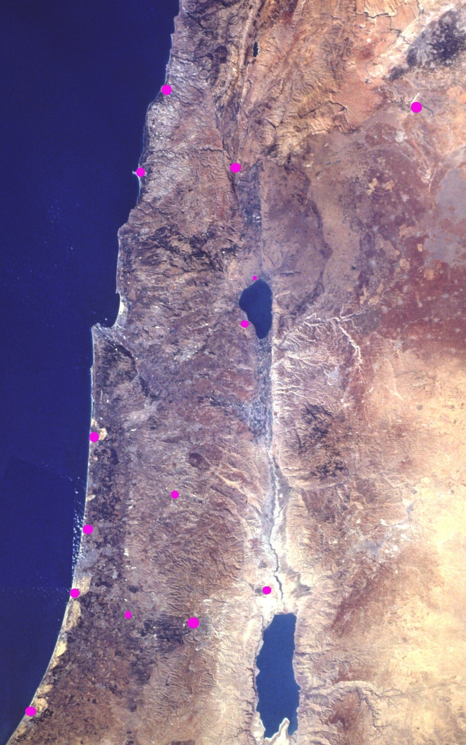
“Get up and go south to the road that descends from Jerusalem to Gaza.”
Sidon
Damascus
Tyre
Caesarea
Phillippi
Capernaum
Tiberias
Caesarea
Maritima
Samaria
Joppa
Azotus
(Ashdod)
Jericho
Jerusalem
Gaza

Slide 23
The Ethiopian Treasurer – Position & Qualities
Man of Importance – “a court official of Candace, … in charge of all her treasure;”
An honorable man – vs. 27
A religious man (a Jew or proselyte) – vs. 27 (had a desire to serve God)

Slide 24
The Ethiopian was dedicated to worshiping God.
N.B. Hardeman:
1000 miles
Hoffman Com:
1500 miles
DeHauf’s Com:
1500 miles
Studies in Acts by Thomas: 1200 miles

Slide 25
Acts 8:26-40 (Philip & the Ethiopian)
²⁶ But an angel of the Lord spoke to Philip saying, “Get up and go south to the road that descends from Jerusalem to Gaza.” (This is a desert road.) ²⁷ So he got up and went; and there was an Ethiopian eunuch, a court official of Candace, queen of the Ethiopians, who was in charge of all her treasure; and he had come to Jerusalem to worship, ²⁸ and he was returning and sitting in his chariot, and was reading the prophet Isaiah. ²⁹ Then the Spirit said to Philip, “Go up and join this chariot.”

Slide 26
The Ethiopian Treasurer - Qualities
Man of Importance – “a court official of Candace, … in charge of all her treasure;”
An honorable man – vs. 27
A religious man – vs. 27 (had a desire to serve God)
A truth seeker – vs. 28 (reading Isaiah while traveling)

Slide 27
Acts 8:26-40 (Philip & the Ethiopian)
³⁰ Philip ran up and heard him reading Isaiah the prophet, and said, “Do you understand what you are reading?” ³¹ And he said, “Well, how could I, unless someone guides me?” And he invited Philip to come up and sit with him. ³² Now the passage of Scripture which he was reading was this:
“He was led as a sheep to slaughter; And as a lamb before its shearer is silent, So He does not open His mouth. ³³ “In humiliation His judgment was taken away; Who will relate His generation? For His life is removed from the earth.”
By this question , Philip can learn where the Ethiopian is spiritually
He had trouble understanding how the description of humiliation and condemnation could be reconciled with the Jewish idea of a conquering Messiah.
Isaiah 53:7-8

Slide 28
Acts 8:26-40 (Philip & the Ethiopian)
³⁴ The eunuch answered Philip and said, “Please tell me, of whom does the prophet say this? Of himself or of someone else?” ³⁵ Then Philip opened his mouth, and beginning from this Scripture he preached Jesus to him. ³⁶ As they went along the road they came to some water; and the eunuch said, “Look! Water! What prevents me from being baptized?” ³⁷ [And Philip said, “If you believe with all your heart, you may.” And he answered and said, “I believe that Jesus Christ is the Son of God.”] ³⁸ And he ordered the chariot to stop; and they both went down into the water, Philip as well as the eunuch, and he baptized him.
Lowly birth & life
Hostile reception by His people
Unjust Trials
Beatings/Humiliation/Crucifixion
Burial in rich man’s tomb
Resurrection and Ascension
Intercession for sinners
Baptism/Remission of Sins/HS
Confession = Rom. 10:9; Matt 10:32; I Tim 6:12-13
We need to go back to Jerusalem to get a vote from the church
You need to undergo three months of catechism or read a creed and accept it and pledge loyalty to it

Slide 29
The Ethiopian Treasurer - Qualities
Man of Importance – “a court official of Candace, … in charge of all her treasure;”
An honorable man – vs. 27
A religious man – vs. 27 (had a desire to serve God)
A truth seeker – vs. 28
A humble man – vs. 30,31,34 (admit need of instruction)
A “ready” man – vs. 36
A convicted man – vs. 37 (confession & baptism)
An obedient man – vs. 38 (baptism)
A joyful man – vs. 39 - saved and added to the Lord’s Church

Slide 30
Acts 8:26-40 (Philip & the Ethiopian)
³⁹ When they came up out of the water, the Spirit of the Lord snatched Philip away; and the eunuch no longer saw him, but went on his way rejoicing. ⁴⁰ But Philip found himself at Azotus, and as he passed through he kept preaching the gospel to all the cities until he came to Caesarea.

Slide 31
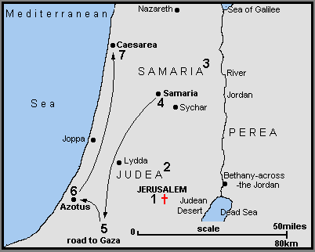
But Philip found himself at Azotus, and as he passed through he kept preaching the gospel to all the cities until he came to Caesarea
Over 20 years later we read:
Acts 21:8 - On the next day we left and came to Caesarea, and entering the house of Philip the evangelist, who was one of the seven, we stayed with him.

Slide 32
Observations
Here the Spirit is working through the evangelist. The Holy Spirit operates through the Word in conversion, not directly upon the heart apart from the Word. The gospel is the power of God unto salvation (Romans 1:16)
Preaching Jesus must include instruction on what to do to become a Christian. Baptism is included in preaching Jesus.

Slide 33
ACTS 9

Slide 34
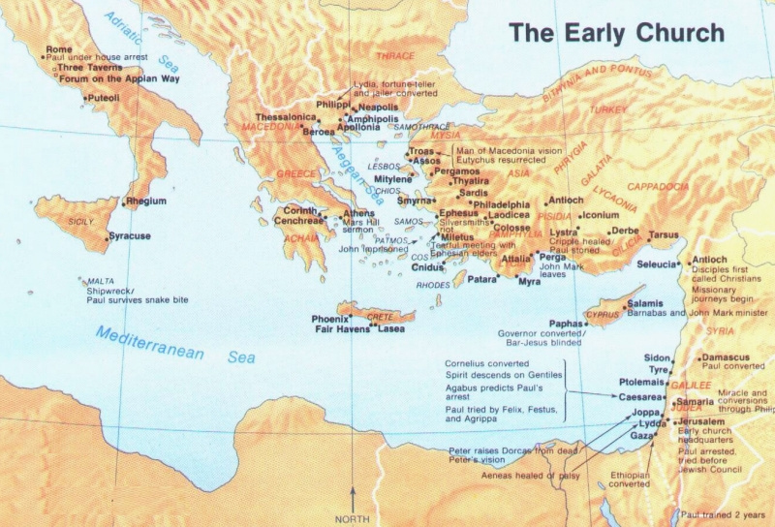
The Scattering of Acts 8 is pivotal to the Lord’s plan.
First, we follow the persecuted (Acts 8)
Next follow the chief persecutor (Acts 9)

Slide 35
Conversion of the Chief Persecutor
Conversion recorded 3 times Acts 9 Acts 22
Acts 26
Chief Persecutor
One of the strongest proofs of the resurrection.
Chief Proclaimer

Slide 36
Acts 9:1-2
Then Saul, still breathing threats and murder against the disciples of the Lord, went to the high priest ² and asked letters from him to the synagogues of Damascus, so that if he found any who were of the Way, whether men or women, he might bring them bound to Jerusalem.
Journey of about 150 miles

Slide 37
³ As he journeyed he came near Damascus, and suddenly a light shone around him from heaven. ⁴ Then he fell to the ground, and heard a voice saying to him, “Saul, Saul, why are you persecuting Me?” ⁵ And he said, “Who are You, Lord?”
Then the Lord said, “I am Jesus, whom you are persecuting. It is hard for you to kick against the goads.”
⁶ So he, trembling and astonished, said, “Lord, what do You want me to do?”
It was about noon – 22:6; 26:13
His traveling companions also saw the light and fell to the ground (22:9; 26:14).
Does he believe in Jesus?
Then the Lord said to him, “Arise and go into the city, and you will be told what you must do.”
⁷ And the men who journeyed with him stood speechless, hearing a voice but seeing no one.

Slide 38
⁸ Then Saul arose from the ground, and when his eyes were opened he saw no one. But they led him by the hand and brought him into Damascus. ⁹ And he was three days without sight, and neither ate nor drank.
¹⁰ Now there was a certain disciple at Damascus named Ananias; and to him the Lord said in a vision, “Ananias.”
And he said, “Here I am, Lord.”
¹¹ So the Lord said to him, “Arise and go to the street called Straight, and inquire at the house of Judas for one called Saul of Tarsus, for behold, he is praying. ¹² And in a vision he has seen a man named Ananias coming in and putting his hand on him, so that he might receive his sight.”
¹³ Then Ananias answered, “Lord, I have heard from many about this man, how much harm he has done to Your saints in Jerusalem. ¹⁴ And here he has authority from the chief priests to bind all who call on Your name.”
Is he penitent?
In emotional turmoil, suffering deep grief and an enormous sense of guilt = no appetite
First use of word in NT – one who is spiritually and morally separated from the world

Slide 39
¹⁵ But the Lord said to him, “Go, for he is a chosen vessel of Mine to bear My name before Gentiles, kings, and the children of Israel. ¹⁶ For I will show him how many things he must suffer for My name’s sake.”
¹⁷ And Ananias went his way and entered the house; and laying his hands on him he said, “Brother Saul, the Lord Jesus, who appeared to you on the road as you came, has sent me that you may receive your sight and be filled with the Holy Spirit.” ¹⁸ Immediately there fell from his eyes something like scales, and he received his sight at once; and he arose and was baptized.
Saw a grieving blind man
See verse 12
How was this accomplished?
When was this accomplished?
See Acts 2:38; 5:32
Galatians 4:6

Slide 40
When was Saul Saved?
He saw Jesus
He heard Jesus
He believed in Jesus
He repented
He fasted and prayed
He received the miracle of sight
He was baptized
Why did he see Jesus?
^{Acts 22:14} Then he said, ‘The God of our fathers has chosen you that you should know His will, and see the Just One, and hear the voice of His mouth. ¹⁵ For you will be His witness to all men of what you have seen and heard. ¹⁶ And now why are you waiting? Arise and be baptized, and wash away your sins, calling on the name of the Lord.’
Am I not an apostle? Have I not seen Jesus our Lord? ( Cor. 9:1)
What would have been good reasons to wait and baptize Paul in front of a crowd of people?

Slide 41
Must have been very wicked!
Very Moral:
“as to the righteousness which is in the Law, found blameless in the law.” (Phil. 3:6).
Very Religious:
“and I was advancing in Judaism beyond many of my contemporaries among my countrymen, being more extremely zealous for my ancestral traditions.” (Gal. 1:14 KJV)
Very Sincere:
“Men and brethren, I have lived in all good conscience before God until this day” (Acts 23:1)
“Christ Jesus came into the world to save sinners, of whom I am chief.” (1 Tim. 1:15)
Notes:
Original Title was Must have been very wicked!

Slide 42
^{Acts 9:19} So when he had received food, he was strengthened. Then Saul spent some days with the disciples at Damascus.
²⁰ Immediately he preached the Christ in the synagogues, that He is the Son of God.
²¹ Then all who heard were amazed, and said, “Is this not he who destroyed those who called on this name in Jerusalem, and has come here for that purpose, so that he might bring them bound to the chief priests?”
²² But Saul increased all the more in strength, and confounded the Jews who dwelt in Damascus, proving that this Jesus is the Christ.
²³ Now after many days were past, the Jews plotted to kill him. ²⁴ But their plot became known to Saul. And they watched the gates day and night, to kill him. ²⁵ Then the disciples took him by night and let him down through the wall in a large basket.
`
as a proclaimer of the gospel and a foe of the Jewish unbelievers
Spent time (parts of 3 yrs) in Arabia then returned to Damascus (Gal. 1:15-18) before going to Jerusalem

Slide 43
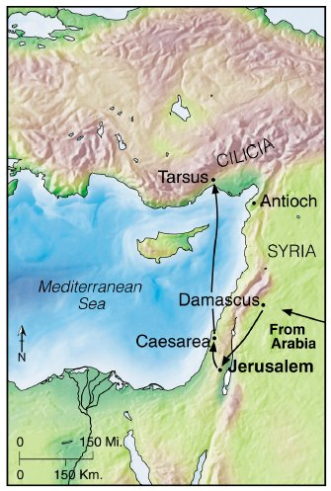
^{Acts 9:26} And when Saul had come to Jerusalem, he tried to join the disciples; but they were all afraid of him, and did not believe that he was a disciple. ²⁷ But Barnabas took him and brought him to the apostles. And he declared to them how he had seen the Lord on the road, and that He had spoken to him, and how he had preached boldly at Damascus in the name of Jesus. ²⁸ So he was with them at Jerusalem, coming in and going out. ²⁹ And he spoke boldly in the name of the Lord Jesus and disputed against the Hellenists, but they attempted to kill him. ³⁰ When the brethren found out, they brought him down to Caesarea and sent him out to Tarsus.
Most had evidently left the city by this time (Gal 1:18-19)
Obedience to the Lord and aware of His power
³¹ Then the churches throughout all Judea, Galilee, and Samaria had peace and were edified. And walking in the fear of the Lord and in the comfort of the Holy Spirit, they were multiplied.

Slide 44
Acts 1:8
But you shall receive power when the Holy Spirit has come upon you; and you shall be witnesses to Me in Jerusalem, and in all Judea and Samaria, and to the end of the earth.”
Gospel preached in Jerusalem (Acts 2-7)
Not recorded but done according to Acts 9:31
Done by Phillip, Peter & John (Acts 8:1-25)
Ethiopian’s conversion a beginning (Acts 8:39)

Slide 45
Now we return to follow Peter

Slide 46
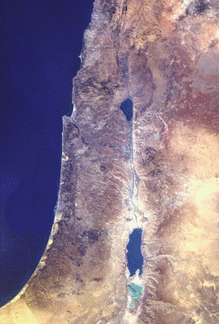
Israel in the New Testament
Sidon
Caesarea
Philippi
Tyre
Acts 9:32 Now it came to pass, as Peter went through all parts of the country, that he also came down to the saints who dwelt in Lydda. ³³ There he found a certain man named Aeneas, who had been bedridden eight years and was paralyzed. ³⁴ And Peter said to him, “Aeneas, Jesus the Christ heals you. Arise and make your bed.” Then he arose immediately. ³⁵ So all who dwelt at Lydda and Sharon saw him and turned to the Lord.
Capernaum
Bethsaida
Nazareth
Sea of Galilee
Caesarea
Jordan River
Mediterranean
Samaria
Joppa
Lydda
Jerusalem
Hebron
Dead Sea
Gaza
New Testament Israel
© EBibleTeacher.com
NASA PHOTO
Notes:
Review the N.T. map of Israel. Note that the land is no longer divided by tribes. The people, however kept detailed records of their lineage and could easily describe from what tribe they had descended. This was particularly important in regards to determining who could serve as priest. Only descendants of the tribe of Levi were allowed to serve as priests.

Slide 47
Israel in the New Testament
Sidon
Caesarea
Philippi
Acts 9:36-38
At Joppa there was a certain disciple named Tabitha, which is translated Dorcas. This woman was full of good works and charitable deeds which she did. ³⁷ But it happened in those days that she became sick and died. When they had washed her, they laid her in an upper room. ³⁸ And since Lydda was near Joppa, and the disciples had heard that Peter was there, they sent two men to him, imploring him not to delay in coming to them.
Tyre
Capernaum
Bethsaida
Nazareth
Sea of Galilee
Caesarea
Jordan River
Mediterranean
Samaria
Joppa
Lydda
Jerusalem
Hebron
Dead Sea
Gaza
New Testament Israel
© EBibleTeacher.com
Notes:
Review the N.T. map of Israel. Note that the land is no longer divided by tribes. The people, however kept detailed records of their lineage and could easily describe from what tribe they had descended. This was particularly important in regards to determining who could serve as priest. Only descendants of the tribe of Levi were allowed to serve as priests.

Slide 48
Acts 9:39-42
³⁹ Then Peter arose and went with them. When he had come, they brought him to the upper room. And all the widows stood by him weeping, showing the tunics and garments which Dorcas had made while she was with them. ⁴⁰ But Peter put them all out, and knelt down and prayed. And turning to the body he said, “Tabitha, arise.” And she opened her eyes, and when she saw Peter she sat up. ⁴¹ Then he gave her his hand and lifted her up; and when he had called the saints and widows, he presented her alive. ⁴² And it became known throughout all Joppa, and many believed on the Lord.

Slide 49
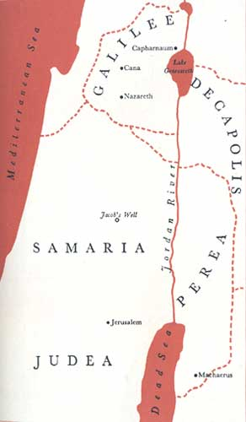
Caesarea was at this time the usual residence of the Roman governor of Judea, and consequently a garrison of troops was regularly found there.
* Caesarea
Joppa
*

Slide 50
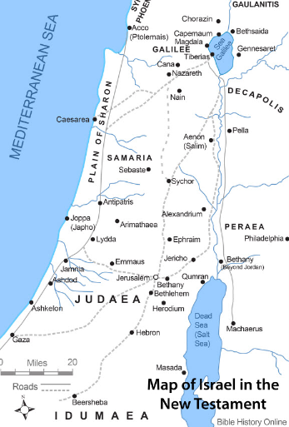
Peter preaches in Lydda & Sharon (Acts 9:32-35)
Peter “went here and there among them all” (ESV)
He finds Aeneas, paralyzed for eight years, and heals him (9:33-34)
Lead to many turning to the Lord (9:35)

Slide 51
Peter raises Dorcas from the dead (Acts 9:36-43)
At Joppa: a disciple named Tabitha (Dorcas), a woman full of good works and charitable deeds
She became sick and died
Her friends send for Peter, who is in Lydda, imploring him not to delay

Slide 52
Peter raises Dorcas from the dead (Acts 9:36-43)
Peter comes and witnesses the results of Tabitha’s deeds
Peter puts her friends out of the house and prays and asks her to arise
She is presented alive
It became known and many believed

