Slide 1
The Book of Acts
Lesson 7: Acts 10-12

Slide 2
Very Moral:
“as to the righteousness which is in the Law, found blameless in the law.” (Phil. 3:6).
Very Religious:
“and I was advancing in Judaism beyond many of my contemporaries among my countrymen, being more extremely zealous for my ancestral traditions.” (Gal. 1:14 KJV)
Very Sincere:
“Men and brethren, I have lived in all good conscience before God until this day” (Acts 23:1)
Saved?
“Christ Jesus came into the world to save sinners, of whom I am chief.” (1 Tim. 1:15)
Acts 9:6 – get up and enter the city and it will be told you what you must do.

Slide 3
When was Saul Saved?
He saw Jesus
He heard Jesus
He believed in Jesus
He repented
He fasted and prayed
He received the miracle of sight
He was baptized
Why did he see Jesus?
^{Acts 22:14} Then he said, ‘The God of our fathers has chosen you that you should know His will, and see the Just One, and hear the voice of His mouth. ¹⁵ For you will be His witness to all men of what you have seen and heard. ¹⁶ And now why are you waiting? Arise and be baptized, and wash away your sins, calling on the name of the Lord.’
Am I not an apostle? Have I not seen Jesus our Lord? ( Cor. 9:1)
What would have been good reasons to wait and baptize Paul in front of a crowd of people?

Slide 4
^{Acts 9:19} So when he had received food, he was strengthened. Then Saul spent some days with the disciples at Damascus.
²⁰ Immediately he preached the Christ in the synagogues, that He is the Son of God.
²¹ Then all who heard were amazed, and said, “Is this not he who destroyed those who called on this name in Jerusalem, and has come here for that purpose, so that he might bring them bound to the chief priests?”
²² But Saul increased all the more in strength, and confounded the Jews who dwelt in Damascus, proving that this Jesus is the Christ.
²³ Now after many days were past, the Jews plotted to kill him. ²⁴ But their plot became known to Saul. And they watched the gates day and night, to kill him. ²⁵ Then the disciples took him by night and let him down through the wall in a large basket.
`
as a proclaimer of the gospel and a foe of the Jewish unbelievers
Spent time (parts of 3 yrs) in Arabia then returned to Damascus (Gal. 1:15-18) before going to Jerusalem

Slide 5
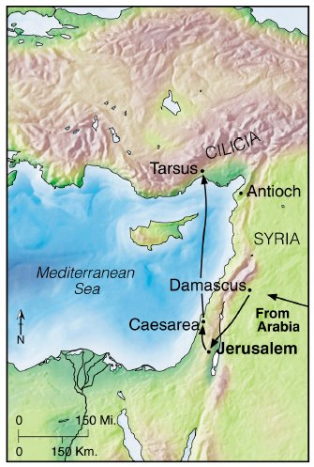
^{Acts 9:26} And when Saul had come to Jerusalem, he tried to join the disciples; but they were all afraid of him, and did not believe that he was a disciple. ²⁷ But Barnabas took him and brought him to the apostles. And he declared to them how he had seen the Lord on the road, and that He had spoken to him, and how he had preached boldly at Damascus in the name of Jesus. ²⁸ So he was with them at Jerusalem, coming in and going out. ²⁹ And he spoke boldly in the name of the Lord Jesus and disputed against the Hellenists, but they attempted to kill him. ³⁰ When the brethren found out, they brought him down to Caesarea and sent him out to Tarsus.
Most had evidently left the city by this time (Gal 1:18-19)
Because of Saul’s Conversion
³¹ Then the churches throughout all Judea, Galilee, and Samaria had peace and were edified. And walking in the fear of the Lord and in the comfort of the Holy Spirit, they were multiplied.

Slide 6
Now we return to follow Peter

Slide 7
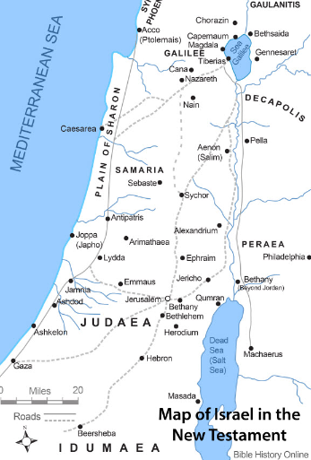
Peter preaches in Lydda & Sharon (Acts 9:32-35)
“Now as Peter was traveling through all those regions”
He finds Aeneas, paralyzed for eight years, and heals him (9:33-34)
Lead to many turning to the Lord (9:35)

Slide 8
Peter raises Dorcas from the dead (Acts 9:36-43)
At Joppa: a disciple named Tabitha (Dorcas = greek), a woman full of good works and charitable deeds
She became sick and died
Her friends send for Peter, who is in Lydda (≈ 10 miles), imploring him not to delay

Slide 9
Peter raises Dorcas from the dead (Acts 9:36-43)
Peter comes and witnesses the results of Tabitha’s deeds
Peter puts her friends out of the house and prays and asks her to arise
She is presented alive
It became known and many believed
And Peter stayed many days in Joppa with a tanner named Simon. 9:43

Slide 10
Acts Memorization
Chapter 1:
Chapter 2:
Chapter 3:
Chapter 4:
Chapter 5:
Chapter 6:
Chapter 7:
Chapter 8:
Chapter 9:
Chapter 10:
Ascension & Reign of the King / Waiting on the Spirit/
Matthias replaces Judas
Peter preaches on Pentecost /Outpouring of the Holy Spirit/
Beginning of the Church
Lame man healed / Peter’s 2nd Sermon
Peter & John Arrested
Ananias & Sapphira / Apostles arrested
Widows neglected
Stephen’s Defense & Martyrdom
Church Scattered/ Samaria & Ethiopian
Conversion of Saul/ Peter heals Aeneas and raises Dorcas
Conversion of First Gentile - Cornelius
Notes:
Chapter 9: Conversion of Saul/Peter heals Aeneas and raises Dorcas
Chapter 10: Conversion of First Gentile-Cornelius

Slide 11
Acts Memorization
Chapter 11:
Chapter 12:
Chapter 13:
Chapter 14:
Chapter 15:
Chapter 16:
Chapter 17:
Chapter 18:
Chapter 19:
Chapter 20:
Gospel To Antioch
James Martyred/Peter Escapes
First Journey Begins
Preaching in Asia Minor
Conference in Jerusalem
2nd Journey / European converts – Lydia & Jailer
Notes:
Chapter 9: Conversion of Saul/Peter heals Aeneas and raises Dorcas
Chapter 10: Conversion of First Gentile-Cornelius

Slide 12
Lesson 7 Objectives (the student will be able to …)
List the conditions that must be met to obtain remission of sins and the gift of the Holy Spirit
Explain the purpose of the Holy Spirit falling upon Cornelius and his household and for the seven Jews who witnessed the event
Describe when Cornelius and his household were saved?
List four themes found in Peter’s sermon.

Slide 13
OT Prophecies of Gentile Inclusion
Genesis 12:3 - And in you all the families of the earth will be blessed.
Psalm 22:27 -²⁷ All the ends of the earth will remember and turn to the Lord, And all the families of the nations will worship before You.
Isaiah 2:2 - Now it will come about that In the last days The mountain of the house of the Lord Will be established as the chief of the mountains, And will be raised above the hills; And all the nations will stream to it.
Isaiah 49:6 - I will also make You a light of the nations So that My salvation may reach to the end of the earth.”
Joel 2:28 - It will come about after this That I will pour out My Spirit on all mankind;
Zechariah 2:11 - “Many nations will join themselves to the Lord in that day and will become My people
Matthew 28:19 - Go therefore and make disciples of all the nations
Acts 1:8 - you shall be My witnesses both in Jerusalem, and in all Judea and Samaria, and even to the remotest part of the earth.”
Ephesians 3:3-7 - that by revelation there was made known to me the mystery, as I wrote before in brief. ⁴ By referring to this, when you read you can understand my insight into the mystery of Christ, ⁵ which in other generations was not made known to the sons of men, as it has now been revealed to His holy apostles and prophets in the Spirit; ⁶ to be specific, that the Gentiles are fellow heirs and fellow members of the body, and fellow partakers of the promise in Christ Jesus through the gospel, ⁷ of which I was made a minister, according to the gift of God’s grace which was given to me according to the working of His power.
Notes:
Genesis 12:3 New American Standard Bible (NASB)
³ And I will bless those who bless you, And the one who curses you I will curse. And in you all the families of the earth will be blessed.
Psalm 22:27 New American Standard Bible (NASB)
²⁷ All the ends of the earth will remember and turn to the Lord, And all the families of the nations will worship before You.
Isaiah 2:2 New American Standard Bible (NASB)
² Now it will come about that In the last days The mountain of the house of the Lord Will be established as the chief of the mountains, And will be raised above the hills; And all the nations will stream to it.
Isaiah 49:6 New American Standard Bible (NASB)
⁶ He says, “It is too small a thing that You should be My Servant To raise up the tribes of Jacob and to restore the preserved ones of Israel; I will also make You a light of the nations So that My salvation may reach to the end of the earth.”
Joel 2:28 New American Standard Bible (NASB)
The Promise of the Spirit
²⁸ “It will come about after this That I will pour out My Spirit on all mankind; And your sons and daughters will prophesy, Your old men will dream dreams, Your young men will see visions.
Zechariah 2:11 New American Standard Bible (NASB)
¹¹ “Many nations will join themselves to the Lord in that day and will become My people. Then I will dwell in your midst, and you will know that the Lord of hosts has sent Me to you.
Matthew 28:18-20 New American Standard Bible (NASB)
¹⁸ And Jesus came up and spoke to them, saying, “All authority has been given to Me in heaven and on earth. ¹⁹ Go therefore and make disciples of all the nations, baptizing them in the name of the Father and the Son and the Holy Spirit, ²⁰ teaching them to observe all that I commanded you; and lo, I am with you always, even to the end of the age.”
Acts 1:8 New American Standard Bible (NASB)
⁸ but you will receive power when the Holy Spirit has come upon you; and you shall be My witnesses both in Jerusalem, and in all Judea and Samaria, and even to the remotest part of the earth.”

Slide 14
Acts 1:8
But you shall receive power when the Holy Spirit has come upon you; and you shall be witnesses to Me in Jerusalem, and in all Judea and Samaria, and to the end of the earth.”
Gospel preached in Jerusalem (Acts 2-7)
Not recorded but done according to Acts 9:31
Done by Phillip, Peter & John (Acts 8:1-25)
Ethiopian’s conversion a beginning (Acts 8:39)
Conversion of Gentiles, a Major Obstacle

Slide 15
If the gospel was to go to “every creature,” the door had to be opened to the Gentiles.
Three things would be necessary.
The Gentiles would have to find a preacher willing to preach to them.
The Preacher would have to be prepared.
It would have to be made clear that the Gentiles were equally acceptable with Jews as Disciples.

Slide 16
Cornelius – Acts 10—11:18
An important conversion. (48 verses)
The gospel is for all men, but until this time, its proclamation had been limited to Jews
It involves conversion of the first Gentile.
Difficult for Jews to believe that Gentiles could be saved without becoming Jews.
“Peter rose up and said to them: ‘Men and brethren, you know that a good while ago God chose among us, that by my mouth the Gentiles should hear the word of the gospel and believe.’” (Acts 15:7)

Slide 17
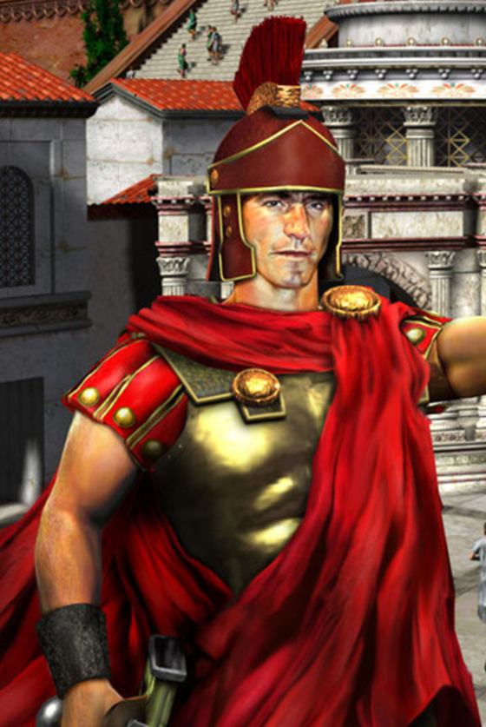
Who Was Cornelius?
‘A centurion’ – over 100 men of the Italian regiment – (v. 1)
‘A devout man’ – very religious, godly, devoted to God - (v. 2).
‘Feared God’ - He and his house - (v. 2; 22; cf Pr 1:7)
‘Gave alms generously’ - a caring, kind man - (v.2)
‘Prayed to God always’ – (v. 2)
‘A just man’ – fair and honest - (v. 22)
‘respected by all the Jewish people’ - even though a foreigner – (vs 22)
Regardless of his godly character, moral purity, sincerity, devotion in worship, generosity, conduct & reputation - Cornelius still NEEDED to be saved! – 10:6,22, 32,33; 11:14; cf. Rom. 3:23; 6:23
Notes:
A centurion, a non-commissioned officer in the Roman army, was over a “century,” a unit consisting of 100 soldiers. Cornelius’ century was a part of a larger division of soldiers, the band called the Italian band. The word translated band (speira) denotes a “cohort” — that is, the tenth part of a “legion.” The Roman legion consisted of 6,000 men. In minor provinces like Judea, however, there were no legions, and the cohorts were “auxiliary” cohorts composed of 500 to 1,000 soldiers
There was a class of Gentiles who worshiped the true God but remained uncircumcised, not converting to Judaism. They worshiped in Jewish synagogues and were sometimes called “God-fearers.” Cornelius was such a Gentile. His piety was manifested in his daily life as he gave much alms (generously helped the needy) and prayed regularly. That he feared God means that he held God in reverence due to his awareness of God’s power and willingness to punish sin.

Slide 18
Finding a Preacher Acts 10:1-6
There was a certain man in Caesarea called Cornelius, a centurion of what was called the Italian Regiment, ² a devout man and one who feared God with all his household, who gave alms generously to the people, and prayed to God always. ³ About the ninth hour of the day he saw clearly in a vision an angel of God coming in and saying to him, “Cornelius!”
⁴ And when he observed him, he was afraid, and said, “What is it, lord?”
So he said to him, “Your prayers and your alms have come up for a memorial before God. ⁵ Now send men to Joppa, and send for Simon whose surname is Peter. ⁶ He is lodging with Simon, a tanner, whose house is by the sea. He will tell you what you must do.”
Acts 11:13-14 - And he reported to us how he had seen the angel standing in his house, and saying, ‘Send to Joppa and have Simon, who is also called Peter, brought here; ¹⁴ and he will speak words to you by which you will be saved, you and all your household.’

Slide 19
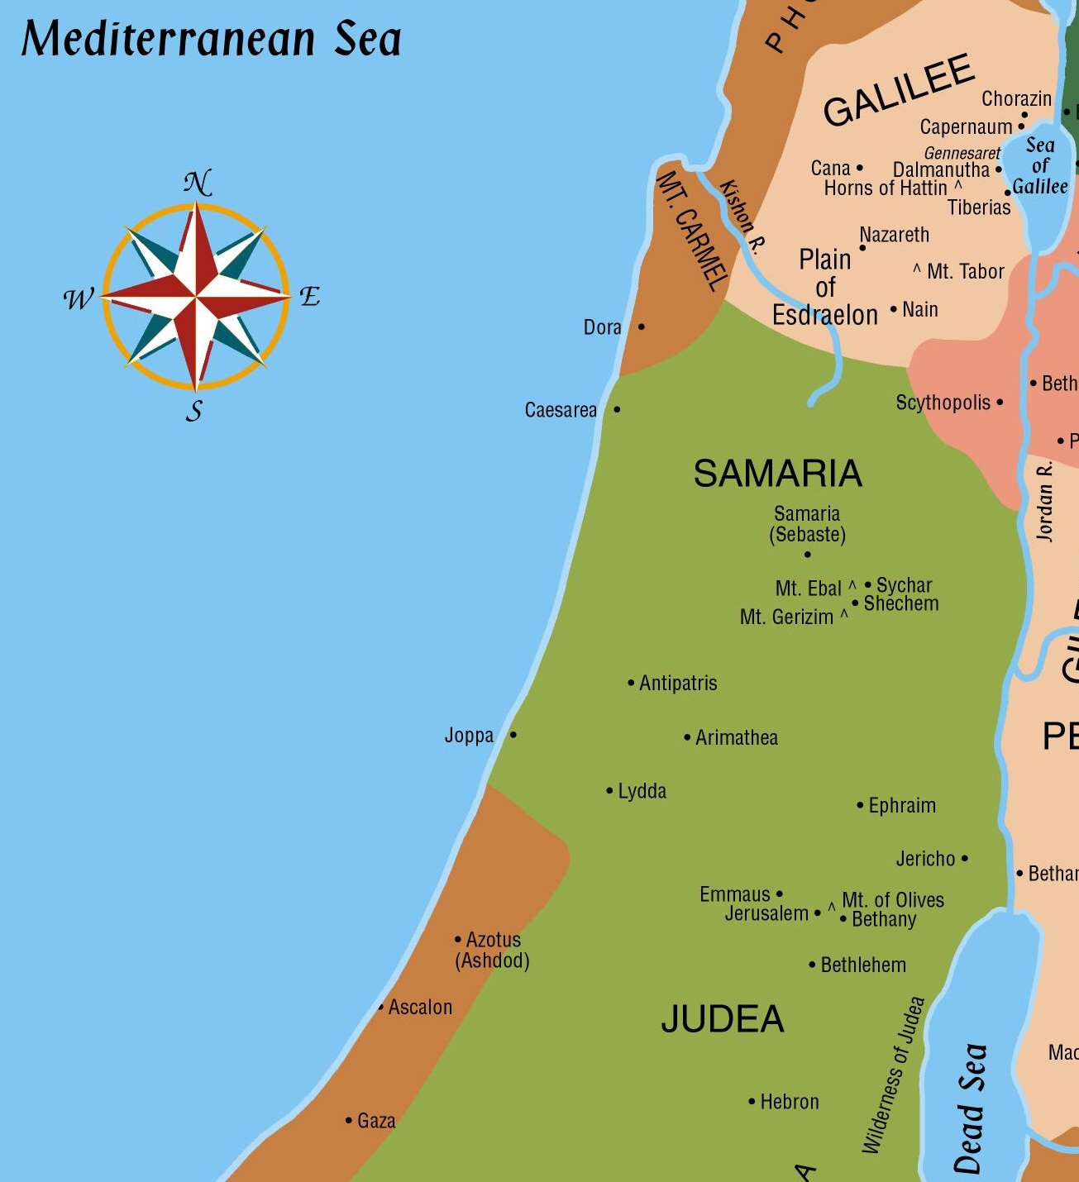
⁷ And when the angel who spoke to him had departed, Cornelius called two of his household servants and a devout soldier from among those who waited on him continually. ⁸ So when he had explained all these things to them, he sent them to Joppa.
Cornelius’ vision of an angel – (3-8)
“Send men to Joppa”
which Cornelius did – (4-8)
32 miles
Peter’s vision of unclean animals in Joppa – (9-16)

Slide 20
Preparing the Preacher (Acts 10:9-16)
⁹ The next day, as they went on their journey and drew near the city, Peter went up on the housetop to pray, about the sixth hour. ¹⁰ Then he became very hungry and wanted to eat; but while they made ready, he fell into a trance ¹¹ and saw heaven opened and an object like a great sheet bound at the four corners, descending to him and let down to the earth. ¹² In it were all kinds of four-footed animals of the earth, wild beasts, creeping things, and birds of the air. ¹³ And a voice came to him, “Rise, Peter; kill and eat.”
¹⁴ But Peter said, “Not so, Lord! For I have never eaten anything common or unclean.” ¹⁵ And a voice spoke to him again the second time, “What God has cleansed you must not call common.” ¹⁶ This was done three times. And the object was taken up into heaven again.
The meaning of the vision was deeper than the fact that God no longer recognizes distinctions between clean and unclean animals
Notes:
Food permitted and forbidden under the old law:
Leviticus 11:2-27
Deuteronomy 14:3-20

Slide 21
¹⁷ Now while Peter wondered within himself what this vision which he had seen meant, behold, the men who had been sent from Cornelius had made inquiry for Simon’s house, and stood before the gate. ¹⁸ And they called and asked whether Simon, whose surname was Peter, was lodging there.
¹⁹ While Peter thought about the vision, the Spirit said to him, “Behold, three men are seeking you. ²⁰ Arise therefore, go down and go with them, doubting nothing; for I have sent them.”
²¹ Then Peter went down to the men who had been sent to him from Cornelius, and said, “Yes, I am he whom you seek. For what reason have you come?”
²² And they said, “Cornelius the centurion, a just man, one who fears God and has a good reputation among all the nation of the Jews, was divinely instructed by a holy angel to summon you to his house, and to hear words from you.” ²³ Then he invited them in and lodged them.
On the next day Peter went away with them, and some brethren from Joppa accompanied him.
11:22 – Six brethren

Slide 22
Cornelius’ vision of an angel – (3-8)
“Send men to Joppa”
which Cornelius did – (4-8)
32 miles
Peter’s vision of unclean animals in Joppa – (9-16)
Peter receives the men from Cornelius and goes with them– (17-23)

Slide 23
Peter was ready to go but not sure what to do when they arrived.
concerned not only with his own salvation, but with the salvation of his loved ones
²⁴ And the following day they entered Caesarea. Now Cornelius was waiting for them, and had called together his relatives and close friends. ²⁵ As Peter was coming in, Cornelius met him and fell down at his feet and worshiped him. ²⁶ But Peter lifted him up, saying, “Stand up; I myself am also a man.” ²⁷ And as he talked with him, he went in and found many who had come together. ²⁸ Then he said to them, “You know how unlawful it is for a Jewish man to keep company with or go to one of another nation. But God has shown me that I should not call any man common or unclean. ²⁹ Therefore I came without objection as soon as I was sent for. I ask, then, for what reason have you sent for me?”
God is to be exalted, not the messenger
“unlawful” (athemitos) does not refer to the violation of a law that has been enacted; rather, it denotes a violation of custom

Slide 24
Cornelius’ Answer
³⁰ So Cornelius said, “Four days ago I was fasting until this hour; and at the ninth hour I prayed in my house, and behold, a man stood before me in bright clothing, ³¹ and said, ‘Cornelius, your prayer has been heard, and your alms are remembered in the sight of God. ³² Send therefore to Joppa and call Simon here, whose surname is Peter. He is lodging in the house of Simon, a tanner, by the sea. When he comes, he will speak to you.’ ³³ So I sent to you immediately, and you have done well to come. Now therefore, we are all present before God, to hear all the things commanded you by God.”
Now Peter knew he should preach to them if an angel directed Cornelius to send for him.

Slide 25
Outline of Peter’s Sermon (Acts 10:34-47)
10:34,35 God’s Impartiality
10:36-38 The Word of Jesus’ Ministry
10:39-41 Witnessed Death & Resurrection
10:42,43 Message of Judgment & Forgiveness
10:47 Instructions for Obedience

Slide 26
Peter’s Introduction
³⁴ Then Peter opened his mouth and said: “In truth I perceive that God shows no partiality. ³⁵ But in every nation whoever fears Him and works righteousness is accepted by Him.
Revolutionary truth - He does not show partiality to certain persons because of some external condition like nationality, race, rank, or wealth
How did Peter learn this?
What kind of peace?
³⁶ The word which God sent to the children of Israel, preaching peace through Jesus Christ—He is Lord of all— ³⁷ that word you know, which was proclaimed throughout all Judea, and began from Galilee after the baptism which John preached: ³⁸ how God anointed Jesus of Nazareth with the Holy Spirit and with power, who went about doing good and healing all who were oppressed by the devil, for God was with Him.
Notes:
Then Peter opened his mouth was used to introduce an utterance of great import (Book of Acts 211). Indeed, what Peter was about to say was a truth of monumental proportions in a time when Jews were convinced that only Jews could be acceptable to God. Through his experiences beginning with the vision on the housetop, Peter had been led to perceive the revolutionary truth that God is no respecter of persons — that is, he does not show partiality to certain persons because of some external condition like nationality, race, rank, or wealth. The next verse shows Peter’s point — namely, that people of all nations can be acceptable to God. It
It is true that during the Old Testament period the nation of Israel was God’s chosen nation. His choice of that nation, however, did not involve choosing them and only them for eternal salvation. Indeed, many of them would not be eternally saved, and Gentiles were not beyond the pale of salvation. He chose Israel as the nation from which the Savior would come and the nation he would prepare for the Savior’s coming. Those from this specially prepared nation who received the Savior would then carry the message of salvation to people of other nations. God’s choice of Israel, therefore, was simply a part of his plan to save people of all nations who would accept Christ. He has never shown partiality to any nation, including Israel, in the matter of salvation. The Jews did not understand this fact.
To fear God is to revere him out of regard for his power and willingness to punish sin. To work righteousness is to do the things that are right, obeying God’s commandments (Ps. 119:172).
36 The word which God sent unto the children of Israel, preaching peace by Jesus Christ: (he is Lord of all:). The word God had sent to Israel was a message of peace. Through Christ men can enjoy peace with God as our sins, which alienate us from God, are forgiven; we can enjoy peace with all others who submit to Christ; and we can enjoy an inner peace, a tranquility that comes from God’s assurances to Christians. To his Gentile audience, Peter emphasizes that Christ is Lord of all; he is not simply a Jewish prophet concerned only with Jews
Others affirm that the words ye know in v. 37 are connected with this verse. If so, Peter was saying that they knew the word God had sent out, particularly facts regarding the life and teaching of Jesus (vv. 37-38).
He is saying that the Gentiles in his audience were familiar with certain facts about Jesus and his message of peace. As we discuss the details about which there is disagreement and uncertainty, we should remember that the important thing is that basic point.

Slide 27
³⁹ And we are witnesses of all things which He did both in the land of the Jews and in Jerusalem, whom they killed by hanging on a tree. ⁴⁰ Him God raised up on the third day, and showed Him openly, ⁴¹ not to all the people, but to witnesses chosen before by God, even to us who ate and drank with Him after He arose from the dead. ⁴² And He commanded us to preach to the people, and to testify that it is He who was ordained by God to be Judge of the living and the dead. ⁴³ To Him all the prophets witness that, through His name, whoever believes in Him will receive remission of sins.”
What would believing involve?
But did that include Gentiles?

Slide 28
Proving Equality of Jew and Gentile
Acts 11:15 - And as I began to speak, the Holy Spirit fell upon them just as He did upon us at the beginning
⁴⁴ While Peter was still speaking these words, the Holy Spirit fell upon all those who heard the word. ⁴⁵ And those of the circumcision who believed were astonished, as many as came with Peter, because the gift of the Holy Spirit had been poured out on the Gentiles also. ⁴⁶ For they heard them speak with tongues and magnify God.
Then Peter answered, ⁴⁷ “Can anyone forbid water, that these should not be baptized who have received the Holy Spirit just as we have?” ⁴⁸ And he commanded them to be baptized in the name of the Lord. Then they asked him to stay a few days.
Had they met the conditions to have their sins forgiven?
Likely speaking in the Jewish language (Aramaic)

Slide 29
Why Was The Holy Spirit Given To Cornelius?
1. To fulfill prophecy. Joel 2:28; cf. Acts 2:16ff
2. Not to change Cornelius, but for the instruction of Peter and the six Jews. Note: Peter’s response (10:47) and His arguments used at Jerusalem (11:17; 15:7-9)
Acts 11:17-18 Therefore if God gave to them the same gift as He gave to us also after believing in the Lord Jesus Christ, who was I that I could stand in God’s way?” ¹⁸ When they heard this, they quieted down and glorified God, saying, “Well then, God has granted to the Gentiles also the repentance that leads to life.
Acts 15:7-9 "Brothers, you know that some time ago God made a choice among you that the Gentiles might hear from my lips the message of the gospel and believe. ⁸God, who knows the heart, showed that he accepted them by giving the Holy Spirit to them, just as he did to us. ⁹He made no distinction between us and them…”
Notes:
Acts 15:7 - "Brothers, you know that some time ago God made a choice among you that the Gentiles might hear from my lips the message of the gospel and believe. ⁸God, who knows the heart, showed that he accepted them by giving the Holy Spirit to them, just as he did to us. ⁹He made no distinction between us and them…”
Joel 2:28 New American Standard Bible (NASB)
The Promise of the Spirit
²⁸ “It will come about after this That I will pour out My Spirit on all mankind; And your sons and daughters will prophesy, Your old men will dream dreams, Your young men will see visions.
Acts 10:47 New American Standard Bible (NASB)
⁴⁷ “Surely no one can refuse the water for these to be baptized who have received the Holy Spirit just as we did, can he?”
Acts 11:17 New American Standard Bible (NASB)
¹⁷ Therefore if God gave to them the same gift as He gave to us also after believing in the Lord Jesus Christ, who was I that I could stand in God’s way?”
Acts 15:8-9 New American Standard Bible (NASB)
⁸ And God, who knows the heart, testified to them giving them the Holy Spirit, just as He also did to us; ⁹ and He made no distinction between us and them, cleansing their hearts by faith.
1 Corinthians 14:22 New American Standard Bible (NASB)
²² So then tongues are for a sign, not to those who believe but to unbelievers; but prophecy is for a sign, not to unbelievers but to those who believe.
. Those six Jewish brethren who accompanied Peter, now had seen Gentiles speak with tongues and glorify God just as the Jews had some 8 - 10 years earlier. cf. Acts 11:12

Slide 30
Did the Holy Spirit come to Save Them?
^{11:13} And he told us how he had seen an angel standing in his house, who said to him, ‘Send men to Joppa, and call for Simon whose surname is Peter, ¹⁴ who will tell you words by which you and all your household will be saved.’
And as I began to speak, the Holy Spirit fell upon them, as upon us at the beginning.
What were the words by which they were saved?
They already knew about Jesus (10:36-37)
“And he commanded them to be baptized in the name of the Lord.” (Acts 10:48)

Slide 31
The Three Obstacles Removed
Where a Gentile could find a preacher.
How a Jewish preacher could be persuaded to preach to Gentiles
Evidence that Gentiles were equally acceptable as Jews to be disciples.
The angel’s appearance and instructions to Cornelius.
Peter’s vision of animals and instructions to go with the messengers
The Gentiles’ baptism of the Holy Spirit

Slide 32
Themes in Acts Sermons
chapter 2 3 7 10
Miracles 22 16 38
Rejection by Jews 23,36 4:11 51,52 39
Resurrection 24 15 (56) 40
Prophecies… 24 37 43
Suffering Messiah 27 18 52
Resurrection 24,31 (24) (56)
Coronation 33,34 4:11 (56)
Reign in Heaven 36 21 (56) 42
Judgment 20,40 21 42
God’s Control 17-on 15,18… -all- 36,38,40,42
Human Guilt 36,40 26 51-53
Forgiveness 38,40 19 (60?) 36, 43
Repentance 38 19 11:18
Baptism 38 47
Exclusivity 40 4:12 6 “must do”
Universality 39 25,26 34,35

Slide 33
ACTS 11

Slide 34
Acts 11:1-3
Now the apostles and brethren who were in Judea heard that the Gentiles had also received the word of God. ² And when Peter came up to Jerusalem, those of the circumcision contended with him, ³ saying, “You went in to uncircumcised men and ate with them!”

Slide 35
Acts 11:15-18
And as I began to speak, the Holy Spirit fell upon them, as upon us at the beginning. ¹⁶ Then I remembered the word of the Lord, how He said, ‘John indeed baptized with water, but you shall be baptized with the Holy Spirit.’ ¹⁷ If therefore God gave them the same gift as He gave us when we believed on the Lord Jesus Christ, who was I that I could withstand God?”
¹⁸ When they heard these things they became silent; and they glorified God, saying, “Then God has also granted to the Gentiles repentance to life.”

Slide 36
This should have settled the Gentile Question for all time!
Sadly, it did not!
The Gentile question is a constant factor in many of the following events in Acts.
Their conversion does open the door for the next development.

Slide 37
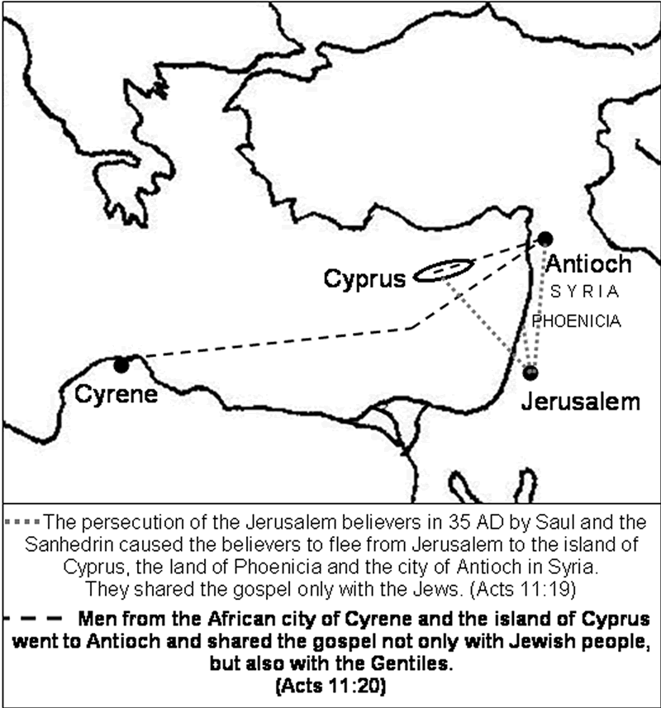
Antioch becomes the launching base for the gospel to the Gentiles.
^{20 “}But some of them were men from Cyprus and Cyrene, who, when they had come to Antioch, spoke to the Hellenists, preaching the Lord Jesus. ²¹ And the hand of the Lord was with them, and a great number believed and turned to the Lord.”
God’s power was present to help them
Antioch was the capital of the Roman province of Syria. Was one of the largest cities in the Roman Empire.
“Now those who were scattered after the persecution that arose over Stephen traveled as far as Phoenicia, Cyprus, and Antioch, preaching the word to no one but the Jews only.” (Acts 11:19)

Slide 38
Acts 11:22-26
²² Then news of these things came to the ears of the church in Jerusalem, and they sent out Barnabas to go as far as Antioch. ²³ When he came and had seen the grace of God, he was glad, and encouraged them all that with purpose of heart they should continue with the Lord. ²⁴ For he was a good man, full of the Holy Spirit and of faith. And a great many people were added to the Lord.
²⁵ Then Barnabas departed for Tarsus to seek Saul. ²⁶ And when he had found him, he brought him to Antioch. So it was that for a whole year they assembled with the church and taught a great many people. And the disciples were first called Christians in Antioch.
Isaiah 62:2 - The nations will see your righteousness, And all kings your glory; And you will be called by a new name Which the mouth of the Lord will designate.
Became the place from which he embarked on three evangelistic journeys
Most prominent feature of these people - Devoted to Christ

Slide 39
Acts 11:27-30
And in these days prophets came from Jerusalem to Antioch. ²⁸ Then one of them, named Agabus, stood up and showed by the Spirit that there was going to be a great famine throughout all the world, which also happened in the days of Claudius Caesar. ²⁹ Then the disciples, each according to his ability, determined to send relief to the brethren dwelling in Judea. ³⁰ This they also did, and sent it to the elders by the hands of Barnabas and Saul.
How was the need made known?
How were funds raised?
For whom were funds sent?
Who took the funds?
Who received them?
What organization was involved?

Slide 40
 | Acts 1-12 | Acts 13-28
Most Prominent Church | Jerusalem | Antioch
Most Prominent Apostle | Peter | Paul
Most Prominent Church
Most Prominent Apostle
Most Prominent People | Jews | Gentiles
Where Gospel was preached | Jerusalem, Judea, Samaria | “Uttermost part of the world”

