Slide 1
Revelation

Slide 2
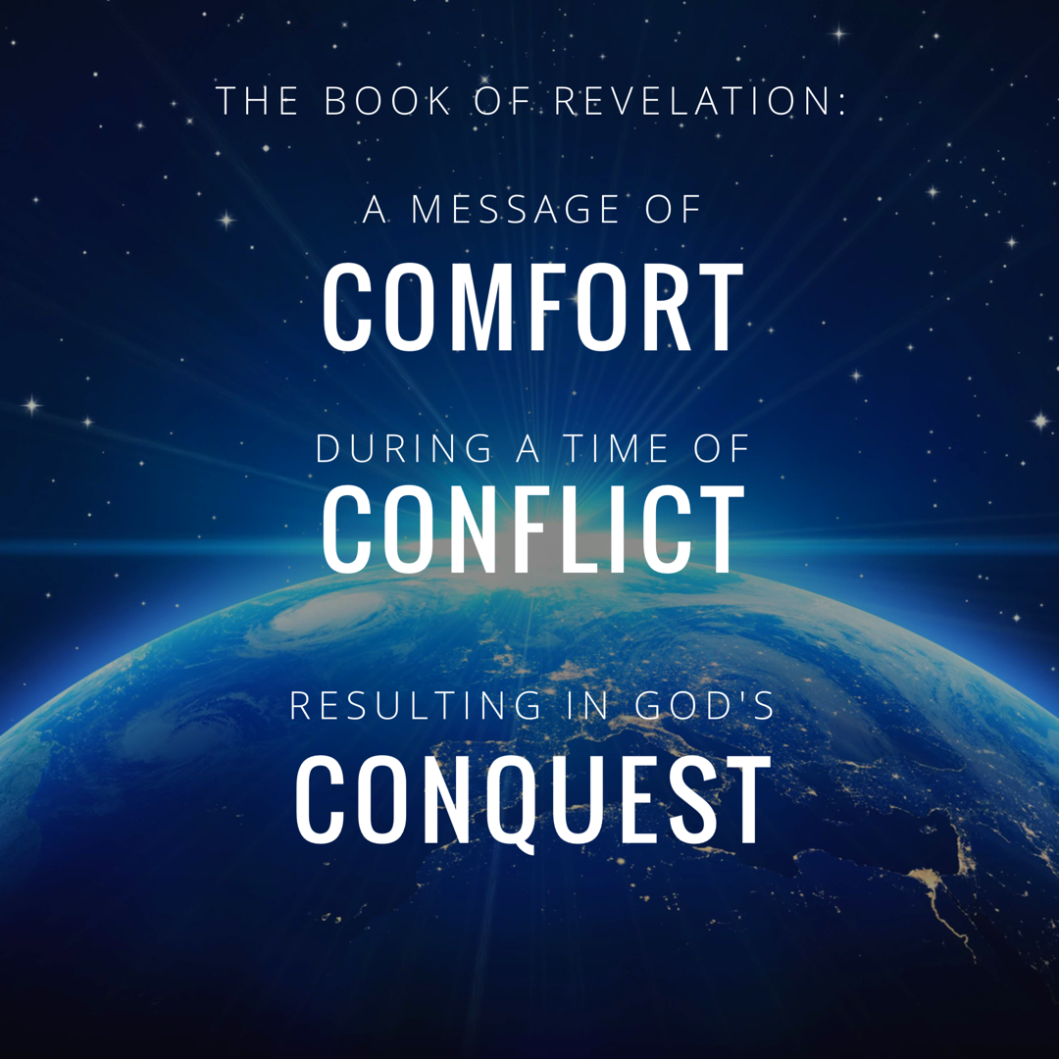
Notes:
In studying 12 we really rejoiced in GOD’s CONQUEST.
Rev. 12:11 “And they overcome him because of the blood of the Lamb and because of the word of their testimony, and they did not love their life even when faced with death.”

Slide 3
Overview of The Revelation
Introduction (Ch. 1)
The 7 Churches (Ch. 2-3)
Heavenly Scene: The Throne & The Lamb (Ch. 4-5)
The 7 Seals (Ch. 6-8)
Heavenly Scene: Silence in Heaven (Ch. 8)
The 7 Trumpets (Ch. 8-11)
Heavenly Scene: The Spiritual Conflict (Ch. 12-14)
The 7 Bowls (Ch. 15-18)
Heavenly Scene: The Spiritual Victory (Ch. 19)
Conclusion: The Rule of Christ (Ch. 20-22)

Slide 4
Revelation Chapter 1-3
Jesus Leads His Church
“The Revelation of Jesus Christ, which God gave Him to show to His bond-servants, the things which must soon take place; and He sent and communicated it by His angel to His bond-servant John,” (Rev 1:1)
“Do not fear what you are about to suffer. Behold, the devil is about to cast some of you into prison, so that you will be tested, and you will have tribulation for ten days. Be faithful until death, and I will give you the crown of life.” (Rev 2:10)
Notes:
A story, written in a time of crisis and distress, that is given by otherworldly beings explaining how God will reverse everything so the righteous will triumph.

Slide 5
Revelation Chapter 4-5
The Throne of Our Holy God
And the four living creatures, each one of them having six wings, are full of eyes around and within; and day and night they do not cease to say, “Holy, holy, holy is the Lord God, the Almighty, who was and who is and who is to come.” (Rev. 4:8)
The Worthy Lamb
“Worthy are You to take the book and to break its seals; for You were slain, and purchased for God with Your blood men from every tribe and tongue and people and nation.” (Rev. 5:9)

Slide 6
Revelation Chapter 6-8
The Nation (Of Israel) Is Judged
“The sky was split apart like a scroll when it is rolled up, and every mountain and island were moved out of their places.” (Revelation 6:14)
The People of God Are Identified & Protected
“saying “Do not harm the earth or the sea or the trees until we have sealed the bond-servants of our God on their foreheads.” (Revelation 7:3)
A Portion of Israel Begins To Suffer.
“And the seven angels who had the seven trumpets prepared themselves to sound them.” (Revelation 8:6)

Slide 7
Revelation Chapter 9-10
A Great Army Comes Against The Nation of Israel.
“The appearance of the locusts was like horses prepared for battle; and on their heads appeared to be crowns like gold, and their faces were like the faces of men.” (Revelation 9:7)
The Delay Is Ending So John Must Prepare To Act.
“…there will be delay no longer, but in the days of the voice of the seventh angel, when he is about to sound, then the mystery of God is finished, as He preached to His servants the prophets.” (Revelation 10:6b-7)

Slide 8
Revelation Chapter 11
The Faithful Worship & Witness As Judgment Arrives.
“Then there was given me a measuring rod like a staff; and someone said, “Get up and measure the temple of God and the altar, and those who worship in it.” (Revelation 11:1)
“And I will grant authority to my two witnesses, and they will prophecy for twelve hundred and sixty days, clothed in sackcloth.” (Revelation 11:3)
“When they have finished their testimony, the beast that comes up out of the abyss will make war with them, and overcome them and kill them.” (Revelation 11:7)
Notes:
If you want a phrase for the whole chapter I would say: Silence Followed By Suffering.
The judgement that was pronounced in Chapter 6 as each seal was opened – is now beginning to occur. And this judgment affects a third of the people.

Slide 10
Revelation Chapter 12
The Heavenly Victory Behind The Earthly Difficulty.
“And there was war in heaven, Michael and his angels waging war with the dragon. The dragon and his angels waged war, “ (Rev 12:7)
“And they overcame him because of the blood of the Lamb and because of the word of their testimony, and they did not love their life even when faced with death.” (Revelation 12:11)
“So the dragon was enraged with the woman, and went off to make war with the rest of her children, who keep the commandments of God and hold to the testimony of Jesus.” (Revelation 12:17)
Notes:
If you want a phrase for the whole chapter I would say: Silence Followed By Suffering.
The judgement that was pronounced in Chapter 6 as each seal was opened – is now beginning to occur. And this judgment affects a third of the people.

Slide 11
Revelation Chapter 13-14
Satan Stirs Up The Roman Empire Against The Saints.
“they worshipped the dragon because he gave his authority to the beast; and they worshipped the beast, saying, “Who is like the beast, and who is able to wage war with him?” (Rev 13:4)
The Lamb Stirs Up His Angels Against Babylon.
“and he said with a loud voice, “Fear God, and give Him glory, because the hour of His judgment has come; worship Him who made the heavens and the earth and sea and springs of waters.”(7)
Notes:
If you want a phrase for the whole chapter I would say: Silence Followed By Suffering.
The judgement that was pronounced in Chapter 6 as each seal was opened – is now beginning to occur. And this judgment affects a third of the people.

Slide 12
Revelation Chapter 15
God Is Exalted In All The World.
“And they sang the song of Moses, the bond-servant of God, and the song of the Lamb, saying, “Great and marvelous are Your works, O Lord God, the Almighty; Righteous and true are Your ways, King of the nations! Who will not fear, O Lord, and glorify Your name? For You alone are holy; For all the nations will come and worship before You, For Your righteous acts have been revealed.” (Rev 15:3-4)
“Then one of the four living creatures gave to the seven angels seven golden bowls full of the wrath of God, who lives forever and ever.” (Rev. 15:7)
Notes:
Ch 13 – Satan stirred up the Beast
Ch 14 – Jesus stirred up the Angels
Ch 15 – Celebrating Jesus’ Superiority
God Is Exalted: The song of Moses is a song of deliverance and rescue. The saints who have given their lives aren’t asking: How could you let this happen. They are praising Him for His wonderful works. *Hymn: Come let us worship and bow down.

Slide 13
Revelation Chapter 16
God’s Conquest Over Rome Will Be Just & Decisive.
“And I heard the angel of the waters saying, “Righteous are You, who are and who were, O Holy One, because You judged these things; for they poured out the blood of saints and prophets, and You have given them blood to drink. They deserve it.” Rev. 16:5-6
“And I saw coming out of the mouth of the dragon an out of the mouth of the beast and out of the mouth of the false prophet, three unclean spirits like frogs; for they are spirits of demons, performing signs, which go out to the kings of the whole world, to gather them together for the war of the great day of God, the Almighty. (Rev. 16:13-14)
Notes:
16:13 – this is not the final day of judgment – but a judgment against the beast and it’s blaspheme.
** Key Word is MOUTH: When this battle does take place, it is JESUS and the sword of HIS MOUTH that brings Victory. Rev. 19:20-21

Slide 14
Revelation Chapter 17
God’s Conquest Over Rome Will Punish Her Harlotry
“…I will show you the judgment of the great harlot who sits on many waters, with whom the kings of the earth committed acts of immorality, and those who dwell on the earth were made drunk with the wine of her immorality.” (Rev. 17:1b-2)
“And I saw the woman drunk with the blood of the saints, and with the blood of the witnesses of Jesus. When I saw her, I wondered greatly.” (Rev. 17:6)
“These will wage war against the Lamb, and the Lamb will overcome them, because He is Lord of lords and King of kings, and those who are with Him are the called and chosen and faithful.” (Rev. 17:14)
Notes:
CH 17 and 18 function as the follow up to 16. WE know the fall of the beast will be Just and Decisive….but what happens to ROME is going to effect not just the empire – but everyone who has had international relationships with Rome.
So those relationships are revealed for WHAT THEY REALLY ARE: Harlotry. Prostitution. Rome enticed the other nations and their relationships were mutually destructive. So 17 describes the relationships and ch. 18 describes the loss.

Slide 15
Revelation Chapter 18
God’s Conquest Over Rome Will Destroy Her Wealth
“And the kings of the earth…” (18:9) “And the merchants of the earth…” (18:11) “And every shipmaster and every passenger and sailor…” (18:17) “And they threw dust on their heads and were crying out, weeping and mourning, saying “Woe, woe, the great city, in which all who had ships at sea became rich by her wealth, for in one hour she has been laid waste.” (18:19) “Rejoice over her, O heaven…” (18:20)
“Then a strong angel took up a stone like a great millstone and threw it into the sea, saying, “So will Babylon, the great city, be thrown down with violence, and will not be found any longer.” (21)
Notes:
Ch 13 – Satan stirred up the Beast
Ch 14 – Jesus stirred up the Angels
Ch 15 – Celebrating Jesus’ Superiority
God Is Exalted: The song of Moses is a song of deliverance and rescue. The saints who have given their lives aren’t asking: How could you let this happen. They are praising Him for His wonderful works. *Hymn: Come let us worship and bow down.

Slide 16
Revelation Chapter 17
God’s Conquest Over Rome Will Punish Her Harlotry
Babylon Described As A Great Harlot (vs. 1-6)
The Great Harlot: Drunk On Murder & Immorality (vs 1-2, Hosea 4:11-12)
The Harlot’s Company: The Beast full of Blaspheme (vs 3)
The Harlot’s Attire: Jeremiah 4:30 (vs 4)
The Harlot’s Identity: “mother/source of…abominations” (vs 5)
The Harlot’s Crimes: Jeremiah 51:7-8 (vs 6)
The Angel Explains The Vision To John (vs. 7-13)
The Angel Explains The Lamb’s Conquest To John (vs. 14-18)
Notes:
CH 17 and 18 function as the follow up to 16. WE know the fall of the beast will be Just and Decisive….but what happens to ROME is going to effect not just the empire – but everyone who has had international relationships with Rome.
So those relationships are revealed for WHAT THEY REALLY ARE: Harlotry. Prostitution. Rome enticed the other nations and their relationships were mutually destructive. So 17 describes the relationships and ch. 18 describes the loss.

Slide 17
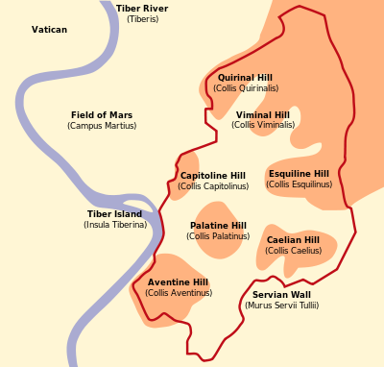
Revelation Chapter 17
God’s Conquest Over Rome Will Punish Her Harlotry
Babylon Described As A Great Harlot (vs. 1-6)
The Angel Explains The Vision To John (vs. 7-13)
The Beast Appears Unstoppable (17:8, Revelation 13:3)
The Beast Is Known For Seven Mountains (17:9)
The Beast Is Known For Seven Kings + 1 More King
Notes:
CH 17 and 18 function as the follow up to 16. WE know the fall of the beast will be Just and Decisive….but what happens to ROME is going to effect not just the empire – but everyone who has had international relationships with Rome.
So those relationships are revealed for WHAT THEY REALLY ARE: Harlotry. Prostitution. Rome enticed the other nations and their relationships were mutually destructive. So 17 describes the relationships and ch. 18 describes the loss.

Slide 18
Revelation Chapter 17
God’s Conquest Over Rome Will Punish Her Harlotry
Babylon Described As A Great Harlot (vs. 1-6)
The Angel Explains The Vision To John (vs. 7-13)
The Beast Appears Unstoppable (17:8, Revelation 13:3)
The Beast Is Known For Seven Mountains (17:9)
The Beast Is Known For Seven Kings + 1 More King
Option 1: Represents The Emperors with More Trouble To Come.
Option 2: Seek To Identify Specific Emperors
“Five Have Fallen” Possibly: Augustus, Tiberius, Caligula, Claudius, & Nero
“One Is” Possibly Vespasian in 69-79AD (Not Counting Galba, Otho, & Vitellius)
“Remain A Little While” Possibly: Titus 79-81 AD
“Himself Also An Eighth” Possibly Domitian, who claimed to be god.
Notes:
I am not a history teacher and do not like this level of speculation. Speculating is where people so often lose their credibility. The exact identity would have been much easier for the original audience to recognize.
This is one possibility I read, and am willing to share for the sake of curiosity.
5 Officially wore the title of Emperor. (Julius was a dictator)
AD 69 was a year of great unrest with 4 emperors, Vespasian being the one who actually succeeds in ruling.
Verse 12-13… 10 Kings (local governors, future leaders) John’s purpose is clear regardless: they serve the beast short term. See 17:2 the chapter as a whole is describing the far reaching evil impact of the Roman Empire and vs 12-13 continue in that purpose.

Slide 19
Revelation Chapter 17
God’s Conquest Over Rome Will Punish Her Harlotry
Babylon Described As A Great Harlot (vs. 1-6)
The Angel Explains The Vision To John (vs. 7-13)
The Beast Is Known For Seven Kings + 1 More King
The Angel Explains The Lamb’s Conquest To John (vs. 14-18)
Jesus Is Superior To ANY AND ALL rulers described in verses 10-13.
Lord Help Us To Be: Called by the Gospel, Chosen in Christ, Faithful to the End!
John Is Specifically Told to Understand The Waters As The Nations (vs. 15)
John Is Told The Nation Will Fall From Within (vs. 16-17, Ezekiel 16:35-37)
John Is Specifically Told to Understand The Woman As A City (vs. 18)
Bottom Line: We Can Be Faithful Like A Bride, or Adulterous With The Harlot. Victory Is For Those Who Are Faithful To The Lamb. (19:7)
Notes:
CH 17 and 18 function as the follow up to 16. WE know the fall of the beast will be Just and Decisive….but what happens to ROME is going to effect not just the empire – but everyone who has had international relationships with Rome.
So those relationships are revealed for WHAT THEY REALLY ARE: Harlotry. Prostitution. Rome enticed the other nations and their relationships were mutually destructive. So 17 describes the relationships and ch. 18 describes the loss.

Slide 20
Revelation Chapter 18
God’s Conquest Over Rome Will Destroy Her Wealth
“And the kings of the earth…” (18:9) “And the merchants of the earth…” (18:11) “And every shipmaster and every passenger and sailor…” (18:17) “And they threw dust on their heads and were crying out, weeping and mourning, saying “Woe, woe, the great city, in which all who had ships at sea became rich by her wealth, for in one hour she has been laid waste.” (18:19)
“Then a strong angel took up a stone like a great millstone and threw it into the sea, saying, “So will Babylon, the great city, be thrown down with violence, and will not be found any longer.” (21)
Notes:
Ch 13 – Satan stirred up the Beast
Ch 14 – Jesus stirred up the Angels
Ch 15 – Celebrating Jesus’ Superiority
God Is Exalted: The song of Moses is a song of deliverance and rescue. The saints who have given their lives aren’t asking: How could you let this happen. They are praising Him for His wonderful works. *Hymn: Come let us worship and bow down.

Slide 21
Revelation Chapter 18
God’s Conquest Over Rome Will Destroy Her Wealth
“After These Things I Saw…”
The Call To Come Out (Isaiah 52:11, 2 Corinthians 6:16-18)
God’s Wrath Will Be A Double Portion (18:6-8)
The Downfall of Babylon
The End of the Kings’ Political Power (vs. 9-10)
The End of the Merchants’ Trading Products (vs. 11-12) & Food (vs. 13-16)
The End of the Shipmasters’ Imports & Exports (vs. 17-19)
Those Who Place Their Treasure Above Can Rejoice. (Mt. 6:19-21)
The Conquest Over The Roman Empire Is Permanent.
Daniel 2:43, Jeremiah 51:63-64
Notes:
If we seek the world = It will cost us everything!
1 John 2:15. “Do not love the world not the things in the world. If anyone loves the world, the love of the Father is not in him.”
2:17 “The world is passing away, and also its lusts, but the one who does the will of God lives forever.

Slide 22
“Thrown Down With Violence & Will Not Be Found Any Longer.” Revelation 18:21
“When you finish reading this book, tie a stone to it and cast it into the midst of the Euphrates, and say, ‘Thus shall Babylon sink, to rise no more, because of the disaster that I am bringing upon her, and they shall become exhausted.’” Thus far are the words of Jeremiah.” (Jeremiah 51:63-64)

Slide 23
Revelation

Slide 24
Revelation Should Be Studied In Harmony With Other Clear Passages.
Passages That Discuss The Destruction of the World.
2 Peter 3:10-14
Passages That Discuss The Resurrection of All Mankind.
1 Corinthians 15:20-58
Passages That Discuss The Reign of Jesus.
1 Corinthians 15:25, 1 Timothy 6:13-16
Passages That Discuss The Return of Jesus.
1 Thessalonians 4:13 - 5:11
Notes:
How should we approach the rest of the book? On Sunday we wrapped up the 7 churches and now before we get into chapter 4 and 5 seems like the best time to discuss how we study this book as a a whole.
We’ve established that it is apocalyptic literature – with visions and symbolic language.
This language

