Slide 1
Revelation
Notes:
Ch. 19 ends with the destruction of the beast and the false prophet – but we are left to wonder? What about the dragon who was behind it all? What will be his end?
Ch 20 shows us that the answer to that question is CERTAIN but is not simultaneous with the fall of Rome. The defeat of Satan in fact will come after Christ has reigned for a long time – at an appointed time.

Slide 2
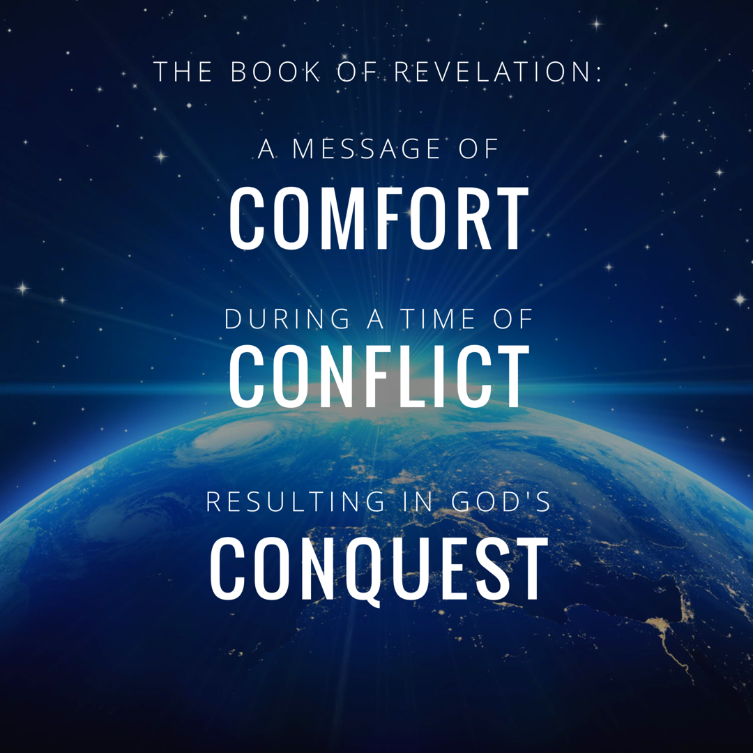
Notes:
In studying 12 we really rejoiced in GOD’s CONQUEST.
Rev. 12:11 “And they overcome him because of the blood of the Lamb and because of the word of their testimony, and they did not love their life even when faced with death.”

Slide 3
Revelation Chapter 1-3
Jesus Leads His Church
“The Revelation of Jesus Christ, which God gave Him to show to His bond-servants, the things which must soon take place; and He sent and communicated it by His angel to His bond-servant John,” (Rev 1:1)
“Do not fear what you are about to suffer. Behold, the devil is about to cast some of you into prison, so that you will be tested, and you will have tribulation for ten days. Be faithful until death, and I will give you the crown of life.” (Rev 2:10)
Notes:
A story, written in a time of crisis and distress, that is given by otherworldly beings explaining how God will reverse everything so the righteous will triumph.

Slide 4
Revelation Chapter 4-5
The Throne of Our Holy God
And the four living creatures, each one of them having six wings, are full of eyes around and within; and day and night they do not cease to say, “Holy, holy, holy is the Lord God, the Almighty, who was and who is and who is to come.” (Rev. 4:8)
The Worthy Lamb
“Worthy are You to take the book and to break its seals; for You were slain, and purchased for God with Your blood men from every tribe and tongue and people and nation.” (Rev. 5:9)

Slide 5
Revelation Chapter 6-8
The Nation (Of Israel) Is Judged
“The sky was split apart like a scroll when it is rolled up, and every mountain and island were moved out of their places.” (Revelation 6:14)
The People of God Are Identified & Protected
“saying “Do not harm the earth or the sea or the trees until we have sealed the bond-servants of our God on their foreheads.” (Revelation 7:3)
A Portion of Israel Begins To Suffer.
“And the seven angels who had the seven trumpets prepared themselves to sound them.” (Revelation 8:6)

Slide 6
Revelation Chapter 9-10
A Great Army Comes Against The Nation of Israel.
“The appearance of the locusts was like horses prepared for battle; and on their heads appeared to be crowns like gold, and their faces were like the faces of men.” (Revelation 9:7)
The Delay Is Ending So John Must Prepare To Act.
“…there will be delay no longer, but in the days of the voice of the seventh angel, when he is about to sound, then the mystery of God is finished, as He preached to His servants the prophets.” (Revelation 10:6b-7)

Slide 7
Revelation Chapter 11
The Faithful Worship & Witness As Judgment Arrives.
“Then there was given me a measuring rod like a staff; and someone said, “Get up and measure the temple of God and the altar, and those who worship in it.” (Revelation 11:1)
“And I will grant authority to my two witnesses, and they will prophecy for twelve hundred and sixty days, clothed in sackcloth.” (Revelation 11:3)
“When they have finished their testimony, the beast that comes up out of the abyss will make war with them, and overcome them and kill them.” (Revelation 11:7)
Notes:
If you want a phrase for the whole chapter I would say: Silence Followed By Suffering.
The judgement that was pronounced in Chapter 6 as each seal was opened – is now beginning to occur. And this judgment affects a third of the people.

Slide 8
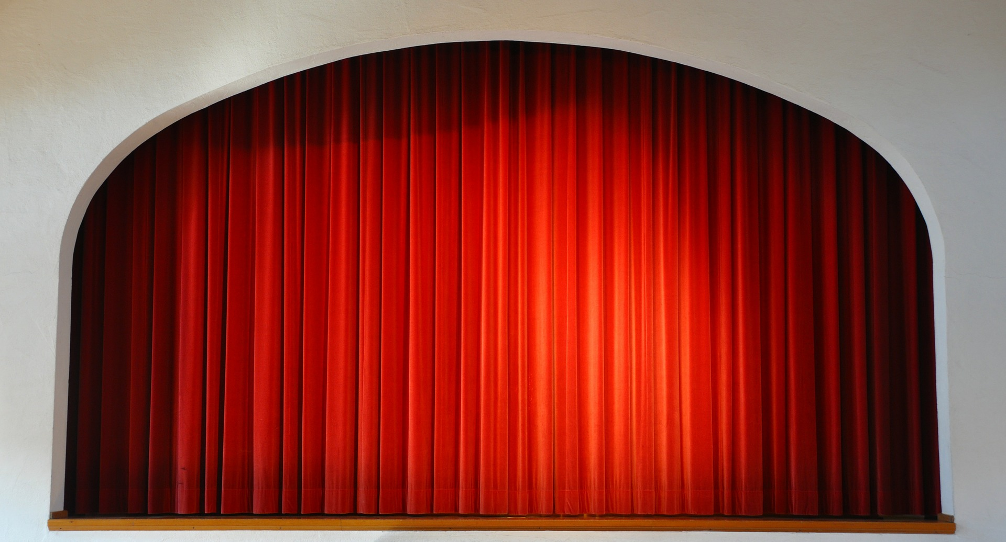

Slide 9
Revelation Chapter 12
The Heavenly Victory Behind The Earthly Difficulty.
“And there was war in heaven, Michael and his angels waging war with the dragon. The dragon and his angels waged war, “ (Rev 12:7)
“And they overcame him because of the blood of the Lamb and because of the word of their testimony, and they did not love their life even when faced with death.” (Revelation 12:11)
“So the dragon was enraged with the woman, and went off to make war with the rest of her children, who keep the commandments of God and hold to the testimony of Jesus.” (Revelation 12:17)
Notes:
If you want a phrase for the whole chapter I would say: Silence Followed By Suffering.
The judgement that was pronounced in Chapter 6 as each seal was opened – is now beginning to occur. And this judgment affects a third of the people.

Slide 10
Revelation Chapter 13-14
Satan Stirs Up The Roman Empire Against The Saints.
“they worshipped the dragon because he gave his authority to the beast; and they worshipped the beast, saying, “Who is like the beast, and who is able to wage war with him?” (Rev 13:4)
The Lamb Stirs Up His Angels Against Babylon.
“and he said with a loud voice, “Fear God, and give Him glory, because the hour of His judgment has come; worship Him who made the heavens and the earth and sea and springs of waters.”(7)
Notes:
If you want a phrase for the whole chapter I would say: Silence Followed By Suffering.
The judgement that was pronounced in Chapter 6 as each seal was opened – is now beginning to occur. And this judgment affects a third of the people.

Slide 11
Revelation Chapter 15
God Is Exalted In All The World.
“And they sang the song of Moses, the bond-servant of God, and the song of the Lamb, saying, “Great and marvelous are Your works, O Lord God, the Almighty; Righteous and true are Your ways, King of the nations! Who will not fear, O Lord, and glorify Your name? For You alone are holy; For all the nations will come and worship before You, For Your righteous acts have been revealed.” (Rev 15:3-4)
“Then one of the four living creatures gave to the seven angels seven golden bowls full of the wrath of God, who lives forever and ever.” (Rev. 15:7)
Notes:
Ch 13 – Satan stirred up the Beast
Ch 14 – Jesus stirred up the Angels
Ch 15 – Celebrating Jesus’ Superiority
God Is Exalted: The song of Moses is a song of deliverance and rescue. The saints who have given their lives aren’t asking: How could you let this happen. They are praising Him for His wonderful works. *Hymn: Come let us worship and bow down.

Slide 12
Revelation Chapter 16-18
God’s Conquest Over Rome Will Be Just & Decisive.
“And I heard the angel of the waters saying, “Righteous are You, who are and who were, O Holy One, because You judged these things; for they poured out the blood of saints and prophets, and You have given them blood to drink. They deserve it.” Rev. 16:5-6
God’s Conquest Over Rome Will Punish Her Harlotry
“…I will show you the judgment of the great harlot who sits on many waters, with whom the kings of the earth committed acts of immorality, and those who dwell on the earth were made drunk with the wine of her immorality.” (Rev. 17:1b-2)
God’s Conquest Over Rome Will Destroy Her Wealth
“And they threw dust on their heads and were crying out, weeping and mourning, saying “Woe, woe, the great city, in which all who had ships at sea became rich by her wealth, for in one hour she has been laid waste.” (18:19) “Rejoice over her, O heaven…” (18:20)
Notes:
16:13 – this is not the final day of judgment – but a judgment against the beast and it’s blaspheme.
** Key Word is MOUTH: When this battle does take place, it is JESUS and the sword of HIS MOUTH that brings Victory. Rev. 19:20-21

Slide 13
Revelation Chapter 19
Hallelujah! The Victory of The Lamb & His Bride.
“After these things…a great multitude in heaven saying, “Hallelujah! Salvation and glory and power belong to our God…for He has judged the great harlot.” (Rev. 19:1-2a) “Let us rejoice….for the marriage of the Lamb has come and His bride has made herself ready.” (vs. 7)
“Then I fell at his feet to worship him. But he said to me, “Do not do that….worship God.” (Rev 19:10)
“And the beast was seized, and with him the false prophet who performed the signs in his presence, by which he deceived those who had received the mark of the beast and those who worshiped his image; these two were thrown alive into the lake of fire which burns with brimstone.” (20)
Notes:
This chapter picks up the pace significantly. IT crams in AMAZING and FANTASTIC images of Victory!
This one chapter has 6 key scenes
A.) John Sees the Hallelujah’s
B.) Then the Bride
C.) Then The Instruction To Worship God
D.) Then Lord Coming in Victory
E.) Then the Birds Gather
F.) Then The Lake of Fire.
The Conquest Brings The Destruction of the Beast & False Prophet

Slide 14
Revelation Chapter 20
Jesus Defeats Both The Devil & Death Forever
“And the devil who deceived them was thrown into the lake of fire and brimstone, where the beast and the false prophet are also; and they will be tormented day and night forever and ever.” Rev. 20:10.
“Then I saw a great white throne and Him who sat upon it, from whose presence earth and heaven fled away, and no place was found for them.” Rev. 20:11
“Then death and Hades were thrown into the lake of fire. This is the second death, the lake of fire.” Rev. 20:14
Notes:
16:13 – this is not the final day of judgment – but a judgment against the beast and it’s blaspheme.
** Key Word is MOUTH: When this battle does take place, it is JESUS and the sword of HIS MOUTH that brings Victory. Rev. 19:20-21

Slide 15
Revelation Chapter 19
Hallelujah! The Victory of The Lamb & His Bride.
Four-Fold Hallelujah (vs. 1-6)
Hallelujah! Salvation and glory and power belong to God; (vs. 1)
Hallelujah! Her smoke rises up forever and ever. (vs. 3)
Amen. Hallelujah! (vs. 4)
Hallelujah! For the Lord our God, the Almighty, reigns. (vs 6)
The Marriage of the Lamb Anticipated (vs. 7-10)
3 Responses of the Saved: Rejoice, Be Glad, Give Glory.
The Saints Are Clothed In Righteous Acts.
The Invitation To The Marriage Super (vs. 9 – Matthew 22:1-14)
The Primary Lesson Repeated: “Worship God” (vs. 10)
Notes:
This chapter picks up the pace significantly. IT crams in AMAZING and FANTASTIC images of Victory!
This one chapter has 6 key scenes
A.) John Sees the Hallelujah’s
B.) Then the Bride
C.) Then The Instruction To Worship God
D.) Then Lord Coming in Victory
E.) Then the Birds Gather
F.) Then The Lake of Fire.
The Conquest Brings The Destruction of the Beast & False Prophet

Slide 16
Revelation Chapter 19
Hallelujah! The Victory of The Lamb & His Bride.
And I Saw… The Word & Wrath of God (vs. 11-16)
White Horse = Victory In Battle
Faithful & True = Primary Attributes
Righteous Judgment & War = Just Cause
Eyes, Flames of Fire = Insight & Intensity
Many Diadems = The Spoils of War Already In His Possession
Unknown Name = (Ways Higher Than Our Ways, Thoughts Higher…)
Robe Dipped In Blood = Conqueror
Word of God = Word became Flesh
Armies in Heaven = Countless Mighty Followers
Mouth: Sword & Rod = Power of His Words
Winepress of Fierce Wrath = Judgment Against Sin
Robe & Thigh = Royal & Faithful In His Covenants
King of Kings & Lord of Lords = Possesses All Authority
Notes:
This chapter picks up the pace significantly. IT crams in AMAZING and FANTASTIC images of Victory!
This one chapter has 6 key scenes
A.) John Sees the Hallelujah’s
B.) Then the Bride
C.) Then The Instruction To Worship God
D.) Then Lord Coming in Victory
E.) Then the Birds Gather
F.) Then The Lake of Fire.
The Conquest Brings The Destruction of the Beast & False Prophet

Slide 17
Revelation Chapter 19
Hallelujah! The Victory of The Lamb & His Bride.
Then I Saw… Birds of the Air (vs. 17-18)
Ezekiel 39:17-20
And I Saw… Jesus Defeats Both The Beast & False Prophet Forever. (vs. 19-21)
“thrown alive into the lake of fire which burns with brimstone.” (vs 20)
“and all the birds were filled with their flesh.” (vs 21)
Notes:
This chapter picks up the pace significantly. IT crams in AMAZING and FANTASTIC images of Victory!
This one chapter has 6 key scenes
A.) John Sees the Hallelujah’s
B.) Then the Bride
C.) Then The Instruction To Worship God
D.) Then Lord Coming in Victory
E.) Then the Birds Gather
F.) Then The Lake of Fire.
The Conquest Brings The Destruction of the Beast & False Prophet

Slide 18
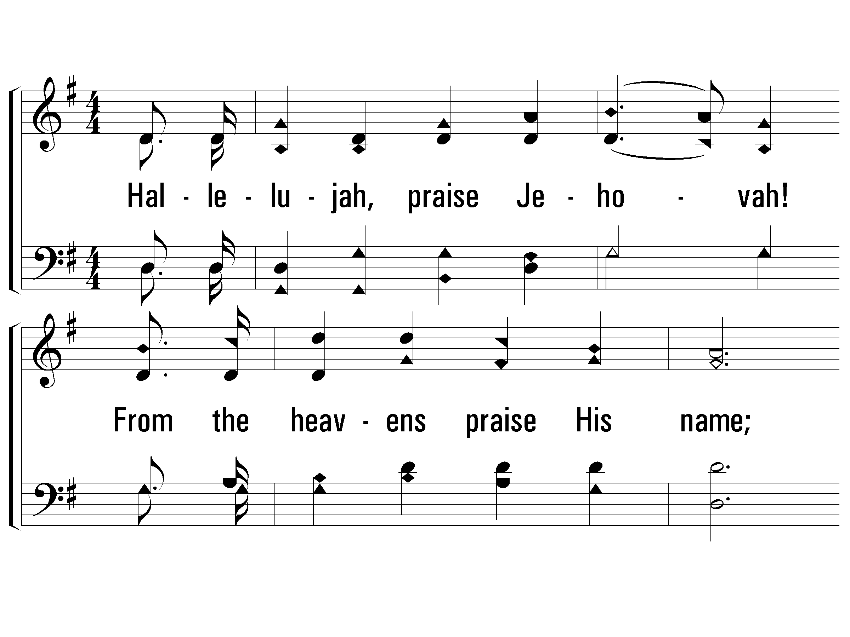
1 – Hallelujah, Praise Jehovah
200
1.
Hallelujah, praise Jehovah!
From the heavens praise His name;
Praise Jehovah in the highest;
All His angels praise proclaim,
All His hosts together praise Him,
Sun and moon and stars on high;
Praise Him, O ye heaven of heavens,
And ye floods above the sky.
Words and Music by: William J. Kirkpatrick
© 2001 The Paperless Hymnal™

Slide 19
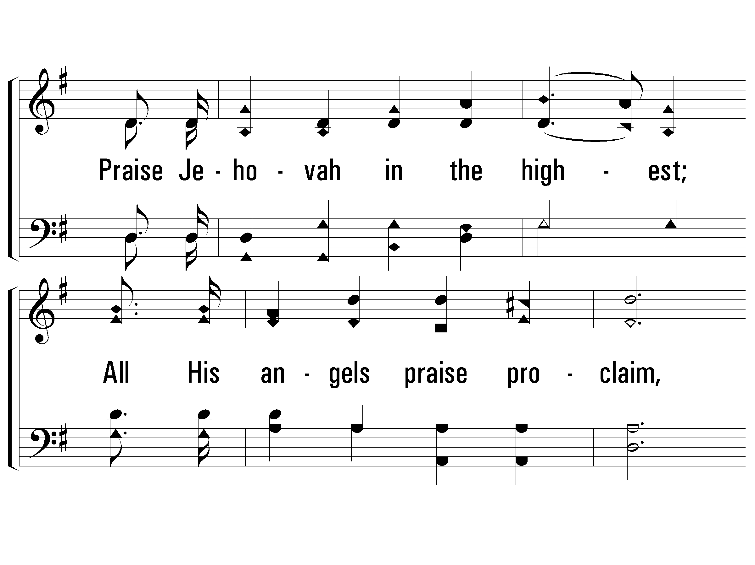
1 – Hallelujah, Praise Jehovah
200
© 2001 The Paperless Hymnal™

Slide 20
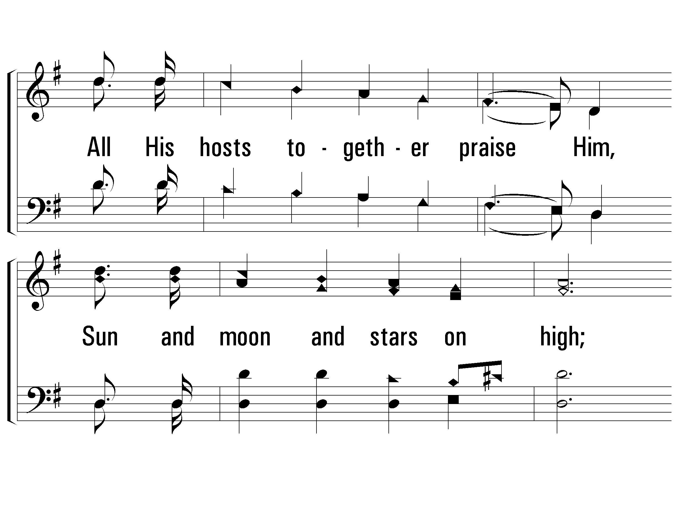
1 – Hallelujah, Praise Jehovah
200
© 2001 The Paperless Hymnal™

Slide 21
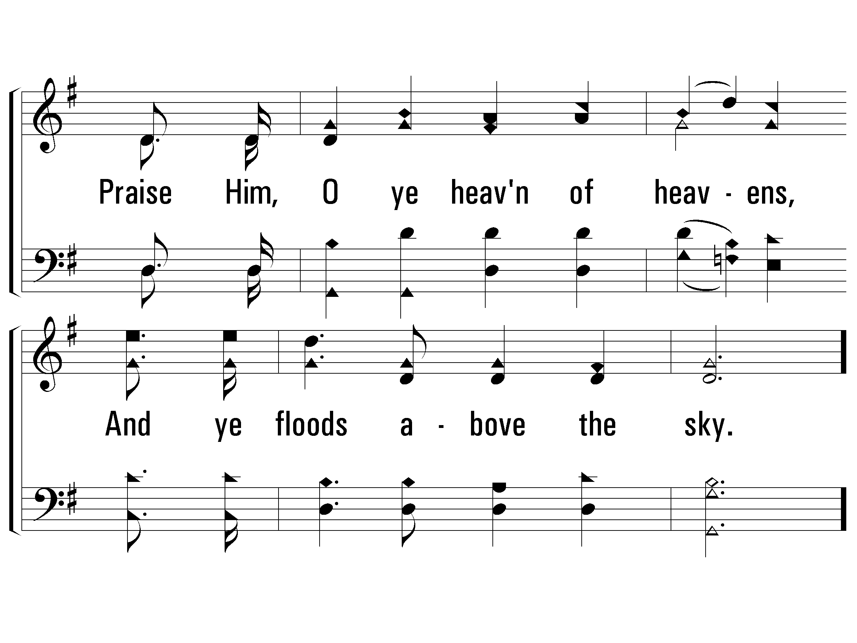
1 – Hallelujah, Praise Jehovah
200
© 2001 The Paperless Hymnal™

Slide 22
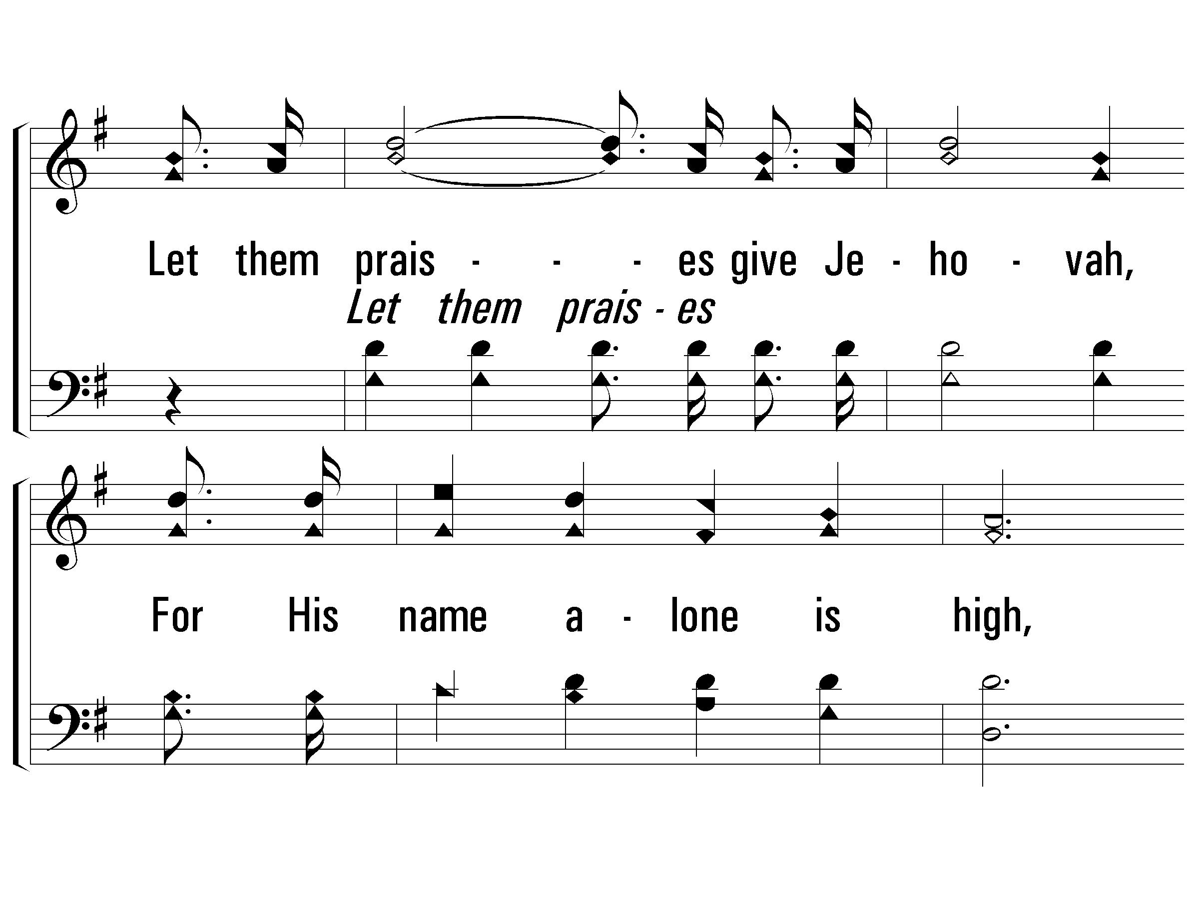
c – Hallelujah, Praise Jehovah
200
Let them praises give Jehovah,
For His name alone is high,
And His glory is exalted,
And His glory is exalted,
And His glory is exalted,
Far above the earth and sky.
© 2001 The Paperless Hymnal™

Slide 23
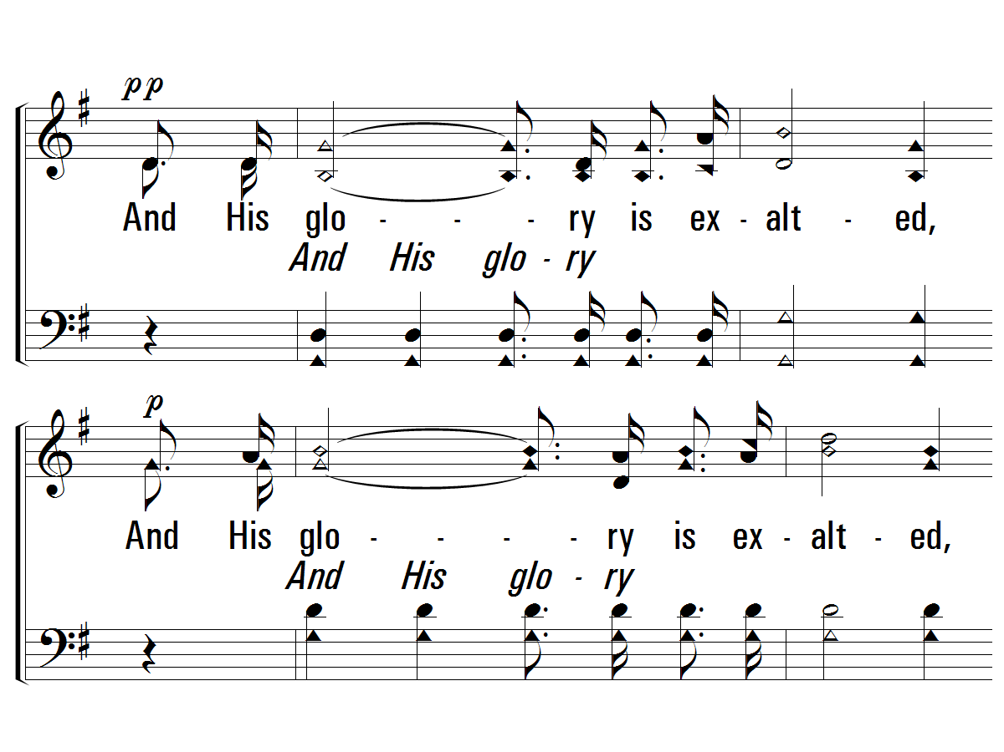
c – Hallelujah, Praise Jehovah
200
© 2001 The Paperless Hymnal™

Slide 24
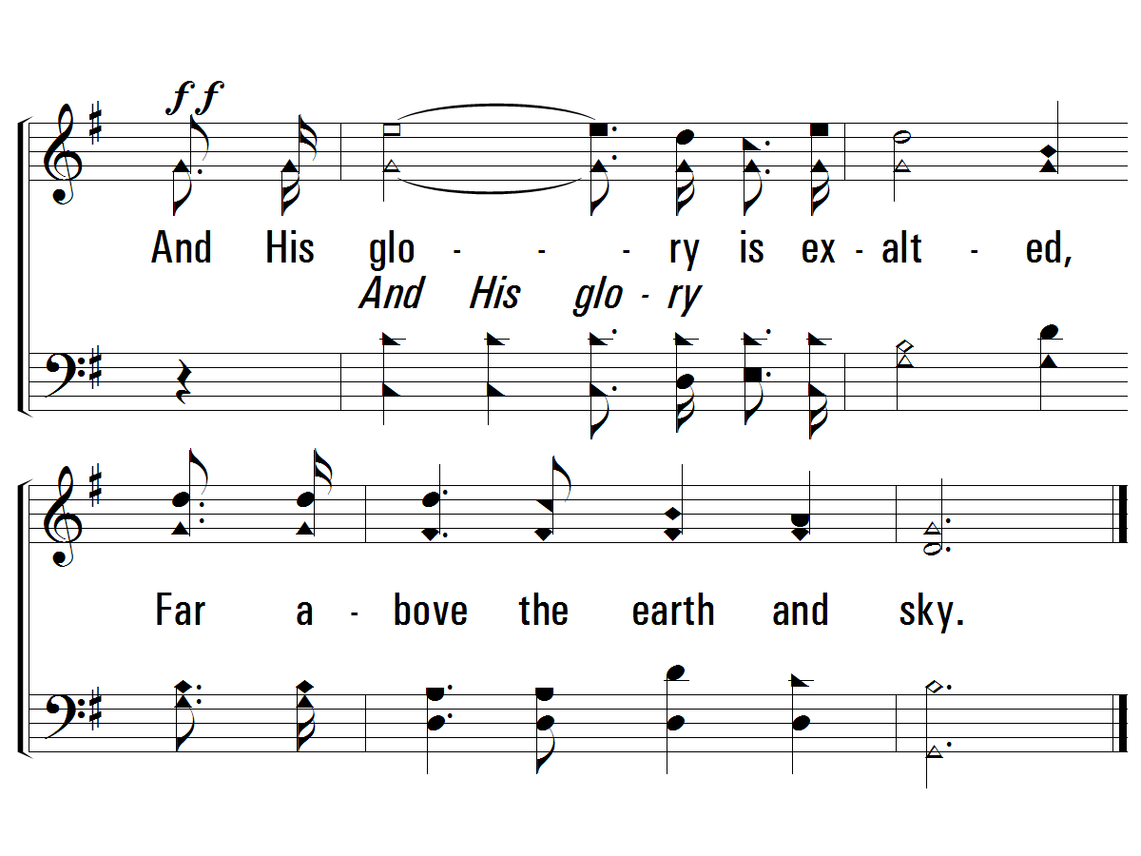
c – Hallelujah, Praise Jehovah
200
© 2001 The Paperless Hymnal™

Slide 25
Revelation Chapter 20
Jesus Defeats Both The Devil & Death Forever
“And the devil who deceived them was thrown into the lake of fire and brimstone, where the beast and the false prophet are also; and they will be tormented day and night forever and ever.” Rev. 20:10.
“Then I saw a great white throne and Him who sat upon it, from whose presence earth and heaven fled away, and no place was found for them.” Rev. 20:11
“Then death and Hades were thrown into the lake of fire. This is the second death, the lake of fire.” Rev. 20:14
Notes:
16:13 – this is not the final day of judgment – but a judgment against the beast and it’s blaspheme.
** Key Word is MOUTH: When this battle does take place, it is JESUS and the sword of HIS MOUTH that brings Victory. Rev. 19:20-21

Slide 26
Revelation Chapter 20
Jesus Defeats Both The Devil & Death Forever.
Then I Saw… Satan, The Dragon, Bound (vs. 1-3)
Then I Saw… Saints, The Saved, Reigning with Christ (vs. 4-6)
What Happens After The 1,000 Years? (vs. 7-10)
Satan Will “Deceive The Nations” (vs. 7-8a)
Satan Will Rally “Gog & Magog” (vs. 8b and 9, Ezekiel 38:1-3, 17-19, 23)
Satan Will Be Fully & Finally Defeated (vs. 10)
Then I Saw… A Great White Throne (vs. 11-15)
“earth and heaven fled away” (vs 11)
“the dead were judged from the things which were written in the books.” (vs 12)
“death and Hades were thrown into the lake of fire” (vs 14)
The wicked are “thrown into the lake of fire.” (vs. 15)
Notes:
16:13 – this is not the final day of judgment – but a judgment against the beast and it’s blaspheme.
** Key Word is MOUTH: When this battle does take place, it is JESUS and the sword of HIS MOUTH that brings Victory. Rev. 19:20-21

Slide 27
Revelation Chapter 20
Jesus Defeats Both The Devil & Death Forever.
“…bound him for a thousand years…”
Revelation 20:2
“…until the thousand years were completed…”
Revelation 20:3
“…came to life and reigned with Christ for a thousand years…”
Revelation 20:4
“…until the thousand years were completed…”
Revelation 20:5
“…reign with Him for a thousand years.”
Revelation 20:6
Notes:
If someone asks you: Do you believe that Jesus Christ will reign with the saints for 1,000 years? Please say yes! This chapter describes the 1,000 years in five different statements! John does want us to focus on it.
But you do not have to answer that it is a literal 1,000 years. Nor do you need to agree to a physical or earthly kingdom. Because this chapter is about SOULS who are reigning with the Lord – not people on earth.

Slide 28
Revelation Chapter 20
Jesus Defeats Both The Devil & Death Forever.
Then I Saw… Satan, The Dragon, Bound (vs. 1-3)
10 Details of Satan’s Defeat:
dragon • Threw
serpent of Old • The Abyss
The devil • Shut
Satan • Sealed
Bound • Not Deceive
What’s Next? Released For A Short Time.
Then I Saw… Saints, The Saved, Reigning with Christ (vs. 4-6)
Notes:
16:13 – this is not the final day of judgment – but a judgment against the beast and it’s blaspheme.
** Key Word is MOUTH: When this battle does take place, it is JESUS and the sword of HIS MOUTH that brings Victory. Rev. 19:20-21

Slide 29
Revelation Chapter 20
Jesus Defeats Both The Devil & Death Forever.
Then I Saw… Satan, The Dragon, Bound (vs. 1-3)
Then I Saw… Saints, The Saved, Reigning with Christ (vs. 4-6)
10 Details of The Soul’s Victory
Thrones • Word of God
Sat (Peace) • Not Worshipped Beast
Judges • No Marks
Beheaded • Life
Testimony of Jesus • Reign with Christ
What’s Next? The 2nd Death Has No Power.
Notes:
16:13 – this is not the final day of judgment – but a judgment against the beast and it’s blaspheme.
** Key Word is MOUTH: When this battle does take place, it is JESUS and the sword of HIS MOUTH that brings Victory. Rev. 19:20-21

Slide 30
Revelation Chapter 20
Jesus Defeats Both The Devil & Death Forever.
Then I Saw… Satan, The Dragon, Bound (vs. 1-3)
Then I Saw… Saints, The Saved, Reigning with Christ (vs. 4-6)
What Happens After The 1,000 Years? (vs. 7-10)
Satan Will “Deceive The Nations” (vs. 7-8a)
Satan Will Rally “Gog & Magog” (vs. 8b and 9, Ezekiel 38:1-3, 17-19, 23)
Satan Will Be Fully & Finally Defeated (vs. 10)
Then I Saw… A Great White Throne (vs. 11-15)
“earth and heaven fled away” (vs 11)
“the dead were judged from the things which were written in the books.” (vs 12)
“death and Hades were thrown into the lake of fire” (vs 14)
The wicked are “thrown into the lake of fire.” (vs. 15)
Notes:
Do Take Comfort In The Victory.
Do Not worry about Gog & Magog…This entire book has been teaching us the keys to handling these battles: be faithful unto death and worship ONLY God.

Slide 31
“Gog & Magog” Ezekiel 38:1-3, 17-19
And the word of the Lord came to me saying, ² “Son of man, set your face toward Gog of the land of Magog, the prince of Rosh, Meshech and Tubal, and prophesy against him³ and say, ‘Thus says the Lord God, “Behold, I am against you, O Gog, prince of Rosh, Meshech and Tubal. (vs. 1-3)
¹⁷ ‘Thus says the Lord God, “Are you the one of whom I spoke in former days through My servants the prophets of Israel, who prophesied in those days for many years that I would bring you against them? ¹⁸ It will come about on that day, when Gog comes against the land of Israel,” declares the Lord God, “that My fury will mount up in My anger. ¹⁹ In My zeal and in My blazing wrath I declare that on that day there will surely be a great earthquake in the land of Israel.
Notes:
Just like the Battle of Megido was used to talk about a DECISIVE battle.
Gog & Magog are being used to describe a collection of the Adversaries Against the Lord.

Slide 32
“Gog & Magog” Ezekiel 38:22-23
²² With pestilence and with blood I will enter into judgment with him; and I will rain on him and on his troops, and on the many peoples who are with him, a torrential rain, with hailstones, fire and brimstone. ²³ I will magnify Myself, sanctify Myself, and make Myself known in the sight of many nations; and they will know that I am the Lord.”’ day there will surely be a great earthquake in the land of Israel.
Notes:
Just like the Battle of Megido was used to talk about a DECISIVE battle.
Gog & Magog are being used to describe a collection of the Adversaries Against the Lord.

Slide 33
“New Heaven & A New Earth” Isaiah 65:17-19
¹⁷ “For behold, I create new heavens and a new earth; And the former things will not be remembered or come to mind. ¹⁸ “But be glad and rejoice forever in what I create; For behold, I create Jerusalem for rejoicing And her people for gladness. ¹⁹ “I will also rejoice in Jerusalem and be glad in My people; And there will no longer be heard in her The voice of weeping and the sound of crying.
Notes:
We all need to approach this chapter with some humility.
We are preparing to see the GLORIFIED church. Is it the church GLORIFIED in eternity or on earth… some significant points in favor of each!
There does seem to be a common appeal in either interpretation to think about the good in store in our future.

Slide 34
“New Heaven & A New Earth” Isaiah 66:22-23
²² “For just as the new heavens and the new earth Which I make will endure before Me,” declares the Lord, “So your offspring and your name will endure. ²³ “And it shall be from new moon to new moon And from sabbath to sabbath, All mankind will come to bow down before Me,” says the Lord.
Notes:
It is a time for complete devotion and true worship.

Slide 35
“New Heaven & A New Earth” 2 Peter 3:10-14
“¹⁰ But the day of the Lord will come like a thief, in which the heavens will pass away with a roar and the elements will be destroyed with intense heat, and the earth and its works will be burned up.
¹¹ Since all these things are to be destroyed in this way, what sort of people ought you to be in holy conduct and godliness, ¹² looking for and hastening the coming of the day of God, because of which the heavens will be destroyed by burning, and the elements will melt with intense heat! ¹³ But according to His promise we are looking for new heavens and a new earth, in which righteousness dwells.
¹⁴ Therefore, beloved, since you look for these things, be diligent to be found by Him in peace, spotless and blameless,

Slide 36
Revelation

Slide 37
Revelation Should Be Studied In Harmony With Other Clear Passages.
Passages That Discuss The Destruction of the World.
2 Peter 3:10-14
Passages That Discuss The Resurrection of All Mankind.
1 Corinthians 15:20-58
Passages That Discuss The Reign of Jesus.
1 Corinthians 15:25, 1 Timothy 6:13-16
Passages That Discuss The Return of Jesus.
1 Thessalonians 4:13 - 5:11
Notes:
How should we approach the rest of the book? On Sunday we wrapped up the 7 churches and now before we get into chapter 4 and 5 seems like the best time to discuss how we study this book as a a whole.
We’ve established that it is apocalyptic literature – with visions and symbolic language.
This language

