Slide 1
Lesson 11:21:17-23:35

Slide 2
Paul’s Instruction to the Elders
“Watch” and “warn” against wolves
Stick “to God” and “to the word of His Grace”
Support the weak (by laboring like Paul)
What would this look like for Embry Hills today?
Whatever it looks like, we must go about it like Paul:
²⁴But none of these [chains or tribulations] move me; nor do I count my life dear to myself, so that I may finish my race with joy, and the ministry which I received from the Lord Jesus, to testify to the gospel of the grace of God.

Slide 3
Class Goals
To better understand the challenges, growth and practices of the New Testament church. Especially their worship, leadership, sharing, perseverance, and involvement in the Great Commission.
To equip one another to imitate the role models of the early church
First, to respond to the gospel with trust and loyalty towards God
Second, to tell others about Jesus in a loving and bold manner.
Third, to serve one another thoughtfully for edification.
Learn and imitate the teaching of the early Christian preachers, by evaluating the background and needs of the audience, and studying the content of the inspired preachers.

Slide 4
Timeline of Paul’s Incarceration
Acts 20:23; 21:10,11 – Prophecies of Coming Arrest in Jerusalem
Acts 21:26 – Paul Arrested on 7th Day in Temple
Acts 21:31-36 – Paul Rescued by Roman Soldiers
Acts 22:22 – Paul speaks to Jews, want him dead upon mention of Gentiles
Acts 23:1-10 – Paul Examined by Commander, with Sanhedrin Present
Acts 23:11-35 – Plot of Jews to kill Paul foiled by trip to Caesarea by Night
Acts 24:1-21 – Paul’s hearing before Felix (Tertullus prosecuting
Acts 24:22-27 – Two years of Procrastination by Felix
Acts 24:27 – Felix Replaced by Festus
Acts 25:1-12 – Jews attempt to get Paul to Jerusalem foiled by appeal to Caesar.
Acts 25:13-27 – Herod Agrippa II Visits Festus, asks to hear Paul’s case. Paul addresses Agrippa, Bernice, & group

Slide 5
Paul Goes to Jerusalem
19:21 “When these things were accomplished, Paul purposed in the Spirit, when he had passed through Macedonia and Achaia, to go to Jerusalem, saying, “After I have been there, I must also see Rome.”

Slide 6
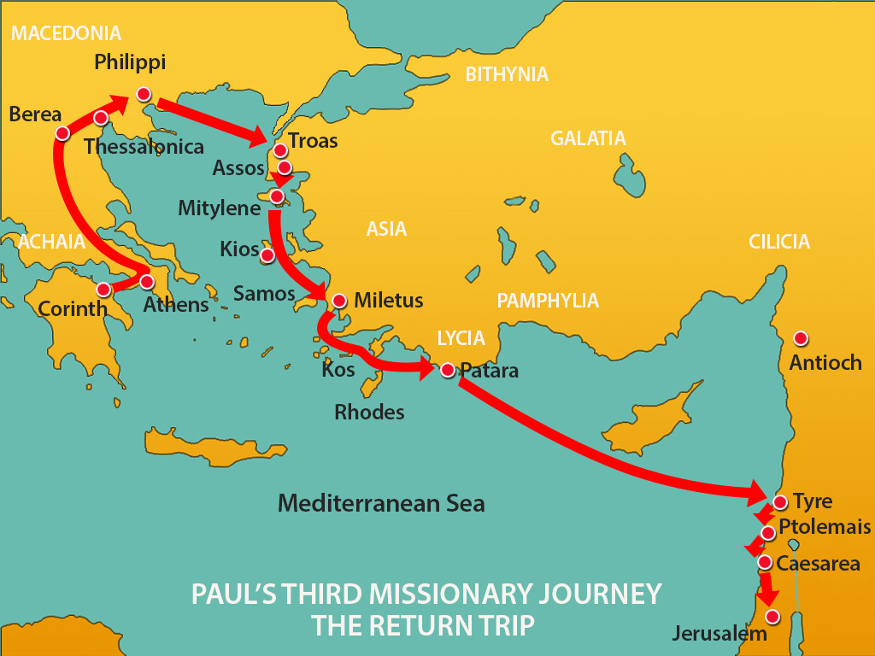

Slide 7
Paul Goes to Jerusalem
19:21 “When these things were accomplished, Paul purposed in the Spirit, when he had passed through Macedonia and Achaia, to go to Jerusalem, saying, “After I have been there, I must also see Rome.”
21:4 And finding disciples, we stayed there seven days. They told Paul through the Spirit not to go up to Jerusalem.
21:11 When he had come to us, he took Paul’s belt, bound his own hands and feet, and said, “Thus says the Holy Spirit, ‘So shall the Jews at Jerusalem bind the man who owns this belt, and deliver him into the hands of the Gentiles.’ ”
Are these statements contradictory?
Acts 21:14 So when he would not be persuaded, we ceased, saying, “The will of the Lord be done.”

Slide 8
Acts 21:17-25
“You see, brother, how many myriads of Jews there are who have believed, and they are all zealous for the law; ²¹ but they have been informed about you that you teach all the Jews who are among the Gentiles to forsake Moses, saying that they ought not to circumcise their children nor to walk according to the customs. ²² What then? The assembly must certainly meet, for they will hear that you have come. ²³ Therefore do what we tell you: We have four men who have taken a vow. ²⁴ Take them and be purified with them, and pay their expenses so that they may shave their heads, and that all may know that those things of which they were informed concerning you are nothing, but that you yourself also walk orderly and keep the law. ²⁵ But concerning the Gentiles who believe, we have written and decided that they should observe no such thing, except that they should keep themselves from things offered to idols, from blood, from things strangled, and from sexual immorality.”
Num. 6:2-12 Being purified included:
Shaving of head
Sin offering
Burnt offering
Loss of time under the vow
How would you describe the “myriads of Jews” in this passage?
What accusations are being brought against Paul?
What passages from Acts and from Paul’s letters may have contributed to these accusations?
What is the response from James and the elders?
What does this story teach us?

Slide 9
Timeline of Paul’s Incarceration
Acts 20:23; 21:10,11 – Prophecies of Coming Arrest in Jerusalem
Acts 21:26 – Paul Arrested on 7th Day in Temple
Acts 21:31-36 – Paul Rescued by Roman Soldiers
Acts 22:22 – Paul speaks to Jews, want him dead upon mention of Gentiles
Acts 23:1-10 – Paul Examined by Commander, with Sanhedrin Present
Acts 23:11-35 – Plot of Jews to kill Paul foiled by trip to Caesarea by Night
Acts 24:1-21 – Paul’s hearing before Felix (Tertullus prosecuting
Acts 24:22-27 – Two years of Procrastination by Felix
Acts 24:27 – Felix Replaced by Festus
Acts 25:1-12 – Jews attempt to get Paul to Jerusalem foiled by appeal to Caesar.
Acts 25:13-27 – Herod Agrippa II Visits Festus, asks to hear Paul’s case. Paul addresses Agrippa, Bernice, & group

Slide 10
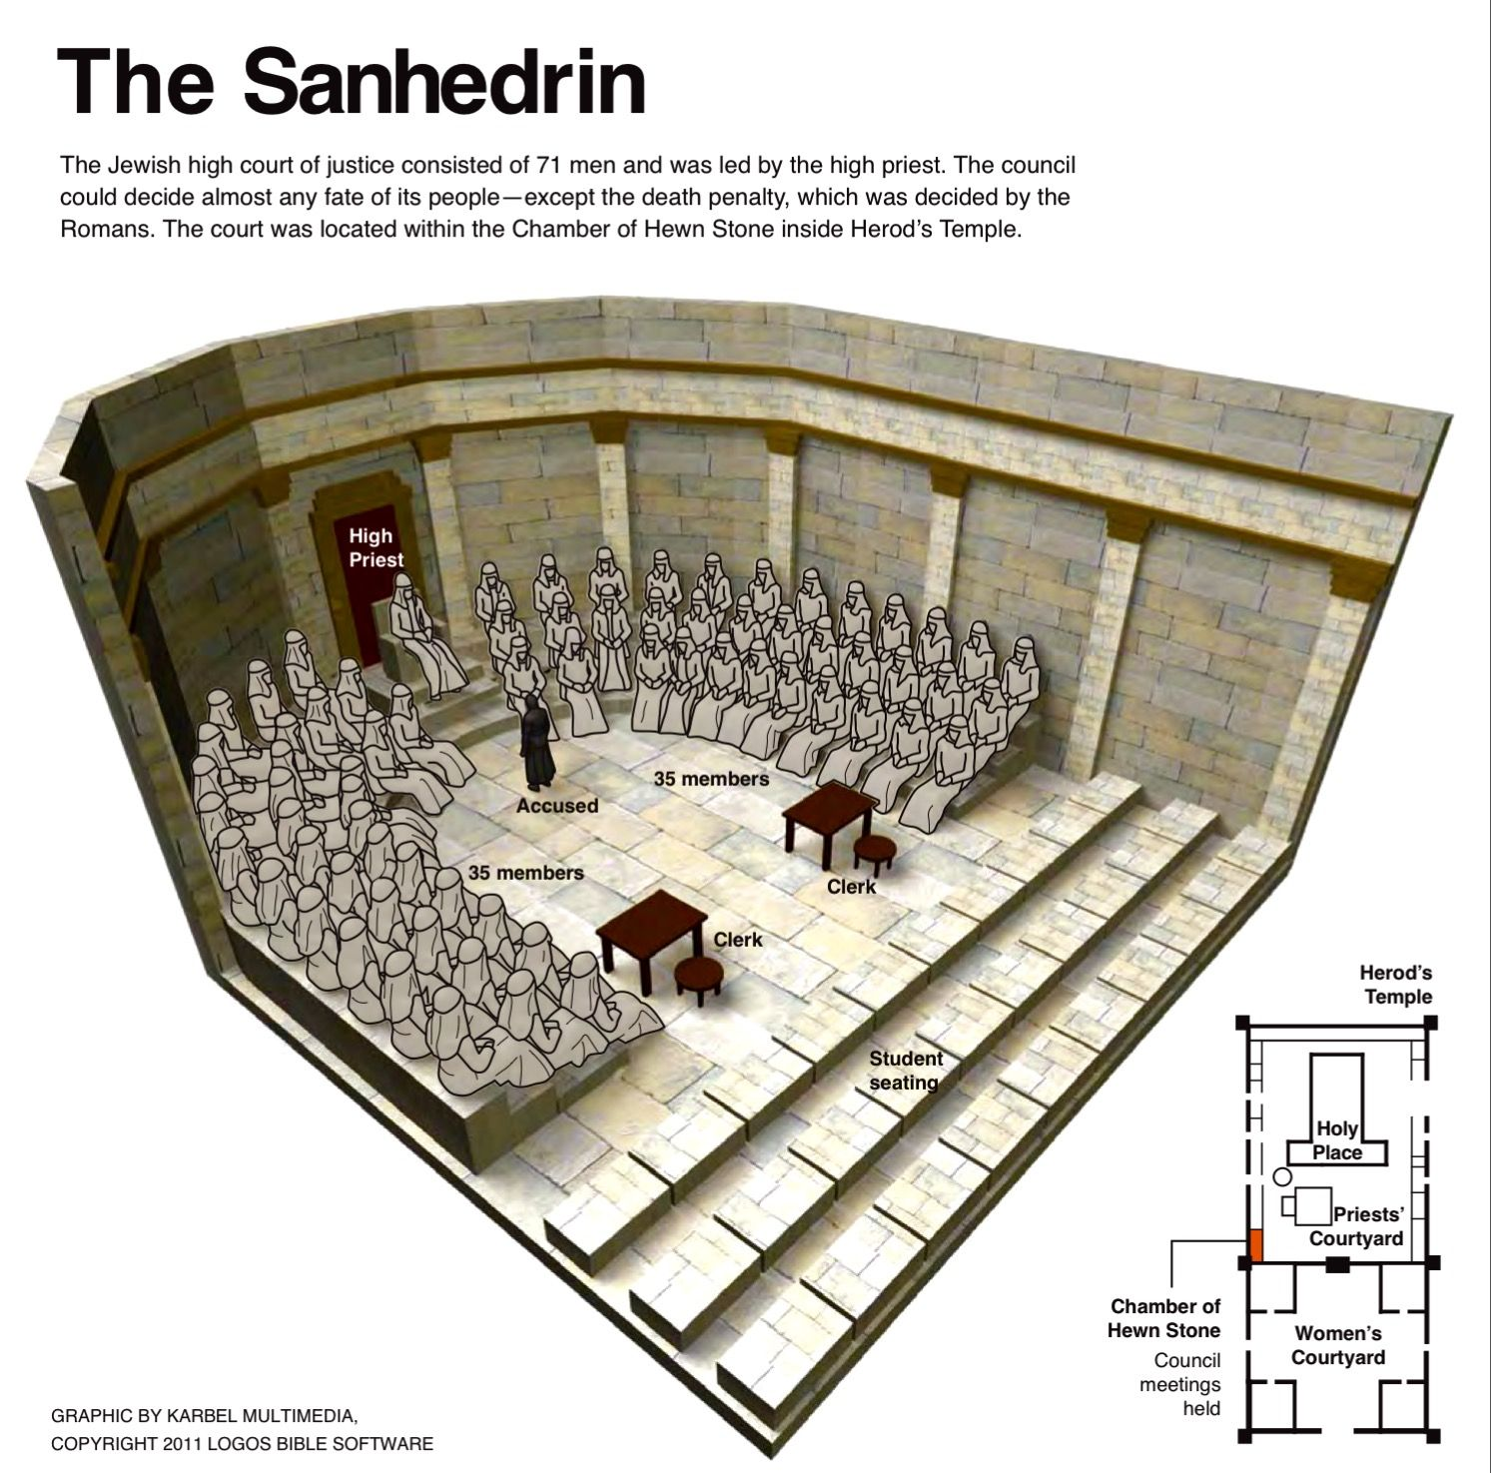
Sanhedrin
Council of 71 (Sadducees and Pharisees)
Presided over by the High Priest
Jewish High Court whose responsibility was to interpret civil and religious laws
It was made up more of Sadducees than Pharisees but the masses were more loyal to the Pharisees and thus made it hard on the Sadducees to do as they pleased.

Slide 11
Acts 22:30-23:10
³⁰ The next day, because he wanted to know for certain why he was accused by the Jews, he released him from his bonds, and commanded the chief priests and all their council to appear, and brought Paul down and set him before them.
23 Then Paul, looking earnestly at the council, said, “Men and brethren, I have lived in all good conscience before God until this day.” ² And the high priest Ananias commanded those who stood by him to strike him on the mouth. ³ Then Paul said to him, “God will strike you, you whitewashed wall! For you sit to judge me according to the law, and do you command me to be struck contrary to the law?”
⁴ And those who stood by said, “Do you revile God’s high priest?”
⁵ Then Paul said, “I did not know, brethren, that he was the high priest; for it is written, ‘You shall not speak evil of a ruler of your people.’ ”

Slide 12
Acts 22:30-23:10
⁶ But when Paul perceived that one part were Sadducees and the other Pharisees, he cried out in the council, “Men and brethren, I am a Pharisee, the son of a Pharisee; concerning the hope and resurrection of the dead I am being judged!”
⁷ And when he had said this, a dissension arose between the Pharisees and the Sadducees; and the assembly was divided. ⁸ For Sadducees say that there is no resurrection—and no angel or spirit; but the Pharisees confess both. ⁹ Then there arose a loud outcry. And the scribes of the Pharisees’ party arose and protested, saying, “We find no evil in this man; but if a spirit or an angel has spoken to him, let us not fight against God.” ¹⁰ Now when there arose a great dissension, the commander, fearing lest Paul might be pulled to pieces by them, commanded the soldiers to go down and take him by force from among them, and bring him into the barracks.
Seems calculated by Paul.
About what type of issue are they divided?
What was this dissension over?
Acts 5:33-39

Slide 13
Lesson 11 Application
Acts 21:17-25 – Unity Among Differences
1 Cor. 9:20-21 – There is a distinction between that we are at liberty to do for the sake of others, and that which we are bound to do in order to obey God.
Eph. 4:1-3 – This difference shows a unity consistent with scripture.
For a deeper study on this, study 1 Corinthians (specifically ch. 8-10) and Romans (specifically ch. 14)
Acts 23:1-10 – Disunity Among Differences
Unity in regards to salvation is crucial.

Slide 14
Conversion of the Chief Persecutor
Conversion recorded 3 times Acts 9 Acts 22
Acts 26
Chief Persecutor
One of the strongest proofs of the resurrection.
Chief Proclaimer

