Slide 1
Lesson 8: 13-15:35

Slide 2
Class Goals
To better understand the challenges, growth and practices of the New Testament church. Especially their worship, leadership, sharing, perseverance, and involvement in the Great Commission.
To equip one another to imitate the role models of the early church
First, to respond to the gospel with trust and loyalty towards God
Second, to tell others about Jesus in a loving and bold manner.
Third, to serve one another thoughtfully for edification.
Learn and imitate the teaching of the early Christian preachers, by evaluating the background and needs of the audience, and studying the content of the inspired preachers.

Slide 3
 | Acts 1-12 | Acts 13-28
Most Prominent Church | Jerusalem | Antioch
Most Prominent Apostle | Peter | Paul
Most Prominent Church
Most Prominent Apostle
Most Prominent People | Jews | Gentiles
Where Gospel was preached | Jerusalem, Judea, Samaria | “Uttermost part of the world”
“But you shall receive power when the Holy Spirit has come upon you; and you shall be witnesses to Me in Jerusalem, and in all Judea and Samaria, and to the end of the earth.” Acts 1:8
Ch. 1-7
Ch. 8-12
Ch. 13-28

Slide 4
Acts 13-15 First Missionary Journey
Acts 13:1-2 Barnabas and Saul Appointed
Acts 13:3-12 Saul/Paul Calls Out Bar-Jesus
Acts 13:13-52 Paul’s Sermon at Antioch of Pisidia
Acts 14:1-7 Paul and Barnabas Driven out of Iconium
Acts 14:8-20 Paul Heals Lame Man
Acts 14:21-28 Paul and Barnabas Strengthen Churches
Acts 15:1-35 Conflict and Decision Over Circumcision
Acts 15:36-41 Departure of Barnabas and John-Mark

Slide 5
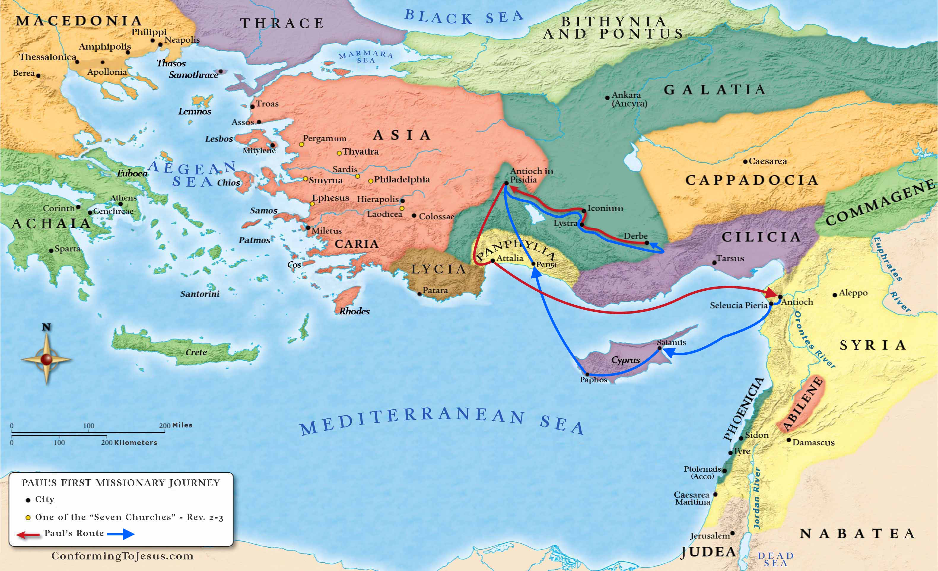
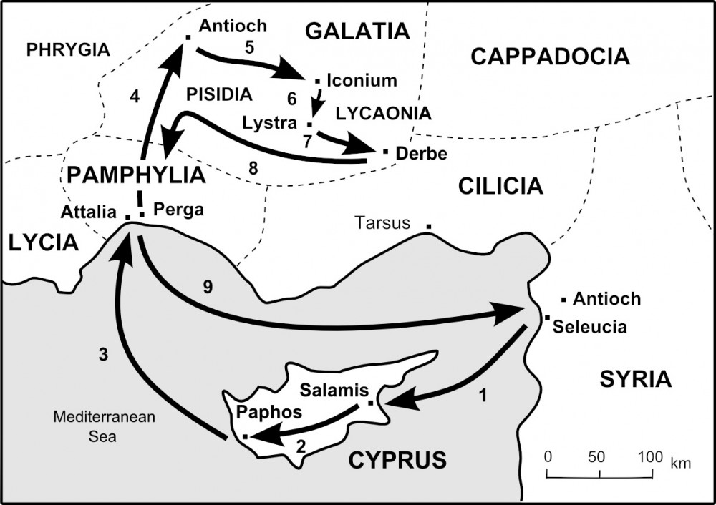
Jerusalem

Slide 6
Outline of Paul’s Sermon (Acts 13:16-48)
13:16-22 – History of Israel (Jacob to David)
13:23-25 – The Coming of Jesus, the Savior
13:26-31 – Jews Fulfilled Prophecies of Jesus (Condemnation, Death, Burial)
13:32-37 – Resurrection Prophecies Fulfilled
13:38-41 – Remission of Sins, Apart from Law

Slide 7
Acts 13:16-22 History of Israel (Jacob to David)
¹⁶Then Paul stood up, and motioning with his hand said, “Men of Israel, and you who fear God, listen: ¹⁷ The God of this people Israel chose our fathers, and exalted the people when they dwelt as strangers in the land of Egypt, and with an uplifted arm He brought them out of it. ¹⁸ Now for a time of about forty years He put up with their ways in the wilderness. ¹⁹ And when He had destroyed seven nations in the land of Canaan, He distributed their land to them by allotment. ²⁰ “After that He gave them judges for about four hundred and fifty years, until Samuel the prophet. ²¹ And afterward they asked for a king; so God gave them Saul the son of Kish, a man of the tribe of Benjamin, for forty years. ²² And when He had removed him, He raised up for them David as king, to whom also He gave testimony and said, ‘I have found David the son of Jesse, a man after My own heart, who will do all My will.
v. 42 implies Gentiles were in attendance
Paul establishes credibility with his audience and appeals to them in a way they could follow and understand.

Slide 8
Acts 13:23-25 – The Coming of Jesus, the Savior
²³ From this man’s seed, according to the promise, God raised up for Israel a Savior—Jesus— ²⁴ after John had first preached, before His coming, the baptism of repentance to all the people of Israel. ²⁵ And as John was finishing his course, he said, ‘Who do you think I am? I am not He. But behold, there comes One after me, the sandals of whose feet I am not worthy to loose.’
The point of Paul’s sermon is Jesus because he was:
“the promise” (Ps. 132:10-12)
The savior of Israel

Slide 9
Acts 13:26-31 – Jews Fulfilled Prophecies of Jesus
²⁶ “Men and brethren, sons of the family of Abraham, and those among you who fear God, to you the word of this salvation has been sent. ²⁷ For those who dwell in Jerusalem, and their rulers, because they did not know Him, nor even the voices of the Prophets which are read every Sabbath, have fulfilled them in condemning Him. ²⁸ And though they found no cause for death in Him, they asked Pilate that He should be put to death. ²⁹ Now when they had fulfilled all that was written concerning Him, they took Him down from the tree and laid Him in a tomb. ³⁰ But God raised Him from the dead. ³¹ He was seen for many days by those who came up with Him from Galilee to Jerusalem, who are His witnesses to the people.
Psalm 22:8,15,16,18

Slide 10
Acts 13:32-37 – Resurrection Prophecies Fulfilled
³²And we declare to you glad tidings—that promise which was made to the fathers. ³³God has fulfilled this for us their children, in that He has raised up Jesus. As it is also written in the second Psalm:
‘You are My Son, Today I have begotten You.’
³⁴And that He raised Him from the dead, no more to return to corruption, He has spoken thus:
‘I will give you the sure mercies of David.’
³⁵Therefore He also says in another Psalm:
‘You will not allow Your Holy One to see corruption.’
³⁶“For David, after he had served his own generation by the will of God, fell asleep, was buried with his fathers, and saw corruption; ³⁷but He whom God raised up saw no corruption.
Ps. 2:7
Isa. 55:3
Ps. 16:10

Slide 11
Acts 13:38-41 – Remission of Sins, Apart from Law
³⁸ Therefore let it be known to you, brethren, that through this Man is preached to you the forgiveness of sins; ³⁹ and by Him everyone who believes is justified from all things from which you could not be justified by the law of Moses. ⁴⁰ Beware therefore, lest what has been spoken in the prophets come upon you:
⁴¹ ‘Behold, you despisers, Marvel and perish! For I work a work in your days, A work which you will by no means believe, Though one were to declare it to you.’ ”
Hab. 1:5
So Jesus was promised and fulfilled, what now?
You can be justified through Him not the law.

Slide 12
What does Paul’s Sermon in Acts 13 teach us?
Create a spiritual connection with your audience.
Preach Jesus
The promised Savior
Salvation is through Him and nothing else.
1 Corinthians 2:1-2 “And I, brethren, when I came to you, did not come with excellence of speech or of wisdom declaring to you the testimony of God. ² For I determined not to know anything among you except Jesus Christ and Him crucified.”

Slide 13
Acts 14:21-28 Paul and Barnabas Strengthen Churches
Acts 13 ⁵¹ But they shook off the dust from their feet against them, and came to Iconium. ⁵² And the disciples were filled with joy and with the Holy Spirit.
²¹ And when they had preached the gospel to that city and made many disciples, they returned to Lystra, Iconium, and Antioch, ²² strengthening the souls of the disciples, exhorting them to continue in the faith, and saying, “We must through many tribulations enter the kingdom of God.” ²³ So when they had appointed elders in every church, and prayed with fasting, they commended them to the Lord in whom they had believed. ²⁴ And after they had passed through Pisidia, they came to Pamphylia. ²⁵ Now when they had preached the word in Perga, they went down to Attalia. ²⁶ From there they sailed to Antioch, where they had been commended to the grace of God for the work which they had completed. ²⁷ Now when they had come and gathered the church together, they reported all that God had done with them, and that He had opened the door of faith to the Gentiles. ²⁸ So they stayed there a long time with the disciples.
They recently faced persecution.
13:50; 14:19

Slide 14
What did Paul and Barnabas do to strengthen the brethren?
We see this repeated again in Acts 15:30-. After the Jerusalem Council the Judas and Silas:
Exhorted/Strengthened
Remained there some time
Gave a report to others
Paul and Barnabas…
Returned (v. 21)
Exhorted (v. 22)
Appointed Elders (provided leadership; did not leave them to fend for themselves) (v. 23)
Prayed and Fasted with Them (v. 23)
Gave a Report (v. 27)
Stayed with Them a Long Time (v. 28)

Slide 15
Acts 15 – Jerusalem Council
This was an issue over salvation.
¹And certain men came down from Judea and taught the brethren, “Unless you are circumcised according to the custom of Moses, you cannot be saved.” ² Therefore, when Paul and Barnabas had no small dissension and dispute with them, they determined that Paul and Barnabas and certain others of them should go up to Jerusalem, to the apostles and elders, about this question.
Implies Paul and Barnabas had already come to a conclusion on this matter and were arguing against it.

Slide 16
Lesson 9: 16-18

Slide 17
Class Goals
First – Follow a pattern of believe, repent, and baptism
Second – Paul immediately begins preaching the word (Acts 9)
Third – Paul returns to churches to strengthen (Acts 14); Also Judas and Silas (Acts 15)
To better understand the challenges, growth, and practices of the New Testament church. Especially their worship, leadership, sharing, perseverance, and involvement in the Great Commission.
To equip one another to imitate the role models of the early church
First, to respond to the gospel with trust and loyalty towards God
Second, to tell others about Jesus in a loving and bold manner.
Third, to serve one another thoughtfully for edification.
Learn and imitate the teaching of the early Christian preachers, by evaluating the background and needs of the audience, and studying the content of the inspired preachers.
All 5 sermons preach Jesus and the resurrection and follow the same doctrinal pattern (Acts 2, 3, 7, 10, 13)
However, articulated in different ways based on the specific needs of the audience
Acts 2, 3, 13 – Coming Messiah based on prophecy
Acts 7 – Appeals to scripture (but for a different purpose)
Acts 10 – Jesus of Nazareth was from God
Persecution
Led by the Holy Spirit
Gave of themselves (Acts 2)
Appointed elders and other workers (Acts 6 & 13)
Spoke to people of all backgrounds(Acts 10)

Slide 18
When Doctrinal Issues Arise…
Examples from Acts 15:
They came together to discuss (v. 6-7)
Many people spoke
Sect of Pharisees, Peter, Paul, Barnabas, and James
They appealed to what God revealed (v. 7-9; 14-17)
While some today appeal to visions from God, Peter’s vision did not bring about any new doctrine but emphasized what had already been prophesied (v. 16-17 i.e. Amos 9:11).
They came to a conclusion, and it was doctrine everywhere (v.22-30)
All was done in love.
Peter, Paul, Barnabas, and James do not ridicule the sect of the Pharisees, but educate them.
The goal was to correct false doctrine but also to, within correct doctrine, make it easier to follow God
^{10 ”}Now therefore, why do you test God by putting a yoke on the neck of the disciples which neither our fathers nor we were able to bear?”
¹⁹ ”Therefore I judge that we should not trouble those from among the Gentiles who are turning to God…”

Slide 19
Lesson 8 Application
Preach
Edify
Educate
Christ and Him Crucified. While other issues may arise, our goal must be to preach Christ—his death, burial, and resurrection.
All converts—new or old, but especially new—must be exhorted/strengthened and set with necessary resources to grow.
Doctrinal issues will surface, but we must be rooted and root others in the word of God with love and patience.

Slide 20
What is the most threatening problem concerning the church today?
Much of Answers 3 & 4 revolved around the youth

Slide 21
Class Goals
To better understand the challenges, growth and practices of the New Testament church. Especially their worship, leadership, sharing, perseverance, and involvement in the Great Commission.
To equip one another to imitate the role models of the early church
First, to respond to the gospel with trust and loyalty towards God
Second, to tell others about Jesus in a loving and bold manner.
Third, to serve one another thoughtfully for edification.
Learn and imitate the teaching of the early Christian preachers, by evaluating the background and needs of the audience, and studying the content of the inspired preachers.

Slide 22
Acts 16-18 Second Missionary Journey
Acts 16:1-5 Timothy Joins Paul and Silas
Acts 16:6-10 Macedonian Call
Acts 16:11-15 Lydia from Philippi is Baptized
Acts 16:16-40 Paul and Silas Imprisoned in Philippi
Acts 17:1-9 Preaching in Thessalonica
Acts 17:10-15 Preaching in Berea
Acts 17:16-34 Preaching in Athens
Acts 18:1-17 Preaching in Corinth
Acts 18:18-23 Paul Strengthens Churches
Acts 18:24-28 Apollos is Taught the Way

Slide 23
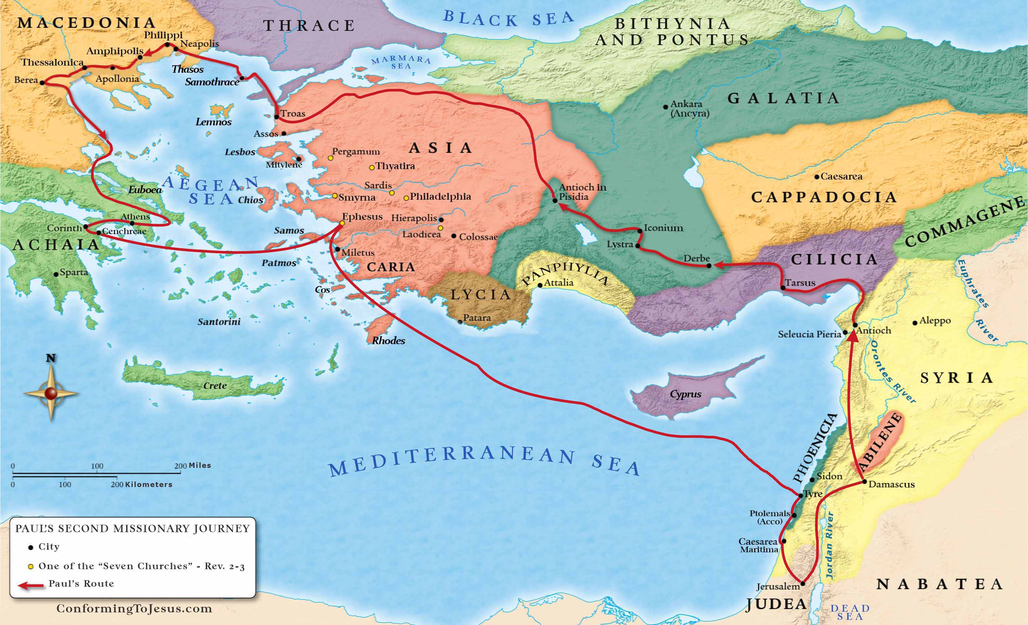

Slide 24
Acts 16:1-5 Timothy Joins Paul and Silas
Then he came to Derbe and Lystra. And behold, a certain disciple was there, named Timothy, the son of a certain Jewish woman who believed, but his father was Greek. ² He was well spoken of by the brethren who were at Lystra and Iconium. ³ Paul wanted to have him go on with him. And he took him and circumcised him because of the Jews who were in that region, for they all knew that his father was Greek. ⁴ And as they went through the cities, they delivered to them the decrees to keep, which were determined by the apostles and elders at Jerusalem. ⁵ So the churches were strengthened in the faith, and increased in number daily.
1 Tim. 4:12 “Let no one despise your youth…”
Youth was considered all the way to 40
It is assumed 1 Timothy was written roughly 15 years after Paul’s second missionary journey
If these numbers are correct, Timothy is, at the oldest, in his early 20s at this point.

Slide 25
“Increased in Number Daily…”
Acts 2:41 Then those who gladly received his word were baptized; and that day about three thousand souls were added to them.”
Acts 4:4 However, many of those who heard the word believed; and the number of the men came to be about five thousand.
Acts 5:14 And believers were increasingly added to the Lord, multitudes of both men and women…
Acts 6:1, 7 Now in those days, when the number of the disciples was multiplying…⁷ Then the word of God spread, and the number of the disciples multiplied greatly in Jerusalem, and a great many of the priests were obedient to the faith.
Acts 8:6 And the multitudes with one accord heeded the things spoken by Philip…

Slide 26
“Increased in Number Daily…”
Acts 9:31 Then the churches throughout all Judea, Galilee, and Samaria had peace and were edified. And walking in the fear of the Lord and in the comfort of the Holy Spirit, they were multiplied.
Acts 11:21 And the hand of the Lord was with them, and a great number believed and turned to the Lord.
Acts 13:48 Now when the Gentiles heard this, they were glad and glorified the word of the Lord. And as many as had been appointed to eternal life believed.
Acts 16:5 So the churches were strengthened in the faith, and increased in number daily.
Acts 17:4, 12 And some of them were persuaded; and a great multitude of the devout Greeks, and not a few of the leading women, joined Paul and Silas…¹² Therefore many of them believed, and also not a few of the Greeks, prominent women as well as men.

Slide 27
Paul Continues to Preach
1. Thessalonica 17:1-9 2. Berea 17:10-15
3. Athens 17:16-34 4. Corinth 18:4-11
Where did Paul preach within the city?
What did Paul preach?
To whom did he preach?
What was the reaction of the listeners?
From where did the opposition come?
What was Paul’s reaction to the opposition?

Slide 28
Acts 18:24-28 Apollos is Taught the Way
²⁴ Now a certain Jew named Apollos, born at Alexandria, an eloquent man and mighty in the Scriptures, came to Ephesus. ²⁵ This man had been instructed in the way of the Lord; and being fervent in spirit, he spoke and taught accurately the things of the Lord, though he knew only the baptism of John. ²⁶ So he began to speak boldly in the synagogue. When Aquila and Priscilla heard him, they took him aside and explained to him the way of God more accurately. ²⁷ And when he desired to cross to Achaia, the brethren wrote, exhorting the disciples to receive him; and when he arrived, he greatly helped those who had believed through grace; ²⁸ for he vigorously refuted the Jews publicly, showing from the Scriptures that Jesus is the Christ.
Notice again, despite the good intent of Apollos, he still needed to be taught more clearly the way.

Slide 29
Lesson 9 Application
Preach
Edify
Educate
Throughout the book of Acts, its should come as no surprise that people are added to the church when we preach.
We edify in spite of opposition.
Paul stayed in Corinth a year and a half.
Even after conversion, we must remain educated in the word. Apollos proved useful when educated.

