Slide 1
What is the Evidence of that Jesus was seen Alive after His Death on the Cross?
Lesson 11

Slide 2
Class Outline
Lesson | Description
1 | Jesus of the Bible vs Reinvented Jesus of Modern Man
2 | Tools for Examination of the Evidence
3 | Does the Eyewitness Evidence of the Biographies of Jesus the Christ Stand Up to Scrutiny?
4 | Was the Documentary Evidence (Jesus’ Biographies) Reliably Preserved for Us?
5 | Is There Credible Non-Biblical Evidence for Jesus outside His Biographies?
6 | Does Archaeology/the Scientific Evidence Confirm or Contradict Biographies of Jesus?
7 | Was Jesus Really Convinced That He Was the Son of God and did Jesus the Christ fulfill the Attributes of God?
8 | The Psychological Evidence; Was Jesus Crazy When He Claimed to Be the Son of God?
9 | The Fingerprint Evidence – Prophecy Did Jesus—and Jesus Alone—Match the Identity of the Messiah?
10 | The Resurrection – was Jesus Raised from the Dead?
11 | What is the Evidence of that Jesus was seen Alive after His Death on the Cross?
12 | Tactics for Discussing the Case for Jesus the Christ
13 | What Does the Evidence Establish—And What Does It Mean Today?

Slide 3
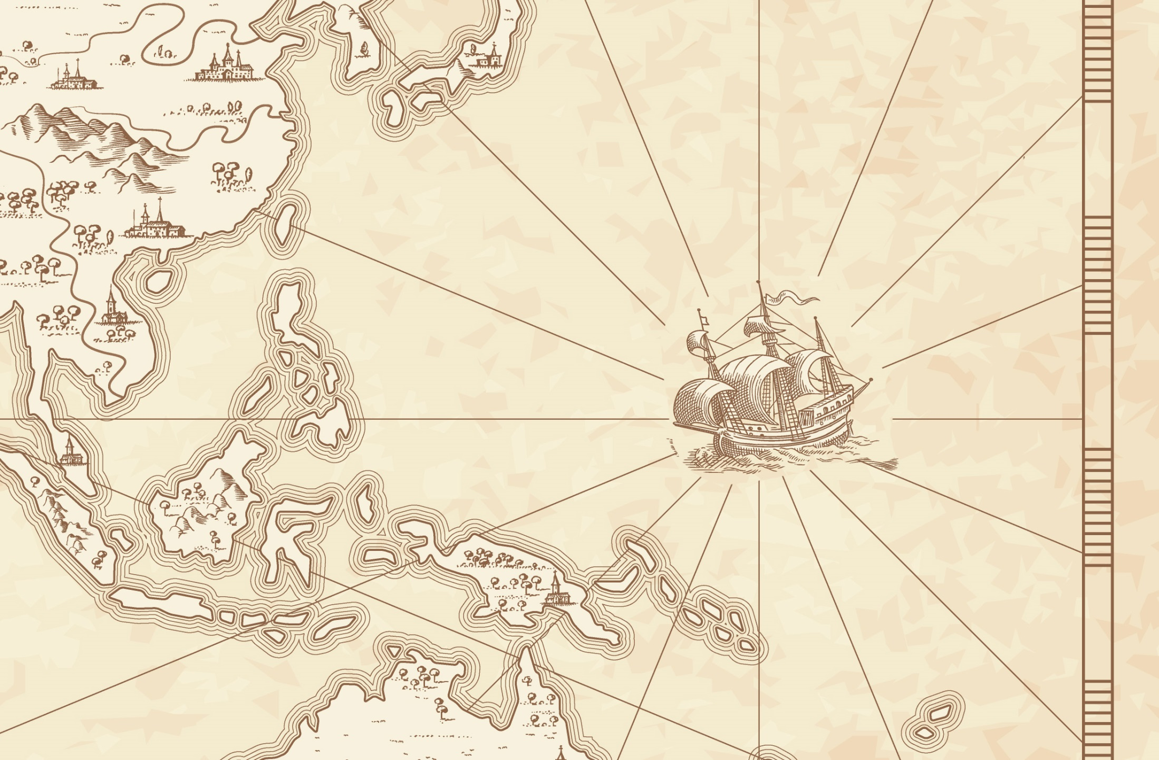
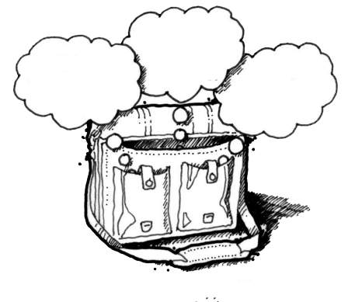
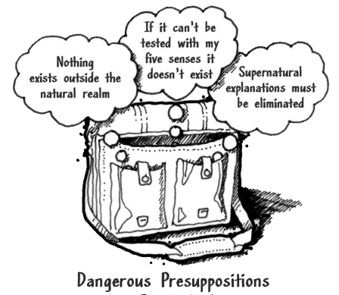
God
Supreme Being
We are created
Bible is
Accurate
Bible is Inspired
Bible is
Reliable
Super Naturalism it is possible that there is
a supreme being/someone beyond natural order
Intelligent Design – a programmer
nothing exists beyond the natural realm
Philosophical Naturalism The presuppositional belief
that only natural laws and forces occur
No God
No Supreme Being
We come from nothing
Using God
To fill in the Gaps

Slide 4



God
Supreme Being
We are created
Super Naturalism
Bible is
Accurate
Bible is Inspired
Bible is
Reliable
Resurrection
Prophecy/Messiah
Jesus Son of God
Was
Jesus
Crazy
Archaeology/the Scientific
Credible
Non-Biblical
Evidence
nothing exists beyond the natural realm
Reliably Preserved
Gospel Eyewitness Evidence
No God
No Supreme Being
We come from nothing

Slide 5
Class Objectives
Understand the number of people who observed Jesus after the Resurrection and evaluate what they observed to make additional conclusions to the death, burial and resurrection of Jesus.

Slide 6
Questions
What about John 1:1-18 do you see that would help in speaking about the Gospel?
If Jesus was not raised from the dead and appear before all of these people how can you explain what people saw?
The current class
Confirms/gives context
Mt 2: 5-6 Born in Bethlehem – Micah 5:2
Mt 2:13-15 Flees to Egypt - Hosea 11:1
Mt 2:16-18 Death of male children in Bethlehem – Jeremiah 31:15
Mt 2:22-23 He shall be called a Nazarene ?
The current class
The current class
Notes:
Matthew 2:5-6 (NKJV) ⁵ So they said to him, "In Bethlehem of Judea, for thus it is written by the prophet:
⁶ 'But you, Bethlehem, in the land of Judah, Are not the least among the rulers of Judah; For out of you shall come a Ruler Who will shepherd My people Israel.' " Micah 5:2
Matthew 2:13-15 (NKJV) ¹³ Now when they had departed, behold, an angel of the Lord appeared to Joseph in a dream, saying, "Arise, take the young Child and His mother, flee to Egypt, and stay there until I bring you word; for Herod will seek the young Child to destroy Him."
¹⁴ When he arose, he took the young Child and His mother by night and departed for Egypt,
¹⁵ and was there until the death of Herod, that it might be fulfilled which was spoken by the Lord through the prophet, saying, "Out of Egypt I called My Son." (Hosea 11:1)
Matthew 2:16-18 (NKJV) ¹⁶ Then Herod, when he saw that he was deceived by the wise men, was exceedingly angry; and he sent forth and put to death all the male children who were in Bethlehem and in all its districts, from two years old and under, according to the time which he had determined from the wise men.
¹⁷ Then was fulfilled what was spoken by Jeremiah the prophet, saying:
¹⁸ "A voice was heard in Ramah, Lamentation, weeping, and great mourning, Rachel weeping for her children, Refusing to be comforted, Because they are no more." Jeremiah 31:15
Matthew 2:22-23 (NKJV) 22 But when he heard that Archelaus was reigning over Judea instead of his father Herod, he was afraid to go there. And being warned by God in a dream, he turned aside into the region of Galilee.
And he came and dwelt in a city called Nazareth, that it might be fulfilled which was spoken by the prophets, "He shall be called a Nazarene.“
Three major options exist for interpreting this verse. First, it may be that Matthew is associating the word Nazarene with the Hebrew word netser (“branch or sprout”). The “Branch” was a common term for the Messiah, such as in Isaiah 11:1: “A shoot will come up from the stump of Jesse; from his roots a Branch will bear fruit.” Hebrew was written with only consonants, and netser would have appeared as NZR—the same main consonants as Nazareth. In fact, in Aramaic, the common language of Jesus’ day, the word for “Nazareth” and the Hebrew word for “branch” sounded very much alike. Matthew’s point could be that Jesus was “sprouting up” from an obscure village in Galilee; Jesus was the Branch predicted by the prophets, and the name of the town He grew up in happens to sound just like the prophets’ word for “branch.”
A second option is that Matthew is citing a prophecy not found in the Old Testament but in another source. If so, Matthew referred to a prophecy known to his original audience yet unknown to us today. However, this is unlikely and an argument from silence.
A third option is that Matthew uses the word Nazarene in reference to a person who is “despised and rejected.” In the first century, Nazareth was a small town about 55 miles north of Jerusalem, and it had a negative reputation among the Jews. Galilee was generally looked down upon by Judeans, and Nazareth of Galilee was especially despised (see John 1:46). If this was Matthew’s emphasis, the prophecies Matthew had in mind could include these two passages concerning the Messiah:
“But I am a worm and not a man, scorned by everyone, despised by the people. All who see me mock me; they hurl insults, shaking their heads” (Psalm 22:6–7). It’s true that Nazarenes were “scorned by everyone,” and so one could see this messianic prophecy as an allusion to Jesus’ hometown of Nazareth.
“He was despised and rejected by mankind, a man of suffering, and familiar with pain. Like one from whom people hide their faces he was despised, and we held him in low esteem” (Isaiah 53:3). Again, in Jesus’ day, Nazarenes were “despised and rejected,” and so Isaiah’s prophecy could be viewed as an indirect reference to Jesus’ background as the supposed son of a carpenter from Nazareth.
If Psalm 22:6–7 and Isaiah 53:3 are the prophecies that Matthew had in mind, then the meaning of “He shall be called a Nazarene” is something akin to “He shall be despised and mocked by His own people.”

Slide 7
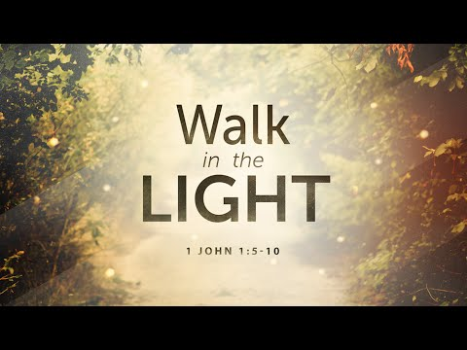
John 1:1 (NKJV) In the beginning was the Word, and the Word was with God, and the Word was God.
John 1:6-7 (NKJV) ⁶ There was a man sent from God, whose name was John. ⁷ This man came for a witness, to bear witness of the Light, that all through him might believe.
John 1:11 (NKJV) 11 He came to His own, and His own did not receive Him.
John 1:12 (NKJV) ¹² But as many as received Him, to them He gave the right to become children of God, to those who believe in His name
Notes:
John 1:11 (NKJV) ¹¹ He came to His own, and His own did not receive Him.
John 1:12 (NKJV) ¹² But as many as received Him, to them He gave the right to become children of God, to those who believe in His name:

Slide 8
Matthew 16:13 (NKJV) When Jesus came into the region of Caesarea Philippi, He asked His disciples, saying, "Who do men say that I, the Son of Man, am?"
Matthew 16:14 (NKJV) So they said, "Some say John the Baptist, some Elijah, and others Jeremiah or one of the prophets."
Matthew 16:15 (NKJV) He said to them, "But who do you say that I am?"
Matthew 16:16 (NKJV) ¹⁶ Simon Peter answered and said,
"You are the Christ, the Son of the living God."

Slide 9
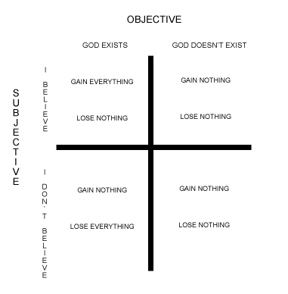
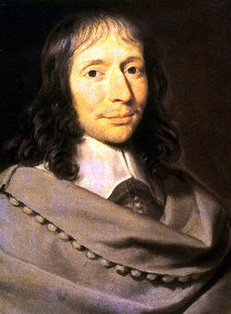
Blaise Pascal
“Pascal’s Wager”
“If Christianity isn’t true, it really doesn’t matter…
I lived a much happier life with it.”
1 Corinthians 15:17 & 19
And if Christ has not been raised, your faith is futile; you are still in your sins.
If only for this life we have hope in Christ, we are to be pitied more than all men.
Notes:
9

Slide 10
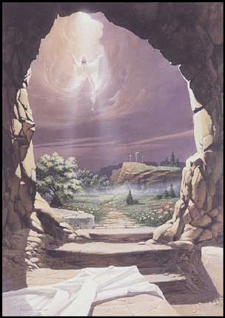
The Criticality of the Resurrection
Christianity stands or falls on the resurrection of Jesus.
If Jesus was not raised from the dead, then Jesus is a liar.
Further, either all His disciples and the Apostle Paul are liars or else they were deceived.
The one way to end Christianity once and for all is to produce the body of the Nazarene Carpenter.

Slide 11
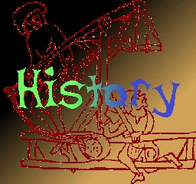
How to Approach the Question of the Resurrection?
From historical study, deliver factually-based claims that the vast majority of historical scholars agree upon.
Support claims with good historical evidence and reason.
Use (1) relevant sources; (2) responsible methods; (3) restrained results to help validate claims.

Slide 12

Key Facts of Jesus’ Resurrection
Jesus was murdered and buried.
Three days afterward, his body went missing.
There were appearances of Jesus over the course of many days to various people, including his disciples and unbelievers.
Christ’s appearances transformed his followers and some previous skeptics, with his resurrection becoming the central focus of their teaching.

Slide 13

Key Facts of Jesus’ Resurrection
These four facts about Jesus’ resurrection are agreed to by the vast majority of historians, Christian and non-Christian.
What evidence exists to support them?

Slide 14
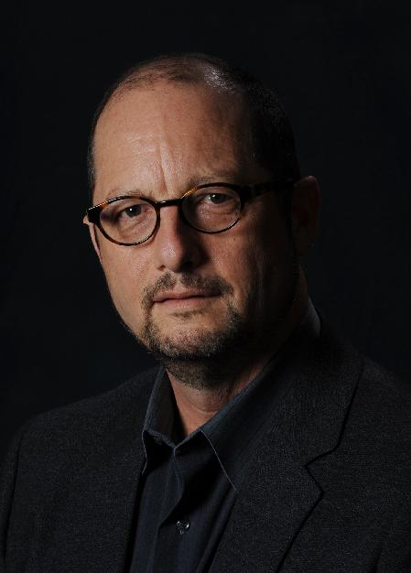
Did Jesus Die and Was He Buried?
“One of the most certain facts of history is that Jesus was crucified on orders of the Roman prefect of Judea, Pontius Pilate.”
– Bart Ehrman

Slide 15
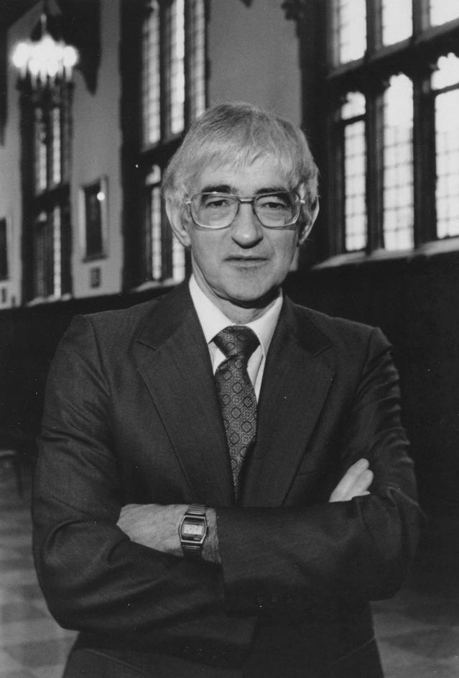
Did Jesus Die and Was He Buried?
“That he [Jesus] was crucified is as sure as anything historical ever can be.”
– John Dominic Crossan

Slide 16

Did Jesus Die and Was He Buried?
Jesus’ death and burial is recorded in all the gospel accounts.
Jesus’ death under Pilate is referred to in several extra-Biblical writings.
The burial by Joseph of Arimathea in his own tomb is nearly universally held; Joseph was a Sanhedrin member: unlikely that this account would be made up by the gospel writers.
The tomb would be known to all living in Jerusalem.
Jesus’ burial was witnessed by close friends.
His tomb was guarded by soldiers.
Jews never denied that Jesus was dead and buried.

Slide 17
Did Jesus’ Body Go Missing After His Death?
Jesus’ body has never been found up to this day.
Empty tomb first viewed / reported by a group of Jesus’ women followers: Mary Magdalene, Mary mother of James, etc.
Peter and John later reported the tomb was empty.
Jewish leaders devised lie to cover up the resurrection. They never refuted the claim that the body was gone.
Non-Christian historians record Christian’s claims of Jesus being alive and the body being gone.

Slide 18
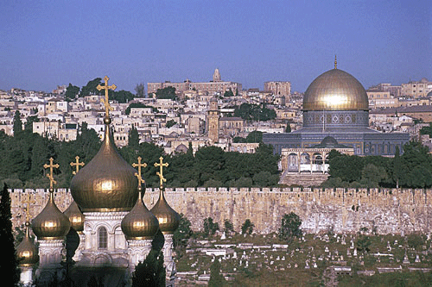
Did Jesus’ Body Go Missing After His Death?
Jesus was publicly executed in Jerusalem, his appearances took place there, and his resurrection was proclaimed there.
If the body had still been in the tomb, it would have been very easy to stop Christianity’s message in its tracks by simply going to a well-known tomb and producing the body.

Slide 19
Did the Disciples and Paul Experience Appearances of Jesus?
 | Appeared to | Where | When | References
1 | Mary Magdalene | Jerusalem | Sunday | Mark 6:9-11; John 20:11-18
2 | Other Women | Jerusalem | Sunday | Matt 28:9-10
3 | Peter | Jerusalem | Sunday | Luke 24:32; 1 Cor. 15:5
4 | Emmaus disciples | Emmaus | Sunday | Luke 24:13-35; Mark 16:12
5 | 10 disciples | Jerusalem | Sunday | Mark 16:14; Luke 24:26-42; John 20:19-25
6 | 11 disciples | Jerusalem | A week later | John 20:26-31; 1 Cor. 15:5
7 | 7 disciples | Galilee | ? | John 21:1-25
8 | 500 brethren | Galilee | ? | 1 Cor. 15:6
9 | James | ? | ? | 1 Cor. 15:7
10 | 11 disciples | Galilee | ? | Matt 28:16-20; Mark 16:15-18
11 | 11 disciples | Jerusalem | 40 days later | Acts 1:3-12
12 | Paul | Road Emmaus | ? | Acts 9

Slide 20
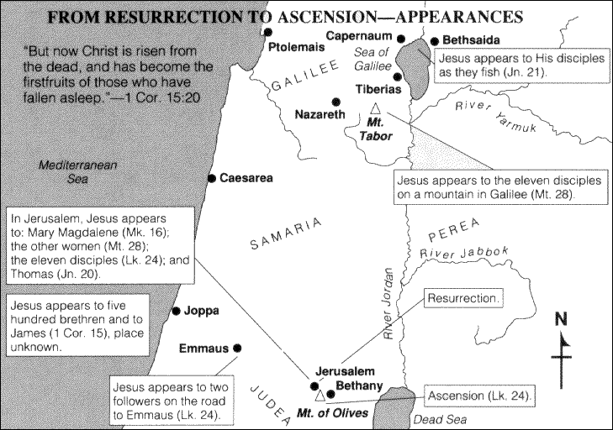

Slide 21
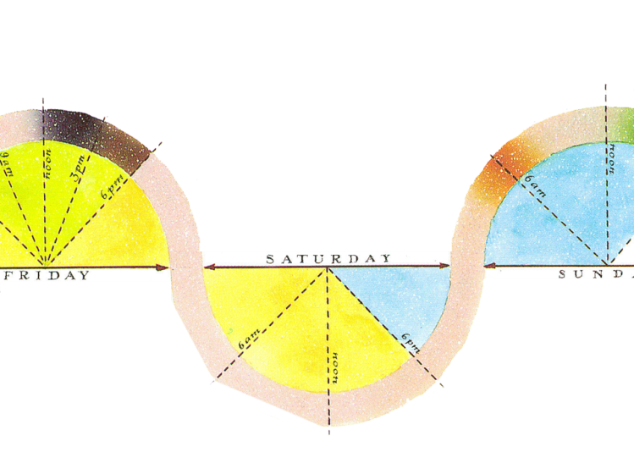
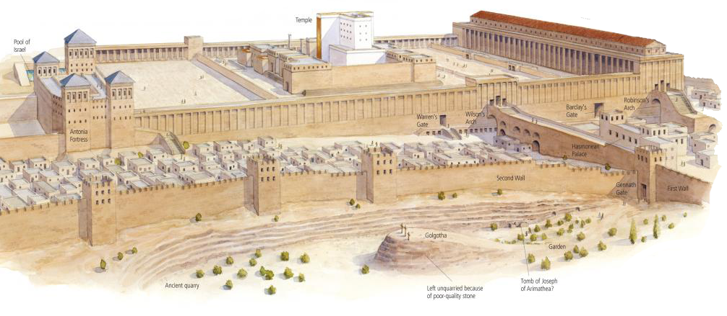
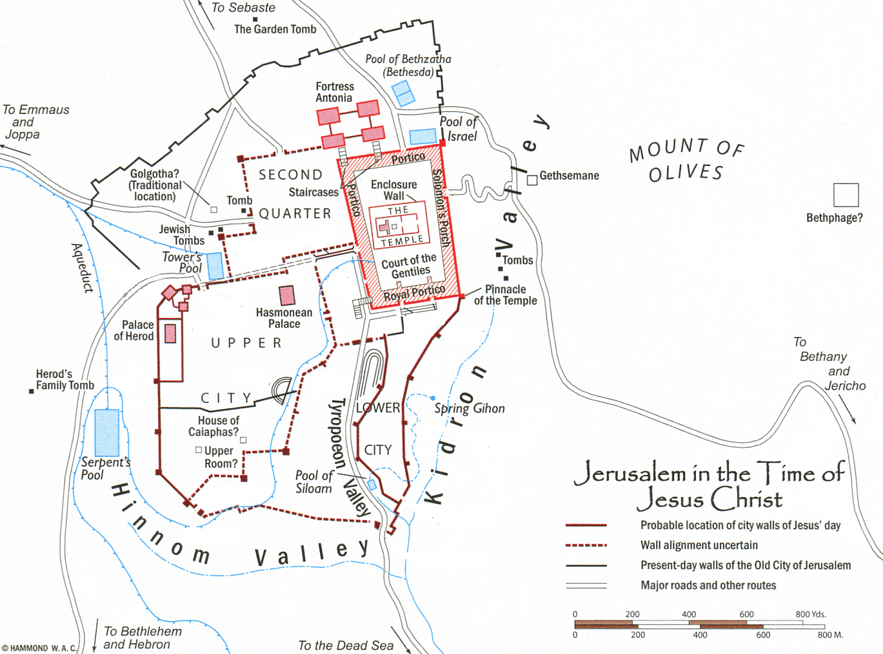
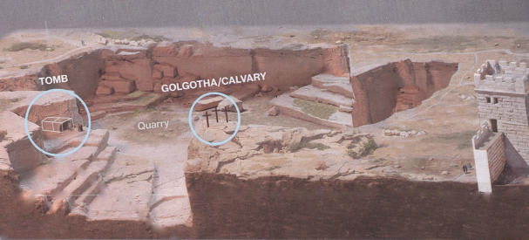
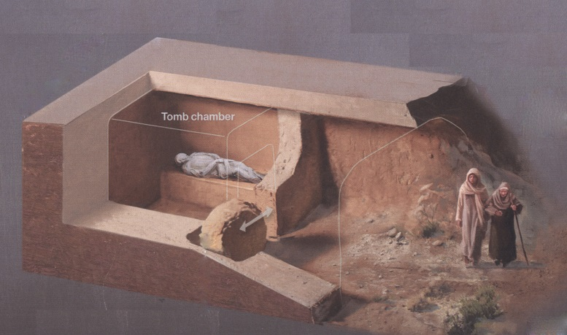
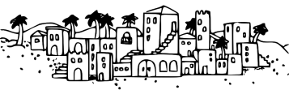
Jesus dies (9th hr – 3 PM)
Cross
Golgotha
Tomb
Tomb & Cross – Distance 140 ft
Tomb
Bethany

Slide 22
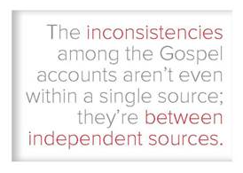
Contradictions?

Slide 23
Did the Disciples and Paul Experience Appearances of Jesus?
“Why, then, did some of the disciples claim to see Jesus alive after his crucifixion?
I don’t doubt at all that some of the disciples claimed this. . . .Paul, writing about twenty-five years later, indicates that this is what they claimed, and I don’t think he is making it up. And he knew at least a couple of them, whom he met just three years after the event.”
– Bart Ehrman

Slide 24

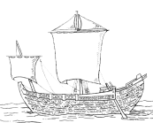







~55 AD
Mark
~60 AD
Matthew
~62 AD
Luke
~90 AD
John
Paul’s Missionary
Journeys
1 st
45-46
AD
2 nd
48-51
AD
3 rd
52-57
AD
Paul’s Epistles
70 AD
Temple
Destroyed
27-30 AD
Gal ~53
Ro ~57
Ministry of Jesus
1 Thess ~50 AD
Phil ~55
Phmn~55
1 Cor ~53-54
2 Cor ~55-56
20AD
30AD
40 AD
50AD
60 AD
70 AD
80 AD
90 AD
100 AD
75-90AD
Matthew
90 AD
John
65-75 AD
Mark
80-95 AD
Luke

Slide 25

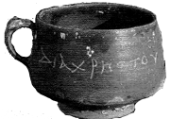
53-54 AD
1 Corinthians 15:1-11
55 AD
Philippians 2:5-11
60-62 AD
Colossians 1:15-20
61 AD
Ephesians 2:13-16
~55 AD
Mark
~60 AD
Matthew
1 st
45-46
AD
2 nd
48-51
AD
3 rd
52-57
AD
~62 AD
Luke
~90 AD
John
Paul’s Missionary
Journeys
Paul’s Epistles
70 AD
Temple
Destroyed
27-30 AD
Gal ~53
Ro ~57
Ministry of Jesus
1 Thess ~50 AD
Phil ~55
Phmn~55
1 Cor ~53-54
2 Cor ~55-56
20AD
32-38 AD
Conversion of
Paul
50AD
80 AD
90 AD
100 AD
30AD
40 AD
60 AD
70 AD
Non-believing
Scholars date Gospels
After Jerusalem destruction
75-90AD
Matthew
90 AD
John
65-75 AD
Mark
50 AD
Christ cup
Egypt
80-95 AD
Luke

Slide 26
Review - Key Facts of Jesus’ Resurrection
Jesus was murdered on a cross and buried.
Three days afterward, his body went missing, no body ever produced.
There were appearances of Jesus over the course of many days to various people, including his disciples and unbelievers.
Jesus’s disciples believed that they saw Jesus resurrected from the dead.
Christ’s appearances transformed his followers and some previous skeptics, with his resurrection becoming the central focus of their teaching.
Notes:
both friends and foes of Christianity:
1. Jesus died on the cross and was buried.
2. Jesus’s tomb was empty, and no one ever produced a body.
3. Jesus’s disciples believed that they saw Jesus resurrected from the dead.
4. Jesus’s disciples were transformed following their alleged resurrection observations.

Slide 27

Foundation for the Undisputed Facts
Multiple independent, early sources support the facts.
Attestation by enemies of Christianity support the facts.
Embarrassing admissions support the facts.
Eyewitness testimony support the facts.
Early testimony support the facts.
Notes:
both friends and foes of Christianity:
1. Jesus died on the cross and was buried.
2. Jesus’s tomb was empty, and no one ever produced a body.
3. Jesus’s disciples believed that they saw Jesus resurrected from the dead.
4. Jesus’s disciples were transformed following their alleged resurrection observations.

Slide 28
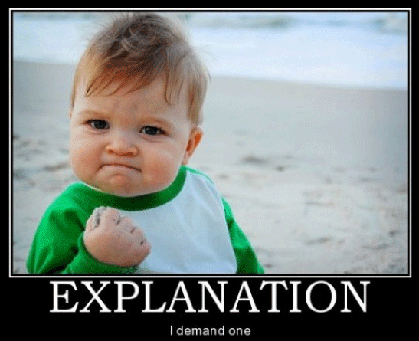
What Best Explains the Facts of Jesus’ Resurrection?
Examine resurrection hypotheses with the philosophical “appeal to the best explanation” approach.
Also called the “cumulative case” or “abductive argumentation” method.

Slide 29

Most Common Resurrection Hypotheses
Legend/Later Distortions
Hallucination
Stolen body
Wrong tomb
Swoon theory
Spiritual only
Mistaken identity/Imposter
Delusional
Disciples Lied
Accurate Reporting/Act of God
Notes:
THE DISCIPLES WERE WRONG ABOUT JESUS’S DEATH
THE DISCIPLES LIED ABOUT THE RESURRECTION
THE DISCIPLES WERE DELUSIONAL
THE DISCIPLES WERE FOOLED BY AN IMPOSTER
THE DISCIPLES WERE INFLUENCED BY LIMITED SPIRITUAL SIGHTINGS
THE DISCIPLES’ OBSERVATIONS WERE DISTORTED LATER
THE DISCIPLES WERE ACCURATELY REPORTING THE RESURRECTION OF JESUS

Slide 30
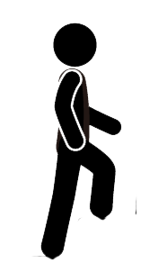


Bible Authority Established
Creation, Flood, Redemption Story, Moses, Moral Laws, Miracles, Nature of Man, Purpose of Man, Nature of God, Christ & Holy Spirit, Requirements for Worship, Personality of Jesus, Coming Judgment, Heaven, Hell, Angels, Demons, & Satan
Bible would be Accurate
Based on Bible Testimony Jesus is Son of God
Teachings of
Jesus are True
Accurate Account of Jesus’ Life
A Step of Faith not
A Leap of Faith
Bible can be Understood
Bible is Inspired
Bible is Accurate
Bible is Reliable
If Bible Revelation of Creator then
Divine Revelation Possible
& Accurate So Purpose is Known
Starting Point for
How We Got the Bible
class
Creation
has a purpose
Likely a Moral Law
Miracles &
Revelations
Universe had an Intelligent, Personal Origin
Possible that Universe had Supernatural Origin
It is Possible that there is Supernatural Force
Based on material from mmb, jr Establishing Bible Authority Class - 10/30/2002

Slide 31
Class Objectives
Understand the number of people who observed Jesus after the Resurrection and evaluate what they observed to make additional conclusions to the death, burial and resurrection of Jesus.

Slide 32
Questions
How do we know that Jesus rose from the dead?
How do you explain the contradictions in the resurrection story?
How could Jesus have remained in the tomb three days and three nights if He was crucified on Friday and rose on Sunday
The current class & Lesson 11
Confirms/gives context
Mt 2: 5-6 Born in Bethlehem – Micah 5:2
Mt 2:13-15 Flees to Egypt - Hosea 11:1
Mt 2:16-18 Death of male children in Bethlehem – Jeremiah 31:15
Mt 2:22-23 He shall be called a Nazarene ?
The current class
The current class
Notes:
Matthew 2:5-6 (NKJV) ⁵ So they said to him, "In Bethlehem of Judea, for thus it is written by the prophet:
⁶ 'But you, Bethlehem, in the land of Judah, Are not the least among the rulers of Judah; For out of you shall come a Ruler Who will shepherd My people Israel.' " Micah 5:2
Matthew 2:13-15 (NKJV) ¹³ Now when they had departed, behold, an angel of the Lord appeared to Joseph in a dream, saying, "Arise, take the young Child and His mother, flee to Egypt, and stay there until I bring you word; for Herod will seek the young Child to destroy Him."
¹⁴ When he arose, he took the young Child and His mother by night and departed for Egypt,
¹⁵ and was there until the death of Herod, that it might be fulfilled which was spoken by the Lord through the prophet, saying, "Out of Egypt I called My Son." (Hosea 11:1)
Matthew 2:16-18 (NKJV) ¹⁶ Then Herod, when he saw that he was deceived by the wise men, was exceedingly angry; and he sent forth and put to death all the male children who were in Bethlehem and in all its districts, from two years old and under, according to the time which he had determined from the wise men.
¹⁷ Then was fulfilled what was spoken by Jeremiah the prophet, saying:
¹⁸ "A voice was heard in Ramah, Lamentation, weeping, and great mourning, Rachel weeping for her children, Refusing to be comforted, Because they are no more." Jeremiah 31:15
Matthew 2:22-23 (NKJV) 22 But when he heard that Archelaus was reigning over Judea instead of his father Herod, he was afraid to go there. And being warned by God in a dream, he turned aside into the region of Galilee.
And he came and dwelt in a city called Nazareth, that it might be fulfilled which was spoken by the prophets, "He shall be called a Nazarene.“
Three major options exist for interpreting this verse. First, it may be that Matthew is associating the word Nazarene with the Hebrew word netser (“branch or sprout”). The “Branch” was a common term for the Messiah, such as in Isaiah 11:1: “A shoot will come up from the stump of Jesse; from his roots a Branch will bear fruit.” Hebrew was written with only consonants, and netser would have appeared as NZR—the same main consonants as Nazareth. In fact, in Aramaic, the common language of Jesus’ day, the word for “Nazareth” and the Hebrew word for “branch” sounded very much alike. Matthew’s point could be that Jesus was “sprouting up” from an obscure village in Galilee; Jesus was the Branch predicted by the prophets, and the name of the town He grew up in happens to sound just like the prophets’ word for “branch.”
A second option is that Matthew is citing a prophecy not found in the Old Testament but in another source. If so, Matthew referred to a prophecy known to his original audience yet unknown to us today. However, this is unlikely and an argument from silence.
A third option is that Matthew uses the word Nazarene in reference to a person who is “despised and rejected.” In the first century, Nazareth was a small town about 55 miles north of Jerusalem, and it had a negative reputation among the Jews. Galilee was generally looked down upon by Judeans, and Nazareth of Galilee was especially despised (see John 1:46). If this was Matthew’s emphasis, the prophecies Matthew had in mind could include these two passages concerning the Messiah:
“But I am a worm and not a man, scorned by everyone, despised by the people. All who see me mock me; they hurl insults, shaking their heads” (Psalm 22:6–7). It’s true that Nazarenes were “scorned by everyone,” and so one could see this messianic prophecy as an allusion to Jesus’ hometown of Nazareth.
“He was despised and rejected by mankind, a man of suffering, and familiar with pain. Like one from whom people hide their faces he was despised, and we held him in low esteem” (Isaiah 53:3). Again, in Jesus’ day, Nazarenes were “despised and rejected,” and so Isaiah’s prophecy could be viewed as an indirect reference to Jesus’ background as the supposed son of a carpenter from Nazareth.
If Psalm 22:6–7 and Isaiah 53:3 are the prophecies that Matthew had in mind, then the meaning of “He shall be called a Nazarene” is something akin to “He shall be despised and mocked by His own people.”

Slide 33
Matthew 16:13 (NKJV) When Jesus came into the region of Caesarea Philippi, He asked His disciples, saying, "Who do men say that I, the Son of Man, am?"
Matthew 16:14 (NKJV) So they said, "Some say John the Baptist, some Elijah, and others Jeremiah or one of the prophets."
Matthew 16:15 (NKJV) He said to them, "But who do you say that I am?"
Matthew 16:16 (NKJV) ¹⁶ Simon Peter answered and said,
"You are the Christ, the Son of the living God."

Slide 34
Who is Jesus
He is the Christ (Messiah), the Anointed One foreseen by the Old Testament prophets.
(Isaiah 9:6; Matthew 16:16; John 4:25–26; John 6:69)
He is the Savior of the world, the one who delivers from sin.
  (John 3:16–18; John 4:42; Acts 5:31; 1 John 4:14)
He is the Lamb of God, the one who sacrificed His life for sins.
  (Isaiah 53:7; John 1:29)
He is the Son of God, having a unique and intimate relationship with God the Father.
  (John 20:31)
He is the Creator of all things. (John 1:3; Colossians 1:16–17, Hebrews 1:2, 3)
He is equal to God. (John 5:23; Philippians 2:6)
He is eternal, existing with God from the very beginning. (John 1:1–2)
He is God in the flesh, revealing to us what God is like. (John 1:18, Hebrews 1:3)
He is the Lord of all. (Acts 10:36, Philippians 2:9–11)
He was born of a virgin. (Isaiah 7:14, Matthew 1:22–23; Luke 1:27–35)
He has the authority to forgive sins. (Mark 2:10)
He is worshiped. (John 9:38; Luke 24:52; Hebrews 1:6)
He is the living Savior, raised from the dead and sitting today at the right hand of God;
By His resurrection we have new life. (1 Peter 3:21–22; Romans 8:34)

Slide 35
Jesus of Modern Scholar
The followers of Jesus invented his deity after his death
Jesus was a Magician
Jesus is a non-apocalyptic, teasing teacher
Jesus was an apocalyptic prophet
Jesus was a Cynic
Jesus just man
Jesus never claimed to be God
Jesus was a revolutionary, a sage, an iconoclastic Jew

Slide 36




Paul’s Epistles
1 Thess ~50 AD
Gal ~53
1 Cor ~53-54
Phil ~55
Phmn~55
2 Cor ~55-56
Ro ~57
70 AD
Temple
Destroyed
27-30 AD
Ministry of Jesus
75 AD
100 AD
150 AD
200 AD
250 AD
25 AD
50 AD

Slide 37

Paul’s Epistles
1 Thess ~50 AD
Gal ~53
1 Cor ~53-54
Phil ~55
Phmn~55
2 Cor ~55-56
Ro ~57
70 AD
Temple
Destroyed
Polycarp
120 AD
Letter Quotes
16 NT Books
Clement
95 AD
Letter Quotes
10 NT Books
27-30 AD
Ministry of Jesus
75 AD
100 AD
150 AD
200 AD
250 AD
25 AD
50 AD
Tertullian (c. 150-c. 229) quotes from 23 of the 27 NT canon
AD 115,
Ignatius, bishop of Antioch,
Refers to “The Gospel” as
authoritative writing

Slide 38



100-200 AD
P104/ P. Oxy. 4404
Matthew 21
150-200 AD
P90 /P. Oxy. 3523
John 18-19
Paul’s Epistles
1 Thess ~50 AD
Gal ~53
1 Cor ~53-54
Phil ~55
Phmn~55
2 Cor ~55-56
Ro ~57
175-200 AD
Magdalen" papyrus
Matthew 3,5,26
70 AD
Temple
Destroyed
Polycarp
120 AD
Letter Quotes
16 NT Books
Clement
95 AD
Letter Quotes
10 NT Books
125-175 AD
J Ryland
John 18
27-30 AD
Ministry of Jesus
75 AD
100 AD
150 AD
200 AD
250 AD
25 AD
50 AD
Tertullian (c. 150-c. 229) quotes from 23 of the 27 NT canon
AD 105- 115
Ignatius, bishop of Antioch,
Refers to “The Gospel” as
authoritative writing

Slide 39
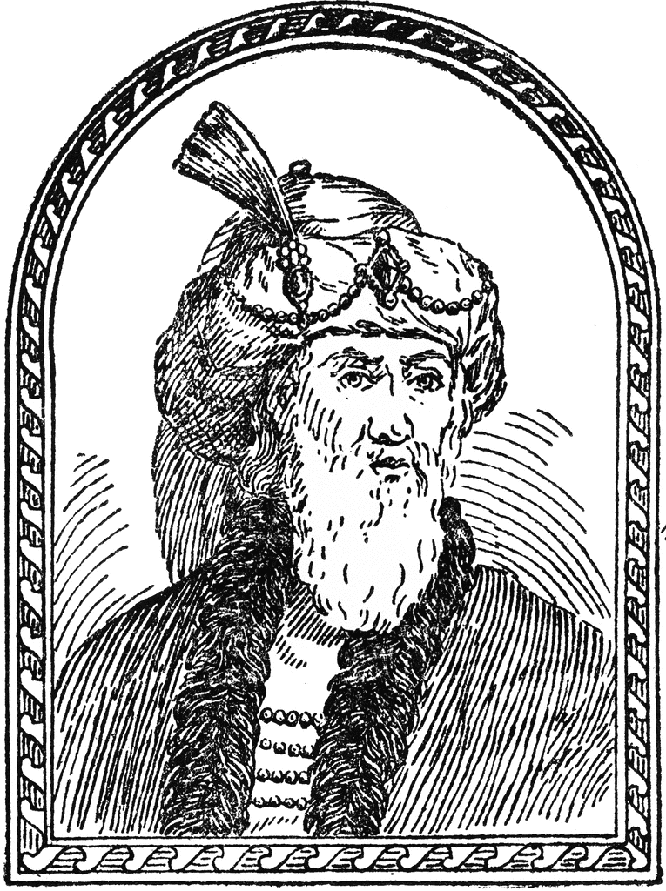

50 AD
Christ cup
Egypt
93 AD
Josephus
The Antiquities
100-200 AD
P104/ P. Oxy. 4404
Matthew 21
150-200 AD
P90 /P. Oxy. 3523
John 18-19
Paul’s Epistles
1 Thess ~50 AD
Gal ~53
1 Cor ~53-54
Phil ~55
Phmn~55
2 Cor ~55-56
Ro ~57
175-200 AD
Magdalen" papyrus
Matthew 3,5,26
70 AD
Temple
Destroyed
Polycarp
120 AD
Letter Quotes
16 NT Books
Clement
95 AD
Letter Quotes
10 NT Books
125-175 AD
J Ryland
John 18
27-30 AD
Ministry of Jesus
75 AD
100 AD
150 AD
200 AD
250 AD
25 AD
50 AD
28-29 AD
Death of
John The Baptist
Jesus ~30 AD
62 AD
Death of
James
Brother of Jesus
Tertullian (c. 150-c. 229) quotes from 23 of the 27 NT canon
AD 115,
Ignatius, bishop of Antioch,
Refers to “The Gospel” as
authoritative writing
Notes:
Suetonius Tranquillas (AD 69-160) wrote under the Roman emperor Hadrian, and he was a friend of Pliny the Younger. mentions early Christians and may refer to Jesus Christ in his work Lives of the Twelve Caesars, written in AD 121

Slide 40
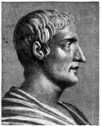
115 AD
Tacitus
Nero & Christians
50 AD
Christ cup
Egypt
93 AD
Josephus
The Antiquities
100-200 AD
P104/ P. Oxy. 4404
Matthew 21
150-200 AD
P90 /P. Oxy. 3523
John 18-19
Paul’s Epistles
1 Thess ~50 AD
Gal ~53
1 Cor ~53-54
Phil ~55
Phmn~55
2 Cor ~55-56
Ro ~57
175-200 AD
Magdalen" papyrus
Matthew 3,5,26
70 AD
Temple
Destroyed
Polycarp
120 AD
Letter Quotes
16 NT Books
Clement
95 AD
Letter Quotes
10 NT Books
125-175 AD
J Ryland
John 18
27-30 AD
Ministry of Jesus
75 AD
100 AD
150 AD
200 AD
250 AD
25 AD
50 AD
64 AD
28-29 AD
Death of
John The Baptist
Jesus ~30 AD
62 AD
Death of
James
Brother of Jesus
Tertullian (c. 150-c. 229) quotes from 23 of the 27 NT canon
AD 115,
Ignatius, bishop of Antioch,
Refers to “The Gospel” as
authoritative writing
Notes:
Suetonius Tranquillas (AD 69-160) wrote under the Roman emperor Hadrian, and he was a friend of Pliny the Younger. mentions early Christians and may refer to Jesus Christ in his work Lives of the Twelve Caesars, written in AD 121

Slide 41
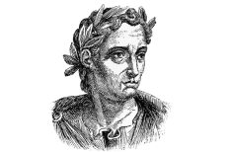

Mark 9:38-39 (NKJV) ³⁸ Now John answered Him, saying, "Teacher, we saw someone who does not follow us casting out demons in Your name, and we forbade him because he does not follow us."
³⁹ But Jesus said, "Do not forbid him, for no one who works a miracle in My name can soon afterward speak evil of Me.
111 AD
Pliny the Younger
Letter to Trajan
115 AD
Tacitus
Nero & Christians
121 AD
Suetonius
Claudius, Nero & Christians
50 AD
Christ cup
Egypt
93 AD
Josephus
The Antiquities
100-200 AD
P104/ P. Oxy. 4404
Matthew 21
150-200 AD
P90 /P. Oxy. 3523
John 18-19
Paul’s Epistles
1 Thess ~50 AD
Gal ~53
1 Cor ~53-54
Phil ~55
Phmn~55
2 Cor ~55-56
Ro ~57
175-200 AD
Magdalen" papyrus
Matthew 3,5,26
70 AD
Temple
Destroyed
Polycarp
120 AD
Letter Quotes
16 NT Books
Clement
95 AD
Letter Quotes
10 NT Books
125-175 AD
J Ryland
John 18
27-30 AD
Ministry of Jesus
75 AD
100 AD
150 AD
200 AD
250 AD
25 AD
50 AD
28-29 AD
Death of
John The Baptist
Jesus ~30 AD
~53 AD
Jews out Rome
62 AD
Death of
James
Brother of Jesus
Tertullian (c. 150-c. 229) quotes from 23 of the 27 NT canon
AD 115,
Ignatius, bishop of Antioch,
Refers to “The Gospel” as
authoritative writing
Notes:
Suetonius Tranquillas (AD 69-160) wrote under the Roman emperor Hadrian, and he was a friend of Pliny the Younger. mentions early Christians and may refer to Jesus Christ in his work Lives of the Twelve Caesars, written in AD 121

Slide 42
Written by Paul - Undisputed
Resurrection, Miracles, Deity
L07 First Epistle to the Thessalonians (51 AD) Danny H
L07 Epistle to the Galatians (47 (51-53)AD?) Joel Y
L11 First Epistle to the Corinthians (52-56 AD) Luke Rosetti
L11Second Epistle to the Corinthians (52-56 AD) Danny
L08 Epistle to the Philippians (60-62 AD) Jana S, Chester T, Corey W, DeAnna B
L08 Epistle to Philemon (60-62 AD) Sara H
L13 Epistle to the Romans (52-57 AD) Marty B

Slide 43
What Paul tells us about Jesus
Jesus was born of a woman. (Gal. 4: 4;
  But since Paul believes that Christ was the incarnation of a preexistent divine being [see Phil. 2: 6– 8] it makes sense that he also wants to emphasize that he “came to the world in the usual way.”)
• He was born as a Jew. (Gal. 4: 4)
• He was descended from the line of King David. (Rom. 1: 3)
• He had brothers (1 Cor. 9: 5), one of whom was named James. (Gal. 1: 19)
• He had twelve disciples. (1 Cor. 15: 5)
• He conducted his ministry among Jews. (Rom. 15: 8)
• He had a last meal with his disciples on night he was turned over to the authorities.(1 Cor. 11:23)
• Paul knows two things Jesus said at this last supper. (1 Cor. 11: 23– 25)
• Paul knows two other teachings of Jesus:
that Christians should not get divorced (1 Cor. 7: 10) and
that they should pay their preacher. (1 Cor. 9: 14)
• Jesus appeared before Pontius Pilate. (1 Tim. 6: 13; this datum found only in a letter Paul wrote)
• Jesus died of crucifixion. (1 Cor. 2: 2)
• Those responsible for his death were Judeans. (1 Thess. 2: 14– 15)

Slide 44
1 Corinthians
Deity
1 Corinthians 1:1-3 (ESV) ¹ Paul, called by the will of God to be an apostle of Christ Jesus, and our brother Sosthenes,
² To the church of God that is in Corinth, to those sanctified in Christ Jesus, called to be saints together with all those who in every place call upon the name of our Lord Jesus Christ, both their Lord and ours: ³ Grace to you and peace from God our Father and the Lord Jesus Christ.
1 Corinthians 1:4-9 (ESV) ⁴ I give thanks to my God always for you because of the grace of God that was given you in Christ Jesus,
⁵ that in every way you were enriched in him in all speech and all knowledge—
⁶ even as the testimony about Christ was confirmed among you—
⁷ so that you are not lacking in any gift, as you wait for the revealing of our Lord Jesus Christ,
⁸ who will sustain you to the end, guiltless in the day of our Lord Jesus Christ.
⁹ God is faithful, by whom you were called into the fellowship of his Son, Jesus Christ our Lord.
Gospel?
1 Corinthians 1:10 (ESV) ¹⁰ I appeal to you, brothers, by the name of our Lord Jesus Christ, that all of you agree, and that there be no divisions among you, but that you be united in the same mind and the same judgment.
Notes:
Deity
Miracles
Resurrection

Slide 45
1 Corinthians
Resurrection
1 Corinthians 1:17-31 (ESV)
¹⁷ For Christ did not send me to baptize but to preach the gospel, and not with words of eloquent wisdom, lest the cross of Christ be emptied of its power.
¹⁸ For the word of the cross is folly to those who are perishing, but to us who are being saved it is the power of God.
¹⁹ For it is written, “I will destroy the wisdom of the wise, and the discernment of the discerning I will thwart.”
²⁰ Where is the one who is wise? Where is the scribe? Where is the debater of this age? Has not God made foolish the wisdom of the world?
²¹ For since, in the wisdom of God, the world did not know God through wisdom, it pleased God through the folly of what we preach to save those who believe.
²² For Jews demand signs and Greeks seek wisdom,
²³ but we preach Christ crucified, a stumbling block to Jews and folly to Gentiles,
²⁴ but to those who are called, both Jews and Greeks, Christ the power of God and the wisdom of God.
²⁵ For the foolishness of God is wiser than men, and the weakness of God is stronger than men.
²⁶ For consider your calling, brothers:
not many of you were wise according to worldly standards,
not many were powerful, not many were of noble birth.
²⁷ But God chose what is foolish in the world to shame the wise;
God chose what is weak in the world to shame the strong;
²⁸ God chose what is low and despised in the world, even things that are not, to bring to nothing things that are, ²⁹ so that no human being might boast in the presence of God.
³⁰ And because of him you are in Christ Jesus, who became to us wisdom from God, righteousness and sanctification and redemption,
³¹ so that, as it is written, “Let the one who boasts, boast in the Lord.”
Notes:
Deity
Miracles
Resurrection

Slide 46
Galatians
Resurrection
Deity
Miracles
Galatians 2:2 (ESV) ² I went up because of a revelation and set before them (though privately before those who seemed influential) the gospel that I proclaim among the Gentiles, in order to make sure I was not running or had not run in vain.
Galatians 1:15-16 (ESV) ¹⁵ But when he who had set me apart before I was born, and who called me by his grace,
¹⁶ was pleased to reveal his Son to me, in order that I might preach him among the Gentiles, I did not immediately consult with anyone;
Galatians 1:1 (ESV) ¹ Paul, an apostle—not from men nor through man, but through Jesus Christ and God the Father, who raised him from the dead—
Galatians 1:3-4 (ESV) ³ Grace to you and peace from God our Father and the Lord Jesus Christ,
⁴ who gave himself for our sins to deliver us from the present evil age, according to the will of our God and Father,
Galatians 3:1 (ESV) ¹ O foolish Galatians! Who has bewitched you? It was before your eyes that Jesus Christ was publicly portrayed as crucified.
Galatians 2:20-21 (ESV) ²⁰ I have been crucified with Christ. It is no longer I who live, but Christ who lives in me. And the life I now live in the flesh I live by faith in the Son of God, who loved me and gave himself for me. ²¹ I do not nullify the grace of God, for if righteousness were through the law, then Christ died for no purpose.
Galatians 2:7 (ESV) ⁷ On the contrary, when they saw that I had been entrusted with the gospel to the uncircumcised, just as Peter had been entrusted with the gospel to the circumcised
Galatians 4:4-5 (ESV) ⁴ But when the fullness of time had come, God sent forth his Son, born of woman, born under the law, ⁵ to redeem those who were under the law, so that we might receive adoption as sons.
Notes:
Deity
Miracles
Resurrection

Slide 47
Galatians
Gospel
Galatians 2:2 (ESV) ² I went up because of a revelation and set before them (though privately before those who seemed influential) the gospel that I proclaim among the Gentiles, in order to make sure I was not running or had not run in vain.
Galatians 1:6-7 (ESV) ⁶ I am astonished that you are so quickly deserting him who called you in the grace of Christ and are turning to a different gospel—
⁷ not that there is another one, but there are some who trouble you and want to distort the gospel of Christ.
Galatians 1:11-12 (ESV) ¹¹ For I would have you know, brothers, that the gospel that was preached by me is not man’s gospel.
¹² For I did not receive it from any man, nor was I taught it, but I received it through a revelation of Jesus Christ.
Galatians 2:2 (ESV) ² I went up because of a revelation and… the gospel that I proclaim among the Gentiles, in order to make sure I was not running or had not run in vain.
Galatians 1:9 (ESV) ⁹ As we have said before, so now I say again: If anyone is preaching to you a gospel contrary to the one you received, let him be accursed.
Galatians 3:8 (ESV) ⁸ And the Scripture, foreseeing that God would justify the Gentiles by faith, preached the gospel beforehand to Abraham, saying, “In you shall all the nations be blessed.”
Galatians 2:7 (ESV) ⁷ …that I had been entrusted with the gospel to the uncircumcised, just as Peter had been entrusted with the gospel to the circumcised
Galatians 2:7 (ESV) ⁷ On the contrary, when they saw that I had been entrusted with the gospel to the uncircumcised, just as Peter had been entrusted with the gospel to the circumcised
What is the Gospel?
Galatians 3:13-14 (ESV) ¹³ Christ redeemed us from the curse of the law by becoming a curse for us—for it is written, “Cursed is everyone who is hanged on a tree”—
¹⁴ so that in Christ Jesus the blessing of Abraham might come to the Gentiles, so that we might receive the promised Spirit through faith.
Notes:
Deity
Miracles
Resurrection

Slide 48
Gospel Preached by Paul
1 Corinthians 15:1-8 (ESV)
¹ Now I would remind you, brothers, of the gospel I preached to you, which you received, in which you stand,
² and by which you are being saved, if you hold fast to the word I preached to you—unless you believed in vain.
³ For I delivered to you as of first importance what I also received:
that Christ died for our sins in accordance with the Scriptures,
⁴ that he was buried, that he was raised on the third day in accordance with the Scriptures,
⁵ and that he appeared to Cephas, then to the twelve.
⁶ Then he appeared to more than five hundred brothers at one time, most of whom are still alive, though some have fallen asleep.
⁷ Then he appeared to James, then to all the apostles.
⁸ Last of all, as to one untimely born, he appeared also to me.
Notes:
Deity
Miracles
Resurrection

Slide 49
I Thessalonians
1 Thessalonians 1:5 (ESV) because our gospel came to you not only in word, but also in power and in the Holy Spirit and with full conviction. You know what kind of men we proved to be among you for your sake.
1 Thessalonians 1:9-10 (ESV) ⁹ For they themselves report concerning us the kind of reception we had among you, and how you turned to God from idols to serve the living and true God, ¹⁰ and to wait for his Son from heaven, whom he raised from the dead, Jesus who delivers us from the wrath to come.
1 Thessalonians 2:4 (ESV) ⁴ but just as we have been approved by God to be entrusted with the gospel, so we speak, not to please man, but to please God who tests our hearts.
1 Thessalonians 2:6 (ESV) ⁶ Nor did we seek glory from people, whether from you or from others, though we could have made demands as apostles of Christ.
1 Thessalonians 2:8 (ESV) ⁸ So, being affectionately desirous of you, we were ready to share with you not only the gospel of God but also our own selves, because you had become very dear to us.

Slide 50
I Thessalonians
1 Thessalonians 2:14-16 (ESV) ¹⁴ For you, brothers, became imitators of the churches of God in Christ Jesus that are in Judea. For you suffered the same things from your own countrymen as they did from the Jews,
¹⁵ who killed both the Lord Jesus and the prophets, and drove us out, and displease God and oppose all mankind
¹⁶ by hindering us from speaking to the Gentiles that they might be saved—so as always to fill up the measure of their sins. But wrath has come upon them at last!
1 Thessalonians 3:2 (ESV) ² and we sent Timothy, our brother and God’s coworker in the gospel of Christ, to establish and exhort you in your faith,
1 Thessalonians 3:11-13 (ESV) ¹¹ Now may our God and Father himself, and our Lord Jesus, direct our way to you,
¹² and may the Lord make you increase and abound in love for one another and for all, as we do for you,
¹³ so that he may establish your hearts blameless in holiness before our God and Father, at the coming of our Lord Jesus with all his saints.
1 Thessalonians 4:1-3 (ESV)
² For you know what instructions we gave you through the Lord Jesus.
³ For this is the will of God, your sanctification: that you abstain from sexual immorality;
Notes:
Deity
Miracles
Resurrection

Slide 51
I Thessalonians
1 Thessalonians 4:14-16 (ESV) ¹⁴ For since we believe that Jesus died and rose again, even so, through Jesus, God will bring with him those who have fallen asleep.
¹⁵ For this we declare to you by a word from the Lord, that we who are alive, who are left until the coming of the Lord, will not precede those who have fallen asleep.
¹⁶ For the Lord himself will descend from heaven with a cry of command, with the voice of an archangel, and with the sound of the trumpet of God. And the dead in Christ will rise first.
1 Thessalonians 5:9-10 (ESV) ⁹ For God has not destined us for wrath, but to obtain salvation through our Lord Jesus Christ,
¹⁰ who died for us so that whether we are awake or asleep we might live with him.
1 Thessalonians 5:23 (ESV) ²³ Now may the God of peace himself sanctify you completely, and may your whole spirit and soul and body be kept blameless at the coming of our Lord Jesus Christ.
Notes:
Deity
Miracles
Resurrection

Slide 52
Philippians
Notes:
Deity
Miracles
Resurrection

Slide 53
Philippians
a "case study" of a crucial passage that comprises a particularly revealing "window" upon early Christian belief and piety, especially with reference to the place of Jesus in early Christian faith and practice.'
Philippians 2:5-11 (ESV) ⁵ Have this mind among yourselves, which is yours in Christ Jesus,
⁶ who, though he was in the form of God,
did not count equality with God a thing to be grasped,
⁷ but emptied himself,
by taking the form of a servant,
being born in the likeness of men.
⁸ And being found in human form,
he humbled himself by becoming obedient to the point of death,
even death on a cross.
⁹ Therefore God has highly exalted him
and bestowed on him the name that is above every name,
¹⁰ so that at the name of Jesus every knee should bow,
in heaven and on earth and under the earth,
¹¹ and every tongue confess that Jesus Christ is Lord, to the glory of God the Father.
Notes:
Deity
Miracles
Resurrection

Slide 54
Philemon
Notes:
Deity
Miracles
Resurrection

Slide 55
II Thessalonians
2 Thessalonians 1:1-2 (ESV) ¹ Paul, Silvanus, and Timothy, To the church of the Thessalonians in God our Father and the Lord Jesus Christ:
² Grace to you and peace from God our Father and the Lord Jesus Christ.
2 Thessalonians 1:7-8 (ESV) ⁷ and to grant relief to you who are afflicted as well as to us, when the Lord Jesus is revealed from heaven with his mighty angels ⁸ in flaming fire, inflicting vengeance on those who do not know God and on those who do not obey the gospel of our Lord Jesus.
2 Thessalonians 1:12 (ESV) ¹² so that the name of our Lord Jesus may be glorified in you, and you in him, according to the grace of our God and the Lord Jesus Christ.
2 Thessalonians 2:13-14 (ESV) ¹³ But we ought always to give thanks to God for you, brothers beloved by the Lord, because God chose you as the first fruits to be saved, through sanctification by the Spirit and belief in the truth. ¹⁴ To this he called you through our gospel, so that you may obtain the glory of our Lord Jesus Christ.
2 Thessalonians 2:16-17 (ESV) ¹⁶ Now may our Lord Jesus Christ himself, and God our Father, who loved us and gave us eternal comfort and good hope through grace,
¹⁷ comfort your hearts and establish them in every good work and word.
Notes:
Deity
Miracles
Resurrection

Slide 56
II Thessalonians
2 Thessalonians 3:5 (ESV) ⁵ May the Lord direct your hearts to the love of God and to the steadfastness of Christ.
2 Thessalonians 3:6 (ESV) ⁶ Now we command you, brothers, in the name of our Lord Jesus Christ, that you keep away from any brother who is walking in idleness and not in accord with the tradition that you received from us.
2 Thessalonians 3:12 (ESV) ¹² Now such persons we command and encourage in the Lord Jesus Christ to do their work quietly and to earn their own living.
2 Thessalonians 3:17-18 (ESV) ¹⁷ I, Paul, write this greeting with my own hand. This is the sign of genuineness in every letter of mine; it is the way I write.
¹⁸ The grace of our Lord Jesus Christ be with you all.
Notes:
Deity
Miracles
Resurrection

