Slide 1
Lesson 7
Isaiah, Micah and the Kings of Judah Alone

Slide 2
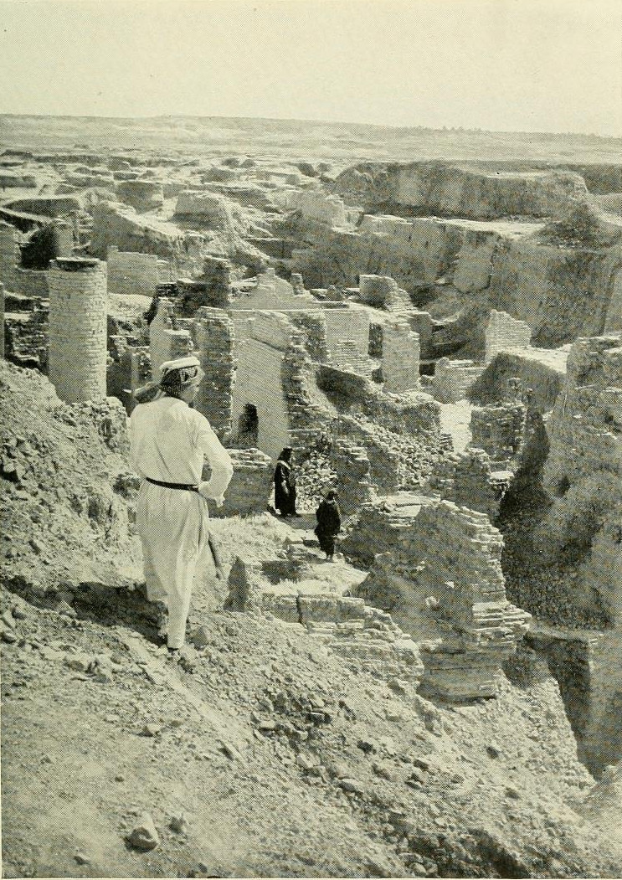
Return from Captivity
Can this be rebuilt?
Why did Jehovah let this happen?
What about a king?
What about the temple?
What do I do to keep this from happening again?

Slide 3
The Role of the Prophets
They are Spokesmen for God, serving as “forthtellers,” speaking what God put in their mouth.
They are Preachers of the Covenant, relating their message to God’s previous promises to the nation of Israel. These covenants were made with or through Abraham, Moses, and David
They are historians, or Interpreters of the Israelites’ History. With out their interpretation God’s people would not know why an event was occurring.

Slide 4
God’s Test for a Prophet
Deuteronomy 18:18-22(ESV) ¹⁸I will raise up for them a prophet like you from among their brothers.
And I will put my words in his mouth, and he shall speak to them
all that I command him.
¹⁹And whoever will not listen to my words that he shall speak in my name, I myself will require it of him.
²⁰But the prophet who presumes to speak a word in my name that I have not commanded him to speak, or who speaks in the name of other gods, that same prophet shall die.’
²¹And if you say in your heart, ‘How may we know the word that the Lord has not spoken?’—
²² when a prophet speaks in the name of the Lord, if the word does not come to pass or come true, that is a word that the Lord has not spoken; the prophet has spoken it presumptuously. You need not be afraid of him.

Slide 5
Kings of United & Divided Kingdom
United
Kingdom
Divided Kingdom
Judah Alone
Early Kings – Israel
Dynasty 1&2
Omri
Dynasty 3
Jehu
Dynasty 4
Confusing
Dynasties
Hezekiah
Hezekiah
(728-686)
Manasseh
Amon
1
Jereboam
Nadab
3
Omri
Ahab
(874-853)
Ahaziah
Jehoram
4
Jehu
(841-814)
Jehoahaz
Jehoash
Jereboam II
(793-753)
Zechariah
Shallum
Menahem
Pekaiah
Pekah
Hosea
(732-722)
5
Saul
(1050-1010)
David
(1010-970)
Solomon
(970-930)
2
Baasha
Elah
Josiah &
Sons
Zimri ~ 885
Tibni
Josiah
(640-609)
Jehoahaz
Jehoiakim
Jehoiachin
Zedekiah
(597-586)
Early Kings – Judah
Dynasty 1&2
Omri
Dynasty 3
Jehu
Dynasty 4
Confusing
Dynasties
Rehoboam
Abijam
Asa
(930-870)
Jehosphat
(873-848)
Jehoram
Ahaziah
Athaliah
Joash
Amaziah
Azariah/Uzziah
(790-739)
Jotham
Ahaz
Hezekiah
Judah Return
Zerubbabel (538-515)
Ezra (458-456)
Nehemiah (444-432)

Slide 7
Ahijah
Jehu
Man of God
Micaiah
Man of God
Syria
Shemaiah
Azariah
Hanani
Assyria
Babylon/Persia

Slide 8
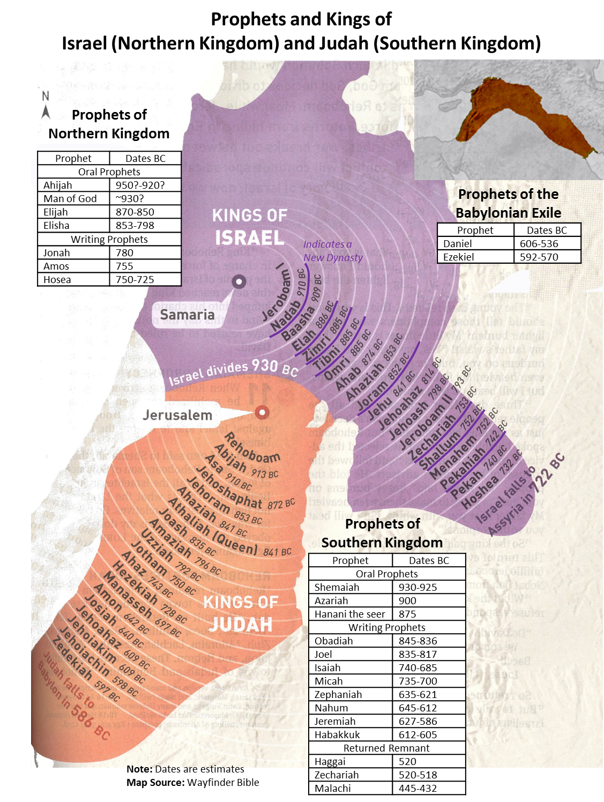

Slide 9
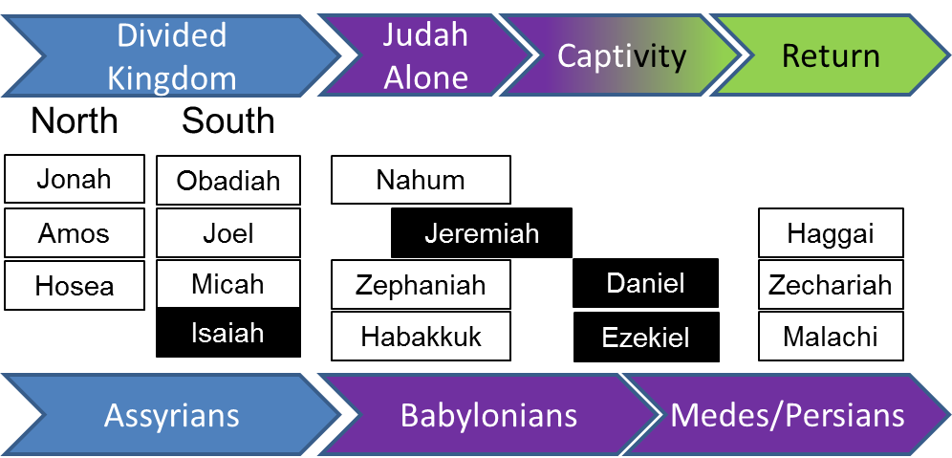

Slide 11
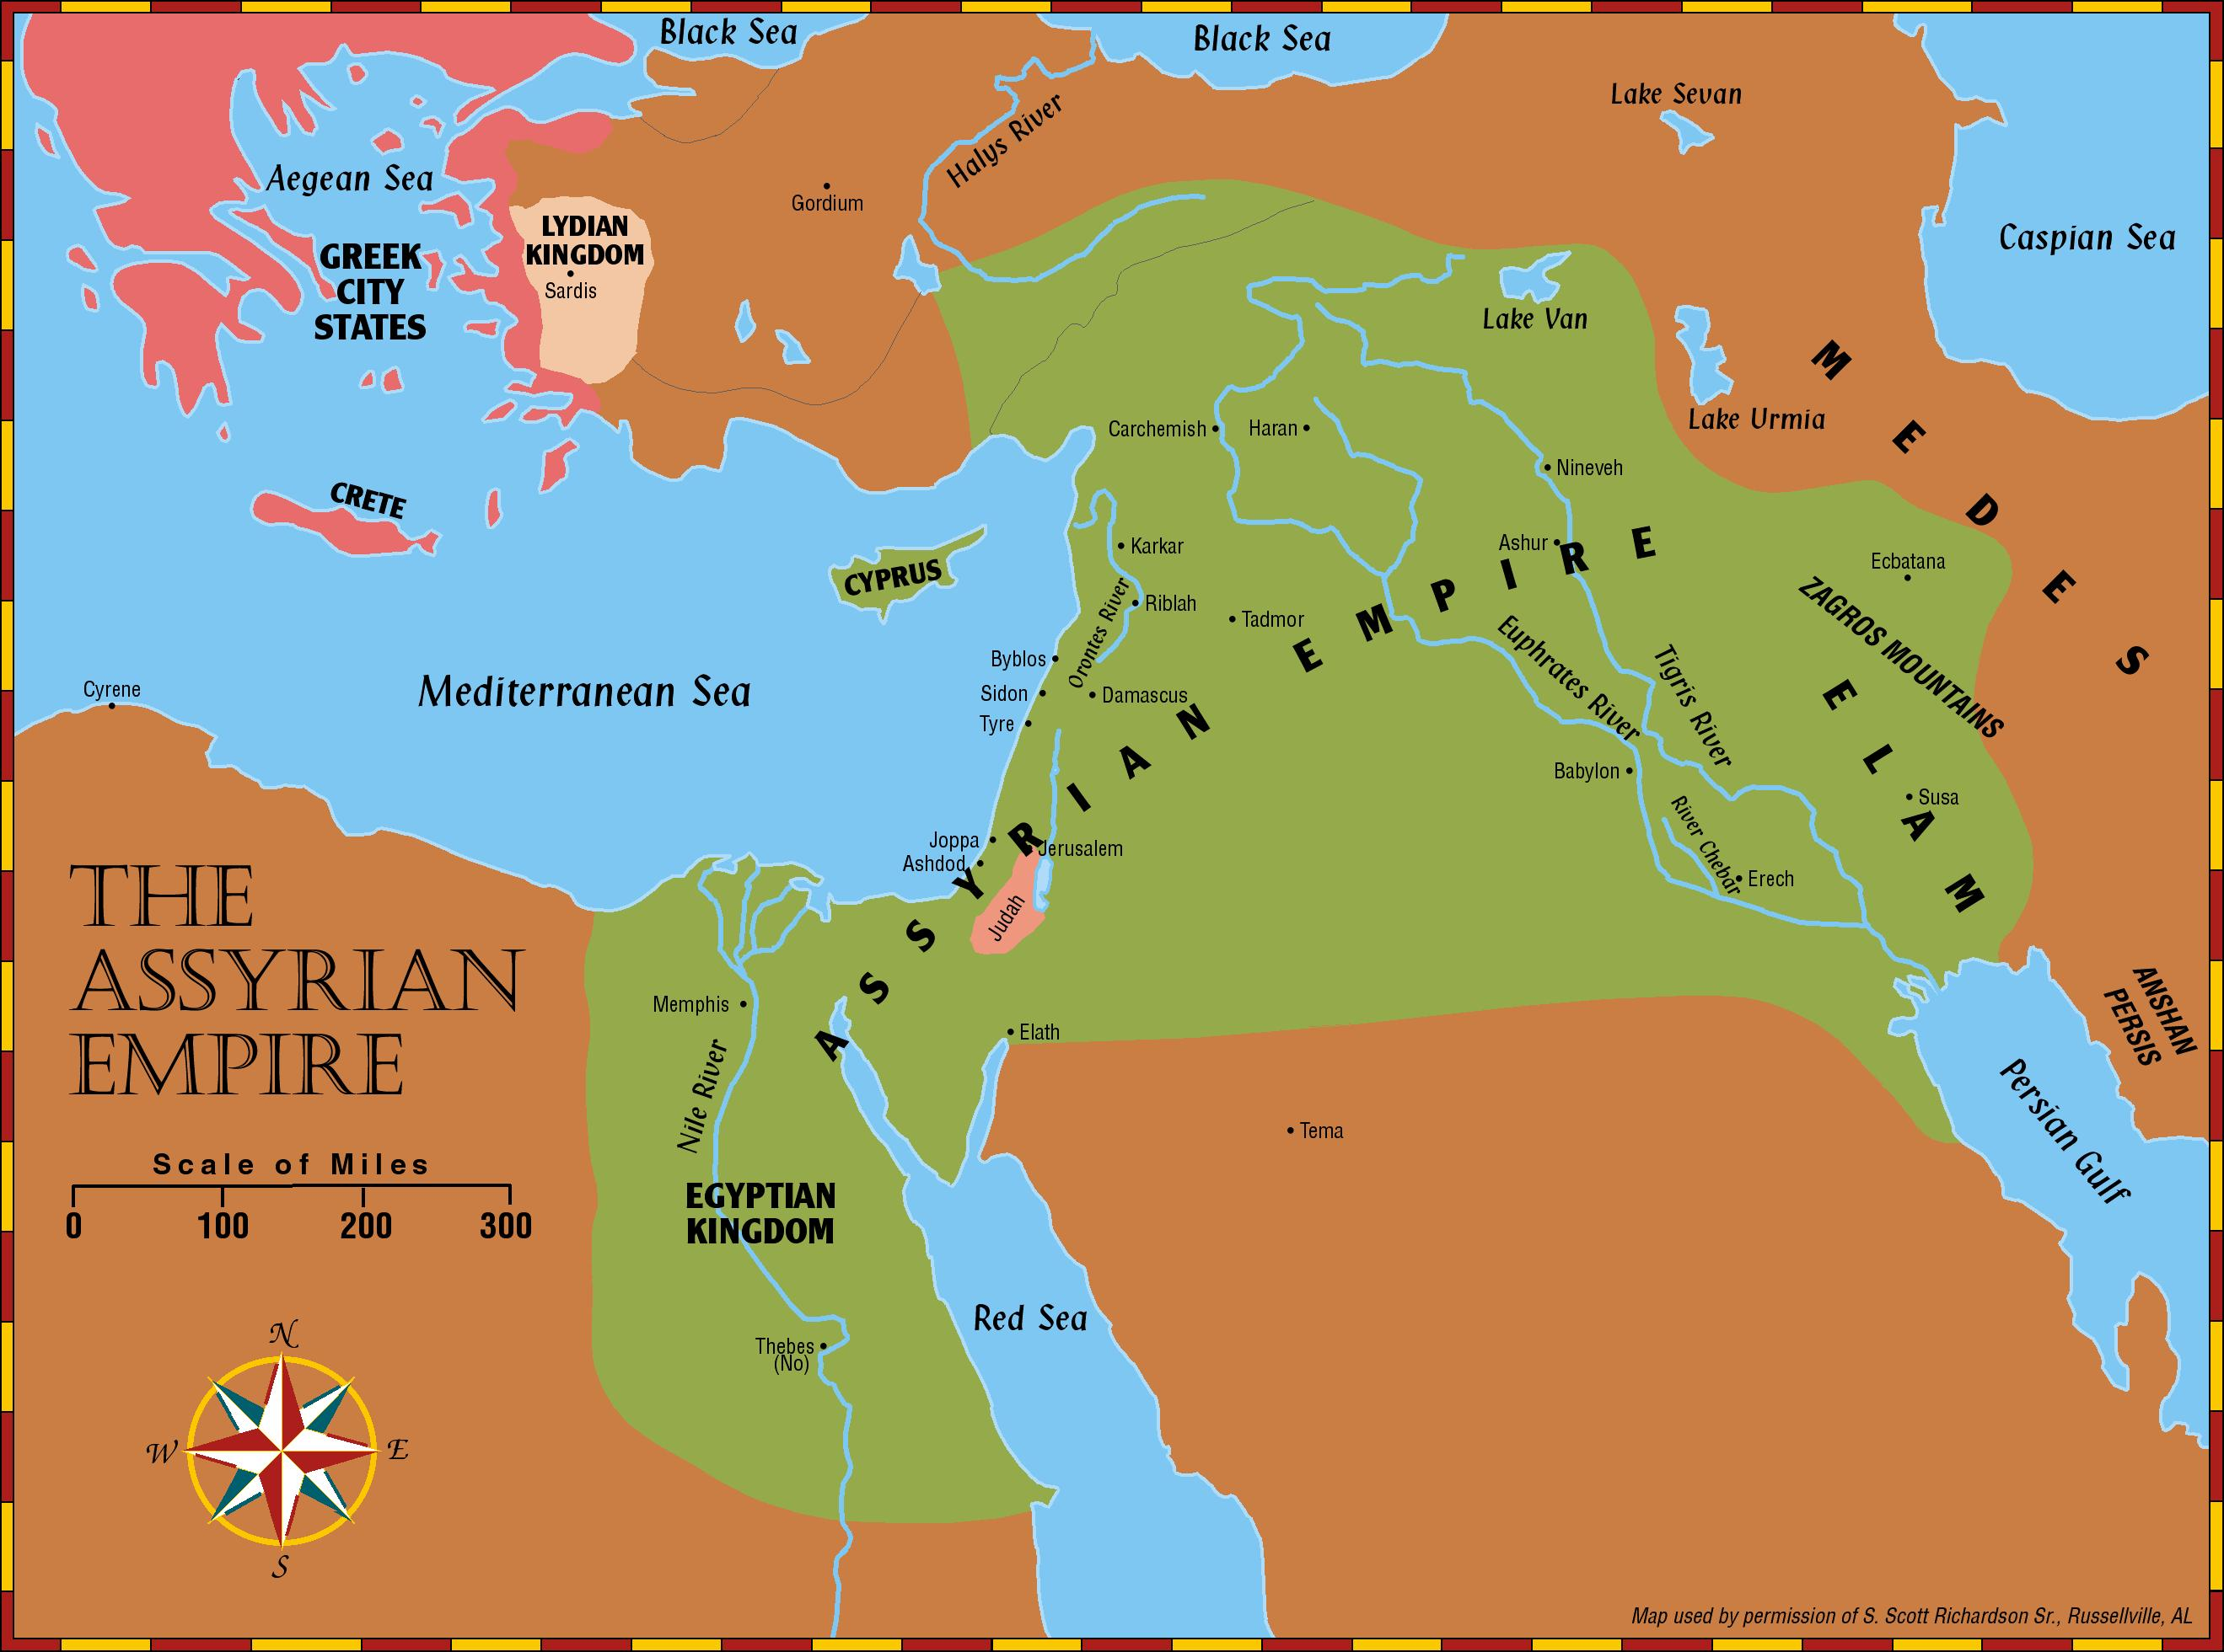
Prophets of the Assyrian Period
Obadiah (~845 BC)
Joel (~830)
Jonah (~780)
Amos (~755)
Hosea (750-725)
Isaiah (740-690)
Micah (735-700)

Slide 12
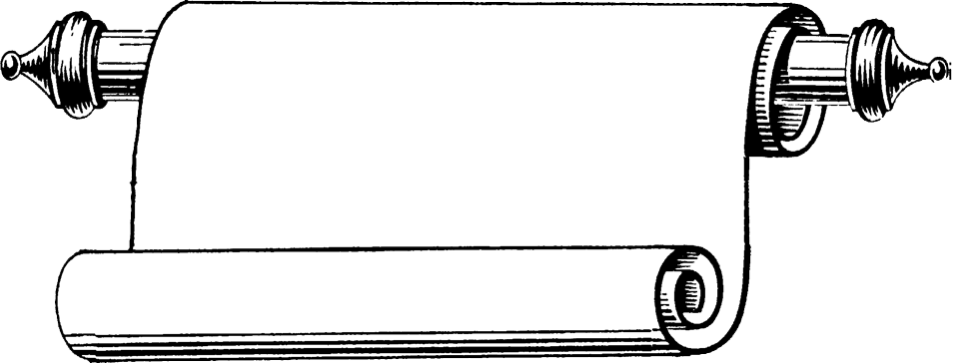
Edomites invaded Judah just as Judah was being ransacked - prophesies Edom's downfall
The
Judges
OBADIAH
845 Edom
JOEL
Judah see severe locust plague as a coming
Day of the LORD
830
Told to preach in Nineveh resulted in his being swallowed by a fish & city repenting
Kings & Prophets
JONAH
780 Nineveh
Israel, repent of injustice and idolatry or else go into exile
AMOS
Divided Kingdom
Israel & Judah
755
HOSEA
His life with adulterous wife like God & Israel
750-725
MICAH
Judah, repent of injustice and idolatry or else go into exile
735-700
ISAIAH
Isaiah 1-6 Reason for God’s Actions &
Isaiah’s Call
Isaiah 7-35 Immediate threat & Judgments
Isaiah 36-39 Historical account of siege
Isaiah 40-66 Cyrus, Future Threats & Hopes
740-690

Slide 13
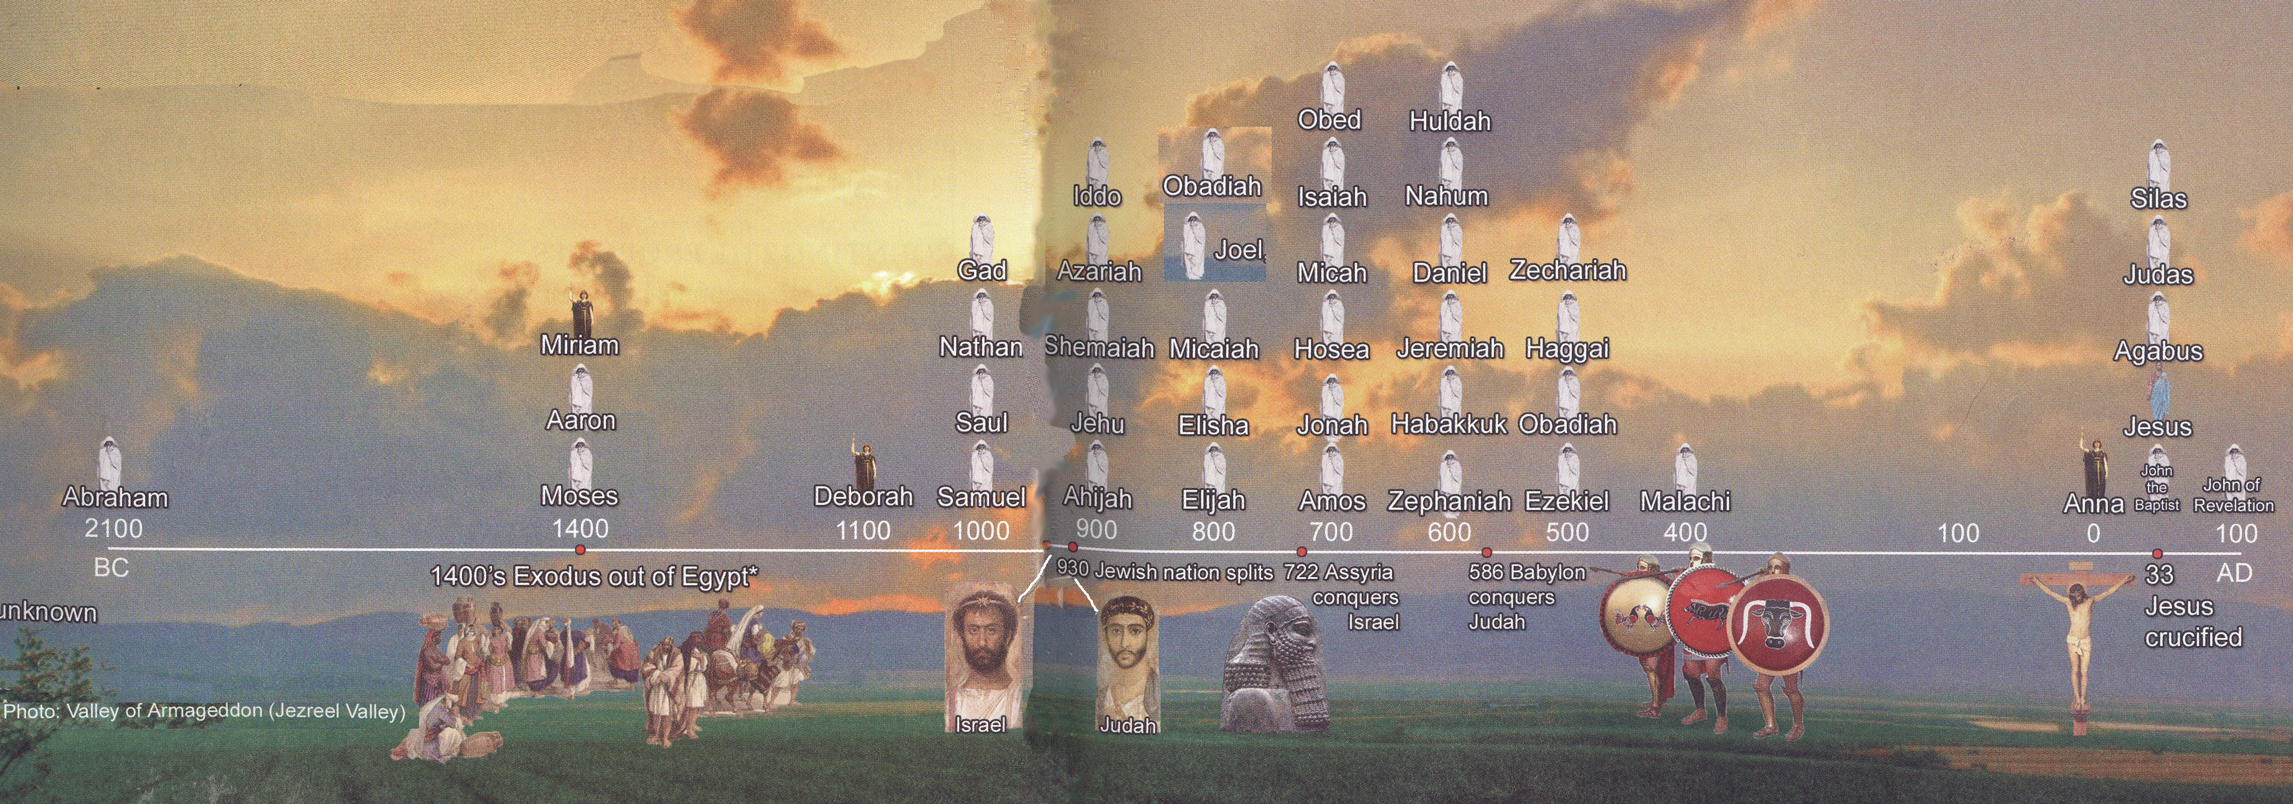
Prophets Time Line
Zachariah & Ezra

Slide 14
Prophetic Waves
Assyrian Threat
Syrian Threat
Babylonian Threat
Romans
Moses
Exodus
Persian
Written
Israel Falls
Abraham
Judah Falls
Judges
Kingdom Divides
Manasseh
Captivity
& Return
United Kingdom
Oral
Greeks
2100
1400
1100
1000
900
800
700
600
500
400
100
0
~30
100
609
597
586
538
458
444
722
Christ
Exile
Return

Slide 15
Kings & Prophets
NAHUM
Divided Kingdom
Judah Alone
& Fall of Judah
The prophet predicts the fall of Nineveh
630-612 Nineveh
ZEPHANIAH
Prophet emphasizes the need for the people of Judah to turn away from idolatry
630-625
HABAKKUK
"Why do the wicked and cruel Babylonians go unpunished?" Prophet finds his answer in God's goodness and wisdom
612-606
Jer 1-20 Sermons & prophecies during Josiah
Jer 21-39 Prophecies of Specific Events
Jer 40-45 Sermons after fall of Israel
Jer 46-51 God’s Judgment on Foreign Nations
Jer 52 Fall of Jerusalem
JEREMIAH
627-586
LAMENTATIONS
Jeremiah cries from the depths of his heart over the destruction of Jerusalem
586

Slide 16
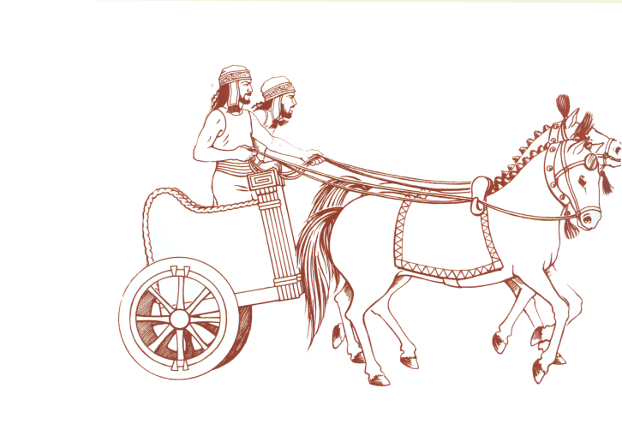
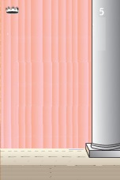
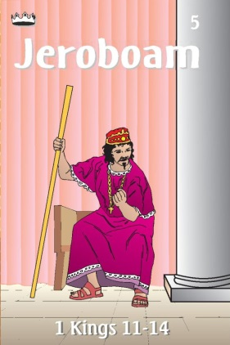
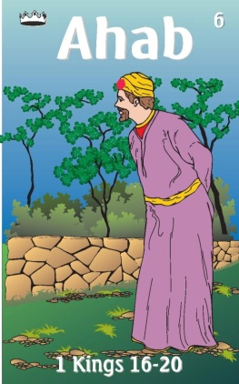
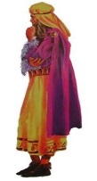
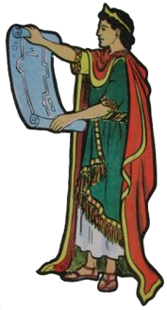
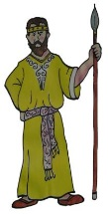
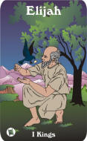
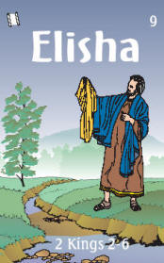
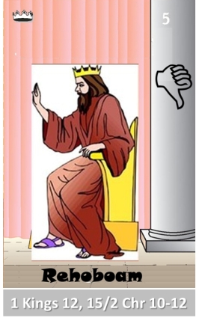
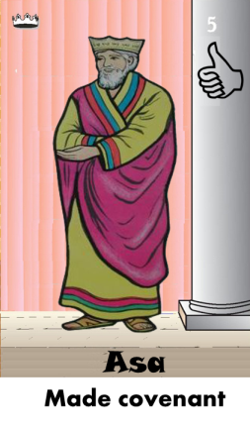
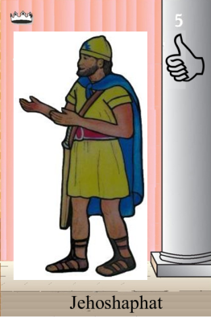
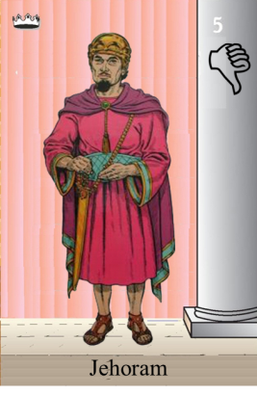
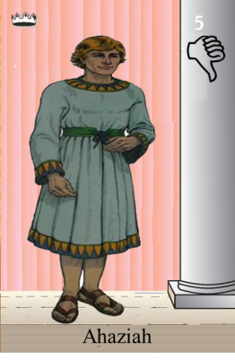
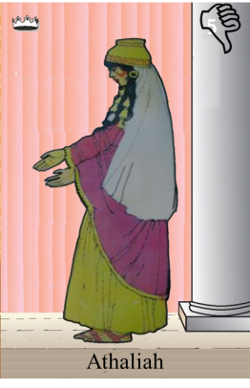
Ahaziah
Jehoram
Killed by Jehu
Baasha
Jehu
Ahijah
Man of God
Rocks for
Mizpah & Geba
Early Kings
Omri Kings
Jehu Kings
Brings in Syria
Obadiah - 830
Killed by Jehu
Shemaiah
Azariah
Hanani the Seer

Slide 17
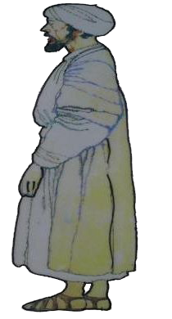
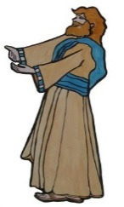
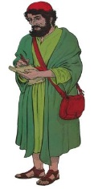
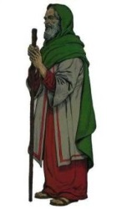
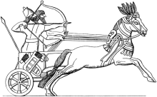
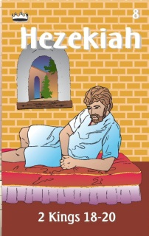
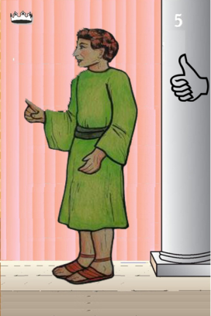
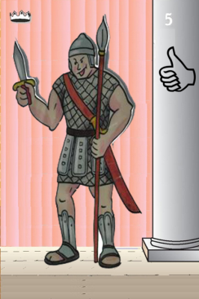
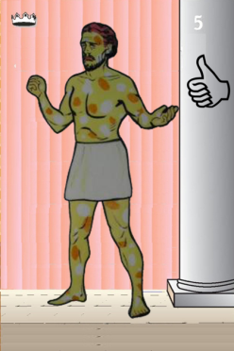
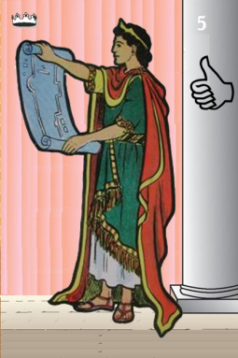
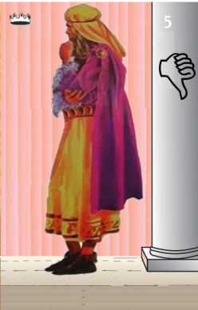
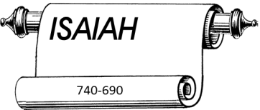
Jehu
841-814
Jehoahaz
Jehoash
Elisha &
the Arrows
Jeroboam II
Zechariah
Tiglath-pileser III
(745–727 b.c.)
793-753
Jehu Kings
Confusing
Brings in Assyria
Joash
Amaziah
Uzziah
Jotham
Ahaz
Jehoiada Made covenant

Slide 18
Confusing
Judah Alone
Tiglath-pileser III
(745–727 b.c.)
Shallum 752
Menahem 752-742
Pekahiah 742-740
Pekah(752) 740-732
Hoshea 732-722
Uzziah
Jotham
Ahaz

Slide 19
Ahaz
Ahaz was an evil man who participated in the most monstrous of idolatrous practices.
2 Kings 16 2 Chronicles 28
2 – Did not do what was right in eyes of Lord 1 – Did not do what was right in eyes of Lord
3 - Walked in ways of Kings of Israel 2- Walked in ways of Kings of Israel
3 - burned his son as an offering 2 – Made metal images of Baal
4-scarificed –high places, hills,
under every tree 3 made offering in Valley of Hinnom
3 burned his son as an offering
10-13 – Made altar like one in Damascus 4-scarificed –high places, hills,
under every tree
23 sacrificed to gods of Damascus
24 shut up doors of house of the Lord
24 made altars in every corner of Jerusalem
25 in every city of Judah he made high places
Isaiah gave counsel to Ahaz during the Syro-Ephraimitic crisis (Isaiah 7), when Rezin, king of Syria, and Pekah, king of Israel, joined forces to attack Jerusalem. Ahaz refused the prophet’s advice and appealed for help to Tiglath-pileser III of Assyria. That appeal and the resulting entanglement had unfortunate results religiously and politically in that Ahaz surrendered to Assyrian domination. The prophet Oded rescued some captives from Israel (2 Chron. 28).

Slide 20
Seeking Help
Asa ask Syria for Help 2
2 Chr 16:2
Ahaz ask Assyria to help 2 Chr 28:16

Slide 21
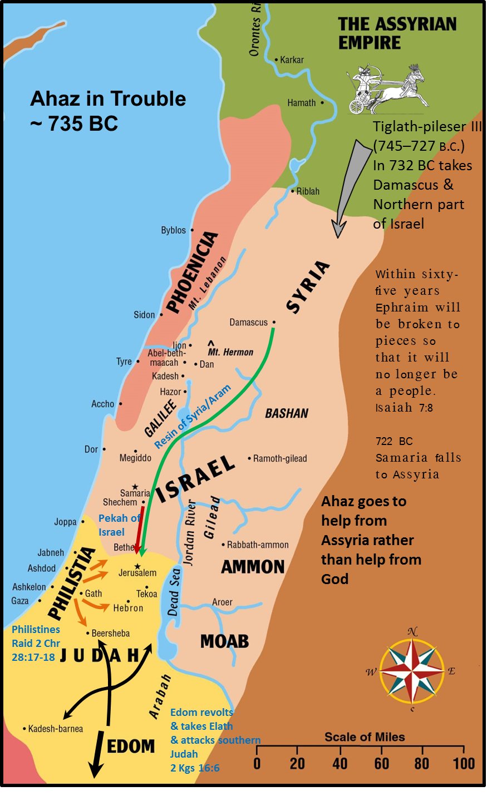
2 Chronicles 28:4-6(ESV) ⁴And he sacrificed and made offerings on the high places and on the hills and under every green tree. ⁵Therefore the Lord his God gave him into the hand of the king of Syria, who defeated him and took captive a great number of his people and brought them to Damascus. He was also given into the hand of the king of Israel, who struck him with great force. ⁶For Pekah the son of Remaliah killed 120,000 from Judah in one day, all of them men of valor, because they had forsaken the Lord, the God of their fathers.
2 Chronicles 28:19-20(ESV) ¹⁹For the Lord humbled Judah because of Ahaz king of Israel, for he had made Judah act sinfully and had been very unfaithful to the Lord. ²⁰So Tiglath-pileser king of Assyria came against him and afflicted him instead of strengthening him.

Slide 22
Outline of Micah
Judgment 1:1-3:12
Judgment on People (1:1-2:13)
Judgment on Leaders (3:1-3:12)
Promises of Restoration 4:1-5:15
Promise of Coming Kingdom (4:1-4:5)
Promise of Coming Captivity (4:6-5:1)
Promise of Coming King (5:2-5:15)
Plea for Repentance 6:1-7:20
First Plea of God (6:1-6:9)
Second Plea of God (6:10-7:6)
Promise of Final Salvation (7:7-7:20)

Slide 23
Micah 1:3 - 4 (NKJV)
³ For behold, the Lord is coming out of His place;
He will come down
And tread on the high places of the earth.
⁴ The mountains will melt under Him,
And the valleys will split
Like wax before the fire,
Like waters poured down a steep place.
Judgment on People (1:1-2:13)

Slide 24
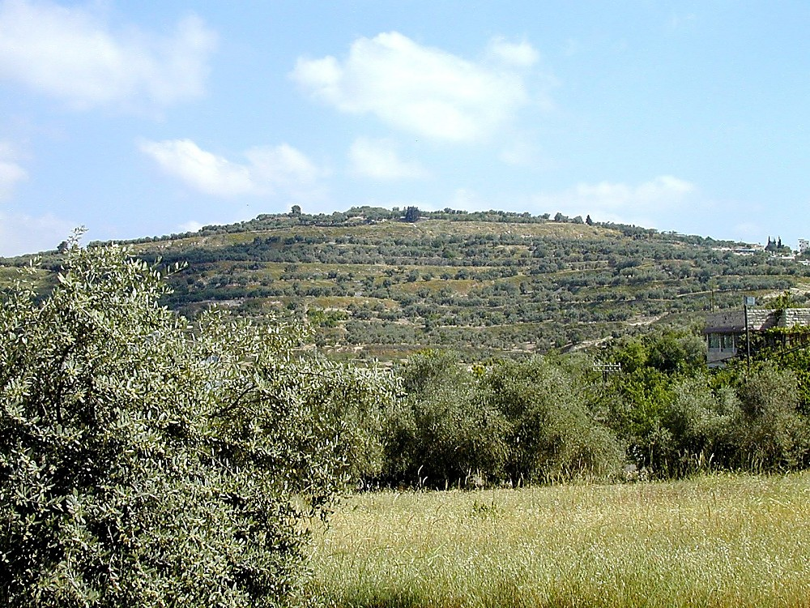
Tell Samaria from south
Micah 1:6 (NKJV)
⁶ “Therefore I will make Samaria a heap of ruins in the field,
Places for planting a vineyard;
I will pour down her stones into the valley,
And I will uncover her foundations.
Tell Samaria from south
Judgment on People (1:1-2:13)
Notes:
Samaria: Introduction
The site may have been as large as 150 acres (as large as Hezekiah’s Jerusalem). At 100 people per acre, the population would equal 15,000.
The importance of the site diminished with non-westward-looking rulers. “For as long as there ruled in the land a power with no interests towards the coast and sea, Samaria was forced to yield again to central Shechem the supremacy which Ahab and Herod, with their western obligations, had taken from Shechem to give her” (G. A. Smith 1931: 229).
Isaiah 28:1 (NIV) “Woe to that wreath, the pride of Ephraim’s drunkards, to the fading flower, his glorious beauty, set on the head of a fertile valley–to that city, the pride of those laid low by wine!”
Geographical Situation
Samaria was in the tribal territory of the sons of Joseph (Josh 16-17).
It was in a good position for defense, as illustrated by history. The summit sits 300 ft above the valleys below.
It withstood lengthy sieges:
By the Syrians (2 Kings 6).
By the Assyrians–it withstood a 3 year Assyrian siege before capture (2 Ki 17:5).
By the Hasmoneans–it resisted Hasmonean capture for one year.
“‘It must before the invention of gun-powder have been almost impregnable’ (Conder). The sieges of Samaria were always prolonged” (G. A. Smith 1931: 228).
It was centrally located on the Trans-Samaria highway, looking towards the west. Samaria was the capital of the northern kingdom from the time of Omri (880 B.C.) to the final conquest of the nation (722 B.C.). In this period of time, the two powerful dynasties of Omri and Jehu dominated the city and country, followed only by a quick succession of weak and short-lived rulers.
Mountains surround and overlook Samaria on three sides, but Samaria has a view to the west. Thus the city faced toward Phoenicia, with easy access by a gentle valley to the coastal plain or through Dothan Valley to Jezreel Valley. It was 23 mi from the coast.
Omri made a treaty with the king of Tyre, marrying his son Ahab to Jezebel.
A temple was built to Baal in Samaria.
Omri recognized that he needed this link to Tyre. It gave him a good market for selling his grain, gave him a link to sea, and further facilitated the international relations which prospered his kingdom economically.
“Forts and isolated defensive towers protected important strategic points and roads in the kingdom. About a dozen fortresses, discovered in a survey of the vicinity of Samaria, created a defensive belt around the capital and protected all its access roads” (Mazar 1990: 416).

Slide 25
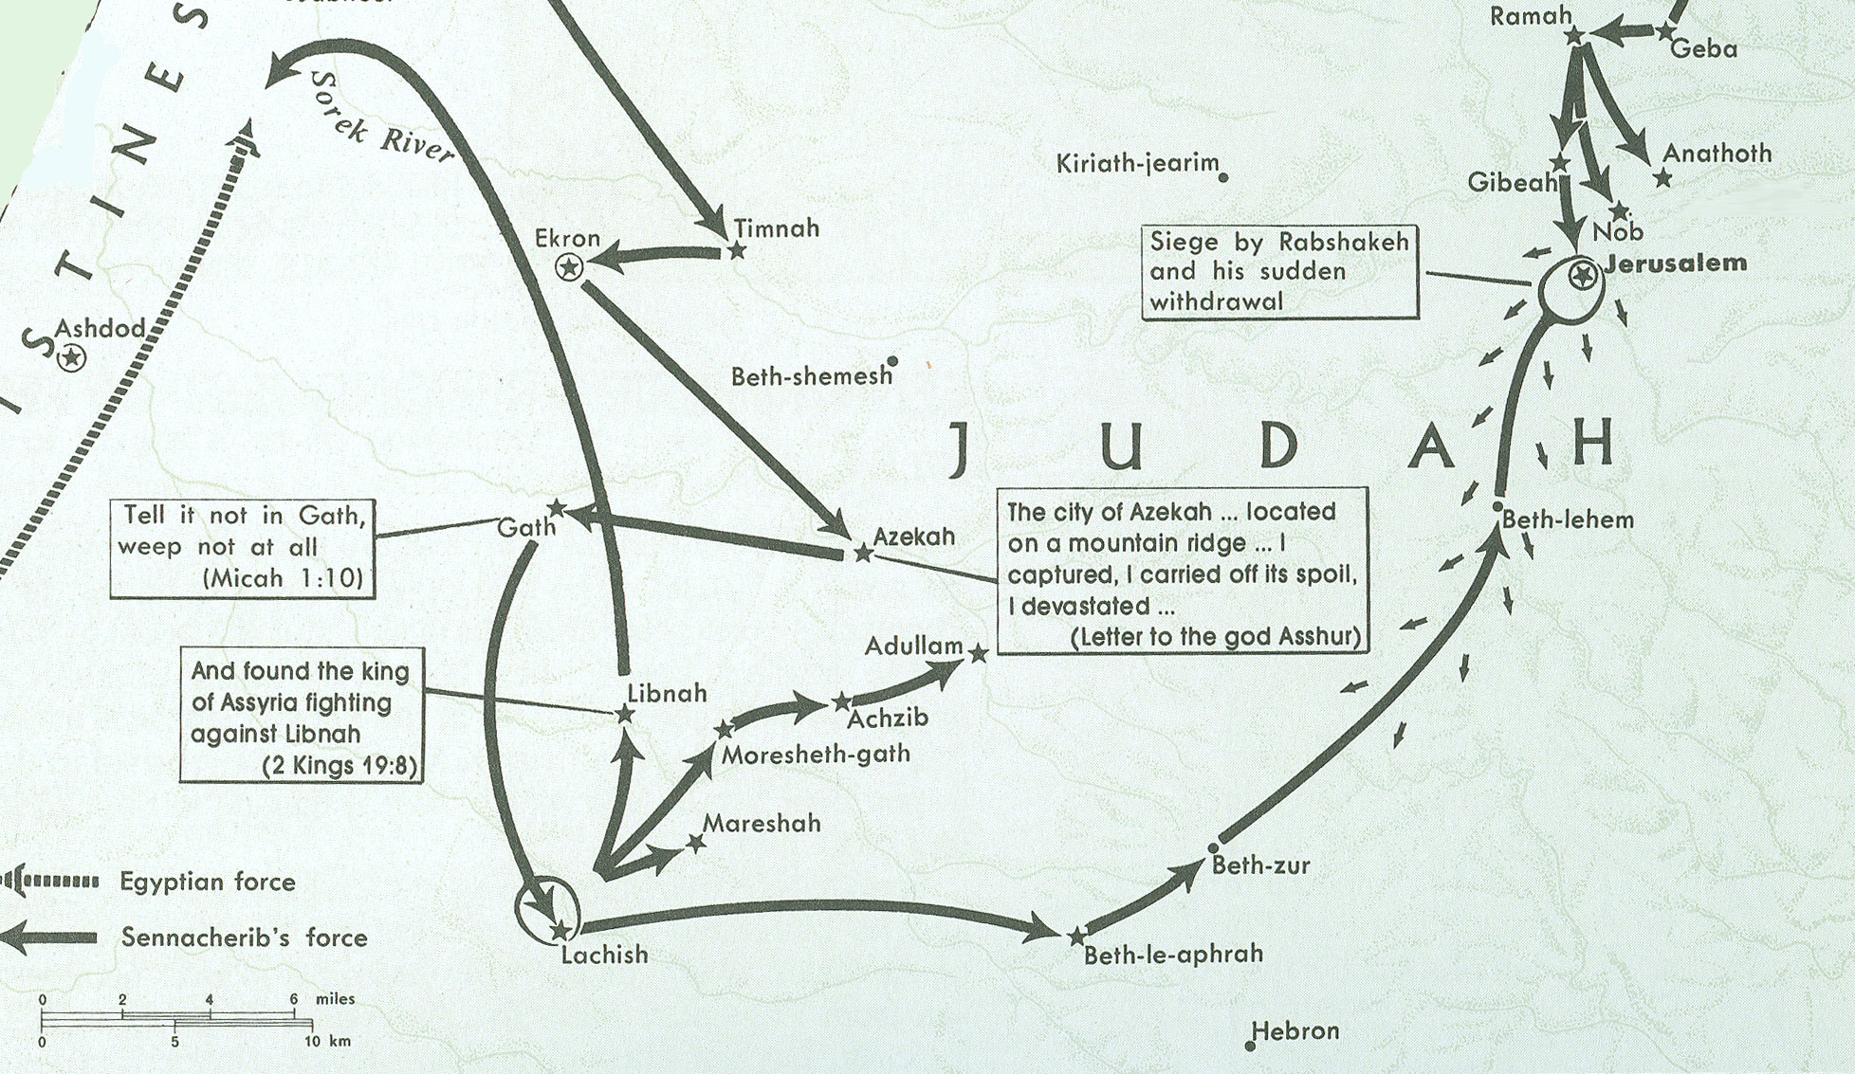
Sennacherib in Philistia & Judah 701 BC
Beth-le-aphrah/ophrah
Micah’s
hometown

Slide 26
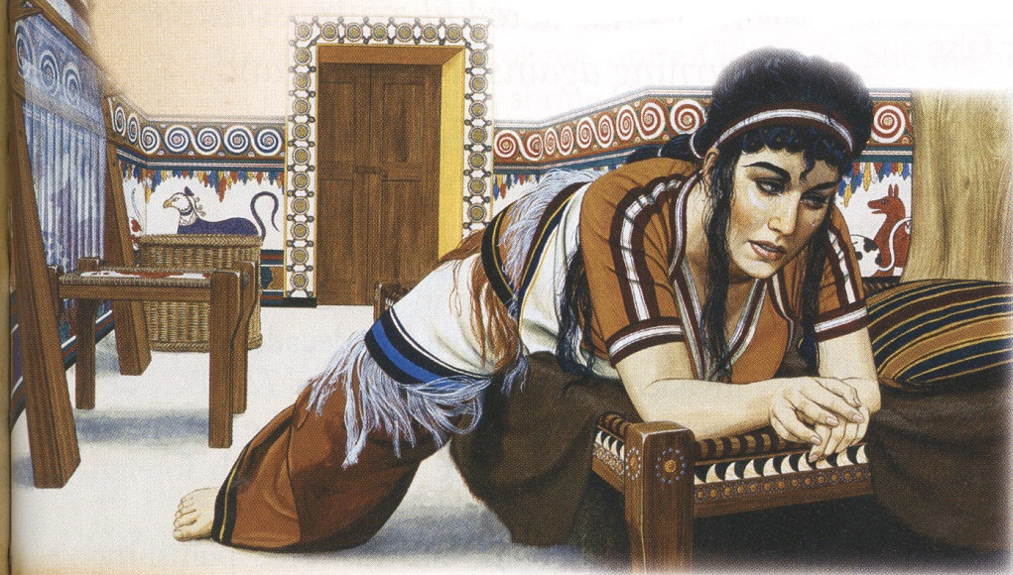
Beds of Ivory
Micah 2
¹ Woe to those who devise iniquity,
And work out evil on their beds!
At morning light they practice it,
Because it is in the power of their hand.
² They covet fields and take them by violence,
Also houses, and seize them.
So they oppress a man and his house,
A man and his inheritance.
Amos 6:3-7(NKJV) ³ Woe to you who put far off the day of doom, Who cause the seat of violence to come near; ⁴ Who lie on beds of ivory, Stretch out on your couches, Eat lambs from the flock And calves from the midst of the stall; ⁵ Who sing idly to the sound of stringed instruments, And invent for yourselves musical instruments like David; ⁶ Who drink wine from bowls, And anoint yourselves with the best ointments, But are not grieved for the affliction of Joseph. ⁷ Therefore they shall now go captive as the first of the captives, And those who recline at banquets shall be removed.
Judgment on People (1:1-2:13)

Slide 27
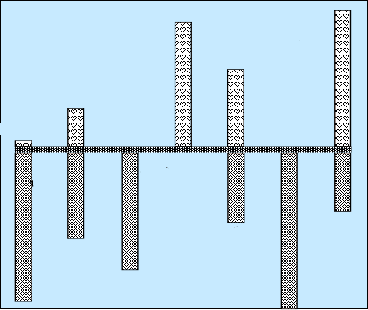
Hear Micah
Sermon 5
Woe is me
Sermon 3
He has Laid
Siege
4:1-13
God will hear me
Mentions
Samaria
& Jerusalem
Words of Comfort & Hope
2:12-13
Sermon 4
Hear now
7:7-20
5:2-9
1:1
Hear All you People
Hear Now
He will not hear
Now hear this
5:1, 10-15
7:1-6
2:1-11
3:1-12
6:1-16
1:2-16
Nations not heard
Words of Warning/Judgment
Focus on
Jerusalem
Hear Now
Hear Lord’s complaint
Hear the rod
Sermon 1
Hear All
You Peoples
Sermon 2
Hear now

Slide 28
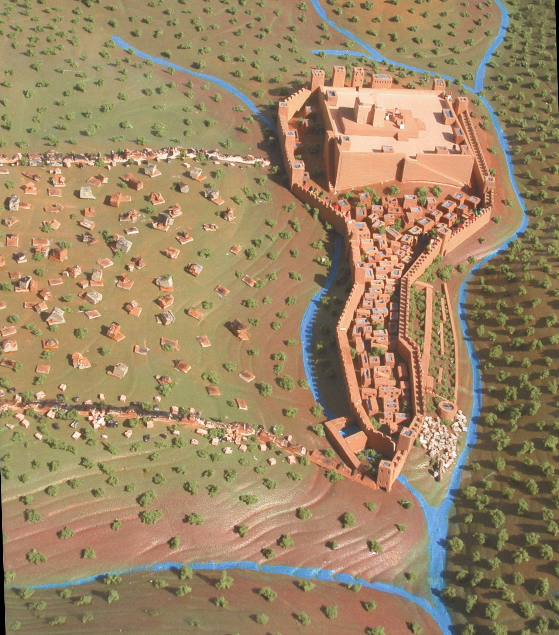
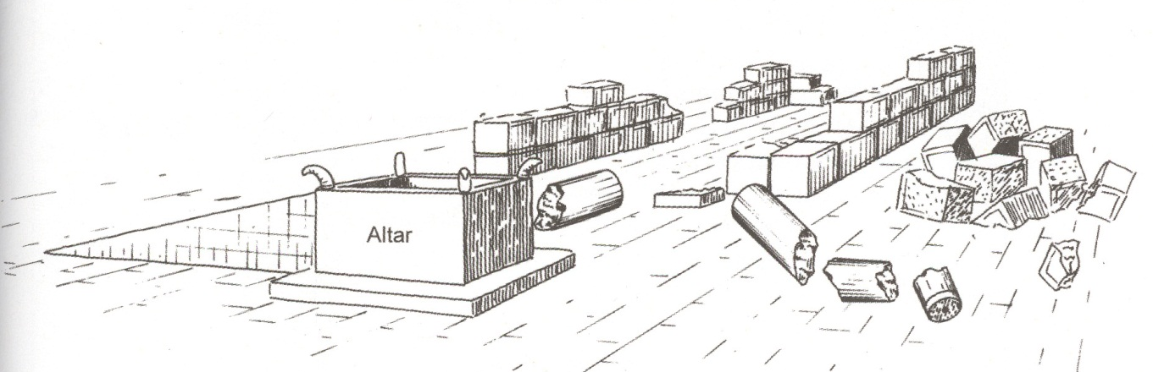
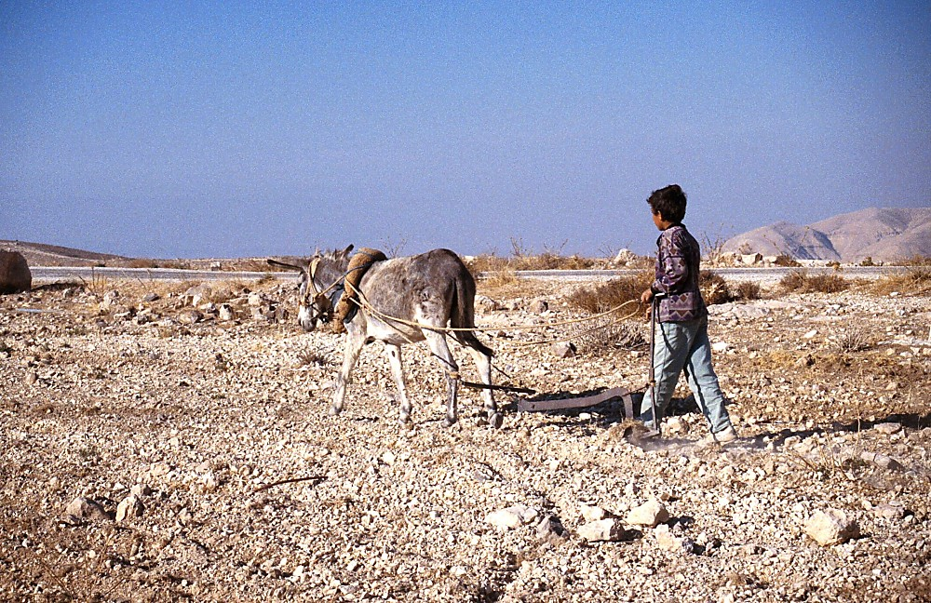
Micah 3:9-11
⁹ Now hear this,
…rulers of the house of Israel,
…judge for a bribe,
….priests teach for pay,
…prophets divine for money.
Yet they lean on the Lord, and say,
“Is not the Lord among us?
No harm can come upon us.”
¹² Therefore because of you
Zion shall be plowed like a field,
Jerusalem shall become heaps of ruins,
And the mountain of the temple
Like the bare hills of the forest.

Slide 29
Sennacherib in Philistia & Judah 701 BC
Micah 5
¹ Now gather yourself in troops,
O daughter of troops;
He has laid siege against us;
They will strike the judge of Israel with a rod on the cheek.
² “But you, Bethlehem Ephrathah,
Though you are little among the thousands of Judah,
Yet out of you shall come forth to Me
The One to be Ruler in Israel,
Whose goings forth are from of old,
From everlasting.”
Beth-le-aphrah/ophrah

Slide 30
Who is speaking in verses 6:1 thru 5?
¹Hear now what the Lord says:
“Arise, plead your case before the mountains,
And let the hills hear your voice.
² Hear, O you mountains, the Lord’S complaint,
And you strong foundations of the earth;
For the Lord has a complaint against His people,
And He will contend with Israel.
³ “O My people, what have I done to you?
And how have I wearied you?
Testify against Me.
⁴ For I brought you up from the land of Egypt,
I redeemed you from the house of bondage;
And I sent before you Moses, Aaron, and Miriam.
⁵ O My people, remember now
What Balak king of Moab counseled,
And what Balaam the son of Beor answered him,
From Acacia Grove to Gilgal,
That you may know the righteousness of the Lord.”
God is Lord Of History
Election of Israel
Rebellion of Israel
Election of Israel
God is Lord Of History
Judgment of God

Slide 31
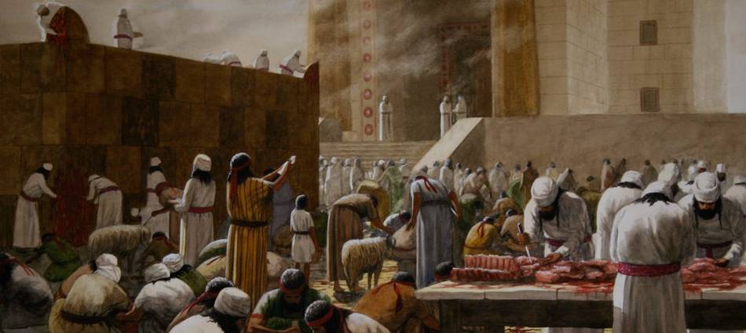
Who is His Audience 6:6 thru 7?
6 With what shall I come before the Lord,
And bow myself before the High God?
Shall I come before Him with burnt offerings,
With calves a year old?
7 Will the Lord be pleased with thousands of rams,
Ten thousand rivers of oil?
Shall I give my firstborn for my transgression,
The fruit of my body for the sin of my soul?
8 He has shown you, O man, what is good;
And what does the Lord require of you
But to do justly,
To love mercy,
And to walk humbly with your God?

Slide 32
What is their question to the Lord?
6 With what shall I come before the Lord,
And bow myself before the High God?
Shall I come before Him with burnt offerings,
With calves a year old?
7 Will the Lord be pleased with thousands of rams,
Ten thousand rivers of oil?
Shall I give my firstborn for my transgression,
The fruit of my body for the sin of my soul?
8 He has shown you, O man, what is good;
And what does the Lord require of you
But to do justly,
To love mercy,
And to walk humbly with your God?

Slide 33
What is their understanding of the Lord?
6 With what shall I come before the Lord,
And bow myself before the High God?
Shall I come before Him with burnt offerings,
With calves a year old?
7 Will the Lord be pleased with thousands of rams,
Ten thousand rivers of oil?
Shall I give my firstborn for my transgression,
The fruit of my body for the sin of my soul?
8 He has shown you, O man, what is good;
And what does the Lord require of you
But to do justly,
To love mercy,
And to walk humbly with your God?

Slide 34
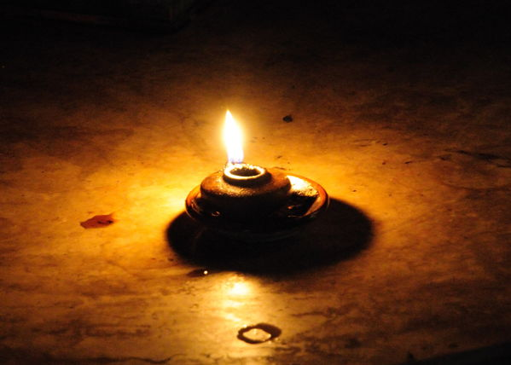
What is the attitude of the God-fearing individual as expressed in verses 7 to 8?
Micah 7
⁷ Therefore I will look to the Lord;
I will wait for the God of my salvation;
My God will hear me.
⁸ Do not rejoice over me, my enemy;
When I fall, I will arise;
When I sit in darkness,
The Lord will be a light to me.

Slide 35
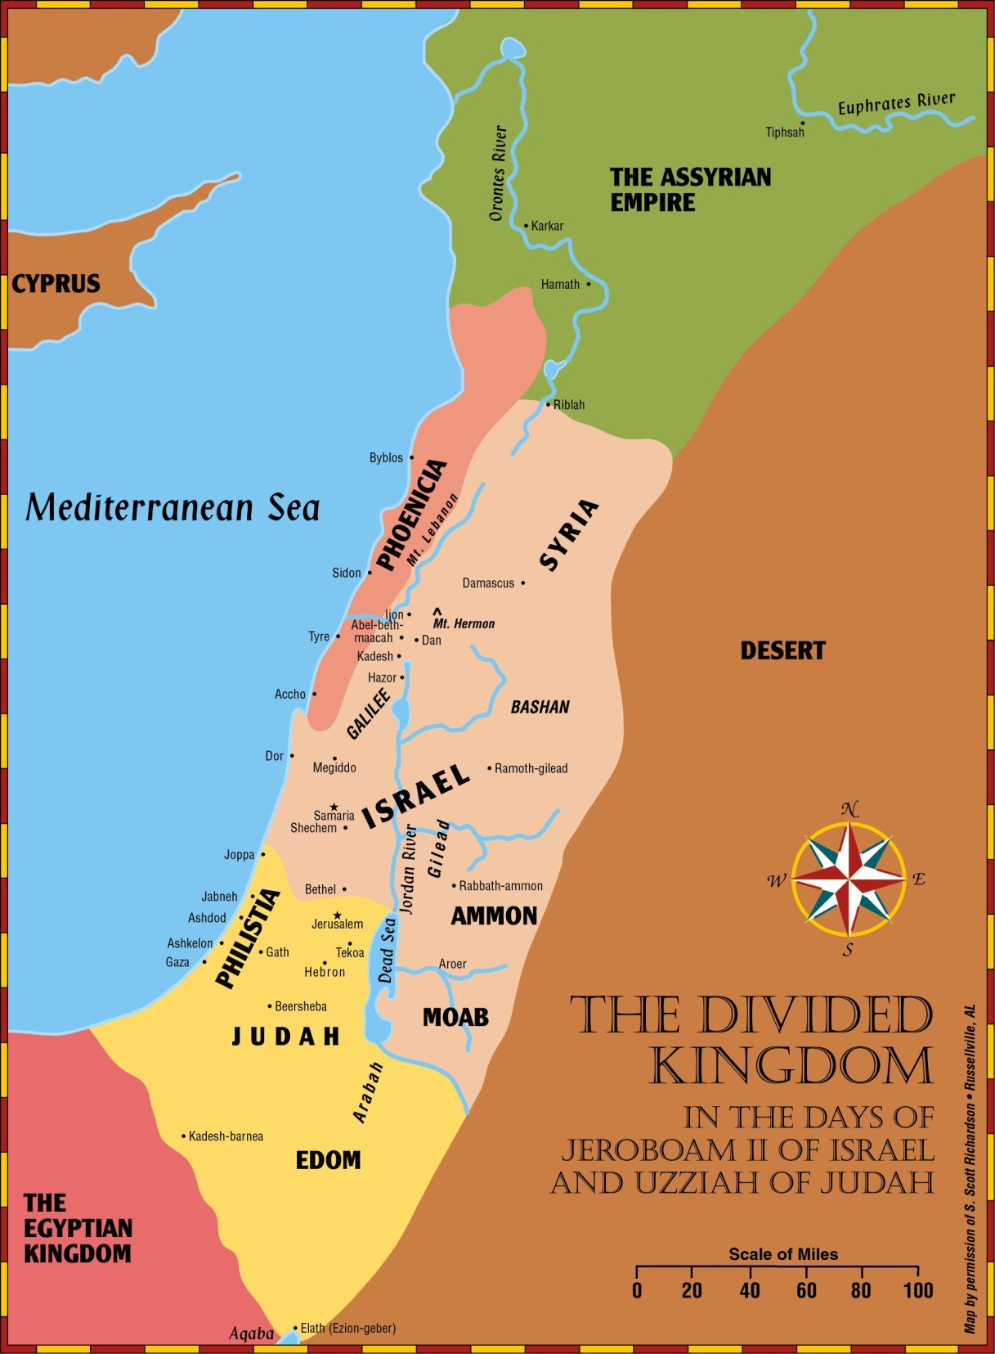
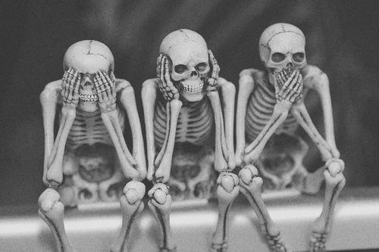
How will the other nations react to that as stated in verses 16 to 17?
Micah 7
¹⁶ The nations shall see and be ashamed of all their might;
They shall put their hand over their mouth;
Their ears shall be deaf.
¹⁷ They shall lick the dust like a serpent;
They shall crawl from their holes like snakes of the earth.
They shall be afraid of the Lord our God,
And shall fear because of You.

Slide 36
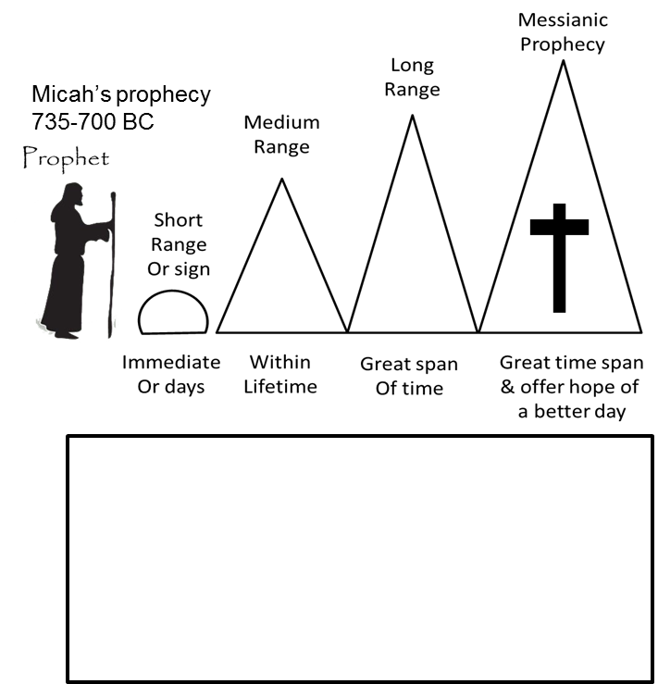
Place the following prophecies
under the correct prophecy range
1:6-7 Fall of Samaria in 722 BC
1:9-16 Invasion of Judah by Sennacherib (701 BC)
3:12,7:13 Fall of Jerusalem (586 BC)
4:10 Exile in Babylon (586 BC)
4:10 Return fr captivity (~516 BC)
5:2 Birth of Jesus (~4 BC)
4:1-5 Kingdom of God

Slide 37
List Your Favorite Verse/s

Slide 38
Life of Hezekiah; Bible Conflict? 728 or 725 BC?
2 Kings 18:13(ESV) In the fourteenth year of King Hezekiah, Sennacherib king of Assyria came up against all the fortified cities of Judah and took them.
2 Kings 18:10(ESV) and at the end of three years he took it. In the sixth year of Hezekiah, which was the ninth year of Hoshea king of Israel, Samaria was taken.
Sargon attacks Judah
728
722
720
714/13
711/709
701
Sargon attacks Judah
~699/697
25 yrs old
4th yr- Samaria
Under Siege
Sennacherib
attacks
6th yr- Samaria
Taken by Shalmaneser
Sargon II
(722–705 b.c.)
Manasseh born
12 yrs old
Philistines
fall
3rd yr
Hoshea
Sick life extended 15 yrs
2 Kings 18:13(ESV) In the fourteenth year (life extended) of King Hezekiah, Sennacherib king of Assyria came up against all the fortified cities of Judah and took them.
2 Kings 18:1-2(ESV) ¹In the third year of Hoshea son of Elah, king of Israel, Hezekiah the son of Ahaz, king of Judah, began to reign. ²He was twenty-five years old when he began to reign, and he reigned twenty-nine years in Jerusalem. His mother’s name was Abi the daughter of Zechariah.

