Slide 1
Lesson 13:27-28

Slide 2
Paul’s eyewitness testimony and preaching is dismissed in Acts 22 and 26.
Why did they reject him?
How are his writings still dismissed today?
Are the reasons for rejecting him today similar to the reasons given thousands of years ago?

Slide 3
Class Goals
To better understand the challenges, growth and practices of the New Testament church. Especially their worship, leadership, sharing, perseverance, and involvement in the Great Commission.
To equip one another to imitate the role models of the early church
First, to respond to the gospel with trust and loyalty towards God
Second, to tell others about Jesus in a loving and bold manner.
Third, to serve one another thoughtfully for edification.
Learn and imitate the teaching of the early Christian preachers, by evaluating the background and needs of the audience, and studying the content of the inspired preachers.

Slide 4
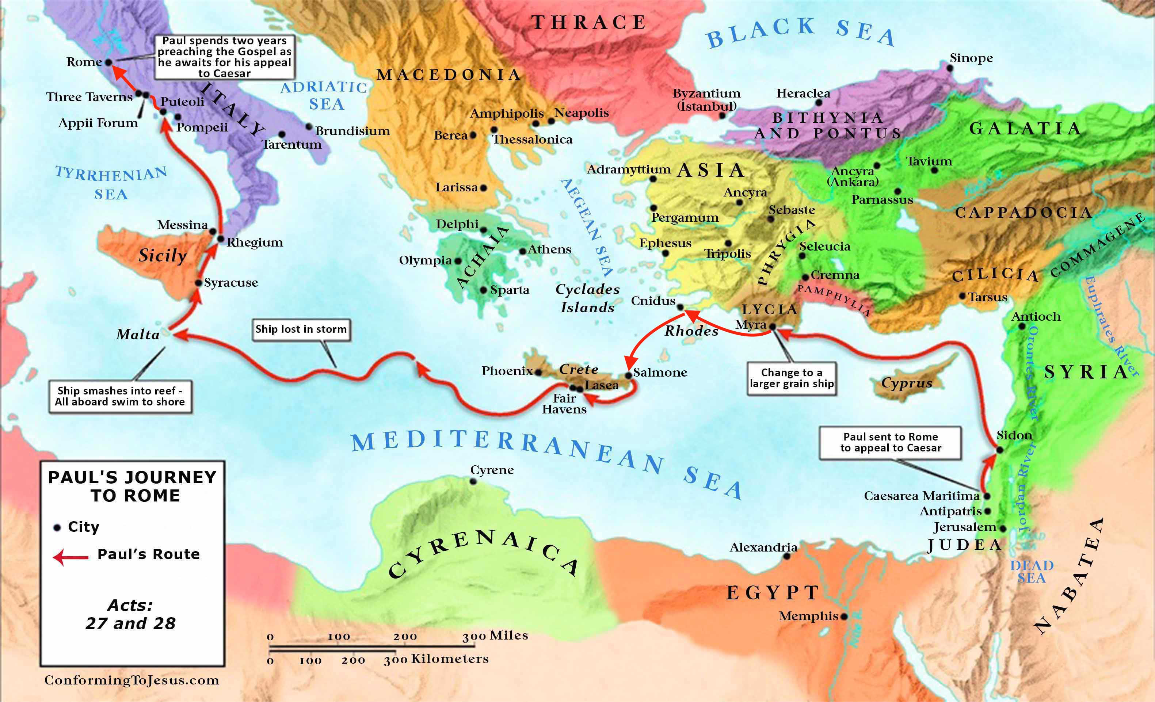

Slide 5
Acts 27 Outline
v. 20 “…all hope that we would be saved was finally given up.”
But Paul prayed!
And God protected!
27:1-8 Set sail; Change ships
27:9-12 Paul’s warning is ignored
27:13-20 Forced to throw cargo overboard
27:21-26 Paul encourages through God’s vision
27:27-32 Paul keeps men from leaving
27:33-38 Paul feeds the crew
27:39-44 Shipwrecked on Malta
Weary from fighting a storm for weeks, men had not eaten.
Paul, a prisoner, shows leadership
Paul saves by character:
Soldiers want to kill prisoners
All prisoners saved because Paul is saved.

Slide 6
Acts 28:17-31
¹⁷ And it came to pass after three days that Paul called the leaders of the Jews together. So when they had come together, he said to them: “Men and brethren, though I have done nothing against our people or the customs of our fathers, yet I was delivered as a prisoner from Jerusalem into the hands of the Romans, ¹⁸ who, when they had examined me, wanted to let me go, because there was no cause for putting me to death. ¹⁹ But when the Jews spoke against it, I was compelled to appeal to Caesar, not that I had anything of which to accuse my nation. ²⁰ For this reason therefore I have called for you, to see you and speak with you, because for the hope of Israel I am bound with this chain.” ²¹ Then they said to him, “We neither received letters from Judea concerning you, nor have any of the brethren who came reported or spoken any evil of you. ²² But we desire to hear from you what you think; for concerning this sect, we know that it is spoken against everywhere.”
Hope of Israel = Resurrection of Christ

Slide 7
Acts 28:17-31
Back in Acts 13 Paul spoke concerning Jesus from both the Law of Moses and the Prophets.
²³ So when they had appointed him a day, many came to him at his lodging, to whom he explained and solemnly testified of the kingdom of God, persuading them concerning Jesus from both the Law of Moses and the Prophets, from morning till evening. ²⁴ And some were persuaded by the things which were spoken, and some disbelieved.²⁵ So when they did not agree among themselves, they departed after Paul had said one word: “The Holy Spirit spoke rightly through Isaiah the prophet to our fathers, ²⁶ saying,
‘Go to this people and say: “Hearing you will hear, and shall not understand; And seeing you will see, and not perceive; ²⁷ For the hearts of this people have grown dull. Their ears are hard of hearing, And their eyes they have closed, Lest they should see with their eyes and hear with their ears, Lest they should understand with their hearts and turn, So that I should heal them.” ’
Isa. 6:9-10
Jesus Quotes as well in reference to parables
Mt. 13:14-15
Mk. 4:12-13
Back in Acts 13, Paul preached to Jews first, then to the Gentiles

Slide 8
Acts 28:17-31
²⁸ “Therefore let it be known to you that the salvation of God has been sent to the Gentiles, and they will hear it!” ²⁹ And when he had said these words, the Jews departed and had a great dispute among themselves.
³⁰ Then Paul dwelt two whole years in his own rented house, and received all who came to him, ³¹ preaching the kingdom of God and teaching the things which concern the Lord Jesus Christ with all confidence, no one forbidding him.
In Acts 26 King Agrippa says he would have let Paul go, but it is during this two years letters are written:
Philemon, Colossians, Ephesians, Philippians
Then in the years proceeding, more letters are written:
1 Timothy, Titus, 2 Timothy
Paul’s own protection was never his concern only if it meant continuing the gospel.

Slide 9
“Increased in Number Daily…”
Acts 2:41 Then those who gladly received his word were baptized; and that day about three thousand souls were added to them.”
Acts 4:4 However, many of those who heard the word believed; and the number of the men came to be about five thousand.
Acts 5:14 And believers were increasingly added to the Lord, multitudes of both men and women…
Acts 6:1, 7 Now in those days, when the number of the disciples was multiplying…⁷ Then the word of God spread, and the number of the disciples multiplied greatly in Jerusalem, and a great many of the priests were obedient to the faith.
Acts 8:6 And the multitudes with one accord heeded the things spoken by Philip…

Slide 10
“Increased in Number Daily…”
Acts 9:31 Then the churches throughout all Judea, Galilee, and Samaria had peace and were edified. And walking in the fear of the Lord and in the comfort of the Holy Spirit, they were multiplied.
Acts 11:21 And the hand of the Lord was with them, and a great number believed and turned to the Lord.
Acts 13:48 Now when the Gentiles heard this, they were glad and glorified the word of the Lord. And as many as had been appointed to eternal life believed.
Acts 16:5 So the churches were strengthened in the faith, and increased in number daily.
Acts 17:4, 12 And some of them were persuaded; and a great multitude of the devout Greeks, and not a few of the leading women, joined Paul and Silas…¹² Therefore many of them believed, and also not a few of the Greeks, prominent women as well as men.

Slide 11
“Increased in Number Daily…”
Acts 18:8 Then Crispus, the ruler of the synagogue, believed on the Lord with all his household. And many of the Corinthians, hearing, believed and were baptized.
Acts 19:18 And many who had believed came confessing and telling their deeds.
Acts 21:20 “You see, brother, how many myriads of Jews there are who have believed, and they are all zealous for the law…”
Acts 28:24 And some were persuaded by the things which were spoken…
Because of Luke’s letter to Theophilus and Paul’s letters we can consider ourselves a part of this number as well.

Slide 12
What is the most threatening problem concerning the church today?
Much of Answers 3 & 4 revolved around the youth

