Slide 1
Lesson 13
Messianic Prophecies

Slide 2
Kings of United & Divided Kingdom
United
Kingdom
Divided Kingdom
Judah Alone
Early Kings – Israel
Dynasty 1&2
Omri
Dynasty 3
Jehu
Dynasty 4
Confusing
Dynasties
Hezekiah
Hezekiah
(728-686)
Manasseh
Amon
1
Jereboam
Nadab
3
Omri
Ahab
(874-853)
Ahaziah
Jehoram
4
Jehu
(841-814)
Jehoahaz
Jehoash
Jereboam II
(793-753)
Zechariah
Shallum
Menahem
Pekaiah
Pekah
Hosea
(732-722)
5
Saul
(1050-1010)
David
(1010-970)
Solomon
(970-930)
2
Baasha
Elah
Josiah &
Sons
Zimri ~ 885
Tibni
Josiah
(640-609)
Jehoahaz
Jehoiakim
Jehoiachin
Zedekiah
(597-586)
Early Kings – Judah
Dynasty 1&2
Omri
Dynasty 3
Jehu
Dynasty 4
Confusing
Dynasties
Rehoboam
Abijam
Asa
(930-870)
Jehosphat
(873-848)
Jehoram
Ahaziah
Athaliah
Joash
Amaziah
Azariah/Uzziah
(790-739)
Jotham
Ahaz
Hezekiah
Judah Return
Zerubbabel (538-515)
Ezra (458-456)
Nehemiah (444-432)

Slide 3
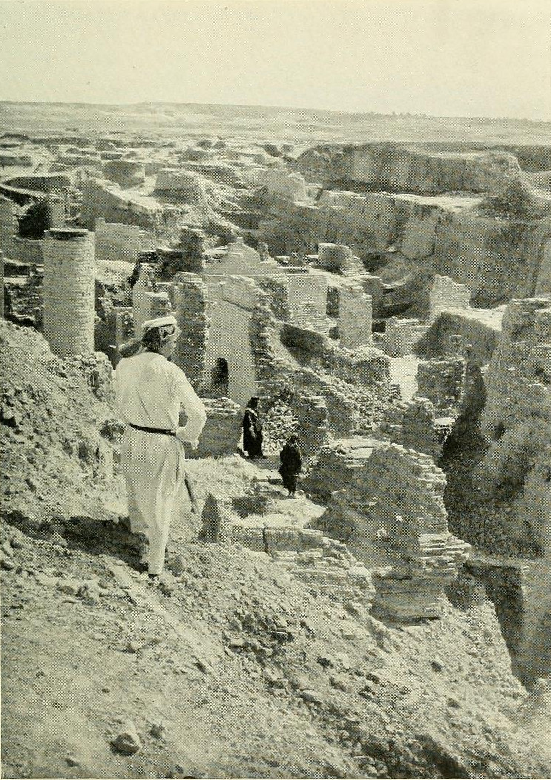
Return from Captivity
Can this be rebuilt?
Why did Jehovah let this happen?
What about a king?
What about the temple?
What do I do to keep this from happening again?

Slide 4
God’s Test for a Prophet
Deuteronomy 18:18-22(ESV)
¹⁸I will raise up for them a prophet like you from among their brothers.
And I will put my words in his mouth, and he shall speak to them
all that I command him.
¹⁹And whoever will not listen to my words that he shall speak in my name, I myself will require it of him.
²⁰But the prophet who presumes to speak a word in my name that I have not commanded him to speak, or who speaks in the name of other gods, that same prophet shall die.’
²¹And if you say in your heart, ‘How may we know the word that the Lord has not spoken?’—
²² when a prophet speaks in the name of the Lord, if the word does not come to pass or come true, that is a word that the Lord has not spoken; the prophet has spoken it presumptuously. You need not be afraid of him.

Slide 5
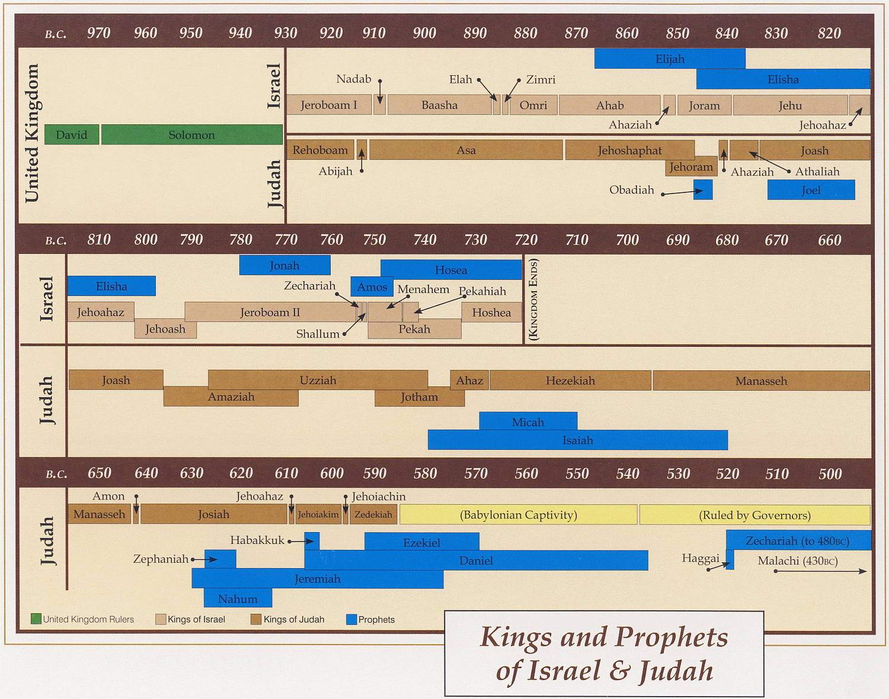
Ahijah
Jehu
Man of God
Micaiah
Man of God
Syria
Shemaiah
Azariah
Hanani
Assyria
Babylon/Persia

Slide 6
Hebrews 1:1-2(ESV)
¹Long ago, at many times and in many ways, God spoke to our fathers by the prophets,
²but in these last days he has spoken to us by his Son, whom he appointed the heir of all things, through whom also he created the world.
1 Peter 1:10-11(ESV)
¹⁰Concerning this salvation, the prophets who prophesied about the grace that was to be yours searched and inquired carefully,
¹¹inquiring what person or time the Spirit of Christ in them was indicating when he predicted the sufferings of Christ and the subsequent glories.

Slide 7
Prophetic Waves
Assyrian Threat
Syrian Threat
Babylonian Threat
Romans
Moses
Exodus
Persian
Written
Israel Falls
Abraham
Judah Falls
Judges
Kingdom Divides
Captivity
& Return
United Kingdom
Oral
Greeks
2100
1400
1100
1000
900
800
700
600
500
400
100
0
~30
100
609
597
586
538
458
444
722
Christ
Exile
Return

Slide 8
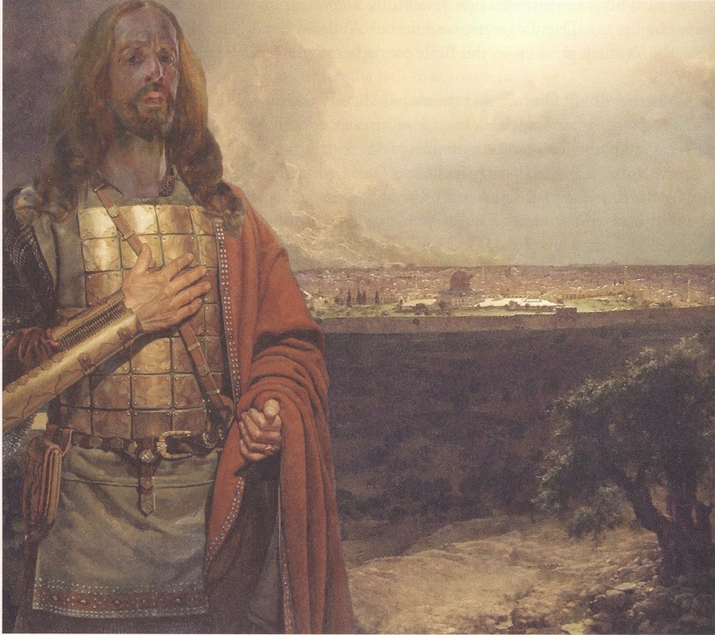
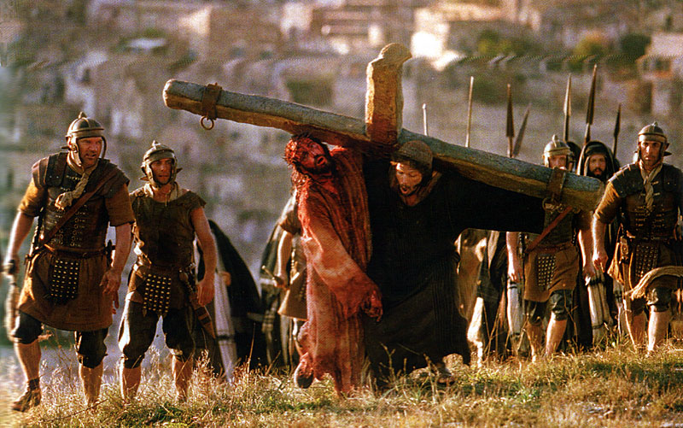
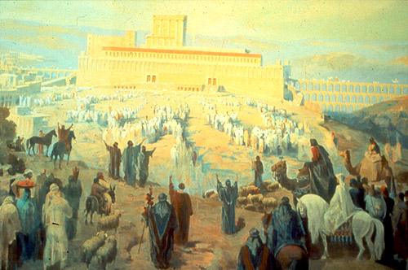
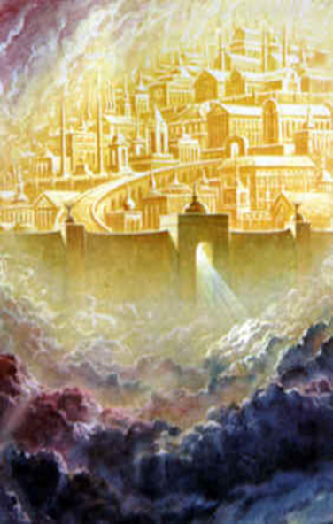
Messiah
A Warrior King or A Suffering Servant

Slide 9
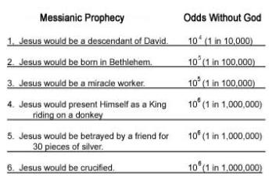


Messiah
Then
Today
God’s Eternal Purpose
Fulfilled
God Rules
God is Stronger than
  idols of other nations
Events due to God
Know God’s Power & Plan
# | Prophecy | Scripture | Odds
1 | Born in Bethlehem | Micah 5:2 | 2.8 x 10⁵
2 | A Forerunner To Prepare the Way | Malachi 3:1 | 1 in 10³
3 | Enter Jerusalem as King on a Colt | Zechariah 9:9 | 1 in 10²
4 | Betrayed By Friend, Wounds In Hands | Zechariah 13:6 | 1 in 10³
5 | Betrayed for 30 Pieces of Silver | Zechariah 11:12 | 1 in 10³
6 | 30 Pieces Cast to Potter in Lord’s House | Zechariah 11:13 | 1 in 10⁵
7 | Oppressed and Afflicted, Yet Silent | Isaiah 53:7 | 1 in 10³
8 | Pierced Hands and Feet | Psalm 22:16 | 1 in 10⁴
“We find that the chance that any man might have lived down to the present time and fulfilled all eight prophecies is 1 in 10¹⁷.”
-Peter W. Stoner
Quoted in Evidence That Demands A Verdict, p.167
God’s Eternal Purpose
Failed??
Prophecy applies to >2000 AD??
Still waiting for literal fulfillment??

Slide 10
“… Just the same chance that the prophets would have had in writing these eight prophecies and having them all come true in any one man, from their day to the present time, providing they wrote them in their own wisdom. Now these prophecies were either given by inspiration of God or the prophets just wrote them as they thought they should be. In such a case the prophets had just one chance in 10¹⁷ of having them come true in any man, but they all came true in Christ.”
-Peter W. Stoner
Quoted in Evidence That Demands A Verdict, p.167

Slide 11
“This means that the fulfillment of these eight prophecies alone proves that God inspired the writing of those prophecies to a definiteness which lacks only one change in 10¹⁷ of being absolute.”
-Peter W. Stoner

Slide 12

Triumphal Entry
Event/Situation
Triumphal Entry
OT Prophecy
Like Haggai, urges the people to complete temple. Stresses they must be a holy people. He is certain that the Messiah will come.
Mark 11:7-10(ESV)
⁷And they brought the colt to Jesus and threw their cloaks on it, and he sat on it.
⁸And many spread their cloaks on the road, and others spread leafy branches that they had cut from the fields.
⁹And those who went before and those who followed were shouting, “Hosanna! Blessed is he who comes in the name of the Lord!
¹⁰Blessed is the coming kingdom of our father David! Hosanna in the highest!”
Zechariah 9:9(ESV)
⁹ Rejoice greatly, O daughter of Zion! Shout aloud, O daughter of Jerusalem! behold, your king is coming to you; righteous and having salvation is he, humble and mounted on a donkey, on a colt, the foal of a donkey.
Zechariah 8:3 “Thus says the Lord: ‘I will return to Zion, And dwell in the midst of Jerusalem. Jerusalem shall be called the City of Truth, The Mountain of the Lord of hosts, The Holy Mountain.’
ZECHARIAH

Slide 13
Piercing of His Body
Event/Situation
Crucifixion of Christ
OT Prophecy
Like Haggai, urges the people to complete temple. Stresses they must be a holy people. He is certain that the Messiah will come.
John 19:33-37(ESV)
³³But when they came to Jesus and saw that he was already dead, they did not break his legs. ³⁴But one of the soldiers pierced his side with a spear, and at once there came out blood and water. ³⁵He who saw it has borne witness—his testimony is true, and he knows that he is telling the truth—that you also may believe.
³⁶For these things took place that the Scripture might be fulfilled: “Not one of his bones will be broken.” ³⁷And again another Scripture says, “They will look on him whom they have pierced.”
Zechariah 12:10(ESV)
¹⁰“And I will pour out on the house of David and the inhabitants of Jerusalem
a spirit of grace and pleas for mercy, so that, when they look on me,
on him whom they have pierced, they shall mourn for him, as one mourns for an only child, and weep bitterly over him, as one weeps over a firstborn.
Zechariah 8:3 “Thus says the Lord: ‘I will return to Zion, And dwell in the midst of Jerusalem. Jerusalem shall be called the City of Truth, The Mountain of the Lord of hosts, The Holy Mountain.’
ZECHARIAH

Slide 14
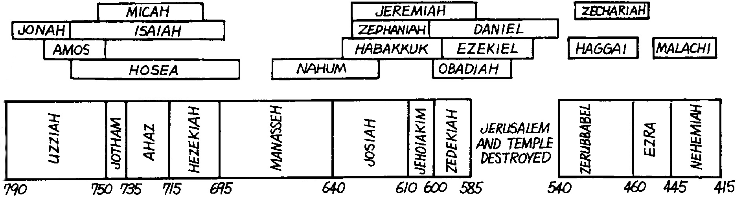
Kings & Prophets
Israel & Judah
Judah Alone
Fall of Judah
Exile & Return
JOEL
AMAZIAH
796
Zachariah’s Prophecy
Entry on Colt
Pierced Side
Fulfilled ~30 AD
Assyria
Babylonian
Persian

Slide 15
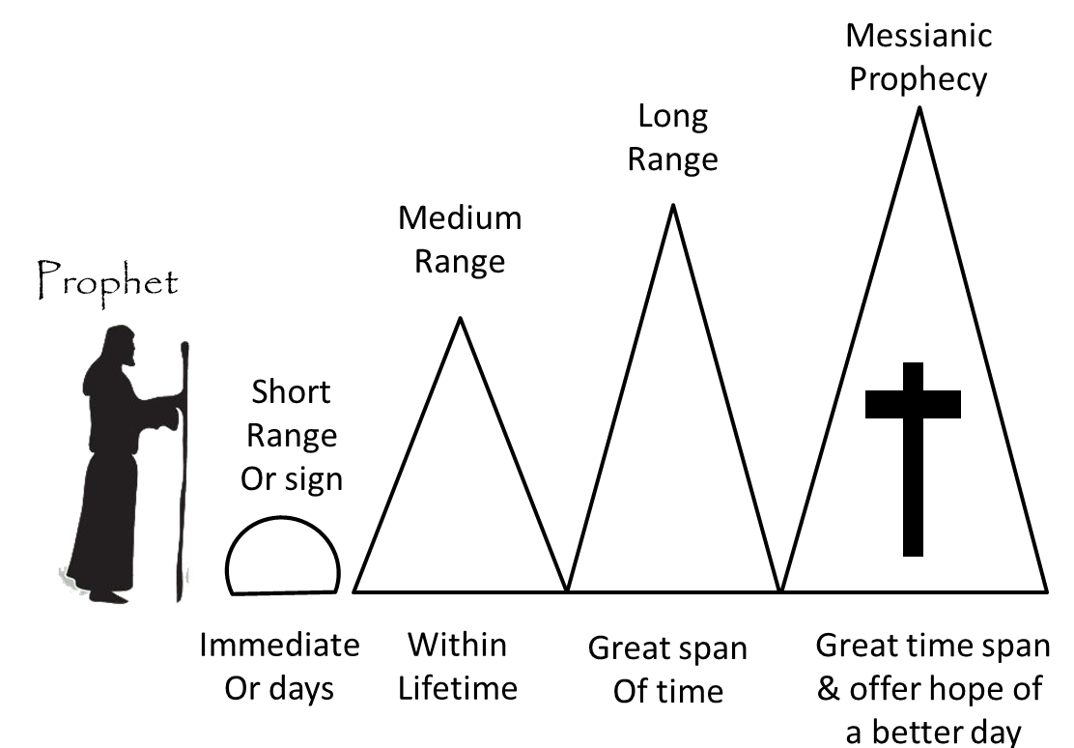
David
1000 BC
30/33 AD
Psalms 2:7-9(ESV)
⁷ I will tell of the decree: The Lord said to me,
“You are my Son; today I have begotten you.
⁸ Ask of me, and I will make the nations your heritage,
and the ends of the earth your possession.
⁹ You shall break them with a rod of iron
and dash them in pieces like a potter’s vessel.”
Peter’s Sermon
at Pentecost
Acts 2:5-12
Many Nations

Slide 16
Joel
30/33 AD
825 BC
Joel 2:28-29(ESV)
28 “And it shall come to pass afterward, that I will pour out my Spirit on all flesh;
your sons and your daughters shall prophesy, your old men shall dream dreams,
and your young men shall see visions.
29 Even on the male and female servants in those days I will pour out my Spirit.
Where Peter starts Sermon on Day of at Pentecost

Slide 17
Isaiah
700 BC
30/33 AD
Isaiah 2:2(ESV)
² It shall come to pass in the latter days that the mountain of the house of the Lord shall be established as the highest of the mountains, and shall be lifted up above the hills; and all the nations shall flow to it,
Book of Acts onwards

Slide 18
Habakkuk
30/33 AD
610 BC
Habakkuk 2:3-4(ESV)
³ For still the vision awaits its appointed time;
it hastens to the end—it will not lie.
If it seems slow, wait for it; it will surely come; it will not delay.
⁴ “Behold, his soul is puffed up; it is not upright within him,
but the righteous shall live by his faith.

Slide 19
Daniel
550 BC
30/33 AD
Daniel 2:44(ESV)
⁴⁴And in the days of those kings the God of heaven will set up a kingdom that shall never be destroyed, nor shall the kingdom be left to another people. It shall break in pieces all these kingdoms and bring them to an end, and it shall stand forever,

Slide 20
Haggai
520 BC
30/33 AD
Haggai 2:6-9(ESV)
⁶For thus says the Lord of hosts: Yet once more, in a little while,
I will shake the heavens and the earth and the sea and the dry land.
⁷And I will shake all nations, so that the treasures of all nations shall come in,
and I will fill this house with glory, says the Lord of hosts.
⁸The silver is mine, and the gold is mine, declares the Lord of hosts.
⁹The latter glory of this house shall be greater than the former,
says the Lord of hosts. And in this place I will give peace, declares the Lord of hosts.’”

Slide 21
Zechariah
518 BC
30/33 AD
Zechariah 2:10-12(ESV)
10 Sing and rejoice, O daughter of Zion, for behold, I come and I will dwell in your midst,
declares the Lord.
11And many nations shall join themselves to the Lord in that day, and shall be my people.
And I will dwell in your midst, and you shall know that the Lord of hosts has sent me to you.
12And the Lord will inherit Judah as his portion in the holy land,
and will again choose Jerusalem.”

Slide 22
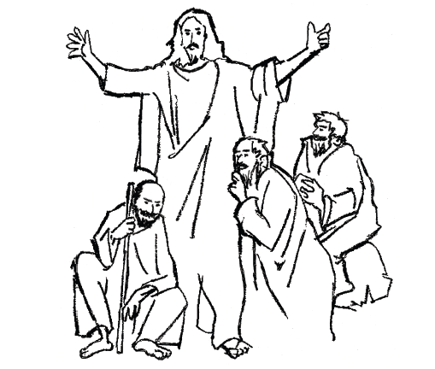
what Prophecy tells us about the Messiah
Is 7:14
___________________
virgin birth/Immanuel (God is with us)
Micah 5:2
___________________
Ps 41:9
___________________
But you, O Bethlehem
from you shall come forth for me
one who is to be ruler in Israel,
close friend in whom I trusted,
who ate my bread,
has lifted his heel against me
Is 53:3
___________________
He is despised and rejected by men
Is 53:6
___________________
the Lord has laid on him
the iniquity of us all
Is 53:12
___________________
And He was numbered with the transgressors
Zachariah 11:12
___________________
And they weighed out as my wages thirty pieces of silver.

Slide 23
what Prophecy tells us about the Messiah
1000 BC >>>>>>>> 30/33 AD
Ps 22:1
___________________
My God, my God,
why have you forsaken me?
Why are you so far from saving me,
from the words of my groaning?
Ps 16:10
___________________
For you will not abandon my soul to Sheol, or let your holy one see corruption
Ps 22:18
___________________
they divide my garments
among them,
and for my clothing
they cast lots
Ps 34:20
___________________
He keeps all his bones;
not one of them is broken
Ps 22:16
___________________
company of evildoers encircles me;
they have pierced my hands and feet

