Slide 1
“One Accord”
The Church in Jerusalem

Slide 2
Accord
Discord
Never said of the
Church in Jerusalem
Church in Corinth
“So continuing daily with one accord in the temple” (Acts 2:46)
“they raised their voice to God with one accord” (Acts 4:24)
“they were all with one accord in Solomon’s Porch.” (Acts 5:12)
“being assembled with one accord,” (Act 15:25)
Now the multitude of those who believed were of one heart and one soul.” (Acts 4:32)
Quarrelling about Preachers (1 Corinthians 1:11)
Going to law against one another (1 Corinthians 6:6)
The strong were ignoring conscientious scruples of the weak (1 Cor. 8-10)
The Lord’s supper had been turned into a heathen feast, favoring the rich and shaming the poor (1 Cor. 11)
Pride and envy in exercise of spiritual gifts (1 Cor. 12-13)

Slide 3
Why was the church in Corinth in Discord?
Different ethnic backgrounds
Different Educational attainment
Different levels of Understanding
Rich and poor
Male and Female
They were divided in loyalty
They were “puffed up” (5 times)
They lacked love for each other.
They were carnal—”behaving like mere men.” (1 Cor. 3:3)
“Where envy and self-seeking exist, confusion and every evil thing are there.” (James 3:16)

Slide 4
Why was the Church in Jerusalem “in One Accord”?
Leaders were committed to Jesus even before the church began. (Acts 1:4, 14; 2:1)
Members had been baptized “in the name of Jesus Christ” (2:38)
They continued steadfastly in Apostles’ teaching. (2:42)
Loved one another (2:44-45)
Assembling daily (2:46)
“Now the multitude of those who believed were of one heart and one soul.” (Acts 4:32)
They desired peace. (Acts 6:1-7)

Slide 5
What will be the future of The Embry Hills Church?
Accord
Or
Discord?

Slide 6
I am confident it will be ACCORD
This has been its history.
The leaders look to Jesus as head of the church—”the chief shepherd.”
The members have been baptized “in the name of Jesus Christ.”
The members are committed to “the apostles’ teaching.”
A loving fellowship binds us together

Slide 7
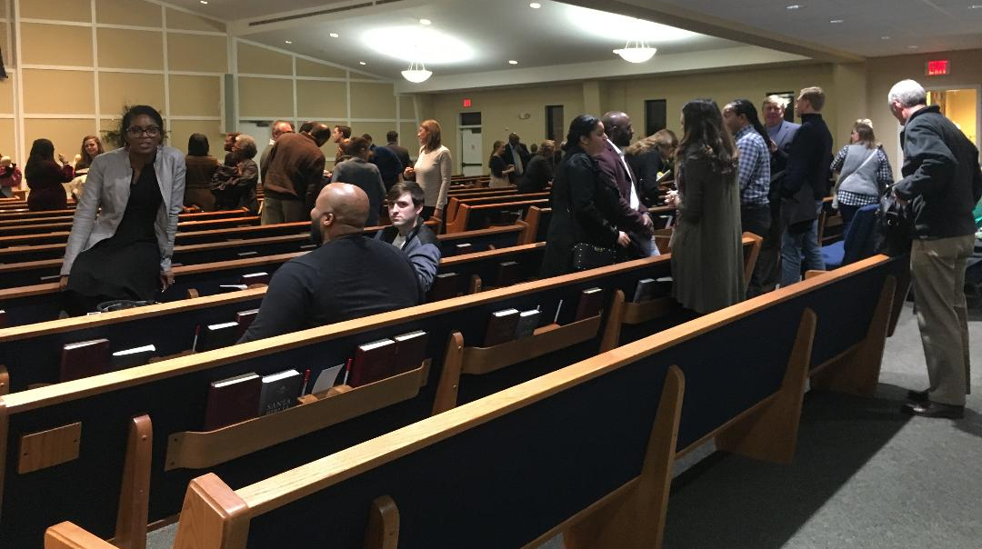
Thirty Minutes After Service, Sunday Night, December 30th

Slide 8
I am confident it will be ACCORD
This has been its history.
The leaders look to Jesus as head of the church—”the chief shepherd.”
The members have been baptized “in the name of Jesus Christ.”
The members are committed to “the apostles’ teaching.”
A loving fellowship binds us together.
The members respect one another’s conscience.
There is a genuine desire for unity.

Slide 9
“Now may the God who gives perseverance and encouragement grant you to be of the same mind with one another according to Christ Jesus, ⁶ so that with one accord you may with one voice glorify the God and Father of our Lord Jesus Christ.” Romans 15:5-6

