Slide 2
Free In Christ

Slide 3
2018-2019 Theme Lessons Free in Christ (Galatians 5:1,13-14)
From
To
September | Overview | Our Highest Freedom Is Found In Jesus Christ
October | Appreciating Our Freedom | From Slaves to Sons: Freedom In The Family of God
November |  | From Tutor to Savior: Freedom In The Gospel
December |  | From Fear to Hope: Freedom In Steadfast Faith
January |  | From Flesh to Spirit: Freedom In The Holy Spirit
February | Living Free In Christ | Free Christians Overcome Satan’s Attack
March |  | Free Christians Are Propelled By Love
April |  | Free Christians Are Devoted To Building Up Others
May |  | Free Christians Bear One Another’s Burdens, Part 1
June |  | Free Christians Bear One Another’s Burdens, Part 2
July |  | Free Christians Reap & Sow For A Great Harvest
August | The Good News of our Freedom | Free Christians Bring Others To True Freedom
Abilities & Responsibilities

Slide 4
Galatians 5:1; 13-14
^{5:1}Stand fast therefore in the liberty by which Christ has made us free, and do not be entangled again with a yoke of bondage…
¹³For you, brethren, have been called to liberty; only do not use liberty as an opportunity for the flesh, but through love serve one another. ¹⁴ For all the law is fulfilled in one word, even in this: “You shall love your neighbor as yourself.”

Slide 5
Principles of Liberty (Gal 5)
Freedom “from” one thing is bondage “to” another (1-3)
¹⁶ Do you not know that to whom you present yourselves slaves to obey, you are that one’s slaves whom you obey. …²⁰ For when you were slaves of sin, you were free in regard to righteousness. … ²² But now having been set free from sin, and having become slaves of God… (Rom 6:16, 20, 22)

Slide 6
Liberty
Freedom “from” one thing is bondage “to” another (1-3)
Freedom is a mind-set (3, 13)
⁶ And because you are sons, God has sent forth the Spirit of His Son into your hearts, crying out, “Abba, Father!” ⁷ Therefore you are no longer a slave but a son, and if a son, then an heir of God through Christ. (Gal 4:6-7)

Slide 7
Liberty (Gal 5)
Freedom “from” one thing is bondage “to” another (1-3)
Freedom is a mind-set (3, 13)
Freedom is defined by outcome/consequence (5)
For as many as are of the works of the law are under the curse; for it is written, “Cursed is everyone who does not continue in all things which are written in the book of the law, to do them.” … (Gal 3:10)
¹³ Christ has redeemed us from the curse of the law…that we might receive the promise of the Spirit through faith. (Gal 3:13-14)

Slide 8
Devoted to Building Up Others
April 2019

Slide 9
Questions on Building Each Other Up
What does it mean to build each other up?
What inhibits building each other up?
How does freedom in Christ enable us to build others?

Slide 10
What Does it Mean?
“Building up” “Edifying” – oikodomeō (dwelling + build)
House-building (see Matt 7:24: “builds house on a rock”)
Oikos extended to: family or household (see I Tim 5:8; Eph 2:19)
Also refers to building a body
Eph 4:12: “edifying of the body…”
Eph 4:16: “growth of the body… edifying of itself.”

Slide 11
What Does it Mean?
“Building up” “Edifying” – oikodomeō (dwelling + build)
Implications of house-building
Intentional activity → follows a plan (I Pet 2:5)
For a purpose → a dwelling place/temple (I Cor 3:16)
Many materials & tasks in relationship → one structure (I Cor 12:18)
Testament to the Builder (Eph 3:10; Lk 14:29)
Now, therefore, you are …members of the household of God, ²⁰having been built on the foundation of the apostles and prophets, Jesus Christ Himself being the chief cornerstone, ²¹ in whom the whole building, being fitted together, grows into a holy temple in the Lord, ²² in whom you also are being built together for a dwelling place of God in the Spirit. (Eph 2:19-22)
Notes:
I Pet 2:5 – you also, as living stones, are being built up a spiritual house, a holy priesthood, to offer up spiritual sacrifices acceptable to God through Jesus Christ.
I Cor 3:16 - Do you not know that you are the temple of God and that the Spirit of God dwells in you?
Eph 3:10 - to the intent that now the manifold wisdom of God might be made known by the church to the principalities and powers in the heavenly places
Luke 14:29-30 - lest, after he has laid the foundation, and is not able to finish, all who see it begin to mock him, ³⁰ saying, ‘This man began to build and was not able to finish’?

Slide 12
What Does it Mean?
“Building up” “Edifying” – oikodomeō (dwelling + build)
Implications of house-building
Associated Activities and Conditions

Slide 13
Associated Activities and Conditions
Knowledge/Teaching of the Word (Acts 20:32)
So now, brethren, I commend you to God and to the word of His grace, which is able to build you up and give you an inheritance among all those who are sanctified.
Exhortation/Comfort (parakaleō) (I Thess 5:11)
Therefore comfort each other and edify one another, just as you also are doing.
Burden-bearing (Rom 15:2)
Let each of us please his neighbor for his good, leading to edification.
Peace (Acts 9:31)
Then the churches throughout all Judea, Galilee, and Samaria had peace and were edified. And walking in the fear of the Lord and in the comfort of the Holy Spirit, they were multiplied.
Graceful Speech (Eph 4:29)
Let no corrupt word proceed out of your mouth, but what is good for necessary edification, that it may impart grace to the hearers.
Prayer (Jude 20)
But you, beloved, building yourselves up on your most holy faith, praying in the Holy Spirit…
Notes:
Exhort/comfort, same word as “comforter,” “helper” in John 14:16.

Slide 14
Responsibilities of All to Build Up
Elders
Acts 20:28; I Pet 5:1-3
Take Heed, Feed, Be Examples
Evangelists
II Tim 4:2,5; I Tim 4:6, 11-16
Preach Urgently, Reprove,
Rebuke, Exhort, Teach, Remind
Teachers
James 3:1; I Cor12:28; Rom 12:7; I Pet 4:10;
Teach carefully, as “Oracles of God”
‘Gifted’ People
I Cor 14:12,26; Rom 12:6-8; I Pet 4:10,11
Abound in edifying, according
to grace given, strength supplied
Trainers, ‘Gift Imparters’
Rom 1:11,12; II Tim 2:2; Titus 2:4
Train, Establish Faith, Comfort
One Another
I Tim 4:12; Titus 2:6,7; Rom 14:19-21
Be example in: Word, Life, Faith,
Purity; Good Works, Doctrine
One Another
Rom 15:1,2; Rom 15:14
Strong Help Weak, Admonish [Warn/Counsel]
One Another
I Thes 5:14; I Cor 5:4-8 (see II Cor 13:10)
Warn, Rebuke, Purge Impurity

Slide 15
Questions on Building Each Other Up
What does it mean to build each other up?
What inhibits building each other up?
How does freedom in Christ enable us to build others?

Slide 16
What Inhibits Building Up?
Knowledge
I Cor 8:1 – “…Knowledge puffs up, but love edifies.”
I Cor 8:9-13 – Because of your knowledge a weak brother perishes
I Cor 8:9 – “Do not let your liberty become a stumbling block”
…without love
Therefore let us pursue the things which make for peace and the things by which one may edify another. ²⁰ Do not destroy the work of God for the sake of food. (Rom 14:19-20)

Slide 17
What Inhibits Building Up?
…without love
Knowledge
Demanding our rights
I Cor 9:1-5 – Paul foregoes his personal rights for the Gospel
I Cor 9:1,19,27 – “free,” yet “servant to all” & “disciplined”
I Cor 10:33-11:1 – Imitate Christ, seeking the good of others
All things are lawful for me, but not all things are helpful; all things are lawful for me, but not all things edify. ²⁴ Let no one seek his own, but each one the other’s well-being. (I Cor 10:23-24)

Slide 18
What Inhibits Building Up?
…without love
Knowledge
Demanding our rights
Exercising our abilities with pride
Different gifts, but for the profit of all (I Cor 12:4-7)
None are superior or inferior (I Cor 12:14-16, 21-22)
The “best” gifts edify (I Cor 14:3-5, 12)
How is it then, brethren? Whenever you come together, each of you has a psalm, has a teaching, has a tongue, has a revelation, has an interpretation. Let all things be done for edification. (I Cor 14:26)

Slide 19
What Inhibits Building Up?
Knowledge
Demanding our rights
Exercising our abilities with pride
…without love
What do these have in common?

Slide 20
Questions on Building Each Other Up
What does it mean to build each other up?
What inhibits building each other up?
How does freedom in Christ enable us to build others?

Slide 21
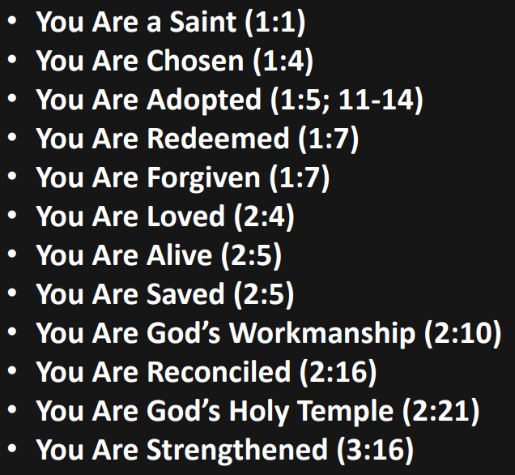
Ways We Seek Affirmation*
The Approval of Other Men (John 12:42-43)
The Failures of Other Men (Luke 18:9-14)
Affirmation of Ourselves
Wrong Sources Which Ultimately Fail.
*Borlaug, Eric, “Strengthened by God’s Blessings,” 7 Apr 2019.

Slide 22
Enabled by the Grace of God
You therefore, my son, be strong in the grace that is in Christ Jesus. ² And the things that you have heard from me among many witnesses, commit these to faithful men who will be able to teach others also. (II Tim 2:1-2)
And God is able to make all grace abound toward you, that you, always having all sufficiency in all things, may have an abundance for every good work. (II Cor 9:8)
And my God shall supply all your need according to His riches in glory by Christ Jesus. (Phil 4:9)
As each one has received a gift, minister it to one another, as good stewards of the manifold grace of God. ¹¹ If anyone speaks, let him speak as the oracles of God. If anyone ministers, let him do it as with the ability which God supplies, that in all things God may be glorified through Jesus Christ… (I Pet 4:10-11)

Slide 23
Gal 5:13-14
¹³For you, brethren, have been called to liberty; only do not use liberty as an opportunity for the flesh, but through love serve one another. ¹⁴ For all the law is fulfilled in one word, even in this: “You shall love your neighbor as yourself.”

