Slide 1
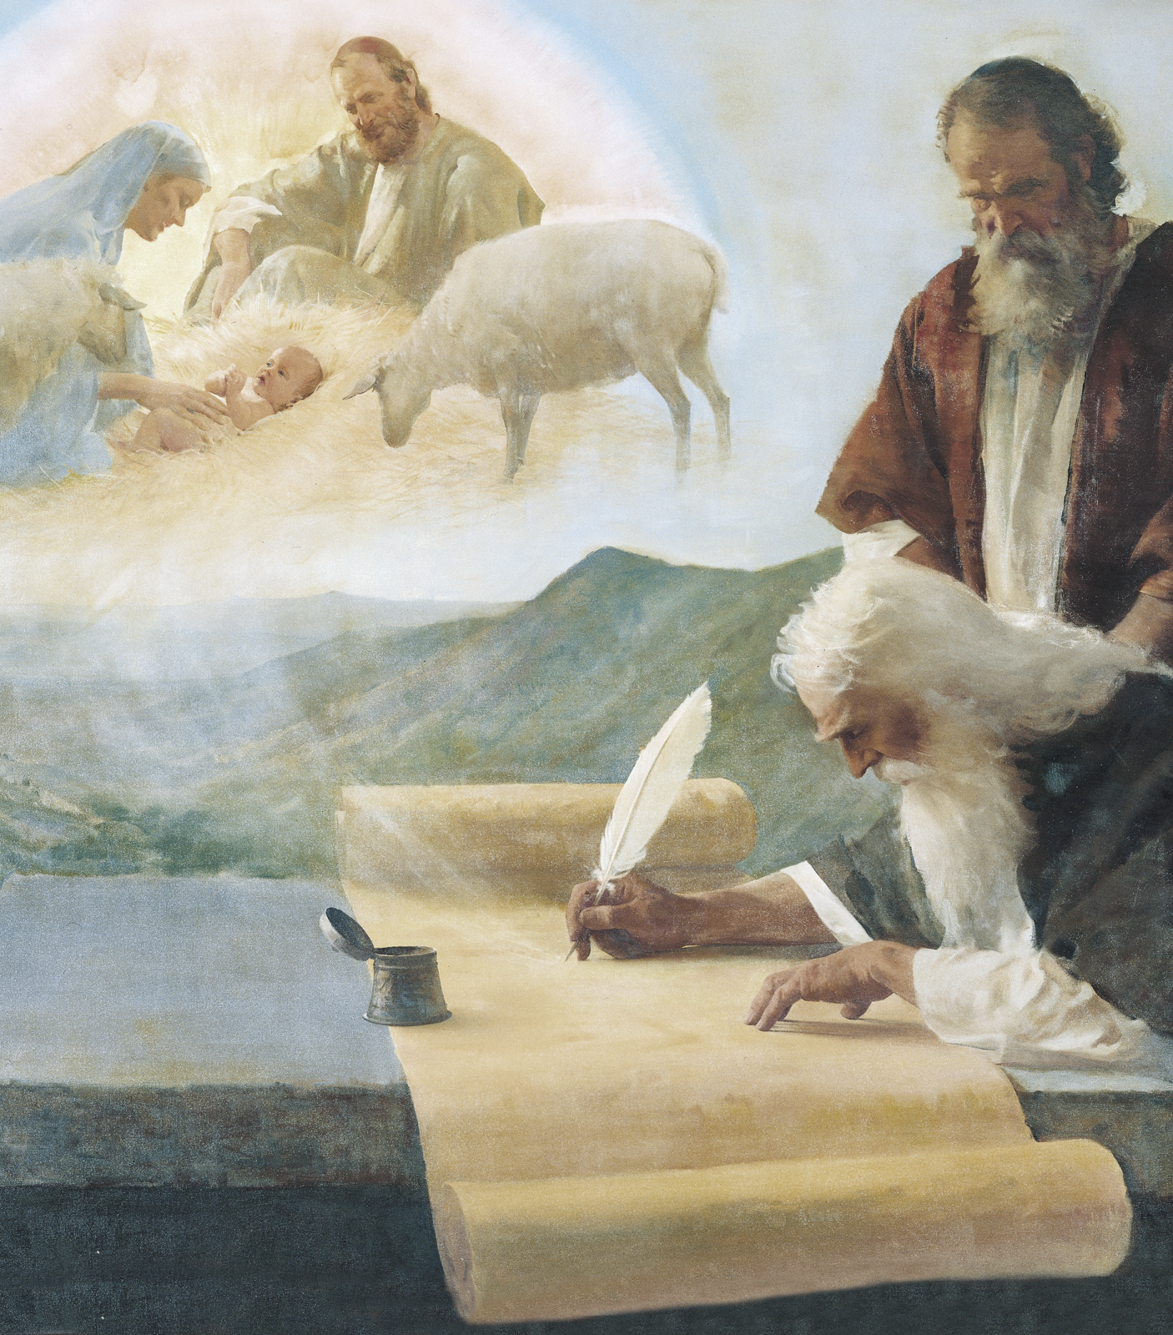
The Messiah in the Old Testament
Spring 2019

Slide 2
What do you want to learn about Messianic prophecy in this class?
(In other words, why are you here?)

Slide 3
Class Goals
Draw a fuller, more detailed image of Jesus as the Messiah prophesied in the Old Testament
Understand better the prophetic idiom and images, and how they develop across the Old Testament
See the development of the role of prophets and the scope of prophecy across the Old Testament

Slide 4
Methodology
Investigate the Old Testament books by genre, rather than individually
Trace images and themes through each genre to see how they develop and combine over time
Make a list of messianic images and symbols paired with their New Testament fulfillment
Use the New Testament as the touchstone for what is prophetic and what is not, and what is Messianic and what is not

Slide 5
Class Schedule
LESSON | TITLE | DATE | TEACHER
1 | Introduction | Sunday Feb. 24 | Mason
2 | The Messiah in Moses’ Writings 1 | Wednesday Feb. 27 | Grady
3 | The Messiah in Moses’ Writings 1 | Sunday Mar. 3 | Grady
4 | The Messiah in the Minor Prophets 1 | Wednesday Mar. 6 | Grady
5 | The Messiah in the Minor Prophets 2 | Sunday Mar. 10 | Mason
6 | The Messiah in the Major Prophets 1 | Wednesday, Mar. 13 | Grady
7 | The Messiah in the Major Prophets 2 | Sunday, Mar. 17 | Mason
8 | The Messiah in the Psalms 1 | Wednesday, Mar. 20 | Mason
9 | The Messiah in the Psalms 2 | Sunday, Mar. 24 | Mason
 | NO CLASS – MEETING | Wednesday, Mar. 27 | --
10 | The Messiah in Isaiah 1 | Sunday, Mar. 31 | Mason
11 | The Messiah in Isaiah 2 | Wednesday, Apr. 3 | Grady
12 | The Messiah in Isaiah 3 | Sunday, Apr. 7 | Mason
13 | Review/How Jesus & the Apostles Applied Prophecy | Wednesday, Apr. 10 | Grady

Slide 6
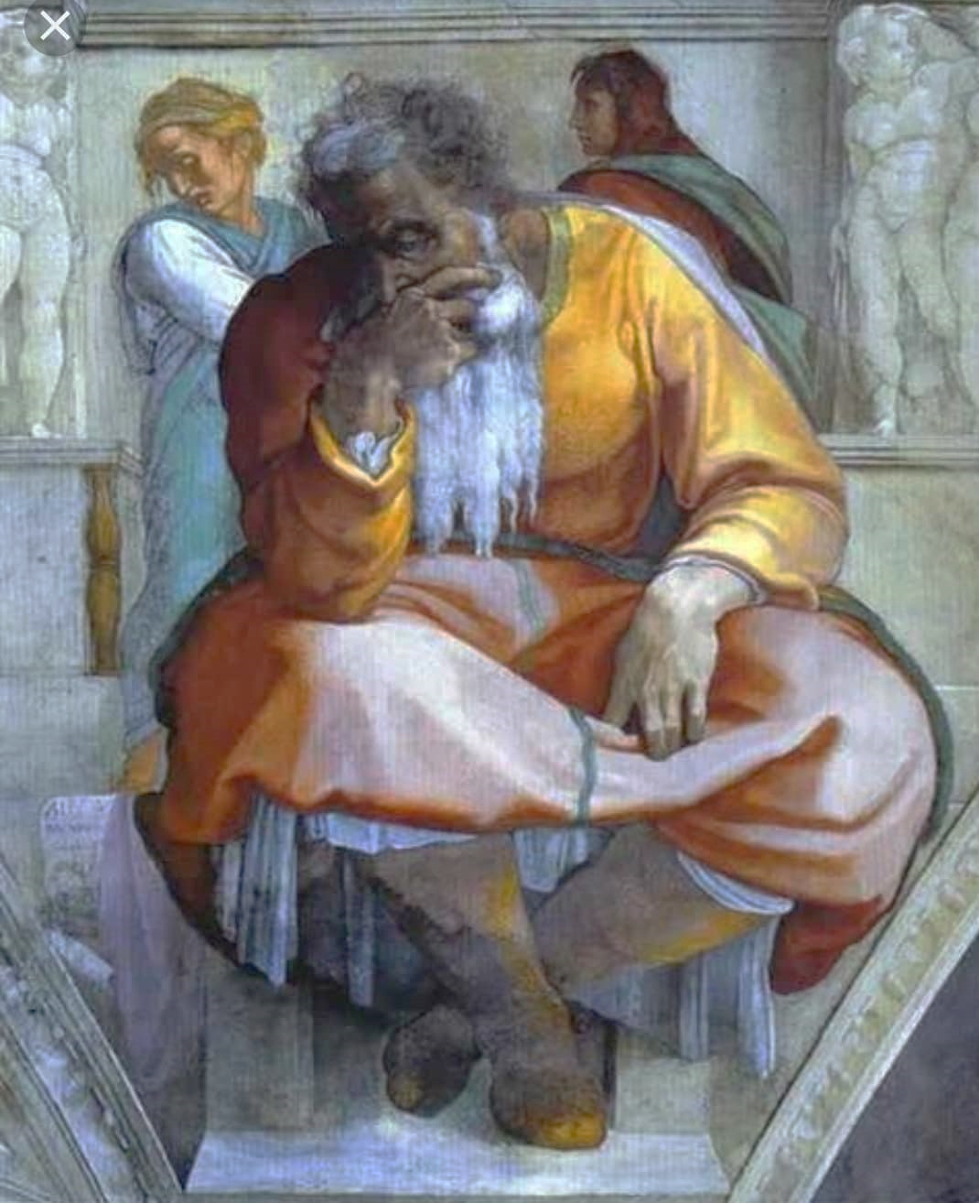
Lesson 1
Introduction
The Prophet Jeremiah
Michelangelo Buonarroti, 1512

Slide 7
Lesson 1 Objectives
Describe the differences between prophecy, type, and foreshadowing and identify a sample passage of each
Identify 3 general periods of prophetic revelation in Israel’s history
Explain how Moses’ “prophet test” helps explain the shift of prophecy from “forth-telling” to “fore-telling” in the Divided Kingdom period

Slide 8
Prophecy, Type, Foreshadowing
Prophecy
Often denoted by “Thus says the Lord,” though not always (Psalm 110:1)
Often accompanied by a promise of fulfillment (Isaiah 9:7)
May feature apocalyptic or symbolic language
Can usually be matched with a statement of direct fulfillment (Matthew 1:22)
Type
More-than-coincidental similarity between historical events and people
Key attributes or details of typological events described
Can usually be matched with a statement of typological significance (antitype)
Look for “just as…” language (Matthew 12:40; John 3:14)
Foreshadowing
Similar details shared between actions, people, or events (Genesis 22:1-13)
No statement of fulfillment or typological significance
Rhetorical use of Old Testament passages (Deut 21:22-23→Gal 3:13)
Notes:
Prophecies relating to the person of the Messiah are usually identified in the New Testament. Prophecies relating to the kingdom or the signs of the age (spirit being poured out, etc.) are not always positively identified (cf. Zephaniah 3). However, NT references to OT passages describing some aspect of the Messianic age can be read as a confirmation of other prophetic passages that are clearly describing the same event (often in the same terms—cf. various qtd passages in Isaiah, Micah, Ezekiel as parallel to Zephaniah 3). Also consider Christ’s use of “thus it is written” in Luke 24:44-47 to introduce a summary of the prophecies of the Messianic person, mission, and age.
It is fair to say that almost every verse in the OT points in some way to the coming of the Messiah (Luke 24:27). The better job we can do of understanding

Slide 9
Prophecy, Type, Foreshadowing
Exodus 17:6 – Behold, I will stand before you there on the rock at Horeb; and you shall strike the rock, and water will come out of it, that the people may drink.” And Moses did so in the sight of the elders of Israel.
1 Corinthians 10:4 – and all drank the same spiritual drink, for they were drinking from a spiritual rock which followed them; and the rock was Christ.
Leviticus 25:25 – If a brother of yours becomes so poor he has to sell part of his property, then his nearest kinsman is to come and redeem what his brother has sold.
Galatians 4:4-5 – God sent forth His Son, born of a woman, born under the Law, so that He might redeem those who were under the Law, that we might receive the adoption as sons.
Deuteronomy 18:18-19 – I will raise up a prophet from among their countrymen like you, and I will put My words in his mouth, and he shall speak to them all that I command him. It shall come about that whoever will not listen to My words which he shall speak in My name, I Myself will require it of him.
Acts 3:22-23 – Moses said, ‘The Lord God will raise up for you a prophet like me from your brethren; to Him you shall give heed to everything He says to you. ²³ And it will be that every soul that does not heed that prophet shall be utterly destroyed from among the people.’
TYPE
FORESHADOWING
PROPHECY

Slide 10
What images of the Messiah stand out to you as significant?
Why do you find them significant?

Slide 11
Periods of Messianic Prophecy
Genesis to Judges
Vague but forceful prophecies—no clear time or place references
Images introduced: victorious sufferer, king, lion, star, prophet
Overall picture: no cohesion, no clarity
Early kingdom and psalms
More specific promises—time not specified, but Israel clearly the place
Images expanded: victorious (vindicated) sufferer, king
Images introduced: priest, anointed, son of God, David
Overall picture: some clarity, little cohesion
Later kingdom and prophets
Very detailed images and descriptions—time and places specified for events
Images expanded: vindicated sufferer, king, anointed, son of God, David
Images introduced: lamb, servant, root and branch, son of man, shepherd
Overall picture: great clarity, moderate cohesion

Slide 12
An OT Believer’s Keys to the Messianic Age
The coming redeemer—the seed of Abraham and David; prophet, priest, and king of Israel; a light to the Gentiles
The kingdom of God—God’s rule over Israel (and the world) fully realized through His chosen king
The new covenant—a covenant which Israel would not break
The restoration of Israel—redemption from captivity (physical & spiritual)
The outpouring of the Spirit—direct communication with God
The day of the Lord—God coming down to judge and to save
The new heavens and new earth—a clean slate on which God’s new covenant will be enacted
from The Bible and the Future
Anthony A. Hoekema: Eerdmans, 1979
Notes:
All of these are predicated upon the Messiah coming to redeem, establish a kingdom/covenant, restore Israel, etc. The item that the OT speaks about the most is the coming redeemer, followed by the kingdom (which requires a king). Understanding the Messiah is key to understanding both the OT and the NT.

Slide 13
The Prophetic Test and Far-Future Prophecy
Moses gave Israel a way to test for true and false prophets:
Does the sign or event come to pass as predicted? (Deut. 18:22)
Does the prophet who predicts or performs a true sign tell you to turn to other gods besides Jehovah? (Deut. 13:1-2)
How does this test apply to prophecies about events several generations forward in time?
Every prophet delivers moral messages about covenant obedience, God’s love and discipline, etc. that accord with God’s previously-revealed will
Each of the prophets also predicted events that happened very quickly to demonstrate their credibility
These near-future predictions often appear early in their prophecies or careers
Far-future predictions increase in frequency late in Israel’s history
God and His prophets have established their credibility over 1000 years of “forthtelling”
Concurrent with the Babylonian Captivity, the balance shifts toward “foretelling”
Notes:
Expository and hortatory discourse—forthtelling
Predictive discourse—foretelling

