Slide 1

Journey thru the Bible with Archaeology
A Bible and Spade Evidence Class.
Lesson 3
Joshua and the Conquest

Slide 2
Objectives:
Improve our knowledge of Bible Locations, People and Timeline
Gain an understanding that the Bible deals with real events, real people, and real places.
Strengthen our faith by examining the physical remains/evidence that have been discovered in Middle East and Mediterranean related to Bible events.

Slide 3
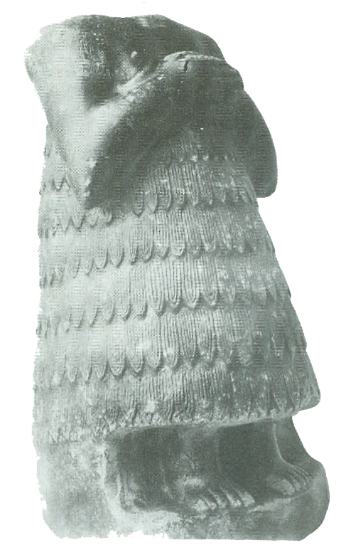
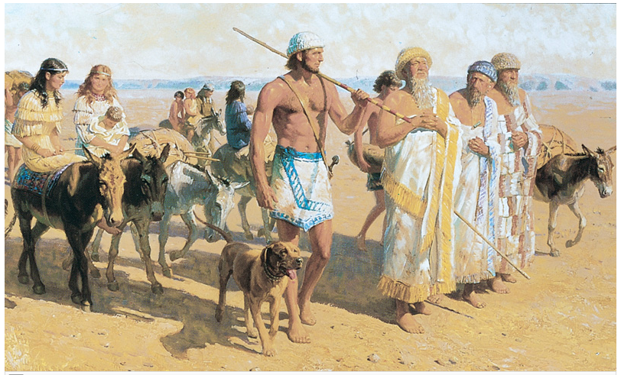
Hebrews 11:8-10 (ESV)
⁸ By faith Abraham obeyed when he was called to go out to a place that he was to receive as an inheritance. And he went out, not knowing where he was going.
⁹ By faith he went to live in the land of promise, as in a foreign land, living in tents with Isaac and Jacob, heirs with him of the same promise.
¹⁰ For he was looking forward to the city that has foundations, whose designer and builder is God.

Slide 4


Journey thru the Bible with Archaeology
03-Joshua and the Conquest
03-Joshua and the Conquest
01-Introduction to Bible Archaeology
02-Patriarchs
and Camels
05-David, Samson and the Philistines
04-Shechem a City for All Times
17-Archaeology and the Bible Text
06-Solomon the Builder
07-Ahab and the Northern Kingdom
11-Crucifixion and Burial
16-Archaeology in Jerusalem
15-Museums and Key Bible Finds
14-Daniel and the Kingdoms
08-The Hezekiah Defense
09-Jeremiah and the Last Days of Judah
12-Cities of Paul and John
10-In the Days of Jesus
13-Finding People in the Bible Outside the Bible

Slide 5
Sin Separates Us from God
Bible is God’s Effort to Redeem Us
See it Unfold via Bible Periods
Creation & Fall
The Patriarchs
Exodus Conquest
The Judges
Kings & Prophets
Exile & Return
Life of Jesus
Early Church
United
Divided
Between the Testaments

Slide 6
Putting Bible Time to Archaeological Time
Archaeological Periods Levant | Chronological Date | Historical Events | Biblical Historical Event | Bible Periods
Neolithic & Chalcolithic | 8500-3150 BC |  |  | Creation & Fall & Flood
Early Bronze I | 3150–2850 BC | Early Dynastic Period in Egypt (ca. 2900BC Menes) |  | Patriarchs
Early Bronze Age II | 2850-2650 BC |  |  | Patriarchs
Early Bronze Age III | 2650-2200 BC | Egyptian Old Kingdom Dynasty III to VI |  | Patriarchs
Early Bronze Age IV | 2200-2000 BC |  | Abraham b ~2166 BC Departs Ur 2091 Isaac b 2066 Esau & Jacob b~2006 BC | Patriarchs
Middle Bronze Age I | 2000-1550 BC | Egyptian Middle Kingdom (2050-1640 BC) Dynasty XI to XIII Hyksos Egyptian Dynasty (~1663-1555 BC) | Joseph b 1915 BC Jacob & Family enter Egypt~1876 BC | Patriarchs
Middle Bronze Age II | 1550-1400BC | Egyptian New Kingdom (1539-1070 BC) Dynasty XVIII -XX | Moses Born 1526 BC | Patriarchs
Late Bronze Age I | 1550-1400 BC |  | Exodus 1446 BC Conquest 1406- BC | Exodus/Conquest
Late Bronze Age II | 1400-1200 BC | Amarna Period ~1386-1334 BC |  | Judges

Slide 7
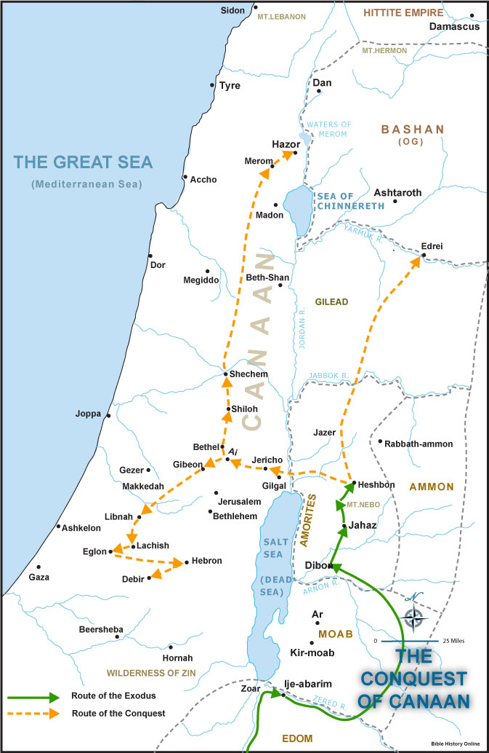
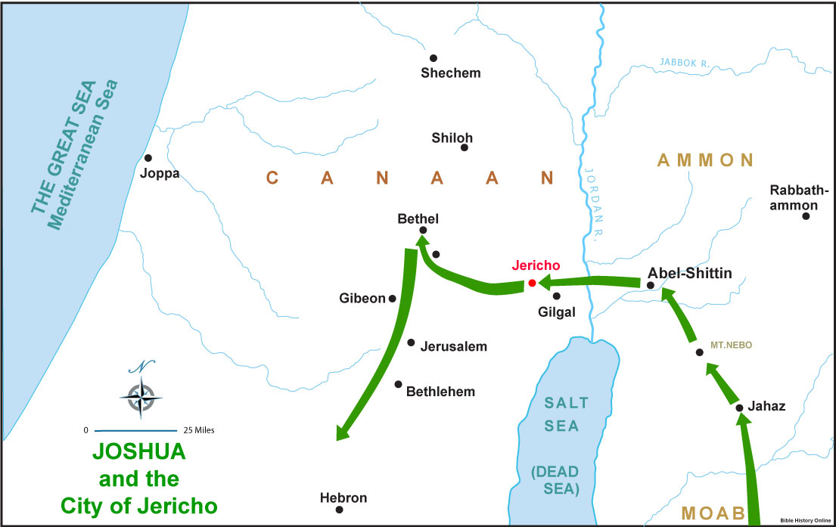
Bible Places

Slide 8
Joshua & the Conquest
There is a lot of misunderstanding about the Conquest of Canaan by Israel. Read the different descriptions given of the conquest to better understand and describe what happened. From the bible passages what archaeology remains might give us further insight into the passage?
Archaeology can add to Bible Event:
Build confidence in general trustworthiness, historical nature and reliability of Bible
Confirm events described in Bible
Clarify/Correct/Provide Understanding about our assumptions and conclusions about the past
Complement or Enhance our knowledge of events, customs and people
Prove a given event or people mentioned in the Bible

Slide 9
Conquest of Canaan
# | Chapter & Verse | Description of the Conquest
1 | Genesis 12:5-7 | ⁵...When they came to the land of Canaan, ⁶Abram passed through the land to the place at Shechem, to the oak of Moreh. At that time the Canaanites were in the land. ⁷Then the Lord appeared to Abram and said, “To your offspring I will give this land.” So he built there an altar to the Lord, who had appeared to him.
2 | Genesis 15:7, 3-14, 16 | ⁷And he said to him, “I am the Lord who brought you out from Ur of the Chaldeans to give you this land to possess.” ¹³Then the Lord said to Abram, “Know for certain that your offspring will be sojourners in a land that is not theirs and will be servants there, and they will be afflicted for four hundred years. ¹⁴But I will bring judgment on the nation that they serve, and afterward they shall come out with great possessions. ¹⁶And they shall come back here in the fourth generation, for the iniquity of the Amorites is not yet complete.”
4 X 40 ~ 160 yrs

Slide 10
Conquest of Canaan
# | Chapter & Verse | Description of the Conquest
6 | Genesis 50 | ²⁴And Joseph said to his brothers, “I am about to die, but God will visit you and bring you up out of this land to the land that he swore to Abraham, to Isaac, and to Jacob.” ²⁵Then Joseph made the sons of Israel swear, saying, “God will surely visit you, and you shall carry up my bones from here.”
7 | Exodus 3:16-17 | ¹⁶Go and gather the elders of Israel together and say to them, ‘The Lord, the God of your fathers, the God of Abraham, of Isaac, and of Jacob, has appeared to me, saying, “I have observed you and what has been done to you in Egypt, ¹⁷and I promise that I will bring you up out of the affliction of Egypt to the land of the Canaanites, the Hittites, the Amorites, the Perizzites, the Hivites, and the Jebusites, a land flowing with milk and honey.”’

Slide 11
Conquest of Canaan
# | Chapter & Verse | Description of the Conquest
 | Exodus 34 | ¹¹“Observe what I command you this day. Behold, I will drive out before you the Amorites, the Canaanites, the Hittites, the Perizzites, the Hivites, and the Jebusites. ¹²Take care, lest you make a covenant with the inhabitants of the land to which you go, lest it become a snare in your midst.
17 | Numbers 33:51-56 | 51“Speak to the people of Israel and say to them, When you pass over the Jordan into the land of Canaan, 52then you shall drive out all the inhabitants of the land from before you and destroy all their figured stones and destroy all their metal images and demolish all their high places. 53And you shall take possession of the land and settle in it, for I have given the land to you to possess it. 54You shall inherit the land by lot according to your clans. To a large tribe you shall give a large inheritance, and to a small tribe you shall give a small inheritance. Wherever the lot falls for anyone, that shall be his. According to the tribes of your fathers you shall inherit. 55 But if you do not drive out the inhabitants of the land from before you, then those of them whom you let remain shall be as barbs in your eyes and thorns in your sides, and they shall trouble you in the land where you dwell. 56And I will do to you as I thought to do to them.”

Slide 12
Conquest of Canaan
# | Chapter & Verse | Description of the Conquest
10 | Exodus 23 | ²⁸And I will send hornets before you, which shall drive out the Hivites, the Canaanites, and the Hittites from before you.
11 | Exodus 23 | ²⁹I will not drive them out from before you in one year, lest the land become desolate and the wild beasts multiply against you. ³⁰Little by little I will drive them out from before you, until you have increased and possess the land. ³¹And I will set your border from the Red Sea to the Sea of the Philistines, and from the wilderness to the Euphrates, for I will give the inhabitants of the land into your hand, and you shall drive them out before you.

Slide 13
Conquest of Canaan
# | Chapter & Verse | Description of the Conquest
18 | Joshua 1:3-4 | 3 Every place that the sole of your foot will tread upon I have given to you, just as I promised to Moses. 4 From the wilderness and this Lebanon as far as the great river, the river Euphrates, all the land of the Hittites to the Great Sea toward the going down of the sun shall be your territory.
23 | Joshua 24:11-13 | 11 And you went over the Jordan and came to Jericho, and the leaders of Jericho fought against you, and also the Amorites, the Perizzites, the Canaanites, the Hittites, the Girgashites, the Hivites, and the Jebusites. And I gave them into your hand. 12 And I sent the hornet before you, which drove them out before you, the two kings of the Amorites; it was not by your sword or by your bow. 13 I gave you a land on which you had not labored and cities that you had not built, and you dwell in them. You eat the fruit of vineyards and olive orchards that you did not plant.’

Slide 14
Joshua & the Conquest
We often think of all the cities conquered by Joshua were destroyed. Read the different descriptions given of the conquest of different cities to better understand and describe what happened. From the bible passages what archaeology remains might give us further insight into the passage?
Archaeology can add to Bible Event:
Build confidence in general trustworthiness, historical nature and reliability of Bible
Confirm events described in Bible
Clarify/Correct/Provide Understanding about our assumptions and conclusions about the past
Complement or Enhance our knowledge of events, customs and people
Prove a given event or people mentioned in the Bible

Slide 15
What Cities were Burned?
# | City Defeated | Chapter & Verse | King's Fate | Cities Fate
3 | Jericho | Josh 6:21,24, 10:1, 12:9 | Killed | devoted all in the city to destruction burned the city with fire, precious items treasury of Lord
4 | Ai | Josh 8:19, 26-29, 12:9 | King taken alive & hanged him on a tree | burned Ai and made it forever a heap of ruins, struck down men, Israel took as their plunder, All the people of Ai killed
Date Issues?
Location Issues?
Date Issues?
15 | Hazor | 11:1,8-10,13-14 | Jabin | But none of the cities that stood on mounds did Israel burn, except Hazor alone

Slide 16
Dating the Conquest #1
Samuel
Saul
David
Solomon
1400 BC
1300 BC
1200 BC
1100 BC
1000 BC
900 BC
480 yrs
1446
~300 yrs
~1100
966
~40 yrs wilderness
Reign of Solomon started – 970 BC
1 Kings 6:1(ESV)
¹ In the four hundred and eightieth year after the people of Israel came out of the land of Egypt, in the fourth year of Solomon’s reign over Israel, in the month of Ziv, which is the second month, he began to build the house of the Lord.
Dating of Exodus Based on –
1 Kings 6:1
Jephthah’s statement Judges 11:26
Late date shortens the time of the Judges
1 Chron 6:33-37 the 19 Generations for Heman from Levi to Solomon

Slide 17
Dating the Conquest #2
Samuel
Saul
David
Solomon
1400 BC
1300 BC
1200 BC
1100 BC
1000 BC
900 BC
480 yrs
1446
~300 yrs
~1100
966
~40 yrs wilderness
Jephthah & the Ammonite King ~ 1100 BC
Judges 11:12-13,26 (ESV)
¹²Then Jephthah sent messengers to the king of the Ammonites and said, “What do you have against me, that you have come to me to fight against my land?” ¹³And the king of the Ammonites answered the messengers of Jephthah, “Because Israel on coming up from Egypt took away my land, from the Arnon to the Jabbok and to the Jordan; now therefore restore it peaceably.” … ²⁶ While Israel lived in Heshbon and its villages, and in Aroer and its villages, and in all the cities that are on the banks of the Arnon, 300 years, why did you not deliver them within that time?
Dating of Exodus Based on –
1 Kings 6:1
Jephthah’s statement Judges 11:26
Late date shortens the time of the Judges
1 Chron 6:33-37 the 19 Generations for Heman from Moses to Solomon

Slide 18
1446-1406 BC
1260-1220 BC
1 Kings 6:1 480 yrs from Temple dedication in 966 BC
Judges 11:26 Jephthah assigns 300 years between his day & the conquest

Slide 19
1446-1406 BC
1260-1220 BC
1 Kings 6:1 480 yrs from Temple dedication in 966 BC
Judges 11:26 Jephthah assigns 300 years between his day & the conquest
Archaeology has found no evidence of widespread destruction
Israelite population in hill country (4-room house)
Jericho has the evidence
Kenyon put it at 1550 BC because no Cypriot Pottery
Bryant says local copies there
Collapse of Late Bronze Age Cities
Iron Age – able to support more people

Slide 20
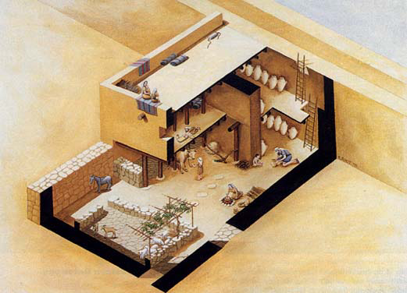
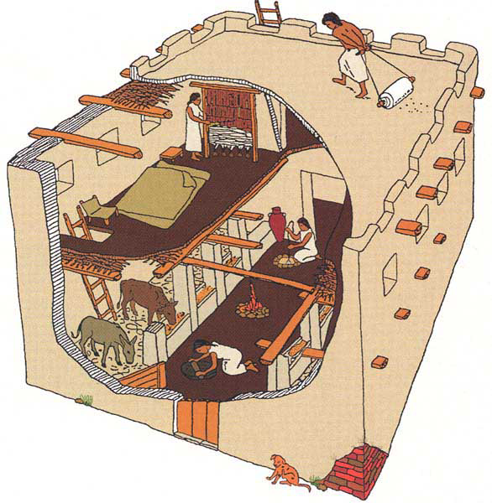
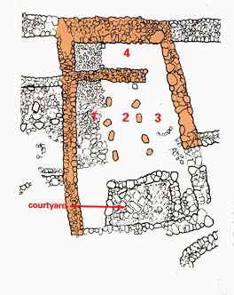
Paving Stones – 8 tons (2 men & donkey)
Ground floor walls -3 ft thick
Perimeter wall portion 7 to 8 ft thick
Total Wall Stones – 280 tons (4 men & donkey an intensive month
for walls + a week for interior walls)
Mortar & Plaster – 14 tons would take
(28 tons of limestone & 28 tons of wood to make mortar)
Wooden Posts and beams – 27 tons of lumber
Ceiling & Roof (15 in) – 14 tons of material
Mud brocks for 2nd floor walls – 2000 bricks (124 tons of clay)
The transitional period between the Late Bronze Age and the early Iron Age (the late 13th to early 12th centuries B.C.E.) is represented at ‘Umayri by two settlements: a short-lived one that was destroyed by an earthquake around 1200 B.C.E.† and a rebuilt town with beautifully preserved houses and a fortification system. We know very little about the earlier settlement except for its pottery, which was found in layers that date to before the earthquake. † The evidence for the earthquake is very clear: collapsed slabs of bedrock and rapidly deposited fills in open fissures in the ground.
Editor, Hershel Shanks: BAR 27:02 (March/April 2001). Biblical Archaeology Society, 2004; 2004
Israelite House about
1200 BC from tribe of Reuben at beginning
Of Iron Age 1
= ~470 tons
BAR 27:02 (March/April 2001).
Notes:
Rhonda Root/Madaba Plains Project
Excavators have uncovered an early example of a four-room house, a type of domestic dwelling often associated with the Israelites and found only infrequently east of the Jordan River. The cutaway drawing allows us to look into ‘Umayri’s Building B, the best-preserved Iron Age I four-room house from anywhere in the Levant. The two-story structure was divided into three long rooms by two rows of pillars, and a broad room spanned the back of the house (see photo and plan, opposite). The first floor was given over to animals and to food storage. The inhabitants, probably three generations of an extended family, ate, entertained and slept on the second floor (and possibly on the roof).
Editor, Hershel Shanks: BAR 27:02 (March/April 2001). Biblical Archaeology Society, 2004; 2004
The Four-Room House: What It Took to Get It Built
By Douglas R. Clark
Building a home for an extended family during Iron Age I (1200–1000 B.C.E.) was a huge task. An analysis of Building B, the well-preserved four-room house at ‘Umayri, shows just how large an investment in manpower and material was needed to assemble such a structure. We know because we have been restoring the first story of Building B and plan to build a full-size replica of it to use as a visitor center.
Let’s look at what went into each component of the house.
Floor
Building B had two types of floors: stone and beaten earth. Stone floors, not surprisingly, required greater labor, including finding and gathering flat stones, hauling them to the house and installing them carefully so they would be even. It would have taken at least two men and a donkey to locate, transport and lay the stones. The paving stones in Building B together weighed 8 tons. The sections of the floor that were of beaten earth consisted of finely laminated layers of ash and clay. Although this part of the floor would not have required as much effort to build as the stone floor, it still would have needed a fair bit of expertise and labor to make it level and smooth.
Walls
The exterior stone walls at ground level were about 3 feet thick. The exterior wall of the broad room, however, was between 7 and 8 feet thick, since it was built against, and formed part of, the perimeter wall of the city and served to thicken the city’s defenses. The stones ranged from small field stones to large boulders; they had been either transported from the surrounding slopes or reused from earlier structures at the site. The wall was chinked with cobbles to give it more stability. Raouf Abujaber, a local historian and landowner, estimates that it would take four men and a donkey about a month of intensive labor to collect the stones and to erect the first-story exterior walls. The interior walls and the animal pen would take another week. The stones in the walls weighed more than 280 tons.
Mortar and Plaster
Stable and smooth walls required mortar and plaster, which required lime, not an easy product to manufacture. Laborers had to carve large kilns in a hillside and fill them with wood and limestone; it took three to six days of continuous burning at 900 degrees centigrade to turn the stone into lime. Two tons of limestone and two tons of chopped wood were needed to produce one ton of lime. The mortar and plaster in the house weighed about 14 tons.
Supports
Large wooden posts, capable of bearing many tons of weight, supported the house’s second story. The ancient builders had to locate, fell, transport, trim and securely install these posts. Much lumber was also needed for beams spanning walls and posts and for branches to give additional support to the first-floor ceiling and the roof. All this lumber would have weighed 27 tons.
Ceiling and Roof
Small branches served as the base of the house’s two ceilings. Above the first-story ceiling these branches supported 8 to 10 inches of clay and mud mixed with sand, charcoal, ash and other types of temper; the second-story ceiling, because it also served as the roof, had a mixture 15 inches thick. The material in the two ceilings weighed about 14 tons.
Mudbrick Walls
The walls of the second story and the parapets were built entirely of large mudbricks measuring about 20 by 16 by 6 inches. The mudbricks were laid with mortar and were evidently plastered to form smooth, finished surfaces. Making the bricks required digging, collecting and transporting the clay, mixing the wet clay with straw or dung (about 130 pounds of straw were needed per 100 bricks), molding the bricks and laying them in place. The ‘Umayri house contained more than 2,000 bricks, which weighed 124 tons.
The total weight of the four-room house? About 470 tons!
Our partial reconstruction of the four-room house is part of a wider restoration project at ‘Umayri. The first phase of the project involved consolidating the stone walls of Building B. We then rebuilt the first story to show visitors what the structure originally looked like. For the sake of low maintenance, we used old utility poles as posts and beams (covering them with branches to give them a more authentic look), and we used concrete imitations to recreate the ceiling and mudbricks. In the next phase, undertaken just this past summer, we drew up plans for a platform from which visitors can view the site, and we installed fences, walls and a guardhouse to protect against grazing animals and would-be looters. The last and most ambitious phase calls for a full-size replica of the four-room house, which will serve as a visitor center, and the installation of directional signs to the site and interpretive labels at the site itself. Initial funding came from Jordanian royal and government sources, as well as from foreign sources, but the remainder—about $100,000—has to be raised by our project. If you would like to support us, write to Douglas Clark, Walla Walla College, College Place, WA 99234 (e-mail: clardo@wwc.edu). Contributions are tax deductible in the United States and Canada. For more photos and information, visit our Web site at http://mpp.wwc.edu.
Shanks, H. (Ed.). (2001). BAR 27:02 (March/April 2001).

Slide 21
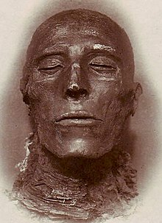
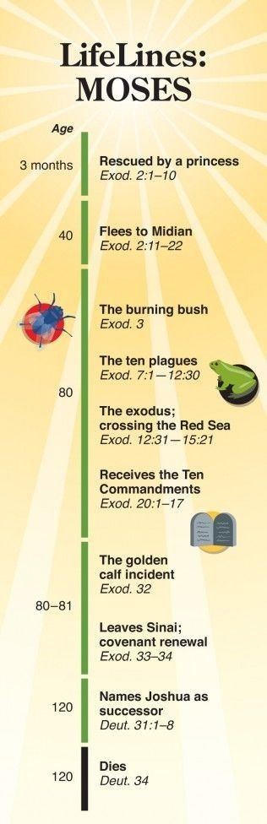
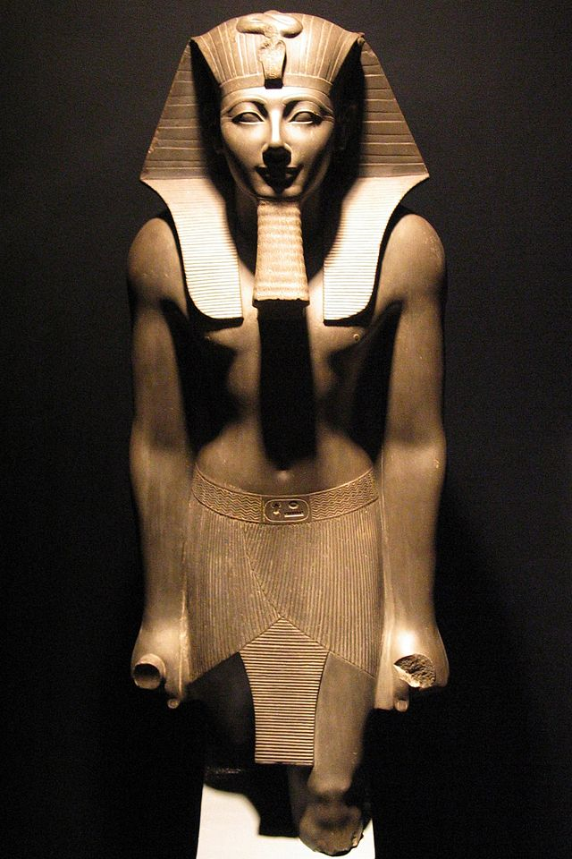
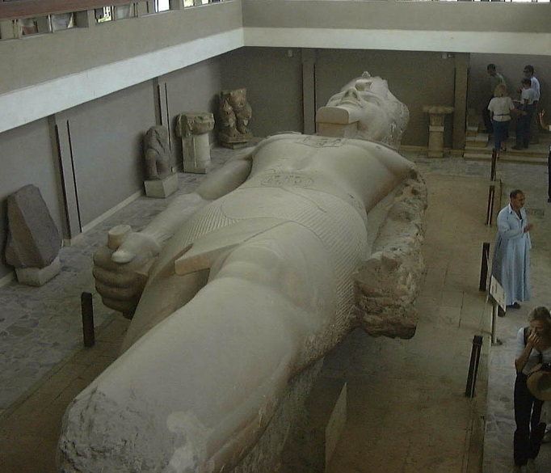
Pharaoh need to reign at least 40 yrs
Rameses II father reigned about 11 yrs
1446-1406 BC
1260-1220 BC
Pharaoh to reign for 40 yrs while Moses in wilderness – Thutmose III? (~1486 BC)
Pharaoh to reign for 40 yrs while Moses in wilderness – Rameses II (1300)?
Sixth Pharaoh of the Eighteenth Dynasty ruled for 54 years. During the first twenty-two years of Thutmose's reign he was co-regent with his stepmother and aunt, Hatshepsut, who was named the pharaoh
Known as Ramesses the Great, was the third pharaoh of the Nineteenth Dynasty of Egypt. He is often regarded as the greatest, most celebrated, and most powerful pharaoh of the Egyptian Empire he ruled 69 yrs
Exodus 2:23 (ESV)
23 During those many days the king of Egypt died, and the people of Israel groaned because of their slavery and cried out for help. Their cry for rescue from slavery came up to God.
Exodus 7:7 (ESV)
⁷ Now Moses was eighty years old, and Aaron eighty-three years old, when they spoke to Pharaoh.

Slide 22
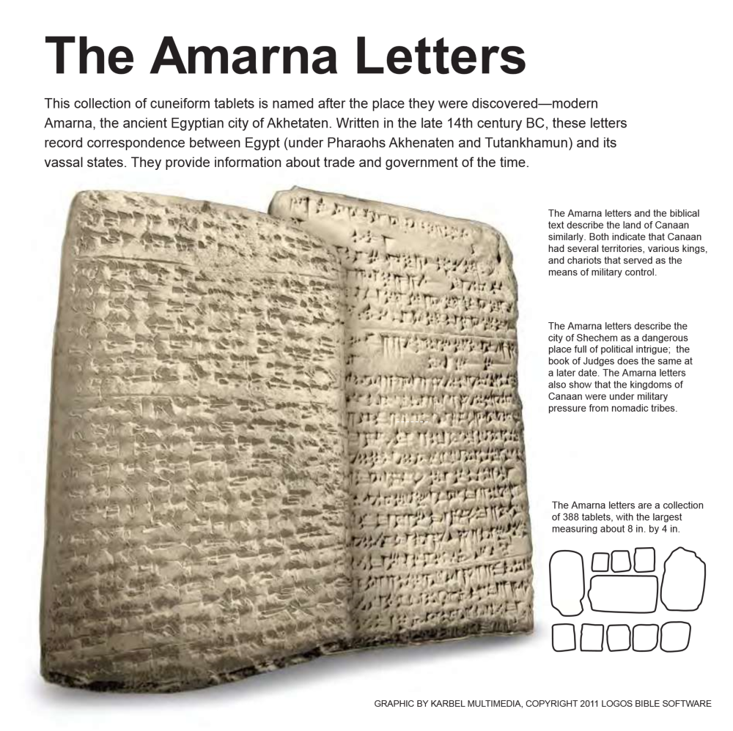
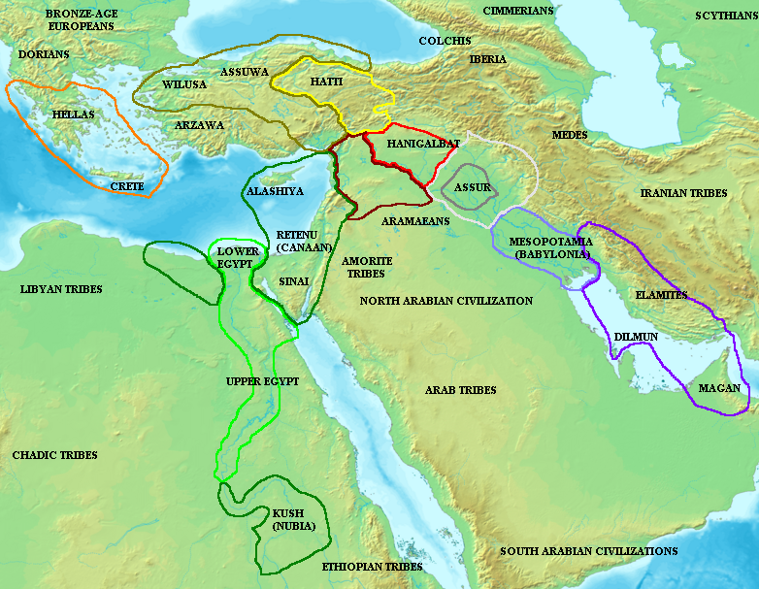
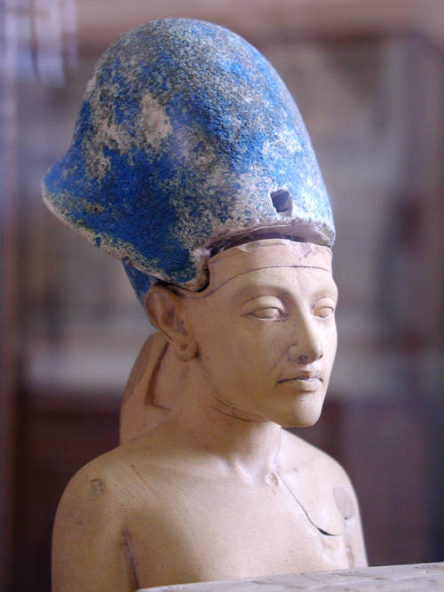
Akhenaten is thought to have been born 1379 BC or 1362 BC.
He succeeded his father in 1367 BC or 1350 BC at the age of twelve.
He reigned from 1367 BC to 1350 BC
or from 1350 BC/1349 BC
to 1334 BC/ 1333 BC
during the Eighteenth Dynasty.

Slide 23
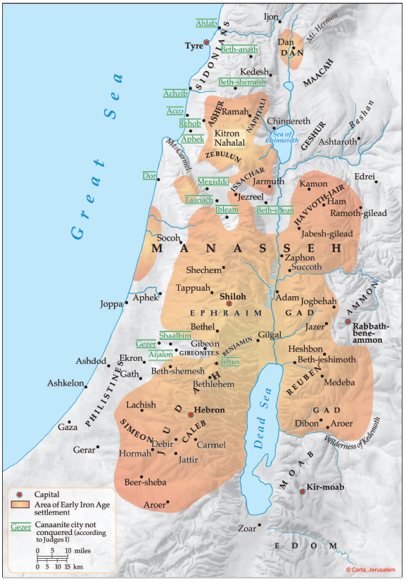
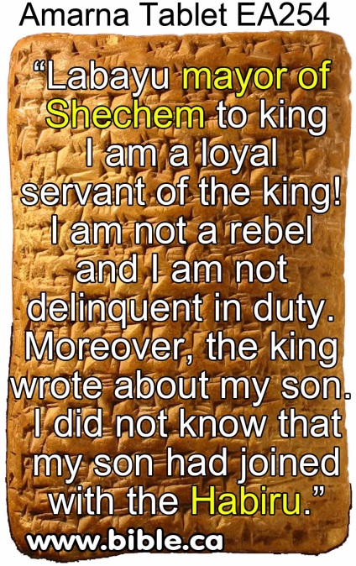
Acco
232-234
235+327
Hazor
227-228
Gath Padalla
249-250
Megiddo
242-248
365
Beth Shan 0
Gezer
292-294
267-277
297-300
378
Pella
255-256
Gath
63-65
278-284
335, 366
Shechem
252-254
Jerusalem
285-291
Ashkelon 320-326
Jericho 0
Gaza 0
Hebron 0?
Lachish
328-332

Slide 24
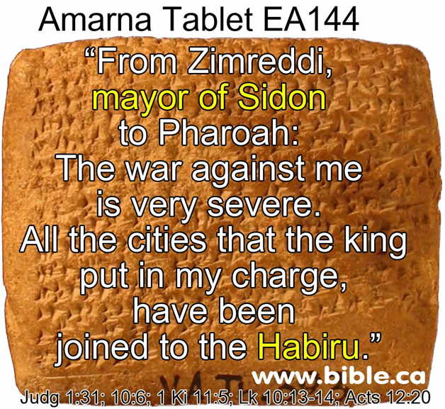
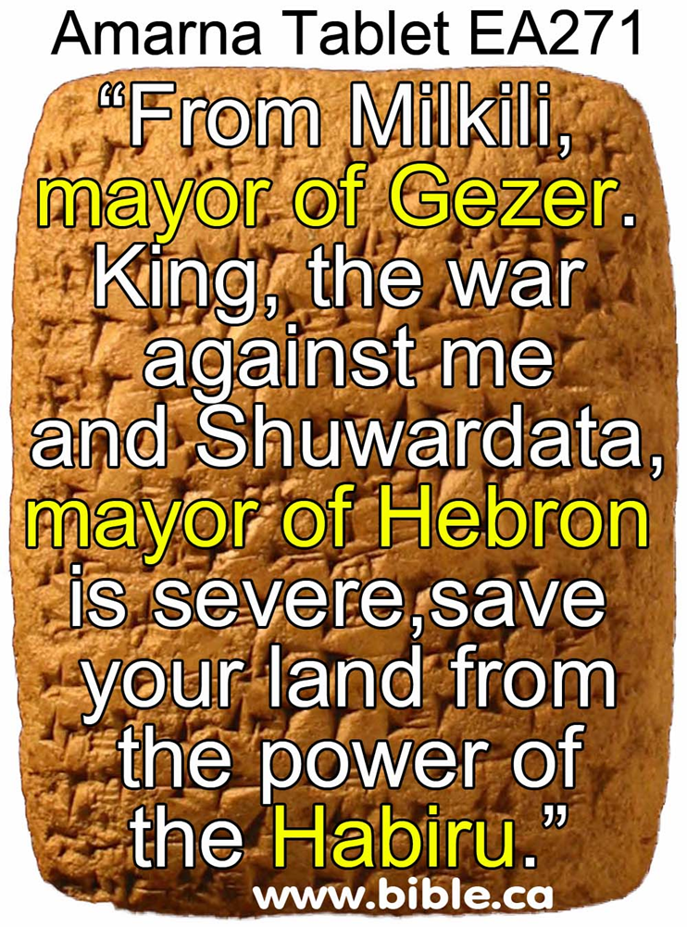

Slide 25
1446-1406 BC
1260-1220 BC
1 Kings 6:1 480 yrs from Temple dedication in 966 BC
Judges 11:26 Jephthah assigns 300 years between his day & the conquest
Archaeology has found no evidence of widespread destruction
Israelite population in hill country (4-room house)
Pharaoh to reign for 40 yrs while Moses in wilderness – Thutmose III
Pharaoh to reign for 40 yrs while Moses in wilderness – Rameses II
Amarna Tablets (~1350) from cities not in Israelite control – Habiru could include Hebrew
Habiru can not be identified with Israelites

Slide 26
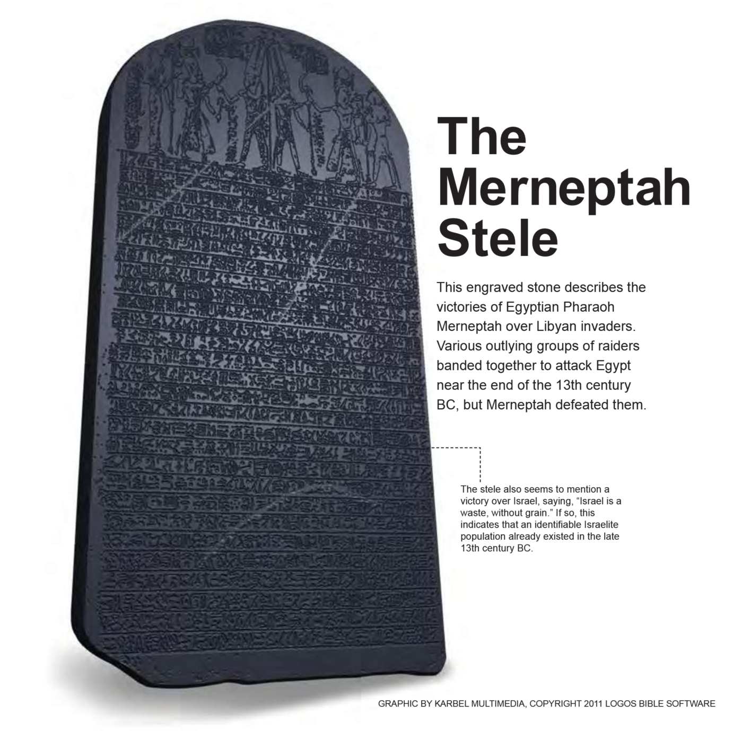
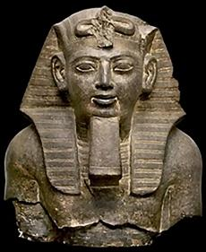

Slide 27
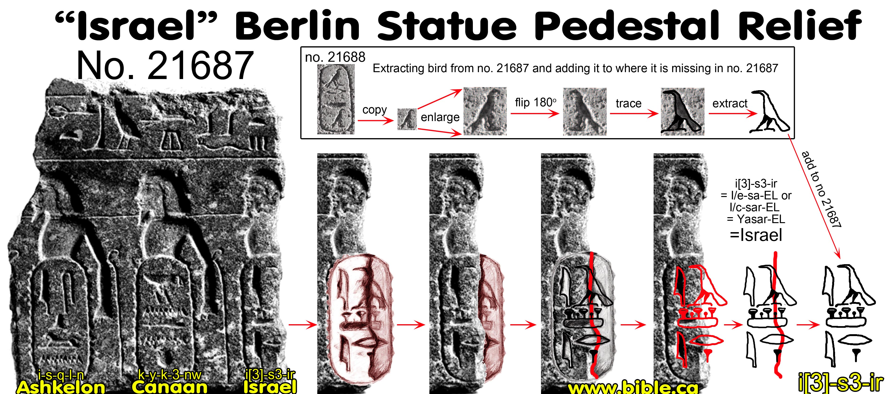
Part of a statue pedestal, was acquired in 1913 by Ludwig Borchardt
Possible date of 1350 - 1213 BC
Israel not widely accepted as 3rd figure
Notes:
Israel Berlin Statue Pedestal Relief"
1. Discovery of the tablet in museum storage drawers:
"The topographical relief that is the subject of this article is found on a grey granite slab measuring 46 cm in height and 39.5 cm in width (no. 21687). According to the Egyptian Museum’s warehouse archival notes, the fragment, most likely part of a statue pedestal, was acquired in 1913 by Ludwig Borchardt from a merchant named M. Nachman, along with several other objects. One of these is an additional pedestal relief of about the same size (50 × 38 cm) that is likewise made of grey granite (no. 21688; Figure 2). Although its presentation of prisoners and name rings is not exactly the same as on no. 21687, its overall size and layout does suggest it could have had a similar provenance. While no. 21687 in its present state of preservation contains three name rings superimposed on Western Asiatic prisoners, no. 21688 has three name rings superimposed on two Western Asiatic prisoners (outer left and right) and one Nubian prisoner in the center."(Israel in Canaan Long Before Pharaoh Merenptah?, Peter van der Veen, Journal of Ancient Egyptian Interconnections, Vol. 2:4, p15-25, 2010 AD)
Dating the Israel Berlin Statue Pedestal Relief no. 21687: 1350 - 1213 BC
a. The Berlin relief has been dated in a range as early as Amenhotep II (1400 BC) or Amenhotep III 1360 BC and as late as Ramesses II (1213 BC)
b. Since we know the exodus was in 1446 BC and the conquest started in 1406 BC, is seems unlikely that Egypt would recognize Israel any earlier than after the death of Joshua in 1358 BC.
c. We would set the oldest possible date for the Berlin "Israel" relief at 1350 BC and the youngest date to Ramesses II.
d. Scholars tend to view the Berlin relief as 14th century, which would favour a date 1350-1300 BC.
e. As stated above, we tentatively ascribe the Berlin pedestal relief to the reign of Ramesses II. Although the reference to “Israel” in association with Ashkelon and Canaan recalls the reference from the reign of Merenptah, a Ramesside date is by no means certain. Gorg originally ascribed the block to the reign of Amenhotep II due to the archaic renderings of the names “Ashkelon” and “Canaan.” Giveon preferred a date during the reign of Amenhotep III, which was tentatively accepted by Shmuel Ahituv. A date later than Ramesses II (for instance, during the reigns of Merenptah or Ramesses III) seems unlikely, however, as suggested by the short renderings (i.e., largely void of group writings) and the earlier form of the theophoric element 'El. These clearly deviate from the longer versions during the late Nineteenth and Twentieth Dynasties. (Israel in Canaan Long Before Pharaoh Merenptah?, Peter van der Veen, Journal of Ancient Egyptian Interconnections, Vol. 2:4, p15-25, 2010 AD)

Slide 28
1446-1406 BC
1260-1220 BC
1 Kings 6:1 480 yrs from Temple dedication in 966 BC
Judges 11:26 Jephthah assigns 300 years between his day & the conquest
Archaeology has found no evidence of widespread destruction
Israelite population in hill country (4-room house)
Pharaoh to reign for 40 yrs while Moses in wilderness – Thutmose III
Pharaoh to reign for 40 yrs while Moses in wilderness – Rameses II
Amarna Tablets (~1350) from cities not in Israelite control – Habiru could be Hebrew
Habiru can not be identified with Israelites
Days of the Judges not an issue
Merneptah Stela 1220 BC mentions defeating Israel the nation – little time

Slide 29
Dating the Conquest #3
Late Date
Samuel
Saul
David
Solomon
1400 BC
1300 BC
1200 BC
1100 BC
1000 BC
900 BC
480 yrs
1446
~300 yrs
~1100
966
~40 yrs wilderness
Early Date
Dating of Exodus Based on –
1 Kings 6:1
Jephthah’s statement Judges 11:26
Late date shortens the time of the Judges
1 Chron 6:33-37 the 19 Generations for Heman from Levi to Solomon

Slide 30
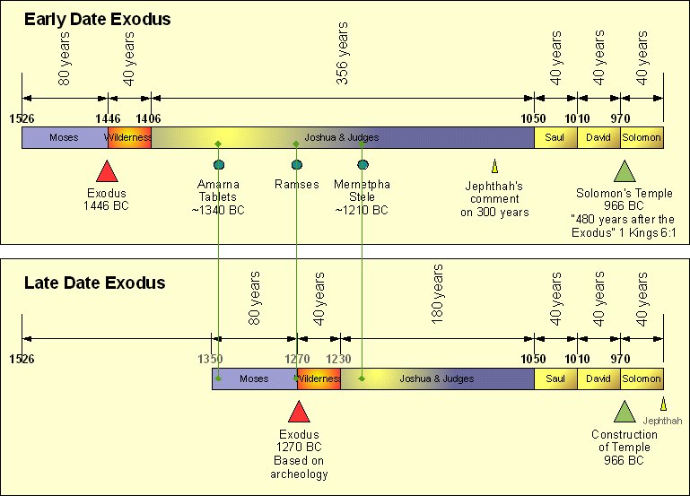
Early & Late Dates

Slide 31
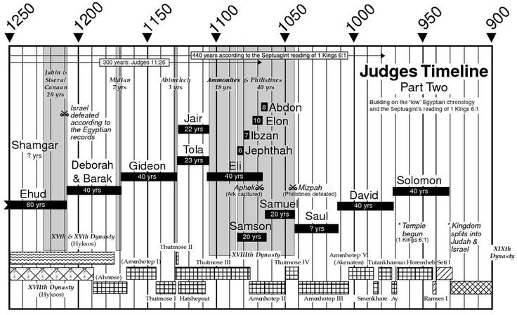
1446-1406 BC
1260-1220 BC
Adequate time to fit Judges into time period of 1370 to 1010 BC
Difficult to fit Judges into shorten time period of 1200 to 1050 BC

Slide 32
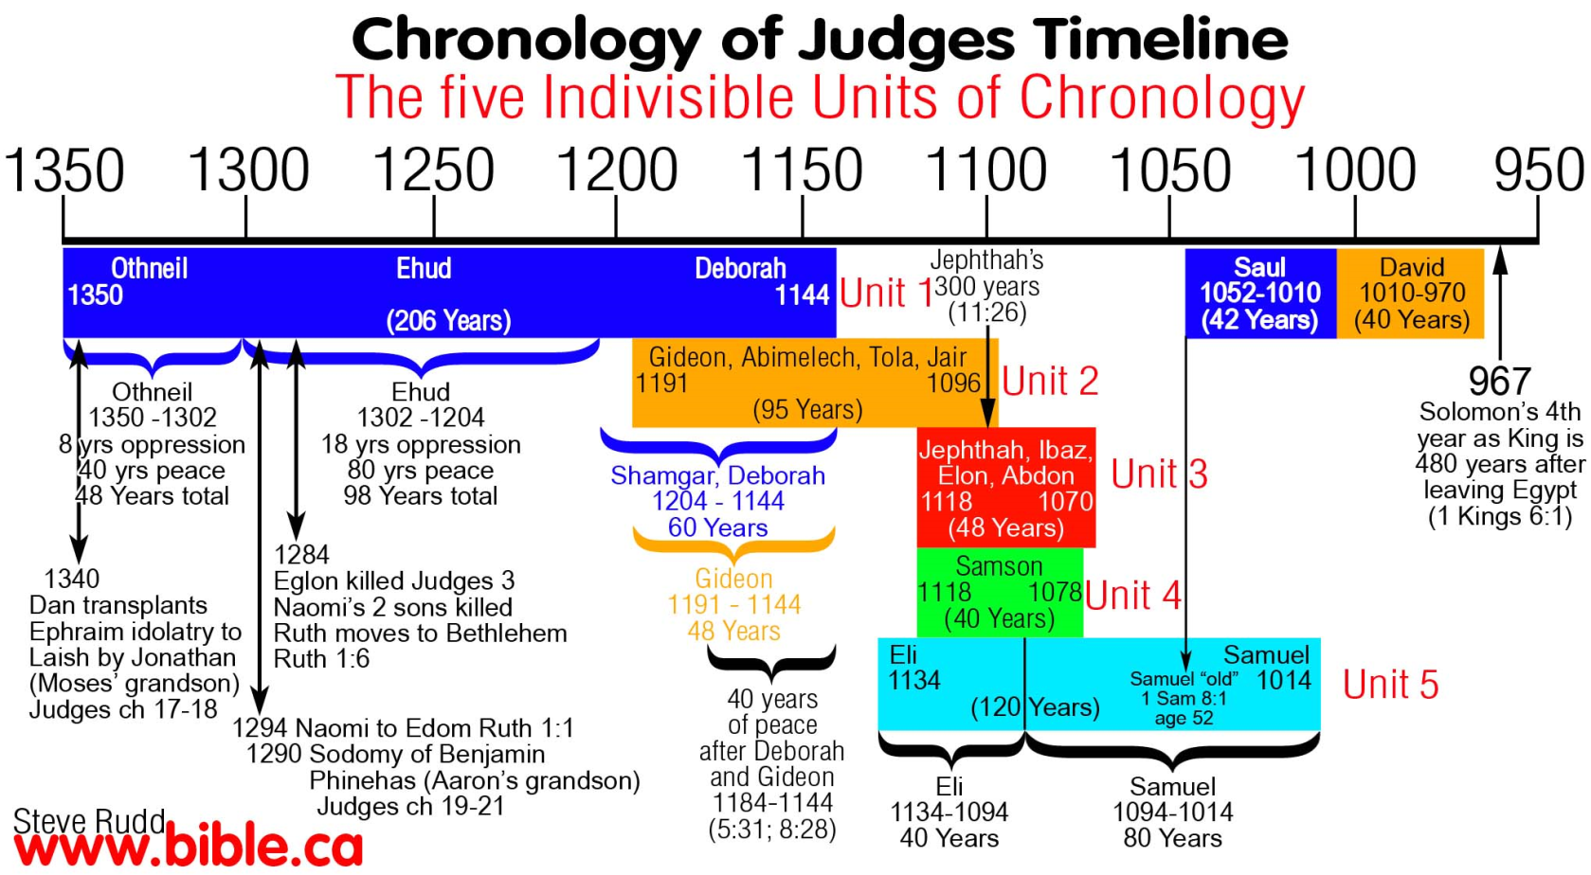
1446-1406 BC
1260-1220 BC
Adequate time to fit Judges into time period of 1350 to 1050 BC
Difficult to fit Judges into shorten time period of 1200 to 1050 BC

Slide 33
1446-1406 BC
1260-1220 BC
Adequate time to fit Judges into time period of 1370 to 1010 BC
Difficult to fit Judges into shorten time period of 1200 to 1050 BC
City being built in days before birth of Moses – Rameses used earlier than 1300
Exodus 1:11 says Israelites building city of Ramses, Pharaoh of Exodus
430 yrs in Egypt fits with fall of Hyksos rise of Pharaohs did not know Joseph
Hyksos not part of the discussion – Whole time under New Kingdom
1446 BC+ 430yrs = 1876 BC Entering Egypt
Hyksos/Semites rule from 1786 to 1580BC

Slide 34
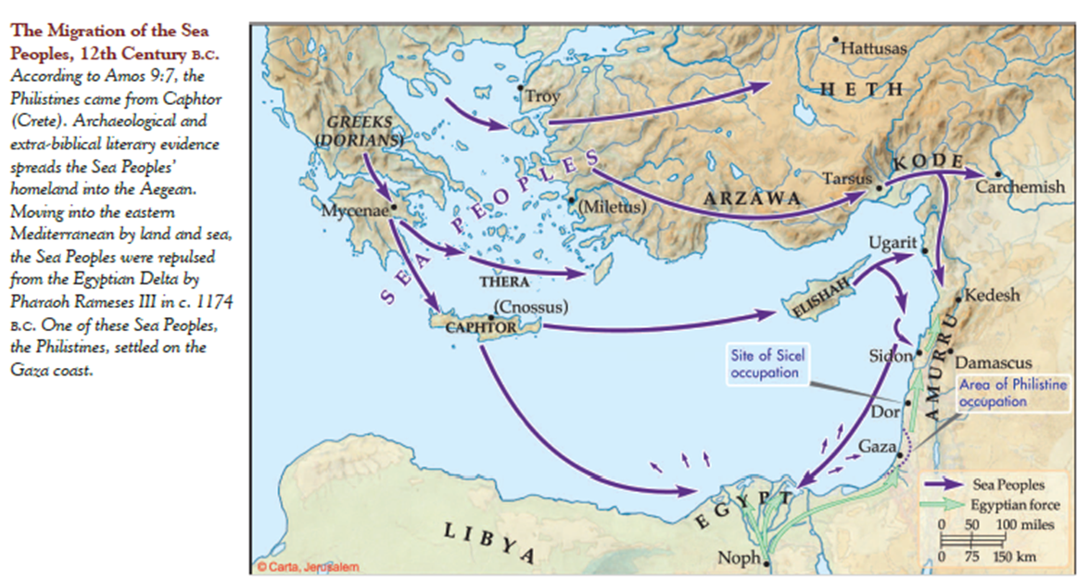

Slide 35
1446-1406 BC
1260-1220 BC
Adequate time to fit Judges into time period of 1370 to 1010 BC
Difficult to fit Judges into shorten time period of 1200 to 1050 BC
City being built in days before birth of Moses – Rameses used earlier than 1300
Exodus 1:11 says Israelites building city of Ramses, Pharaoh of Exodus
430 yrs in Egypt fits with fall of Hyksos rise of Pharaohs did not know Joseph
Hyksos not part of the discussion – Whole time under New Kingdom
Land of the Philistines not conquered-
Joshua 2:2-3 (1200 BC)
Philistines arrival fit in times of the Conquest
Hittite texts from the reign of King Suppiluliumas (1380-1340 BC) indicate that a migration of people had already taken place from Asia minor (modern Turkey) into the Levant
Charles River - The Sea Peoples: The Mysterious Nomads Who Ushered in the Iron Age

Slide 36
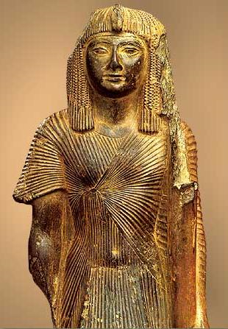
Seti I about 1289 BC
Ramses II passes thru to fight Hittite
Wenamon traveled Levant about 1180 BC
Egyptians avoid region of Israel

Slide 37
1446-1406 BC
1260-1220 BC
Adequate time to fit Judges into time period of 1370 to 1010 BC
Difficult to fit Judges into shorten time period of 1200 to 1050 BC
City being built in days before birth of Moses – Rameses used earlier than 1300
Exodus 1:11 says Israelites building city of Ramses, Pharaoh of Exodus
430 yrs in Egypt fits with fall of Hyksos rise of Pharaohs did not know Joseph
Hyksos not part of the discussion – Whole time under New Kingdom
Land of the Philistines not conquered-
Joshua 2:2-3 (1200 BC)
Philistines arrival fit in times of the Conquest
Israel not mentioned in Palestine invasions of Seti I & or Ramses II
Israel not there so no mention
Adequate time to fit Judges into time period of 1370 to 1010 BC
Hazor burned only once – not Joshua & Deborah & Barak

Slide 38
Dating the Conquest #4
Samuel
Saul
David
Solomon
1400 BC
1300 BC
1200 BC
1100 BC
1000 BC
900 BC
480 yrs
1446
~300 yrs
~1100
966
~40 yrs wilderness
Dating of Exodus Based on –
1 Kings 6:1
Jephthah’s statement Judges 11:26
Late date shortens the time of the Judges
1 Chron 6:33-37 the 19 Generations for Heman from Jacob(Israel) to Solomon
Genealogy of Heman in 1 Chron 6:33–37 lists 20 from Levi generations - Wikepedia gives a length of a generation of 25.2 to 27.4 (25) years or ~ 475-500 years , the lower would put it at about 1446 BC or if 40 yrs = 800 yrs ((1776 BC vs 1886)
1 Chronicles 6:33-38 (ESV)
33 These are the men who served and their sons. Of the sons of the Kohathites: Heman the singer the son of Joel, son of Samuel, 34 son of Elkanah, son of Jeroham, son of Eliel, son of Toah, 35 son of Zuph, son of Elkanah, son of Mahath, son of Amasai, 36 son of Elkanah, son of Joel, son of Azariah, son of Zephaniah, 37 son of Tahath, son of Assir, son of Ebiasaph, son of Korah, 38 son of Izhar, son of Kohath, son of Levi, son of Israel;
20
19
18
17
16
15
14
13
12
11
10
9
8
7
6
5
4
3
2
1

Slide 39
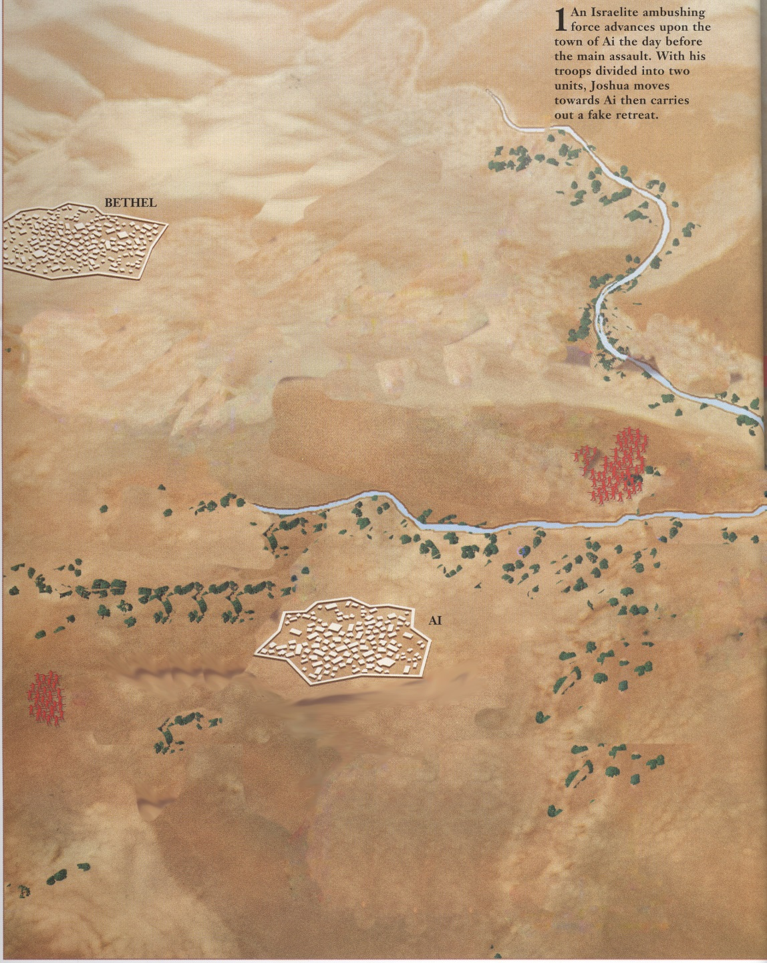
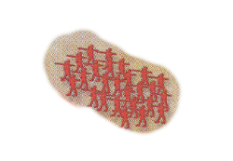

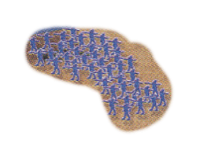



Joshua 8
1-5000 men Bethel/Ai
6-And when Joshua and all Israel saw that the ambush had captured the city, and that the smoke of the city went up, then they turned back and struck down the men of Ai.
7- And Israel struck them down, until there was left none that survived or escaped
North Gate
Not a man was left in Ai or Bethel who did not go out after Israel. They left the city open and pursued Israel.
1-30,000 mighty men of valor and sent them out by night.
3- we shall flee before them.
Location of Ai????

Slide 40
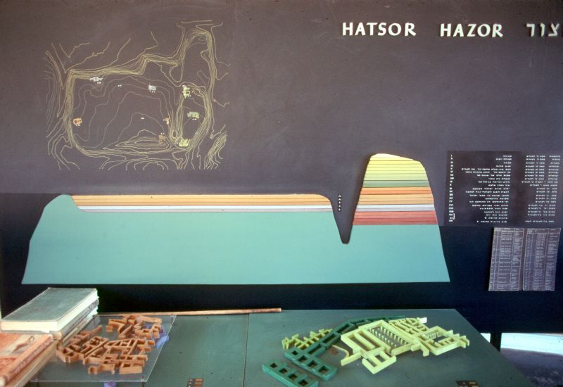
Hazor Diagram – Mound City
Upper Hazor
Lower Hazor

Slide 41
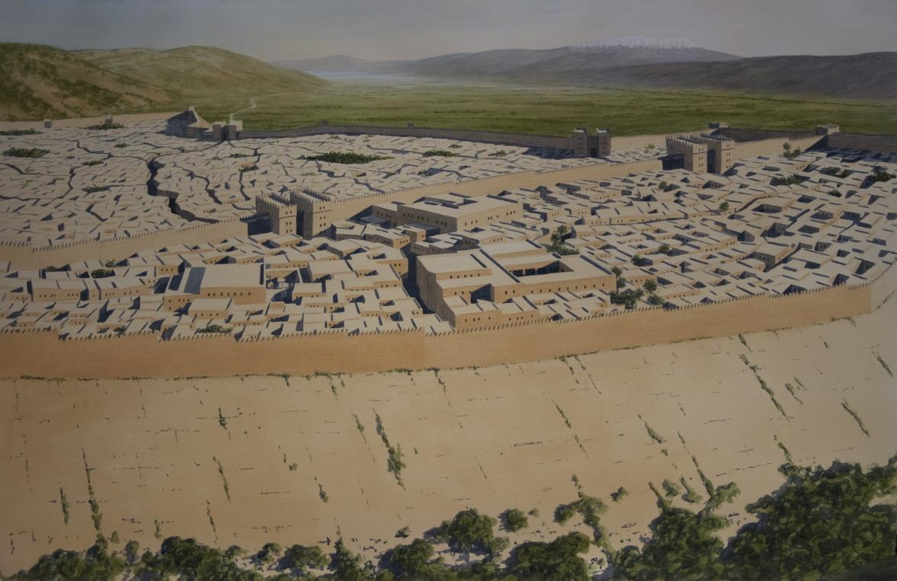
Hazor 1400’s

Slide 42
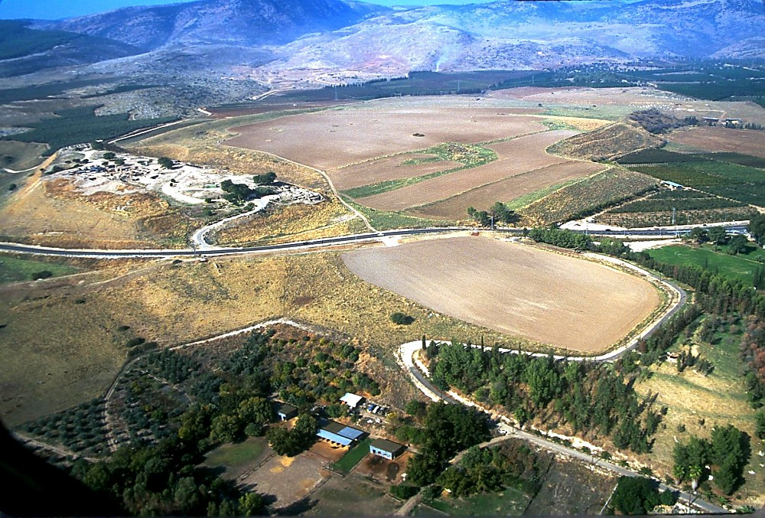
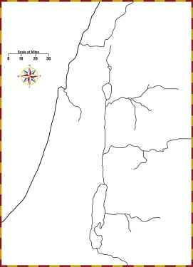
Hazor aerial from southeast
Upper Hazor
Lower Hazor
Hazor aerial from southeast – Mound City
Notes:
Hazor: Introduction
Known in Joshua's day as "the head of all those kingdoms," the 200-acre tell of Hazor is today the largest one in Israel. At its height, in the Canaanite period, the city encompassed the entire tell, both the lower section and the upper. Later, when it was inhabited by Israelites, the fortified city included only the Upper City. Anyone who passed through the main valley had to pass by Hazor. This was the route of the main International Highway (sometimes known as the “Via Maris”).

Slide 43
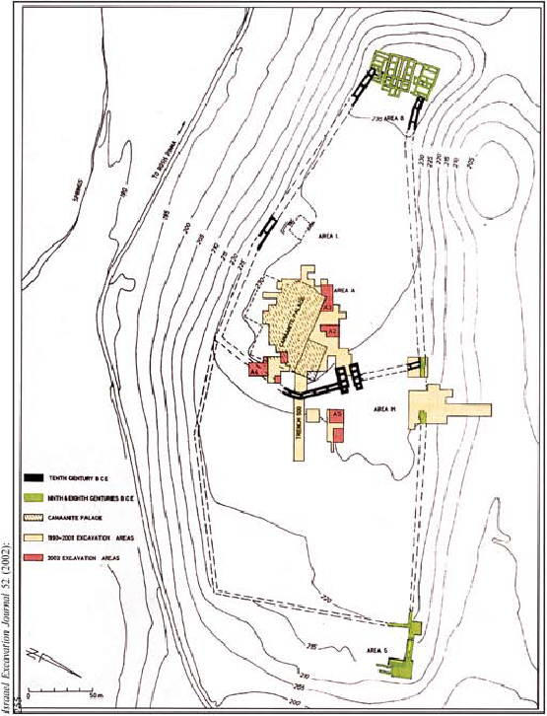
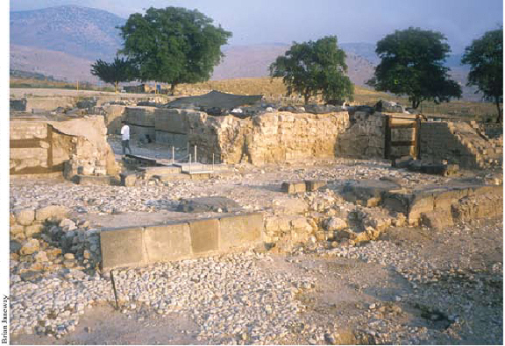
The Canaanite Palace, has provided additional evidence relating to the destruction of the city. Statues found in the rubble were seemingly intentionally decapitated and disfigured. Who where the most likely candidates for such actions?
Egyptians?
Hittites?
Israelites?
Notes:
, the Canaanite Palace, has provided additional evidence relating to the destruction of the city. Statues found in the rubble were seemingly intentionally decapitated and disfigured. Who where the most likely candidates for such actions? Would it have been the Egyptians who campaigned in the region under Seti I around 1300 BC? Or perhaps Ramses II, who traveled through the region enroute to battle the Hittites at Kadesh in 1275 BC? The evidence points instead to the Israelites, in Ben-Tor’s view (Ben-Tor 1997:123; Rabinovich and Silberman 1998:53).
Nonetheless, Ben-Tor now believes that the destruction could very well date earlier, as early as the late 14th century. He says, “If it were somewhat earlier it could still be Israelite, but the earlier you go the less the chances of that” (Rabinovich 1998:53). The earlier dating of this destruction creates a problem for “late-daters,” but not if the Israelites had been in the land for some time, as held by early-date proponents. Is this evidence of the burning of Hazor by Joshua, or could Deborah and Barak have been responsible during the period of the Judges? The latter would accord better with Biblical data.
There is also, however, evidence of an earlier destruction. In Area A, just north of the Canaanite palace, a “royal temple” was excavated in the 1968 season. It is of the migdol fortress type and is paralleled by buildings at Megiddo VII and Shechem. The structure was destroyed “at some time in the Late Bronze I” and never again restored (Yadin 1972:103; Ben-Tor 1993:604). Additionally, in Area M, the plateau area that joins the lower city to the upper city, a “huge pit,” whose function is unknown, revealed another Late Bronze destruction. In the excavator’s view, “it is so far the only clear indication of an earlier destruction, still in the Late Bronze Age, pre-dating the final destruction of the city” in ca. 1300 BC (Ben-Tor 2000:248–49). The excavator attributes this destruction to Thutmose III (ca. 1483 BC). Could the earlier destruction be assigned to Joshua and the later one to Deborah and Barak? It would seem like a tenable solution.

Slide 44
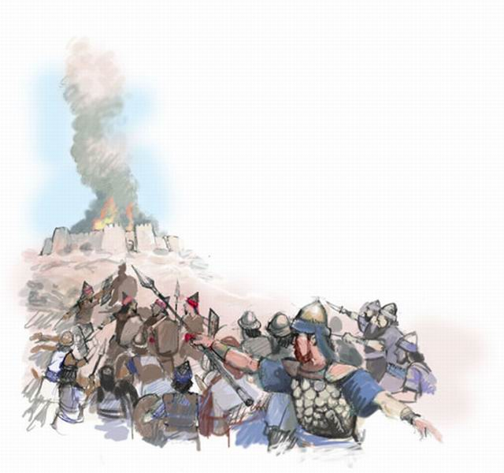
How many of the cities defeated where burned in the northern campaign
¹³But none of the cities that stood on mounds did Israel burn, except Hazor alone; that Joshua burned.

Slide 45
1446-1406 BC
1260-1220 BC
Adequate time to fit Judges into time period of 1370 to 1010 BC
Difficult to fit Judges into shorten time period of 1200 to 1050 BC
City being built in days before birth of Moses – Rameses used earlier than 1300
Exodus 1:11 says Israelites building city of Ramses, Pharaoh of Exodus
430 yrs in Egypt fits with fall of Hyksos rise of Pharaohs did not know Joseph
Hyksos not part of the discussion – Whole time under New Kingdom
Land of the Philistines not conquered-
Joshua 2:2-3 (1200 BC)
Philistines arrival fit in times of the Conquest
Israel not mentioned in Palestine invasions of Seti I & or Ramses II
Israel not there so no mention
Generations of Heman could fit
Generations of Heman does not fit
Adequate time to fit Judges into time period of 1370 to 1010 BC
Hazor burned only once – not Joshua & Deborah & Barak

Slide 46
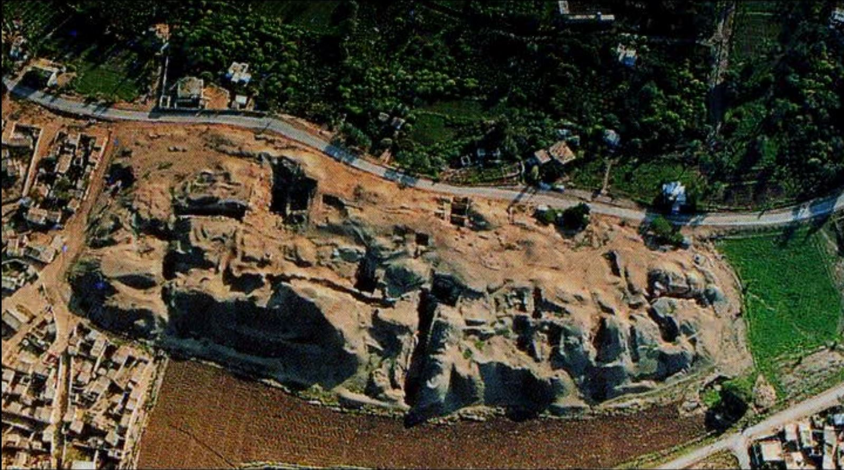
Jericho Today

Slide 47
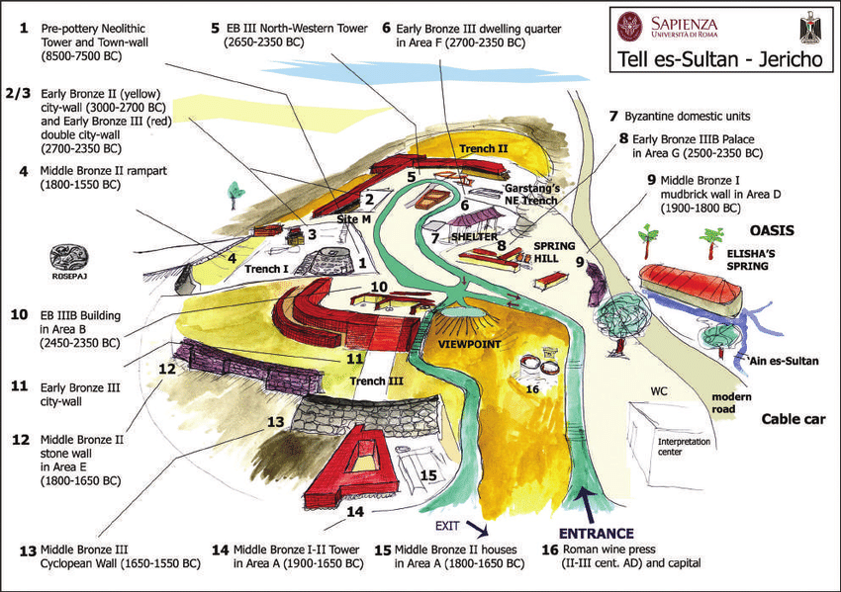

Slide 48
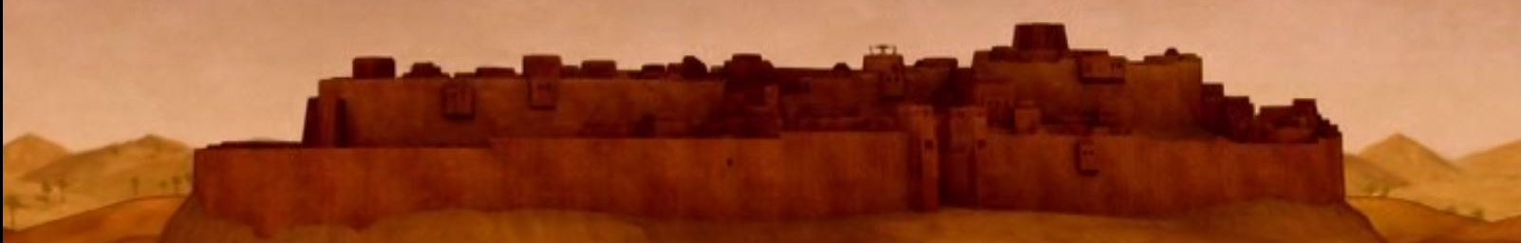
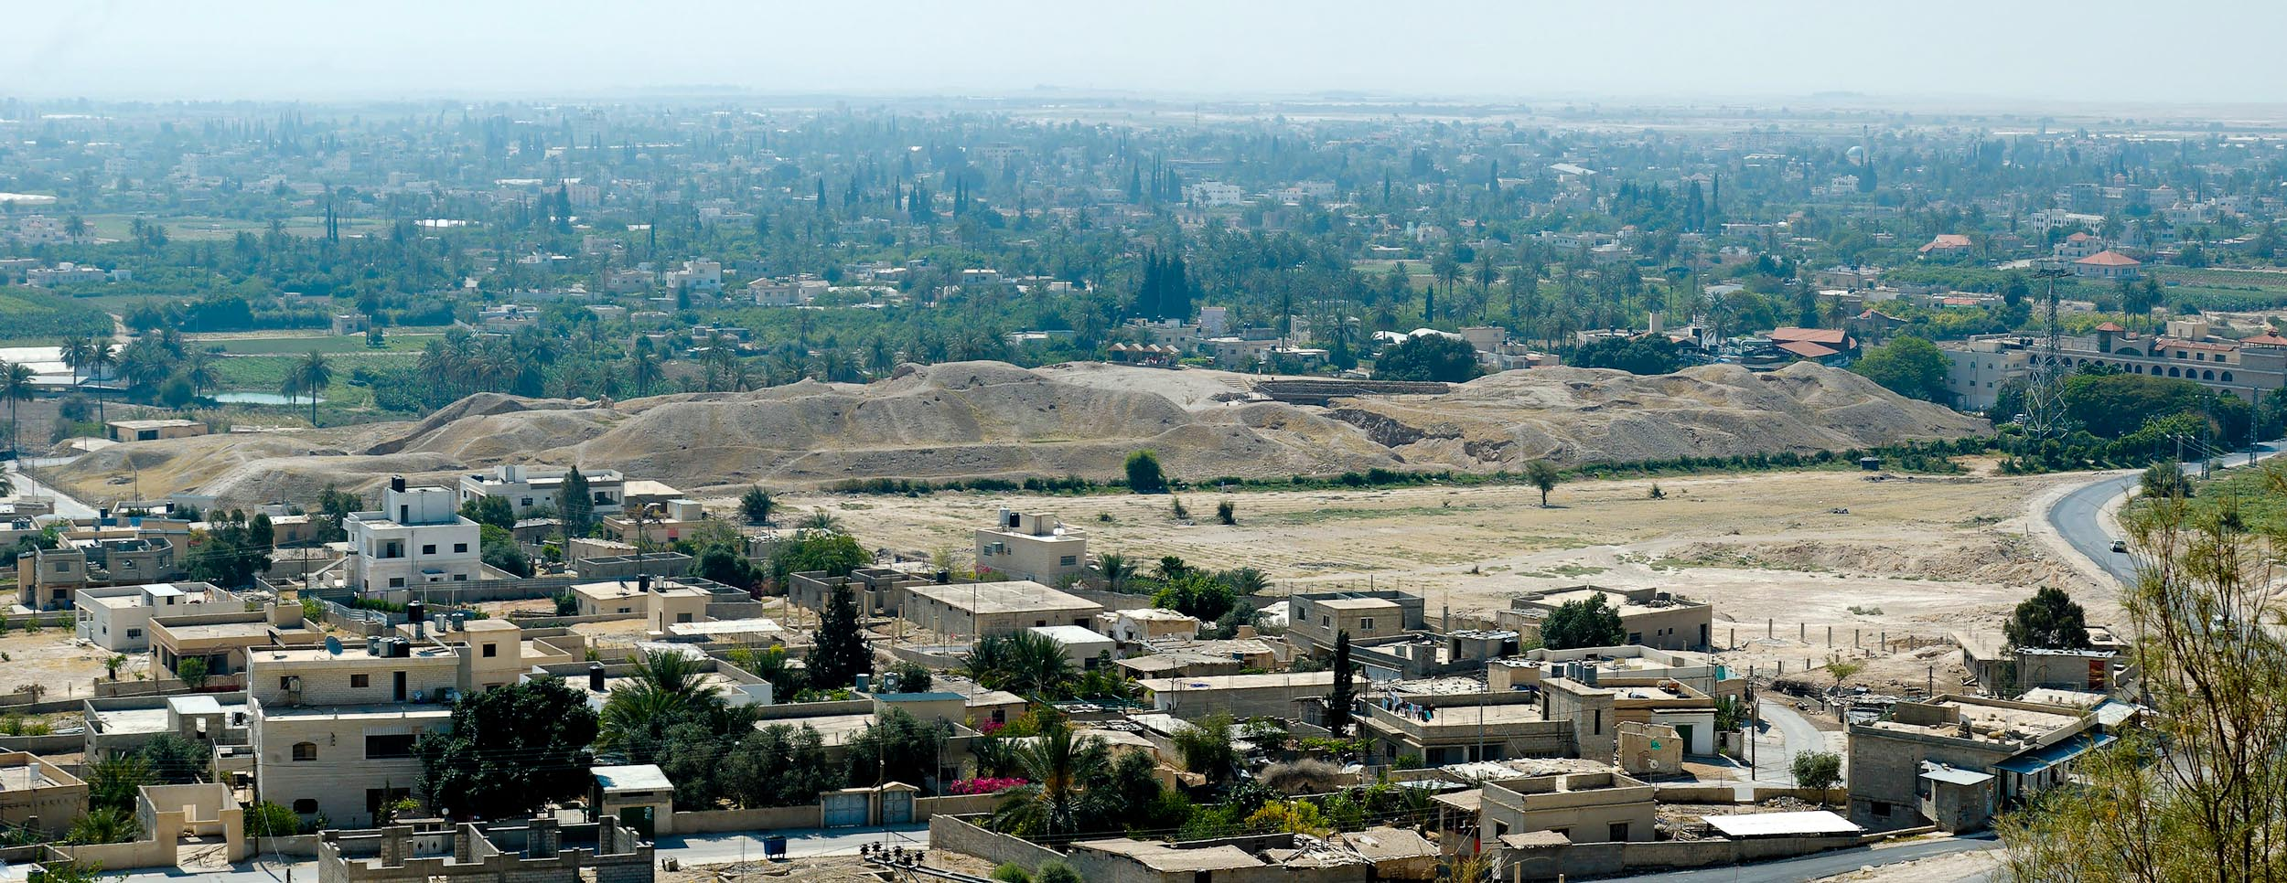
Jericho, Tell es-Sultan from west panorama
Notes:
Jericho in the Persian Period
Jericho became a Persian administrative center during late 6th century BC.
The city was rebuilt by the Jews after their return from Babylon (Ezra 2:34; Neh 2:35; 7:36), and the residents here also helped to rebuild the walls of Jerusalem (Neh 3:2).
tb05110685p

Slide 49
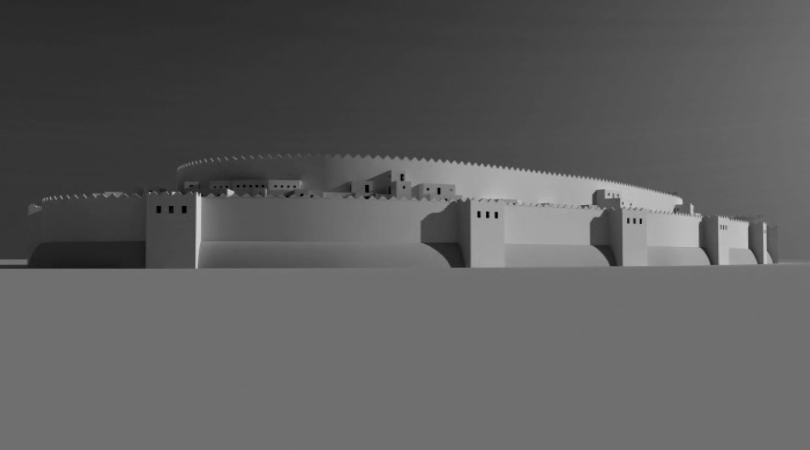
Hebrews 11:30-31(ESV)
³⁰By faith the walls of Jericho fell down after they had been encircled for seven days.
³¹By faith Rahab the prostitute did not perish with those who were disobedient, because she had given a friendly welcome to the spies.

Slide 50
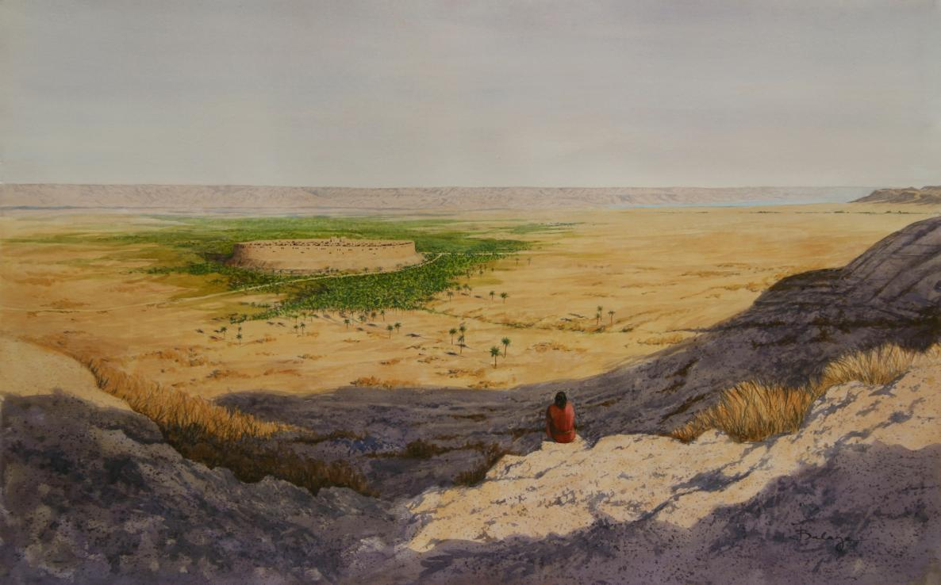

Slide 51
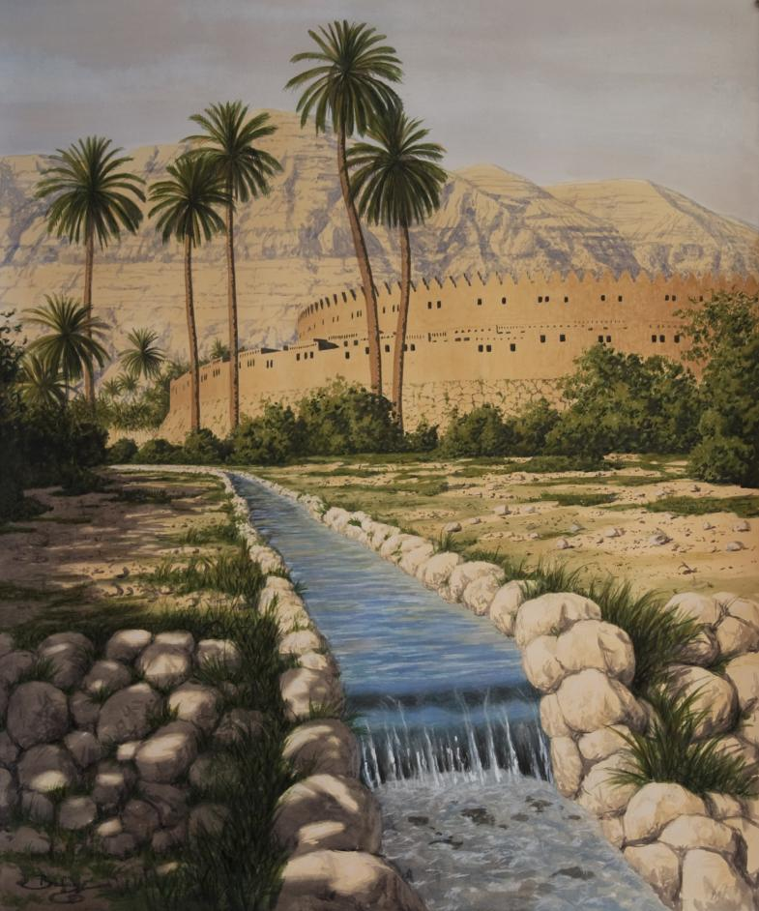

Slide 52
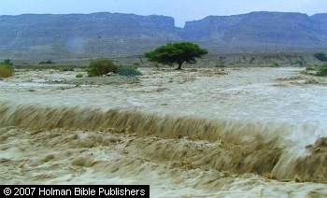
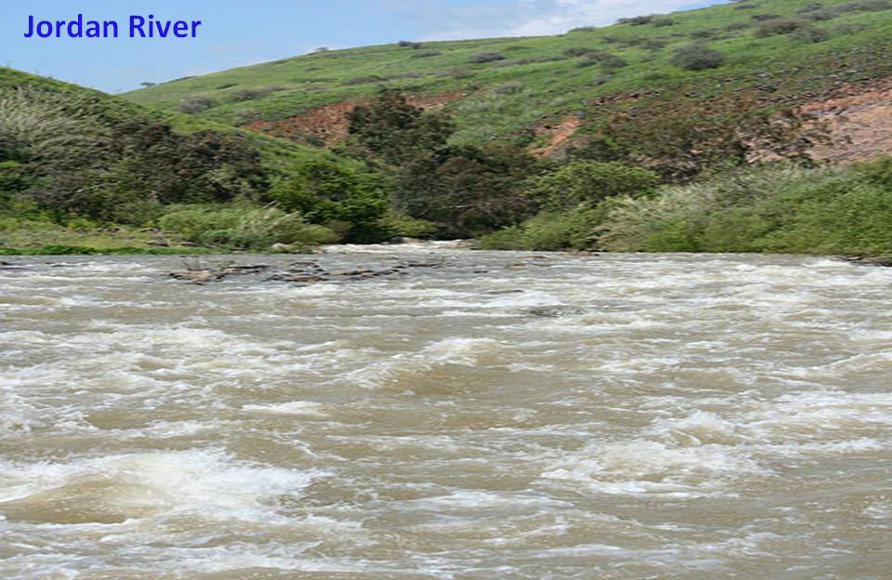
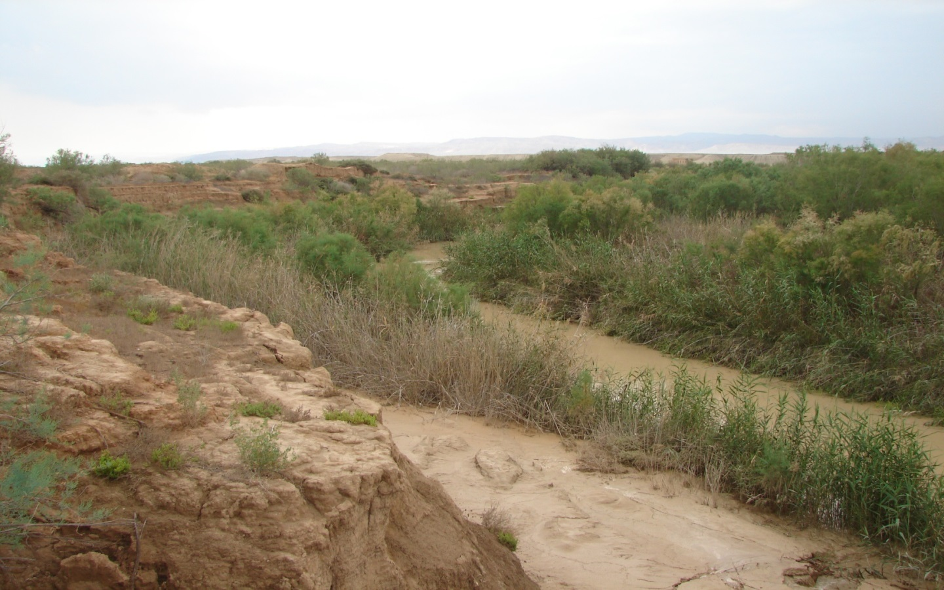
Normal vs Flooded Jordan River
Joshua 3:15(ESV)
¹⁵ …(now the Jordan overflows all its banks throughout the time of harvest),
Joshua 4 ¹⁴On that day the Lord exalted Joshua in the sight of all Israel, and they stood in awe of him just as they had stood in awe of Moses, all the days of his life.

Slide 53
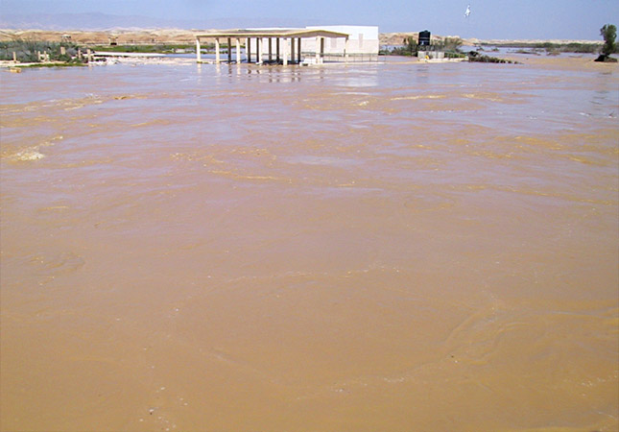
Jordan River during the Flood
Joshua 3:15 and as those who bore the ark came to the Jordan, and the feet of the priests who bore the ark dipped in the edge of the water (for the Jordan overflows all its banks during the whole time of harvest),

Slide 54
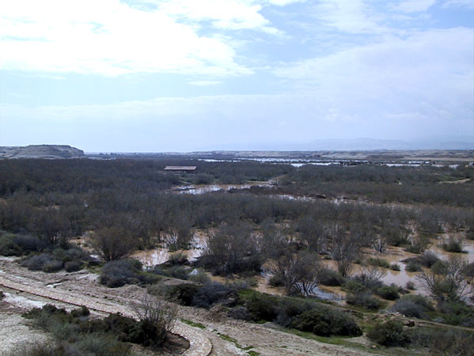
Jordan River during the Flood
Joshua 3:16 that the waters which came down from upstream stood still, and rose in a heap very far away at Adam, the city that is beside Zaretan. So the waters that went down into the Sea of the Arabah, the Salt Sea, failed, and were cut off; and the people crossed over opposite Jericho.
Notes:
www.baptismsite.com/facilities.asp

Slide 55
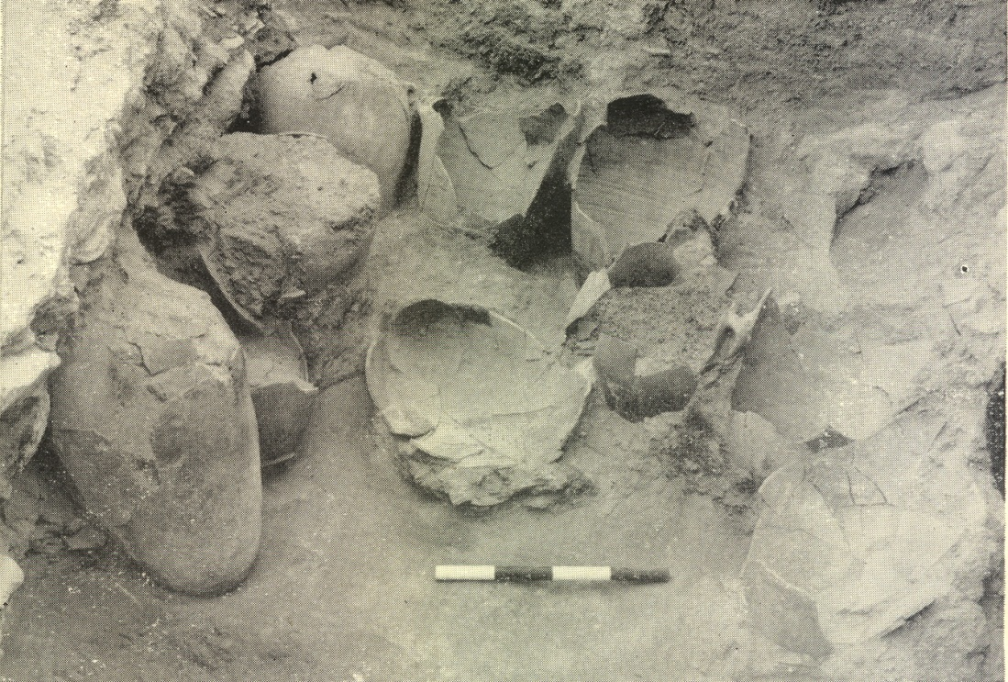
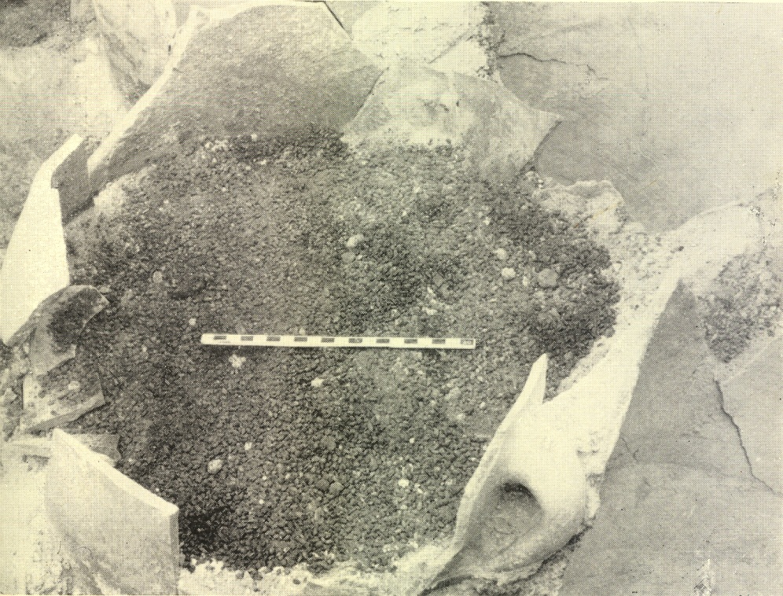
Joshua 6
A Short Siege – City Full of Grain
¹Now Jericho was securely shut up because of the children of Israel; none went out, and none came in
¹⁵But it came to pass on the seventh day that they rose early, … ¹⁷Now the city shall be doomed by the Lord to destruction, it and all who are in it.

Slide 56



Grain storejars in Kenyon's balk
Grain storejars in Kenyon's balk

Slide 57

Joshua’s Challenges –
People who had failed last time – 40 yrs
New Leader
New Generation
A swollen river
A walled city
Unknown city/people
Be Strong & Courageous
Just as I was with Moses, so I will be with you.
I will not leave you or forsake you
People – tell Be Strong & Courageous
Prepared people (3 days provisions)
Checked that Tribes across Jordan with him
Sent spies into Jericho
Lord took care of the river
& walled city
Jo 1:2 Now therefore arise, go over this Jordan

Slide 58


Jordan Stopped near city of Adam, about 15 miles North of where the river was crossed
X

Slide 59


Slide 60


Slide 61


Slide 62

Jericho Then

Slide 63


A Mighty Wall Taking By Faith

Slide 64

A Double
Walled City
Inner Wall
Outer Wall
Retaining Wall

Slide 65


Kenyon’s Section Drawing
Notes:
Top: after Kenyon, Jericho 3, Plate 236/Lower left: Sellin & Watzinger, Jericho/Lower right: Garstang, PEFQS (1931)A slice of Jericho. A section drawing, top, prepared by Kathleen Kenyon, describes what she found in a trench cut through the western defenses of the city. It pictures the excavated materials as if a vertical slice had been cut—as in fact it was by her trench—through the revetment wall at the base of the tell and through the high earthen embankment that rose to the top of the tell. The 15 foot-high stone revetment wall at the base of the tell (gray) was buried under later remains. (See photograph of the outer face of this wall.)
All three excavations at Jericho found evidence—at different points around the tell—of a mudbrick parapet wall atop the stone revetment wall. In Kenyon’s drawing, as well as in the two sections below it, by Sellin and Watzinger (left) and Garstang (right), gray indicates the revetment wall and violet highlights the parapet wall on top of it.

Slide 66

A High Walled City
Inner Wall
Outer Wall
Just the
Retaining Wall

Slide 67

A High Walled City
Just the
Retaining Wall

Slide 68



The revetment wall at Jericho
Stone Revetment Wall
15 ft high
Notes:
Sellin and Watzinger, Jericho
A new look at an old excavation. This photo was taken at the first major excavation at ancient Jericho, conducted by Sellin and Watzinger. On a diagonal at lower right is a portion of the stone revetment wall, rising to a height of some 15 feet; its scale is evident from the man at far right. The revetment wall surrounded the city at the base of the sloping earthen rampart and provided a first line of defense for the city at the top of the slope (see plan). Atop this revetment wall a mudbrick parapet wall is clearly visible. Behind the parapet, across the center of the photo, are the remains of houses inside the revetment wall on the top of the rampart. These same buildings can be seen on the plan. These houses seem to have been on the “wrong side of the tracks” in ancient Jericho; their walls were rather flimsy—only one brick thick. Author Wood suggests that Rahab, the prostitute who assisted Joshua’s spies, might have lived in one of these houses on the sloping rampart between the revetment wall encircling the bottom of the hill and the city wall that surrounded the top of the tell.
Editor, H. S. 2002;2002. BAR 16:02 (March/April 1990). Biblical Archaeology Society
Sellin and Watzinger, JerichoLife on the edge. This plan provides a bird’s-eye-view of the Sellin and Watzinger excavations on the northern end of the tell. On the right, labelled “Israelitische Böschungsmauer” (Israelite Revetment Wall), is the tell’s outermost fortification. The buildings shown here were built on the rampart that rose to Jericho’s city wall proper. The city wall is not shown here; it would have been just off the left side of this plan.

Slide 69



Commander of the Lord’s Army Plan

Slide 70

Hebrews 11:30-31(ESV)
³⁰By faith the walls of Jericho fell down after they had been encircled for seven days.
³¹By faith Rahab the prostitute did not perish with those who were disobedient, because she had given a friendly welcome to the spies.

Slide 72


Slide 73


Slide 74

Joshua 6:20 (ESV)
²⁰ So the people shouted, and the trumpets were blown. As soon as the people heard the sound of the trumpet, the people shouted a great shout, and the wall fell down flat, so that the people went up into the city, every man straight before him, and they captured the city.

Slide 75

Joshua 6:20 (ESV)
²⁰ So the people shouted, and the trumpets were blown. As soon as the people heard the sound of the trumpet, the people shouted a great shout, and the wall fell down flat, so that the people went up into the city, every man straight before him, and they captured the city.

Slide 76

Joshua 6:20 (ESV)
²⁰ So the people shouted, and the trumpets were blown. As soon as the people heard the sound of the trumpet, the people shouted a great shout, and the wall fell down flat, so that the people went up into the city, every man straight before him, and they captured the city.

Slide 77

Joshua 6:20 (ESV)
²⁰ So the people shouted, and the trumpets were blown. As soon as the people heard the sound of the trumpet, the people shouted a great shout, and the wall fell down flat, so that the people went up into the city, every man straight before him, and they captured the city.

Slide 78

Joshua 6:20 (ESV)
²⁰ So the people shouted, and the trumpets were blown. As soon as the people heard the sound of the trumpet, the people shouted a great shout, and the wall fell down flat, so that the people went up into the city, every man straight before him, and they captured the city.

Slide 79

Joshua 6:20 (ESV)
²⁰ So the people shouted, and the trumpets were blown. As soon as the people heard the sound of the trumpet, the people shouted a great shout, and the wall fell down flat, so that the people went up into the city, every man straight before him, and they captured the city.

Slide 80

Joshua 6:20 (ESV)
²⁰ So the people shouted, and the trumpets were blown. As soon as the people heard the sound of the trumpet, the people shouted a great shout, and the wall fell down flat, so that the people went up into the city, every man straight before him, and they captured the city.

Slide 81



Slide 82


Slide 83


Slide 84



Walls survived on
Northern End
Rahab’s House?

Slide 85
What should be seen at Jericho?
Houses in wall (2:15) she lived in the wall
Harvest Time (3:15) find grain??
Walls Fallen (6:20) wall fell down flat
Wall Make a Ramp (6:20) people went up into the city
City Burned (6:24) burned the city
Sign saying Joshua was here

Slide 86



What should be seen at Jericho?
Houses in wall (2:15) she lived in the wall
Outer
Wall
Retaining Wall

Slide 87


What should be seen at Jericho?
Harvest Time (3:15) find grain??

Slide 88

Jericho, Tell es-Sultan grain storejars in balk
Notes:
Storage Jars of Grain
Both Garstang and Kenyon found dozens of storejars full of burnt grain from the last Canaanite city of Jericho. Bryant Wood has suggested that this fits the biblical account of the destruction of the city by Joshua:
Joshua’s destruction occurred in the spring just after harvest time.
The city was not looted by God’s command. Any other conquering army would have taken the grain for food supplies.
The city was burned.
The storage jars pictured here still remain in one of Kenyon's balks at Jericho.
tb052006445

Slide 89

Jericho, Tell es-Sultan grain storejars in balk
Notes:
tb020707494

Slide 90

Jericho, Tell es-Sultan mudbrick wall
Notes:
tb052205944

Slide 91

Walls Fallen (6:20) wall fell down flat
Fallen Wall flat
City has history of walls falling

Slide 92
Wall Make a Ramp (6:20) people went up into the city
Retaining Wall

Slide 93

City Burned (6:24) – layer showing
City was burnt

Slide 94
JOSHUA WAS HERE

Slide 95
What should be seen at Jericho?
City Burned (6:24) burned the city – burnt grain / 3 ft of burnt debris
Fallen Walls
Sign saying Joshua was here - Nope

Slide 96

Jericho falls about 1400 BC
King Ahab rules 874-853 BC
>500 yrs
Joshua 6:26 (ESV)
²⁶Joshua laid an oath on them at that time, saying, “Cursed before the Lord be the man who rises up and rebuilds this city, Jericho.
“At the cost of his firstborn shall he lay its foundation,
and at the cost of his youngest son shall he set up its gates.”
Dating Strata not easy due to erosion

Slide 97



Slide 98

Egyptian Scarabs at Jericho
Three scarabs and a seal recovered from a cemetery northwest of Jericho. A scarab is a small, beetle-shaped Egyptian amulet, inscribed on its underside, often with the name of a pharaoh. Shown clockwise from upper left are scarabs bearing the names of Tuthmosis III (c. 1504–1450 B.C.E.), Amenhotep III (c. 1386–1349 B.C.E.) and Hatshepsut (c. 1503–1483 B.C.E.) and the reverse side of a seal, lower left, of Thutmosis III.
Notes:
T. Sagiv, Israel Department of Antiquities
Three scarabs and a seal recovered from a cemetery northwest of Jericho. A scarab is a small, beetle-shaped Egyptian amulet, inscribed on its underside, often with the name of a pharaoh. Shown clockwise from upper left are scarabs bearing the names of Tuthmosis III (c. 1504–1450 B.C.E.), Amenhotep III (c. 1386–1349 B.C.E.) and Hatshepsut (c. 1503–1483 B.C.E.) and the reverse side of a seal, lower left, of Thutmosis III.
The cemetery outside Jericho has yielded a continuous series of Egyptian scarabs from the 18th through the early-14th centuries B.C.E., contradicting Kenyon’s claim that the city was abandoned after 1550 B.C.E.
Editor, H. S. 2002;2002. BAR 16:02 (March/April 1990). Biblical Archaeology Society

Slide 99

Jericho – Strata IV
stone revetment wall
Kathleen Kenyon,
Excavated Jericho in the 1950s,
Claimed that Jericho was destroyed in the 16th century B.C.E.
No walled city for Joshua to conquer.
A new survey of Kenyon’s evidence at Jericho, has led Bryant Wood to conclude
  A walled city existed at Jericho until about 1400 B.C.E.
  it was destroyed in a conquest strikingly similar to the Biblical account.
plastered rampart
rampart on top of the tell was a mudbrick wall
Kathleen Kenyon
1930s
John Garstang
Notes:
Bryant WoodCity IV at Jericho—the city that all scholars agree was violently destroyed—was a fortified enclave. The city’s outer defenses consisted of a stone revetment wall at the base of the tell that held in place a high, plastered rampart. Above the rampart on top of the tell was a mudbrick wall which served as Jericho’s city wall proper. The approximate line of this wall is indicated by the dashed line. In the 1930s, British archaeologist John Garstang excavated a residential area, marked “A,” just west of the perennial spring that supplied the city’s water and which now fills the modern reservoir. (A significant portion of the tell was destroyed to make way for the modern road.) Signs of a fiery destruction and his dating of the remains led Garstang to conclude that the Israelites had indeed put the city to the torch about 1400 B.C.E., in harmony with the Biblical narrative.
Kathleen Kenyon, Garstang’s successor at Jericho, excavated the area marked “B.” Her conclusions dated

Slide 100


Kathleen Kenyon’s conclusion that the conquest of Jericho was a myth that the Israelites invented because they saw a destroyed city.
John Garstang
Jericho fell to Joshua
1400 BC

Slide 101

No Cypriot Pottery
= no Jericho around 1400 BC
Kathleen Kenyon’s conclusion that the conquest of Jericho was a myth that the Israelites invented because they saw a destroyed city.

Slide 102


No Cypriot Pottery
= no Jericho around 1400 BC
Kathleen Kenyon’s conclusion that the conquest of Jericho was a myth that the Israelites invented because they saw a destroyed city.
Dr Bryant Wood -Garstung
found local copies of
Cypriot Pottery = Jericho
around 1400 BC

Slide 103
Conquest as Described by the Bible
A unified military conquest of the central hill country under Joshua at the end of the Late Bronze I period, ca. 1410–1400 BC (Jos 1–12).
The Israelites lived initially as pastoralists under the leadership of judges in the Late Bronze II period, ca. 1400–1200 BC (Jgs 1–5).
In the 12th century BC, still under the leadership of judges, the Israelites went through a process of sedentarization. This was a wide-spread phenomenon resulting from the collapse of the Late Bronze urban culture. The proliferation of small agricultural villages in the Iron Age I was the result of this process (Jgs 6–10).

Slide 104



Sources of Jericho Visuals

Slide 105

Lesson 3

