Slide 1

Journey thru the Bible with Archaeology
A Bible and Spade Evidence Class.
Lesson 12 Cities of Paul and John

Slide 2
Objectives:
Improve our knowledge of Bible Locations, People and Timeline
Gain an understanding that the Bible deals with real events, real people, and real places.
Strengthen our faith by examining the physical remains/evidence that have been discovered in Middle East and Mediterranean related to Bible events.

Slide 3

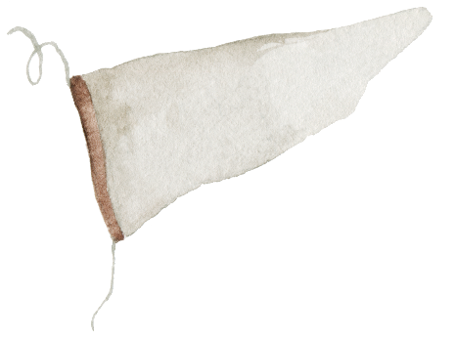
Journey thru the Bible with Archaeology
04-Shechem a City for All Times
03-Joshua and the Conquest
01-Introduction to Bible Archaeology
03-Joshua and the Conquest
02-Patriarchs
and Camels
05-David, Samson and the Philistines
17-Archaeology and the Bible Text
06-Solomon the Builder
07-Ahab and the Northern Kingdom
11-Crucifixion and Burial
16-Archaeology in Jerusalem
15-Museums and Key Bible Finds
14-Daniel and the Kingdoms
08-The Hezekiah Defense
09-Jeremiah and the Last Days of Judah
12-Cities of Paul and John
13-Finding People in the Bible Outside the Bible

Slide 4
Sin Separates Us from God
Bible is God’s Effort to Redeem Us
See it Unfold via Bible Periods
Creation & Fall
The Patriarchs
Exodus Conquest
The Judges
Kings & Prophets
Exile & Return
Life of Jesus
Early Church
United
Divided
Judah Alone
Between the Testaments

Slide 5
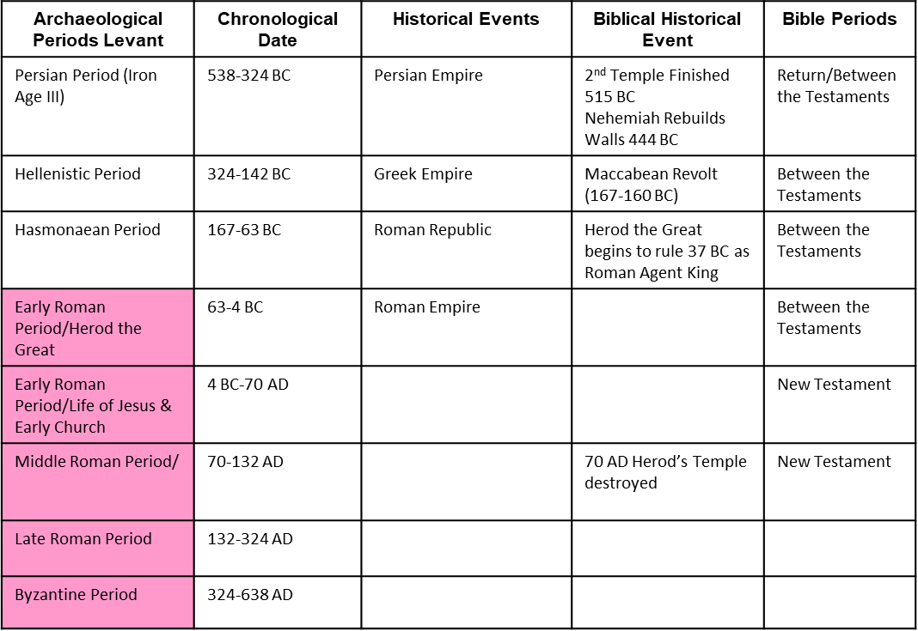
Putting Bible Time to Archaeological Time

Slide 6
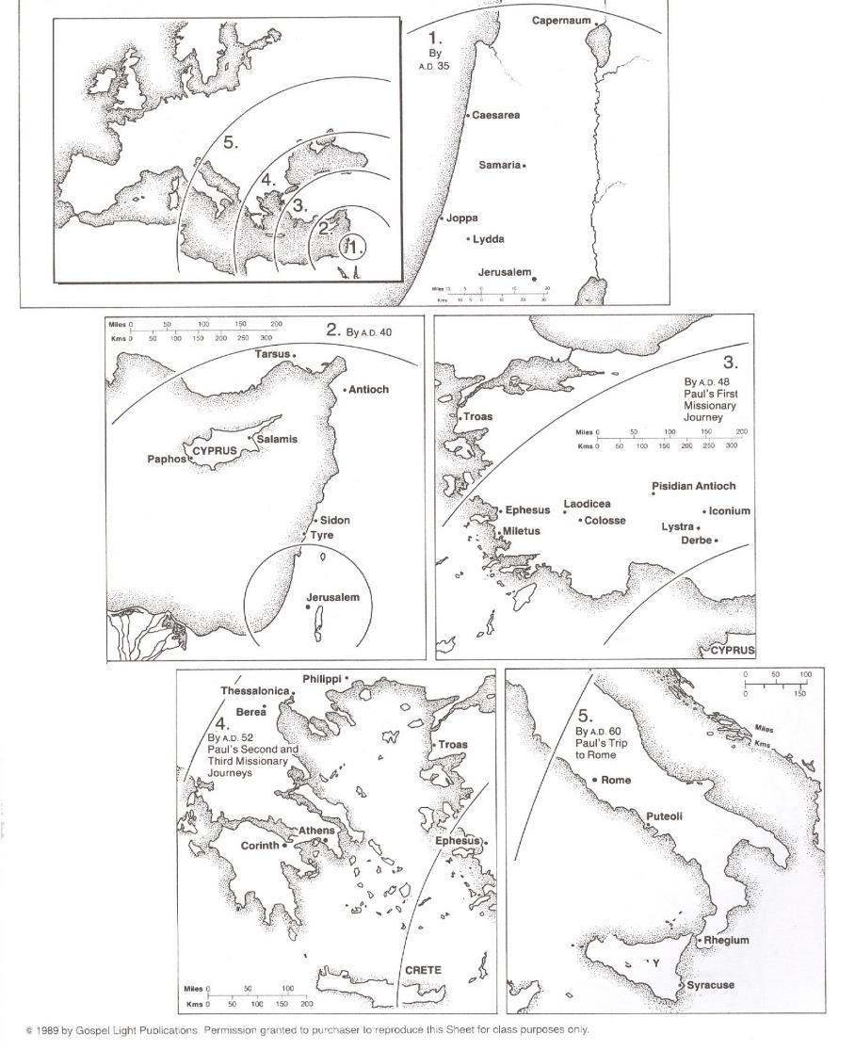

Slide 7
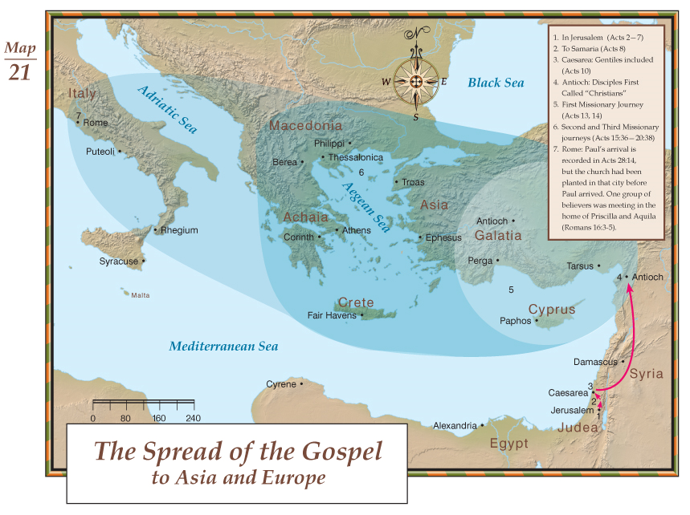

Slide 8

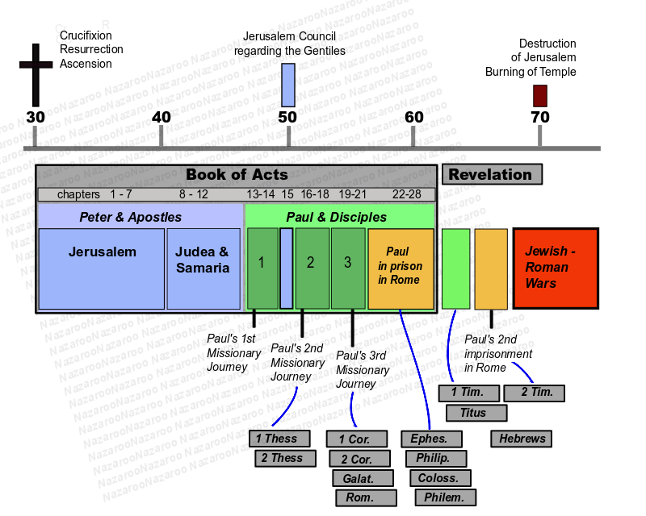
Timing of the Book of Acts
AD 90s

Slide 9
How Much to Travel
 | Distance (miles) | Travel Time (days) | Cost per Person (denarii)
First | 1,581 | 53 | 237
Second | 3,050 | 100 | 314
Third | 3,307 | 92 | 481
Rome | 2,344 | 36 | 699

Slide 10
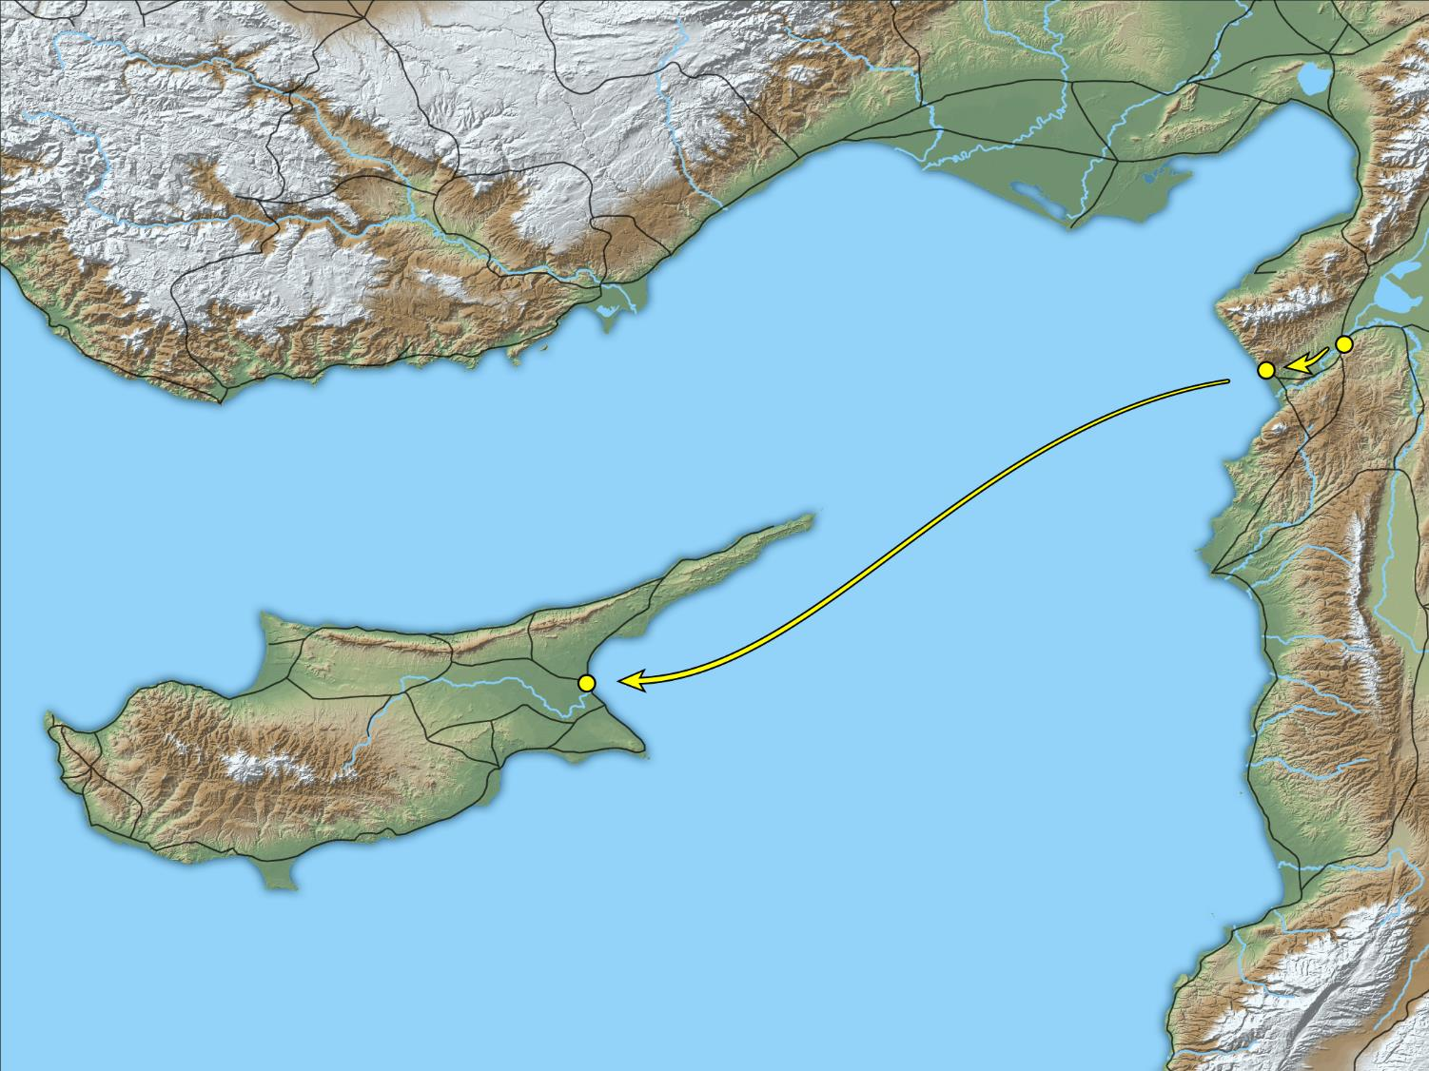
So, being sent out by the Holy Spirit, they went down to Seleucia
Antioch
Seleucia
Salamis
Cyprus
Paphos
Map of Barnabas and Saul’s route from Antioch to Salamis
13:4
Notes:
This map was created by A.D. Riddle, RiddleMaps.com. Data sources: Ancient World Mapping Center shapefiles were used for road lines, under Open Database License (ODbL 1.0; http://awmc.unc.edu/wordpress/map-files/). ASTER-GDEM 2 or SRTM data were used to render the terrain (https://asterweb.jpl.nasa.gov/gdem.asp and https://www2.jpl.nasa.gov/srtm/). Natural Earth was used for streams and inland water bodies. Their data have been placed in the public domain. https://www.naturalearthdata.com/about/terms-of-use/.

Slide 11
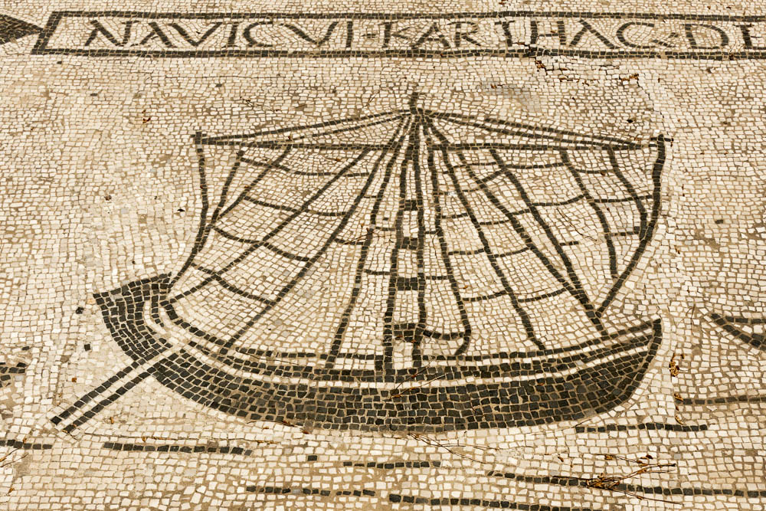
And from there they sailed to Cyprus
Ship mosaic in the Plaza of the Guilds at Ostia -1st century AD
13:4
Notes:
Ostia was the primary port city of Rome in the 1st century AD. The city housed various trade guides, and the Plaza of the Guilds (Piazzale delle Corporazioni) held 70 commercial offices with mosaic floors portraying the specific trades and guilds. This provides us with much useful illustrative material from the time of the Book of Acts.
tb051717295s

Slide 12
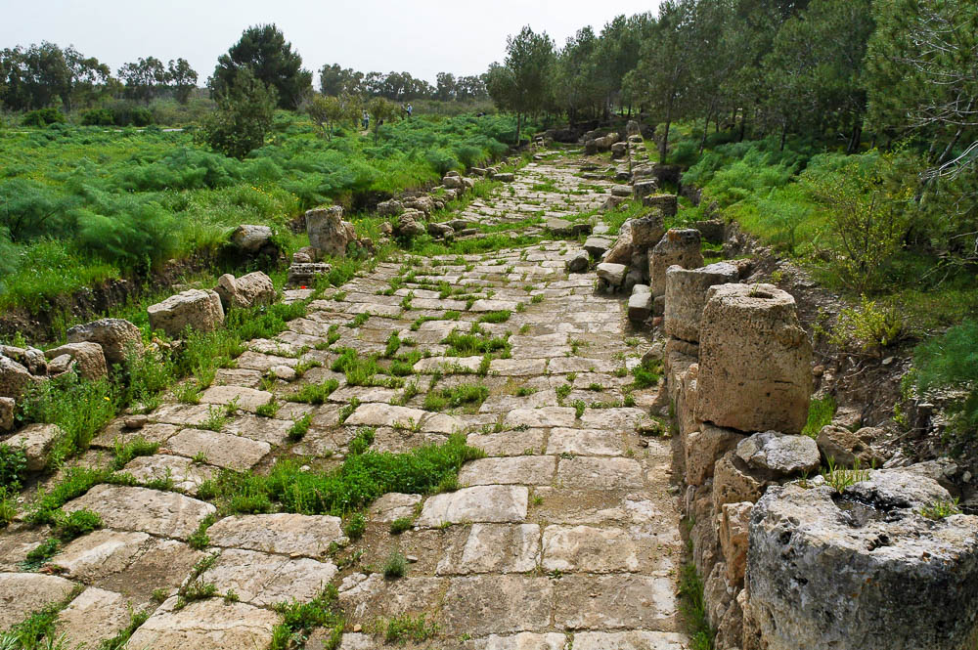
And when they arrived at Salamis, they proclaimed the word of God in the synagogues
Street near a Roman bathhouse in Salamis
13:5
Notes:
Excavations at Salamis have revealed extensive Roman remains, including the street above, a Roman bathhouse, and a gymnasium.
tb030305723

Slide 13
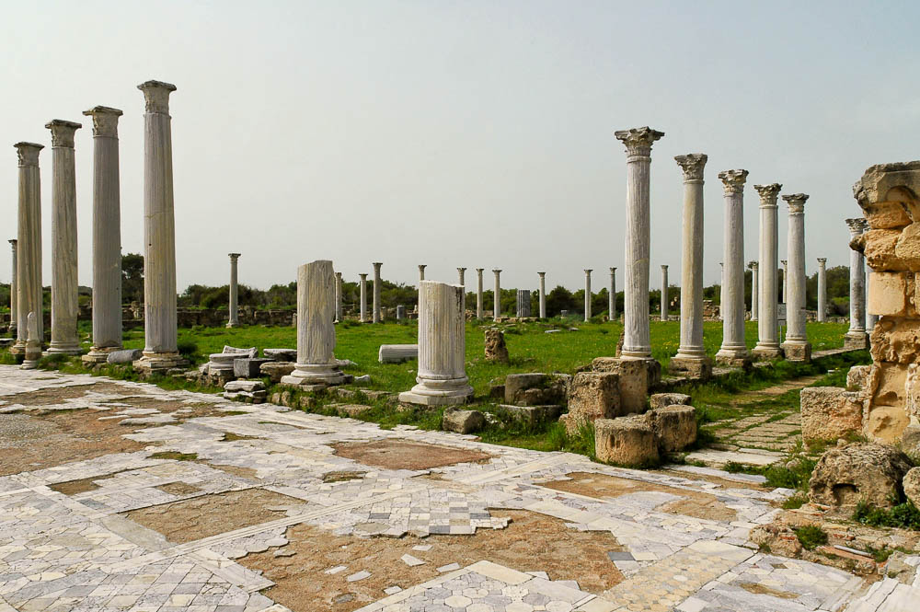
And when they arrived at Salamis, they proclaimed the word of God in the synagogues
Gymnasium in Salamis (from the north)
13:5
Notes:
Most of the marble columns now located here originally belonged to the theater. When the city was destroyed by an earthquake in the 4th century, the theater was not rebuilt. Christians moved the columns to this area, which served as a public meeting place. In addition to the gymnasium, a theater and forum were also excavated at Salamis.
tb030305614

Slide 14
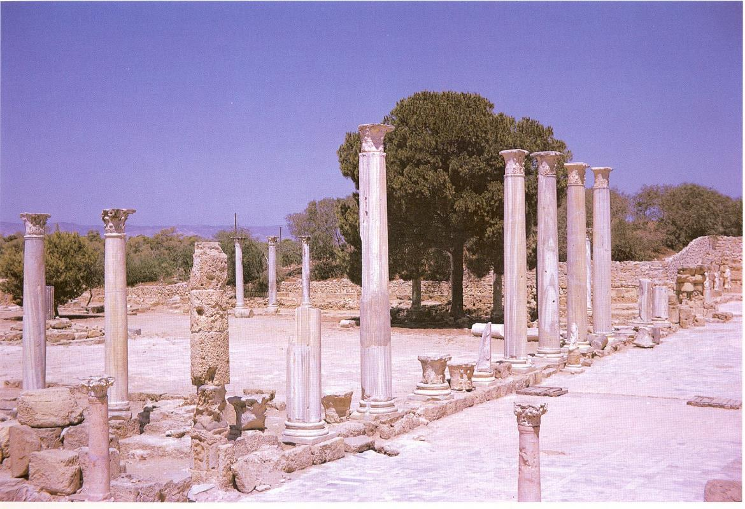
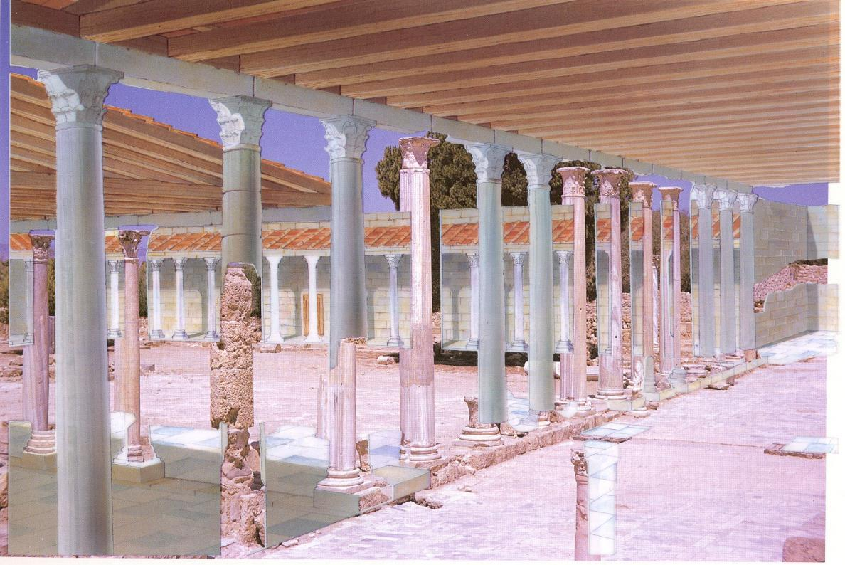
Gymnasium in Salamis, Cyprus
Acts 13:4-5 (ESV)
⁴ So, being sent out by the Holy Spirit, they went down to Seleucia, and from there they sailed to Cyprus. ⁵ When they arrived at Salamis, they proclaimed the word of God in the synagogues of the Jews. And they had John to assist them.

Slide 15
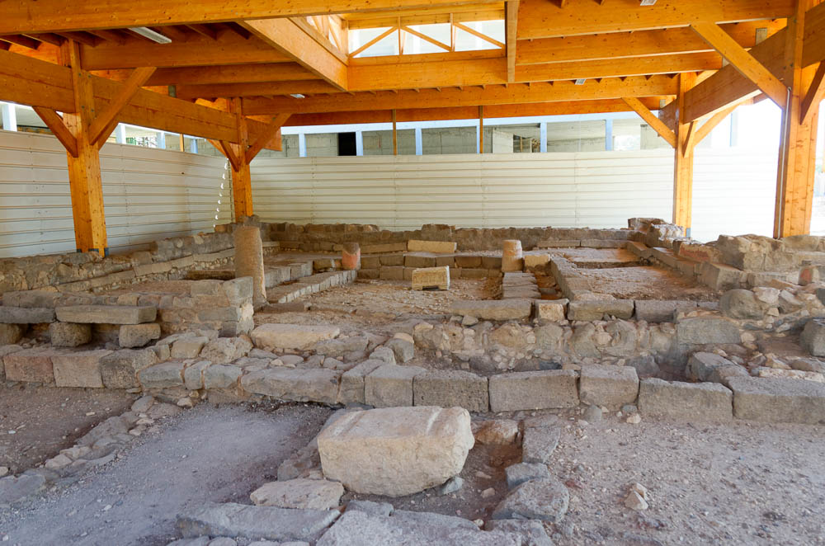
They proclaimed the word of God in the synagogues of the Jews
Synagogue in Magdala (from the west)
13:5
Notes:
A handful of Jewish synagogues from the 1st century AD have been discovered. One of them is located in Magdala, in the region of Galilee. The synagogue at Magdala can help us visualize the type of synagogues in which Barnabas and Paul taught.
tb053116422

Slide 16
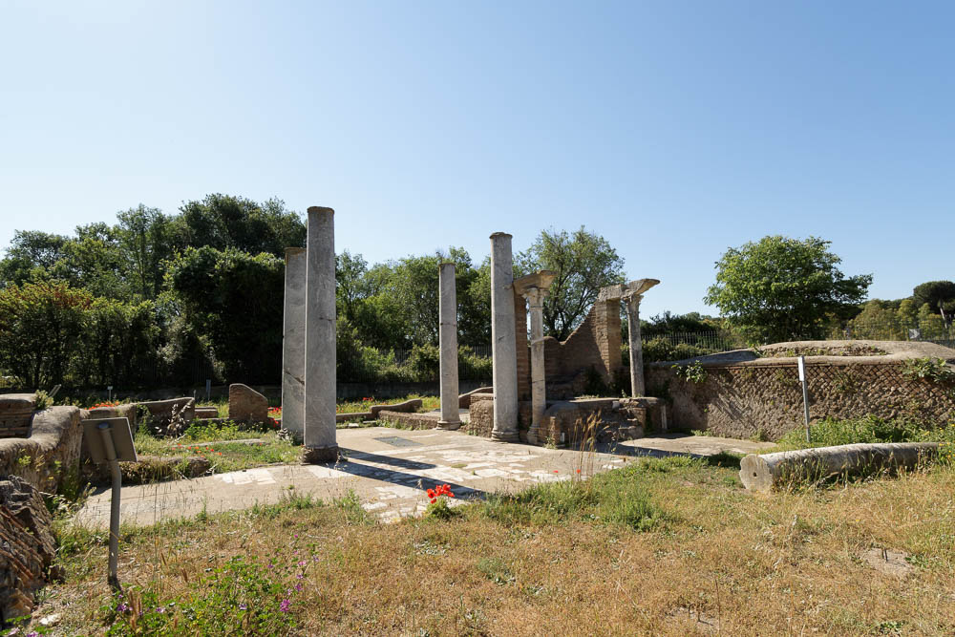
They proclaimed the word of God in the synagogues of the Jews
Interior of a Roman synagogue in Ostia (from the north)
13:5
Notes:
While this synagogue slightly post-dates Paul and Barnabas, it still provides us with a visual for the structure of the synagogues of the time. Located near the water’s edge, this ancient synagogue includes remains from the 1st century AD, but most of the building dates to the 4th century AD. The entire synagogue measures 112 by 75 feet (36.6 by 23.5 m); the main hall measures 80 by 40 feet (24.9 by 12.5 m). Mosaics and carvings decorated the synagogue.
tb0517172424

Slide 17
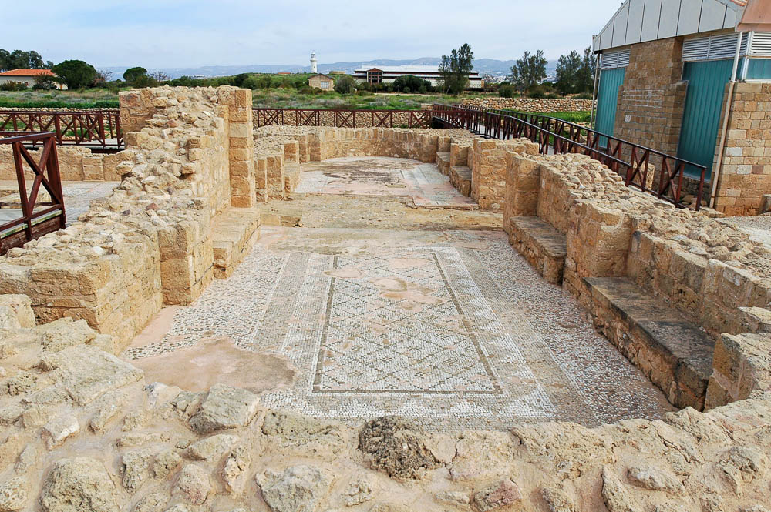
And when they had gone through the whole island as far as Paphos
East wing reception hall in the Villa of Theseus at Paphos
13:6
Notes:
The Villa of Theseus is the largest residential building on the island of Cyprus, measuring 360 feet (112 m) by 250 feet (78 m). It was built in the 2nd century AD, after the time of Paul, but it reflects the wealth of Paphos’s citizens. The proconsul Sergius Paulus presumably resided in a large home in the city.
tb030505397

Slide 18
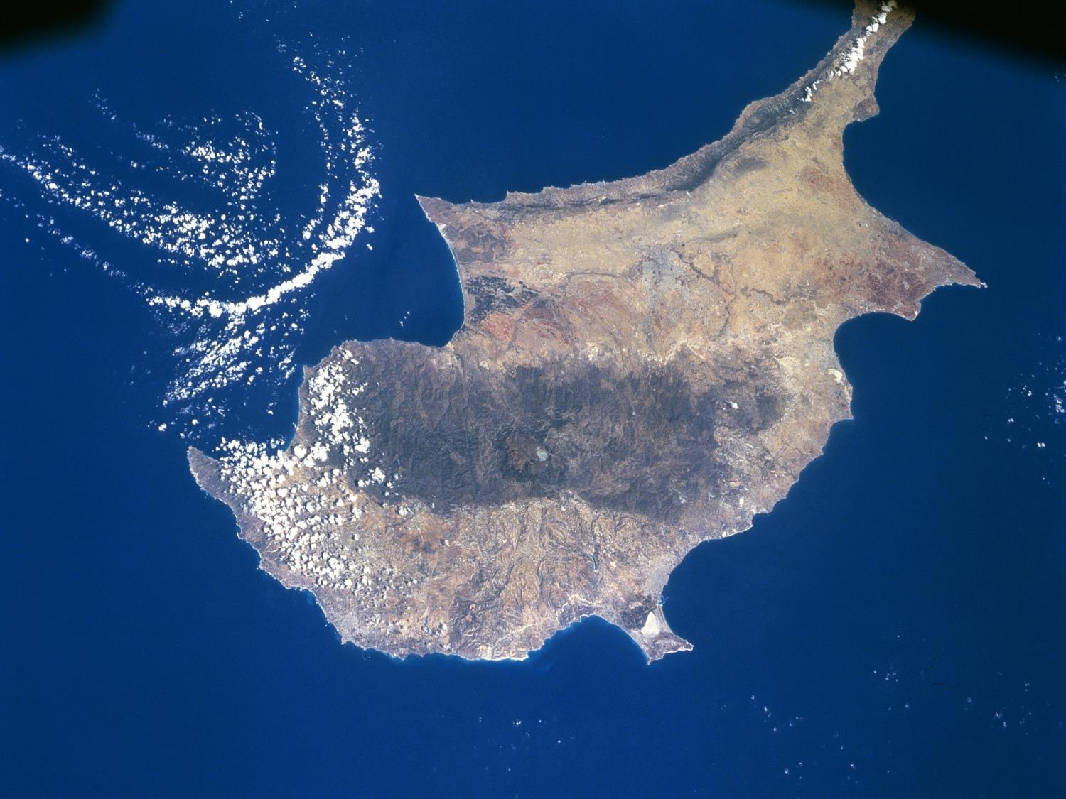
Acts 13 – Paul’s First Journey
^{Acts 13:6} Now when they had gone through the island to Paphos, they found a certain sorcerer, a false prophet, a Jew whose name was Bar-Jesus, ⁷who was with the proconsul, Sergius Paulus, an intelligent man.
Salamis
Amathous
Paphos
Kourion

Slide 19
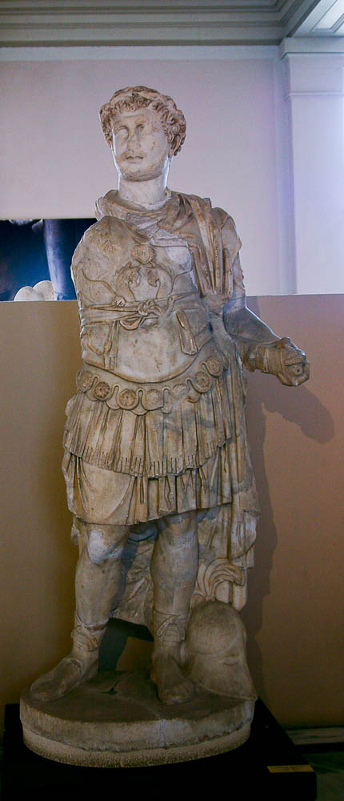
The proconsul, Sergius Paulus, a man of intelligence
Statue of Polemeanus, proconsul of Asia, from Ephesus, AD 106–107
13:7
Notes:
While this is not the proconsul mentioned in Acts 13:7, he does portray the look and bearing of a proconsul in the same era. This marble statue was photographed at the Istanbul Archaeological Museum.
adr1006053348

Slide 20
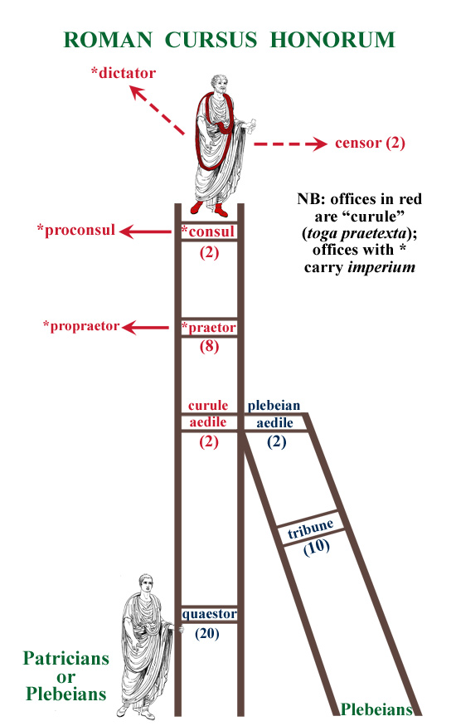
Consuls
Two senators were chosen as consuls
1 year term, each could veto the other
Could not declare war by themselves
Responsible for public finances, justice and city administration
The proconsul was the highest-ranking official in a Roman senatorial province.

Slide 21
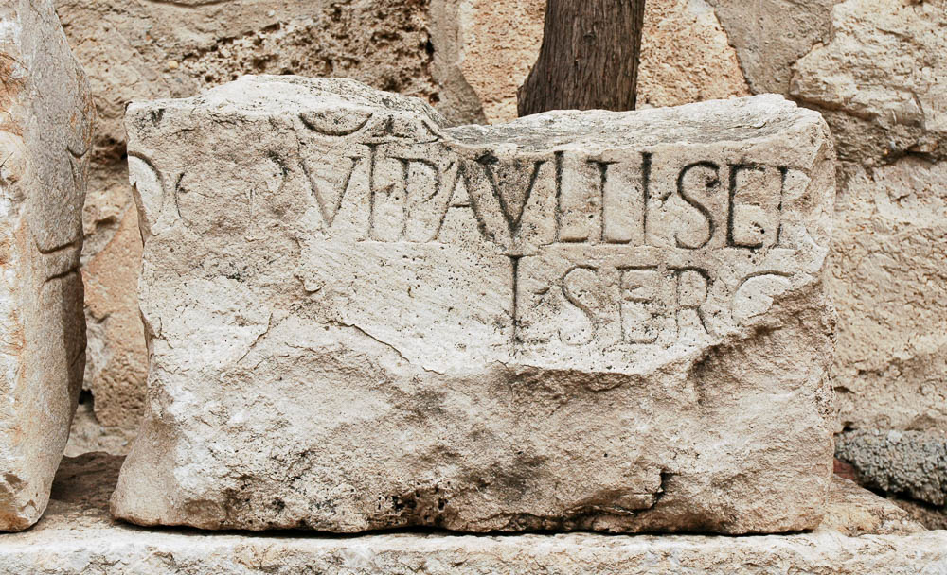
The proconsul, Sergius Paulus, a man of intelligence
“Sergio Paulus” inscription
13:7
Notes:
This Latin inscription was found near Pisidian Antioch, and it includes the name “Paulus,” (PAVLLI) and the following word could be the beginning of “Sergius” (SERGII). While it is unknown whether this refers to the Sergius Paulus of Acts 13:7, it does provide a contemporary use of the name. This inscription was photographed at the Yalvac Museum near Pisidian Antioch.
tb041205693

Slide 22
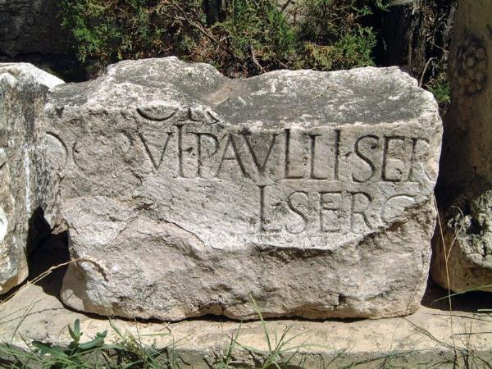
Roman Proconsul
Sergius Paulus inscriptions
In 1877 inscription found near Paphos, bearing Sergius Paulus's name & title of proconsul
In 1887 name was also found on a memorial stone in Rome
Stone states in AD 47 he was appointed one of keepers of the banks and channel of the river Tiber
Thus governor of Cyprus from 44 to 47
Sergius Paulus's family had large land-holdings in the area of Pisidian Antioch
Notes:
Sergius Paulus inscriptions
The Bible records in Acts chapter 13 verses 6 to 12 how when Paul, Barnabas and John Mark visited Paphos, on Cyprus, at the start of Paul's first missionary journey, they had a dramatic encounter with the Roman governor (or proconsul) Sergius Paulus, which led to him becoming a follower of Christ.
In 1877, an inscription was found near Paphos, bearing Sergius Paulus's name and title of proconsul.
Ten years later, his name was also found on a memorial stone in Rome. The stone records that in AD 47 he was appointed as one of the keepers of the banks and channel of the river Tiber. He held this office when he returned to Rome after his three years as governor of Cyprus.
Photo: www.HolyLandPhotos.org
Sergius Paulus's family had large land-holdings in the area of Pisidian Antioch, and this stone inscription discovered there contains his name. This inscription is now on display in the Yalvac museum, in Turkey.
Acts chapter 13 verses 13-14 records how Paul and Barnabas went from Cyprus to Pisidian Antioch.
Dr. Carl Rasmussen theorizes that Sergius Paulus may have asked them to go there to speak to members of his family - and perhaps even given them a letter of introduction.
A remarkable memorial of this proconsul was recently (1887) discovered at Rome. On a boundary stone of Claudius his name is found, among others, as having been appointed (A.D. 47) one of the curators of the banks and the channel of the river Tiber. After serving his three years as proconsul at Cyprus, he returned to Rome, where he held the office referred to. As he is not saluted in Paul's letter to the Romans, he probably died before it was written.
Sergius Paulus, governor of Cyprus
"So, being sent out by the Holy Spirit, they (the apostles Paul and Barnabas) went down to Seleucia, and from there they sailed to Cyprus ... Now when they had gone through the island to Paphos, they found a certain sorcerer, a false prophet, a Jew whose name was Bar-Jesus, who was with the proconsul, Sergius Paulus, an intelligent man" (Acts 13:4-7, emphasis added throughout).
From Antioch Paul and Barnabas first went to Cyprus, Barnabas's birthplace (Acts 4:36). Historians have confirmed several background details about this account. For example, the Roman orator Cicero mentions in one of his books that Paphos was indeed the Roman headquarters of Cyprus during Roman rule (Ad Familiares, XIII.48).
Also, Luke is correct in mentioning that Cyprus was governed by a proconsul when Paul and Barnabas visited the island. Before A.D. 22 Cyprus had been administered by a direct representative of the emperor, called a propraetor. But after 22 the island's rule was turned over to the Roman senate, whose representatives were called proconsuls. "Annexed by the Romans in 55 B.C.," notes The Interpreter's Dictionary of the Bible, "Cyprus became a senatorial province in 22 B.C., with a governor bearing the title of proconsul, as Acts 13:7 correctly names Sergius Paulus, who received Barnabas and Paul" (1962, Vol. 3, p. 648).
The Expositor's Bible Commentary adds: "That Luke distinguishes correctly between senatorial and imperial provinces and has the former governed by a proconsul on behalf of the senate and the latter governed by a propraetor representing the emperor says much for his accuracy, for the status of provinces changed with the times" (Richard Longenecker, Vol. 9, 1981, notes on Acts 18:12-13, p. 485).
Sergius Paulus was a member of a noble Roman family, who served with distinction over a period of several generations. We know of one Lucius Sergius Paulus who was a curator of the Tiber in the principate of Claudius, another of the same name (perhaps his son) who was an official in Galatia, in 168. Several inscriptions have been found in Cyprus bearing the name of this important man
http://immanuelmankato.org/bibleclass/pauls_life/07_paul.htm
(4) The First Missionary Tour.
Sergius Paulus is proconsul of Cyprus when Barnabas and Saul visit the island (Acts 13:7). The proconsul Paulus is mentioned in a Greek inscription of Soloi (Hogarth, Devia Cypria, 1889, 114) and Lucius Sergius Paulus in CIL, VI, 31, 545, but, as no mention of his being proconsul is here made, it is probably earlier than that time. The Soloi inscription bears the date 53 AD, but Sergius Paulus was not proconsul in 51 or 52. Hence, he may have been proconsul in 50 or the early part of 51 AD.It could not be later and may have been earlier.
http://www.searchgodsword.org/enc/isb/view.cgi?number=T6741

Slide 23
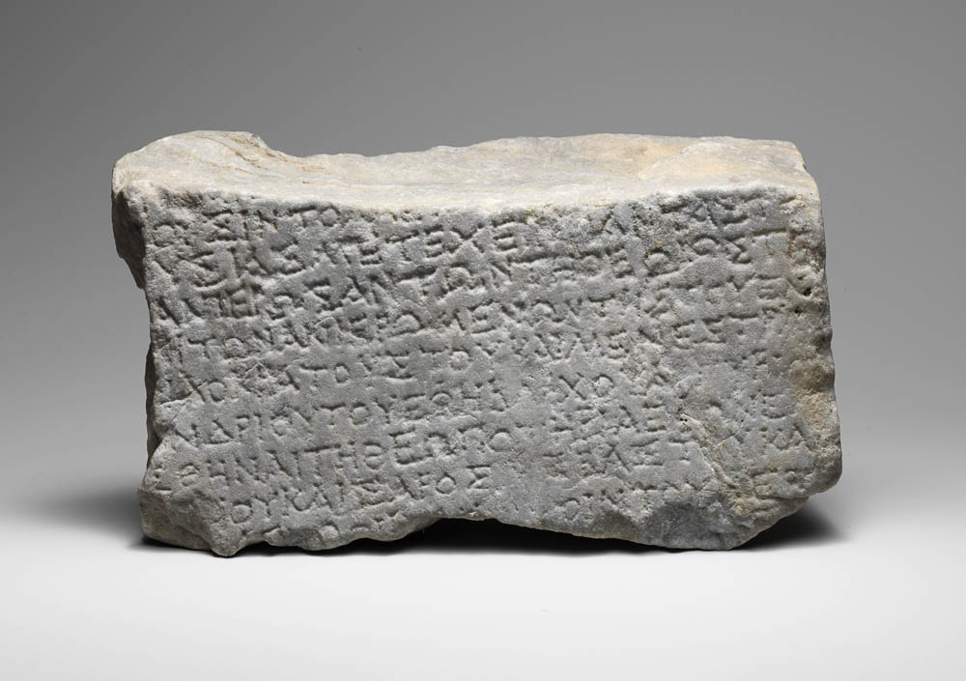
The proconsul, Sergius Paulus, a man of intelligence
The name appears on the last line of this inscription, “Quintus Ser[gius]” (ΚΟΙΝΤΟΥ ΣΕΡ[ΓΟΥ]),
Marble block possibly mentioning Sergius Paulus, from Kythrea, early 1st century AD
13:7
Notes:
The block above is a portion of a marble stone dictating sacrifices and offerings for a sacrificial site. Although important portions are lost (including the name of the emperor), the inscription does mention a Quintus Sergius, whom some believe to be the same man as Sergius Paulus. This identification is supported by Douglas Campbell in “Possible Inscriptional Attestation to Sergius Paul[l]us (Acts 13:6-12) and the Implications for Pauline Chronology," The Journal of Theological Studies, 56/1 (2005): 1–29. The name appears on the last line of this inscription, “Quintus Ser[gius]” (ΚΟΙΝΤΟΥ ΣΕΡ[ΓΟΥ]), and may have been followed by the name “Paulus.” This image comes from The Metropolitan Museum of Art, public domain, The Cesnola Collection, Purchased by subscription, 1874–76, accession number 74.51.2425, http://metmuseum.org/art/collection/search/241979.
met241979

Slide 24
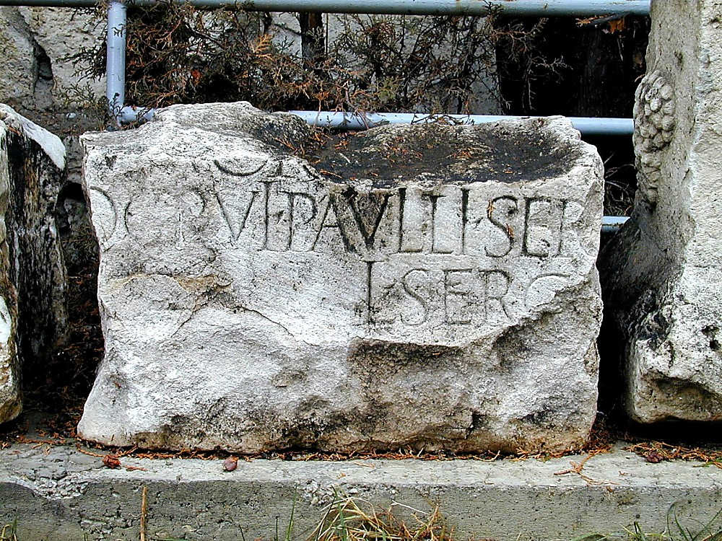
Sergio Paulus inscription
It is probable that Sergius Paulus had estates and relatives here in Pisidian Antioch. Sergius Paulus, the proconsul of Cyprus who had previously been converted probably sent a letter of introduction with Paul and Barnabas.

Slide 25
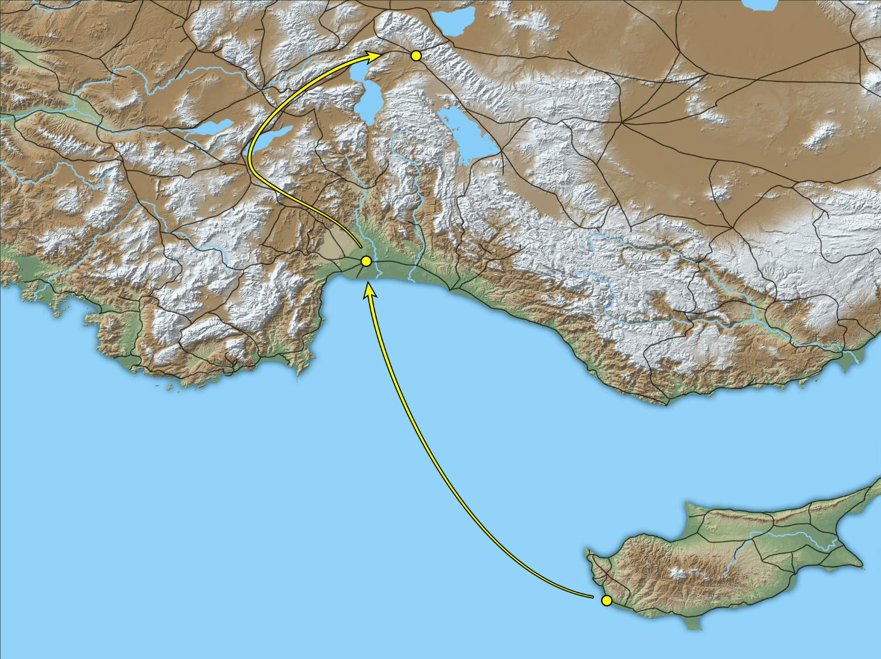
And Paul and his companions set sail from Paphos, and came to Perga in Pamphylia
Antioch near Pisidia
Perga
Paphos
Map showing route from Paphos to Perga
13:13
Notes:
This map shows Paul traveling from Perga to Antioch on the Via Sebaste, a more natural and easy route. Another suggestion is that Paul took the more difficult route that headed more directly north from Perga to Antioch. This map was created by A.D. Riddle, RiddleMaps.com. Data sources: Ancient World Mapping Center shapefiles were used for road lines, under Open Database License (ODbL 1.0; http://awmc.unc.edu/wordpress/map-files/). ASTER-GDEM 2 or SRTM data were used to render the terrain (https://asterweb.jpl.nasa.gov/gdem.asp and https://www2.jpl.nasa.gov/srtm/). Natural Earth was used for streams and inland water bodies. Their data have been placed in the public domain. https://www.naturalearthdata.com/about/terms-of-use/.

Slide 26
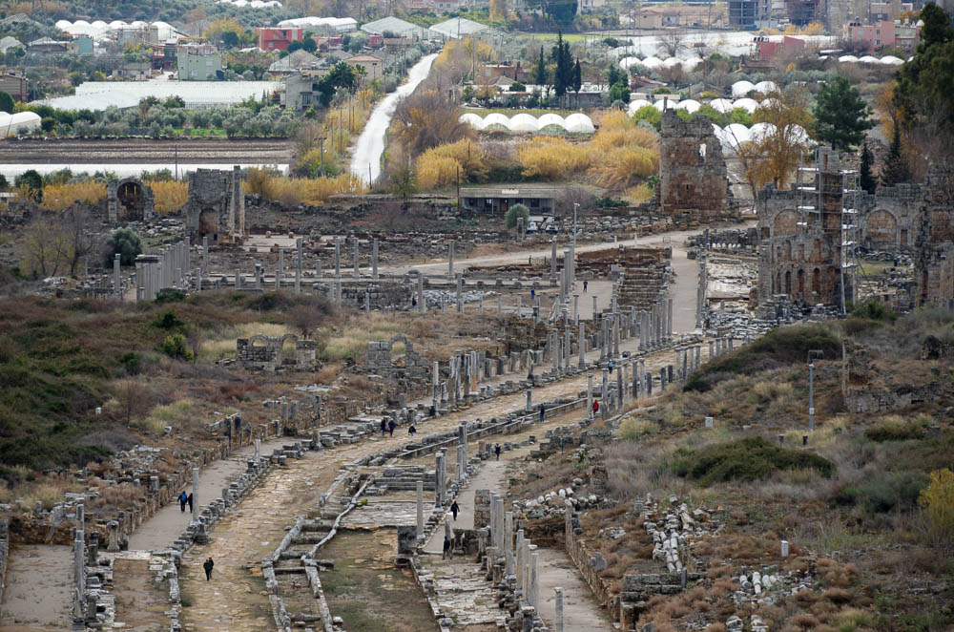
And Paul and his companions set sail from Paphos, and came to Perga in Pamphylia
Roman
gate
Hellenistic
gates
agora
colonnaded
street
Colonnaded street and agora of Perga, from the acropolis
13:13
Notes:
This photo shows the ancient “downtown” of Perga, including its colonnaded street and marketplace (agora).
mjb123016923

Slide 27
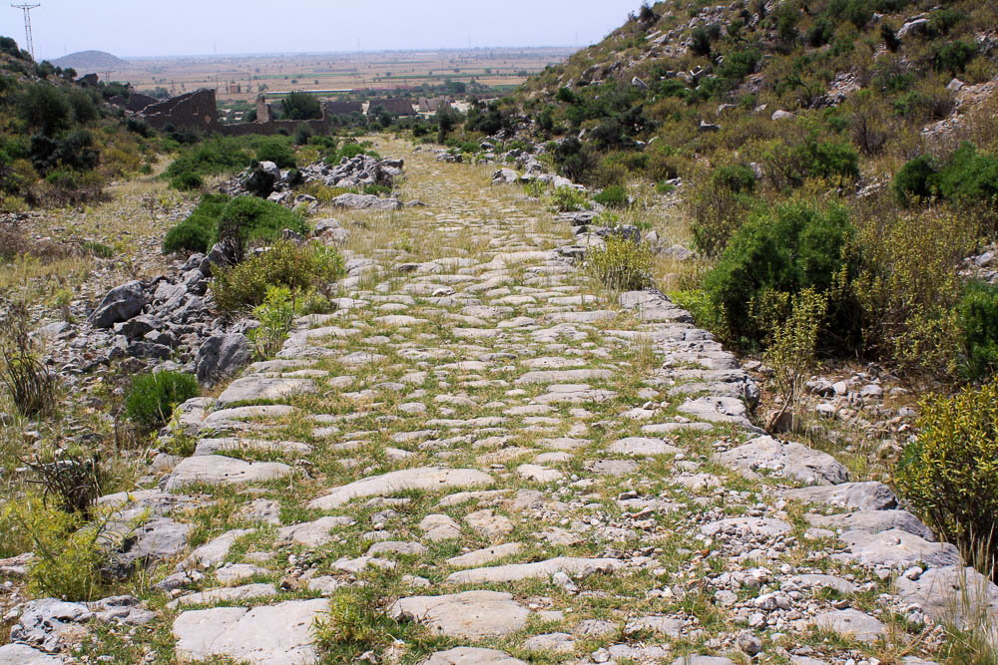
But going on from Perga, they arrived at Pisidian Antioch
Via Sebaste ascending from Pamphylian plain northwest of Perga
13:14
Notes:
Paul and his companions had three possible routes to travel from Perga to Pisidian Antioch. The most likely is the western route on the Via Sebaste. Though at 156 (250 km) it is longer than the central (114 miles; 182 km) and eastern (149 miles; 238 km) routes, it was the easiest, fastest, and probably the safest. For more details on these three routes, see Mark Wilson, “The Route of Paul’s First Journey to Pisidian Antioch,” New Testament Studies 55, no. 4 (2009): 471–83. This photo and the ones following of the Via Sebaste were provided by Mark Wilson.
mw061310023

Slide 28
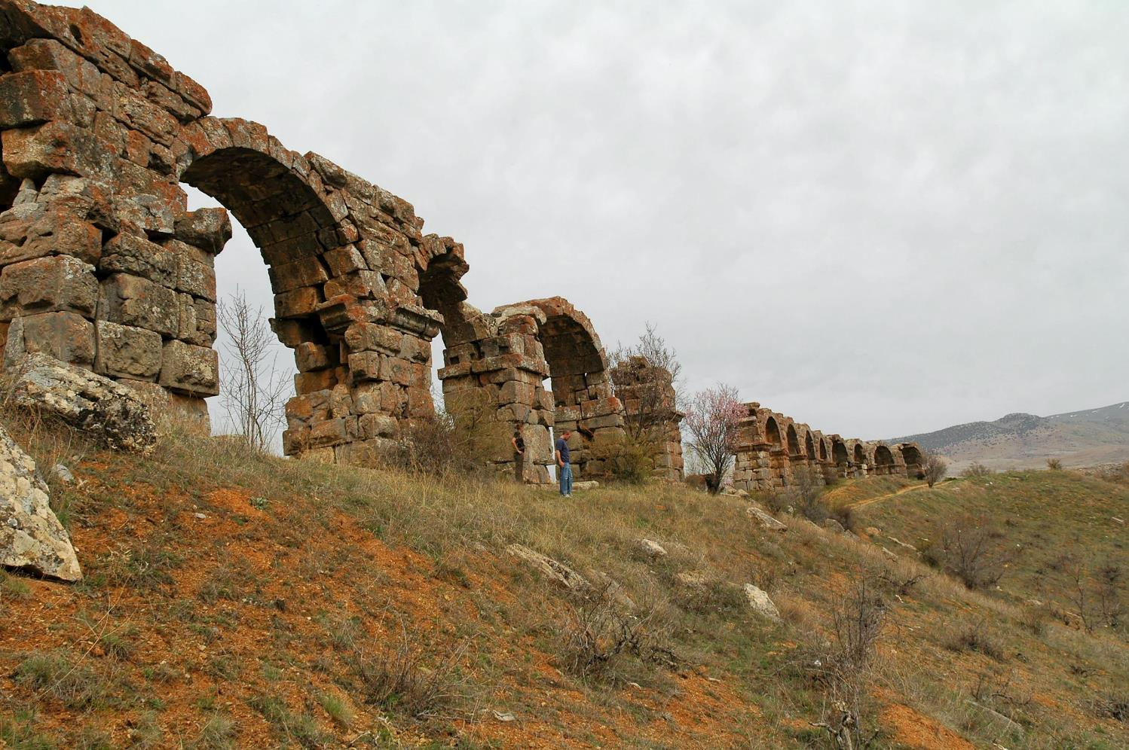
But going on from Perga, they arrived at Pisidian Antioch
Arched aqueduct at Pisidian Antioch
13:14
Notes:
Pisidian Antioch was located in Phrygia and closely related to Pisidia. The city was the administrative center for the central part of Galatia (the overarching region in which both Pisidia and Phrygia were located). The aqueduct, pictured above, was located to the north of the city.
tb041205670

Slide 29
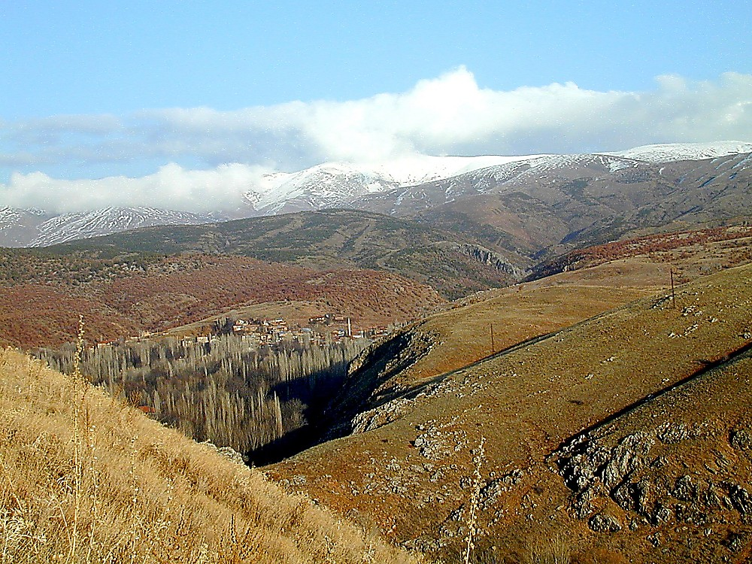
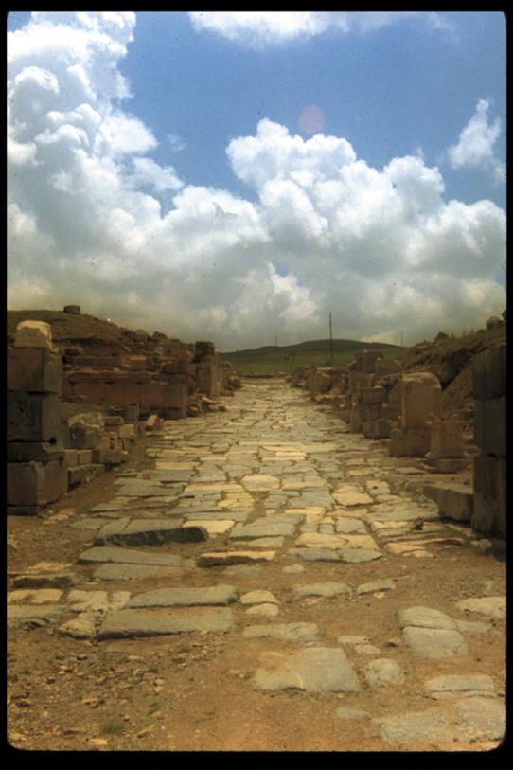
Pisidian Antioch mountains
Pisidian Antioch mountains
Notes:
Historical Background
Antioch of Pisidia was founded in the 4th or 3rd century B.C. by a Seleucid king, either Antiochus I or II. It was situated along the Anthios River in Phrygia near Pisidia (western central Asia Minor), just east of the modern city of Yalvac. It sat along the main trade route running from Ephesus to Cilicia, which contributed to its growth into a major Hellenistic city.
Settlers at Pisidian Antioch came from Magnesia and Maeandrum in Ionia. Antiochus also settled many Babylonian Jews on the site ca. 200 B.C. for political and commercial reasons. The city remained under Seleucid rule until the treaty of Apameia in 189-88 B.C., making it free. Antioch of Pisidia was part of a region dedicated to the Anatolian moon god Men Askaenos, for whom an Ionic temple was built at Antioch in the 2nd century B.C.
In 39 B.C. the Romans under Antony gave Antioch to Amyntas, the ruler of Galatia who aided him in the battle of Actium eight years later. The city only achieved prominence after its re-founding as a Roman colony by Augustus in 25 B.C., in the province of Galatia.
Army veterans were settled at the site, then named Colonia Caesarea Antiocheia. Pisidian Antioch was one of the most Romanized cities of the region; three members of the imperial family even served as honorary magistrates there from 15 B.C. to 35 A.D., attesting to the importance of the city: Drusus (brother of future emperor Tiberius), C. Domitius Ahenobarbus (father of emperor Nero), and L. Cornelius Sulla Felix (son-in-law of Germanicus). Augustus built the Via Sebaste in 6 B.C., putting Antioch at the crossroads of two major trade routes.
The city gradually declined; Arab raiders attacked it in the 7th and 8th centuries A.D. and the Turks eventually gained control after the battle of Manzikert.

Slide 30
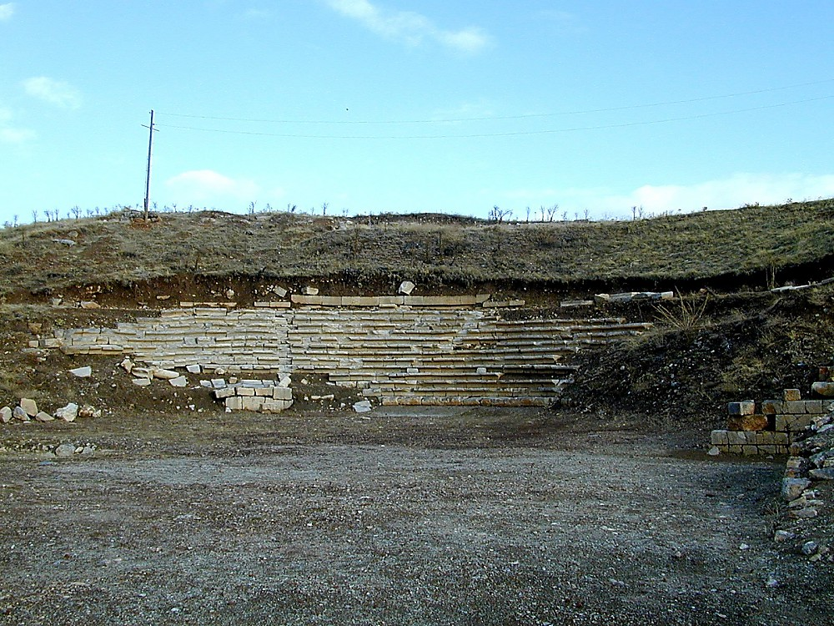
Pisidian Antioch theater
Pisidian Antioch theater
Notes:
Constructed in the Hellenistic times and further developed by the Romans, the theater at Pisidian Antioch could seat approximately 5,000 spectators in its 26 rows.

Slide 31
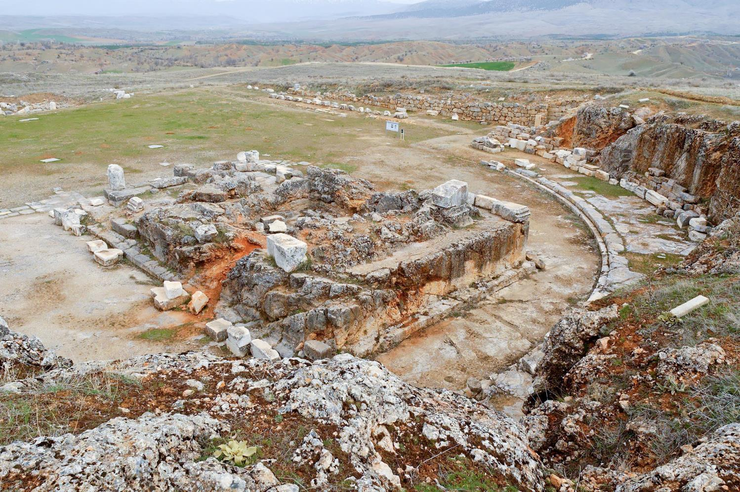
But going on from Perga, they arrived at Pisidian Antioch
Built sometime around AD 25, this temple was dedicated to Augustus, who was honored as the founder of the city
Temple of Augustus in Pisidian Antioch
13:14
Notes:
Built sometime around AD 25, this temple was dedicated to Augustus, who was honored as the founder of the city. Constructed in front of a two-story semi-circular portico and adjacent to a large colonnaded courtyard (with about 150 columns), this podium temple became the focal point of the city.
tb041205595

Slide 32
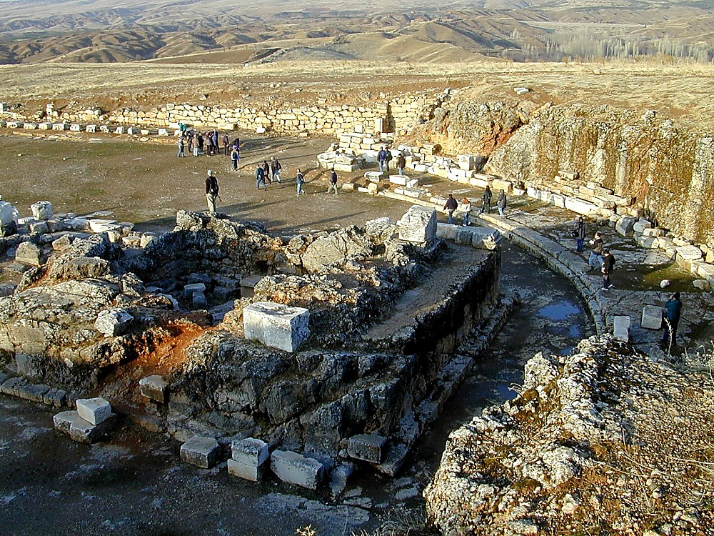
Pisidian Antioch Temple of Augustus from west
Pisidian Antioch Temple of Augustus from west

Slide 33
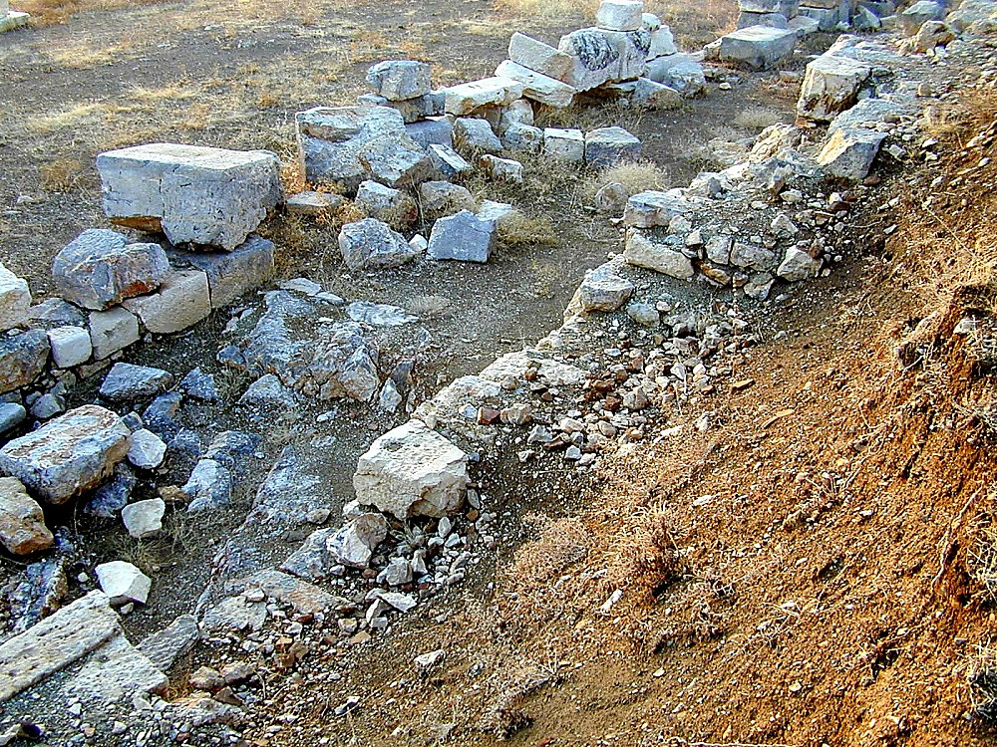
Pisidian Antioch synagogue foundations
^{Acts 13:14}But when they departed from Perga, they came to Antioch in Pisidia, and went into the synagogue on the Sabbath day and sat down.
Pisidian Antioch 1st Century synagogue foundations
Underneath Church of St. Peter
Notes:
Recent excavations have revealed a first century building underneath the Church of St. Peter which has been identified as a synagogue. This supports the site’s authenticity as being the place where Paul preached in Acts 13.

Slide 34
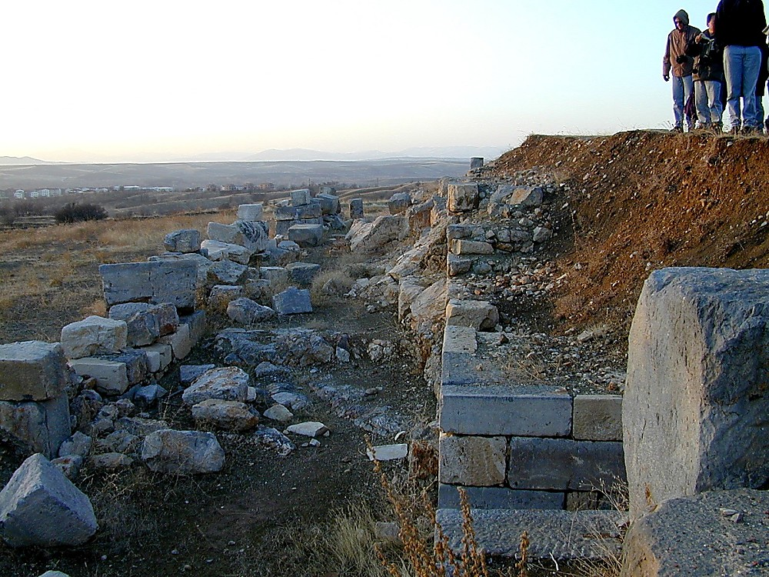
Pisidian Antioch synagogue foundations
^{Acts 13:15}And after the reading of the Law and the Prophets, the rulers of the synagogue sent to them, saying, “Men and brethren, if you have any word of exhortation for the people, say on.”
Pisidian Antioch synagogue foundations

Slide 35
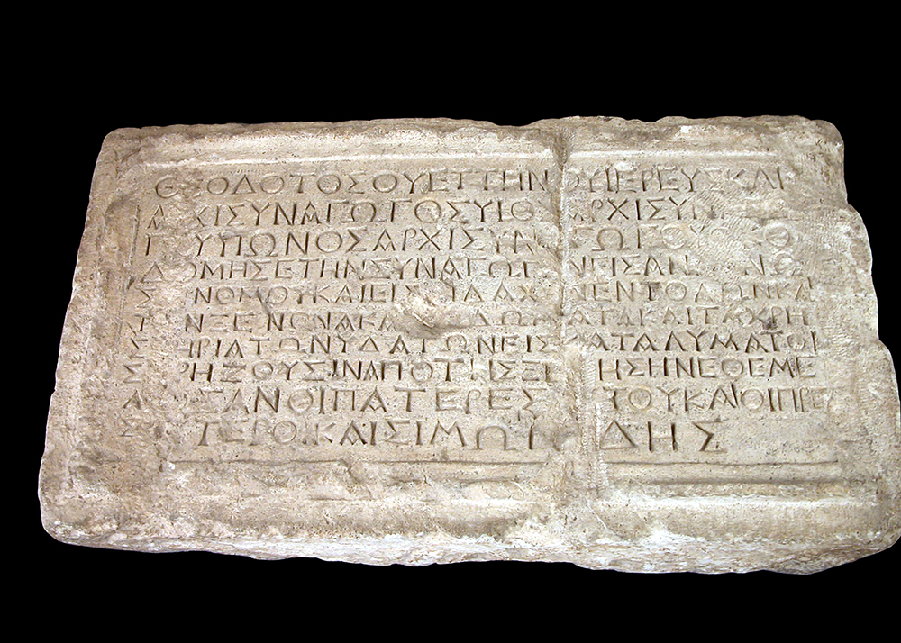
After the reading from the law and the prophets, the rulers of the synagogue sent to them
Theodotos Inscription, mentioning “synagogue rulers,” 1st century BC
13:15
Notes:
The term translated here as “rulers of the synagogue” (αρχισυναγωγος) is the first word in the second line on this inscription. The Theodotos Inscription was originally part of a synagogue in Jerusalem, but archaeologists in the early 20th century discovered this inscription in discarded debris. This inscription was photographed in the Rockefeller Museum.
tb042403156b

Slide 36
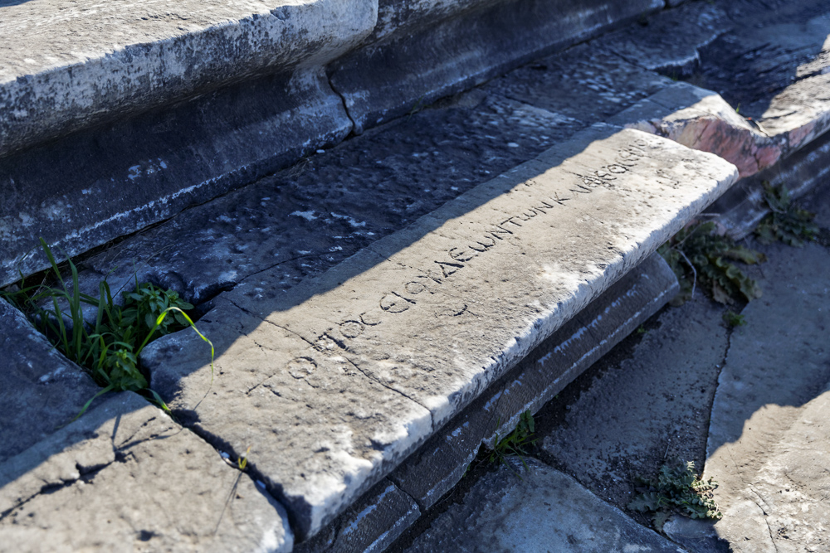
Men of Israel and you who fear God, listen
“Place of the Jews and the Godfearers” inscription in the theater of Miletus
13:16
Notes:
An inscription on a theater seat in Miletus mentions “Godfearers.” Paul would later visit this city in Acts 20:15. See the next slide for the text of the inscription and a more detailed description.
jc0102150114

Slide 37
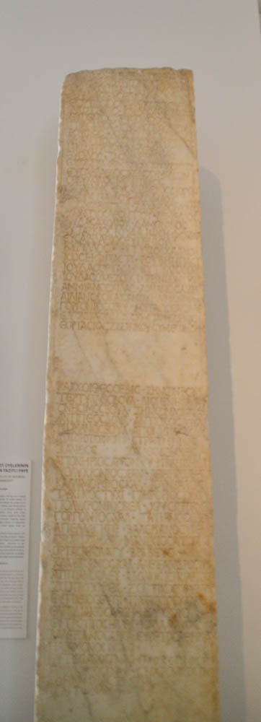
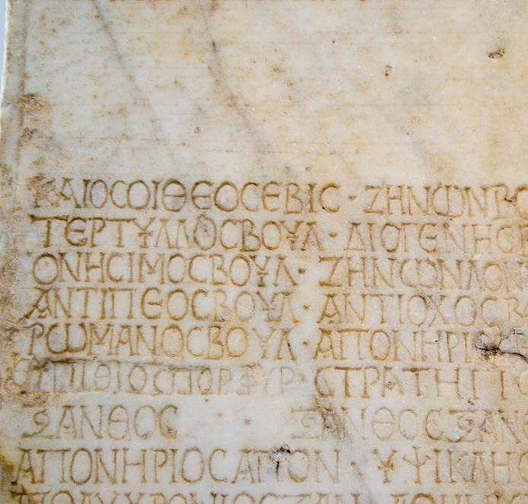
Brothers, sons of the family of Abraham, and those among you who fear God
Gentiles who worshipped the true God, and particularly those who converted to Judaism, were often referred to as “God-fearers” (e.g. Acts 10:2).
Pillar recording the names of God-fearers and of a Jewish community, 4th century AD
13:26
Notes:
Gentiles who worshipped the true God, and particularly those who converted to Judaism, were often referred to as “God-fearers” (e.g. Acts 10:2). Such Gentiles, who were already familiar with the God of the Bible, might have been more accepting of Paul’s message than many of those who still worshipped pagan deities. The inscription shown here lists many names of Gentiles. The first line of the portion shown here reads, “and such are the God-fearers” (ΚΑΙ ΟΣΟΙ ΘΕΟΣΕΒΙΣ), followed by a list of names. This pillar comes from the ancient city of Aphrodisias and is on display in the Aphrodisias Museum.
shs031215315 (left); shs031215316 (right)

Slide 38
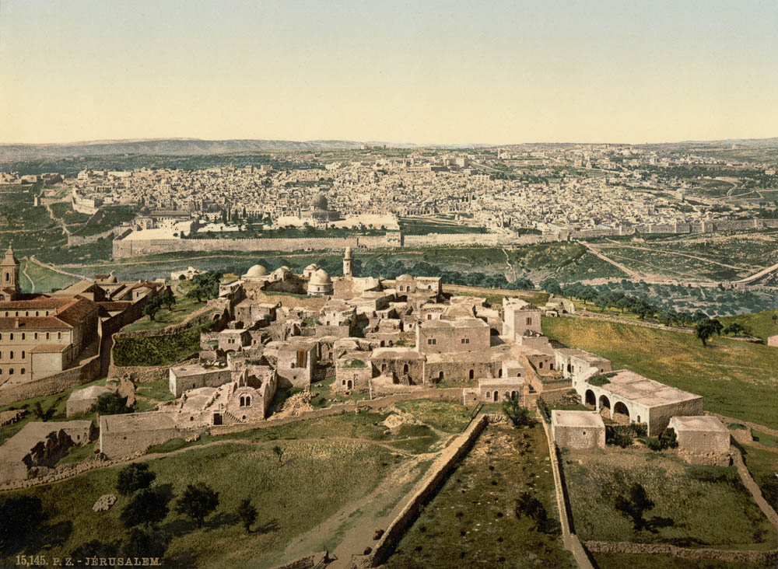
Those who live in Jerusalem 1890s
Jerusalem from the Mount of Olives (from the east)
13:27
Notes:
This photochrom image was taken in the 1890s. The perspective is from the tower of the Russian Orthodox Church. The Church of the Pater Noster is visible on the right foreground.
pcm02685

Slide 39
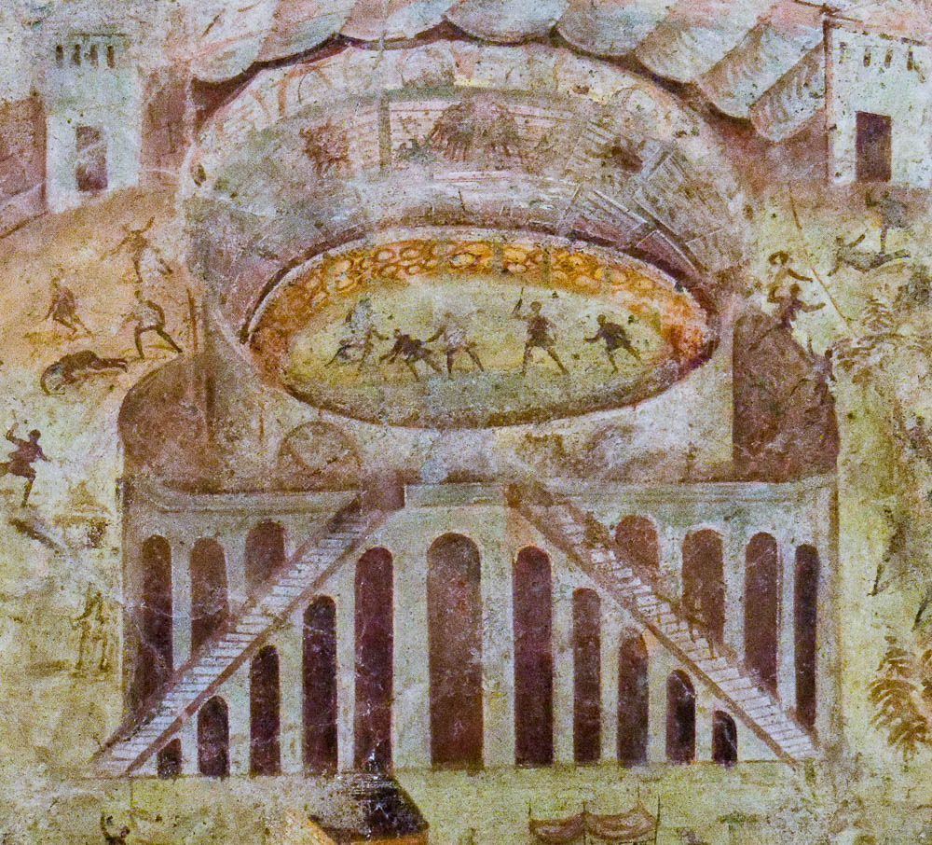
They stirred up persecution against Paul and Barnabas
Fresco of a riot in the amphitheater of Pompeii, from Pompeii, AD 59
13:50
Notes:
This fresco depicts a riot in the city of Pompeii a few years after the events of this chapter. Though it is not depicting persecution against Christians, it provides a visual image of contemporary violence. In later years, many Christians faced death at the hands of men and wild beasts in Roman amphitheaters.
tb051517028c

Slide 40
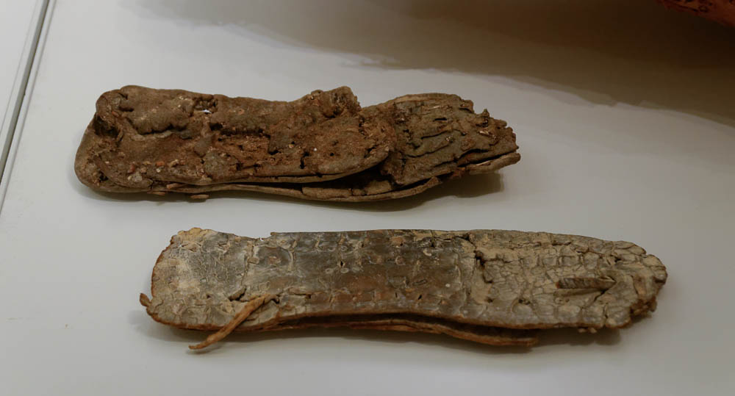
But they shook off the dust of their feet against them
Sandals from the Cave of the Letters in Nahal Hever, 2nd century AD
13:51
Notes:
These leather sandals were photographed at the Israel Museum.
tb032014702

Slide 41
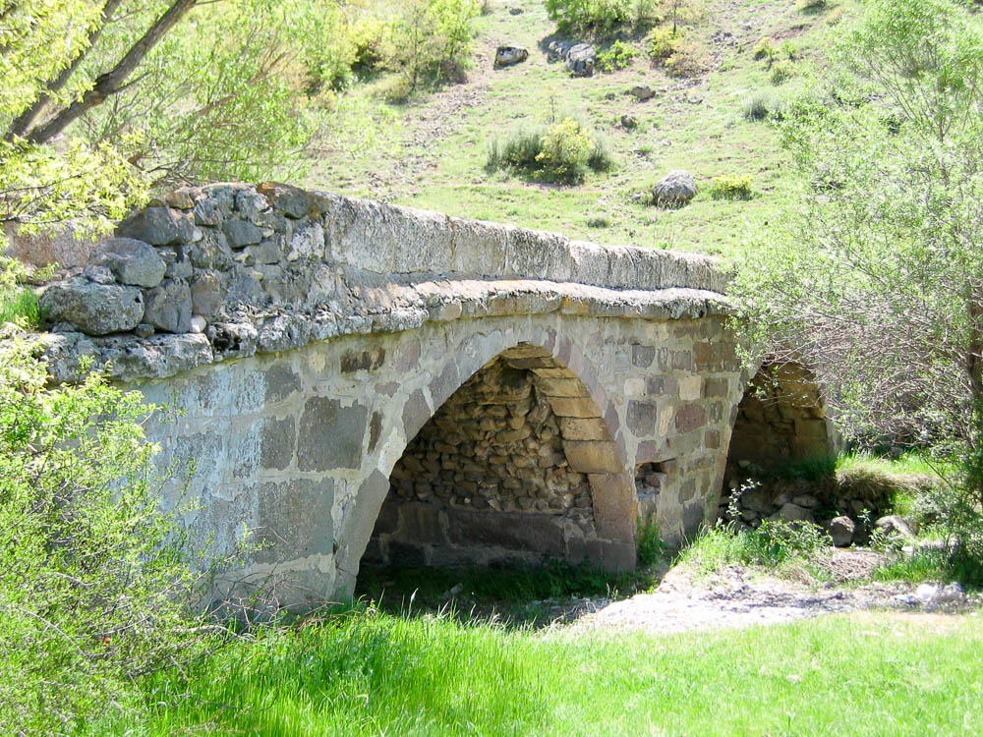
But they shook off the dust of their feet against them and went to Iconium
Roman bridge on the Via Sebaste east of Yunuslar between Pisidian Antioch and Iconium
13:51
Notes:
This well-preserved Roman bridge is located on the Via Sebaste about 32 miles (52 km) west of Iconium. He may have passed over this bridge each time he passed between Iconium and Pisidian Antioch. This photograph was provided by Mark Wilson.
mw051106101

Slide 42
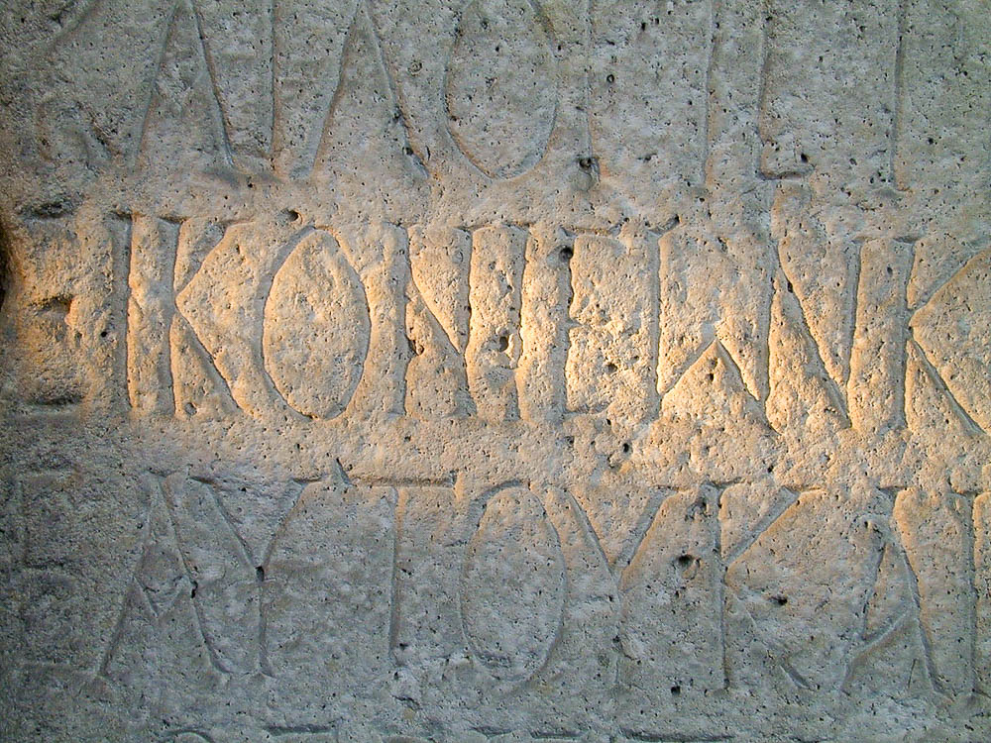
But they shook off the dust of their feet against them and went to Iconium
Inscription mentioning “Iconium”
13:51
Notes:
The inscription pictured here mentions the city of Iconium. It was photographed at the Konya Museum. (Konya is the modern name of ancient Iconium.)
tb010201644

Slide 43
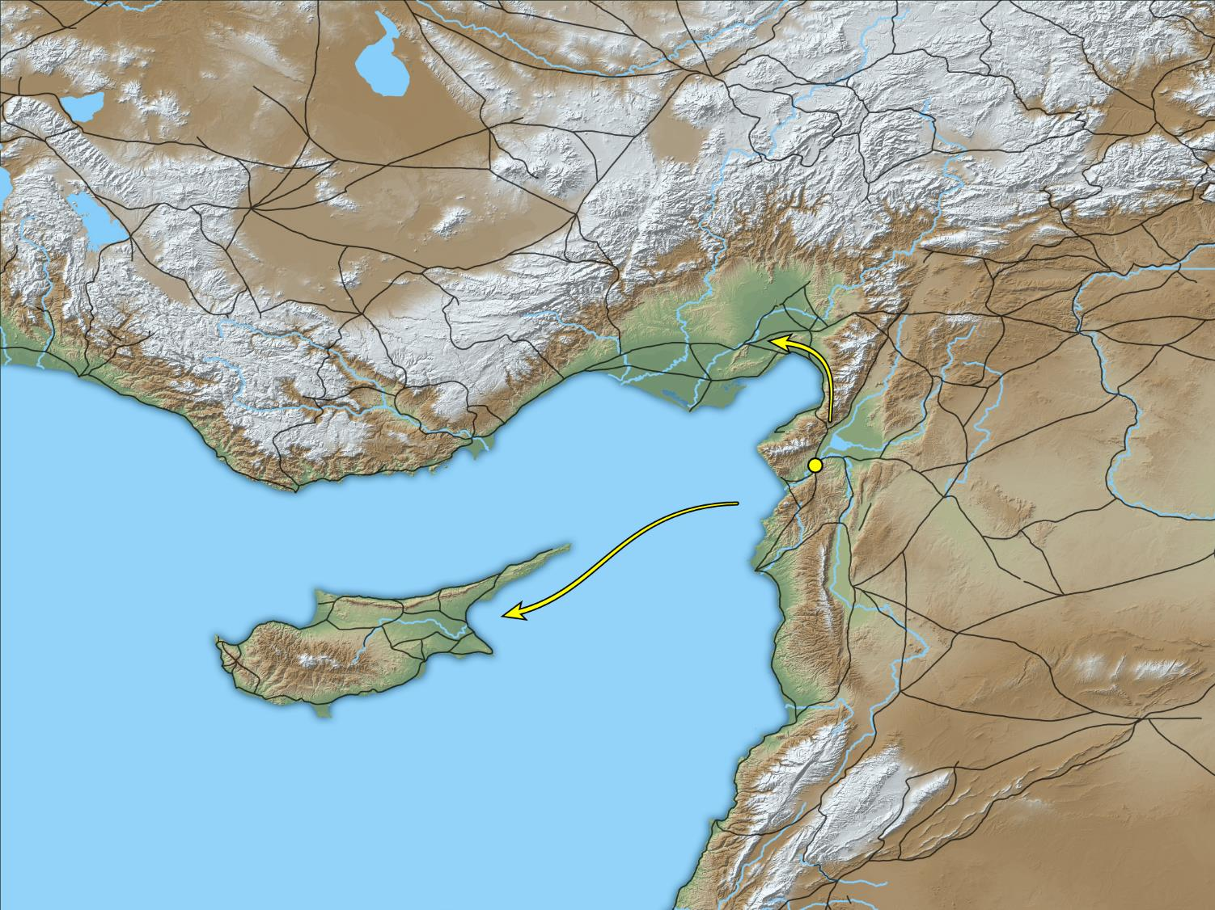
Barnabas . . . sailed away to Cyprus . . . But Paul . . . went through Syria and Cilicia
Cilicia
Antioch
Syria
Cyprus
Map showing independent routes of Barnabas and Paul
15:39-41
Notes:
This map was created by A.D. Riddle, RiddleMaps.com. Data sources: Ancient World Mapping Center shapefiles were used for road lines, under Open Database License (ODbL 1.0; http://awmc.unc.edu/wordpress/map-files/). ASTER-GDEM 2 or SRTM data were used to render the terrain (https://asterweb.jpl.nasa.gov/gdem.asp and https://www2.jpl.nasa.gov/srtm/). Natural Earth was used for streams and inland water bodies. Their data have been placed in the public domain. https://www.naturalearthdata.com/about/terms-of-use/.

Slide 44
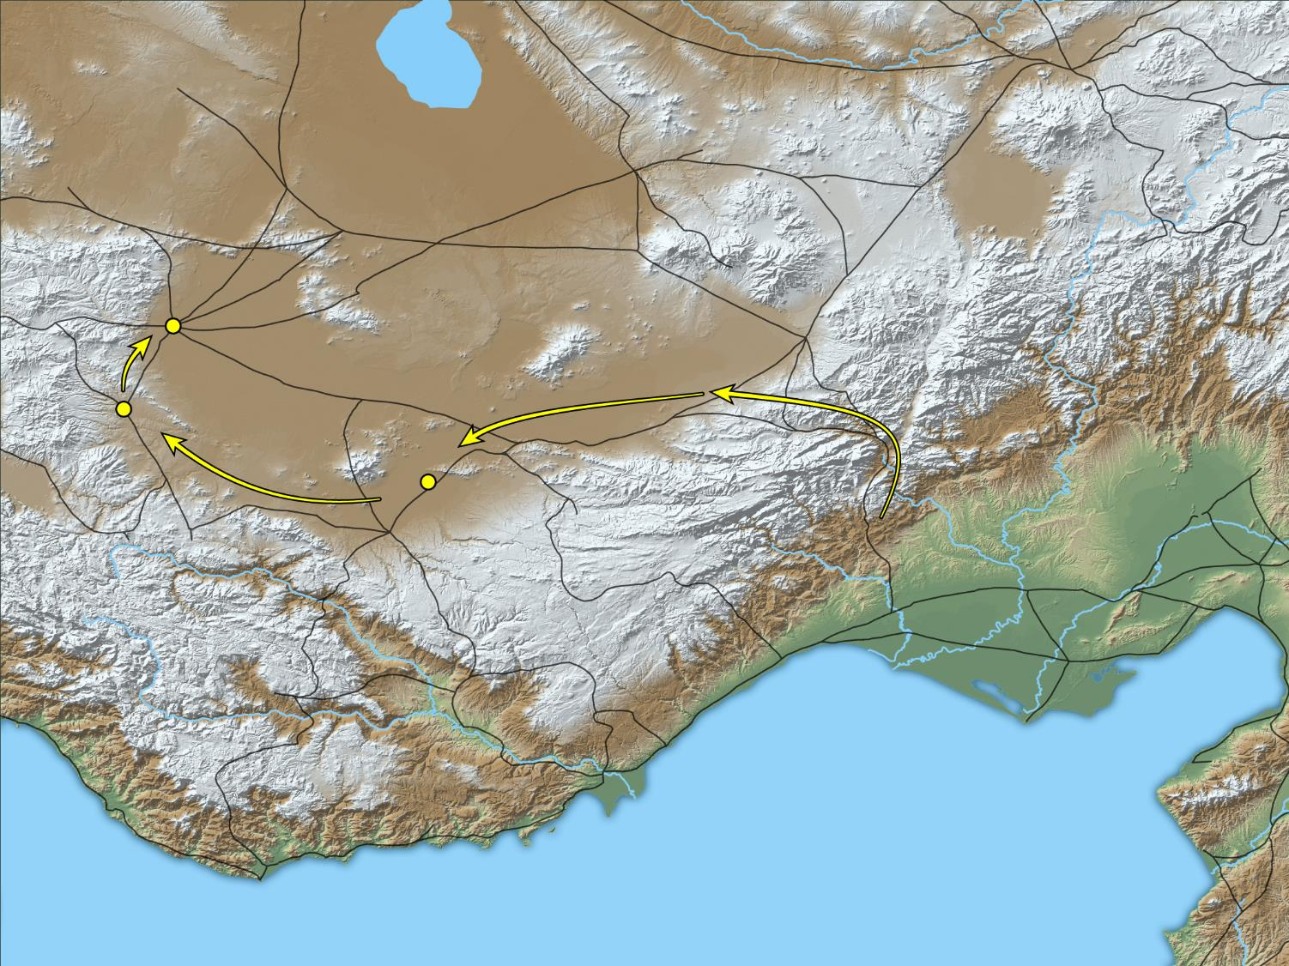
He came also to Derbe and to Lystra
Iconium
Lystra
Derbe
Cilicia
Map showing Paul’s route through Derbe, Lystra, and Iconium
16:1
Notes:
Paul began his second missionary journey by going overland, instead of by sea (and Cyprus) like he did on the first trip. Having set out from Antioch and likely traveled through Tarsus, he now continued west to Derbe. This map was created by A.D. Riddle, RiddleMaps.com. Data sources: Ancient World Mapping Center shapefiles were used for road lines, under Open Database License (ODbL 1.0; http://awmc.unc.edu/wordpress/map-files/). ASTER-GDEM 2 or SRTM data were used to render the terrain (https://asterweb.jpl.nasa.gov/gdem.asp and https://www2.jpl.nasa.gov/srtm/). Natural Earth was used for streams and inland water bodies. Their data have been placed in the public domain. https://www.naturalearthdata.com/about/terms-of-use/.

Slide 45
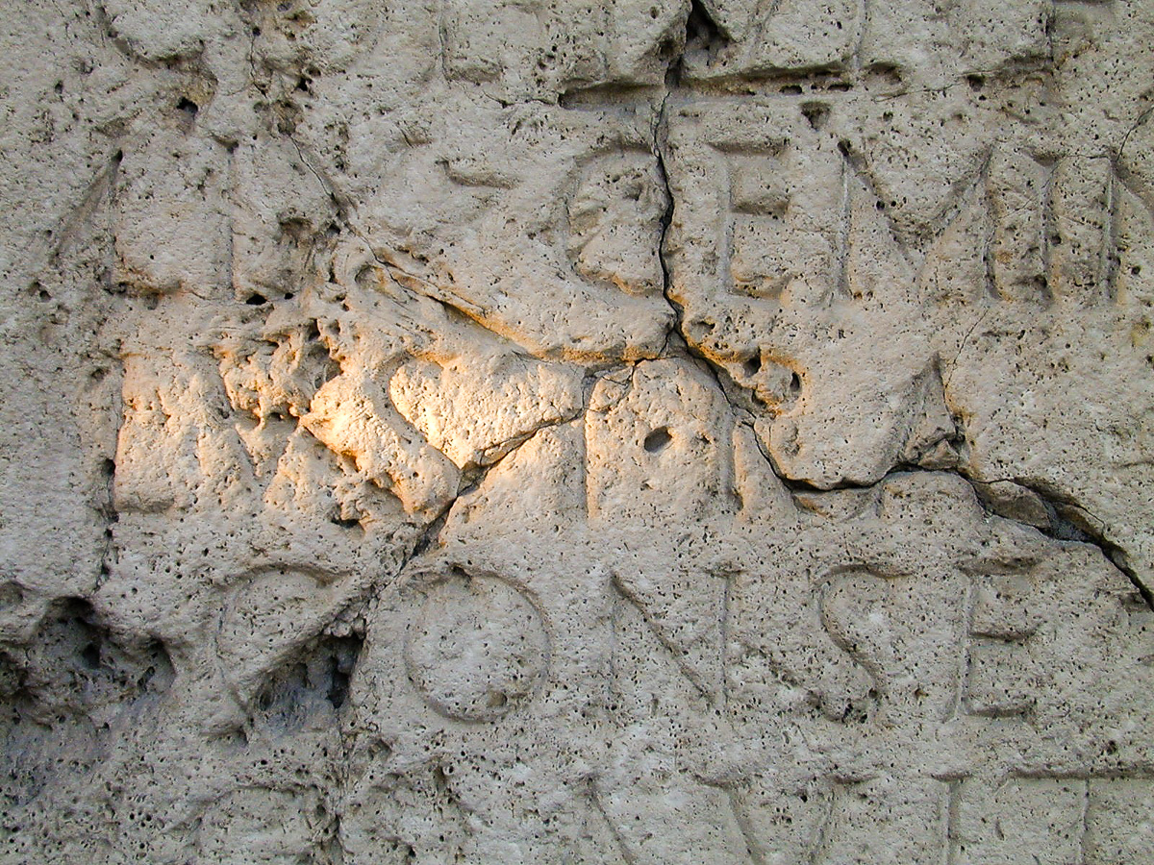
He came also to Derbe and to Lystra
Latin inscription mentioning Lystra (LVSTRA), 2nd century AD
16:1
Notes:
This inscription is on display in the Konya Museum.
tb010201698

Slide 46
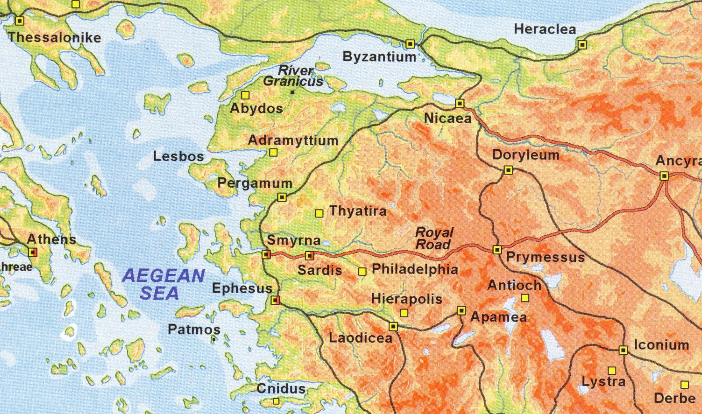
Acts 16: ⁶Now when they had gone through Phrygia and the region of Galatia, they were forbidden by the Holy Spirit to preach the word in Asia.
⁷ And when they had come up to Mysia, they attempted to go into Bithynia, but the Spirit of Jesus did not allow them.
Bithynia
Troas
Myasia
Asia
Galatia
Phrygia

Slide 47
Where did they go instead?
Bithynia
Troas
Myasia
Asia
Galatia
Phrygia

Slide 48
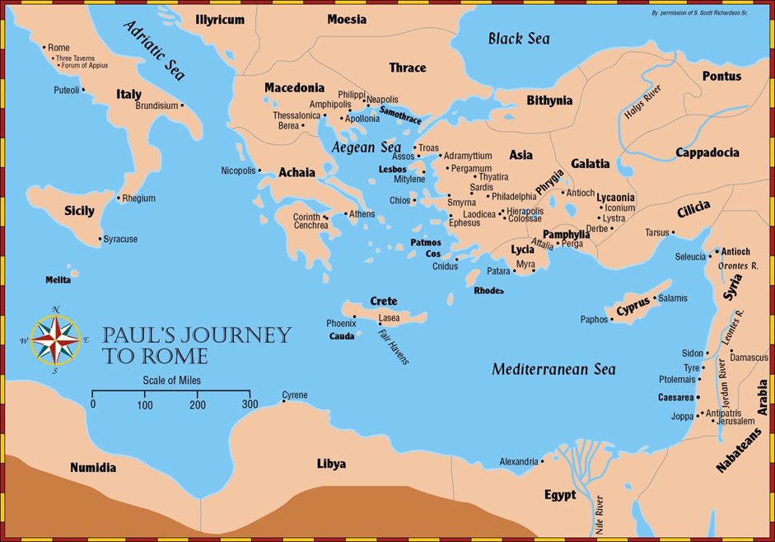

Where did Paul Go?
Acts 16:9 (ESV)
⁹ And a vision appeared to Paul in the night: a man of Macedonia was standing there, urging him and saying, “Come over to Macedonia and help us.”

Slide 49
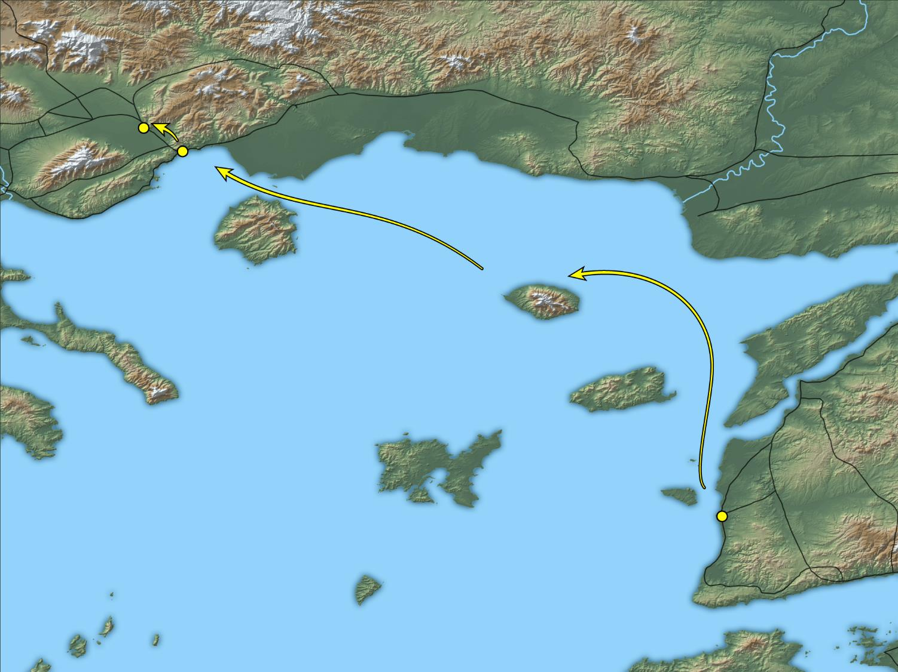
Setting sail from Troas, we ran a straight course to Samothrace, and the next day to Neapolis
Philippi
Neapolis
Samothrace
Troas
Map showing Paul’s journey by sea
16:11
Notes:
The trip from Troas, past Samothrace, to the port at Neapolis was roughly 135 miles (217 km). This map was created by A.D. Riddle, RiddleMaps.com. Data sources: Ancient World Mapping Center shapefiles were used for road lines, under Open Database License (ODbL 1.0; http://awmc.unc.edu/wordpress/map-files/). ASTER-GDEM 2 or SRTM data were used to render the terrain (https://asterweb.jpl.nasa.gov/gdem.asp and https://www2.jpl.nasa.gov/srtm/). Natural Earth was used for streams and inland water bodies. Their data have been placed in the public domain. https://www.naturalearthdata.com/about/terms-of-use/.

Slide 50
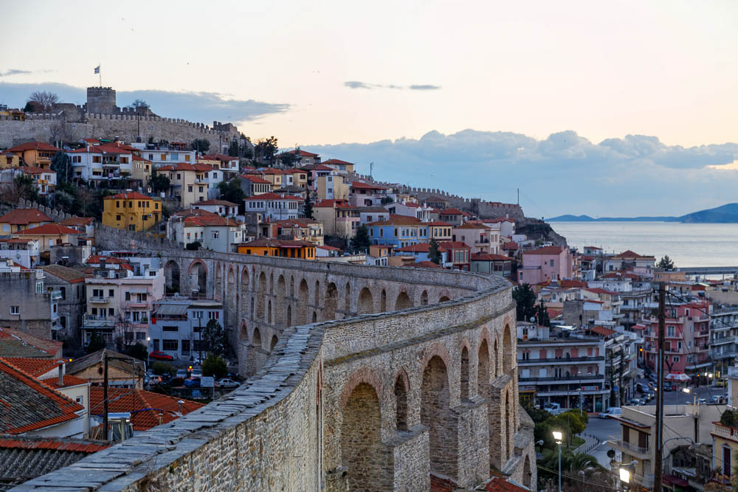
Setting sail from Troas, we ran a straight course to Samothrace, and the next day to Neapolis
Aqueduct in Neapolis
16:11
Notes:
This aqueduct was built by the Romans sometime between the 1st and 6th centuries AD. It brings water from the mountains about 3.5 miles (6 km) to the north. The aqueduct was renovated by Suleiman the Magnificent in the 16th century AD in order to supply water for the Turkish baths.
jc0105151255

Slide 51
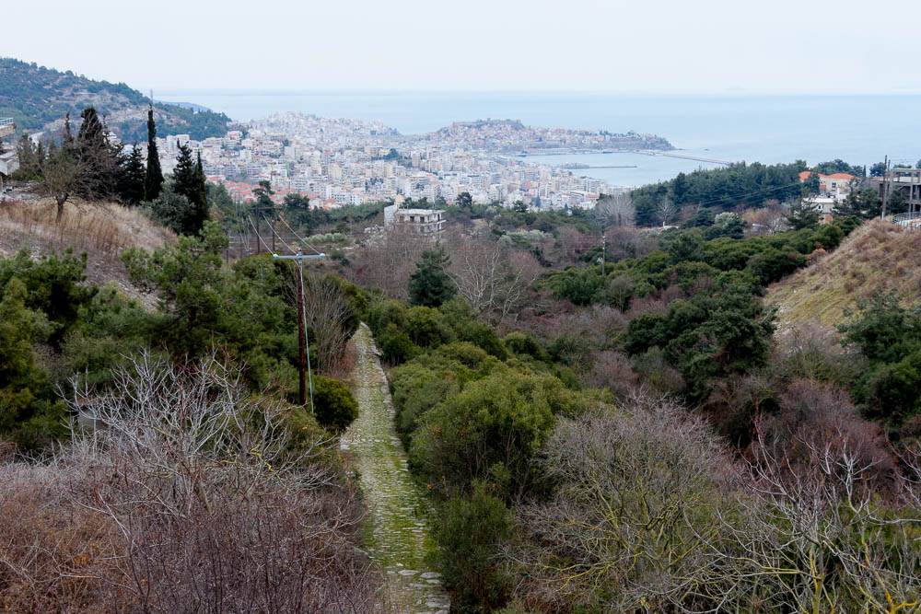
And from there to Philippi
Via Egnatia with a view to Neapolis
16:11
Notes:
In Roman times, Neapolis was the main Aegean port along the Via Egnatia, an important trade route across Macedonia. Remains of the old Roman road still exist, as shown here. Paul would have walked this road from Neapolis to Philippi. The road is not mentioned by name in Acts, but since it was the main road connecting cities that he visited, there can be little doubt that he used it.
tb010717002

Slide 52
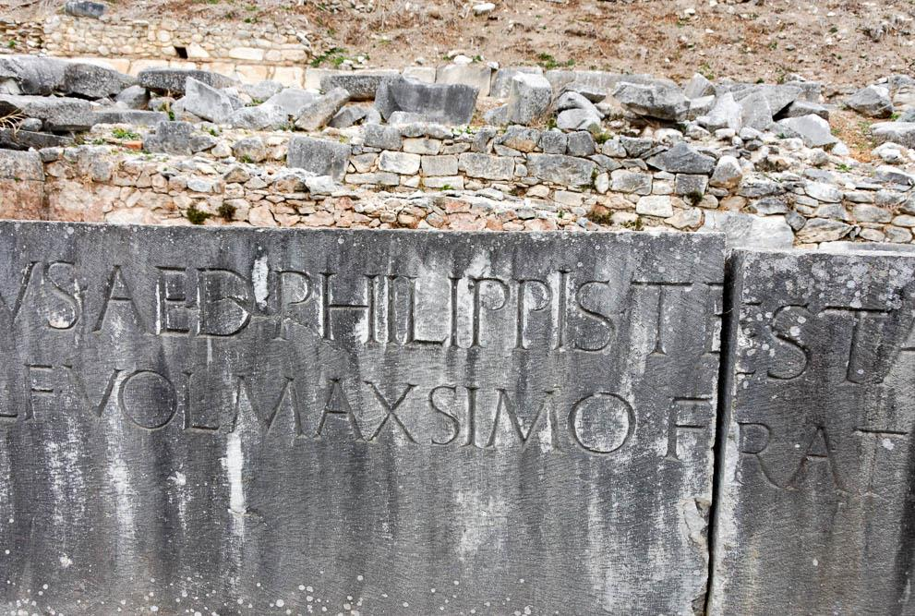
And from there to Philippi, which is a leading city of the district of Macedonia
Monumental Latin inscription at Philippi, with the name Philippi
16:12
Notes:
tb010717130

Slide 53

And from there to Philippi, which is a leading city of the district of Macedonia
Neapolis
Octagon
church
commercial
agora
Basilica B
baths
library
palestra
forum
Basilica A
traditional prison
of Paul
Excavations at Philippi (from the north)
16:12
Notes:
Because the site is not built over by modern settlement, Philippi has been a rewarding excavation for archaeologists. The structures visible in the photo below date from the Roman and Byzantine periods.
tb031106652

Slide 54

City Plan of Philippi

Slide 55

Gangitis River by Philippi, place of Lydia
Where did Paul go when he reached Philippi?
^{Acts 16:13}And on the Sabbath day we went out of the city to the riverside, where prayer was customarily made…
Gangitis River by Philippi, place of Lydia
Notes:
Apparently there was no synagogue in Philippi at the time of Paul's arrival, for this was always his first stop in a city. Instead, he went to the river where prayers were offered. The Gangitis River, to the east of Philippi, is assumed to be the river spoken of in the text.

Slide 56

Philippi excavations and valley from above
Who did he find there?
Acts 16: 13 …and we sat down and spoke to the women who had come together.
14 One who heard us was a woman named Lydia, from the city of Thyatira, a seller of purple goods, who was a worshiper of God. The Lord opened her heart to pay attention to what was said by Paul.
Gangitis River by Philippi
Philippi excavations and valley from above

Slide 57

A woman named Lydia, from the city of Thyatira, a seller of purple cloth
Wool textile with purple stripe, made with vegetal indigotin and madder, 132-136 AD
16:14
Notes:
The purple wool incorporated into this piece of fabric was dyed using a vegetal indigotin and madder. This cloth was recovered from the caves in Wadi Murabba’at, presumably left there by rebels of the Bar-Kochba Revolt who hid there in AD 132–135. This artifact was photographed in the Bible Lands Museum Jerusalem.
adr1806274371

Slide 58

If you have judged me to be faithful to the Lord, come into my house and stay there
Structures east of the forum in Philippi
16:15
Notes:
While Lydia and her household were in Philippi, they may have stayed somewhere among the structures shown here. Lydia was apparently wealthy and was able to keep Paul and his companions in comfortable quarters. Since the ruins shown here are not well preserved, the following slides will show better preserved remains from about the same period, but from Ephesus and Pompeii.
jc0106151412

Slide 59

What resulted when he taught the gospel to Lydia & her household?
14 …The Lord opened her heart to pay attention to what was said by Paul. 15 And after she was baptized, and her household as well

Slide 60

What did Lydia ask Paul and those with him to do?
15 And after she was baptized, and her household as well, she urged us, saying, “If you have judged me to be faithful to the Lord, come to my house and stay.” And she prevailed upon us.

Slide 61

They dragged them into the marketplace before the rulers
commercial
agora
commercial
road
forum
route of the Via Egnatia
traditional prison
of Paul
Forum at Philippi (from the north)
16:19
Notes:
Paul and Silas were dragged into the forum, or marketplace, since that was the location of the rulers or magistrates (Gk. archon [ἄρχων]).
tb031106668

Slide 62

City Plan of Philippi Forum
They dragged them into the marketplace before the rulers

Slide 63

They dragged them into the marketplace before the rulers
Forum at Philippi (from the northeast)
16:19
Notes:
The majority of the forum consisted of a public, open-air square, surrounded by a columned portico on several or all sides. The forum was used for a great number of activities, including business transactions and a variety of civic functions. The forum at Philippi measured 300 by 150 feet (90 by 45 m) and was oriented east-west along the Via Egnatia. It was largely rebuilt during the reign of Marcus Aurelius (AD 161–180), but the general plan was constructed in the reign of Claudius, which in turn was built over earlier remains from the Augustan age (31 BC–AD 14) and the Hellenistic period (4th–2nd centuries BC).
tb010717124

Slide 64


They dragged them into the marketplace before the rulers
Three possibilities for the location of the court before which Paul and Silas were taken
Commonly used as a court of law
records office
Forum (marketplace)
Roman
basilica
bema
Acts 18 (Corinth)
Council of Citizens (senate)
met
bouleuterion
Possible locations for the judgment of Paul at Philippi
16:19
Notes:
There are three possibilities for the location of the court before which Paul and Silas were taken. One is the bema, a raised platform along the north side of the Philippi forum that was used for public address, but sometimes also for court proceedings (e.g., Acts 18:12). Another good possibility is that he was taken to either the Roman basilica or the bouleuterion, both of which were located at the west end of the forum. The basilica was commonly used by the Romans both for public assemblies and as a court of law, and the bouleuterion was where the council of citizens (or senate) met. In the slides that follow we will show these locations in turn.
tb031106668

Slide 65

Philippi forum
Why charge Paul & Silas?
Acts 16: ¹⁹ But when her owners saw that their hope of gain was gone, they seized Paul and Silas and dragged them into the marketplace before the rulers.
Philippi forum
Notes:
The Forum
The forum (agora) of Philippi consisted of a paved square, bounded by stoas and buildings. Measuring 300 by 150 feet, the forum was oriented lengthwise along the Ignatia Way. It was largely rebuilt during the reign of Marcus Aurelius (161-180 B.C.), but the general plan is presumably the same as it was in Paul’s day and as late as it was used, ca. the 5th or 6th century A.D.
At the northwest corner of the Forum stood a temple dedicated to Emperor Antonius Pius (138-161 B.C.). The architectural remains of this temple suggest that the building had two Corinthian columns on the façade, a marble floor, and plaster-coated walls.
The Roman commercial agora lay southeast of the forum, between it and the Palastra.

Slide 66

Philippi Paul's Prison
What happened to Paul & Silas?
Philippi Paul's Prison

Slide 67
City Plan of Philippi Forum
What happened to Paul & Silas?
Acts 16
²² The crowd joined in attacking them, and the magistrates tore the garments off them and gave orders to beat them with rods.
²³ And when they had inflicted many blows upon them, they threw them into prison, ordering the jailer to keep them safely.
²⁴ Having received this order, he put them into the inner prison and fastened their feet in the stocks.

Slide 68

Paul’s Prison ?
What were the doing in the middle of the night when the earthquake struck?

Slide 69

What were the doing in the middle of the night when the earthquake struck?
Acts 16: ²⁵ But at midnight Paul and Silas were praying and singing hymns to God, and the prisoners were listening to them. ²⁶ Suddenly there was a great earthquake, so that the foundations of the prison were shaken; and immediately all the doors were opened and everyone’s chains were loosed.

Slide 70

And immediately all the doors were opened and everyone’s bonds were released
Iron chains worn by slaves, 1st century AD
16:26
Notes:
Those who were in the prison had been bound with chains, similar to the ones pictured above. This display was photographed at the Spartacus Exhibit, a temporary exhibition at the Ara Pacis Museum in Rome.
tb0518174080

Slide 71


Slide 72

Paul’s Prison ?
What happened to the other prisoners?
Acts 16: ²⁶ Suddenly there was a great earthquake, so that the foundations of the prison were shaken; and immediately all the doors were opened and everyone’s chains were loosed… ²⁸ But Paul cried with a loud voice, “Do not harm yourself, for we are all here.”

Slide 73

Philippi alleged place of Paul's prison
What was the jailor ready to do?
Acts 16: ²⁷ And the keeper of the prison, awaking from sleep and seeing the prison doors open, supposing the prisoners had fled, drew his sword and was about to kill himself. ²⁸ But Paul called with a loud voice, saying, “Do yourself no harm, for we are all here.”
Why did he not do it?
Philippi alleged place of Paul's prison

Slide 74

Philippi Ignatia Way
When Paul & Silas were released the next morning. Of what did they inform the authorities?
³⁷ But Paul said to them, “They have beaten us publicly, uncondemned, men who are Roman citizens, and have thrown us into prison; and do they now throw us out secretly? No! Let them come themselves and take us out.”
³⁸ The police reported these words to the magistrates, and they were afraid when they heard that they were Roman citizens.
³⁹ So they came and apologized to them. And they took them out and asked them to leave the city.
Philippi Ignatia Way

Slide 75

When they had seen the brothers, they encouraged them and departed
Via Egnatia
16:40
Notes:
After spending time with Lydia and her household, the apostles embarked again upon their journey, continuing towards the west along the Via Egnatia. This photograph was taken along a section of the road from Neapolis that Paul had previously traveled on.
tb031106967

Slide 76

Amphipolis is on the Via Egnatia
The Via Egnatia is the name of a Roman Road that connected ports on the Adriatic Sea with Byzantium
Acts 17
¹Now when they had passed through Amphipolis and Apollonia, they came to Thessalonica, where there was a synagogue of the Jews.
Notes:
The Via Egnatia is the name of a Roman Road that connected ports on the Adriatic Sea with Byzantium. From east to west, a traveler from Rome (Italy – not on map) would head west overland to Brundisium (a port on the west coast of Italy). There they would sail across the Adriatic Sea landing at either Apollonia or Dyrrhachium (both on map). From there they would head east on the “Via Egnatia” toward Byzantium — via Thessalonica, Amphipolis, Philippi, and Kypsela.
Although completed in stages, it was begun in the second century B.C. and it was expanded and repaired by the Romans in subsequent centuries. It is named after the second century B.C. Roman proconsul of Macedonia, “Gnaios Egnatios.”
Its length varied according to the period, but Roman milestones suggest it was 535 Roman miles long (= 493 English miles [790 km.]).
Paul probably traveled this road on both his second and third missionary journeys, as he traveled between Philippi and Thessalonica.

Slide 77

Now after they had traveled through Amphipolis . . .
Lion of Amphipolis, 4th century BC
17:1
Notes:
This lion, dating to the 4th century BC, has been reconstructed from the pieces found around the area over the space of several decades. The base has also been reconstructed. The purpose of the statue is not conclusively known, but some archaeologists suspect it may have honored Laomedon, a friend of Alexander the Great, and a man who eventually became governor of Syria. It was standing when Paul traveled through the area.
tb010717211

Slide 78

They came to Thessalonica
Ancient street in the forum of Thessalonica
17:1
Notes:
Paul would have walked on streets in Thessalonica similar to this one.
tb010817333

Slide 79

Where did Paul go when he reached Thessalonica?
Acts 17: ¹ …they came to Thessalonica, where there was a synagogue of the Jews.
² And Paul went in, as was his custom, and on three Sabbath days he reasoned with them from the Scriptures,

Slide 80

What did he reason with the Jews concerning the Scriptures?
Acts 17 ³ explaining and demonstrating that the Christ had to suffer and rise again from the dead, and saying, “This Jesus whom I preach to you is the Christ.”

Slide 81

What resulted from his teaching?
Acts 17
⁴ And some of them were persuaded and joined Paul and Silas, as did a great many of the devout Greeks and not a few of the leading women.

Slide 82

Thessalonica Agora-Market
Acts 17:5 But the Jews who were not persuaded, becoming envious, took some of the evil men from the marketplace, and gathering a mob, set all the city in an uproar and attacked the house of Jason, and sought to bring them out to the people.

Slide 83

But the Jews . . . taking along some wicked men from the marketplace and forming a mob . . .
Shops in the forum of Thessalonica
17:5
Notes:
The arches shown here once served as doorways to the shops of Thessalonica.
tb010817324

Slide 84

But the Jews . . . forming a mob, started a riot in the city
Fresco of a fight in and around the amphitheater of Pompeii, AD 59
17:5
Notes:
Mobs and riots often found their beginnings in public places like the forum, theaters, or amphitheaters. In the fresco from Pompeii shown here, fighting has broken out at the amphitheater and spilled into the surrounding streets. This fresco was photographed in the Naples Museum.
tb0515170287

Slide 85

But the Jews . . . forming a mob, started a riot in the city
Sketch of fresco of a fight in the amphitheater of Pompeii in AD 59, from Pompeii
17:5
Notes:
This sketch of the fresco shown on the previous slide comes from Pierre Gusman, Pompeii: The City, Its Life and Art (London: William Heinemann, 1900), page 156.
pg1900156

Slide 86

They dragged Jason and certain brothers before the politarchs
odeon
forum
The politarchs would have most likely met in either the forum or the odeon of Thessalonica
Forum with odeon in Thessalonica
17:6
Notes:
The politarchs would have most likely met in either the forum or the odeon of Thessalonica. Since the odeon is so close to the forum here, it seems quite possible as the location for this portion of the chapter.
tb011301291

Slide 87

They dragged Jason and certain brothers before the politarchs
Model of the forum in Thessalonica
17:6
Notes:
This model gives an overview of the excavations of the forum and odeon at Thessalonica. This model was photographed in the Archaeological Museum of Thessaloniki.
tb011301287

Slide 88


They dragged Jason and certain brothers before the politarchs
“Politarchs” mentioned in an inscription from Thessalonica, 1st century AD
17:6
Notes:
Another reference to “politarchs” appears in this inscription. Although some of the inscriptions referring to politarchs date later than Paul, the one shown here and the one shown previously both come from the 1st century AD. This artifact was photographed in the Archaeological Museum of Thessaloniki.
jc0107151519 (left); jc0107151518 (right)

Slide 89




When they had taken bond from Jason and the rest, they let them go
Gold aureus of Claudius
Silver denarius depicting Tiberius
Bronze coin from Tarsus
Bronze sestertius of Claudius
Various coins in circulation in the 1st century AD
17:9
Notes:
The coins pictured here were all of types that were in circulation during the 1st century AD and were likely known and perhaps used to Jason and his companions. The bond payment could have been made with coins like these, or many others. The top right and bottom left images comes from Yale University Art Gallery and are in the public domain. Sources: Top right - https://artgallery.yale.edu/collections/objects/127667; bottom left - https://artgallery.yale.edu/collections/objects/117913
top left: adr1305249887b; top right: yale127667b; bottom left: yale117913b; bottom right: adr1305249886b

Slide 90

How many Sabbaths did Paul preach in the synagogue?
Acts 17:2-3(ESV)
²And Paul went in, as was his custom, and on three Sabbath days he reasoned with them from the Scriptures,
³explaining and proving that it was necessary for the Christ to suffer and to rise from the dead, and saying, “This Jesus, whom I proclaim to you, is the Christ.”

Slide 91

The brothers immediately sent Paul and Silas away by night to Berea
Thessalonica
Apollonia
Berea
Athens
Map of Paul’s route to Berea and Athens
17:10
Notes:
Situated in the region of Ithmia, in northeastern modern-day Greece, Beroea/Berea (modern Veria) was located 24 miles (38 km) inland from the Aegean Gulf of Thermai and roughly 40 miles (64 km) west of Thessalonica. This map was created by A.D. Riddle, RiddleMaps.com. Data sources: Ancient World Mapping Center shapefiles were used for road lines, under Open Database License (ODbL 1.0; http://awmc.unc.edu/wordpress/map-files/). ASTER-GDEM 2 or SRTM data were used to render the terrain (https://asterweb.jpl.nasa.gov/gdem.asp and https://www2.jpl.nasa.gov/srtm/). Natural Earth was used for streams and inland water bodies. Their data have been placed in the public domain. https://www.naturalearthdata.com/about/terms-of-use/.

Slide 92

When they arrived, they went into the synagogue of the Jews
Old synagogue in the Jewish quarter of Berea
17:10
Notes:
Set in the old Jewish Quarter (Ghetto), this unused synagogue is thought to be one of the oldest synagogues still standing in northern Greece. Some think that it may have been built over an even more ancient synagogue, which some suggest could have been the one where Paul thought.
jc0107151633

Slide 93

When they arrived, they went into the synagogue of the Jews
Interior of the old synagogue in the Jewish quarter of Berea
17:10
Notes:
tb031406494

Slide 94

Scribe writing
Acts 17:¹¹ These were more fair-minded than those in Thessalonica, in that they received the word with all readiness, and searched the Scriptures daily to find out whether these things were so.
Why were these people more fair-minded?
Scribe writing
Notes:
Deuteronomy 17:18 (KJV) “And it shall be, when he sitteth upon the throne of his kingdom, that he shall write him a copy of this law in a book out of that which is before the priests the Levites.”

Slide 95

Who believed besides the Jews?
Acts 17
¹² Many of them therefore believed, with not a few Greek women of high standing as well as men.

Slide 96

The Jews of Thessalonica . . . came there also, agitating and stirring up the crowds
Area of the ancient agora in Berea
17:13
Notes:
Ancient crowds often gathered in the forums of their cities, as they did in the account of Paul’s visit to Thessalonica. The crowds now agitated by the Thessalonians may well have been gathered in the forum (agora) at Berea.
tb031406482

Slide 97

Immediately the brothers sent Paul off to go as far as the sea
Main street in Dion
17:14
Notes:
It is not certain whether Paul travelled to Athens by land or sea, although most scholars believe he travelled by sea. If so, he likely set sail from Dion. The city of Dion was only about one mile (1.6 km) from the shore of the Thermaikos Gulf, making it the most likely place from which Paul embarked on a ship to Athens. Although today the gulf has silted in, making the city further from the sea, Dion is connected with the gulf by the once navigable river Baphyras.
tb031406424

Slide 98

Paul’s Journey
From Berea to Athens
Acts 17: ¹⁵So those who conducted Paul brought him to Athens; and receiving a command for Silas and Timothy to come to him with all speed, they departed.

Slide 99

Those who escorted Paul brought him as far as Athens
Harbor of Piraeus, from the Hill of Philopappus in Athens
17:15
Notes:
Piraeus is the third largest city in Greece today. Unfortunately, few ancient remains have been preserved or are visible to visitors today.
tb011501057

Slide 100

Athens acropolis from Likavittos
Athens acropolis from Likavittos
Notes:
The Acropolis
Occupation at the acropolis dates back to prehistoric times. A Mycenaean palace sat here in the Late Bronze Age; it served as a political and religious center in the Archaic period. The acropolis was solely religious in Classical times, its structures including a monument to Agrippa, the propylaia, the temple of Athena Nike, an older temple of Athena, the Parthenon, and the Erechtheion. Following the Classical period, this area was always a key military position, the first part of the city taken during invasions (e.g. by the Franks, Venetians, Turks, Bavarians).

Slide 101

Athens agora concert hall of Agrippa
Why was Paul provokes at Athens?
Acts 17:¹⁶Now while Paul waited for them at Athens, his spirit was provoked within him when he saw that the city was given over to idols.
Athens agora concert hall of Agrippa
Notes:
A concert hall was constructed in the agora during Roman times. During this time, the agora was no longer a political center, but it served a more cultural purpose.

Slide 102

Now while Paul waited for them at Athens . . . he saw the city was full of idols
Erechtheion, with a “sacred tree” and the Porch of the Caryatids
17:16
Notes:
The Erechtheion was completed in 406 BC and was dedicated to the goddess Athena and the god Poseidon Erechtheus. The structure included the sanctuary of Erechtheus (the hero-king for which the Erechtheion was named) and the temple of Athena Polias. The Porch of the Caryatids (on the right side of this photo) is the most famous part of the structure, where six statues of maidens, called Caryatids, were used as columns. Although they are now missing, their right hands once held libation bowls which were used for drink offerings. The statues on site today are replicas, while four of the originals are stored in the Acropolis Museum, and another, taken by Lord Elgin, is on display at the British Museum. The Erechtheion was repaired in the 4th and 1st centuries BC, the latter due to fire damage. It was used as a church during the 7th century AD.
tb031806348

Slide 103

Athens
In what 2 places did Paul reason with the people?
Synagogue??

Slide 104

He reasoned in the synagogue with the Jews
No evidence exists of the Athenian synagogue, but this photo shows preserved remains from the synagogue of Corinth
“Synagogue of the Hebrews” inscription, and decorative menorah carvings
17:17
Notes:
Even in Athens, a very pagan city, a small Jewish population thrived. No evidence exists of the Athenian synagogue, but this photo shows preserved remains from the synagogue of Corinth, Paul’s next stop on his itinerary. These objects were photographed at the Corinth Museum.
tb031706083

Slide 105

Acts 17
Acts 17:¹⁷Therefore he reasoned in the synagogue with the Jews and with the Gentile worshipers, and in the marketplace daily with those who happened to be there.

Slide 106

He reasoned . . . in the marketplace every day with those who happened to be there
Agora in Athens, as seen from the Acropolis
17:17
Notes:
The agora was the political, financial, and religious center of ancient Athens. Situated at the foot of the acropolis, the ancient agora (or marketplace) sprawled out into the city. Merchants from all over the Mediterranean came to the Athenian agora to sell their goods in rented booths, tables, or stands. Each vendor had to pay the local authorities a fee, and a general council operated to ensure fair bargains. In Roman times, the agora served a more cultural purpose. It was visited by tourists and remained prominent until AD 267, when the Heruli destroyed much of the city. The large roofed building on the right side of the photo is the Stoa of Attalos. It was once the eastern edge of the agora, and was rebuilt during the 1950s. The columned temple at the left edge of the picture is the Temple of Hephaestus, on the western edge of the ancient agora.
tb031806376

Slide 107

Athens agora and Stoa of Attalos from west
Acts 17:¹⁷Therefore he reasoned in the synagogue with the Jews and with the Gentile worshipers, and in the marketplace daily with those who happened to be there.
Athens agora (market place) and Stoa of Attalos from west
Notes:
The Agora
At the foot of the acropolis, the ancient agora (or marketplace) sprawled out into the city. Merchants from all over the Mediterranean came to the Athenian agora to sell their goods in rented booths, tables, or stands. Each vendor had to pay the local authorities a fee, and a general council operated to ensure fair bargains.
The agora area was settled in Neolithic times and used as a cemetery until the 6th century B.C., when communal buildings were erected. The 5th century was a significant time for building; the area continued to fill with structures, statues, and paintings through the next two centuries.
The agora was the civil center of ancient Athens. Here social, political, and legal meetings took place. Disputes, discussions, and inquiries took place at the stoa, colonnaded structures bordering the marketplace.
In Roman times the agora served a more cultural purpose. It was visited by tourists and remained prominent until 267 A..D., when the Heruli destroyed much of the city. The Alaric contributed to the damage in 396 A.D. The agora was reoccupied but again abandoned when the Slavs invaded (582 A.D.).

Slide 108

He reasoned . . . in the marketplace every day with those who happened to be there
Acropolis
Stoa of Attalos
agora
Acropolis and agora in Athens (from the northwest)
17:17
Notes:
This photo was taken from the Temple of Hephaestus looking toward the agora and Acropolis. The agora once extended from where the photographer stands all the way to the large Stoa of Attalos in the distance. The Acropolis is visible ever further back on the right side of the photo. Since the agora was the center of ancient Athens in so many ways, it was an excellent place for Paul to be heard by many people. It was where all disputes, discussions, and inquiries took place.
jc011015225p

Slide 109

He reasoned . . . in the marketplace every day with those who happened to be there
Scene of life in the forum, from Pompeii, 1st century AD
17:18
Notes:
This fresco, photographed at the Naples Archaeological Museum, shows the sale of pottery and footwear—normal marketplace activities.
tb0515170863

Slide 110

Acts 17:¹⁷Therefore he reasoned in the synagogue with the Jews and with the Gentile worshipers, and in the marketplace daily with those who happened to be there.

Slide 111

Certain also of the Epicurean and Stoic philosophers encountered him
Epicurean philosopher on a Roman adaptation of a Greek lampstand, late 1st century BC
17:18
Notes:
This bronze sculpture was photographed in the Metropolitan Museum of Art in New York City.
adr1605242828

Slide 112

Certain also of the Epicurean and Stoic philosophers encountered him
Bust of Zeno of Citium, founder of Stoicism, late 1st century BC
17:18
Notes:
Zeno of Citium founded the Stoic school of philosophy. He lived around the 3rd century BC, close to the time of Epicurus. This bust of him was carved about the time of Christ, but is thought to be a copy of a Greek original that may have been created during Zeno’s lifetime. This bust of Zeno was photographed at the Naples Archaeological Museum.
tb0515171517c

Slide 113


Stoa of Attalos and Market Place (Agora) from the Areopagus. Photo by Leon Mauldin.
What reaction did the Athenians have to his message?
¹⁸Some of the Epicurean and Stoic philosophers also conversed with him. And some said, “What does this babbler wish to say?” Others said, “He seems to be a preacher of foreign divinities”—because he was preaching Jesus and the resurrection.
What reaction did the Athenians have to his message?

Slide 114

They took hold of him and brought him to the Areopagus
Mars Hill, from the Acropolis
17:19
Notes:
Next to the acropolis of Athens stands a smaller rocky outcropping. This is the Areopagus, or “Mars Hill,” named for Ares, the Greek god of war, called Mars by the Romans. From the beginning of its democratic tradition, the Athenian government had the Council of the Areopagus, an advisory board of nobles that met on this hill. The council was originally composed mainly of former elected officials who had completed their terms. It grew into the senate and supreme judicial court. However, Solon’s reforms of 594 BC introduced a new council of citizen representatives, the Boule, which greatly reduced the duties of the council of the Areopagus. By the 5th century BC, the sole official function of the Areopagus was the trying of murderers and arsonists. The council met in the open air so that they would not be contaminated with the blood crimes being tried. On top of the hill were two stones: the stone of wrath (where the prosecutor stood) and the stone of shame (where the accused stood). In the 1st century BC, there was an actual structure on this hill in which the council met. In the decades before Paul arrived, the Areopagus had been reinstated as the governing body of Athens. It had judicial authority, and had come to dominate the Athenian government, so Paul’s appearance there was potentially serious.
tb031806377

Slide 115

Athens Mars Hill from acropolis
Acts 17: ¹⁹And they took him and brought him to the Areopagus, saying, “May we know what this new doctrine is of which you speak?
Athens Mars Hill from acropolis

Slide 116


Slide 117

Athens Mars Hill from north
Acts 17:²¹For all the Athenians and the foreigners who were there spent their time in nothing else but either to tell or to hear some new thing.
Athens Mars Hill from north

Slide 118

Paul’s Sermon in Athens
Acts 17:²²Then Paul stood in the midst of the Areopagus and said, “Men of Athens, I perceive that in all things you are very religious;
Notes:
Acts 17:19-22: The Areopagus (Mars Hill) in Athens, where Paul made his defense before the Athenians.
Quickverse-Parson Bible Pictures

Slide 119

Paul’s Sermon in Athens
Acts 17:²²Then Paul stood in the midst of the Areopagus and said, “Men of Athens, I perceive that in all things you are very religious;
Notes:
Acts 17:19-22: The Areopagus (Mars Hill) in Athens, where Paul made his defense before the Athenians.
Quickverse-Parson Bible Pictures

Slide 120

I also found an altar with this inscription, “TO AN UNKNOWN GOD”
Display of altars dedicated to various gods
17:23
Notes:
Altars were usually dedicated to specific gods and were decorated and inscribed to that effect. These miniature altars were photographed at the Antalya Museum in Turkey.
tb123016848

Slide 121

An Altar to the Unknown God
Acts 17:^{23…}for as I was passing through and considering the objects of your worship, I even found an altar with this inscription:
TO THE UNKNOWN GOD.
Altar Located on Palatine Hill, Rome
Notes:
The above altar is located on Palatine Hill, Rome, where once stood the palaces of the Caesars. It dates from about 100 B.C. and has the inscription, ´To the unknown God.´ The apostle Paul saw just such an altar while waiting in Athens for Timothy and Silas to join him. He used the Athenians religious zeal to worship gods they don't even know the name of as a springboard for telling them about the TRUE God:
" Now while Paul waited for them (Timothy and Silas) at Athens, his spirit was stirred in him, when he saw the city wholly given to idolatry (e.g. statues, images or any object used as aid to worship false gods or the true God). Therefore disputed he in the synagogue with the Jews, and with the devout persons, and in the market daily with them that met with him. " Then certain philosophers of the Epicureans (followers of Epicurus. They taught that the highest aim of man was to seek a pleasant and smooth life.) and of the Stoicks (they taught that man's happiness consisted in bringing himself into harmony with the course of the universe.), encountered him. And some said, What will this babbler say? other some, He seemeth to be a setter forth of strange gods: because he preached unto them Jesus, and the resurrection.
" Then Paul stood in the midst of Mars' hill (the Areopagus or rocky hill in Athens where the Athenian supreme tribunal and court of morals was held), and said, [Ye] men of Athens, I perceive that in all things ye are too superstitious. For as I passed by, and beheld your devotions, I found an altar with this inscription, TO THE UNKNOWN GOD. Whom therefore ye ignorantly worship, him declare I unto you." (Acts 17:16-18, 22-23)
Scriptural References: Acts 17 (KJV Bible)
Sources Used: Easton's Bible Dictionary

Slide 122

Athens Parthenon
Acts 17: ²⁵Nor is He worshiped with men’s hands, as though He needed anything, since He gives to all life, breath, and all things.
Athens Parthenon

Slide 123

Paul Quotes a Greek Poet from
his home province at the Areopagus
for in Him we live and move and exist, as even some of your own poets have said, ‘For we also are His children.’
“Being then the children of God, we ought not to think that the Divine Nature is like gold or silver or stone, an image formed by the art and thought of man. ”
(Acts 17:28-29 NAU)
Cretan poet Epimenides
Aratus of Cilicia
Acts 21:39 But Paul said, “I am a Jew of Tarsus in Cilicia, a citizen of no insignificant city; and I beg you, allow me to speak to the people.”
Cilician poet Aratus.
British Museum
Notes:
As Paul taught the Areopagus about the God that could be known, he cited two Greek poets who had indicated belief in a supreme being.
for in Him we live and move and exist, as even some of your own poets have said, ‘For we also are His children.’ “Being then the children of God, we ought not to think that the Divine Nature is like gold or silver or stone, an image formed by the art and thought of man. (Acts 17:28-29 NAU)
The first quotation is attributed to the Cretan poet Epimenides. The second quotation is attributed to Aratus of Cilicia, which was also Paul’s home (Acts 21:39). These poets certainly did not have in mind the same God that Paul was preaching, but they acknowledged that there was a supreme power back of the universe.

Slide 124



³²Now when they heard of the resurrection of the dead, some mocked.
But others said, “We will hear you again about this.”
³³So Paul went out from their midst.
³⁴But some men joined him and believed, among whom also were Dionysius the Areopagite and a woman named Damaris and others with them.

