Slide 1

Journey thru the Bible with Archaeology
A Bible and Spade Evidence Class.
Lesson 12 Cities of Paul and John

Slide 2
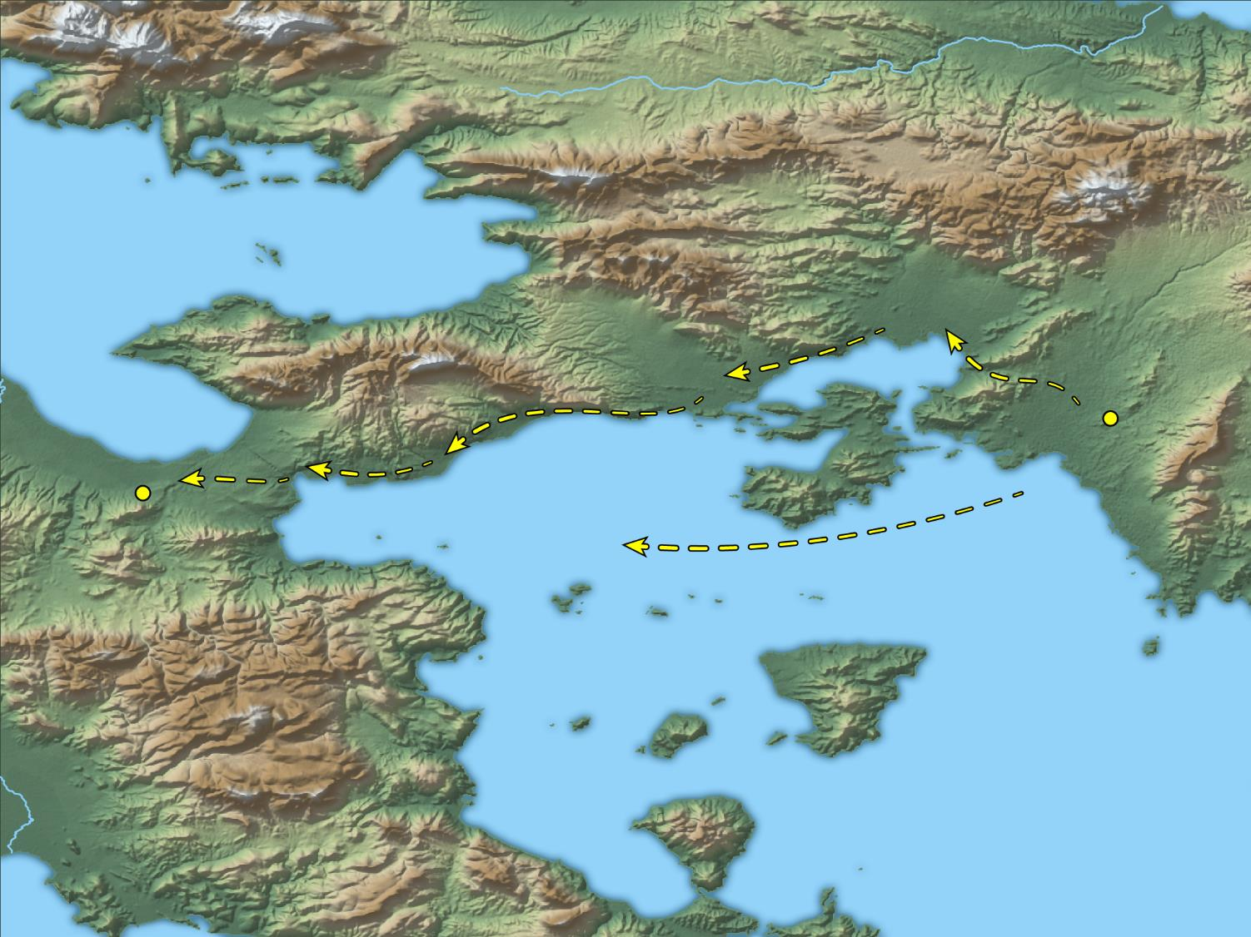
After these things he departed from Athens and came to Corinth
Athens
Corinth
Paul’s trip from Athens to Corinth
18:1
Notes:
This map shows a couple of possible options for Paul’s travel to Corinth. If he traveled by land, the route is fairly well defined by the coastline and the mountains. If he sailed, his boat would have departed from the port of Piraeus and landed at the port of Cenchreae. This map was created by A.D. Riddle, RiddleMaps.com. Data sources: Ancient World Mapping Center shapefiles were used for road lines, under Open Database License (ODbL 1.0; http://awmc.unc.edu/wordpress/map-files/). ASTER-GDEM 2 or SRTM data were used to render the terrain (https://asterweb.jpl.nasa.gov/gdem.asp and https://www2.jpl.nasa.gov/srtm/). Natural Earth was used for streams and inland water bodies. Their data have been placed in the public domain. https://www.naturalearthdata.com/about/terms-of-use/.

Slide 3
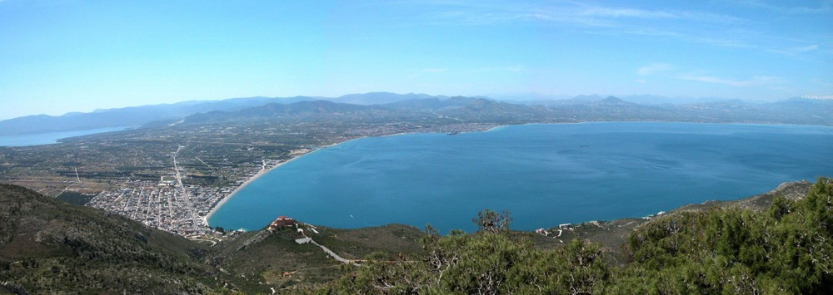
After these things he departed from Athens and came to Corinth
Cenchreae
Peloponnesus
Corinth
Corinth canal
Gulf of Corinth
Mainland Greece
The gulf and isthmus of Corinth (from the north)
18:1
Notes:
This photo provides a broad panoramic perspective of the Corinth area. Paul arrived from the east (the left side of this photo), either by land or by sea. If by land, he would have crossed the isthmus to the city of Corinth. If arriving by boat, he would have landed at the port at Cenchreae. The ancient city of Corinth was one of the major commercial centers of the ancient world. It was perfectly situated near the narrowest part of the Isthmus, a strip of limestone four miles wide connecting mainland Greece with the southern peninsula (Peloponnesus). Corinth had a port on either side of the Isthmus—Lechaion on the Corinth Gulf and Cenchreae on the Saronic Gulf—and thus held control of the seas on both sides of Greece.
tb050803400

Slide 4
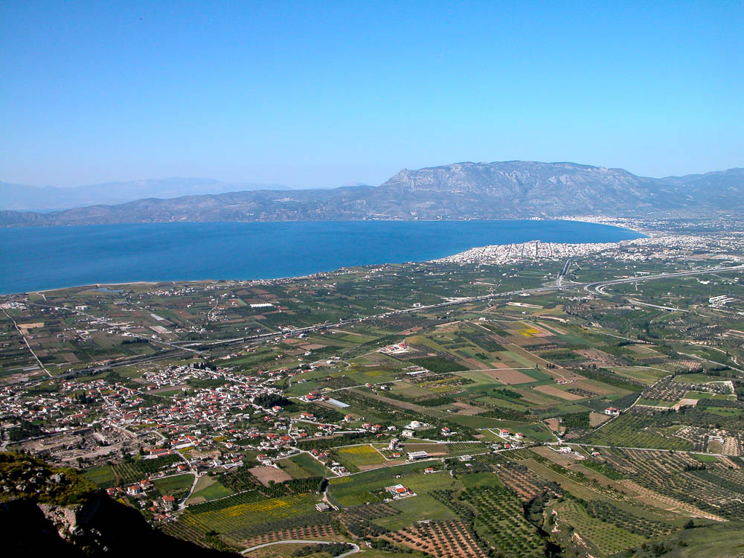
After these things he departed from Athens and came to Corinth
Lechaion harbor
Gulf of Corinth
Corinth excavations
Excavations of Corinth, the harbor of Lechaion, and the Gulf of Corinth, from the Acrocorinth
18:1
Notes:
Corinth was a major city of ancient Greece in the first century AD, but it had a rough history before that. Destroyed by the Romans in 146 BC, the city was only rebuilt in 44 BC when Julius Caesar re-founded it as a Roman colony. Most of its citizens were former slaves from Rome, but businessmen also came. The city grew to economic and cultural prosperity as the capital city of the Roman province of Achaia (2nd century AD). It held its own during the attacks of the Herulians in the 3rd century AD, but Alaric took Corinth in AD 396. Earthquakes finally brought it down in AD 522 and 551, beginning a steady decline.
tb050803017

Slide 5
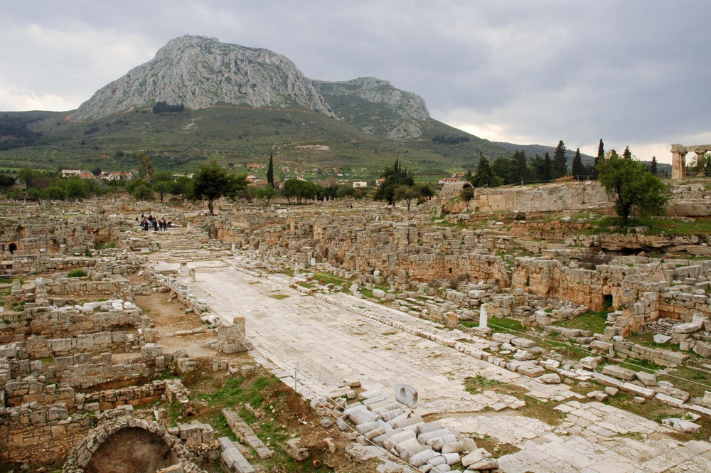
After these things he departed from Athens and came to Corinth
Excavations at Corinth, with the Lechaion Road and the Acrocorinth
18:1
Notes:
The Lechaion Road ran from the city of Corinth north to the port of Lechaion. This road was 35 feet (11 m) wide and included a drainage system. In the background of the photo is the Acrocorinth, or the acropolis of Corinth. The Acrocorinth was situated at an elevation of nearly 2,000 feet (600 m) above sea level and was said to be impenetrable. An imposing mountain of limestone, it was naturally fortified and contributed to Corinth’s strategic significance. Because of its control over the isthmus and, thus, all travel between mainland Greece and the Peloponnesus, Corinth was coveted by anyone seeking power in the Peloponnesus.
tb031706966

Slide 6
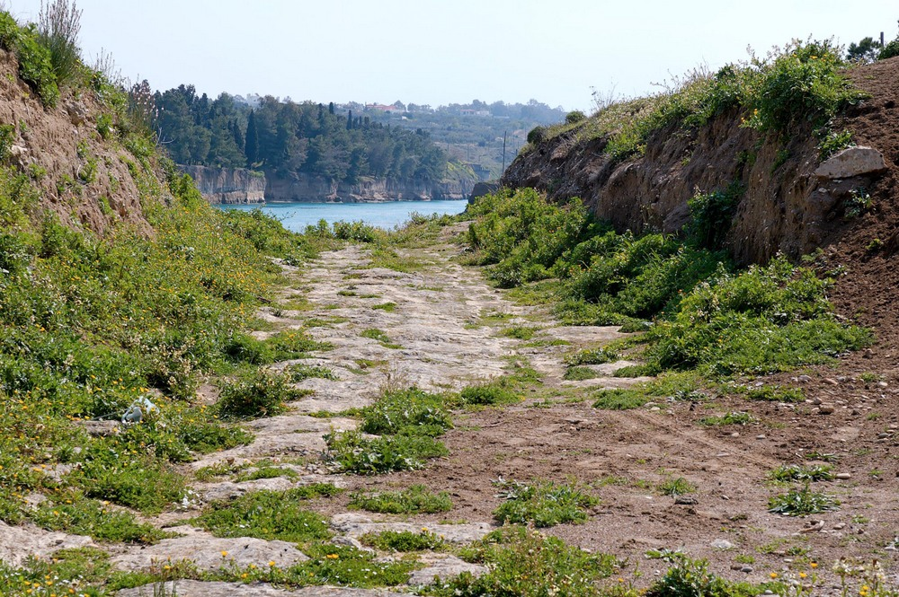
After these things he departed from Athens and came to Corinth
Diolkos on the south side of the Corinth Canal
18:1
Notes:
Because of the distance around the Peloponnesus and rough seas at the southern tip, the ancients used a slipway called the Diolkos to drag light ships across the isthmus from one gulf to the other. They would remove the cargo from the ship, drag the ship and cart the goods across the isthmus, and reload the ship with the cargo on the other side. The cargo of larger ships was transferred to ships waiting on the other side. Part of this road, built in 600 BC, is still visible on the western side of the isthmus. It was excavated by the Greek Archaeological Society from 1956 to 1962. The road ran along much the same route as a modern canal which cuts across the isthmus. The portage of ships across the isthmus generated considerable economic activity for the city of Corinth.
tb031706906

Slide 7
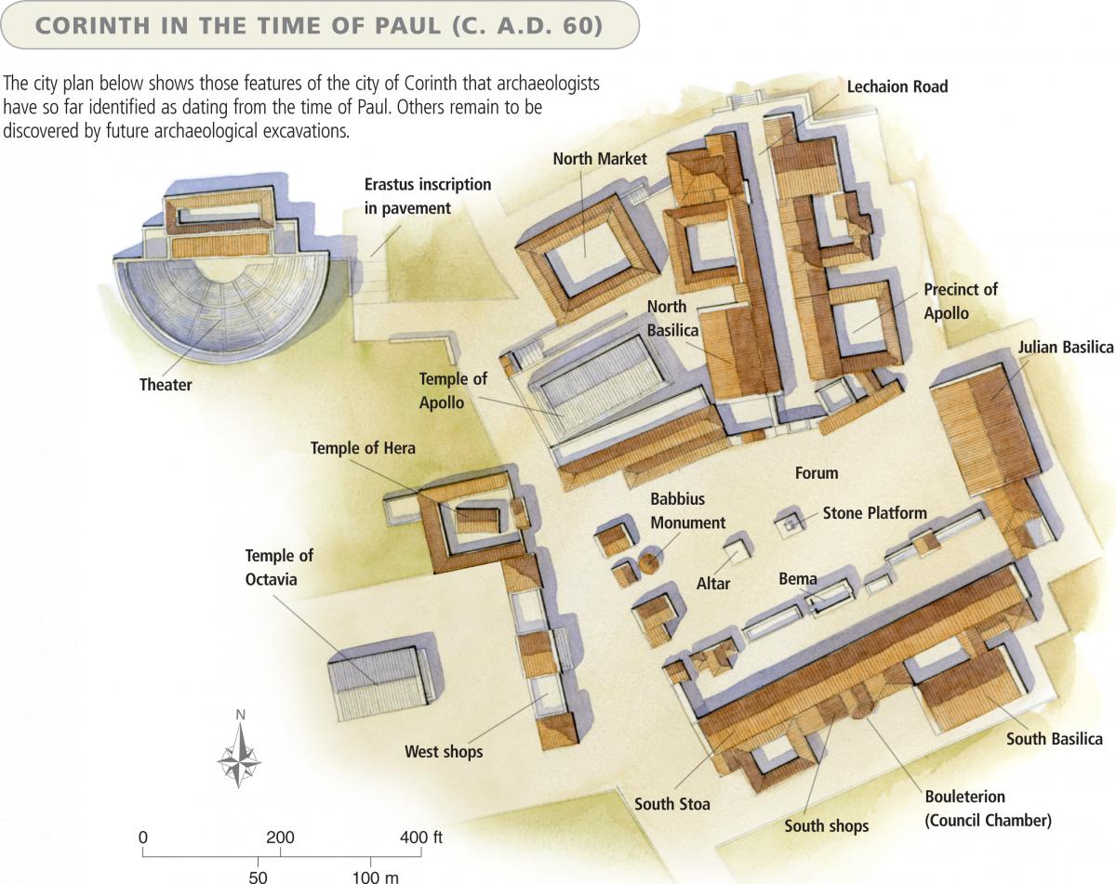

Slide 8
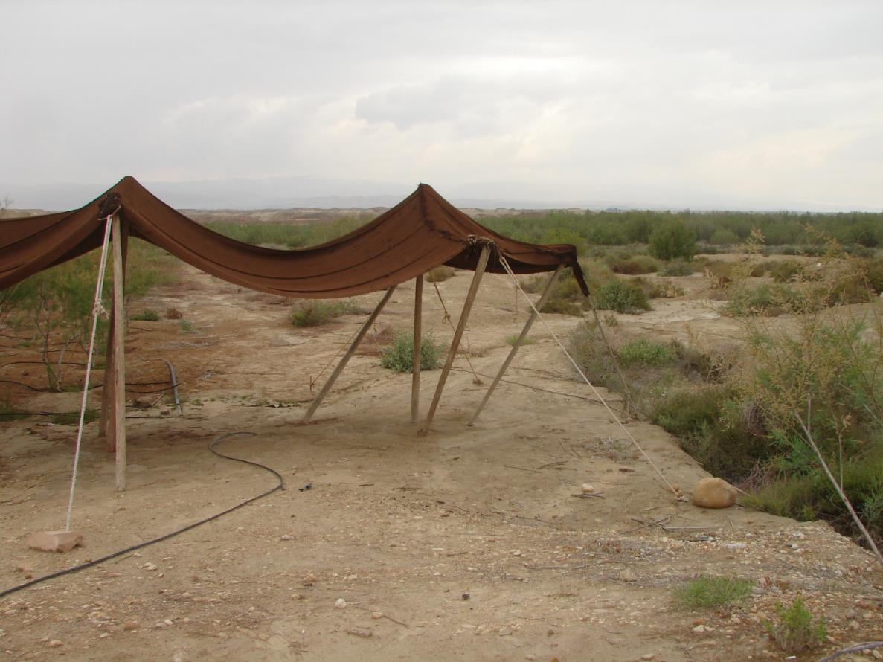
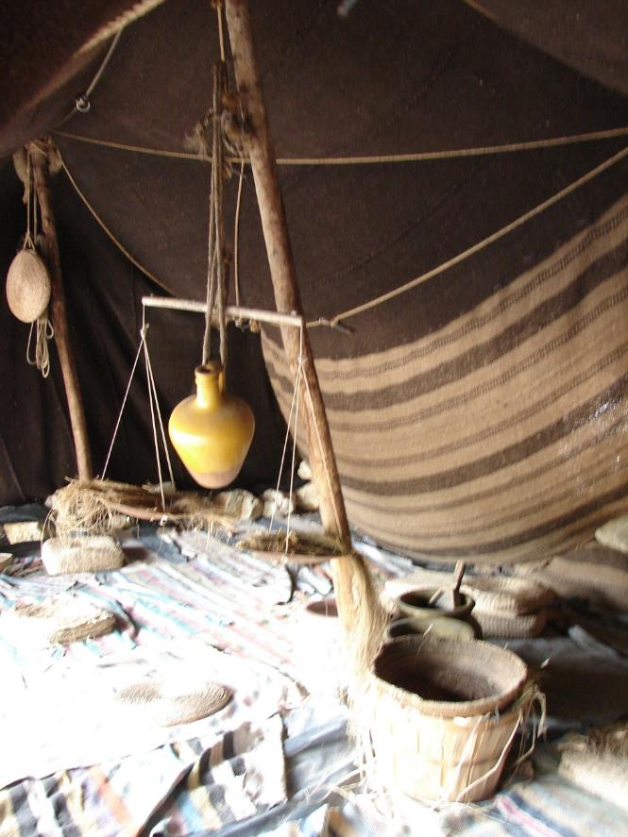
Acts 18:3 So, because he was of the same trade, he stayed with them and worked; for by occupation they were tentmakers.

Slide 9
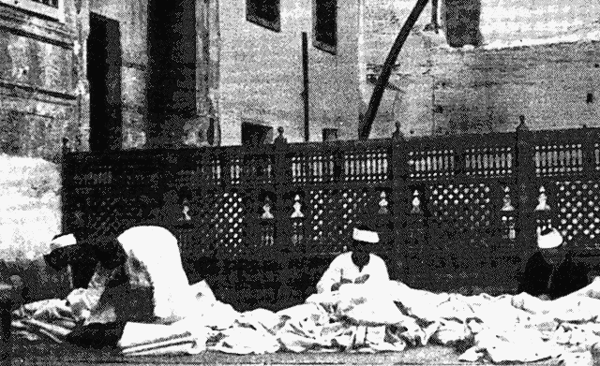
Do you think it helped Paul to find them & How?
Acts 18:3 So, because he was of the same trade, he stayed with them and worked; for by occupation they were tentmakers.
Arab tent makers plying their craft in a yard in Jerash. An early photograph.

Slide 10
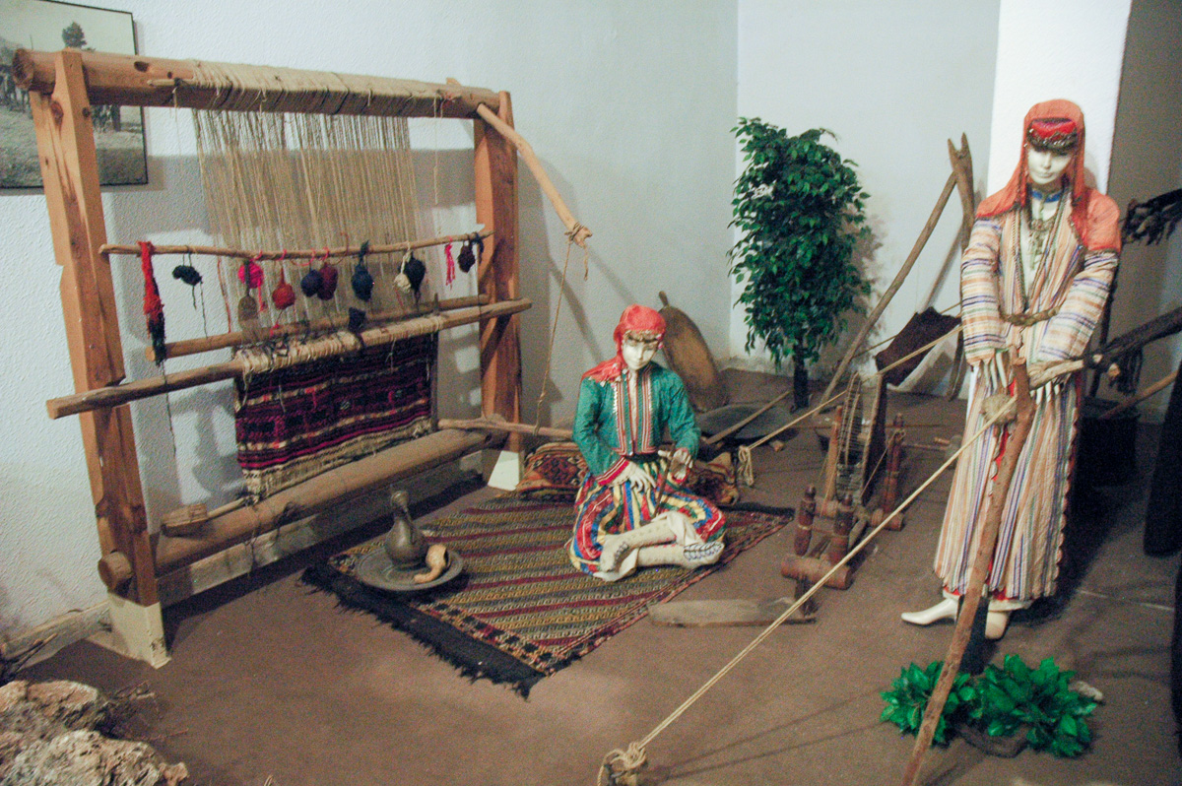
By their trade they were tentmakers
Reconstruction of a Bedouin tent
18:3
Notes:
The weaving of material for a tent may have looked similar to this scene, displayed at the Antalya Museum.
tb040905175

Slide 11
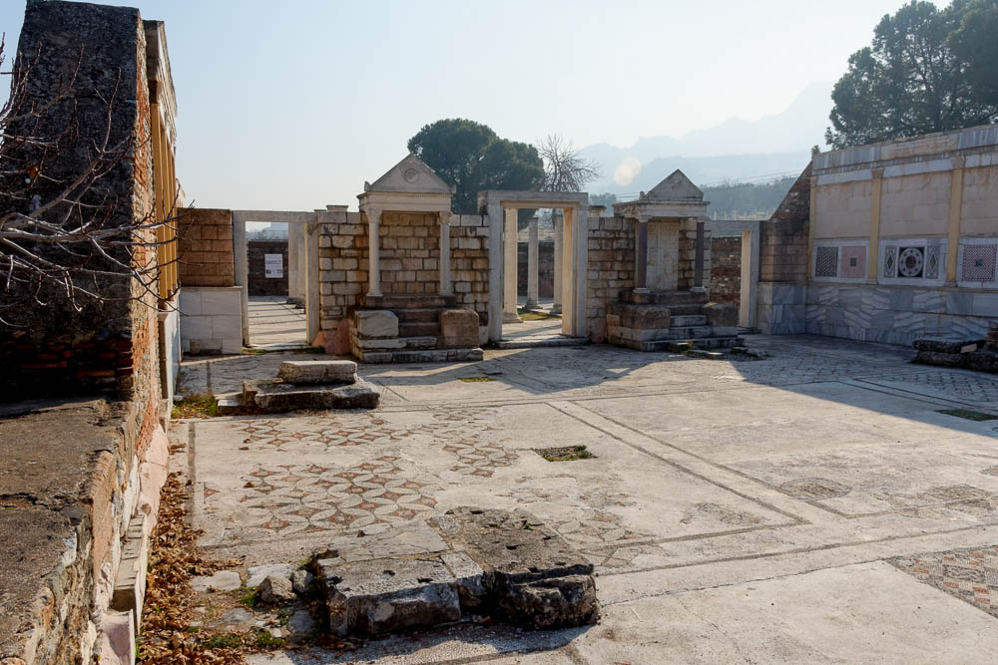
He reasoned in the synagogue every Sabbath, trying to persuade Jews and Greeks
Synagogue in Sardis with bemas, 4th century AD
18:4
Notes:
The bema in the ancient synagogue was used as a pulpit is in churches today. The speaker or reader would stand near or sit on the bema as he read the Torah and discussed its meaning. Jesus did this many times, as Paul does here.
tb010217772

Slide 12
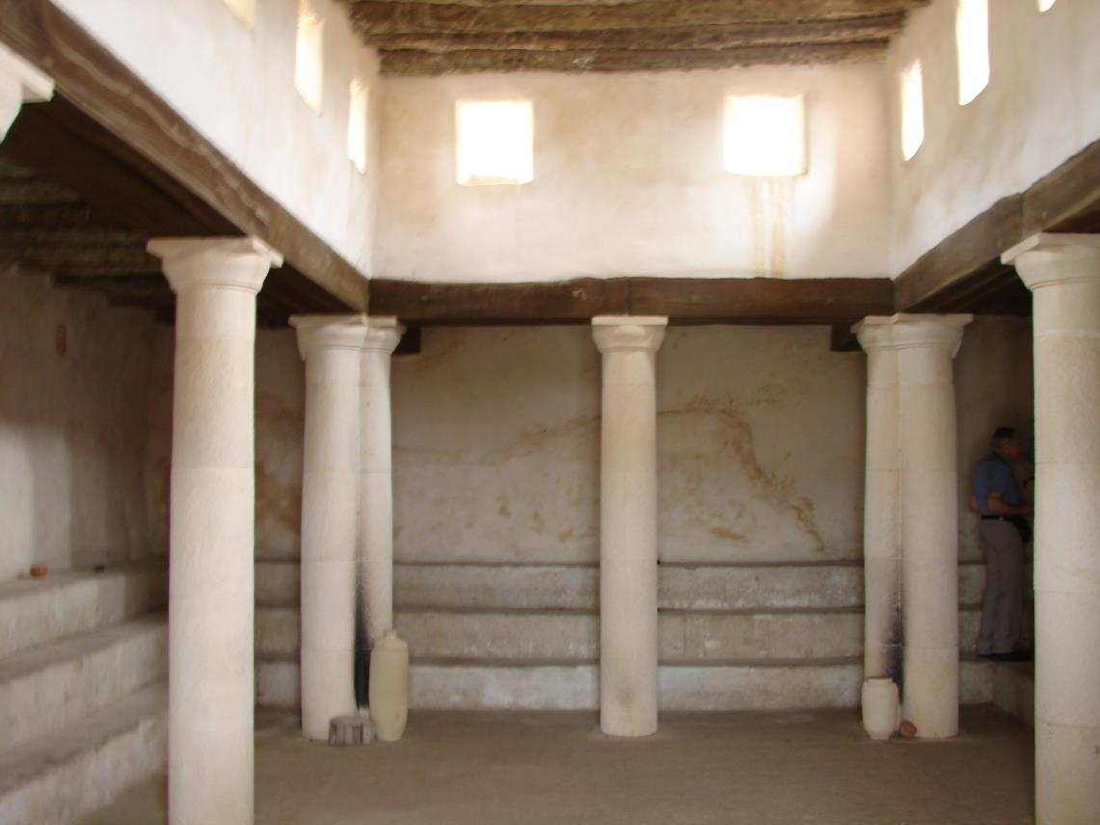
Where did Paul do his teaching?
Acts 18
⁴ And he reasoned in the synagogue every Sabbath, and tried to persuade Jews and Greeks.

Slide 13
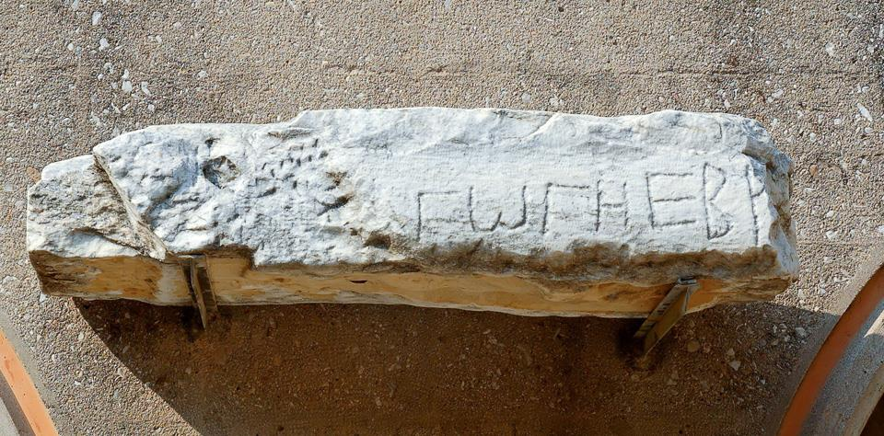
He reasoned in the synagogue every Sabbath, trying to persuade Jews and Greeks
“Synagogue of the Hebrews” inscription from Corinth, 5th century AD
18:4
Notes:
This Greek inscription, which reads “[syna]gogue of the Hebr[ews]” ([ΣΥΝΑ]ΓΩΓΗ ΕΒΡ[ΑΙΩΝ]), was found in a Late Roman synagogue in Corinth (dated by archaeologists to the 5th century AD). No earlier remains of a synagogue in Corinth have yet been discovered. This inscription was photographed in the Corinth Museum.
tb031706079

Slide 14
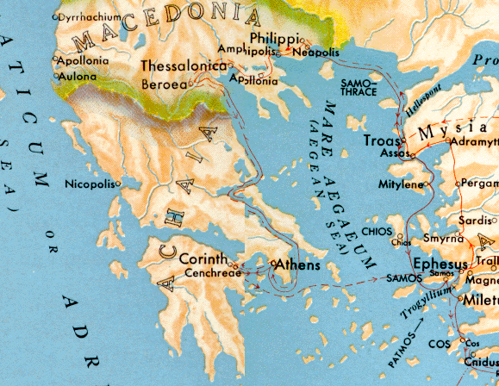
Acts 18 – Paul in Corinth
Acts 18: ⁵When Silas and Timothy had come from Macedonia, Paul was compelled by the Spirit, and testified to the Jews that Jesus is the Christ.

Slide 15
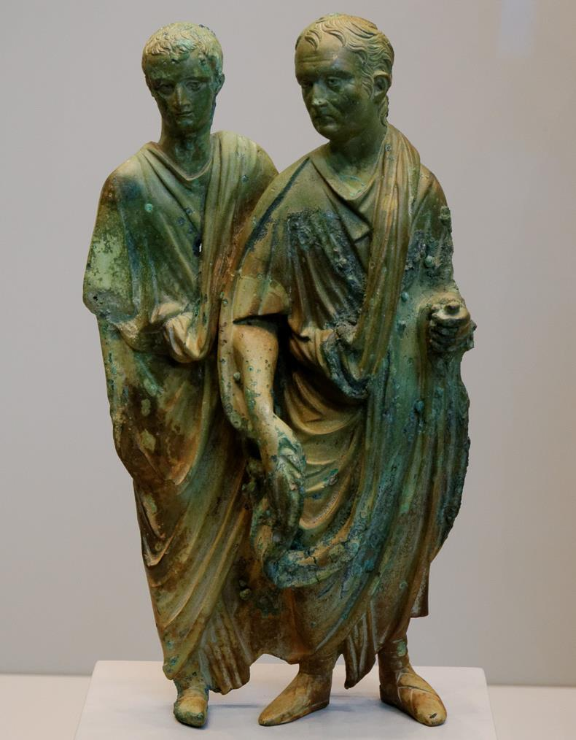
He shook out his clothing and said unto them
Statue of two Roman men with typical, loose clothing, AD 50–75
18:6
Notes:
Paul’s act of shaking out his clothing communicated that he did not want to be contaminated by the blasphemy of the Jews who resisted his message. The two men shown here are wearing the typical, loose togas of the period, clothing which is easily used for such a symbolic gesture. This statue was photographed at the Getty Villa in California.
tb082214653

Slide 16
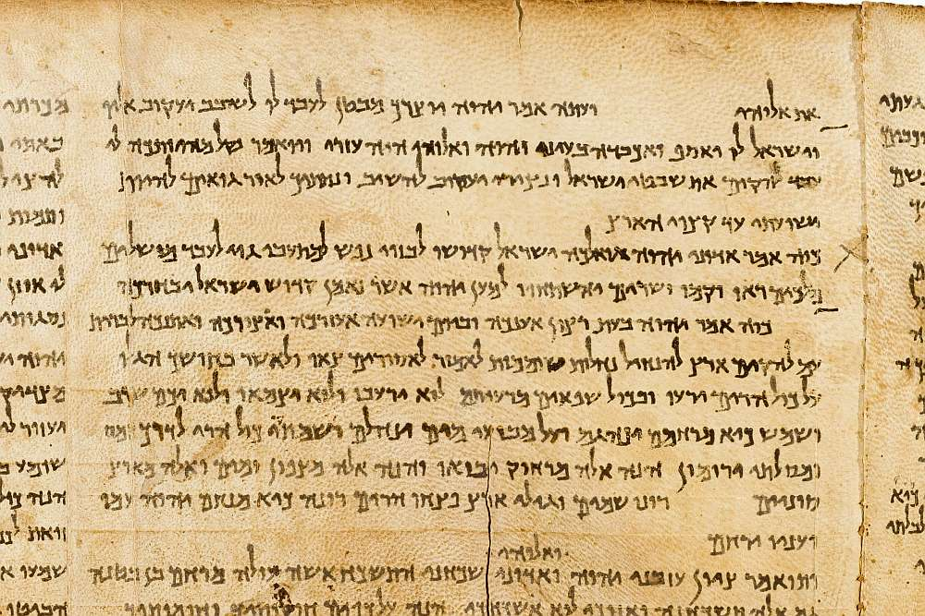
From now on, I will go to the Gentiles
“A light to the Gentiles,” written in Isaiah 49:6 on the Great Isaiah Scroll
18:6
Notes:
“Yea, he saith, It is too light a thing that thou shouldest be my servant to raise up the tribes of Jacob, and to restore the preserved of Israel: I will also give thee for a light to the Gentiles, that thou mayest be my salvation unto the end of the earth” (Isa 49:6, ASV). Paul recognized his ministry to the Gentiles as a fulfillment of this passage (Acts 13:47). The Great Isaiah Scroll is preserved at the Israel Museum in Jerusalem. This image is public domain, from Wikimedia: https://commons.wikimedia.org/wiki/File:The_Great_Isaiah_Scroll_MS_A_(1QIsa)_-_Google_Art_Project-x1-y0.jpg
isax1y0

Slide 17
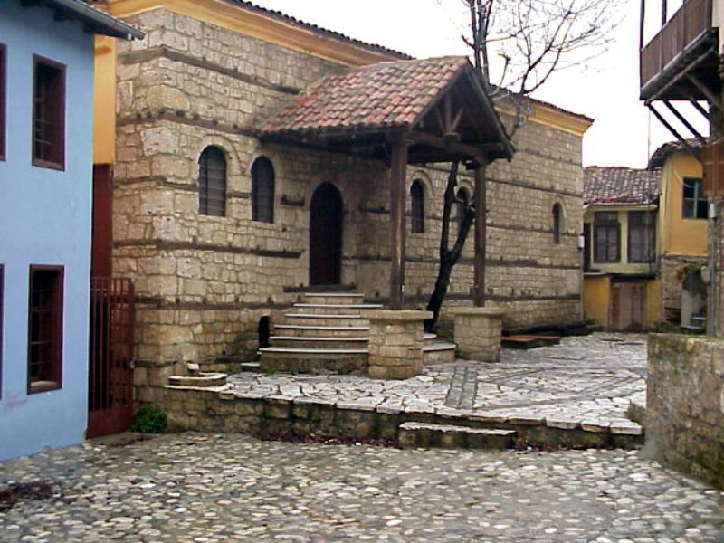
Acts 18:7 And he departed from there and entered the house of a certain man named Justus, one who worshiped God, whose house was next door to the synagogue.
Where did Paul teach after leaving the synagogue?
Notes:
Photo Comments
View of a building thought to have been built over the remains of an ancient synagogue at Berea (Acts 17:10–12).
For a map and a brief description of the biblical significance of Berea Click Here.

Slide 18
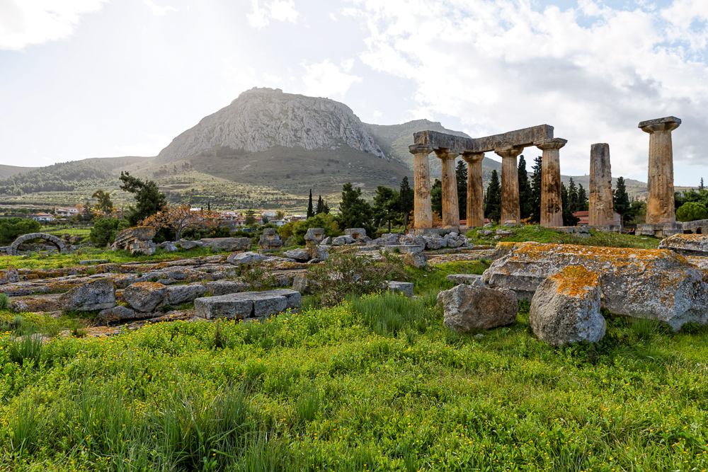
And he stayed there a year and six months, teaching the word of God among them
The Temple of Apollo and the Acrocorinth
18:11
Notes:
Paul stayed in Corinth for a significant amount of time; his concern for the church he founded here is evident from the epistles he wrote to them. The temple shown here, as well as the view of the Acrocorinth, would have been familiar sights to Paul.
jc0111152447

Slide 19
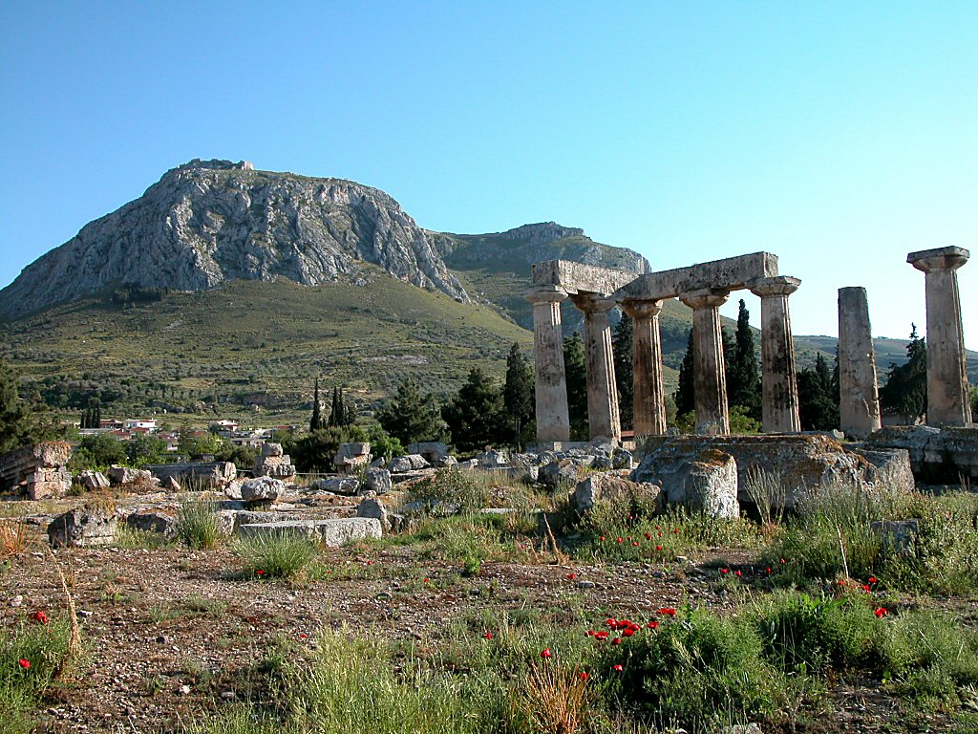
Corinth Temple of Apollo and Acrocorinth
How did the Lord encourage Paul to stay in Corinth?
Acts 18:9 Now the Lord spoke to Paul in the night by a vision, “Do not be afraid, but speak, and do not keep silent; 10 for I am with you, and no one will attack you to hurt you; for I have many people in this city.”
Corinth Temple of Apollo and Acrocorinth

Slide 20
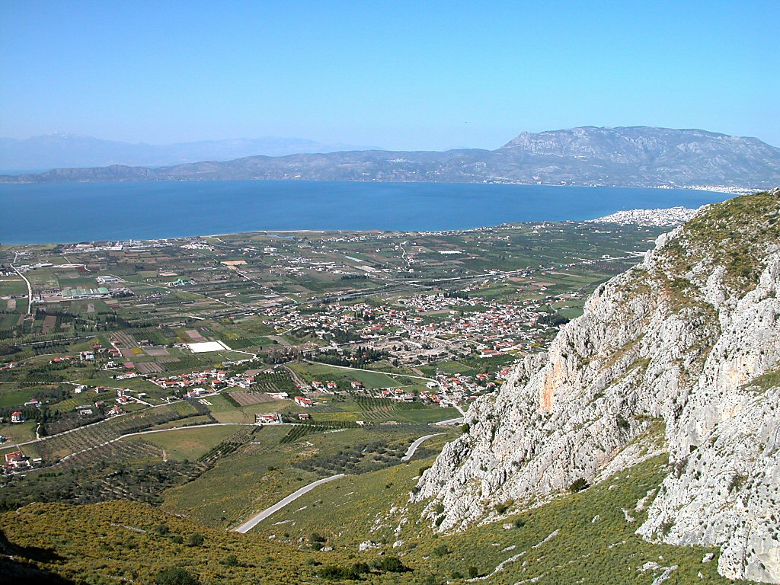
Corinth plain and excavations from Acrocorinth
How long did he stay?
Acts 18:11 And he stayed a year and six months, teaching the word of God among them.
Corinth excavations
Corinth plain and excavations from Acrocorinth

Slide 21
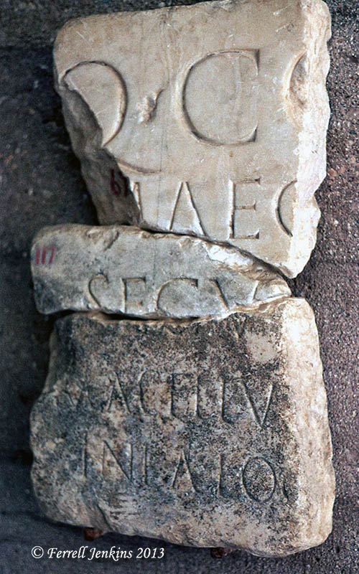
As tentmakers, Paul and his companions, Priscilla and Aquilla, would have likely been very familiar with the Corinthian Market; they may have even plied their trade there (Acts 18:1-3).
Excavations have revealed that the North Market was built in the first half of the first century AD on the north slope of the Temple Hill.
It was likely in this area that the local meat market was located. An inscription was discovered in 1898 which reads, “MACELLV” – “Meat Market,” which scholar F.J. DeWaele believed came from the North Market.
The Apostle Paul would later reference this market, instructing the church at Corinth to “eat whatever is sold in the meat market without raising any question on the ground of conscience.” (1 Cor. 10:25).

Slide 22
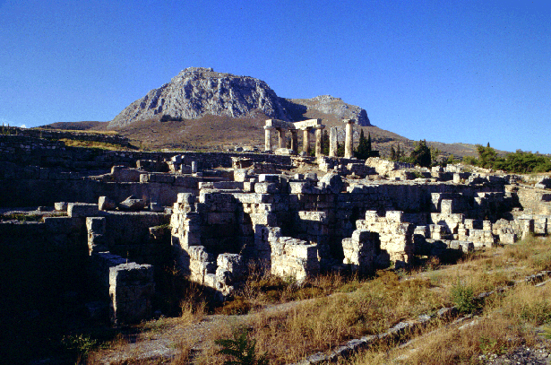
In the photo below you will see the Latin word MACELLV[M] in the fourth line from the top. Paul used the same Greek word in 1 Corinthians 10:25.
Bema = judgment seat

Slide 23
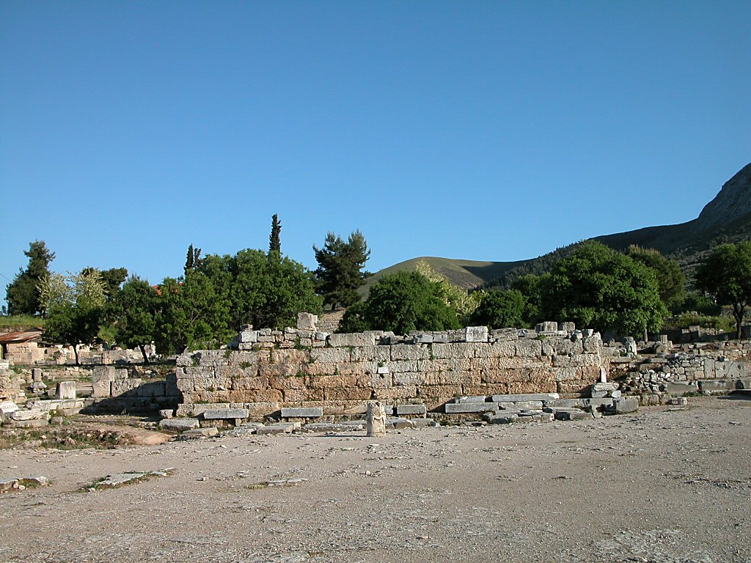
Corinth bema
What charges did the Jews bring against Paul before Gallio?
Acts 18:12 - 13 (NKJV) ¹²When Gallio was proconsul of Achaia, the Jews with one accord rose up against Paul and brought him to the judgment seat, ¹³saying, “This fellow persuades men to worship God contrary to the law.”
Corinth bema/Judgement Seat
Notes:
The Roman tribunal where Paul was dragged before Gallio has been uncovered in the center of the agora. This was the bema, where Roman officials would appear before the public. An inscription mentioning riots in Achaia and Gallio’s name, from which we are able to date Gallio’s proconsulship to between 51 and 52 A.D., was found in Delphi. A church was built atop the bema in Christian times.

Slide 24
Bema = judgment seat

Slide 25

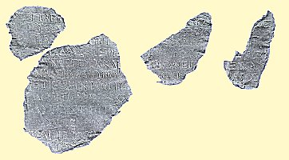
Who was Gallio?
Elder brother of Seneca, the philosopher and tutor of Nero.
Gallio in office in Corinth between A.D. 51 and 53.
He was apparently proconsul from May 1, 51, to May 1, 52,
Counseled Nero until he and Seneca joined a conspiracy against the emperor.
First Seneca died; then Nero forced Gallio to commit suicide about A.D. 65.
An inscription in Delphi from the Emperor Claudius to Gallio, the proconsul of Achaia. & dated to 52 AD, placing Gallio’s proconsulship in early A.D. 51, and Paul’s arrival in Corinth in the winter of 49/50AD or maybe a year later
Notes:
But in 1905, a doctoral student in Paris was sifting through a collection of inscriptions that had been collected from the Greek city of Delphi. In these various inscriptions, he found four different fragments that, when put together, formed a large portion of a letter from the Emperor Claudius. The letter from the emperor was written to none other than Gallio, the proconsul of Achaia. In the years following this discovery, the letter has been dated to 52AD, placing Gallio’s proconsulship in early A.D. 51, and Paul’s arrival in Corinth in the winter of 49/50AD!

Slide 26
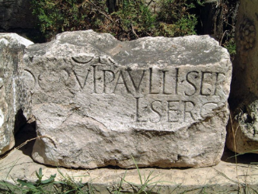
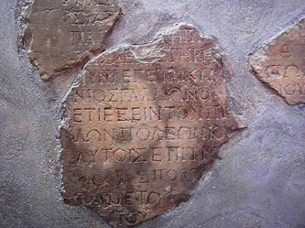
Luke’s Naming of Rulers Gives us a Time Line
1st
47-48 AD
2nd
50-52 AD
3rd
Gallio – Acts 18:12-17
served in this role 51–52 AD
Sergius Paulus
AD 34 Conversion
AD 46 To Antioch
AD 47-48 1st Missionary Journey
AD 49-50 Jerusalem Council
AD 50-52 2nd Missionary Journey
AD 53-58 3rd Missionary Journey
AD 58 Arrested in Jerusalem
AD 58-60 Imprisoned in Caesarea
AD 60-61 Journey to Rome
AD 61-63 In Rome
AD 67/68 Paul Martyred
Antonius Felix Roman procurator of Judea Province 52-58/54-60
Porcius Festus was procurator of Judea from about
AD 59 to 62
About 60 AD
Paul held for 2 years by Felix and left in prison when Festus takes position – so ~ 58-60 AD

Slide 27
Corinth bema
How did Gallio react?
Acts 18:
¹⁴And when Paul was about to open his mouth, Gallio said to the Jews, “If it were a matter of wrongdoing or wicked crimes, O Jews, there would be reason why I should bear with you. ¹⁵ But if it is a question of words and names and your own law, look to it yourselves; for I do not want to be a judge of such matters.”
Corinth bema
Notes:
The Roman tribunal where Paul was dragged before Gallio has been uncovered in the center of the agora. This was the bema, where Roman officials would appear before the public. An inscription mentioning riots in Achaia and Gallio’s name, from which we are able to date Gallio’s proconsulship to between 51 and 52 A.D., was found in Delphi. A church was built atop the bema in Christian times.

Slide 28
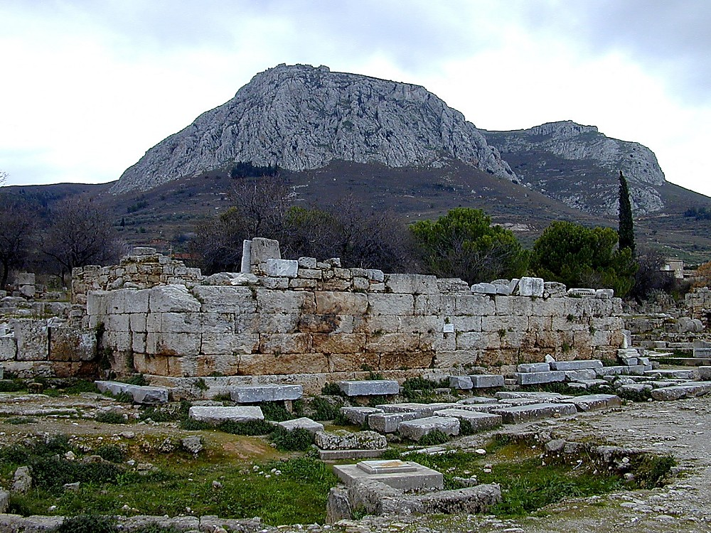
Corinth bema and Acrocorinth
Who was beaten as a result?
Acts 18: ¹⁶ And he drove them from the tribunal. ¹⁷ And they all seized Sosthenes, the ruler of the synagogue, and beat him in front of the tribunal. But Gallio paid no attention to any of this.
Corinth bema and Acrocorinth

Slide 29
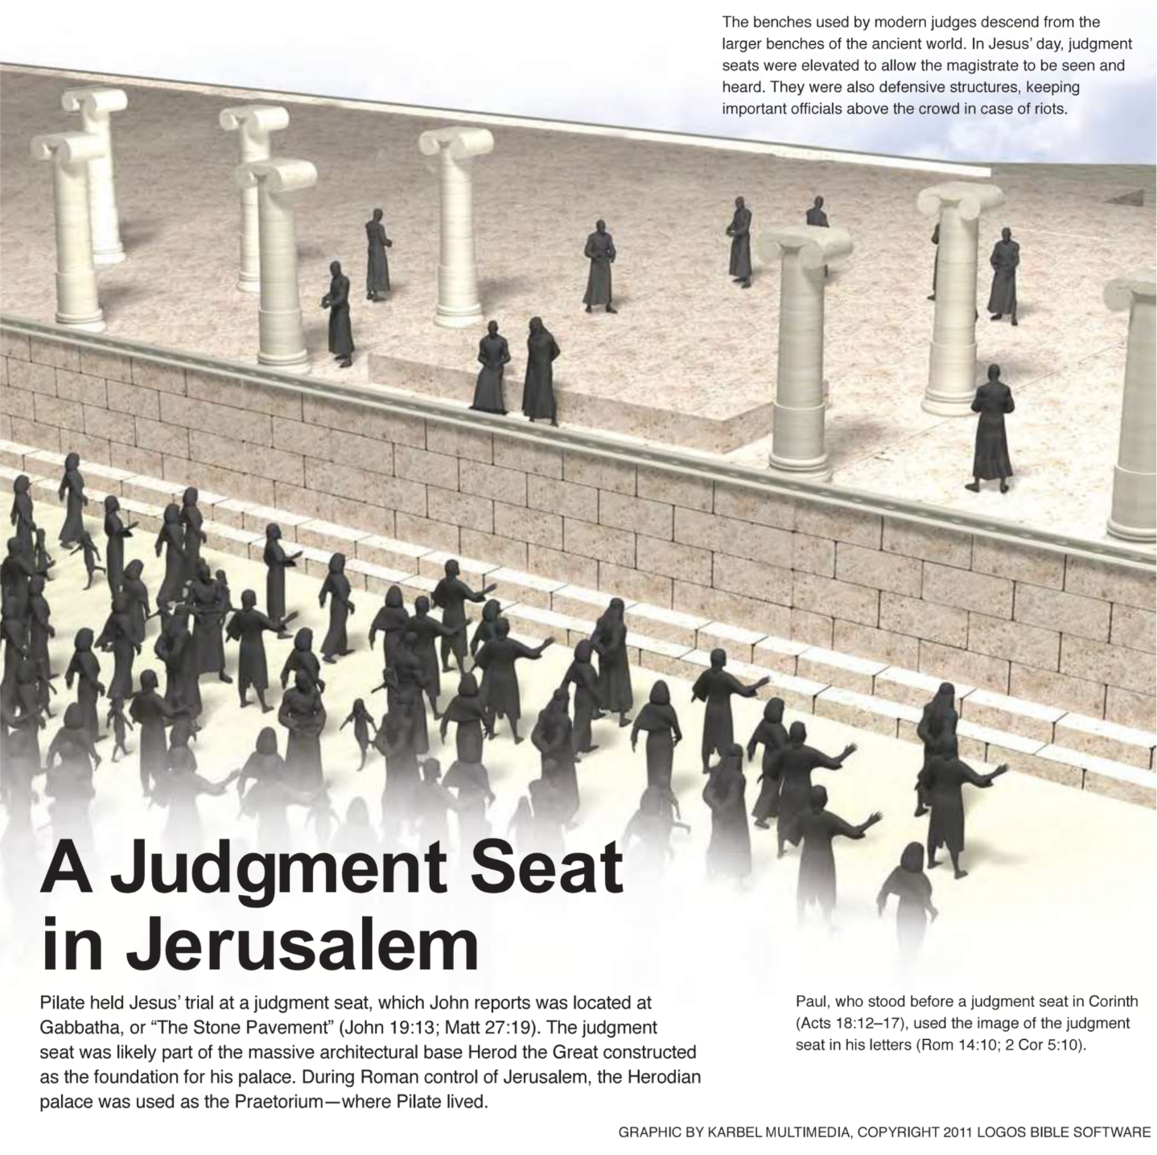

Slide 30
Where did Paul go in Ephesus?
Acts 18
¹⁹ And they came to Ephesus, and he left them there, but he himself went into the synagogue and reasoned with the Jews.

Slide 31
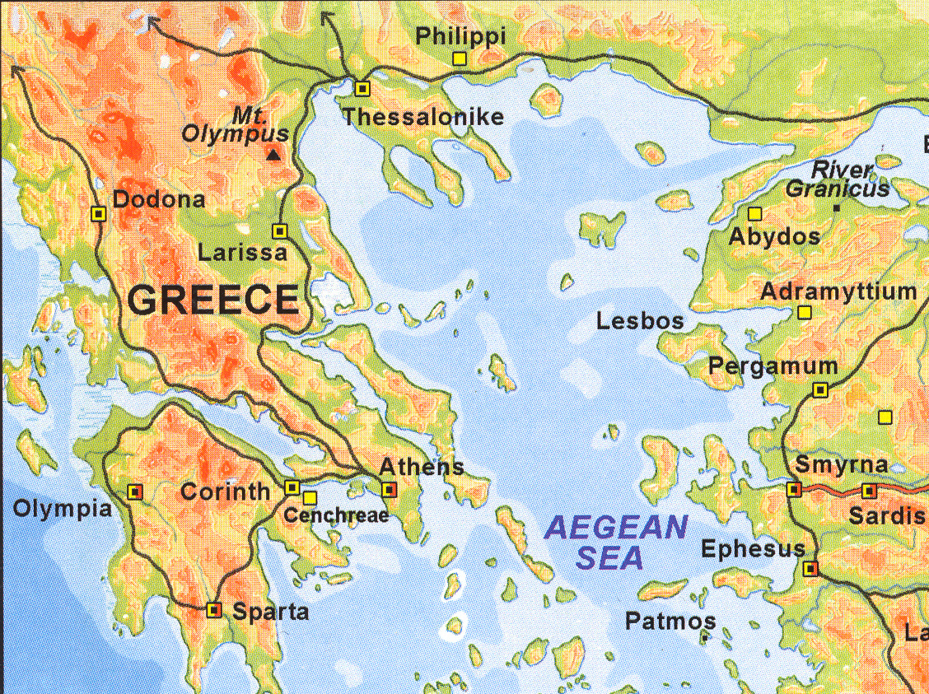
Why did he not stay there longer?
Via Egnatia
Acts 18
²⁰When they asked him to stay for a longer period, he declined.
²¹ But on taking leave of them he said, “I will return to you if God wills,” and he set sail from Ephesus.
Troas

Slide 32
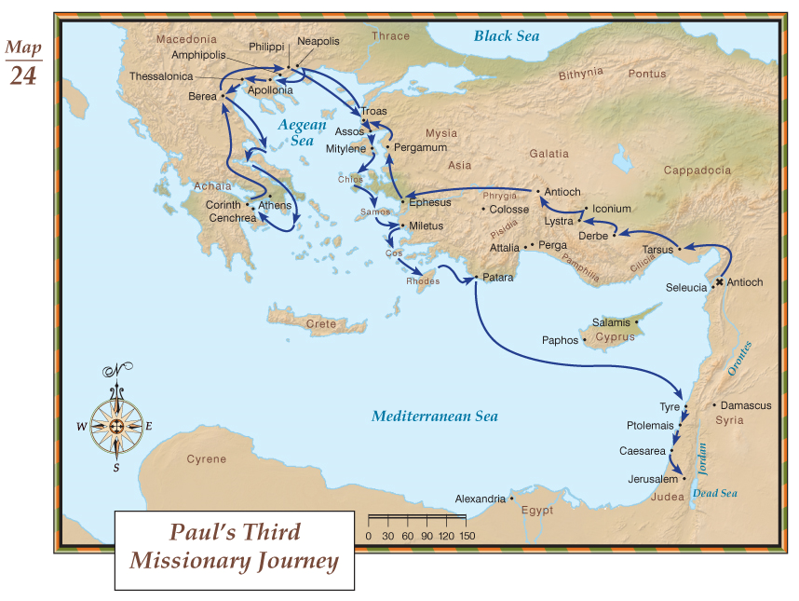

Slide 33
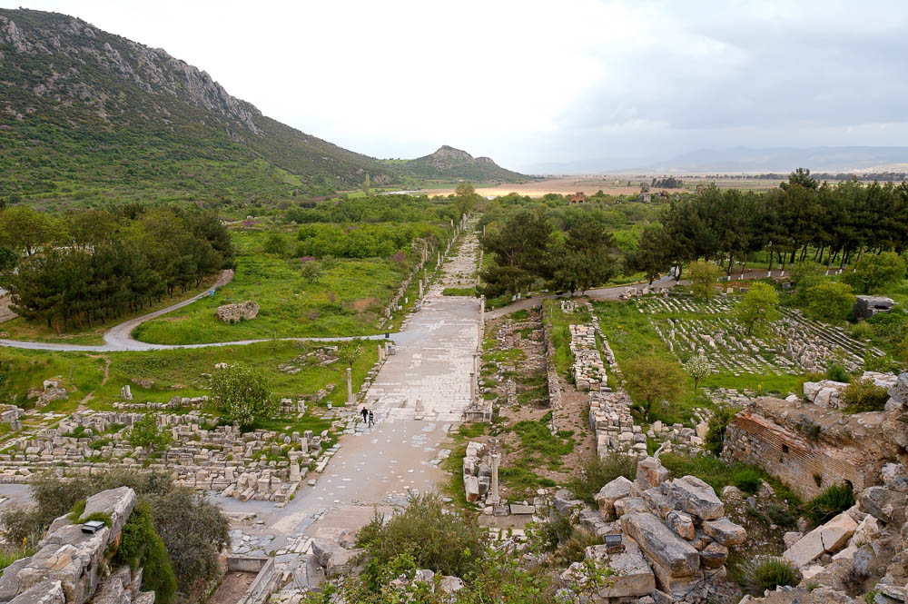
After the uproar ceased, Paul . . . departed to go to Macedonia
Harbor Street in Ephesus facing toward the ancient harbor
20:1
Notes:
At the time that Paul left Ephesus, the harbor was an important international one; it was located at the end of the street seen in this photo. As centuries passed, the Ephesus harbor decayed and silted in, and the ancient city is now 3.5 miles (5.6 km) from the coast.
tb041405347

Slide 34
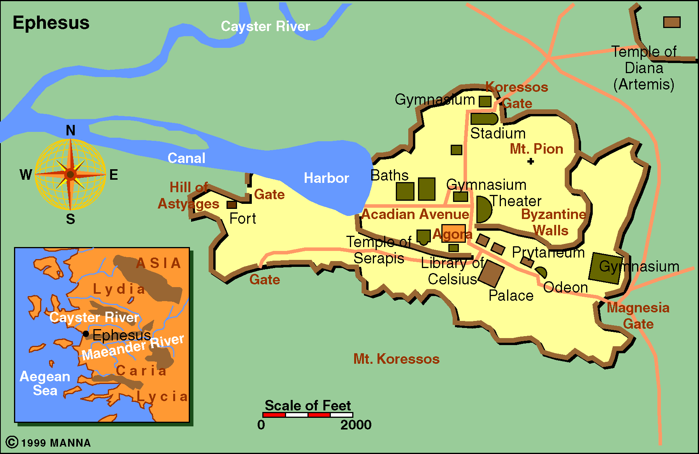
Ephesus

Slide 35
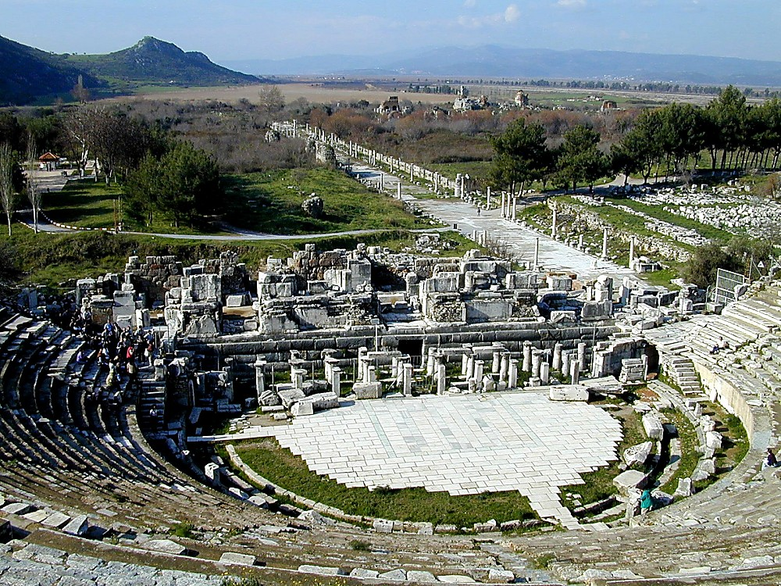

Ephesus theater with Arcadian Way
Acadian Ave
Ephesus theater with Arcadian Way
& View of Silted Harbor

Slide 36
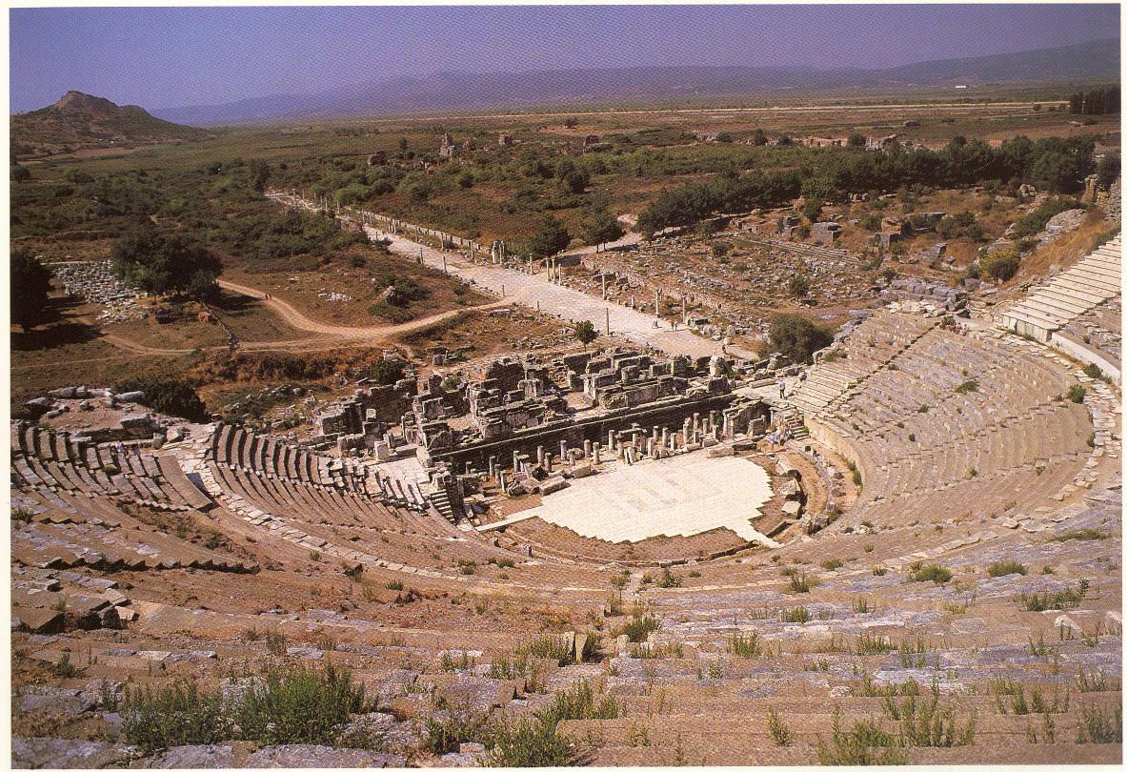
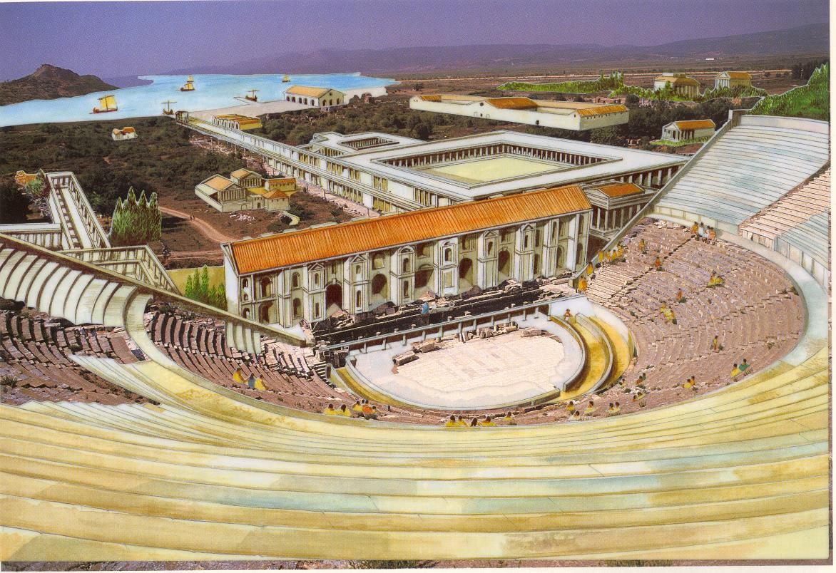
Ephesus – Now & Then

Slide 37
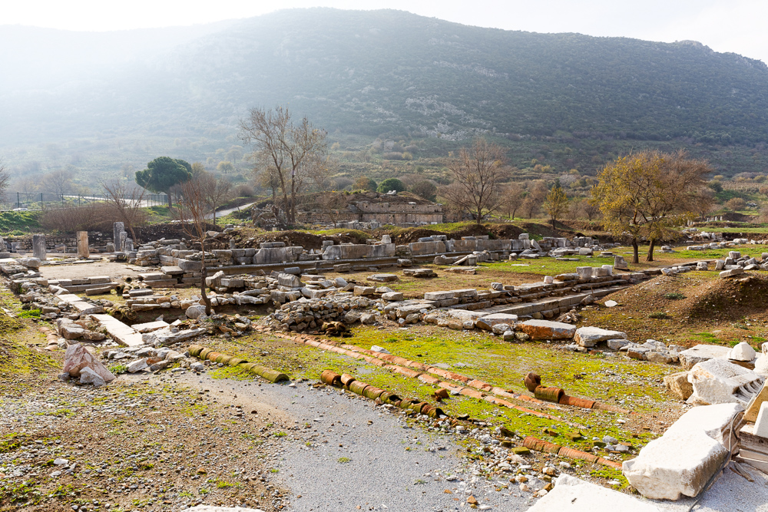
Paul passed through the interior regions and came to Ephesus
Civic agora at Ephesus
19:1
Notes:
The civic agora, which was situated over part of the city’s ancient necropolis, was colonnaded on its north and south ends. Foundations of a temple, perhaps dedicated to Isis, have been discovered on the western side, along with the head of a great statue, thought to be Marc Antony.
jc0102150197

Slide 38
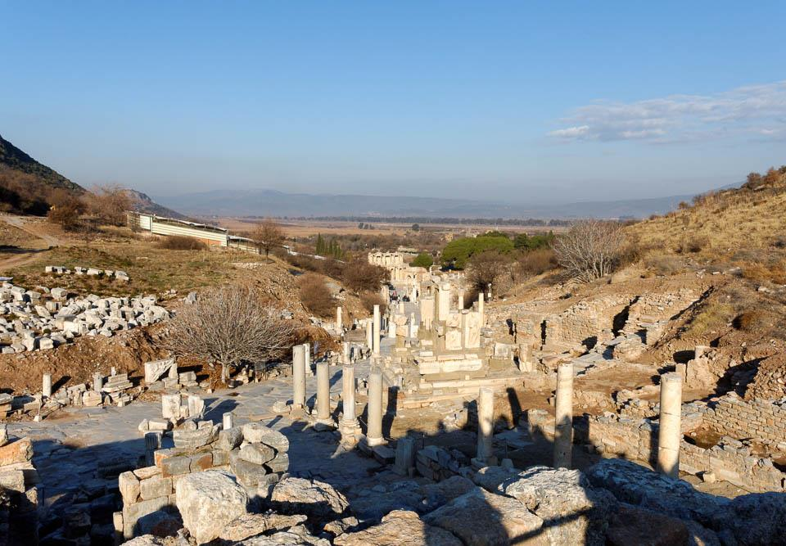
Paul passed through the interior regions and came to Ephesus
Curetes Street leading down to the Library of Celsus
19:1
Notes:
This view is looking down the main street of the upper town toward the Library of Celsus, beyond which the agora and the harbor once lay. During the period of the Roman Empire, Ephesus vied for political, economic, and religious supremacy among all cities of Asia Minor. It was the capital of the Roman province of Asia and an important seaport for travel and trade through Asia Minor along the Cayster (Kaystros) River Valley. Ephesus moved around as the Cayster River silted the harbor. As the city decayed, the harbor was neglected, and today Ephesus sits 3.5 miles (5.6 km) from the coast.
tb010317946

Slide 39
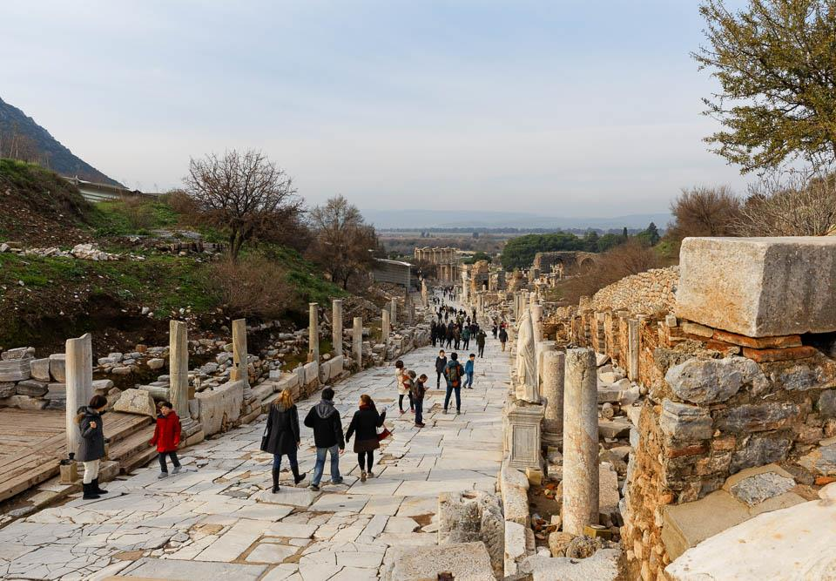
Paul passed through the interior regions and came to Ephesus
Curetes Street in Ephesus (from the east)
19:1
Notes:
The street seen here, Curetes Street, began in an area lined by temples, a Roman forum, and other city buildings. Farther back on either side were residential buildings. The street descends to the Library of Celsus, then turns right and leads to the commercial agora, theater, and the Temple of Artemis. Where it reaches the theater, another major street, the Arcadian Way, branches off to the west and leads to the ancient harbor.
jc0102150250

Slide 40
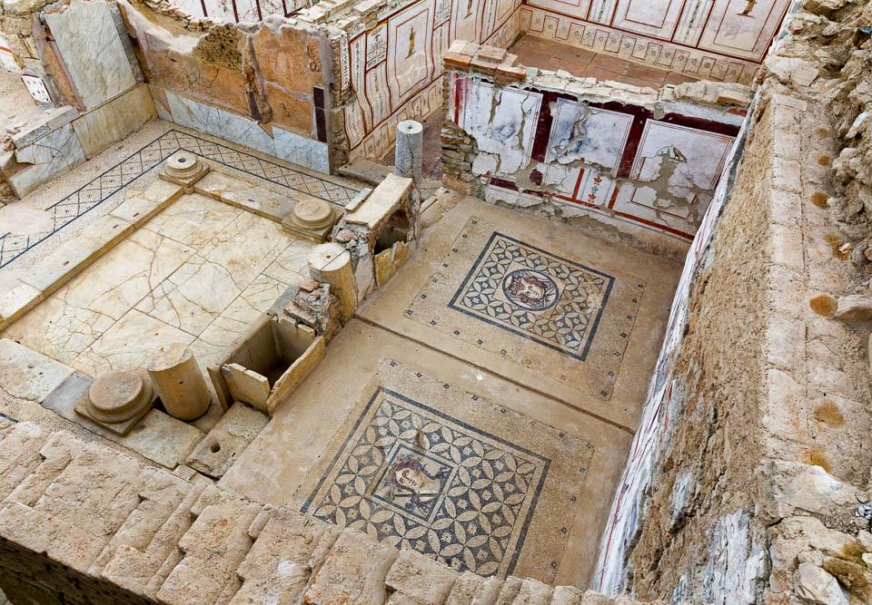
Paul passed through the interior regions and came to Ephesus
Terrace house with painted walls in Ephesus
19:1
Notes:
A series of six luxurious residences are located on terraces on the side of the hill south of the Library of Celsus. The oldest building dates to the 1st century BC and continued in use as a residence until the 7th century AD. Some of what is preserved here is older than Paul, and some had not been constructed yet in his day; many also underwent renovation through the centuries. These houses give us an unprecedented look into the way the wealthy lived during this time. It is unknown whether Paul ever entered these houses, but their owners likely knew of him and his work, particularly after the riot that eventually forced him out of town. Among the features to note in this photo and those following are the tiled floors, the mosaic floor panels, and the beautifully preserved frescoed walls.
jc0102150361

Slide 41
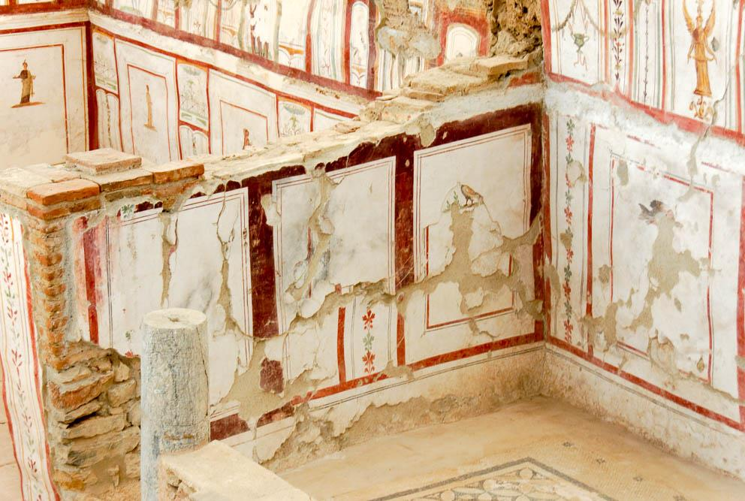
Paul passed through the interior regions and came to Ephesus
Frescoes on walls in terrace house in Ephesus
19:1
Notes:
Close inspection reveals that there are multiple layers of frescoes preserved on some of these walls. This is in Terrace House 2.
tb010317080

Slide 42
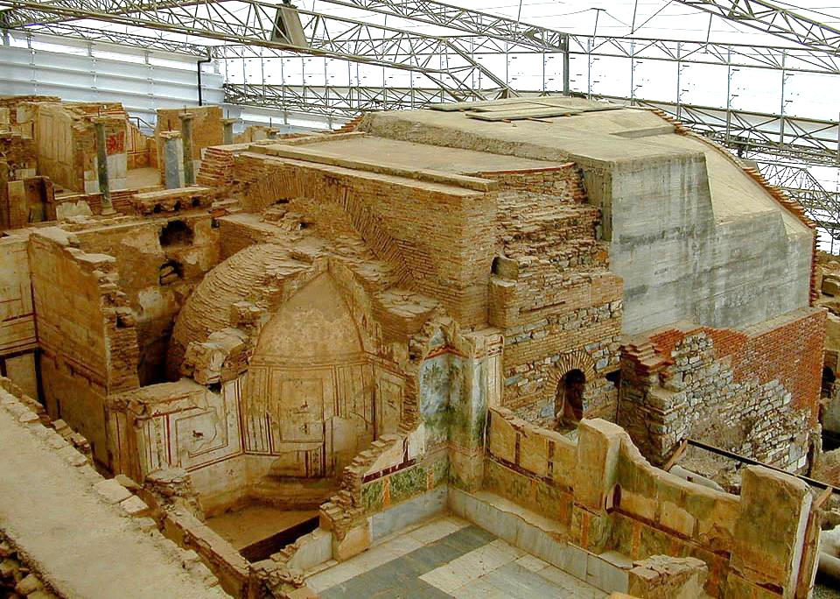
Paul passed through the interior regions and came to Ephesus
Bathhouse in the home of a priestly family in Ephesus
19:1
Notes:
The area shown is part of Dwelling Unit 6 in Terrace House 2. The house belonged to the family of C. Flavius Furius Aptus, a man who held priestly and municipal offices in Ephesus.
tb010501512

Slide 43
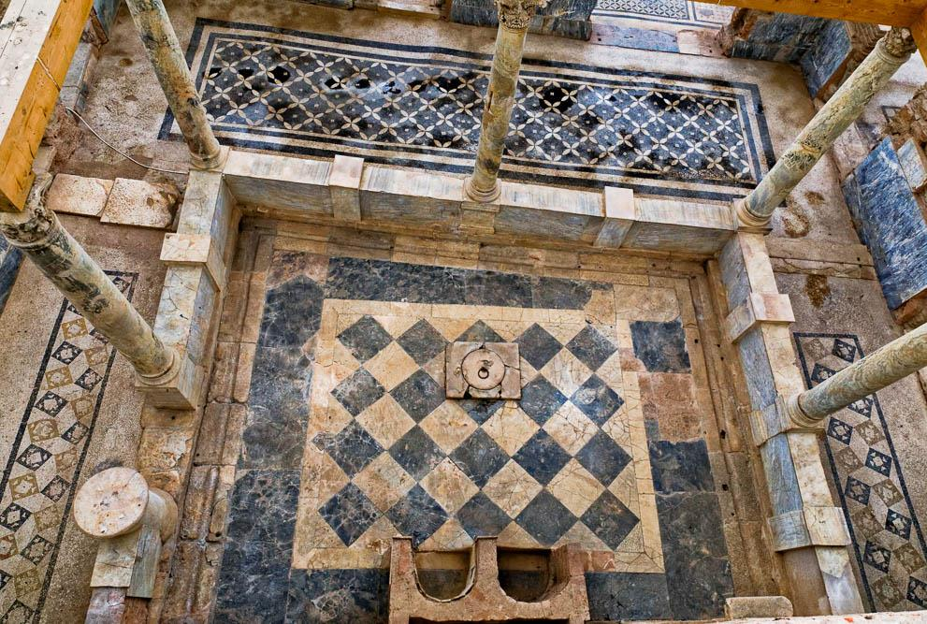
Paul passed through the interior regions and came to Ephesus
Cut tiles and mosaic floors in the courtyard of a terrace house in Ephesus
19:1
Notes:
Churches at this time met in homes. Larger homes would accommodate a growing church, and from records in Corinth and elsewhere, it seems that churches were often hosted in the home of a wealthier member.
jc0102150377

Slide 44
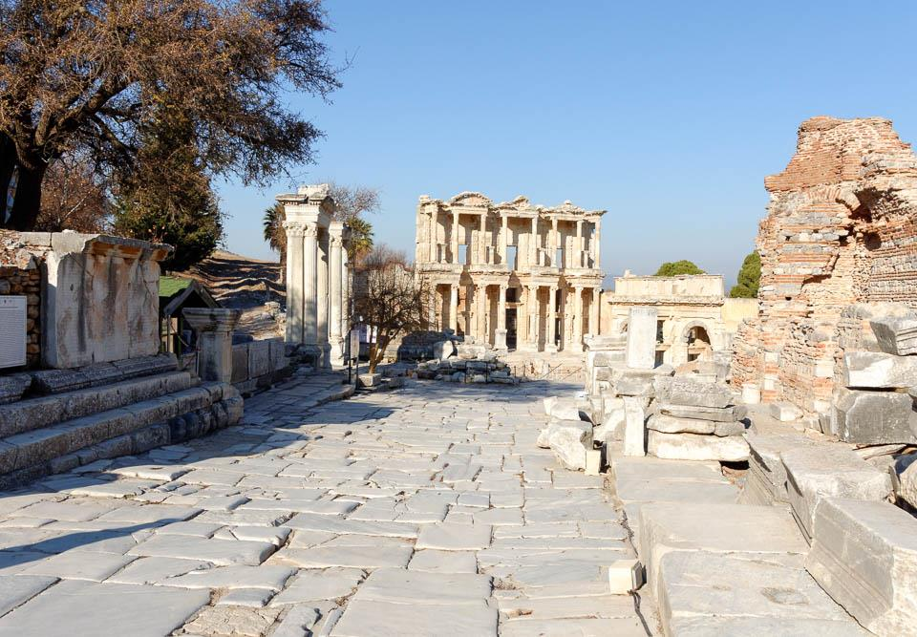
Paul passed through the interior regions and came to Ephesus
Library of Celsus and Curetes Street
19:1
Notes:
The tall edifice seen here is the façade of the Library of Celsus. It was constructed about fifty years after the time of Paul and thus is not something he would have seen, but it is shown here because it is a major well-known feature of the ancient city today. The Library of Celsus was built in honor of the Roman Senator Tiberius Julius Celsus Polemaeanus and completed around AD 114–117. Even though this library was not standing in Paul’s day, it gives some idea of the grand architecture he would have encountered elsewhere at the site, although none has yet been reconstructed to this extent. The façade of the library was re-erected by archaeologists between 1970 and 1978.
tb010317013

Slide 45
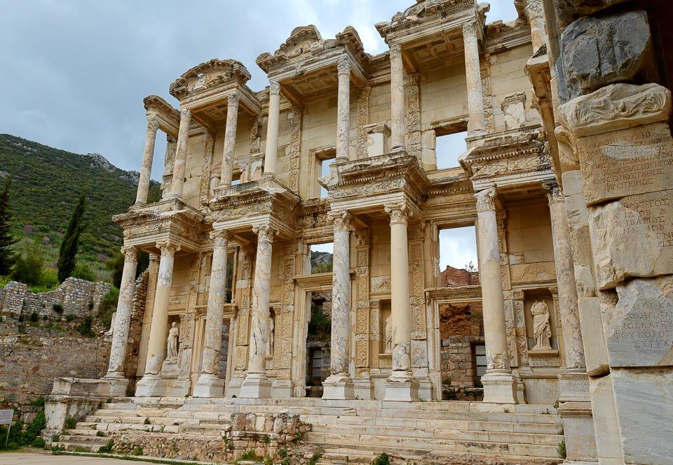
Paul passed through the interior regions and came to Ephesus
Ephesus Library of Celsus
19:1
Notes:
The Library of Celsus was originally built to store about 12,000 scrolls, making it one of the largest libraries at that time, perhaps behind only the libraries of Alexandria and Pergamum. This indicates that the citizenry of Ephesus was large, wealthy, and well–educated. The existence of such a library at Ephesus only a short time after Paul is also interesting in light of the large number of scrolls that were apparently burned during Paul’s stay (Acts 19:19).
tb041405304

Slide 46
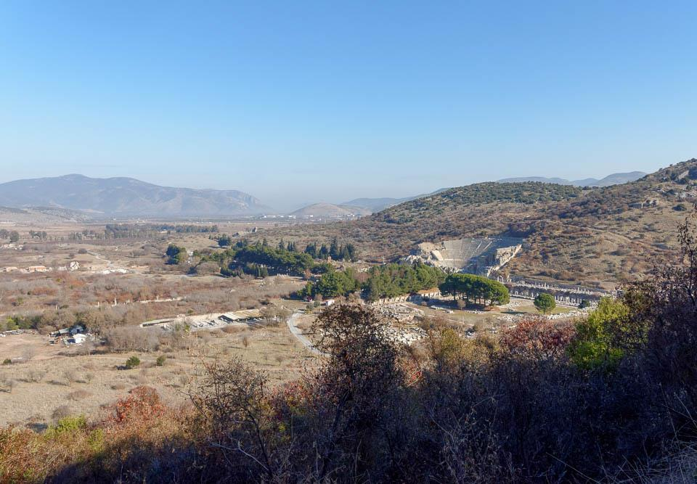
Paul passed through the interior regions and came to Ephesus
Upper town
Temple of Artemis
Hippodrome
Great Theater
Marble Road
Celsus Library
Gymnasium
Arcadian Way
Commercial Agora
Harbor
Ephesus (from the southwest)
19:1
Notes:
Beyond the Gate of Mazaeus and Mithridates, a number of other important features are visible. This photo was taken from the hillside to the south and provides a general view of another of the city’s theaters, another of the city’s agoras, and more.
tb010317135

Slide 47
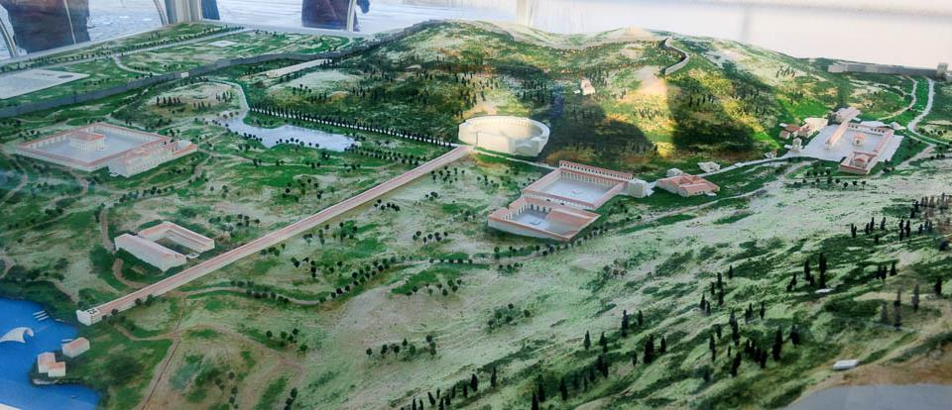
Paul passed through the interior regions and came to Ephesus
Hippodrome
Great Theater
Civic Agora
Temple of Artemis
Marble Road
Harbor Gymnasium
Arcadian Way
Commmercial Agora
Harbor
Ephesus model (from the west)
19:1
Notes:
This model includes some of the major features of Ephesus.
mjb010317097

Slide 48
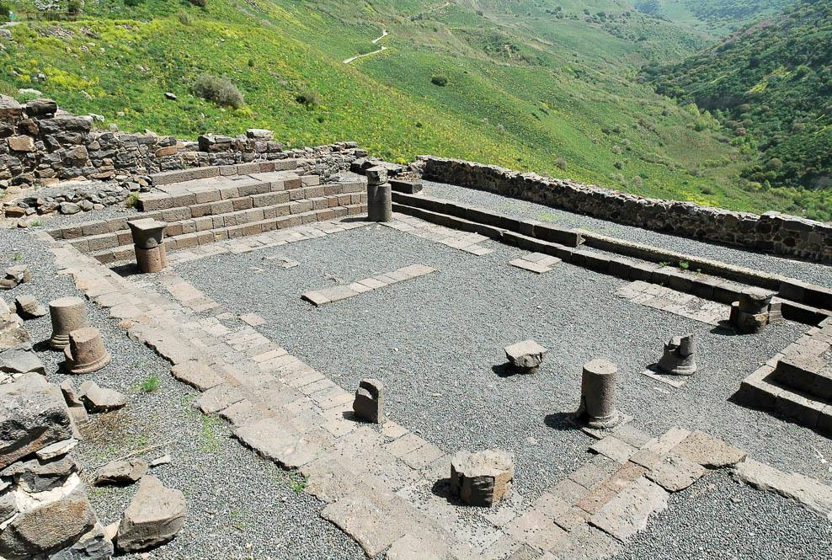
And he entered the synagogue
Synagogue at Gamla, Israel, 1st century AD
19:8
Notes:
No synagogue has been identified yet at Ephesus, although a basilica-like building north of the gymnasium has been suggested by some as a possible location. If the synagogue at Ephesus followed the traditional layout seen in first century synagogues in Israel, it would have looked somewhat like the one pictured here at Gamla. Support columns were built inside the building (unlike pagan temples, where they were typically on the exterior), and the room was surrounded by benches for seating. This fit with the use of a synagogue, which was a gathering-place for activities like reading and teaching.
tb032705371

Slide 49
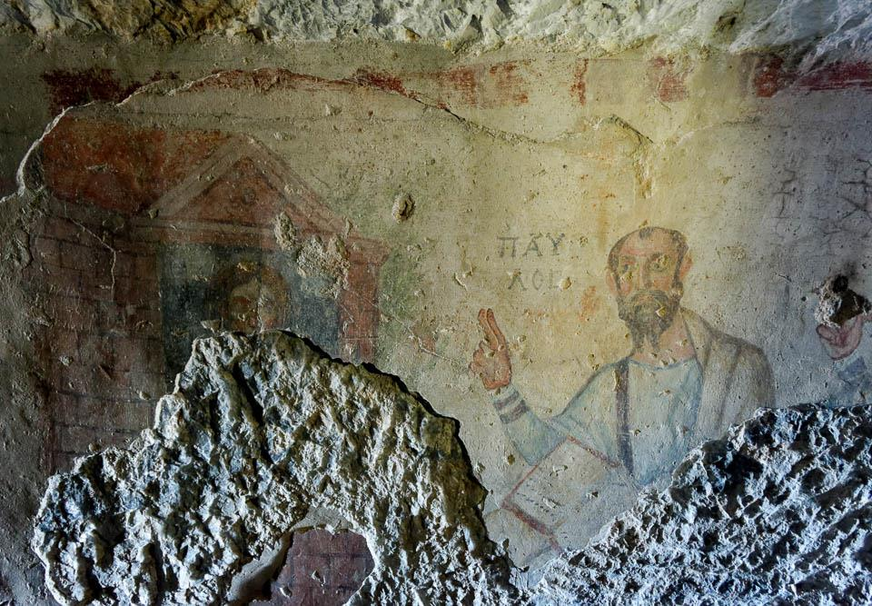
And he spoke boldly . . . reasoning and persuading about the kingdom of God
Fresco of Paul in the Grotto of Paul at Ephesus
19:8
Notes:
Paul spent much of the book of Acts reasoning with the religious leaders and intellectuals of the cities he visited. In this fresco Paul is shown preaching. Note that Paul’s name (ΠΑΥΛΟΣ) is written next to him. This fresco was discovered in a cave known as the Grotto of Saint Paul, located in the foothills on the southern side of ancient Ephesus. It dates to the late 5th or early 6th century AD.
tb010317141

Slide 50
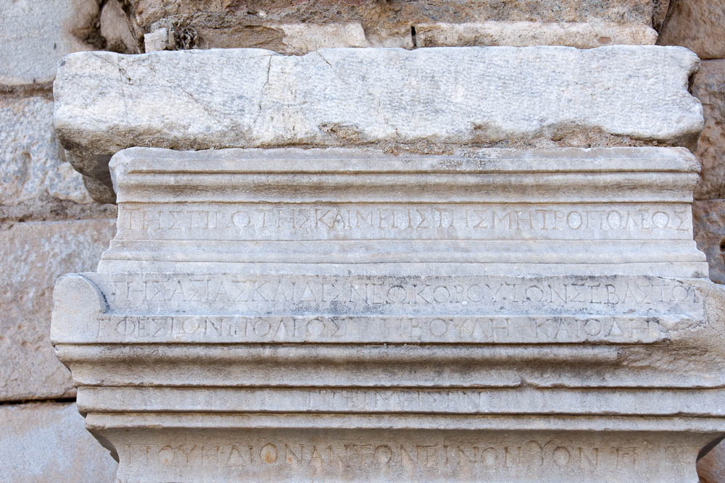
All those who lived in Asia heard the word of the Lord, both Jews and Greeks
“The first and great mother city of Asia,” inscription in Greek, from Ephesus, 2nd century AD
19:10
Notes:
Because of the length of Paul’s stay (about three years) and the stature and influence of Ephesus in the region, his word spread far beyond the city itself. This inscription from Ephesus boasts of the city’s status. It begins with the portion translated in the caption, “The first and great mother city of Asia . . .” (ΤΗΣ ΠΡΩΤΗΣ ΚΑΙ ΜΕΓΙΣ ΤΗΣ ΜΗΤΡΟ ΠΟΛΕΩΣ ΤΗΣ ΑΣΙΑΣ . . .).
tb010317001

Slide 51
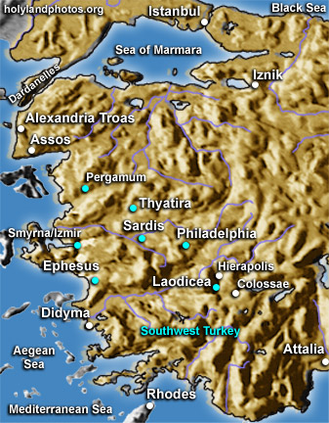
Ephesus
Acts 19:10 And this continued for two years, so that all who dwelt in Asia heard the word of the Lord Jesus, both Jews and Greeks.

Slide 52

Acts 19:10
And this continued for two years, so that all who dwelt in Asia heard the word of the Lord Jesus, both Jews and Greeks.
Pictorial Library Vol. 10: Western Turkey
Notes:
This map is intended to help users locate the places which appear in the photographs in this presentation. The map therefore does not represent or label every geographic feature, and the sites are a mixture of modern and ancient place names.

Slide 53

A certain man named Demetrius, a silversmith
Grave monument of Publius Curtilius Agatus, a silversmith, AD 1–25
19:24
Notes:
This marble portrait shows a silversmith making a small cup. Silversmiths did much business with the religious sector, making items like the shrines mentioned in this verse, as well as idols, jewelry, and household utensils. This artifact was photographed in the Getty Villa.
tb082214258

Slide 54

A certain man named Demetrius, a silversmith, who made silver shrines of Artemis
Silver statuettes of Isis Panathea, Venus, and coiled serpent, 1st century AD
19:24
Notes:
These small silver statuettes come from lararium of the villa of Cneus Domitius Auctus on outskirts of Pompeii. They were photographed at the Naples Museum.
tb0515170459

Slide 55



Slide 56

There is danger . . . that the temple of the great goddess Artemis may be made of no account
Reconstruction of the Temple of Artemis
19:27
Notes:
As one of the Seven Wonders of the Ancient World, the Temple of Artemis was an impressive structure. It measured 377 feet (115 m) long and 197 feet (60 m) wide; compare this with the well-known and large structure of the Parthenon on the Acropolis in Athens, which was 228 feet (69 m) long and 101 feet (31 m) wide. While more of the Parthenon has been reconstructed and remains standing today, the Temple of Artemis was almost as wide as the Parthenon was long. This miniature model of the Temple of Artemis is from Miniatürk, a park of miniature classical buildings in Istanbul, Turkey. This image comes from Zee Prime and is licensed under CC-BY-SA-3.0, via Wikimedia Commons: https://commons.wikimedia.org/wiki/File:Miniaturk_009.jpg.
wiki032620092340

Slide 57

And they rushed with one accord into the theater
The Great Theater of Ephesus (aerial view from the west)
19:29
Notes:
bb00420111

Slide 58

The assembly was in confusion and most of them did not know why they had gathered together
Political demonstration in Jerusalem
19:32
Notes:
One can imagine the tightly packed crowds at the theater, with more drawn just by the noise and confusion. This scene was captured by an American Colony photographer outside the Damascus Gate of Jerusalem on March 8, 1920.
mat07459

Slide 59

And they brought Alexander out of the crowd, since the Jews had put him forward
Stage of the Great Theater of Ephesus
19:33
Notes:
From the stage area Alexander would have been visible to the entire crowd. That Alexander motioned with his hand to quiet the crowd indicates that he could be seen and thus was standing in such a place.
tb041405354

Slide 60

And Alexander, beckoning with his hand, was wanting to make a defense to the crowd
Column sarcophagus with a gesturing figure, from the Vatican Necropolis, circa AD 375–400
19:33
Notes:
A gesture used to signal that one is about to speak is to hold out the thumb, index, and middle fingers with the remaining two folded into the hand. Ajax, in the center of the depiction here, can be seen using this gesture. This gesture is prescribed in several rhetorical handbooks dating from around the 1st century AD (see, for example, the comments on this verse in Parsons, Mikeal C. Acts. Paideia Commentaries on The New Testament. Grand Rapids, MI: Baker Academic, 2008, 306–7). Compare the slides on Acts 21:40.
tb0512175546

Slide 61

They all cried out with one voice for about two hours, “Great is Artemis of the Ephesians!”
The Great Theater of Ephesus
19:34
Notes:
One can imagine this theater filled with a roaring mob of Artemis–followers, all shouting the slogan of the religion of Ephesus.
jc0102150469

Slide 62


Slide 63


Slide 64


Slide 65

After the uproar ceased, Paul . . . departed to go to Macedonia
Philippi
Macedonia
Troas
Greece
Ephesus
Map showing Paul’s route from Ephesus to Macedonia and back
20:1
Notes:
While in Ephesus, Paul wrote 1 Corinthians, telling them that he was coming to visit them and receive the collection they were taking for Jewish believers. He explained then that he planned to travel through Macedonia on his way to them (1 Cor 16:1-9). This map was created by A.D. Riddle, RiddleMaps.com. Data sources: Ancient World Mapping Center shapefiles were used for road lines, under Open Database License (ODbL 1.0; http://awmc.unc.edu/wordpress/map-files/). ASTER-GDEM 2 or SRTM data were used to render the terrain (https://asterweb.jpl.nasa.gov/gdem.asp and https://www2.jpl.nasa.gov/srtm/). Natural Earth was used for streams and inland water bodies. Their data have been placed in the public domain. https://www.naturalearthdata.com/about/terms-of-use/.

Slide 66

Notes:
The circular postal route of the Seven Churches
The seven letters, described in chapters 2 and 3 of Revelation were sent to the Seven Churches in Ephesus, Smyrna, Pergamum, Thyatira, Sardis, Philadelphia and Laodicea. The order in which the letters were written was not randomly chosen, but follows a circular postal route. The messenger would have sailed from Patmos in a north-easterly direction to the harbour of Ephesus and disembarked there.
The average distance between these cities is 45 miles (72 km.), but the road back from Laodicea back to Ephesus was 110 miles (175 km.). It would have taken about three days between each visit, giving the messenger ample time to contemplate his last visit and prepare himself for the next. When visiting the Seven Churches today, the modern roads one travels on roughly follow the ancient Roman roads.

Slide 67

There were many lamps in the upper room where we were gathered together
Roman lampstand, bronze, 1st century AD
20:8
Notes:
A number of lampstands were recovered from the cities of Pompeii and Herculaneum, buried in the eruption of Mount Vesuvius in AD 79. They are reminiscent of Jesus’s statement that a lamp is put on a lampstand, in order to give light to those in the room (Luke 11:33). Although they may not have used such an expensive lampstand as the bronze one shown in this picture, it is not unlikely that such stands were used in the room where Paul was preaching. This lampstand was photographed at the Walters Art Museum in Baltimore.
adr1311245133

Slide 68

The Temple of the Sebastoi in Ephesus
The construction of this Temple of the Sebastoi (”Revered ones”) or Temple of Domitian in 82 A.D. gave Ephesus the honour of neokoros (“temple guardian”).
Notes:
The Temple of the Sebastoi in Ephesus
The construction of this Temple of the Sebastoi (”Revered ones”) or Temple of Domitian in 82 A.D. gave Ephesus the honour of neokoros (“temple guardian”). The name of Domitian, who was an unpopular Roman Emperor, was erased after his death. However, in order for the city not to lose its status of neokoros, the temple was rededicated to Vespasian, also of the Flavian dynasty (the father of Domitian). This conflict may have formed the background to John’s exile to Patmos and his writing of the book of Revelation to the Seven Churches. Some have suggested that the figure on the upper left column represents Titus, the Roman general who sacked Jerusalem in 70 A.D. and who succeeded his father Vespasian as emperor. It would have reminded the messenger of the prediction made by Jesus: “Do you not see all these things? Assuredly, I say to you, not one stone shall be left here upon another, that shall not be thrown down” (Matthew 24.2).

Slide 69

Notes:
Model of the Temple of Artemis in the Ephesus Museum
This is a model of the Temple of Artemis in its Hellenistic phase, when it was four times as large as the Parthenon in Athens. In front of the temple is a monumental altar, where the sacred bulls were sacrificed. At the back of the temple stood an enormous statue of the goddess. The statue of Artemis that we saw on the right in Slide 21 is a copy of this representation. Although it was used as a centre for financial transactions and as an asylum for for people who were accused, but innocent of a committed crime, it was primarily a major religious institution. In Acts 19.35, the city clerk reminded the people in no uncertain terms of the importance of the fact that: “the city of the Ephesians is temple guardian of the great goddess Diana (Greek: Artemis) and of the image, which fell down from Zeus (Greek: the sky)?”
A grove nearby was believed to be the birthplace of the goddess and was known as a paradeisos (a Persian word for a formal garden). With people still flocking to the site in the New Testament period, the promise that the “overcomers” of Ephesus would be allowed to eat of the tree of life, which is “in the midst of the Paradise of God,” (Revelation 2.7), would have been full of significance.

Slide 70

Notes:
The Artemision at Ephesus
The Temple of Artemis at Ephesus was regarded by ancient writers as one of the Seven Wonders of the World and was destroyed and rebuilt several times. A temple built with the help of donations by King Croesus about 560 B.C. was the largest monumental building of the time to be built of marble. A fire started by a man called Herostratus, who wished to become famous, burned this temple to the ground in 356 B.C. The reconstruction made in the Hellenistic period had more or less the same dimensions as the previous one. Pliny gives its dimensions as: 220 ft. (67 m.) wide and 425 ft. (130 m.) long and records that it was supported by 127 columns. Each fluted column was 57 ft. (17 m.) high and was capped with an Ionic capital. This single standing column has been assembled from fragments that were found in the excavations. Today, storks nest on top of the pillar. The Hellenistic temple was built on a thirteen-step platform which raised it above the marshy ground which has overtaken the area today. The sanctuary of Artemis was surrounded by a public garden, called Paradise, a Persian word for a formal garden. This sacred compound, called Artemision, served as a sanctuary for people who were accused, but innocent, of a committed crime.

Slide 71

Notes:
The journey of the messenger from Ephesus to Smyrna
The distance between Ephesus and Smyrna is about 40 miles, so that the messenger could have reached the next stage on his journey in two or three days. On leaving Ephesus for Smyrna, he would have travelled over the processional way (which later became Marble Way), in front of the Theatre and gone north, passing by the Artemision.
After walking through a pass in the mountain range to the north of Ephesus, he would have reached a large plain. Going north, an inland road would have led him straight to Smyrna. As the terrain determines the direction a road can take, today’s motorway still follows the same route.
On reaching the hills south of Smyrna, he would have seen the beautiful bay of Smyrna and easily picked out the high Pagus mountain with its white crown of temples and palaces that graced its top. He undoubtedly looked forward to announcing the unqualified praise of the believers in Smyrna described in the letter from Jesus, which he was carrying.

Slide 72

Smyrna was the second of the Seven Churches to receive a letter from Jesus Christ. As with Ephesus, this was not surprising as, during the Imperial period, Smyrna vied with Ephesus and Pergamum to be “First in Asia in beauty and size” (as proclaimed the legend that appeared on some of their coins). He also reminded them of their proverbial faithfulness, which was of such fame that Cicero wrote of Smyrna that it was: “the city of our most faithful and most ancient allies.” Now translated into loyalty to Christ, it would entitle them to the true crown of eternal life.
Notes:
The State Agora of Smyrna
The remains of the State Agora of the city are some of the best preserved of such a public space in the entire country. It owes its preservation to the fact that this area was used as an Ottoman graveyard, surrounded by a namazgah (the name the locality is known by today) which indicates “an open area where people performed prayer called namaz.” Now a busy hive of restoration by the Turkish authorities, the site preserves a structure built in the form of a rectangle, surrounded by porticoes, which had a magnificent basilica on its northern side. The dimensions of this courtyard were 394 ft. (120 m.) by 262 ft. (80 m.), with the stoas on the east and west sides measuring 59 ft. (18 m.) long and the Northern Basilica measuring 95 ft. (29 m.) long.
The original market place was built during the Hellenistic period and improved by the Romans. We can imagine the messenger passing by and seeing some of the believers in this, the bustling heart of the city. Some of them may have had to give up jobs making idols or other occupations that conflicted with their beliefs. Some may have had their property confiscated for refusing to bow to Caesar. They may have been forced to hire themselves out doing jobs more menial than they were accustomed to, in order to keep a clear conscience and thus have stood out in the crowd.

Slide 73

Notes:
The journey of the messenger from Smyrna to Pergamum
The messenger would have left Smyrna and gone north, skirting the end of the gulf and climbing up a mountain range. The road descended into the Hermus Valley, where the terrain was relatively flat. Continuing on this road, he would have passed through hilly terrain and followed the coastline of the Aegean, which he had not seen since he left Smyrna, for a while. Climbing again over a few low hills, he entered the Caicus Valley, which was wide at first, but then became a little narrower. While walking alongside the Caicus River, the messenger would have seen some high mountains on his left side. Soon he would see the high and strongly fortified rocky mountain on which Pergamum was built, standing out in splendid isolation from the other mountains nearby.

Slide 74

Entrance to the Asclepium at Pergamum
Notes:
Entrance to the Asclepium at Pergamum
The Via Tecta led into the propylon, or monumental entrance gate of the Asclepium of Pergamum, in front of which was a courtyard surrounded on three sides by colonnaded stoas. There was an altar to Asclepius in the centre of this courtyard and the entire complex was dedicated to the cult of this serpent god. The road to the Asclepium would have been crowded daily with people seeking healing. This practice was, of course, in direct opposition to the real healing power and salvation, which is only available in Christ. As the other major sanctuary of Asclepius was at Epidaurus in Greece, the shrine in Pergamum was the most important cult site of this pagan worship in Asia and must have been a real threat to the believers in this city. What would a Christian do when he was sick? He needed help, it was supposedly available in the Asclepium hospital. But offering to the serpent god would have been against his conscience! Although the Asclepium itself is not mentioned in the Book of Revelation, the symbol of the snake is used to depict Satan, the “adversary” in Revelation 12.9 and 20.2).

Slide 75

The restored Great Altar of Zeus superimposed on the present-day Acropolis of Pergamum
Notes:
The restored Great Altar of Zeus superimposed on the present-day Acropolis of Pergamum
Here we see the reconstructed Altar of Zeus, as it would have appeared to believers in ancient Pergamum. The main approach was on the west, overlooking the valley. The messenger would have seen the smoke arising from the horseshoe-shaped altar from afar. It was constructed of white marble and measured 117 ft. (36 m.) wide and 110 ft. (33 m.) deep. In the ancient world, only the Temple of Athena Parthenon in Athens has a longer continuous band of relief. It extended for 371 ft. (113 m.) around the podium. The Gigantomachy portrays a mythical battle between the gods and the giants. It was thought that the relief commemorated the victory of the Attalid kings, (to which dynasty Eumenes II belonged), over the Gauls, but this cannot be proved.
Some interpreters have identified this altar as” Satan’s throne,” but it would appear, as already mentioned in Slide 40, that it was the cult of emperor worship that was the chief threat to the believers of Pergamum.

Slide 76

The reconstructed Great Altar of Zeus in the Pergamon Museum, Berlin
Notes:
The reconstructed Great Altar of Zeus in the Pergamon Museum, Berlin
The largest altar in antiquity is now the highlight of the Pergamon Museum in Berlin, where it has a room entirely to itself. The frieze took over twenty years to assemble from the fragments recovered in the excavations of Carl Humann. A 66 ft. (20 m.) wide flight of steps led up to a colonnade of Ionic columns. An altar for burnt offerings stood in the open place behind the colonnade. The walls around the altar were also covered with a frieze depicting the story of Telephus, son of Hercules and traditionally, the founder of Pergamum. The roof of the structure was originally decorated with sculptures of centaurs, horses and gods. Carl Humann is buried near the site of the original altar in Pergamum.

Slide 77

Pergamum at the time this letter was written, the city was one of the most important centers of paganism and the first place in Asia to have a temple specifically dedicated to the worship of the emperor. In Pergamum, “Satan’s throne” was the seat of Roman government. The Roman governors insisted on emperor worship and persecuted Christians, who refused to compromise
Notes:
The Temple of Trajan in Pergamum
This gleaming white temple dominated the Acropolis and was visible for miles around. It is thought to have been constructed for the Emperor Trajan (98-117 A.D.) by his successor Hadrian (117-138 A.D.). A German team have recently re-erected the temple columns and the colonnades that surrounded it on the northern, southern and eastern sides. The arched and vaulted substructure of the temple was made of the dark local andesite stone, but then overlaid with panels of white marble. Although it would not yet have been standing when the messenger brought the letter to Pergamum, it gives us an insight into the power of the Imperial cult, which made life so difficult for believers in the city. Although the first temple dedicated to the cult of the emperors, was built in Pergamum in 29 B.C., no archaeological remains of it have been found, However, by the time of the writing of the Book of Revelation, the cult of emperor worship had been thriving for over a hundred years. As we have mentioned before (Slide 19), Domitian, who is thought to have ruled at the time of the visit of the messenger, liked to be called: “Lord and God.”

Slide 78

The Library at Pergamum
Notes:
The Library at Pergamum
On the north side of the northern cloister of the Sanctuary of Athena, behind the Theatre, four rooms, identified as the famous Library of Pergamum (also built by Eumenes II) were located. These stood on a platform of rock 20 ft. (6 m.) higher than the adjoining sanctuary. The easternmost of these rooms, seen here in the picture, was the largest and is believed to have been the Library Reading Room. The discovery of a statue base as well as a complete statue of Athena (the latter which is now in Berlin), indicates that the statue of the goddess stood here in a commanding position in the centre of the northern side of the Reading Room. Notches in the walls are understood to show how the wooden shelves, containing the Library’s scrolls were hung, in order to keep them at a distance from the dampness of the walls.

Slide 79

The fame of the Library of Pergamum stems from the record of Plutarch that it contained 200,000 volumes, making it the second largest in the ancient world, after the library in Alexandria. The Roman writer Varro, (116–27 B.C.) wrote that, in order to prevent the Library of Pergamum from becoming too much of a rival, the Egyptians banned the export of papyrus. Because of this, it is claimed that the people of Pergamum invented parchment created from animal skins
Notes:
Parchment from Pergamum
The fame of the Library of Pergamum stems from the record of Plutarch that it contained 200,000 volumes, making it the second largest in the ancient world, after the library in Alexandria. The Roman writer Varro, (116–27 B.C.) wrote that, in order to prevent the Library of Pergamum from becoming too much of a rival, the Egyptians banned the export of papyrus. Because of this, it is claimed that the people of Pergamum invented parchment created from animal skins. The truth is that animal skins had long been used as writing material in this part of the world. However, the Pergamenes so improved the process that the Latin name charta pergamene (pergamene paper), by which the material began to be called, is the origin of our word for “parchment”. The exact fate of the Library is unknown, but Plutarch recorded that Mark Anthony promised its contents to Cleopatra after Julius Caesar damaged the Library of Alexandria in 48 B.C

Slide 80

Notes:
The journey of the messenger from Pergamum to Thyatira
The road to Thyatira runs on the northern side of the Caicus Valley for a distance and then turns north-east to skirt around a high mountain range. The road slopes gradually over the rising terrain that is the watershed between the Caicus and Hermus river systems, then descends into a wide and level plain. It then continues south-east through this plain until Thyatira, which is located in the centre of this broad valley, is reached. The distance of 50 miles (80 km.) between Pergamum and Thyatira could have been covered in three days walking.
.

Slide 81

Remains of the monumental entrance to an ancient colonnaded street in Thyatira
Thyatira least is known of this church but it received the longest letter. This is the only place in the Book of Revelation where Jesus is called the Son of God. Emperors were worshipped as the incarnate Apollo Tyrimnaeus, son of Zeus, who was the patron god of Thyatira and protector of the guilds, bringing the believers into conflict with the authorities.
Notes:
Remains of the monumental entrance to an ancient colonnaded street in Thyatira
This monumental entrance stood to the west of the colonnaded street (see previous slide). As Roman cities followed a similar architectural plan, all of these remains may have belonged to the agora, the busy market place where the members of the different guilds sold their wares. Because of Thyatira’s lack of any geographical aids to defense, its only claim to importance lay in the prominence of its trade guilds. Ancient sources refer to guilds, such as those of workers in linen, wool and leather, tanners and potters. The unions of copper smiths and of dyers were especially powerful. Thyatira was known to have had more guilds than any other city in Asia Minor. There were Jews, Christians and pagans living in the same city and finding employment in the various guilds. At regular intervals, guild-feasts were kept where food was consumed, which was first offered to idols, and sexual immorality was practiced as part of the entertainment. It would have been difficult to stay away from these feasts and remain separate, because of the threat of losing one’s employment.

Slide 82

Notes:
The journey of the messenger from Thyatira to Sardis
The road from Thyatira to Sardis is 37 miles (50 km.) long and runs south-east through a wide valley. It passes by the huge Gygean (Marmara) Lake and over some hills and descends into the Hermus River valley.
Sardis is located on the other side of the valley, at the base of the Tmolus mountain range.

Slide 83

Notes:
Roman street in Sardis
North of the modern highway, whose fence can be seen at top left of the picture, are the well-preserved remains of a Roman colonnaded street. It was paved with marble and was 20 yds. (18.5 m.) wide. The columns of the southern side are buried beneath the highway. Under Persian rule, Sardis became the administrative centre in the west of the Empire. The Royal Road that linked Sardis to Susa brought prosperity arising from trade to the city. A section of this 1,500 mile (2,414 km.) long road awaits excavation under this street. Shops dating from the Byzantine period are visible on the right of the street (see Slides 73, 74).

Slide 84

Notes:
Jewish dye shop in Sardis
Between the colonnaded street and Sardis’ synagogue (see Slides 75–79), a row of shops has been excavated, which indicate that Christians and Jews lived and traded peaceably together in this city during the Byzantine period. The foundations and low walls of 27 shops have been restored. An upper floor would have been used as a dwelling. Artifacts and inscriptions found in these shops have made it possible to determine the religious affiliation of the shop owners. Of the 27 shops, 10 had Christian owners, 6 were owned by Jews and the religion of the remainder could not be determined. One of the Jewish shops (which comprised three adjacent rooms) belonged to Jacob, who was a dyer of fabric. Two amphorae inscribed with his name were found in the shop’s middle room, shown in the picture. The dyeing vats can still be seen in an adjacent room (on left in the picture). We know he was Jewish from the finding of two menorot incised on the door jamb of this combined entrance and work area (see Slide 74).

Slide 85

Notes:
Two incised menorot on the door jamb of Jacob’s dye shop in Sardis
On the inside face of the western door jamb of the middle room of the dye shop, are two menorot incised in stone. These religious symbols identify Jacob, the shop’s owner, as Jewish. Another paint and dye shop, six shops away, may also have belonged to Jacob, as the same name was found here on an amphora. Crosses, identifying the shop owners as Christian have been found on an ampulla (a small teracotta container), a finger ring and a ceramic plate, among other objects, in some of the other shops. It seems that, at least in the Byzantine period, Jews and Christians shared the same colonnaded commercial area and their establishments adjoined each other. The proximity of the synagogue (see Slides 75–79) would have brought custom to the area, although Jacob’s shop would have been closed on the Sabbath. The same evidence of accommodation to the cultural surroundings as is evidenced in the synagogue is clearly seen here.

Slide 86

Notes:
Forecourt of the Synagogue at Sardis
The ancient Synagogue of Sardis, which is the largest outside of Israel, has a very untypical location. It stands in the centre of the city and originally formed part of a large bathing complex. A Roman basilica style building was redesigned as a synagogue where 1,000 worshipers could congregate at one time, at the end of the 2nd century A.D. The synagogue has now been partly restored. Here we see the Forecourt or courtyard
with its monolithic columns that led into the synagogue from the east. A fountain in the centre, which had the shape of a krater, is believed to have served for public use by both Jews and Gentiles, just one aspect of the unusual religious accommodation seen here in Sardis. The floors below the colonnades were decorated with intricate geometric designs in mosaic. Greek inscriptions in the mosaic contain the names of donors to the Synagogue. The original building was about 262 ft. (80 m.) long, with the Forecourt measuring 82 ft. (25 m.) long, after it was subdivided.

Slide 87

Notes:
Entrance to the Synagogue at Sardis
Three doors led from the Forecourt into the Synagogue, which faced east towards Jerusalem. There were two pedimented shrines (aediculae) in between these doors. These held Torah scrolls, with the southernmost of these shrines (right in the picture), holding the main scrolls of the Synagogue. This identification was confirmed by the finding of an inscription on a piece of marble inlay, which refers to the Torah shrine as a nomophylakion – “that which protects the law.” Hebrew inscriptions and a marble slab decorated with a menorah, with Torah scrolls under its branches, flanked by a lulav and a shofar, were found under this shrine. The other shrine is believed to have held additional scrolls.

Slide 88

Notes:
The Main Hall of the Synagogue at Sardis
After the Roman basilica style building was subdivided, the Main Hall of the Synagogue measured approximately 197 ft. (60 m.) long. This is almost twice the length of the largest ancient synagogue yet discovered. The synagogue proper had mosaic floors of elaborate geometric patterns. The lower part of the walls was decorated with marble panels and intricate designs in coloured stone in between Corinthian pilasters (see partial restoration at eastern end of the Hall). Greek inscriptions found in the Main Hall commemorate the names of community members as well as benefactors of the synagogue and their wives, who were “God-fearers,” as well as Jews. These Jews were apparently citizens of the city and some held positions in its civic administration. This synagogue differed from others in that it lacked benches along its side walls, with the worshippers either standing on the mosaic floors or sitting on mats or rugs. Neither was provision made for the usual women’s gallery, so that we assume either that women worshipped together with the men or that they were excluded altogether. In this connection, we remember that wives were often mentioned as co-donors with their husbands in the Synagogue inscriptions..

Slide 89

Notes:
The journey of the messenger from Sardis to Philadelphia
The 30 mile (48 km.) journey to Philadelphia is relatively short. Leaving Sardis, the messenger would have walked in a south-easterly direction, through the pleasant Cogamus River Valley. The Cogamus is a tributary of the Hermus River. The road to Philadelphia followed the ancient Persian Royal Road, which ran from Susa to Sardis. Philadelphia is located on a small rise at the foot of the long Tmolus Mountain range.

Slide 90

Among the promised rewards for the overcomers in Philadelphia was to become a pillar in God’s Temple and not to have to go out anymore. This area is notoriously prone to earthquakes. This promise would have given them a security, since they were used to being always ready to leave when an earthquake occurred.
Notes:
The Acropolis of Philadelphia
The modern city of Alasehir almost completely covers the ancient remains of Philadelphia. The city was located at the south side of the broad Cogamus River Valley, which flowed into the Hermus River near Sardis. The ancient Acropolis was built on an elevated spur of the Tmolus Mountain. The city was founded by Attalus II, King of Pergamum (159–138 B.C.) He earned the epithet “Philadelphus,” from his loyalty to his brother Eumenes II, who preceded him as King of Pergamum. The name of the city reflects this ”brotherly love” and it has bequeathed this name to many cities around the world. It was situated on an important road which ran from beyond Pergamum to Perga and Attalia. It had therefore good connections with Sardis and Pergamum to the north-west and with Laodicea to the south-east and the areas beyond these cities. Philadelphia was also located close to another important road that led east toward Antioch in Pisidia. The city was founded because of its geographical location, namely to serve as a gateway into the ancient kingdoms of Lydia and Phrygia. The idea was to spread Greek culture and develop a loyalty to the Hellenized Attalid monarchy. A depression can be seen in the Acropolis where the ancient stadium was located.
On the death of Attalus III in 133 A.D., the Kingdom of Pergamum, including Philadelphia, was bequeathed to Rome. It prospered so much during this period that it was referred to as: “Little Athens.” In 17 A.D., a massive earthquake struck Philadelphia and nearby areas, resulting in the complete destruction of the city. The Emperor Tiberius remitted Philadelphia’s tribute for five years in order to assist with the rebuilding of the city. For a short period the city was called Neocaesarea and a temple to Tiberius was constructed there.

Slide 91

Notes:
The journey of the messenger from Philadelphia to Laodicea
Going southeast through the Cogamus River Valley, the messenger followed the ancient Persian Royal Road, which began to climb some 2,000 ft. (610 m.) over the eastern foothills of another mountain range before descending into the Lycus Valley. This valley gradually widens until it becomes a large plain, which is dominated by two large mountain ranges in the south. The city of Laodicea is located on a hill in the middle of this valley. Two other Christian sites are located nearby. Hierapolis is 6 miles to the north-east and Colossae 10 miles (16 km.) to the south-east. Although only Laodicea is mentioned among the Seven Churches of Revelation, these three cities were closely linked together, as shown in Paul’s letter to the Colossians who vouched for Epaphras that: “he has a great zeal for you, and those who are in Laodicea, and those in Hierapolis” (Colossians 4.13). It is therefore impossible to speak of Laodicea on its own, without bearing Colossae and Hierapolis also in mind.

Slide 92

Notes:
Syrian Street in Laodicea
Laodicea was a very large city, spread over 500 hectares (2 square miles) and built according to the Hippodamian grid plan, with streets crossing at right angles. The messenger would have entered Laodicea from the east, through the Syrian Gate. The very moving image of Christ knocking on the door for admission has perhaps this location for its backdrop. Each of the city’s four gates entered from a busy trade route and the triple Ephesus Gate has been discovered, though not yet excavated (see Slide 103). A paved colonnaded street ran due west through most of the city and has been preserved in its rebuilt Byzantine form. The cover stones for the drainage channel that ran under the street are visible in the middle of the picture. Flanking the street on the north is a marble temple, which, prior to its proper identification, is referred to as Temple A. It may have been used in the Imperial cult. Looking east through the columns of the street, we see Colossae located at the foot of Mount Cadmus (today Mount Honaz).

Slide 93

Notes:
The North Theatre of Laodicea
Laodicea had two theatres, of which this is the largest. It is built into the hillside, facing north-east and was apparently constructed during the Hellenistic period, when the theatre on the west side became too small. Its capacity was about 12,000 people, compared to the older theatre’s 8,000. The new theatre appears to have been modified during the Roman period. The theatre is in a poor state of preservation, but 46 rows of seats can be recognised, as well as part of the stage. We know that some of these seats were reserved for important personages, as they were marked with the names of some of the city’s chief families. To have been invited to sit in these seats, alongside people of rank, would have been a much sought-after honour. The final promise of Jesus to any overcomers in this self-satisfied church, was to be granted to sit with him on his throne and would have been very meaningful to them. Of course, it referred to future joint rulership and glory in God’s kingdom and not present-day recognition. Beyond the theatre, we see the Lycus valley, where Colossae is located.

Slide 94

Notes:
The Central Baths at Laodicea
Laodicea had several bathing complexes. Here we see the entrance to the Central Bath complex, located to the south of the Central Agora, which flanked Syrian Street. The complex comprised of a caldarium (hot bath), seen here through the pillars, a tepidarium (warm bath) and a frigidarium (cold bath). There were two changing rooms and another cold bath further inside the complex. These baths have been dated to the 2nd century A.D., the Roman Imperial period. Water was brought in through a five-mile long aqueduct from a spring near present-day Denizli, but its water had a high mineral content and was lukewarm on its arrival in Laodicea. This photograph was taken in April, when the site was covered with poppies.

Slide 95

Laodicea had a poor quality of the water and drinking of this tepid water often induced vomiting. The equation of the temperature of the water in Laodicea with the spiritual condition of the city’s believers, is perhaps the most familiar of the local metaphors used in the letters to the Seven Churches “So then, because you are lukewarm, and neither cold nor hot, I will vomit you out of My mouth” (Revelation 3.16), the believers would have recognized immediately what he had in mind, namely that their works were done in a half-hearted spirit and therefore as distasteful as their insipid water supply. Jesus wished that the believers in Laodicea were hot or cold. This is obviously a reference to the water supply in the Lycus Valley
Notes:
Calcified Water Pipes from Laodicea
Some pipes that were found close to the Central Baths in Laodicea show that the poor quality of the water caused them to fur up, slowing down the water supply. The drinking of this tepid water often induced vomiting. The equation of the temperature of the water in Laodicea with the spiritual condition of the city’s believers, is perhaps the most familiar of the local metaphors used in the letters to the Seven Churches. When Jesus wrote, in the letter to Laodicea: “So then, because you are lukewarm, and neither cold nor hot, I will vomit you out of My mouth” (Revelation 3.16), the believers would have recognized immediately what he had in mind, namely that their works were done in a half-hearted spirit and therefore as distasteful as their insipid water supply.
Jesus wished that the believers in Laodicea were hot or cold. This is obviously a reference to the water supply in the Lycus Valley. Neighbouring Colossae was located at the foot of a snow-capped mountain and the Lycus River (today Aksu River) that flowed next to it, had refreshingly cold waters (see Slide 98). Hierapolis was well known for its hot springs (see Slide 100) and attracted many visitors who enjoyed bathing in the warm waters. Both of these were welcome contrasts, impossible to find in Laodicea.

