Slide 1
Journey thru the Bible with Archaeology
A Bible and Spade Evidence Class.
Lesson 15
Museums and Key Bible Finds

Slide 2
Objectives:
Improve our knowledge of Bible Locations, People and Timeline
Gain an understanding that the Bible deals with real events, real people, and real places.
Strengthen our faith by examining the physical remains/evidence that have been discovered in Middle East and Mediterranean related to Bible events.

Slide 3
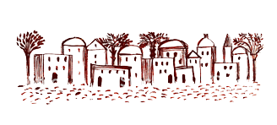
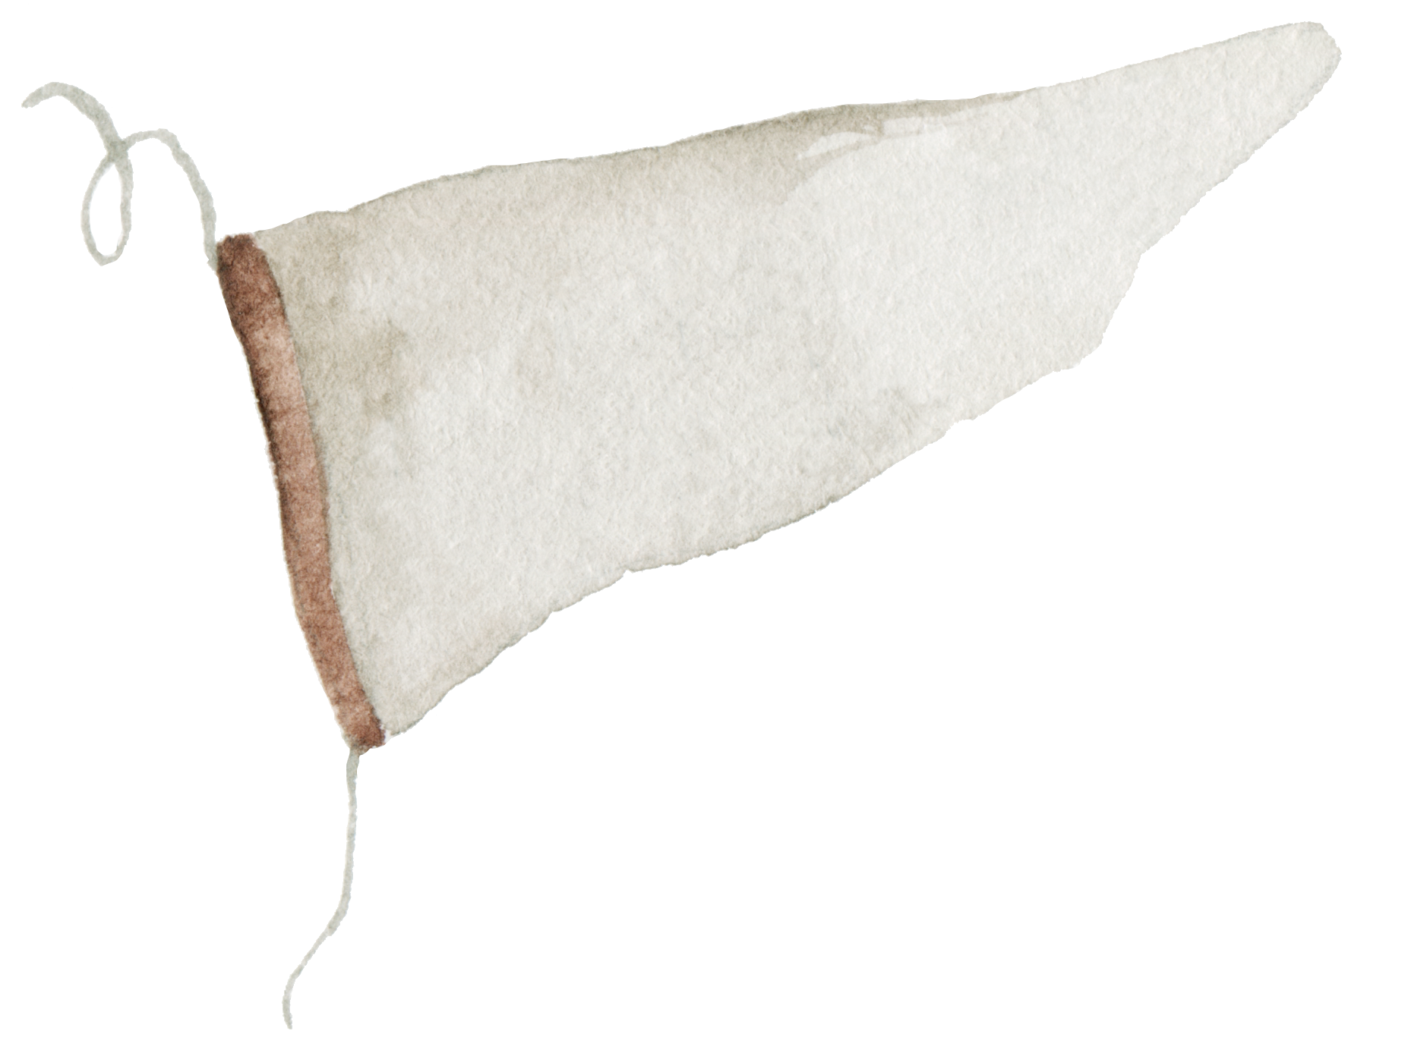
Journey thru the Bible with Archaeology
03-Joshua and the Conquest
01-Introduction to Bible Archaeology
03-Joshua and the Conquest
02-Patriarchs
and Camels
05-David, Samson and the Philistines
04-Shechem a City for All Times
17-Archaeology and the Bible Text 9/1
06-Solomon the Builder
07-Ahab and the Northern Kingdom
11-Crucifixion and Burial
16-Archaeology in Jerusalem 8/11
15-Museums and Key Bible Finds 8/4
08-The Hezekiah Defense
14-Daniel and the Kingdoms 7/28
09-Jeremiah and the Last Days of Judah
12-Cities of Paul and John
10-In the Days of Jesus
13-Finding People in the Bible Outside the Bible
Notes:
Daniel and the Kingdoms
7/28
Museums and Key Bible Finds
8/4
Archaeology in Jerusalem
8/11
Archaeology and the Bible Text
9/1

Slide 4
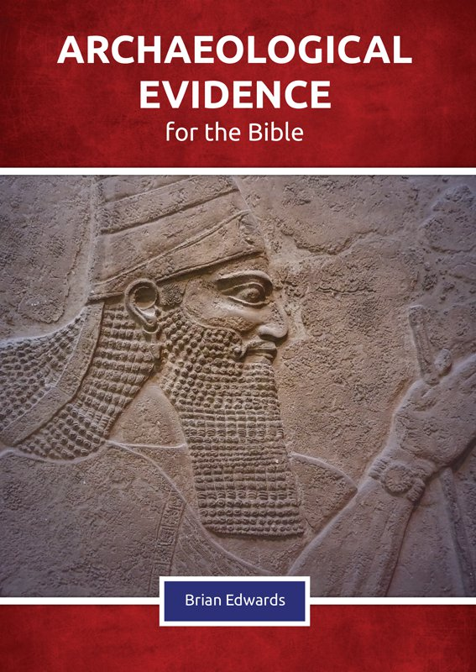
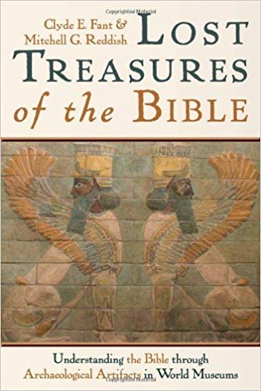

Slide 5
Old Testament Finds | Importance | Bible Period | Location of Find
Tel Dan Stele at Israel Museum | Existence of House of David | ~842 BC Divided Kingdom | Dan, Israel
Silver Ketef Hinnom Scrolls at Israel Museum | Oldest Biblical Text | ~640 to 609 BC Judah Alone | Jerusalem
Moabite Stone at Louvre in Paris | Moabite version of 2 Kings 3 | ~ 835 BC Divided Kingdom | Dibon, Jordan
Hezekiah’s Tunnel at Arch Museum in Istanbul | confirms Hezekiah's efforts to fortify Jerusalem | before 701 BC Judah Alone | Jerusalem
Lachish Reliefs at British Museum | Depicts Siege of Lachish in days of Hezekiah | ~700-691 BC Judah Alone | Palace of Nineveh, Iraq

Slide 6
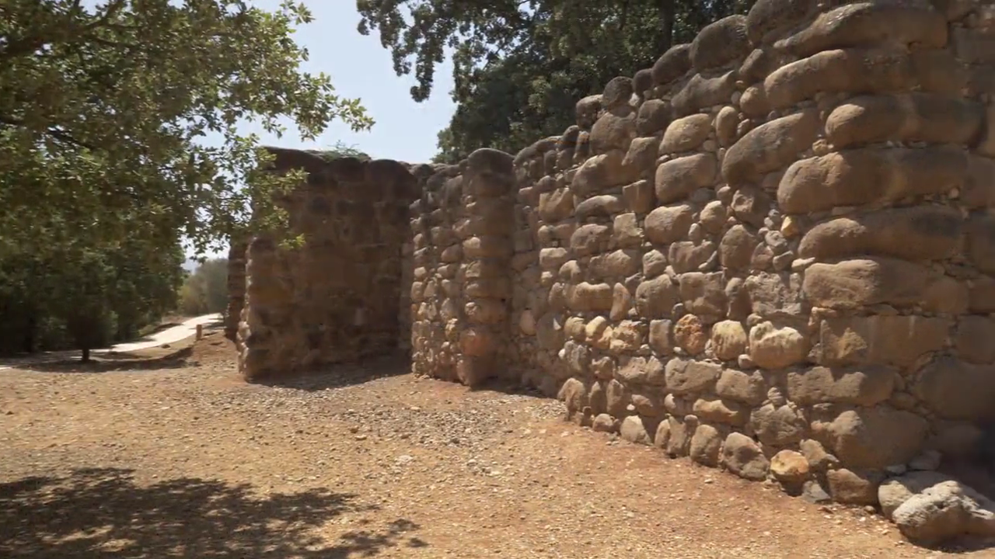

Slide 8
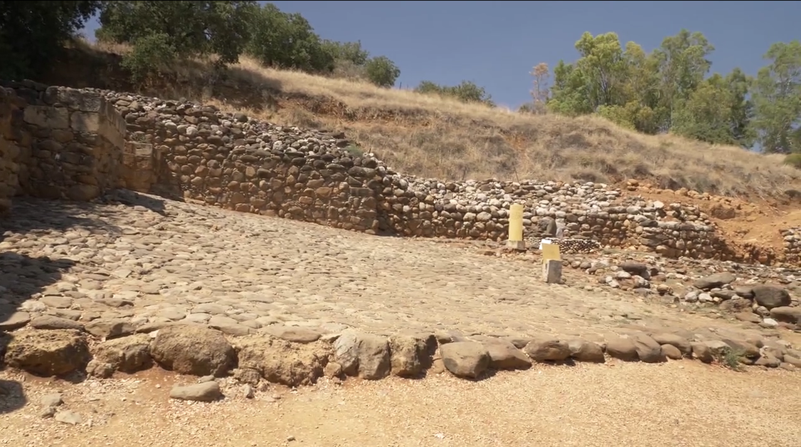

Slide 9
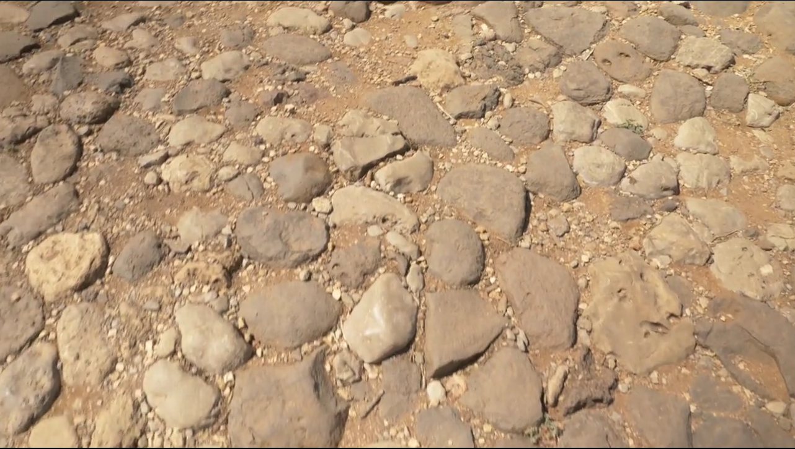

Slide 10
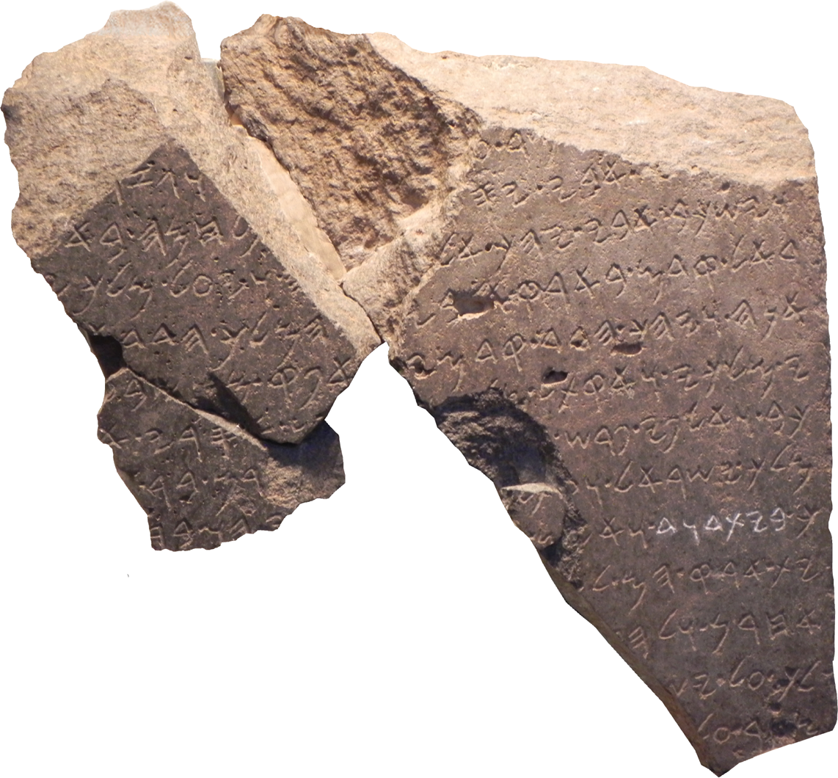

Slide 11
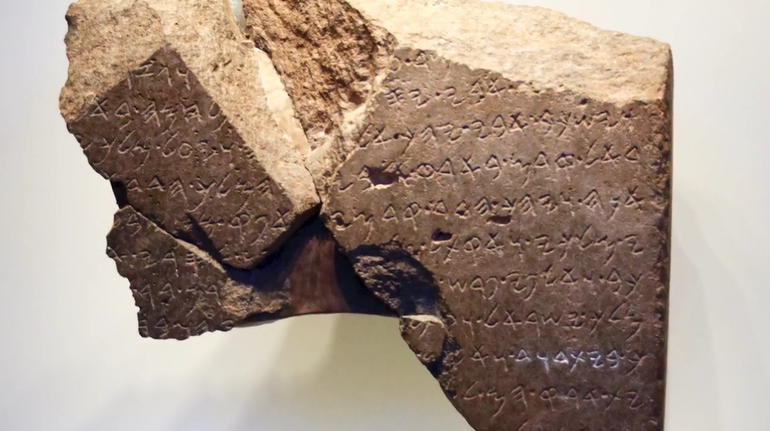
Notes:
museum and restored,
it turned out that these stones had on it a beautifully carved Aramaic inscription,
three portions of a much larger inscription,
which, unfortunately, has not been discovered.
In this inscription, we hear of a very,
very important and fascinating story.
Apparently, this inscription was set up at Tel Dan by King Hazael,
the King of Aram-Damascus.
After he conquered Dan sometime in the mid ninth century BCE,
let's say, around 840 BCE,

Slide 12
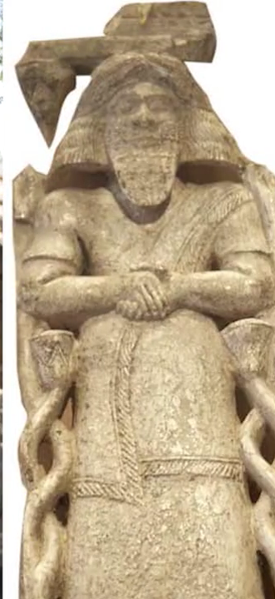
The inscription dating to 850 BC found at Tel Dan in Northern Israel in 1993 comes from the time of Hazael of Syria. The king boasts that he killed the king of Israel and the king of Judah (2 Kgs 10:32, 13:3.22 and even may take credit for Jehu’s work 2 Kgs 9:21-28). The significance for the evidence of David is that the inscription includes the claim: ‘the king of Israel and [I] killed him and the king of Bayt-Dawid” (same wording as Isa 7:2 and reads as “House of David”). Thus, 250 years before the stories of David were supposed to have been invented, he was recognized as the founder of the kingdom of Judah.

Slide 13
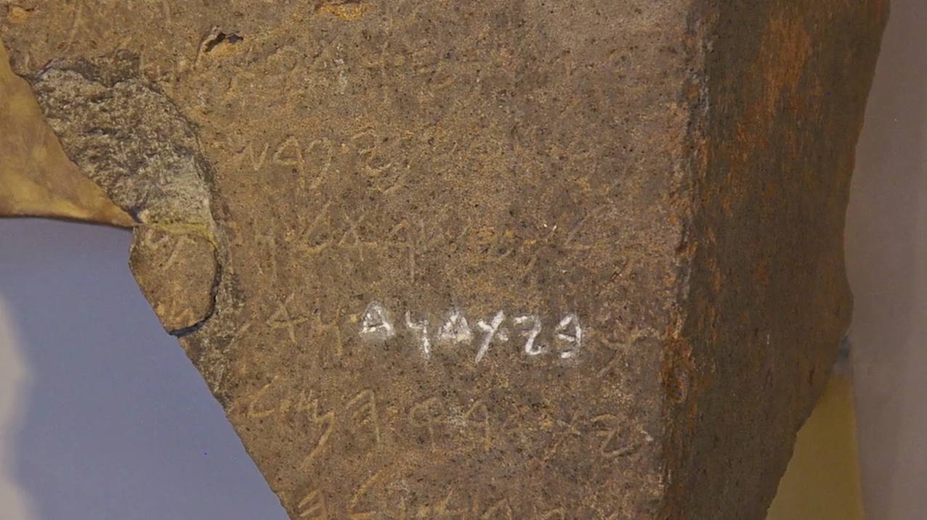
Then, he gets to a point where he describes a victory in
which he conquered and killed the King of Israel,
and very importantly, the king of the House of David, "Melekh beit David".
This is an important find and the important significance of this inscription because here,
we have a written document from about 100 years after the time of David which distinctly remembers that the Kingdom of Judah was founded by a person by the name of David.

Slide 14
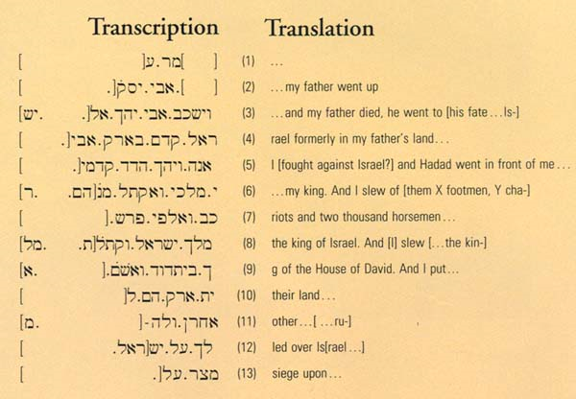

Slide 15
Old Testament Finds | Importance | Bible Period | Location of Find
Tel Dan Stele at Israel Museum | Existence of House of David | ~842 BC Divided Kingdom | Dan, Israel
Silver Ketef Hinnom Scrolls at Israel Museum | Oldest Biblical Text | ~640 to 609 BC Judah Alone | Jerusalem
Moabite Stone at Louvre in Paris | Moabite version of 2 Kings 3 | ~ 835 BC Divided Kingdom | Dibon, Jordan
Hezekiah’s Tunnel at Arch Museum in Istanbul | confirms Hezekiah's efforts to fortify Jerusalem | before 701 BC Judah Alone | Jerusalem
Lachish Reliefs at British Museum | Depicts Siege of Lachish in days of Hezekiah | ~700-691 BC Judah Alone | Palace of Nineveh, Iraq

Slide 16
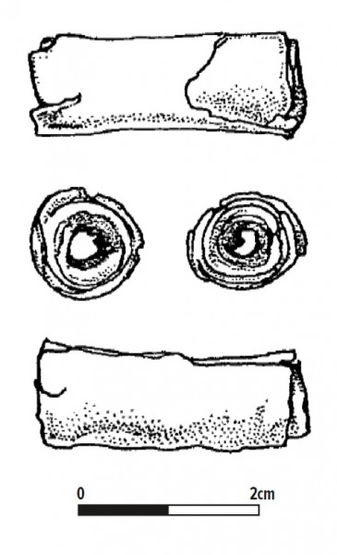
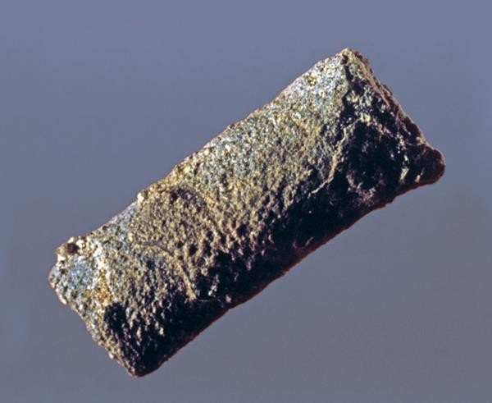
SILVER BLESSINGS. Standing only 1 inch tall, this miniature silver scroll (Amulet 1) contains one of the earliest Hebrew inscriptions ever uncovered. In 1979, archaeologist Gabriel Barkay and his team found this scroll and another smaller silver scroll—both of which date to the eighth–sixth centuries B.C.E.—in a burial cave at Ketef Hinnom in Jerusalem. In antiquity, they would have been worn as amulets. The photograph shows the first scroll before it was unrolled.

Slide 17
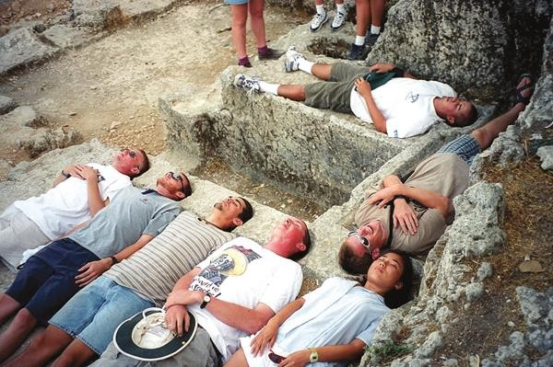
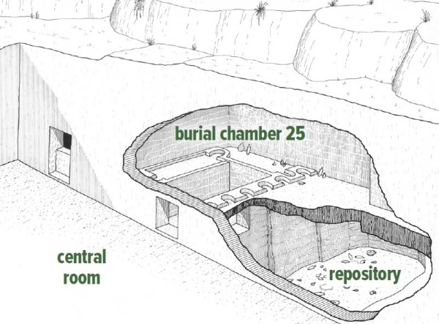
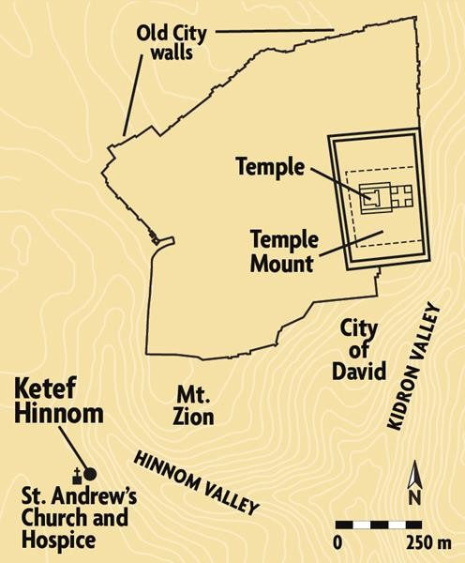
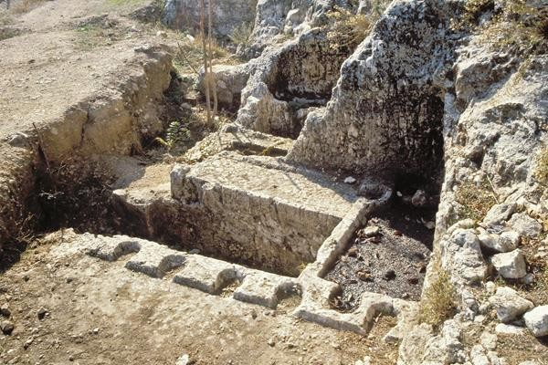

Slide 18
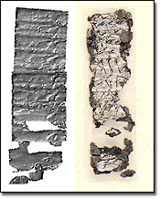
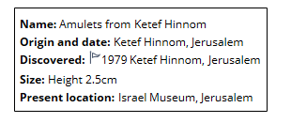
Ketef Hinnom Amulets
Two tiny silver amulets scrolls discovered at a burial cave at Ketef Hinnom overlooking Mt. Zion.
Written in ancient Hebrew script date to 7th century BC.
Scrolls comprise the earliest-known fragments of a biblical text and pre-date the earliest scrolls from Qumran by more than 300 years.
Form of Priestly blessing Num 6:24,25
"The Lord bless you and protect you. The Lord make his face to shine upon you and be gracious to you. The Lord lift up his countenance to you and give you peace."
Notes:
3) Amulet scroll - 1979
The oldest passage of scripture currently known was found written on a tiny scrap of silver. It was rolled up and apparently worn around someone's neck, and buried with them, then found in an excavation of burial caves directed by archaeologist Gabriel Barkai in the shoulder of Hinnom area, overlooking Mt. Zion. The scripture passage is from the Aharonic or priestly blessing, found in Numbers 6:24,25. The amulet scroll can now be seen in the Israel Museum in Jerusalem.

Slide 19
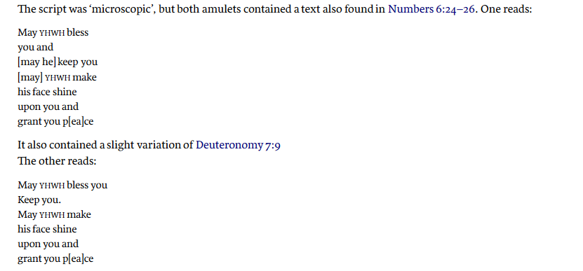
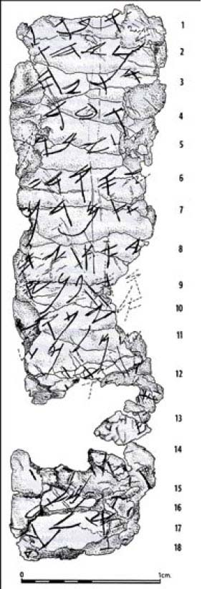

Slide 20
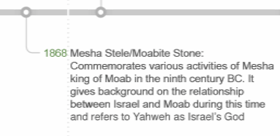
Old Testament Finds | Importance | Bible Period | Location of Find
Tel Dan Stele at Israel Museum | Existence of House of David | ~842 BC Divided Kingdom | Dan, Israel
Silver Ketef Hinnom Scrolls at Israel Museum | Oldest Biblical Text | ~640 to 609 BC Judah Alone | Jerusalem
Moabite Stone at Louvre in Paris | Moabite version of 2 Kings 3 | ~ 835 BC Divided Kingdom | Dibon, Jordan
Hezekiah’s Tunnel at Arch Museum in Istanbul | confirms Hezekiah's efforts to fortify Jerusalem | before 701 BC Judah Alone | Jerusalem
Lachish Reliefs at British Museum | Depicts Siege of Lachish in days of Hezekiah | ~700-691 BC Judah Alone | Palace of Nineveh, Iraq

Slide 21
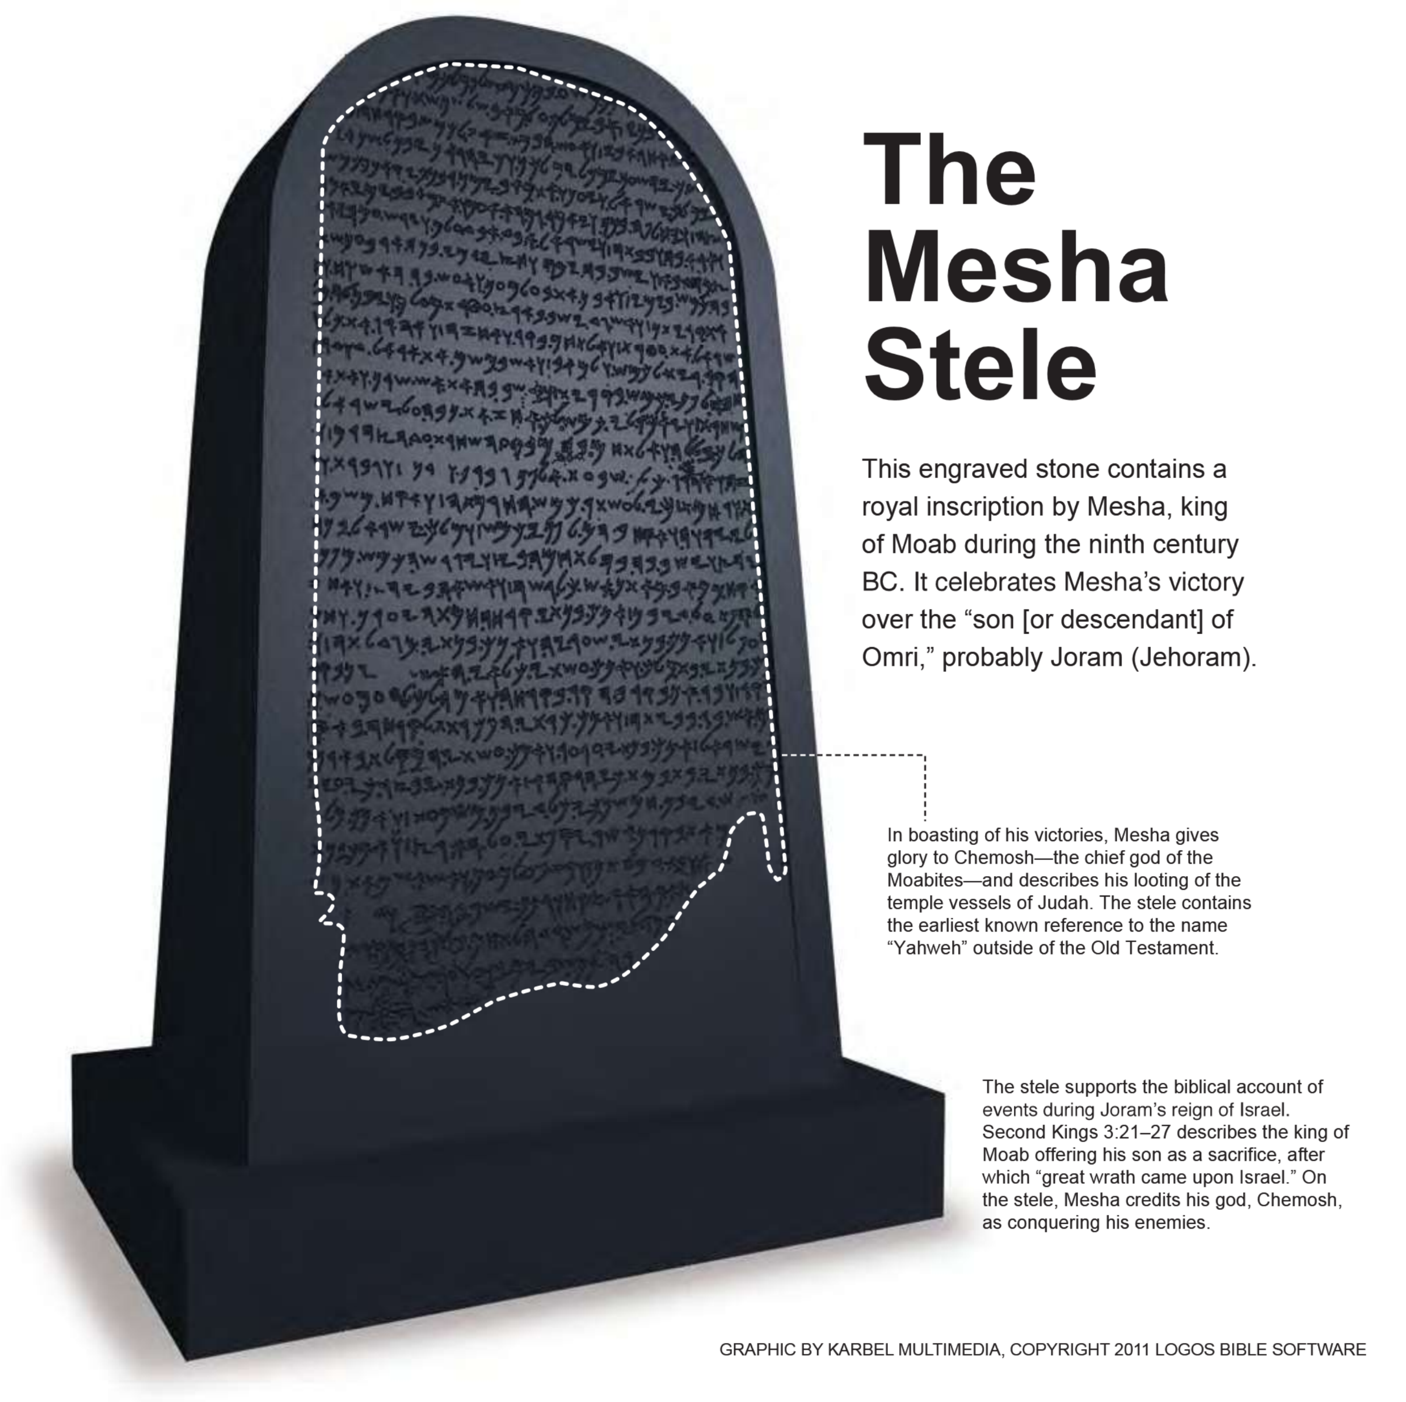
2 Kings 3 records how the kings of Israel, Judah and Edom joined forces to defeat Moab, but when its king, Mesha, offered his son as a sacrifice, the allies aborted the campaign and returned home (vs 26, 27).
On the Mesha Stela—or Moabite Stone—(see also page 48), Mesha boasts that in the time of Jehoram (king of Israel) he threw off Israel and occupied some of her cities including Ataroth and Nebo, where he ‘took from there the vessels of Yahweh’ (ltb pp 99–100). Dated around 840 BC, it concludes the account in 2 Kings 3:27 and is one of the earliest reference outside the Bible to the covenant name for Israel’s God

Slide 22
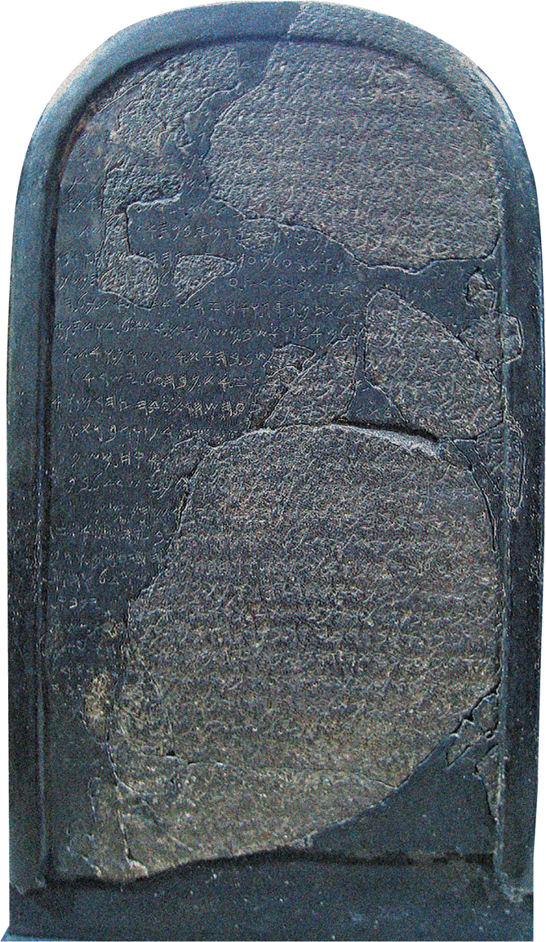
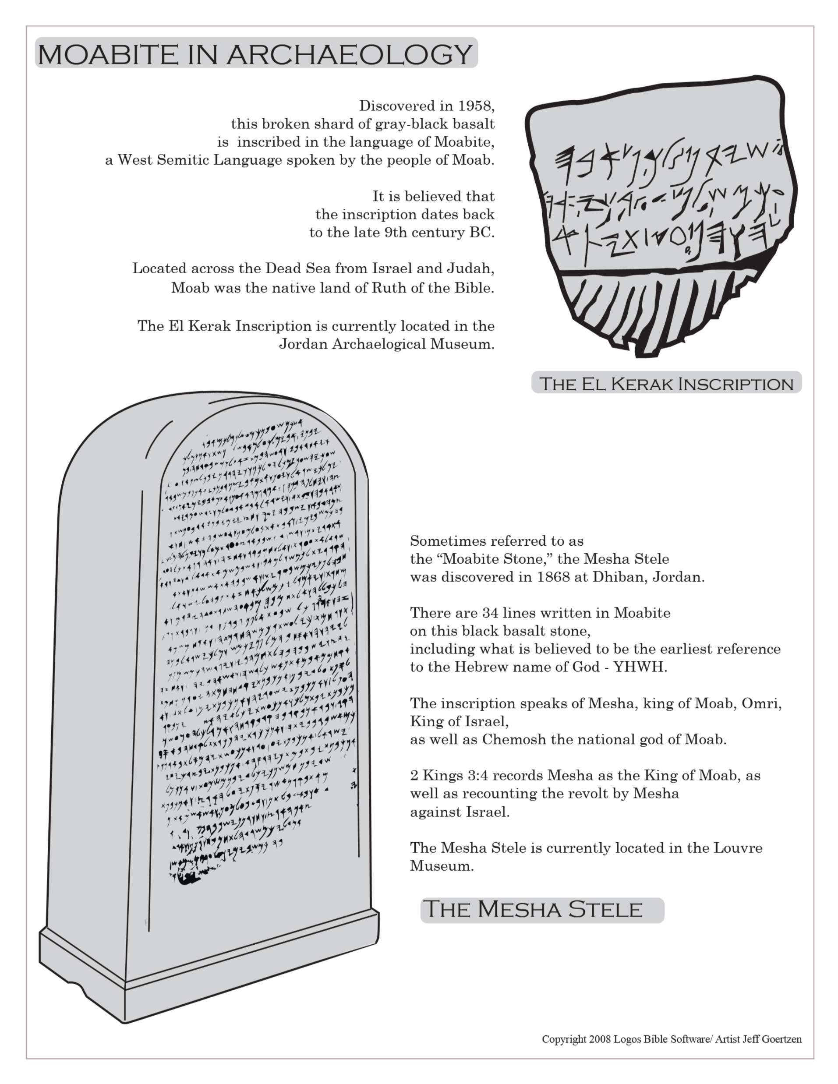
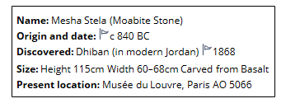

Slide 23
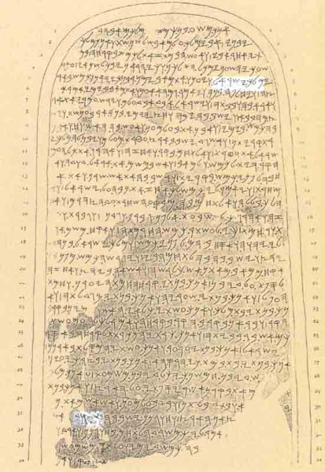
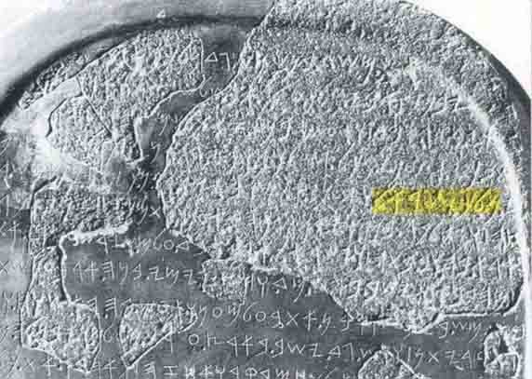
5. (was) king of Israel, and he oppressed Moab many days, for Kamosh was angry with his
31. [……………] the sheep of the land. And the house [of Da]vid dwelt in Horonên
The critical letters in lines 5 and 31 are highlighted in white.

Slide 24
Old Testament Finds | Importance | Bible Period | Location of Find
Tel Dan Stele at Israel Museum | Existence of House of David | ~842 BC Divided Kingdom | Dan, Israel
Silver Ketef Hinnom Scrolls at Israel Museum | Oldest Biblical Text | ~640 to 609 BC Judah Alone | Jerusalem
Moabite Stone at Louvre in Paris | Moabite version of 2 Kings 3 | ~ 835 BC Divided Kingdom | Dibon, Jordan
Hezekiah’s Tunnel at Arch Museum in Istanbul | confirms Hezekiah's efforts to fortify Jerusalem | before 701 BC Judah Alone | Jerusalem
Lachish Reliefs at British Museum | Depicts Siege of Lachish in days of Hezekiah | ~700-691 BC Judah Alone | Palace of Nineveh, Iraq

Slide 25
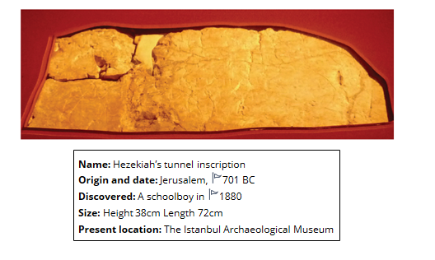
In 1880 a young boy, skipping school by playing in the tunnel, found an inscription chiselled into the rock at the halfway point. It had been left by Hezekiah’s engineers in 701 BC.
The inscription, at the point where the two groups met, in part reads, ‘… While [the stone cutters were swinging their] axe, each man toward his fellow, and while there were still three cubits to be cut through, [there was heard] the voice of a man calling to his fellow, for there was an overlap [crevice?] in the rock on the right … And when the tunnel was driven through, the quarrymen hewed [the rock] each man toward his fellow, axe against axe; and the water flowed from the spring toward the reservoir for 1,200 cubits, and the height of the rock above the heads of the quarrymen was 100 cubits’
Confident that Jerusalem’s walls would be breached, the officers of Sennacherib could boast to the city’s defenders that no army had been able to withstand Assyria and that one by one the gods of the nations had fallen before the might of the great king (Isaiah 36:18–20).
Within the city, the prophet Isaiah encouraged Jerusalem with the promise: ‘This is what the Lord says concerning the king of Assyria: “He will not enter this city or shoot an arrow here. He will not come before it with shield or build a siege ramp against it. By the way that he came he will return; he will not enter this city” ’ (Isa. 37:33–34).

Slide 27
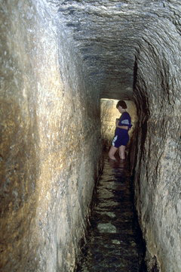
Hezekiah’s Tunnel
Hezekiah’s Tunnel, which connected the city of Jerusalem to a safe water supply even in times of siege.
(2 Kings 20:20; 2 Chronicles 32:3-5; 2 Chronicles 32:30;
Isaiah 22:9-11)

Slide 28
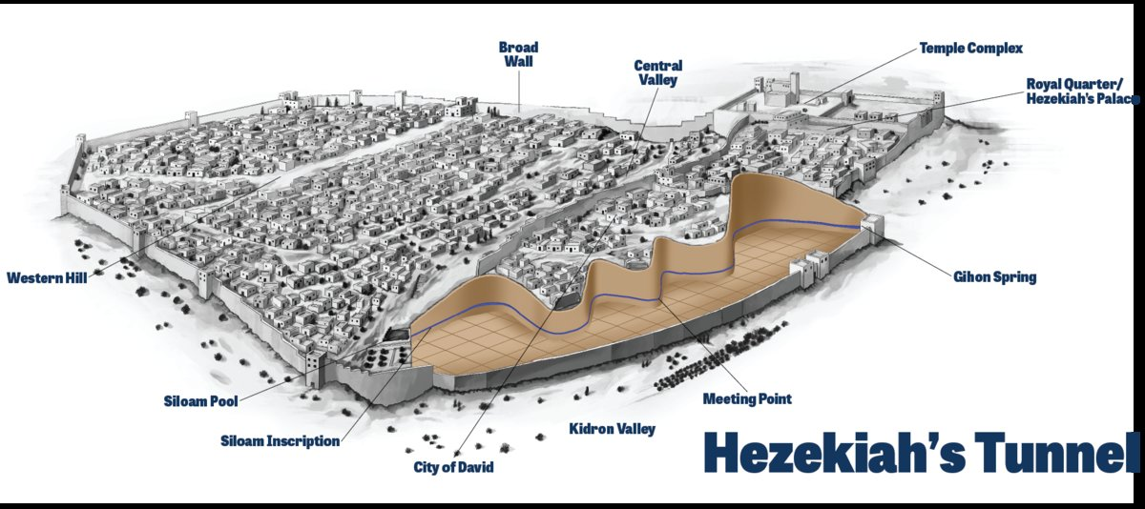
Side View of the Tunnel
Copyright 1995 Hebrew University of Jerusalem

Slide 30
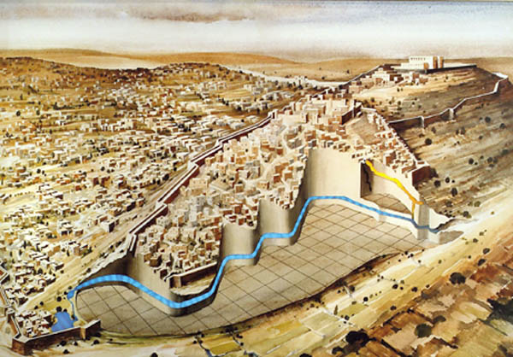
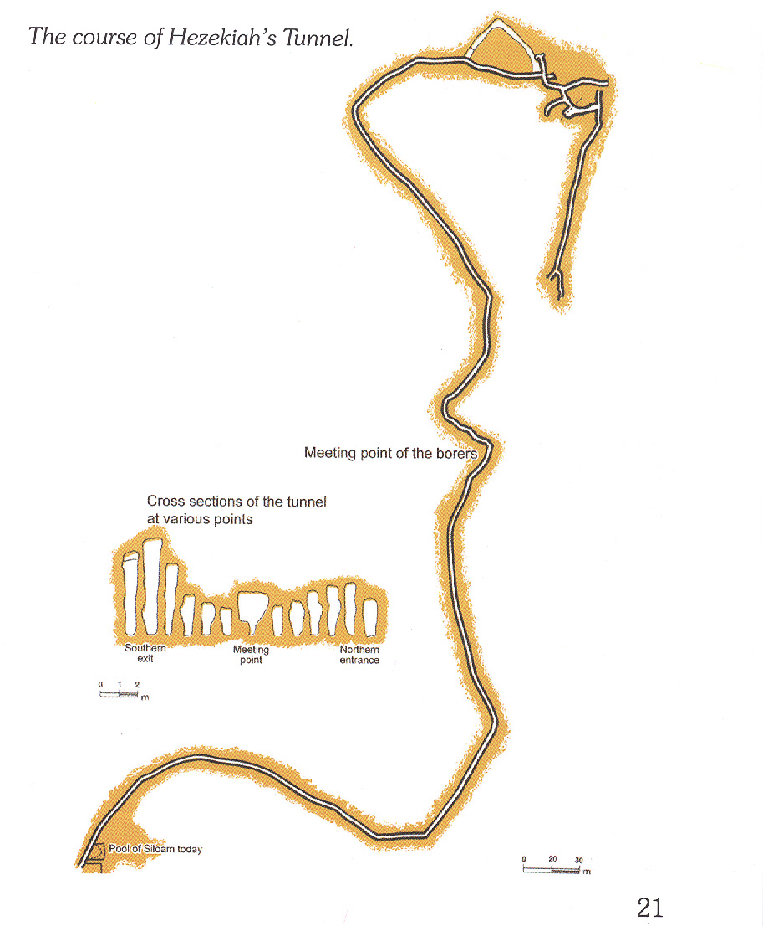
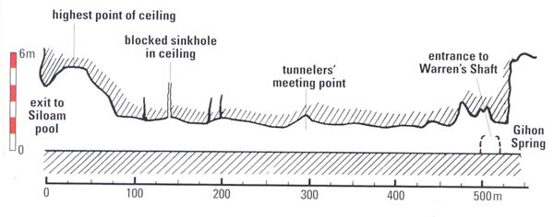
Side View of the Tunnel
Copyright 1995 Hebrew University of Jerusalem

Slide 31
Old Testament Finds | Importance | Bible Period | Location of Find
Tel Dan Stele at Israel Museum | Existence of House of David | ~842 BC Divided Kingdom | Dan, Israel
Silver Ketef Hinnom Scrolls at Israel Museum | Oldest Biblical Text | ~640 to 609 BC Judah Alone | Jerusalem
Moabite Stone at Louvre in Paris | Moabite version of 2 Kings 3 | ~ 835 BC Divided Kingdom | Dibon, Jordan
Hezekiah’s Tunnel at Arch Museum in Istanbul | confirms Hezekiah's efforts to fortify Jerusalem | before 701 BC Judah Alone | Jerusalem
Lachish Reliefs at British Museum | Depicts Siege of Lachish in days of Hezekiah | ~700-691 BC Judah Alone | Palace of Nineveh, Iraq

Slide 32
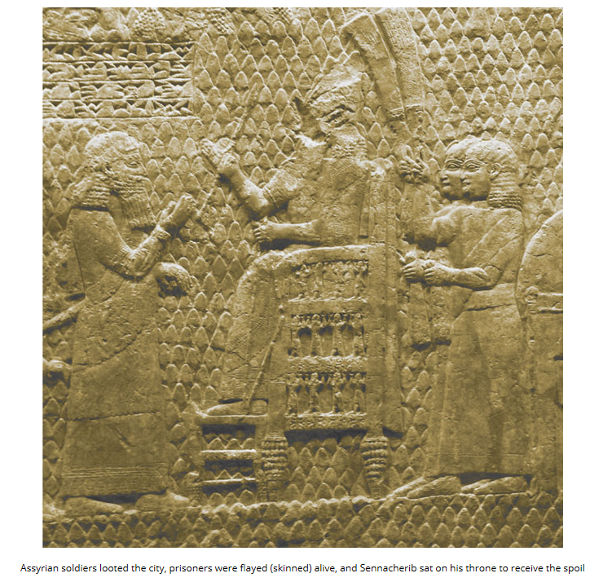
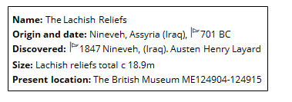
This victory room was discovered in 1847 by the British archaeologist Austen Henry Layard. It made international news as the first story from the Bible to be dug out of the ground.
The air is thick with missiles as the Assyrians fire arrows and stones into the city and the defenders desperately hurl firebrands and rocks upon the attackers. At the bottom of the panel is the gruesome scene of men being impaled on stakes. This was a forerunner of crucifixion.
.
The discovery of the remains of the siege ramp and a mass burial pit containing hundreds of men, women and children are vivid evidence of the battle of Lachish and its aftermath.

Slide 33
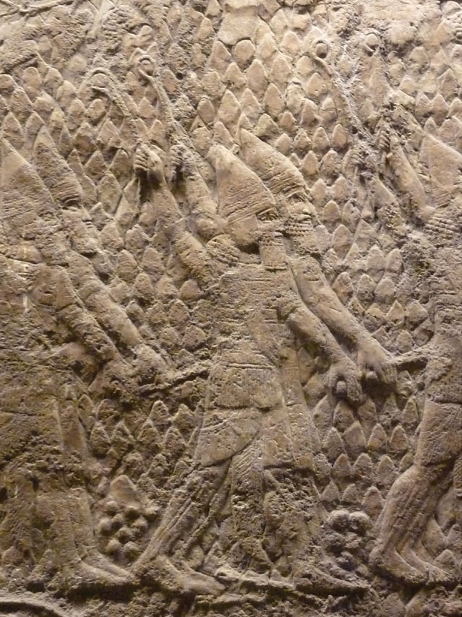
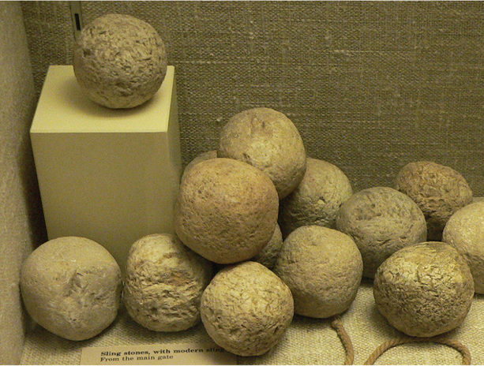
These sling stones, discovered at Lachish and approximately 44 mm in diameter, were used in the actual battle in 701 BC

Slide 34
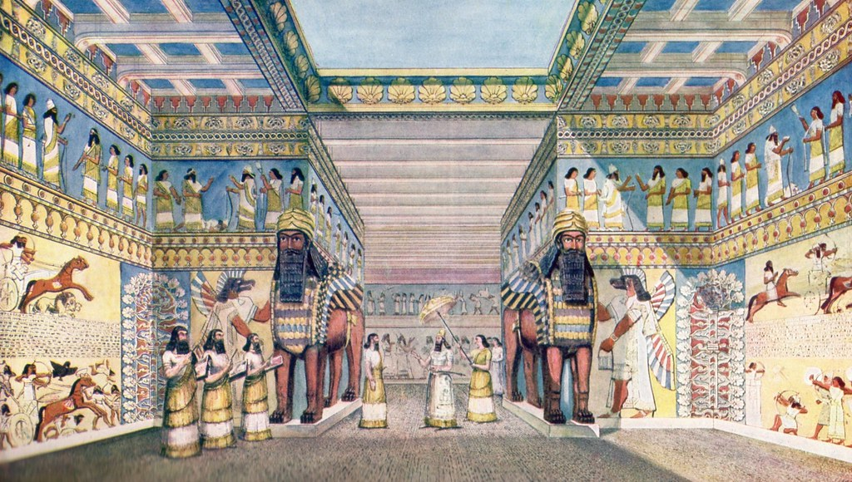

Slide 35
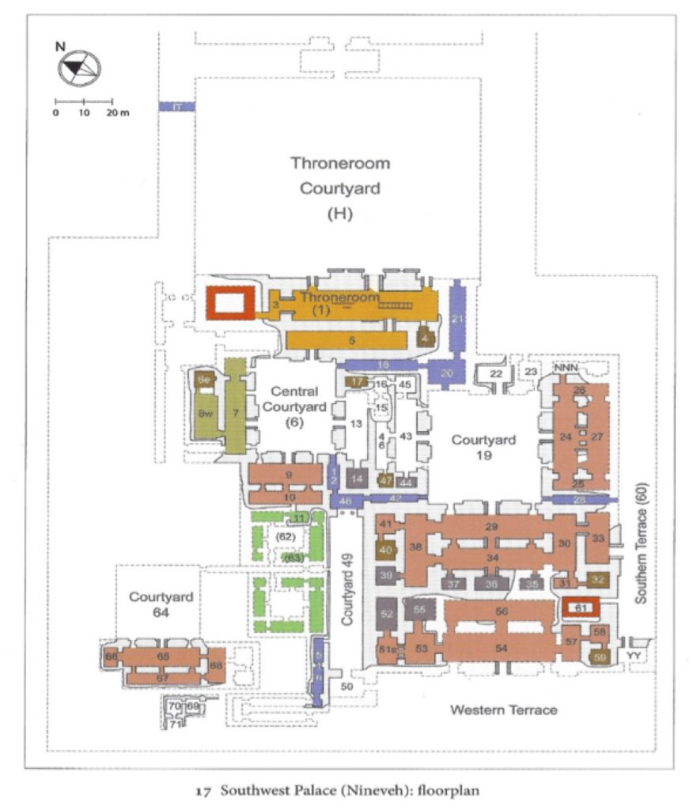
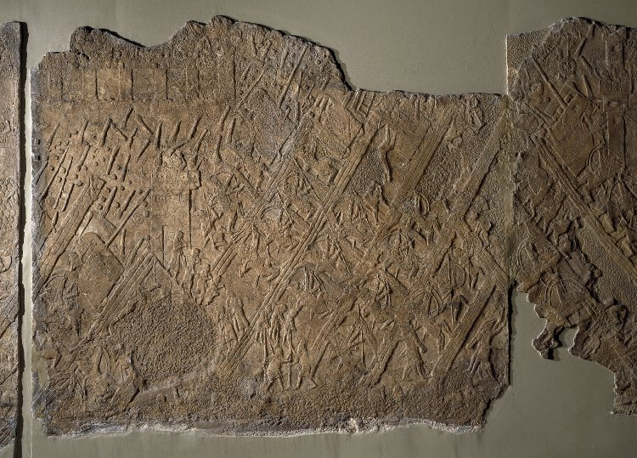
In the Nineveh palace a room labeled Courtyard 19 introduces Room 36, a small inner chamber and the place where the reliefs of the battle of Lachish were found.

Slide 36
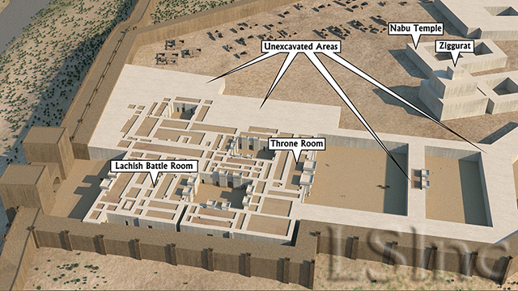
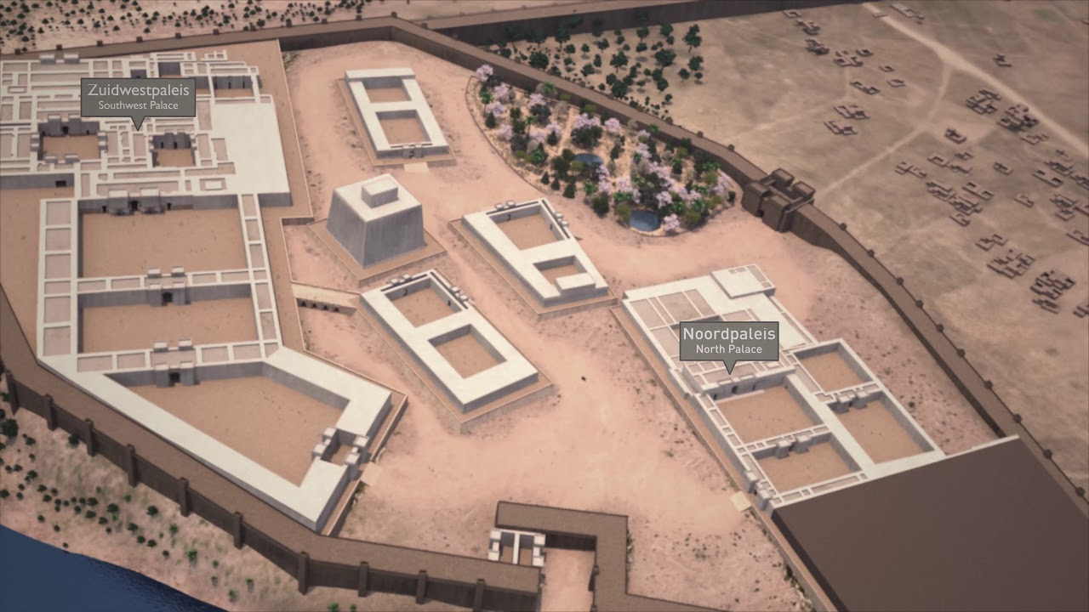

Slide 37
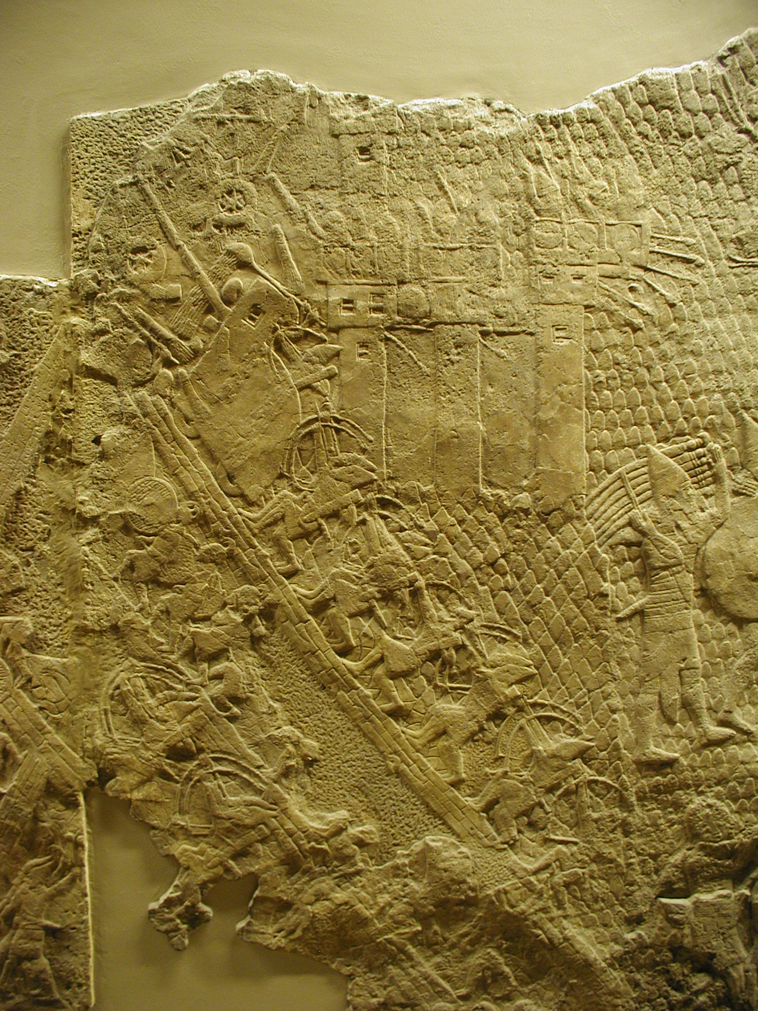
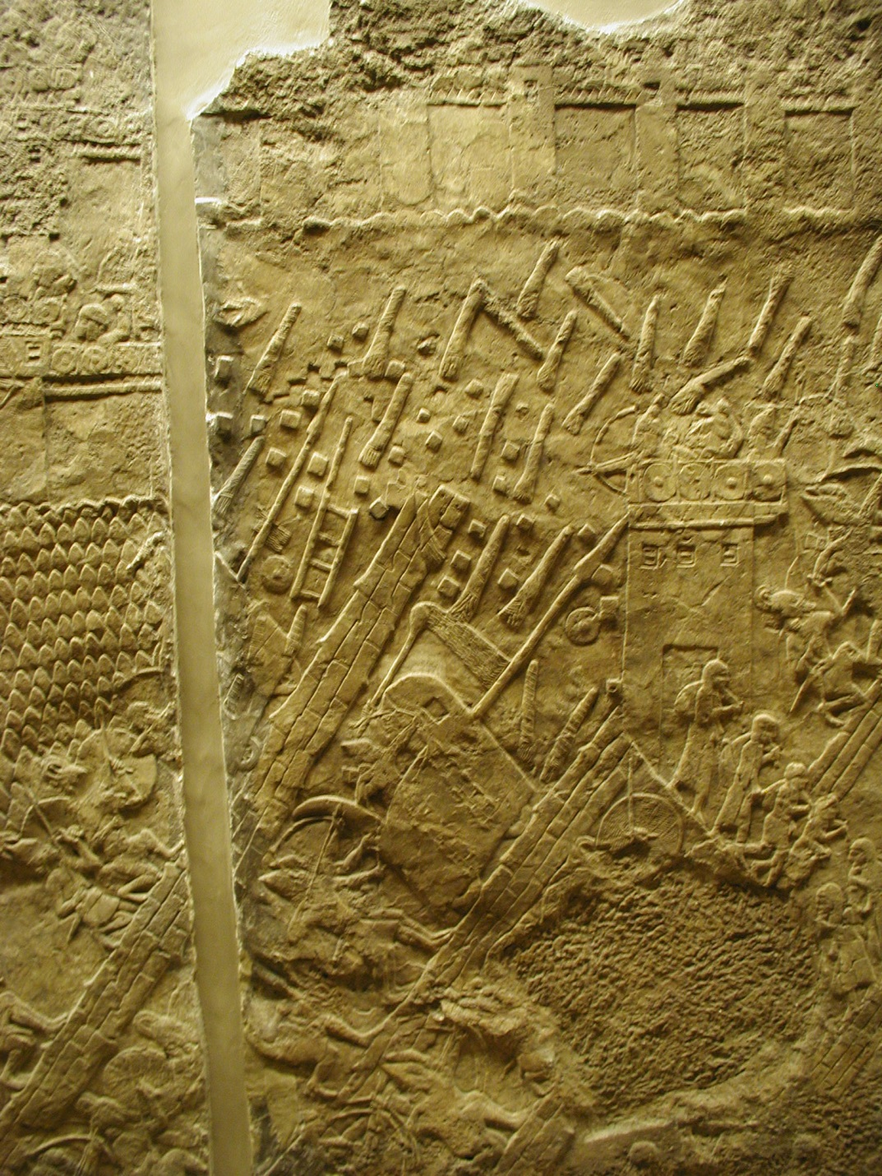
Seigie Machine & Assault

Slide 38
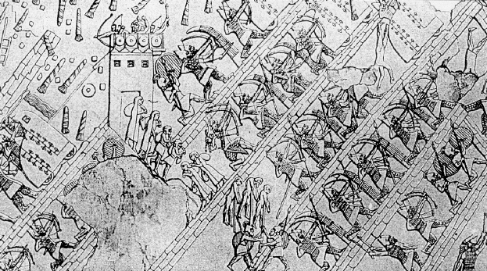

Slide 39
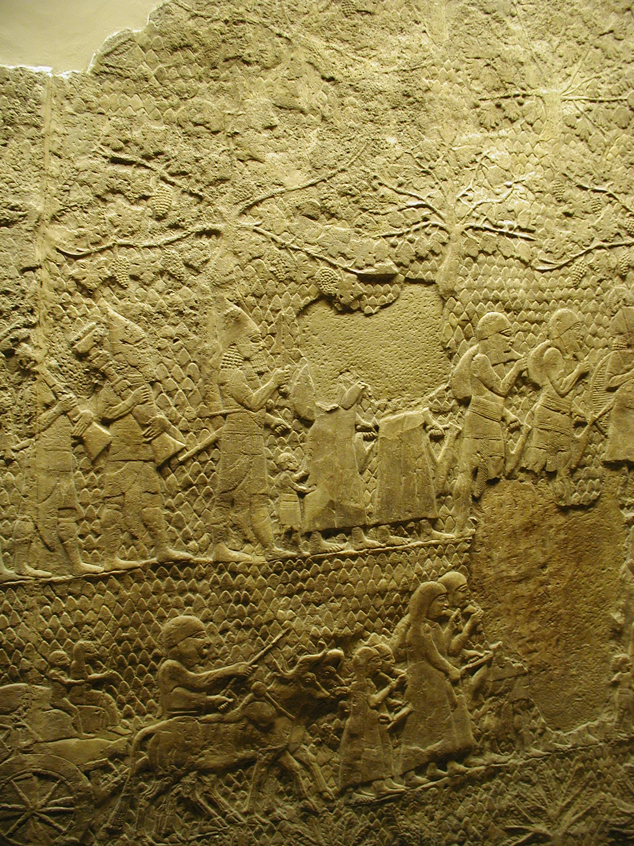
Deportees

Slide 40
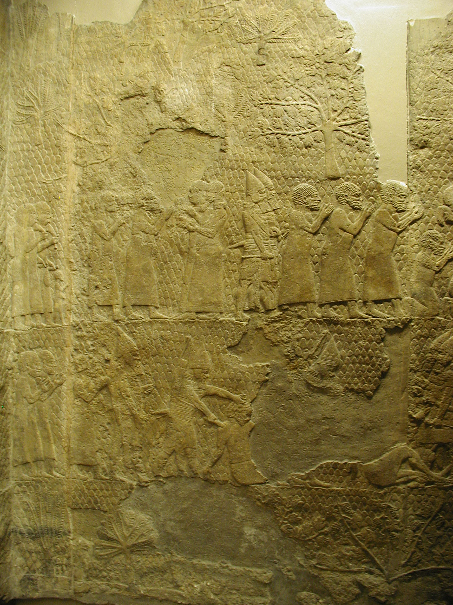
Captives from Lacish

Slide 41
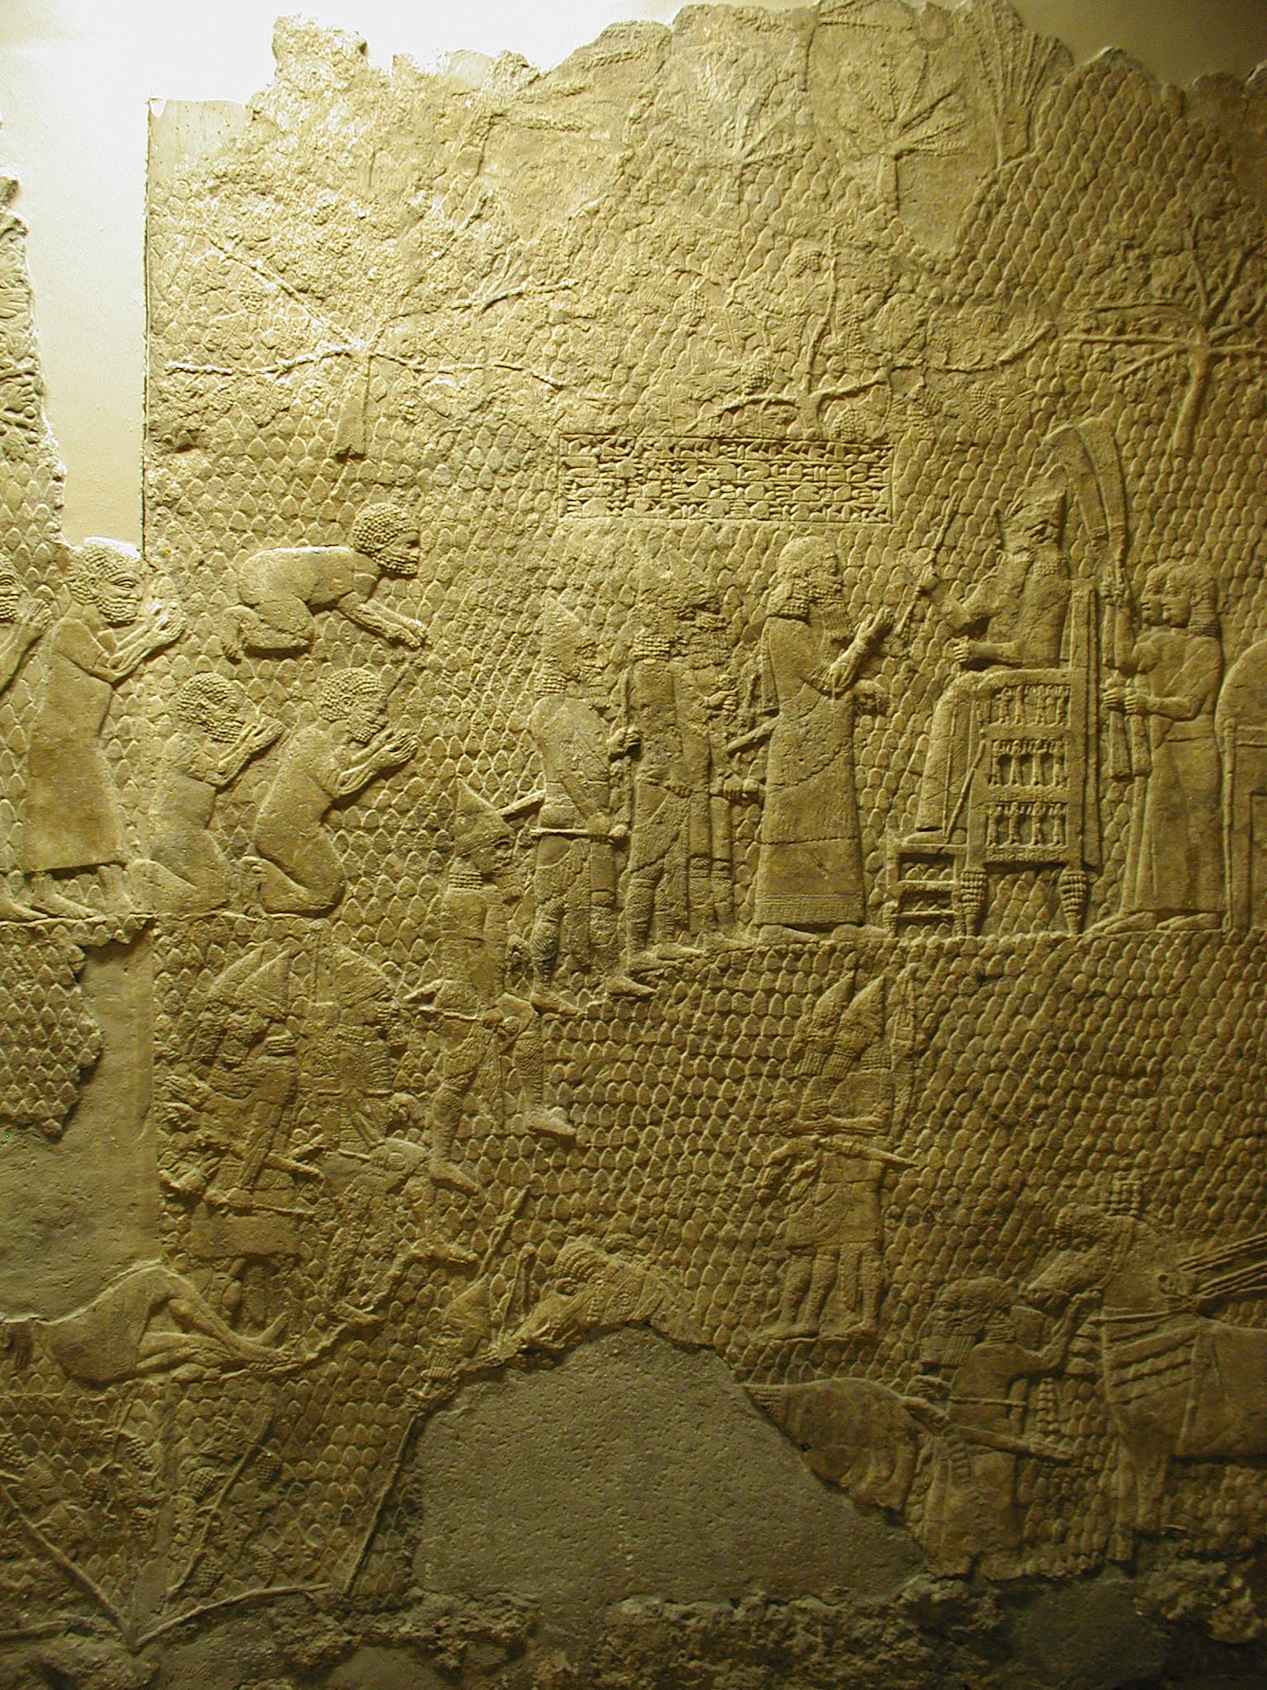
Presentation of Prisoners

Slide 42
Sennacherib on Throne

Slide 43
#7 on List

Slide 44
\
New Testament Finds | Importance | Bible Period | Location of Find
Dead Sea Scrolls at Israel Museum | Oldest OT Manuscripts | Between the Testaments to Apostolic 150 BC to 60 AD | Qumran, Israel
Heel Bone of Crucified Man at Israel Museum | crucifixion | Apostolic- before 70 AD | Jerusalem
P52 Manuscript (Fragment of the Gospel of John) at Rylands Library | Gospels | Early Church Fathers AD 125-175 | Egypt
The Pilate Stone at Israel Museum | Gospels-confirmed that Pilate’s title | Life of Christ 26-36 AD | Caesarea
Caiaphas Ossuary at Israel Museum | Gospels - Trial of Jesus High Priest from 18 to 36 AD | Gospels-Apolostic before 70 AD | Jerusalem

Slide 45
Dead Sea Scrolls
Part of the great Isaiah Scroll, the best preserved of the biblical scrolls found at Qumran. This picture shows all of Isaiah 53 (and is mostly identical to the Masoretic Text)

Slide 46
Importance of Dead Sea Scrolls to Biblical Evidence
Isaiah 53 and Psalm 22 describe the details of the death of Jesus Christ and the anguish of His soul without even the slightest error.
But the scrolls cannot be dated later than 100 B.C. -- though Isaiah was likely written c. 750 and the Psalms c. 1,000 B.C., when crucifixion was unknown.
What Power or Intelligence is capable of such knowledge?
Psalm 14:1-2!.
1 The fool has said in his heart, "There is no God." They are corrupt, They have done abominable works, There is none who does good.
2 The LORD looks down from heaven upon the children of men, To see if there are any who understand, who seek God.

Slide 47
Notes:
That Qumran was not home to the Essenes has been suggested before, with theories that identify the site as everything from a Roman villa, military fortress, fortified farm, and now a pottery factory. To be sure, Magen and Peled are respected scholars who have excavated at Qumran. But their view is clearly in the minority. When you read a statement like this, "There is not an iota of evidence that it was a monastery," red flags should be flying. That the majority of scholars would hold to a certain interpretation without one iota of evidence tel ls us more about the speaker than the theory. That the only outside scholar that the NYT quotes is Norman Golb should cause all the bells to be sounding. Anyone who has spent time in the area has to just bust out laughing when reading Magen's idea that these caves are “the last spot they could hide the scrolls before descending to the shore” of the Dead Sea. I can just picture these guys running away from the Romans and just stopping by Cave 1 to drop off some scrolls! Oh wait, we need some jars for these - quick, run to the pottery factory and bring some back here! Those who have been to Cave 1 will understand the humor more; it's not exactly "on the way" (Cave 2 even less so). The proximity of Caves 4, 5, 7, 8, 9, and 10 to the site is telling as well. They are all less than 50 meters from the inhabitation. The attempts to separate the scrolls from the site are an utter failure. I certainly wouldn't discourage anyone from reading the articles or the book about this theory. But here's the problem: too often these minority theories get the sensational coverage and people read about them and, lacking any other knowledge, are taken in. Instead, they should be first directed to the theories which have long been held and tested. After reviewing the mountain of evidence that Qumran was an Essene settlement, then go and weigh it against the latest view.

Slide 50
Qumran Dates

Slide 51
New Testament Finds | Importance | Bible Period | Location of Find
Dead Sea Scrolls at Israel Museum | Oldest OT Manuscripts | Between the Testaments to Apostolic 150 BC to 60 AD | Qumran, Israel
Heel Bone of Crucified Man at Israel Museum | crucifixion | Apostolic- before 70 AD | Jerusalem
P52 Manuscript (Fragment of the Gospel of John) at Rylands Library | Gospels | Early Church Fathers AD 125-175 | Egypt
The Pilate Stone at Israel Museum | Gospels-confirmed that Pilate’s title | Life of Christ 26-36 AD | Caesarea
Caiaphas Ossuary at Israel Museum | Gospels - Trial of Jesus High Priest from 18 to 36 AD | Gospels-Apolostic before 70 AD | Jerusalem

Slide 52
Crucifixion (9.00 am on Friday 3 April AD 30)
In 1968 an ossuary was discovered in Jerusalem containing the bones of a young child and a man in his mid 20s. The inscription indicates that both the adult and the child were named Yehohanan (John) and that the child was ‘son of the one hanged with knees apart’. The right heel bone of the man has an 11.5cm (4.5 in) nail driven through it and the end of the nail has buckled, making it impossible to remove when the bones of the victim were later gathered into the ossuary. The rest of the skeleton shows no obvious signs of nailing so perhaps the arms were tied to the cross.
There is almost no skeletal evidence of crucifixion in spite of the wealth of texts referring to crucifixion throughout history

Slide 53
New Testament Finds | Importance | Bible Period | Location of Find
Dead Sea Scrolls at Israel Museum | Oldest OT Manuscripts | Between the Testaments to Apostolic 150 BC to 60 AD | Qumran, Israel
Heel Bone of Crucified Man at Israel Museum | crucifixion | Apostolic- before 70 AD | Jerusalem
P52 Manuscript (Fragment of the Gospel of John) at Rylands Library | Gospels | Early Church Fathers AD 125-175 | Egypt
The Pilate Stone at Israel Museum | Gospels-confirmed that Pilate’s title | Life of Christ 26-36 AD | Caesarea
Caiaphas Ossuary at Israel Museum | Gospels - Trial of Jesus High Priest from 18 to 36 AD | Gospels-Apolostic before 70 AD | Jerusalem

Slide 54
New Testament Manuscripts
The Rylands Papyrus, also known as the St John's fragment, is a papyrus fragment measuring only 3.5 by 2.5 inches at its widest
Dated to the first half of the 2nd century, making it the earliest NT fragment in existance
The front (recto) contains lines from the Gospel of John 18:31-33, in Greek, and the back (verso) contains lines from verses 37-38.

Slide 55
Rylands Library Papyrus P52
The, also known as the St John's fragment, is a papyrus fragment measuring only 3.5 by 2.5 inches at its widest, conserved at the John Rylands Library, Manchester, UK.
The style of the script is strongly Hadrianic, which would suggest a date somewhere between 125 and 160 AD.
The front (recto) contains lines from the Gospel of John 18:31-33, in Greek, and the back (verso) contains lines from verses 37-38.

Slide 56
New Testament Finds | Importance | Bible Period | Location of Find
Dead Sea Scrolls at Israel Museum | Oldest OT Manuscripts | Between the Testaments to Apostolic 150 BC to 60 AD | Qumran, Israel
Heel Bone of Crucified Man at Israel Museum | crucifixion | Apostolic- before 70 AD | Jerusalem
P52 Manuscript (Fragment of the Gospel of John) at Rylands Library | Gospels | Early Church Fathers AD 125-175 | Egypt
The Pilate Stone at Israel Museum | Gospels-confirmed that Pilate’s title | Life of Christ 26-36 AD | Caesarea
Caiaphas Ossuary at Israel Museum | Gospels - Trial of Jesus High Priest from 18 to 36 AD | Gospels-Apolostic before 70 AD | Jerusalem

Slide 58
Pilate Inscription
Discovered at Caesarea in secondary use in a later wall, this inscription bears witness to a major New Testament figure and settles the debate over Pilot’s title of Prefect rather than the inferior Procurator.
Notes:
Pilate Inscription:
Discovered at Caesarea in secondary use in a later wall, this inscription bears witness to a major New Testament figure and settles the debate over Pilot’s title of Prefect rather than the inferior Procurator.
7) Pontius Pilate inscription - 1961
Italian excavators working at the Roman theater in Caesarea Maritima uncovered a monumental inscription naming another central figure in Christ's crucifixion drama. Though only partly legible, it clearly says: "Pontius Pilatus, Prefect of Judea." Visitors to Caesarea's theater today see a replica, the original is in the Israel Museum in Jerusalem.

Slide 59
Bronze Ring
Of Pilate

Slide 60
New Testament Finds | Importance | Bible Period | Location of Find
Dead Sea Scrolls at Israel Museum | Oldest OT Manuscripts | Between the Testaments to Apostolic 150 BC to 60 AD | Qumran, Israel
Heel Bone of Crucified Man at Israel Museum | crucifixion | Apostolic- before 70 AD | Jerusalem
P52 Manuscript (Fragment of the Gospel of John) at Rylands Library | Gospels | Early Church Fathers AD 125-175 | Egypt
The Pilate Stone at Israel Museum | Gospels-confirmed that Pilate’s title | Life of Christ 26-36 AD | Caesarea
Caiaphas Ossuary at Israel Museum | Gospels - Trial of Jesus High Priest from 18 to 36 AD | Gospels-Apolostic before 70 AD | Jerusalem

Slide 62
Two of the ossuaries bore the name “Caiaphas.” One just bore the name “Caiaphas” alone, and had very little ornamentation. It contained the bones of five individuals. The other ossuarywas very ornate, and on the side it contained the following inscription: yhwsp br qp’. Translated, this reads “Joseph son of Caiaphas.” This ossuary contained the bones of six people: two babies, a young child, a teenage boy, an adult woman, and a 60 year old man.

Slide 63
Caiaphas Ossuary
From the Caiaphas family tomb in Jerusalem,
Ossuary bears the inscription "Yehosef bar Qafa: (Joseph, son of Caiaphas)
Dated to the Second Temple Period
Caiaphas is the name of the High Priest who presided over the trial of Jesus.
Notes:
6) Caiaphas' ossuary - 1991
A dump truck accidentally smashed through the roof of a tomb during some work at the Jerusalem Peace Forest. Inside were found a number of ossuaries, stone boxes for retaining bones of the deceased. One of the ossuaries was inscribed with the name of Caiaphas, the high priest who presided over the trial of Jesus shortly before his

Slide 64
#10 The Erastus inscription at Corinth
John McRay says the pavement in which this inscription was found dates to before A.D. 50. The letters are 7 inches high. The complete inscription reads:
ERASTVS-PRO-AEDILIT[at]E S-P-Stravit In full:
Erastus pro aedilitate sua pecunia stravit.
The English translation of the inscription is, “Erastus in return for his aedileship laid (the pavement) at his own expense.”
Originally the letters were filled with bronze, but most of that was removed long ago. The name ERASTVS is seen in the closeup below.
https://ferrelljenkins.blog/2013/10/23/the-erastus-inscription-at-corinth/
Notes:
The Erastus inscription at Corinth
Posted on October 23, 2013 | 5 Comments
Even though the relationship between the Apostle Paul and the Corinthians was always a strained one, we know the names of numerous saints at Corinth who were helpful to Paul in his ministry.
Paul calls attention to a person named Erastus who was a “city treasurer.” He would be one of the few (“not many”) Christians who were among the socially elite at Corinth (1 Corinthians 1:26). A person named Erastus is mentioned three times in the New Testament. Whether these are two or three different persons, or all the same person, I do not know. Here are the biblical references:
“And having sent into Macedonia two of his helpers, Timothy and Erastus, he himself stayed in Asia for a while.” (Acts 19:22 ESV)
“Gaius, who is host to me and to the whole church, greets you. Erastus, the city treasurer, and our brother Quartus, greet you.” (Romans 16:23 ESV) [We understand that Romans was written from Corinth. The Greek term for “city treasurer” is oikonomos.]
“Erastus remained at Corinth, and I left Trophimus, who was ill, at Miletus.” (2 Timothy 4:20 ESV)
It is of interest that during the 1929 archaeological excavation of the area near the theater (see here), a plaza was located that contained a stone inscription bearing the name of Erastus and indicating that he was a public official.
For those who have interest in a more technical discussion of this inscription may find it in David W.J. Gill, “Erastus The Aedile.” Tyndale Bulletin 40.2 (1989): 298. Gill asks,
Are we to identify the Erastus inscription with the Erastus of Romans? It needs to be pointed out that the evidence will not allow a certain identification or a certain rejection.
We are not able to answer the question with certainty, but the possibility that this man was among the disciples at Corinth, and a friend of Paul, is intriguing.

