Slide 1
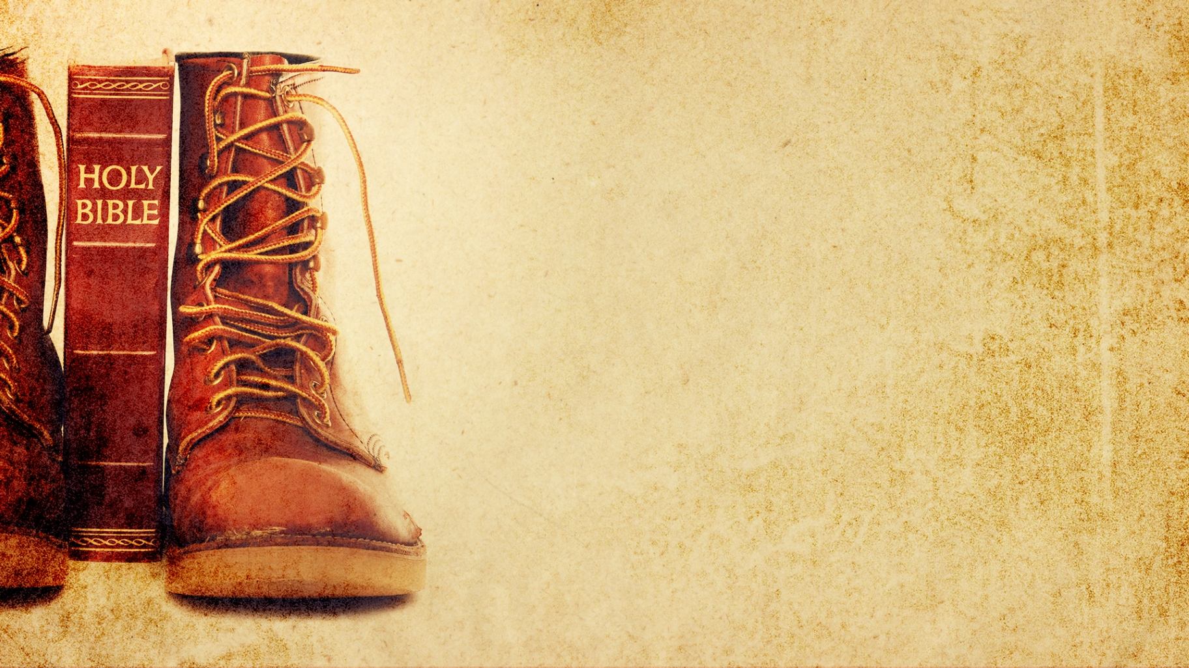
Journey thru the Bible with Archaeology
A Bible and Spade Evidence Class.
Lesson 16
Archaeology in Jerusalem

Slide 2
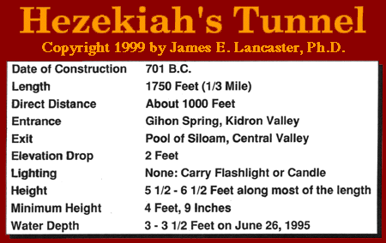
Hezekiah’s Tunnel

Slide 3
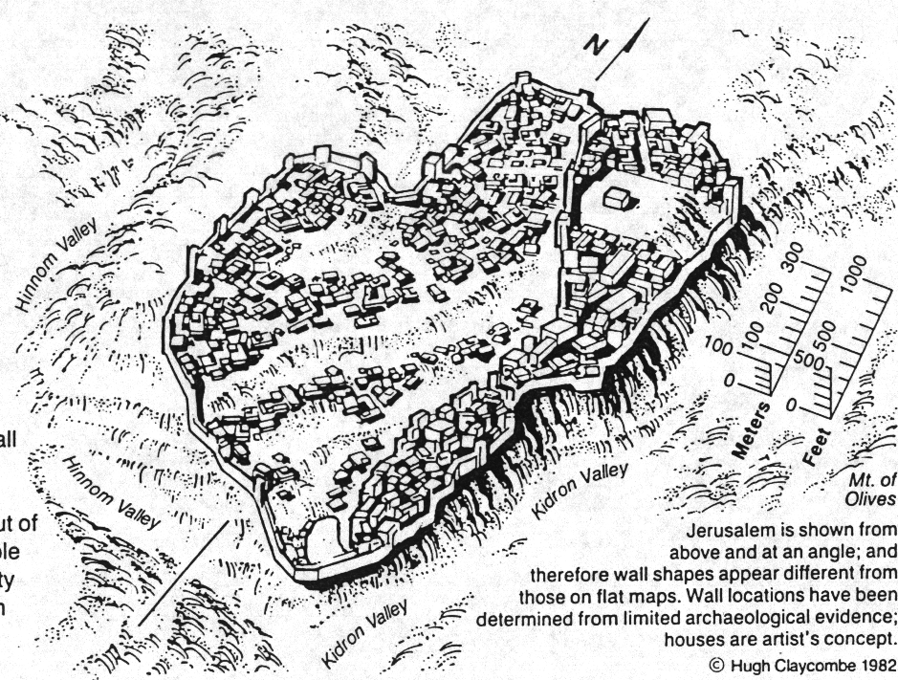
Jerusalem in Time of Hezekiah

Slide 4
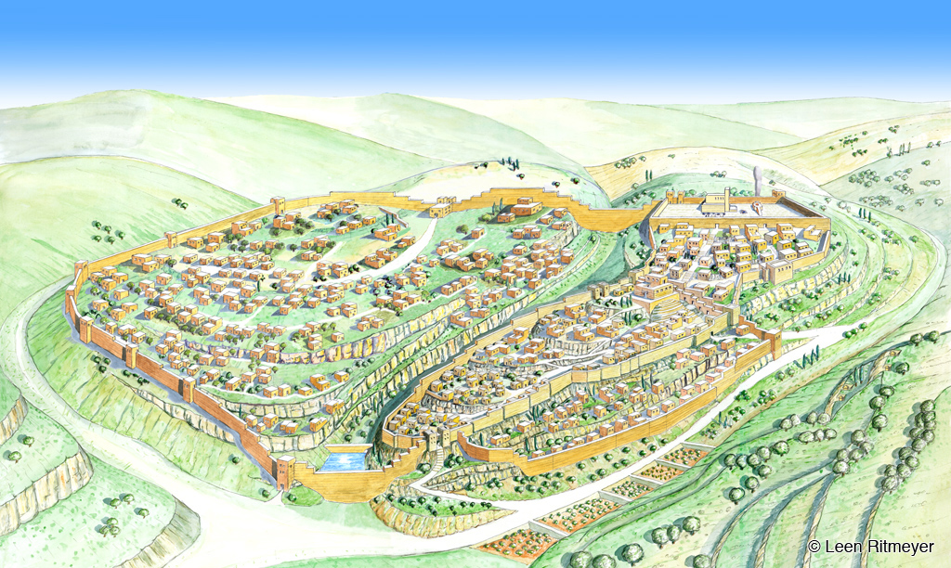
Hezekiah

Slide 5
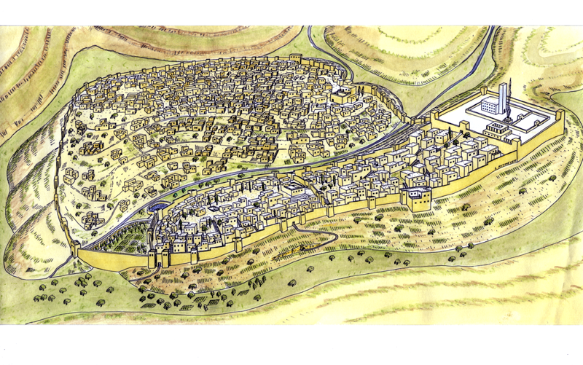
City of Hezekiah
Jerusalem
City of Solomon
City of David
Ps. 122.3 Jerusalem is built as a city that is joined together.
Notes:
King Hezekiah built a new city wall round the Western Hill of Jerusalem, joining it to the Eastern Hill. The Temple Mount was also enlarged to a square platform measuring 500 cubits each side. The Temple itself had suffered much damage during the three centuries since it was built.

Slide 6
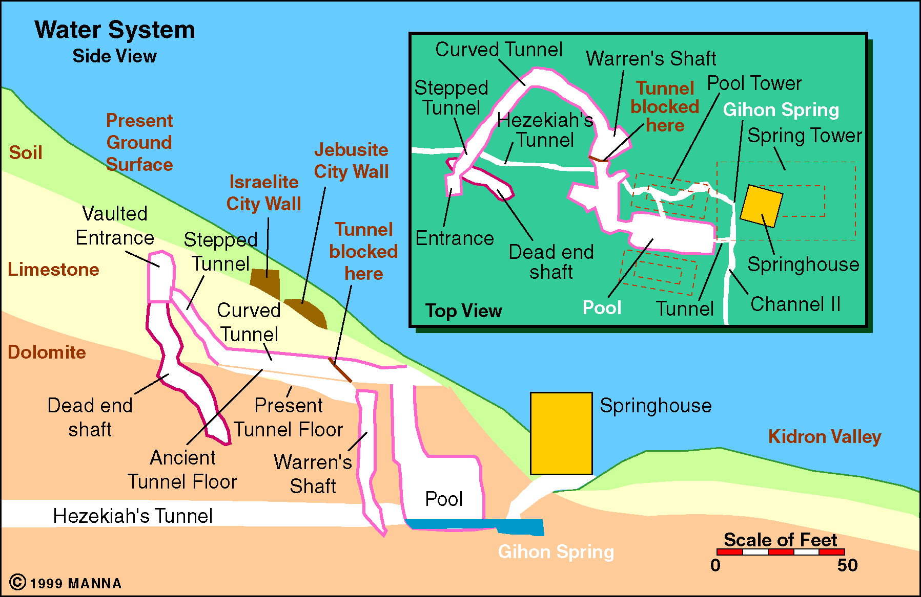
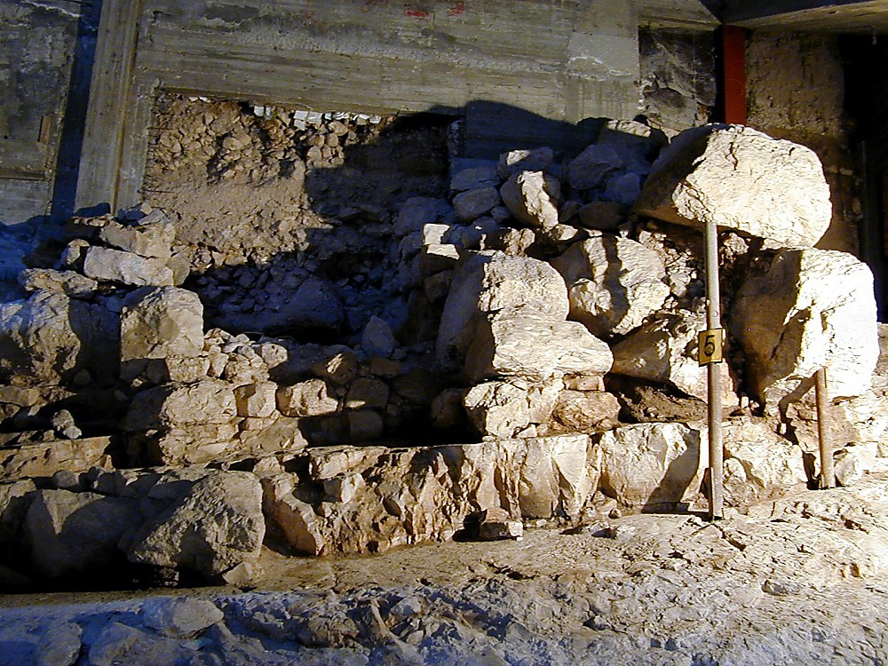

Water System - Jerusalem

Slide 7
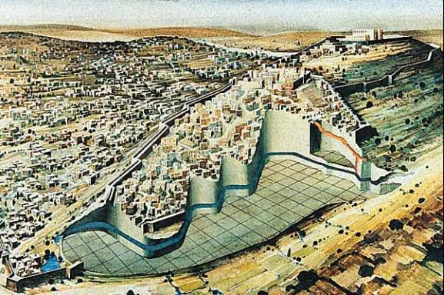
Side View of the Tunnel
Copyright 1995 Hebrew University of Jerusalem

Slide 8
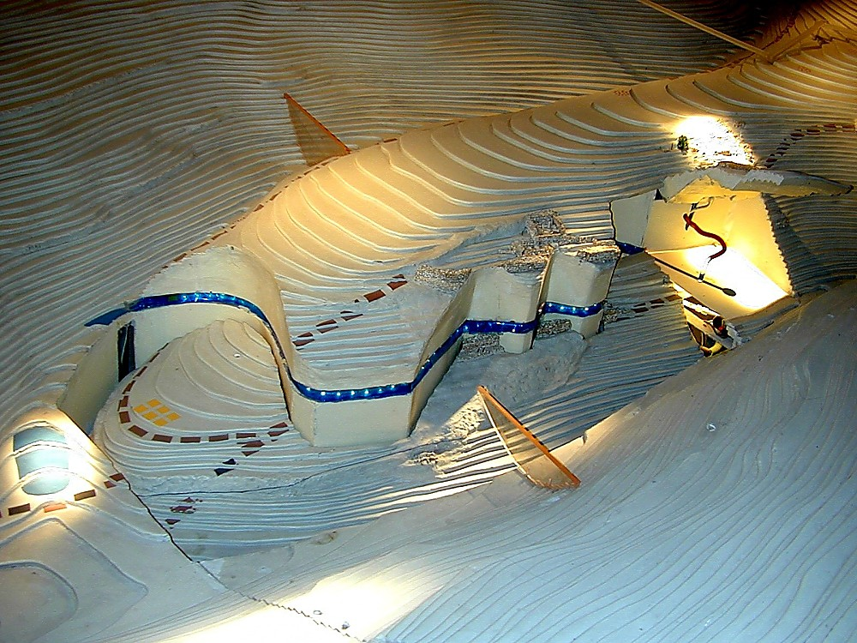
City of David from southeast

Slide 9
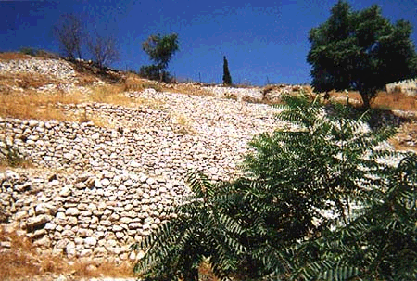
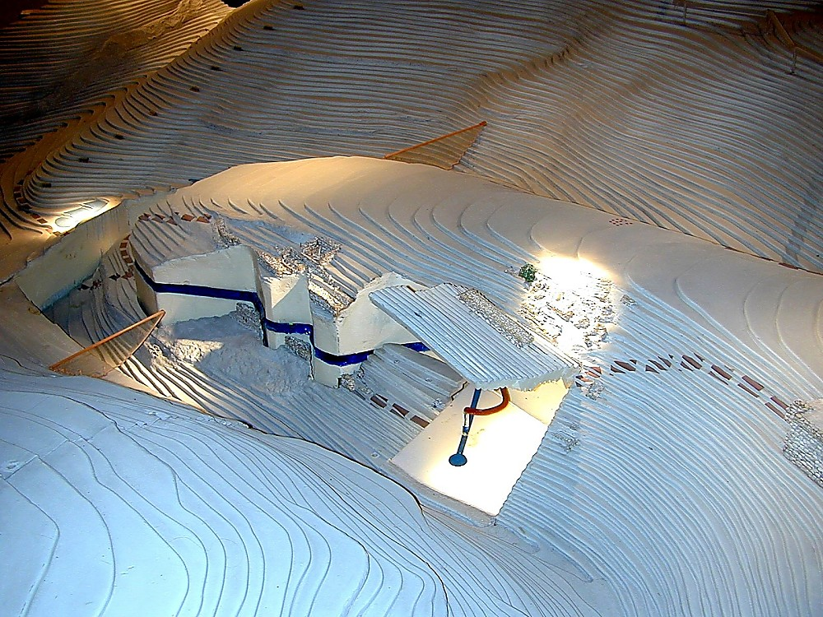
City of David model with watersystems

Slide 10
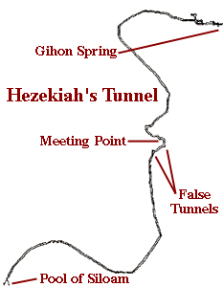
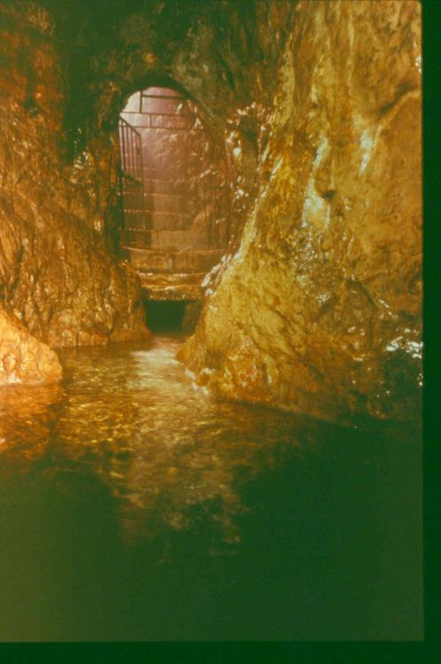
Gihon Spring -
Interior of Spring House

Slide 11
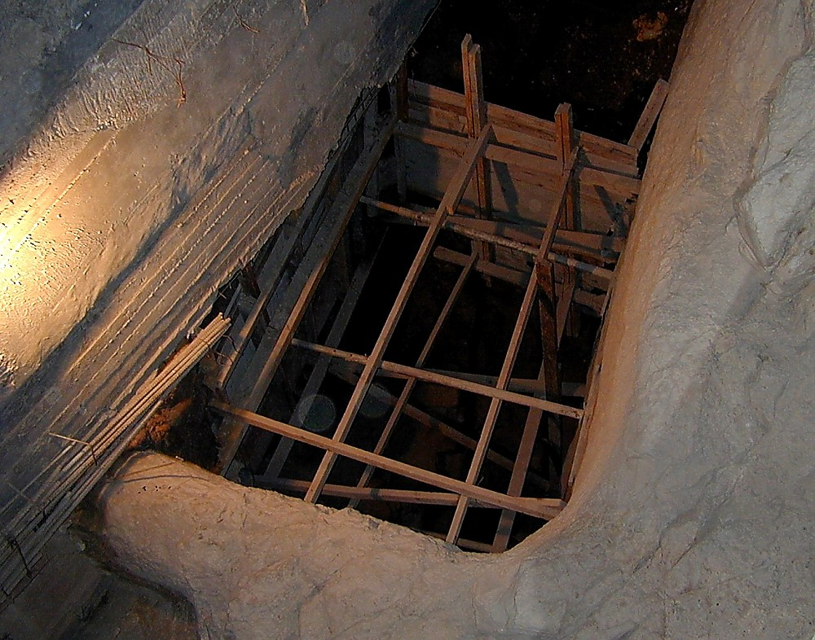
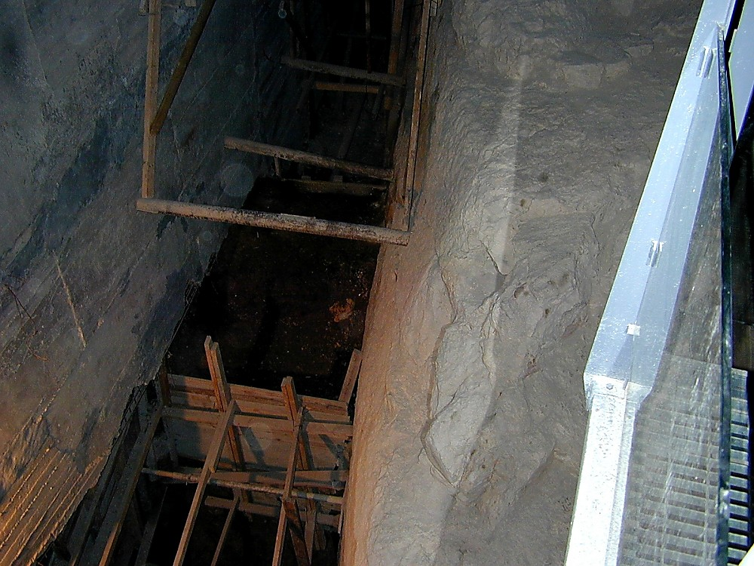
Gihon Spring - Pool

Slide 12
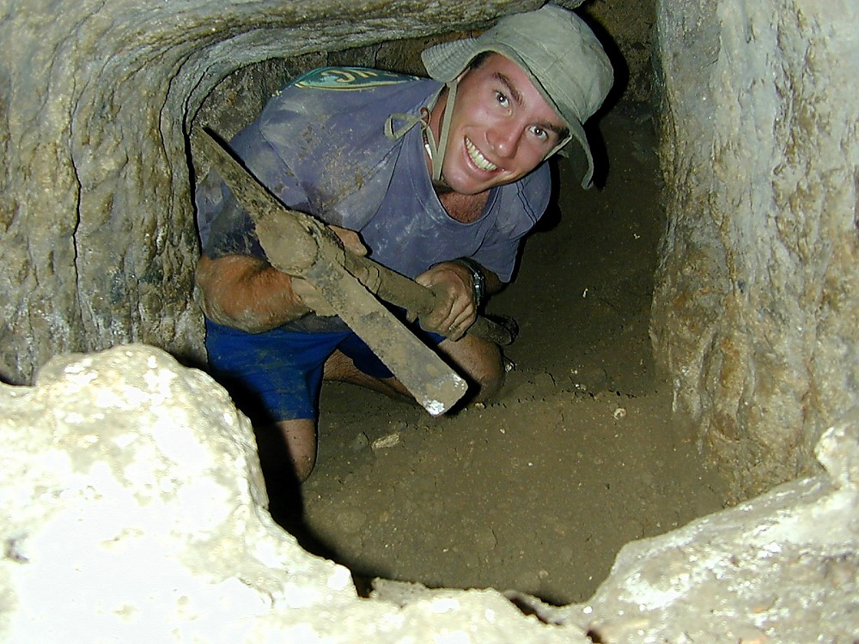
Hezekiah's Tunnel excavation
-fall 1999-

Slide 13
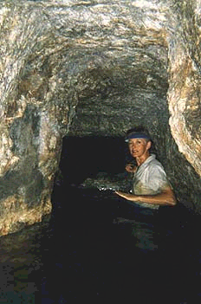
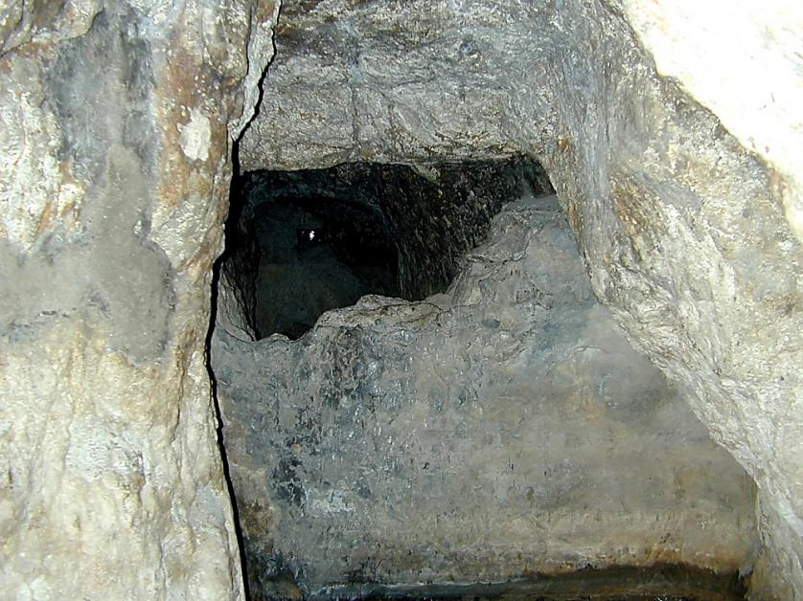
Gihon Spring - View of Warren’s Shaft

Slide 14
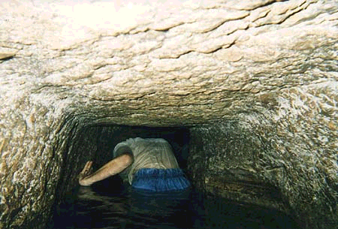
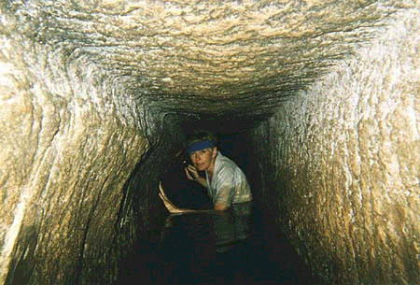
After Warren’s Shaft

Slide 15
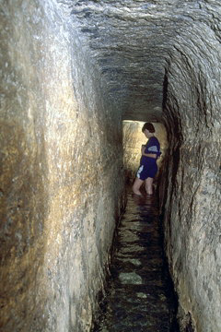
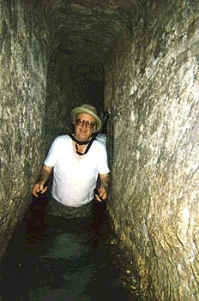
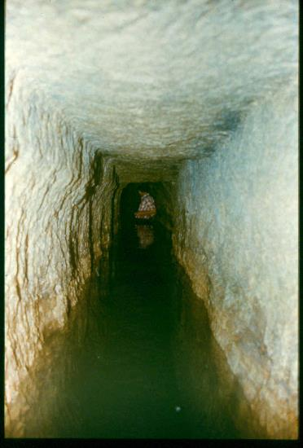
Hezekiah’s Tunnel - North End

Slide 16
    Hezekiah’s Tunnel, which connected the city of Jerusalem to a safe water supply even in times of siege. (2 Kings 20:20; 2 Chronicles 32:3-5; 2 Chronicles 32:30; Isaiah 22:9-11)

Slide 17
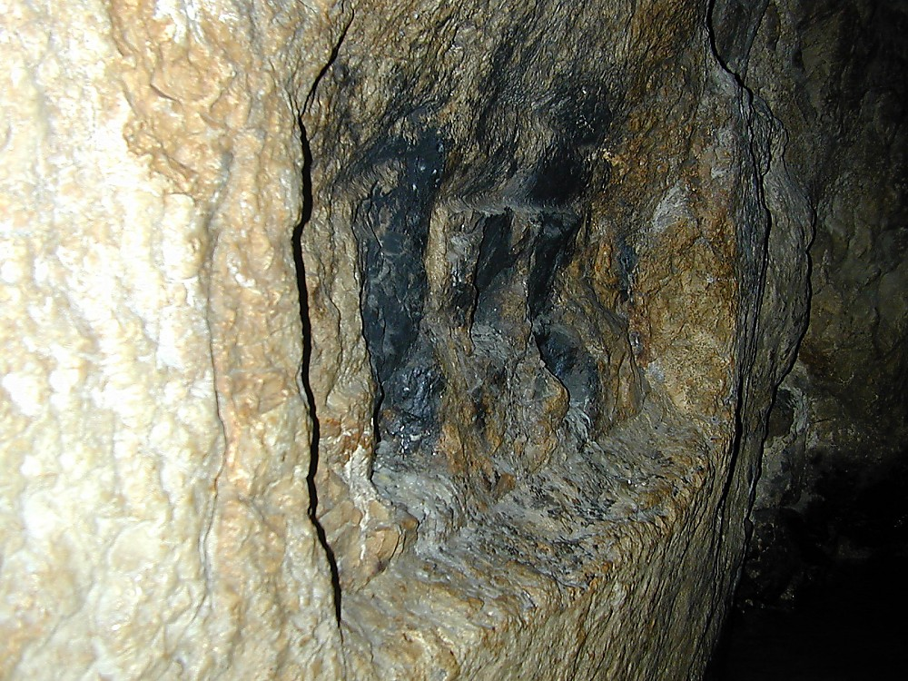
Location of Siloam Inscription in Hezekiah’s Tunnel

Slide 18
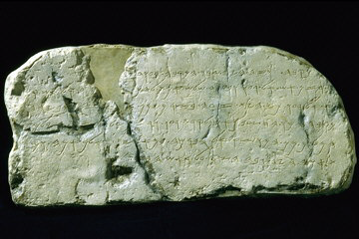
Siloam Inscription
    The remaining portion reads, “… when the tunnel was driven through. And this was the way in which it was cut through: While … were still … axes, each man toward his fellow, and while there were still three cubits to be cut through, there was heard the voice of a man calling to his fellow, for there was an overlap in the rock on the right and on the left. And when the tunnel was driven through, the quarrymen hewed the rock, each man toward his fellow, ax against ax; and the water flowed from the spring toward the reservoir for twelve hundred cubits, and the height of the rock above the heads of the quarrymen was one hundred cubits.” (2 Kings 20:20; 2 Chronicles 32:30)

Slide 19
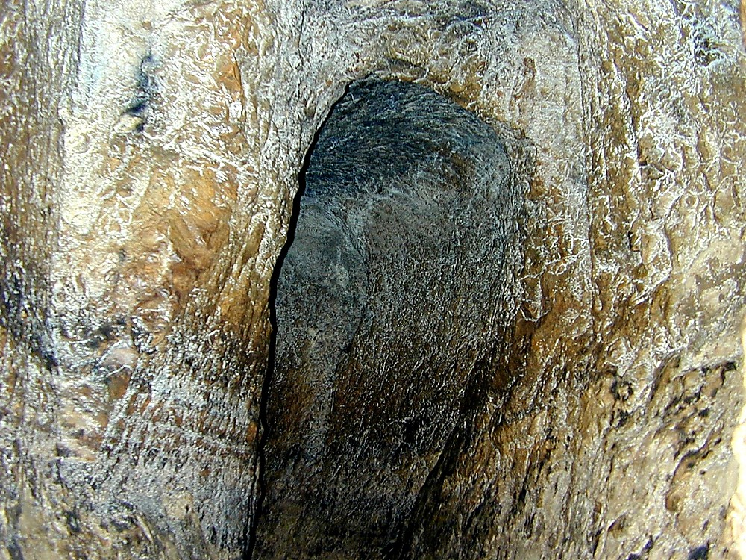
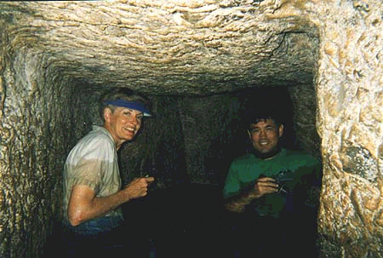
The Meeting Point

Slide 20
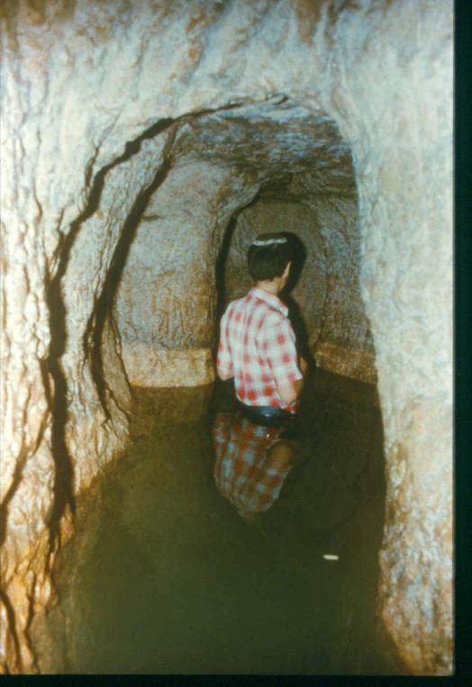
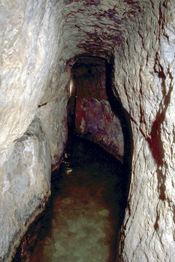

Slide 21
    The place of the join in Hezekiah’s Tunnel, Jerusalem, which was dug by estimating the path from both ends and following some natural crevices in the rock. When the people working from both ends reached the middle, they had to adjust their course slightly to meet each other. (2 Kings 20:20; 2 Chronicles 32:3-5)

Slide 22
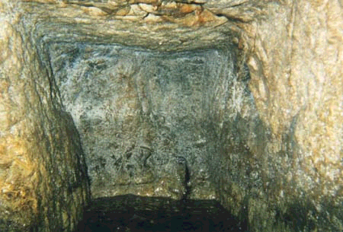
False Tunnels

Slide 23
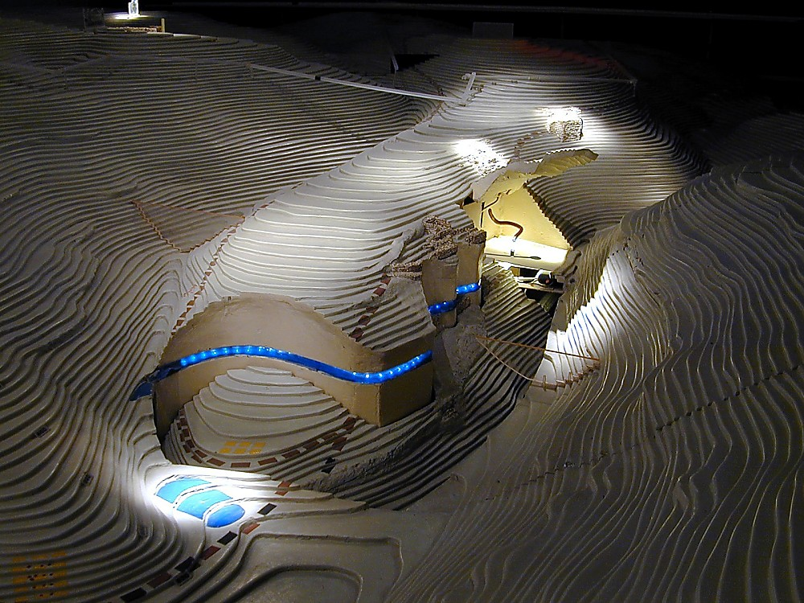
OT Model, City of David from south

Slide 24
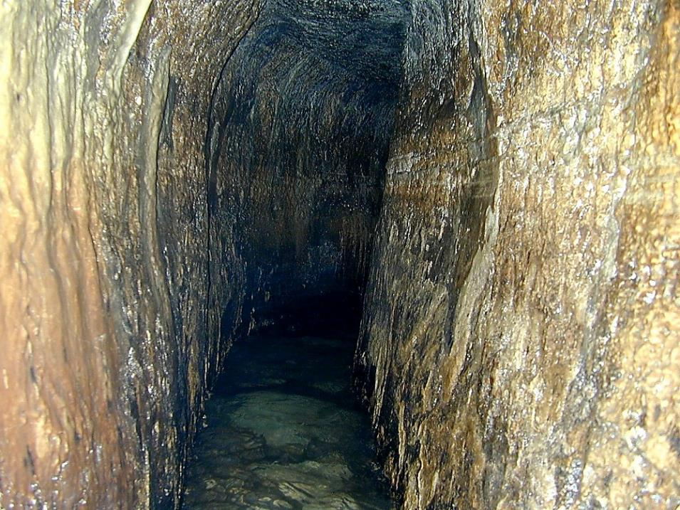
Hezekiah's Tunnel - South

Slide 25
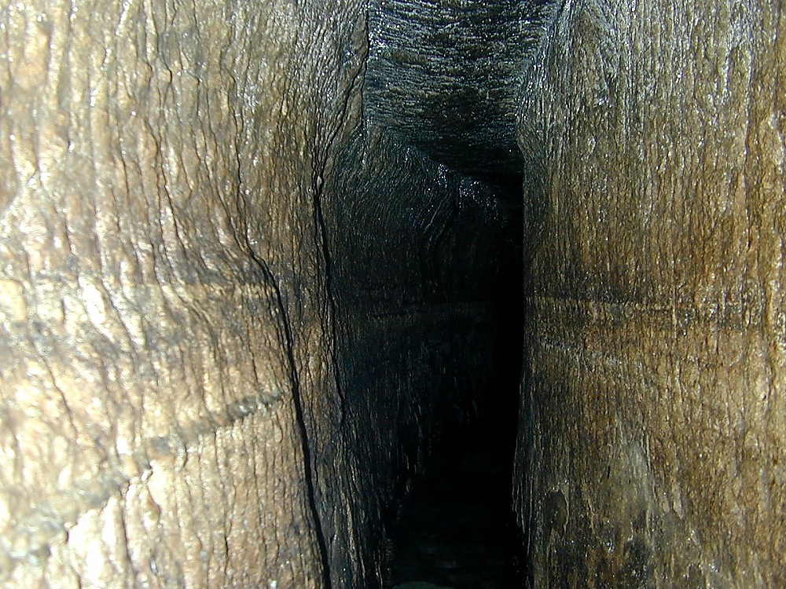
Hezekiah's Tunnel

Slide 26
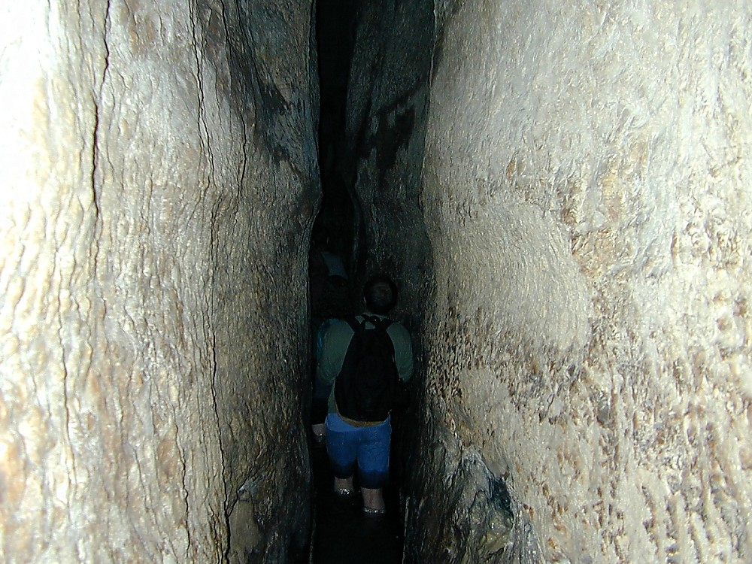
Hezekiah's Tunnel – higher roof near southern end

Slide 27
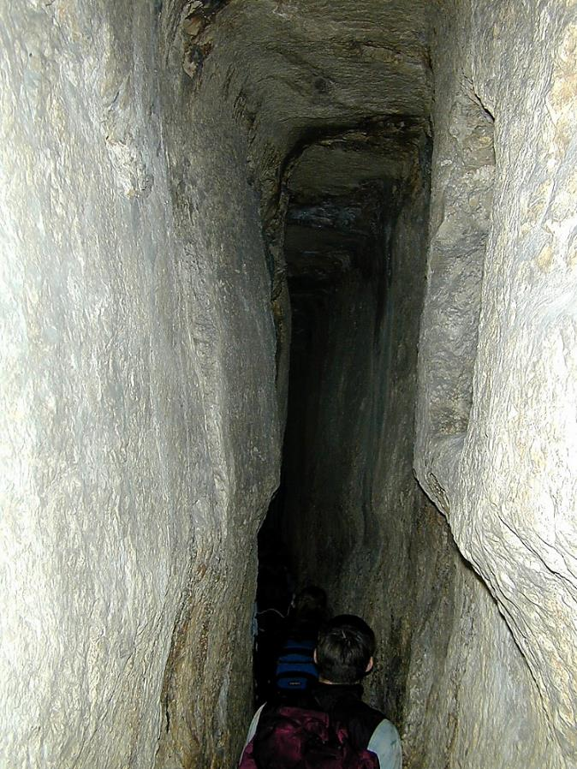
Hezekiah's Tunnel south end with high ceiling

Slide 28
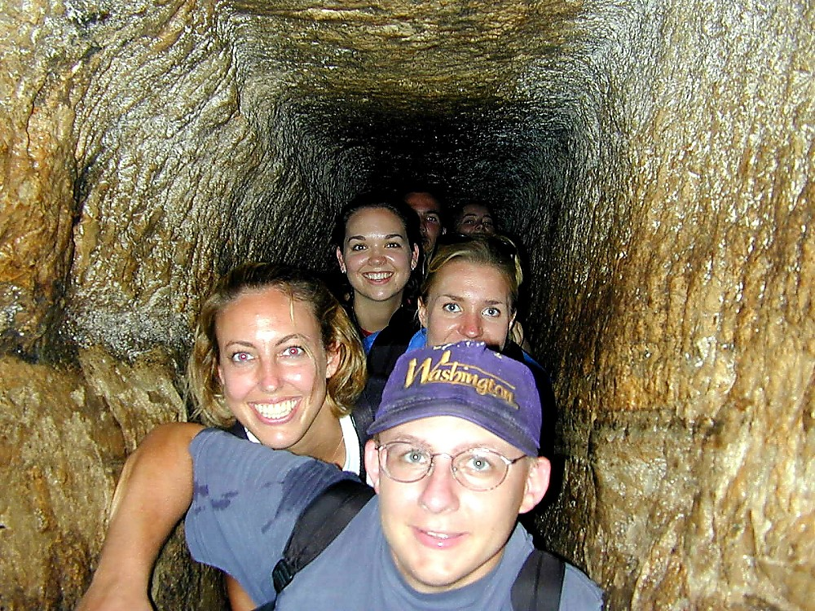
Hezekiah's Tunnel

Slide 29
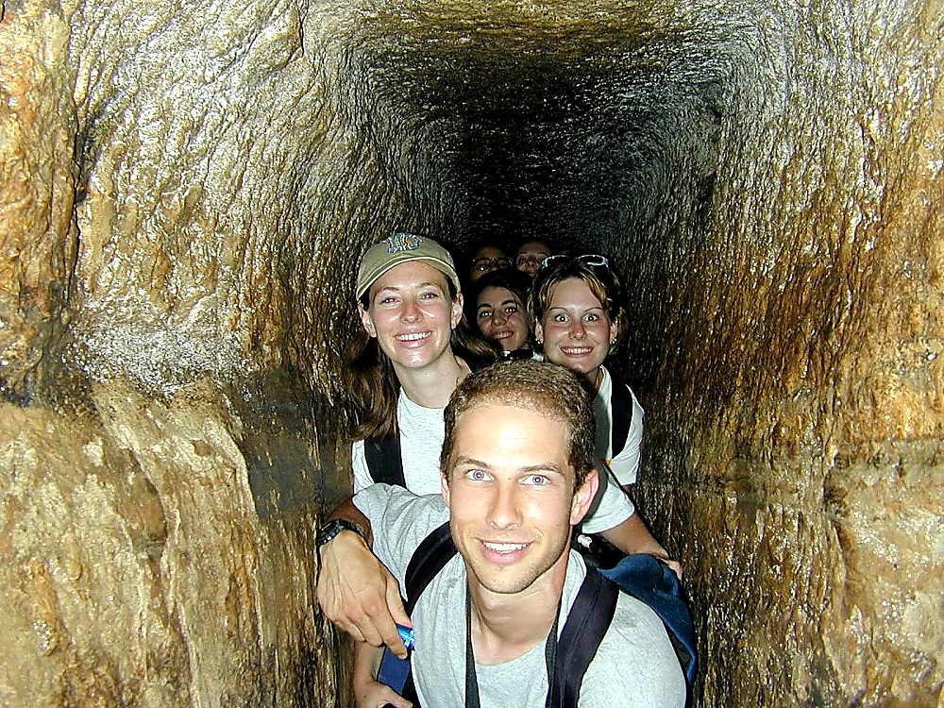
Hezekiah's Tunnel

Slide 30
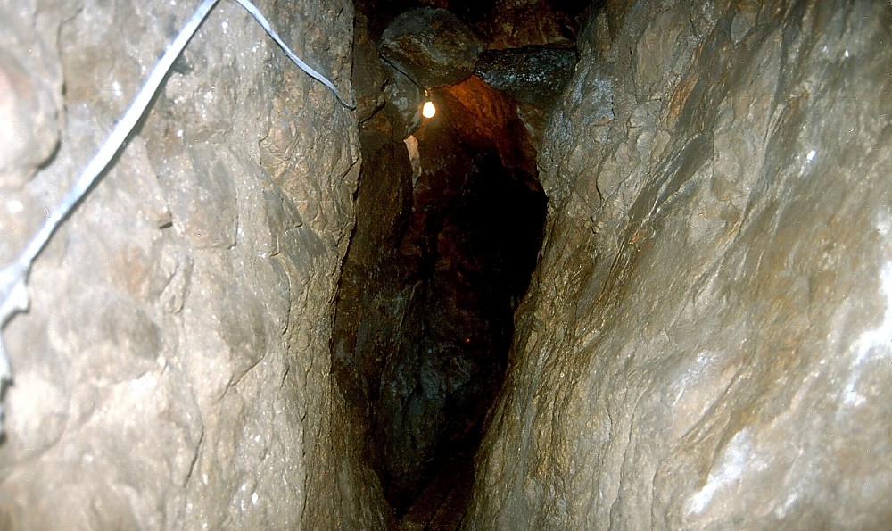
Siloam Channel
-separate watersystem from Hezekiah’s Tunnel-

Slide 31
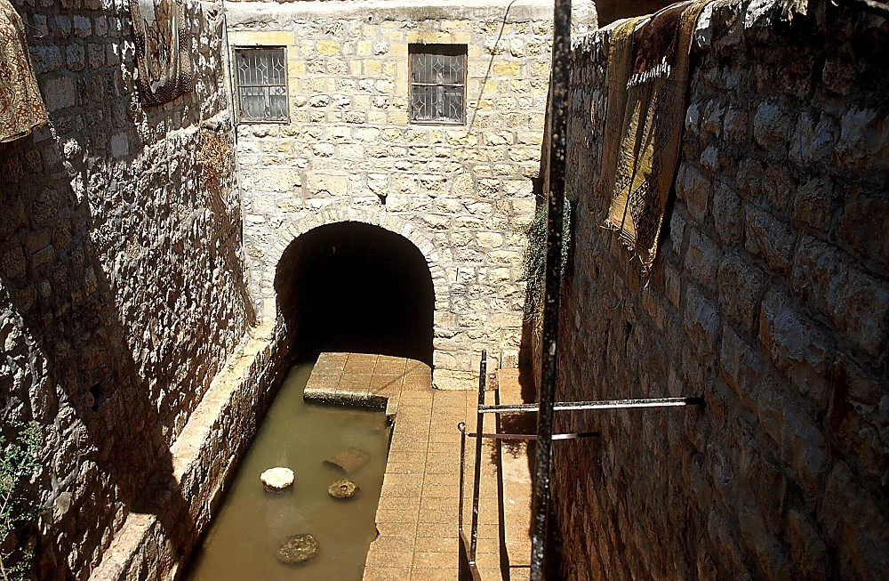
Siloam Pool
-exit of Hezekiah’s Tunnel; location of John 9 miracle-

Slide 32
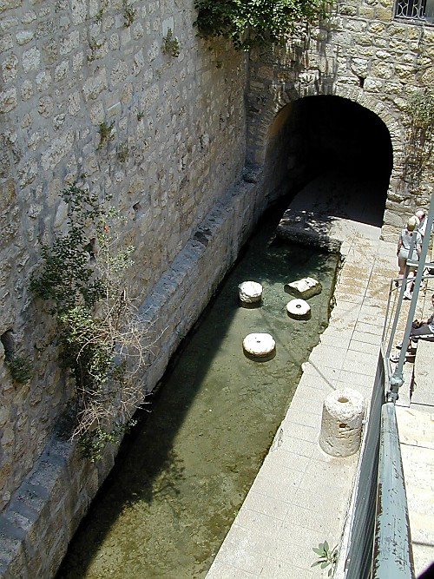
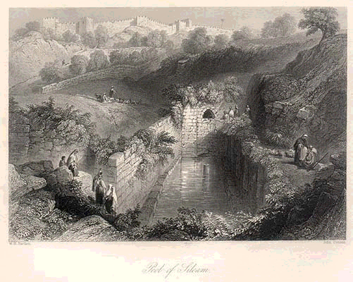
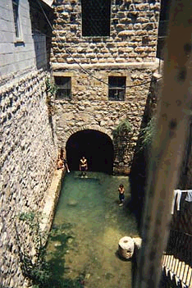
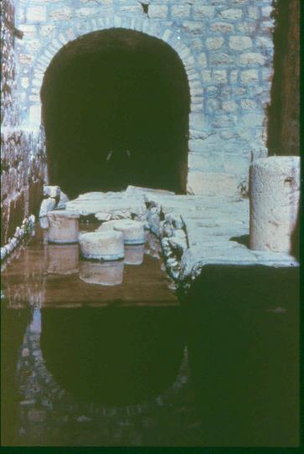
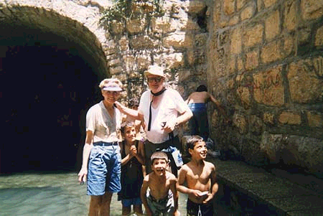

Slide 33
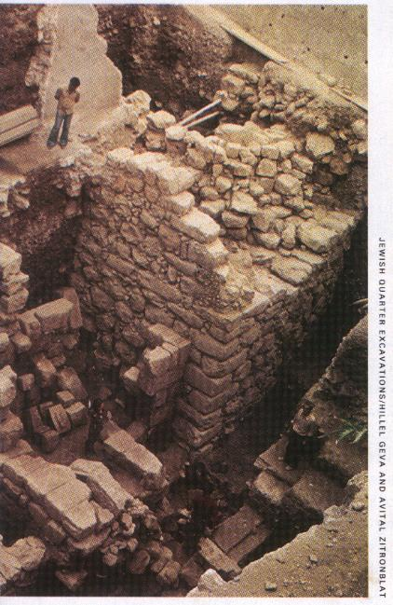
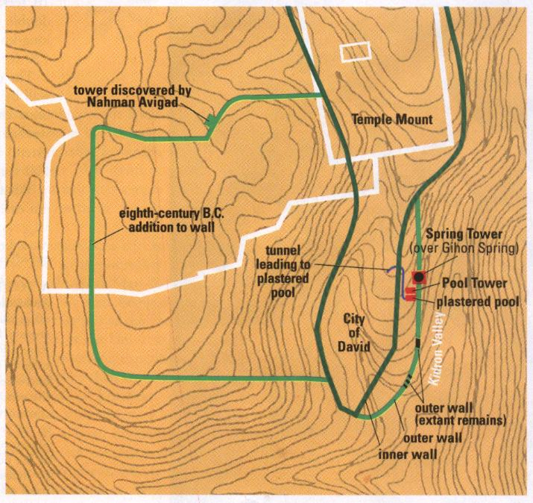
Nebuchadnezzar’s Assault on Jerusalem
Tower was originally 30-ft High
& 12-ft Thick. Babylonian
arrowheads found at base.
Bibibal Archaeology Review
pg. 40-41, Vol. 26 No 5, Sept/Oct 2000

Slide 34
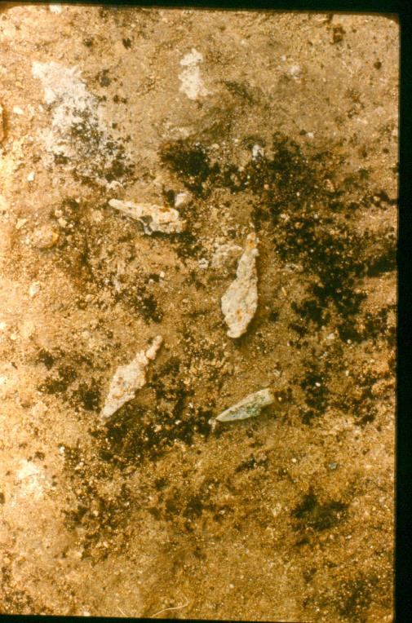

Babylonian Arrows

Slide 35
Where is the Destruction?

Slide 36
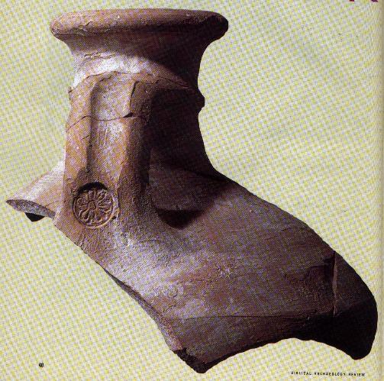
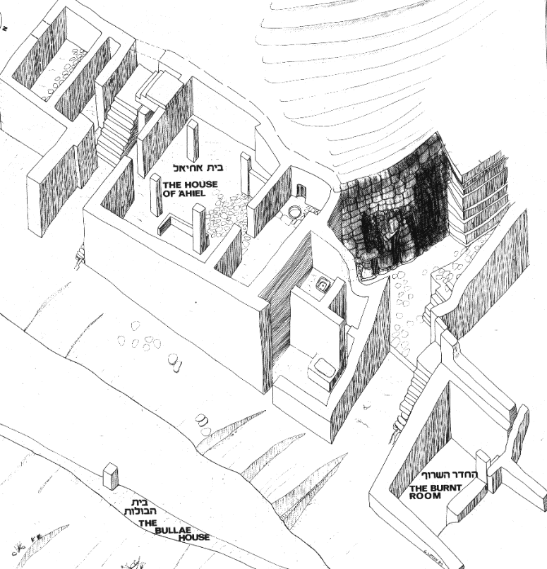
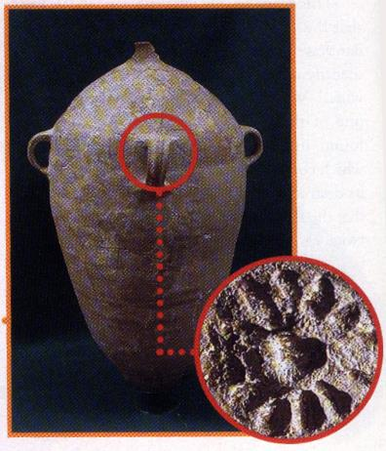
Evidence of Destruction

Slide 37

The Burnt Room

Slide 38

The Bullae House
Germariah son of Shapan, Member of King Jehoiakim’s Court (608-598 BC)
Jer 36:10

Slide 39

Nehemiah

Slide 40


Slide 41


Slide 42
Seleucid Addition 186 BC

Slide 43


Hasmonean Extension - 141 BC
Secrets of Jerusalem’s Temple Mount
by Leen & Kathleen Ritmeyer, 1998
Biblical Archaeology Society

