Slide 1
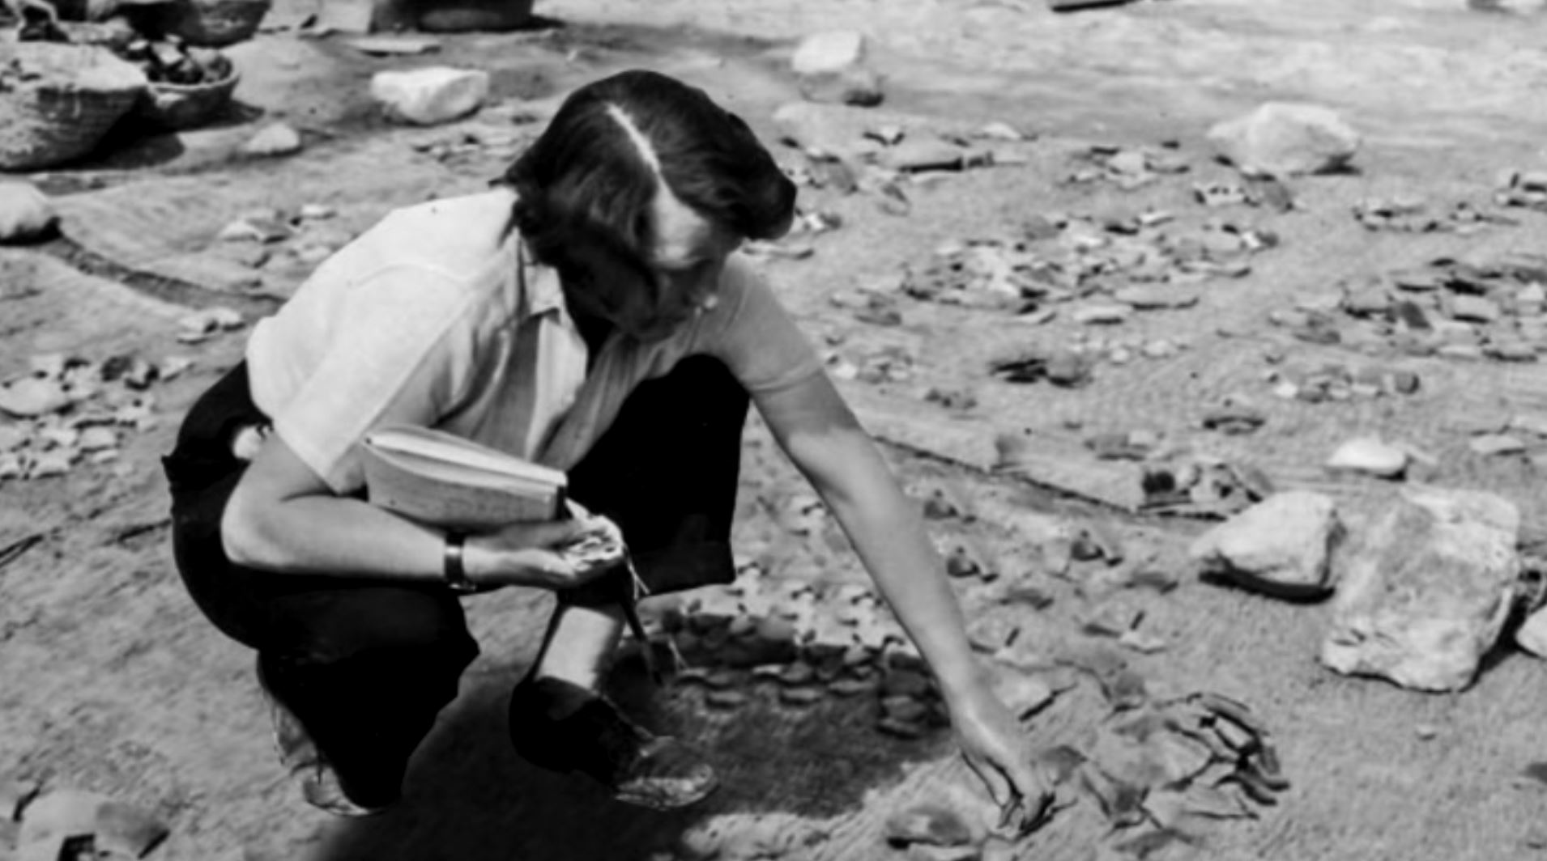
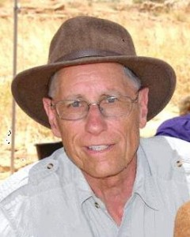
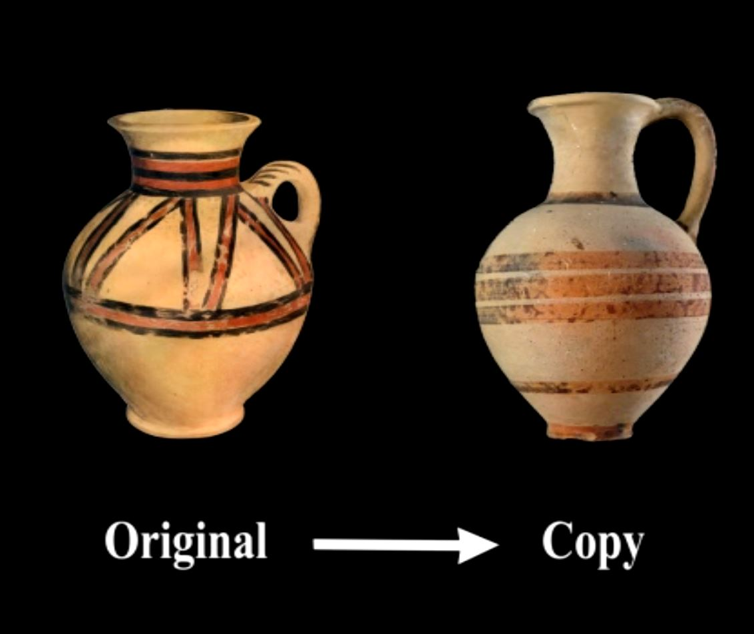
No Cypriot Pottery
= no Jericho around 1400 BC
Kathleen Kenyon’s conclusion that the conquest of Jericho was a myth that the Israelites invented because they saw a destroyed city.
Dr Bryant Wood -Garstung
found local copies of
Cypriot Pottery = Jericho
around 1400 BC

Slide 2
Journey thru the Bible with Archaeology
A Bible and Spade Evidence Class.
Lesson 4
Shechem a City for All Times

Slide 3
First, the author established that the event took place at Sychar (Jn 4:6). By making reference to Jacob he reminded his readers/hearers that this is where Jacob first settled when he returned to the Promised Land from Paddan Aram (Gn 33:18). At this spot Abram received God’s promise that “To your offspring I will give this land” (Gn 12:7). In addition to God’s promise given here to Abram, the writer wanted the hearer/reader to remember that many human agreements were made at Shechem in Bible history. Unfortunately, most were corrupted because of man’s sin. For example, Jacob made a promise to spare Hamor and the Shechemites after Dinah was sexually violated. Jacob’s use of circumcision to confirm the agreement with the Shechemites was the same symbol God had ordained as “the sign of the covenant between Me and you” (Gn 17:11). To seal a human agreement in this manner and have it subsequently abrogated as Jacob’s sons had done (Gn 34), could not have escaped the attention of the original hearers/reader.
Later, we read in the Bible that Jacob did not destroy family idols: rather he simply placed them under a tree near Shechem (Gn 35). This whole account is a testimony to the human condition and our willful tendency not to obey God. Jacob, who even had the privilege of a personal revelation from God, still could not totally eliminate idol worship; he played on the edge and placed the idols under a tree rather than destroying them.
The reader/hearer also should have been reminded that Shechem was near the place where Joseph’s brothers sold him into slavery and then concocted a lie to explain Joseph’s absence to their father Jacob (Gn 37)—another example of man’s deceit and deception.
All of these accounts are, in themselves, mini-stories that illustrate the human condition and how incapable we are of making a lasting promise to God. As a result, we are in need of rescue and restoration and only God, with His patience, could develop and execute a plan, seen throughout Bible history, for accomplishing a restoration that did not rely on man’s fallible nature.
Juxtaposed against the human failings, lies and deceits, the hearer/reader’s attention was brought to the fact that Shechem was where God reminded the people that He is faithful. Having given Abram the promise of the land, the Israelites were to remember that promise by going to Shechem, building an altar worshipping and re-reading God’s Law. This would refresh in the minds of the Israelites how God had led them out of bondage as He had promised and into a land He had promised. The rededication ceremony was accomplished and is described in Joshua 8. Following the conquest, Joshua again assembled the people at Shechem where he reviewed God’s promises and Israel’s obligations, eliciting from the people an agreement that they would “serve the Lord our God and obey Him” (Jos 24:24). This promise was another one that was repeatedly broken as revealed in the succeeding books of the Old Testament.
Earlier in Israel’s history Joseph, as he lay dying in Egypt, reminded the people that God would lead them to the land He had promised to Abraham, Isaac and his father Jacob. He asked that when they did return, they “carry my bones up from this place” (Gn 50:25). This was fulfilled in Joshua 24:32 when the body of Joseph was placed in a tomb in Shechem.
The Hebrew hearer/reader would also remember that Shechem became the center for the idolatrous worship practices that occurred following Israel’s capture by the Assyrians. Importing peoples from other lands and exporting Jewish believers, syncretism of pagan beliefs and Jewish practices resulted in a corrupted form of worship that became centered at Shechem and on Mt. Gerizim by people who were known as Samaritans. They chose to be worshippers of other gods despite their earlier promise in Joshua 24.

Slide 4
Objectives:
Improve our knowledge of Bible Locations, People and Timeline
Gain an understanding that the Bible deals with real events, real people, and real places.
Strengthen our faith by examining the physical remains/evidence that have been discovered in Middle East and Mediterranean related to Bible events.

Slide 5
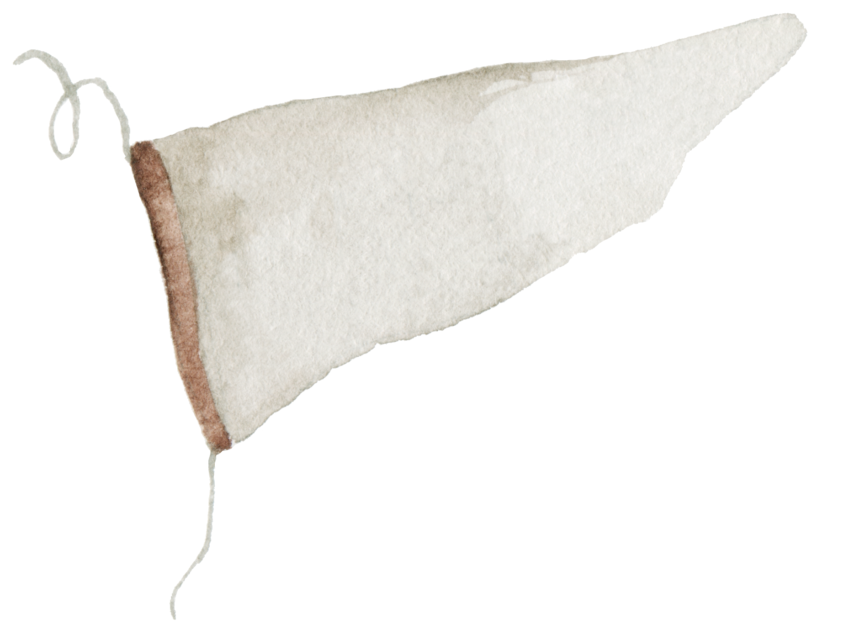
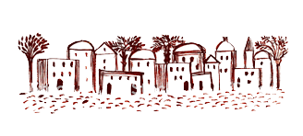
Journey thru the Bible with Archaeology
04-Shechem a City for All Times
03-Joshua and the Conquest
01-Introduction to Bible Archaeology
03-Joshua and the Conquest
02-Patriarchs
and Camels
05-David, Samson and the Philistines
17-Archaeology and the Bible Text
06-Solomon the Builder
07-Ahab and the Northern Kingdom
11-Crucifixion and Burial
16-Archaeology in Jerusalem
15-Museums and Key Bible Finds
14-Daniel and the Kingdoms
08-The Hezekiah Defense
09-Jeremiah and the Last Days of Judah
12-Cities of Paul and John
10-In the Days of Jesus
13-Finding People in the Bible Outside the Bible

Slide 6
Joshua’s Challenge at Shechem
Just before Joshua’s death, he gathered the nation to Shechem again—years after their antiphonal shouting. Here Joshua reminded them:
Abram was an idolater at one time, but left it all to follow the Lord (Joshua 24:2). Joshua elevated the grace of God in calling them out of a pagan past.
Jacob buried his idols and worshipped God at Shechem. What a humble beginning.
He then urged them to choose personally to serve the Lord “in sincerity and truth” (Joshua 24:14).

Slide 7
Sin Separates Us from God Bible is God’s Effort to Redeem Us See it Unfold via Bible Periods
Creation & Fall
The Patriarchs
Exodus Conquest
The Judges
Kings & Prophets
Exile & Return
Life of Jesus
Early Church
United
Divided
Between the Testaments

Slide 8
Putting Bible Time to Archaeological Time
Archaeological Periods Levant | Chronological Date | Historical Events | Biblical Historical Event | Bible Periods
Neolithic & Chalcolithic | 8500-3150 BC |  |  | Creation & Fall & Flood
Early Bronze I | 3150–2850 BC | Early Dynastic Period in Egypt (ca. 2900BC Menes) |  | Patriarchs
Early Bronze Age II | 2850-2650 BC |  |  | Patriarchs
Early Bronze Age III | 2650-2200 BC | Egyptian Old Kingdom Dynasty III to VI |  | Patriarchs
Early Bronze Age IV | 2200-2000 BC |  | Abraham b ~2166 BC Departs Ur 2091 Isaac b 2066 Esau & Jacob b~2006 BC | Patriarchs
Middle Bronze Age I | 2000-1550 BC | Egyptian Middle Kingdom (2050-1640 BC) Dynasty XI to XIII Hyksos Egyptian Dynasty (~1663-1555 BC) | Joseph b 1915 BC Jacob & Family enter Egypt~1876 BC | Patriarchs
Middle Bronze Age II | 1550-1400BC | Egyptian New Kingdom (1539-1070 BC) Dynasty XVIII -XX | Moses Born 1526 BC | Patriarchs
Late Bronze Age I | 1550-1400 BC |  | Exodus 1446 BC Conquest 1406- BC | Exodus/Conquest
Late Bronze Age II | 1400-1200 BC | Amarna Period ~1386-1334 BC |  | Judges

Slide 9
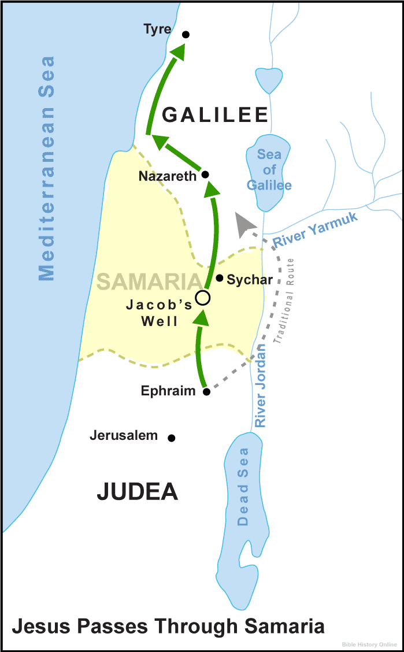
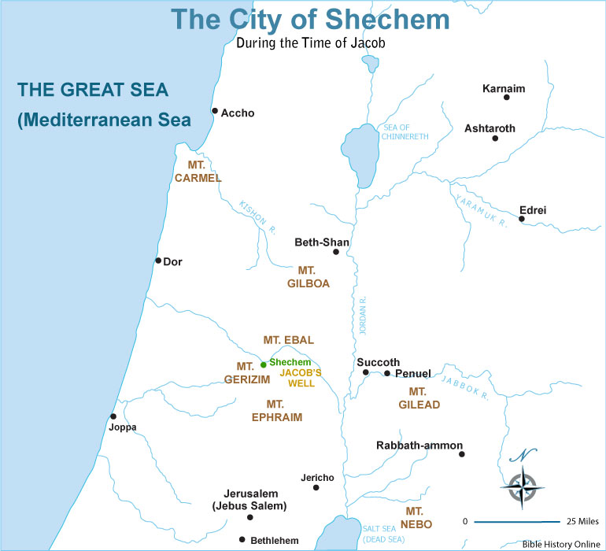
Bible Places

Slide 10
ABRAHAM & Jacob at Shechem: Genesis 12:1-9, 33:18-35:4
Shechem was a stopping point for Abraham when he can into Canaan from Haran as also for Jacob when he returned to the land after working for Laban in Haran. From the bible passage what archaeology remains might give us further insight into the passage?
Archaeology can add to Bible Event:
Build confidence in general trustworthiness, historical nature and reliability of Bible
Confirm events described in Bible
Clarify/Correct/Provide Understanding about our assumptions and conclusions about the past
Complement or Enhance our knowledge of events, customs and people
Prove a given event or people mentioned in the Bible

Slide 11
Abraham at Shechem
Genesis 12:4-9 (ESV) ⁴ So Abram went, as the LORD had told him, and Lot went with him. Abram was seventy-five years old when he departed from Haran. ⁵ And Abram took Sarai his wife, and Lot his brother’s son, and all their possessions that they had gathered, and the people that they had acquired in Haran, and they set out to go to the land of Canaan. When they came to the land of Canaan, ⁶ Abram passed through the land to the place at Shechem, to the oak of Moreh. At that time the Canaanites were in the land. ⁷ Then the LORD appeared to Abram and said, “To your offspring I will give this land.” So he built there an altar to the LORD, who had appeared to him. ⁸ From there he moved to the hill country on the east of Bethel and pitched his tent, with Bethel on the west and Ai on the east. And there he built an altar to the LORD and called upon the name of the LORD. ⁹ And Abram journeyed on, still going toward the Negeb.

Slide 12
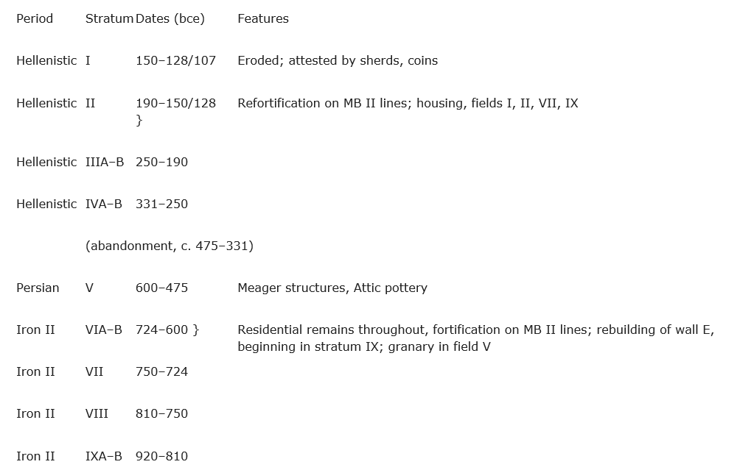
Shechem Strata

Slide 13
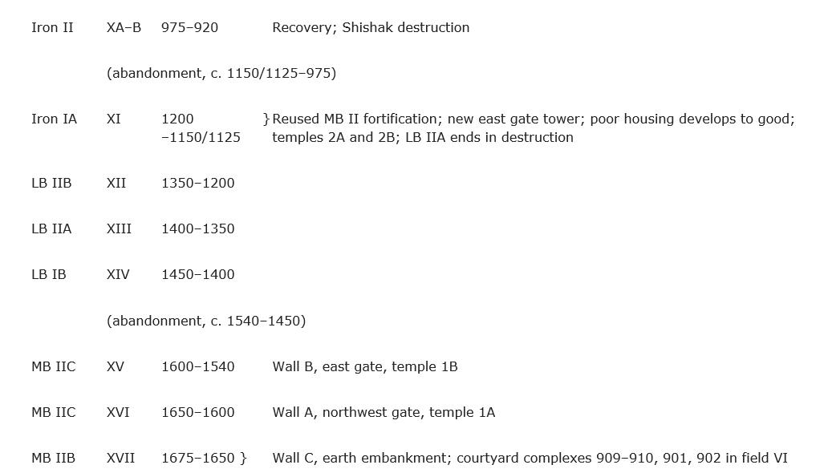
Shechem Strata

Slide 14
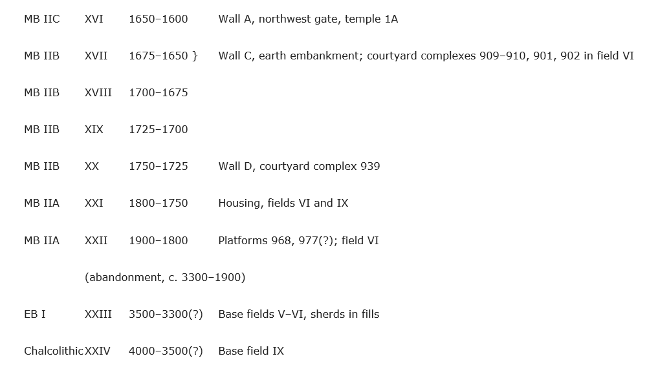
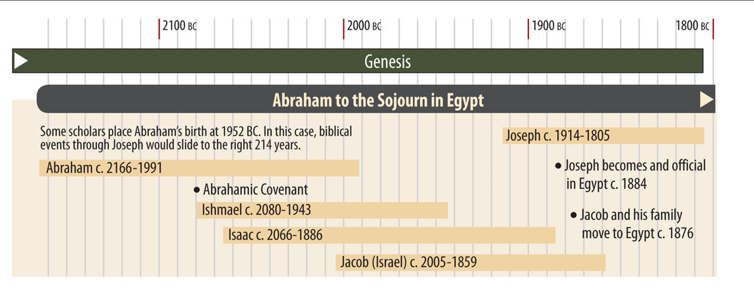
Shechem Strata
⁶ Abram passed through the land to the place at Shechem, to the oak of Moreh. At that time the Canaanites were in the land.

Slide 15
Shechem Strata
Genesis 33:18-20 (ESV) ¹⁸ And Jacob came safely to the city of Shechem, which is in the land of Canaan, on his way from Paddan-aram, and he camped before the city. ¹⁹ And from the sons of Hamor, Shechem’s father, he bought for a hundred pieces of money the piece of land on which he had pitched his tent. ²⁰ There he erected an altar and called it El-Elohe-Israel. .

Slide 16
Shechem
Abraham – Gen 12:6 “Abram traveled through the land as far as the site of the great tree of Moreh at Shechem.”
Jacob - “camped within sight of the city” after returning from sojourney with Laban & he bought for a hundred pieces of money the piece of land on which he had pitched his tent. (Gn 33:18-19). He moves on to Bethel & Hebron after Dinah incident
Simeon, Levi & Dinah - The sons of Jacob came upon the slain and plundered the city, because they had defiled their sister. Genesis 34:27 After all who went out of the gate of his city listened to Hamor and his son Shechem, and every male was circumcised.
Shechem was destroyed around 1540 BC resulted in debris covering the city up to a depth of 5.25 ft. It is surmised that the Egyptian armies of Ahmose I or Amenhotep I. Rebuilt about 1450 BC (50 yrs before return)

Slide 17
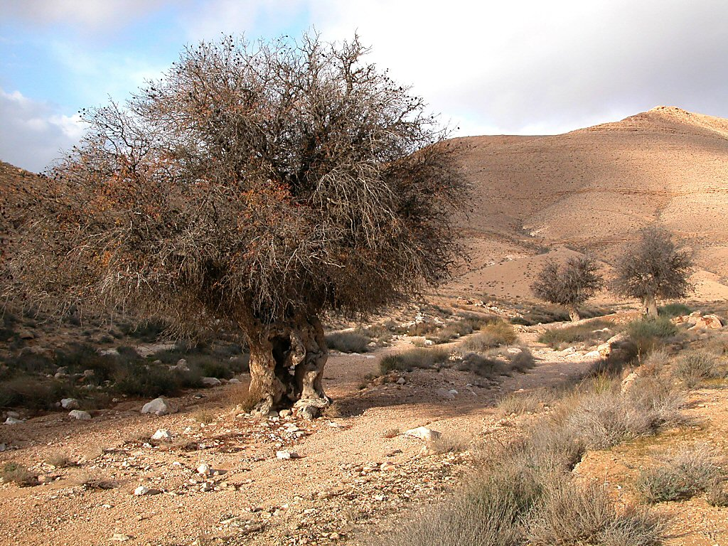
Genesis 35:1-4 (ESV) ¹ God said to Jacob, “Arise, go up to Bethel and dwell there. Make an altar there to the God who appeared to you when you fled from your brother Esau.” ² So Jacob said to his household and to all who were with him, “Put away the foreign gods that are among you and purify yourselves and change your garments. ³ Then let us arise and go up to Bethel, so that I may make there an altar to the God who answers me in the day of my distress and has been with me wherever I have gone.” ⁴ So they gave to Jacob all the foreign gods that they had, and the rings that were in their ears. Jacob hid them under the terebinth tree that was near Shechem.
Nahal Elot with terebinth tree
Notes:
The Atlantic terebinth tree can be found throughout the Negev highlands. One of the most common trees in Israel in biblical times, these trees can produce fruit even if there is very little rain each year. Because it could live for up to 800 years, and could regenerate from its stump, it was a symbol of fertility and was worshipped by the Canaanites and Israelites.
tb010303570

Slide 18
Joshua at Shechem: Joshua 8:30-35, 24:1-32
Joshua gathered the tribes of Israel when entering land to renew the law and addressed his final words of counsel and exhortation. It was established as one of the cities of refuge. From the bible passage what archaeology remains might give us further insight into the passage?
Archaeology can add to Bible Event:
Build confidence in general trustworthiness, historical nature and reliability of Bible
Confirm events described in Bible
Clarify/Correct/Provide Understanding about our assumptions and conclusions about the past
Complement or Enhance our knowledge of events, customs and people
Prove a given event or people mentioned in the Bible

Slide 19
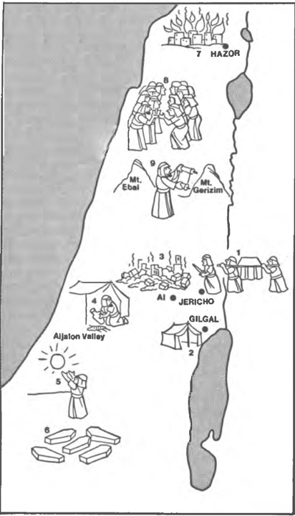
Main Events in Joshua
Hazor Burns
Land Divided
Covenant Renewed
Law Read
Cross Jordan River
Ai & Achan
Sun Stands
Still
Jericho
HQ at
Gilgal
5 Amorite Kings

Slide 20
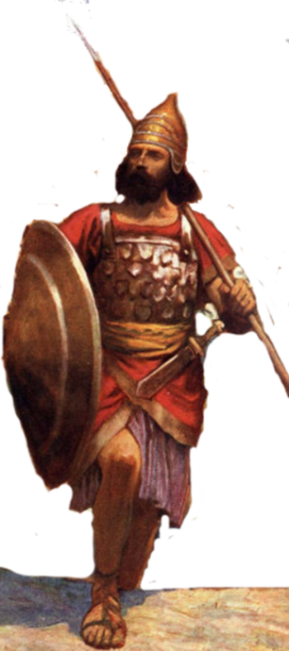
Joshua now that
You crossed Jordan River
Circumcised the People
Partaking of the 1st Passover in the Promised Land
Taken Jericho and it’s walls
Had your first defeat in the land
Dealt with sin of Achan
Taken Ai that opens land of Canaan
Where are you going now?
Notes:
I. Claiming the Land (1:1–5:15)
II. Conquering the Land (6:1–12:24)
III. Distributing the Land (13:1–21:45)
IV. Living in the Land (22:1–24:28)
V. Resting in the Land (24:29–33)

Slide 21
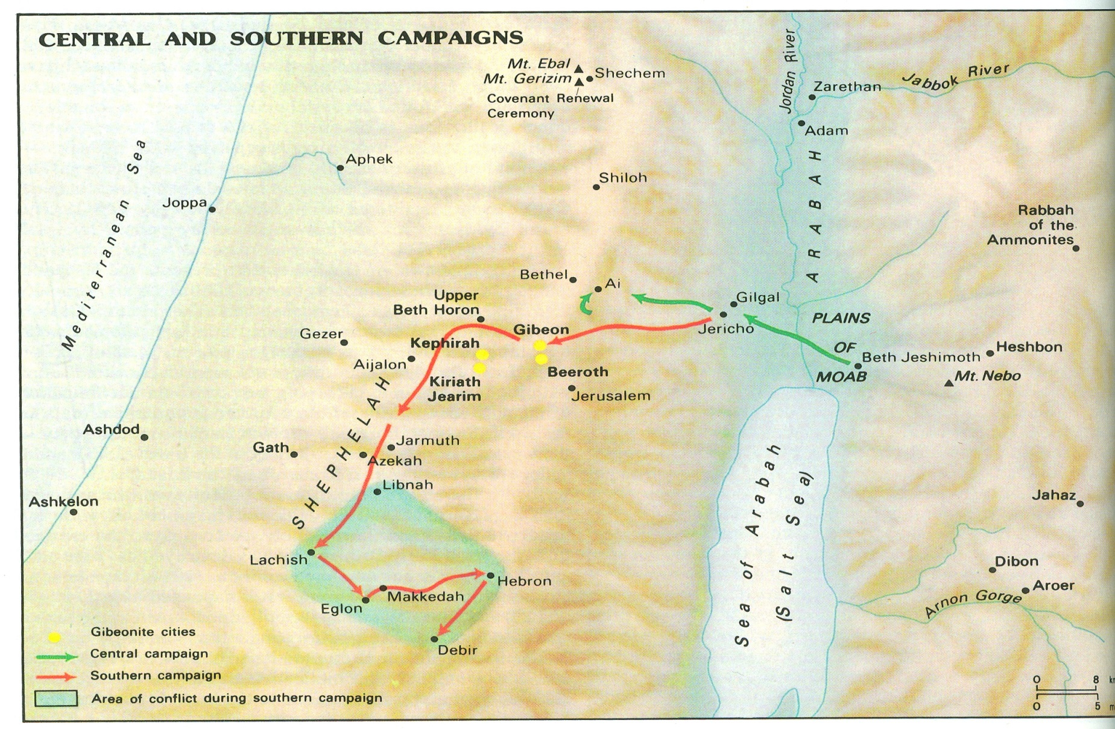
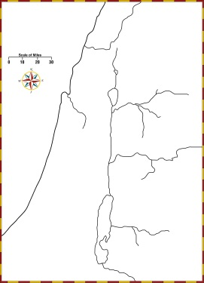

Slide 22
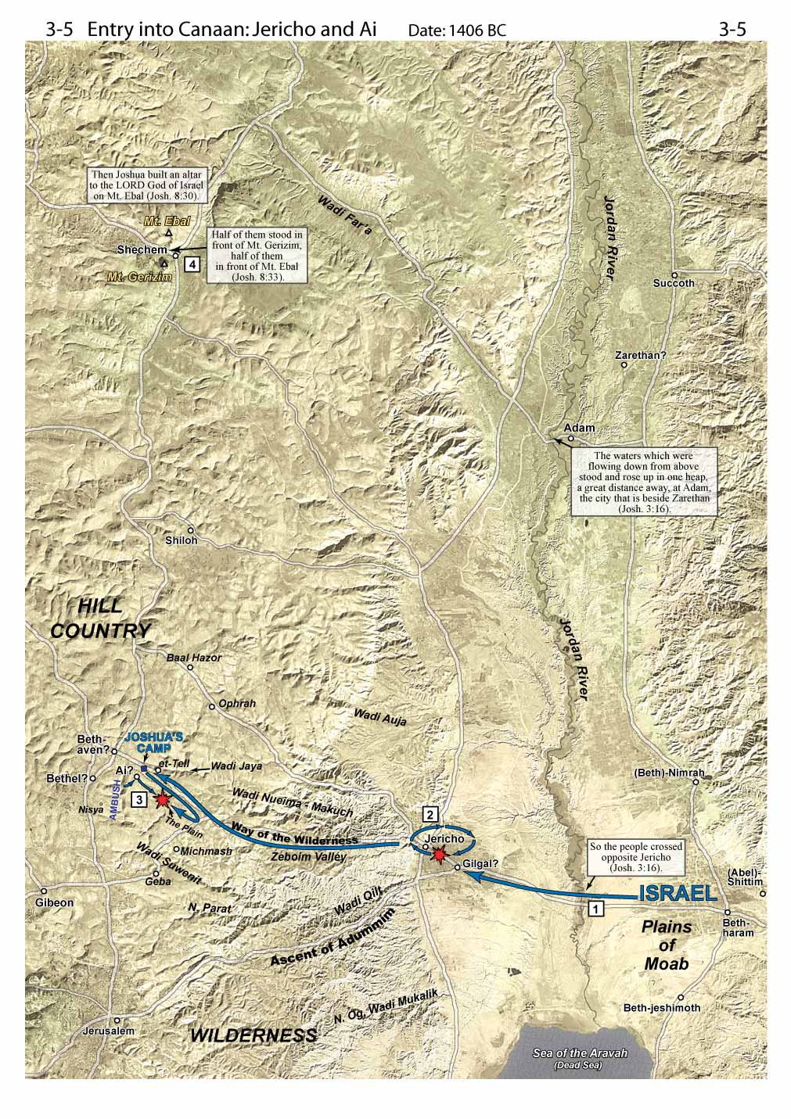
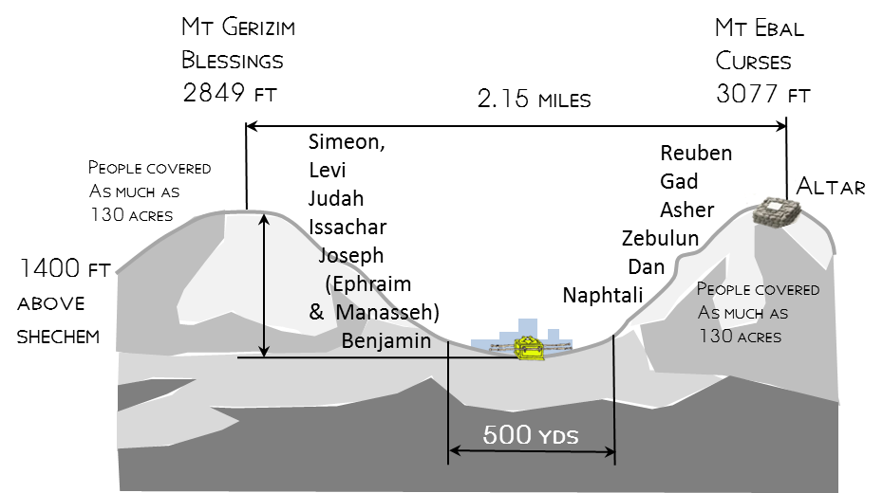

Slide 23
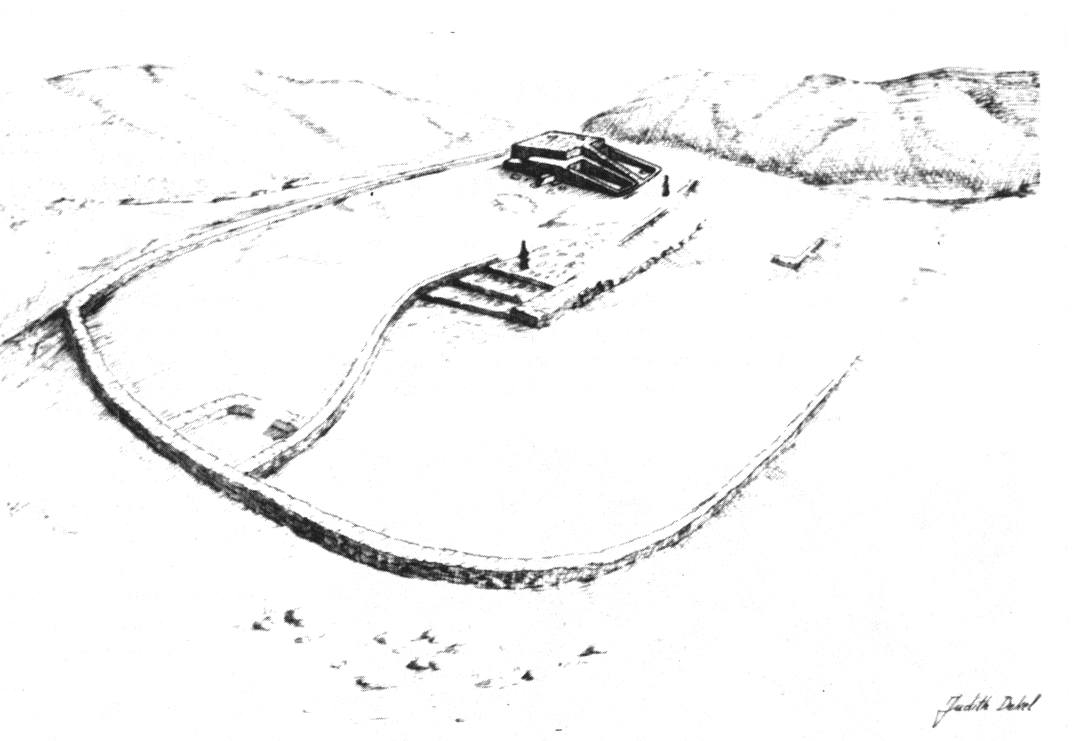
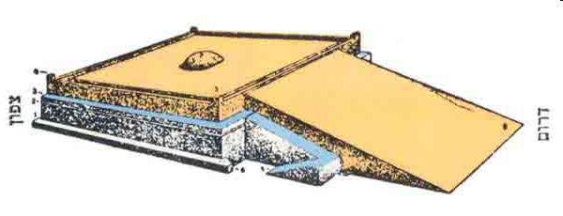
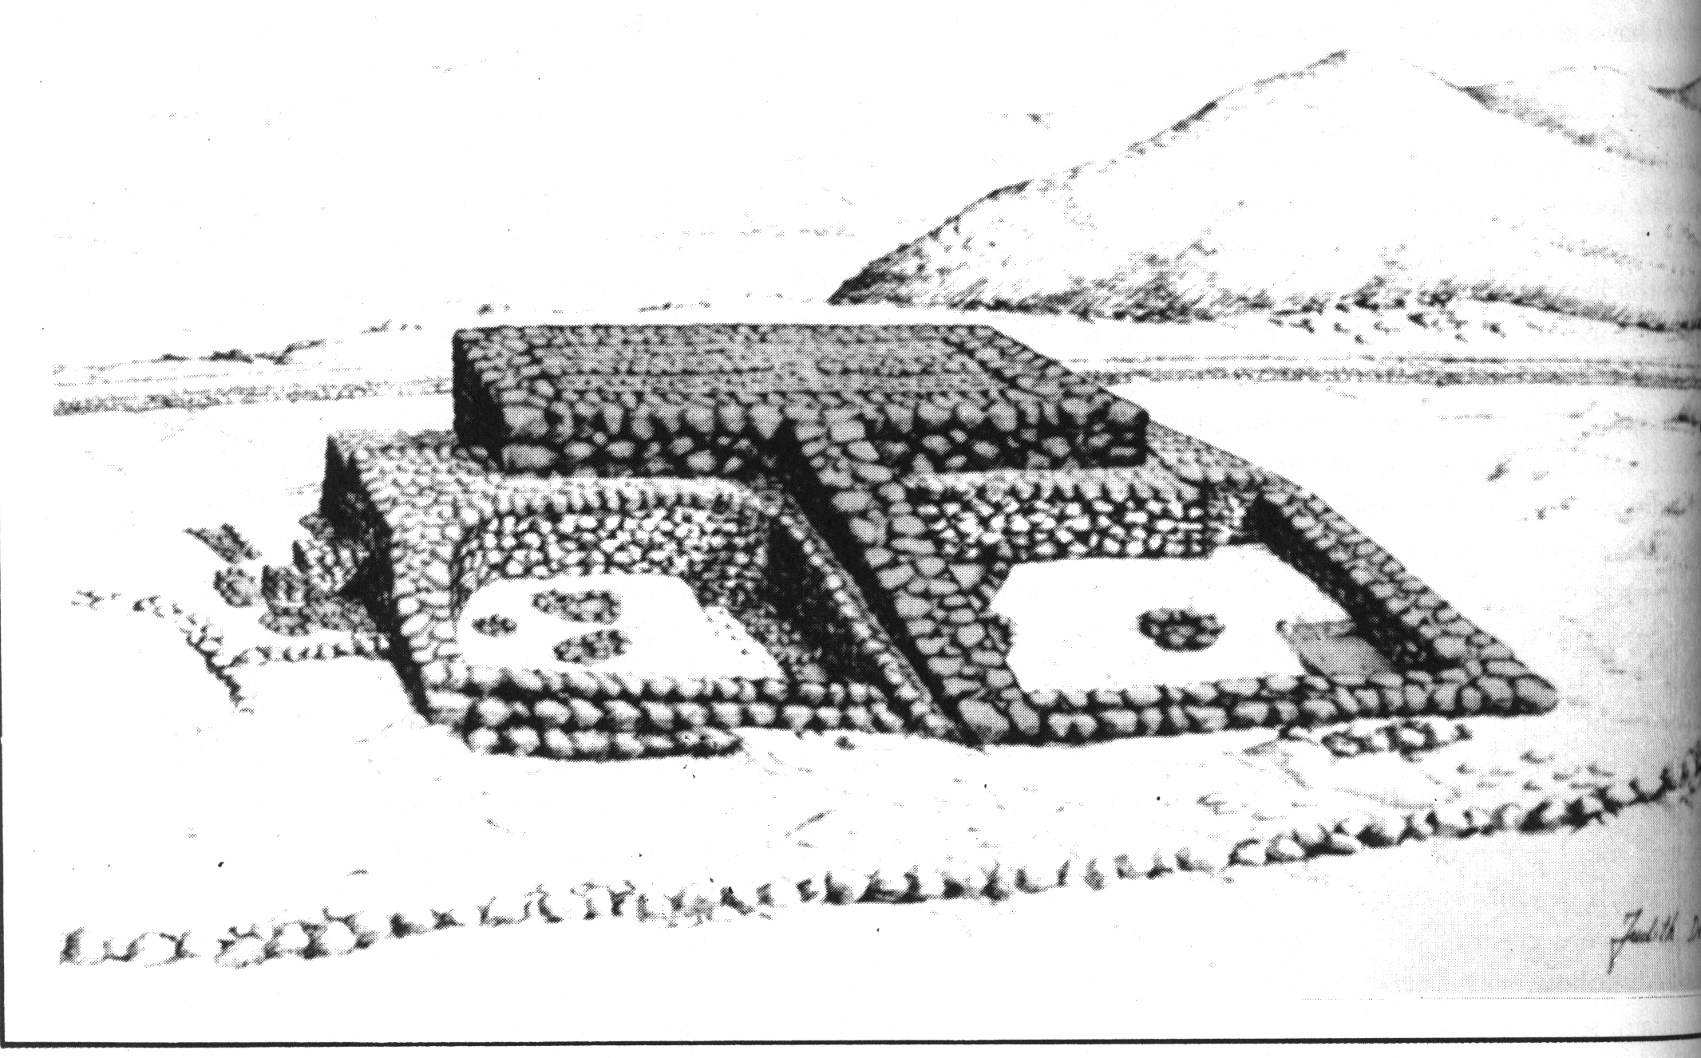
Altar at Mt. Ebal
Joshua 8:30 (ESV) ³⁰ At that time Joshua built an altar to the LORD, the God of Israel, on Mount Ebal,

Slide 25
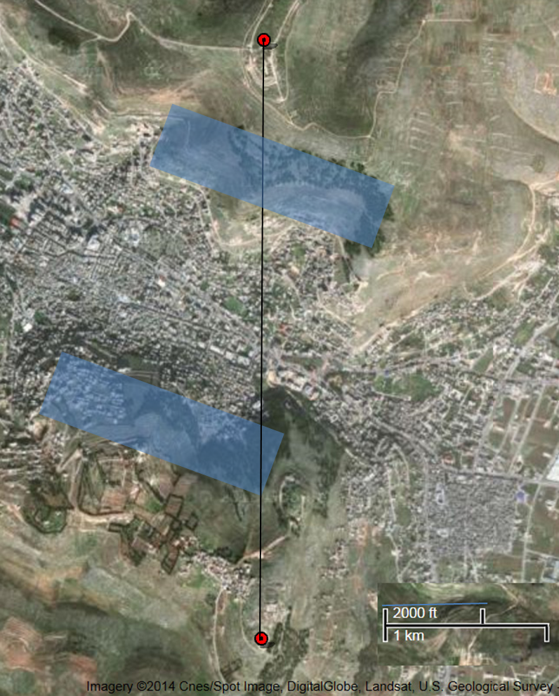
How much Space needed on the sides of Mountain?
Joshua 8:35(ESV) ³⁵There was not a word of all that Moses commanded that Joshua did not read before all the assembly of Israel, and the women, and the little ones, and the sojourners who lived among them.
ft wide | ft deep | space per person
1.5 | 3 | 4.5 | sq ft
 |  | 1250000 | people - bible ca site
 |  | 5625000 | total sq ft
 |  | 43500 | sq ft/acre
 |  | 129 | acres
130 acres

Slide 26
Natural Amphitheater at Shechem

Slide 27
Mt. Ebal
Sychar
Michmethath Valley
Shechem
(Tell Balata)
Jacob’s
Well
Balata
refugee camp
Mount Ebal, Shechem and Michmethath panorama
Notes:
tb052106504

Slide 28
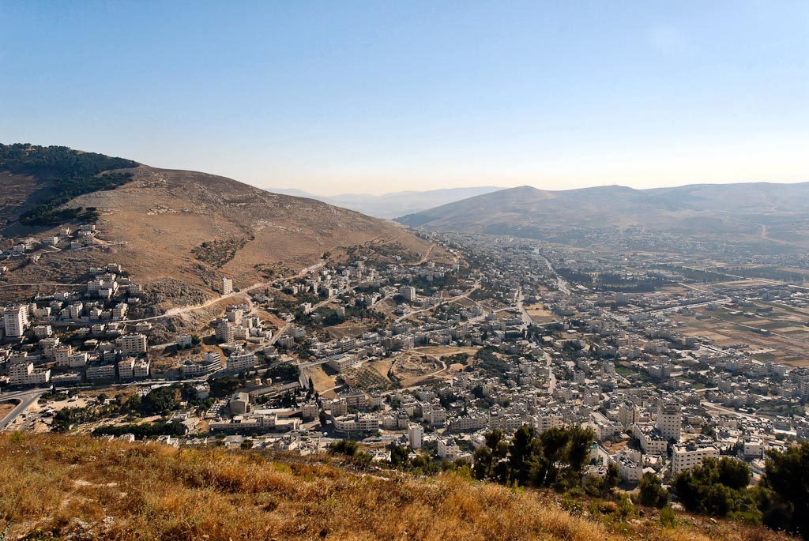
Mt. Ebal
Sychar
Shechem
(Tell Balata)
Mt. Gerizim
Shechem, Mount Ebal, Sychar from Mount Gerizim
Notes:
tb070507675

Slide 29
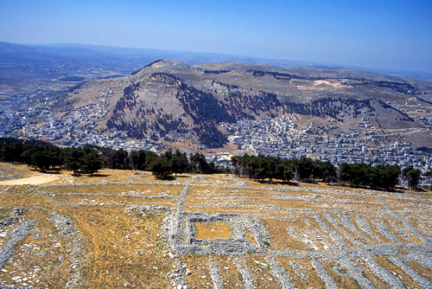
View of Mount Gerizim from above Mount Ebal.
Mt. Ebal
Curses
Mt. Gerizim
Blessings

Slide 30
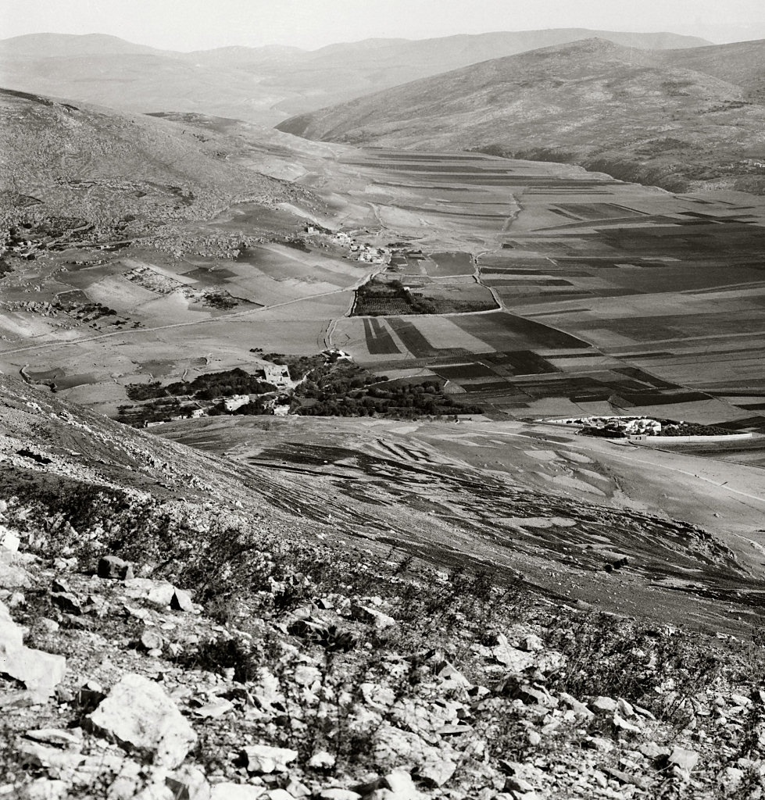
Looking north from Mount Gerizim
Mt. Ebal
Sychar
Tell Balata (Shechem)
Jacob’s Well
Looking north from Mount Gerizim
Notes:
“Nâblûs, the ancient Shechem, has been described by every traveller in Palestine. Situated in the most beautiful position possible, the modern town is also on the site of an overwhelming crowd of scriptural events. Mount Gerizim, ‘the Mountain of Blessing,’ is on its south; Mount Ebal, ‘the Mountain of Cursing,’ on the north. Its history begins 4,000 years ago, when as yet Jerusalem had no existence. To run through it seems like running through the history of the Bible, from Abraham to our Lord. Here is Jacob’s Well, a site accepted nominally; here is the traditional tomb of Joseph; here was the ancient temple of the Samaritans; here where they annually kept the Feast of the Passover; here where the Law was read, Israel standing half over against Mount Gerizim, and half over against Mount Ebal” (Besant 1873: 199-200).
“Those mountains were now before us in all their beauty; Mount Gerizim, crowned by a Wely on its highest point, bearing North; just beyond it the entrance of the valley of Nâbulus bearing nearly N. N. East; further North the rugged heights of Mount Ebal; and then the fine plain extending beyond towards the N. N. E. skirted on its eastern side in its whole length by tracts of picturesque though lower hills” (Robinson and Smith 1841: 3: 92).
Date of photograph: between 1910 and 1920
mat05142

Slide 31
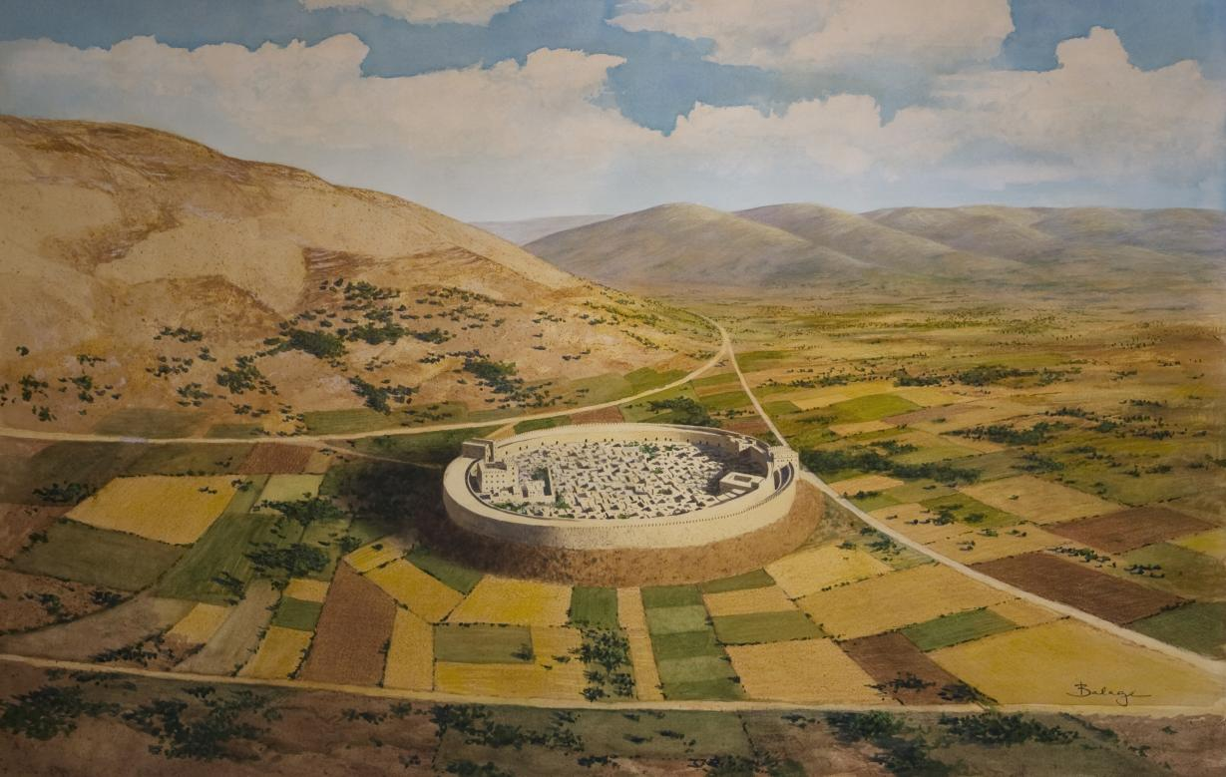

Slide 32
Shechem Strata
Late Bronze Age I | 1550-1400 BC |  | Exodus 1446 BC Conquest 1406- BC | Exodus/Conquest

Slide 33
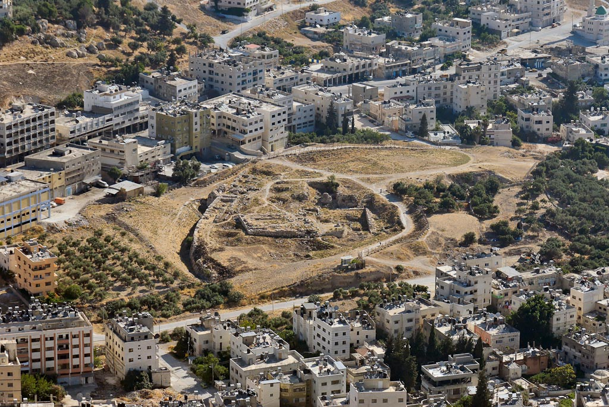
Late Bronze Age I | 1550-1400 BC |  | Exodus 1446 BC Conquest 1406- BC | Exodus/Conquest
Middle Bronze
gate
Middle Bronze
wall
standing stone
Baal Berith temple
Shechem, Tell Balata, from Mount Gerizim
Notes:
tb070507673

Slide 34
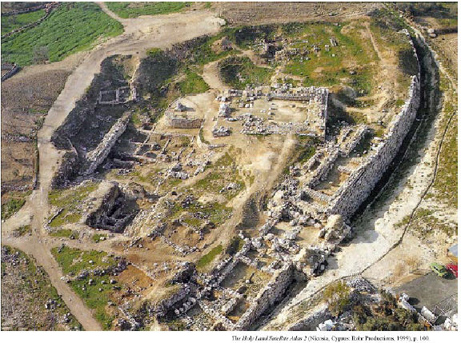

Slide 35
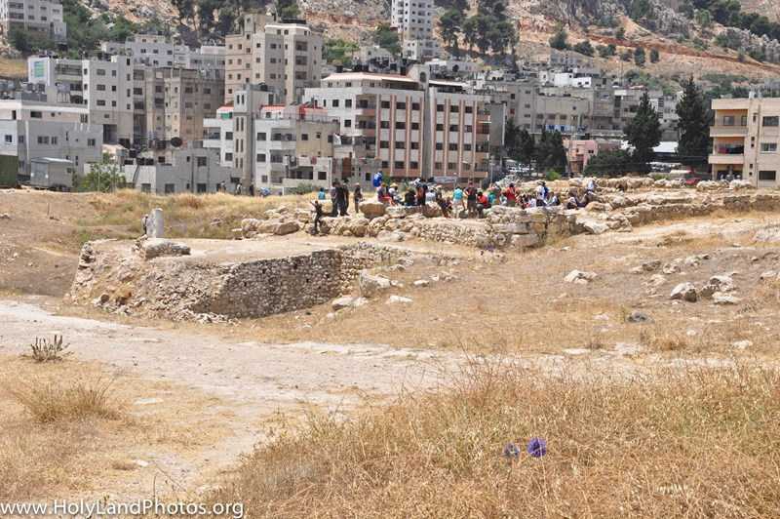
Fortress/Temple
Notes:
View looking west–southwest at the "Fortress Temple." The temple dates to the Middle and Later Bronze Ages (ca. 1650–1200 BC). The group of people is standing in the entrance to the temple. On the left side of the image the rebuilt courtyard of the fortress/temple is visible as is, on the far left, the standing stone.
Note in the background all of the modern buildings of Nablus on the lower slope of Mt. Gerizim.

Slide 36
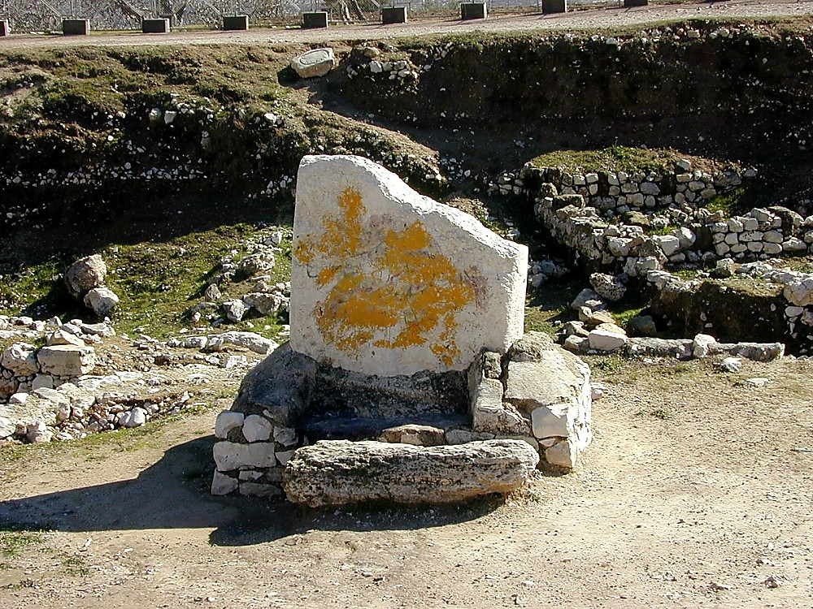
Shechem, Tell Balata, standing stone
Notes:
This stone pillar (massebah) found at Shechem may be similar to the one that Joshua set up as a witness to the renewal of the covenant.
tb011300115

Slide 37
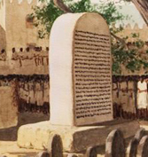
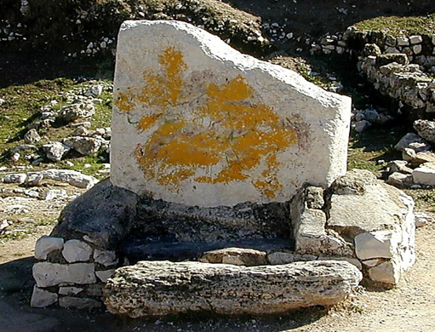
What would be gained from copying the law on stone & from reading the law to the people (Deut 27:2-4)?
stone pillar (massebah) found at Shechem may be similar to the one that Joshua set up as a witness to the renewal of the covenant.
Notes:
Deuteronomy 27:2-3(ESV)
2And on the day you cross over the Jordan to the land that the Lord your God is giving you, you shall set up large stones and plaster them with plaster.
3And you shall write on them all the words of this law, when you cross over to enter the land that the Lord your God is giving you, a land flowing with milk and honey, as the Lord, the God of your fathers, has promised you.

Slide 38
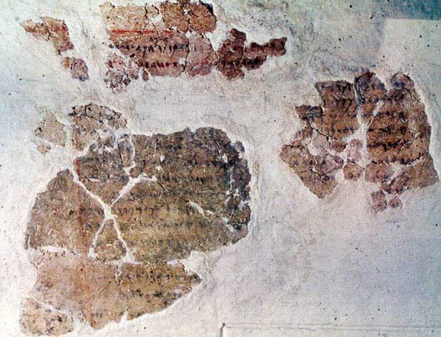
The sayings of Balaam, son of Beor, the man who was a seer of the gods.” It is written with ink on plaster and refers to the non-Israelite prophet known from Numbers 22–24
What would be gained from copying the law on stone & from reading the law to the people (Deut 27:2-4)?
Deuteronomy 27:2-3(ESV)
2And on the day you cross over the Jordan to the land that the Lord your God is giving you, you shall set up large stones and plaster them with plaster.
3And you shall write on them all the words of this law, when you cross over to enter the land that the Lord your God is giving you, a land flowing with milk and honey, as the Lord, the God of your fathers, has promised you.
stone pillar (massebah) found at Shechem may be similar to the one that Joshua set up as a witness to the renewal of the covenant.
Notes:
Deuteronomy 27:2-3(ESV)
2And on the day you cross over the Jordan to the land that the Lord your God is giving you, you shall set up large stones and plaster them with plaster.
3And you shall write on them all the words of this law, when you cross over to enter the land that the Lord your God is giving you, a land flowing with milk and honey, as the Lord, the God of your fathers, has promised you.

Slide 39
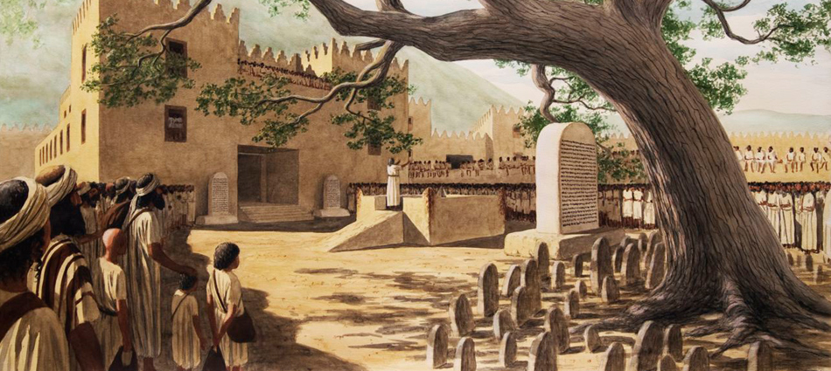
Deuteronomy 27:7-8(ESV) ⁷and you shall sacrifice peace offerings and shall eat there, and you shall rejoice before the Lord your God. ⁸And you shall write on the stones all the words of this law very plainly.”

Slide 40
Joshua 24
²⁷And Joshua said to all the people, “Behold, this stone shall be a witness against us, for it has heard all the words of the Lord that he spoke to us. Therefore it shall be a witness against you, lest you deal falsely with your God.”

Slide 41
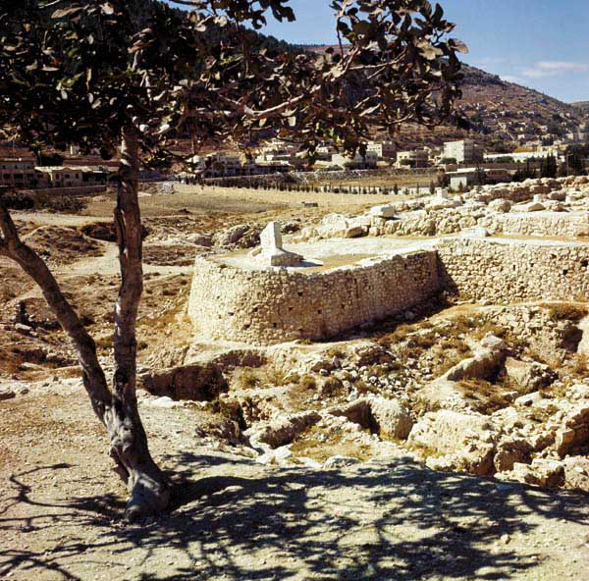
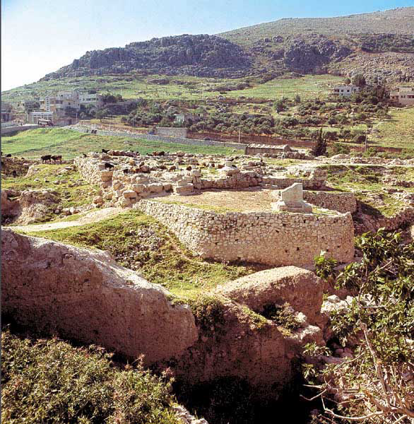
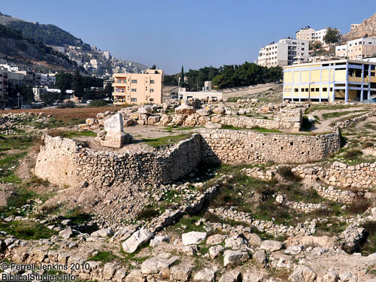

Slide 42
Shechem standing stone
Shechem standing stone
Notes:
This stone pillar (massebah) found at Shechem might be similar to the one that Joshua set up as a witness to the renewal of the covenant.

Slide 43
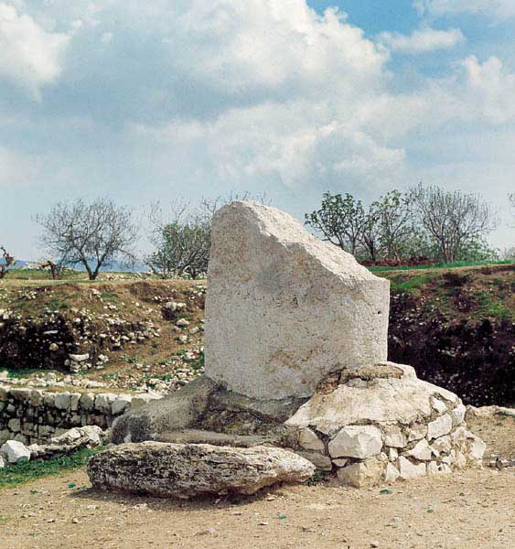
A great white slab, today only about half its original 10-foot-height, still meets visitors to Shechem’s fortress-temple. The slab, or masseba, had two smaller counterparts, which flanked the temple entrance

Slide 44
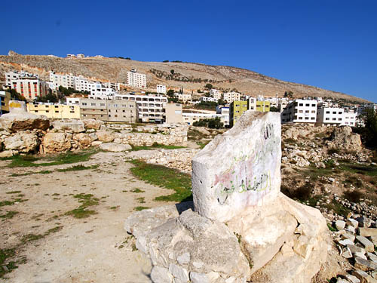
The sacred standing stone at Shechem.
Dr. Bryant Wood says,
Since the temple existed in Joshua’s day, it is possible this was the “large stone” he set up “under the oak that was by the sanctuary of the Lord” at Shechem (Josh. 24:26). The stela is undoubtedly the “pillar” where Abimelech was made king (Judges 9:6)”
(Bryant Wood. “From Ramesses to Shiloh.” Giving the Sense. Kregel, 2003).
Photo by Ferrell Jenkins

Slide 45
Joshua 8
³²And there, in the presence of the people of Israel, he wrote on the stones a copy of the law of Moses, which he had written.
Deuteronomy 27
²And on the day you cross over the Jordan to the land that the Lord your God is giving you, you shall set up large stones and plaster them with plaster.
³And you shall write on them all the words of this law, when you cross over to enter the land that the Lord your God is giving you, a land flowing with milk and honey, as the Lord, the God of your fathers, has promised you.

Slide 46
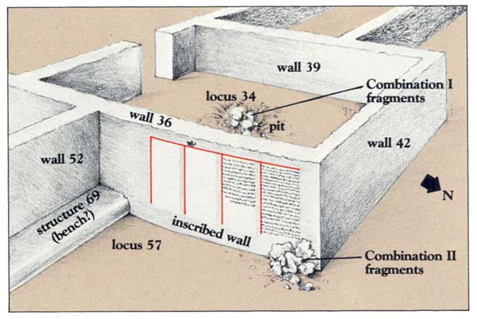
This inscription found at Deir ‘Alla, in Jordan, begins,
“The sayings of Balaam, son of Beor, the man who was a seer of the gods.” It is written with ink on plaster and refers to the non-Israelite prophet known from Numbers 22–24;
BAR 29:04 (July/Aug 2003).

Slide 47
The first mention of Shechem in the Bible is Genesis 12:6, when Abram first entered Canaan. It is succinctly described: “Abram traveled through the land as far as the site of the great tree of Moreh at Shechem.” At that time, God promised Abram, “To your offspring I will give this land” (Gn 12:7). The next mention of Shechem is 11 chapters,
and about 200 years, later, when the Bible records that Jacob, Abram’s grandson, “camped within sight of the city” (Gn 33:18).
Assuming a conservative dating for the Patriarchal events in the Bible,3 note that Abram camped in Canaan about 2090 BC and there is no mention of a city. However, when Jacob arrived 200 hundred years later, around 1890 BC, the Bible notes that he “camped within sight of the city [Shechem].” In the original Hebrew, the word translated in our English Bible as “city” meant a permanent, walled settlement (Hansen 2003:81, Wood 1999:23). Genesis 34:20 and 24 report that Shechem had a city gate; therefore it was fortified.
Can archaeology clarify if there was or was not a city? Yes. The absence of a “city” and walls at Tell Balata when Abram came through and the existence of a city in the time of Jacob is in complete agreement with what the Bible indicates is Shechem’s early history.
Excavations have revealed that the earliest urbanization at Tell Balata was in MB I (Levels XXII-XXI), about 1900–1750 BC. MB I was when Jacob lived by the city of Shechem. Prior to MB I, in the time of Abram’s visit, archaeology has demonstrated that there was a gap in settlement and an absence of fortification walls. Thus, there was no “city” for Abram to reference, as the Bible correctly infers (Campbell 1993: 1347).

Slide 48
Joshua fulfilled Moses’ instructions and led the people directly to Gerizim and Ebal after defeating the stronghold at Ai (Jos 7–8). Assuming an “early Exodus” date (1446 BC), the Israelite entry into Canaan, after 40 years in the wilderness, was approximately 1406 BC, in the Late Bronze (LB) IB period.4 LB IB corresponds with Tell Balata’s Level XIV (Campbell 1993: 1347; Toombs 1992: 1178). During the 350 years of the previous MB period, the city had been fortified with earthen embankments and cyclopean wall fortifications. However, Shechem was destroyed around 1540 BC. The ferocity of the destruction resulted in debris covering the city up to a depth of 5.25 ft (1.6 m). It is surmised that the Egyptian armies of Ahmose I or Amenhotep I were the aggressors (Toombs 1992: 1182).
About 90 years after that catastrophe the city was rebuilt early in the LB I period, around 1450 BC. Level XIV corresponds to this date and is noted for the reconstruction of the city’s defensive walls, homes, and a well built, fortress-type, temple. This Level XIV occupation was the city at which Joshua and the Israelites arrived to fulfill Moses’ orders to read the Law before Ebal and Gerizim around 1406 BC.
The Book of Joshua makes an interesting observation about that visit:
All Israel, aliens and citizens alike.... were standing on both sides of the ark of the covenant of the LORD, facing those who carried it.... There was not a word of all that Moses had commanded that Joshua did not read to the whole assembly of Israel, including the women and children, and the aliens who lived among them (Jos 8:33, 35).
It appears that the crowd who heard the words of the Law that day was composed of both Israelites and native Shechemites (aliens)! The Bible implies that both Shechemites and Israelites co-existed at Shechem. This unusual situation can be further confirmed by the fact that Shechem became one of only three Israelite Cities of Refuge on the west side of the Jordan River, as well as being a city of the Levitical priesthood (Jos 20:7; 21:21). All this occurred even though there is no record in the Bible of it being taken in battle.5
Years later, Joshua again gathered the Israelites at Shechem (Jos 24). He reminded them of God’s promises and how He had fulfilled those promises and delivered them from diversities. Joshua then challenged the people to say whom they would serve and they promised to serve God (Jos 24:14–20). The renewal ceremony between the Israelites and God recognized the promises God made to Abraham (Gn 12:7; 17:7, 8), Jacob, and the people at Sinai through Moses (Ex 24:8).

Slide 49
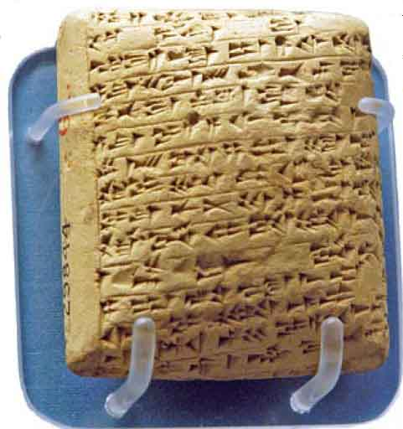
Late Bronze Age II | 1400-1200 BC | Amarna Period ~1386-1334 BC |  | Judges
The discovery of a LB Egyptian library at Amarna has provided additional insights on the LB period. Letters in the library reveal Egypt’s relationship with Canaan’s rulers in the mid-14th century BC. Some of the letters disclose that the kings of Shechem were independent of Egypt. Further, Shechem’s rulers were criticized by other Canaanite rulers for cooperating with an invading group of desert people called the Habiru. Many conservative evangelical scholars (e.g., Wood 1997; 2003: 269–71) believe the Habiru were the Israelites of the early Judges period.6
Shechem, to the king of Egypt, probably Amenhotep III. It is defiant in tone, suggesting Labayu had a measure of independence from Egypt (Hess 1993). The letter, numbered El Amarna 252, is written in Akkadian cuneiform, albeit with Canaanite grammar and syntax, and is on display in the British Museum. Mike Luddeni.

Slide 50
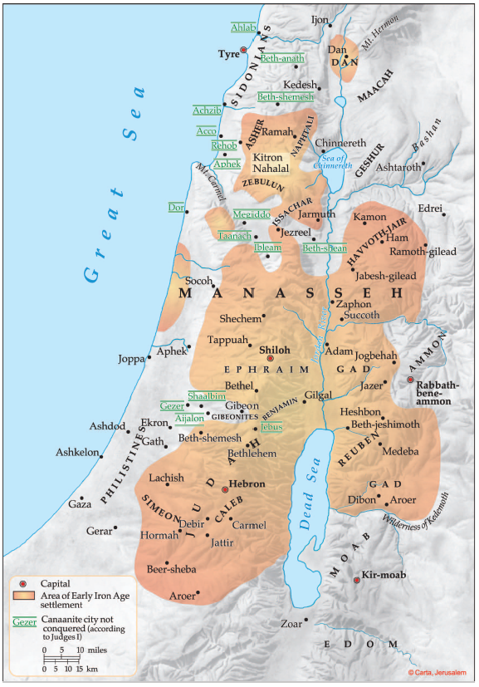
Acco
232-234
235+327
Hazor
227-228
Gath Padalla
249-250
Megiddo
242-248
365
Beth Shan 0
Gezer
292-294
267-277
297-300
378
Pella
255-256
Gath
63-65
278-284
335, 366
Shechem
252-254
Jerusalem
285-291
Ashkelon 320-326
Jericho 0
Gaza 0
Hebron 0?
Lachish
328-332

Slide 51
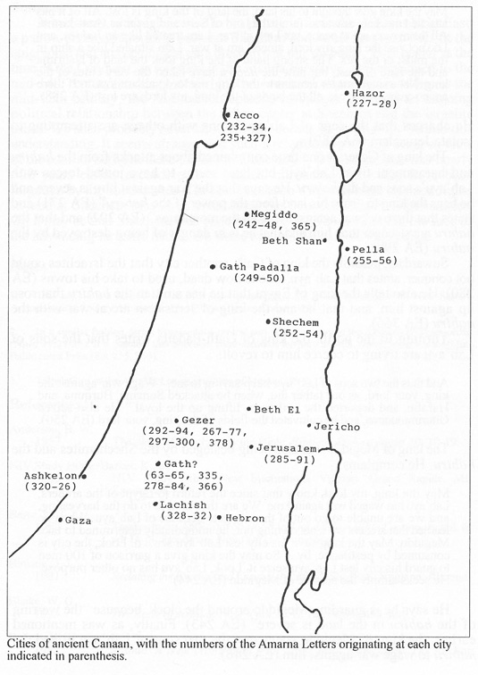
Notes:
The Amarna Letters
The Conquest of Canaan did not end with the covenant ceremony of Joshua 24. The tribes continued the struggle in their individual allotments for many decades, as documented in the book of Judges, and reflected, I believe, in the Amarna Letters (abbreviated as EA plus letter number). The debate over the possible connection between the habiru of the Amarna Letters and the biblical Israelites is well known. The term habiru is a social designation meaning fugitive or refugee, which was in use throughout the ancient Near East for most of the second millennium (Lemche 1992). While every reference to habiru in the Amarna Letters does not necessarily refer to the Israelites, if the Israelites came into the land at the end of the 15th century, as the Bible indicates, and if the Israelites were involved in an armed struggle to gain control of the central hill country, as the Bible also indicates, then at least some of the references to habiru in the areas where the Israelites were active must refer to the Israelites (Merrill 1987: 102-108). Such an assumption correlates quite well with the biblical data and the information gleaned from the Amarna Letters.
A number of the Amarna Letters indicate that the Shechemites were working with the habiru/Israelites to expand their territory. Since Lab'ayu was a third generation ruler (EA 253), there was continuity in leadership from the time of the conquest. This could account for a continuing relationship between the Shechemites and the Israelites/habiru. We have three letters from the king of Shechem (EA 252-254). In one letter, Lab'ayu has a somewhat defiant tone, much different than the letters from the other city states (EA 252; Campbell 1965: 195-196; Hess 1993: 99) This, coupled with the fact that Shechem was fortified during this period, suggests that Shechem was somewhat independent of Egyptian control and was pursuing its own best interests.
The king of Jerusalem complains that Lab'ayu gave the land of Shechem to the habiru (EA 289). The sons of Lab'ayu, and Miliku, king of Gezer, are accused of giving the land of the king (of Egypt) to the habiru (EA 287). The king of Megiddo charges that "two sons of Lab'ayu have indeed given their money to the habiru and to the Suteans in order to wage war against me" (EA 246).(3) Lab'ayu answers the charge that his son was "consorting with the habiru" (EA 254). These allusions suggest a close alliance between Lab'ayu and the habiru (Harrelson 1957: 7, 8; Reviv 1966: 253-255).
A number of the Amarna Letters indicate that, in the mid- 14th century, the habiru and the Shechemites were attempting to subdue areas that the Israelites failed to subdue during the Conquest. The Israelites were able to take most of the south, with the notable exception of Jerusalem and the Shephelah. The king of Jerusalem complained loud and long to the king of Egypt that he was being besieged by Lab'ayu and the habiru. He pleads:
May the king give thought to his land; the land of the king is lost. All of it has attacked me. I am at war as far as the land of Seru and as far as Ginti-kirmil. All the mayors are at peace, but I am at war. I am treated like an habiru, and I do not visit the king, my lord, since I am at war. I am situated like a ship in the midst of the sea. The strong hand of the king took the land of Nahrima and the land of Kasi, but now the habiru have taken the very cities of the king. Not a single mayor remains to the king, my lord ; all are lost. ... If there are no archers this year, all the lands of the King, my lord, are lost (EA 288).
He charges that the sons of Lab'ayu, along with others, are attempting to isolate Jerusalem (EA 289).
The king of Gezer at one time complained about attacks from the habiru and harassment from Lab'ayu, but later seems to have joined forces with Lab'ayu's sons and the habiru. He says that the war against him is severe and he begs the king to "save his land from the power of the habiru" (EA 271) and states that there is "war against me from the mountains" (EA 292) and that the habiru are stronger than him and that he is in danger of being destroyed by the habiru (EA 299).
Suwardata, possibly the king of Gath, another city that the Israelites could not conquer, states that Lab'ayu, who is now dead, used to take his towns (EA 280). He also tells the king of Egypt that he has smitten the habiru that rose up against him, and that he and the king of Jerusalem are at war with the habiru (EA 366).
Turning to the north, the king of Gath-Padella writes that the sons of Lab'ayu are trying to coerce him to revolt:
And thus the two sons of Lab'ayu keep saying to me, "Wage war against the king, your lord, as our father did, when he attacked Sunama, Burquna, and Harabu, and deported the evil ones, lifting up the loyal." He also seized Gittirimmunima, and he cultivated the fields of the king, your lord (EA 250).
The king of Megiddo was also being besieged by the Shechemites and the habiru. He complains:
May the king, my lord, know that since the return to Egypt of the archers, Lab'ayu has waged war against me. We are thus unable to do the harvesting, and we are unable to go out of the city gate because of Lab'ayu. When he learned that archers were not coming out, he immediately determined to take Megiddo. May the king save his city lest Lab'ayu seize it. Look, the city is consumed by pestilence, by... So may the king give a garrison of 100 men to guard his city lest Lab'ayu seize it. Look, Lab'ayu has no other purpose. He seeks simply the seizure of Megiddo (EA 244).
He says he is guarding Megiddo around the clock, because "the warring of the habiru in the land is severe" (EA 243). Finally, as was mentioned earlier, the king of Megiddo states that the two sons of Lab'ayu bribed the habiru to wage war against him (EA 246).
Summary
In summary, although I can offer no parallels from the Ancient Near East, a patron-client relationship between Shechem and Israel seems to best fit the epigraphic and archaeological data presently at our disposal. This began at the time of the Conquest, as reflected in the Joshua narrative, and continued to the mid-14th century, as demonstrated by the Amarna Letters, Even as late as the mid-12th century, the Abi-melech episode of Judges 9 shows an ongoing political relationship between the urban center at Shechem and the Israelite tribes. We shall probably never know the full details as to what lay behind this understanding. It seems strange that such a relationship should occur in view of the conflict between these parties in Genesis 34. Of course, that was nearly 500 years earlier according to a biblical chronology and may have been forgotten by the Shechemites. The fact that Jacob's descendants retained rights to land at Shechem may have maintained ties between the two communities. Or, it may be that Shechem was concerned about its own safety in the face of the advancing Israelite tribes. On these matters we can only speculate.
This article first appeared in: The Role of Shechem in the Conquest of Canaan. Pp. 245-56 in To Understand the Scriptures: Essays in Honor of William H. Shea, ed. David Merling. Berrien Springs MI: The Institute of Archaeology/Siegfried H. Horn Archaeological Museum (1997). Posted with permission.

Slide 52
Abimelech and the Men of Shechem: Judges 9:1-6, 22-57
Abimelech, a son of Gideon the Judge declares himself a king with the help of the men of Shechem, but both meet a bad end. From the bible passage what archaeology remains might give us further insight into the passage?
Archaeology can add to Bible Event:
Build confidence in general trustworthiness, historical nature and reliability of Bible
Confirm events described in Bible
Clarify/Correct/Provide Understanding about our assumptions and conclusions about the past
Complement or Enhance our knowledge of events, customs and people
Prove a given event or people mentioned in the Bible

Slide 53
Temple at Shechem
BAR July/August 2003 – pg 26
Lawerence E Stager
Dorot Professor
of Archaeology of Israel
at Harvard University
Student of G. Ernest Wright
Will Relate Bible Stories to Archaeology
Supports Documentary Hypothesis
Likes Comparative Analysis
& Inventive Event Construction

Slide 54
Archeological evidence indicates a general decline in the city during the twelfth century BC: dilapidating buildings with poor rebuilding. The end of the Iron age I period marked the destruction of Shechem (heaps of destruction were found dating around 1120 BC). {28} This is consistent with the biblical record of the destruction Judges 9:40-49. (footnote entire text). There is no evidence that the temple was ever rebuilt. {29}
Abimelech’s maternal kin persuaded the notables of Shechem to give Abimelech 70 shekels of silver from the “house of ba‘al-berith” (that is, the temple of the “Lord of the Covenant” [Judges 9:4], apparently an epithet for El-berith [Judges 9:46])—the temple we will be examining more closely here. With the money, Abimelech hired a band of ruffians and slew his 70 half-brothers, all except the youngest, so the story goes, who escaped the slaughter by hiding; Abimelech was declared king of the region at the “Oak-of-the-Pillar in Shechem” (Judges 9:6).³

Slide 55
G. Ernest Wright

Slide 56
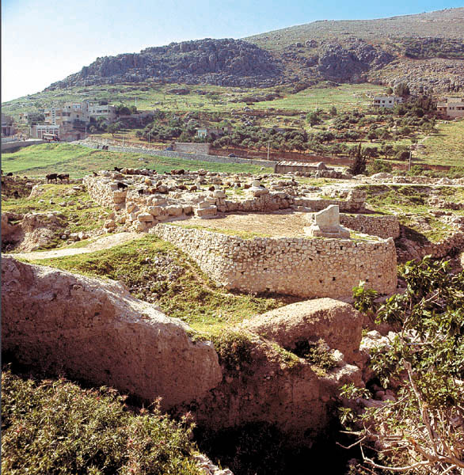
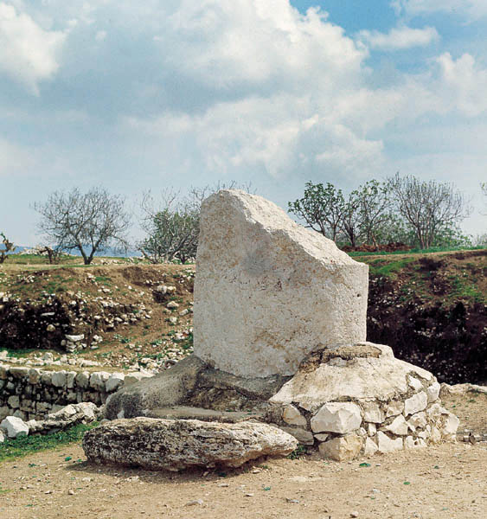
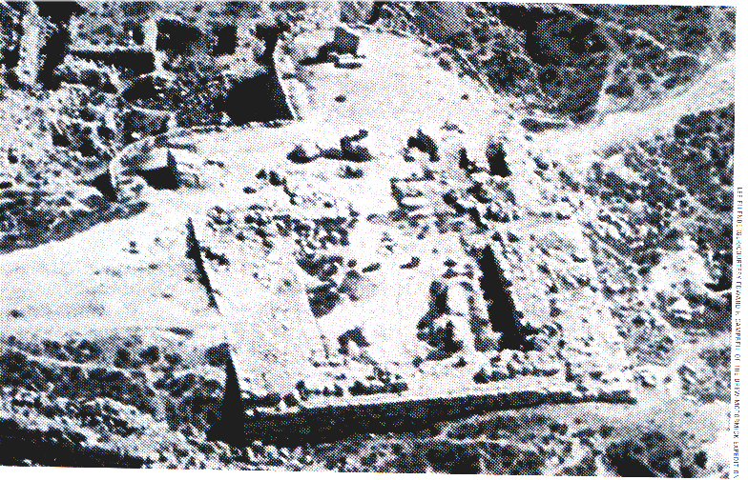
Temple at Shechem
. An enormous limestone stela, or massebah, stood 6.6 ft (2 m) further to the southeast. It is 4.8 ft (1.48 m) wide, 1.4 ft (42 cm) thick, and, although broken, 4.8 ft (1.45 m) high. Since the temple existed in Joshua’s day, it is possible this was the “large stone” which he set up “under the oak near the holy place of the Lord” at Shechem (Jos 24:26; Stager 2003: 68; 1999: 242; Campbell and Ross 1963: 11). The stela is undoubtedly the “pillar” where Abimelech was made king (v. 6; Stager 2003: 31, 33; 1999: 242; Campbell and Ross 1963: 11).

Slide 57
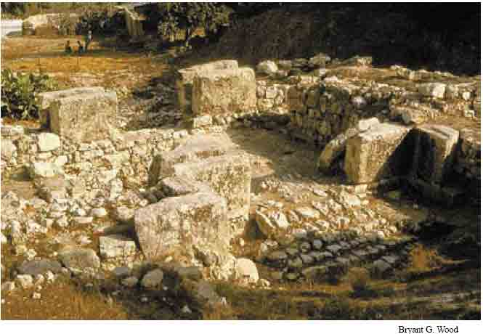
East Gate at Shechem where Zebal and Gaal watched Abimelech’s forces advance on the city as dawn was breaking (Jgs 9:345–40). One entered the gate from a cobbled street that ran along the city wall (left side of photo), through the gate and down five steps into the city.

Slide 58
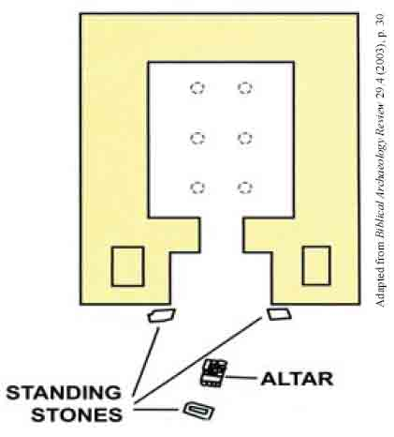
Plan of the fortress temple at Shechem, showing the locations of the altar and standing stones (Hebrew, masseboth) in the courtyard in front.

Slide 59
Destruction Level Abimelech “destroyed the city and scattered salt over it” (v. 45). Abundant evidence was found throughout the site that a violent destruction had occurred at the time of Abimelech (Seger 1997: 22; Toombs 1993: 1347; 1992: 1178,1184; 1979: 70, 71, 72, 73, 78; 1976:58, 59; 1972: 106; Wright 1967: 364; 1965: 101–102). Lawrence Toombs, one of the excavators of Shechem, described the devastation as follows (1979: 73): The Iron I city underwent violent destruction, which obliterated its buildings and left the site a wilderness of ruins. At the time of its destruction, the culture of the city was fully developed Iron I. The end of the Iron I city is almost certainly to be attributed to its capture by Abimelech (Judges 9). The excavators date the destruction to ca. 1125–1100 BC

Slide 60
Temple’s History
Building 5900 (the Granary) was in use during Iron Age II (860–810 B.C.E.)
In 1926 German Excavator
Ernst Sellin dug a trench
GE Wright = 1650 to 1550 BC
LE Stager = 1650 to 1100 BC
GE Wright
= 1450 to 1125 BC
LE Stager
= No Temple 2
GE Wright & LE Stager
= 860 to 810 BC
Note: 4 Room Design
That Temple 1 is the temple referred to in Judges 9 is far more compelling. For Temple 1 is indeed an impressive structure—a real Migdal (Tower/Fortress) Temple. Unlike the imaginary Temple 2, Temple 1 was large enough to hold the thousand desperate Shechemites described in Judges 9,
Lower than
5903
Wider than
5904
BAR July/August 2003
Lawerence E Stager

Slide 61
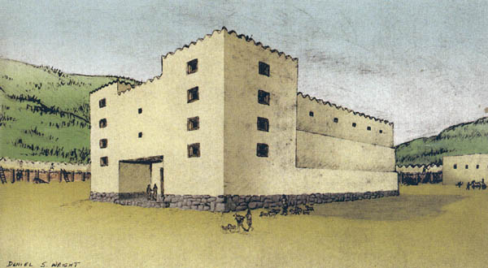
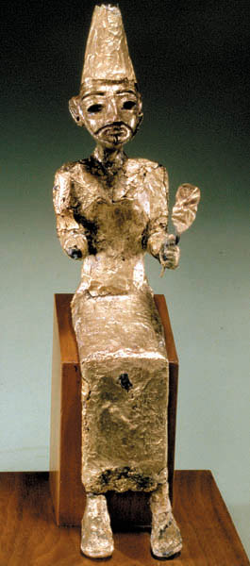
Judges 9 – Temple/Stronghold at Shechem
El-Berith
Megiddo
⁴⁶Now when all the men of the tower of Shechem had heard that, they entered the stronghold of the temple of the god Berith. ⁴⁷And it was told Abimelech that all the men of the tower of Shechem were gathered together. … ⁴⁹So each of the people likewise cut down his own bough and followed Abimelech, put them against the stronghold, and set the stronghold on fire above them, so that all the people of the tower of Shechem died, about a thousand men and women.
Notes:
Temple of Baal-berith References to the “temple of Baal-Berith” (v. 4), “Beth-Millo” (vv. 6, 20), “temple of their god” (v. 27), “tower of Shechem” (vv.46, 49) and “temple of El-Berith” (v. 46) all appear to be the same structure at Shechem (Stager 2003; 1999: 242, 245; Toombs 1992:1184; Campbell 1983: 269; Campbell and Ross 1963: 16). Berith is the Hebrew word for covenant, so the temple was for “Baal of the covenant.” A large fortress temple discovered on the acropolis of Shechem has been identified as the temple of Judges 9 (Stager 2003; 1999). It was constructed in the 17th century BC and lasted until the destruction of the city by Abimelech in the 12th century BC. The largest temple yet found in Canaan, it measures 70 x 86.3 ft (21.2 x 26.3 m), and has foundations 17 ft (5.1 m) thick that supported a multistoried superstructure of mud bricks and timber.

Slide 62
Notes:
Abimelech’s attack on Shechem culminates with the “notables of the Tower of Shechem” taking refuge in the seriah—sometimes translated as “the stronghold”—of the Temple of El-berith (Judges 9:46). Abimelech and his troops gathered brushwood and “laid it against the seriah and they set the seriah on fire over [or against] them, so that all the people of the Tower of Shechem also died, about a thousand men and women” (Judges 9:46, 49).
The word seriah remains a conundrum (it appears only one other time in the Hebrew Bible, in 1 Samuel 13:6, but its use there does not help us understand its meaning here). Some scholars have interpreted seriah to mean a rockcut tunnel or chamber. Taking into consideration the context of Judges 9, I would suggest that seriah refers to the corridors or ambulatory inside the walls that surrounded Shechem’s temple on three sides. It seems unlikely that the 16.7-foot-thick foundation wall of the temple rose two or three stories high as solid walls. More likely, the side walls consisted of parallel interior and exterior walls with room enough between them for corridors. Later analogies can perhaps be found in the three-story “side rooms” attached to Solomon’s Temple in Jerusalem (1 Kings 6–7). Archaeological remains of a well-preserved temple at ’Ain Dara, in Syria, provide a contemporary parallel to the Jerusalem Temple.ª The outer stone walls of the ’Ain Dara temple are 18 feet thick at the base. Parallel walls once built several stories high on the thick stone socles (base) still stand high enough to create corridors 6.6 feet to 8.2 feet wide on three sides of the temple. Access to the ambulatory was through a side door of the great portico at the front of the building.¹
I can imagine such doors leading into one or both of the great towers that flanked the entrance to the Fortress-Temple at Shechem. At ground level the corridor would have the appearance of a rather dark, narrow tunnel. Stairwells in the temple towers led to upper stories. Like the “side rooms” of the Jerusalem Temple (see 1 Kings 6:6), the interior of the corridors at the upper levels of Shechem’s Fortress-Temple would have become increasingly more spacious as the load-bearing side walls became narrower. If this were the seriah to which the elite of Shechem fled to escape Abimelech in Judges 9, smoke from bonfires at the entrance of the corridors would have suffocated many of the people crowded inside; bonfires laid up against the outer walls of the temple would have roasted the rest.

Slide 64
Time of Judges - Abimlech

Slide 68
Rehoboam & Jeroboam: 1 Kings 12:1-17,25
Abimelech, a son of Gideon the Judge declares himself a king with the help of the men of Shechem, but both meet a bad end. From the bible passage what archaeology remains might give us further insight into the passage?
Archaeology can add to Bible Event:
Build confidence in general trustworthiness, historical nature and reliability of Bible
Confirm events described in Bible
Clarify/Correct/Provide Understanding about our assumptions and conclusions about the past
Complement or Enhance our knowledge of events, customs and people
Prove a given event or people mentioned in the Bible

Slide 69
Creation
& Fall
& Flood
The
Patriarchs
Exodus & Conquest
Judges
United Kingdom
Divided Kingdom
Exile & Return
Between the Testaments
New Testament

Slide 70
Jesus & the Woman at the Well: John 4:1-26, 39-42
Jesus speaks to a woman at Jacob’s well from a city called Sychar which was near Shechem. Part of the discussion includes the fact that the Samaritans worshiped on Mt Gerizim. From the bible passage what archaeology remains might give us further insight into the passage?
Archaeology can add to Bible Event:
Build confidence in general trustworthiness, historical nature and reliability of Bible
Confirm events described in Bible
Clarify/Correct/Provide Understanding about our assumptions and conclusions about the past
Complement or Enhance our knowledge of events, customs and people
Prove a given event or people mentioned in the Bible

Slide 71
Jacob’s Well
158 ft deep
About 500 yd (460 m) southeast of Tell Balata is an ancient well, venerated to be a well that Jacob, the Patriarch, dug when he lived there. Such a well is not mentioned in the Old Testament. There is a small Arab village, Askar, just north of the well. Most scholars associate Askar with Sychar, the village in John 4 near “Jacob’s well” (Jn 4:6). The authenticity of the well is not only based on its physical identification in John 4, but also on “the fact that all traditions-—Jewish, Samaritan, Christian and Muslim-—support it”
Jacob’s well as it appeared in the 1870s. In the right background is Mt. Gerizim with the tomb of the Arab sheikh, where the ruins of the Samaritan temple were located in New Testament times, visible at the peak. Todd Bolen.

Slide 72
The Gospel of John contains another well-known account involving Samaritans. Jesus meets a Samaritan woman by Jacob’s well near Shechem and asks her for a drink. “How is it that you, a Jew, ask a drink of me, a woman of Samaria?” she asks (John 4:9). Eventually, Jesus reveals himself to her as the Messiah (John 4:25–26). In the course of their conversation, the woman points to Mt. Gerizim and tells Jesus that her forebears “worshipped on this mountain,” whereas the “Jews say that the Temple where God should be worshipped is in Jerusalem” (John 4:20).

Slide 73
A passage in 2 Kings 17 implies that after the Assyrian conquest and destruction of the northern kingdom of Israel in 721 B.C.E., the Assyrians brought foreigners into the land who intermarried with those Israelites who had not been deported; the progeny of these marriages between Israelites and foreigners mixed foreign ways and foreign gods with their allegiance to the Israelite God; these people became the Samaritans (see 2 Kings 17:6, 24, 29–41).

Slide 74
Map of Shechem area showing the location of Tell Balata (ancient Shechem), Joseph’s tomb and Jacob’s Well. ASOR, 2002.
Location and Exploration

Slide 75
Aerial view of the ruins of Shechem. On the right is the Middle Bronze fortification wall and in the upper center the “Migdal,” or fortress, temple. Holy Land Satellite Atlas, 1999, p. 100.

Slide 76
The Samaritan Community
The Samaritans believe that they are the true Israelites of the tribes of Ephraim, Manasseh and Levi. According to tradition, after the destruction of Samaria and the exile of Israel in 722 BC, a small group of Israelites survived the destruction and continued to believe in the sanctity of Mt. Gerizim. The history of the Samaritans during the seventh-sixth centuries BC is shrouded in uncertainly. Only during the time of the return to Zion from the Babylonian exile at the end of the fifth century BC did Sanballat, governor of Samaria, construct a temple on Mt. Gerizim. A large city grew around it and nourished during the Hellenistic period. This city was the spiritual, religious and administrative center of the Samaritan people and unified the Samaritans in Israel and the Diaspora. The temple and city at Mt. Gerizim were destroyed by John Hyrcanus I at the end of the second century BC, a destruction that had a devastating effect upon the Samaritans. For the Hasmonean and Herodian periods we have no evidence for the fate of the Samaritans. The Hasmonean rulers probably attempted to bring them closer to Judaism, perhaps sometimes by force. With the Roman conquest of Israel (63 BC) the Samaritans were liberated from the Hasmonean yoke and serious attempts at renewing their cult at Mt. Gerizim were made. The Romans suppressed these endeavors by force and through the establishment of the city of Flavia-Neapolis (Shechem), put an end to these national-religious aspirations. During the second-fourth centuries AD, the Samaritan community flourished and became firmly rooted in Roman rule and culture.

Slide 77
Bells Pendants Snakes and Stones
A Samaritan temple to the Lord on Mt. Gerizim
BAR 36:06, Nov/Dec 2010
According to the first-century Jewish historian Josephus, the Samaritan leader Sanballat promised to build a temple on Gerizim, the Samaritan’s holy mountain, in imitation of the Jerusalem temple. This, Josephus tells us, occurred at the time of Alexander the Great’s conquest of the Land of Israel (332 B.C.E.).
Notes:
The Samaritan Bible consists only of the Pentateuch, the five books of Moses. Moreover, the Samaritan Pentateuch (or SP, as it is abbreviated in scholarly literature) differs from the standard Hebrew Pentateuch (or MT, for Masoretic Text) in several of important details.
In the MT, upon entering the Holy Land the Israelites are commanded to build an altar on Mt. Ebal (Deuteronomy 27:4), opposite Mt. Gerizim; in the SP, the altar is to be built on Mt. Gerizim. In Samaritan tradition, the Israelites’ Tent of Meeting (or Tabernacle) was set up on Mt. Gerizim. In the MT, it is set up in Shiloh (Joshua 18:1). More importantly, wherever the MT has “the place the Lord (Yahweh) will choose” (envisioning Jerusalem, which had not yet been conquered), the SP has “the place the Lord has chosen,” (referring to Gerizim).² The SP even has an additional commandment to worship on Mt. Gerizim.

Slide 78
NOT THE TEMPLE. Excavations atop Mt. Gerizim have not exactly revealed the temple of YHWH that Josephus says the Samaritans built here. (The prominent square walls with an octagonal structure in the center are from a later Byzantine church that razed the walls of the temple itself.) But the excavations revealed walls of three sacred precincts from the Persian, Hellenistic and Byzantine periods.

Slide 79
The sacred precinct from the Persian period was a nearly square compound more than 300 feet on each side with walls over 3 feet thick. Impressive six-chamber gates (with entrance halls)—similar to those at Gezer, Hazor and Megiddo in the First Temple period—were located on the northern, eastern and southern walls of the Samaritan precinct. The assumed proximity of the temple’s holy of holies to the western wall explains the absence of a gate on that side of the complex.
In all we have recovered more than 400,000 bone fragments of sacrificed animals! Not all of them are from the Persian period, but most are. Moreover, most of the animals were less than a year old when they were sacrificed.
Notes:
When Jesus was talking to the Samaritan woman at Jacob's well in Sychar (modern Nablus), she said to Him, 'Our fathers worshiped on this mountain' (Jn 4:20). She was referring to Mount Gerizim 2 km (1.2 mi) to the southwest, the center of Samaritan worship since the eighth century BC. After nearly two decades of work, the Samaritan sacred precinct and a later Byzantine church have been laid bare, thanks to the efforts of the Israel Antiquities Authority. Yitzhak Magen, director of the excavations, summarizes the findings in the following article.

Slide 80
Isometric plan of the Samaritan temple and sacred precinct on Mt. Gerizim. The complex was built in the fifth century BC and extensively renovated in the early second century BC. Josephus states that the Samaritan temple was modeled after the Jerusalem Temple (Antiquities 11.8.2). Due to hostilities between the Jews and Samaritans, the temple and sacred precinct were destroyed in 128 BC by the Hasmonean ruler John Hyrcanus I.

Slide 81
MORE COMPLEX COMPLEX. As construction continued in later periods, some of the earlier phases of the sacred precinct were demolished—especially in the central temple area. The Samaritan holy site reached its peak in the Hellenistic period, doubling in size and adding new gates, gatehouses, buildings and monumental staircases on the eastern and southwestern sides.

Slide 82
The incident he described, he says, occurred at the time of Alexander the Great’s conquest of the East (332 B.C.E.).⁴ Our excavations have revealed that actually the Samaritan temple was built more than a century earlier—in the time of Nehemiah (mid-fifth century B.C.E.). Indeed, the Book of Nehemiah tends to confirm this: It records the very marriage that Josephus says led to the building of the temple at Gerizim (Nehemiah 13:28). Both descriptions mention Sanballat as ruler of the Samaritans. But Josephus got the wrong Sanballat, which is a generic name that can be applied to any Samaritan governor.

Slide 83
In all we have recovered more than 400,000 bone fragments of sacrificed animals! Not all of them are from the Persian period, but most are. Moreover, most of the animals were less than a year old when they were sacrificed. The bones are from sheep, goats, cows and pigeons, mainly found in ash layers and usually mixed with pottery sherds, which, of course, enable us to date the levels (and therefore the bones)—dates confirmed by carbon-14 tests on the bones. We also found 68 coins from the Persian period (out of a total of 16,000). The earliest coin is dated 480 B.C.E.

Slide 84
Notes:
Previously Proposed Solutions
There have been a number of solutions proposed for the unusual relationship that existed between Israel and Shechem. One possibility often suggested is that Josh 8:30-35 and Joshua 24 are simply literary constructs. De Vaux, for example, says that Josh 8:30-35 is a late editorial insertion (1978: 594, 620). This may explain the journeys to Shechem for covenant ceremonies, but it does not explain the lack of military campaigns in the territory of Shechem, or the burial of Joseph there.
Another explanation is that the area of Shechem had already been conquered by the Israelites as described in Genesis 34. Here, we have the account of the slaughter of the men of Shechem by two of Jacob's sons, Simeon and Levi, because of the rape of Dinah, their sister. According to this theory some Israelites settled in Shechem at that time and were still living there at the time of the Conquest (Jack 1925: 151, 152; Campbell and Ross 1963; Boling 1982: 254; Wright 1962: 77; Wright 1965: 20, 21, 135). This proposition is pure speculation, since there is no hint of Israelites living in Shechem between the time of Jacob and the Conquest. According to the biblical record, Jacob's family stayed together and were forced to move to Egypt because of a famine in Canaan.
A third idea is the possibility that Israel conquered Shechem, or Shechem surrendered without resistance, although the event was not recorded in the Bible (Blaike 1893: 202; Kitchen 1966: 71; Davis 1969: 59). Again, because of its importance, if Shechem was defeated by the Israelites, logic dictates that it would have been included in the Conquest narrative.
A fourth prospect, suggested by John Bimson (1981: 211-214), is that Shechem was already destroyed and abandoned before the Israelites arrived. The possibility that this could be the case is dependent upon one's chronology for the Conquest. There are two windows of opportunity for this reconstruction. According to the archaeological findings, Shechem was abandoned in the LB IA period, ca. 1500-1450 BC, following the violent destruction at the end of the Middle Bronze Age. Another such abandonment occurred in the Iron I period, after the Abi-melech destruction, 1150-975 BC (Campbell 1993: 1347). Bimson would place the Conquest at the end of the Middle Bronze period and thus postulates that the Israelites visited the ruined site just before the rebuilding of the city in the LB IB period. Such a scenario would work only if his dating of the Conquest is correct. According to biblical chronology, however, we should expect the Conquest to have taken place at the end of the 15th century (Shea 1982: 233), in which case this particular explanation would be ruled out.
The most attractive solution thus far proposed is that the Israelites made a treaty or covenant with Shechem, which is not recorded in the Bible (Anderson 1957: 14; Gray 1967: 94; Bright 1972: 132; Soggin 1972: 229; Wright and Campbell 1988: 461). In the Septuagint, Josh 8:30-35 is placed after Josh 9:2, apparently in an effort to link the journey to Shechem with the Gibeonite covenant. Some have suggested that the covenant with the Gibeonites included Shechem (NIV Study Bible: 302). This is not compatible with historical reality, however, since Shechem was a much more important center than Gibeon and surely would have been mentioned if it were part of a covenant with Israel.
International treaties were of two types. Parity treaties, between equal powers, sought to establish nonaggression between the parties to guarantee the stability of the respective ruling dynasties (Bar-re 1992: 654). Such a treaty does not seem to fit the Israel-Shechem situation, however, since Israel had no political status at the time of the Conquest and could not be considered an equal with a well established, urban-based, power such as Shechem.
The second type, suzerain-vassal treaties, were made between a major power and a lesser power. They served to consolidate the hegemony of the suzerain, with the interests of the vassal being subordinate to those of the suzerain (Barré 1992: 654). Again, this type of treaty does not fit the relationship of Shechem and the Israelites because there is no hint in the biblical record that Israel was a vassal to Shechem.
A New Proposal
As a proposed solution, I suggest a slight variation on the treaty/covenant approach. In view of the power and influence of Shechem, it seems most plausible that Israel came into central Canaan under the patronage of the king of Shechem. Such an arrangement would differ from a covenant or treaty. In a patron-client relationship, the client is under the care and protection of the patron, and in the case of Shechem and Israel, both parties stood to gain by the arrangement. According to this scenario, after Israel had wandered in the Sinai for 40 years, they struck a deal, evidently while Moses was still alive, with the king of Shechem. The terms of the agreement seems to have been that if the Israelites would help expand his holdings north and south, the king of Shechem would allow the Israelite tribes to settle in his domain, most likely in previously unoccupied areas, and in newly-acquired regions. This would have applied only to the hill country, since the Egyptians were firmly in control of the lowland areas along the coast and the inland Jezreel Valley.
One objection to this idea is the strong biblical prohibition against entering into treaties with the inhabitants of the land (Exod 23:32; 34:12, 15; Deut 7:2; Judg 2:2). This prohibition would have to be understood as applying only to the enemies of Israel, i.e. those outside Shechemite dominion. Such a patron-client agreement is reflected in both the biblical narrative and the Amarna letters, written about a half century after the arrival of the Israelites, according to a late-15th century dating of the Conquest.

Slide 86
At a moment when the Seleucid empire (of which both Judea and Samaria were a part) was weakened, the Judean governor John Hyrcanus I took advantage of the situation and campaigned militarily to expand his rule. On a march into Samaria, he captured Gerizim and destroyed the temple and the city. The city was completely consumed by fire. We found a thick conflagration stratum everywhere we dug. John Hyrcanus’s soldiers apparently left nothing in their wake. The many weapons—arrowheads, a sword, lead projectiles, spearheads and daggers—along with coins of John Hyrcanus, reflect the brutal battle that must have been waged here. The temple at Gerizim was never rebuilt. It remained a mound of ruins until our excavation.

Slide 87
Approximately 400 inscriptions were recovered in our excavation at Gerizim. Some of them provide strong evidence for the existence of the Samaritan temple. For example, several of them contain the expression “for good remembrance before God in this place,” a clear reference to the temple. Moreover, the Biblical phrase “before God” always refers to God’s physical presence, that is, a temple or holy site.
Photo by Shlomi Ammami and Avraham Hai/Courtesy the Staff Officer of Archaeology
A stone bearing the name of the Israelite god YHWH.
The personal name of the Israelite God is Yahweh, written YHWH, the so-called tetragrammaton. We found a stone inscribed with the tetragrammaton. It is written in paleo-Hebrew script, the script used before the Babylonian destruction of the First Temple in 586 B.C.E. This script was rarely used thereafter, mostly to invoke the sanctity of the inscription and a time long ago. In this case it was apparently part of the phrase “House of YHWH.” We also found the tetragrammaton on a silver finger ring

Slide 88
Photo by Shlomi Ammami and Avraham Hai/Courtesy the Staff Officer of Archaeology
One inscription actually refers to the “[house] of YHWH.”

Slide 89
Photo by Shlomi Ammami and Avraham Hai/Courtesy the Staff Officer of Archaeology
A sundial inscribed with the phrase “God Most High.”

Slide 90
A CAPITAL IDEA. These two proto-Aeolic capitals (and the remnants of a third) likely came from the Samaritan temple of the Persian period. This style of capital was common, however, in temples and royal architecture of the First Temple period in the Near East, as known from a number of examples. But, as the Gerizim exemplars suggest, their use apparently continued into the Persian period. This, in turn, suggests that the contemporaneous Second Temple in Jerusalem, built by the Israelites who returned from the Babylonian exile, may also have had this kind of column capitals. This is one of the very few indications of what the post-Exilic Temple in Jerusalem actually looked like.

Slide 91
Courtesy the Staff Officer of Archaeology
Pomegranates and “bells of gold” decorated the hem of the high priest’s ephod, according to the Bible (Exodus 28:33–35). The tinkling sound of the bells while the high priest officiated in the holy of holies reassured his fellow priests outside that he was alive and well and performing his duties.
Photo by Shlomi Ammami and Avraham Hai/Courtesy the Staff Officer of Archaeology
This gold bell with clapper excavated at Gerizim reflects the sacred nature of the precinct.

Slide 92
He was talking with a woman
Jacob’s Well
4:27
Notes:
This illustration was created in the 1880s and published in Picturesque Palestine.
pp1230

Slide 93
Mt. Gerizim
Mt. Ebal
Shechem
(Tell Balata)
Sychar
Michmethath Valley
Mount Gerizim, Shechem, Mount Ebal from east panorama
Notes:
tb050106401

Slide 94
Mt. Ebal
Mt. Gerizim
Nablus
Shechem
(Tell Balata)
Sychar
Michmetah Valley
Shechem and Mounts Gerizim and Ebal aerial from east
Notes:
bb00120041

Slide 95
Mt. Gerizim
Mt. Ebal
Shechem
(Tell Balata)
Nablus
Jacob’s Well
Shechem, modern Nablus, from east
Notes:
tb070507663

Slide 96
Mount Gerizim from east
Notes:
Mount Gerizim: Introduction
The Mount Gerizim is 2,816 feet (880 m) above sea level and about 1,130 feet (353 m) above Shechem.
The mountain is composed of two perpendicular ridges: a lower ridge that runs east-west, and an upper ridge that runs north-south.
On the summit there is a Hellenistic city and a Byzantine church.
On the northern ridge (Tell er-Ras) there are remains of a Roman temple along with Hellenistic remains. It is an artificial mound measuring 260 x 390 feet (80 x 120 m) and about 33 feet (10 m) high.
Remains of the Crusader period have been found at nearby Ras Kikas.
A Samaritan Temple, Roman Temple, and Byzantine church were all built on Mount Gerizim.
tb050106405

Slide 97
summit
Tell er-Ras
Mount Gerizim from east
Notes:
tb050106405

Slide 98
Mt. Gerizim
summit
Tell er-Ras
Mount Gerizim summit and Tell er-Ras aerial from north
Notes:
bb00120057

Slide 99
Mount Gerizim summit Byzantine church, from east
Notes:
Samaritan Temple on Mount Gerizim: History
According to the Samaritans, Gerizim is Mount Moriah, is mentioned in Genesis 22, and is the place where God chose to place his name according to Deuteronomy 12.
The Samaritans read Gerizim as the place where Joshua built the altar in Joshua 8:30. Some scholars today believe that Gerizim is the original reading, and that it was changed to Ebal because of Jewish anti-Samaritan feeling.
The Samaritans built a temple on Mount Gerizim in the 5th or 4th century BC. This Samaritan temple was modeled after the temple in Jerusalem.
Antiochus IV desecrated the Samaritan temple and dedicated it to “Zeus the Friend of Strangers” (2 Macc 6:2).
In 129 BC John Hyrcanus completely destroyed the temple.
tb070507668

Slide 100
Mount Gerizim summit aerial from west
Notes:
Biblical Events at Mount Gerizim
Toward the end of his life, Joshua reviewed Israel’s history, and with the people, reconfirmed the covenant with God. A stone of witness was set up and Joseph’s bones were buried in Shechem (Josh 24).
Abimelech, Gideon’s son, exalted himself through violence and was proclaimed king at Shechem. Jotham gave his fable of denunciation from Mount Gerizim (Judg 9).
The Samaritans were not allowed to participate in the rebuilding of the Temple, and they opposed the rebuilding of Jerusalem’s city wall (Ezra 4:1-5; Neh 4:1-9).
Jesus traveled through Samaria en route to Galilee. He stopped near Sychar at Jacob’s Well and discussed living water with a Samaritan woman. The woman at the well references the worship of her fathers on “this mountain” (John 4:20).
bb00120082

Slide 101
Mount Gerizim summit aerial from west
Notes:
bb00120055

Slide 102
Mount Gerizim summit excavations north of Byzantine church
Notes:
Samaritan Temple on Mount Gerizim: Discovery
Underneath the Roman temple, the Americans thought they had discovered a Samaritan complex. However, contrary to the conclusion of R. J. Bull, the discovery is really only a podium.
“The excavations so far have produced no evidence of a temple or settlement from the time of the Ptolemies. Although the nucleus of an ancient settlement from the fourth to third centuries BCE may have existed here, no signs of it have been unearthed so far” (Magen 1993: 487).
Several years after that was published, Magen located six-foot-thick walls, gates, and altars under the remains of the 5th-century Byzantine church.
The foundation of the temple that remains appears to be about 400 feet by 560 feet (125 x 175 m).
The remains of the temple’s foundation may help in understanding the Jerusalem temple. Josephus recounts how the priest, Manasseh, driven from Jerusalem when he married a Samaritan woman, had her father, Sanballat, leader of Samaritans, build him an exact replica of the temple and appoint him as high priest (Ant. XI.7-8).
Magen says that inscriptions discovered in paleo-Hebrew from the 2nd century BC show that the Samaritans adopted Jewish worship wholesale, from prayers to sacrifice rituals. Ashes from the sacrifices have also been found, including with charred bones of yearling goats and sheep.
tb041106497

Slide 103
Mount Gerizim summit remains south of Byzantine church
Notes:
tb031807246

Slide 104
Mount Gerizim summit Byzantine wall with Samaritan foundation
Notes:
Yitzhak Magen, archaeological staff officer in Judea and Samaria, conducted excavations of the Hellenistic-era city from 1983 to 1990.
tb031807245

Slide 105
Mount Gerizim summit Samaritan temple steps
Notes:
This monumental eastern staircase was constructed in the early second century BC as part of the construction of a new sacred precinct around the Samaritan temple (Magen 2010: 32-35).
tb031807251

Slide 106
Mt. Ebal
Mt. Gerizim
Sychar
Mount Ebal and Sychar from northeast
Notes:
tb120806819

Slide 107
Mount Ebal and Sychar from east
Notes:
Mount Ebal: Biblical History
Moses commanded that an altar be built on Mount Ebal (Deut 27:1-10).
On Mount Ebal, great stones were to be set up, covered with plaster, and the law written on them. Following this, an altar of unhewn stones was built and sacrifices were offered. Although the practice of plastering stones was previously known from Egypt, it has now been seen in 8th century wall inscriptions found at Tel Deir Alla.
“The stones on which a copy of the law was written were probably not the stones of the altar” (Woudstra 1981: 147). Woudstra notes that “The Hebrew does use the definite article here, as customary in Hebrew when designating objects to be used. It need not mean ‘the just named stones’” (Woudstra 1981: 147, fn. 16).
White-washing stones was an Egyptian technique.
The extent of the law that was to be written on the stones is not specified; it may have been the ten commandments, or it may have been the blessings and curses of Deuteronomy 28. The Jews believed that the written law contained the 613 commands (Woudstra 1981: 148).
tb070507662

Slide 108
Mt. Ebal
Sychar
Mount Ebal and Sychar from east
Notes:
tb070507662

Slide 109
Mount Gerizim view looking east with Mount Ebal on left
Notes:
Acoustical Experiment
Something of a bowl shape in Mount Ebal may be discerned above. An acoustical experiment was performed by J. W. McGarvey in 1879 on his tour of the Holy Land. This section is from Lands of the Bible, originally published in 1880, pages 506-8 (emphasis added).
“On reaching Shechem we called on Brother El Karey, the only Baptist missionary in Palestine. I had a letter of introduction to him, given me by a Baptist preacher from London whom I met at Naples. He received us very cordially, explained to us his missionary labors, and, being a native of the place, though educated in England, he was full of the local information for which we were in search. We especially wanted to learn the best way to reach Aenon, the locality of which was definitely fixed by Lieutenant Conder, but which our dragoman had never visited. He gave us the desired information, and the next morning, leaving our tents pitched at Shechem, we made an excursion to that interesting spot.
Our route took us back through the valley, and we resolved that while passing between the two mountains of Ebal and Gerizim, in the still morning air, we would try the experiment of reading the blessings and curses. It will be remembered by the reader that, in compliance with directions given before the death of Moses, Joshua assembled all the people on these two mountains, stationing six tribes on one, and six opposite to them on the other, and he stood between and read to them all the blessings and curses of the law (See Deut 27-28, Josh 8:30-35).
(continued on next slide)
tbs78139312

Slide 110
Mount Ebal and Shechem from Mount Gerizim
Notes:
Acoustical Experiment (continued)
It has been urged by some skeptics that it was impossible for Joshua to read so as to be heard by the whole multitude of Israel. It is a sufficient answer to this to show that while Joshua read, the Levites were directed to repeat the words “with a loud voice” (Deut 27:14), and that it was an easy matter to station them at such points that their repetitions, like those of officers along the line of a marching army, could carry the words to the utmost limits of the multitude. But it is interesting to know that the spot chosen by God for this reading is a vast natural amphitheatre, in which the human voice can be heard to a surprising distance. About half-way between Shechem and the mouth of the valley in which it stands there is a deep, semicircular recess in the face of Mount Ebal, and a corresponding one precisely opposite to it in Mount Gerizim. No man with his eyes open can ride along the valley without being struck with this singular formation. As soon as I saw it I recognized it as the place of Joshua's reading. It has been asserted repeatedly by travelers that, although two men stationed on the opposite slopes of these two mountains are a mile apart, they can read so as to be heard by each other. We preferred to try the experiment in stricter accordance with Joshua's example; so I took a position, Bible in hand, in the middle of the valley, while Brother Taylor and Frank, to represent six tribes, climbed halfway up the slope of Mount Gerizim; and Brother Earl, to represent the other six tribes, took a similar position on Mount Ebal. I read, and they were to pronounce the amen after each curse or blessing. Brother Taylor heard me distinctly, and I could hear his response. But Brother Earl, though he could hear my voice, could not distinguish the words. This was owing to the fact that some terrace-walls on the side of the mountain prevented him from ascending high enough, and the trees between me and him interrupted the passage of the sound. The experiment makes it perfectly obvious that if Joshua had a strong voice,--which I have not,--he could have been heard by his audience without the assistance of the Levites. As to the space included in the two amphitheatres, I think it ample to accommodate the six hundred thousand men with their families, though of this I cannot be certain. If more space was required, the aid of the Levites was indispensable.”
We express our appreciation to Paul Mitchell for sharing this quotation with us.
tb070507676

Slide 111
Nablus
Shechem
(Tell Balata)
Jacob’s Well
Nablus, Shechem, from east
Notes:
tb050106416

Slide 112
Mt. Ebal
Sychar
Michmethath Valley
Shechem
(Tell Balata)
Jacob’s
Well
Balata
refugee camp
Mount Ebal, Shechem and Michmethath panorama
Notes:
tb052106504

Slide 113
Shechem, Mount Ebal, Sychar from Mount Gerizim
Notes:
Shechem: Introduction
Shechem is located about 31 miles (50 km) north of Jerusalem and 5.5 miles (9 km) southeast of Samaria.
Shechem is located at the juncture of two major valley systems (Michmethath and Shechem). “All the towns mentioned in the Bible lie in the Senonian valleys with their easy communications” (Baly 1974: 170). “As for the capital, the fact that the routes followed the Senonian chalk inside the rim of the basin meant that there was no natural focal point in the center, and such focal points as there were stood at junctions of low-lying valleys (Shechem and Tirzah) and were therefore useless for defense. It was not until Omri decided to build an entirely new city on top of the hill that a satisfactory stronghold was created” (Baly 1974: 169).
Although not easily defended, the city is well-situated because of the fertile valleys, springs and communication routes surrounding it.
The site’s geographical situation contributed to its semi-autonomous, often-times rebellious nature. G. A. Smith calls Shechem “the natural capitol of the Holy Land” (1966: 223), well-situated with water, agriculture, and open communication routes, yet “incapable of defense” (G. A. Smith 1931: 227). Historically, semi-autonomous governments have gravitated to this spot, resisting the control of the dominant power in the region. Examples include the Amarna letters, Abimelech, Jeroboam, the Samaritans (versus the Greeks, Hasmoneans and Romans), and the Byzantine to the modern Israeli periods.
Shechem was the “navel of the land” (Judg 9:37).
Nablus is the second largest Arab city in the West Bank with a population of about 130,000.
tb070507675

Slide 114
Mt. Ebal
Sychar
Shechem
(Tell Balata)
Mt. Gerizim
Shechem, Mount Ebal, Sychar from Mount Gerizim
Notes:
tb070507675

Slide 115
So He came to a city of Samaria called Sychar
Mount Gerizim, Shechem, and Mount Ebal (from the east)
4:5
Notes:
Sychar is located at the eastern base of Mount Ebal (right side). Slides below will provide more close perspectives, but this image shows the general region. Mount Gerizim is 2,816 feet (880 m) above sea level and about 1,130 feet (353 m) above Shechem.
tb050106458

Slide 116
So He came to a city of Samaria called Sychar
Sychar
Mount Ebal
Shechem
Jacob’s Well
Shechem and Sychar from Mount Gerizim
4:5
Notes:
Sychar was probably the main Samaritan settlement in this area in the first century AD. Roman tombs discovered in the area confirm occupation during this time.
tb052106502

Slide 117
So He came to . . . Sychar, near the field that Jacob had given to his son Joseph
Joseph’s Tomb with Mount Gerizim
4:5
Notes:
The bones of Joseph were buried at Shechem in the land that Jacob had purchased from the Canaanites (Josh 24:32). The traditional site remembers this event and is located in close proximity to Joseph’s tomb, though it is impossible to confirm the original location today. Sychar is located to the north (behind the photographer). This American Colony photograph was taken between 1898 and 1914. (The American Colony name is written in reverse, indicating that the photo was published in mirror image. The weli on top of Mount Gerizim proves that the orientation above is correct.)
mat07374

Slide 118
So He came to . . . Sychar, near the field that Jacob had given to his son Joseph
Sychar
Mt. Ebal
Joseph’s tomb
Jacob’s well
Shechem (Tell Balata)
Sychar, Joseph’s tomb, and Jacob’s well (view north from Mount Gerizim)
4:5
Notes:
This photograph shows the proximity of Sychar, Jacob’s well, and Joseph’s tomb. According to Joshua 24, Joseph’s bones were buried in the field that Jacob purchased in Shechem.
tb070507680

Slide 119
So He came to . . . Sychar, near the field that Jacob had given to his son Joseph
Sychar
Jacob’s well
Joseph’s tomb
Mt. Gerizim
Mt. Ebal
Shechem (Tell Balata)
Shechem, Mount Ebal, and Mount Gerizim (aerial view from the west)
4:5
Notes:
All of the major sites are visible from this aerial perspective. Even if the traditional sites are inaccurate, the event undoubtedly occurred somewhere within the frame of this photo.
ws041017800

Slide 120
So He came to . . . Sychar, near the field that Jacob had given to his son Joseph
Jacob’s well
Joseph’s tomb
Shechem (Tell Balata)
Shechem (aerial view from the northwest)
4:5
Notes:
This photograph captures the close relationship between the ancient ruins of Shechem, important in the life of Jacob (Gen 34), the traditional well of Jacob (not mentioned in the OT), and the traditional tomb of Joseph, which may be identified with the land that Jacob gave to Joseph (Gen 48:21).
ws041017787

Slide 121
And Jacob’s well was there; so Jesus . . . was sitting beside the well
Jacob’s Well
4:6
Notes:
This American Colony photograph, taken between 1898 and 1914, shows the site after some initial construction by the Greek Orthodox to build a church over Jacob’s well. The following slides show the progression of the building of the church.
mat07373

Slide 122
A woman of Samaria came to draw water
Sychar
Church of Jacob’s Well
Jacob’s Well with view north to Sychar
4:7
Notes:
This photograph was taken by David Bivin in 1964 and it shows the area that the woman would have traveled from her home in Sychar to Jacob’s well. The distance is about half of a mile (0.8 km).
db6403282703

Slide 123
A woman of Samaria came to draw water
Jacob’s Well
4:7
Notes:
This photochrom image was taken in the 1890s.
pcm05907

Slide 124
Jesus said to her, “Give Me a drink”
Woman drawing and drinking water from well in Bethlehem
4:7
Notes:
This American Colony photograph was taken between 1900 and 1920.
mat05107

Slide 125
How is it that You, being a Jew, ask me for a drink, since I am a Samaritan woman?
Samaritan women gathered on Mount Gerizim before Passover celebration
4:9
Notes:
This American Colony photograph was taken between 1900 and 1920.
mat01871

Slide 126
If you knew . . . you would have asked Him, and He would have given you living water
Springs at Afqa
4:10
Notes:
Afqa is located in the mountains of Lebanon, east of ancient Byblos.
adr1307097114

Slide 127
Sir, you have nothing to draw with, and the well is deep
Miniature bronze bucket, Greco–Roman period
4:11
Notes:
This artifact was photographed in the Johns Hopkins Archaeological Museum.
adr1311223943

Slide 128
Sir, you have nothing to draw with, and the well is deep
Reconstructed well at Nazareth Village
4:11
Notes:
This photograph was taken at the Nazareth Village.
tb052704174

Slide 129
Sir, you have nothing to draw with, and the well is deep
Well from Moabite period in Church of John the Baptist in Medeba
4:11
Notes:
tb031315624

Slide 130
He drank from it himself, as did his sons and his cattle
Scene at Village well
4:12
Notes:
This American Colony photograph was taken between 1934 and 1939.
mat04170

Slide 131
Everyone who drinks from this water will be thirsty again
Upper spring of En Gedi
4:13
Notes:
This American Colony photograph was taken between 1898 and 1914.
mat07359

Slide 132
The water that I will give him will become in him a spring of water welling up to eternal life
Main spring at Afqa
4:14
Notes:
adr1307097130

Slide 133
Sir, give me this water so that I will not be thirsty or come all the way here to draw
Drawing water at the fountain
4:15
Notes:
This American Colony photograph was taken approximately 1900 to 1920.
mat01225

Slide 134
Our fathers worshiped on this mountain
Samaritan men praying on Mount Gerizim
4:20
Notes:
Excavations in recent years have identified remains of the Samaritan temple in the place shown above where the Samaritans pray. (See slides below.) This American Colony photograph was taken approximately 1900 to 1920.
mat01870

Slide 135
Our fathers worshiped on this mountain
Location of Samaritan temple
Mount Gerizim
Jacob’s Well
Mount Gerizim and Jacob's Well (aerial view from the northeast)
4:20
Notes:
This photograph shows the relationship between Jacob’s Well and Mount Gerizim where the Samaritan temple once stood. Jesus and the woman could see the mountain as they talked.
ws030515557

Slide 136
Our fathers worshiped on this mountain
Samaritan temple
Roman temple
Shechem
Mount Gerizim (aerial view from the northeast)
4:20
Notes:
The ruins of the Samaritan temple are located on the peak on the left side. Ruins of a Roman temple are located on the summit in the middle.
ws120716016

Slide 137
And you people say that in Jerusalem is the place where men ought to worship
Herod’s Temple with eastern gates on Jerusalem model
4:20
Notes:
This model depicts Herod’s temple based on the best available historical and archaeological sources. It is on display at the Israel Museum. Jesus worshiped at this temple many times in his life.
tb051703215

Slide 138
The hour is coming when neither on this mountain nor in Jerusalem will you worship the Father
Samaritan temple
Roman temple
Mount Gerizim from Mount Ebal
4:21
Notes:
Mount Gerizim is composed of two perpendicular ridges: a lower ridge that runs east-west, and an upper ridge that runs north-south. On the summit there is a Hellenistic city and a Byzantine church. On the northern ridge (Tell er-Ras) there are remains of a Roman temple along with Hellenistic remains. Tell er-Ras is an artificial mound measuring 260 x 390 feet (80 x 120 m) and about 33 feet (10 m) high.
ws092213009

Slide 139
The hour is coming when neither on this mountain nor in Jerusalem will you worship the Father
Jerusalem from the Mount of Olives
4:21
Notes:
This photograph was taken from the popular viewing area in front of the Seven Arches Hotel.
tb010210539

Slide 140
You worship that which you do not know
Samaritan elders in prayers before Passover sacrifice
4:22
Notes:
The modern-day leaders of the Samaritan people are shown in this photo preparing for their annual Passover sacrifice.
tb041106638

Slide 141
We worship that which we know, for salvation is from the Jews
Prophecy of all peoples coming to Jerusalem in Isaiah 2:3 in the Great Isaiah Scroll
4:22
Notes:
“And many peoples shall go and say, Come ye, and let us go up to the mountain of Jehovah, to the house of the God of Jacob; and he will teach us of his ways, and we will walk in his paths: for out of Zion shall go forth the law, and the word of Jehovah from Jerusalem” (Isa 2:3, ASV).
The Great Isaiah Scroll is owned by the Israel Museum in Jerusalem. This image is public domain, from Wikimedia: https://commons.wikimedia.org/wiki/File:The_Great_Isaiah_Scroll_MS_A_(1QIsa)_-_Google_Art_Project-x4-y0.jpg
isax4y0

Slide 142
The hour is coming, and now is
Sandstone sundial with Aramaic inscription, from Madain Saleh, 1st century BC
4:23
Notes:
This sundial is on display in the Istanbul Museum of the Ancient Orient.
tb122916352

Slide 143
I know that Messiah is coming (He who is called Christ)
Discovered in Cave 4 of Qumran in the early 1950s, this text contains five biblical verses that focused on the coming of the Messiah. This artifact was photographed in the Amman Museum
Dead Sea Scroll 4Q175 Testimonia (“Messianic Anthology”), 1st century BC
4:25
Notes:
Discovered in Cave 4 of Qumran in the early 1950s, this text contains five biblical verses that focused on the coming of the Messiah. This artifact was photographed in the Amman Museum.
tb060108053

Slide 144
So the woman left her water jar, and went away into the city
Women carrying water jars
4:28
Notes:
This American Colony photograph was taken between 1900 and 1920.
mat00063

Slide 145
So the woman left her water jar, and went away into the city
Mount Ebal
Sychar
Shechem
Jacob’s Well
Mount Gerizim
Shechem and Sychar from Mount Gerizim
4:28
Notes:
db6804084004

Slide 146
Do you not say, “There are yet four months, and then comes the harvest?”
Harvesting in Makhaneh Valley south of Shechem
4:35
Notes:
In some parts of the land of Israel, farmers continue to do all of their work by hand, just as their fathers and forefathers have always done. This photograph was taken by David Dorsey in the 1970s.
dad240102

Slide 147
Lift up your eyes, and look at the fields, because they are already white for harvest
Wheat field near Arbel
4:35
Notes:
tb033005857

