Slide 1

Journey thru the Bible with Archaeology
A Bible and Spade Evidence Class.
Lesson 9 Jeremiah and the Last Days of Judah

Slide 2
Josiah’s Reforms and Tragic Death 2 Kings 23:1-30
Josiah (640-609 b.c.) began to reign at age eight after the assassination of his father. In his eighteenth year of reign (621 b.c.) Josiah initiated repairs on the temple, the book of the law found among temple rubble (22:1-10). Josiah renewed the covenant and celebrated the Passover in an unprecedented way. Josiah tore down the shrine at Bethel, which Jeroboam had erected three centuries earlier. Josiah is given the highest commendation of all the kings: "Neither before nor after Josiah was there a king like him who turned to the Lord as he did" (23:25). Josiah attempted to block Pharaoh Neco’s efforts to aid the faltering Assyrians in their last stand against Babylonian armies and was killed..
Mark what you expected to be added to Bible by archaeology?
Archaeology can add to Bible Event:
Build confidence in general trustworthiness, historical nature and reliability of Bible
Confirm events described in Bible
Clarify/Correct/Provide Understanding about our assumptions and conclusions about the past
Complement or Enhance our knowledge of events, customs and people
Prove a given event or people mentioned in the Bible

Slide 3
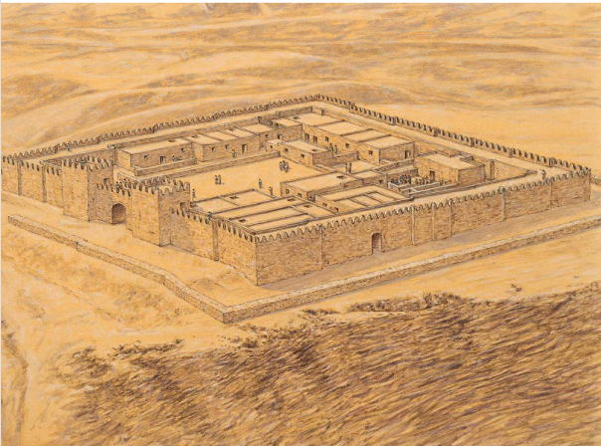
THE FORTRESS OF ARAD Arad was a small fort located in the south-eastern Negev. The fortress was located on a high hill, which dominated the whole surrounding area. Stratum X is dated to the reign of Uzziah. The fortress was protected by a stone wall comprising inset and offset sections. An entrance gate flanked by two towers stood in the middle of the eastern wall. The central courtyard was flanked by storage rooms, dwellings, and a temple located in its north-western corner.
Rocca, Samuel. The Fortifications of Ancient Israel and Judah 1200–586 BC (Fortress) . Bloomsbury Publishing. Kindle Edition.
Rocca, Samuel. The Fortifications of Ancient Israel and Judah 1200–586 BC (Fortress) . Bloomsbury Publishing. Kindle Edition.

Slide 4
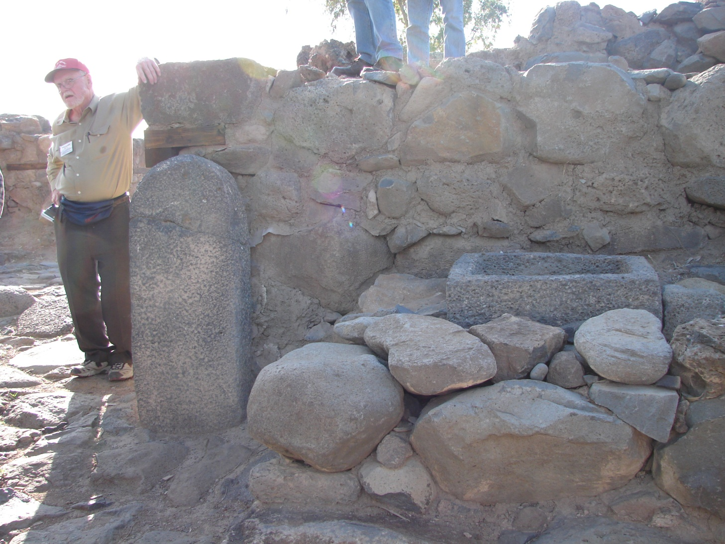
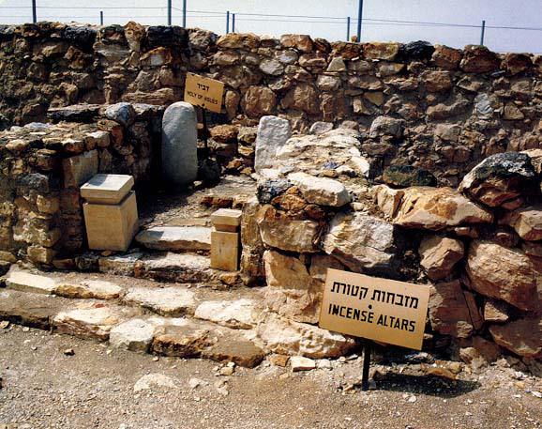
Martin Remembering
Masseboth (sacred stones)
Arad Temple
Jeremiah 11:13(ESV)
¹³For your gods have become as many as your cities, O Judah, and as many as the streets of Jerusalem are the altars you have set up to shame, altars to make offerings to Baal.

Slide 5
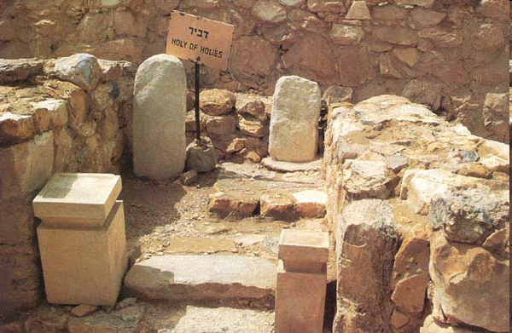
Arad Temple Destroyed by King Josiah
Finally, the temple was abolished in the late seventh century B.C.E., perhaps during the religious reform by King Josiah,
BAR 20:03 (May/June 1994).
Notes:
Werner BraunThe Arad temple consists of a long room entered through one short wall; opposite the entrance, another entryway leads to the temple shrine. Steps flanked by limestone incense altars lead up to a niche, or Holy of Holies. In this 4-by-4-foot niche, two standing stones rise against the rear wall. The standing stones and altars are replicas, placed in position after the original artifacts were removed for safekeeping to the Israel Museum in Jerusalem.
According to one interpretation, when the Israelites built their first fortress at Arad in the tenth century B.C.E., they included a temple containing this Holy of Holies. Although they modified their fortress through the centuries, they preserved the temple. Finally, the temple was abolished in the late seventh century B.C.E., perhaps during the religious reform by King Josiah, who, like King Hezekiah before him, aimed to make the Jerusalem Temple the focus of worship throughout the land. Another view of the Arad temple maintains that it was not built until the seventh century B.C.E. and was destroyed about a century later.Editor, H. S. (2004; 2004). BAR 20:03 (May/June 1994). Biblical Archaeology Society.

Slide 6
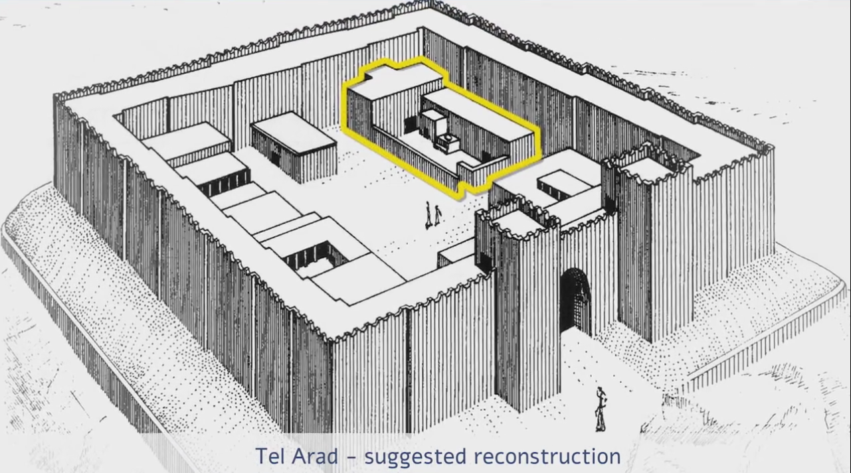

Slide 7
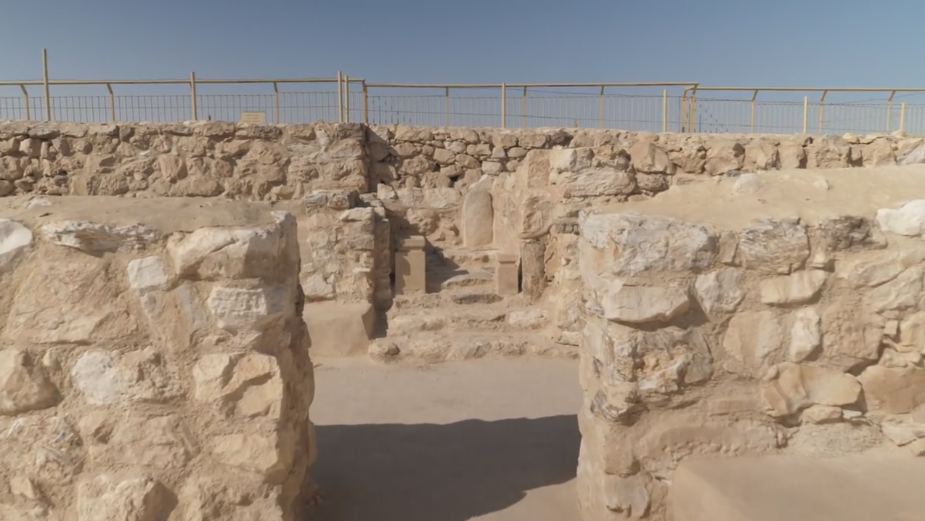
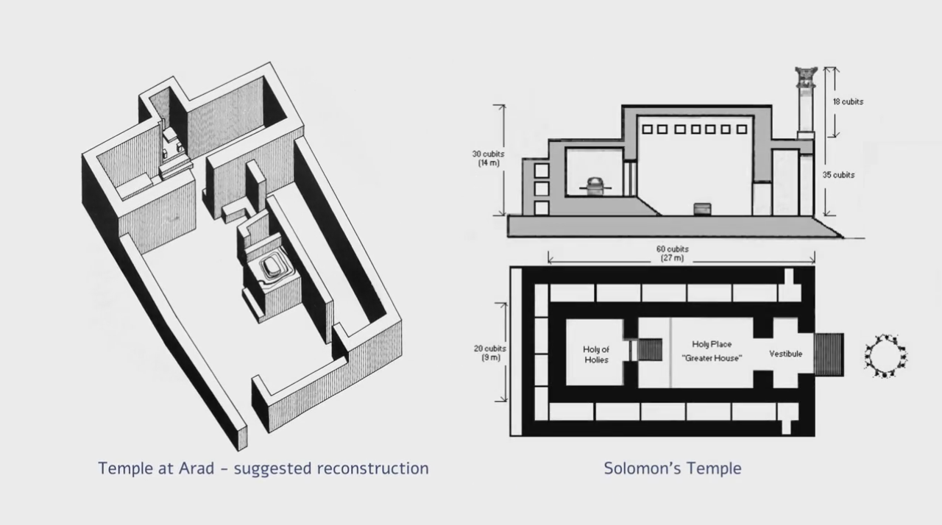

Slide 8
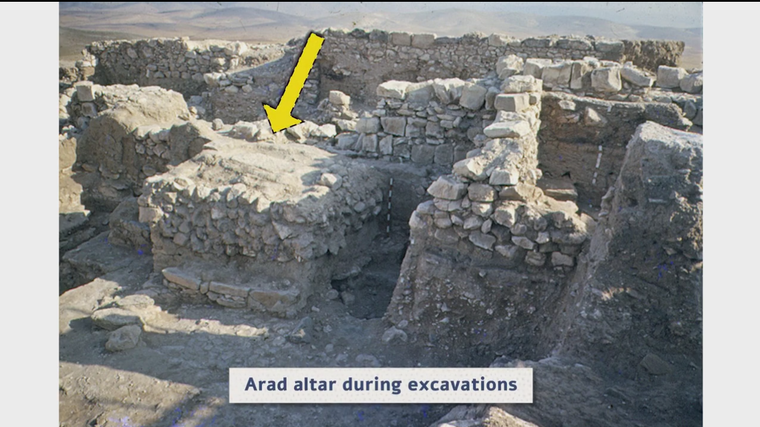

Slide 9
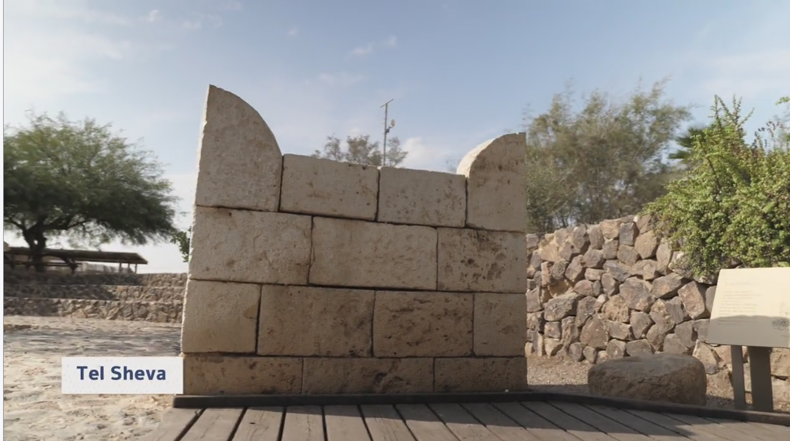

Slide 10
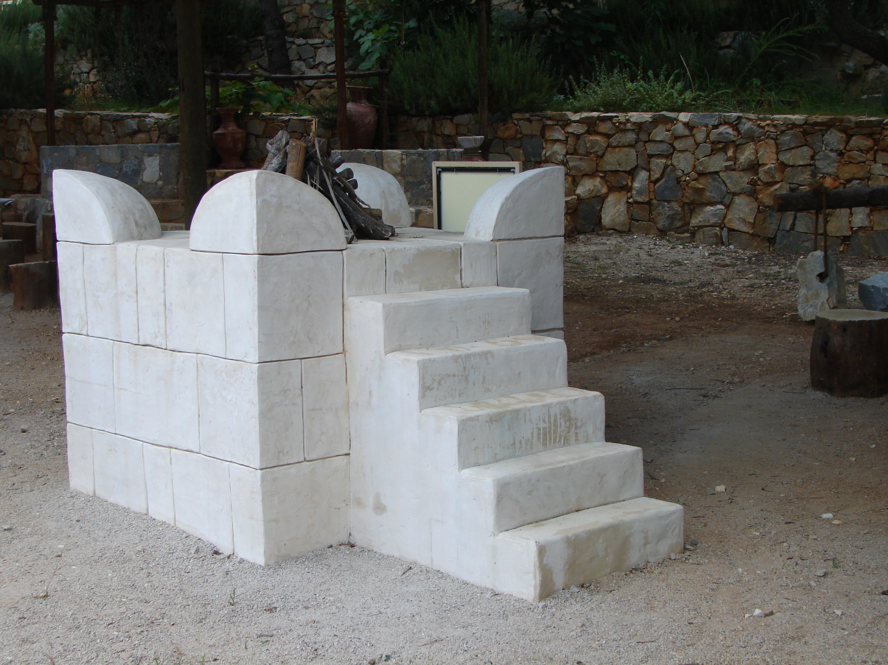
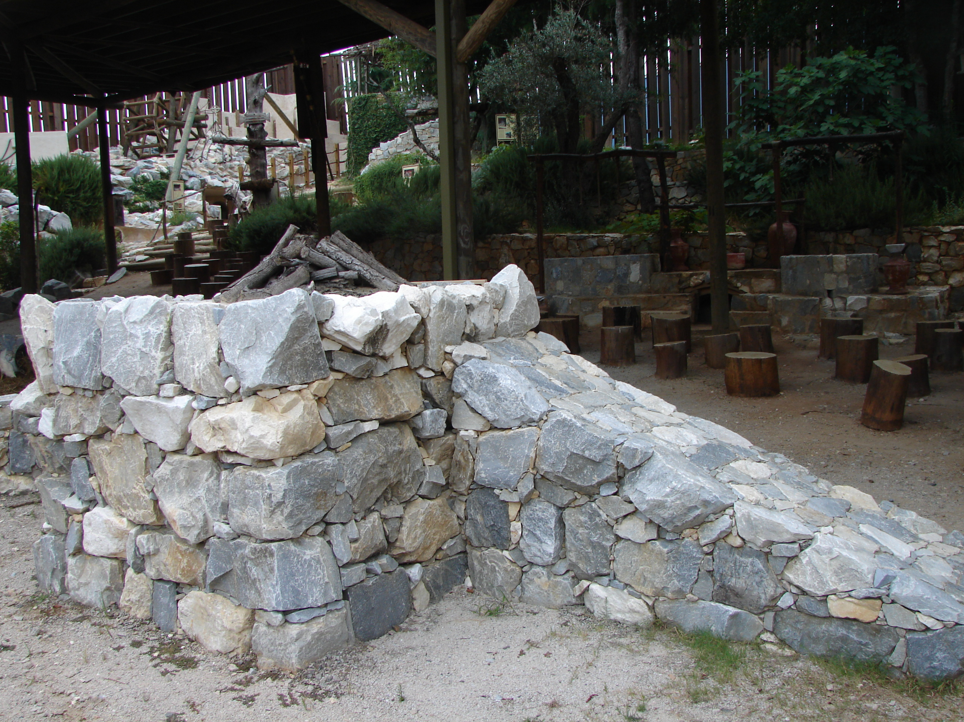
Which is Pleasing to God?

Slide 11
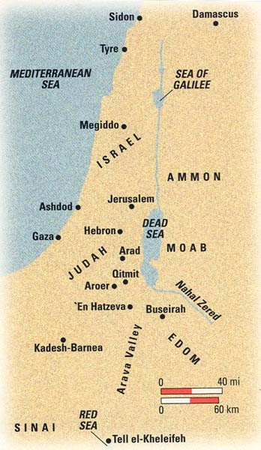
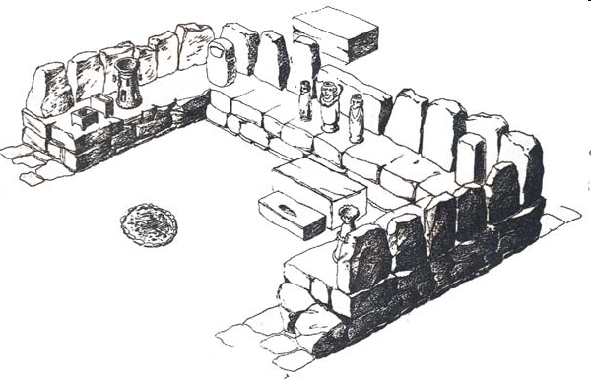
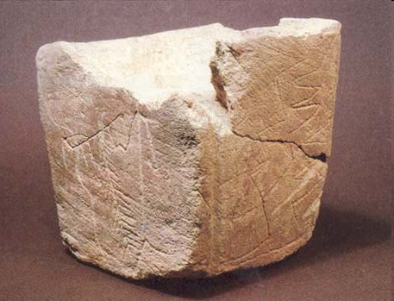
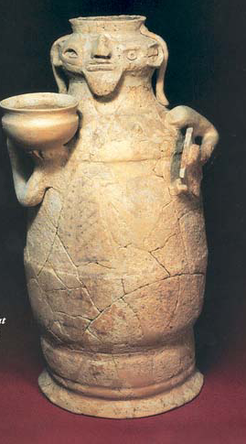
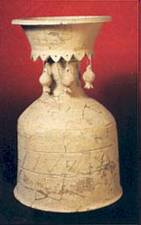
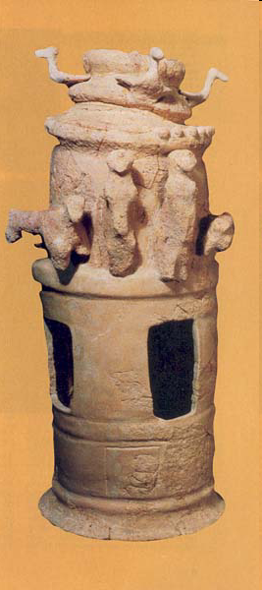
Reconstruction drawing of the cult shrine with smashed idols
A pit containing deliberately smashed figurines was also found in Jerusalem for Kathleen Kenyon’s excavations in the 1960s
Beside the shrine, excavators found a pit containing smashed cultic objects. Curiously, every piece of every vessel has been found, suggesting that intact cultic objects were placed in the pit and then crushed with large
Seven limestone altars, including the one shown, were among the 75 cultic objects found in the ‘En Hatzeva pit
Notes:
Near the northwestern wall of the large fortress (lower right in the photo), excavators discovered a cult shrine (see drawing, below), which can be associated with a later, smaller Iron Age fortress (Stratum 4, seventh-sixth centuries B.C.E.). Beside the shrine, excavators found a pit containing smashed cultic objects. Curiously, every piece of every vessel has been found, suggesting that intact cultic objects were placed in the pit and then crushed with large ashlars.Editor, H. S. (2004; 2004). BAR 22:04 (July/Aug 1996). Biblical Archaeology Society.
Israel Antiquities Authority Seven limestone altars, including the one shown, were among the 75 cultic objects found in the ‘En Hatzeva pit. These altars, like the pottery cult stands, were used to make offerings to a deity—possibly of incense or oil.Editor, H. S. (2004; 2004). BAR 22:04 (July/Aug 1996). Biblical Archaeology Society.

Slide 12
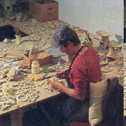
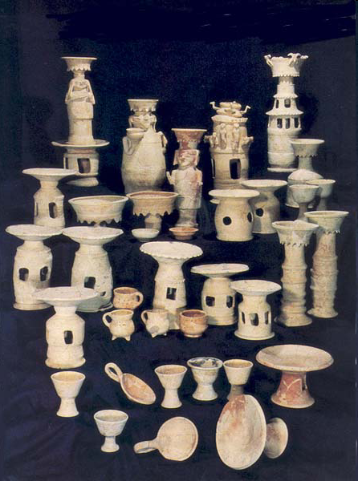
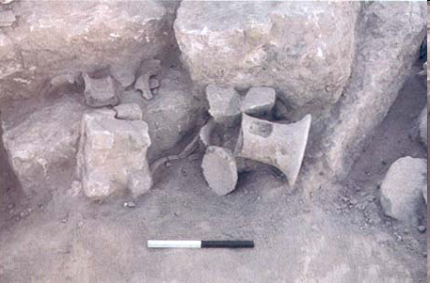
Smashed Cult Items – Edomite Shrine 20 miles SW of Dead Sea
BAR 22:04 (July/Aug 1996).
Incense burners
altar
According to the Bible, Josiah destroyed the idols of the Sidonians, Ammonites and Moabites (2 Kgs 23:13–14). These Edomite objects were dumped in the pit intact and crushed with the ashlars
Notes:
Nachshon Sneh/Israel Antiquities AuthorityShattered cult vessels squeeze out from under the ashlars, or hewn stones, that crushed them in the pit adjacent to ‘En Hatzeva’s Edomite shrine. Since all fragments from each object have been recovered, the vessels were evidently intact when placed in the pit; they were then deliberately crushed with the large stones, probably taken from the shrine.
Why this sudden, violent destruction? In the late seventh century B.C.E., King Josiah instituted a religious reform aimed at purging Judah of pagan worship. According to the Bible, Josiah destroyed the idols of the Sidonians, Ammonites and Moabites (2 Kings 23:13–14). Did he also level this Edomite shrine and smash its cultic objects?Editor, H. S. (2004; 2004). BAR 22:04 (July/Aug 1996). Biblical Archaeology Society.
Zila Sagiv/Israel Antiquities AuthorityON THE COVER: “Who ordered the soup?” is the caption one wag in the office attached to this anthropomorphic (human-shaped) cult stand, found smashed to pieces in a pit near a seventh-sixth century B.C.E. fortress at ‘En Hatzeva, about 20 miles southwest of the Dead Sea. Two other anthropomorphic stands were found in the pit, along with numerous cultic objects, such as stone altars and incense burners; the pit was found covered with ashlars (hewn stones), which had probably been taken from a nearby shrine. In “Smashing the Idols: Piecing Together an Edomite Shrine in Judah,” Rudolph Cohen and Yigal Yisrael note that the anthropomorphic stands, used to make offerings to a deity, appear to identify the shrine as Edomite. The authors also solve a puzzle: How can it be that every piece of every object has been recovered? Because these Edomite objects were dumped in the pit intact and crushed with the ashlars—probably as part of the Judahite king Josiah’s religious reform (late seventh-century B.C.), intended to rid Judah of pagan practices.Editor, H. S. (2004; 2004). BAR 22:04 (July/Aug 1996). Biblical Archaeology Society.

Slide 13
Tomb of the Kings of Judah & Other 1st Temple Tombs

Slide 14





Josiah’s Family
640-609
Age 8
Zebudah
Hamutal
Hamutal
609-597
Age 25
609 (3 mon)
Age 23
597-586
Age 21
Nehushta
597
Age 8/18
Zerubbabel
Governor on Return
Shealtiel

Slide 15
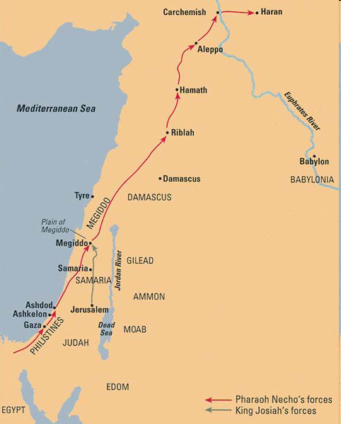
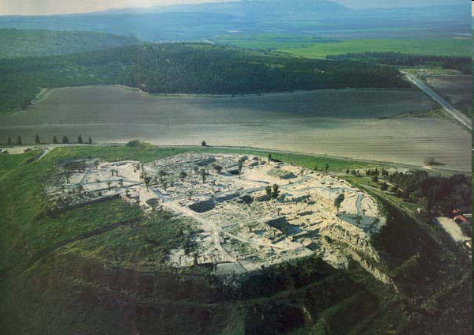
2 Chronicles 35:20 - 23 ²⁰After all this, when Josiah had prepared the temple, Necho king of Egypt came up to fight at Carchemish by the Euphrates; and Josiah went out against him.

Slide 16
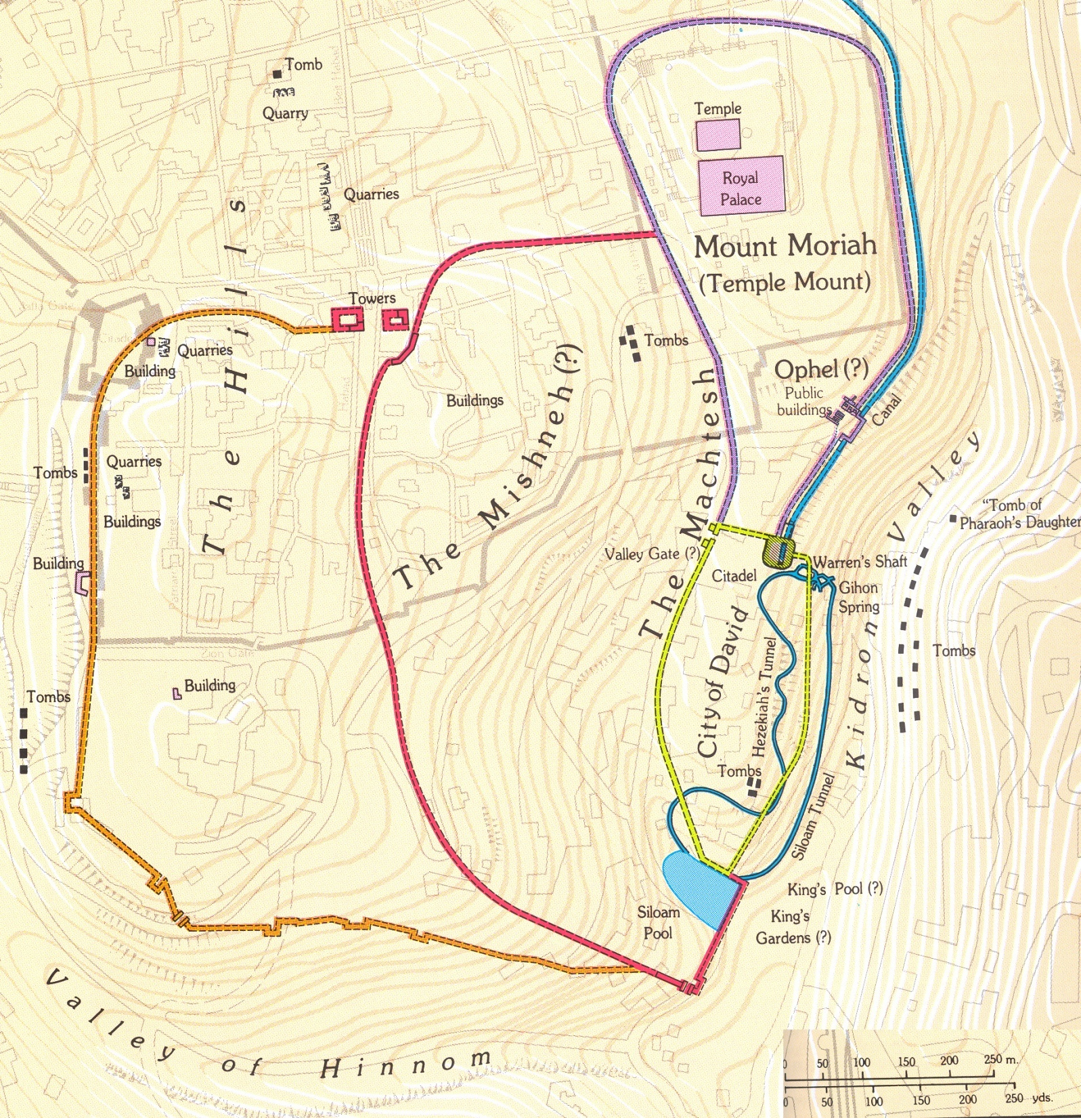
Tombs of
Jerusalem
St Étienne
Tombs
425 yards from Northern tip of City of David or old Jebusite City to Temple
Uzziah’s
Garden Tombs?
Tomb of David?
Ketef Hinnom tombs
King’s Garden?

Slide 17
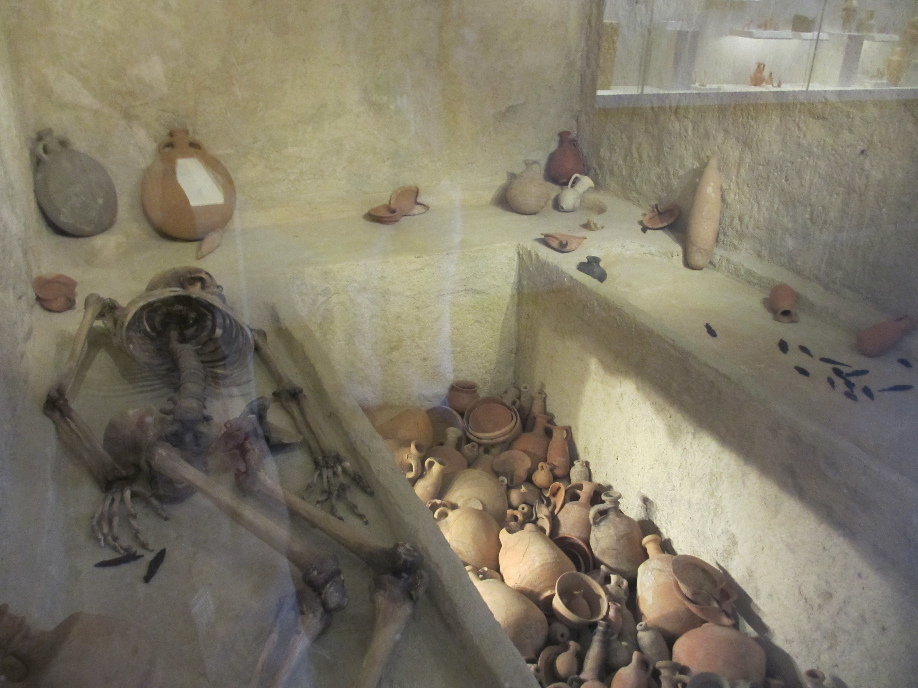

Slide 18
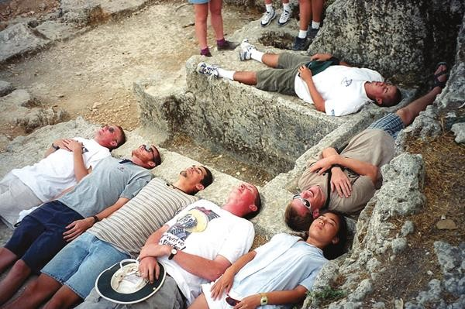
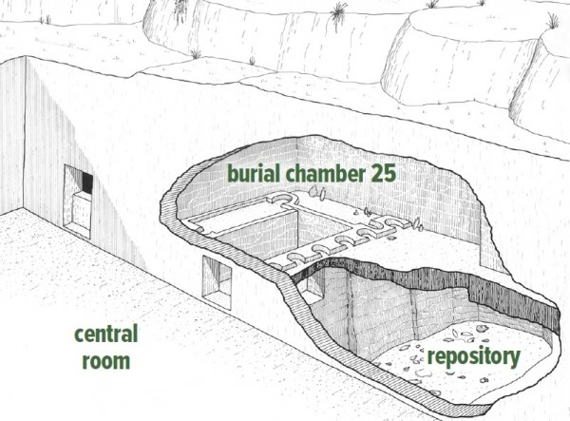
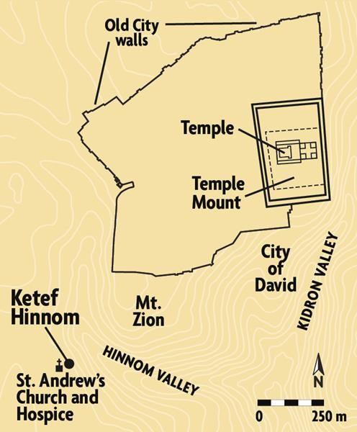
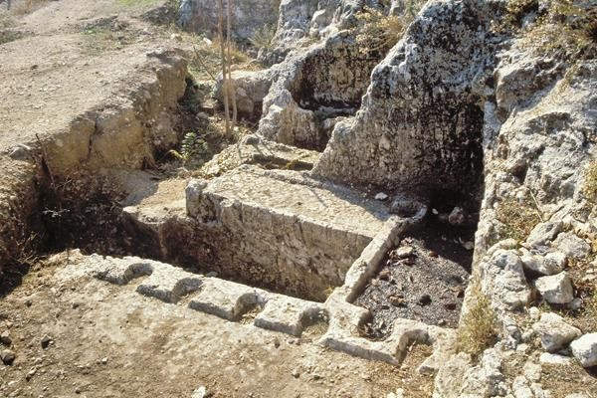

Slide 19
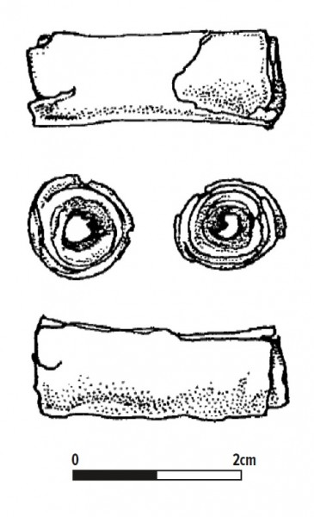
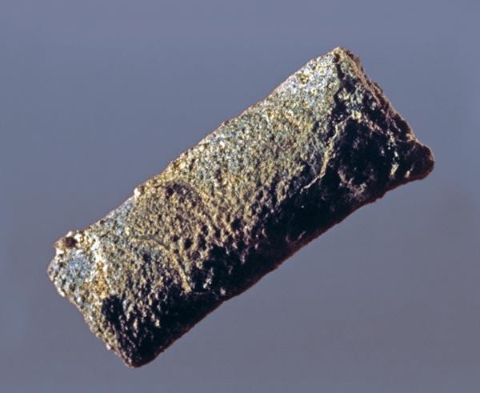
SILVER BLESSINGS. Standing only 1 inch tall, this miniature silver scroll (Amulet 1) contains one of the earliest Hebrew inscriptions ever uncovered. In 1979, archaeologist Gabriel Barkay and his team found this scroll and another smaller silver scroll—both of which date to the eighth–sixth centuries B.C.E.—in a burial cave at Ketef Hinnom in Jerusalem. In antiquity, they would have been worn as amulets. The photograph shows the first scroll before it was unrolled.

Slide 20
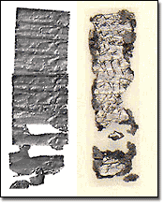
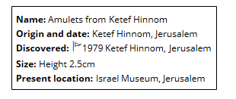
Ketef Hinnom Amulets
Two tiny silver amulets scrolls discovered at a burial cave at Ketef Hinnom overlooking Mt. Zion.
Written in ancient Hebrew script date to 7th century BC.
Scrolls comprise the earliest-known fragments of a biblical text and pre-date the earliest scrolls from Qumran by more than 300 years.
Form of Priestly blessing Num 6:24,25
"The Lord bless you and protect you. The Lord make his face to shine upon you and be gracious to you. The Lord lift up his countenance to you and give you peace."
Notes:
3) Amulet scroll - 1979
The oldest passage of scripture currently known was found written on a tiny scrap of silver. It was rolled up and apparently worn around someone's neck, and buried with them, then found in an excavation of burial caves directed by archaeologist Gabriel Barkai in the shoulder of Hinnom area, overlooking Mt. Zion. The scripture passage is from the Aharonic or priestly blessing, found in Numbers 6:24,25. The amulet scroll can now be seen in the Israel Museum in Jerusalem.

Slide 21
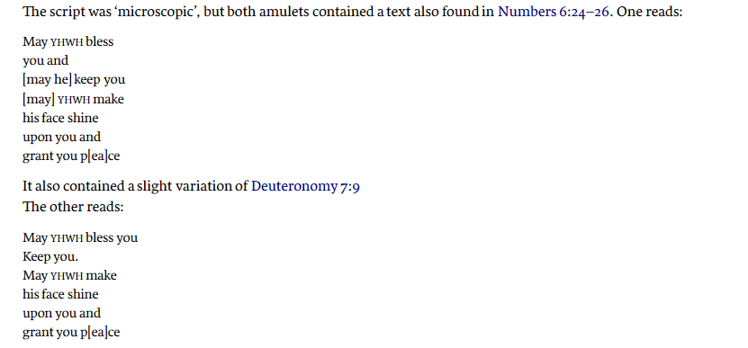
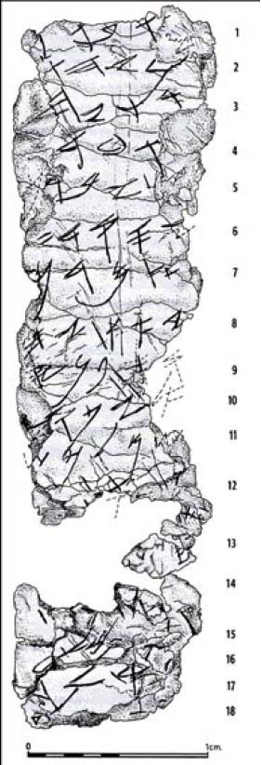
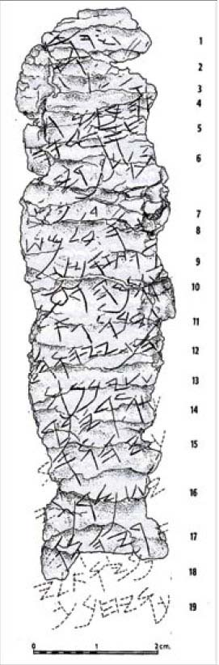

Slide 22
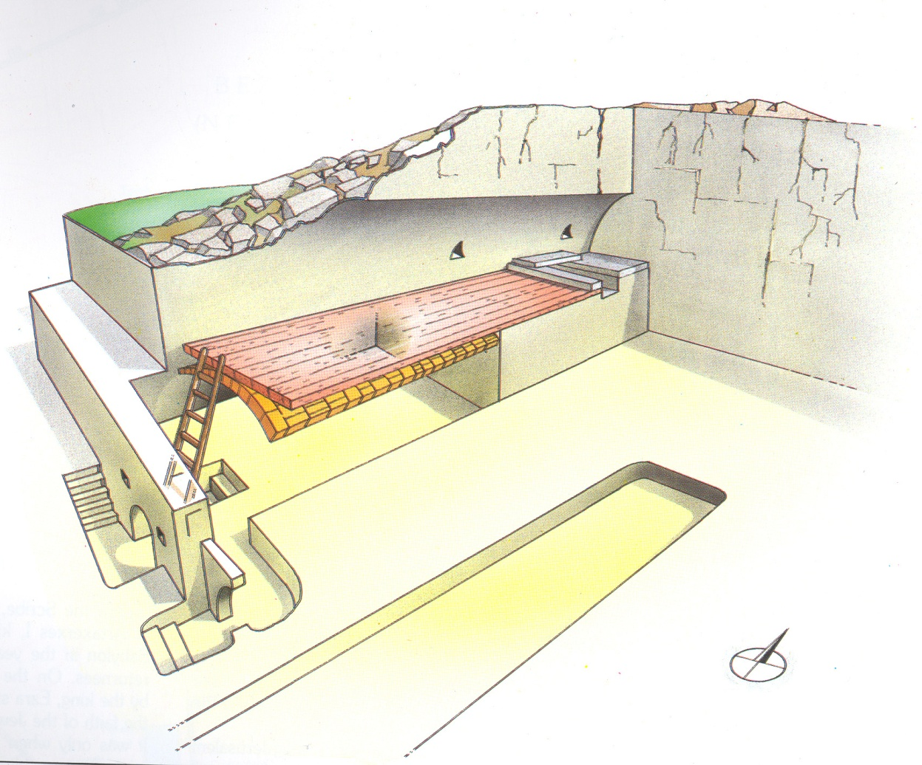
Death of Josiah
2 Chronicles 35:24 - 25 (ESV) ²⁴So his servants took him out of the chariot and carried him in his second chariot and brought him to Jerusalem. And he died and was buried in the tombs of his fathers. All Judah and Jerusalem mourned for Josiah.
²⁵Jeremiah also uttered a lament for Josiah; and all the singing men and singing women have spoken of Josiah in their laments to this day. They made these a rule in Israel; behold, they are written in the Laments.
Tombs of the Kings of Judah

Slide 23
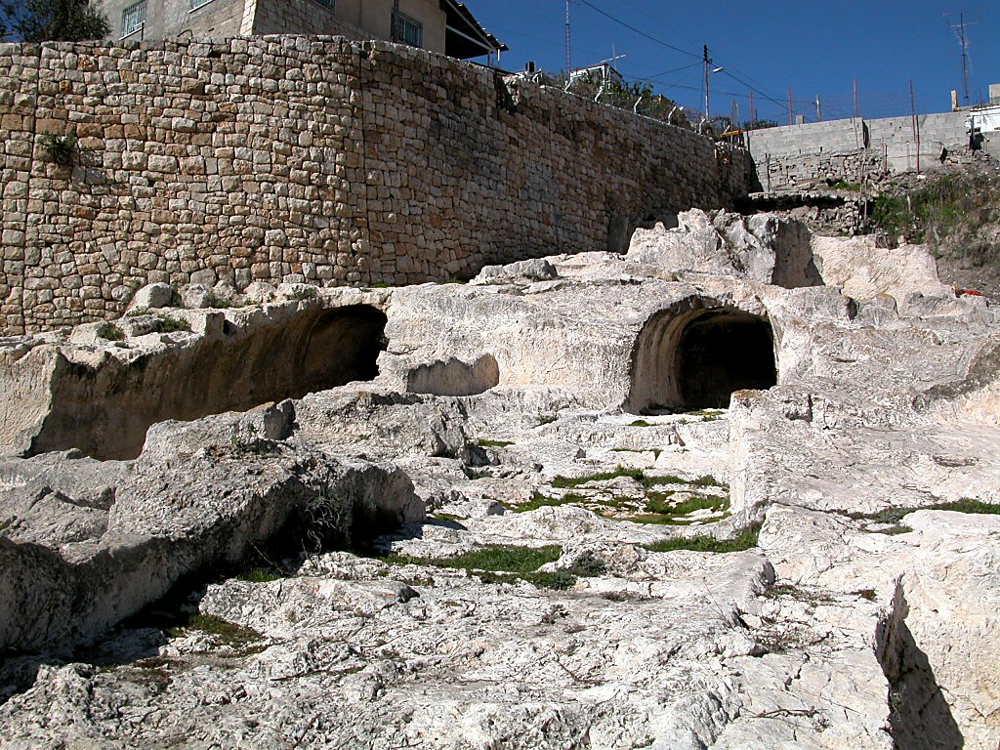
Tomb of David, disputed
Tomb of David, disputed
Notes:
Tomb of David?
Raymond Weill excavated the southeastern portion of the City of David in 1913-14. He uncovered large rock-hewn caverns that he identified as the royal tombs of the House of David.
The description of the city in Nehemiah 3 indicates that the tombs should be found in approximately this area.
Later quarrying and destruction of this area makes archaeological work and interpretation difficult.
When Weill made the identification, most accepted it as accurate. As of today, there is no other candidate for the tomb of David.
Most scholars today reject this identification. These structures do not have features typical of Iron Age tombs; there are no burial benches or repositories. Because of later destruction, there is no stratigraphy, pottery, or burial gifts which would make dating the structure possible. Some scholars think that it dates to the Herodian period and may have been used as wine cellars for the structures built above it.

Slide 24
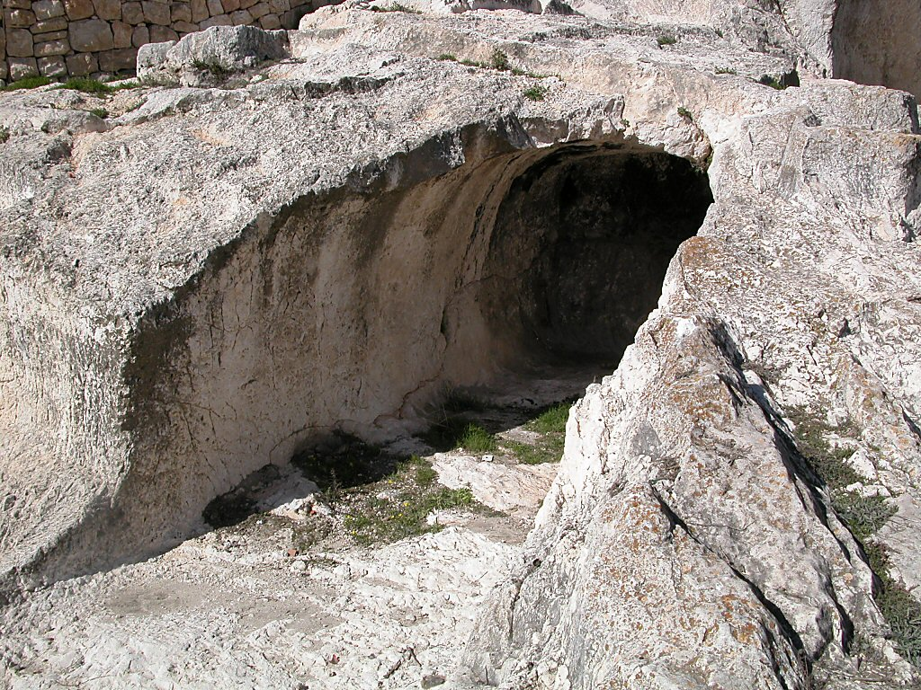
Tomb of David, disputed
Tomb of David, disputed

Slide 25
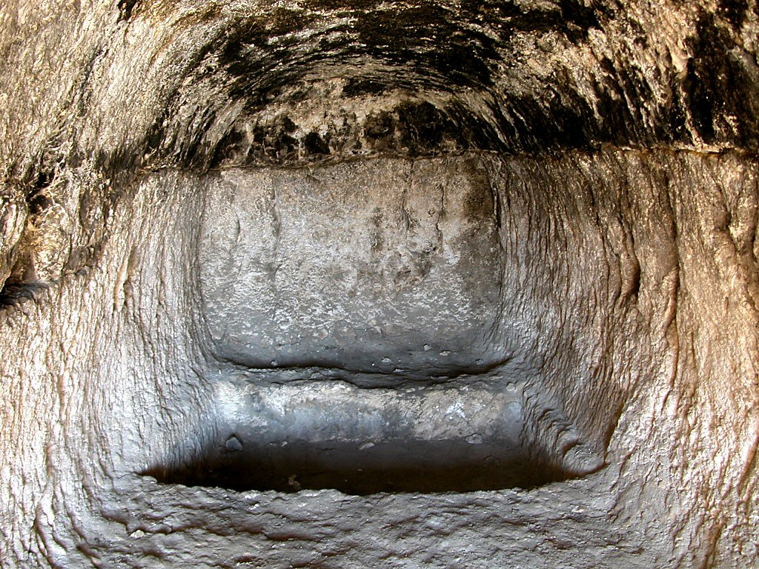
Tomb of David interior
Tomb of David interior

Slide 26
Josiah’s Family
640-609
Age 8
Zebudah
Hamutal
Hamutal
609-597
Age 25
609 (3 mon)
Age 23
597-586
Age 21
Nehushta
597
Age 8/18
Zerubbabel
Governor on Return
Shealtiel

Slide 27
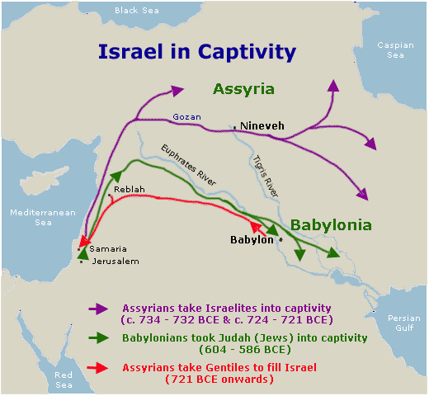
Jeremiah 22 – Fate of Josiah’s Sons - Jehoiachin
Jeremiah 22:24-27(ESV)
²⁴“As I live, declares the Lord, though Coniah the son of Jehoiakim, king of Judah, were the signet ring on my right hand, yet I would tear you off
²⁵and give you into the hand of those who seek your life, into the hand of those of whom you are afraid, even into the hand of Nebuchadnezzar king of Babylon and into the hand of the Chaldeans.
²⁶I will hurl you and the mother who bore you into another country, where you were not born, and there you shall die.
²⁷But to the land to which they will long to return, there they shall not return.”
Jeremiah 22:30(ESV)
³⁰ Thus says the Lord:
“Write this man down as childless,
a man who shall not succeed in his days,
for none of his offspring shall succeed
in sitting on the throne of David
and ruling again in Judah.”

Slide 28
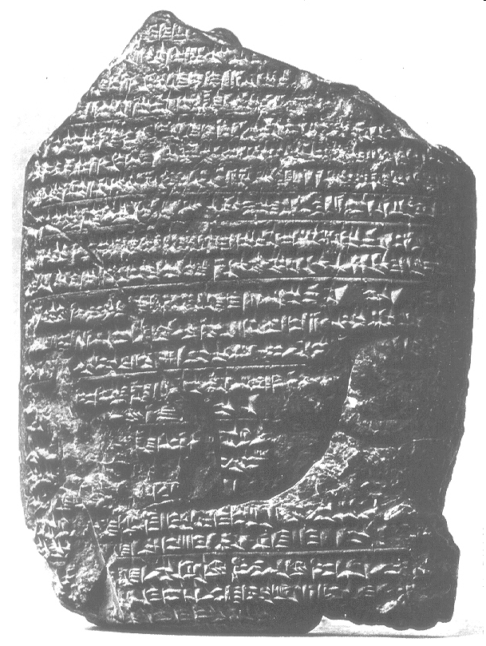
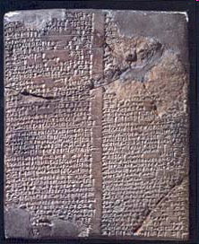
Babylonian Chronicle
The Babylonian Chronicles make it possible to assign the fall of Jerusalem to the Second of Adar (March 16) in 597 B.C. with complete accuracy, confirming the Biblical accounts of Babylonian attacks on Jerusalem in 597 and 586 B.C.
The Babylonian Chronicle for the years 605–595 BC during the reign of Nebuchadnezzar
Notes:
The British MuseumWinners and losers figure in the Babylonian Chronicle, a year-by-year record of events beginning in the eighth century B.C.E., with the reign of King Nabonassar. The publication of the cuneiform chronicle brought to light an otherwise unknown historical event: the Babylonian attack on Egypt in 601/600 B.C.E. The text does not gloss over the Babylonian shortcomings that contributed to Nebuchadnezzar’s subsequent retreat and encouraged the Judahite leadership to defect to the Egyptian side.Editor, H. S. (2004; 2004). BAR 25:04 (July/Aug 1999). Biblical Archaeology Society.
The Babylonian Chronicle for the years 605–595 BC during the reign of Nebuchadnezzar Associates for Biblical Research. (2000; 2003). Bible and Spade (2000) Volume 13 (13:52). Associates for Biblical Research.

Slide 29
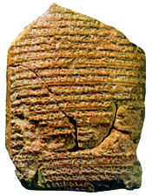
The Babylonian Chronicle records:
"In the seventh month (of Nebuchadnezzar-599 BC.) in the month Chislev (Nov/Dec) the king of Babylon assembled his army, and after he had invaded the land of Hatti (Syria/Palestine) he laid seige to the city of Judah. On the second day of the month of Adara ( 16th of March) he conquered the city and took the king (Jehoiachin) prisoner. He installed in his place a king (Zedekiah) of his own choice, and after he had received rich tribute, he sent (them) forth to Babylon."
When comparing this text from ancient Babylon with the record of the Babylonian invasion in the Book of II Kings 24:7-17 they demonstrate very clearly the accuracy of the Biblical text.
Notes:
The British MuseumWinners and losers figure in the Babylonian Chronicle, a year-by-year record of events beginning in the eighth century B.C.E., with the reign of King Nabonassar. The publication of the cuneiform chronicle brought to light an otherwise unknown historical event: the Babylonian attack on Egypt in 601/600 B.C.E. The text does not gloss over the Babylonian shortcomings that contributed to Nebuchadnezzar’s subsequent retreat and encouraged the Judahite leadership to defect to the Egyptian side.Editor, H. S. (2004; 2004). BAR 25:04 (July/Aug 1999). Biblical Archaeology Society.
The Babylonian Chronicle for the years 605–595 BC during the reign of Nebuchadnezzar Associates for Biblical Research. (2000; 2003). Bible and Spade (2000) Volume 13 (13:52). Associates for Biblical Research.
http://www.bible-history.com/map_babylonian_captivity/map_of_the_deportation_of_judah_archaeology_and_the_babylonian_captivity.html

Slide 30
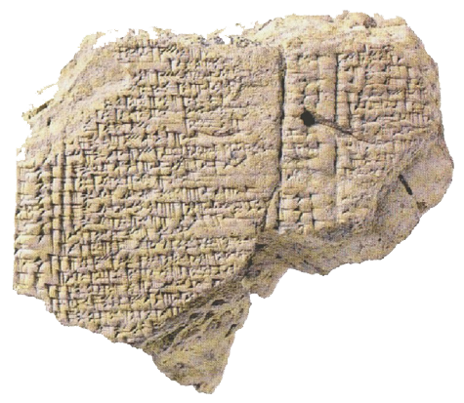
Arm Chair Critics & Jeremiah
Jeremiah 52:31-34(ESV)
³¹And in the thirty-seventh year of the exile of Jehoiachin king of Judah, in the twelfth month, on the twenty-fifth day of the month, Evil-merodach king of Babylon, in the year that he became king, lifted up the head of Jehoiachin king of Judah and brought him out of prison.
³²And he spoke kindly to him, and gave him a seat above the seats of the kings who were with him in Babylon.
³³So Jehoiachin put off his prison garments. And every day of his life he dined regularly at the king’s table,
³⁴and for his allowance, a regular allowance was given him by the king according to his daily need, until the day of his death as long as he lived.

Slide 31
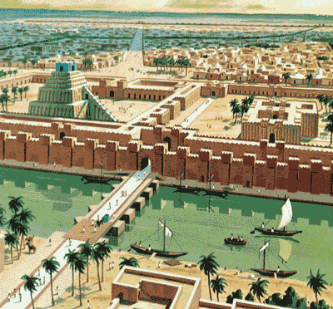
Arm Chair Critics & Jeremiah
Clay tablet listing rations for King Jehoiachin
32 pts (of sesame oil) for Jehoiachin king of Judah
5 pts (of sesame oil) for [the 5] sons of the king of Judah
8 pts (of sesame oil) for 8 men of Judah
About the age of 56 he was released from prison (561/560 BC) & treated well by King – this tablet dates to around 595 – 570 BC
Discovered in an Underground Building close to the Ishtar Gate

Slide 32
Josiah’s Family
640-609
Age 8
Zebudah
Hamutal
Hamutal
609-597
Age 25
609 (3 mon)
Age 23
597-586
Age 21
Nehushta
597
Age 8/18
Zerubbabel
Governor on Return
Shealtiel

Slide 33
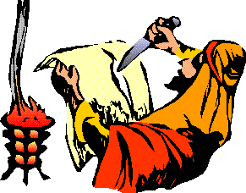
Response of Jehoakim
Jeremiah 36
²¹So the king sent Jehudi to bring the scroll, and he took it from Elishama the scribe’s chamber. And Jehudi read it in the hearing of the king and in the hearing of all the princes who stood beside the king.
²²Now the king was sitting in the winter house in the ninth month, with a fire burning on the hearth before him.
²³And it happened, when Jehudi had read three or four columns, that the king cut it with the scribe’s knife and cast it into the fire that was on the hearth, until all the scroll was consumed in the fire that was on the hearth.
²⁴Yet they were not afraid, nor did they tear their garments, the king nor any of his servants who heard all these words

Slide 34
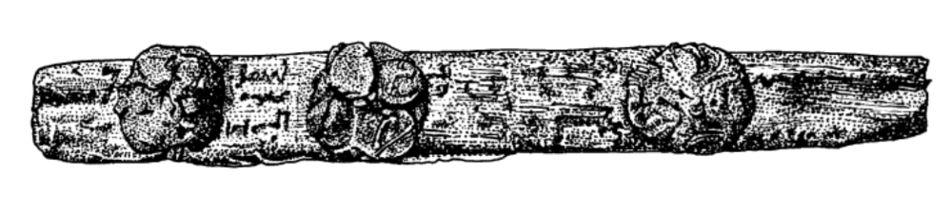
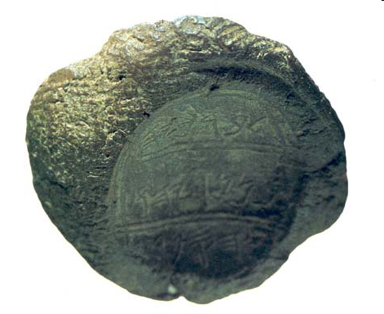
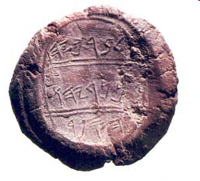
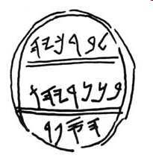
Baruch Bulla
Clay bulla with an Individual’s seal used to secure documents, many have been found from this time
“Belonging to Berekhyahu, son of Neriyahu, the Scribe” declares this bulla or lump of clay - this bulla bears a human detail: a fingerprint—presumably of Jeremiah’s scribe—appears on the upper left edge.
When God told Jeremiah of the disasters that would strike Judah if it did not mend its wicked ways, “Jeremiah called Baruch son of Neriah; and Baruch wrote down in the scroll, at Jeremiah’s dictation, all the words which the Lord had spoken to him” ( Jeremiah 36:3–4 ).
Editor, H. S. 2002;2002. BAR 22:02 (March/April 1996). Biblical Archaeology Society
Notes:
5) Baruch Bulla - 1978.
A bulla (hardened clay seal impression) containing the stamp and name of the scribe of Jeremiah appeared on the antiquties market in the 1970's and was published by archaeologist Nahman Avigad in 1978. The seal, with the inscription "belonging to Berekhyahu, son of Neriyahu, the scribe" in old Hebrew script, can now be seen in the Israel museum in Jerusalem. A number of other seals connected to personalities mentioned in the Bible have also been found.

Slide 35
Baruch Bulla
“Belonging to Berekhyahu, son of Neriyahu, the Scribe” declares this bulla or lump of clay - this bulla bears a human detail: a fingerprint—presumably of Jeremiah’s scribe—appears on the upper left edge.
When God told Jeremiah of the disasters that would strike Judah if it did not mend its wicked ways, “Jeremiah called Baruch son of Neriah; and Baruch wrote down in the scroll, at Jeremiah’s dictation, all the words which the Lord had spoken to him” ( Jeremiah 36:3–4 ).
Baruch also was with Gedaliah and went with Jeremiah to Egypt (Jer 43:1-6)
BAR 22:02 (March/April 1996).
Notes:
5) Baruch Bulla - 1978.
A bulla (hardened clay seal impression) containing the stamp and name of the scribe of Jeremiah appeared on the antiquties market in the 1970's and was published by archaeologist Nahman Avigad in 1978. The seal, with the inscription "belonging to Berekhyahu, son of Neriyahu, the scribe" in old Hebrew script, can now be seen in the Israel museum in Jerusalem. A number of other seals connected to personalities mentioned in the Bible have also been found.

Slide 36


Jeremiah’s scribe, Baruch
Courtesy Nahman Avigad
Jeremiah’s scribe, Baruch, who plays a part in four Biblical episodes (Jeremiah 32:12, 43:1–7, and chapters 36 and 45), apparently owned the seal that made the impression in this bulla (a lump of clay bearing a seal impression). The bulla was baked hard, as would be if caught in the fiery destruction of Jerusalem in 587/586 B.C
BAR 17:04 (July/Aug 1991).
Notes:
David Harris/Israel Museum, Jerusalem Jeremiah’s scribe, Baruch, who plays a part in four Biblical episodes (Jeremiah 32:12, 43:1–7, and chapters 36 and 45), apparently owned the seal that made the impression in this bulla (a lump of clay bearing a seal impression). A bulla (plural, bullae) was affixed to the knot of a string used to bind scrolls, thus ensuring that no unauthorized person could open the document undetected.
The inscription on this bulla appears in three registers, each separated by a pair of parallel lines. The three lines of paleo-Hebrew script read: “Belonging to Berekhyaku / son of Neriyahu / the scribe.” Baruch means “the blessed,” and the suffix -yahu is a form of Yahweh, so Berekhyahu means “blessed of Yahweh.” This full form of Baruch’s name was not known before the discovery of this bulla, because the suffix was dropped in the Biblical spelling. In other names the suffix is usually spelled -iah in the Bible, hence Neriyahu becomes Neriah.
This bulla is part of a hoard obtained on the antiquities market by a private collector. Several factors, however, strongly suggest its identification with the Biblical Baruch: The script is consistent with that used in Baruch’s time, the end of the seventh and beginning of the sixth centuries B.C.E.; the genealogy matches the Bible; the bulla is associated with another biblically connected bulla in the same hoard; and the bullae in the hoard are baked hard, as they would be if they were caught in the fiery destruction of Jerusalem in 587/586 B.C.E.Editor, H. S. (2004; 2004). BAR 17:04 (July/Aug 1991). Biblical Archaeology Society.

Slide 37


Nebuchadnezzar’s
Devastation
Remains of Ashkelon’s destruction (604 BC) include
smashed pots, charred wheat, and collapsed roofs. A
35 yr old woman shows the brutality. Laying back,
recoiled in terror, left arm raised to ward off blow.
It has been determined that she had been clubbed on
the head with a blunt instrument.
Biblical Archaeology Review
pg. 39, Vol. 25 No 4, July/Aug 1999
Notes:
Carl Andrews/Leon Levy Expedition to AshkelonThe remains of a 35-year-old woman bespeak the invaders’ brutality: Lying on her back with her legs recoiled in terror, her left arm is lifted up to her head, as if to ward off a blow. A physical anthropologist determined that she had been clubbed on the head with a blunt instrument.
After razing the Philistine port of Ashkelon in 604 B.C.E., Nebuchadnezzar’s army destroyed Ekron and battled with the Egyptians over Gaza. He then retired to Babylon in 601/600 B.C.E., but his troops returned to the Levant two years later, conquering several Judahite cities and besieging Jerusalem. After surrendering in 597 B.C.E., and then rebelling in 591/589 B.C.E., Jerusalem finally buckled under the onslaught in 586 B.C.E., and the city and its Temple were destroyed. Many of the Jews were led into exile.Editor, H. S. (2004; 2004). BAR 25:04 (July/Aug 1999). Biblical Archaeology Society.
Carl Andrews/Leon Levy Expedition to AshkelonImages of devastation. Nebuchadnezzar’s destructive might is manifest in the remains at Ashkelon. Excavators of the Mediterranean coastal site found evidence of Babylonian devastation throughout the city, including smashed pottery, charred wheat and collapsed roofs.Editor, H. S. (2004; 2004). BAR 25:04 (July/Aug 1999). Biblical Archaeology Society.

Slide 38


Nebuchadnezzar’s Assault on Jerusalem
Tower was originally 30-ft High
& 12-ft Thick. Babylonian
arrowheads found at base.
Bibibal Archaeology Review
pg. 40-41, Vol. 26 No 5, Sept/Oct 2000

Slide 39


Babylonian Arrows

Slide 40



Area of Mount Zion excavations (in 2016)

Slide 41


New Discoveries - 2019
Earring or tassle ornament made of gold and silver from the destruction layer of 587/586 BCE.
The discovery is of a deposit including layers of ash, arrowheads dating from the period. Scythian arrowheads’ and have been found at other archaeological conflict sites from the 7th and 6th centuries BCE. They are known at sites outside of Israel as well. They were fairly commonplace in this period and are known to be used by the Babylonian warriors.

Slide 42

Record of Jerusalem’s Capture
The Babylonian Chronicle records the capture ff Jerusalem on the 2nd Adar of the 7th year o
of Nebuchadnezzar’s reign (March 597 BC)
“A king of his own choice he appointed in the city [and] taking the vast tribute he brought it into Babylon.”

Slide 43
Nebuchadnezzar’s
Devastation
2 Chronicles 36:17(ESV)
¹⁷Therefore he brought up against them the king of the Chaldeans, who killed their young men with the sword in the house of their sanctuary and had no compassion on young man or virgin, old man or aged. He gave them all into his hand.
Remains of Ashkelon’s destruction (604 BC) include
smashed pots, charred wheat, and collapsed roofs. A
35 yr old woman shows the brutality. Laying back,
recoiled in terror, left arm raised to ward off blow.
It has been determined that she had been clubbed on
the head with a blunt instrument.
Biblical Archaeology Review
pg. 39, Vol. 25 No 4, July/Aug 1999
Notes:
Carl Andrews/Leon Levy Expedition to AshkelonThe remains of a 35-year-old woman bespeak the invaders’ brutality: Lying on her back with her legs recoiled in terror, her left arm is lifted up to her head, as if to ward off a blow. A physical anthropologist determined that she had been clubbed on the head with a blunt instrument.
After razing the Philistine port of Ashkelon in 604 B.C.E., Nebuchadnezzar’s army destroyed Ekron and battled with the Egyptians over Gaza. He then retired to Babylon in 601/600 B.C.E., but his troops returned to the Levant two years later, conquering several Judahite cities and besieging Jerusalem. After surrendering in 597 B.C.E., and then rebelling in 591/589 B.C.E., Jerusalem finally buckled under the onslaught in 586 B.C.E., and the city and its Temple were destroyed. Many of the Jews were led into exile.Editor, H. S. (2004; 2004). BAR 25:04 (July/Aug 1999). Biblical Archaeology Society.
Carl Andrews/Leon Levy Expedition to AshkelonImages of devastation. Nebuchadnezzar’s destructive might is manifest in the remains at Ashkelon. Excavators of the Mediterranean coastal site found evidence of Babylonian devastation throughout the city, including smashed pottery, charred wheat and collapsed roofs.Editor, H. S. (2004; 2004). BAR 25:04 (July/Aug 1999). Biblical Archaeology Society.

Slide 44


Slide 45


Slide 46


