Slide 1
Welcome
Please Sit In The Middle Two Sections

Slide 2
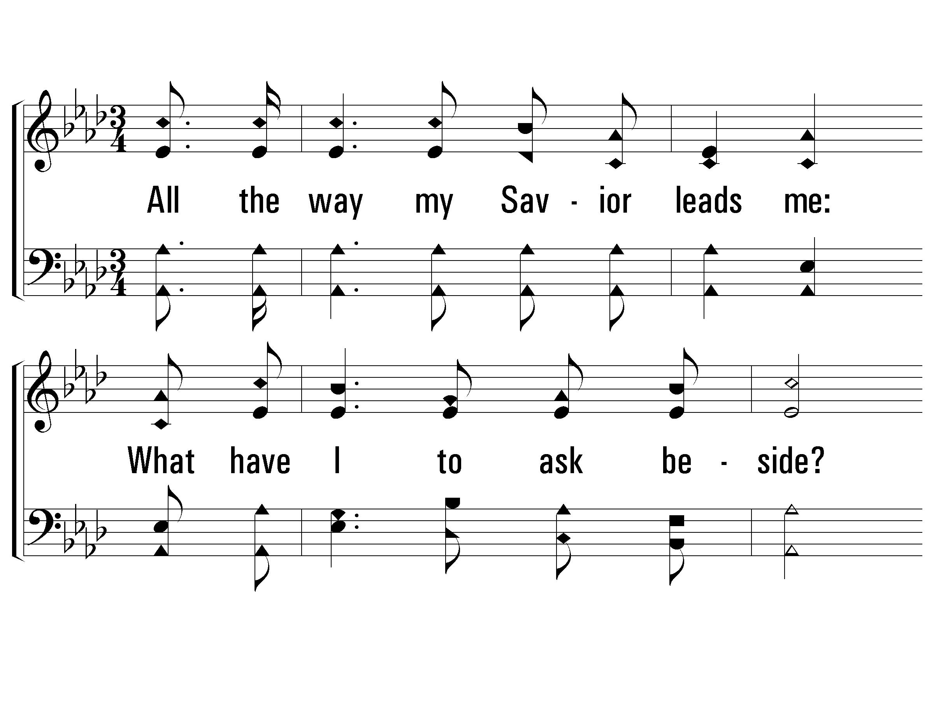
1 – All the Way My Savior Leads Me
22
1.
All the way my Savior leads me:
What have I to ask beside?
Can I doubt His tender mercy,
Who through life has been my Guide?
Heavenly peace, divinest comfort,
Here by faith in Him to dwell!
For I know, whatever befall me,
Jesus doeth all things well;
For I know, whatever befall me,
Jesus do-eth all things well.
Words: Fanny J. Crosby
Music: Robert Lowry
© 2002 The Paperless Hymnal™

Slide 3
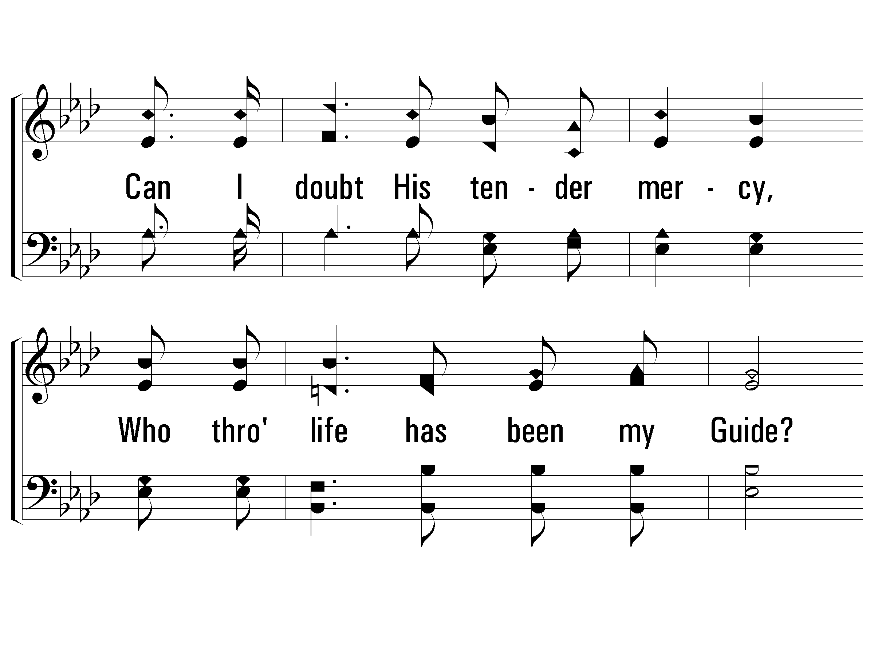
1 – All the Way My Savior Leads Me
22
© 2002 The Paperless Hymnal™

Slide 4
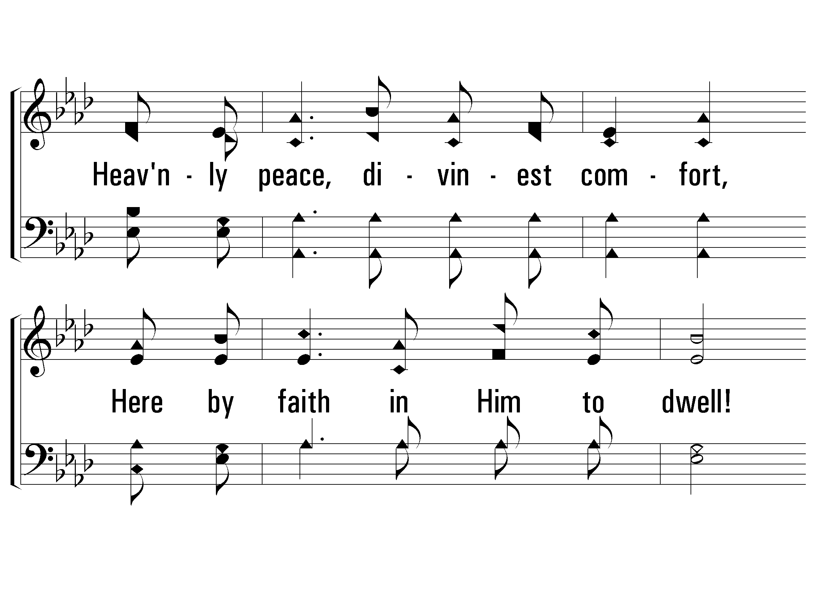
1 – All the Way My Savior Leads Me
22
© 2002 The Paperless Hymnal™

Slide 5
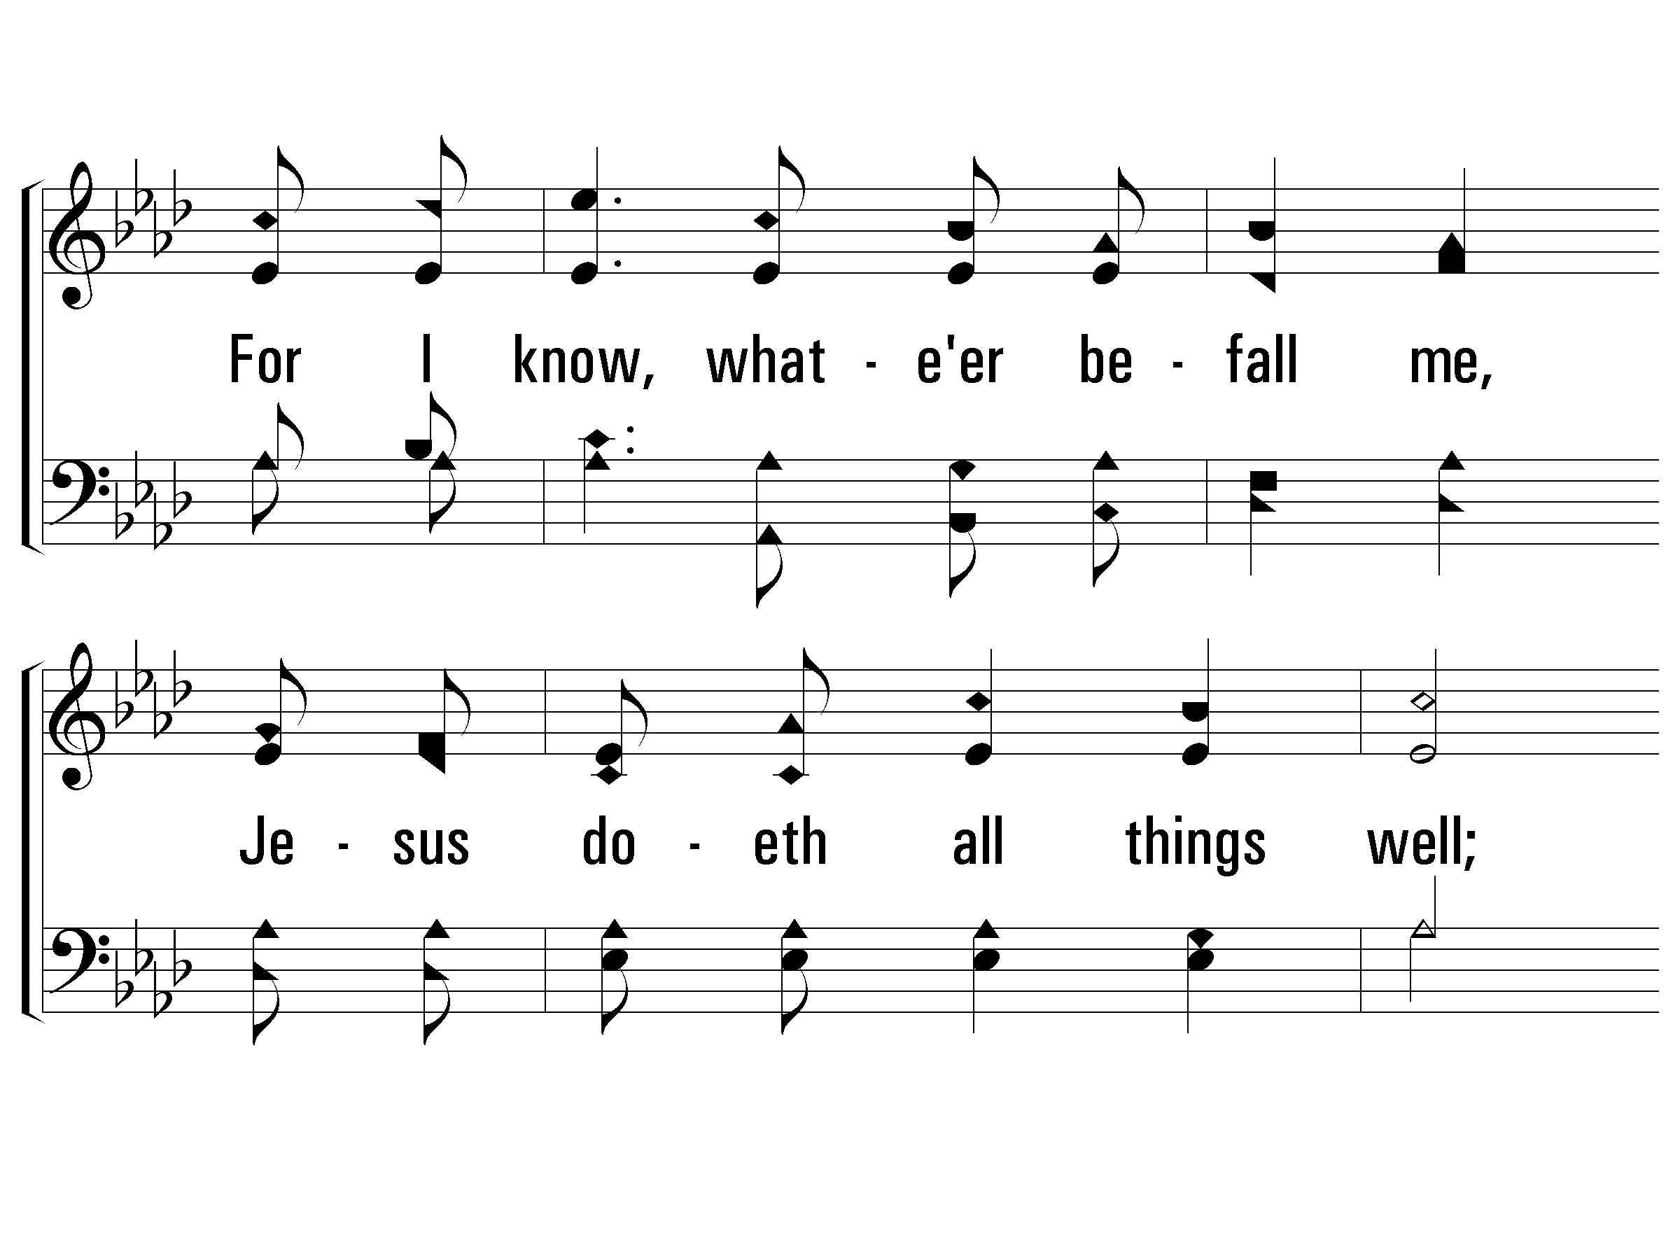
1 – All the Way My Savior Leads Me
22
© 2002 The Paperless Hymnal™

Slide 6
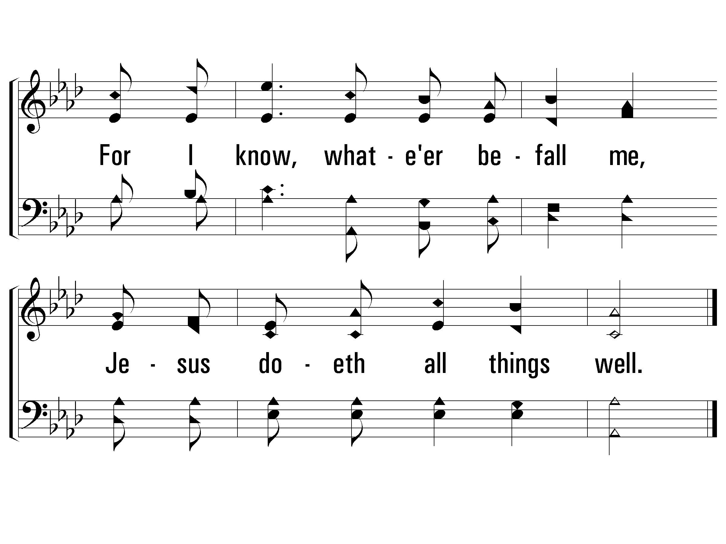
1 – All the Way My Savior Leads Me
22
© 2002 The Paperless Hymnal™

Slide 7
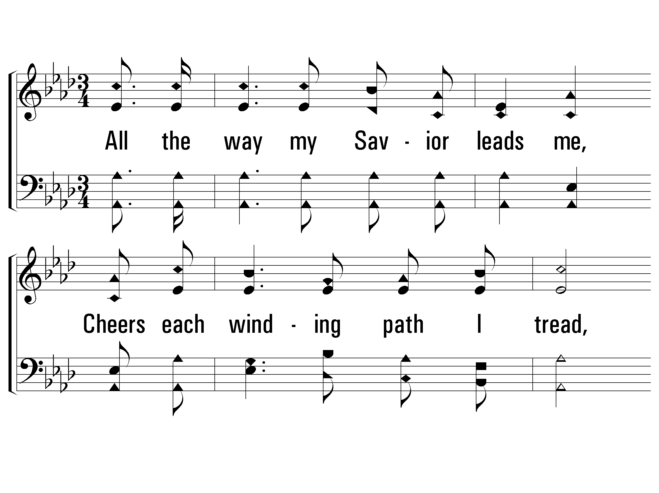
2 – All the Way My Savior Leads Me
22
2.
All the way my Savior leads me,
Cheers each winding path I tread,
Gives me grace for every trial,
Feeds me with the living bread;
Though my weary steps may falter,
And my soul athirst may be,
Gushing from the Rock before me,
Lo! A spring of joy I see;
Gushing from the Rock before me,
Lo! A spring of joy I see.
Words: Fanny J. Crosby
Music: Robert Lowry
© 2002 The Paperless Hymnal™

Slide 8
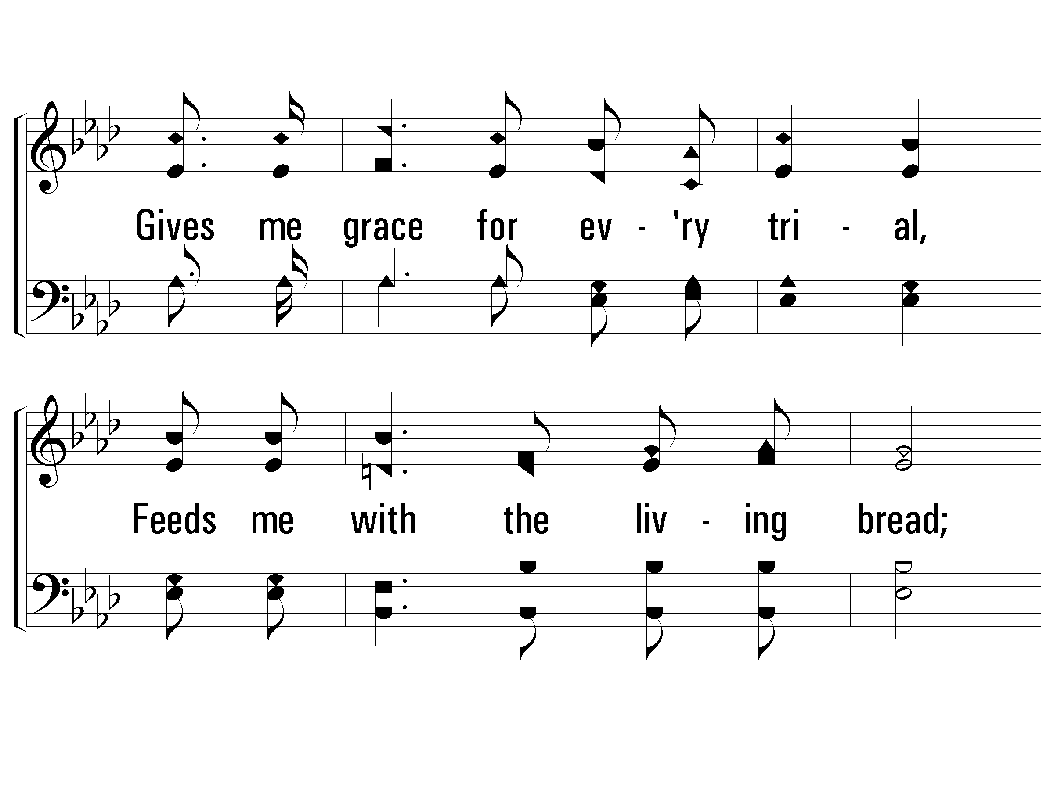
2 – All the Way My Savior Leads Me
22
© 2002 The Paperless Hymnal™

Slide 9
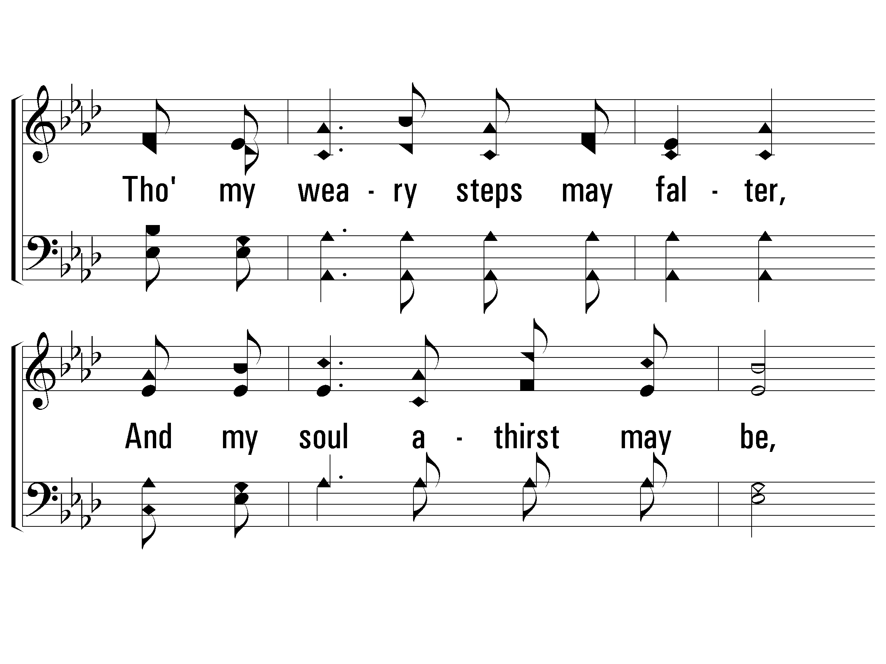
2 – All the Way My Savior Leads Me
22
© 2002 The Paperless Hymnal™

Slide 10
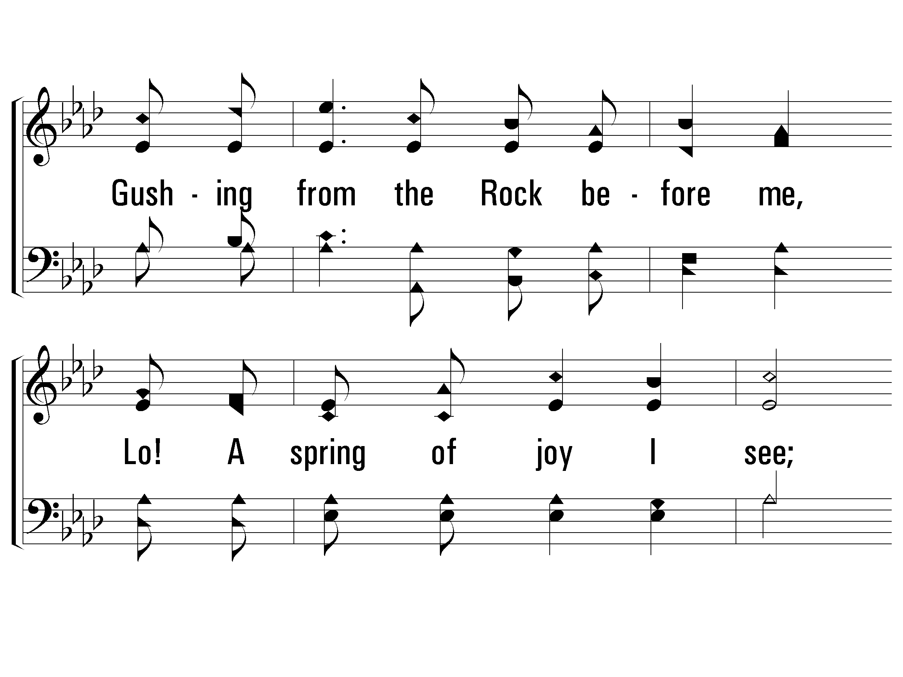
2 – All the Way My Savior Leads Me
22
© 2002 The Paperless Hymnal™

Slide 11
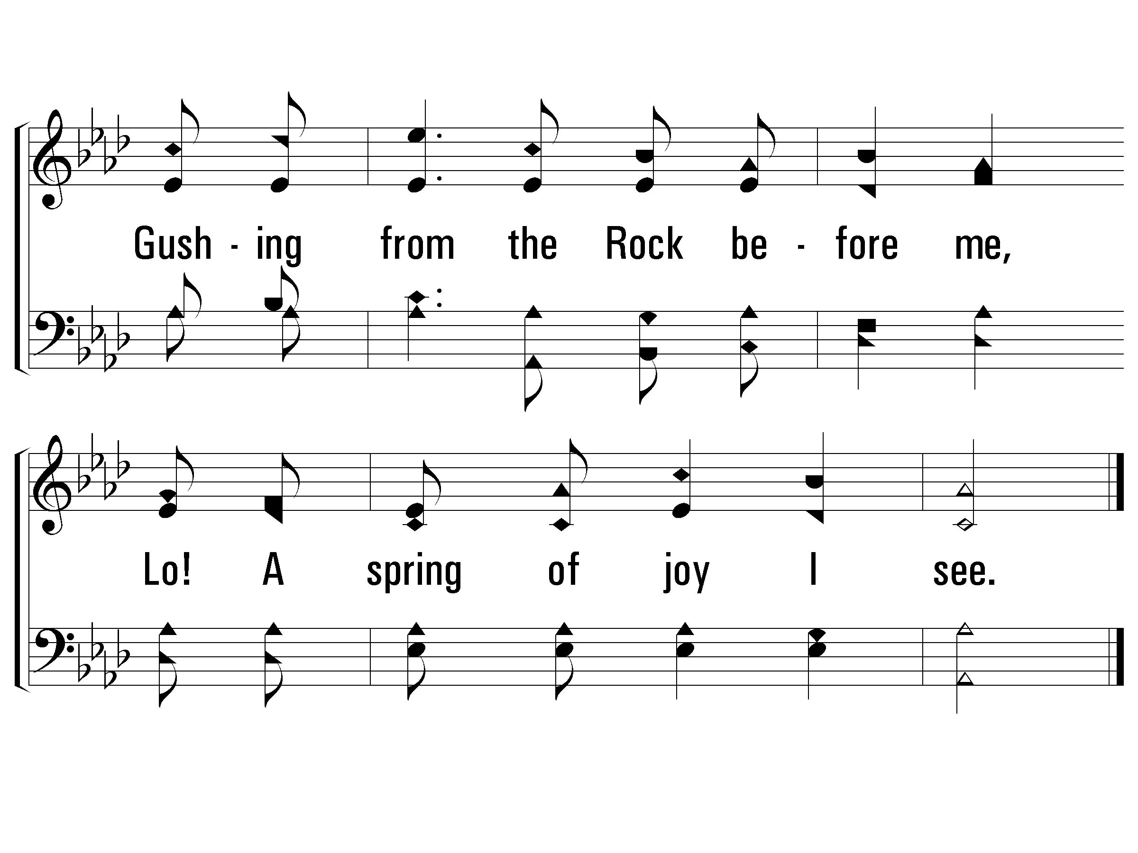
2 – All the Way My Savior Leads Me
22
© 2002 The Paperless Hymnal™

Slide 12
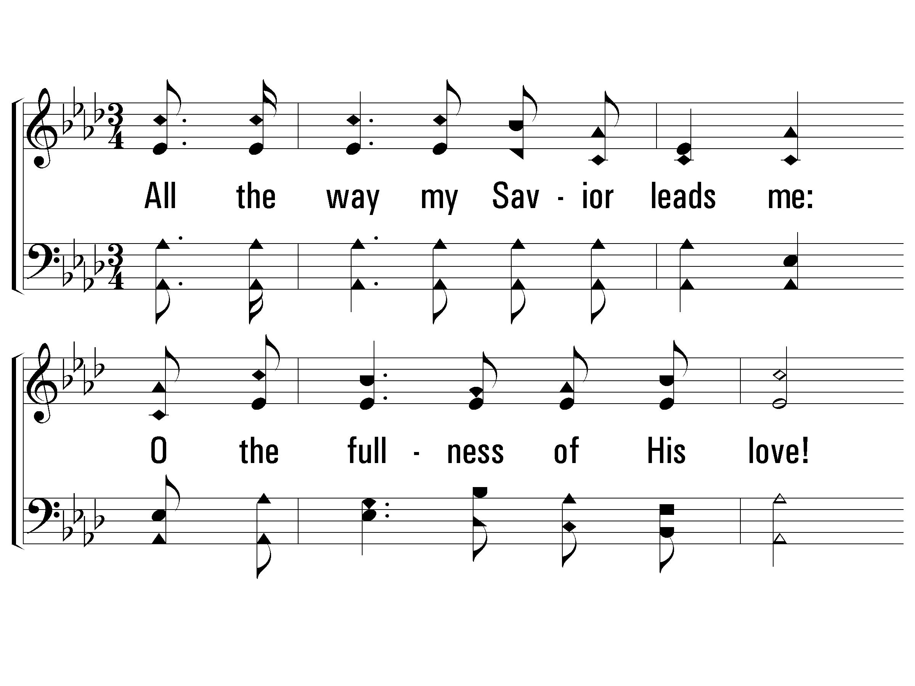
3 – All the Way My Savior Leads Me
22
3.
All the way my Savior leads me:
O the fullness of His love!
Perfect rest to me is promised
In my Father's house above;
When my spirit, clothed immortal,
Wings its flight to realms of day,
This my song through endless ages:
Jesus led me all the way!
This my song through endless ages:
Jesus led me all the way!
Words: Fanny J. Crosby
Music: Robert Lowry
© 2002 The Paperless Hymnal™

Slide 13
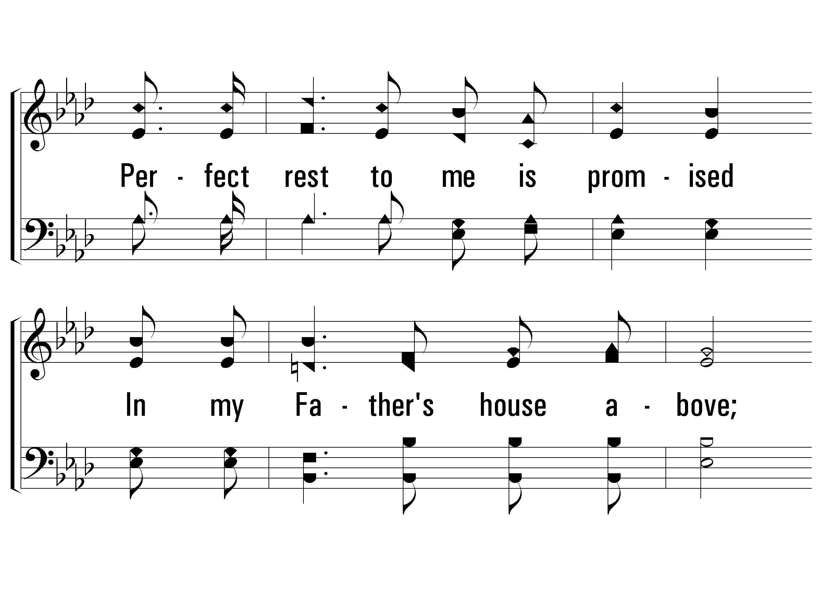
3 – All the Way My Savior Leads Me
22
© 2002 The Paperless Hymnal™

Slide 14
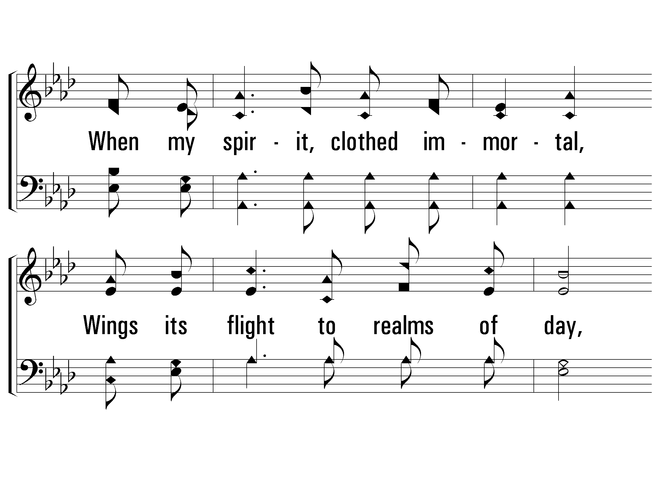
3 – All the Way My Savior Leads Me
22
© 2002 The Paperless Hymnal™

Slide 15
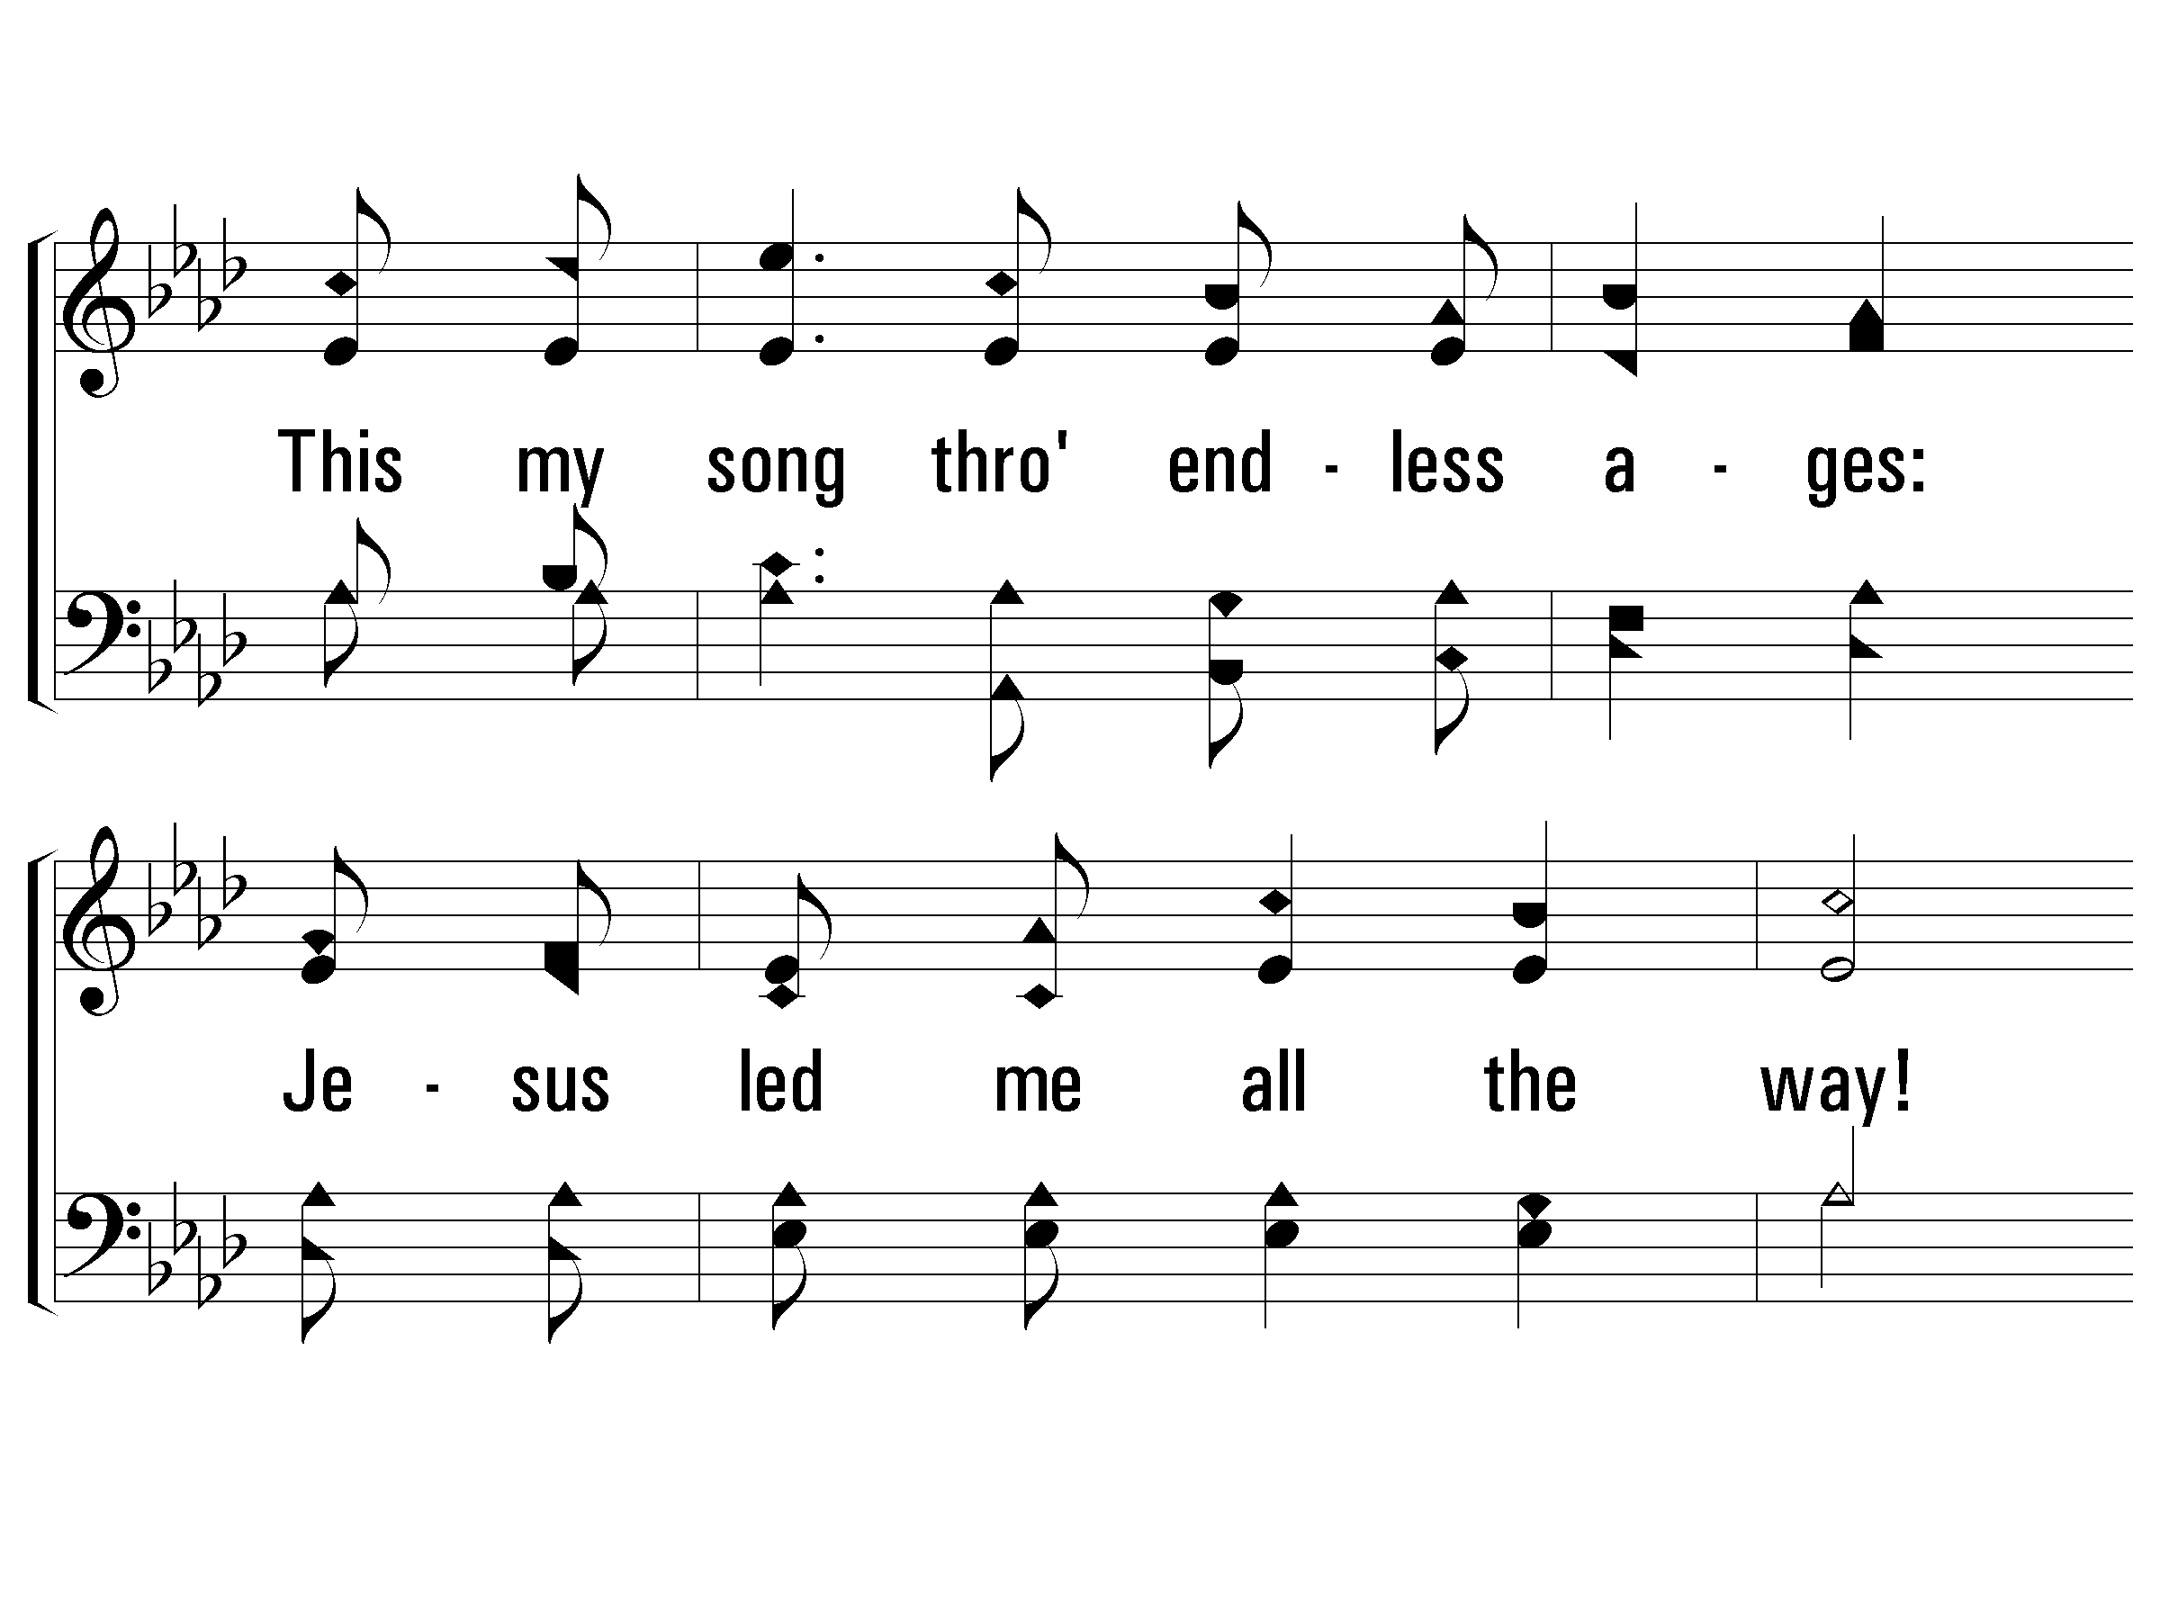
3 – All the Way My Savior Leads Me
22
© 2002 The Paperless Hymnal™

Slide 16
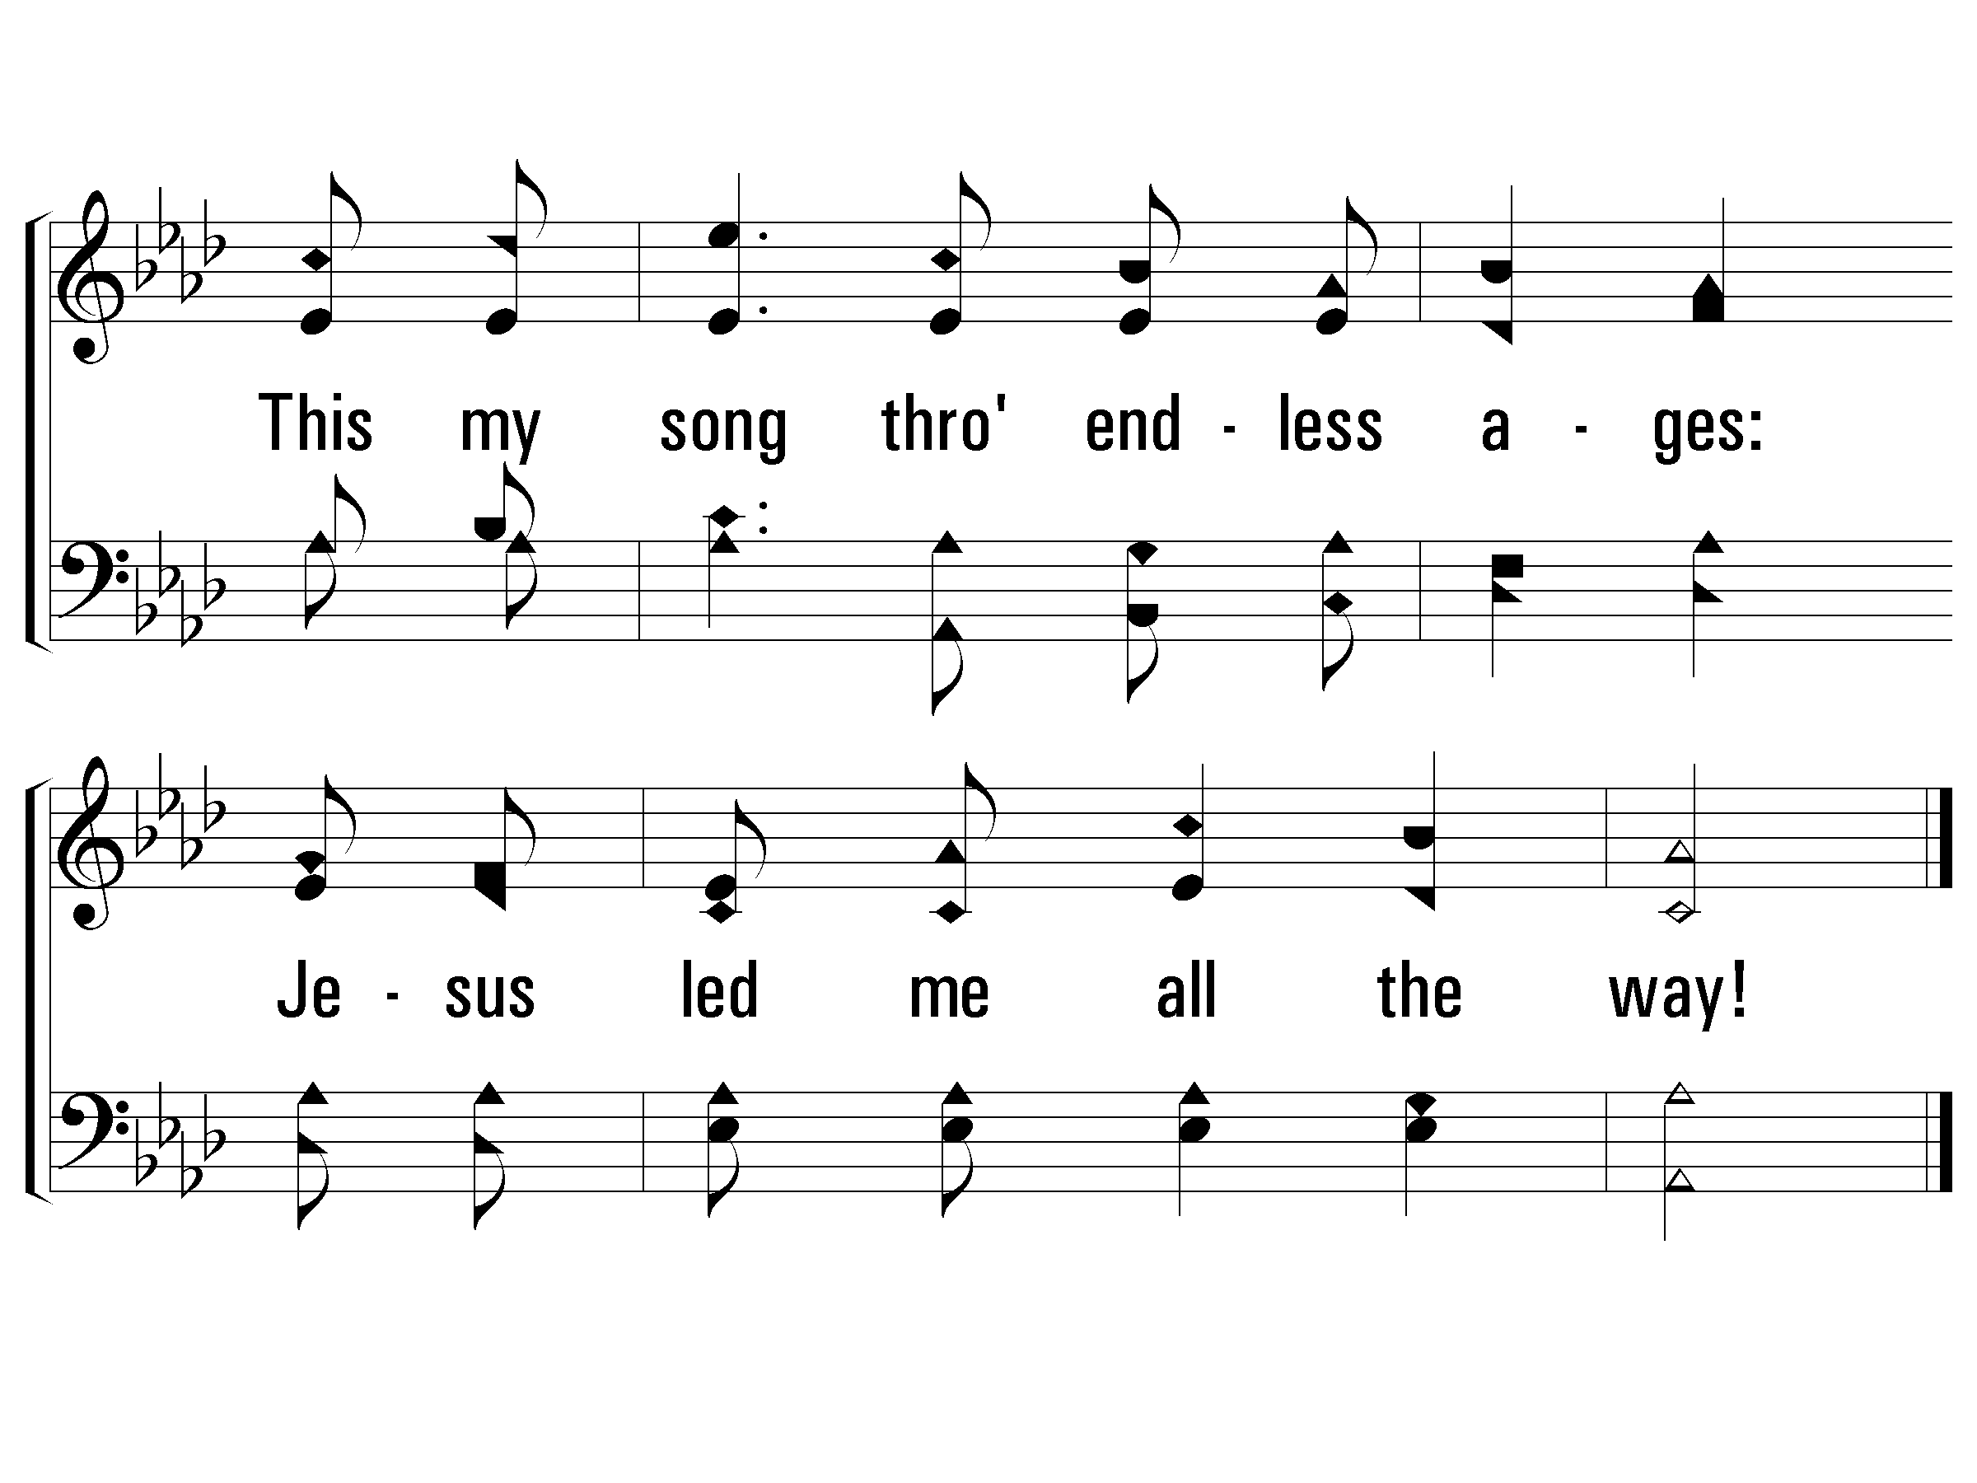
3 – All the Way My Savior Leads Me
22
© 2002 The Paperless Hymnal™

Slide 18

A Fresh Look at Singleness
Notes:
Why this topic?
Share my experience from a few years ago when a single friend who was living in a large college town called me up one night needing to talk.
I had to apologize, because I had not been as thoughtful as a friend or as an evangelist thinking about life from the perspective of adult singleness.

Slide 19
Percentage of Americans ages 18 years old or older who were married:
Chart: The Pew Research Center using US Census Data, September 2017
Notes:
AT FIRST GLANCE, THIS CHART MIGHT BE A GOOD THING. PEOPLE ARE WAITING UNTIL THEY ARE OLDER THAN 18 TO GET MARRIED! I THINK MOST 18 YEAR OLDS WOULD AGREE THAT THEY AREN’T QUITE READY FOR THE RESPONSIBILITIES OF MARRIAGE AT THAT AGE.

Slide 20
Percent of men and women ages 25 and older who have never been married.
Chart: The Pew Research Center using US Census Data, September 2014
Notes:
THE LAST CHART AGREES WITH THIS ONE, THAT PEOPLE ARE WAITING EVEN LATER THAN 18 TO GET MARRIED.

Slide 21
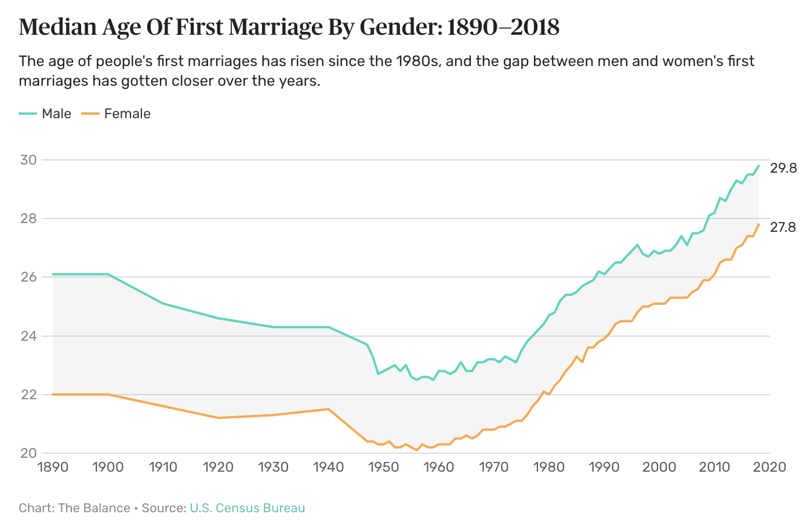
Notes:
EVEN THOSE WHO DO GET MARRIED ARE WAITING LATER AND LATER. IN THE MID-1900’S BOTH MEN AND WOMEN WERE GETTING RELATIVELY YOUNG, THAT IS NO LONGER THE CASE! SOME DON’T GET MARRIED AT ALL.
Remember, these charts do not go into explaining why there has been a societal shift to singleness. All these charts do is track what HAS happened. It is not our goal this weekend to dissect the causes, but to explore the facts: people are getting married later and later, or not at all.
LONG PAUSE…HOLD MY HAND UP TO MY EAR TO HEAR BETTER.
And I think I just heard a well-intentioned match-maker in the back say something like, “Challenge accepted!” =)
The fact that we just laughed reveals there is a kernel of truth in the joke. Actually, we are here this weekend to reevaluate what the Bible says about singleness and maybe learn that the season of life has more value and purpose. That it isn’t a circumstance to be rescued from.

Slide 22
“Of all the many cultural shifts the church did not see coming down the pike – and possibly at the top of the list – may be the growth of singleness.”
- Owen Strachan
Notes:
Owen Strachan

Slide 23
Let’s review some foundational, Bible truths:
REGARDING MARRIAGE:
1
Gen. 2:28
It is not good for man to be alone.
God created marriage, and it is good!
2
Marriage reflects a greater relationship, that of Christ with the church.
Eph. 5:22-33
Marriage reveals a greater mystery
3
Marriage should be a blessing to you and others.
Gen. 1:28, 2:24
There are blessings of marriage
4
Marriage can help guard against immorality, but requires self-control.
Heb. 13:4; 1 Cor. 7:1-5
Physical intimacy is a blessing
5
Not everyone chooses or is free to marry!
Matt. 19:10-12
Some chose singleness!
Notes:
Regarding Marriage:
Gen. 2:28 – It is not good for man to be alone
Eph. 5:22-33 – Marriage is to reflect X and the church. Marriage reveals a greater mystery.
Marriage is temporary! Specific marriages will only last as long as spouses live, but marriage itself as an institution is limited to the created world (Matt. 22:30, For in the resurrection they neither marry nor are given in marriage, but are like angels in heaven)! However, the church’s marriage to Christ will last into eternity!
Gen. 1:8 – There are blessings to being married. One of them is being able to have children. Song of Solomon. Rom. 7:1-5, stability and permanence. Gen. 2.24 & 1 Cor,. 6 – The blessing of the one-flesh dynamic.
Heb. 13:4; 1 Cor. 7:1-5 – Physical intimacy in marriage can guard against immorality, but marriage still requires self-control!
1Matt. 19:10-12 – Despite all of these things being true, some still choose singleness!

Slide 24

Reasons some remain single:
“I don’t believe in marriage.”
“I want to live for myself first.”
“I’m not ready yet.”
“It’s outside of my control.”
“I want to please God.”
Based on experience.
Remember God’s standard.
This can be a selfish approach.
It can create habits.
1 Cor. 6:19-20
This may be legitimate.
This could also be something else.
Hasn’t found someone
Divorcee
Widowed
This should be every unmarried believer!!
Notes:
REASON #1
Based on the marriages you have seen, you may not have a favorable opinion of marriage.
The institution of marriage as God created it, is not the problem. Sinful men and women are the problem.
The answer is not to reject marriage, but to learn what God desires it to be and seek His mercy when we fall short.
The scriptures clearly teach that God created, encourages and uses marriage to the benefit of His people and to His glory!
REASON #2
This is a worldly suggestion, and a selfish philosophy! This approach to singleness has long lasting effects.
It trains us to develop selfish habits that are hard to break, even after marriage.
It made lead us to make choices that keep us from meeting Godly spouses.
What if Jesus had followed this advice?
Single people should live for God, and if there is a possibility of marriage for them, then in consideration of their future spouse!
REASON #3
This may be a true statement!
It could be a young person still in school and maturing to adulthood.
It could be someone who is trying to learn about marriage and all it requires.
If it is true, then as this person grows and matures they should patiently use their singleness for God and prepare themselves for the possibility of marriage.
This may be something else.
This could be someone afraid to become emotionally intimate with a potential spouse.
This could be someone unwilling to make necessary commitment.
This could be someone unwilling to grow.
If this is the case then this person should also use their singleness for God as they allow God to change their attitudes and address the fears that they are allowing to affect them.
2 Tim. 3:16 – God can instruct and change any heart that is submissive to him. It will break you and rebuild you, it will hurt as it changes us. But it is for our good!
REASON #4
This may be a young man seeking a spouse and has not found one yet.
This may be a young woman waiting for a young man to initiate a relationship and no one has.
This may be someone who has dated or been engaged and the other person ended the relationship.
This may be a divorced person who is not free to remarry.
Regardless of the circumstances, this person can live a life of active service in God’s kingdom!
This is a person who is choosing to remain single for the kingdom of heaven’s sake! This is the person who is living for God.

Slide 25

Matt. 19:10-12 - NLT
“For there are eunuchs who have been so from birth, and there are eunuchs who have been made eunuchs by men, and there are eunuchs who have made themselves eunuchs for the sake of the kingdom of heaven. Let the one who is able to receive this receive it.”
Notes:
Jesus is saying three things here, 1) some people, outside of their control, were born without the ability to engage in physical intimacy, 2) some people, against their will, were made incapable of engaging in physical intimacy and 3) that some people chose to refrain from marital intimacy for the sake of the kingdom!

Slide 26
Let’s review some foundational, Bible truths:
REGARDING SINGLENESS:
1
1 Cor. 7:6-7
Singleness is good & glorifies God.
Being single is good!
2
Every Christian is a part of the ultimate marriage as a member of the bride of Christ!
Eph. 5:22-33
Belong to the greater relationship
3
Being single should be a blessing to you and others.
See the chart:
God uses singles in the kingdom!
Notes:
Regarding singleness:
1 Cor. 7:6-7, 25-28 – Being single is a perfectly acceptable thing to be.
1 Eph. 5:22-33 – Every Christian is already a part of what earthly marriage points toward!
Chart – Being single is a blessing to you and to others
1 Cor. 7:36-38 – Self-control is required of every believer regardless of their marital status
Matt. 19:10-12 – Make sure your decision to be single is for the right reasons. Glorify God! You are saying that there is something more important to you than being a marriage with someone. And this is right!

Slide 27
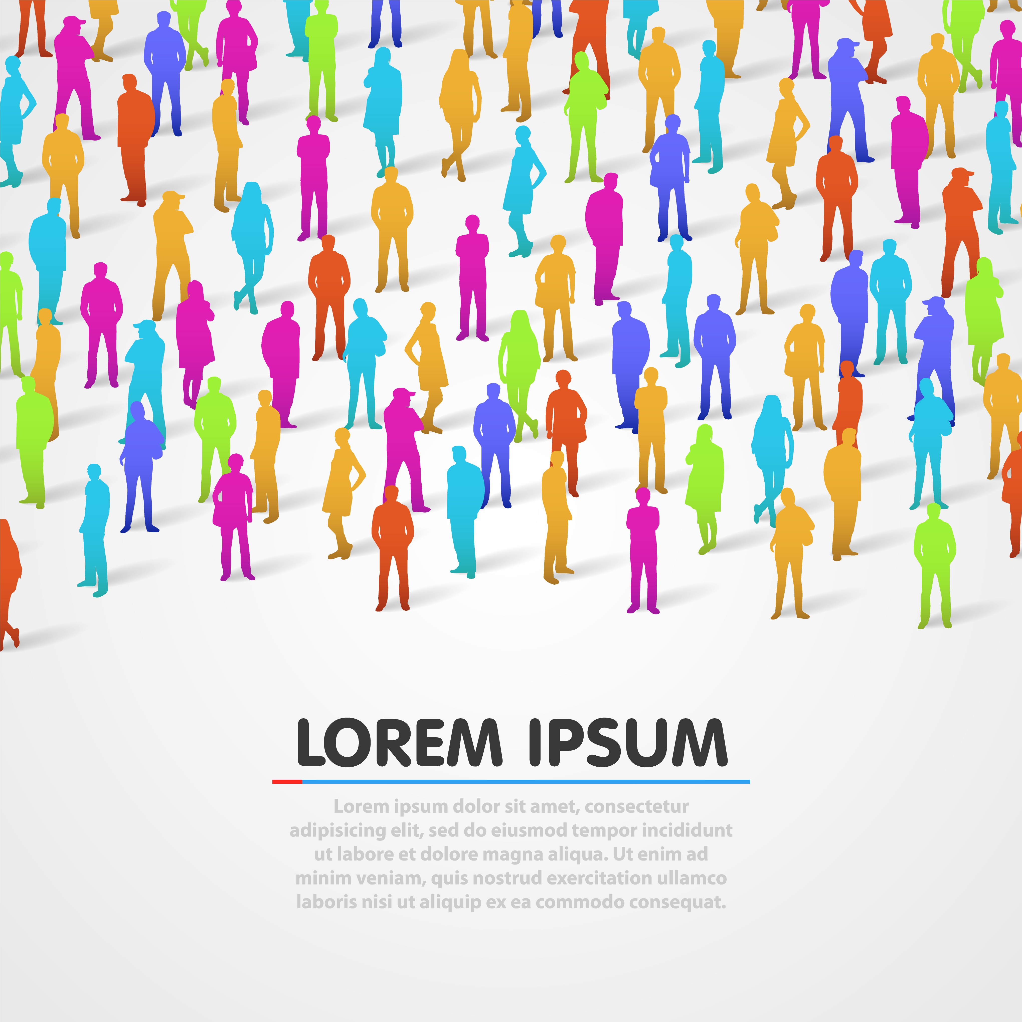
Single people can do incredible things in the kingdom of God!
Joseph (Gen. 39:9, 40:8).
Ruth (Ruth 1:16-18).
Daniel (Dan. 9:1-19).
Nehemiah (Nehemiah).
Anna (Lk. 2:36-38).
John the Baptist (Jn. 3:22-30).
Paul (Phil. 1:12-14).
Lydia (Acts 16:15).
Notes:
Joseph used his season of singleness to obey his father, serve Potiphar and work in a prison while trusting in God (Gen. 39:9, 40:8).
Ruth used her singleness/widowhood to follow God and diligently serve her mother-in-law at great personal cost (Ruth 1:16-18).
Daniel glorified God for more than 70 years in the courts of foreign kings (Dan. 9:1-19)!
Nehemiah led the nation to rebuild the wall and spiritually return to Him (Nehemiah).
Anna remained a widow an as she waited to meet the infant Jesus (Lk. 2:36-38).
John the Baptist used his life of undistracted service to humbly prepare people for the arrival of Jesus (Jn. 3:22-30; Matt. 14:1-12).
Paul traveled the first century world spreading the gospel and encouraging believers (Phil. 1:12-14).
Lydia extended hospitality to Paul and his traveling companions (Acts 16:15).
WHAT ABOUT JESUS?! Isa. 53 – Who can declare his generation? Jesus was the ultimate example of what it meant to please God. Yet he never married or had children. Do we think less of him somehow?

Slide 28
Let’s review some foundational, Bible truths:
REGARDING SINGLENESS:
1
1 Cor. 7:6-7
Singleness is good & glorifies God.
Being single is good!
2
Every Christian is a part of the ultimate marriage as a member of the bride of Christ!
Eph. 5:22-33
Belong to the greater relationship
3
Being single should be a blessing to you and others.
See the chart:
God uses singles in the kingdom!
4
1 Cor. 7:36-38
This is expected of every disciple
Being single requires self-control.
5
Those who choose singleness need to make sure it’s for the right reasons.
Matt. 19:10-12
Own the decision to God’s glory!
Notes:
Regarding singleness:
1 Cor. 7:6-7, 25-28 – Being single is a perfectly acceptable thing to be.
1 Eph. 5:22-33 – Every Christian is already a part of what earthly marriage points toward!
Chart – Being single is a blessing to you and to others
1 Cor. 7:36-38 – Self-control is required of every believer regardless of their marital status
Matt. 19:10-12 – Make sure your decision to be single is for the right reasons. Glorify God! You are saying that there is something more important to you than being a marriage with someone. And this is right!
To those believers in the room who have chosen singleness in order to glorify God, thank you! Thank you for not settling…thank you for not compromising…that you for waiting to mature…and thank you for wanting to learn how to make the most of this season of life!
To those of us in the room who are married, thank you for making the time this weekend to learn how we can better love our single siblings. I hope the weekend is eye-opening, encouraging and that it equips all of us to glorify God as we learn to better love each other.

