Slide 1
Lesson 5

Slide 2
Quiz Class 5
1-4. Give four reasons for maintaining our hope
  God is Merciful, Jesus is Alive, The Nature of Our Inheritance, We are Safely Guarded
5-10. Give six products of our Salvation
  Holiness, Fear, Love, Growth, Spiritual Sacrifice, “Demonstrating” God before others
11. What one word summarizes a Christian’s approach to earthly relationships?

Slide 3
Quiz Class 5
1-4. Give four reasons for maintaining our hope
  God is Merciful, Jesus is Alive, The Nature of Our Inheritance, We are Safely Guarded
5-10. Give six products of our Salvation
  Holiness, Fear, Love, Growth, Spiritual Sacrifice, “Demonstrating” God before others
11. What one word summarizes a Christian’s approach to earthly relationships?
  Submission

Slide 4
Hope
Obey
New
Holy
Fear
Love
Christ : Grace, Love, Mercy, Truth, Light, Holiness, Obedience, Resurrection

Slide 5



The Goal
1 Peter 2:11,12
Beloved, I urge you as aliens and strangers to abstain from fleshly lusts which wage war against the soul. Keep your behavior excellent among the Gentiles, so that in the thing in which they slander you as evildoers, they may because of your good deeds, as they observe them, glorify God in the day of visitation.

Slide 6
Relationships Exhibiting Products of Salvation
(I Pet 2:13-3:12)
For the Lord’s sake (13)
Government (2:13-17)
subjection, honor
So is the will of God (15)
Employment (2:18-25)
subjection, patience
For Conscience toward God (20)
Family (3:1-7)
wives: subjection, pure conduct, meek spirit
husbands: dwell in knowledge, honor
This is acceptable with God (20)
In the sight of God of great price (3:4)
Me
[As] Holy women… who hoped in God (5)
Brotherhood (3:8-12)
As joint heirs of the grace of life (7)
like-minded, compassionate, loving, humble, blessing for evil
For hereunto were you called… (9)
For the eyes of the Lord are upon the righteous (12)

Slide 7
Lesson 5

Slide 8
Class Schedule
Lesson | Title | Date
1 | Introduction to I Peter | Jan 5, 2020
2 | The Great Salvation (I Pet 1:1-12) | Jan 8, 2020
3 | Products of Salvation (I Peter 1:13-2:10) | Jan 12, 2020
4 | The Duties of the Christian (I Peter 2:11-3:12) | Jan 15, 2020
5 | Suffering (I Peter 3:13-4:19) | Jan 19, 2020
6 | Exhortations to Elders and Soldiers (I Peter 5:1-13) | Jan 22, 2020
7 | Introduction to II Peter and Jude | Jan 26, 2020
8 | Call to Growth (II Peter 1:1-21) | Jan 29, 2020
9 | Warnings Against False Teachers (II Peter 2:1-22) | Feb 2, 2020
10 | Warnings Against False Teachers (Jude) | Feb 5, 2020
11 | The Coming of the Lord (II Peter 3) | Feb 9, 2020
12 | Persecution and Ideological Struggles | Feb 12, 2020
13 | Review | Feb 16, 2020

Slide 9
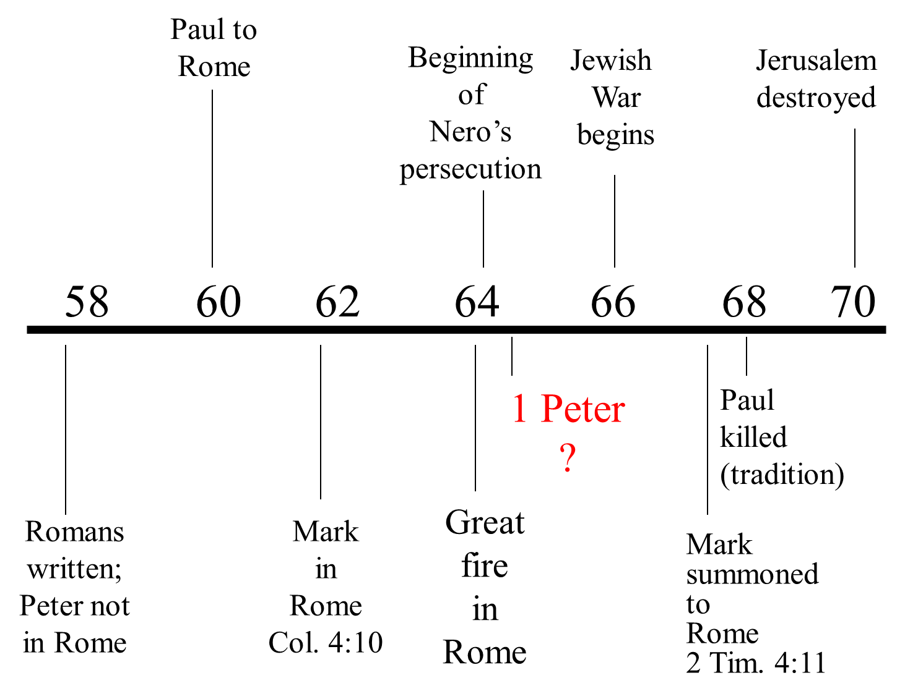

Slide 10
The Persecution Described (First Peter)
Put to Grief in Manifold Trials (1:6)
  For a Little While (6)
  Proving & Testing of Faith (7)
Gentiles… Speak Against You as Evil Doers (2:12)
  A Result of Abstaining from Fleshly Lusts (12)
  Good Works Beheld by Gentiles (12)
Servants … in Subjection to Harsh Masters (2:18)
  For Conscience toward God… Endured Griefs, Suffering Wrongfully. (19)
  Do Well, & Suffer for it (20)
Wives, whose Husbands Obey Not the Word (3:1)
  Not put in Fear by any Terror (6)

Slide 11
1 Peter 3
¹³ And who is he who will harm you if you become followers of what is good? ¹⁴ But even if you should suffer for righteousness’ sake, you are blessed. “And do not be afraid of their threats, nor be troubled.” ¹⁵ But sanctify the Lord God in your hearts, and always be ready to give a defense to everyone who asks you a reason for the hope that is in you, with meekness and fear; ¹⁶ having a good conscience, that when they defame you as evildoers, those who revile your good conduct in Christ may be ashamed. ¹⁷ For it is better, if it is the will of God, to suffer for doing good than for doing evil.

Slide 12
1 Peter 3
¹³ And who is he who will harm you if you become followers of what is good? ¹⁴ But even if you should suffer for righteousness’ sake, you are blessed. “And do not be afraid of their threats, nor be troubled.” ¹⁵ But sanctify the Lord God in your hearts, and always be ready to give a defense to everyone who asks you a reason for the hope that is in you, with meekness and fear; ¹⁶ having a good conscience, that when they defame you as evildoers, those who revile your good conduct in Christ may be ashamed. ¹⁷ For it is better, if it is the will of God, to suffer for doing good than for doing evil.

Slide 13
The Persecution Described (First Peter)
Put to Grief in Manifold Trials (1:6)
  For a Little While (6)
  Proving & Testing of Faith (7)
Suffer for Righteousness (3:14)
  Zealous of What is Good (13)
Spoken Against; Good Manner of Life Reviled (16)
  Suffer for Well-Doing (17)
Gentiles… Speak Against You as Evil Doers (2:12)
  A Result of Abstaining from Fleshly Lusts (12)
  Good Works Beheld by Gentiles (12)
Servants … in Subjection to Harsh Masters (2:18)
  For Conscience toward God… Endured Griefs, Suffering Wrongfully. (19)
  Do Well, & Suffer for it (20)
Wives, whose Husbands Obey Not the Word (3:1)
  Not put in Fear by any Terror (6)

Slide 14
1 Peter 4
2 that he no longer should live the rest of his time in the flesh for the lusts of men, but for the will of God. 3 For we have spent enough of our past lifetime in doing the will of the Gentiles—when we walked in lewdness, lusts, drunkenness, revelries, drinking parties, and abominable idolatries. 4 In regard to these, they think it strange that you do not run with them in the same flood of dissipation, speaking evil of you.
12 Beloved, do not think it strange concerning the fiery trial which is to try you, as though some strange thing happened to you; ¹³ but rejoice to the extent that you partake of Christ’s sufferings, that when His glory is revealed, you may also be glad with exceeding joy. ¹⁴ If you are reproached for the name of Christ, blessed are you, for the Spirit of glory and of God rests upon you. On their part He is blasphemed, but on your part He is glorified. ¹⁵ But let none of you suffer as a murderer, a thief, an evildoer, or as a busybody in other people’s matters. ¹⁶ Yet if anyone suffers as a Christian, let him not be ashamed, but let him glorify God in this matter. ¹⁹ Therefore let those who suffer according to the will of God commit their souls to Him in doing good, as to a faithful Creator.

Slide 15
1 Peter 4
2 that he no longer should live the rest of his time in the flesh for the lusts of men, but for the will of God. 3 For we have spent enough of our past lifetime in doing the will of the Gentiles—when we walked in lewdness, lusts, drunkenness, revelries, drinking parties, and abominable idolatries. 4 In regard to these, they think it strange that you do not run with them in the same flood of dissipation, speaking evil of you.
12 Beloved, do not think it strange concerning the fiery trial which is to try you, as though some strange thing happened to you; ¹³ but rejoice to the extent that you partake of Christ’s sufferings, that when His glory is revealed, you may also be glad with exceeding joy. ¹⁴ If you are reproached for the name of Christ, blessed are you, for the Spirit of glory and of God rests upon you. On their part He is blasphemed, but on your part He is glorified. ¹⁵ But let none of you suffer as a murderer, a thief, an evildoer, or as a busybody in other people’s matters. ¹⁶ Yet if anyone suffers as a Christian, let him not be ashamed, but let him glorify God in this matter. ¹⁹ Therefore let those who suffer according to the will of God commit their souls to Him in doing good, as to a faithful Creator.

Slide 16
The Persecution Described (First Peter)
Put to Grief in Manifold Trials (1:6)
  For a Little While (6)
  Proving & Testing of Faith (7)
Suffer for Righteousness (3:14)
  Zealous of What is Good (13)
Spoken Against; Good Manner of Life Reviled (16)
  Suffer for Well-Doing (17)
Gentiles… Speak Against You as Evil Doers (2:12)
  A Result of Abstaining from Fleshly Lusts (12)
  Good Works Beheld by Gentiles (12)
Gentiles…Speak Evil of You (4:4)
  You no Longer Live in Lust (2)
  They Think it Strange that You Do not Run with Them (4)
Servants … in Subjection to Harsh Masters (2:18)
  For Conscience toward God… Endured Griefs, Suffering Wrongfully. (19)
  Do Well, & Suffer for it (20)
Fiery Trial (4:12)
  Partaker of Christ’s Suffering (13)
  Reproached for Name of Christ (14)
  Suffer as a Christian (16)
Same Sufferings Accomplished in Brethren in the World (5:9)
  Suffer a little while (10)
Wives, whose Husbands Obey Not the Word (3:1)
  Not put in Fear by any Terror (6)

Slide 17
Strength in Persecution
Harm to good? (3:13)
Blessed (3:14)
Sanctify Christ (3:15)
Prepare to defend (3:15)
Keep a good conscience (3:16)
Christ died for all, the just for the unjust (3:18)
Arm yourselves with the purpose of suffering in the flesh (4:1)
Sound judgment and sober spirit (4:7)
Fervent in love (4:8)
Hospitable without complaint (4:9)
Serve one another with our gifts (4:10)
Speak and serve as to glorify God (4:11)
Rejoice in current suffering so that we will rejoice at His revelation (4:13)
Glorify God in the name “Christian” (4:16)

Slide 18
The Problem of Persecution
Specific Persecutions
Thought (called) Strange (4:4)
Spoken of as Evil (4:4)
Spoken Against (3:16)
Good Manner of Life Reviled (3:16)
Accused of Evil Deeds (2:12)
Reproached in Connection with the Name of Christ (4:14)
“Offensive” Doctrines (I Peter)
1:15; 2:16 Holy, Submissive Living Required
4:3; 2:11 Wrong to Follow Natural Desires
1:25; 2:2 Reliance on, Restriction
4:11a To Word of God
1:3,4,9 Reality of End of Time & Resurrection (Spiritual Nature of Man)
Possible Reasons
Pure Living Seen as Implicit Condemnation (2:12)
Independence (Free) from Worldly Thought (2:16)
Independence from Worldly Influence (Fear) (3:13,14)
Offensive Doctrines (see 2:2; 3:15)
1:21;3:22 Resurrection & Kingship of Jesus
4:5,17,18 Coming Judgment & Punishment of Wicked (Accountability of Man)

Slide 19
1 Peter 3
¹⁸ For Christ also suffered once for sins, the just for the unjust, that He might bring us to God, being put to death in the flesh but made alive by the Spirit, ¹⁹ by whom also He went and preached to the spirits in prison, ²⁰ who formerly were disobedient, when once the Divine longsuffering waited in the days of Noah, while the ark was being prepared, in which a few, that is, eight souls, were saved through water. ²¹ There is also an antitype which now saves us—baptism (not the removal of the filth of the flesh, but the answer of a good conscience toward God), through the resurrection of Jesus Christ, ²² who has gone into heaven and is at the right hand of God, angels and authorities and powers having been made subject to Him.

Slide 20

Surrounded by Disobedience 3:19-21
Days of Noah
Escape from judgment… How?
Now
Once were disobedient … in the days of Noah, during the construction of the ark
Disobedient
In Prison
8 souls
Safety
You
Safety

Slide 21
1 Peter 4
7 But the end of all things is at hand; therefore be serious and watchful in your prayers. 8 And above all things have fervent love for one another, for “love will cover a multitude of sins.” 9 Be hospitable to one another without grumbling. 10 As each one has received a gift, minister it to one another, as good stewards of the manifold grace of God.
11 If anyone speaks, let him speak as the oracles of God. If anyone ministers, let him do it as with the ability which God supplies, that in all things God may be glorified through Jesus Christ, to whom belong the glory and the dominion foreverand ever. Amen

Slide 22
Lesson 6

Slide 23
Class Schedule
Lesson | Title | Date
1 | Introduction to I Peter | Jan 5, 2020
2 | The Great Salvation (I Pet 1:1-12) | Jan 8, 2020
3 | Products of Salvation (I Peter 1:13-2:10) | Jan 12, 2020
4 | The Duties of the Christian (I Peter 2:11-3:12) | Jan 15, 2020
5 | Suffering (I Peter 3:13-4:19) | Jan 19, 2020
6 | Exhortations to Elders and Soldiers (I Peter 5:1-13) | Jan 22, 2020
7 | Introduction to II Peter and Jude | Jan 26, 2020
8 | Call to Growth (II Peter 1:1-21) | Jan 29, 2020
9 | Warnings Against False Teachers (II Peter 2:1-22) | Feb 2, 2020
10 | Warnings Against False Teachers (Jude) | Feb 5, 2020
11 | The Coming of the Lord (II Peter 3) | Feb 9, 2020
12 | Persecution and Ideological Struggles | Feb 12, 2020
13 | Review | Feb 16, 2020

Slide 24
The Persecution Described (First Peter)
Gentiles… Speak Against You as Evil Doers (2:12)
  A Result of Abstaining from Fleshly Lusts (12)
  Good Works Beheld by Gentiles (12)
Misunderstanding
Gentiles…Speak Evil of You (4:4)
  You no Longer Live in Lust (2)
  They Think it Strange that You Do not Run with Them (4)
Spoken Against; Good Manner of Life Reviled (16)
  Suffer for Well-Doing (17)
Changed Conduct
Suffer for Righteousness (3:14)
  Zealous of What is Good (13)
Fiery Trial (4:12)
  Partaker of Christ’s Suffering (13)
  Reproached for Name of Christ (14)
  Suffer as a Christian (16)
Standing as a Christian

Slide 25
Gentiles… Speak Against You as Evil Doers (2:12)
  A Result of Abstaining from Fleshly Lusts (12)
  Good Works Beheld by Gentiles (12)
Misunderstanding / Misrepresentations
Suppressors of Women
…are all hypocrites
closeminded ‘Haters’
“…only ones going to heaven”
Hate Orphans
“Antis” against everything…

Slide 26
Gentiles…Speak Evil of You (4:4)
  You no Longer Live in Lust (2)
  They Think it Strange that You Do not Run with Them (4)
Spoken Against; Good Manner of Life Reviled (16)
  Suffer for Well-Doing (17)
Changed Conduct
1 Peter 4: 3 For we have spent enough of our past lifetime in doing the will of the Gentiles—when we walked in lewdness, lusts, drunkenness, revelries, drinking parties, and abominable idolatries. 4 In regard to these, they think it strange that you do not run with them in the same flood of dissipation, speaking evil of you.
Seeking the ‘Middle Ground’ as a Christian?
‘we walk close to’ lewdness
‘Rub shoulders’ with lusts
Drink but ‘try’ to avoid drunkenness
Still attend revelries, drinking parties where abominable idolatries take place but ‘we are not part of them’

Slide 27
Suffer for Righteousness (3:14)
  Zealous of What is Good (13)
Fiery Trial (4:12)
  Partaker of Christ’s Suffering (13)
  Reproached for Name of Christ (14)
  Suffer as a Christian (16)
Standing as a Christian

Slide 28
Being a Christian
Specific Persecutions
Thought (called) Strange (4:4)
Spoken of as Evil (4:4)
Spoken Against (3:16)
Good Manner of Life Reviled (3:16)
Accused of Evil Deeds (2:12)
Reproached in Connection with the Name of Christ (4:14)
Possible Reasons
Pure Living Seen as Implicit Condemnation (2:12)
Independence (Free) from Worldly Thought (2:16)
Independence from Worldly Influence (Fear) (3:13,14)
Offensive Doctrines (see 2:2; 3:15)

Slide 29
“Offensive” Doctrines (I Peter)
1:15; 2:16 Holy, Submissive Living Required
4:3; 2:11 Wrong to Follow Natural Desires
1:25; 2:2 Reliance on, Restriction
4:11a To Word of God
1:3,4,9 Reality of End of Time & Resurrection (Spiritual Nature of Man)
1:21;3:22 Resurrection & Kingship of Jesus
4:5,17,18 Coming Judgment & Punishment of Wicked (Accountability of Man)

Slide 31
Make Sure They Don't Happen in Your Church
In August 2000 the _______Church proposed dropping seven texts from a proposed new Lectionary because they "give an undesirably negative impression regarding women." The new church document recommended the following texts for deletion:
Ephesians 5:22-24 ...wives should submit to their husbands etc.
1 Timothy 2:11-15 A woman should learn in quietness and full submission. I do not permit a woman to teach or to have authority over a man; she must be silent etc.
1 Corinthians 14:33-35 ...women should remain silent in the churches (and following).
1 Corinthians 11:3-16 Now I want you to realize that the head of every man is Christ, and the head of the woman is man (and following).
Colossians 3:18 Wives, submit to your husbands, as is fitting in the Lord.
Peter 3:1-6 Wives in the same way be submissive to your husbands (and following).
Titus 2: 4-5
Responding to the church’s decision, a September 1, 2000 church News Service interview with church leader, reaffirmed the member’s concern about New Testament readings which subordinate women. They also publicized Lectionary alternatives now available to the U.S. church and described below. .
The current U.S. Lectionary ….provides the option of using a short form of the readings from Colossians and Ephesians, that "omit[s] verses which were reported to have caused widespread misunderstandings when proclaimed in some churchs," according to church leader. If a church leader does choose to use the longer form of these readings, church leader said, he should explain the reading in the context of the church's teaching and the original cultural context of the Scripture.
Take this flyer to your pastor and church committee. Ask them to make sure scripture readings that subordinate women aren't being read from the pulpit in your faith community.
Offensive Doctrines

Slide 32
1 Peter 3
¹⁸ For Christ also suffered once for sins, the just for the unjust, that He might bring us to God, being put to death in the flesh but made alive by the Spirit, ¹⁹ by whom also He went and preached to the spirits in prison, ²⁰ who formerly were disobedient, when once the Divine longsuffering waited in the days of Noah, while the ark was being prepared, in which a few, that is, eight souls, were saved through water. ²¹ There is also an antitype which now saves us—baptism (not the removal of the filth of the flesh, but the answer of a good conscience toward God), through the resurrection of Jesus Christ, ²² who has gone into heaven and is at the right hand of God, angels and authorities and powers having been made subject to Him.

Slide 33
Surrounded by Disobedience 3:19-21
Days of Noah
Escape from judgment… How?
Now
Once were disobedient … in the days of Noah, during the construction of the ark
Disobedient
In Prison
8 souls
Safety
You
Safety

Slide 34
1 Peter 5
¹ The elders who are among you I exhort, I who am a fellow elder and a witness of the sufferings of Christ, and also a partaker of the glory that will be revealed: ² Shepherd the flock of God which is among you, serving as overseers, not by compulsion but willingly, not for dishonest gain but eagerly; ³ nor as being lords over those entrusted to you, but being examples to the flock; ⁴ and when the Chief Shepherd appears, you will receive the crown of glory that does not fade away.

Slide 35
Peter’s Credentials vs 1
Fellow elder
  “I’m in your shoes”
Witness of the sufferings of Christ
  “I saw the price as it was paid.”
  “I saw the Example in practice.”
Partaker of the glory that is to be revealed
  “I have the same hope you do.”

Slide 36
Exhortations to Elders (I Pet 5:1-5)
Vs 1 Elders (Presbyters)
Vs 2a Tend (Shepherd, Pastor)
Vs 2b Exercising the Oversight (Episcopountes)
New Testament Plan: “Pastors, Elders, Bishops” are the same office: A plurality of leaders over a single local church.
“Not”
“But”
Implication About the Office
v 2b
Of Constraint
(Under
Compulsion)
Willingly
(Voluntarily)
Could Feel Pressed into Service
A Selected & Appointed Office
A Duty (potentially burdensome)
v 2c
For Filthy Lucre
(Sordid Gain)
Ready Mind
(Eagerness)
Opportunity for Gain:
Could Involve Handling Money
Could be Supported Financially
v 3
As Being Lords
Over
(Domineering)
Proving to be
Examples
Involves Exercise of Authority
Giving Instructions (which would be followed by the elder)
Subjection/Respect of Others (as in v 5)

Slide 37
1 Peter 5
⁵ Likewise you younger people, submit yourselves to your elders. Yes, all of you be submissive to one another, and be clothed with humility, for
“God resists the proud,
But gives grace to the humble.”
⁶ Therefore humble yourselves under the mighty hand of God, that He may exalt you in due time, ⁷ casting all your care upon Him, for He cares for you.
⁸ Be sober, be vigilant; because your adversary the devil walks about like a roaring lion, seeking whom he may devour. ⁹ Resist him, steadfast in the faith, knowing that the same sufferings are experienced by your brotherhood in the world. ¹⁰ But may the God of all grace, who called us to His eternal glory by Christ Jesus, after you have suffered a while, perfect, establish, strengthen, and settle you. ¹¹ To Him be the glory and the dominion forever and ever. Amen.

Slide 38
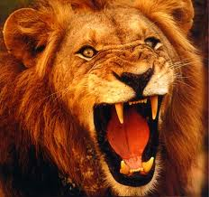
“That He may exalt you…”
“Humble yourselves…”
“Casting all your anxiety on Him…”

Slide 39
The True Grace of God

Slide 40
Lesson 7

Slide 41
1Peter -Quiz 7 – Fill in the ____
Introduction (1:1,2)
The _________ __________ (1:3-12)
The _________ __Salvation (1:13-2:10)
The ______ __ ___Christian (2:11-3:12)
___________ as a Christian (3:13-4:19)
Exhortation to __________ (5:1-5)
Exhortations to _________ (5:6-11)
Conclusions (5:12,13)

Slide 42
Outline of I Peter
Introduction (1:1,2)
The Great Salvation (1:3-12)
The Products of Salvation (1:13-2:10)

Slide 43
1 Peter 1:
13 Therefore gird up the loins of your mind, be sober, and rest your hope fully upon the grace that is to be brought to you at the revelation of Jesus Christ;
Hope
Obey
New
Holy
Fear
Love
Christ : Grace, Love, Mercy, Truth, Light, Holiness, Obedience, Resurrection

Slide 44
Outline of I Peter
Introduction (1:1,2)
The Great Salvation (1:3-12)
The Products of Salvation (1:13-2:10)
The Duties of the Christian (2:11-3:12)
Suffering as a Christian (3:13-4:19)
Exhortation to Shepherds (5:1-5)
Exhortations to Soldiers (5:6-11)
Conclusions (5:12,13)

Slide 45
Class Schedule
Lesson | Title | Date
1 | Introduction to I Peter | Jan 5, 2020
2 | The Great Salvation (I Pet 1:1-12) | Jan 8, 2020
3 | Products of Salvation (I Peter 1:13-2:10) | Jan 12, 2020
4 | The Duties of the Christian (I Peter 2:11-3:12) | Jan 15, 2020
5 | Suffering (I Peter 3:13-4:19) | Jan 19, 2020
6 | Exhortations to Elders and Soldiers (I Peter 5:1-13) | Jan 22, 2020
7 | Introduction to II Peter and Jude | Jan 26, 2020
8 | Call to Growth (II Peter 1:1-21) | Jan 29, 2020
9 | Warnings Against False Teachers (II Peter 2:1-22) | Feb 2, 2020
10 | Warnings Against False Teachers (Jude) | Feb 5, 2020
11 | The Coming of the Lord (II Peter 3) | Feb 9, 2020
12 | Persecution and Ideological Struggles | Feb 12, 2020
13 | Review | Feb 16, 2020

Slide 46
The Persecution Described (First Peter)
Gentiles… Speak Against You as Evil Doers (2:12)
  A Result of Abstaining from Fleshly Lusts (12)
  Good Works Beheld by Gentiles (12)
Misunderstanding
Gentiles…Speak Evil of You (4:4)
  You no Longer Live in Lust (2)
  They Think it Strange that You Do not Run with Them (4)
Spoken Against; Good Manner of Life Reviled (16)
  Suffer for Well-Doing (17)
Changed Conduct
Suffer for Righteousness (3:14)
  Zealous of What is Good (13)
Fiery Trial (4:12)
  Partaker of Christ’s Suffering (13)
  Reproached for Name of Christ (14)
  Suffer as a Christian (16)
Standing as a Christian

Slide 47
Possible Reasons
Pure Living Seen as Implicit Condemnation (2:12)
Independence (Free) from Worldly Thought (2:16)
Independence from Worldly Influence (Fear) (3:13,14)
Offensive Doctrines (see 2:2; 3:15)

Slide 48
“Offensive” Doctrines (I Peter)
1:15; 2:16 Holy, Submissive Living Required
4:3; 2:11 Wrong to Follow Natural Desires
1:25; 2:2 Reliance on, Restriction
4:11a To Word of God
1:3,4,9 Reality of End of Time & Resurrection (Spiritual Nature of Man)
1:21;3:22 Resurrection & Kingship of Jesus
4:5,17,18 Coming Judgment & Punishment of Wicked (Accountability of Man)

Slide 49
Purpose of the 2nd letter
  2 Peter 2:2 But there were also false prophets among the people, even as there will be false teachers among you, who will secretly bring in destructive heresies, even denying the Lord who bought them, and bring on themselves swift destruction. 2 And many will follow their destructive ways, because of whom the way of truth will be blasphemed.

Slide 50
Who wrote 2 Peter?
Simon ---- Peter / Cepha (Aramaic) / Rock
Peter’s Time With Jesus
  Jairus’ daughter raised
  Walks on water
  Blessed by Jesus upon confession
    Resisted idea of Jesus dying
  Witnesses transfiguration
    Proposes to build three “tents”
  At Passover meal – Lord’s Supper
    Bold prediction of faithfulness
  In the Garden of Gethsemane
    Asleep just prior to capture
    Resisted Jesus’ capture
  Denying knowing Jesus during trials
Simon
  Rash
  Headstrong
  Proud
  Impulsive
  Unstable
  Had trouble with his mouth
Peter (Rock)
  Firmness
  Stability
  Strength
  Faithfulness

Slide 51
Written from where?
2 Peter 1:
12 For this reason I will not be negligent to remind you always of these things, though you know and are established in the present truth. 13 Yes, I think it is right, as long as I am in this tent, to stir you up by reminding you, 14 knowing that shortly I must put off my tent, just as our Lord Jesus Christ showed me.

Slide 52
Nero's death

Slide 53
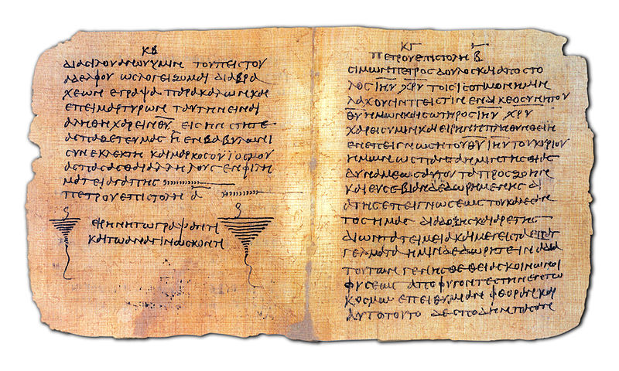
Papyrus Bodmer
Notes:
End of 1 Peter and beginning of 2nd Peter in Greek. Oldest know copy from 3rd/4th century. Papyrus also contains the book of Jude

Slide 54
Purpose of the letter?
  2 Peter 1:2 Grace and peace be multiplied to you in the knowledge of God and of Jesus our Lord, 3 as His divine power has given to us all things that pertain to life and godliness, through the knowledge of Him who called us by glory and virtue, 4 by which have been given to us exceedingly great and precious promises, that through these you may be partakers of the divine nature, having escaped the corruption that is in the world through lust.

Slide 55
“His Divine Power Has Given Us All Things”
God
(Supernatural)
Power &
Coming
Of Jesus
(II Pet 1:16)
Miracles
(II Pet 1:17,18)
(Acts 2:22)
Day of
Judgment &
Destruction
Of Ungodly
(II Pet 2:9;
3:7)
Creation
(II Pet 3:5)
[Prophets]
Moved by
Holy Spirit
(II Pet 1:21)
Commands
[thru Apostles]
(II Pet 3:2,15)
Men
(In the World)

Slide 56
The Great Salvation (I Pet 1:1-12 in time sequence)
R
E
V
E
L
A
T
I
O
N
I
N
C
A
R
N
A
T
I
O
N
R
E
S
U
R
R
E
C
T
I
O
N
R
E
V
E
L
A
T
I
O
N
Christ Mani-
fested (20)
Begotten
Again by the
Word (23)
Beforehand (11)
Now Have Been (12)
Prophets Prophesied of Grace to Come (10,11)
Prophets Searched to Know the time (10,11)
Told They Ministered to You (12)
Suffer-
ing
Glory
Announced to You (12)
In the Gospel
By Them that Preach
Sent by the Holy Spirit
of Christ (11)
Revelation of
Jesus Christ (7)
2
N
D
C
O
M
I
N
G
R
E
S
U
R
R
E
C
T
I
O
N
J
U
D
G
M
E
N
T
Begotten
Again (3)
Now, For a
Little While (6)
“The Last Time” (5)
Living Hope (3)
Guarded (5)
  By God’s Power
  Through Faith
Grief in Manifold Trials (6)
  Proof of Your Faith (7)
Loving & Believing Jesus (8)
Rejoicing (8)
  Joy Unspeakable
  Full of Glory
Inheritance (4)
  Incorruptible
  Undefiled
  Fades Not Away
  Reserved in Heaven
Salvation Revealed (5)
The “End” of Our Faith (9)
Salvation of Souls (9)

Slide 57
Purpose of the letter?
  2 Peter 2:2 But there were also false prophets among the people, even as there will be false teachers among you, who will secretly bring in destructive heresies, even denying the Lord who bought them, and bring on themselves swift destruction. 2 And many will follow their destructive ways, because of whom the way of truth will be blasphemed.

Slide 58
“His Divine Power Has Given Us All Things”
God
(Supernatural)
“Private
Origin”
(1:20)
“Devised
Fables”
(1:16)
“All Things
Continue”
(3:4)
Forget
(3:5)
Deny
(2:1)
Twist /
Distort
(3:16)
Power &
Coming
Of Jesus
(II Pet 1:16)
Miracles
(II Pet 1:17,18)
(Acts 2:22)
Day of
Judgment &
Destruction
Of Ungodly
(II Pet 2:9;
3:7)
Creation
(II Pet 3:5)
[Prophets]
Moved by
Holy Spirit
(II Pet 1:21)
Commands
[thru Apostles]
(II Pet 3:2,15)
Men
(In the World)

Slide 59
Purpose of the letter?
  2 Peter 2:9 The Lord is not slack concerning His promise, as some count slackness, but is longsuffering toward us, not willing that any should perish but that all should come to repentance. 17 You therefore, beloved, since you know this beforehand, beware lest you also fall from your own steadfastness, being led away with the error of the wicked; 18 but grow in the grace and knowledge of our Lord and Savior Jesus Christ.

Slide 60
Introduction 1:1,2
Call to Growth 1:3-11
    God’s Gifts 1:3-4
    Our Growth 1:5-7
    Reasons to Grow 1:8-11
Certain Foundations 1:12-21
    Eyewitness Testimony of Apostles 1:12-18
    Confirmation of Prophecy 1:19-21
False Teachers 2:1-22
    Prediction of their Coming 2:1-3
    Past Examples of God’s Judgment 2:4-10a
    Description of their Activities 2:10b-19
    Danger of Entanglement 2:19b-22
Reminder of the Lord’s Coming 3:1-16
    Argument from the Flood 3:1-7
    Promise of the Day of the Lord 3:8-13
    Admonition to Diligence 3:14-16
Conclusions 3:17,18
Outline of Second Peter

Slide 61
Jude
Who?
When?
Why?
1 Jude, a bondservant of Jesus Christ, and brother of James, To those who are called, sanctified by God the Father, and preserved in Jesus Christ:

Slide 62
Relationship of II Peter & Jude
But there were also false prophets among the people, even as there will be false teachers among you, who will secretly bring in destructive heresies, even denying the Lord who bought them … And many will follow their destructive ways, because of whom the way of truth will be blasphemed. By covetousness they will exploit you… (II Peter 2:1-3)
For certain men have crept in unnoticed, who long ago were marked out for this condemnation, ungodly men, who turn the grace of our God into licentiousness and deny the only Lord God and our Lord Jesus Christ. (Jude 4)
Peter said it would happen.
Jude said it had happened.
But you, beloved, remember the words which were spoken before by the apostles of our Lord Jesus Christ: how they told you that there would be mockers in the last time who would walk according to their own ungodly lusts. (Jude 17,18)
Beloved, I…write to you … that you may be mindful of the words which were spoken before by the holy prophets, and of the commandment of us the apostles of the Lord and Savior, knowing this first: that scoffers will come in the last days, walking according to their own lusts… (II Peter 3:1-3)

Slide 63
Jude
Who?
When?
Why?
Jude
After 2 Peter
3 Beloved, while I was very diligent to write to you concerning our common salvation, I found it necessary to write to you exhorting you to contend earnestly for the faith which was once for all delivered to the saints.

Slide 64
Similarities in II Peter 2 & Jude
II Pet Jude
2:3 4 their condemnation written of old
2:1 4 crept in privately … denying the master
1:12 5 put in remembrance … though ye know
2:4 6 angels that sinned (kept not their habitation)
2:6 7 destruction of Sodom & Gomorrah
2:10 8 false teachers rail at dignities, despise rule
2:11 9 angels (Michael) didn’t dispute with the devil
2:12 10 rail at what they don’t understand … will be destroyed
2:15 11 example of Balaam
2:13 12 hidden (rocks) in (love) feasts
2:17 13 waves, foam, etc. …blackness reserved for them
2:18 16 uttering (speaking) great swelling words
2:18 16 enticing in lusts
3:2 17 remember words of the apostles

Slide 65
Similarities in II Peter 2 & Jude
II Pet Jude
3:3 18 in the last days … mockers will come
1:10 24 ye shall never (guard you from) stumble (ing)

Slide 66
Differences in II Peter 2 & Jude
Jude
5 Deliverance from Egypt & Later Judgment
11 Cain & Korah
12 Selfish Shepherds
13 Wandering Stars
14,15 Enoch’s Prophecy
18 Showing Respect of Persons
II Peter 2
5 Noah & the Flood
7,8 Lot & Sodom
14 Cannot Cease from Sin
19-22 Escaped Defilements, then Return: Worse

