Slide 1
Evangelism Reports
January 26, 2020

Slide 2
December Special Studies at Embry Hills
Blake Edwards
Atlanta, Georgia, USA (Intown)
Ben and Emily Hall
Brooklyn, New York, USA
Gardner and Beverly Hall
New York Metro, USA
Joe and Fiona Hamm
Philadelphia, Pennsylvania, USA
Roger and Cassie Polanco
West Harlem, New York, USA

Slide 3
Ephesians 6:21-22; Colossians 4:7-9
21 But that you may know my affairs and how I am doing, Tychicus, a beloved brother and faithful minister in the Lord, will make all things know to you; 22 whom I have sent to you for this very purpose, that you my know our affairs, and that he may comfort your hearts.
7 Tychicus, a beloved brother, faithful minister, and fellow servant in the Lord ,will tell you all the news about me. 8 I am sending him to you for this very purpose, that he may know your circumstances and comfort your hearts, 9 with Onesimus, a faithful and beloved brother, who is one of you. They will make know to you all things which are happening here.

Slide 4
Goal
Not to give a full picture of the man, his family, and the work…
But to increase awareness of all whom we have fellowship with in the gospel,
and to spur you to regularly read reports, pray, and send encouragement.

Slide 5
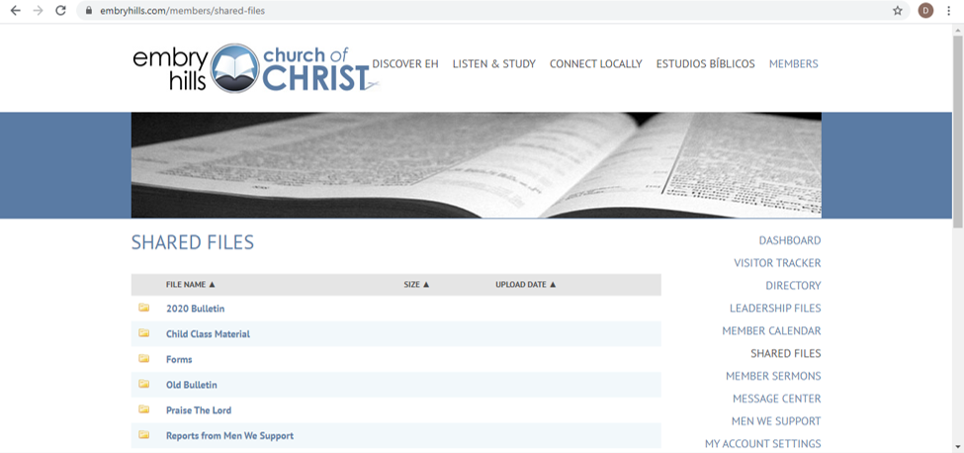
Members → Shared Files → Reports From Men We Support

Slide 6
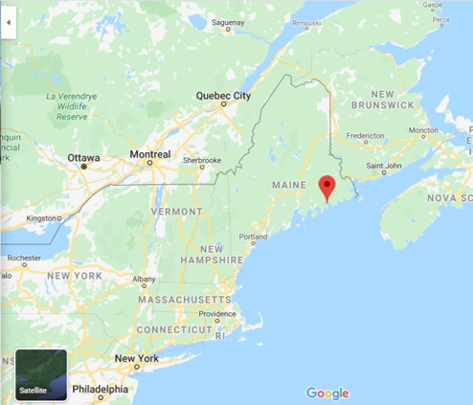
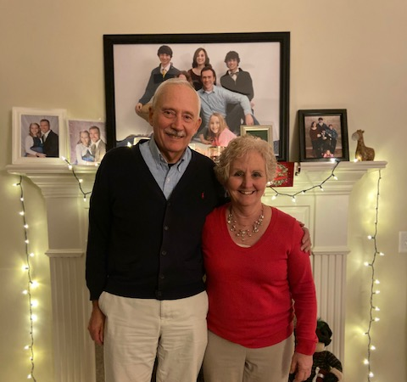
Skip and Carol Paquette
Milbridge, Maine, USA

Slide 7
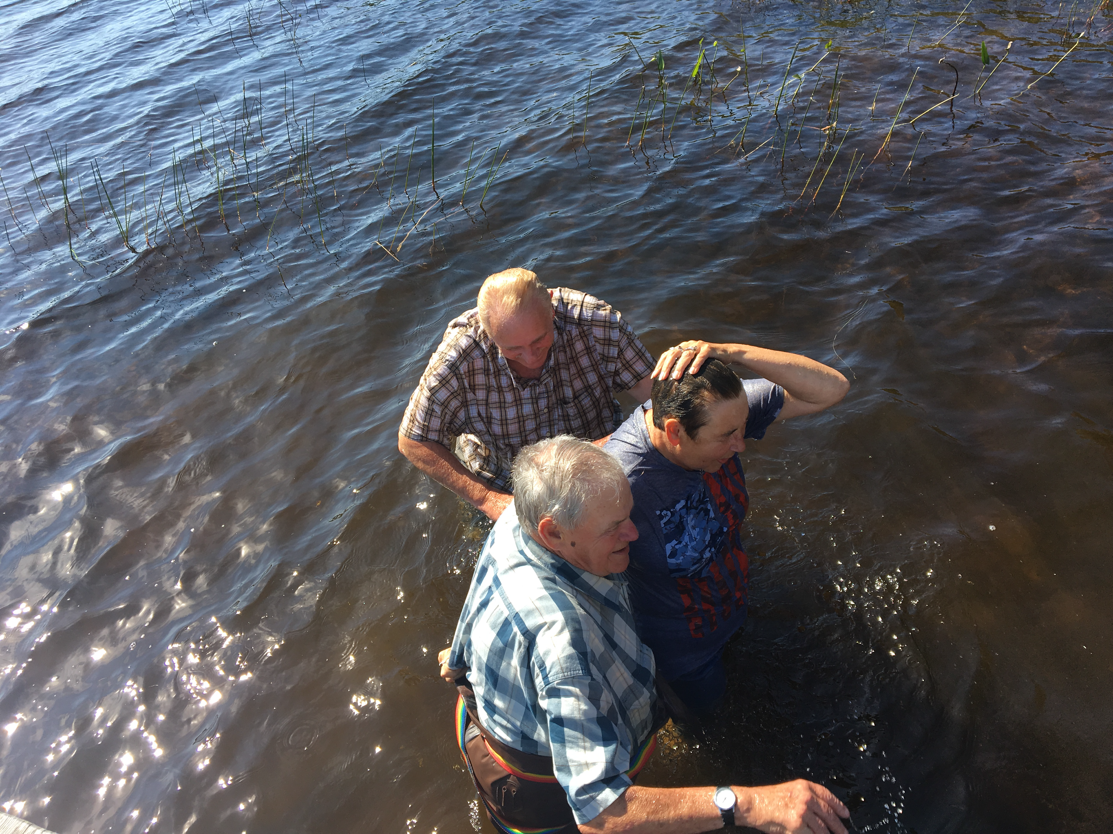
Skip and Carol Paquette
Milbridge, Maine, USA

Slide 8
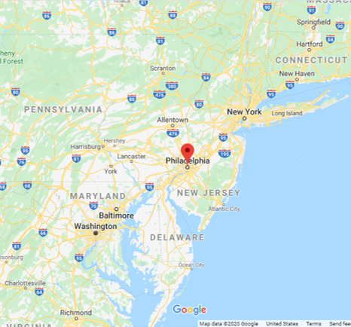
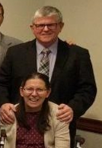
Kieran and Patti Murphy
Philadelphia, Pennsylvania, USA

Slide 9
Kieran and Patti Murphy
Philadelphia, Pennsylvania, USA

Slide 10
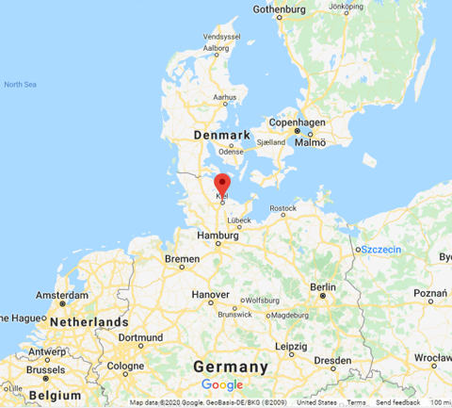
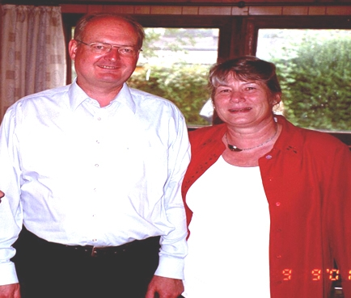
Glenn and Angelika Jones
Kiel, Schleswig-Holstein, Germany

Slide 11
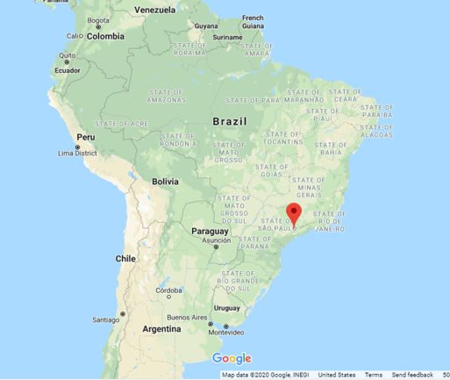
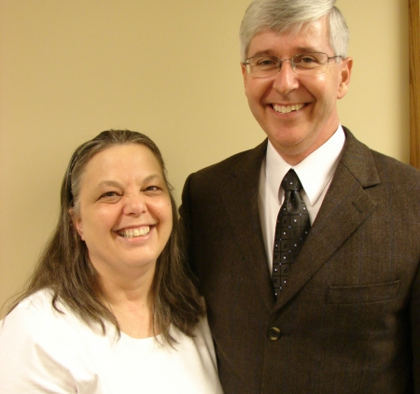
Dennis and Benita Allan
Jarinu, Sao Paulo, Brazil

Slide 12
Dennis and Benita Allan
Pedro sent this selfie with the new congregation in Goiania.
Jarinu, Sao Paulo, Brazil

Slide 13
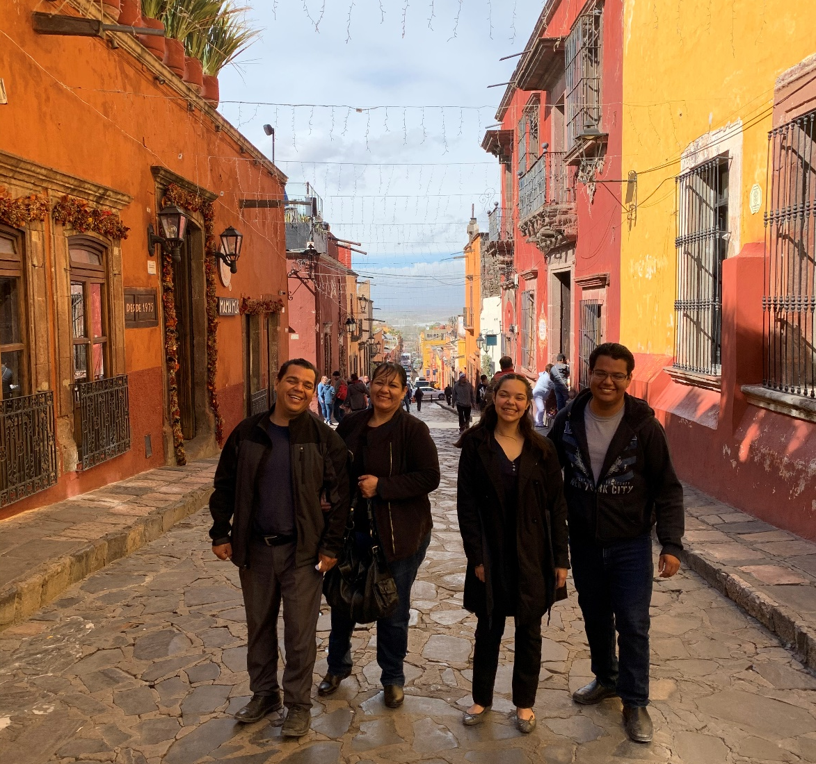
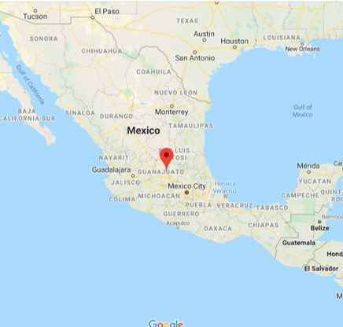
Arturo and Claudia Rojas
San Miguel de Allende, Guanajuato, Mexico

Slide 14
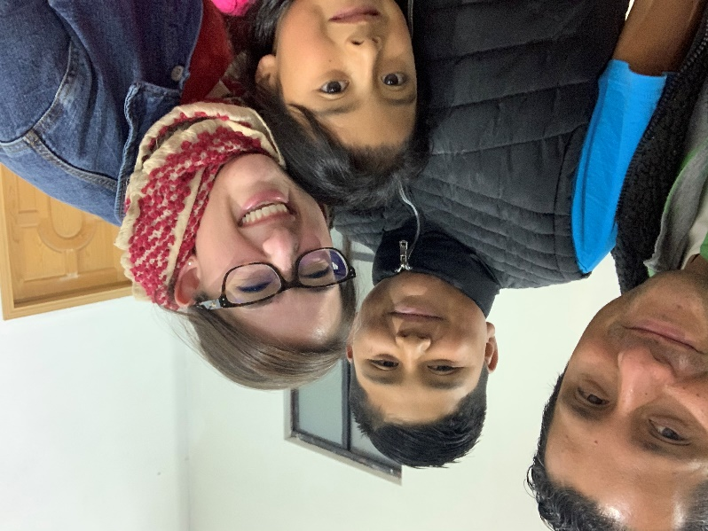
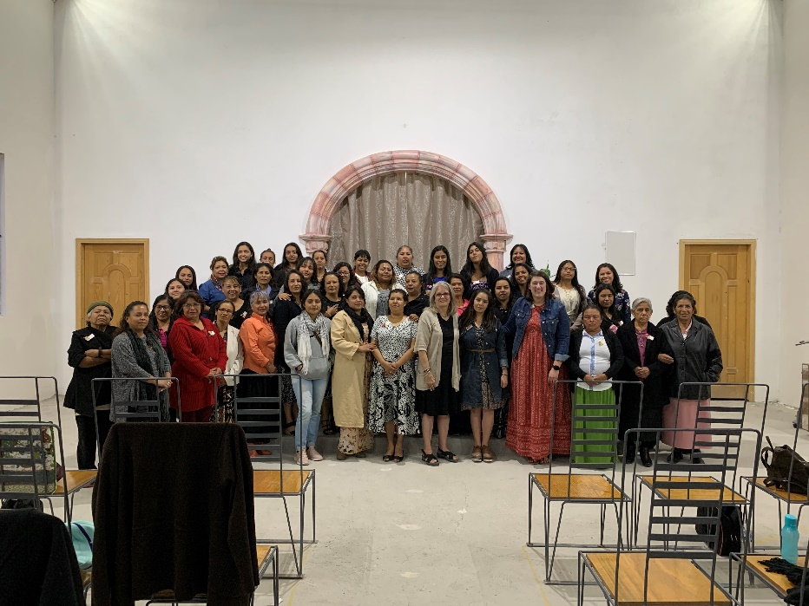
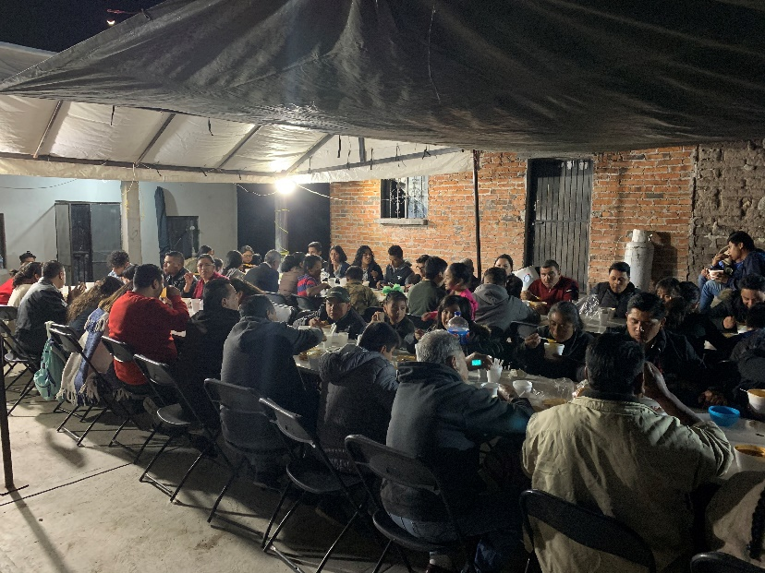
Arturo and Claudia Rojas
San Miguel de Allende, Guanajuato, Mexico

Slide 15
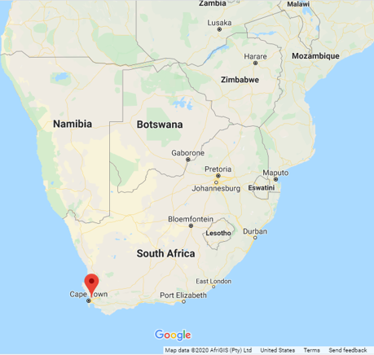
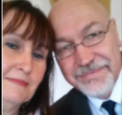
Robin and Lyn Bauer
Durbanville, Western Cape, South Africa

Slide 16
Robin and Lyn Bauer
Durbanville, Western Cape, South Africa

Slide 18
20 Ideas for “Reaching Out” (adapted)
Frequent the same places of business as much as possible – learn the names of those who work there.
Same with restaurants – get to know the hostess, servers.
Go through the same 1 or 2 lines at the grocery store – get to know the cashiers.
“Use what you have!” If you have children, they have friends. Get to know their parents.
Host a Bible study in your home on a topic of interest – invite friends and neighbors (and someone to teach).
Get involved in community activities to meet people – do volunteer work or get a part-time job!
Develop the habit of smiling and speaking to everyone you encounter during your everyday errands.
Work out in the yard / wash your car! Make it a point to get to know your neighbors. Bake cookies!
Have “invitation cards” handy for opportunities – in waiting rooms, standing in line, chance meetings.
Develop the habit of showing enthusiasm about services and studies you attend when you talk to others.
Learn to really listen to others. Show a genuine interest in their lives / challenges. Offer assistance.
At services, consider yourself a one-woman welcoming committee! Be observant to the needs of visitors.
Send cards with a personal note to visitors and those who have shown interest in Bible study.
Sit in on Bible studies others are hosting – befriend those involved.
Get involved with children’s classes, Ladies classes, VBS, etc.
Be prepared with your answers to commonly asked spiritual questions and compliments.
Be alert to “change times” in the lives of others – involve other “sisters”
Show hospitality by opening your home to new-comers.
Baby-sit or provide transportation so others can study together.
Don’t forget to PRAY!

Slide 19
“And He said to them, “Go into all the world and preach the gospel to every creature. He who believes and is baptized will be saved; but he who does not believe will be condemned”
Mark 16:15-16
“For God so loved the world that He gave His only begotten Son, that whoever believes in Him should not perish but have eternal life.”
John 3:16

