Slide 1
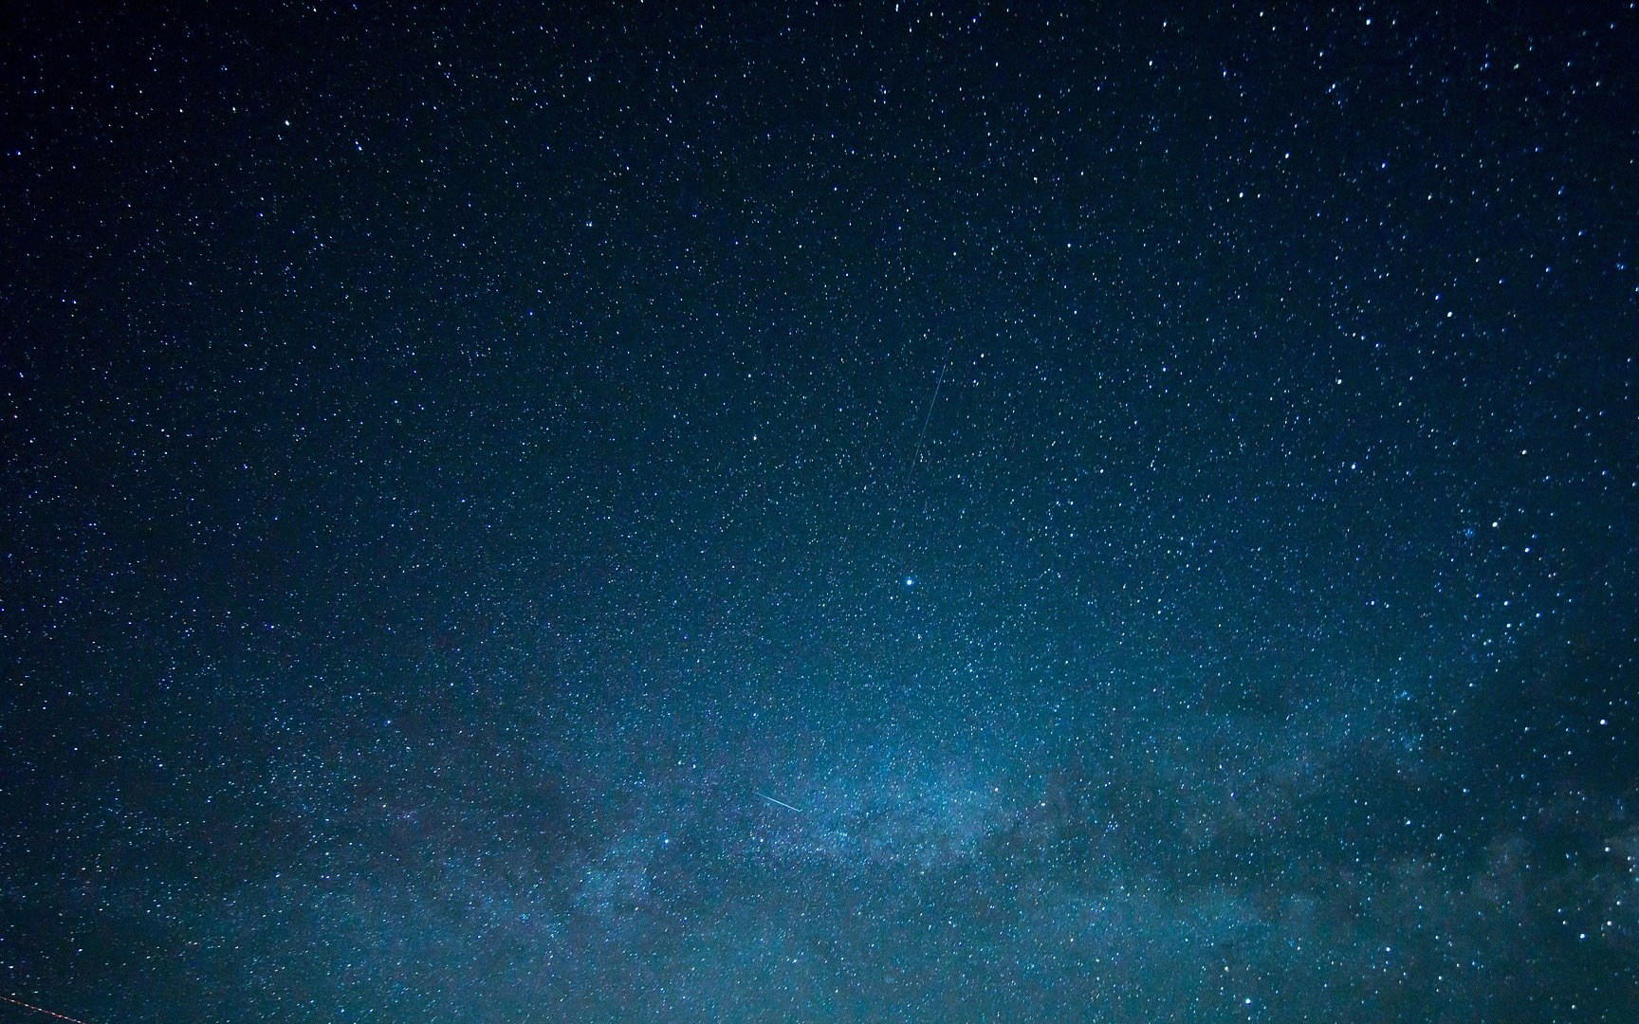
God’s Amazing Design
Notes:
Read from Gen. 1:1. In the beginning God created the heavens and the earth…

Slide 2
God’s Amazing Design
Notes:
God is our Creator. He made everything in our world including you and me.
Tonight we want to look at evidence for God in creation, and we will begin in Hebrews 3:4.
Design: God has given a deliberate and purposeful plan. A purposeful arrangement of the parts and details.
deliberate purposive planning…

Slide 3
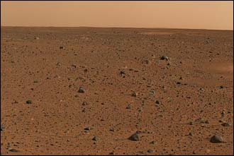
Hebrews 3:4
“For every house is built by someone, but the builder of all things is God.”
01.07.04 Mars – Taken by Spirit – www.nasa.gov
Notes:
Psalm 14:1

Slide 4
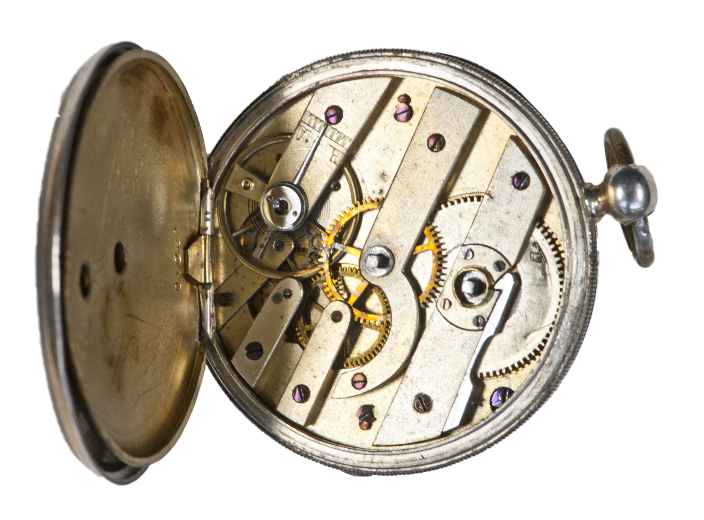
The Watchmaker Analogy
"Anyone finding a pocket watch in a field will recognize that it was designed intelligently; living beings are similarly complex, and must be the work of an intelligent designer.”
William Paley, Natural Theology, published 1802
Notes:
The Watchmaker analogy is a teleological argument. In simple terms, it states that because there is a design, there must be a designer. The analogy is important in natural theology where it is used to show the existence of God as well as supporting the idea of intelligent design. William Paley (1743 – 1805) gave one of the best known explanations for this in his book Natural Theology, published in 1802: "Anyone finding a pocket watch in a field will recognise that it was designed intelligently; living beings are similarly complex, and must be the work of an intelligent designer”.
First Usage:
Bernard le Bovier de Fontenelle is generally credited for this, when he used it in his work Conversations on the Plurality of Worlds, published in 1686.
traced this argument back to at least Thomas Aquinas in the 13th century, who framed the argument as a syllogism: Wherever complex design exists, there must have been a designer; nature is complex; therefore nature must have had an intelligent designer.”
>> The Watchmaker Analogy or the term that gained so much popularity in the 90’s “Intelligent Design” are not scientific theories. They are observations and conclusions.

Slide 5
Romans 1:20
“For since the creation of the world His invisible attributes, His eternal power and divine nature, have been clearly seen, being understood through what has been made, so that they are without excuse.”
We are so surrounded by Incredible Design & Thriving Life…We rarely stop to notice.
Notes:
Romans 1 tells us these qualities: Can be (1) Seen & (2) Understood.
Today, a scientific theory requires: 1) no supernatural elements and 2) testable statement.
Romans isn’t talking about a scientific theory. It is talking about an OBSERVATION. In fact, a WISE OBSERVATION.

Slide 6
God’s Design Is Seen In The Power of Creation
“The heavens are telling of the glory of God; And their expanse is declaring the work of His hands.”
Psalm 19:1
The Power of the Sun.
The Sun gives off more energy every SECOND than a billion large cities would use in a year!
The Core temperature is estimated to be 27 million ºF!
Yet, the temperature is perfect for life…
Notes:
If the Earth was spinning faster…: “Hurricanes will spin faster…and there will be more energy in them.”⁵ A faster rotation speed by only 10% would translate to so much water bulging around the equator, that all equatorial land would be flooded while the sea level at the poles would lower.⁶ Human and animal life would be forced to live closer to the poles, which would result in catastrophic extinctions.
If the Earth’s orbit was closer to the Sun…: If the average distance from the Sun was “reduced by only about three-tenths of a percent,” disastrous atmospheric changes would occur, including “sea-level rise, increases in extreme weather, species extinctions and agricultural disruptions.”⁷ As it makes its elliptical path around the Sun, the Earth bends from its straight course “only one ninth of an inch” every 18½ miles.⁸ “If the orbit changed by one-tenth of an inch every 18 miles, our orbit would be vastly larger and we would all freeze to death. One-eighth of an inch? We would all be incinerated.”⁹ In fact, the Earth’s perfect distance from the Sun is called the “Goldilocks zone,” “where it’s not too close and not too far from the sun for water to be liquid on its surface.”¹⁰ Earth’s temperature is “not too hot or too cold.”¹¹
Victoria Roberts (2017), “Even Tiny Changes in Earth’s Orbit Would Yield Global Catastrophe,” The New York Times, https://www.nytimes.com/2017/07/24/science/earth-orbit-sun-catastrophe.html.
The sun’s temperature and distance from Earth are ideal for life. By contrast, hotter stars produce far more ultraviolet radiation that would have harmful effects on living tissue. And cooler stars emit far more infrared “heat” for a given amount of visible light.

Slide 7
God’s Design Is Seen In The Functionality of Creation
Our world is full of people, animals, and plants that are designed to operate for specific purposes.
Consider the Strength, Flexibility, & Ability to Absorb Energy in a Spider-Web.
Pound-for-pound it is 5 times stronger than steel.
It can stretch 40% beyond it’s original length.
It absorbs energy even better than a bullet proof vest.
Notes:
http://www.apologeticspress.org/apcontent.aspx?category=12&article=2150
it has been said that you could stop a jumbo jet in mid-flight with a spider web made of silk only one centimeter thick.
In truth, even “[t]he best industrial fibers don’t absorb as much kinetic energy as spider silk does.... Despite years of research, scientists still can’t make a material as tough as the silk found within a spider web

Slide 8
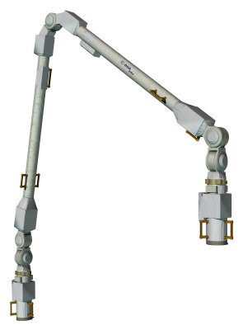
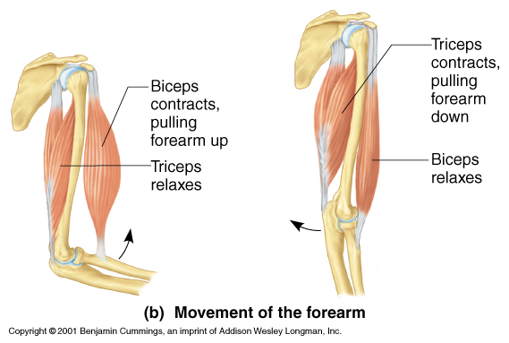
Consider The Design of our Arms
Notes:
When the International Space Station needed a way to unload cargo…the built an arm!

Slide 9
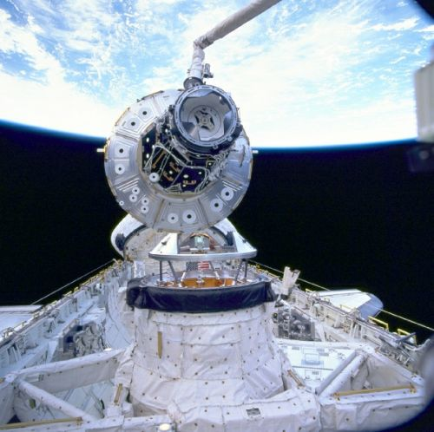
Consider The Design of our Arms
Notes:
No one would look at this wonderful space equipment perfectly suited for it’s job and assume that it ”evolved”. It was painstakingly designed and constructed!!
Our GOD designed the plants and animals on earth to FUNCTION and FUNCTION marvelously!

Slide 10
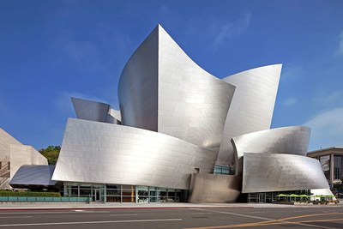
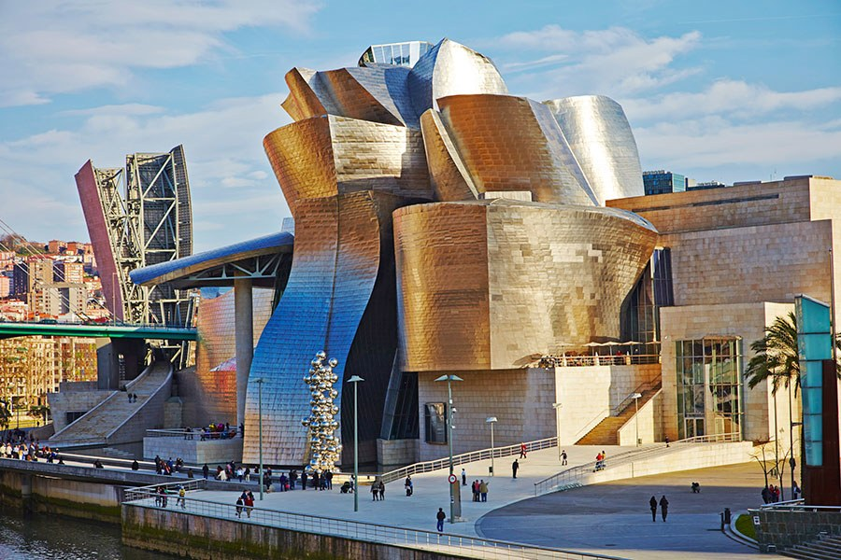
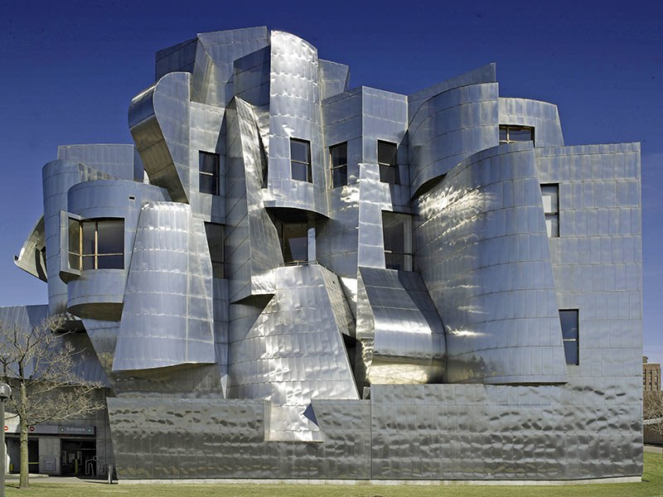
God’s Design Is Seen In The Similarity of Creation
The Wonderful Similarities Seen In Life Are The Result of A Common Architect, Not A Common Ancestor!
For Example, Architect Frank Gehry
Notes:
Gehry loves to use sloping, curved metal panels. It’s his signature style. No one refuses to acknowledge the similarities! In fact – trying to say that these buildings are the result of pure chance is crazy! Each was carefully crafted by THE SAME MIND.
Just as EACH animal and plant we see is designed by the same mind!
Of course there are similarities!!

Slide 11
God’s Design Is Seen In The Similarity of Creation
“Similarity does not equal relationship. Evolutionists often use similarity between animals and man to ‘prove’ Darwinism. They point to the legs, neck, ears, etc., of apes and remind us how similar they are to those of men. Creationist likewise use similarities to support creation…So God used His blueprint for many of His creatures. Similarities don’t mean common ancestry but a common Architect!”

Slide 12
God’s Design Is Seen In The Complexity of Creation
Human Genome: in paper form - all three billion bases in 120 volumes at 4.5pt This is 4.5
Notes:
Complexity.
One criticism of the watchmaker analogy is: then who made God?
The answer is: we can observe ranges of complexity. There are simple machines we all learn about in middle school science like Lever’s, Pulley’s, and Ramps. And there are complex machines which we carry around for txting and video clips. But… on this scale of the Least Complex to the Most Complex… God is the MOST.
A simple lever. God is the Maximum complexity. There is no more powerful,

Slide 13
God’s Design Is Seen In The Complexity of Creation
Even Darwin Struggled to Imagine An Eye Evolving.
“To suppose that the eye with all its inimitable contrivances for adjusting the focus to different distances, for admitting different amounts of light, and for the correction of spherical and chromatic aberration, could have been formed by natural selection, seems, I freely confess, absurd in the highest sense” (1859, p. 170, emp. added).
“The hearing ear and the seeing eye, The Lord has made both of them.”
Prov. 20:12
Notes:
The human eye is a truly amazing phenomenon. Although accounting for just one fourth-thousandth of an adult’s weight, it is the medium which processes some 80% of the information received by its owner from the outside world. The tiny retina contains about 130 million rod-shaped cells, which detect light intensity and transmit impulses to the visual cortex of the brain by means of some one million nerve fibres, while nearly six million cone-shaped cells do the same job, but respond specifically to colour variation. The eyes can handle 500,00 messages simultaneously, and are kept clear by ducts producing just the right amount of fluid with which the lids clean both eyes simultaneously in one five-thousandth of a second (2000, p. 313).
The retina plays a key role in visual perception. In his book, The Wonder of Man, Werner Gitt explains how the retina is a masterpiece of engineering design.
One single square millimetre of the retina contains approximately 400,000 optical sensors. To get some idea of such a large number, imagine a sphere, on the surface of which circles are drawn, the size of tennis balls. These circles are separated from each other by the same distance as their diameter. In order to accommodate 400,000 such circles, the sphere must have a diameter of 52 metres... (1999, p. 15).
Alan L. Gillen also praised the design of the retina in his book, Body by Design.
The most amazing component of the eye is the “film,” which is the retina. This light-sensitive layer at the back of the eyeball is thinner than a sheet of plastic wrap and is more sensitive to light than any man-made film. The best camera film can handle a ratio of 1000-to-1 photons in terms of light intensity. By comparison, human retinal cells can handle a ratio of 10 billion-to-1 over the dynamic range of light wavelengths of 380 to 750 nanometers. The human eye can sense as little as a single photon of light in the dark! In bright daylight, the retina can bleach out, turning its “volume control” way down so as not to overload. The light-sensitive cells of the retina are like an extremely complex high-gain amplifier that is able to magnify sounds more than one million times (2001, pp. 97-98, emp. added).
Without a doubt, this thin (only 0.2 mm) layer of nerve tissue is a marvel of engineering. It contains photoreceptor (light-sensitive) cells and four types of nerve cells, as well as structural cells and epithelial pigment cells. The two kinds of photoreceptor cells are referred to as rods and cones because of their shape. Each eye has about 130 million rods and 7 million cones. The rods are very sensitive to light (whether it is bright or dim), and allow the eye to see in black and white. Cones, on the other hand, are not as sensitive as rods, and function only optimally in daylight. There are three different types of cones—red light, green light, and blue light—each of which is sensitive to its respective color of light, and which allow the eye to see in full color. The rods and cones convert the different lights into chemical signals, which then travel along the optic nerve to the brain.

Slide 14
God’s Design Is Seen In The Compatibility of Creation
In The Food Chain
“Every moving thing that is alive shall be food for you; I give all to you, as I gave the green plant.” Genesis 9:3
Creatine, B-complex vitamins, DHA, etc…
In Reproduction
“And of every living thing of all flesh, you shall bring two of every kind into the ark, to keep them alive with you; they shall be male and female. ²⁰ Of the birds after their kind, and of the animals after their kind, of every creeping thing of the ground after its kind, two of every kind will come to you to keep them alive.” (Genesis 6:19-20)
Notes:
The Food Chain – this is only possible because we can actually absorb the protein

Slide 15
God’s Design Is Seen In The Balance of Creation
The Earth’s elliptical orbit around the Sun curves at a rate of 1/9 of an inch every 18.5 miles.
If the rate was 1/10 of an inch we would all freeze.
If the rate was 1/8 of an inch we would all burn.
The Perfect Location & Size of the Moon
If the Moon were 20% closer to Earth, the Earth’s tides would be so high that much of the currently inhabited lands would often be covered with several feet of water.
Notes:
“a big moon to stabilize our axial wobble,”
the moon's large size is essential for it to provide significant reflected light on the earth. If its mass were reduced by 99% to make an "average size" solar system moon, then the evening light received on earth would be severely decreased by twenty times its present amount.³
The moon causes tides and wind to generate worldwide ocean currents that help to widely redistribute Earth’s water nutrients and toxins. Without this effect, ocean water would be stagnant and seriously interfere with, and eventually kill, most life in the ocean.
Scientists have concluded that if the Moon were 20% closer to Earth, the Earth’s tides would be so high that much of the currently inhabited lands would often be covered with several feet of water. On the other hand, if the Moon were 20% farther away, the oceans would turn into stagnant waters unable to support the billions of living things both in and out of the oceans.

Slide 16
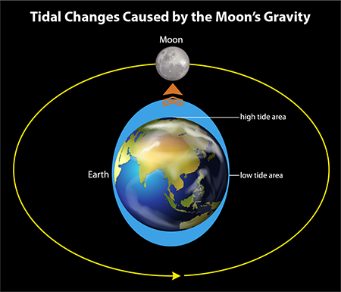
God’s Design Is Seen In The Balance of Creation
Notes:
The moon’s pull has an enormous impact on Earth. It’s not only exceptionally large for a planet of Earth’s size, but astronomically it orbits very close to us. This creates large gravitational forces between the earth and moon, causing both the large ocean tides and the much smaller continental land tides. When the moon travels directly overhead Earth, the atmosphere bulges in distances measured in miles, the oceans bulge in distances measured in feet, and the Earth’s land mass in distances measured in fractions of an inch.¹⁷
https://www.icr.org/article/moon-required-for-life-on-earth

Slide 17
God’s Design Is Seen In YOU!
¹³ For You formed my inward parts; You wove me in my mother’s womb. ¹⁴ I will give thanks to You, for I am fearfully and wonderfully made; Wonderful are Your works, And my soul knows it very well.
Notes:
Your brain.
Your cells.
A human body is composed of over 30 different kinds of cells (red blood cells, white blood cells, nerve cells, etc.), totaling approximately 100 trillion cells in an average adult (Beck, 1971, p. 189).
In an article written for Encyclopedia Britannica, Carl Sagan observed that “the information content of a simple cell has been estimated as around 1 trillion bits. To emphasize to the reader the enormity of this figure, Dr. Sagan then noted that if one were to count every letter in every word of every book in the world’s largest library (over ten million volumes), the final tally would be approximately a trillion letters. Thus, a single cell contains the equivalent information content of every book in the world’s largest library of more than ten million volumes! Every rational person recognizes that not one of the books in such a library “just happened.” Rather, each and every one is the result of intelligence and painstaking design.
*** Context: It would take 7,812 iPhones to hold that much data (assuming a normal 16 Gig iPhone) even if you bumped to a 64 Gig iPhone you would still need almost 2,000 iphones just to store the data in ONE simple CELL!

Slide 18
Galatians 6:14-15
(Galatians 6:14-15) But may it never be that I would boast, except in the cross of our Lord Jesus Christ, through which the world has been crucified to me, and I to the world. For neither is circumcision anything, nor uncircumcision, but a new creation.
Notes:
The God who PLANNED, DESIGNED and CREATED everything – has a plan for you.
Not only did he do an outstanding job planning and creating the perfection and beauty we are surrounded by in nature, He brings the same infinite ability, wisdom, and care to His plan for the church, for our homes, and for our lives!
He LOVES YOU…
He want you to BELIEVE IN HIM and OBEY HIM…

Slide 19
God’s Amazing Design
Notes:
The God who PLANNED, DESIGNED and CREATED everything – has a plan for you.
He LOVES YOU…
He want you to BELIEVE IN HIM and OBEY HIM…

