Slide 1
Lesson #6: Pressing Forward

Slide 2
LESSON DATE TITLE TEXT TEACHER
i. Sun. Feb 23 The Setting of Ezra & Nehemiah Phillip
ii. Wed. Feb 26 Glorifying God in Good Works Jack
1 Sun. Mar 1 Depending on God Ch. 1 Phillip
2 Wed. Mar 4 Casting a Vision Ch. 2 Phillip
3 Sun. Mar 8 Working as a Team Ch. 3 Jack
4 Wed. Mar 11 Overcoming the Critics Ch. 4 Phillip
5 Sun. Mar 15 Leading with Character Ch. 5 Jack
6 Sun. May 24 Pressing Forward Ch. 6 Phillip
7 Wed. Rebuilding The People Ch. 7-8 Phillip
8 Sun. Turning Away from Sin Ch. 9-10 Jack
9 Wed. Volunteering To Walk By Faith Ch. 11-12 Jack
10 Sun. Shaking Up the Status Quo Ch. 13 Phillip
11 Wed. Review Ch. 1-13 Phillip
Notes:
We are having two intro classes on purpose...
Today we want to set the historical and geographical context.
Then, Wed we want to emphasize the Good Works this book inspires us to participate in.

Slide 3
Class Goals
To learn from Nehemiah how to rebuild, restore, and renew our devotion to God.
To align our hearts to care deeply about the things that are important to God.
To engage in good works that honor God and stir our hearts.
To depend on God for restoration, protection, and victory.
To incorporate prayer more fully in our daily lives.
To develop greater leadership and teamwork skills.
Notes:
In chapter 2, we will emphasize…

Slide 4
Pressing Forward
“So I sent messengers to them, saying, “I am doing a great work and I cannot come down. Why should the work stop while I leave it and come down to you?” – Nehemiah 6:3
Notes:
Yes, I hear you, but there is no good reason for me to STOP the important work I am doing.
What you are asking for is NOT as important as what I am working for.

Slide 5
Pressing Forward In Chapter 6
Attacked with Distractions (vs. 1-4)
Attacked with Rumors (vs. 5-8)
Attacked with Discouragement (vs. 9)
Attacked by False Friends (vs. 10-14)
The Wall Is Finished! (vs. 15-16)
Dealing With Deeply Entrenched Problems (vs. 17-19)

Slide 6
Pressing Forward Against Distractions
Great Leaders Choose To Do “Great Work.”
Nehemiah’s Response:
I Know What Really Matters.
I Will Not Stop What Matters Most.
I Will Not Leave What Matters Most.
I Will Not Put You Above What Matters Most.
I Will Not Change My Answer.
Jesus Set His Face To Go To Jerusalem
Mary Choose The Better Part
Notes:
Great Leaders Do Great Work – but it is a choice. It requires knowing that of all the things I could be doing…this is what I should be doing. **During the slowdown – I could do a lot of chores around the house… I needed to do the most important work.
I Will Not Change My Answer: When we give people solid boundaries – they will test them. Nehemiah is fully resolved.

Slide 7
Pressing Forward
What “Great Work” Has Captured Your Heart?
For God’s Kingdom…
For Your Family…
For Those In Need…
Notes:
This is not bragging – this is talking to each other about what really matters most.
Brother Broyles: Devoted to Helping build stronger marriages.
Sister Dana: Devoted to helping orphans and avoid abortions.
Brother David: Devoted to better Teen Bible Study resources.
Brother Ken: Devoted to starting churches in Fiji.
*Helping this church grow…these saints go to heaven.
*Helping single parents…surely there is someone here passionate about this.
*Getting out of debt.
*Taking the gospel to another country.
*Helping Christians get away from being Lukewarm and living with Zeal for God.

Slide 8
Pressing Forward Against Rumors
Rumors & Slander Can Have A Terrible Impact.
Nehemiah’s Response:
He Goes ‘On The Record’ Officially Refuting the Rumor
He Charges Sanballat with Inventing the Accusation
He Maintains His Devotion To The King’s Rebuilding Program
Christians & Rumors
Gossip (Prov. 16:28, 26:20, Titus 2:3)
Slander (Colossians 3:8, 1 Peter 2:12)
Ignorant Speculation (2 Tim. 2:23)
Notes:
Responding to Rumors

Slide 9
What sources try to create fear and discouragement among Christians today? What can we imitate from Nehemiah’s response? (vs. 9)
Notes:
Prayer is a key role in dealing with our fears and discouragement.

Slide 10
Pressing Forward Against False Friends
Shemaiah: Tempting Him To Retreat to the Temple.
Should a man like me? A eunuch? A leader?
This Attack Is Funded By Tobiah & Sanballat.
This Attack Is Designed To Catch Nehemiah In A Compromising Situation.
This Attack Is Disguised Under Pretenses of Support.
“Noadiah the prophetess and the rest of the prophets who were trying to frighten me.”
Notes:
It is so sad when the people who should be a source of truth and encouragement become worldly and urge or support evil.
Pretenses of Support – “I’m just trying to keep you from crossing the wrong people.” “I’m just trying to keep you on the right side of history.”
It is a thinly veiled threat. Nehemiah recognizes it and refuses to give in. Instead he makes a mental note, prays about it, and pushes forward.
** A couple who drove 3 hours away so they could tell a preacher half of the story…to get him to say their marriage was ok.

Slide 11
Pressing Forward Pays Off!
“So the wall was completed on the twenty-fifth of the month Elul, in fifty-two days. ¹⁶ When all our enemies heard of it, and all the nations surrounding us saw it, they lost their confidence; for they recognized that this work had been accomplished with the help of our God.”
Notes:
This is not bragging – this is talking to each other about what really matters most.
Brother Broyles: Devoted to Helping build stronger marriages.
Sister Dana: Devoted to helping orphans and avoid abortions.
Brother David: Devoted to better Teen Bible Study resources.
Brother Ken: Devoted to starting churches in Fiji.
*Helping this church grow…these saints go to heaven.
*Helping single parents…surely there is someone here passionate about this.
*Getting out of debt.
*Taking the gospel to another country.
*Helping Christians get away from being Lukewarm and living with Zeal for God.

Slide 12
Deeply Entrenched Problems
Plow Around The Stump
“You’ll avoid breaking a disc blade or two. It’s cheaper and easier than buying a special attachment. And if the roots are strong and deep – which they always are – getting rid of them can take forever.”
Once the good seed you’ve planted is growing, then circle around and deal with the stump.

Slide 13
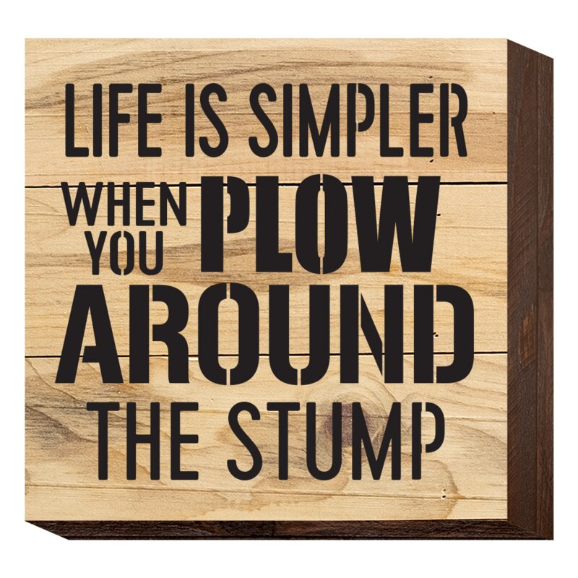
Deeply Entrenched Problems
Tobiah
Well-Connected to the Nobles…
Many Bound by Oaths/Alliances…
Marriage Alliances…
Tobiah married the daughter of an influential Jew: Shecaniah, keeper of the East Gate (3:29)
Tobiah’s son, Jehohanan, married the daughter of an influential Jew: Meshullam, an active builder (3:4, 3:30)
Nehemiah sees Tobiah for the true trouble maker he is. (vs. 19)
Notes:
Please, please understand – I am not suggesting we ignore or overlook when people are in sin.
I am saying – it is wise to BUILD what you MUST BUILD FIRST – before you take the time to deal with this problem.
1 Tim. 5:24-25. Some things require time.
²⁴ The sins of some men are quite evident, going before them to judgment; for others, their sins follow after. ²⁵ Likewise also, deeds that are good are quite evident, and those which are otherwise cannot be concealed.

Slide 14
Pressing Forward
“So I sent messengers to them, saying, “I am doing a great work and I cannot come down. Why should the work stop while I leave it and come down to you?” – Nehemiah 6:3
Notes:
Yes, I hear you, but there is no good reason for me to STOP the important work I am doing.
What you are asking for is NOT as important as what I am working for.

Slide 16
Outline of Nehemiah
Ch. 1-2: Nehemiah Returns to Jerusalem
Ch. 3-6: Rebuilding the Walls of Jerusalem
Ch. 7-10: Restoring the People’s Faith
Ch. 11-13: Renewing the People’s Worship
Notes:
These are the things we will be emphasizing in each section.
You can see that the first half is focused on the projects and the city. The second half is focused on the people who fill the city.

