Slide 1

Leaving Sinai
Numbers 10-11

Slide 3
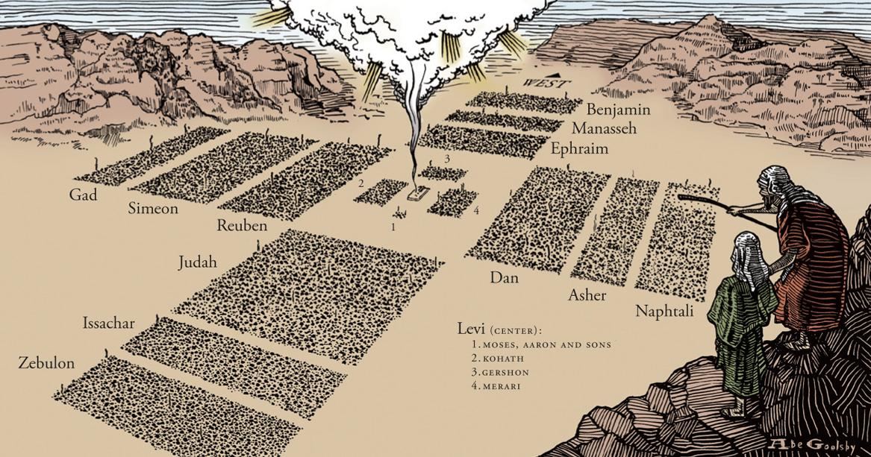

Slide 4

Leaving Sinai
Introductory Thoughts
  They Are Finally Setting Out For Promised Land
  Transition: Obedience to Disobedience
    Israel Obeyed All The Measurable Commands (Ch. 1-10)
    Israel Will Struggle With Their Attitudes (Ch. 11-25)
Outline of Section
  Trumpets (10:1-10)
  Leaving Sinai (10:11-36)
  Complaint #1 (11:1-3)
  Complaint #2 (11:4-35)

Slide 5
Trumpets (10:1-10)
Uses of the Trumpets
  Gathering
    Two Gathers Everyone (vs. 3, 7)
    One Gathers the Leaders (vs. 4)
  Setting Out (vs. 5-6)
  War Signal (vs. 9; cf. Numbers 31:6)
    “In Your Land” (Implicit Promise They Will Receive the Land)
    “That You May be Remembered… & Saved” (God Will Help When They Ask)
  Worship (vs. 10)
    Instruments Tied to Tabernacle/Temple (Which Was Eventually Destroyed)
Users of the Trumpets
  The Priests (vs. 8)
  No Further Instructions for Instruments Until 400 Years Later
    David Added Harps, Lyres, & Cymbals (1 Chronicles 16:1-6)
    David Did So At God’s Command (2 Chronicles 29:25-27; cf. Ezra 3:10; Nehemiah 12:24)

Slide 6
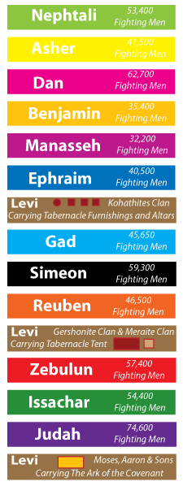
Leaving Sinai (10:11-36)
Setting Out (vs. 11-28)
  Exact Conformity to Numbers 2:1-34
  Duration At Sinai
    11 Months (vs. 11; cf. Ex. 19:1)
    58/187 Chapters of the Pentateuch (31% of Moses’ Writings)
  God Leads From The Front Like a Shepherd (Psalm 68:7)
  God’s Laws Have Brought Organization to the People
Dan Asher Naphtali | Ephraim Manasseh Benjamin | Tabernacle Furniture (Kohath) | Reuben Simeon Gad | Tabernacle Material (Gershon & Merari) | Judah Issachar Zebulun | Ark of the Covenant (Priests)
Numbers 10:25-28 | Numbers 10:22-24 | Numbers 10:21 | Numbers 10:17-20 | Numbers 10:17 | Numbers 10:14-16 | Numbers 10:33-36

Slide 7
Leaving Sinai (10:11-36)
Meeting Hobab (vs. 29-32)
  Who is Hobab the Midianite?
    Debated: Either Brother-in-Law or Father-in-Law of Moses
    Sinai Bookended by Interaction With Family (Ex. 18; Num. 10)
  The Request
    Moses Wants Hobab to Help Guide Them (vs. 31)
      God Already Promised to Guide With Fire, Cloud, & Trumpets
      Hobab Could Help With Specific Matters (Locating Water / Where to Pitch Tents)
    Hobab Evidently Comes
      “Conversion” Allowed Him to be Blessed (vs. 29)
      Judges 1:16 & 4:11 Shows Descendants in Land
The Ark & The First Stage of the Journey (vs. 33-36)
  They Have Travelled For Three Days (35-45 Miles)
    Sinai to Kadesh is 11 Day Journey (Deut. 1:2)
    They Are 27% of the Way There! (Great Progress Will Soon End)
  Moses’ Prayers (vs. 35-36)
    When Ark Sets Out: For God To Defeat the Enemies (Psalm 68:1)
    When Ark Rests: For God To Continually Dwell With Them

Slide 8
 | Passage | Nature of Complaint | God’s Response | Moses’ Response
A | Numbers 11:1-3 | Misfortunes | Sends Fire | Intercedes (11:2)
B | Numbers 11:4-35 | Food | Overabundance of Quail / Great Plague | Complains to God (11:10-15)
C | Numbers 12:1-16 | Leadership of Moses | Leprosy on Aaron & Miriam | Intercedes (12:13)
D | Numbers 13:1-14:45 | Promised Land Too Intimidating | Sentenced to 40 Years of Wandering | Intercedes (14:11-20)
C | Numbers 16:1-17:12 | Leadership of Moses & Aaron | Sends Earthquake & Plague | Intercedes With Aaron (16:43-50)
B | Numbers 20:2-13 | Water | Gives Water | Lacks Faith (20:10-13)
A | Numbers 21:4-9 | Various Misfortunes | Sends Fiery Serpents | Intercedes (21:7-9)

Slide 9
Complaint #1 (11:1-3)
Their Complaint
  What “Misfortunes” Would They Be Experiencing?
    General Discomfort (Sore Legs, Thirsty, Hot Sun, etc…)
    Frightening Animals (Snakes, Scorpions, etc…)
  Three Days of Travel Neglects 400 Years of Agony (How Soon We Forget)
God’s Response
  Fire Burned Among Them & Some Outlying Parts of Camp
  Complaining Spreads Like Fire (First Complaint of Many)
  “⁹We must not put Christ to the test, as some of them did and were destroyed by serpents, ¹⁰nor grumble, as some of them did and were destroyed by the Destroyer.” (1 Corinthians 10:9-10)
Moses’ Intercession
  Moses’ Intercession Causes Fire to “Die Down”
  Our Complaints Require Intercession

Slide 10
Complaint #2 (11:4-35)
The Complaint (vs. 4-9)
  Begins With the Rabble
    The Non-Israelites Who Came With From Egypt (Contrasted With Israel In Vs. 2)
    Nature of the Complaint
      “We Remember” Food From Egypt (Not Remembering God’s Mighty Acts)
      Longing for Greater Variety (“Nothing But This Manna…”)
  Spreads to the Israelites (vs. 4)
    Complaining is Contagious (When I Complain, I Am Spreading a “Virus”)
    Matches How Jews Treated the True Bread From Heaven (John 6:41)
  Description of Manna (vs. 7-9; Exodus 16:31)
    You Can Do a Variety of Things With Manna
    Tastes Like Honey (A Taste of the Promised Land)
    Sinful Hearts Do Not Enjoy the Taste of God’s Food

Slide 11
Complaint #2 (11:4-35)
Moses’ Anguish (vs. 10-15)
  Moses Speaking to God – Not Complaining to Others
    Do We Complain To God or to People?
    Yet, He Doesn’t Intercede For the People
  Burden is Too Great For Moses Alone
    Can’t Do This Alone (Forgetting God Is With Him?)
    Moses Requests to Die (We Can Be Open Before God)
Moses Gets Help (vs. 16-30)
  Instructions (vs. 16-23)
    Gather Seventy Men to Receive “Some of the Spirit”
    God Promises One Month of Meat
    Moses’ Doubt Similar to the Apostles (Vs. 21; cf. Mark 8:4)
    God Doesn’t Have Shortened Arms (Imagine an Alligator)
  The Event (vs. 24-25)
    Seventy Men Received Spirit & Prophesied For a Moment
    Proves to Congregation That These Men Are Designated (Like Apostles in Acts 2)
  Eldad & Medad (vs. 26-30)
    Two Guys Who Missed the Meeting Received Spirit & Prophesied in the Camp
    Joshua Jealous for Moses, But Moses Isn’t Jealous For Himself (cf. Mark 9:38-41)

Slide 12
Complaint #2 (11:4-35)
The Quail (vs. 31-35)
  The Wind From the Lord Brought Quail (Wind = Spirit)
  The Spirit Up to This Point…
    The Spirit of God Involved in Creation (Genesis 1:2)
    The Spirit of God Involved in Recreation (Genesis 8:1)
    The Spirit of God Involved in Exodus (Exodus 14:21)
    The Spirit of God Involved in Tabernacle (Exodus 28:3; 31:3; 35:31)
    The Spirit of God Just Rested on 70 Elders (Numbers 11:24-30)
  Abundance of Quail
    12-15 Mile Radius
    At Minimum, Everyone Gathered 10 Homers (2,200 Liters)
    Meat-Crazed People Hoarding All They Can Get
  God Sends “A Very Great Plague” While Meat is in Their Teeth
    “So also will the rich man fade away in the midst of his pursuits.” (James 1:11)
First Two Stops
  Vs. 1-3 – Named Taberah (Burning)
  Vs. 4-35 – Named Kibroth-Hattaavah (Graves of Craving)

