Slide 1
Archaeology & The Bible

Slide 2
Archaeology & The Bible
Emotional
Volitional
Intellectual

Slide 3
Archaeology & The Bible
Bible & Mythology
“For we did not follow cleverly devised myths when we made known to you the power and coming of our Lord Jesus Christ, but we were eyewitnesses of his majesty.” (2 Peter 1:16)
Jesus Offered Proof
“He presented himself alive to them after his suffering by many proofs, appearing to them during forty days...” (Acts 1:3)

Slide 4
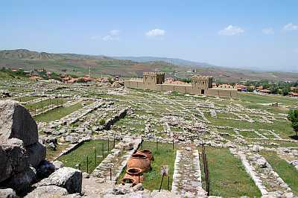
Examples From the Old Testament
Discovery of the Hittites
Named 60 Times
Part of Conquest
Discovered Capital in 1906
Boghaz-koy
Modern Day Turkey
10,000 Clay Tablets

Slide 5
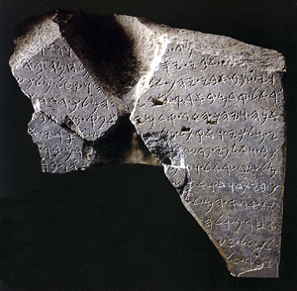
Examples From the Old Testament
Proof of King David
1,081 Times in Bible
62 Chapters of Bible
Obelisk Found In 1993
“I slew mighty kings who harnessed thousands of chariots and thousands of horsemen. I killed the king of the house of David.” (cf. 2 Kings 8:28-29?)

Slide 6
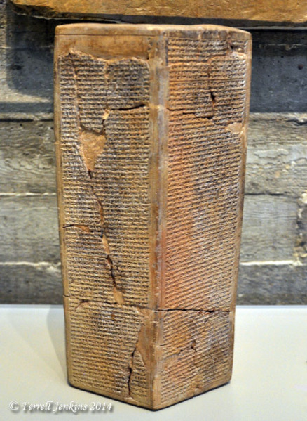
Examples From the Old Testament
Assyrian Besiegement of Jerusalem
“…Sennacherib king of Assyria came up against all the fortified cities of Judah and took them.” ^{(2 Kings 18:13)}
Taylor Prism Found in 1830
“…besieged and captured forty-six of his fortified cities, along with many smaller towns, taken in battle with my battering rams . . . I took as plunder 200,150 people, both small and great, male and female…”

Slide 7
Examples From the Old Testament
“As for Hezekiah, I shut him up like a caged bird in his royal city of Jerusalem. I then constructed a series of fortresses around him, and I did not allow anyone to come out of the city gates.”
“…⁷therefore, behold, the Lord is bringing up against them the waters of the River, mighty and many, the king of Assyria and all his glory. And it will rise over all its channels and go over all its banks, ⁸and it will sweep on into Judah, it will overflow and pass on, reaching even to the neck…” (Isaiah 8:7-8)

Slide 8
Examples From the New Testament
The Accuracy of Acts
Book of Acts Thought to Be Unreliable (1880-1890)
“You may press the words of Luke in a degree beyond any other historian’s, and they stand the keenest scrutiny and the hardest treatment, provided always that the critic knows the subject and does not go beyond the limits of science and justice.” (Sir William Ramsay)
Stats on Acts
32 Countries; 54 Cities; 9 Mediterranean Islands
Names Around 95 People (Including Governmental Officials)
Why Not Trust His Recounting of Miracles?

Slide 9
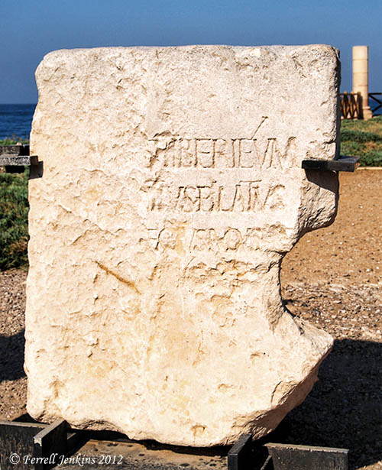
Examples From the New Testament
The Existence of Pilate
Key Figure in Jesus’ Death
Inscription Found in 1961
“Pontius Pilate, prefect of Judaea, made and dedicated the Tibereieum to the Divine Emperor.”
“In the fifteenth year of the reign of Tiberius Caesar, Pontius Pilate being governor of Judea…” ^{(Luke 3:1)}

Slide 10
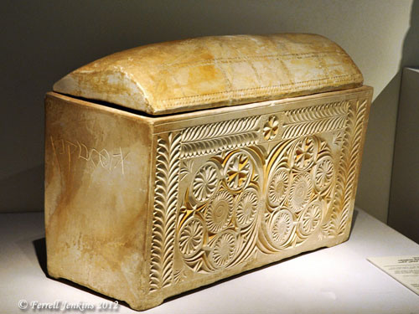
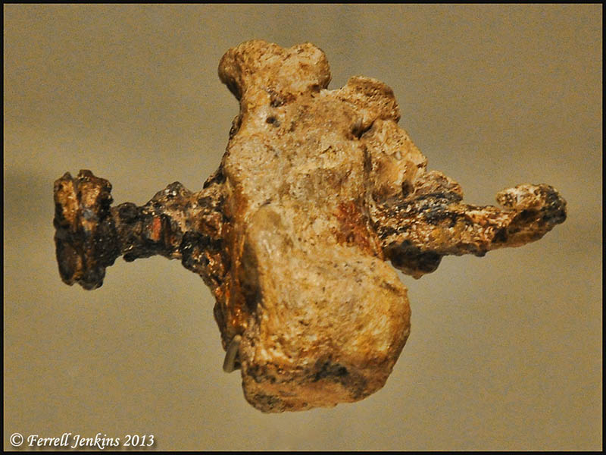
Examples From the New Testament
Crucifixion & Proper Burial
Skeptics Said…
Jesus Wasn’t Nailed to Cross
Jesus Couldn’t Have Been Buried
1968 Discovery
Ossuary Box
Heel Bone With Nail

Slide 11
Archaeology & The Bible
“The grass withers, the flower fades, but the word of our God will stand forever.”
Isaiah 40:8

