Slide 1

Sentenced to the Wilderness
Numbers 13-14

Slide 3
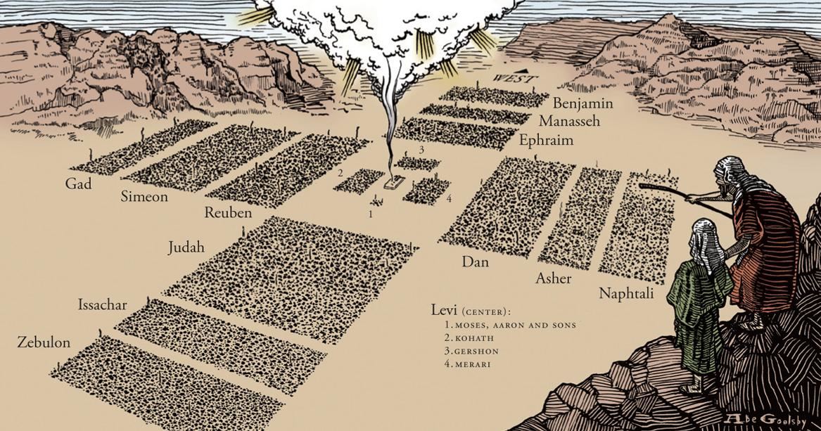

Slide 4
 | Passage | Nature of Complaint | God’s Response | Moses’ Response
A | Numbers 11:1-3 | Misfortunes | Sends Fire | Intercedes (11:2)
B | Numbers 11:4-35 | Food | Overabundance of Quail / Great Plague | Complains to God (11:10-15)
C | Numbers 12:1-16 | Leadership of Moses | Leprosy on Miriam | Intercedes (12:13)
D | Numbers 13:1-14:45 | Promised Land Too Intimidating | Sentenced to 40 Years of Wandering | Intercedes (14:11-20)
C | Numbers 16:1-17:12 | Leadership of Moses & Aaron | Sends Earthquake & Plague | Intercedes With Aaron (16:43-50)
B | Numbers 20:2-13 | Water | Gives Water | Lacks Faith (20:10-13)
A | Numbers 21:4-9 | Various Misfortunes | Sends Fiery Serpents | Intercedes (21:7-9)

Slide 5

Sentenced to the Wilderness
Introductory Thoughts
  Numbers 13-14 Should Be The Conquest
    Despair & Cowardice Prevent Victory
    We Will Not Enter Our “Rest” When We Are Cowardly
  Especially Significant Section of Scripture
    References: Psalm 95, 106; Amos 2:10; Hebrews 3-4
    How is the Number “40” Used in Scripture?
Outline of Section
  The Faithless Report (Numbers 13)
  The Consequence of Cowardice (Numbers 14)

Slide 6
The Faithless Report (Ch. 13)
Orders to the Spies (vs. 1-20)
  Command to Send the Spies (vs. 1-3)
    One Chief For Each Tribe (Respected Men; Not Same From 1:5-15; 7:12-83)
    God’s Idea or the People’s Idea?
      “Then all of you came near me and said, ‘Let us send men before us, that they may explore the land for us and bring us word again of the way by which we must go up and the cities into which we shall come.’” (Deut. 1:22)
      God Granted Their Request & Commanded it to be Done (vs. 3)
  The Names of the Spies (vs. 4-16)
    Who Remembers the Following People?
      Shammua, Shaphat, Igal, Palti, Gaddiel, Gaddi, Ammiel, Sethur, Nahbi, & Geuel
    We Remember: Joshua (AKA Hoshea) & Caleb
  Instructions (vs. 17-20)
    Observe the Land: Strong/Weak, Few/Many, Good/Bad, Rich/Poor
    “Be of Good Courage” (What Would Later Happen in Joshua)

Slide 7
The Faithless Report (Ch. 13)
Obedience of the Spies (vs. 21-25)
  They Spend 40 Days Gathering Intel (Corresponds to Time in Wilderness)
  Descendants of Anak in Hebron
    Ahiman, Sheshai, Talmai
    Caleb Later Took Care of These Giants (Joshua 15:13-14)
  They Take a Large Sampling of the Fruit (vs. 20 – Grapes Are “Ripe for Harvest”)
Report of the Spies (vs. 26-33)
  The Good: The Land Flows With Milk & Honey (vs. 26-27)
  “However…” (vs. 28-29)
    Strong Fortified Towns & the Giants Live There (Does Sin Ever Seem This Way to You?)
    God Promised to Destroy These Nations (vs. 29; cf. Gen. 15:18-21)
  Two Assessments of the Same Intel (vs. 30-33)
    Caleb: The Voice of Faith (Caleb = Bold / Confident)
    Other Spies: The Voice of Doubt
      “The Land Devours its Inhabitants” (Same Word Used in 16:35 For Korah)
      “We Are Like Grasshoppers” (Hyperbole to Instill Fear)
    To Which Voice Are You Listening?

Slide 8
The Consequence of Cowardice (Ch. 14)
Unbelief of the People (vs. 1-10)
  Grumbling (vs. 1-4)
    The Faithless Report Infects the Nation (What Am I Spreading to Others?)
    Ironic Desires
      They Wish They Would Have Died in Wilderness (Wish Will Be Granted)
      They Worry the “Little Ones” Will Become Prey (They Will Be Protected)
      They Want to Go Back to Egypt (As If Egypt Would Welcome Them Back)
    These Tears Do Not Deserve Sympathy
  Parenthetical Attempt to Persuade (vs. 5-9)
    Moses & Aaron Fall Down in Humility (vs. 5)
    Joshua & Caleb Speak Up (Vs. 6-9)
      “If The Lord Delights In Us…” (God Has Proven That He Does)
      “They Are Like Bread to Us” (With God’s Help, Enemies Will Be Defeated)
      If God is For Us, Who Can be Against Us?
  The People Wanted to Stone the Leaders (vs. 10)
    God’s Glory Intervenes (cf. 12:4-5)

Slide 9
The Consequence of Cowardice (Ch. 14)
Moses’ Intercession (vs. 11-20)
  God’s Threat (vs. 11-12)
    Signs From God Didn’t Cause Them to Believe (Plagues, Exodus, Manna)
    Destroy the Nation And Restart With Moses (cf. Exodus 32:10-14)
  Moses’ Prayer (vs. 13-19)
    Concern for God’s Reputation (vs. 13-16)
      Nations Would Assume That God Was Defeated (Principle of Continuity)
      Moses More Concerned With God’s Reputation Than His Own
    Praying According to God’s Promises (vs. 17-19)
      Moses Asks God to Pardon (References to Exodus 20:5-6; 34:6-7)
      “Praying in the Spirit” Involves Praying The Things of Scripture
  God’s Pardon (vs. 20)
    By the Power of Prayer Sinners Are Brought From Death to Life (cf. James 5:19-20)
    God Forgives, But There Will Still Be Consequences
    Where Would Israel Be Without Moses? (Us Without Jesus?)

Slide 10
The Consequence of Cowardice (Ch. 14)
Sentenced to Wilderness (vs. 21-38)
  God’s Promise of Judgment
    Those Who Despised God Will Not See the Land (vs. 21-23)
    Bodies Will Fall in the Wilderness (vs. 26-29, 32)
    40 Years to Match 40 Days of Spying (vs. 34)
    Assurance of Judgment: Faithless Spies Die From Plague (vs. 36)
  Exceptions
    Joshua & Caleb Will Enter (vs. 24, 30, 38)
    The Little Ones (vs. 31, 33)
    Moses, Aaron, & Miriam Are Not Listed as Exceptions (Fates Are Revealed in Numbers 20)
Presumptive Conquest (vs. 39-45)
  The People Mourned When They Heard God’s Oath (vs. 39)
    Mourning Consequences of Sin (Self-Centered Sorrow)
    Deep Sorrow Doesn’t Always Lead to Obedience
  They Seek to Conquer the Land (vs. 40-45)
    Despite Moses Warning (vs. 41-43)
    They Go to Attack Without the Ark (Trying to Win on Their Own)
    They Are Soundly Defeated (How We Handle Our Sin Is Life or Death)

