Slide 1

The Priests & Levites
Numbers 18-19

Slide 3

The Priests & Levites
Introductory Thoughts
  Section on Priesthood & “Holy Things” (Numbers 16-19)
    God Speaks Directly to Aaron (Numbers 18:1, 8, 20)
    Only Other Time in Moses’ Writings is in Leviticus 10:8
  Responding to Concern in 17:12-13
    Numbers 18-19 Establish Clear Boundaries Between People & Priests/Levites
    The People Would Be Receptive to these Laws At This Point
Outline of Section
  Duties of the Priests & Levites (18:1-7)
  Provisions for the Priests & Levites (18:8-32)
  The Red Heifer (19:1-22)

Slide 4
Duties of the Priests (18:1-7)
Responsibilities/Duties of Levites (”They Shall…”)
  Keep Guard of Priests & Whole Tent (vs. 3a; Like a Bodyguard)
  Cannot Touch Holy Vessels/Altar; Death is the Consequence (vs. 3b)
  They are a Gift to the Priests to Do Service For Them (vs. 6)
    In the Wilderness: Carrying the Tabernacle (Numbers 4)
    In the Land: Assisting & Cleaning (2 Chronicles 23:26-32)
Responsibilities/Duties of Priests (“You Shall…”)
  “Bear Iniquity Connected with Sanctuary” (vs. 1)
    Culpable for Sins Committed in Tabernacle (cf. vs. 3b; cf. Malachi 1:6-14)
    Greater Roles Carry Greater Responsibility
  Keep Guard Over the Sanctuary, Altar, & Behind the Veil (vs. 5, 7)
    Failing to Guard Would Lead to Wrath on the People (cf. Num. 16-17)
    Priests Guarded the Entrance Side of the Tabernacle (Numbers 3:38)
  Priesthood is a Gift for Whole Community (vs. 5, 7)
    Without the Priests, the People Would Die (cf. Numbers 17:12-13)
“No Outsider Shall Come Near” (vs. 4, 7)
  Gentiles or Anyone Not a Priest/Levite
  God’s Servants Must Meet Certain Criteria

Slide 5
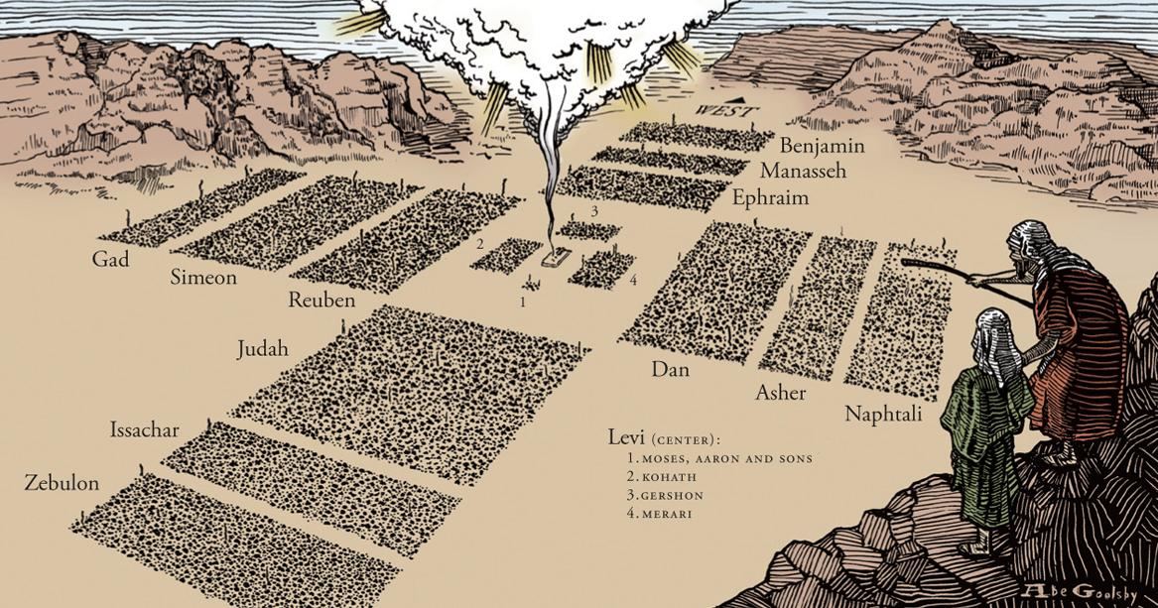

Slide 6
Provisions for the Priests & Levites (18:8-32)
Provision for the Priests (vs. 8-20)
  Additional Notes
    Burnt Offerings Totally Consumed; They Received Nothing From Them
    Firstborn of Man is Redeemed, Not Sacrificed (vs. 15a; cf. Ex. 11:1-10; 13:2-16)
    Unclean Animals Redeemed With Shekels (vs. 15b; Couldn’t Eat Them)
    Covenant of Salt; Emphasizes Permanence (vs. 19; cf. Chron. 13:5)
    No Inheritance in the Land (vs. 20; As Priests Today, We Have No Inheritance Here)
The Sacrifice | Reference | Eating Instructions
Grain, Sin, & Guilt Offerings | Vs. 9-10 | Males May Eat in a “Most Holy Place”
Peace Offerings | Vs. 11 | Sons & Daughters: Everyone Who is Clean
Firstfruits | Vs. 12-13 | Everyone Who is Clean in Your House
Devoted Things | Vs. 14 | N/A
Firstlings | Vs. 15-18 | Blood on Altar & Burn Fat to the Lord; Flesh Given to Priests

Slide 7
Provisions for the Priests & Levites (18:8-32)
Provision for the Levites (vs. 21-24)
  Levites Receive Tithe from the Nation (vs. 21-22; Tithe = 1/10)
    New Details on Previous Law (cf. Lev. 27:30-33)
    They Are Serving the People By Protecting Them
      Offerings Are Their “Inheritance” For Their Service
      Services Especially Important After Korah’s Rebellion (Numbers 16-17)
  No Inheritance For Levites In the Land (vs. 23-34)
    48 Levitical Towns Make up 15 Square Miles (.1% of the Land)
    Anticipates That Israel Will Come to the Land
The Tithe of the Levites (vs. 25-32)
  Levites Give a Tithe From the Tithes They Received
    They Are to Give the Best of the Best (vs. 29-30, 32)
    Servants of God Not Exempt From Contributing
  Priests Receive the Tithe of the Levites (vs. 28)
  Free to Eat the Rest Without Restrictions (vs. 31)

Slide 8
The Red Heifer (19:1-22)
Complications in the Wilderness
  Touching a Dead Body When Tabernacle is Not Set Up
  With Wilderness Generation Dying Off, This is a Practical Concern
“¹¹But when Christ appeared as a high priest of the good things that have come, then through the greater and more perfect tent (not made with hands, that is, not of this creation) ¹²he entered once for all into the holy places, not by means of the blood of goats and calves but by means of his own blood, thus securing an eternal redemption. ¹³For if the blood of goats and bulls, and the sprinkling of defiled persons with the ashes of a heifer, sanctify for the purification of the flesh, ¹⁴how much more will the blood of Christ, who through the eternal Spirit offered himself without blemish to God, purify our conscience from dead works to serve the living God.” (Hebrews 9:11-14)

Slide 9
The Red Heifer (19:1-22)
Preparation (vs. 1-10)
  Slaughtering (vs. 1-3)
    An Unblemished Red Heifer That Has Never Been Yoked (Red Symbolizes Blood?)
    Unusual to be Using a Cow Rather Than a Bull
    Slaughtered Outside the Camp
    Eleazar Goes, Not Aaron (To Protect Aaron’s Consecrated Status? Cf. Lev. 21:10-12)
  Burning (vs. 4-6)
    Sprinkle Some of the Blood Seven Times Towards Tabernacle
    Everything Burned; Even the Blood
    Add Cedarwood, Hyssop, & Yarn to the Fire (Purifying Agents in Lev 14:4)
  Gathering (vs. 7-10)
    Purpose of Ceremony is to Produce Ashes
      A Clean Person Gathers Up Ashes & Stores it for the Water of Impurity
      Ready to be Mixed With Water (cf. vs. 17; Like Instant Coffee)
    Process Makes All Three People Unclean Until Evening
      Priest (vs. 7; Wash Clothes & Bathe in Water)
      Burner (vs. 8; Wash Clothes & Bathe in Water)
      Ash-Gatherer (vs. 9; Only Washes Clothes)

Slide 10
The Red Heifer (19:1-22)
Occasions For the Ashes (vs. 11-16)
  Cases of Uncleanness
    Whoever Touches a Dead Body (vs. 11-12)
    Whoever is in the Tent of a Dead Person (vs. 14)
    Whoever Touches a Dead Body/Grave/Bone in the Open Field (vs. 16)
  How to Become Clean
    Apply the Water on Third & Seventh Day (2 Applications of the Water)
    Cleansed on the Seventh Day (Rest from Uncleanness)
  Disobedience Leads to Being “Cut Off” (vs. 13)
Procedure (vs. 17-22)
  Mix Fresh Water & the Ashes Together in a Vessel (vs. 17)
  Clean Person Takes Hyssop & Applies Water to the Unclean Person
    The Unclean Becomes Clean by the Water (vs. 18-19)
    The Clean Person Is Made Unclean By the Water (vs. 21-22)
  Lessons
    Helping Others Comes at a Cost
    We Cannot Approach God on our Terms

