Slide 1
HOW TO READ THE BIBLE
Embry Hills COC, Segment 2-3 2020-21
Notes:
What is this class about?
Not about how to determine right and wrong (Bible Authority)
Not about reading more
Not about unlocking the hidden secrets of the Bible
Not a new method or gimmick.
This is a class about Reading Well – we intend to shape you toward being better readers, that is more informed and active readers of the Bible who are able to hear the Word of God as it is given in God’s own terms, through the words of the various authors of the Bible. We aren’t so much introducing anything new here, as much as we are making an analytical reflection on a practice that we already do naturally all the time. By slowing down to consider how we read, we will make ourselves more attentive readers of God’s Word.

Slide 2
CLASS SCHEDULE
L1: The Value of Reading Scripture
L2: The Writing(s) of the Bible
L3: Approaches & Assumptions
L4: Getting Started with a Bible
L5: Reading as Observation – Level 1
L6: Reading as Observation – Level 1
L7: I CORINTHIANS OVERVIEW
L8: Reading as Observation – Level 2
L9: I CORINTIANS, CH. 1
L10: I CORINTHIANS, CH. 2
L11: I CORINTHIANS, CH. 3&4
L12: Reading as Observation – Level 3
L13: I CORINTHIANS, CH. 5&6
L14: External Resource for Bible Reading
L15: I CORINTHIANS, CH. 7
L16: I CORINTHIANS, CH. 8
L17: Reading as Interpretation
L18: I CORINTHIANS, CH. 9
L19: I CORINTHIANS, CH. 10
L20: ‘Second-Level’ Readings
L21: I CORINTHINS, CH. 11
L22: I CORINTHIANS,CH. 12&13
L23: I CORINTHIANS, CH. 14
L24: I CORINTHIANS 15
L25: I CORINTHIANS 15&16
L26: Review & Final Considerations
Notes:
Lesson 1 is about why this class is important
Lessons 2&3 are about the ‘theory’ of how a person would go about reading the Bible
Lesson 4 is an introduction the bible as a published document – what the Bible consists of
Lessons 5/6, 8 and 12 are the ‘meat’ of the class. These are three lessons on three ‘levels’ of reading by observing the text of the Bible. Level 1 is about reading the text at the broadest level, by understanding the genre and the intentions of the author. Level 2 is about looking into how the author executes their purpose for a writing by looking at how they intentionally organize the writing and what recurring themes an author uses. Level 3 looks deeper into a text to understand the way individual words and ideas are used to convey the author’s ideas.
Lesson 14 takes a look at some external resources that can be used to aid our understanding of Scripture
Lesson 16 transitions from observing the text to interpreting it – moving from the question of ‘What does the text say?’ to ‘What does the text mean?’
Lesson 20 looks at some other approaches to Scripture that are more focused on the needs of the reader – Topical Studies and Devotional Readings
Throughout this class we will be reading through 1 Corinthians as a means of a) employing some of the lessons learned in our

Slide 3
The value of reading scripture
Lesson 1

Slide 4
‘Take up and read…’
2 Kings 22: Josiah Finds the Law
So was I speaking and weeping in the most bitter contrition of my heart, when, lo! I heard from a neighbouring house a voice, as of boy or girl, I know not, chanting, and oft repeating, “Take up and read; Take up and read.” Instantly, my countenance altered, I began to think most intently whether children were wont in any kind of play to sing such words: nor could I remember ever to have heard the like. So checking the torrent of my tears, I arose; interpreting it to be no other than a command from God to open the book, and read the first chapter I should find…Eagerly then I returned to the place where Alypius was sitting; for there had I laid the volume of the Apostle when I arose thence. I seized, opened, and in silence read that section on which my eyes first fell: “Not in rioting and drunkenness, not in chambering and wantonness, not in strife and envying; but put ye on the Lord Jesus Christ, and make not provision for the flesh, in concupiscence.” [Romans 13:13-14] No further would I read; nor needed I: for instantly at the end of this sentence, by a light as it were of serenity infused into my heart, all the darkness of doubt vanished away. - Confessions of St. Augustine, Chapter 9
Notes:
Questions:
What do you think of this as an example of how to read the Bible? Does Augustine interpret the Bible correctly?
We might say that this is a legitimate reading because it seems to have genuinely changed his life. He is ‘pricked in his heart’ of the need to change his ways and devote himself to Christ. On the other hand, we might bristle against this…He reads the text at random, and completely out of context. His interpretation is clearly subjective and shaped by his own personal experience which is completely disconnected from the purpose of the original message.
Why does this type of reading make us uncomfortable? How can we maintain a belief in the Bible’s ability to convict us at a personal and collective level, but still maintain the integrity of reading the text in the form and context in which it is given?

Slide 5
The Need for Bible Students
1 Corinthians 2:6-14:
We speak God’s wisdom;
We have the mind of Christ
‘A Crisis of Biblical Illiteracy’
The Bible as its own Language
Bible Readers or Bible Quoters?
Reading as a Work of the Church
Notes:
Here follow the written material…

Slide 6
A History of Bible Access
Luke 4:16-21: Jesus reads in the synagogue
Conservative estimates of literacy among 1st century Jews (earliest Christians) suggest less than 5% of the general population could read or write.
No person owned full, personal copies of all books of Scripture
When copies became more prevalent, they were prohibited by Roman Imperial Law
Edicts of Persecution/ March, 303 AD
Colossians 4:16: Read the letter among you
Notes:
Most people couldn’t ‘read’ in the same way we can now. In fact, ‘reading’ was more like ‘oral performance.’ No one went to the library and picked up books and took them home to read on their own. Books existed, but would have been read aloud in public. When Paul’s letters were delivered to churches, they didn’t hand out copies to everyone, they were read aloud to the church for their hearing.
Before the printing press, all document copies were by hand and were very expensive, so copies of the scriptures were few and far between. Synagogues and churches would have possessed some, but certainly not all, of the scriptures.
It is nearly certain that Jesus’ only access to the Scriptures was his hearing them publicly read in Synagogue each Sabbath Day.
How did people know the scriptures? Memorization, oral tradition, separate written copies of particular books/scriptures.

Slide 7
A History of Bible Access
Prominence of Latin Vulgate (400-1400AD) > Catholic Restriction on Scriptures
Decree of the Council of Toulouse (1229 C.E.): “We prohibit also that the laity should be permitted to have the books of the Old or New Testament; but we most strictly forbid their having any translation of these books.”
Ruling of the Council of Tarragona (1234 C.E.): “No one may possess the books of the Old and New Testaments in the Romance language, and if anyone possesses them he must turn them over to the local bishop within eight days after promulgation of this decree, so that they may be burned...”
Notes:
After Christianity becomes the accepted religion of the Roman Empire in 313AD, the bible obviously becomes more accepted, but that ushers in a long period of church control over the texts of Scripture. With this comes one of the most ironic elements of Church History. The once-outlawed Scriptures are now restricted by those who were persecuted for having them. And eventually this led to the same kinds of persecution by the church that it had once endured.
For the next 1,000 years Christianity almost exclusively existed as Catholicism. In that time, the Bible existed almost exclusively in Latin, in text called the Latin Vulgate. Most common people did not know or speak Latin, it was only used by the ‘Clergy’ in the church, and so it was only church officials who even knew the Scriptures at all. Christians would have only known the Bible through what they were taught by their priests. The restrictions on use and possession of the Scriptures became a prominent aspect of Church policy, so much so that official church rulings were made to enforce it. [Council Rulings]
So…WHY would the church do this?!? Why would Christians restrict and prevent other Christians from reading the Bible? It’s because the church leaders knew that the Bible in the hands of everyone means that everyone has their own understanding and interpretation, and when that happens there is no uniformity in doctrinal belief. If everybody has a say, then no one gets to decide who or what is right. And so, in order to protect the doctrinal unity, or ORTHODOXY, of the church, they restricted the Scriptures.

Slide 8
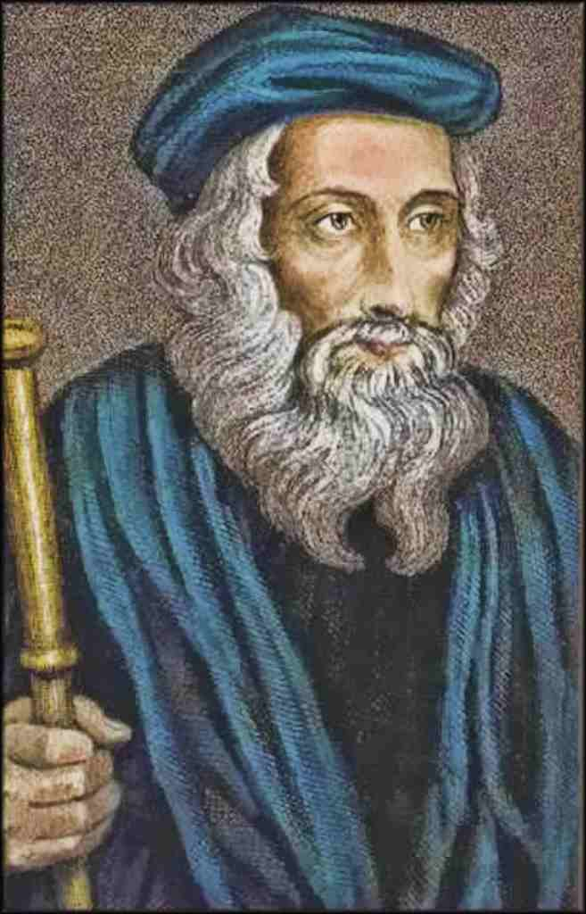
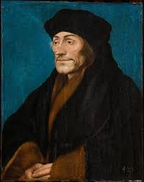
A History of Bible Access
John Wycliffe
First Translation of the Bible from Latin into Middle English in 1382
Desiderius Erasmus
First Greek New Testament developed and published in 1516
Notes:
Wycliffe was deemed a heretic by the Catholic Church after his death. This decree, confirmed by the Pope in 1415, resulted in Wycliffe’s corpse being exhumed from his grave, his body burned, and the ashes thrown into the River Swift.
One of the radical ideas behind the Protestant Reformation was the idea that the text of Scripture should be best known through the original Greek rather than the Latin. Thus Erasmus researched and formulated a Greek version of the NT in 1516.

Slide 9
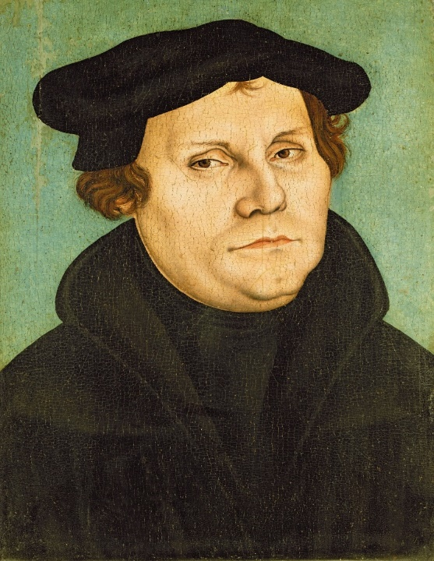
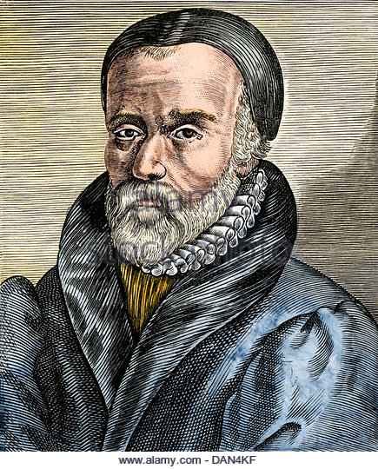
A History of Bible Access
Martin Luther
First Translation of the NT from Greek into German in 1522
William Tyndale
First Translation of the NT from Greek into English in 1526
Notes:
The other radical idea of the time was that people should be able to read the Scriptures on their own without the oversight of the church. And so Martin Luther, using Erasmus’ Greek NT, not the Latin Vulgate, translates the NT into German, the language of the people, in 1516. This was a heinous act of rebellion in his time.
Tyndale’s English translation coined many of the traditional phrases we know from Scripture, like ‘my brother’s keeper,’ ‘seek and ye shall find,’ and ‘the spirit is willing, but the flesh is weak.’ Controversially, he translated the Greek word ‘ekklesia’ meaning ‘assembly’ as ‘congregation’ rather than ‘church.’ This translation was seen as a direct threat to the Catholic Church’s claim to be the sole body of Christ.’ For his heretical action, Tyndale was strangled to death before being burned at the stake
Given this history of lack of access to the Scriptures, it is a small wonder that we can even have a class about how to read the Bible. But understand that with advances in technology came a more democratic attitude toward Bible reading. When Johannes Gutenburg invents the printing press in 1440s, people could publish and distribute texts much more quickly, and it gave people the ability and opportunity to have broader access to the Bible. The novel idea that people in fact should be able to then read the Bible for themselves goes hand in hand with this. As mentioned this was a very controversial idea, because when you open up the scriptures to everyone that means everyone has a say about what the scriptures mean. And when everyone has a say about what the scriptures mean, doctrine gets relativized. And so the Catholic church limited the Bible in an effort to preserve their doctrinal uniformity, or orthodoxy.

Slide 10
A History of Bible Access
Post-1500 AD – The Rise of Denominationalism
Unlimited Access in the Technological Age
Orthodoxy
Competing Values
Personal Belief
Notes:
Despite the ultimate error of Catholic restrictions, it is still true that their fears were valid. History has borne this out, that when individuals are given access to the Bible they ultimately conclude different things and then divisions occur. It is no coincidence that after the Protestant Reformation, Christianity has been divided and sub-divided again and again based on different interpretations of Scripture, and attempts to (re-)unify Christians across denominational lines have been limited in their ‘success’ (in air-quotes).
That leads into the modern age where it feels like we live in a completely opposite world – a world where because of technology, everyone has access to the Bible – in multiple formats and multiple translations, in a single-volume books, or even on our phones. Access to the scriptures is almost limitless, and because of that everybody has a voice and an opinion on it. We see this in the number of books, or blogs, or YouTube videos about the Bible. This is what happens in a world where everyone gets to read the Bible. There is no unity let alone uniformity.
How do we find balance here? On one hand we have to uphold doctrinal consistency but we can’t do that by turning people away from the Bible. Are we doomed to choose between these two failing options?

Slide 11
Orthodoxy
Competing Values
Personal Belief
Matthew 15:1-9
2 Peter 1:20-21
2 Timothy 3:14-15
Galatians 1:8-9
Ephesians 3:3-4
2 Peter 2:2 & 9
2 Peter 3:14-18
Acts 15

Slide 12
Reading as a Work of the Church
Notes:
I think the answer is in promoting individual readings in the context of the church community. In that way, there is both the freedom of individual readings and the check of the church community to shape each other toward learning the Truth. That is one of the great benefits of being part of church like EH, which I think really promotes this kind of balance, a church which encourages personal bible reading, and also brings us together in classes to read and study and participate together. This is why our bible class periods, and your interaction in them is so important. Reading the Bible is not just for the leaders of the church, but everyone to bring that to bear among the group. In this model, we become like the threads of a cord that all bring their individual perspectives together to form a unified and strengthened church.
Thus, the #1 tip for How to Read the Bible, is to read it with someone else – especially with someone who is committed to the Gospel and faithfulness to Jesus Christ.

Slide 13
Discussion Questions
What are some of the blessings we have for Bible study given where we are in history?
What is it about the Bible that makes it hard to read sometimes? Conversely, what is it about discovering something in Bible study that is so encouraging?
What do you feel are some weaknesses in your Bible reading/study? Are there weaknesses beyond just how much time you spend doing it? For instance, do you find particular books of the Bible challenging? Do you wish you understood connections across the Bible more?

