Slide 1
Old Testament Survey in 7 Lessons
Notes:
During the slideshow, hold down the Ctrl key and the left mouse pointer to make the laser pointer appear on the screen.

Slide 2
Class Schedule
Lesson | Bible Period | Bible Reference
1 | Creation and The Patriarchs | Genesis 1-50, Job
2 | Exodus & Wilderness Wanderings | Exodus, Leviticus, Numbers, Deuteronomy
3 | Conquest & Time of Judges | Joshua, Judges & Ruth, 1 Samuel 1-7
4 | United Kingdom | 1 Samuel 8-31 & 2 Samuel 1 Kings 1-11 1 Chron 1-2 Chron 9, Psalm, Proverbs, Ecclesiastes, Song of Solomon
5 | Divided Kingdom – Days of Israel & Judah | I Kings 12-2 Kings 17 2 Chron 10-28
6 | Divided Kingdom – Judah Alone | 2 Kings 18-23 2 Chron 29-35
 | Fall of Judah & the Prophets | 2 Kings 23-25, 2 Chron 36, Jeremiah, Minor Prophets
7 | Exile & Remnant Returns | Jeremiah, Ezekiel & Daniel Ezra, Nehemiah, Esther

Slide 3
Objectives
Learn Major Bible Periods of Old Testament
Learn to Place Bible Events on a Timeline/In Order
Learn God’s Plan to bring Salvation to the World
Learn Main Topics of each Old Testament Book
Learn God’s relationship with man

Slide 4
Bible in Three Words
Problem
Sin
Promises
Fulfillment
Christ
Bruise heel
Bruise head
All the families of the earth shall be blessed
The divine author of the Old Testament …
Supplied authoritative instruction for God’s people.
Recorded the progression and purpose of God’s covenants in redemptive history.
Distinguished the Law, Prophets, and Writings.
Highlighted how the old (Mosaic) covenant was
established, enforced, and enjoyed.
What the Old Testament Authors Really Cared About: A Survey of Jesus' Bible.
Notes:
The divine author of the Old Testament …
Supplied authoritative kingdom instruction for God’s people.
Recorded the progression and purpose of God’s covenants in redemptive history.
Distinguished the Law, Prophets, and Writings.
Highlighted how the old (Mosaic) covenant was established, enforced, and enjoyed.
What the Old Testament Authors Really Cared About: A Survey of Jesus' Bible.

Slide 5
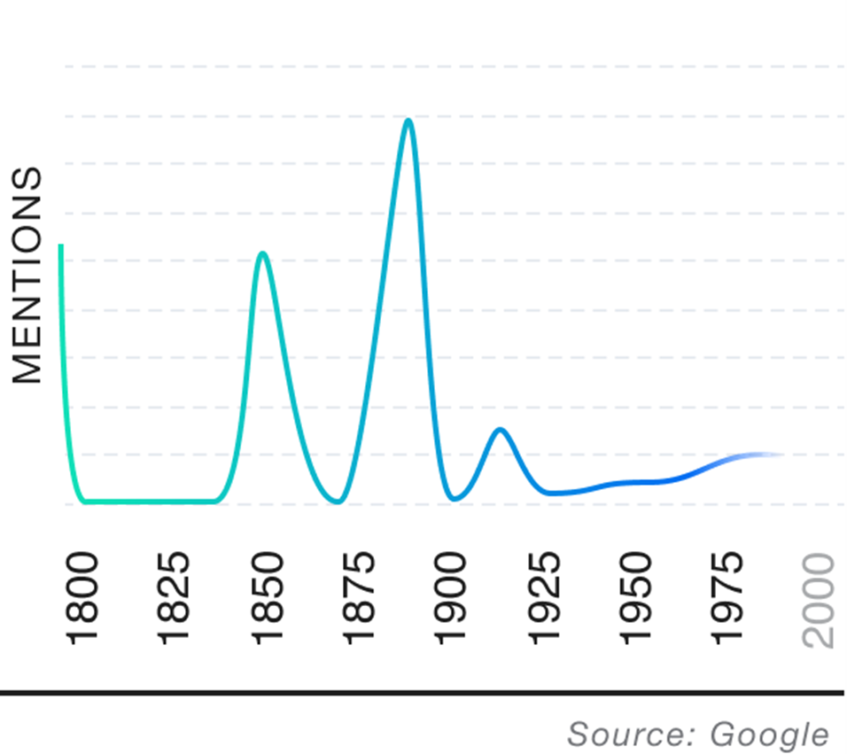
Let Us Reason
Ratiocinate
Origin: Latin, mid 17th century
This verb comes from the
Latin word "ratiocinat,"
which means "deliberated; calculated."
A Century wo Reason
What Makes Me Happy
Situation Ethics
No Absolute Truth
Form judgments by a process of logic.
Reason
Word Genius Word of the Day
1790-1840 Restoration Movement - a Christian movement that began on the United States frontier during the Second Great Awakening
Thomas Paine – Age of Reason – Deism 1794
the Age of Enlightenment, a philosophical movement of the 18th century, characterized by belief in the power of human reason
Notes:
the Enlightenment, a philosophical movement of the 18th century, characterized by belief in the power of human reason and by innovations in political, religious, and educational doctrine.

Slide 6
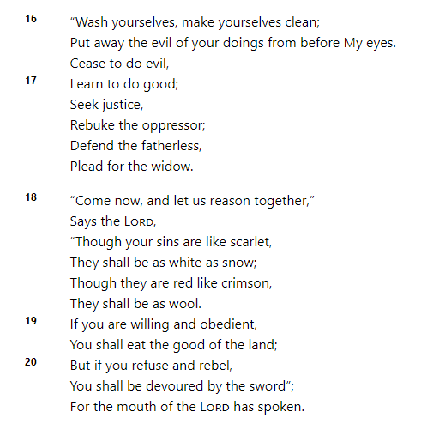
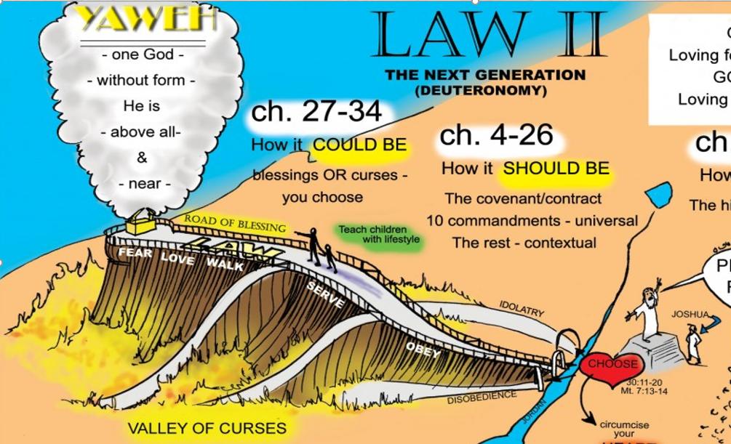
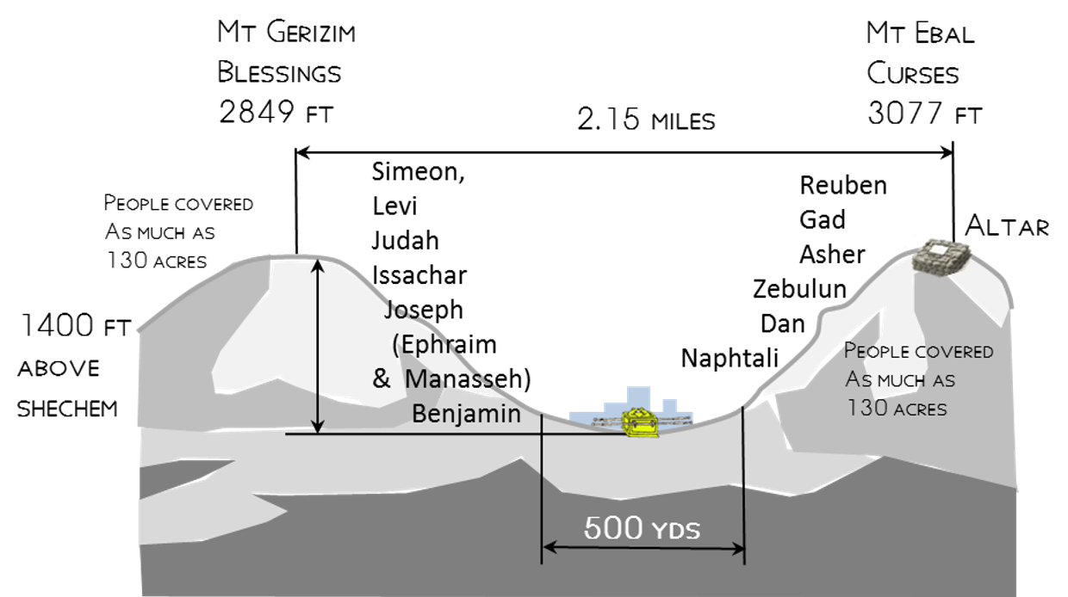
Let Us Reason
Matthew 22:40 (NKJV)
⁴⁰ On these two commandments hang all the Law and the Prophets."
Isaiah 1 NKJV
"'You shall love the LORD your God with all your heart, with all your soul, and with all your mind.’
Dt 6:5
Problem Sin
Isaiah expected people to remember
'You shall love your neighbor as yourself.’ Lev 19:18
Promise
Fulfillment
Blessings
Curses

Slide 7
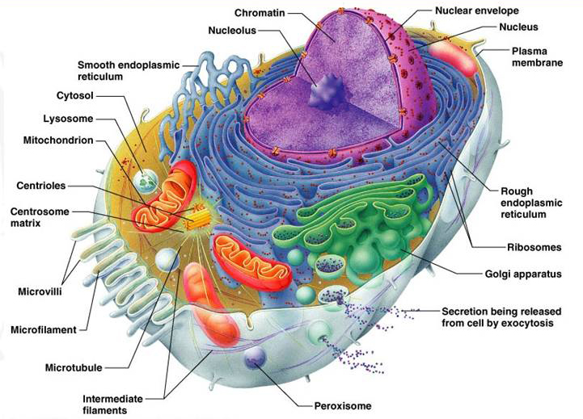
Let Us Reason
How can new fossils be paraded monthly across the front pages of major newspapers as fresh and powerful evidence of evolution, but distinguished scientists still argue against the sufficiency of simple random mutation and natural selection?
How could Darwin’s clunky mechanism—one tiny, random change at a time, each followed by a long, fitful, and uncertain period of natural selection, with no ability to anticipate future needs—account for the molecular marvels that modern biology had uncovered?
Micro or Mere evolution is the bare proposition that organisms living today are descended with modification from organisms that lived in the distant past. There is terrific evidence consistent with that.
We can ask or attempt to reason what caused such astounding changes to take place? What is the reason or mechanism for (macro) evolution?
The most profound insight of modern science is that life is based literally on machines made of molecules. We have always underestimated cells. Indeed, the entire cell can be viewed as a factory that contains an elaborate network of interlocking assembly lines, each of which is composed of a set of large protein machines
Irreducible Complexity Obstacle to Darwinian Evolution Michael J. Behe (A Mousetrap for Darwin)

Slide 8
Period 7
Period 1
Judah Alone
Creation & Fall
Period 8
Period 4
Fall of Judah
Conquest & Judges
Period 2
Period 9
Patriarchs
Period 5
Exile
United Kingdom
Period 3
Exodus & Wanderings
Period 6
Period 10
Divided Kingdom
Return
2091-1876 BC
1445 BC
1405
To 1050 BC
1050-930 BC
930-722 BC
722-605 BC
Genesis
1-11
Genesis
12-50
Job
Exodus
Leviticus
Numbers
Deuteronomy
Joshua
Judges
Ruth
1 Samuel 1-7
1 Samuel 8-31
1 Kings 1-11
1 Chronicles
2 Chronicles 1-9
Psalms
Proverbs
Ecclesiastes
Song of Solomon
1 Kings 12-22
2 Kings 1-17
2 Chron 10-29
2 Kgs 18-22
2 Chron 29-35
605-586 BC
586-538 BC
538-~432 BC
2 Kgs 23-25
2 Chron 36
2 Chron 36
Daniel
Jeremiah
Ezekiel
Ezra
Nehemiah
Esther
Zechariah
Haggai
Malachi
Isaiah
Hosea
Joel
Amos
Obadiah
Jonah
Micah
Jeremiah
Lamentations
Ezekiel
Daniel
Nahum
Habakkuk
Zephaniah

Slide 9

Bible Periods
Period 1
Period 2
Period 3
Creation & Fall
The Patriarchs
Exodus & Wanderings
Pentateuch-Law
Period 4
Period 5
Period 6
Period 7
Conquest & Judges
United Kingdom
Divided Kingdom
Judah Alone
History – Poetry – Major & Minor Prophets
Period 8
Period 9
Fall of Judah
Exile
Return
Period 10
History –Major & Minor Prophets

Slide 10
Old Testament Books
L-03
Joshua
Hosea
L-03
Judges
Joel
L-03
Ruth
Amos
L-03
1 Samuel
Obadiah
2 Samuel
Jonah
1 Kings
Micah
2 Kings
Nahum
Genesis
1 Chronicles
Job
Isaiah
Habakkuk
L-01
Exodus
2 Chronicles
Psalms
Jeremiah
Zephaniah
L-02
Leviticus
Ezra
Proverbs
Lamentations
Haggai
L-02
Numbers
Nehemiah
Ecclesiastes
Ezekiel
Zechariah
L-02
L-02
Deuteronomy
Esther
Song of Songs
Daniel
Malachi
LAW
HISTORY
POETRY
MAJOR
PROPHETS
MINOR
PROPHETS

Slide 11
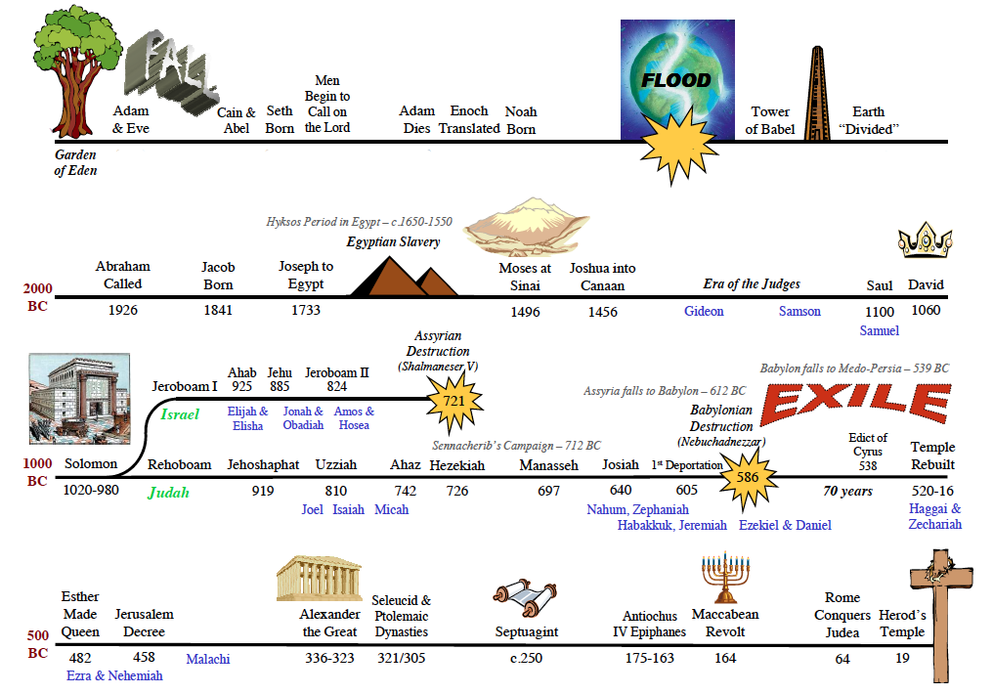

Period 1 Creation & Fall
Period 1 Creation & Fall
Jensen – Hyksos Period 1730-1570
Into Egypt
2091
2006
1876
~1447
1405
1050-1010
1010-970
Period 2 Patriarchs
Period 3 Exodus & Wandering
Period 4 Conquest & Judges
P. 5 United Kingdom
970-930
P. 5 United Kingdom
Period 6 Divided Kingdom
P. 7 Judah Alone
P. 8 Judah Falls
P. 9 Exile
P. 10 Return
486-464
445-432
P. 10 Return
Years of Silence with the Roar of Daniel
Notes:
486–464

Slide 12
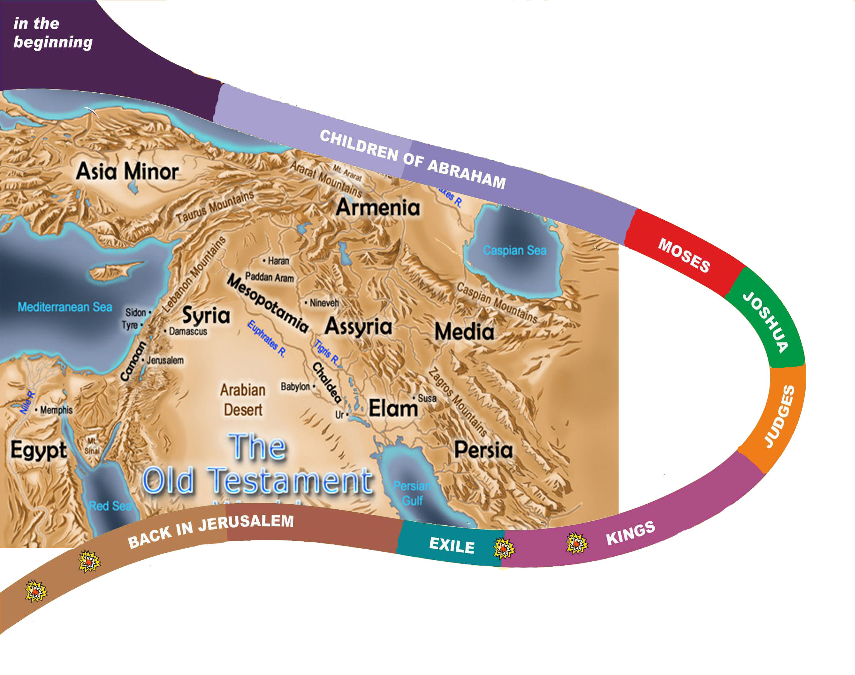

Adam & Eve
Tree of knowing good and evil - he shall bruise your head
Wickedness of men - every intention of the thoughts of his heart was only evil continual
- But Noah found favor in the eyes of the LORD.
Flood
Call of Abraham
2091 BC
Promise to Abraham >> Land, Seed, All Nations Blessed
Promise to Isaac, Jacob /Sojourner for 400 yrs in Egypt
Moses & “I AM WHO I AM/ Law
10 Plagues. People Mummer,
40 Years Wilderness Wanders
Promise of Seed/Nation
1445 BC
1405
Joshua -choose this day whom you will serve, But as for me and my house, we will serve the Lord. Not one word has failed of all the good things that the LORD your God promised concerning you
Promise of Land
~1380
Judges -another generation after them who did not know the LORD or the work that he had done for Israel. Everyone did what was right in his own eyes.
1050
930
~420 BC
End of OT
538
586
722
Notes:
God’s Covenant with Abram
15 After these things the word of the LORD came to Abram in a vision: “Fear not, Abram, I am your shield; your reward shall be very great.” 2 But Abram said, “O Lord GOD, what will you give me, for I continue childless, and the heir of my house is Eliezer of Damascus?” 3 And Abram said, “Behold, you have given me no offspring, and a member of my household will be my heir.” 4 And behold, the word of the LORD came to him: “This man shall not be your heir; your very own son shall be your heir.” 5 And he brought him outside and said, “Look toward heaven, and number the stars, if you are able to number them.” Then he said to him, “So shall your offspring be.” 6 And he believed the LORD, and he counted it to him as righteousness.
7 And he said to him, “I am the LORD who brought you out from Ur of the Chaldeans to give you this land to possess.” 8 But he said, “O Lord GOD, how am I to know that I shall possess it?” 9 He said to him, “Bring me a heifer three years old, a female goat three years old, a ram three years old, a turtledove, and a young pigeon.” 10 And he brought him all these, cut them in half, and laid each half over against the other. But he did not cut the birds in half. 11 And when birds of prey came down on the carcasses, Abram drove them away.
12 As the sun was going down, a deep sleep fell on Abram. And behold, dreadful and great darkness fell upon him. 13 Then the LORD said to Abram, “Know for certain that your offspring will be sojourners in a land that is not theirs and will be servants there, and they will be afflicted for four hundred years. 14 But I will bring judgment on the nation that they serve, and afterward they shall come out with great possessions. 15 As for you, you shall go to your fathers in peace; you shall be buried in a good old age. 16 And they shall come back here in the fourth generation, for the iniquity of the Amorites is not yet complete.”
The Holy Bible: English Standard Version. (2016). (Ge 15:1–16). Wheaton, IL: Crossway Bibles.

Slide 13
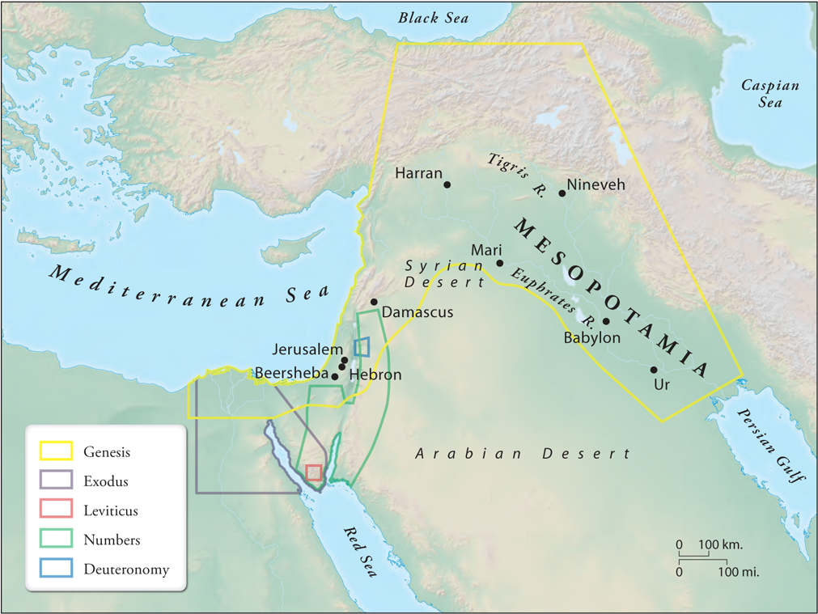
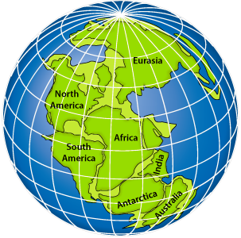
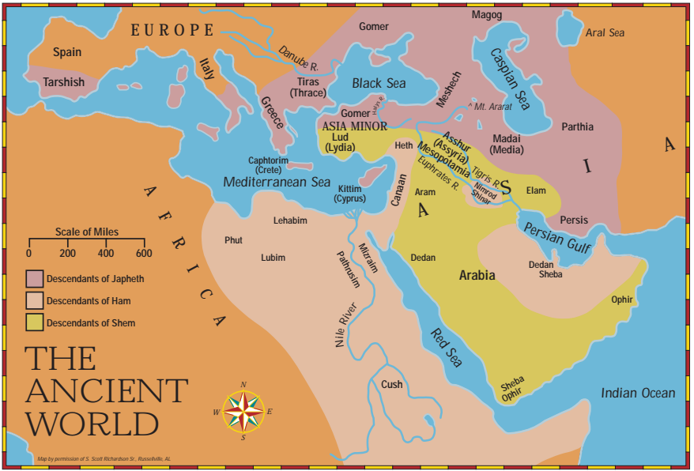
Genesis 1-11
Creation & Fall-Flood
Genesis 12-50
~2166-1800 BC
The Patriarchs
Abraham
Isaac
Jacob & Sons

Slide 14
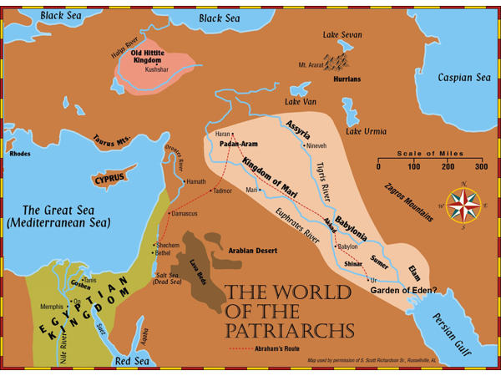
Genesis 1-11
Creation & Fall-Flood
Genesis 12-50
~2166-1800 BC
The Patriarchs
Abraham
Isaac
Jacob & Sons

Slide 15
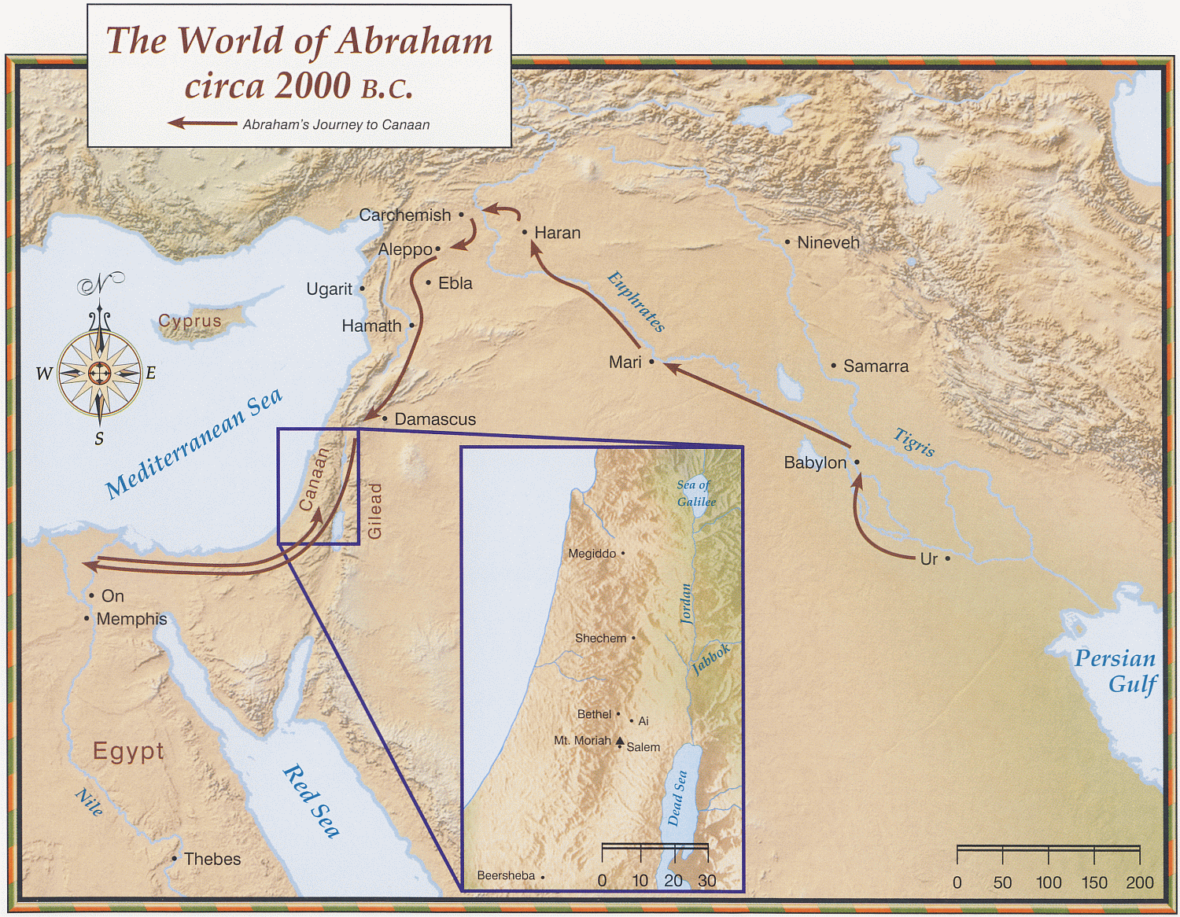
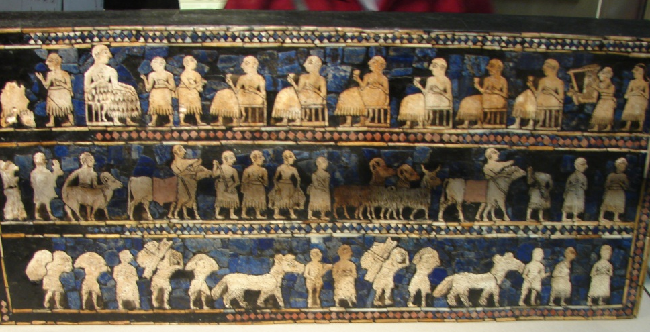
Genesis 12-50
~2166-1800 BC
The Patriarchs
Abraham
Isaac
Jacob & Sons
Abraham
Terah, Abraham & Haran

Slide 16
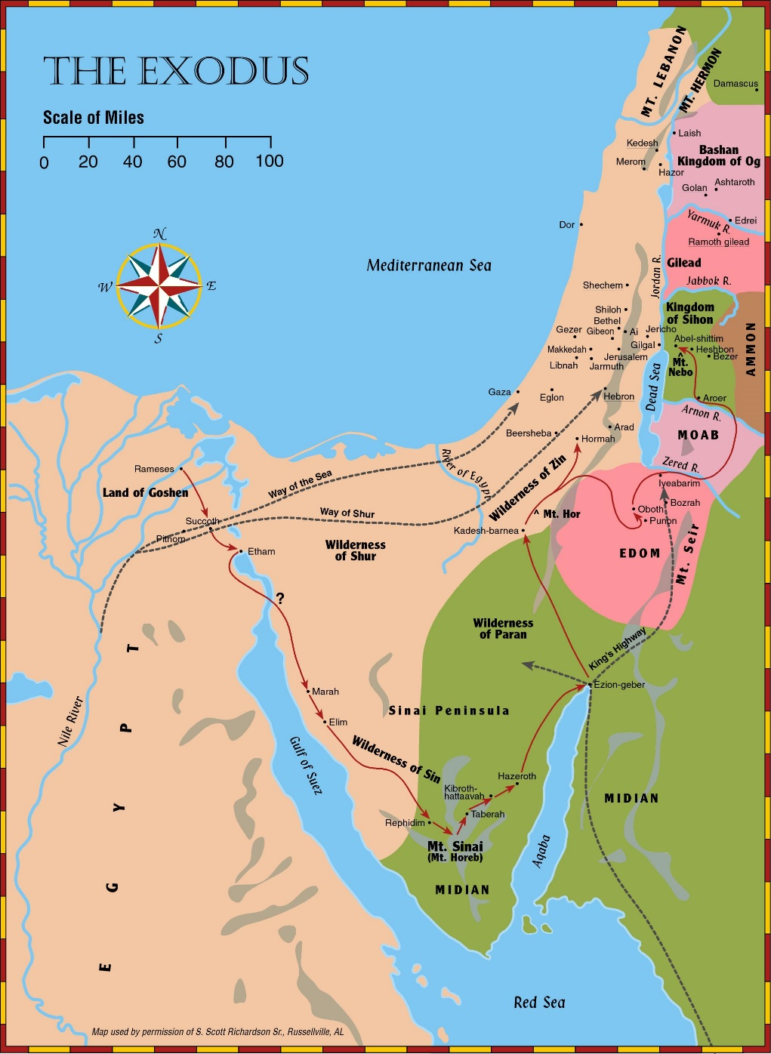
Exodus & Wilderness Wanderings
Exodus, Lev, Num,
Deut, Joshua
~1525-1405 BC
120 years (Life of Moses)

Slide 17
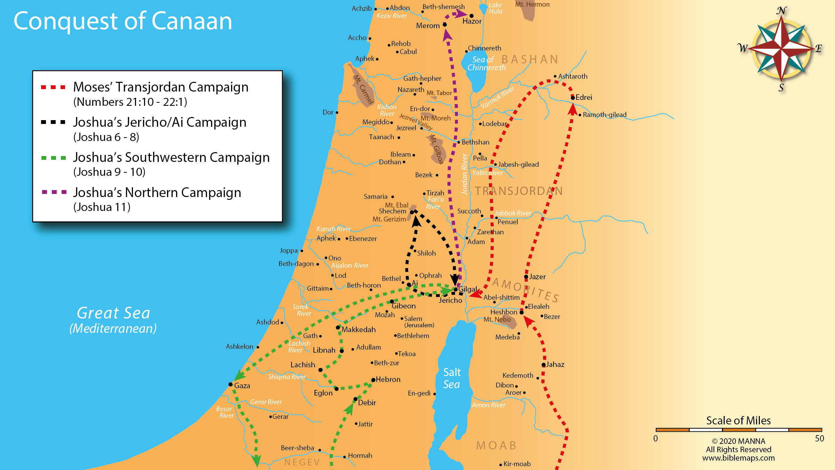
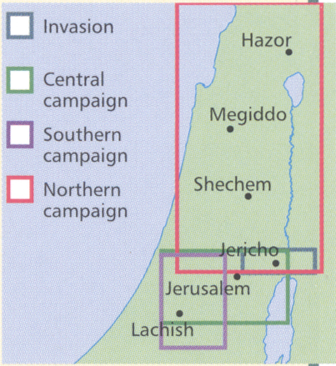
Central
Exodus & Conquest
Southern
Exodus, Lev, Num,
Deut, Joshua
~1525-1390 BC
Northern

Slide 18
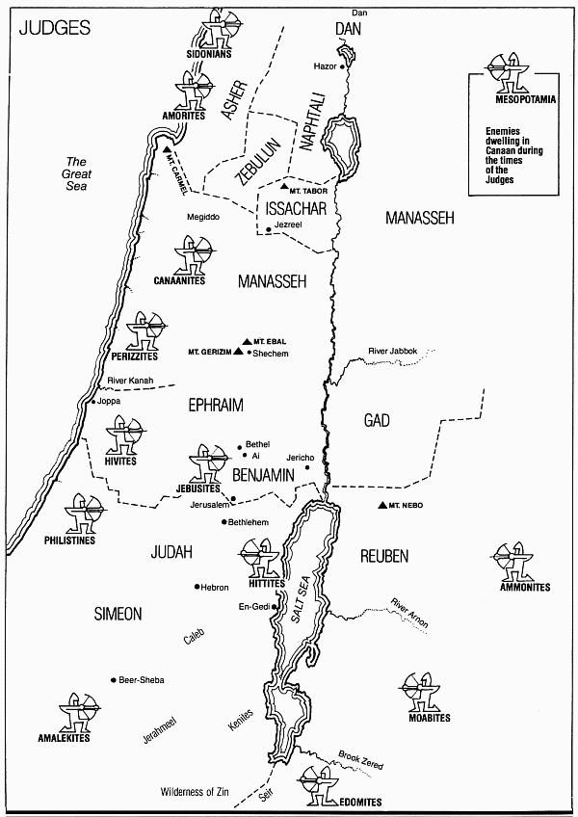
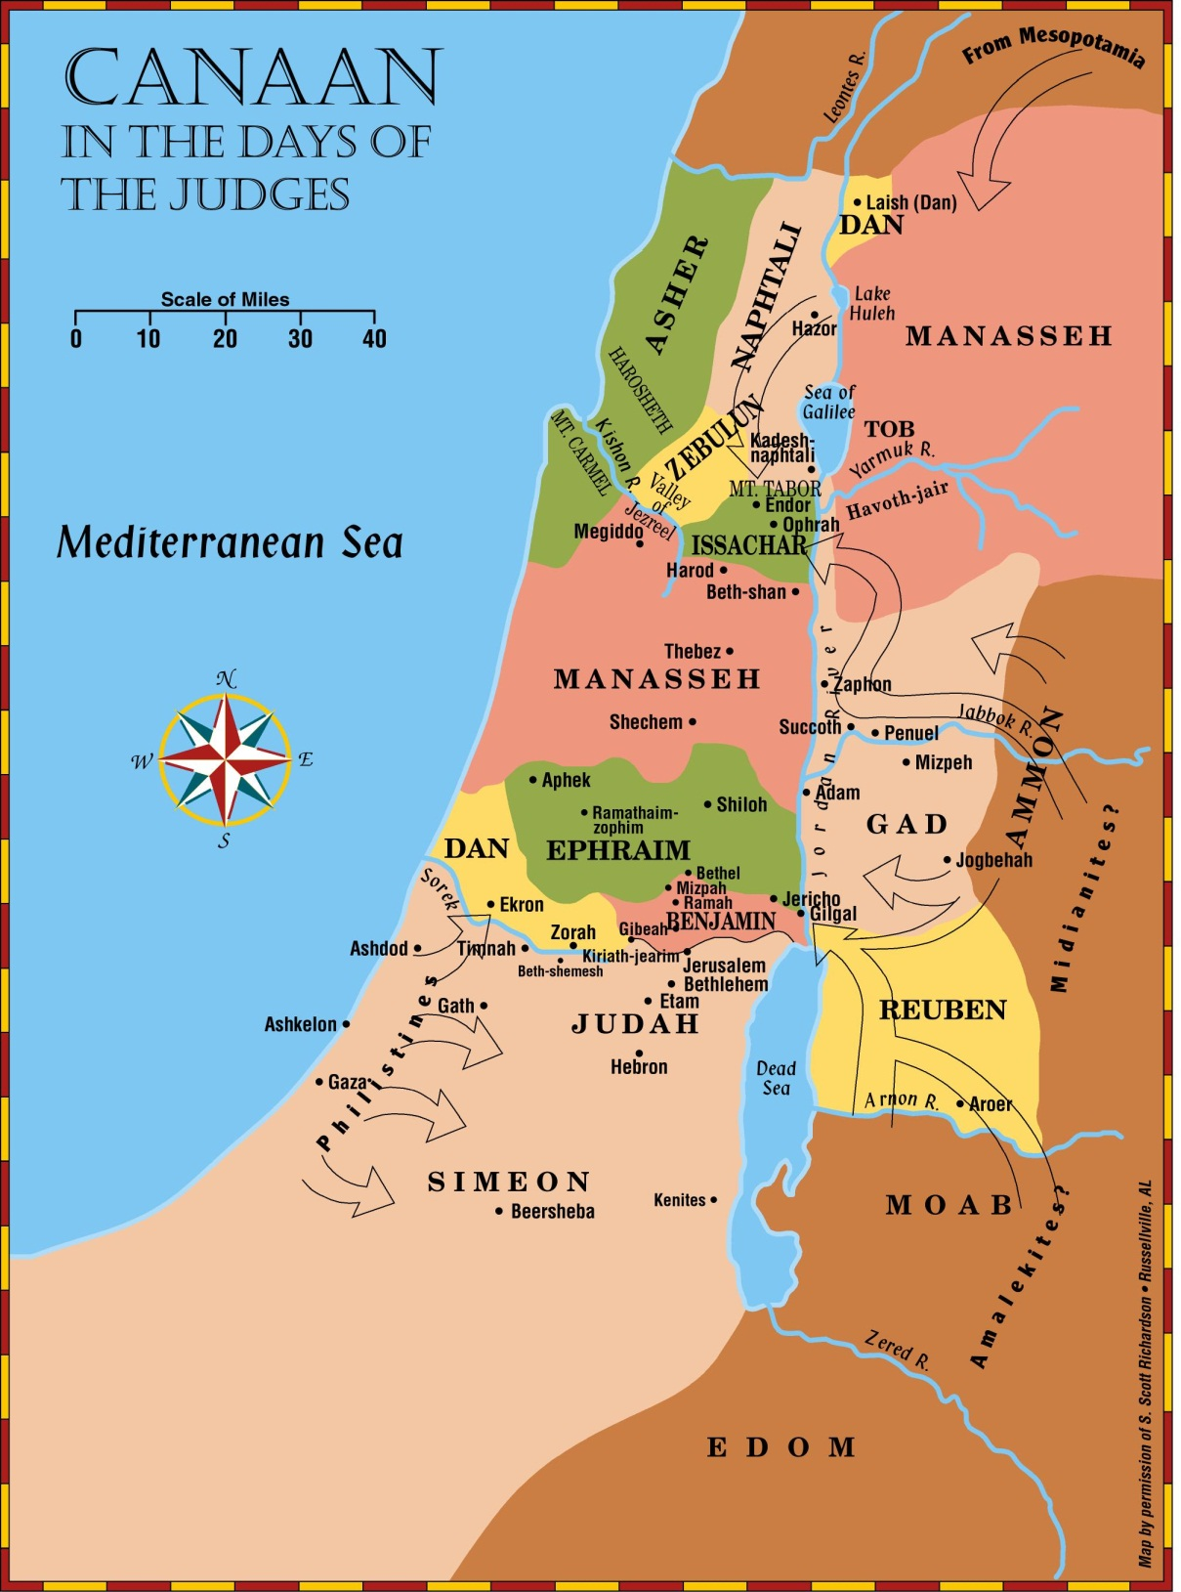
The
Judges
Judges, Ruth
~1390-1040 BC

Slide 19
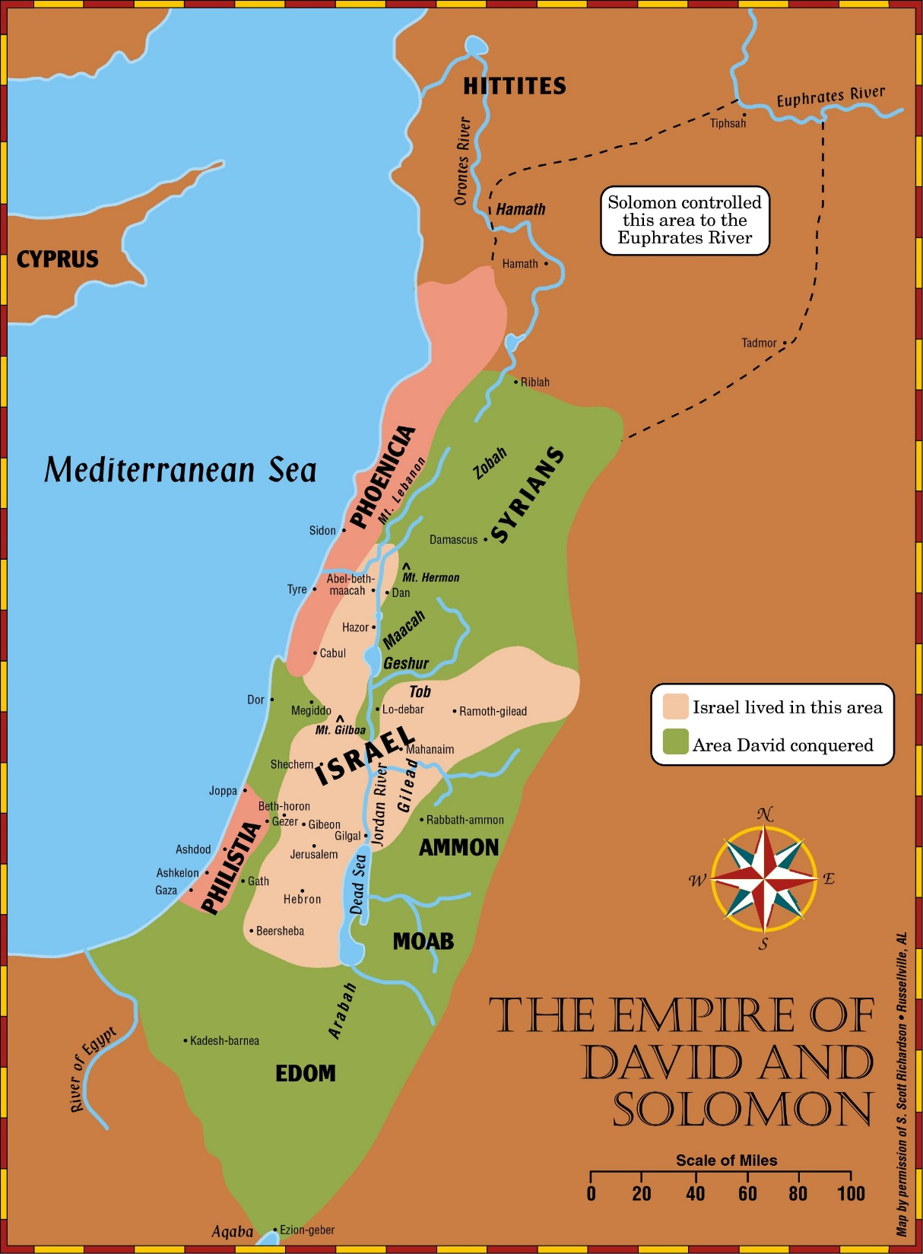
United Kingdom
Samuel, Kings, Chron
Major/Minor Prophets
Psalms, etc
1040-930 BC

Slide 20
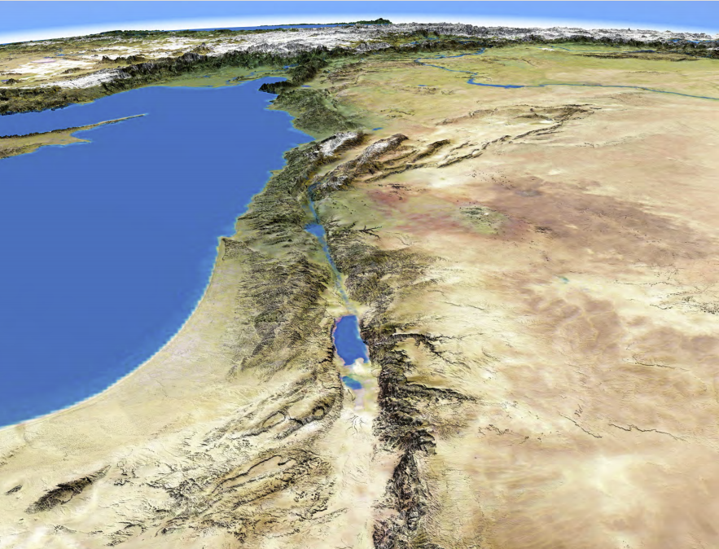
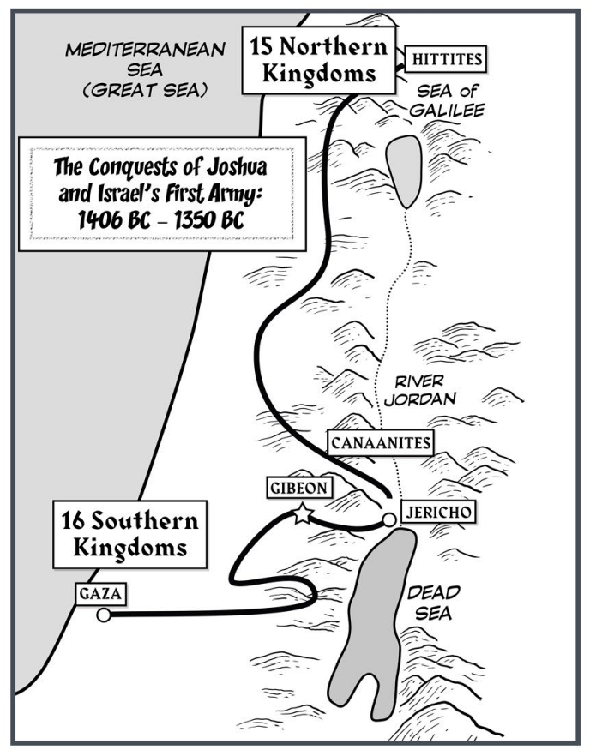

Slide 21
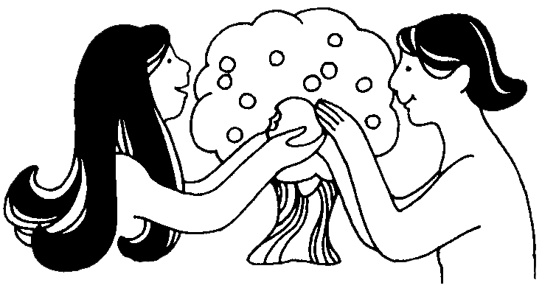
Creation & Fall
Period 1
Creation & Fall
Book - Genesis
Author – Moses
Date of Writing – 1446/45 BC (at Mt Sinai)
Theme – Origins/Beginnings and Promises
BIBLE PERIOD | MAIN ACTORS | MAIN ACTION
CREATION AND FALL Genesis 1 -11 |  | “Four Great Events”
From the undated past up to 2165 b.c. | Adam, Abel, Enoch, Noah | Creation Fall Flood Tower of Babel

Slide 22

Patriarchs
Period 2
The Patriarchs
Book - Genesis
Author – Moses
Date of Writing – 1446/45 BC (at Mt Sinai)
Theme – Origins/Beginnings and Promises
BIBLE PERIOD | MAIN ACTORS | MAIN ACTION
PATRIARCHAL Genesis 12-50, Job | Four Great Men in Genesis & Job
2165 to 1804 b.c. | Abraham, Sarah, Rebekah, Rachel, Leah, Isaac, Jacob, Joseph, Job | Beginning of Hebrew Nation Giving of Abrahamic Covenant Jews Move into Egypt God Allows Satan to Test Job

Slide 23
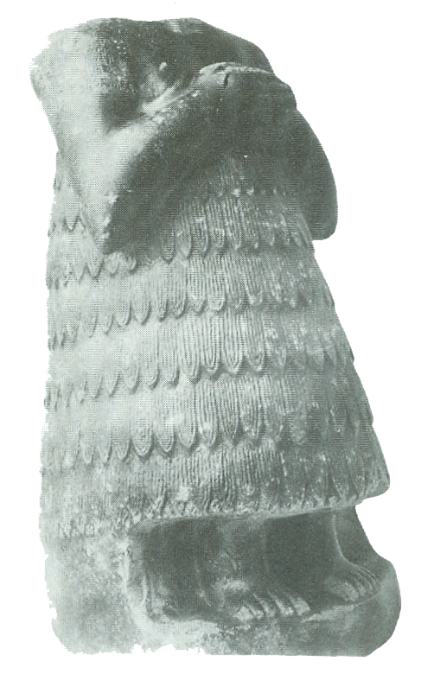
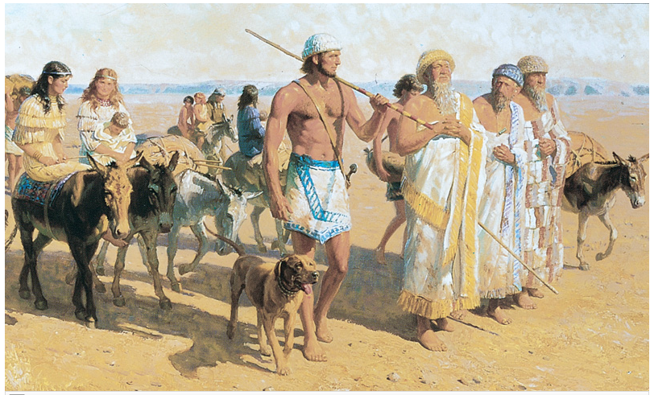
Hebrews 11:8-10 (ESV)
⁸ By faith Abraham obeyed when he was called to go out to a place that he was to receive as an inheritance. And he went out, not knowing where he was going.
⁹ By faith he went to live in the land of promise, as in a foreign land, living in tents with Isaac and Jacob, heirs with him of the same promise.
¹⁰ For he was looking forward to the city that has foundations, whose designer and builder is God.

Slide 24
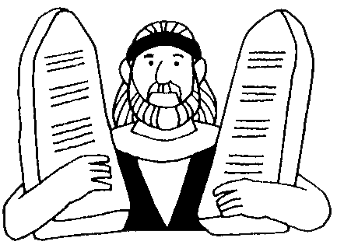
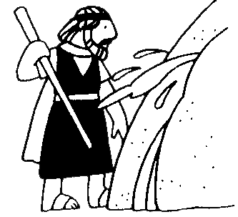
Exodus & Wanderings
Period 3
Exodus & Wanderings
BIBLE PERIOD | MAIN ACTORS | MAIN ACTION
Exodus & Law Giving
1804 to 1405 b.c. | Moses, Aaron, Miriam | Deliverance from Egypt Building of the Tabernacle Giving of the Law
Wilderness Wanderings Numbers, Deuteronomy 1445 to 1405 b.c. | Moses, Aaron, Miriam | The Failure at Kadesh-Barnea 40 years in Wilderness

Slide 25
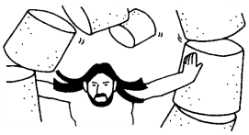
Conquest & Judges
Period 4
Conquest & Judges
BIBLE PERIOD | MAIN ACTORS | MAIN ACTION
Conquest of Land Joshua 1405 to 1382 b.c. | Joshua, Caleb, Rahab | Invasion of the Land Subjection of the Land Division of the Land
Judges Judges & Ruth 1382 to 1043 b.c. | Ehud, Barak, Deborah, Gideon, Jephthah, Samson Ruth, Naomi, Boaz Hannah, Eli, Samuel | 12 Judges Marriage of a Moabite Girl The Prayer of a Mother The Death of a Priest

Slide 26

United Kingdom
Period 5
United Kingdom
BIBLE PERIOD | MAIN ACTORS | MAIN ACTION
United Kingdom 1&2 Samuel, I Kings, & 1&2 Chronicles 1040 to 931 b.c. | Saul, David, Solomon, Joab, Abner, Absalom, Goliath, Nathan, Jonathan, Queen of Sheba | Establishment of the Monarchy The Capture of Jerusalem by David The Bringing of the Ark into Jerusalem The Giving of the Davidic Covenant The Construction of the First Temple

Slide 27

How did Saul, David, and Solomon differ?

Slide 28
United Kingdom – 3 Kings

Slide 29

Prophetic Waves
Assyrian Threat
Syrian Threat
Babylonian Threat
Romans
Moses
Exodus
Persian
Written
Israel Falls
Abraham
Judah Falls
Judges
Kingdom Divides
Captivity
& Return
United Kingdom
Oral
Daniel
roars
Greeks
2100
1400
1100
1000
900
800
700
600
500
400
100
0
~30
100
605
597
586
538
458
444
722
Christ
Exile
Return
Notes:
Prophet waves –
God tends to give the last gen before day of the Lord a chance to repent – ie lots of prophet activity
Between the Testament ok
400 years of silince not so much, Daniel roars In Between the Testament

Slide 30
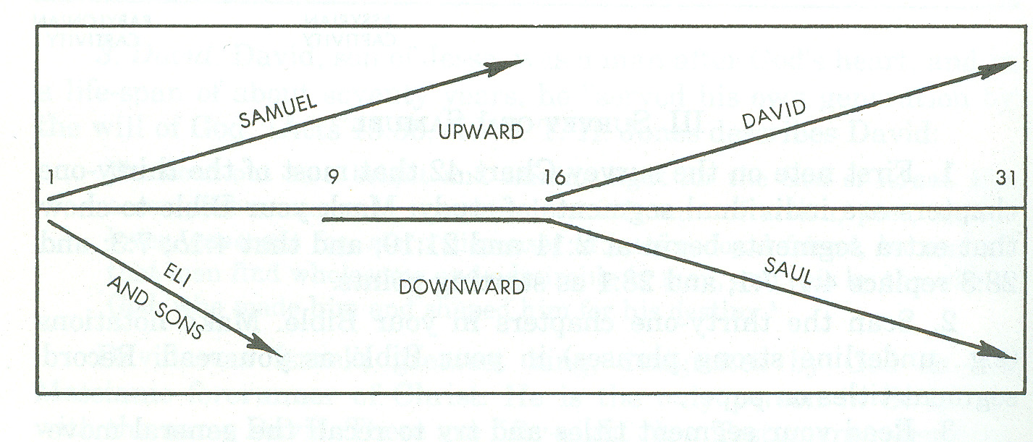
Flow of 1 Samuel
13-Unlawful
Sacrifice
11- defeats Ammonites
15- defeats Amalekites
Saul disobeys God

Slide 31
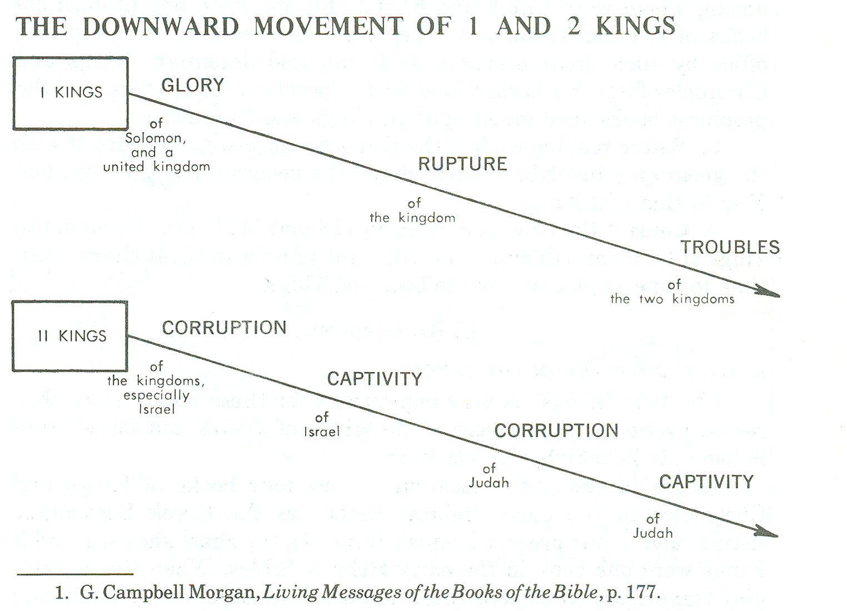
Flow of 1 & 2 Kings
1 KINGS 12

Slide 32
Key Verses
1 Samuel 8:4-5(NKJV)
⁴Then all the elders of Israel gathered together and came to Samuel at Ramah,
⁵and said to him, “Look, you are old, and your sons do not walk in your ways. Now make us a king to judge us like all the nations.”

Slide 33
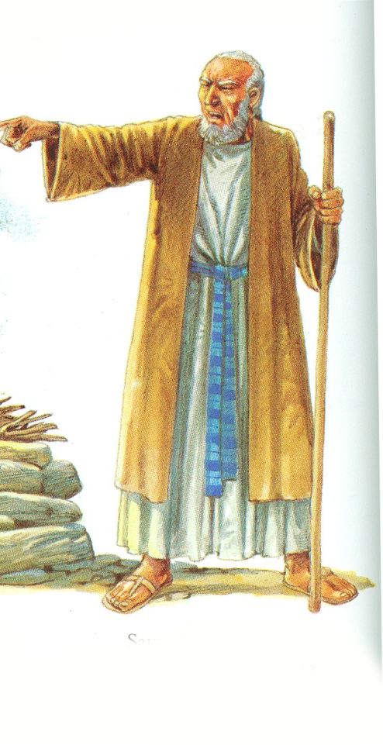
Samuel’s Farewell
Now therefore, stand still, that I may reason with you before the Lord concerning all the righteous acts of the Lord which He did to you and your fathers: (7)
¹²And when you saw that Nahash king of the Ammonites came against you, you said to me, ‘No, but a king shall reign over us,’ when the Lord your God was your king.
¹⁴If you fear the Lord and serve Him and obey His voice, and do not rebel against the commandment of the Lord, then both you and the king who reigns over you will continue following the Lord your God.
¹⁵However, if you do not obey the voice of the Lord, but rebel against the commandment of the Lord, then the hand of the Lord will be against you, as it was against your fathers.

Slide 34
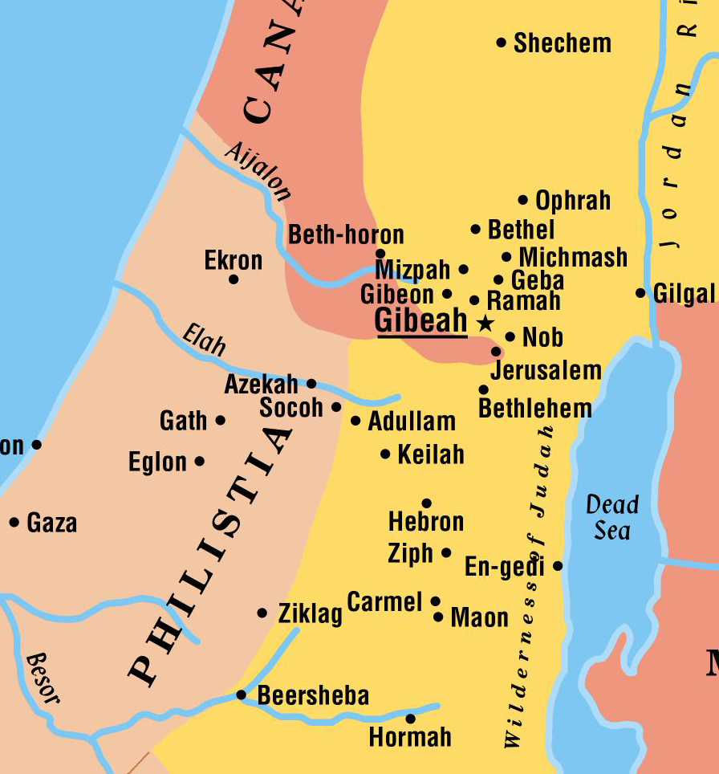
Kingdom of Saul
Ramah
  People gathered to ask Samuel to appoint for them a king
  Samuel is distressed
    God tells him to grant their request
      Not rejecting Samuel, but rather rejecting God as their King
  Samuel anoints Saul as King
    Tribe of Benjamin
Saul

Slide 35
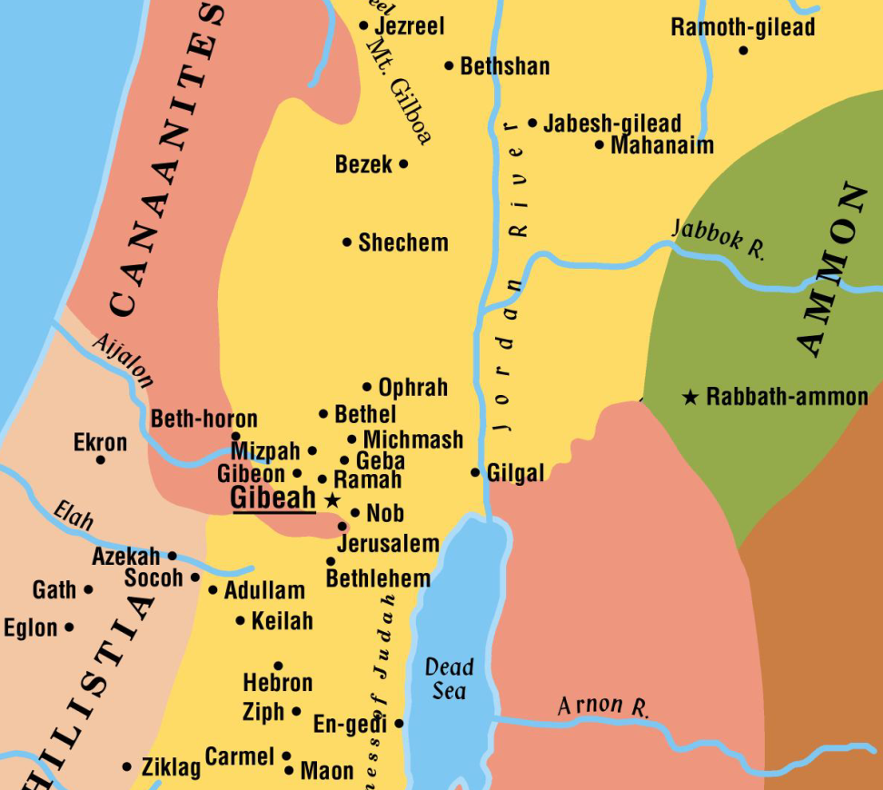
Kingdom of Saul
Ammonites
  Attacked the city of Jabesh-Gilead
  Saul called an army from the coast of Israel
    Ammonites were defeated
Saul
Then Nahash the Ammonite went up and besieged Jabesh-gilead,
The People Rejoice!
  They were unsure of Saul’s capabilities, but now rejoiced in their victory and new King
  They were now confident he could lead them
  Saul, a handsome young man. There was not a man among the people of Israel more handsome than he. From his shoulders upward he was taller than any of the people.

Slide 36
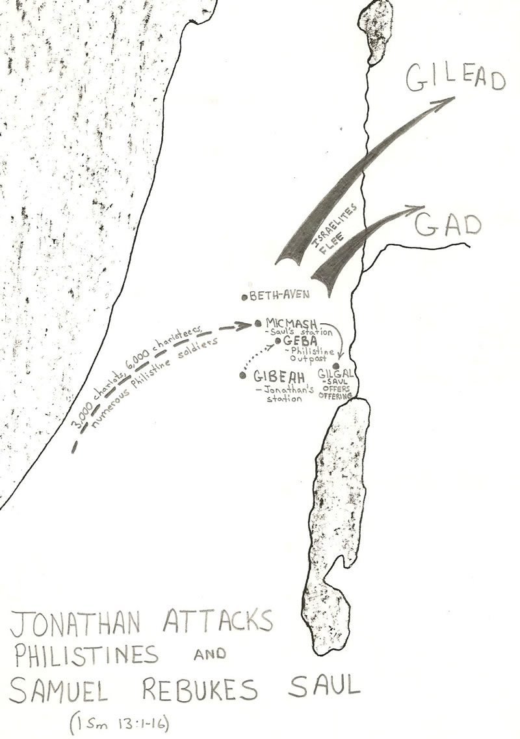
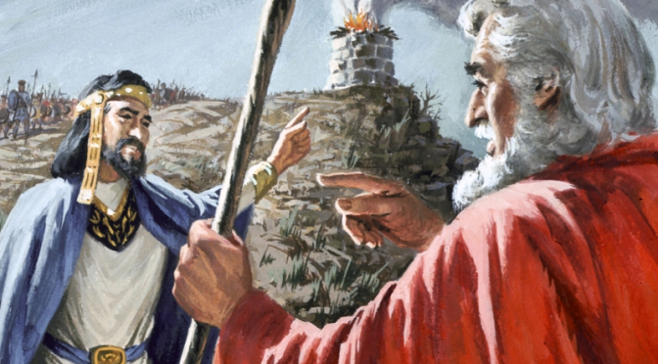
1 Samuel 13
And the Philistines mustered to fight with Israel, thirty thousand chariots and six thousand horsemen and troops like the sand on the seashore in multitude. They came up and encamped in Michmash, to the east of Beth-aven.
He waited seven days, the time appointed by Samuel. But Samuel did not come to Gilgal, and the people were scattering from him.
But now your kingdom shall not continue. The LORD has sought out a man after his own heart, and the LORD has commanded him to be prince over his people, because you have not kept what the LORD commanded you.”
Acts 13:22And when He had removed him, He raised up for them David as king, to whom also He gave testimony and said, ‘I have found David the son of Jesse, a man after My own heart, who will do all My will.’

Slide 37
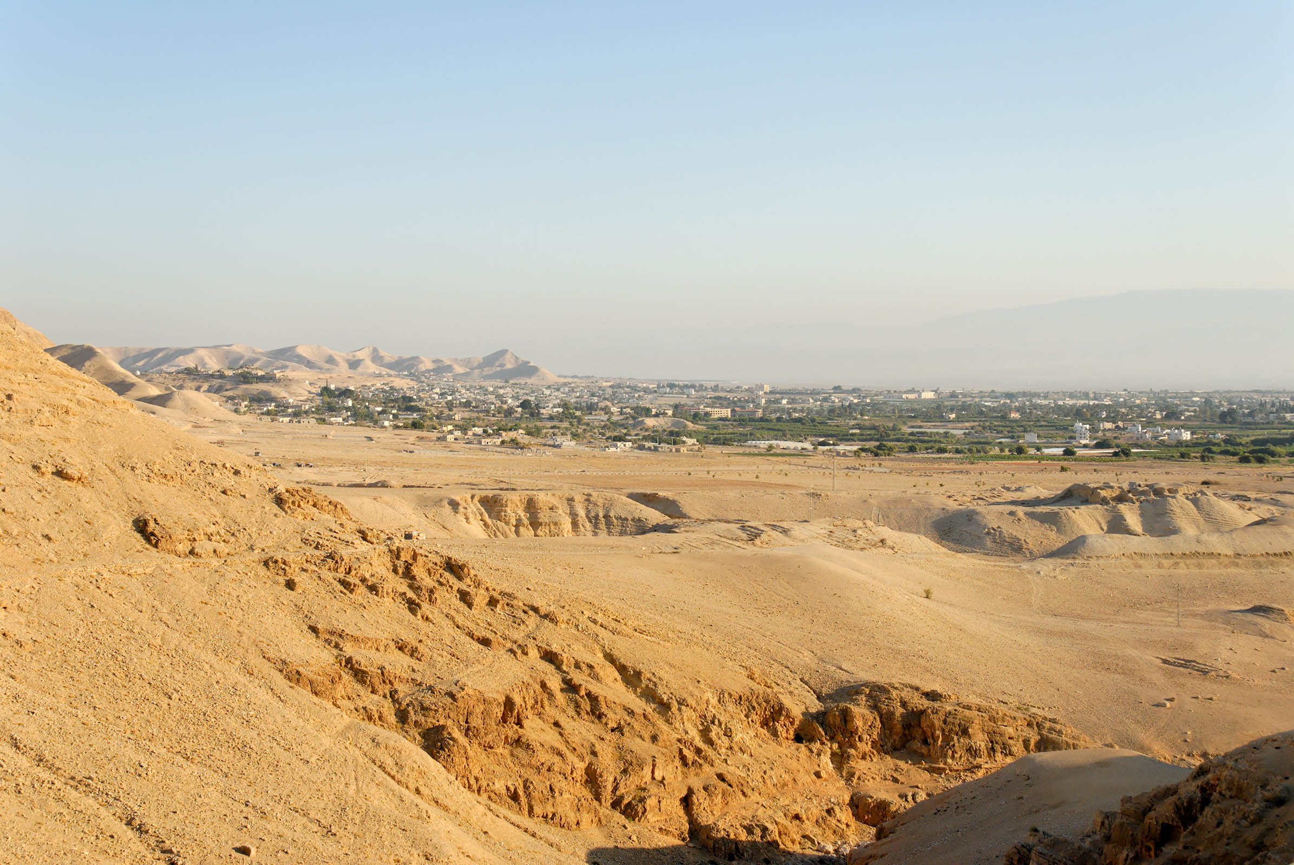
Now Saul waited seven days . . . but Samuel did not come to Gilgal
Jericho and the area of Gilgal (from the south)
13:8
Notes:
This photo shows the plain to the east of ancient Jericho on which Gilgal is thought to have been located.
tb113006530

Slide 38
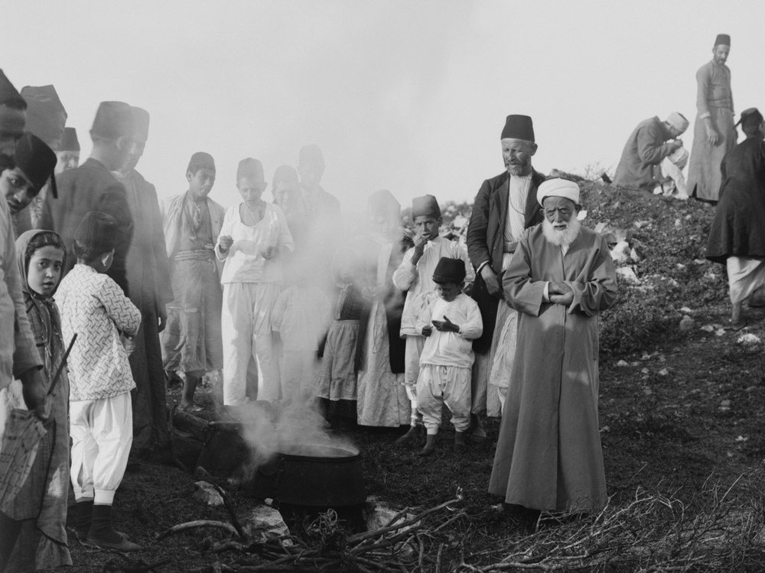
And Saul said, “Bring to me the burnt-offering and the peace offerings.” And he offered them
Water being heated for the sacrifice during the Samaritan Passover
13:9
Notes:
This American Colony photograph was taken between 1900 and 1920.
mat01852

Slide 39
Davidic Covenant
2 Samuel 7
David wants to build a house for God
God’s Reply
  I took you from the pasture, from following the sheep, that you should be prince over my people Israel.
  I will make for you a great name, like the name of the great ones of the earth.
  I will appoint a place for my people Israel
  I will raise up your offspring after you, who shall come from your body, and I will establish his kingdom. He shall build a house for my name, and I will establish the throne of his kingdom forever.
  Your house and your kingdom shall be made sure forever before me. Your throne shall be established forever.’
Notes:
2 Samuel 7:1–17 (ESV)
1Now when the king lived in his house and the Lord had given him rest from all his surrounding enemies,
2the king said to Nathan the prophet, “See now, I dwell in a house of cedar, but the ark of God dwells in a tent.”
3And Nathan said to the king, “Go, do all that is in your heart, for the Lord is with you.”
4But that same night the word of the Lord came to Nathan,
5“Go and tell my servant David, ‘Thus says the Lord: Would you build me a house to dwell in?
6I have not lived in a house since the day I brought up the people of Israel from Egypt to this day, but I have been moving about in a tent for my dwelling.
7In all places where I have moved with all the people of Israel, did I speak a word with any of the judges of Israel, whom I commanded to shepherd my people Israel, saying, “Why have you not built me a house of cedar?” ’
8Now, therefore, thus you shall say to my servant David, ‘Thus says the Lord of hosts, I took you from the pasture, from following the sheep, that you should be prince over my people Israel.
9And I have been with you wherever you went and have cut off all your enemies from before you. And I will make for you a great name, like the name of the great ones of the earth.
10And I will appoint a place for my people Israel and will plant them, so that they may dwell in their own place and be disturbed no more. And violent men shall afflict them no more, as formerly,
11from the time that I appointed judges over my people Israel. And I will give you rest from all your enemies. Moreover, the Lord declares to you that the Lord will make you a house.
12When your days are fulfilled and you lie down with your fathers, I will raise up your offspring after you, who shall come from your body, and I will establish his kingdom.
13He shall build a house for my name, and I will establish the throne of his kingdom forever.
14I will be to him a father, and he shall be to me a son. When he commits iniquity, I will discipline him with the rod of men, with the stripes of the sons of men,
15but my steadfast love will not depart from him, as I took it from Saul, whom I put away from before you.
16And your house and your kingdom shall be made sure forever before me. Your throne shall be established forever.’ ”
17In accordance with all these words, and in accordance with all this vision, Nathan spoke to David.

Slide 40
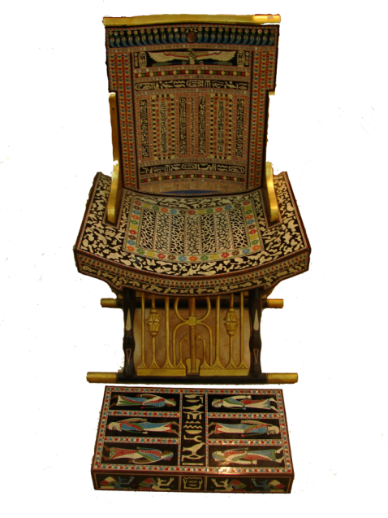
Passage | Characteristic | N.T. Reference | NT Context
Ps 110:1 |  | Matt 22:44 Acts 2:33-36
The Lord said to my Lord,
“Sit at My right hand, Till I make Your enemies Your footstool.”
⁴¹ Now while the Pharisees were gathered together, Jesus asked them a question,
⁴²saying, “What do you think about the Christ? Whose son is he?”
They said to him, “The son of David.”
⁴³He said to them, “How is it then that David, in the Spirit, calls him Lord, saying,
⁴⁴ “‘The Lord said to my Lord, Sit at my right hand, until I put your enemies under your feet’?
⁴⁵If then David calls him Lord, how is he his son?”
⁴⁶And no one was able to answer him a word, nor from that day did anyone dare to ask him any more questions.
Last Week
³²This Jesus God raised up, and of that we all are witnesses.
³³Being therefore exalted at the right hand of God, and having received from the Father the promise of the Holy Spirit, he has poured out this that you yourselves are seeing and hearing.
³⁴For David did not ascend into the heavens, but he himself says,
³⁶Let all the house of Israel therefore know for certain that God has made him both Lord and Christ, this Jesus whom you crucified.”

Slide 41
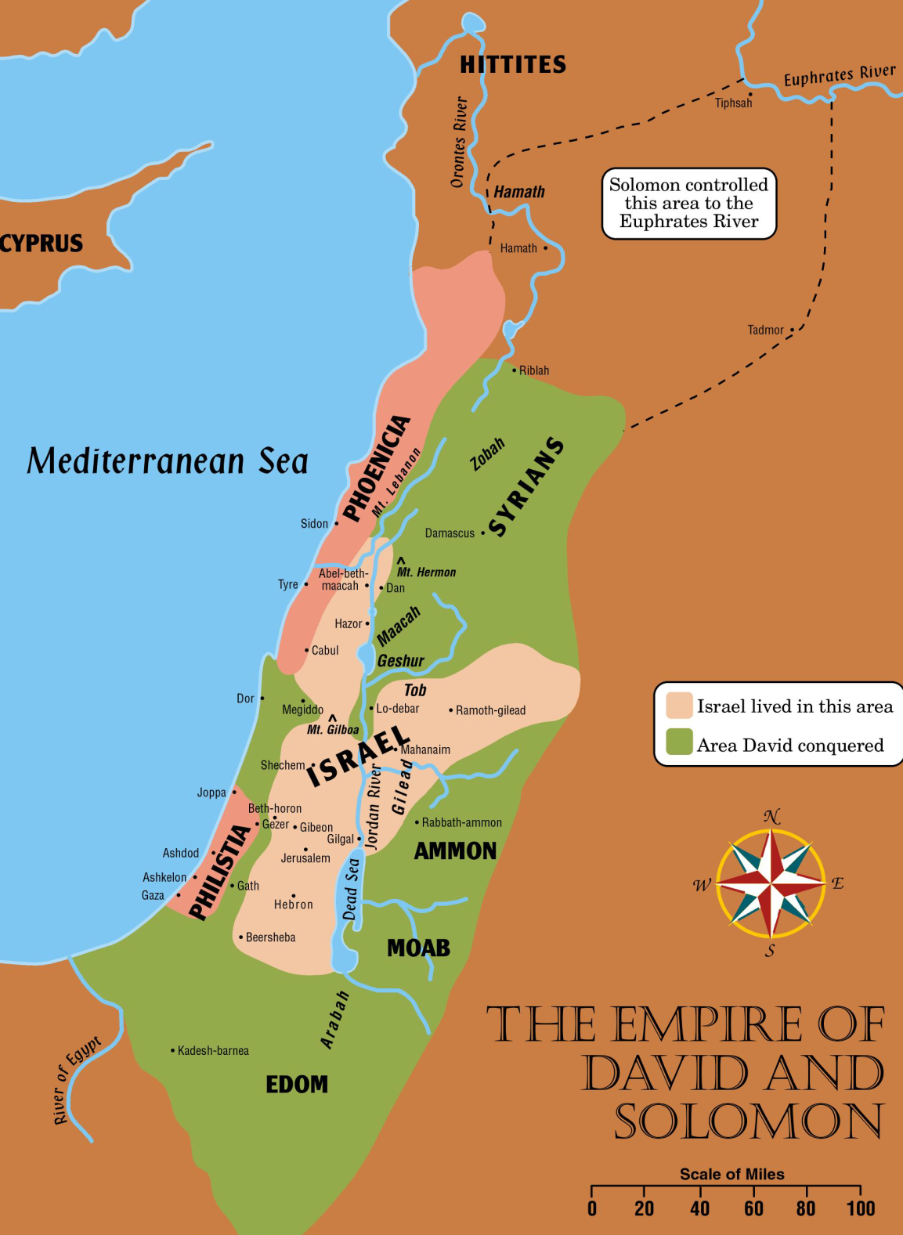
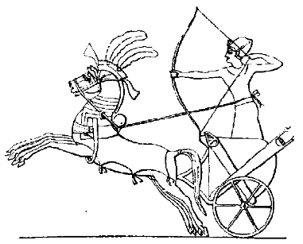
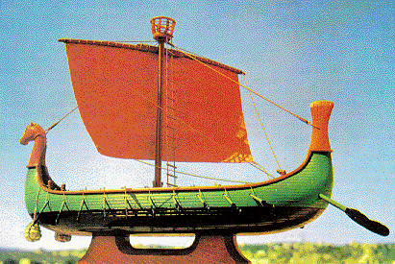
I Kings 10 ²⁹ … and so through the king’s traders they were exported to all the kings of the Hittites and the kings of Syria.
I Kings 10 ^{:14}Now the weight of gold that came to Solomon in one year was 666 talents of gold, ¹⁵besides that which came from the explorers and from the business of the merchants, and from all the kings of the west and from the governors of the land
I Kings 10 ²⁹A chariot could be imported from Egypt for 600 shekels of silver and a horse for 150…
I Kings 10 ²²For the king had a fleet of ships of Tarshish at sea with the fleet of Hiram. Once every three years the fleet of ships of Tarshish used to come bringing gold, silver, ivory, apes, and peacocks

Slide 42
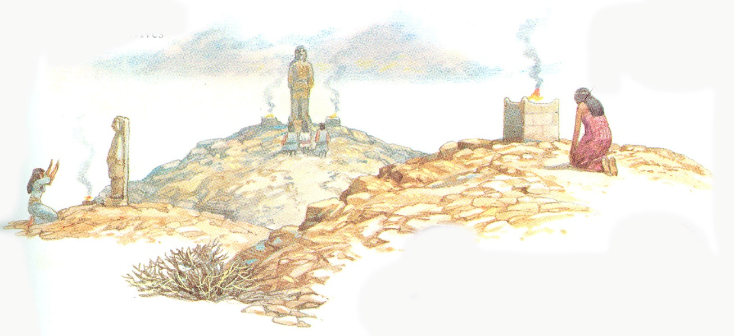
What gods did Solomon build idols/altars for his wives?
1 Kings 11:4-8(NKJV)
⁴For it was so, when Solomon was old, that his wives turned his heart after other gods; and his heart was not loyal to the Lord his God, as was the heart of his father David.
⁵For Solomon went after Ashtoreth the goddess of the Sidonians, and after Milcom the abomination of the Ammonites.
⁶Solomon did evil in the sight of the Lord, and did not fully follow the Lord, as did his father David.
⁷Then Solomon built a high place for Chemosh the abomination of Moab, on the hill that is east of Jerusalem, and for Molech the abomination of the people of Ammon.
⁸And he did likewise for all his foreign wives, who burned incense and sacrificed to their gods.

Slide 43
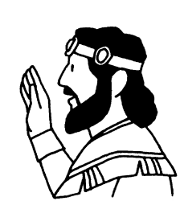
God’s Promises
2 Samuel 7:7-17(ESV)
⁷In all places where I have moved with all the people of Israel, did I speak a word with any of the judges of Israel, whom I commanded to shepherd my people Israel, saying, “Why have you not built me a house of cedar?”’
⁸Now, therefore, thus you shall say to my servant David, ‘Thus says the Lord of hosts, I took you from the pasture, from following the sheep, that you should be prince over my people Israel.
⁹And I have been with you wherever you went and have cut off all your enemies from before you. And I will make for you a great name, like the name of the great ones of the earth.
¹⁰And I will appoint a place for my people Israel and will plant them, so that they may dwell in their own place and be disturbed no more. And violent men shall afflict them no more, as formerly,
¹¹from the time that I appointed judges over my people Israel. And I will give you rest from all your enemies. Moreover, the Lord declares to you that the Lord will make you a house.
¹²When your days are fulfilled and you lie down with your fathers, I will raise up your offspring after you, who shall come from your body, and I will establish his kingdom.
¹³He shall build a house for my name, and I will establish the throne of his kingdom forever.
¹⁴I will be to him a father, and he shall be to me a son. When he commits iniquity, I will discipline him with the rod of men, with the stripes of the sons of men,
¹⁵but my steadfast love will not depart from him, as I took it from Saul, whom I put away from before you.
¹⁶And your house and your kingdom shall be made sure forever before me. Your throne shall be established forever.’”
¹⁷In accordance with all these words, and in accordance with all this vision, Nathan spoke to David.

Slide 44

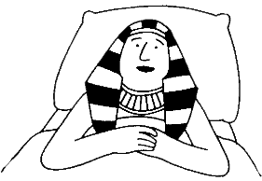
God’s Promises
Genesis 3:15 …He shall bruise your head,
And you shall bruise His heel.”
Genesis 12:1-3 …Lord had said to Abram…² I will make you a great nation; I will bless you And make your name great;… And in you all the families of the earth shall be blessed.”
Genesis 15:13-14 … “Know certainly that your descendants will be strangers in a land that is not theirs, and will serve them, and they will afflict them four hundred years. And also the nation whom they serve I will judge; afterward they shall come out with great possessions.
Genesis 50:24-25(NKJV)
²⁴And Joseph said to his brethren, “I am dying; but God will surely visit you, and bring you out of this land to the land of which He swore to Abraham, to Isaac, and to Jacob.” …“God will surely visit you, and you shall carry up my bones from here.”

Slide 45
God’s Promises
Exodus 3:6-8 ⁶Moreover He said, “I am the God of your father—the God of Abraham, the God of Isaac, and the God of Jacob.”
⁷And the Lord said: “I have surely seen the oppression of My people who are in Egypt, and have heard their cry because of their taskmasters, for I know their sorrows.
⁸So I have come down to deliver them out of the hand of the Egyptians, and to bring them up from that land to a good and large land, to a land flowing with milk and honey, …
Exodus 19:4-6 ⁴‘You have seen what I did to the Egyptians, and how I bore you on eagles’ wings and brought you to Myself.
⁵Now therefore, if you will indeed obey My voice and keep My covenant, then you shall be a special treasure to Me above all people; for all the earth is Mine.
⁶And you shall be to Me a kingdom of priests and a holy nation.’ These are the words which you shall speak to the children of Israel.”

Slide 46
God’s Promises
Deuteronomy 28:1-2
¹“Now it shall come to pass, if you diligently obey the voice of the Lord your God, to observe carefully all His commandments which I command you today, that the Lord your God will set you high above all nations of the earth.
²And all these blessings shall come upon you and overtake you, because you obey the voice of the Lord your God:
Deuteronomy 28:15
¹⁵“But it shall come to pass, if you do not obey the voice of the Lord your God, to observe carefully all His commandments and His statutes which I command you today, that all these curses will come upon you and overtake you:
Deuteronomy 28:37,42,47
³⁷And you shall become an astonishment, a proverb, and a byword among all nations where the Lord will drive you…
⁴²Locusts shall consume all your trees and the produce of your land.
⁴⁷“Because you did not serve the Lord your God with joy and gladness of heart, for the abundance of everything, ⁴⁸therefore you shall serve your enemies, whom the Lord will send against you, in hunger, in thirst, in nakedness, and in need of everything; and He will put a yoke of iron on your neck until He has destroyed you

Slide 47
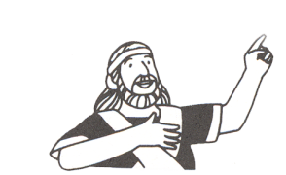
God’s Promises
Joshua 21:43-45
⁴³So the Lord gave to Israel all the land of which He had sworn to give to their fathers, and they took possession of it and dwelt in it.
⁴⁴The Lord gave them rest all around, according to all that He had sworn to their fathers. And not a man of all their enemies stood against them; the Lord delivered all their enemies into their hand.
⁴⁵Not a word failed of any good thing which the Lord had spoken to the house of Israel. All came to pass.
Joshua 24:14-15
¹⁴“Now therefore, fear the Lord, serve Him in sincerity and in truth, and put away the gods which your fathers served on the other side of the River and in Egypt. Serve the Lord!
¹⁵And if it seems evil to you to serve the Lord, choose for yourselves this day whom you will serve, whether the gods which your fathers served that were on the other side of the River, or the gods of the Amorites, in whose land you dwell. But as for me and my house, we will serve the Lord.”
Joshua 24:16,18 (NKJV) ¹⁶So the people answered and said:…
¹⁸And the Lord drove out from before us all the people, including the Amorites who dwelt in the land. We also will serve the Lord, for He is our God.”

