Slide 1
Church History
Lesson 7

Slide 2
Review: We have studied:
The Beginning of the Church described in the N.T.
A falling away that was predicted and occurred.
Development of the Roman Church
Division into East and Western churches (1054)
Corruption during the “Dark Ages”
Renaissance and early efforts to reform
Reformation and beginning of a multitude of denominations

Slide 3
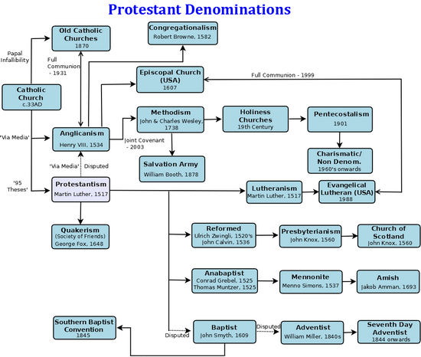

Slide 4
What about the church of Christ?

Slide 5
Look back to New Testament Period
Word church used in two senses
Universal Sense: (All the saved in all the world)
“I will build my church” (singular) (Matthew 16:18)
Included all the saved (Acts 2:47)
Only one (Ephesians 1:22-23; 4:4) Made up of individuals.
Local Sense:
Saved persons in a given location organize and assemble.
Only organization in N.T. Plural: “churches of Christ” (“of God”)
Only the Lord was an infallible judge (7 churches of Asia)
We would judge Ephesus a “sound” church of Christ but Jesus threatened it with removal of its candlestick.
We would judge Thyatira unsound—but it was not threatened. (“to the rest of you” – “no greater burden”)

Slide 6
Did the church of Christ Exist in the Dark Ages?
In Universal Sense – The “one” church
If there was one saved person in the world it did!
In Local Sense – Did any churches of Christ exist?
If a sing group of saved individuals was organized, working and worshiping according to the N.T. pattern anywhere in the world, then it was a church of Christ (of God).
History might not include it.(Even Bible does not include all.)
History does record numerous groups attempting to be.
About all we know is what is reported by their enemies.
History often calls them by derisive names they rejected.
This limits our ability to judge, but our judgment isn’t important.
The Lord’s judgment is what counts.

Slide 7
Reform was Hopeless— Back to the Beginning
Apostle John wrote his epistles late in the First Century, after the apostacy had begun (1 John 2:19).
In them, he mentions the beginning 11 times, most often referring to Pentecost and the beginning of the church.
The idea of going back to the beginning to be the New Testament church did not originate in America.
Many reformers in Europe had this goal after being excommunicated by the pope. but most of them still viewed the church as an association of local churches with councils, creeds, etc.
There is evidence that William Tyndale (1494-1536) was in fellowship with an independent church in London, some members of which helped finance his translating.

Slide 8
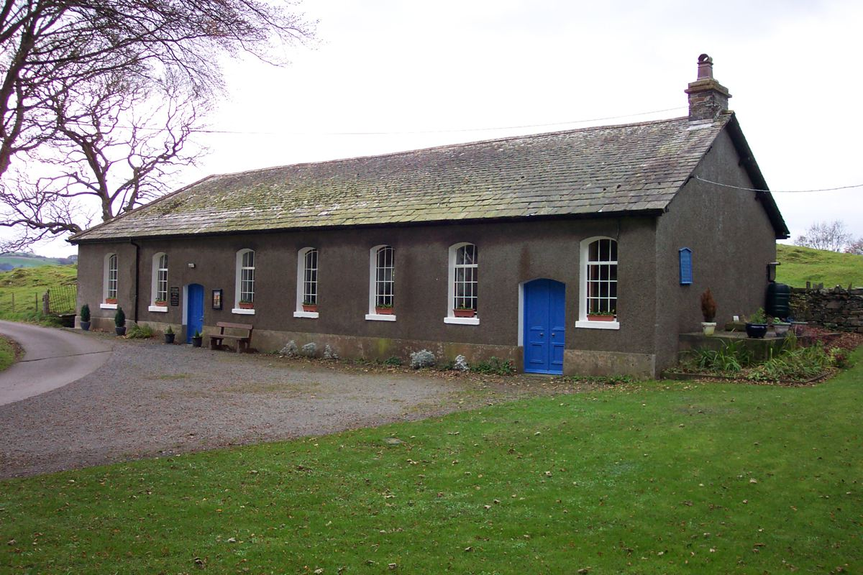
Was it a true church of Christ?
Tottlebank Church of Christ, Lake District, Northern England 1669

Slide 9
Alexander Campbell is sometime credited with founding churches of Christ.
He spent time in Scotland where he was influenced by men attempting to be the New Testament church.
Before he came to America, others in this country were preaching return to the New Testament plan.
James O’Kelley in Chapel Hill, NC 1794
Abner Jones in New England in 1801
Barton W. Stone in Kentucky in 1804
Thomas Campbell in Pennsylvania in 1809
Alexander Campbell only arrived in the U.S. in 1809
Some of these made the mistake of forming associations of churches which led to denominationalism.

Slide 10
The Kingdom is in the Seed
Matthew 13:18-19
Luke 8:11

Slide 11
While excavating in the Judean wilderness, archaeologists found hundreds of seeds from palm trees that grew in the arid region some 2,000 years ago.
In 2008, they successfully germinated a 2,000-year-old seed from the fortress of Masada near the Dead Sea and, appropriately, named this seedling “Methuselah.”
When the seeds were planted, guess what was produced?
When the “seed of the kingdom” was planted in Acts 2, what did it produce?
If the same seed is planted in Atlanta in 2021, what will it produce?

Slide 12
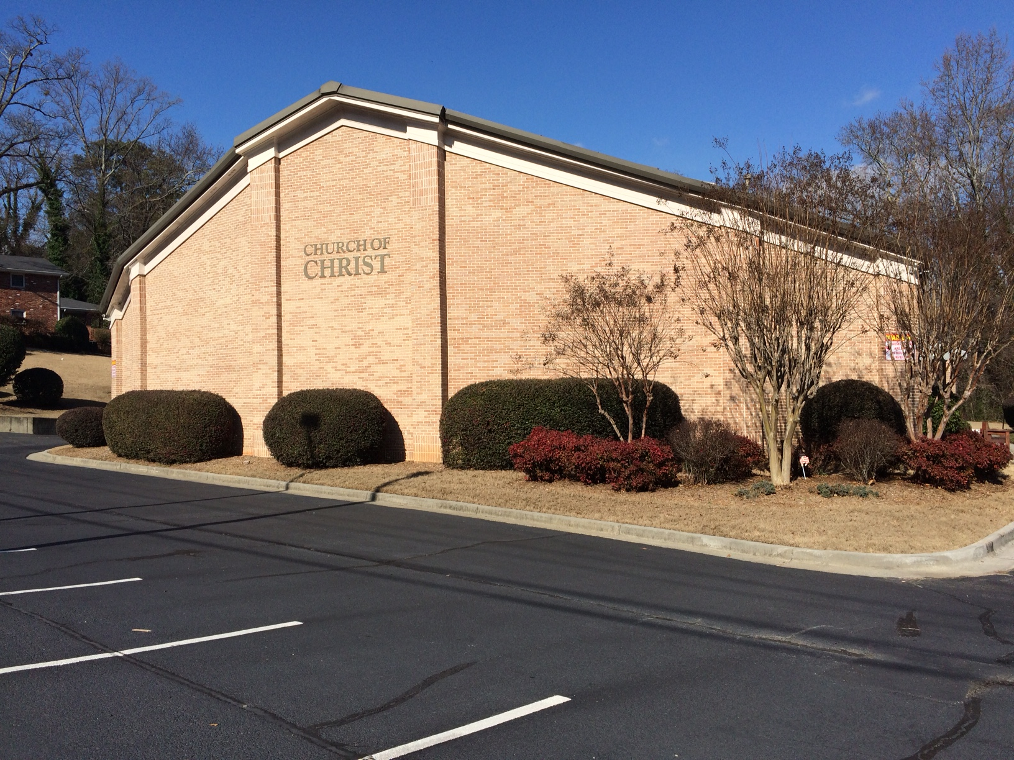
Is the church that meets here a true church of Christ?

Slide 13
Is the church that meets here a true church of Christ?
1. The fact that the name “Church of Christ” is on the building does not make it one.
2. The fact that is listed among “Churches of Christ” does not make it one.
3. QUESTION: “Is it made up of saved people who are ‘of Christ,’ acknowledging Him as their only authority and following His teaching as delivered by His Apostles?

Slide 14
PITFALLS HISTORY TEACHES US THAT WE MUST AVOID:
Multiplying offices.
Clergy/laity distinction (“All of you are brethren”)
Evangelist serving as CEO of the church.
Combining Churches into Associations
Usually beginning as “City-wide” projects
Combining churches for evangelism (Campbell)
Combining churches for social service

Slide 15
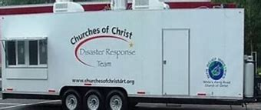
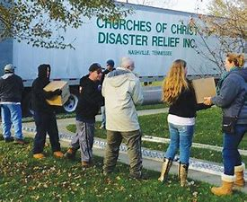

Slide 16
PITFALLS HISTORY TEACHES US THAT WE MUST AVOID:
Multiplying offices.
Clergy/laity distinction (“All of you are brethren”)
Evangelist serving as CEO of the church
Combining Churches into Associations
Usually beginning as “City-wide” projects
Combining churches for evangelism (Campbell)
Combining churches for social service
Respecting other authorities than Scripture
Traditions, Papers, Schools, Prominent preachers
Cultural Trends (Feminism, etc)

