Slide 1
Please sit as near the teacher as possible while observing required “social distancing”.

Slide 2
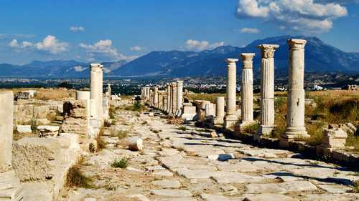
Colossians and Philemon
Lesson 8

Slide 3
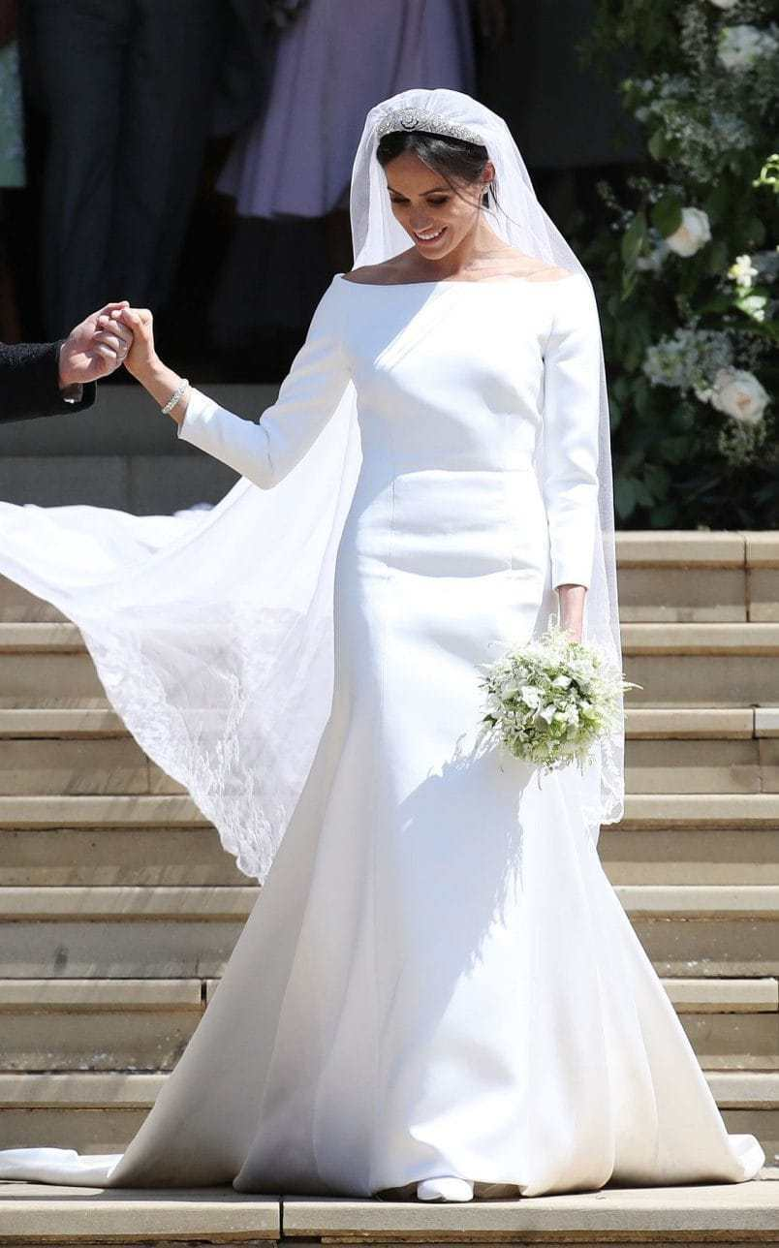
The Church is the Bride of Christ
“Christ also loved the church and gave Himself for her, ²⁶ that He might sanctify and cleanse her with the washing of water by the word, ²⁷ that He might present her to Himself a glorious church, not having spot or wrinkle or any such thing, but that she should be holy and without blemish.”
-Ephesians 5:25-27
What will be necessary for the woman on the left to look like the woman on the right?
1. She would need a bath.
2. Take off the dirty clothes
2. Put on the bride’s dress.
Which one does the Lord want His church to look like?

Slide 4
Things to “put off”–
Fornication
Uncleanness
Evil Desire
Covetousness
Anger
Wrath
Malice
Blasphemy
Filthy Language
Lying

Slide 5
Reasons we must “put off” these things:
Verse 3
Verses 4-5
Verse 6
Verses7, 9-10
³ For you died, and your life is hidden with Christ in God.
⁴ When Christ who is our life appears, then you also will appear with Him in glory. ⁵ Therefore put to death your members which are on the earth: (1 Cor. 6:13-15)
⁶ Because of these things the wrath of God is coming upon the sons of disobedience, ⁷ in which you yourselves once walked when you lived in them. (See Ephesians 5:6)
“…you have put off the old man with his deeds, ¹⁰ and have put on the new man who is renewed in knowledge according to the image of Him who created him”.

Slide 6
Colossians 3:9-11
“,,,you have put off the old man with his deeds, ¹⁰ and have put on the new man who is renewed in knowledge according to the image of Him who created him, ¹¹ where there is neither Greek nor Jew, circumcised nor uncircumcised, barbarian, Scythian, slave nor free, but Christ is all and in all.
Jesus did not make such distinctions.
“Christ is all and in all!”
¹² Therefore, as the elect of God, holy and beloved, put on tender mercies, kindness, humility, meekness, longsuffering; ¹³ bearing with one another, and forgiving one another, if anyone has a complaint against another; even as Christ forgave you, so you also must do. ¹⁴ But above all these things put on love, which is the bond of perfection.
All of the qualities to be “put on” are seen in Christ!

Slide 7
“Put off” “Put on” Jesus
Fornication
Uncleannes(s
Evil Desire
Covetousness
Anger
Wrath
Malice
Blasphemy
Filthy Language
Lying
Compassion
Kindness
Humility
Meekness
Long suffering
Forbearance
Forgiveness
Love
“Seeing the multitudes”
“Go tell His disciples—and Peter”
Washing the Disciples’ feet
1 Peter 2:22-23
When disciples failed to heal
Matthew 26:53
“Father, forgive them…”
John 13:1
“Put on Jesus Christ” (Rom. 13:14; 3:27)
Which would be easier: to live by O.T. rules or by these principles?
Name two persons who were likely in the assembly when this was read.

Slide 8
How do we “put on” these characteristics?
What must “rule” in our hearts?
¹⁵ And let the peace of God rule in your hearts, to which also you were called in one body; and be thankful. ¹⁶ Let the word of Christ dwell in you richly in all wisdom, teaching and admonishing one another in psalms and hymns and spiritual songs, singing with grace in your hearts to the Lord. Lord.¹⁷ And whatever you do in word or deed, do all in the name of the Lord Jesus, giving thanks to God the Father through Him.

Slide 9
John 17:20-23
²⁰ “I do not pray for these alone, but also for those who will believe in Me through their word; ²¹ that they all may be one, as You, Father, are in Me, and I in You; that they also may be one in Us, that the world may believe that You sent Me. ²² And the glory which You gave Me I have given them, that they may be one just as We are one: ²³ I in them, and You in Me; that they may be made perfect in one, and that the world may know that You have sent Me, and have loved them as You have loved Me.

Slide 10
Ephesians 2:14-18
¹⁴ For He Himself is our peace, who has made both one, and has broken down the middle wall of separation, ¹⁵ having abolished in His flesh the enmity, that is, the law of commandments contained in ordinances, so as to create in Himself one new man from the two, thus making peace, ¹⁶ and that He might reconcile them both to God in one body through the cross, thereby putting to death the enmity. ¹⁷ And He came and preached peace to you who were afar off and to those who were near. ¹⁸ For through Him we both have access by one Spirit to the Father.

Slide 11
How do we “put on” these characteristics?
What must “rule” in our hearts?
What must be our attitude?
What must “dwell” in us richly? (See parallel in Ephesians 5:19)
How can we teach and admonish one another?
What tests of a song would this suggest?
Though teaching “one another” to whom are songs directed?
¹⁵ And let the peace of God rule in your hearts, to which also you were called in one body; and be thankful. ¹⁶ Let the word of Christ dwell in you richly in all wisdom, teaching and admonishing one another in psalms and hymns and spiritual songs, singing with grace in your hearts to the Lord. Lord.¹⁷ And whatever you do in word or deed, do all in the name of the Lord Jesus, giving thanks to God the Father through Him.

Slide 12
“The name of the Lord”
‘Blessed is He who comes in the name of the Lord!’ (Mark 11:9).
“…been baptized in the name of the Lord Jesus” (Acts 8:16).
“…preached boldly at Damascus in the name of Jesus” (Acts 9:27).
“…spoke boldly in the name of the Lord Jesus” (Acts 9:29).
“…commanded them to be baptized in the name of the Lord” (Acts 10:48).
“…they were baptized in the name of the Lord Jesus” (Acts 19:5).
“…In the name of our Lord Jesus Christ…deliver such a one to Satan…”. (1 Corinthians. 5:4).
“,,, were justified in the name of the Lord Jesus” (1 Corinthians 6:11)
“…giving thanks always for all things to God in the name of our Lord Jesus Christ. (Ephesians 5:20)

Slide 13
¹⁷ And whatever you do in word or deed, do all in the name of the Lord Jesus, giving thanks to God the Father through Him.
This introduces the next section.

